Slide 1
Pythagoras
Pythagoras
May 2017
1H Q5
SAM
2H Q6
June 2017
2H Q21*
SAM
3H Q16
Edexcel
June 2017
3H Q8
Spec 1
2H Q19
Nov 2017
2H Q7
AQA
Spec 1
3H Q12
Nov 2018
2H Q13*
OCR
Spec 2
1H Q4
Nov 2018
3H Q12
Spec 2
2H Q17
June 2019
2H Q19
Spec 2
3H Q7**
June 2019
3H Q8
3D
*May use Trigonometry instead
**Proof of Pythagoras with areas

Slide 2
Pythagoras
Pythagoras
Edexcel
June 2017
2H Q15
June 2018
3H Q20
AQA
SAM
3H Q28
June 2017
3H Q25
June 2018
3H Q25
1 Marker
OCR
June 2017
3H Q27
Nov 2018
3H Q23
3D
*May use Trigonometry instead

Slide 3
Pythagoras
Pythagoras
June 2017
2H Q20
SAM
1H Q11
June 2017
3H Q18
Edexcel
SAM
1H Q12
Nov 2017
1H Q14
AQA
Practice
1H Q7
June 2018
2H Q11
OCR
Practice
2H Q3
June 2018
3H Q12
Practice
3H Q2*
Nov 2018
1H Q3
Nov 2018
1H Q20
3D
*May use Trigonometry instead

Slide 4
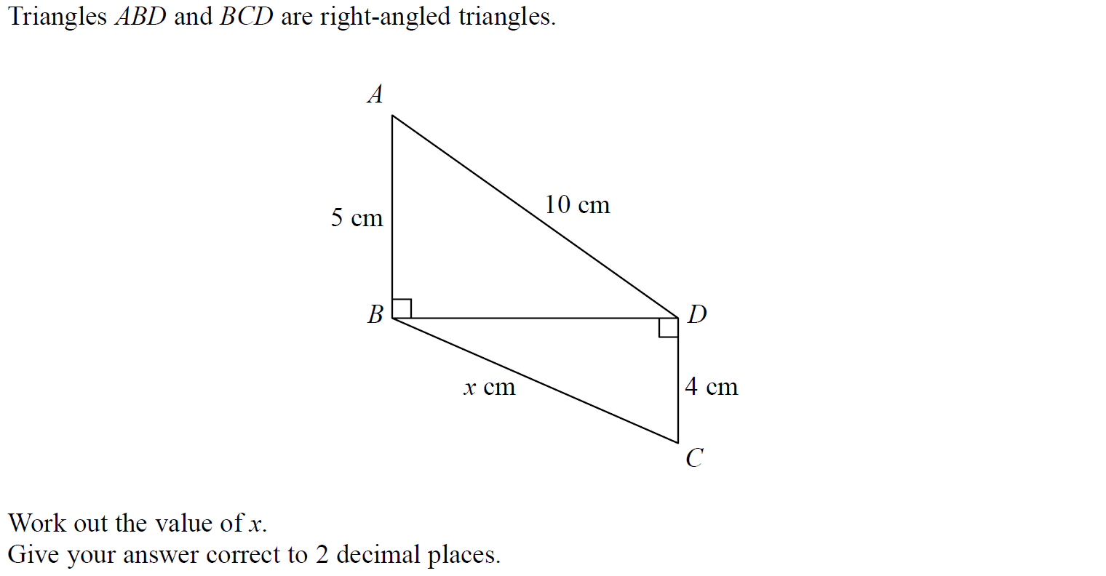
Pythagoras
SAM 2H Q6

Slide 5
Pythagoras
SAM 2H Q6
A

Slide 6
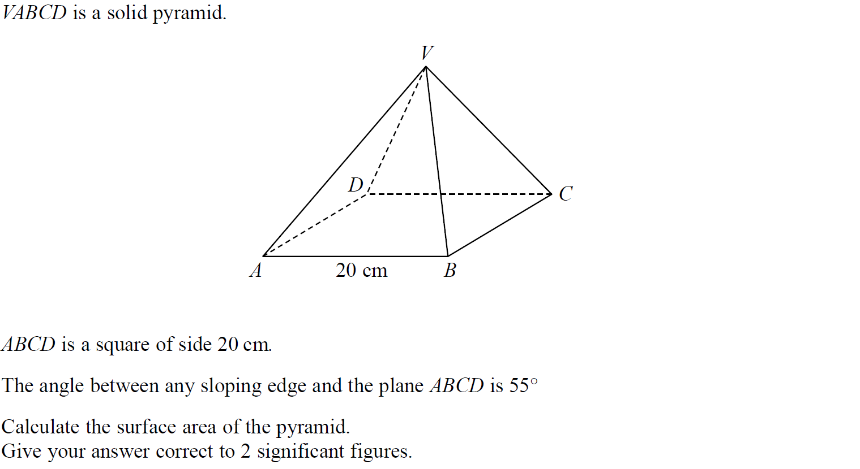
Pythagoras
SAM 3H Q16

Slide 7
Pythagoras
SAM 3H Q16
A

Slide 8
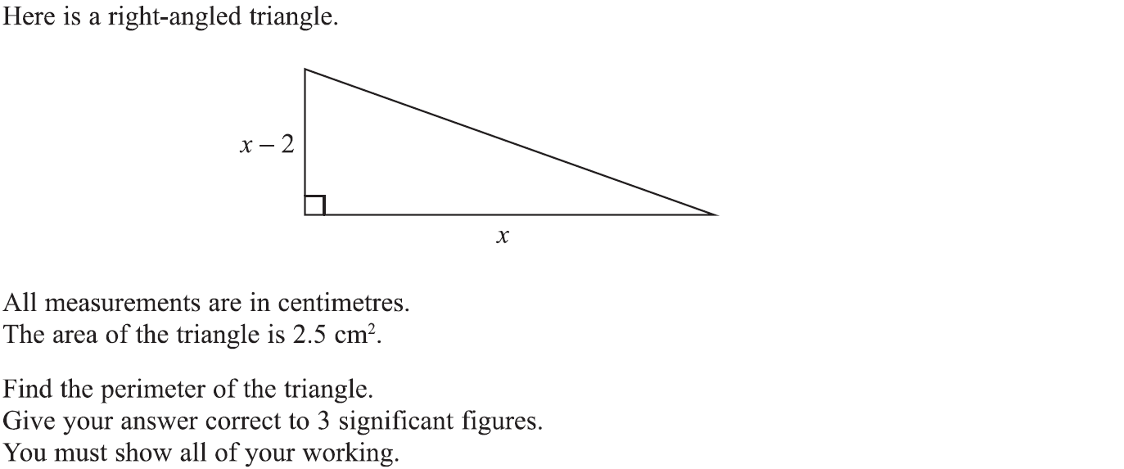
Pythagoras
Specimen Set 1 2H Q19

Slide 9
Pythagoras
Specimen Set 1 2H Q19
A

Slide 10
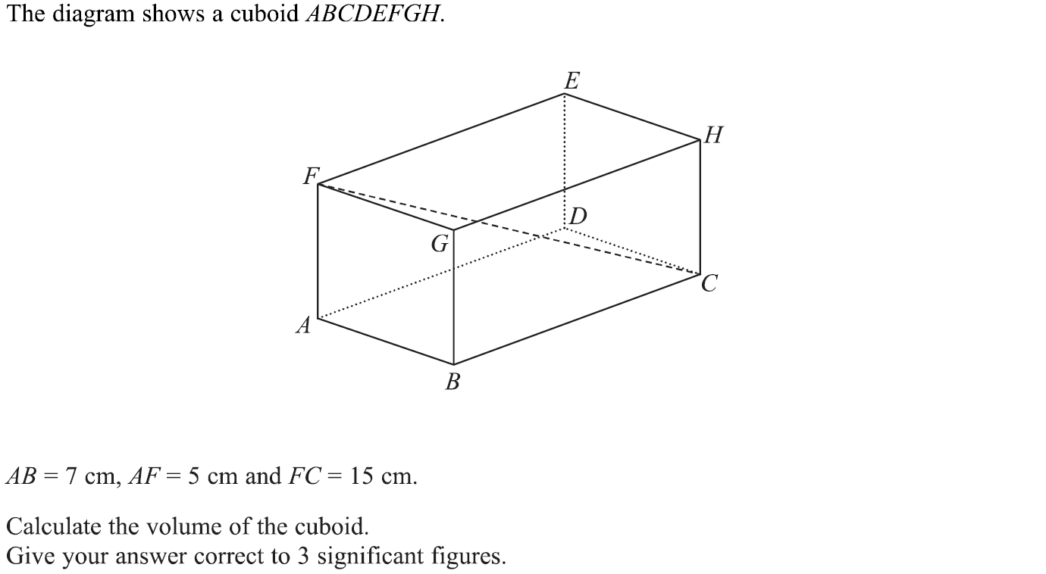
Pythagoras
Specimen Set 1 3H Q12

Slide 11
Pythagoras
Specimen Set 1 3H Q12
A

Slide 12
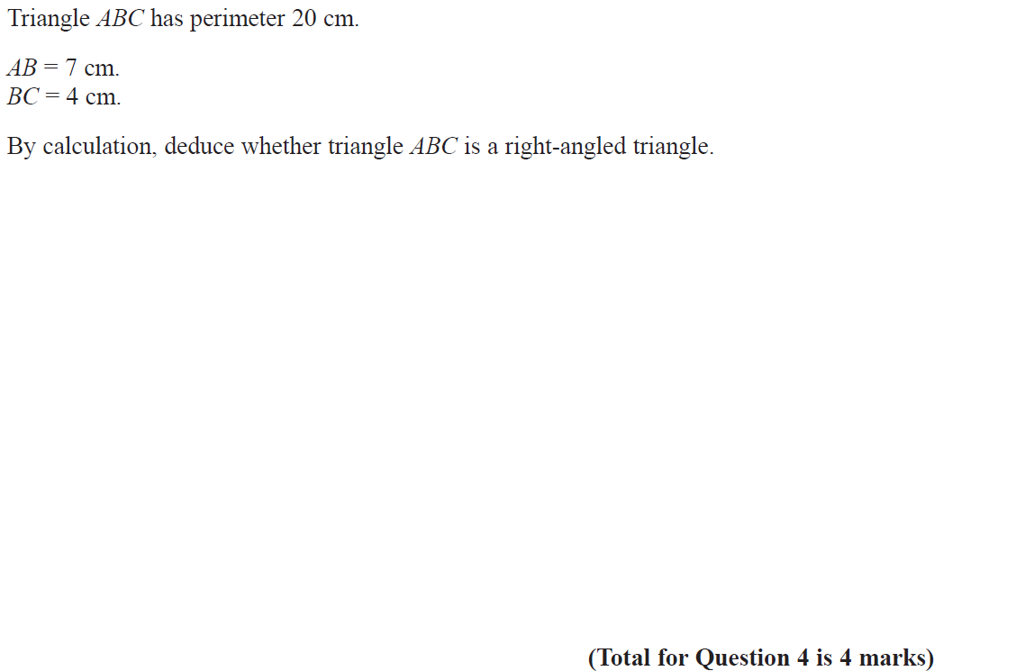
Pythagoras
Specimen Set 2 1H Q4

Slide 13
Pythagoras
Specimen Set 2 1H Q4
A

Slide 14
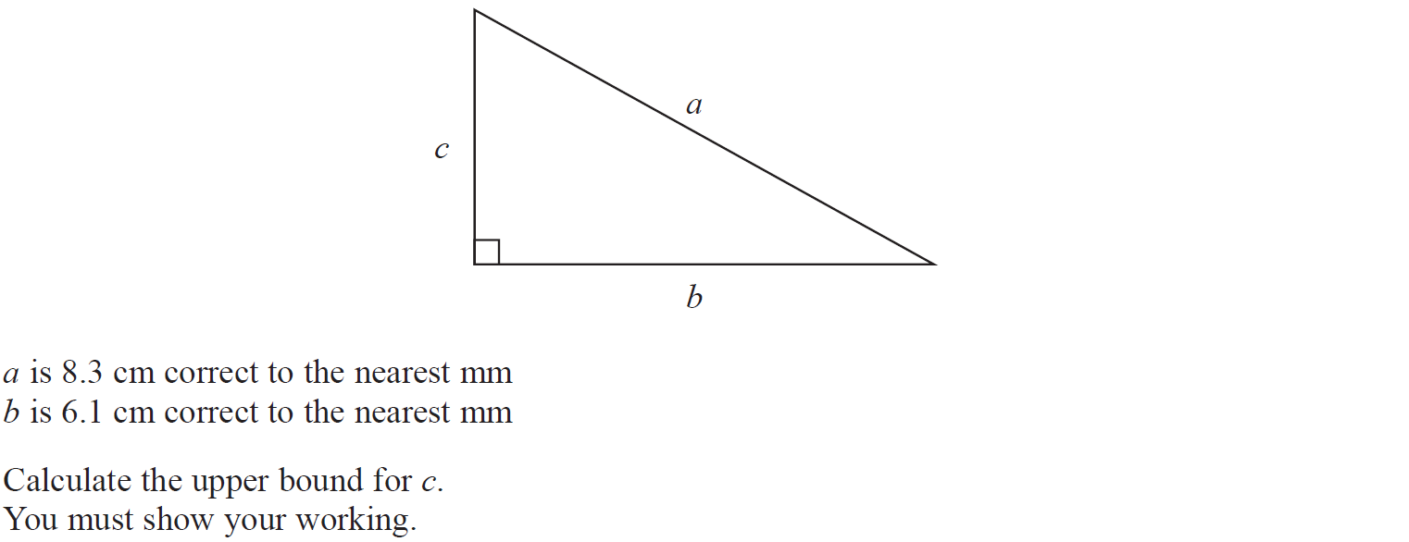
Pythagoras
Specimen Set 2 2H Q17

Slide 15
Pythagoras
Specimen Set 2 2H Q17
A

Slide 16
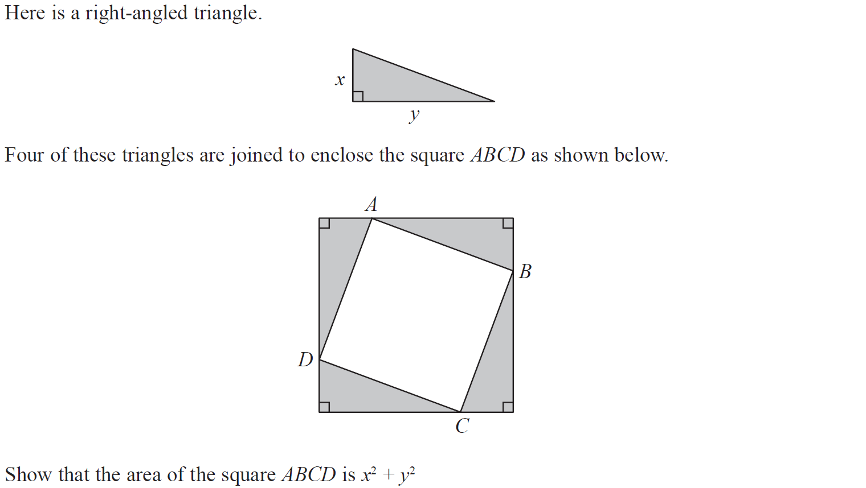
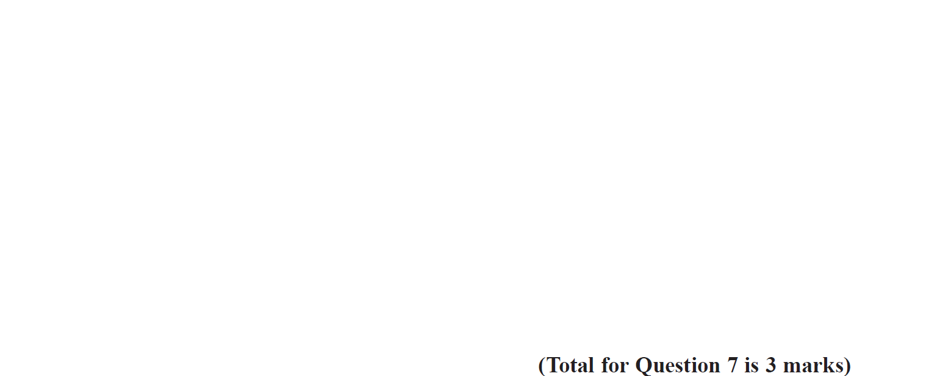
Pythagoras
Specimen Set 2 3H Q7

Slide 17
Pythagoras
Specimen Set 2 3H Q7
A

Slide 18
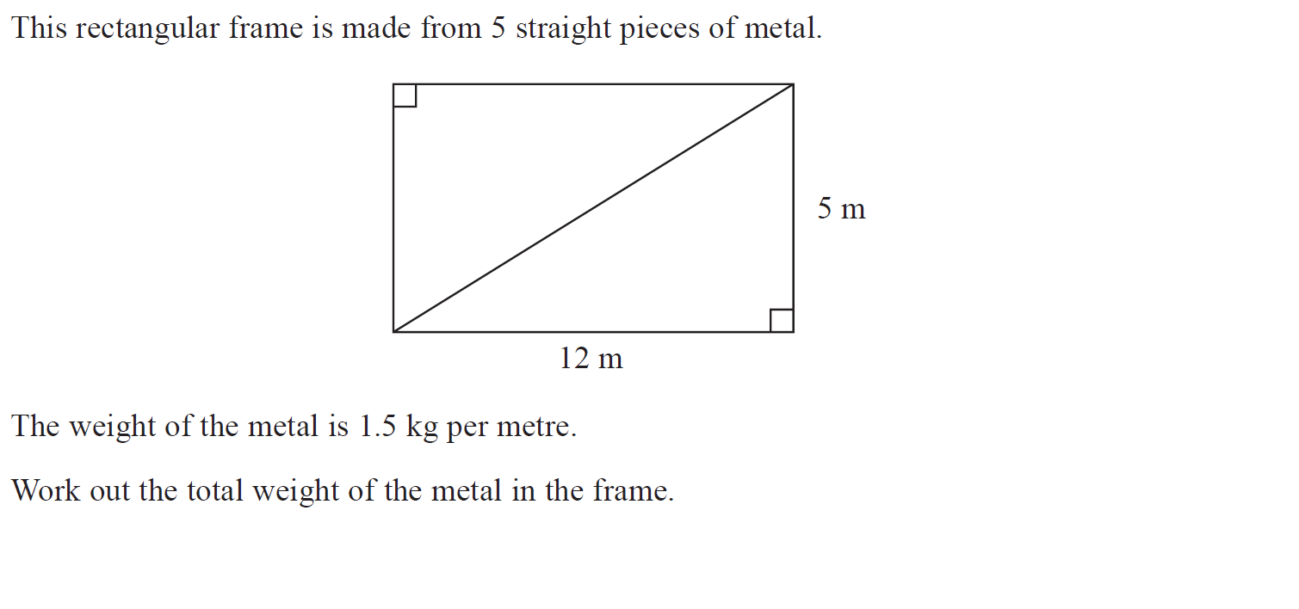
Pythagoras
May 2017 1H Q5

Slide 19
Pythagoras
May 2017 1H Q5
A

Slide 20
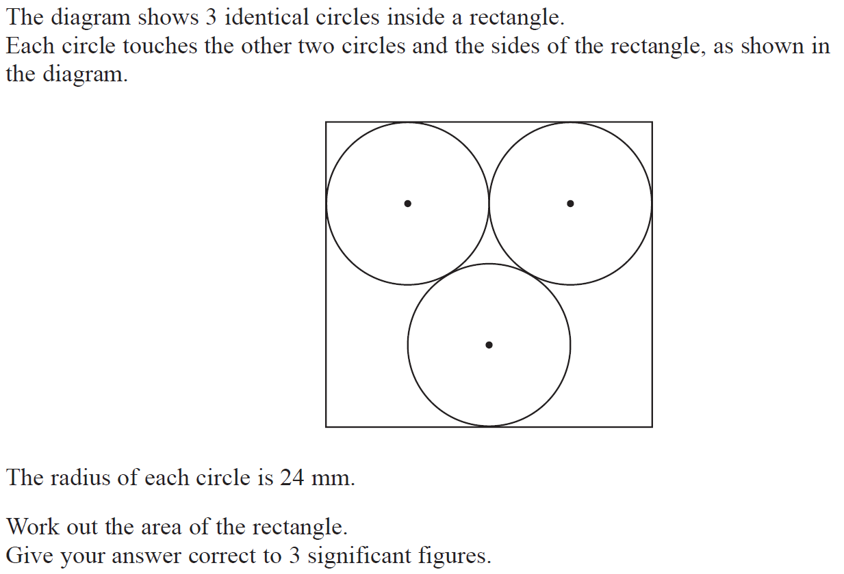
Pythagoras
June 2017 2H Q21

Slide 21
Pythagoras
June 2017 2H Q21
A

Slide 22
Pythagoras
June 2017 3H Q8

Slide 23
Pythagoras
June 2017 3H Q8
A

Slide 24
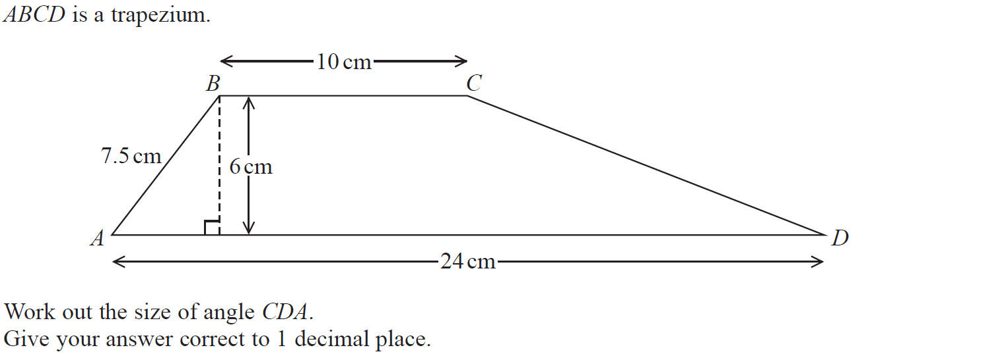
Pythagoras
Nov 2017 2H Q7

Slide 25
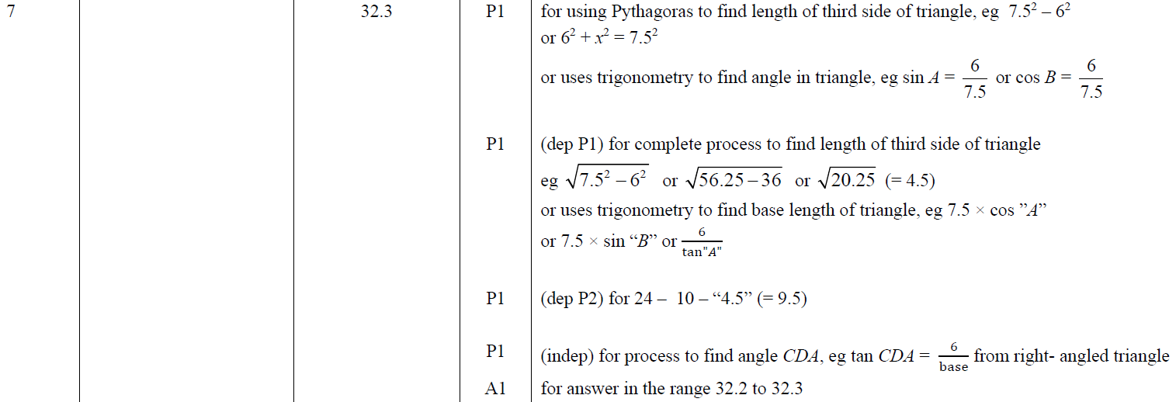
Pythagoras
Nov 2017 2H Q7
A

Slide 26
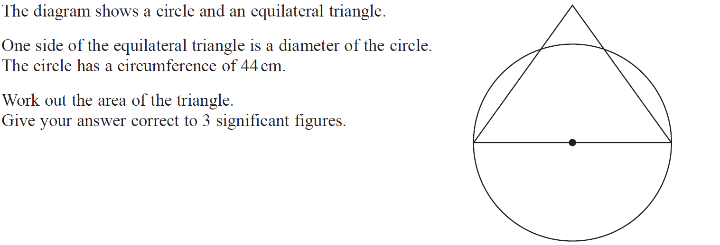
Pythagoras
Nov 2018 2H Q13

Slide 27
Pythagoras
Nov 2018 2H Q13
A

Slide 28
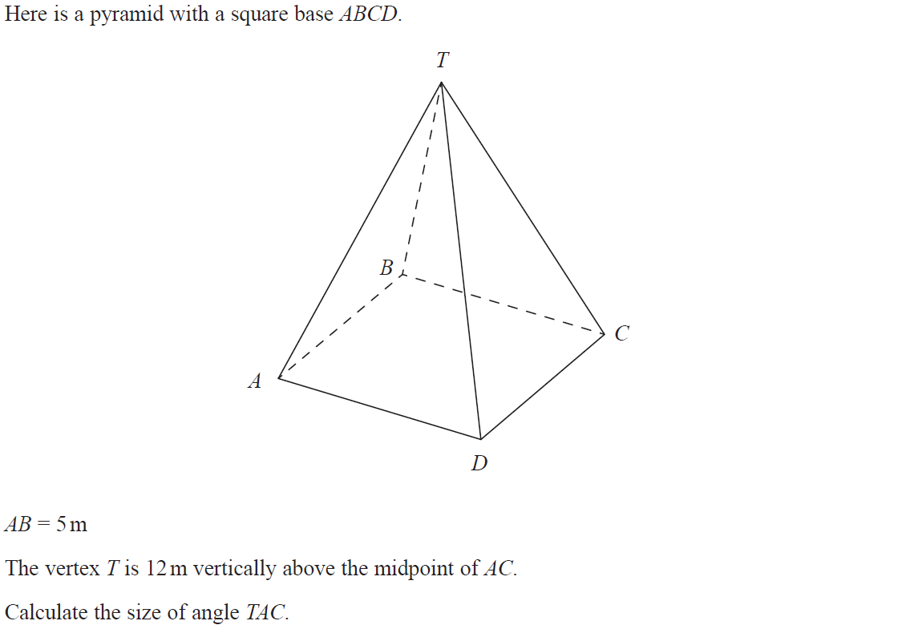
Pythagoras
Nov 2018 3H Q12

Slide 29
Pythagoras
Nov 2018 3H Q12
A

Slide 30
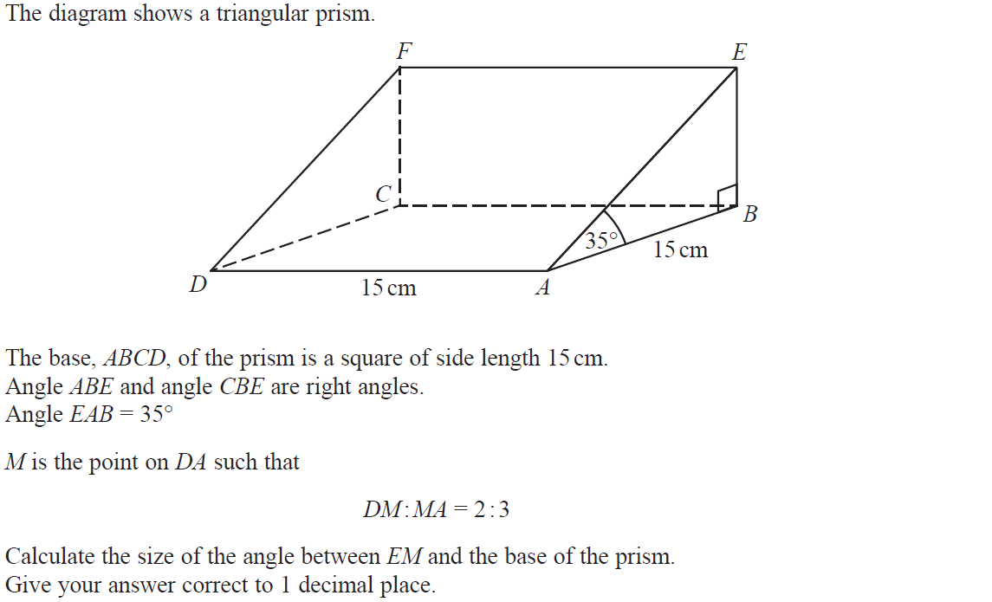
Pythagoras
June 2019 2H Q19

Slide 31
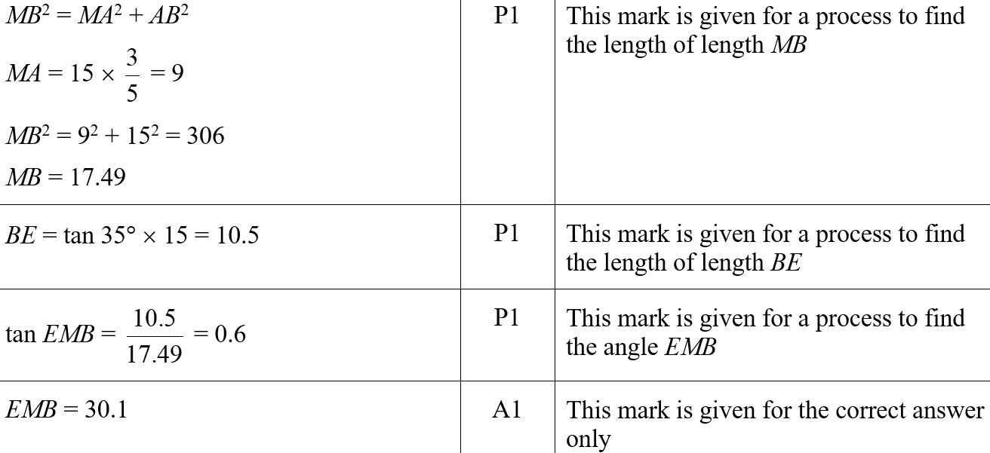
Pythagoras
June 2019 2H Q19
A
A SF

Slide 32
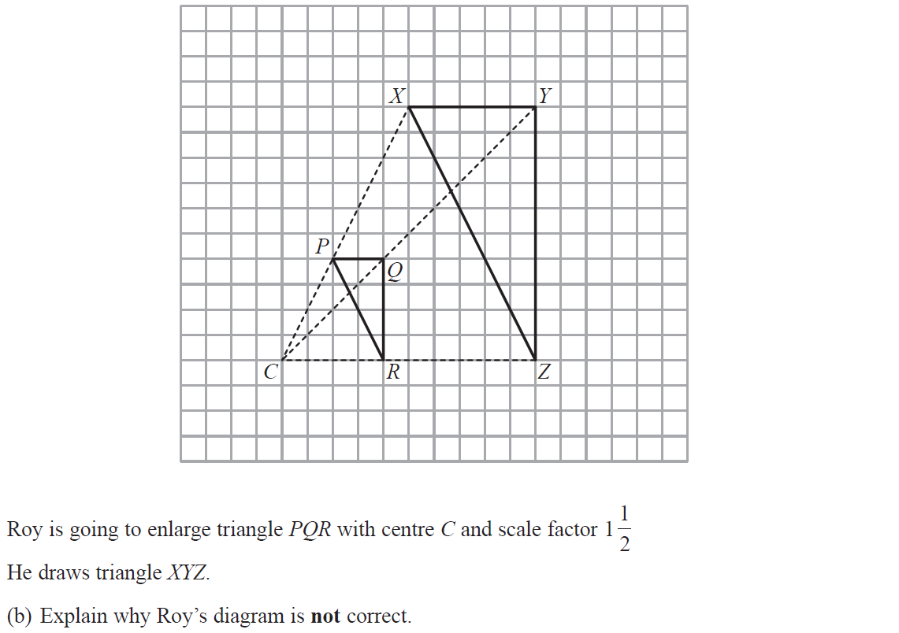
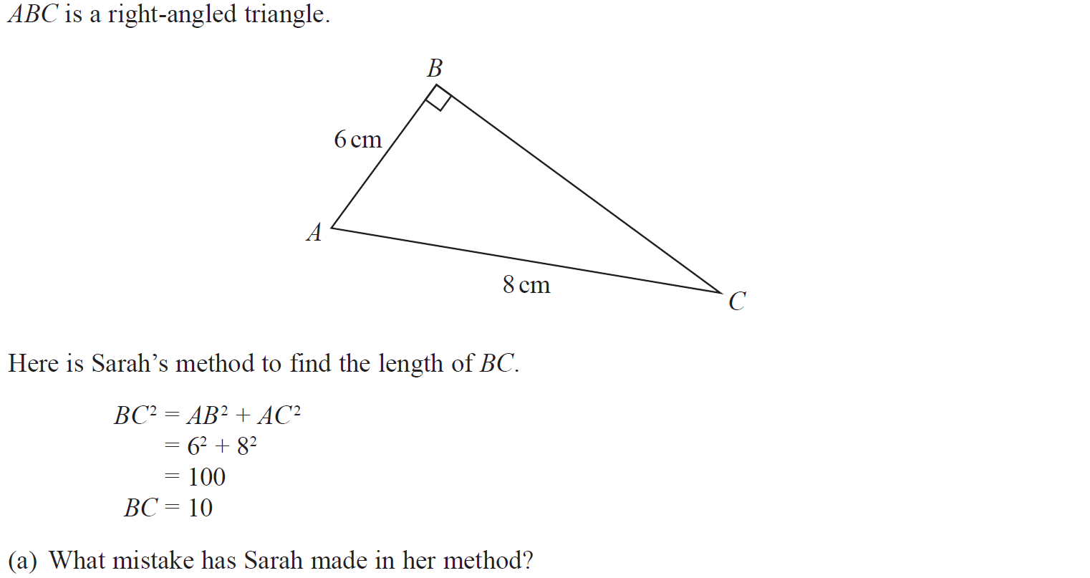
Pythagoras
June 2019 3H Q8

Slide 33
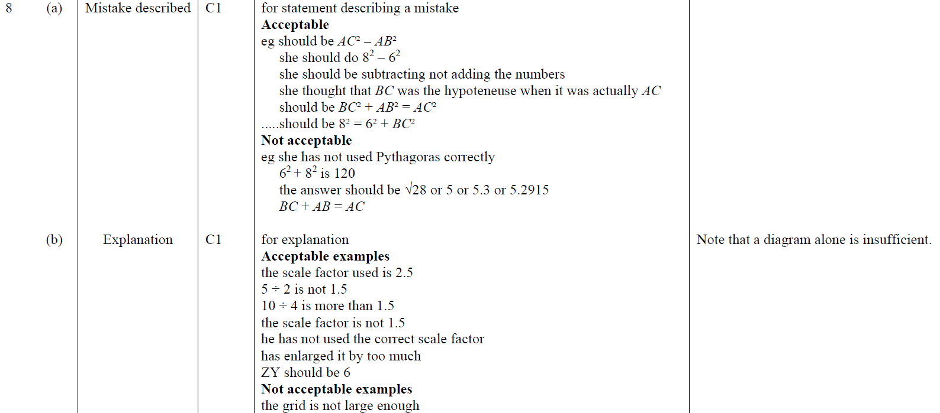
Pythagoras
June 2019 3H Q8
A
B
A SF
B SF

Slide 34
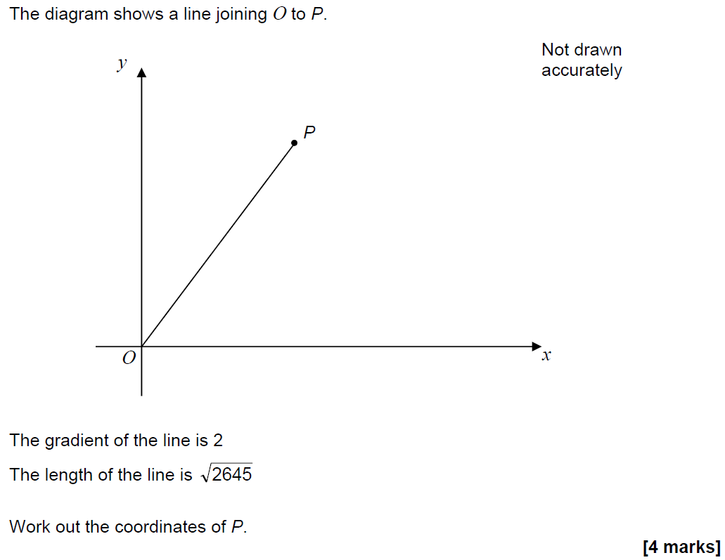
Pythagoras
SAM 3H Q28

Slide 35
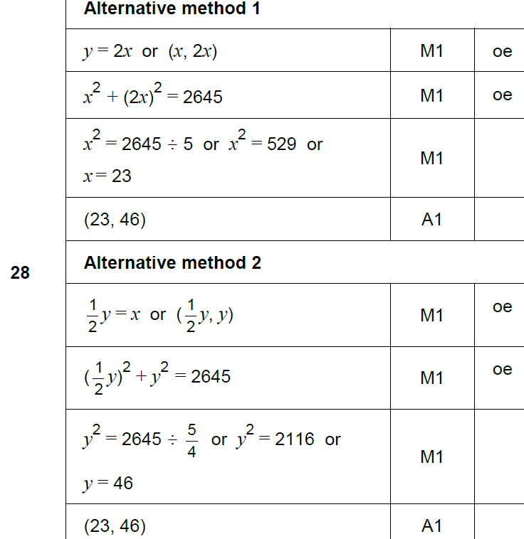
Pythagoras
SAM 3H Q28
A

Slide 36
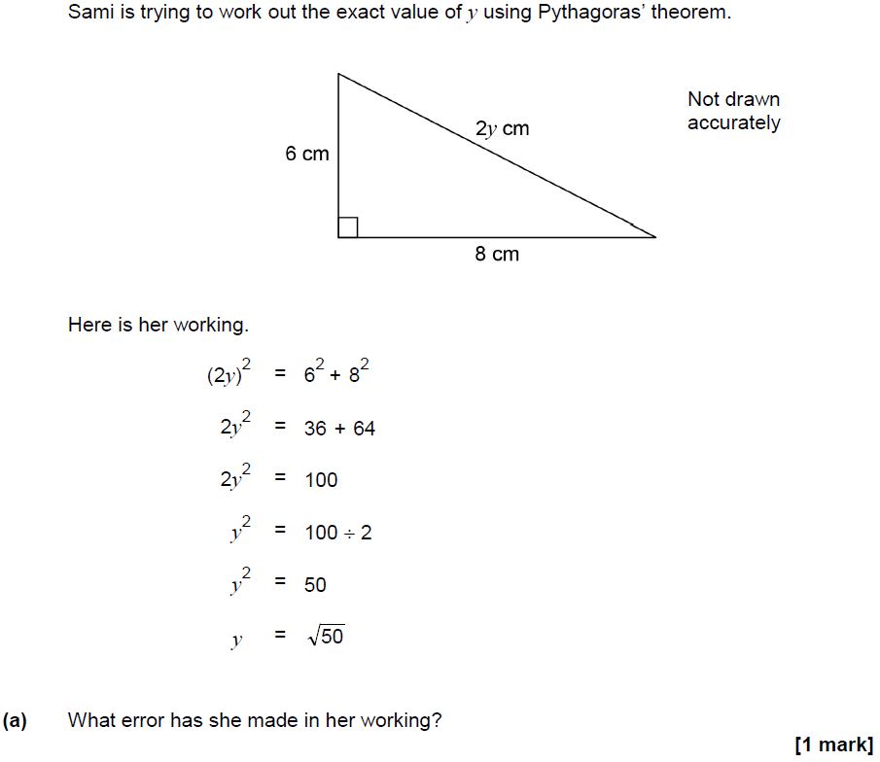
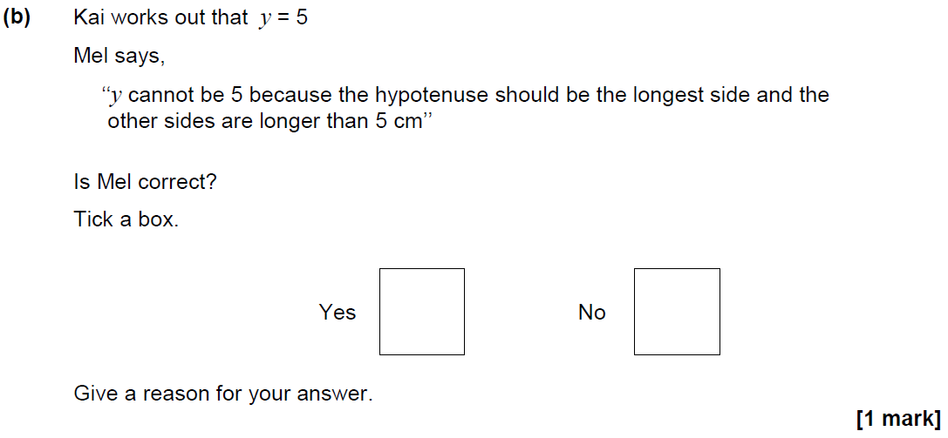
Pythagoras
June 2017 2H Q15

Slide 37
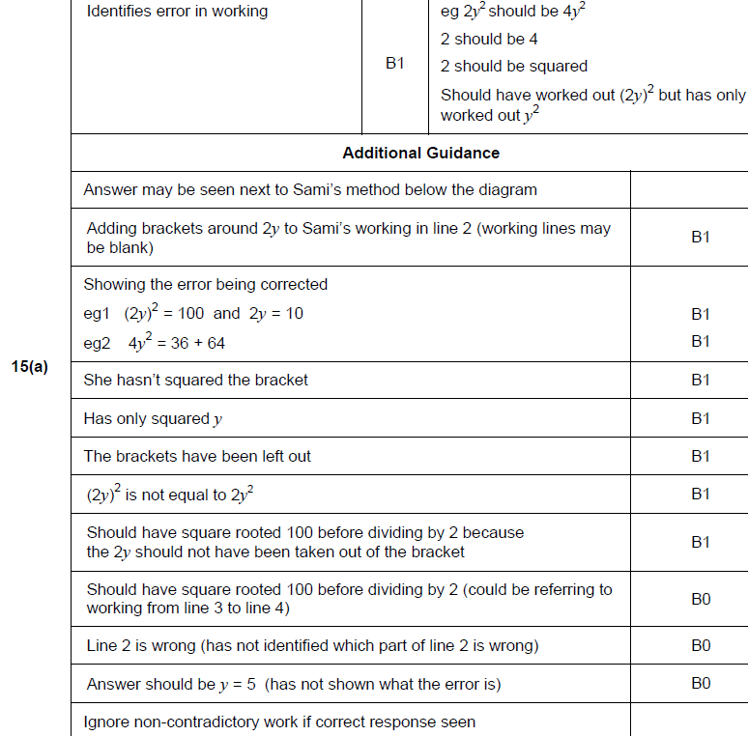
Pythagoras
June 2017 2H Q15
A

Slide 38
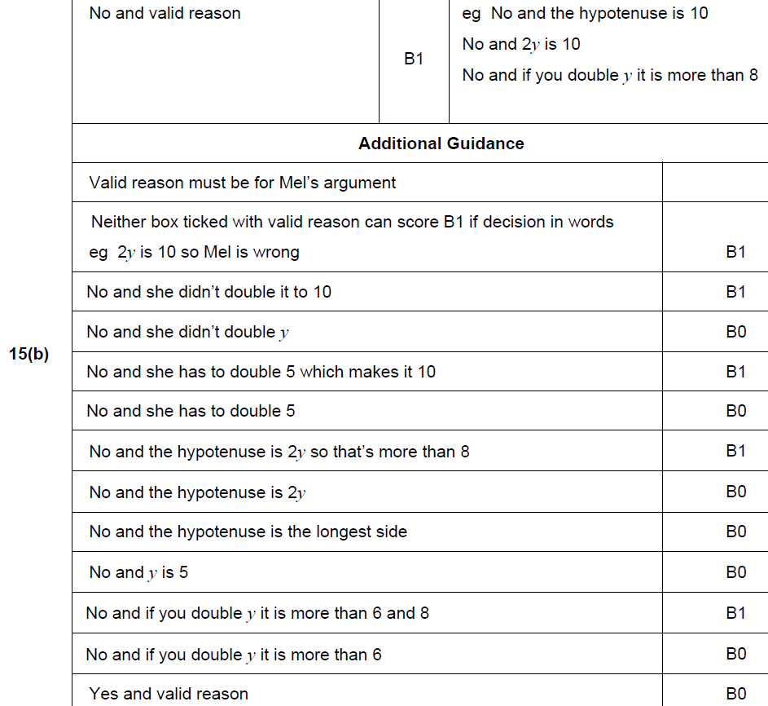
Pythagoras
June 2017 2H Q15
B

Slide 39
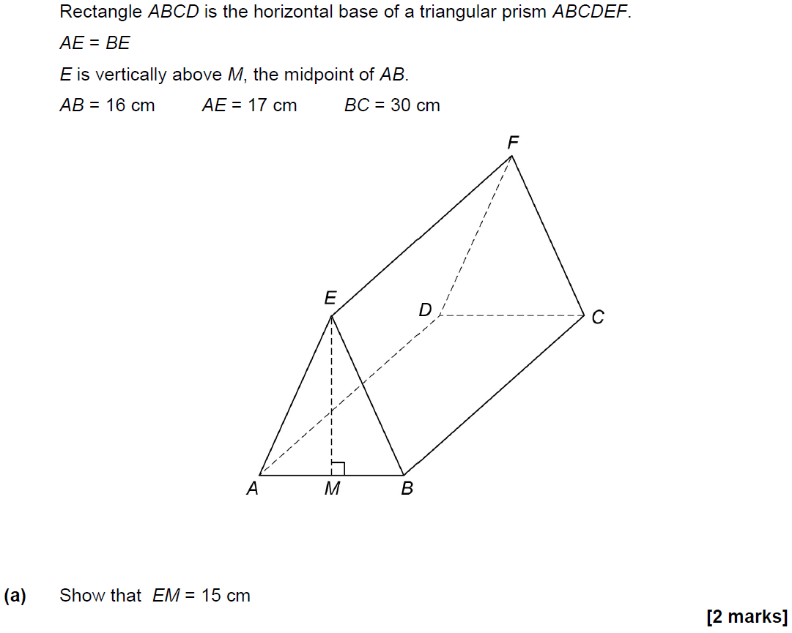
Pythagoras
June 2017 3H Q25

Slide 40
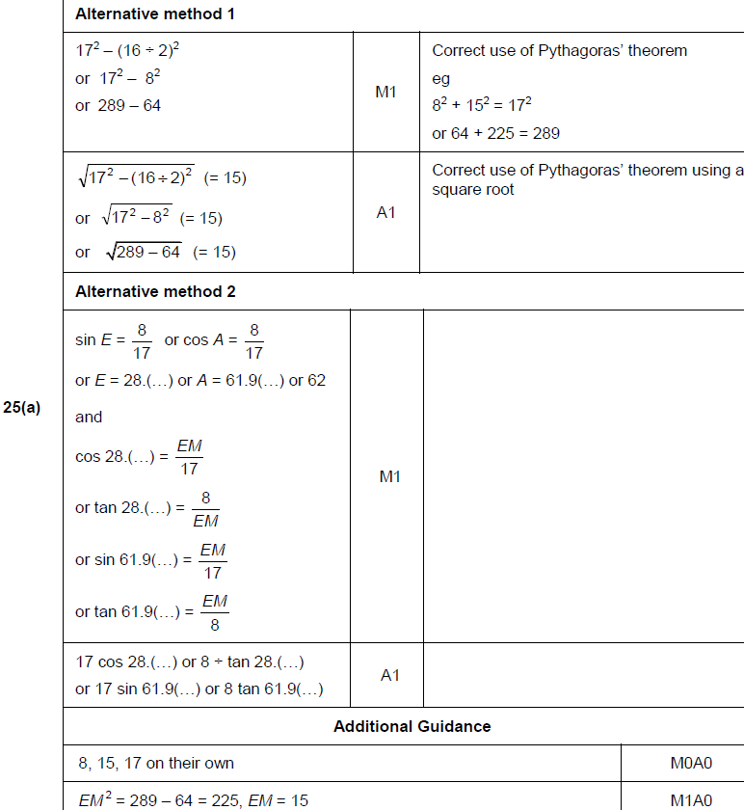
Pythagoras
June 2017 3H Q25
A

Slide 41
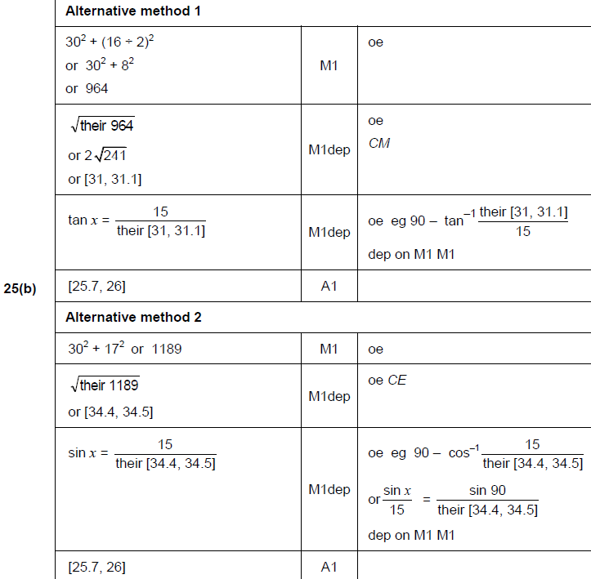
Pythagoras
June 2017 3H Q25
B

Slide 42
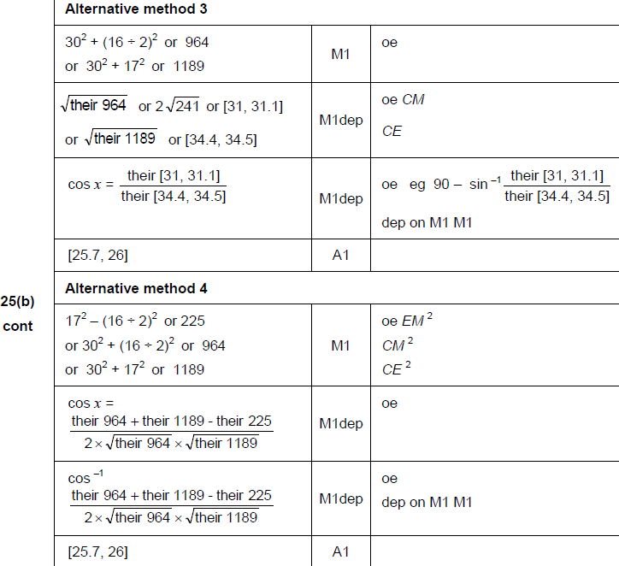
Pythagoras
June 2017 3H Q25
B Alternatives

Slide 43
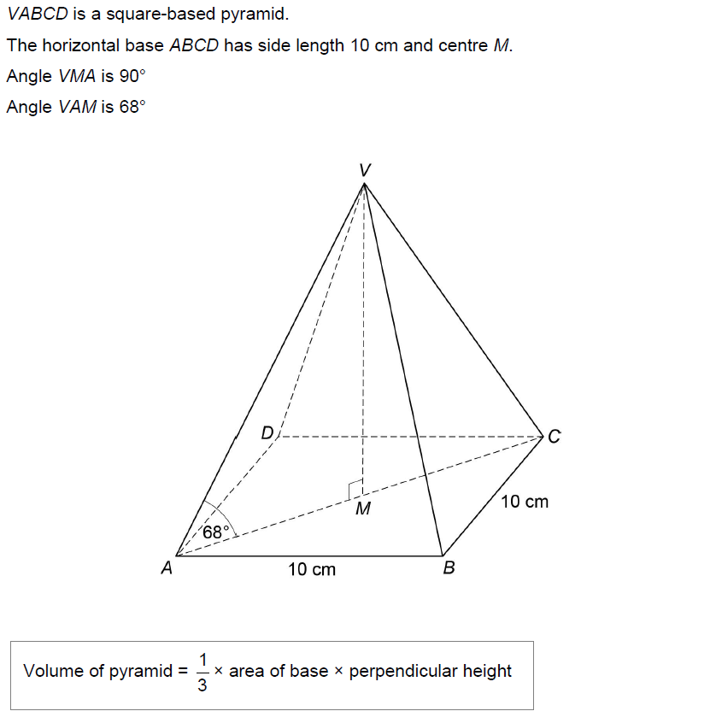
Pythagoras
Nov 2017 3H Q27
Work out the volume of the pyramid.
[6 marks]

Slide 44
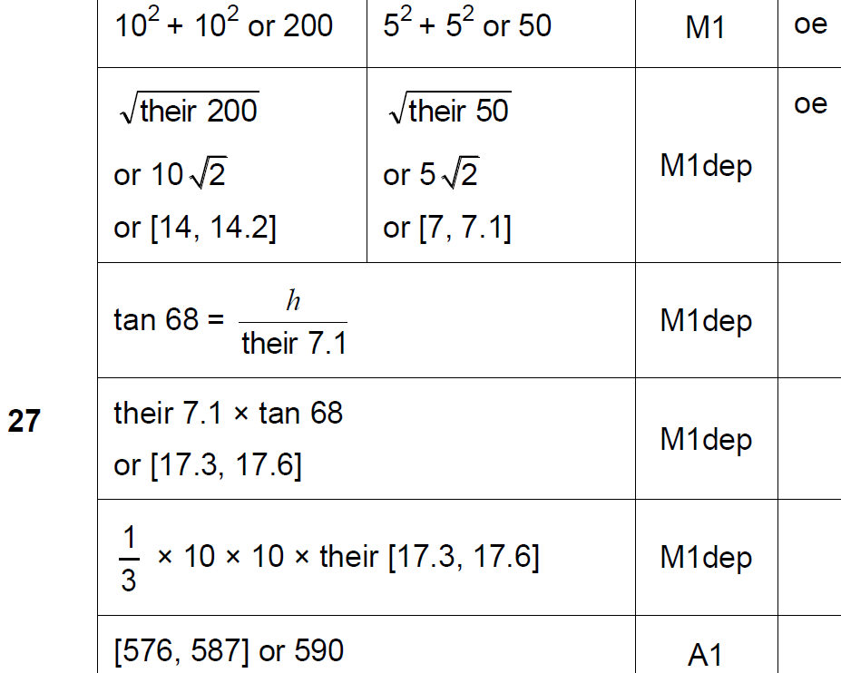
Pythagoras
Nov 2017 3H Q27
A

Slide 45
Pythagoras
June 2018 3H Q20

Slide 46
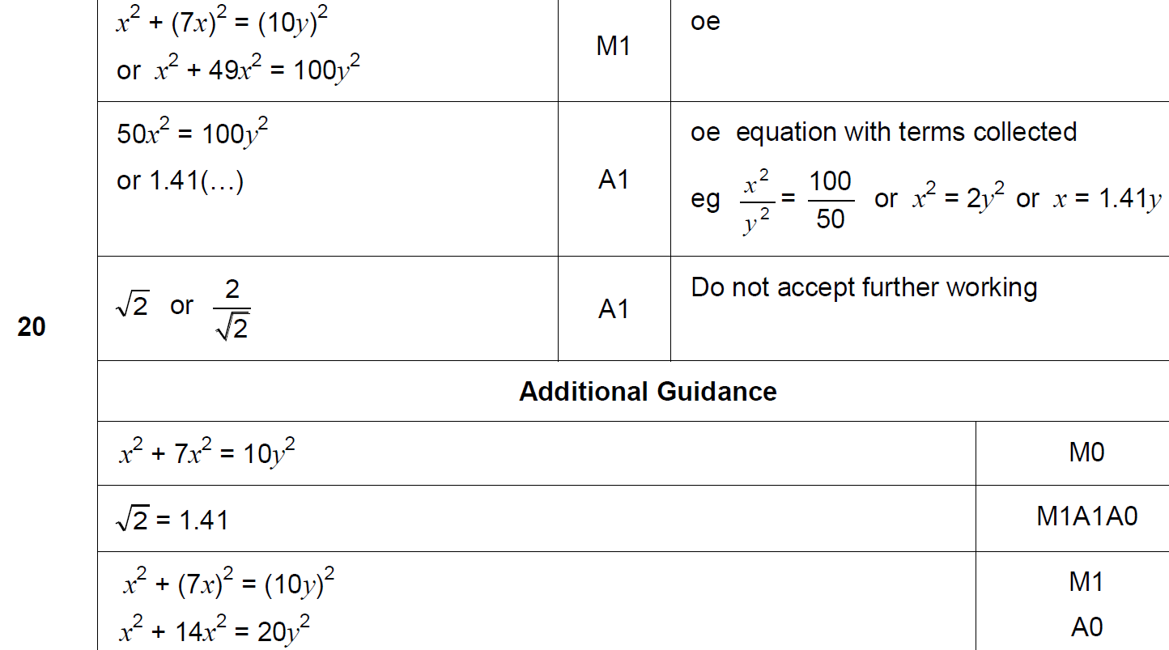
Pythagoras
June 2018 3H Q20
A

Slide 47
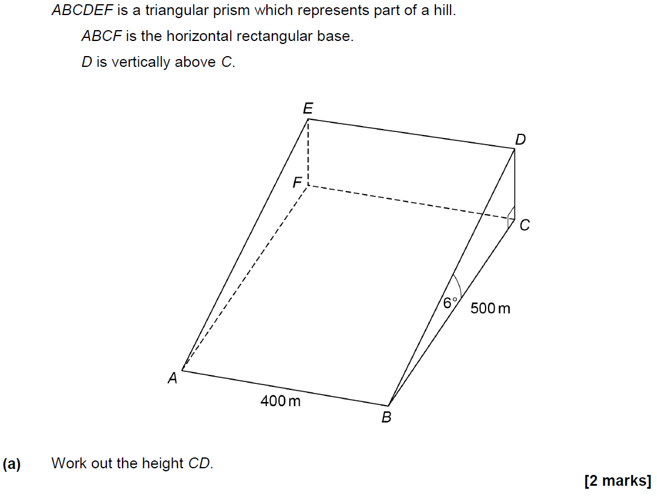
Pythagoras
June 2018 3H Q25

Slide 48
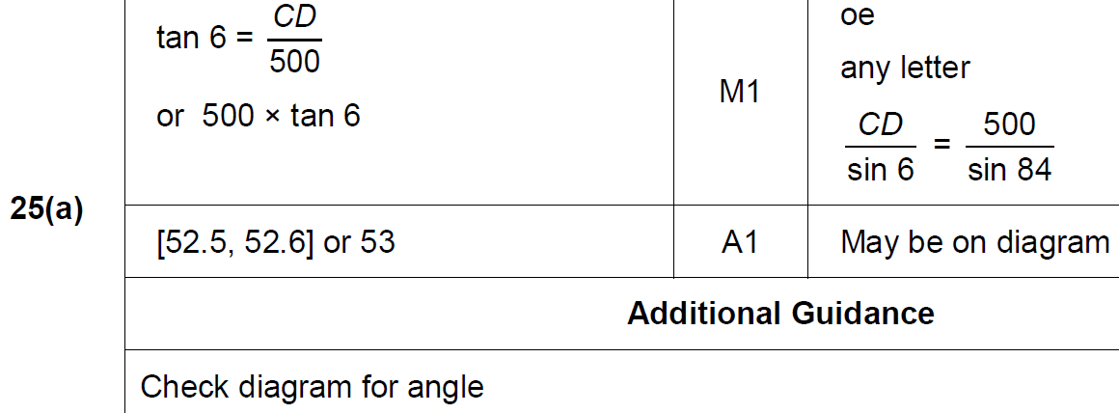
Pythagoras
June 2018 3H Q25
A

Slide 49
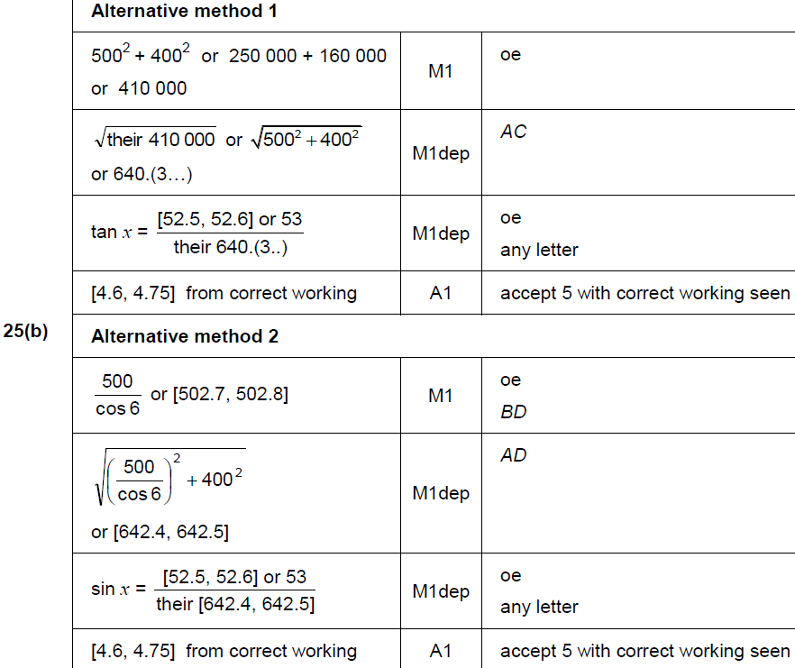
Pythagoras
June 2018 3H Q25
B

Slide 50
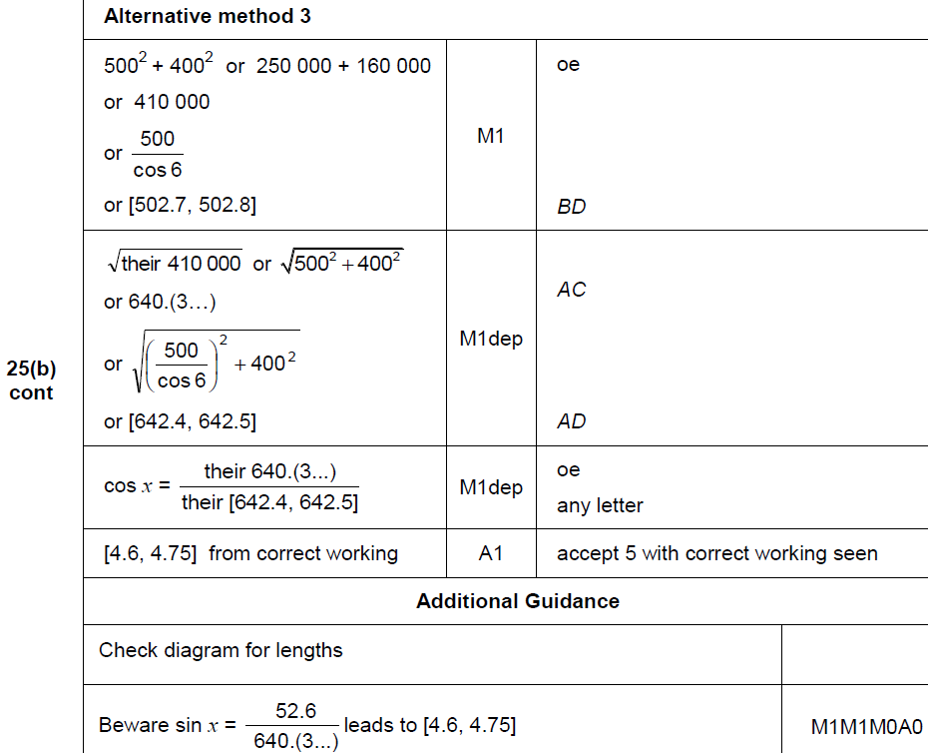
Pythagoras
June 2018 3H Q25
B Alternative

Slide 51
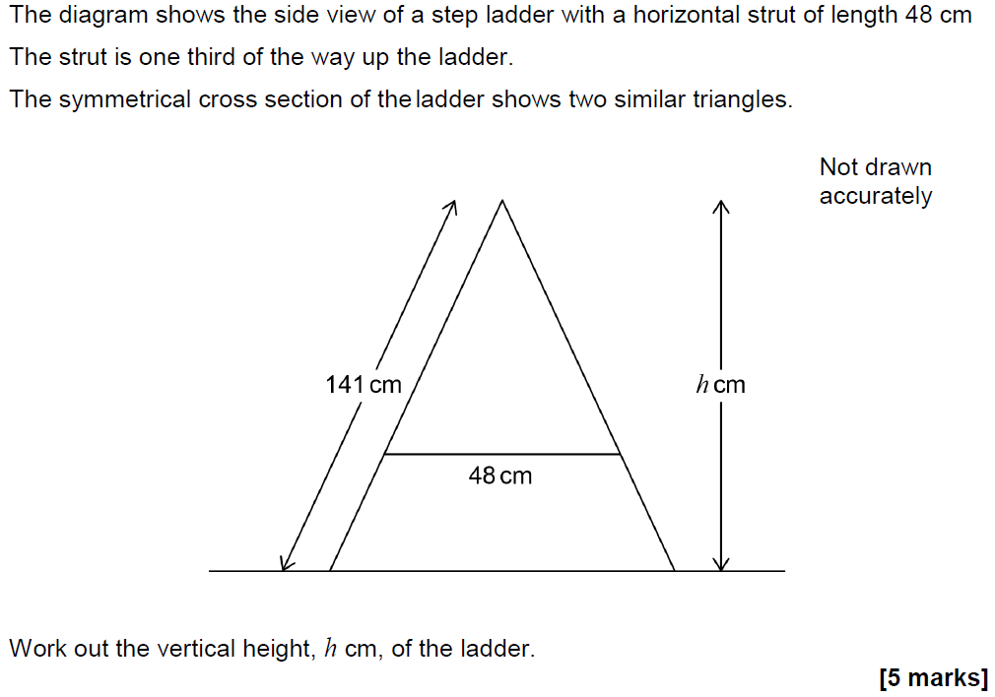
Pythagoras
Nov 2018 3H Q23

Slide 52
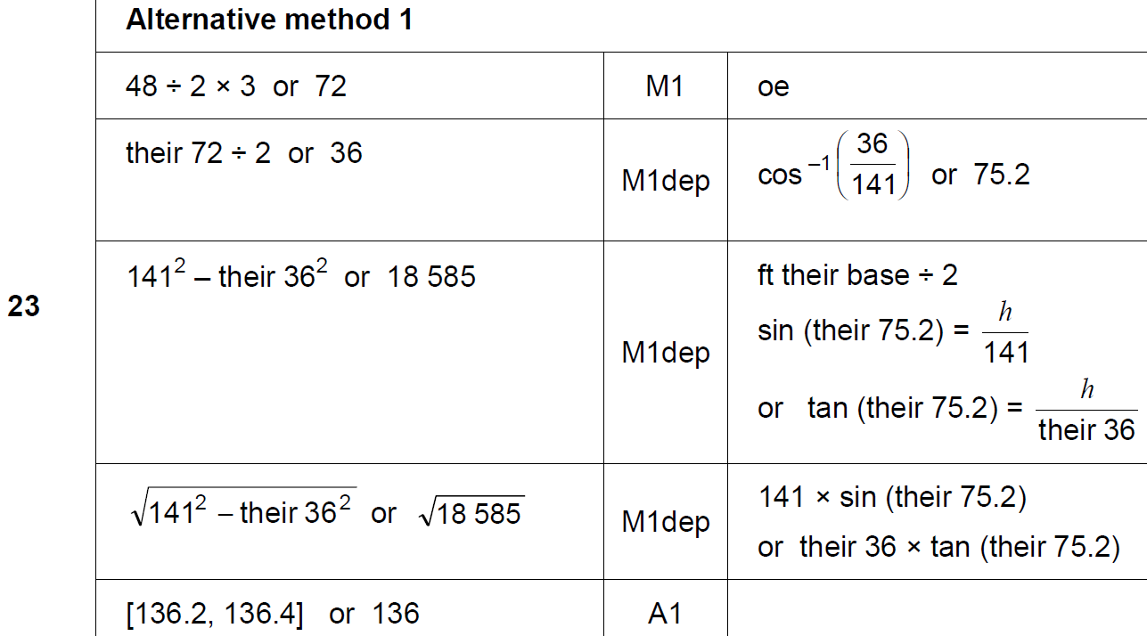
Pythagoras
Nov 2018 3H Q23
A

Slide 53
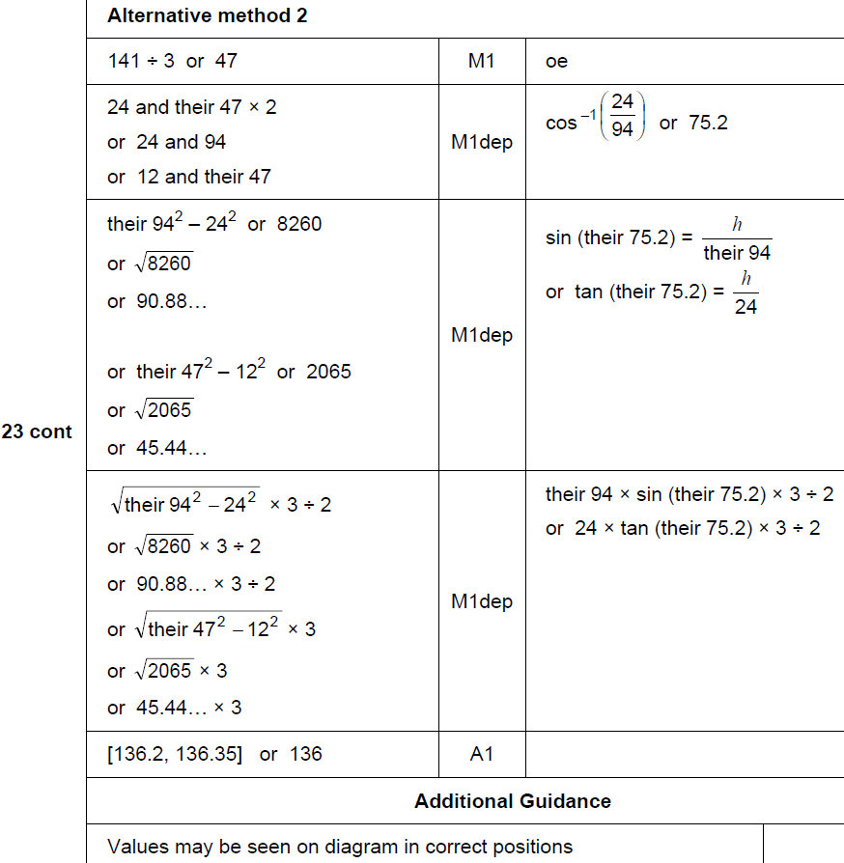
Pythagoras
Nov 2018 3H Q23
A Alternative & notes

Slide 54
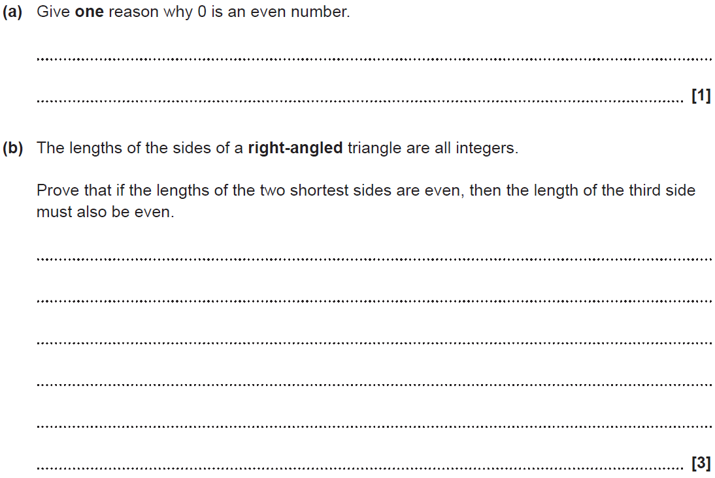
Pythagoras
SAM 1H Q11

Slide 55
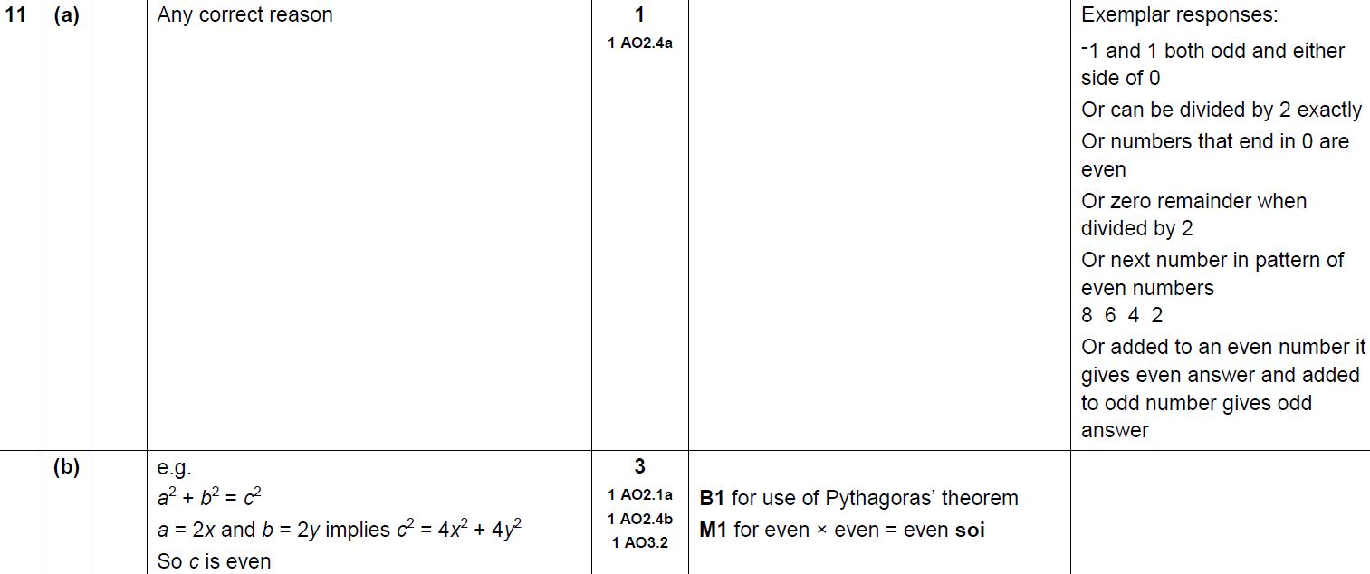
Pythagoras
SAM 1H Q11
A
B

Slide 56
Pythagoras
SAM 1H Q12

Slide 57
Pythagoras
SAM 1H Q12
A

Slide 58
Pythagoras
Practice 1H Q7

Slide 59
Pythagoras
Practice 1H Q7
A

Slide 60
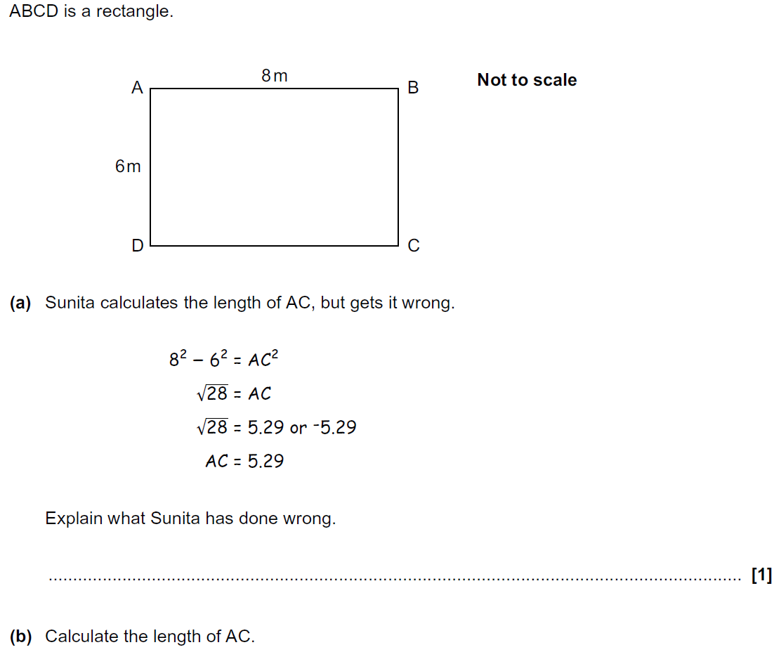
Pythagoras
Practice 2H Q3

Slide 61
Pythagoras
Practice 2H Q3
A
B

Slide 62
Pythagoras
Practice 3H Q2

Slide 63
Pythagoras
Practice 3H Q2
A

Slide 64
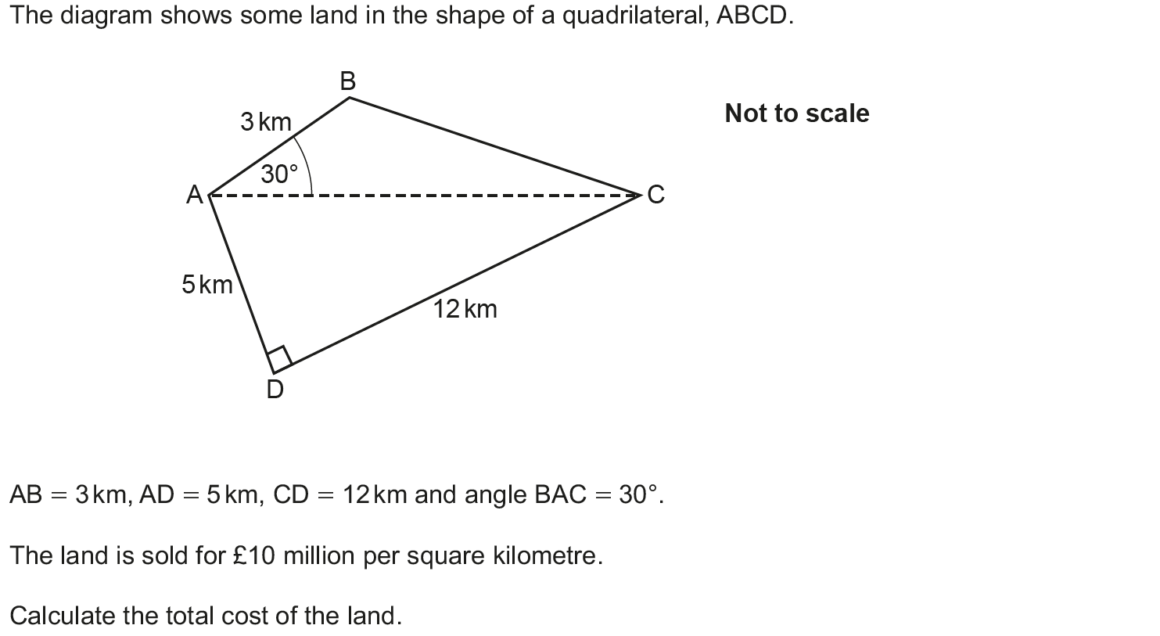
Pythagoras
June 2017 2H Q20

Slide 65
Pythagoras
June 2017 2H Q20
A

Slide 66
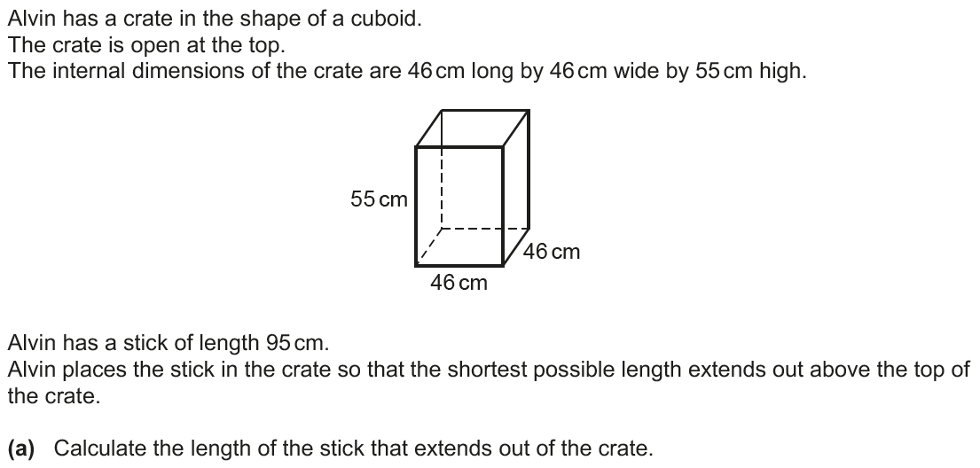
Pythagoras
June 2017 3H Q18

Slide 67
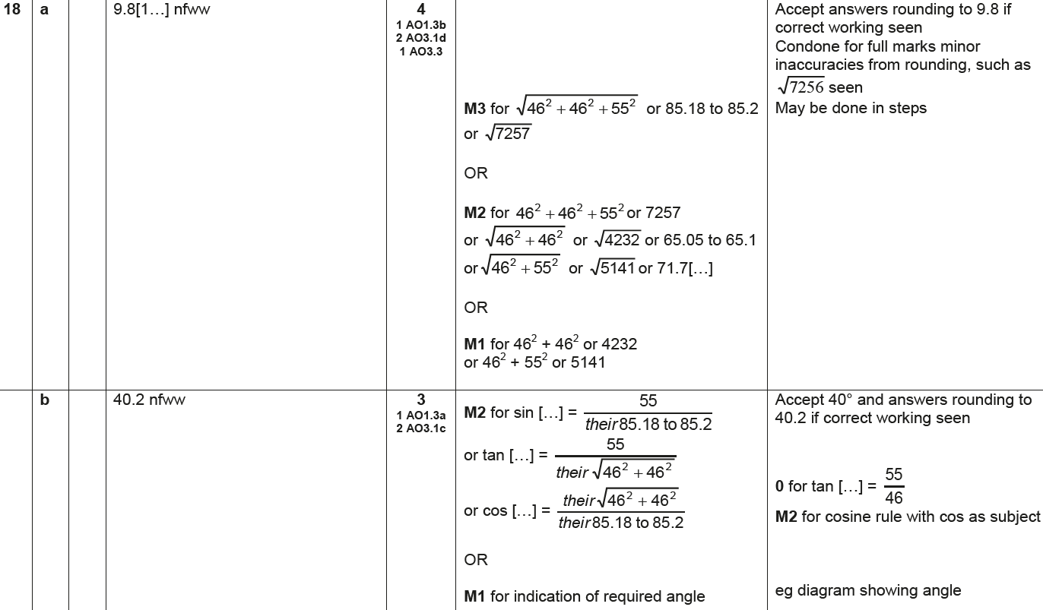
Pythagoras
June 2017 3H Q18
A
B

Slide 68
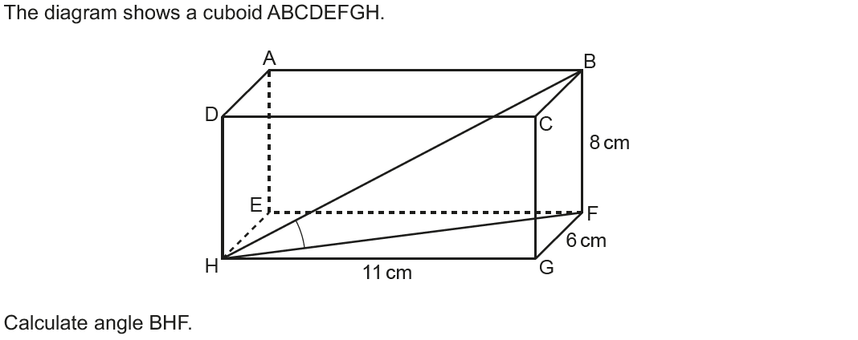
Pythagoras
Nov 2017 1H Q14

Slide 69
Pythagoras
Nov 2017 1H Q14
A

Slide 70
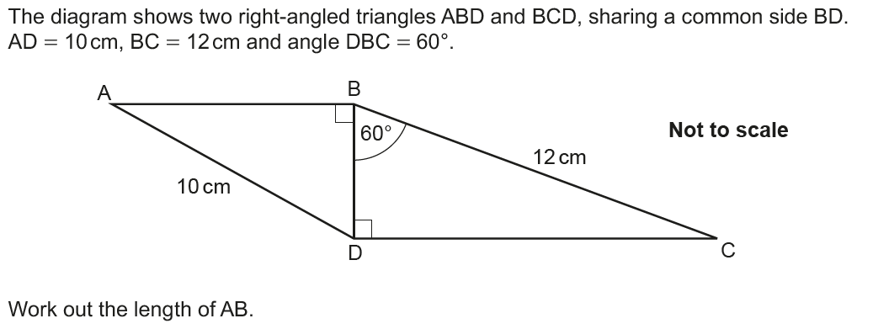
Pythagoras
June 2018 2H Q11

Slide 71
Pythagoras
June 2018 2H Q11
A

Slide 72
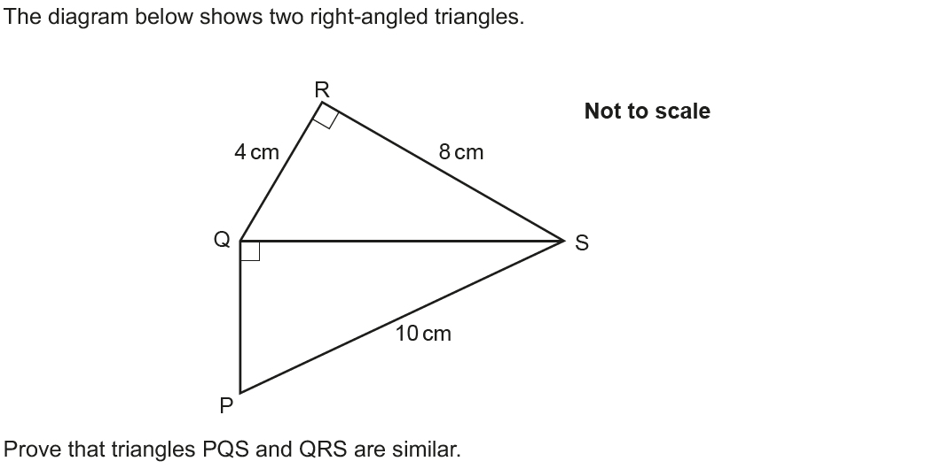
Pythagoras
June 2018 3H Q12

Slide 73
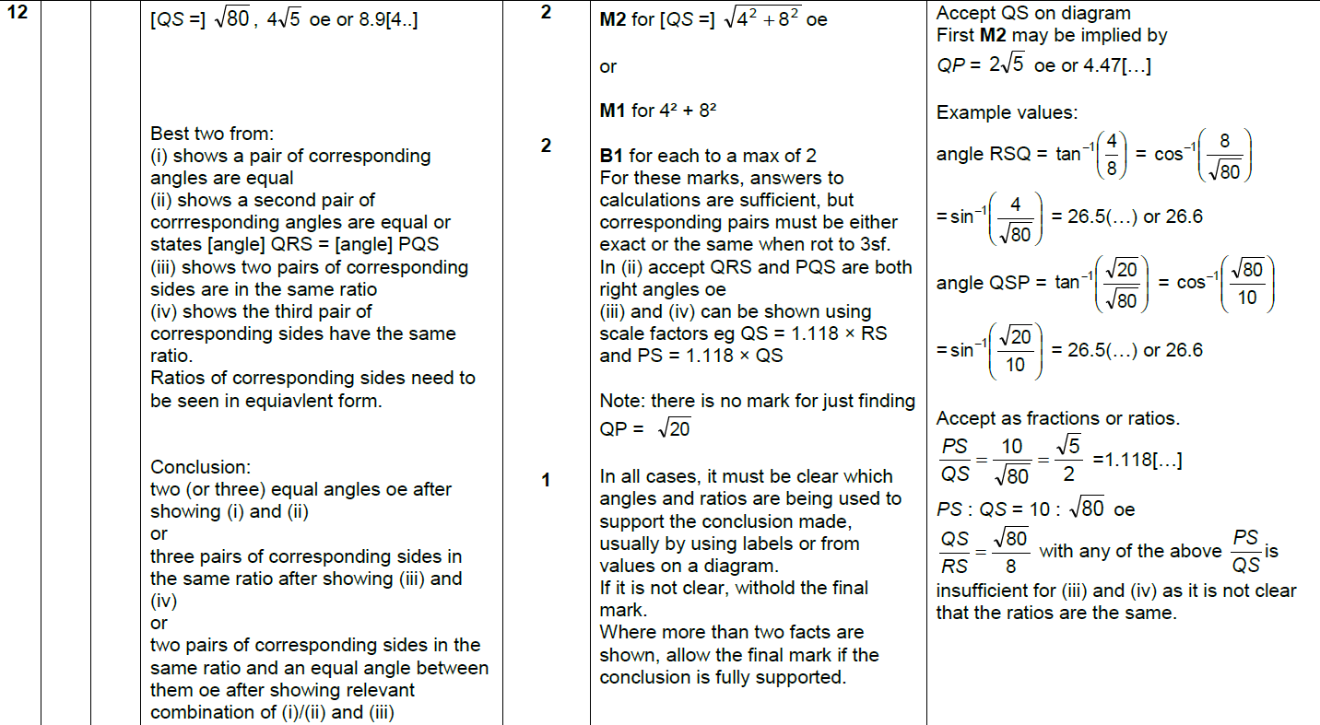
Pythagoras
June 2018 3H Q12
A

Slide 74
Pythagoras
Nov 2018 1H Q3

Slide 75
Pythagoras
Nov 2018 1H Q3
A

Slide 76
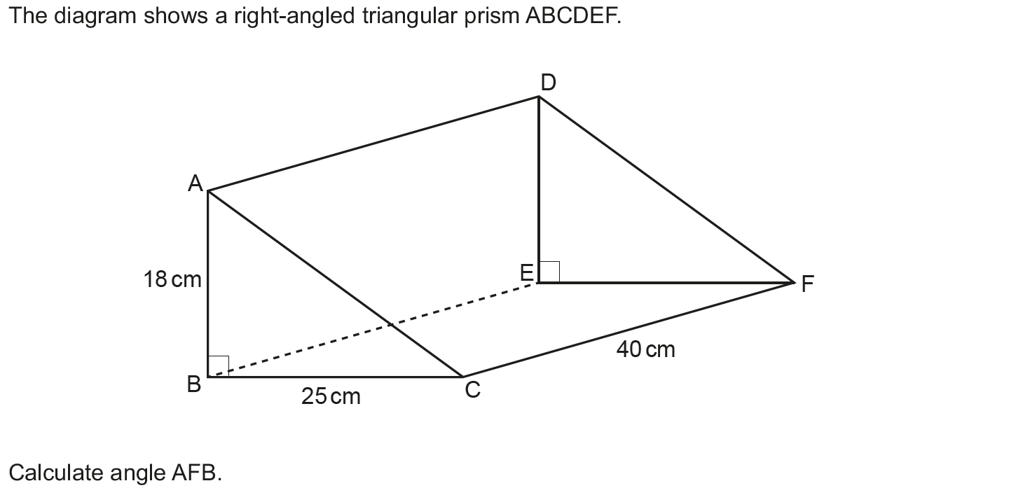
Pythagoras
Nov 2018 1H Q20

Slide 77
Pythagoras
Nov 2018 1H Q20
A

