Slide 1
Properties of Numbers
Properties of Numbers
May 2017
1H Q5
June 2018
3H Q5
SAM
2H Q9
June 2017
2H Q13
Nov 2018
2H Q17
SAM
2H Q18
Nov 2017
3H Q6
1 Marker
Nov 2018
3H Q4
SAM
3H Q12
Nov 2017
3H Q15
Nov 2018
3H Q7
Nov 2017
3H Q26
Prime factors/ HCF/ LCM

Slide 2
Properties of Numbers
SAM 2H Q9

Slide 3
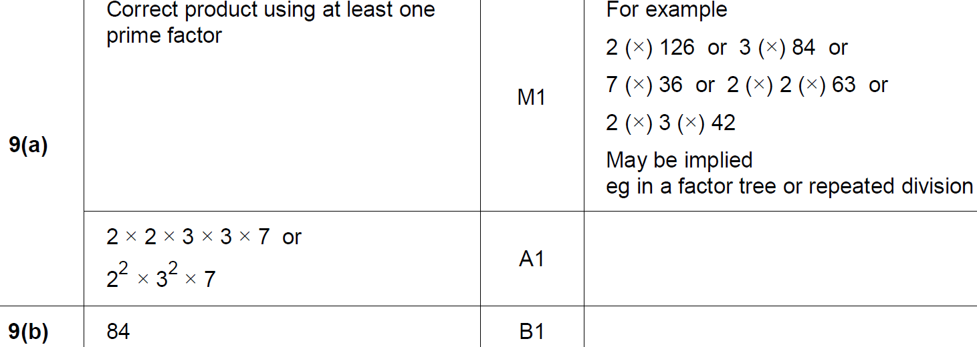
Properties of Numbers
SAM 2H Q9
A
B

Slide 4
Properties of Numbers
SAM 2H Q18

Slide 5
Properties of Numbers
SAM 2H Q18
A
B

Slide 6
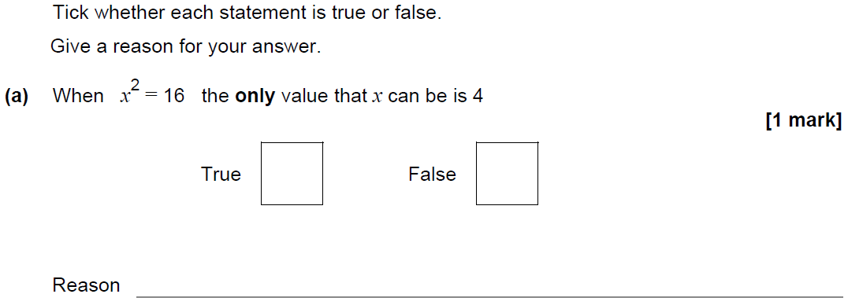
Properties of Numbers
SAM 3H Q12

Slide 7
Properties of Numbers
SAM 3H Q12
A
B
C

Slide 8
Properties of Numbers
May 2017 1H Q5

Slide 9
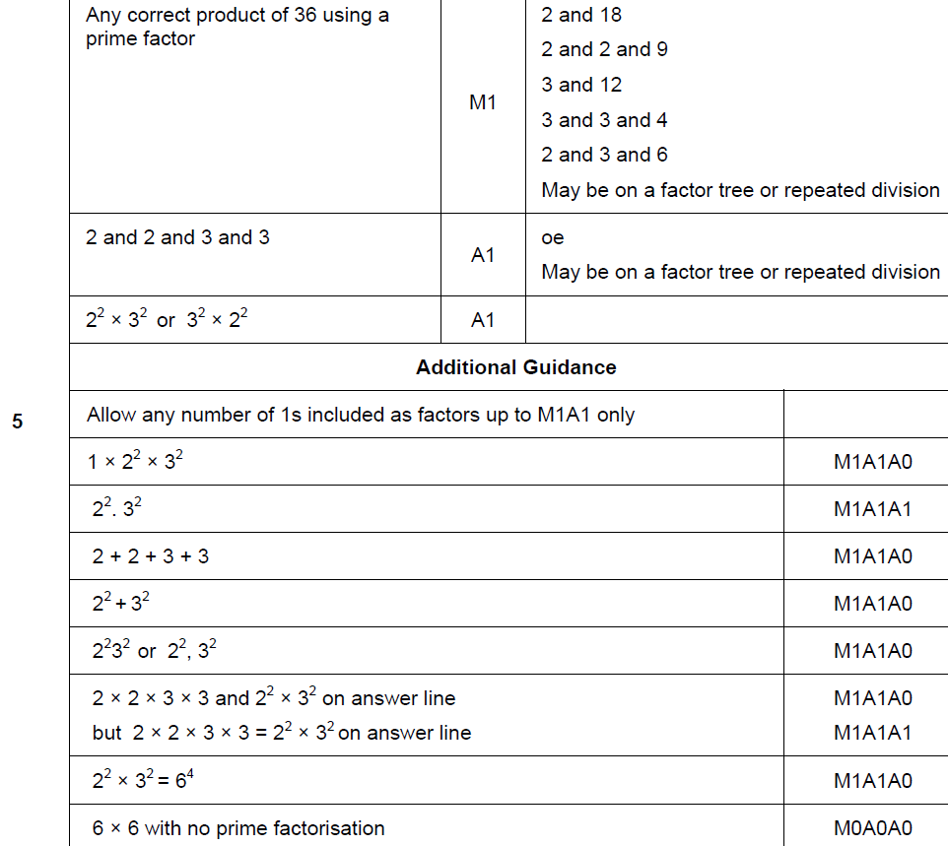
Properties of Numbers
May 2017 1H Q5
A

Slide 10
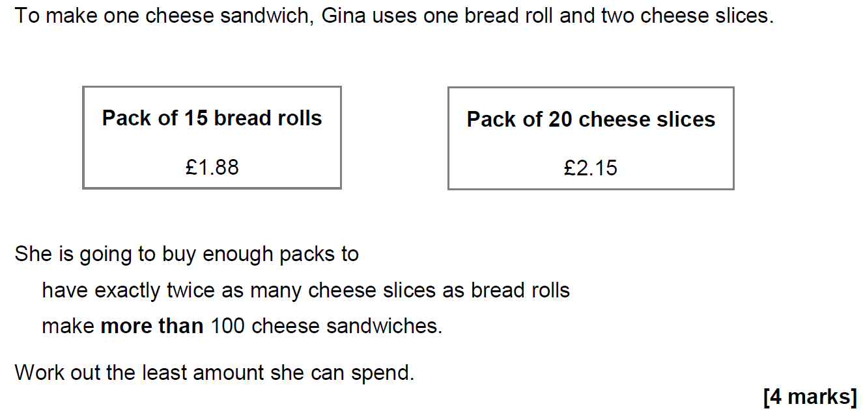
Properties of Numbers
June 2017 2H Q13

Slide 11
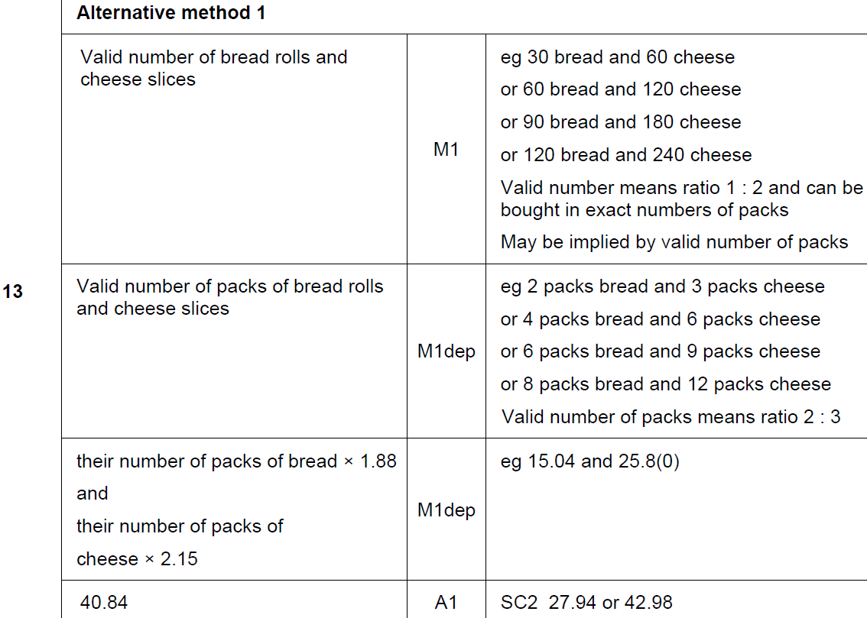
Properties of Numbers
June 2017 2H Q13
A

Slide 12
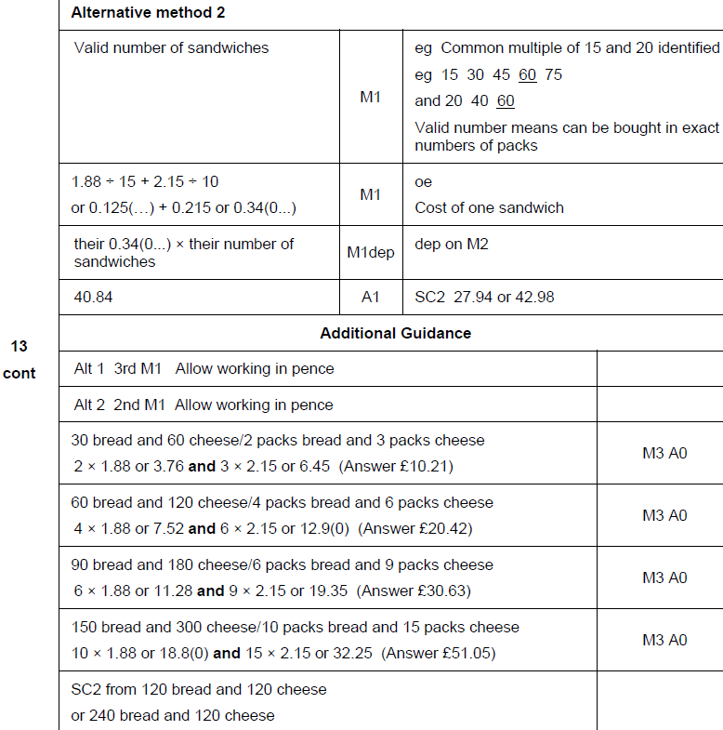
Properties of Numbers
June 2017 2H Q13
A Alternative & notes

Slide 13
Properties of Numbers
Nov 2017 3H Q6

Slide 14
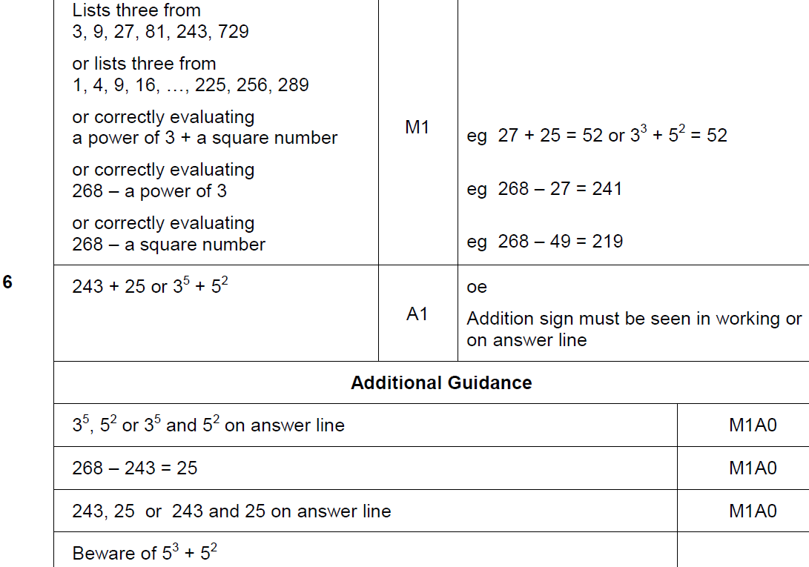
Properties of Numbers
Nov 2017 3H Q6
A

Slide 15
Properties of Numbers
Nov 2017 3H Q15

Slide 16
Properties of Numbers
Nov 2017 3H Q15
A

Slide 17
Properties of Numbers
Nov 2017 3H Q26

Slide 18
Properties of Numbers
Nov 2017 3H Q26
A

Slide 19
Properties of Numbers
June 2018 3H Q5

Slide 20
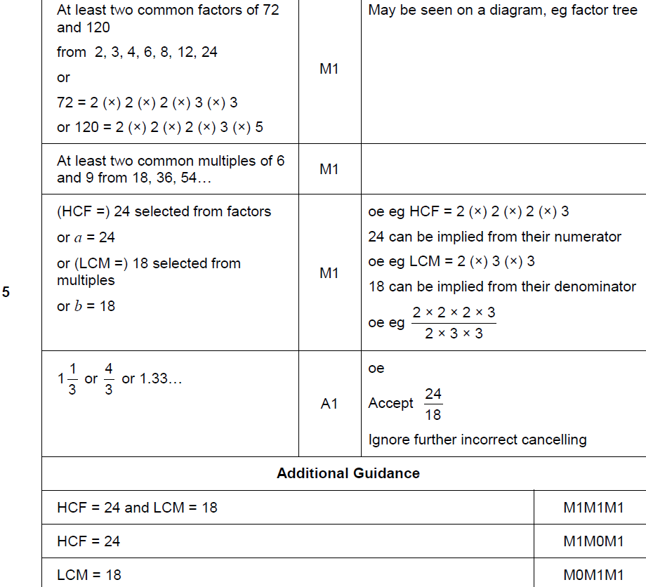
Properties of Numbers
June 2018 3H Q5
A

Slide 21
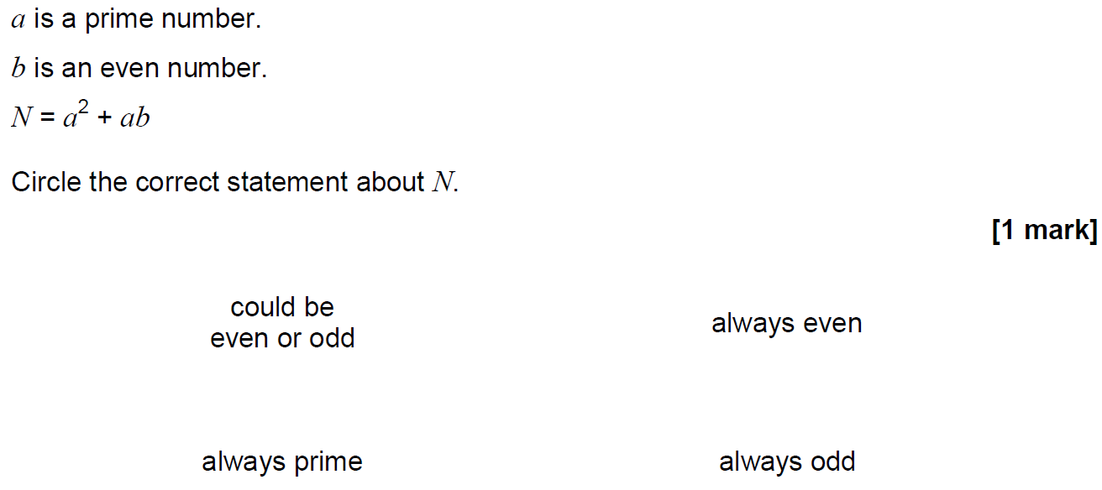
Properties of Numbers
Nov 2018 2H Q17

Slide 22
Properties of Numbers
Nov 2018 2H Q17
A

Slide 23
Properties of Numbers
Nov 2018 3H Q4

Slide 24
Properties of Numbers
Nov 2018 3H Q4
A

Slide 25
Properties of Numbers
Nov 2018 3H Q7

Slide 26
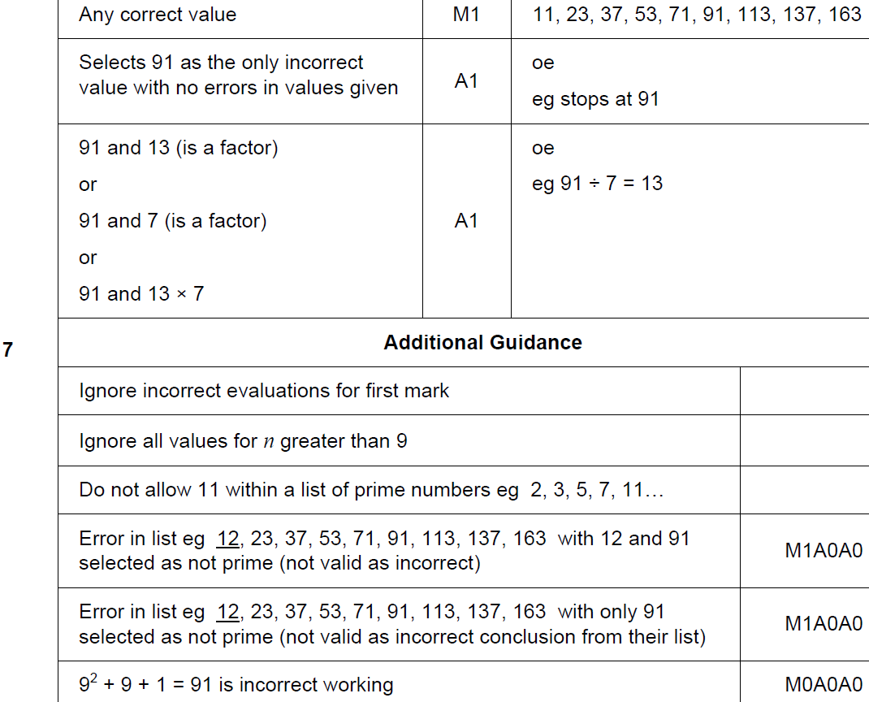
Properties of Numbers
Nov 2018 3H Q7
A

