Slide 1
Old Spec Q’s
Polar Coordinates
SAM 1
2019 1

Slide 2
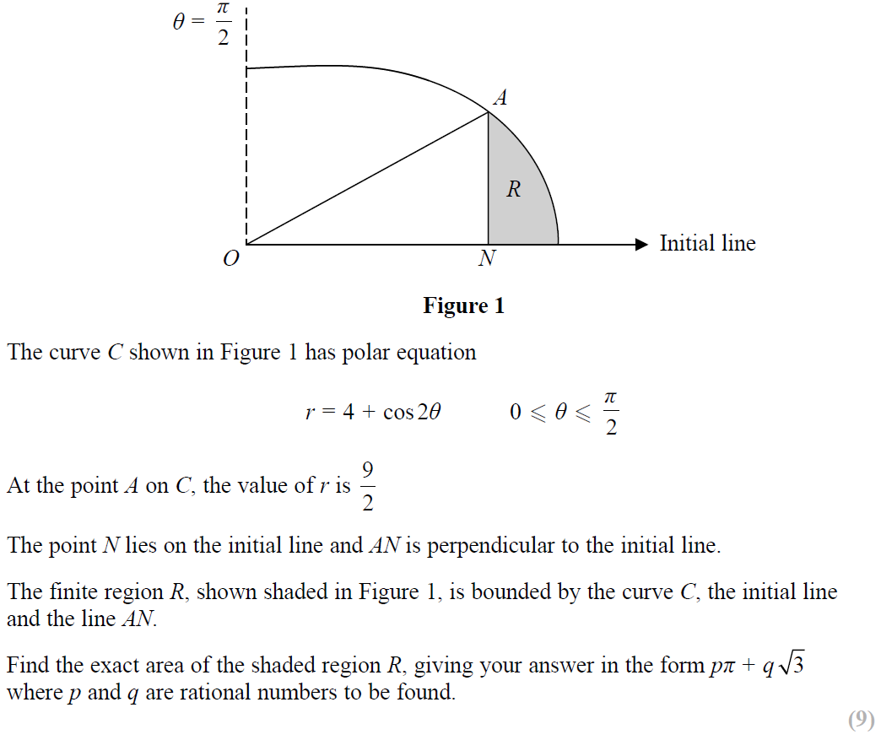
SAM Paper 1

Slide 3
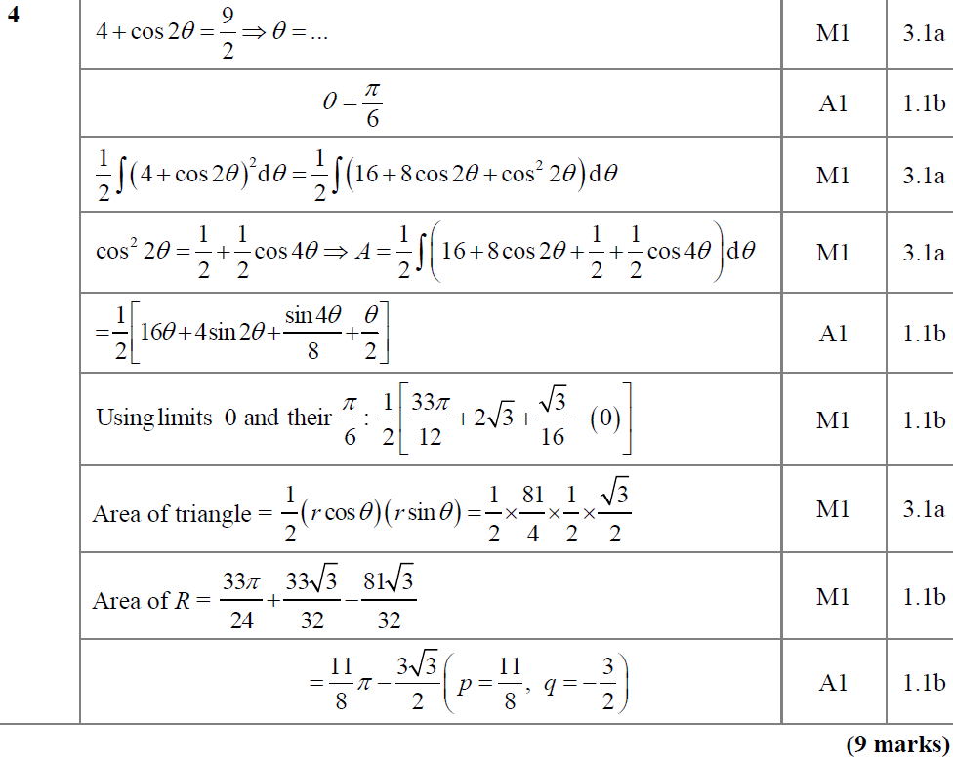
SAM Paper 1
A

Slide 4
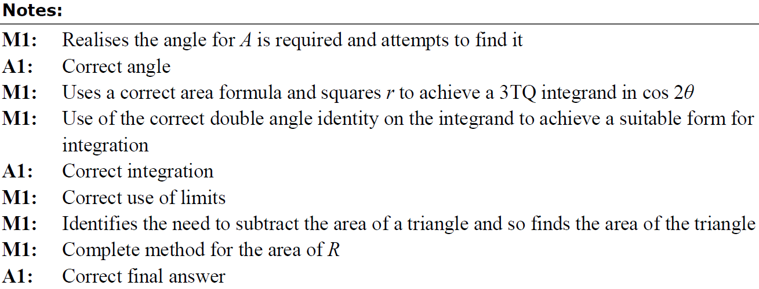
SAM Paper 1
A

Slide 5
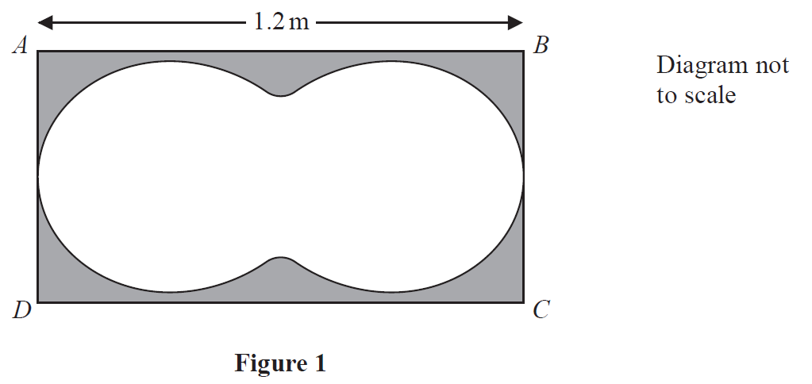
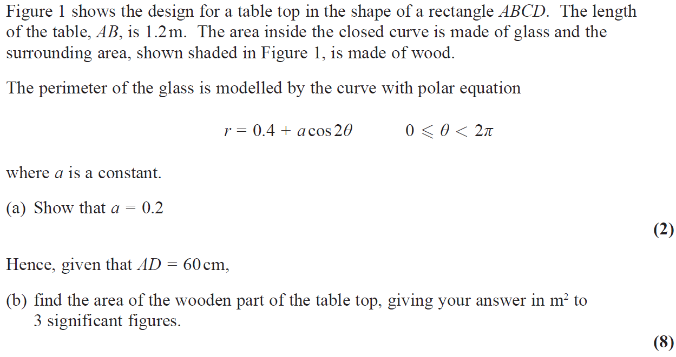
2019 Paper 1

Slide 6
2019 Paper 1
A

Slide 7
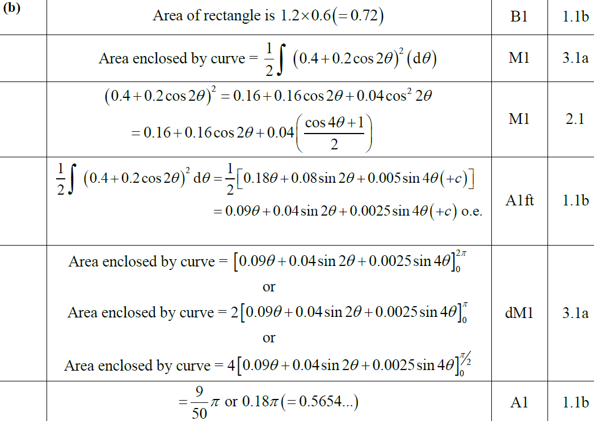
2019 Paper 1
B

Slide 8
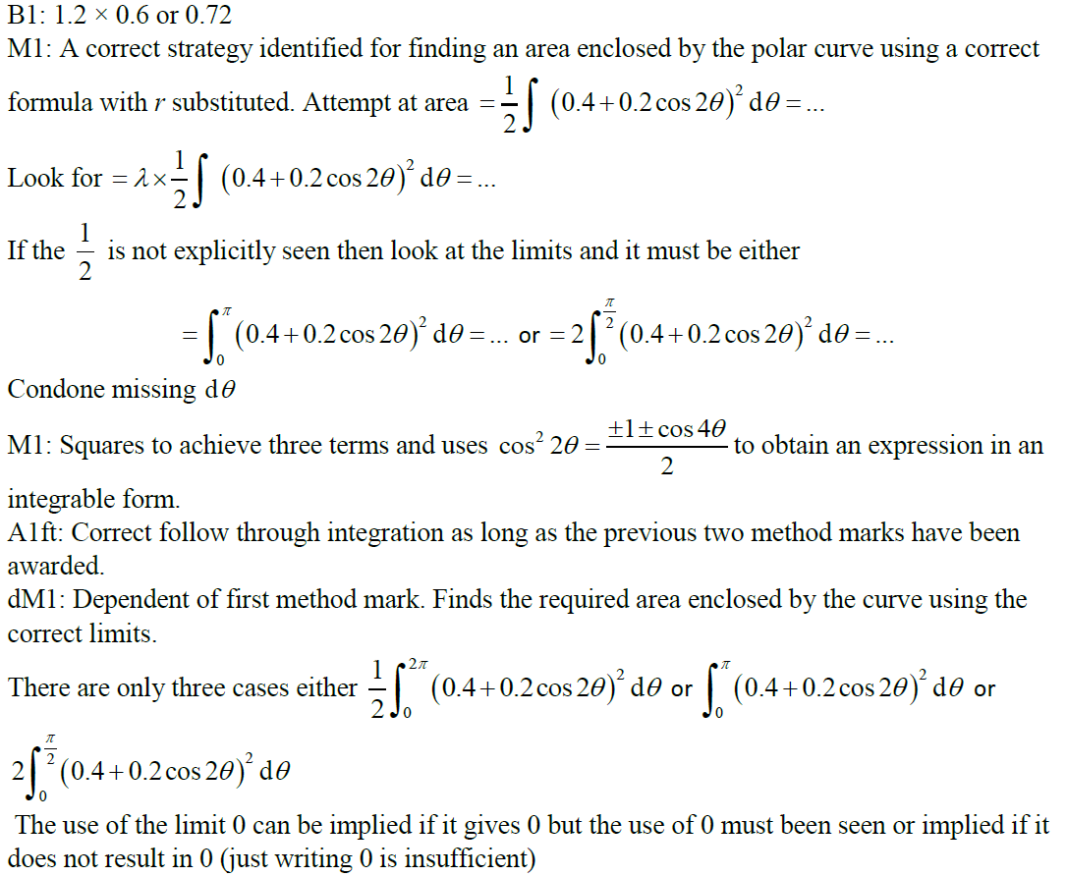
2019 Paper 1
B notes

Slide 9
New Spec Q’s
Old Spec Polar Coordinates
P4/ Old FP1
FP2
Jan 2002
June 2006
June 2009
June 2014 R
June 2002
Jan 2007
June 2010
June 2015
Jan 2003
June 2007
June 2011
June 2016
June 2003
Jan 2008
June 2012
June 2017
Jan 2004
June 2008
June 2013
June 2018
June 2004
Jan 2009
June 2013 R
June 2019
Jan 2005
June 2009
June 2013 W
June 2005
Jan 2010
June 2014
Jan 2006

Slide 10
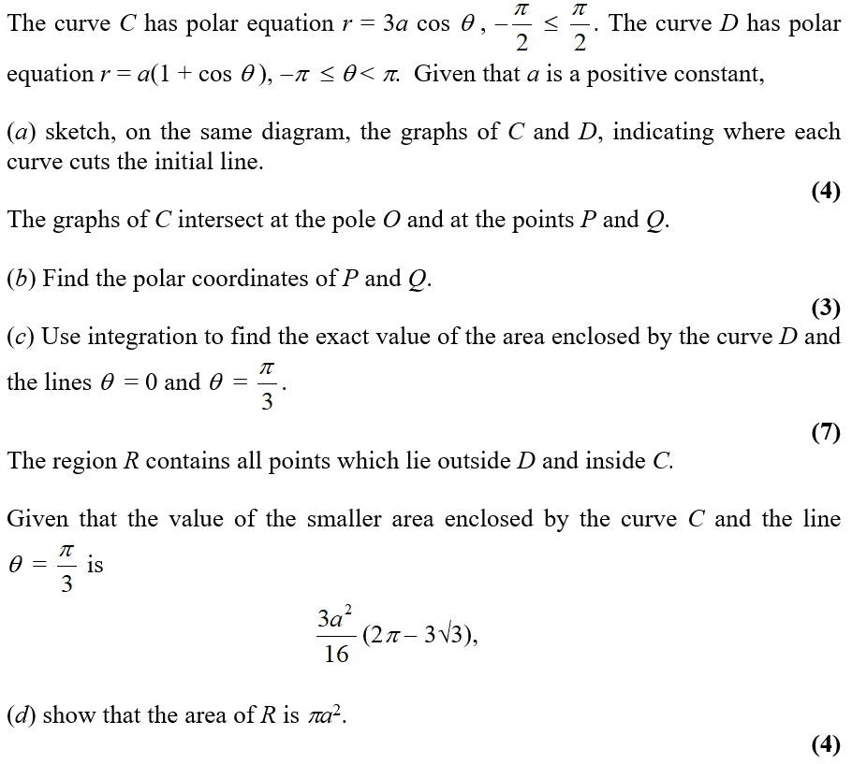
Jan 2002

Slide 11
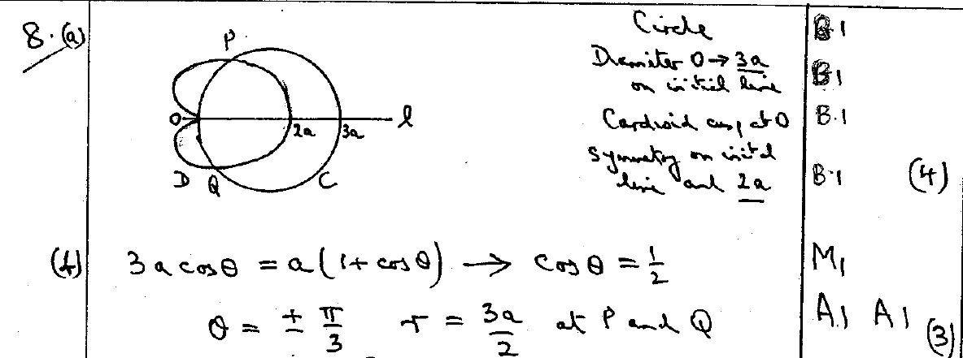
Jan 2002
A
B

Slide 12
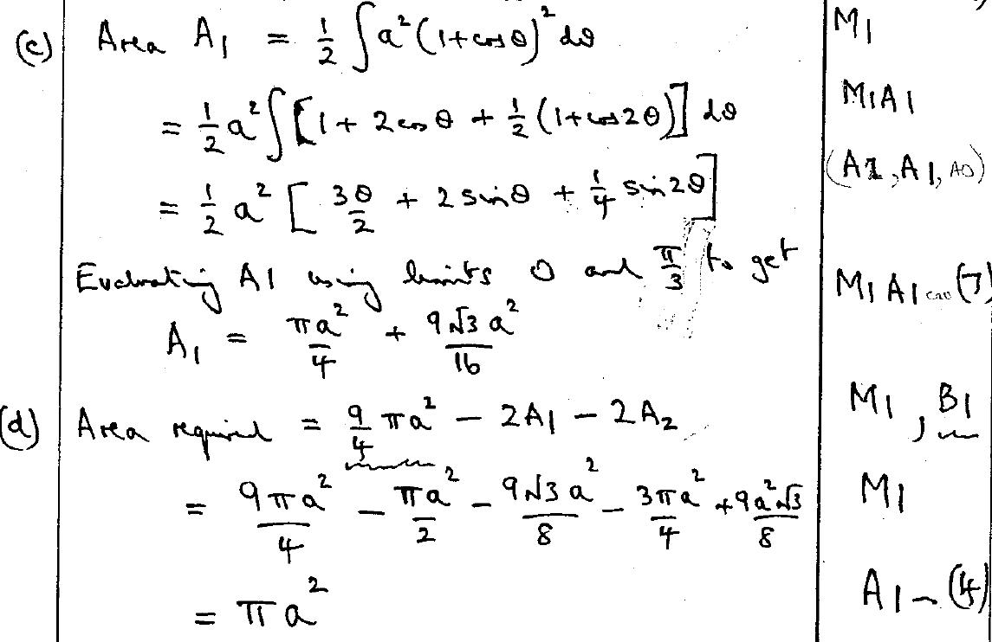
Jan 2002
C
D

Slide 13
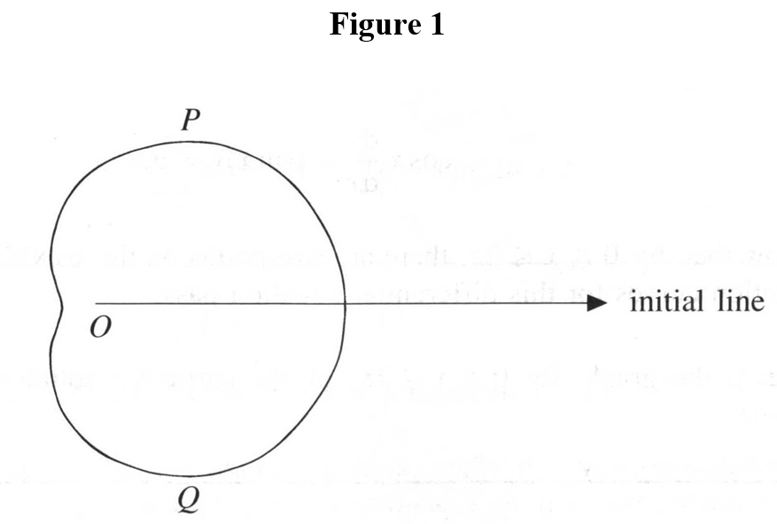
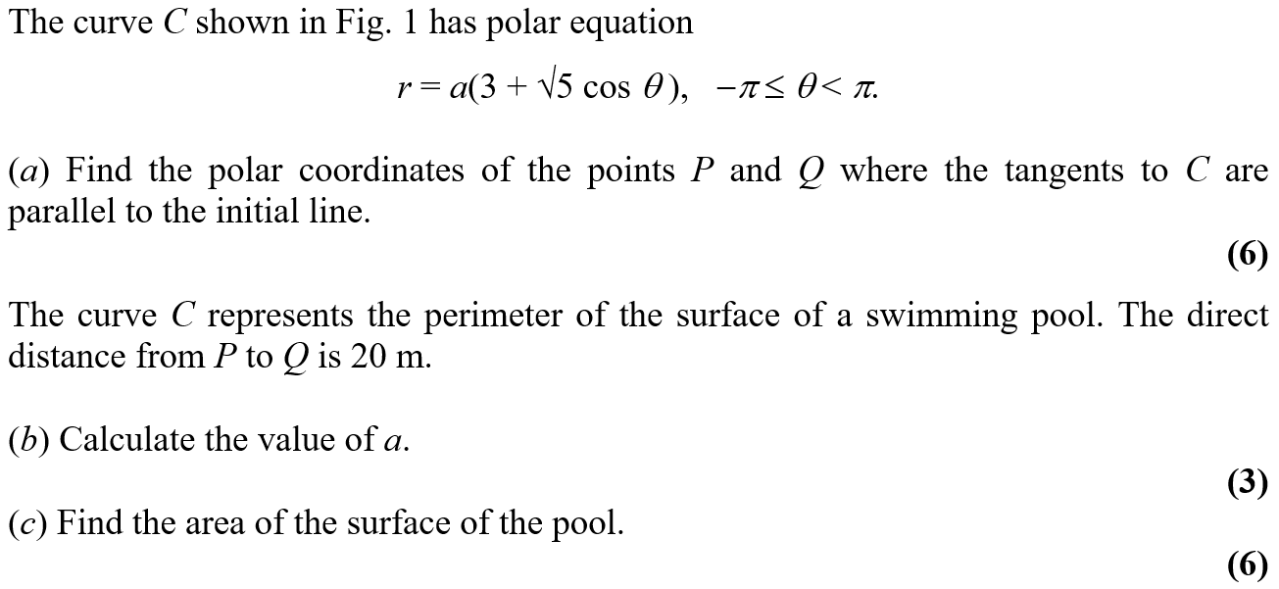
June 2002

Slide 14
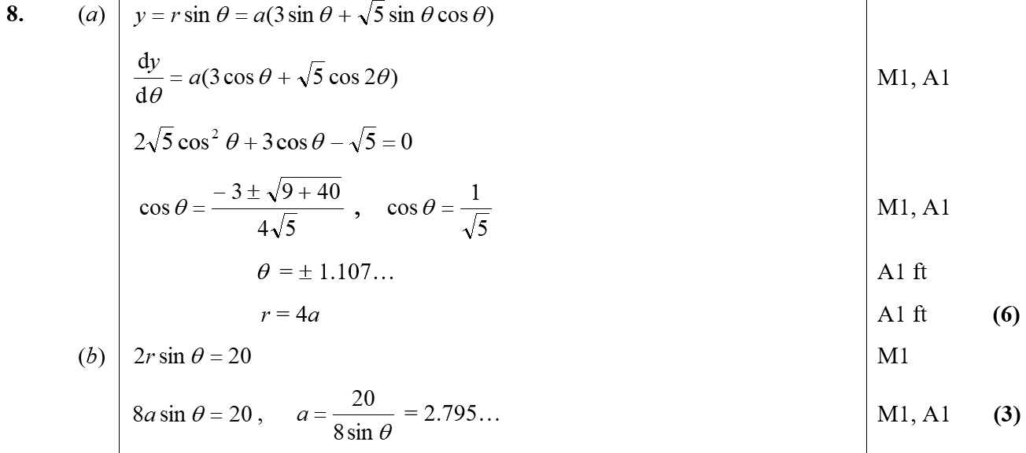
June 2002
A
B

Slide 15
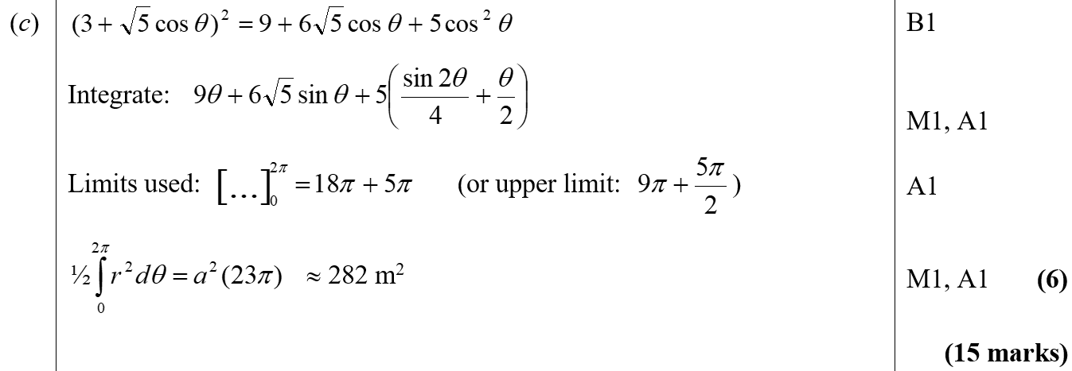
June 2002
C

Slide 16
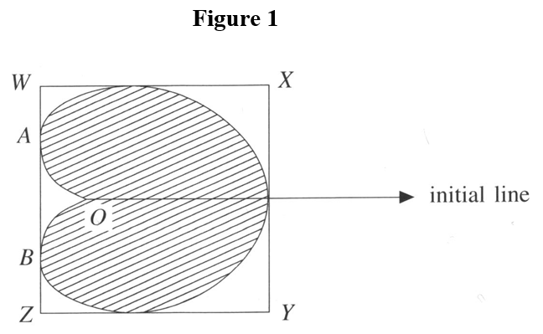
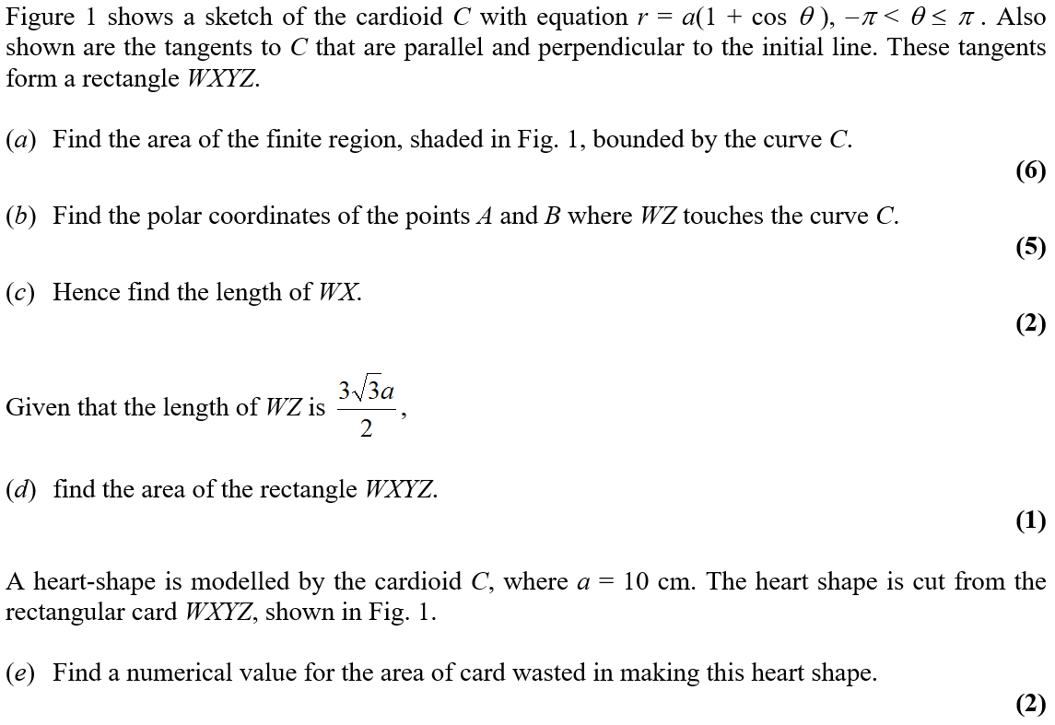
Jan 2003

Slide 17
Jan 2003
A
C
D
E

Slide 18
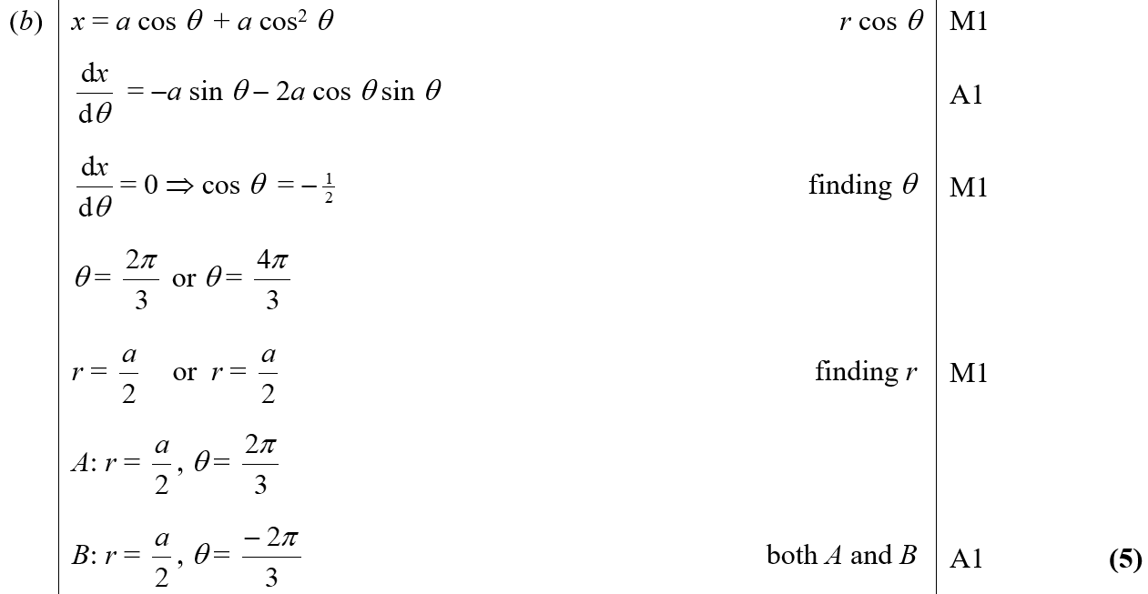
Jan 2003
B

Slide 19
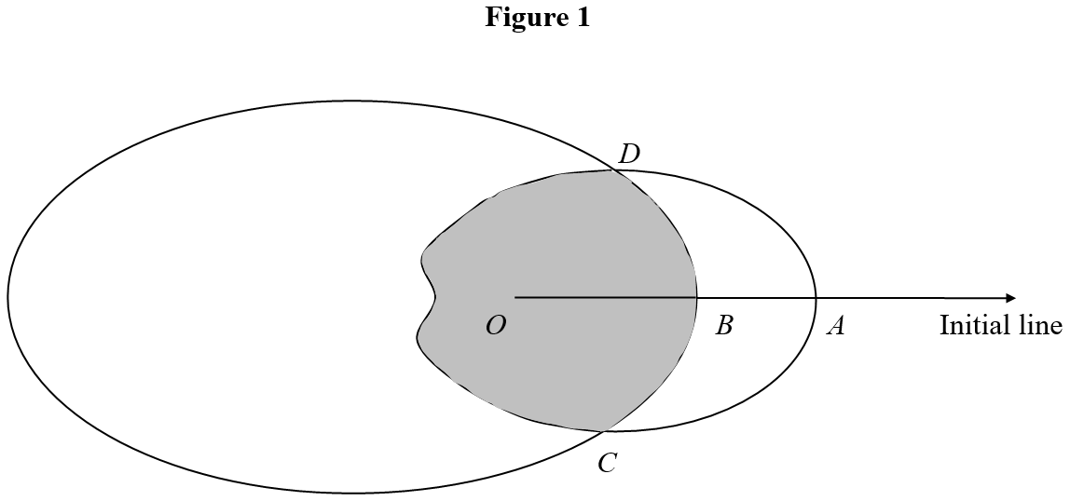
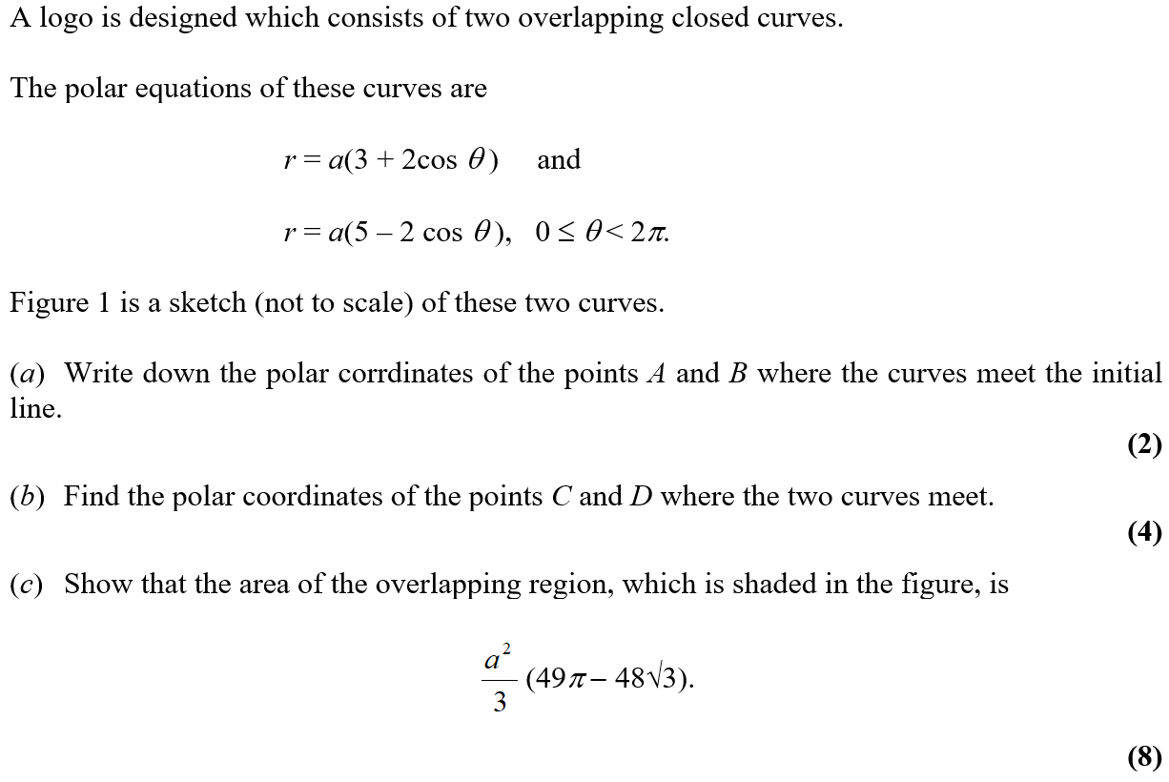
June 2003

Slide 20
June 2003
A
B

Slide 21
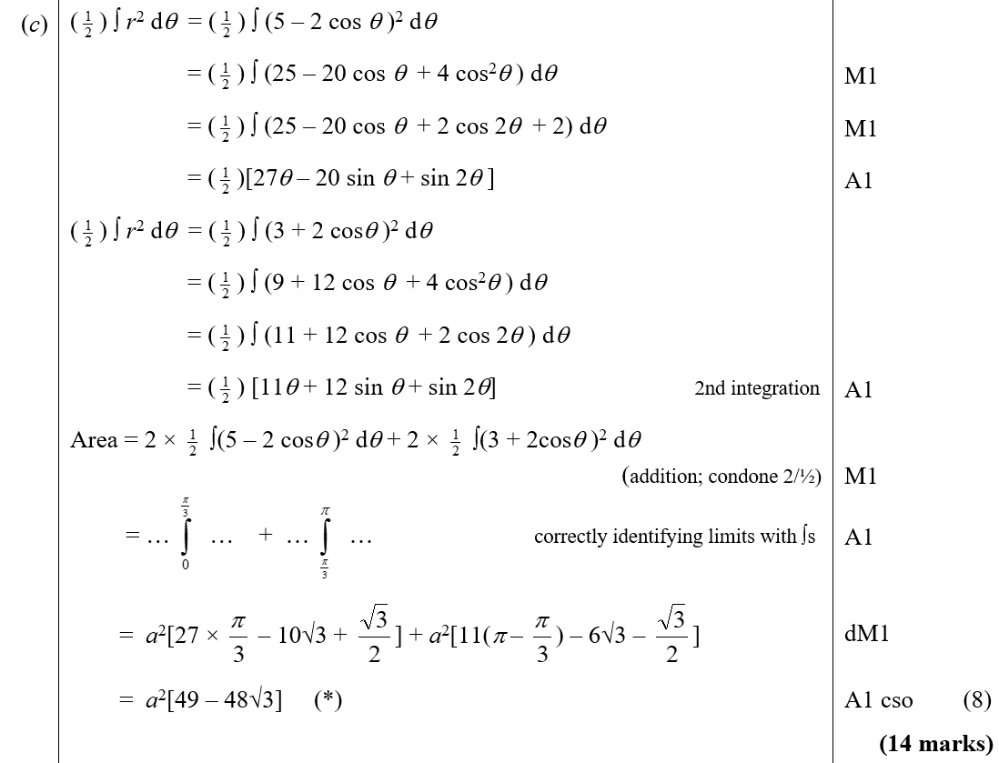
June 2003
C

Slide 22
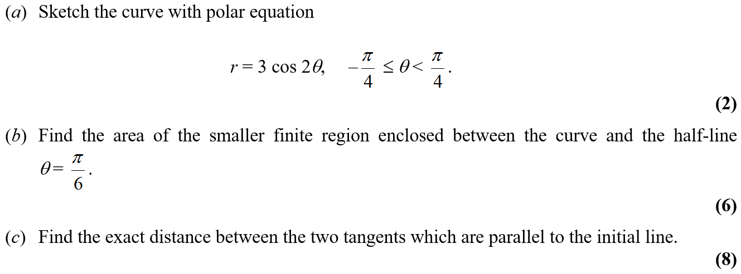
Jan 2004

Slide 23
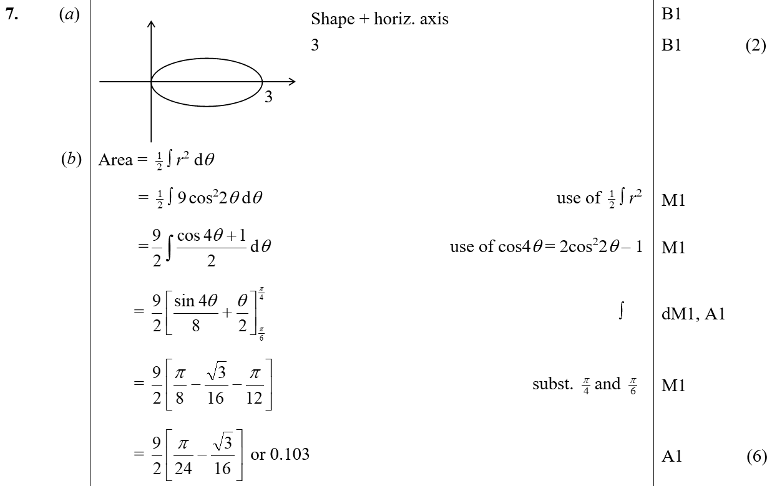
Jan 2004
A
B

Slide 24
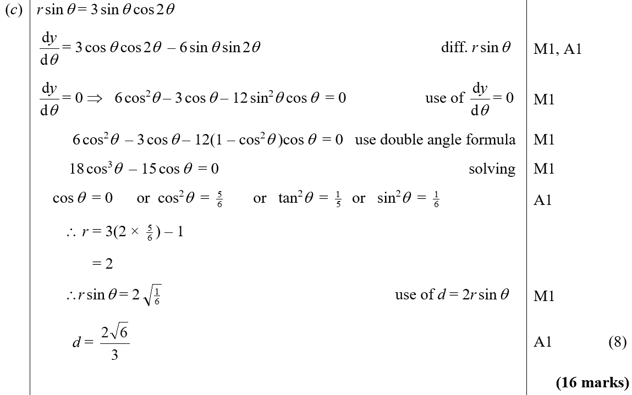
Jan 2004
C

Slide 25
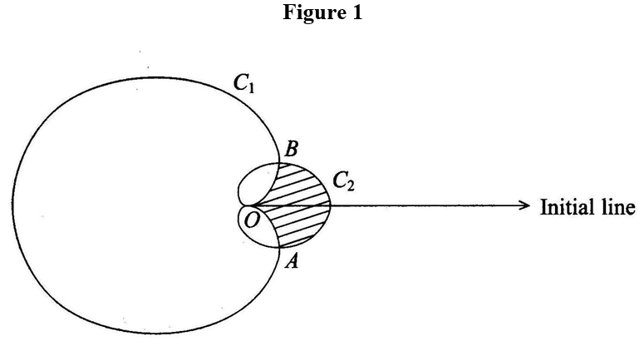
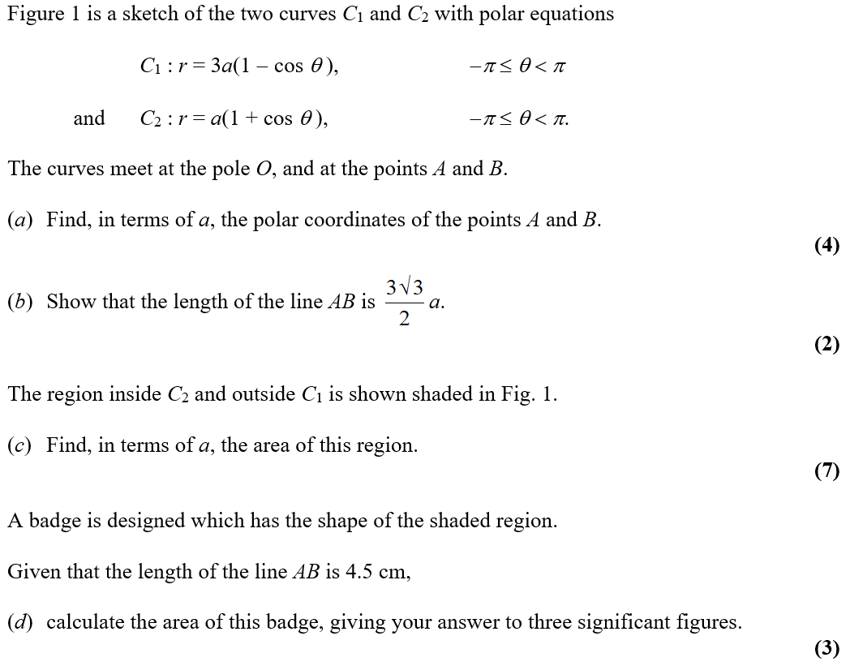
June 2004

Slide 26
June 2004
A
B
D

Slide 27
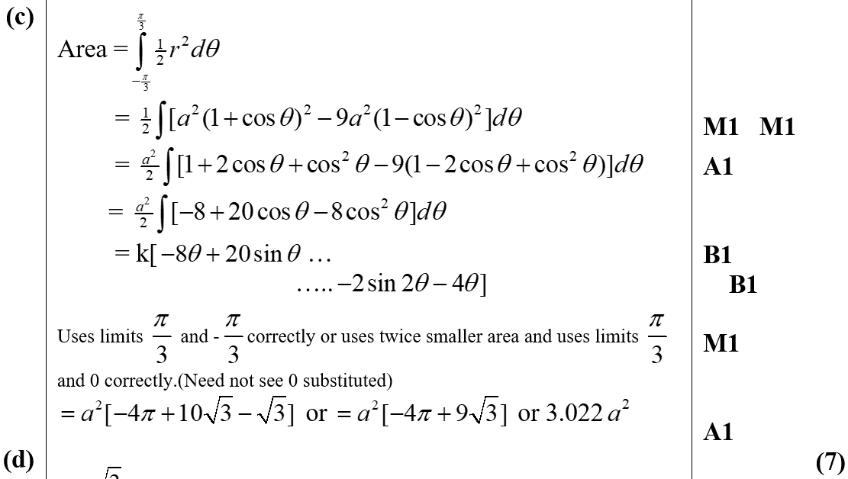
June 2004
C

Slide 28
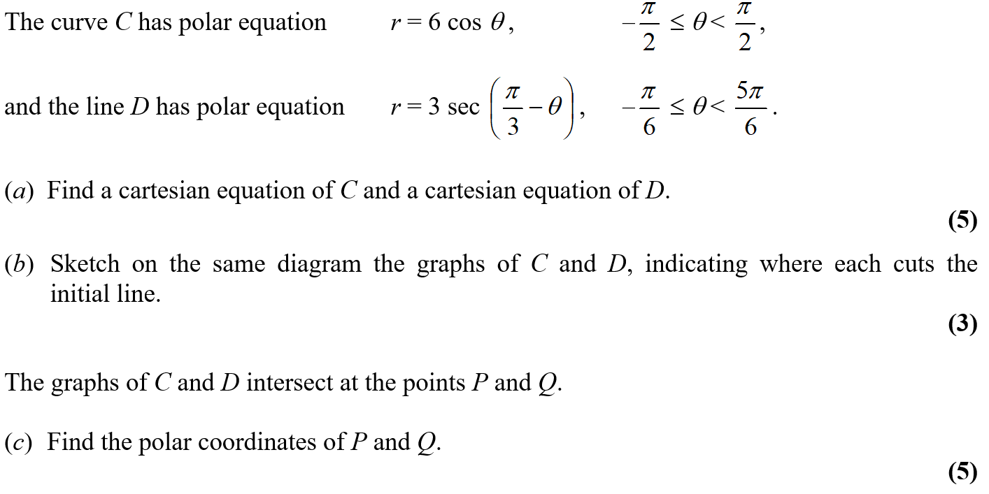
Jan 2005

Slide 29
Jan 2005
A

Slide 30
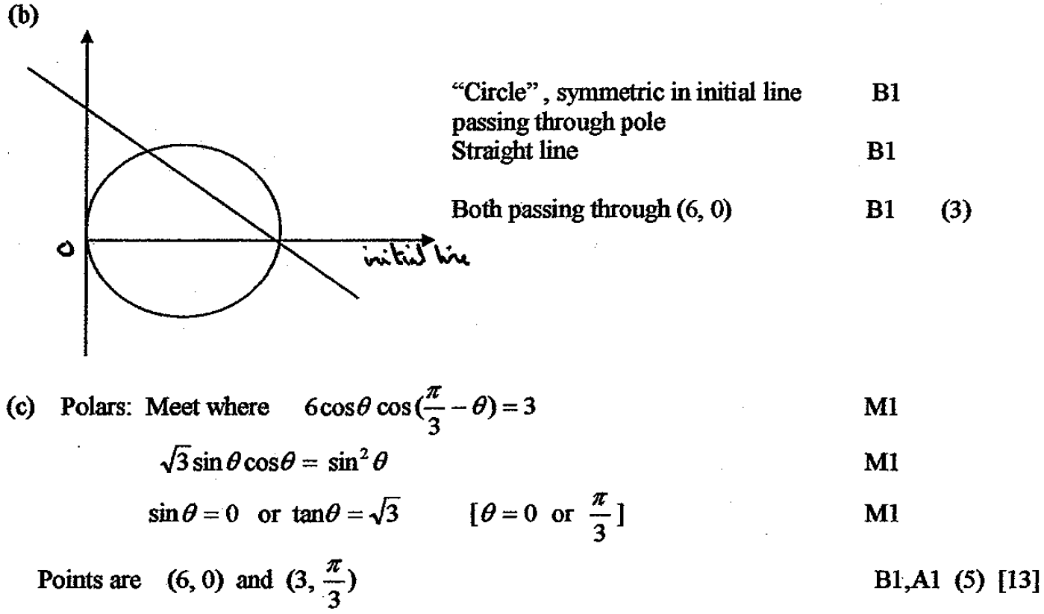
Jan 2005
B
C

Slide 31
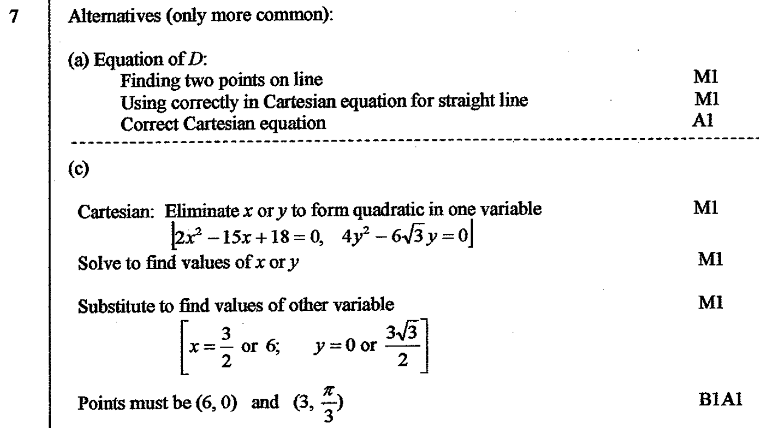
Jan 2005
A Alternative
C Alternative

Slide 32
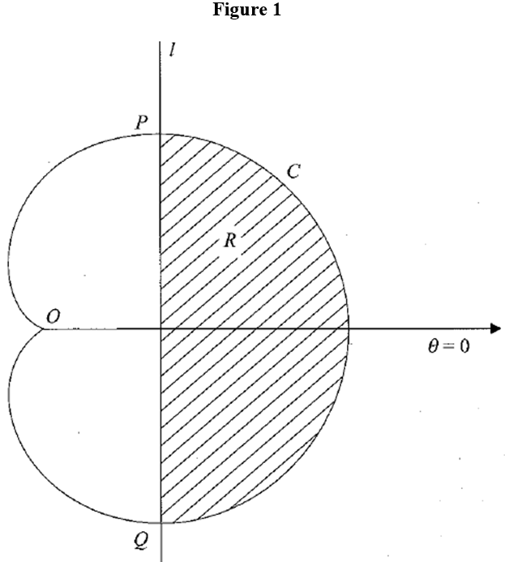
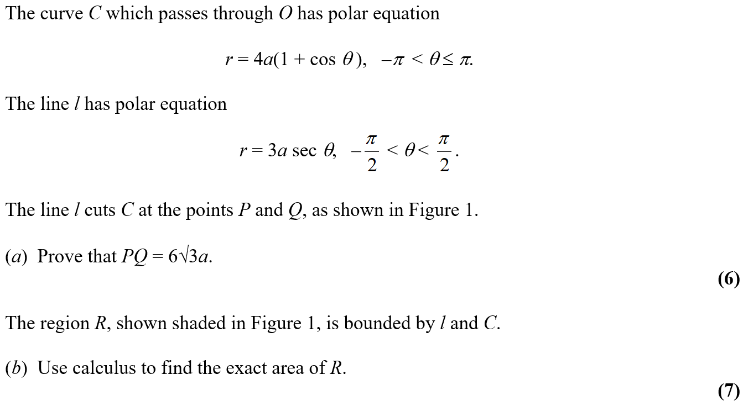
June 2005

Slide 33
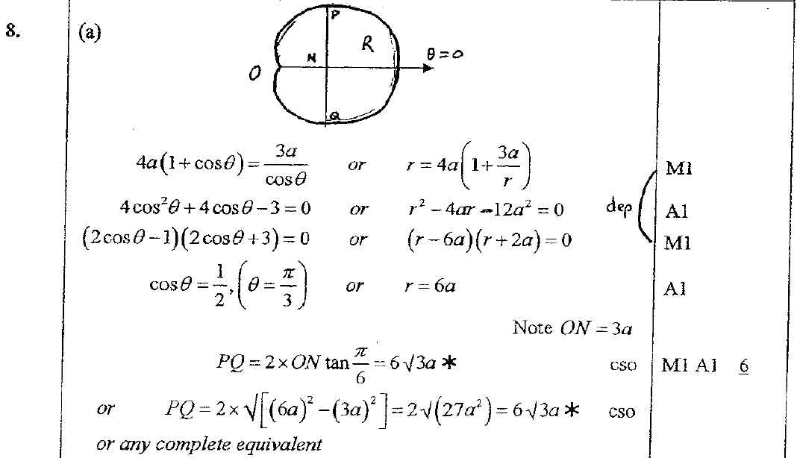
June 2005
A

Slide 34
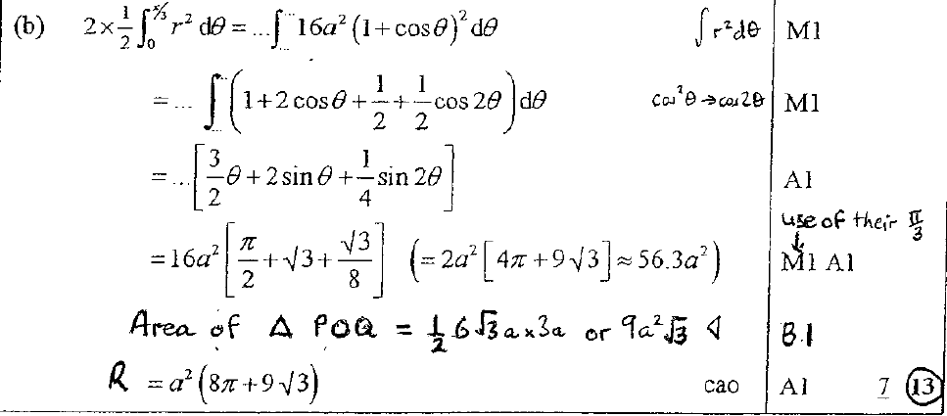
June 2005
B

Slide 35
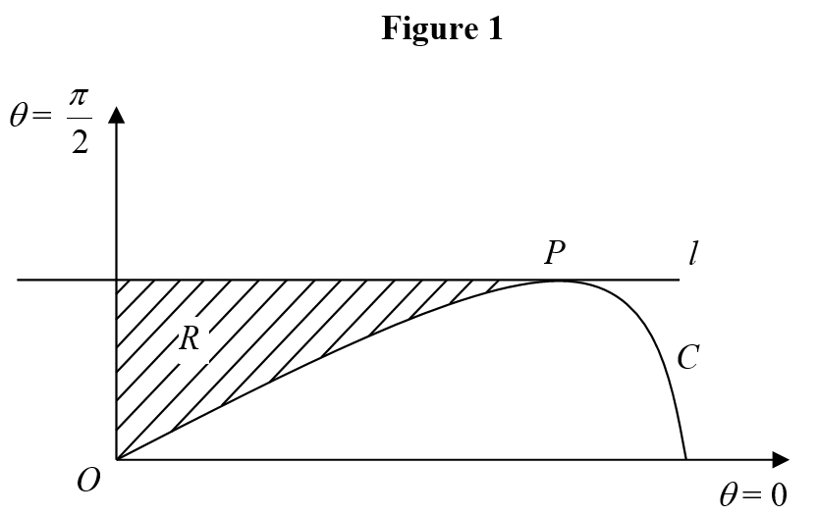
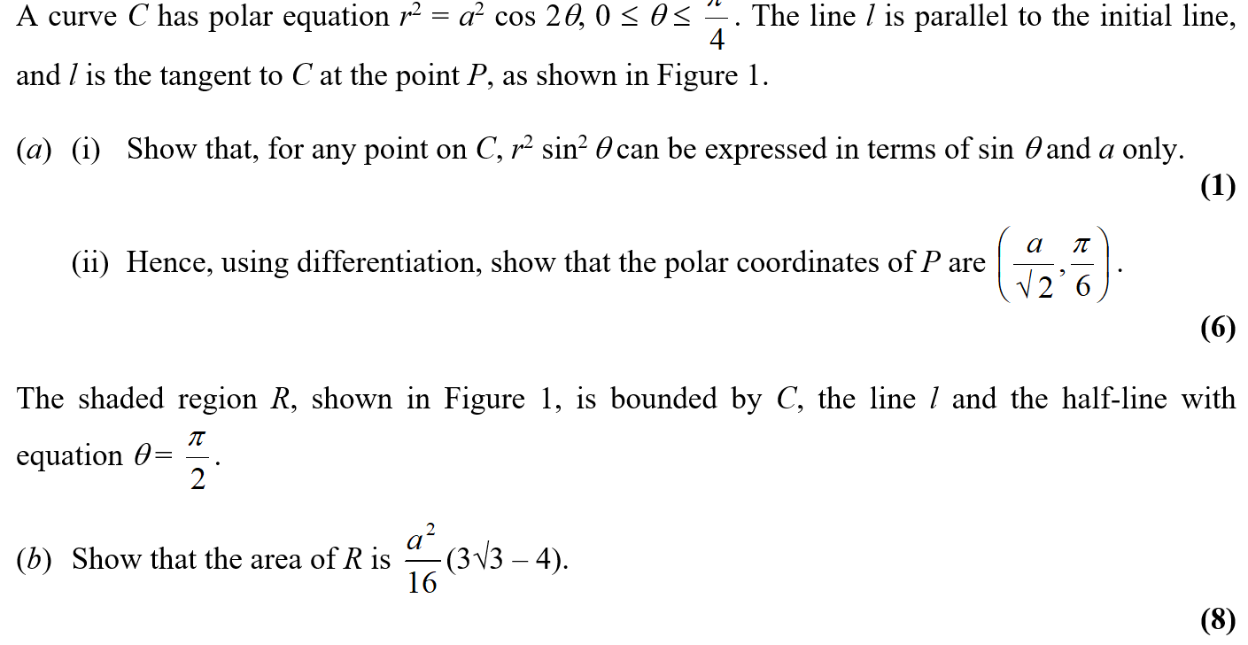
Jan 2006

Slide 36
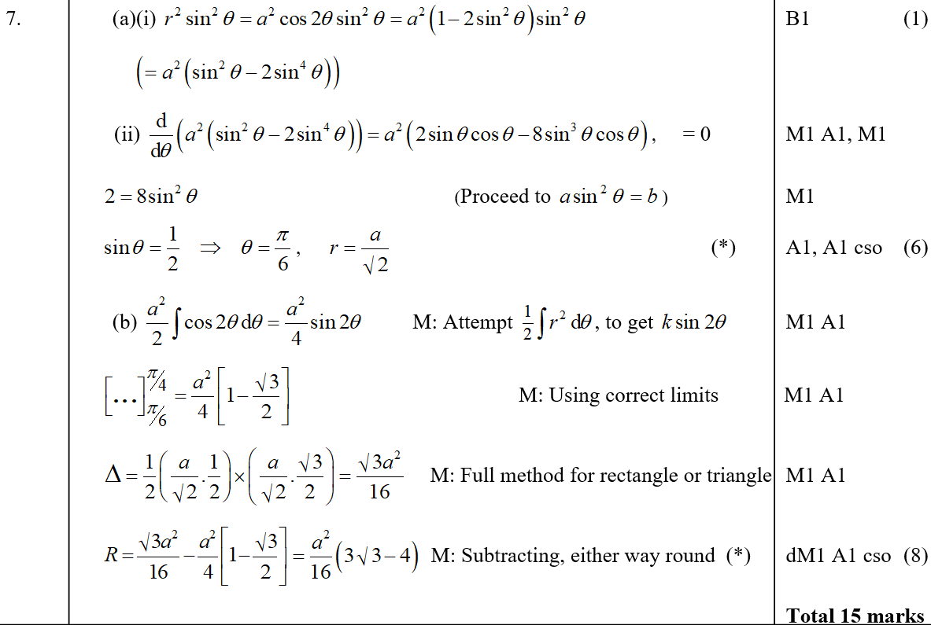
Jan 2006
A (i)
A (ii)
B

Slide 37
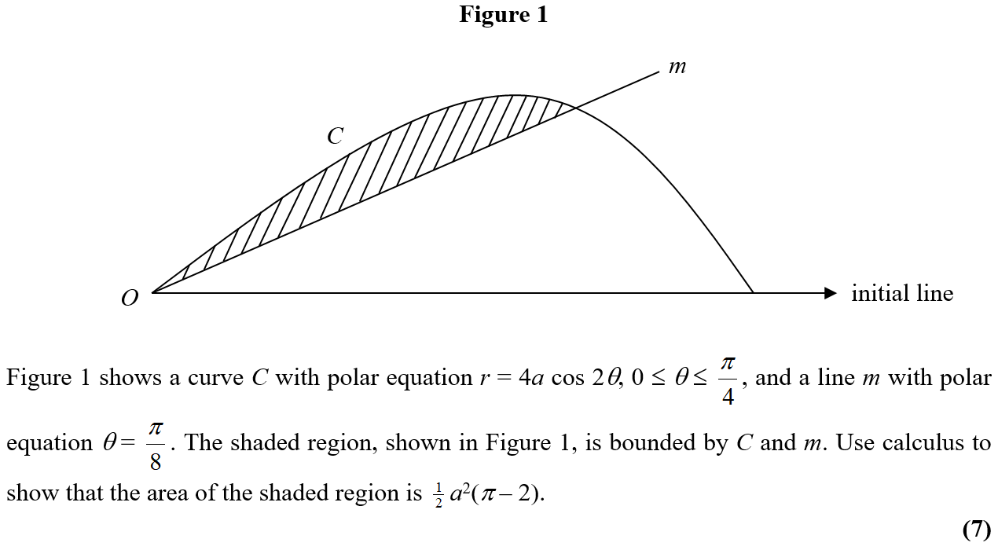
June 2006

Slide 38
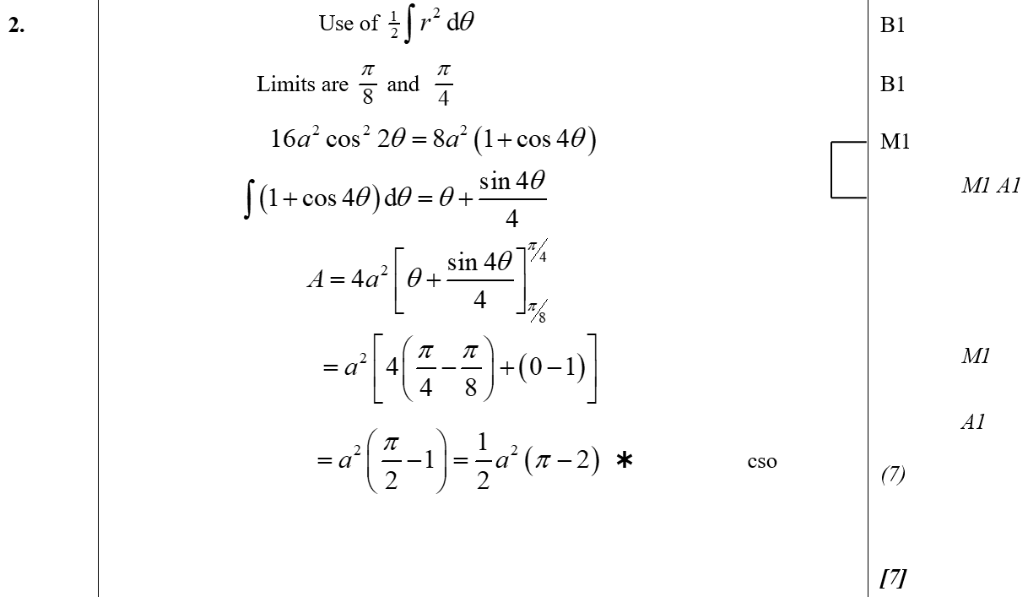
June 2006
A

Slide 39
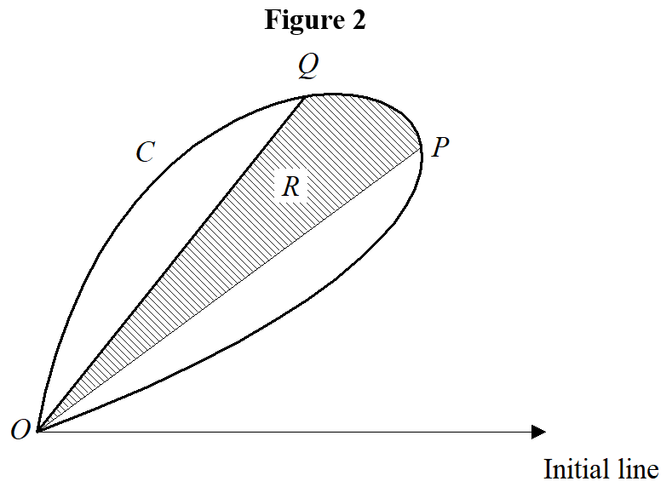
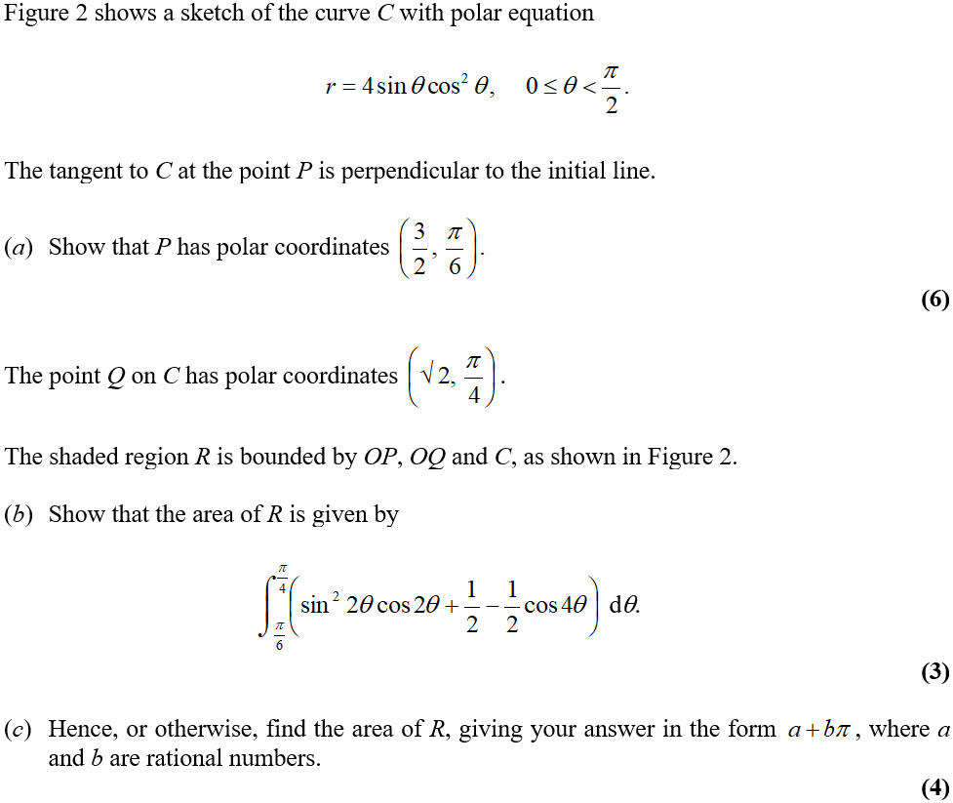
Jan 2007

Slide 40
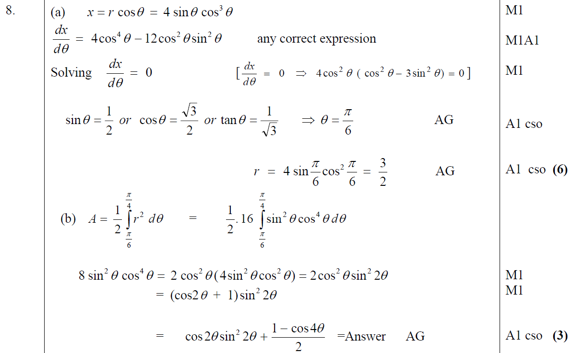
Jan 2007
A
B

Slide 41
Jan 2007
A

Slide 42
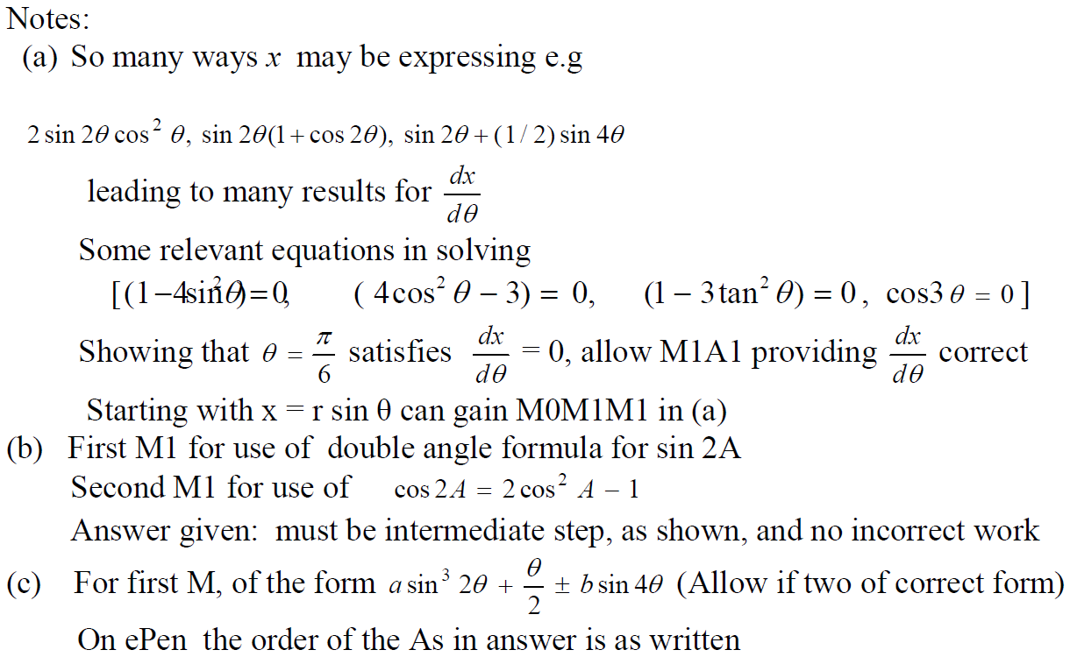
Jan 2007
A notes
B notes
C notes

Slide 43
June 2007

Slide 44
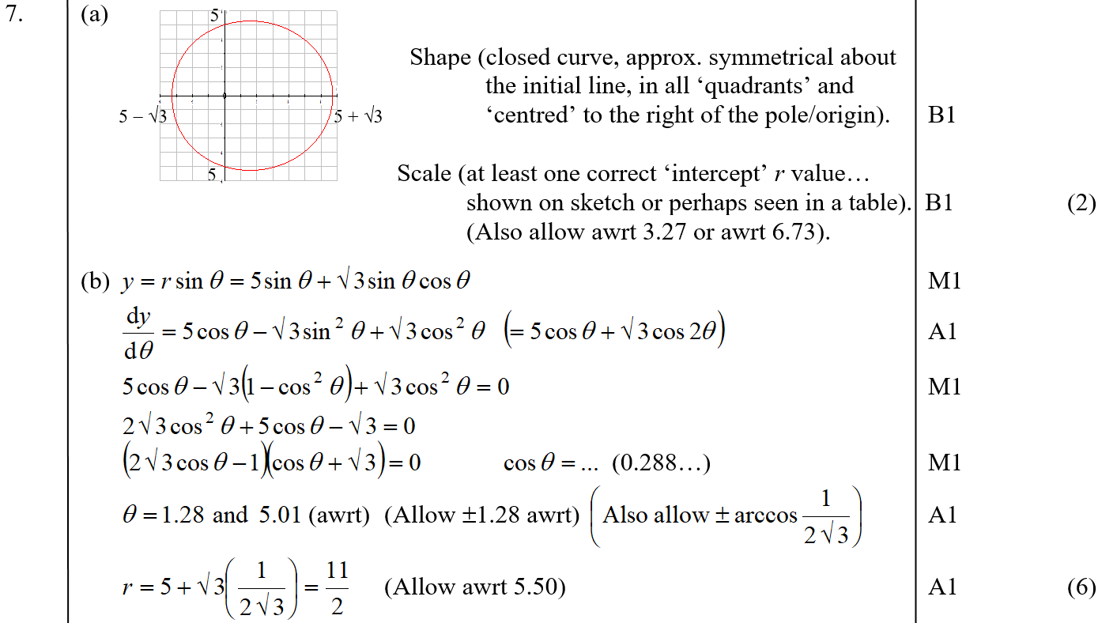
June 2007
A
B

Slide 45
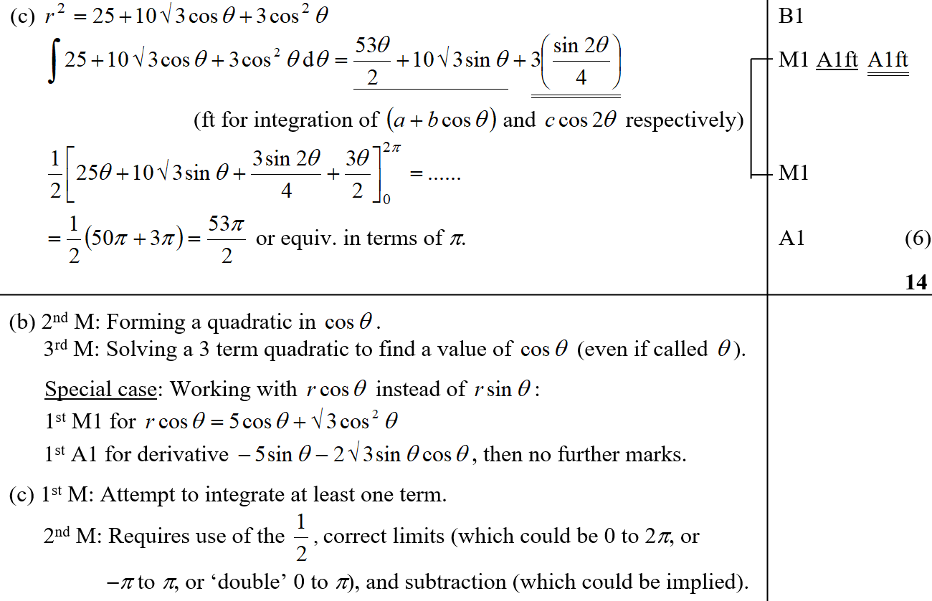
June 2007
C
B notes
C notes

Slide 46
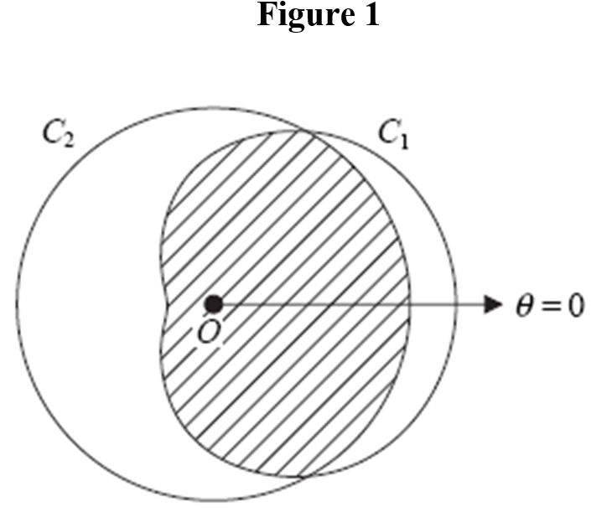
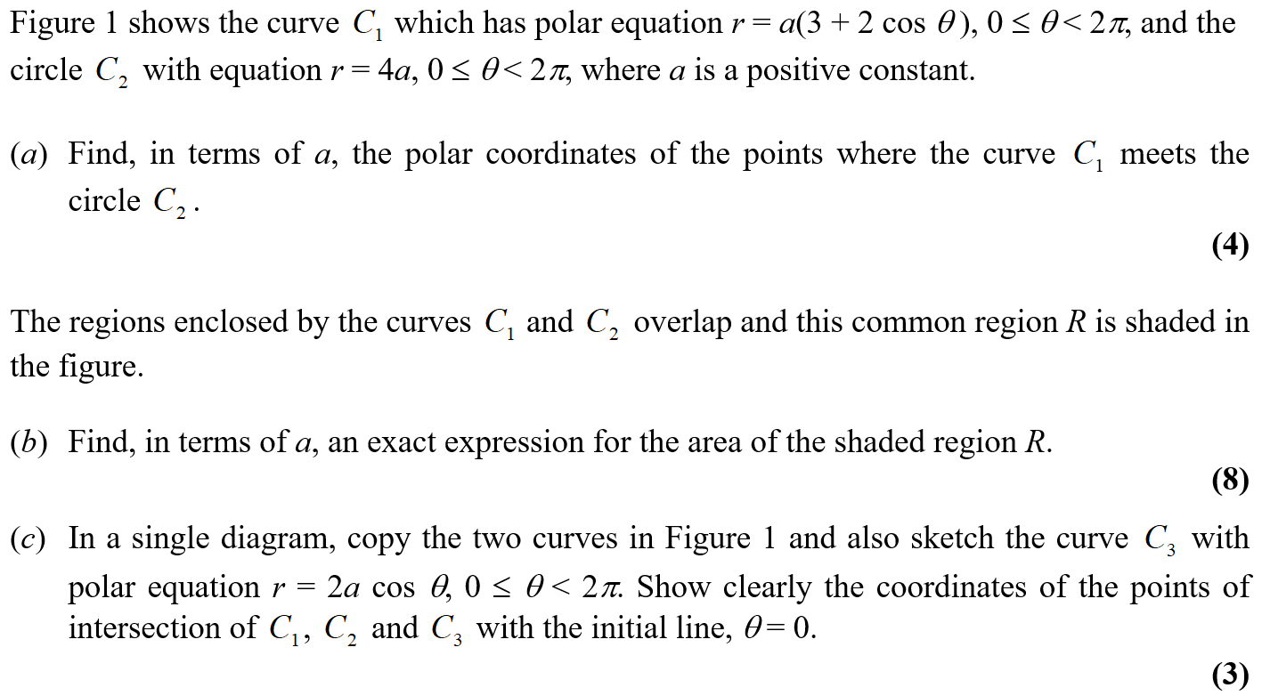
Jan 2008

Slide 47
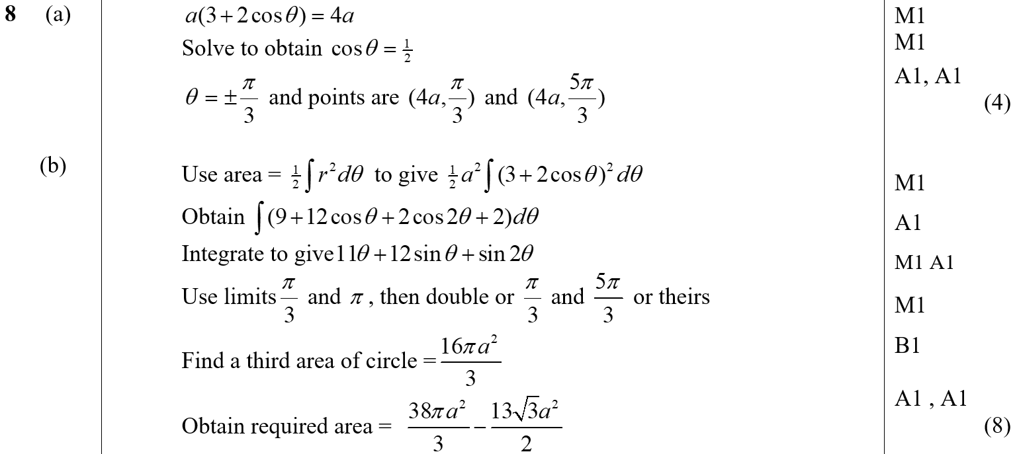
Jan 2008
A
B
A notes
B notes

Slide 48
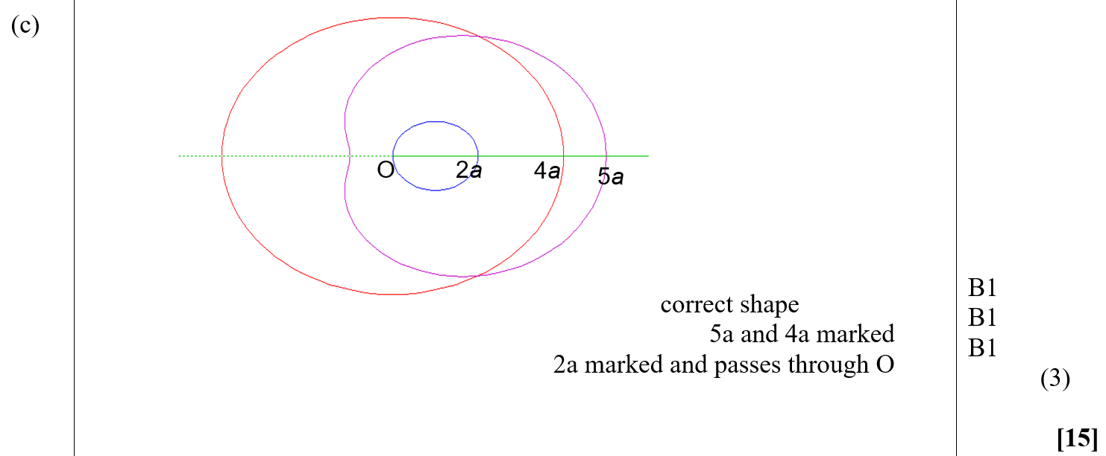
Jan 2008
C
C notes

Slide 49
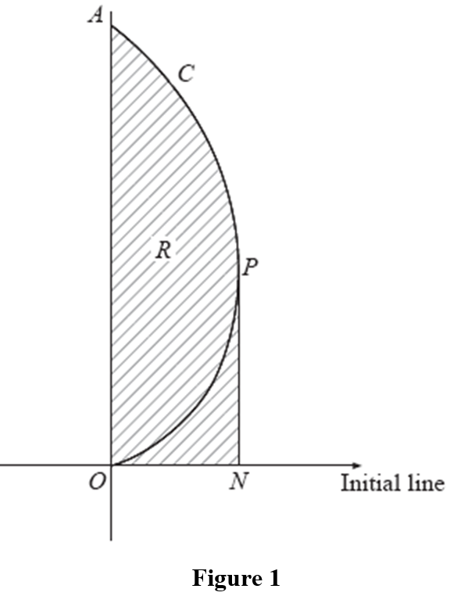
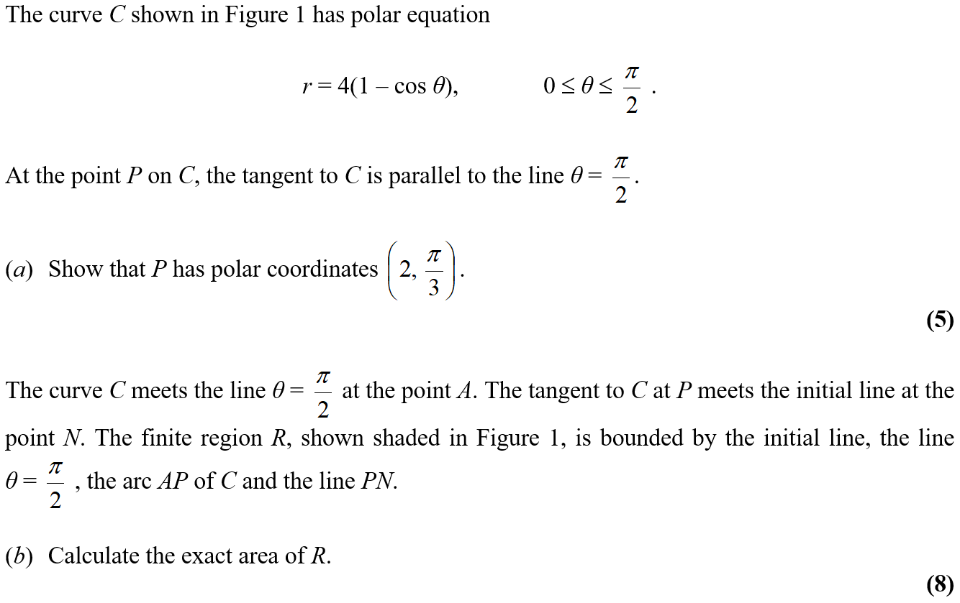
June 2008

Slide 50
June 2008
A
B

Slide 51
June 2008
A Alternative & notes
B notes

Slide 52
Jan 2009

Slide 53
Jan 2009
A
B
C
D
E

Slide 54
Jan 2009
A notes
B notes
C notes
D notes
E notes

Slide 55
June 2009

Slide 56
June 2009
A
B

Slide 57
June 2009
A notes
B notes

Slide 58
Jan 2010

Slide 59
Jan 2010
A
B

Slide 60
June 2009

Slide 61
June 2009
A

Slide 62
June 2010

Slide 63
June 2010
A
B

Slide 64
June 2011

Slide 65
June 2011
A

Slide 66
June 2012

Slide 67
June 2012
A

Slide 68
June 2013

Slide 69
June 2013
A
B

Slide 70
June 2013
C

Slide 71
June 2013
A notes

Slide 72
June 2013
B notes

Slide 73
June 2013
C notes

Slide 74
June 2013
A Alternatives

Slide 75
June 2013 Reserve

Slide 76
June 2013 Reserve
A

Slide 77
June 2013 Reserve
B

Slide 78
June 2013 Reserve
A notes

Slide 79
June 2013 Reserve
B notes

Slide 80
June 2013 Reserve
Alternative approach 1

Slide 81
June 2013 Reserve
Alternative approach 2

Slide 82
June 2013 Reserve
Alternative approach 3

Slide 83
June 2013 Reserve
Alternative approach 4

Slide 84
June 2013 Reserve
Alternative approach 5

Slide 85
June 2013 Reserve
Alternative approach 6

Slide 86
June 2013 Reserve
Alternative approach 7

Slide 87
June 2013 Reserve
Alternative approach 8

Slide 88
June 2013 Reserve
Alternative approach 9

Slide 89
June 2013 Withdrawn

Slide 90
June 2013 Withdrawn
A

Slide 91
June 2013 Withdrawn
B

Slide 92
June 2014

Slide 93
June 2014
A

Slide 94
June 2014
B

Slide 95
June 2014 Reverse

Slide 96
June 2014 Reverse
A

Slide 97
June 2014 Reverse
A notes

Slide 98
June 2015

Slide 99
June 2015
A

Slide 100
June 2015
B

Slide 101
June 2016

Slide 102
June 2016
A

Slide 103
June 2016
B

Slide 104
June 2017

Slide 105
June 2017
A

Slide 106
June 2017
A Alternatives

Slide 107
June 2018

Slide 108
June 2018
A

Slide 109
June 2018
A Alternative 1

Slide 110
June 2018
A Alternative 2

Slide 111
June 2018
A Alternative 3

Slide 112
June 2018
A Special Case

Slide 113
June 2018
B

Slide 114
June 2019

Slide 115
June 2019
A

Slide 116
June 2019
A Alternative

Slide 117
June 2019
B

Slide 118
June 2019
C

Slide 119
June 2019
D

Slide 120
June 2019
D notes

