Slide 1
Pie Charts
Pie Charts
Old Spec Q’s
No Q’s to date

Slide 2
Pie Charts
Pie Charts
New Spec Q’s
Nov 2006
3H Q4
May 2015
3H Q2

Slide 3
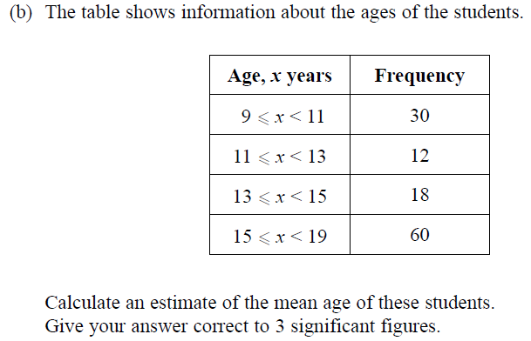
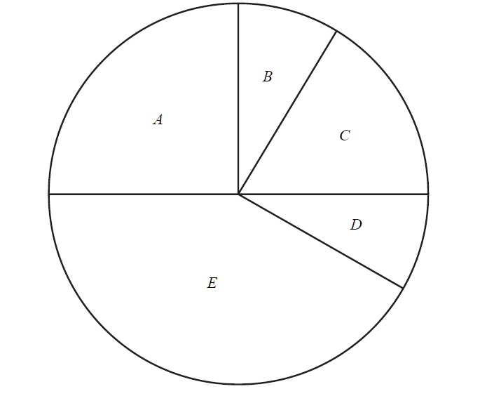
Pie Charts
Nov 2006 3H Q4

Slide 4
Pie Charts
Nov 2006 3H Q4
A
B

Slide 5
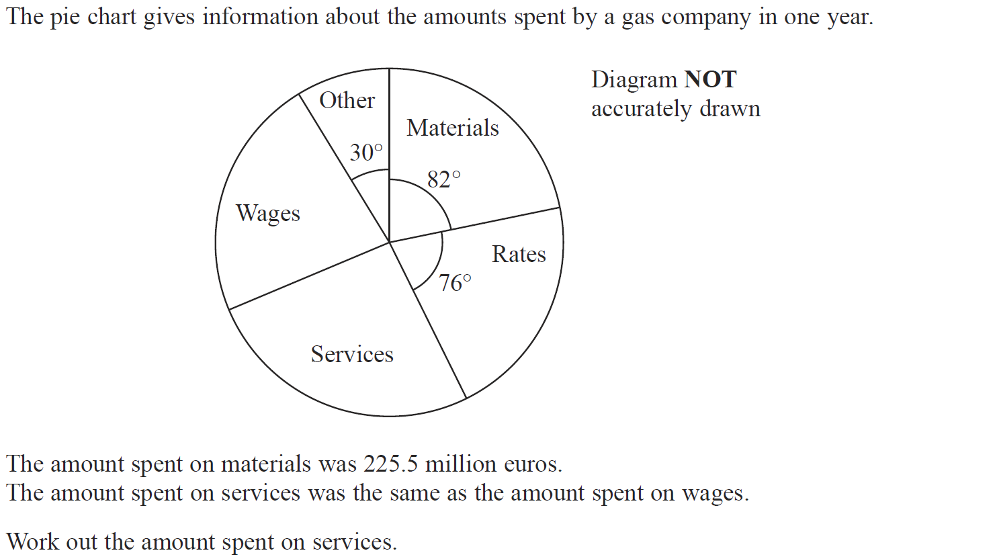
Pie Charts
May 2015 3H Q2

Slide 6
Pie Charts
May 2015 3H Q2
A

