Slide 1
Percentages
Percentages
Old Spec Q’s
SAM
1H Q4
Jan 2019
1H Q4
SAM
1H Q8
Jan 2019
2H Q7
SAM
2H Q5
Jan 2019
2HR Q4
SAM
2H Q8
Jan 2019
2HR Q9
May 2018
1H Q7
Jan 2019
2HR Q13
June 2018
2H Q3
May 2019
1H Q8
May 2018
1HR Q12
June 2019
2H Q5
June 2018
2HR Q3
June 2019
2H Q11
June 2018
2HR Q6
Compound/ Repeated Change

Slide 2
Percentages
SAM 1H Q4

Slide 3
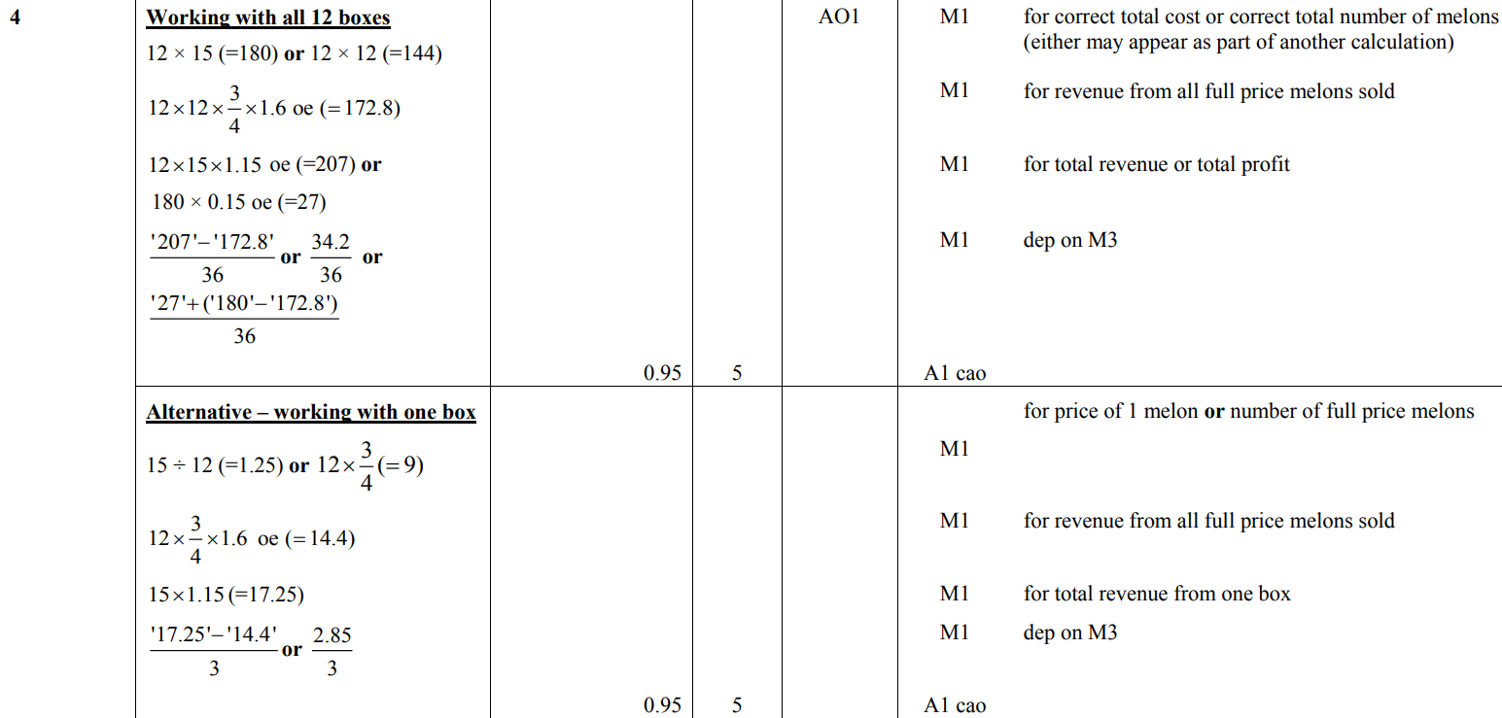
Percentages
SAM 1H Q4
A

Slide 4
Percentages
SAM 1H Q8

Slide 5
Percentages
SAM 1H Q8
A

Slide 6
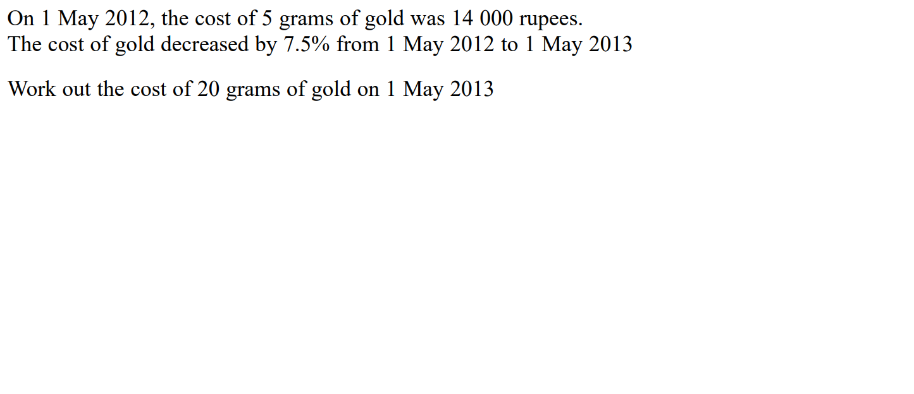
Percentages
SAM 2H Q5

Slide 7
Percentages
SAM 2H Q5
A

Slide 8
Percentages
SAM 2H Q8

Slide 9
Percentages
SAM 2H Q8
A

Slide 10
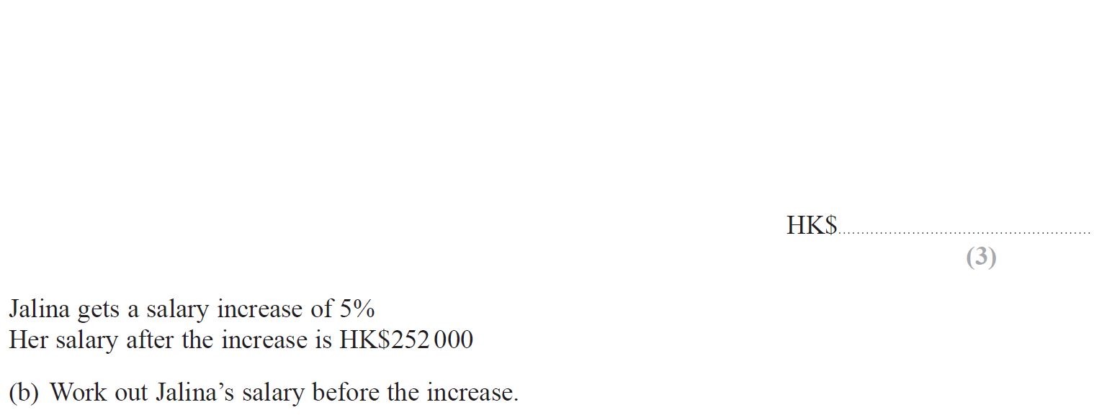
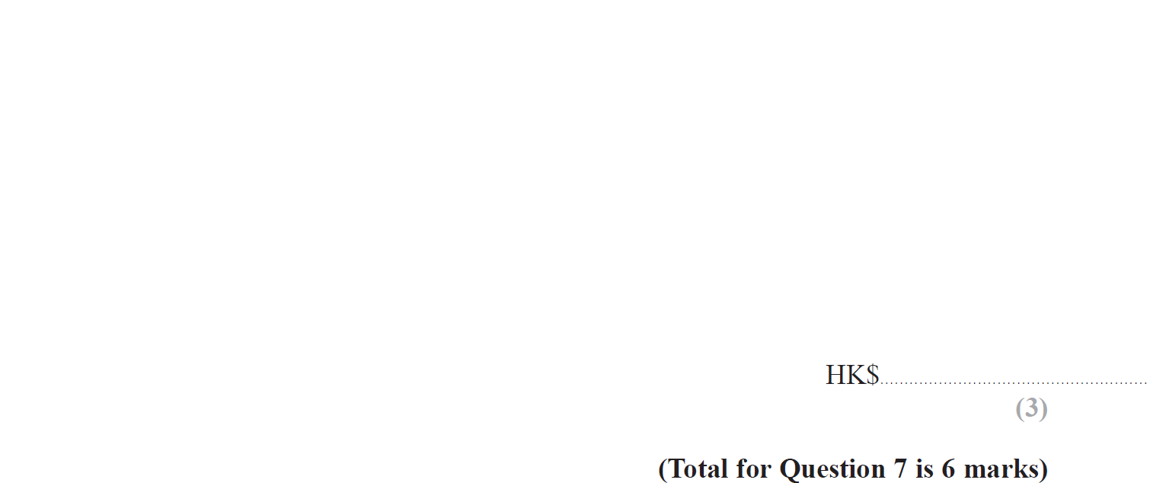
Percentages
May 2018 1H Q7

Slide 11
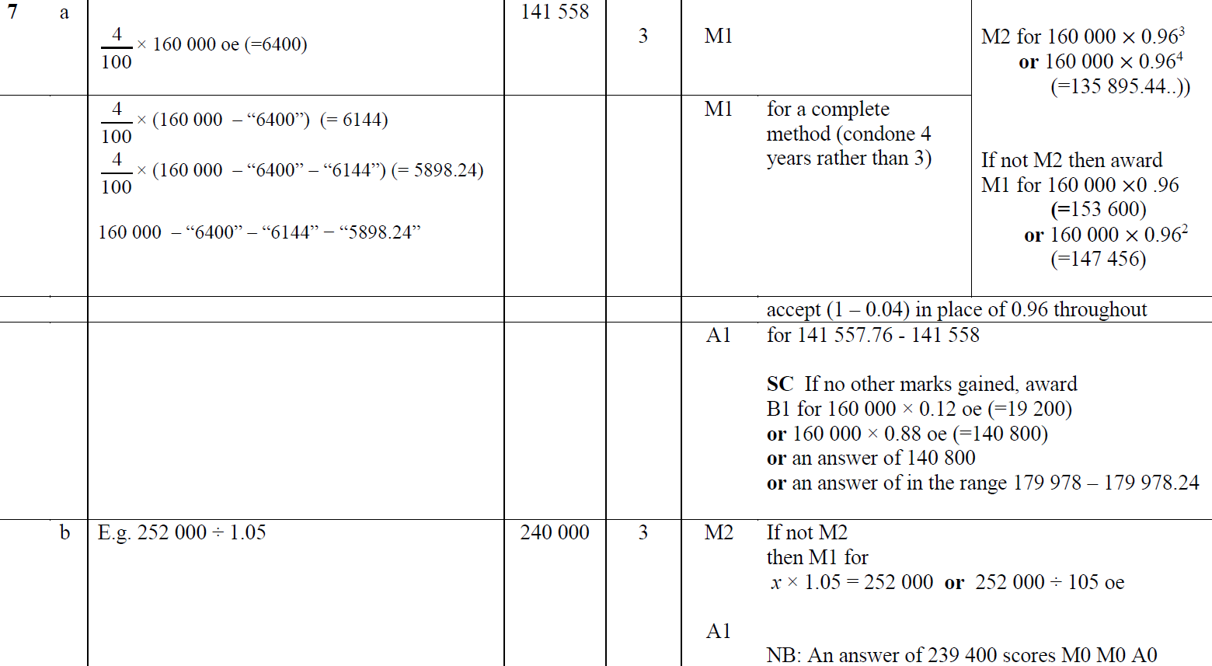
Percentages
May 2018 1H Q7
A
B

Slide 12
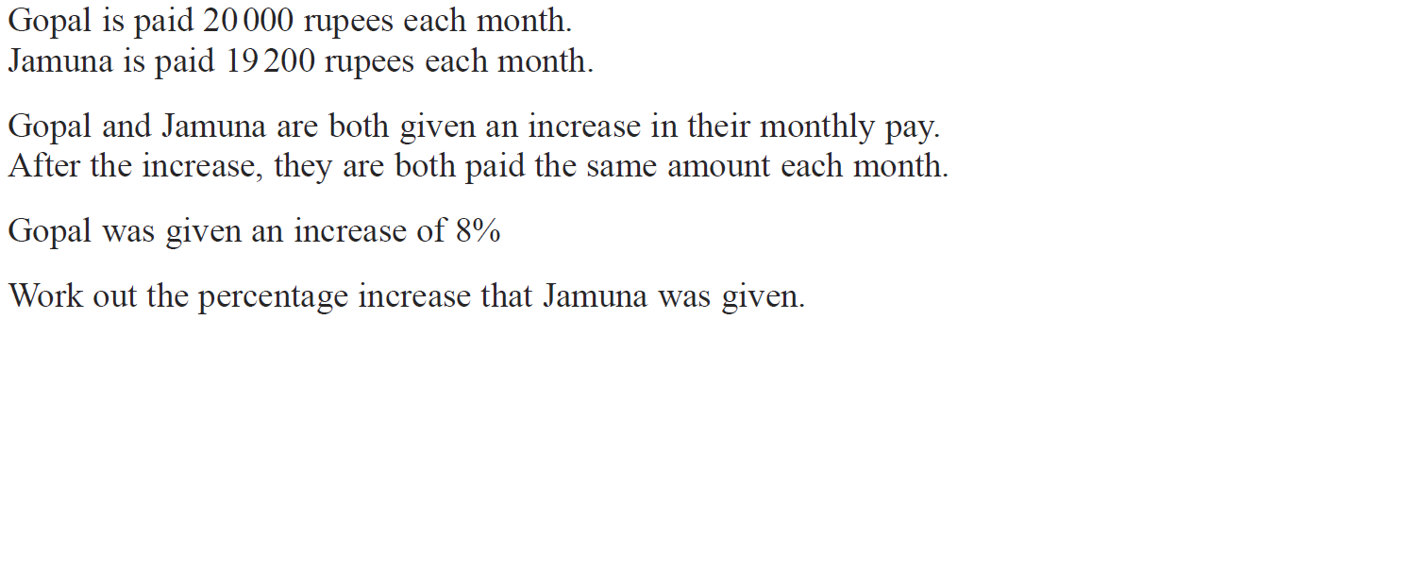
Percentages
June 2018 2H Q3

Slide 13
Percentages
June 2018 2H Q3
A

Slide 14
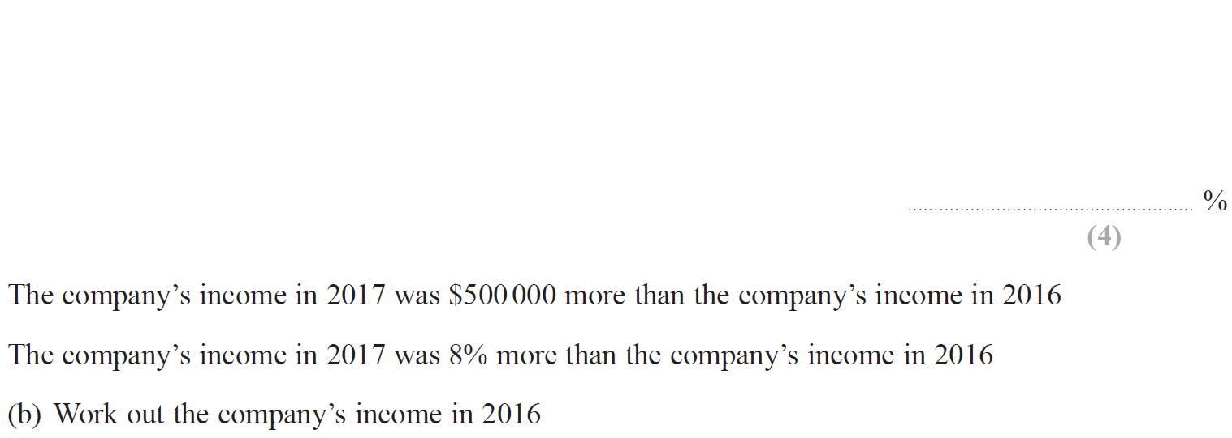
Percentages
May 2018 1HR Q12

Slide 15
Percentages
May 2018 1HR Q12
A
B

Slide 16
Percentages
June 2018 2HR Q3

Slide 17
Percentages
June 2018 2HR Q3
A

Slide 18
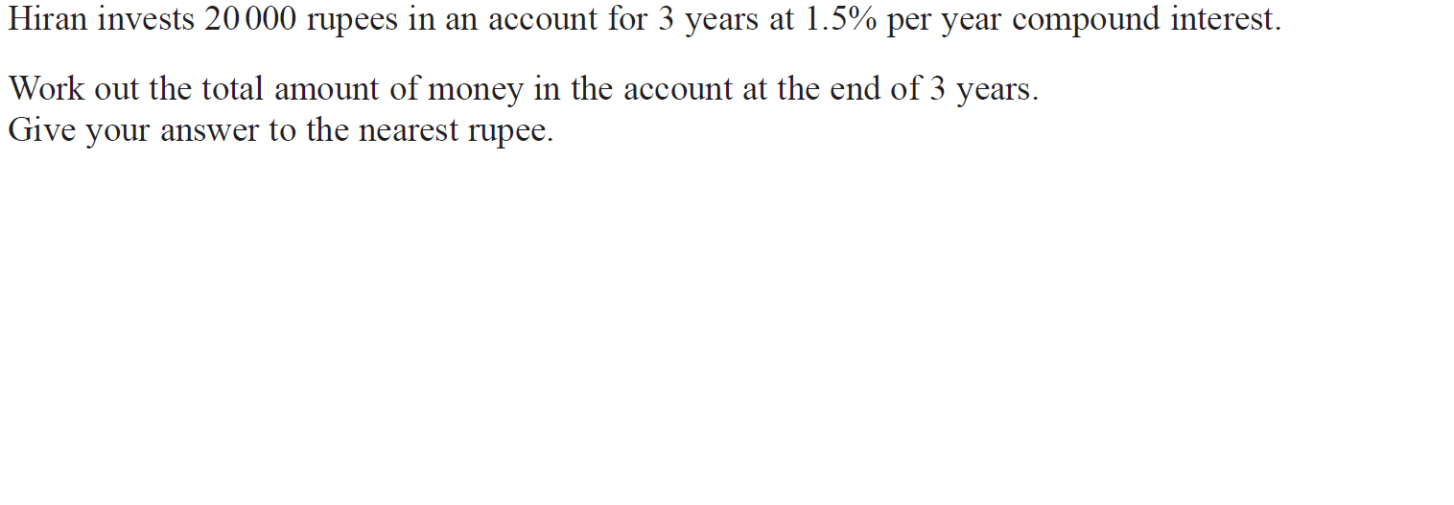
Percentages
June 2018 2HR Q6

Slide 19
Percentages
June 2018 2HR Q6
A

Slide 20
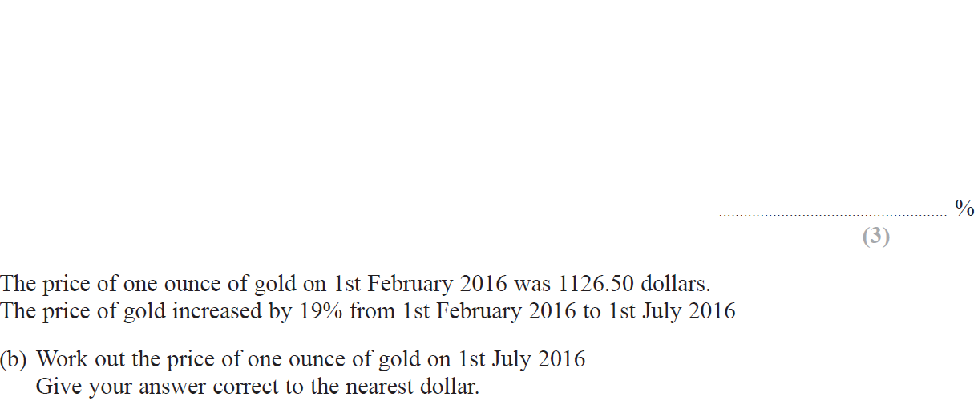
Percentages
Jan 2019 1H Q4

Slide 21
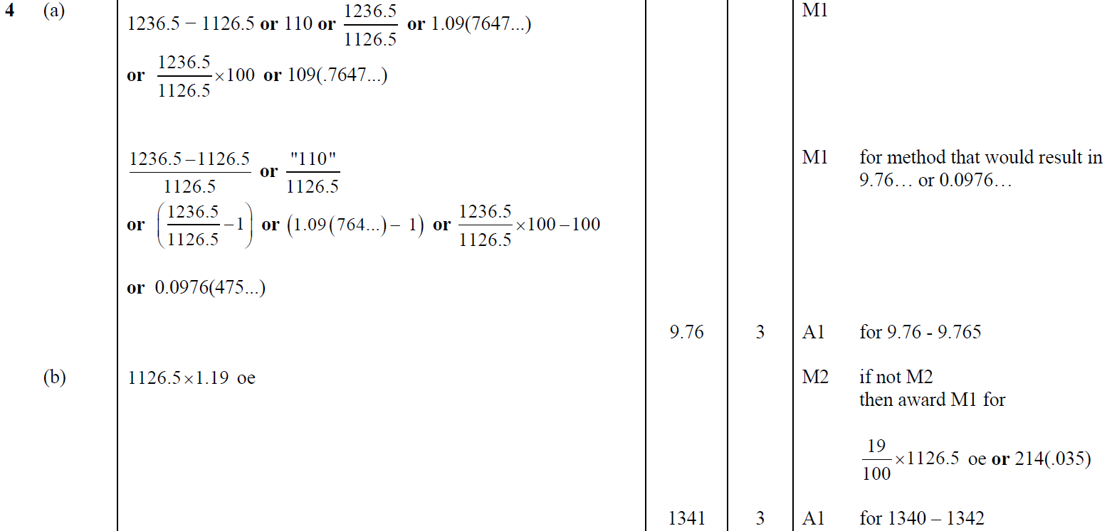
Percentages
Jan 2019 1H Q4
A
B

Slide 22
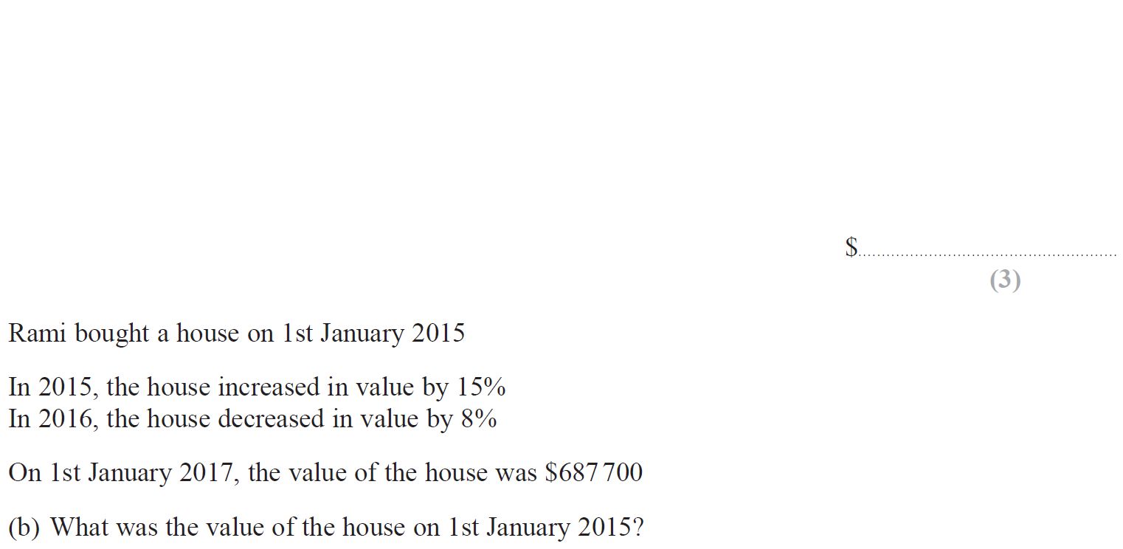
Percentages
Jan 2019 2H Q7

Slide 23
Percentages
Jan 2019 2H Q7
A
B

Slide 24
Percentages
Jan 2019 2HR Q4

Slide 25
Percentages
Jan 2019 2HR Q4
A

Slide 26
Percentages
Jan 2019 2HR Q9

Slide 27
Percentages
Jan 2019 2HR Q9
A

Slide 28
Percentages
Jan 2019 2HR Q13

Slide 29
Percentages
Jan 2019 2HR Q13
A

Slide 30
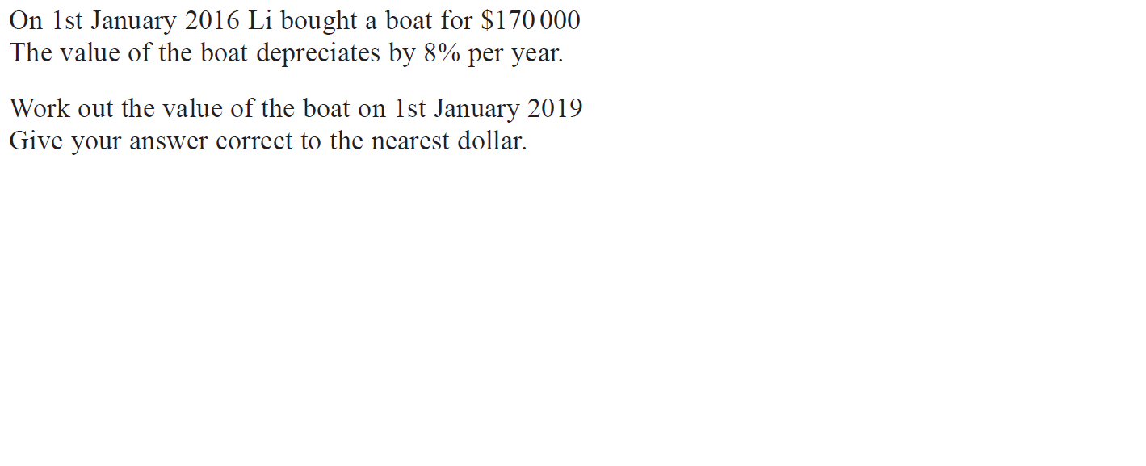
Percentages
May 2019 1H Q8

Slide 31
Percentages
May 2019 1H Q8
A

Slide 32
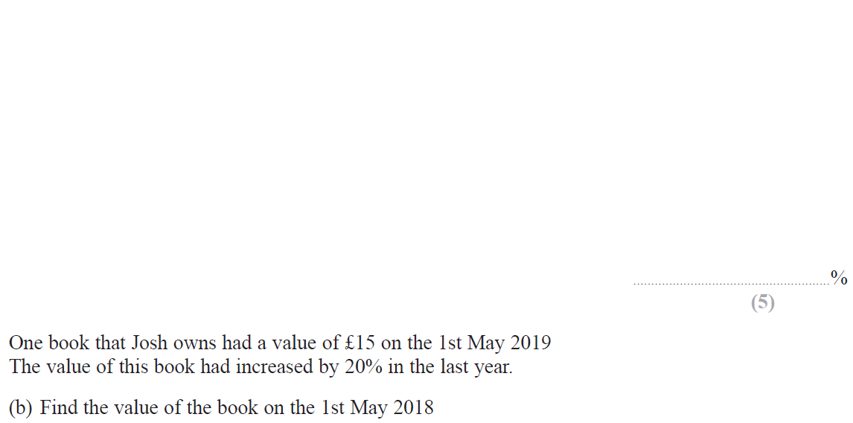
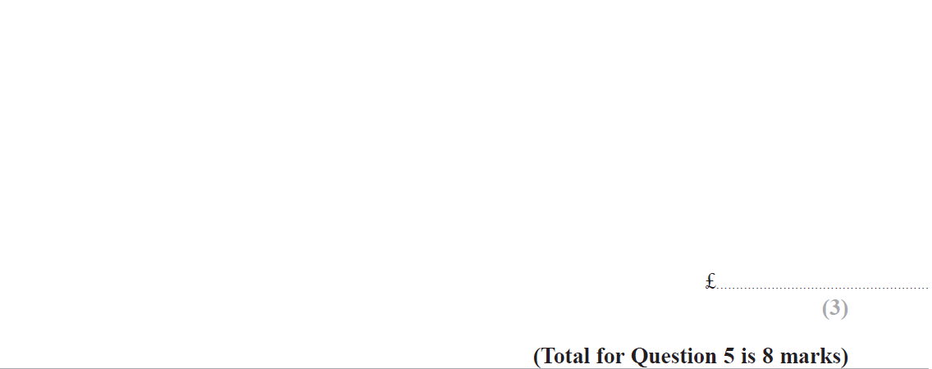
Percentages
June 2019 2H Q5

Slide 33
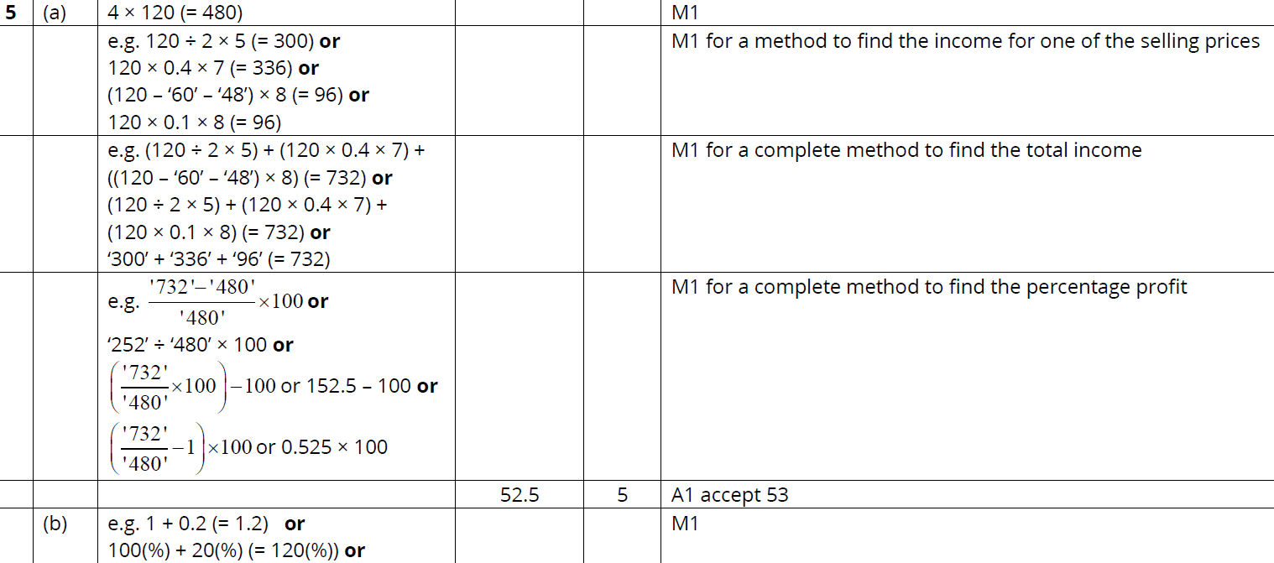
Percentages
June 2019 2H Q5
A
B

Slide 34
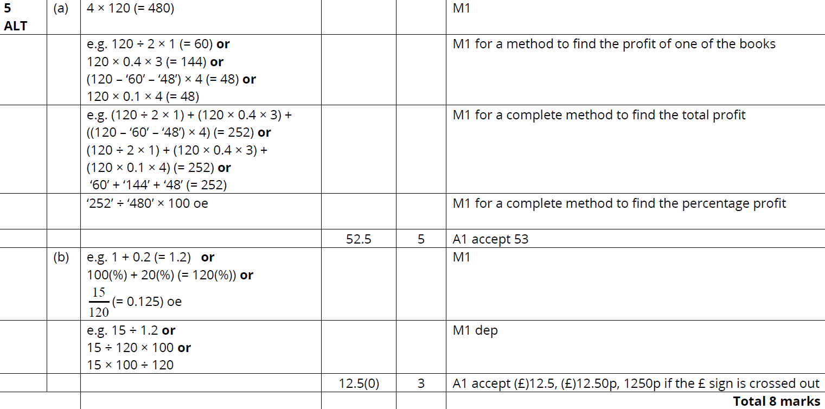
Percentages
June 2019 2H Q5
A
B

Slide 35
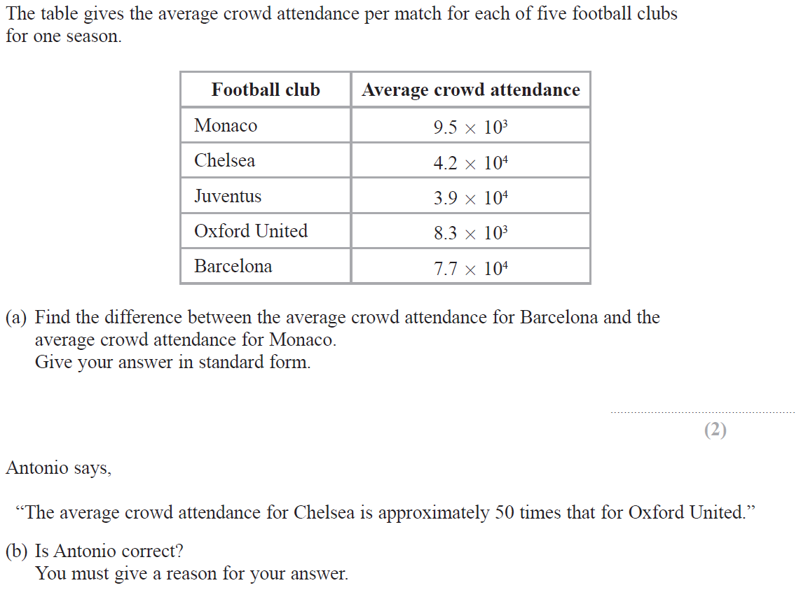
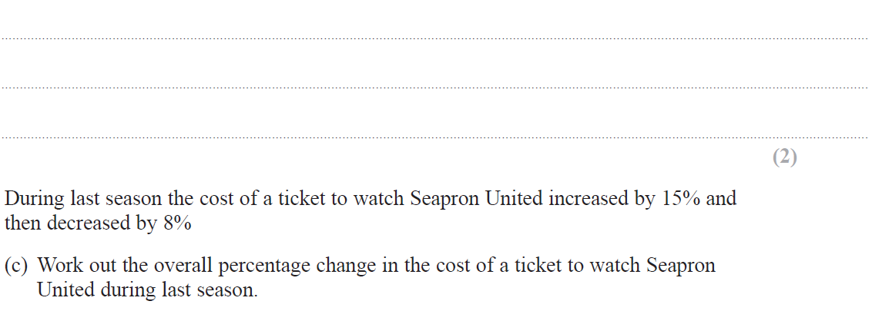
Percentages
June 2019 2H Q11

Slide 36
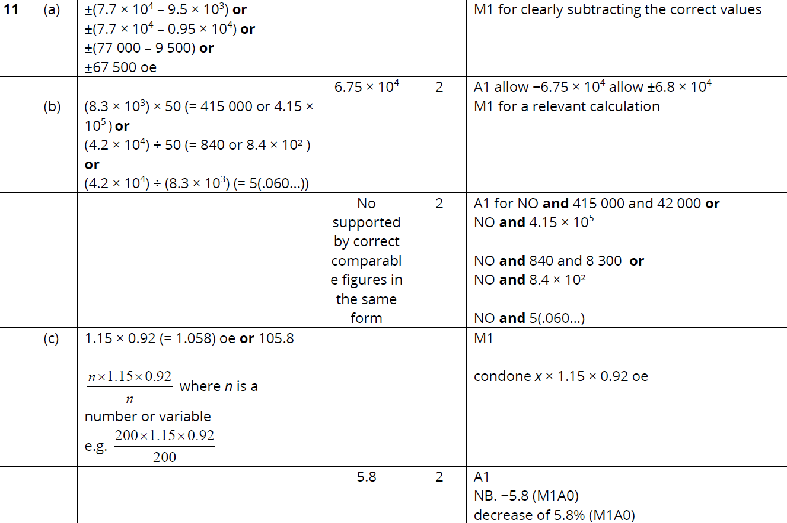
Percentages
June 2019 2H Q11
A
B
C

Slide 37
Percentages
Percentages
New Spec Q’s
May 2004
3H Q1
Nov 2006
3H Q5
June 2010
3H Q8
May 2012 3H Q16
May 2014 4H Q4
Jan 2016 4H Q7
Jan 2017 3HR Q14
Jan 2018 4HR Q1
May 2004
3H Q15
May 2007
3H Q8
June 2010
4H Q4
Jan 2013 3H Q3
May 2014 3HR Q7
Jan 2016 3HR Q8
Jan 2017 4HR Q3
May 2018 3H Q3
Nov 2004
3H Q3
Nov 2007
3H Q4
June 2010
4H Q9
Jan 2013 4H Q24
May 2014 4HR Q6
Jan 2016 4HR Q8
May 2017 3H Q8
June 2018 4H Q2
Nov 2004
4H Q7
Nov 2007
4H Q11
Nov 2010
4H Q11
May 2013 3H Q6
Jan 2015 3H Q7
June 2016 4H Q3
June 2017 4H Q9
May 2018 3HR Q16
May 2005
3H Q8
Nov 2007
4H Q13
June 2011 3H Q9
May 2013 4H Q14
Jan 2015 4H Q14
May 2016 3HR Q5
May 2017 3HR Q10
June 2018 4HR Q4
May 2005
4H Q2
May 2008
3H Q10
June 2011 4H Q1
May 2013 4HR Q5
Jan 2015 3HR Q8
June 2016 4HR Q3
June 2017 4HR Q11
May 2005
4H Q10
Nov 2008
3H Q5
June 2011 4H Q21
May 2013 4HR Q14
May 2015 3H Q5
Jan 2017 3H Q10
Jan 2018 3H Q11
Nov 2005
3H Q10
May 2009
3H Q6
Jan 2012 3H Q1
Jan 2014 3H Q10
June 2015 4H Q12
Jan 2017 3H Q13
Jan 2018 4H Q8
May 2006
3H Q1
Nov 2009
3H Q15
Jan 2012 3H Q10
Jan 2014 3HR Q6
June 2015 4HR Q3
Jan 2017 3HR Q5
Jan 2018 3HR Q7
May 2006
4H Q10
Nov 2009
4H Q5
May 2012 3H Q8
May 2014 3H Q12
Jan 2016 3H Q14
Jan 2017 3HR Q8
Jan 2018 3HR Q14
Compound/ Repeated Change

Slide 38
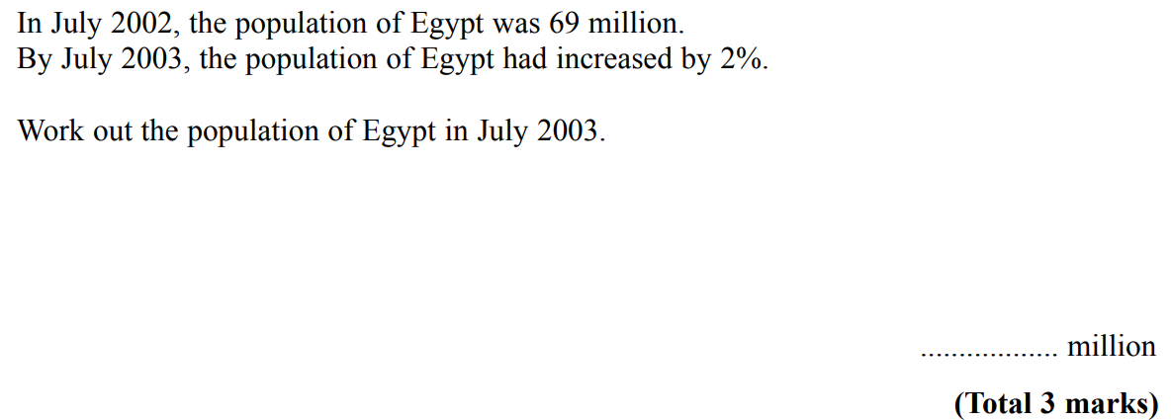
Percentages
May 2004 3H Q1

Slide 39
Percentages
May 2004 3H Q1
A

Slide 40
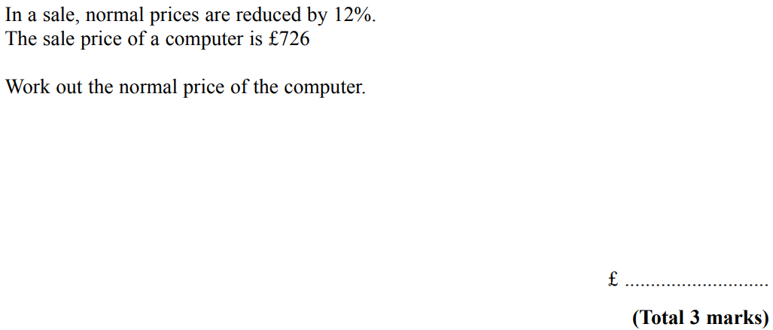
Percentages
May 2004 3H Q15

Slide 41
Percentages
May 2004 3H Q15
A

Slide 42
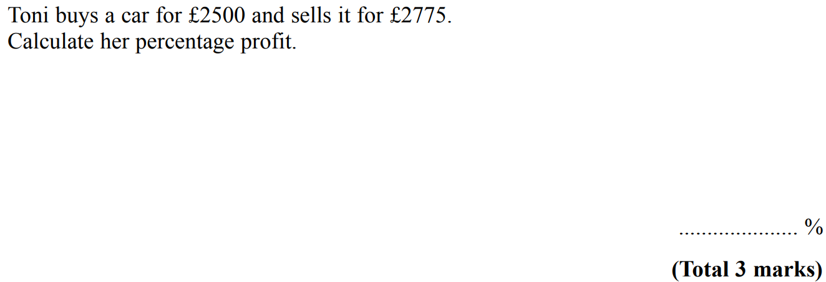
Percentages
Nov 2004 3H Q4

Slide 43
Percentages
Nov 2004 3H Q4
A

Slide 44
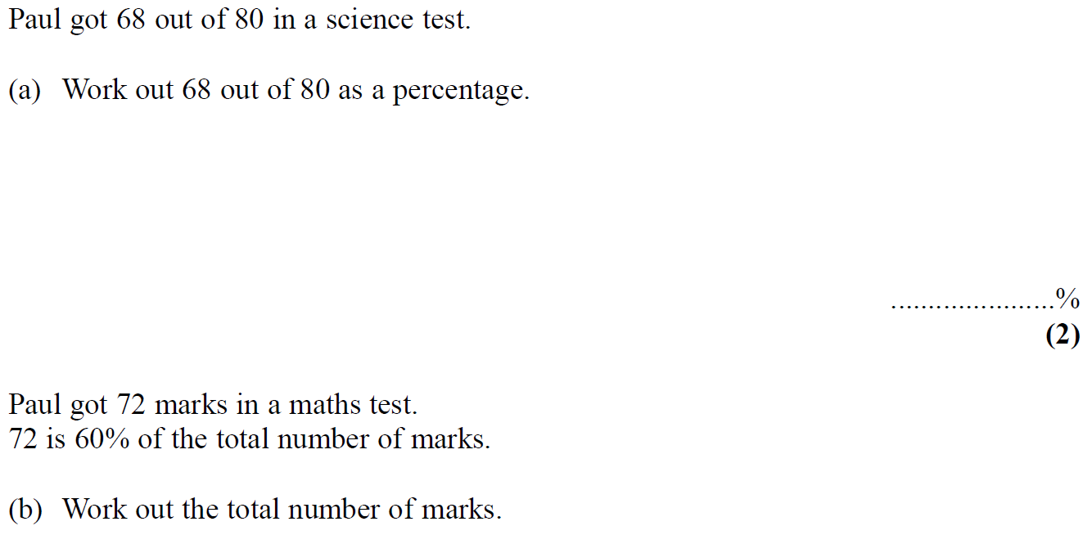
Percentages
Nov 2004 4H Q7

Slide 45
Percentages
Nov 2004 4H Q7
A
B

Slide 46
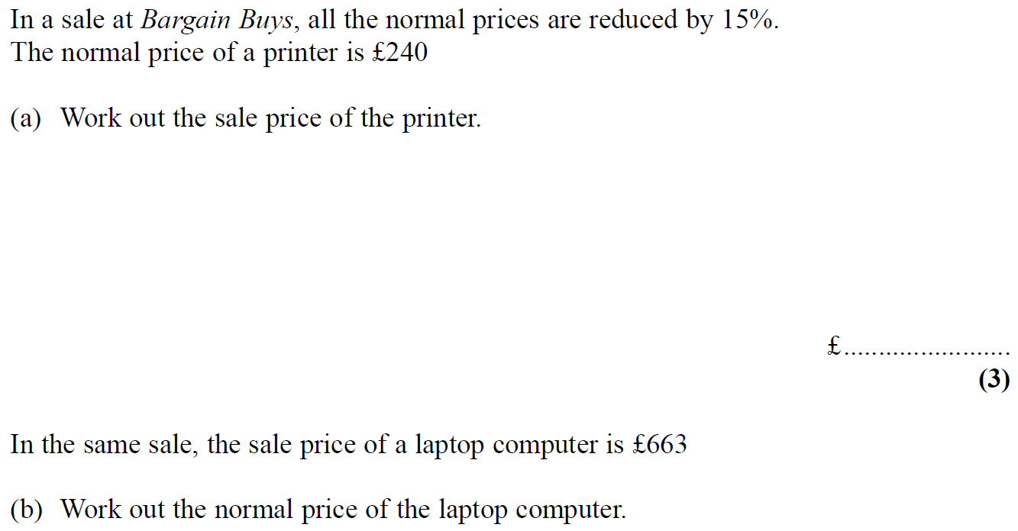
Percentages
May 2005 3H Q8

Slide 47
Percentages
May 2005 3H Q8
A
B

Slide 48
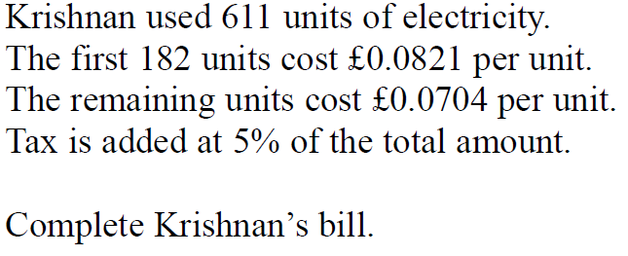
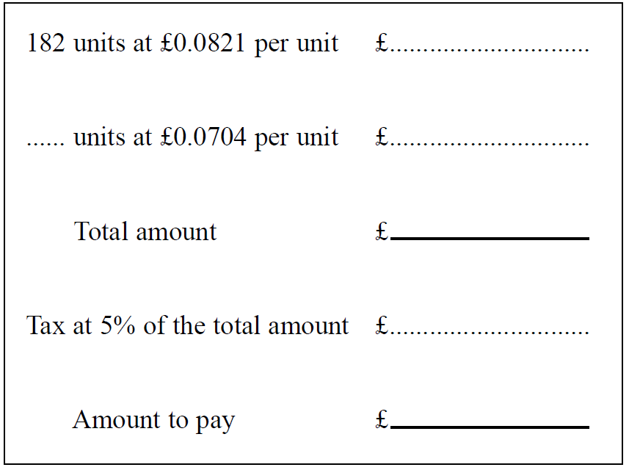
Percentages
May 2005 4H Q2

Slide 49
Percentages
May 2005 4H Q2
A

Slide 50
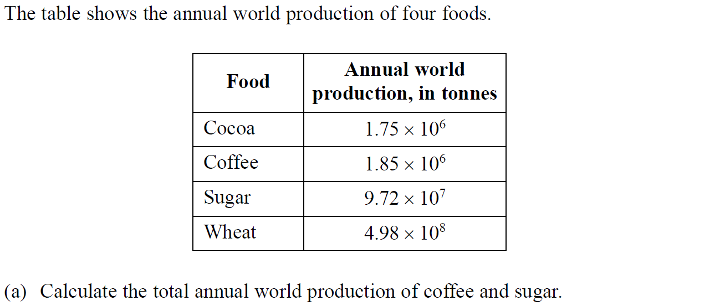
Percentages
May 2005 4H Q10

Slide 51
Percentages
May 2005 4H Q10
A
B
C

Slide 52
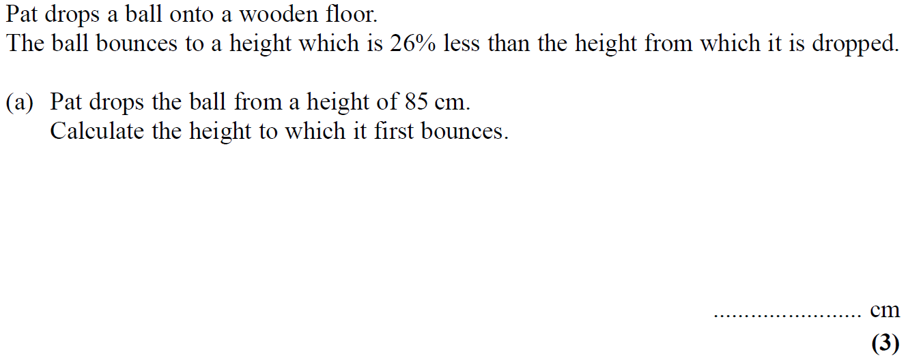
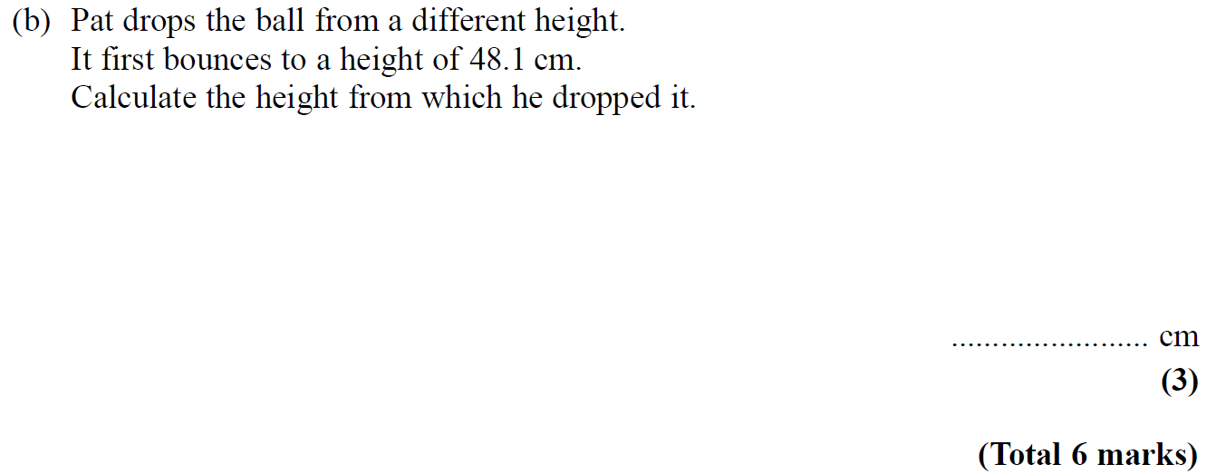
Percentages
Nov 2005 3H Q10

Slide 53
Percentages
Nov 2005 3H Q10
A
B

Slide 54
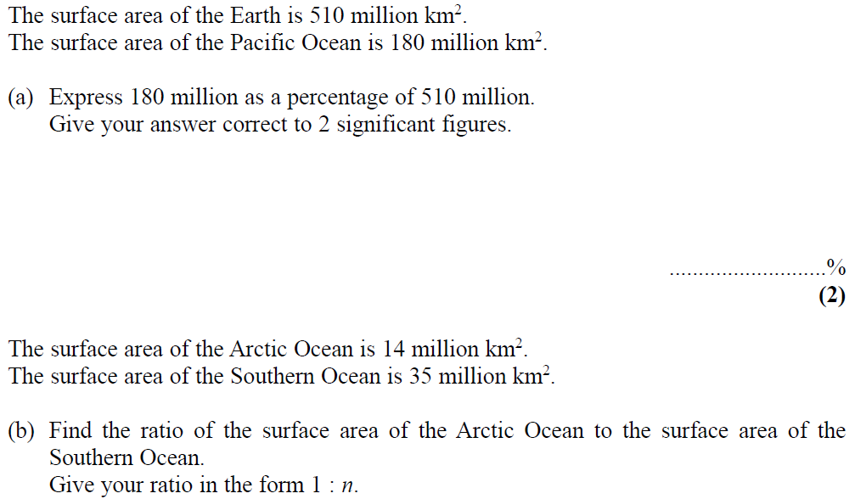
Percentages
May 2006 3H Q1

Slide 55
Percentages
May 2006 3H Q1
A
B

Slide 56
Percentages
May 2006 4H Q10

Slide 57
Percentages
May 2006 4H Q10
A
B
C

Slide 58
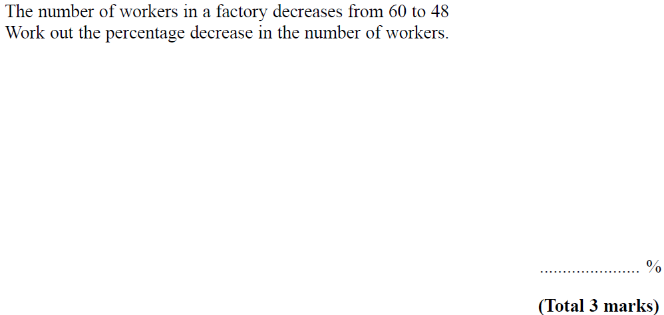
Percentages
Nov 2006 3H Q5

Slide 59
Percentages
Nov 2006 3H Q5
A

Slide 60
Percentages
May 2007 3H Q8

Slide 61
Percentages
May 2007 3H Q8
A
B
C

Slide 62
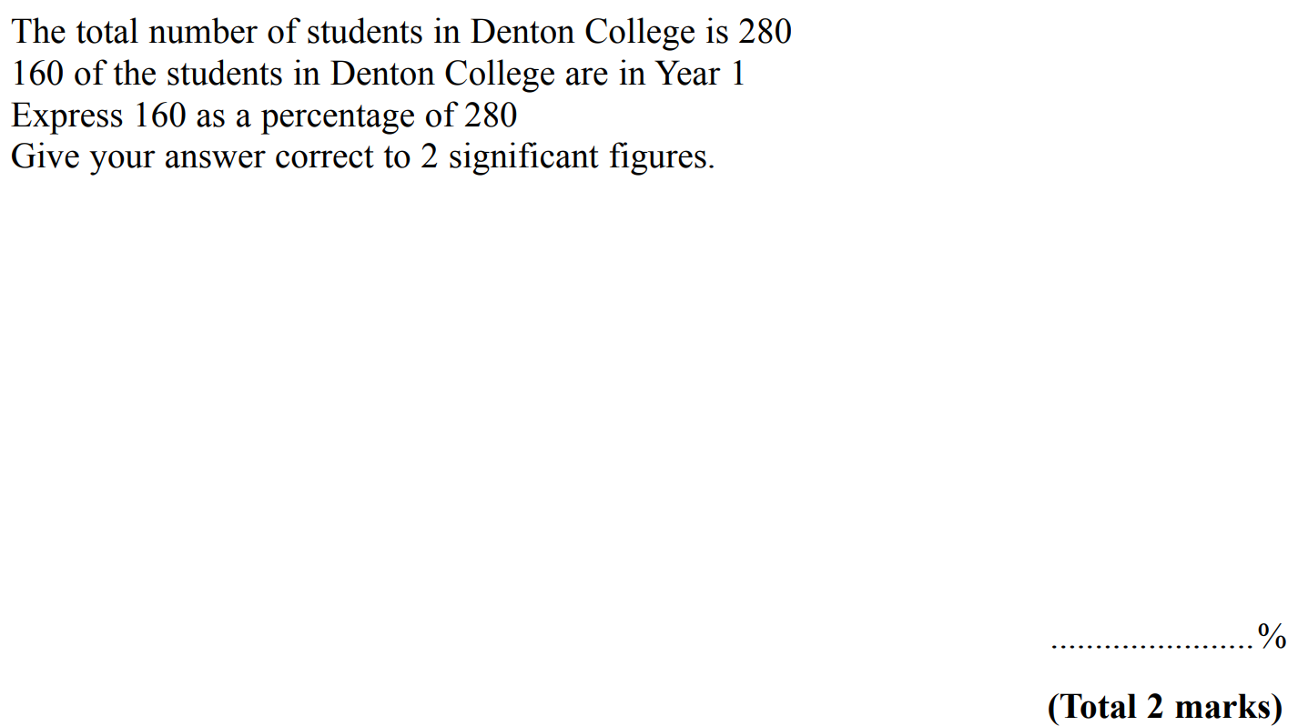
Percentages
Nov 2007 3H Q4

Slide 63
Percentages
Nov 2007 3H Q4
A

Slide 64
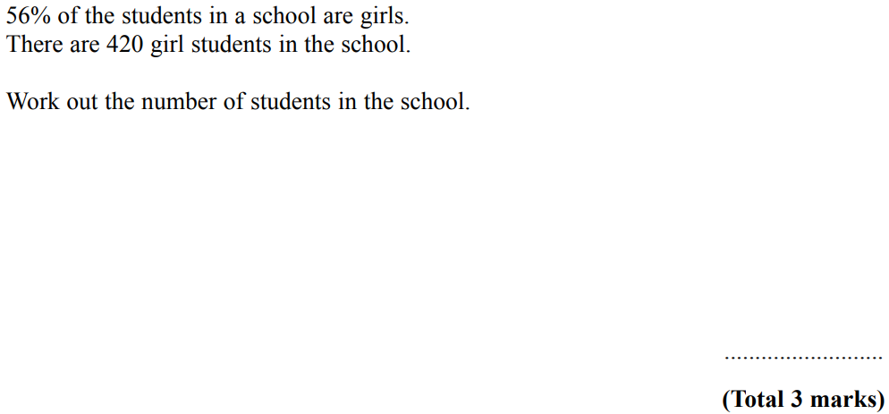
Percentages
Nov 2007 4H Q11

Slide 65
Percentages
Nov 2007 4H Q11
A

Slide 66
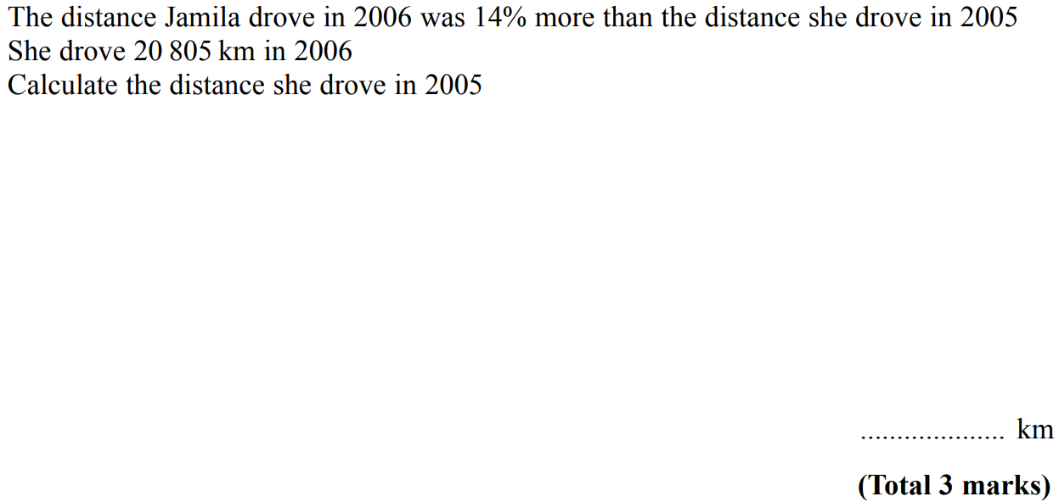
Percentages
Nov 2007 4H Q13

Slide 67
Percentages
Nov 2007 4H Q13
A

Slide 68
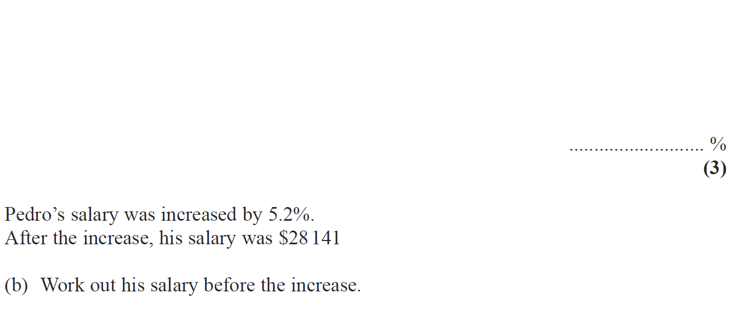
Percentages
May 2008 3H Q10

Slide 69
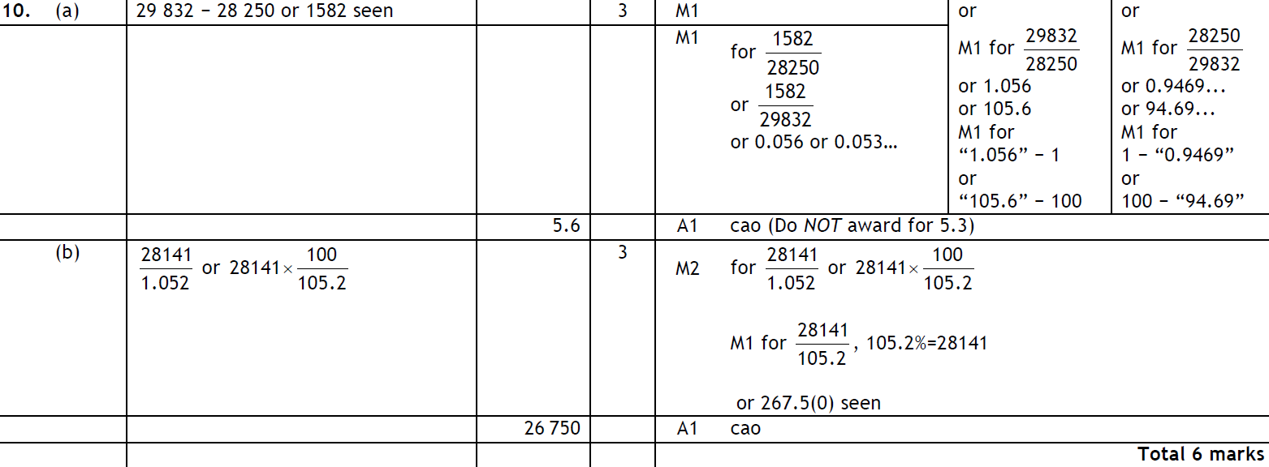
Percentages
May 2008 3H Q10
A
B

Slide 70
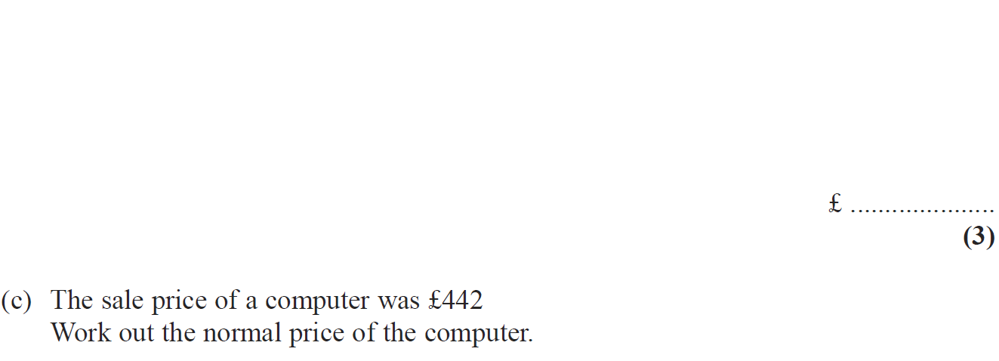
Percentages
Nov 2008 3H Q5

Slide 71
Percentages
Nov 2008 3H Q5
A
B
C

Slide 72
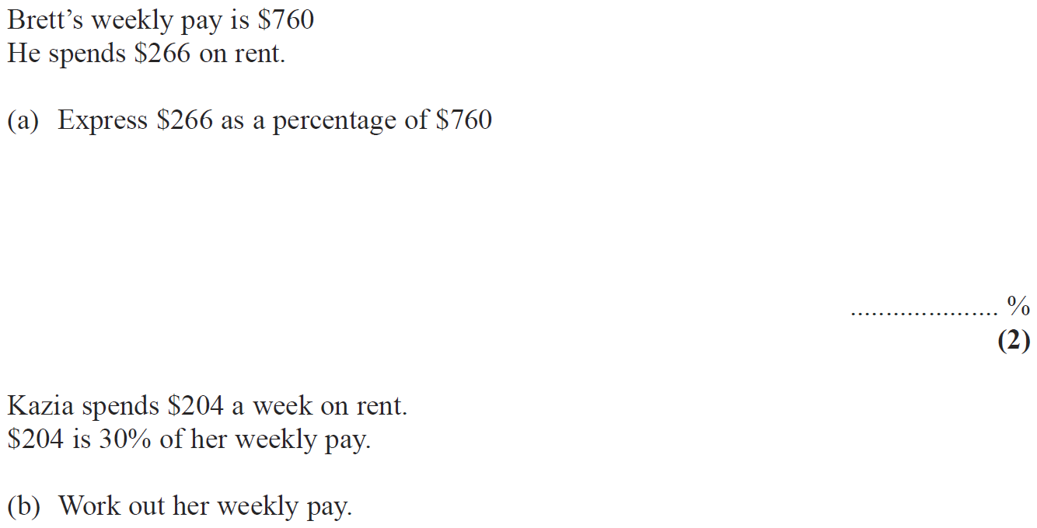
Percentages
May 2009 3H Q6

Slide 73
Percentages
May 2009 3H Q6
A
B

Slide 74
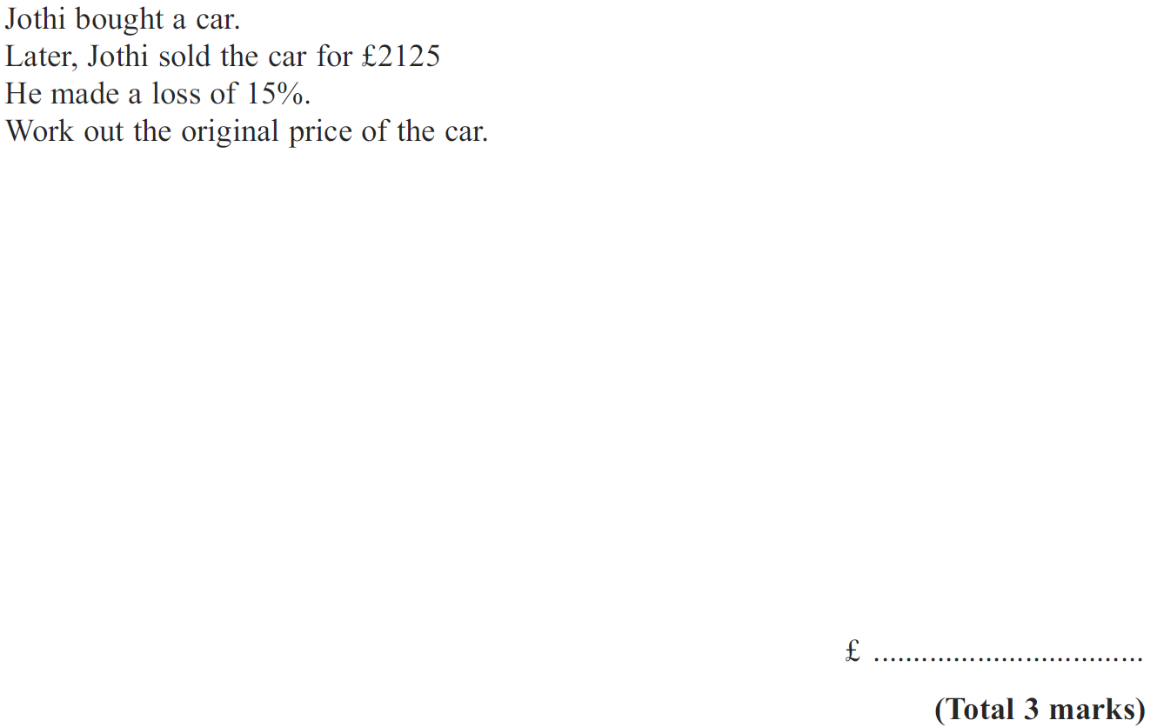
Percentages
Nov 2009 3H Q15

Slide 75
Percentages
Nov 2009 3H Q15
A

Slide 76
Percentages
Nov 2009 4H Q5

Slide 77
Percentages
Nov 2009 4H Q5
A
B

Slide 78
Percentages
June 2010 3H Q8

Slide 79
Percentages
June 2010 3H Q8
A

Slide 80
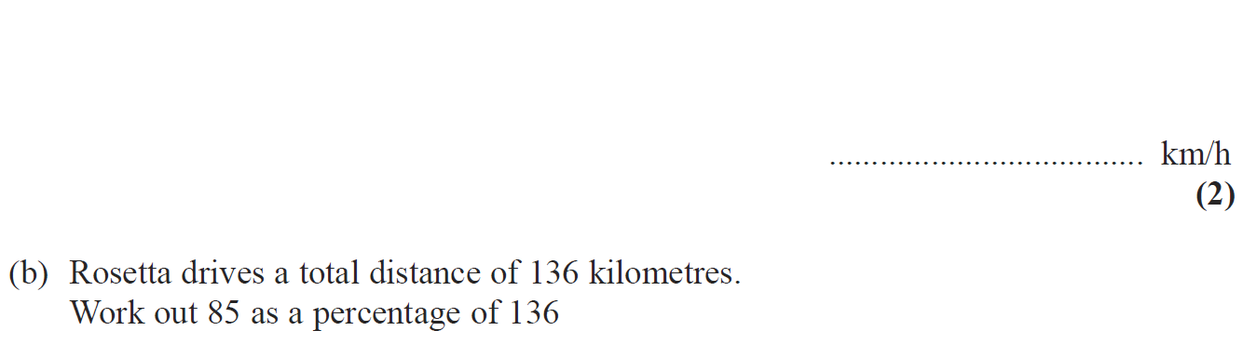
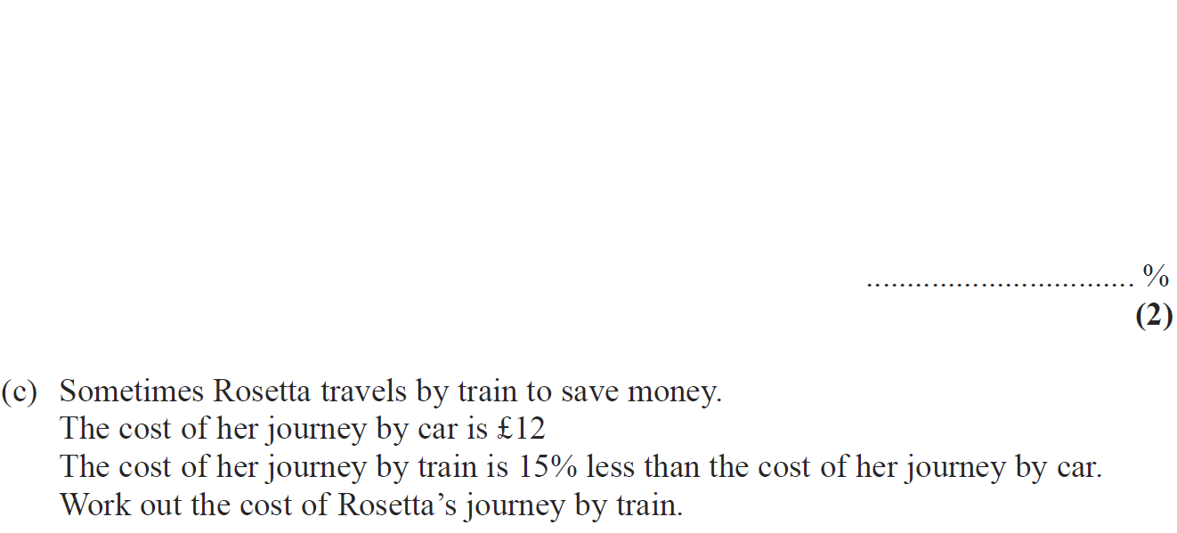
Percentages
June 2010 4H Q4

Slide 81
Percentages
June 2010 4H Q4
A
B
C

Slide 82
Percentages
June 2010 4H Q9

Slide 83
Percentages
June 2010 4H Q9
A

Slide 84
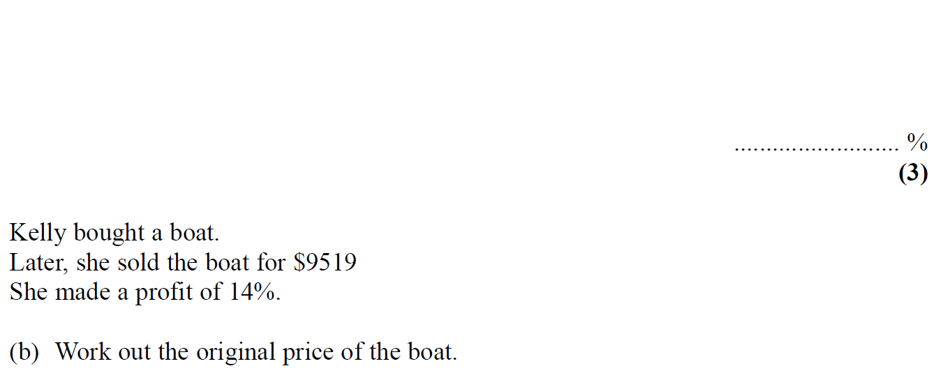
Percentages
Nov 2010 4H Q11

Slide 85
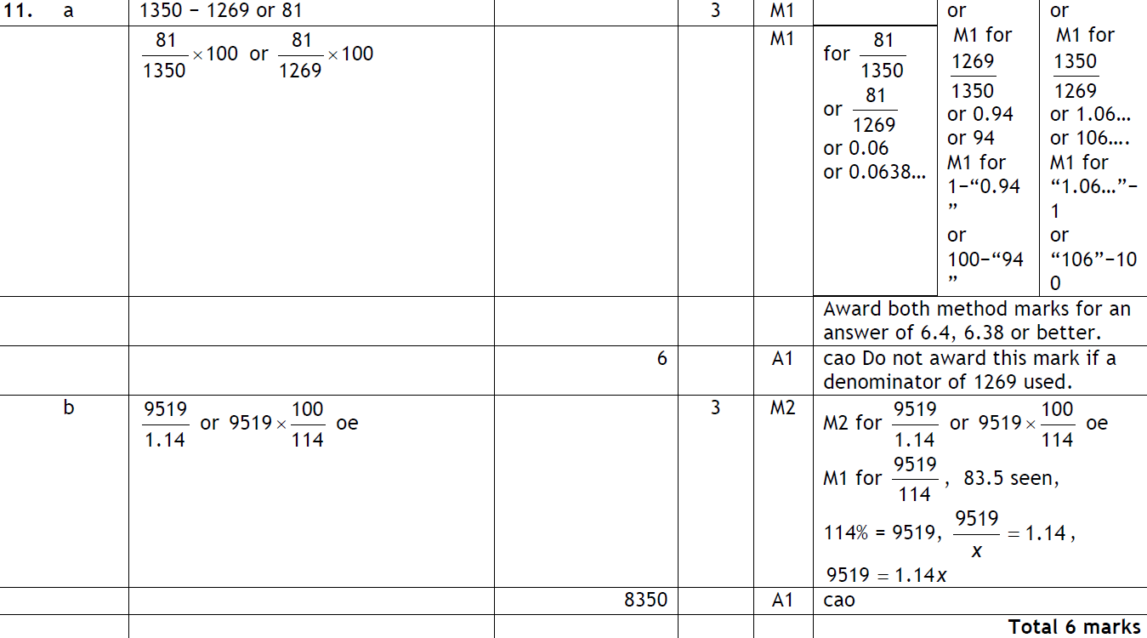
Percentages
Nov 2010 4H Q11
A
B

Slide 86
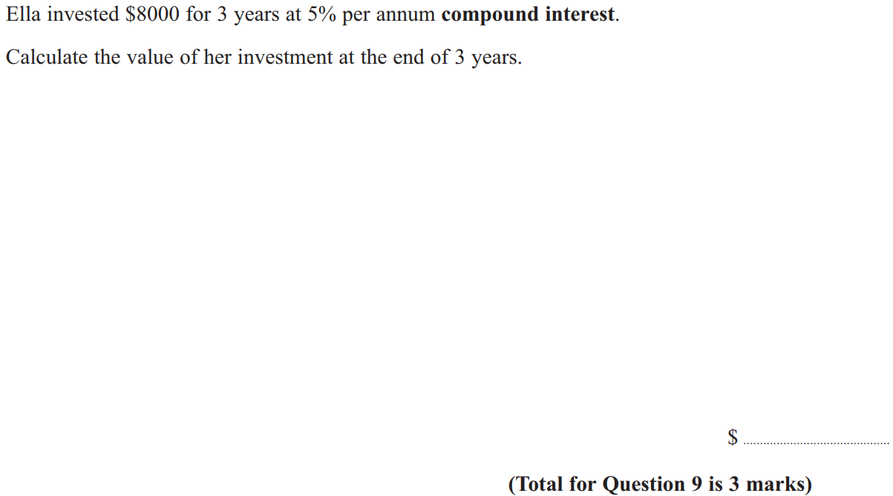
Percentages
June 2011 3H Q9

Slide 87
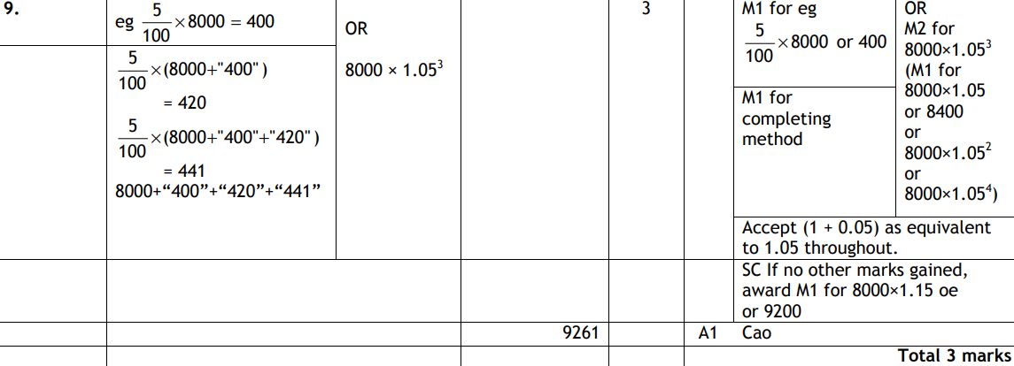
Percentages
June 2011 3H Q9
A

Slide 88
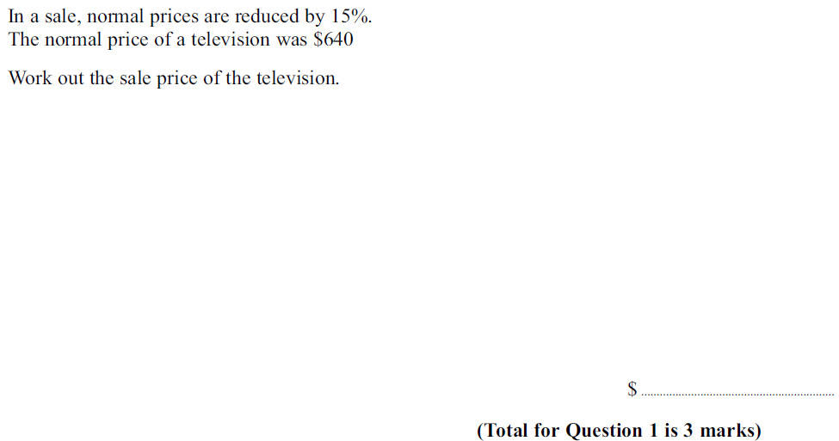
Percentages
June 2011 4H Q1

Slide 89
Percentages
June 2011 4H Q1
A

Slide 90
Percentages
June 2011 4H Q21

Slide 91
Percentages
June 2011 4H Q21
A
B

Slide 92
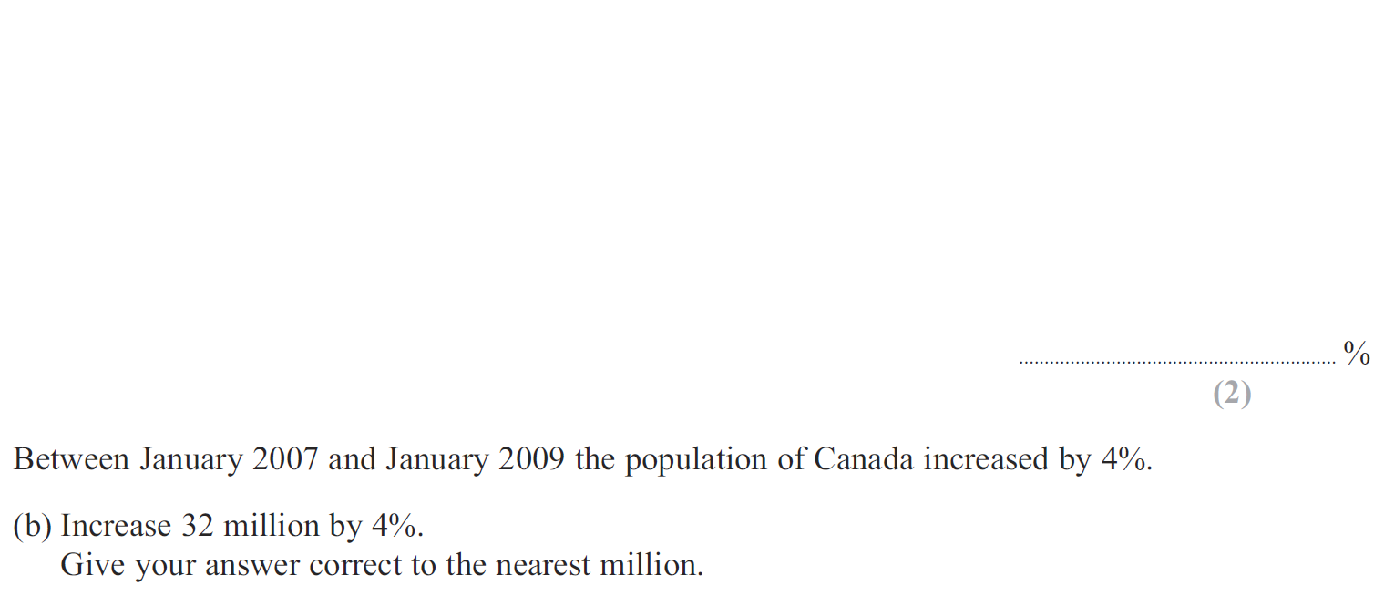
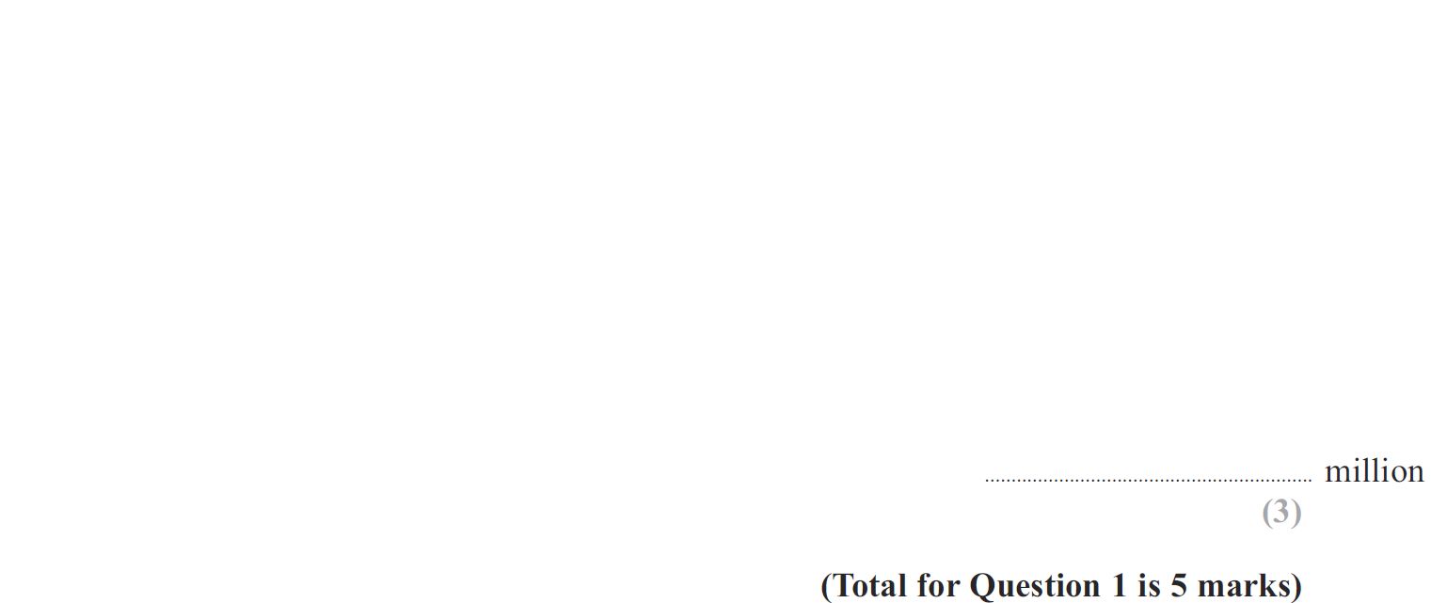
Percentages
Jan 2012 3H Q1

Slide 93
Percentages
Jan 2012 3H Q1
A
B

Slide 94
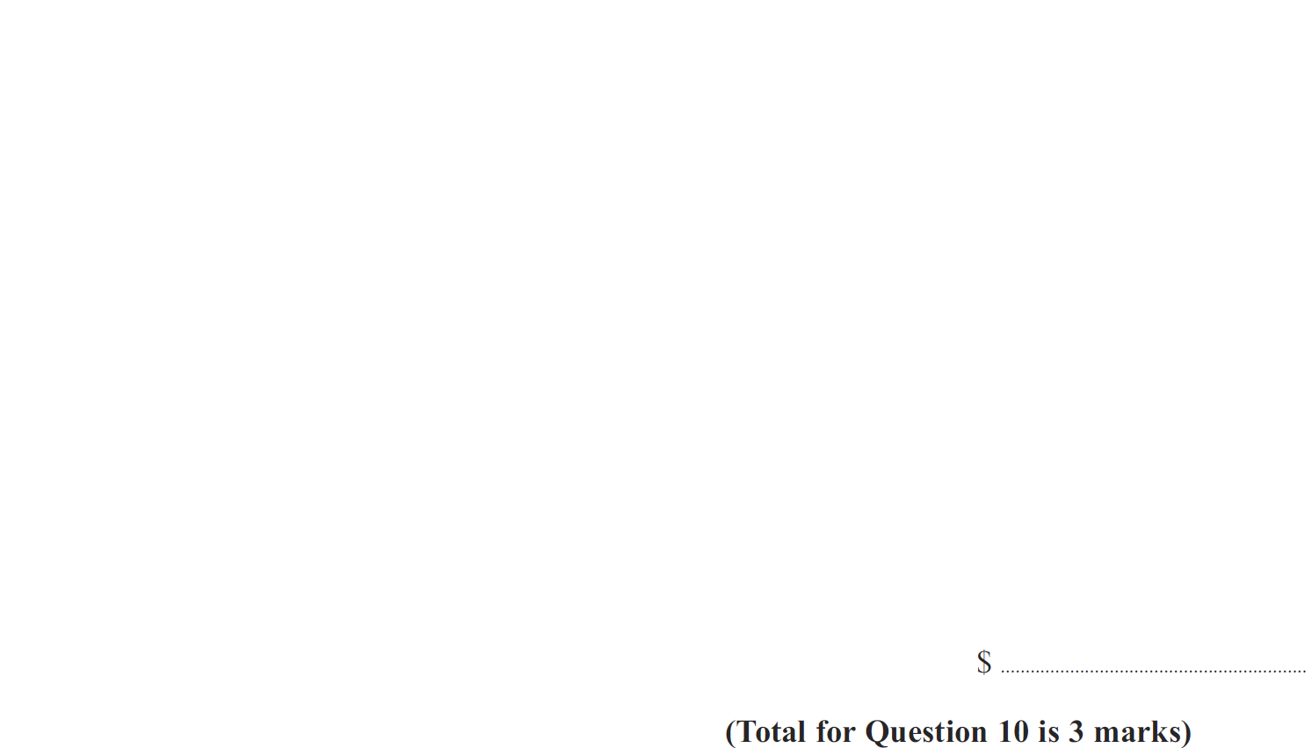
Percentages
Jan 2012 3H Q10

Slide 95
Percentages
Jan 2012 3H Q10
A

Slide 96
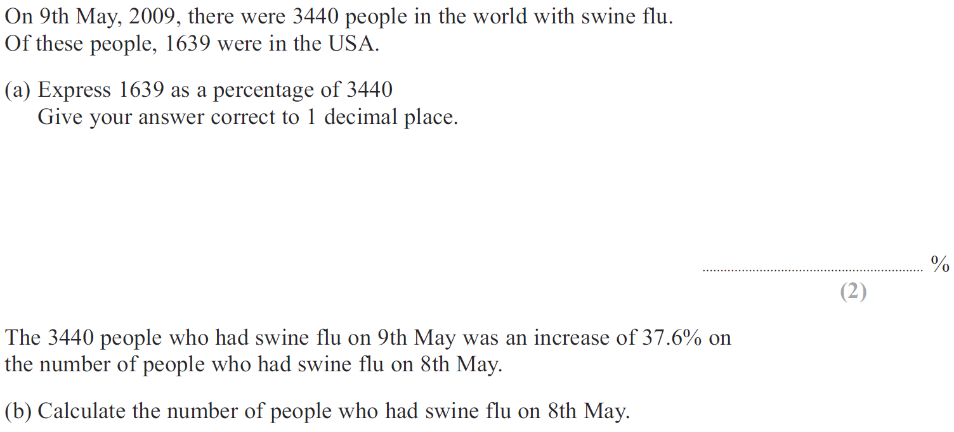
Percentages
May 2012 3H Q8

Slide 97
Percentages
May 2012 3H Q8
A
B

Slide 98
Percentages
May 2012 3H Q16

Slide 99
Percentages
May 2012 3H Q16
A

Slide 100
Percentages
Jan 2013 3H Q3

Slide 101
Percentages
Jan 2013 3H Q3
A
B
C
D

Slide 102
Percentages
Jan 2013 4H Q24

Slide 103
Percentages
Jan 2013 4H Q24
A

Slide 104
Percentages
May 2013 3H Q6

Slide 105
Percentages
May 2013 3H Q6
A
B

Slide 106
Percentages
May 2013 4H Q14

Slide 107
Percentages
May 2013 4H Q14
A
B
C

Slide 108
Percentages
May 2013 4HR Q5

Slide 109
Percentages
May 2013 4HR Q5
A (i)
A (ii)
B

Slide 110
Percentages
May 2013 4HR Q14

Slide 111
Percentages
May 2013 4HR Q14
A

Slide 112
Percentages
Jan 2014 3H Q10

Slide 113
Percentages
Jan 2014 3H Q10
A

Slide 114
Percentages
Jan 2014 3HR Q6

Slide 115
Percentages
Jan 2014 3HR Q6
A
B
C

Slide 116
Percentages
May 2014 3H Q12

Slide 117
Percentages
May 2014 3H Q12
A
B

Slide 118
Percentages
May 2014 4H Q4

Slide 119
Percentages
May 2014 4H Q4
A
B

Slide 120
Percentages
May 2014 3HR Q7

Slide 121
Percentages
May 2014 3HR Q7
A
B

Slide 122
Percentages
May 2014 4HR Q6

Slide 123
Percentages
May 2014 4HR Q6
A

Slide 124
Percentages
Jan 2015 3H Q7

Slide 125
Percentages
Jan 2015 3H Q7
A
B

Slide 126
Percentages
Jan 2015 4H Q14

Slide 127
Percentages
Jan 2015 4H Q14
A

Slide 128
Percentages
Jan 2015 3HR Q8

Slide 129
Percentages
Jan 2015 3HR Q8
A
B

Slide 130
Percentages
May 2015 3H Q5

Slide 131
Percentages
May 2015 3H Q5
A
B

Slide 132
Percentages
June 2015 4H Q12

Slide 133
Percentages
June 2015 4H Q12
A

Slide 134
Percentages
June 2015 4HR Q3

Slide 135
Percentages
June 2015 4HR Q3
A
B

Slide 136
Percentages
Jan 2016 3H Q14

Slide 137
Percentages
Jan 2016 3H Q14
A
B

Slide 138
Percentages
Jan 2016 4H Q7

Slide 139
Percentages
Jan 2016 4H Q7
A
B

Slide 140
Percentages
Jan 2016 3HR Q8

Slide 141
Percentages
Jan 2016 3HR Q8
A
B
C

Slide 142
Percentages
Jan 2016 4HR Q8

Slide 143
Percentages
Jan 2016 4HR Q8
A

Slide 144
Percentages
June 2016 4H Q3

Slide 145
Percentages
June 2016 4H Q3
A
B

Slide 146
Percentages
May 2016 3HR Q5

Slide 147
Percentages
May 2016 3HR Q5
A
B

Slide 148
Percentages
June 2016 4HR Q3

Slide 149
Percentages
June 2016 4HR Q3
A
B
C

Slide 150
Percentages
Jan 2017 3H Q10

Slide 151
Percentages
Jan 2017 3H Q10
A

Slide 152
Percentages
Jan 2017 3H Q13

Slide 153
Percentages
Jan 2017 3H Q13
A

Slide 154
Percentages
Jan 2017 3HR Q5

Slide 155
Percentages
Jan 2017 3HR Q5
A

Slide 156
Percentages
Jan 2017 3HR Q8

Slide 157
Percentages
Jan 2017 3HR Q8
A
B

Slide 158
Percentages
Jan 2017 3HR Q14

Slide 159
Percentages
Jan 2017 3HR Q14
A

Slide 160
Percentages
Jan 2017 4HR Q3

Slide 161
Percentages
Jan 2017 4HR Q3
A

Slide 162
Percentages
May 2017 3H Q8

Slide 163
Percentages
May 2017 3H Q8
A
B

Slide 164
Percentages
June 2017 4H Q9

Slide 165
Percentages
June 2017 4H Q9
A

Slide 166
Percentages
May 2017 3HR Q10

Slide 167
Percentages
May 2017 3HR Q10
A
B

Slide 168
Percentages
June 2017 4HR Q11

Slide 169
Percentages
June 2017 4HR Q11
A

Slide 170
Percentages
Jan 2018 3H Q11

Slide 171
Percentages
Jan 2018 3H Q11
A

Slide 172
Percentages
Jan 2018 4H Q8

Slide 173
Percentages
Jan 2018 4H Q8
A
B
C

Slide 174
Percentages
Jan 2018 3HR Q7

Slide 175
Percentages
Jan 2018 3HR Q7
A

Slide 176
Percentages
Jan 2018 3HR Q14

Slide 177
Percentages
Jan 2018 3HR Q14
A

Slide 178
Percentages
Jan 2018 4HR Q1

Slide 179
Percentages
Jan 2018 4HR Q1
A
B

Slide 180
Percentages
May 2018 3H Q3

Slide 181
Percentages
May 2018 3H Q3
A
B
C

Slide 182
Percentages
June 2018 4H Q2

Slide 183
Percentages
June 2018 4H Q2
A
B
C

Slide 184
Percentages
May 2018 3HR Q16

Slide 185
Percentages
May 2018 3HR Q16
A
B

Slide 186
Percentages
June 2018 4HR Q4

Slide 187
Percentages
June 2018 4HR Q4
A

