Slide 1
Multiple Events
Multiple Events
Old Spec Q’s
SAM
2H Q20
May 2018
1H Q19
June 2018
2HR Q16
Jan 2019
1H Q20
Jan 2019
1HR Q16
Jan 2019
2HR Q15
June 2019
2H Q23

Slide 2
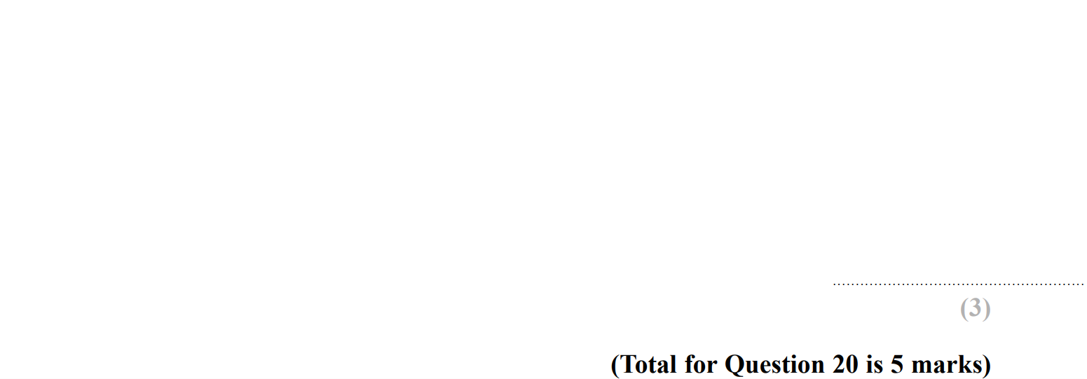
Multiple Events
SAM 2H Q20

Slide 3
Multiple Events
SAM 2H Q20
A
B

Slide 4
Multiple Events
May 2018 1H Q19

Slide 5
Multiple Events
May 2018 1H Q19
A

Slide 6
Multiple Events
June 2018 2HR Q16

Slide 7
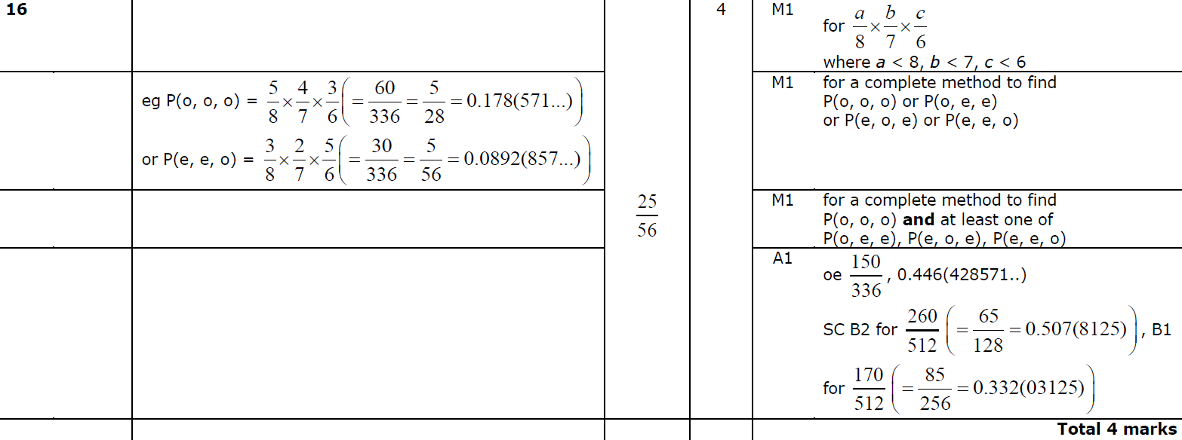
Multiple Events
June 2018 2HR Q16
A

Slide 8
Multiple Events
Jan 2019 1H Q20

Slide 9
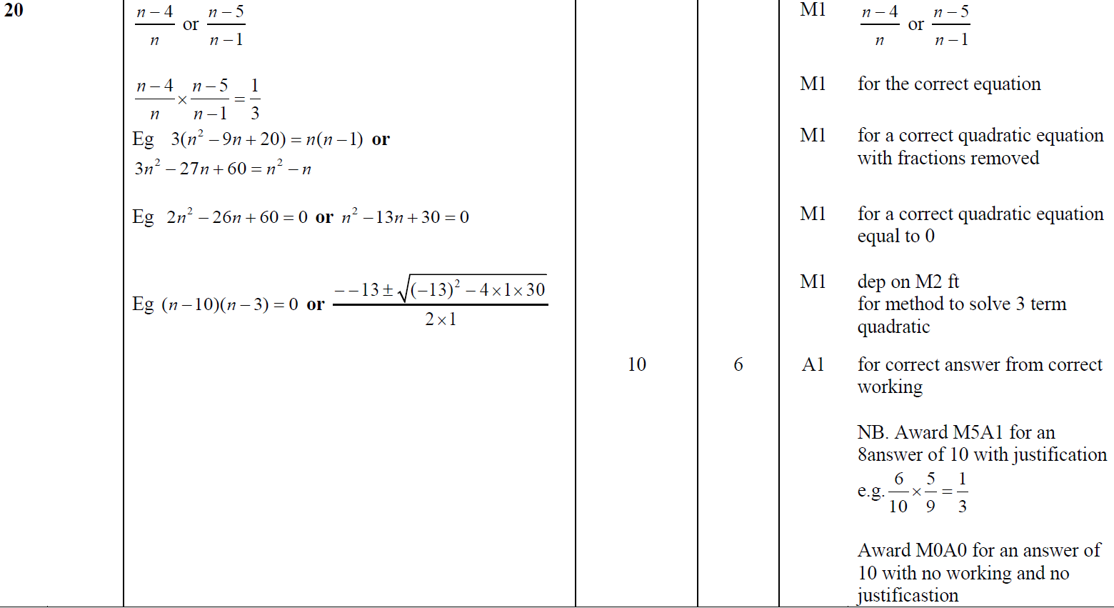
Multiple Events
Jan 2019 1H Q20
A

Slide 10
Multiple Events
Jan 2019 1HR Q16

Slide 11
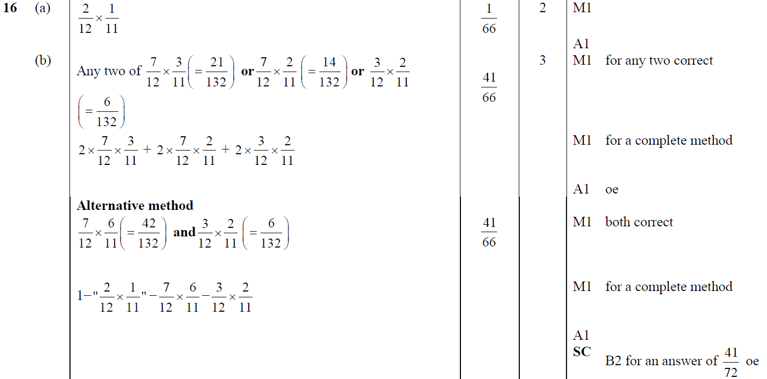
Multiple Events
Jan 2019 1HR Q16
A
B

Slide 12
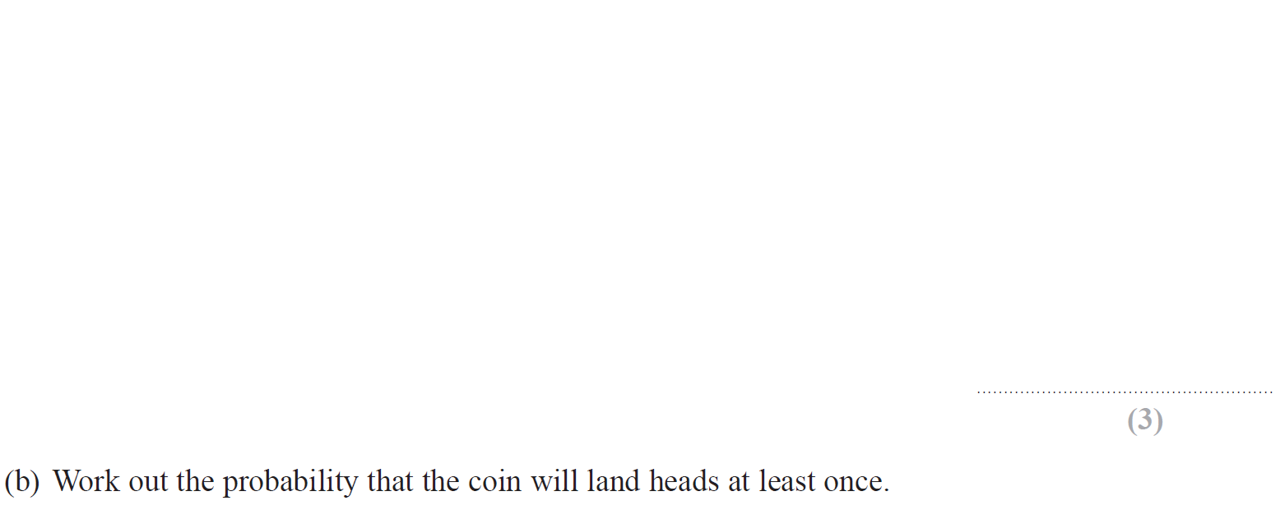
Multiple Events
Jan 2019 2HR Q15

Slide 13
Multiple Events
Jan 2019 2HR Q15
A
B

Slide 14
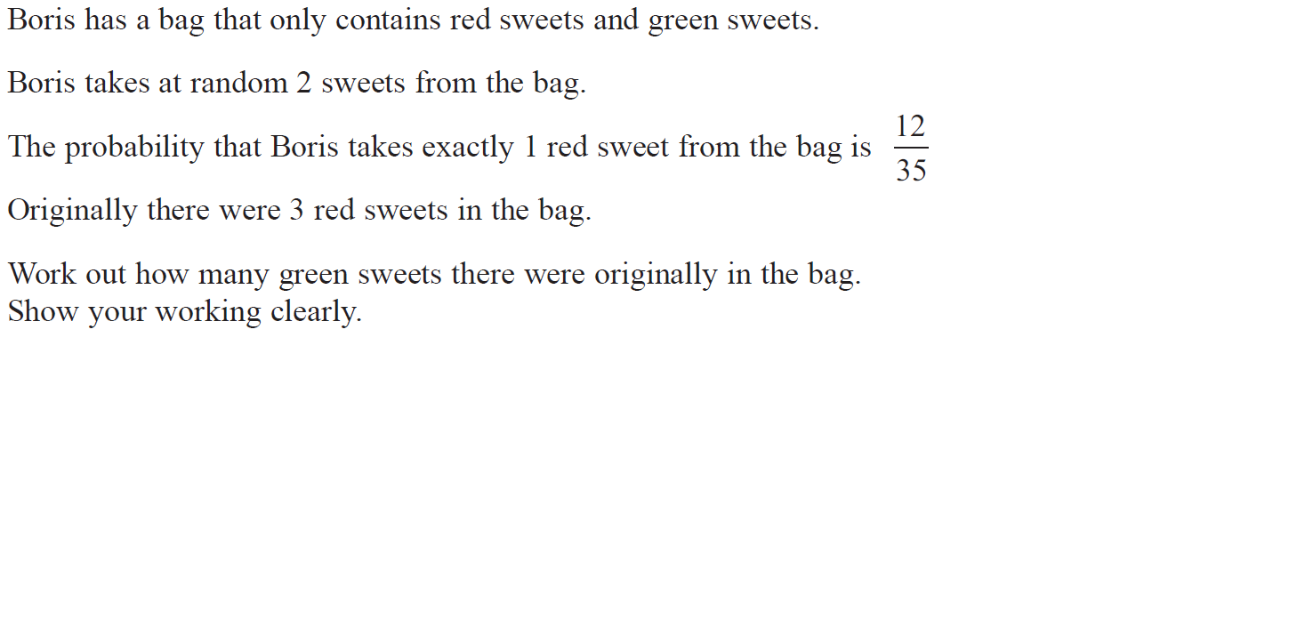
Multiple Events
June 2019 2H Q23

Slide 15
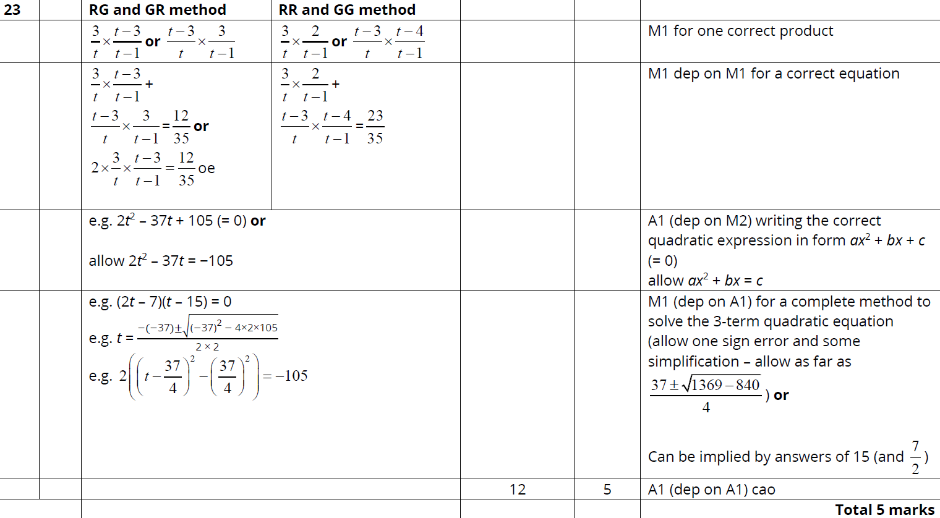
Multiple Events
June 2019 2H Q23
A

Slide 16
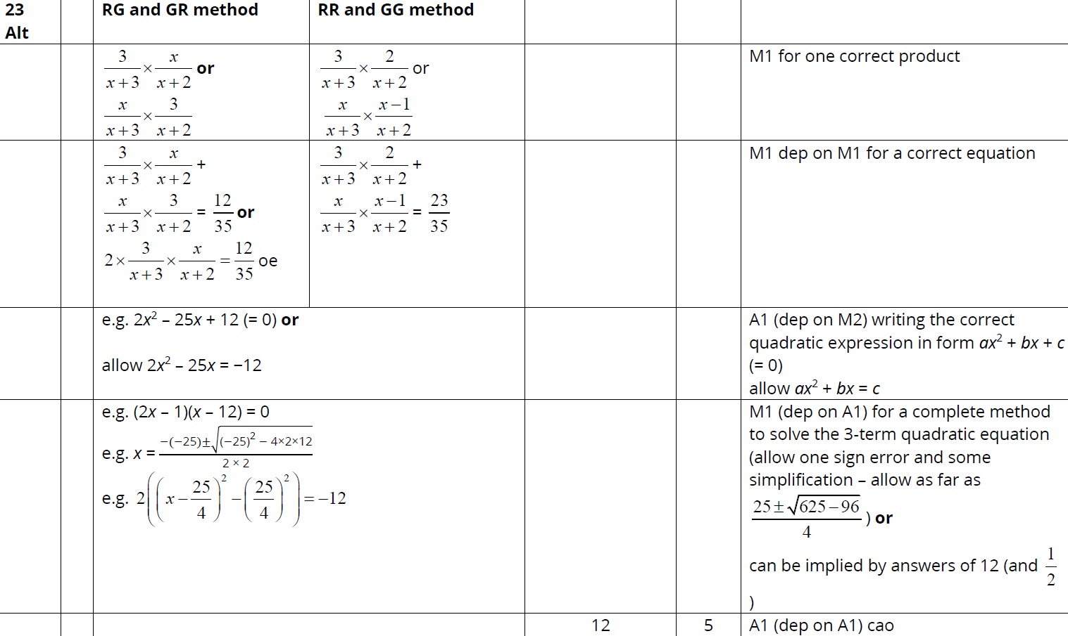
Multiple Events
June 2019 2H Q23
A Alternative Method

Slide 17
Multiple Events
Multiple Events
New Spec Q’s
Nov 2004
3H Q20
May 2007
4H Q18
June 2011 3H Q17
May 2014 3H Q20
Jan 2016 3HR Q18
May 2018 3H Q20
Nov 2004
4H Q23
Nov 2007
3H Q21
Jan 2012 4H Q16
May 2014 3HR Q17
May 2016 3H Q21
May 2018 3HR Q18
May 2005
3H Q19
Nov 2007
4H Q24
May 2012 3H Q10
Jan 2015 3H Q5
June 2016 4HR Q15
Nov 2005
3H Q19
May 2008
3H Q16
Jan 2013 4H Q20
Jan 2015 3H Q16
Jan 2017 3H Q24
May 2006
3H Q14
Nov 2008
3H Q15
May 2013 3H Q17
Jan 2015 3HR Q22
Jan 2017 3HR Q22
May 2006
4H Q16
May 2009
3H Q17
May 2013 3HR Q21
May 2015 3H Q20
May 2017 3H Q20
Nov 2006
3H Q21
Nov 2009
3H Q20
May 2013 4HR Q18
May 2015 3HR Q17
June 2017 4HR Q16
Nov 2006
4H Q22
June 2010
3H Q19
Jan 2014 3H Q13
June 2015 4HR Q16
Jan 2018 3H Q22
May 2007
3H Q10
Nov 2010
3H Q17
Jan 2014 3HR Q8
Jan 2016 3H Q21
Jan 2018 3HR Q18

Slide 18
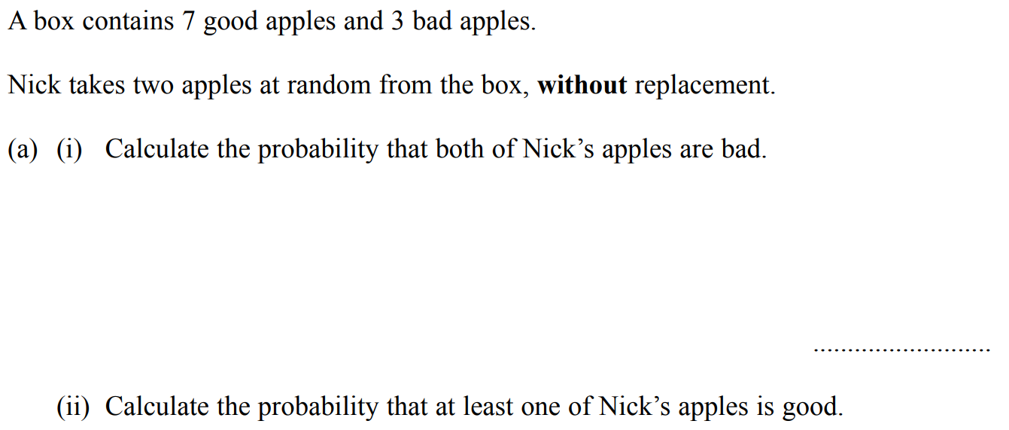
Multiple Events
Nov 2004 3H Q20

Slide 19
Multiple Events
Nov 2004 3H Q20
A (i)
A (ii)
B

Slide 20
Multiple Events
Nov 2004 4H Q23

Slide 21
Multiple Events
Nov 2004 4H Q23
A

Slide 22
Multiple Events
May 2005 3H Q19

Slide 23
Multiple Events
May 2005 3H Q19
A
B

Slide 24
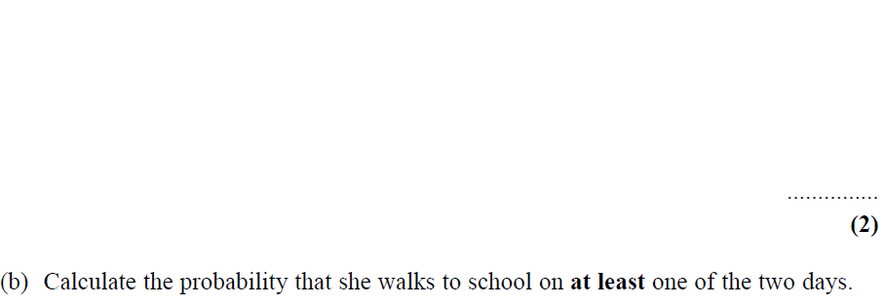
Multiple Events
Nov 2005 3H Q19

Slide 25
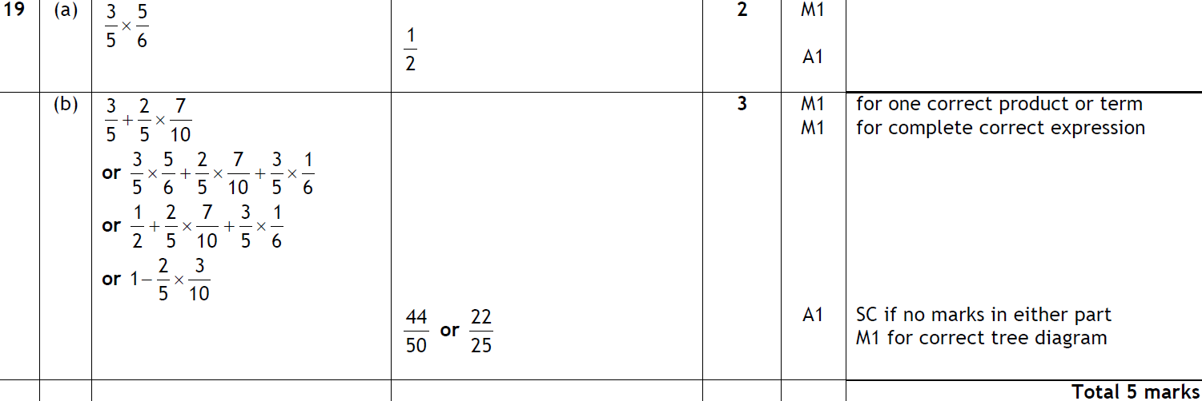
Multiple Events
Nov 2005 3H Q19
A
B

Slide 26
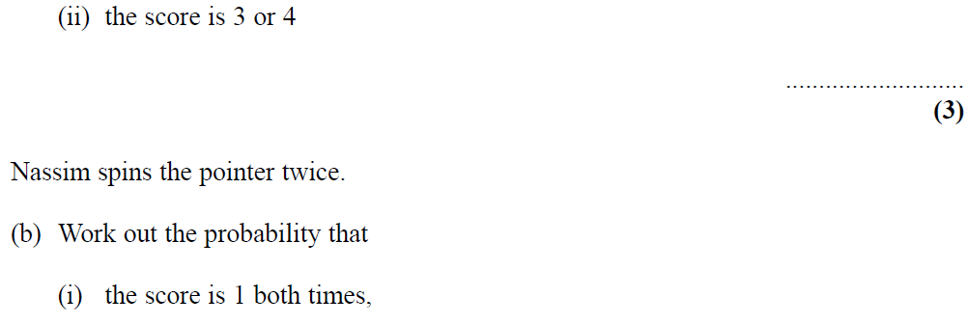
Multiple Events
May 2006 3H Q14

Slide 27
Multiple Events
May 2006 3H Q14
A (i)
A (ii)
B

Slide 28
Multiple Events
May 2006 4H Q16

Slide 29
Multiple Events
May 2006 4H Q16
A

Slide 30
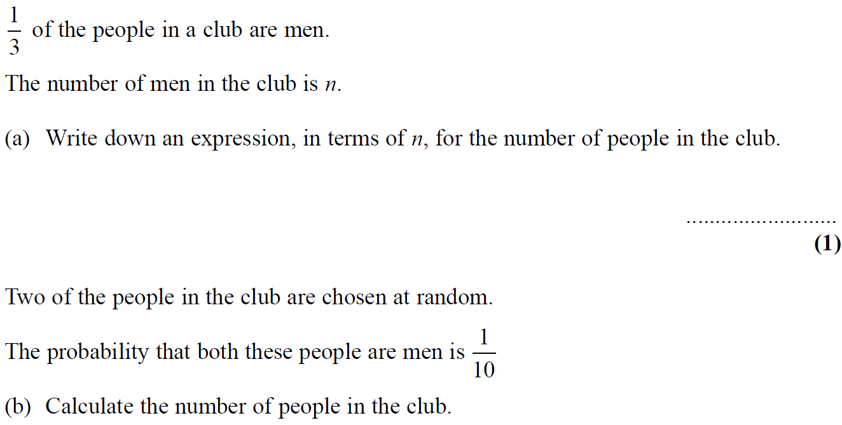
Multiple Events
Nov 2006 3H Q21

Slide 31
Multiple Events
Nov 2006 3H Q21
A
B

Slide 32
Multiple Events
Nov 2006 4H Q22

Slide 33
Multiple Events
Nov 2006 4H Q22
A

Slide 34
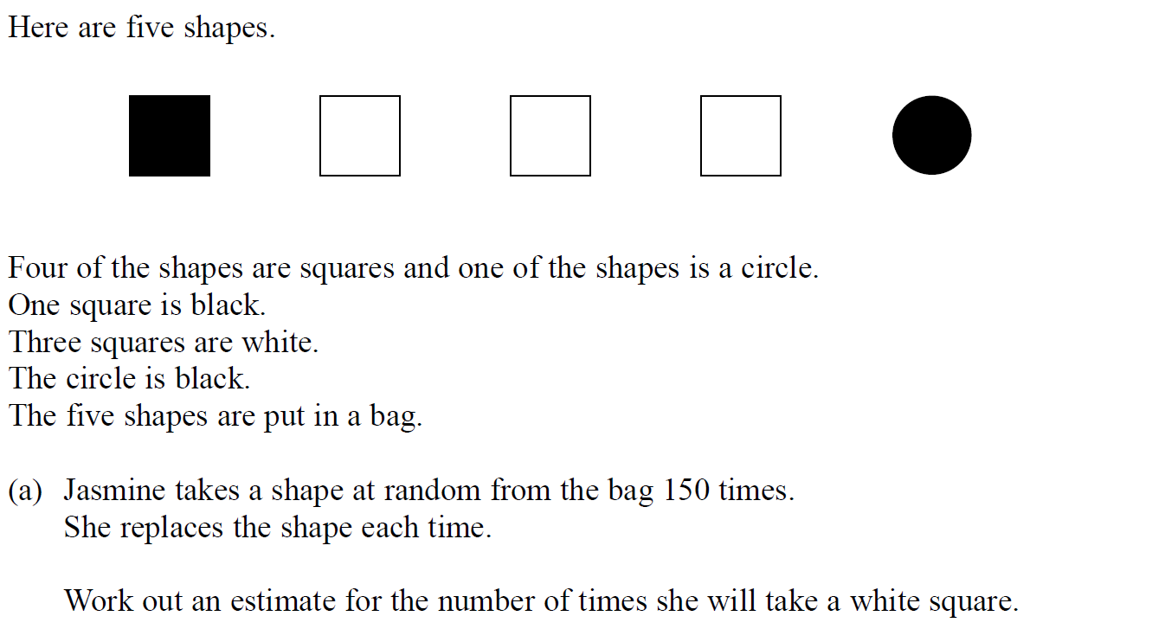
Multiple Events
May 2007 3H Q10

Slide 35
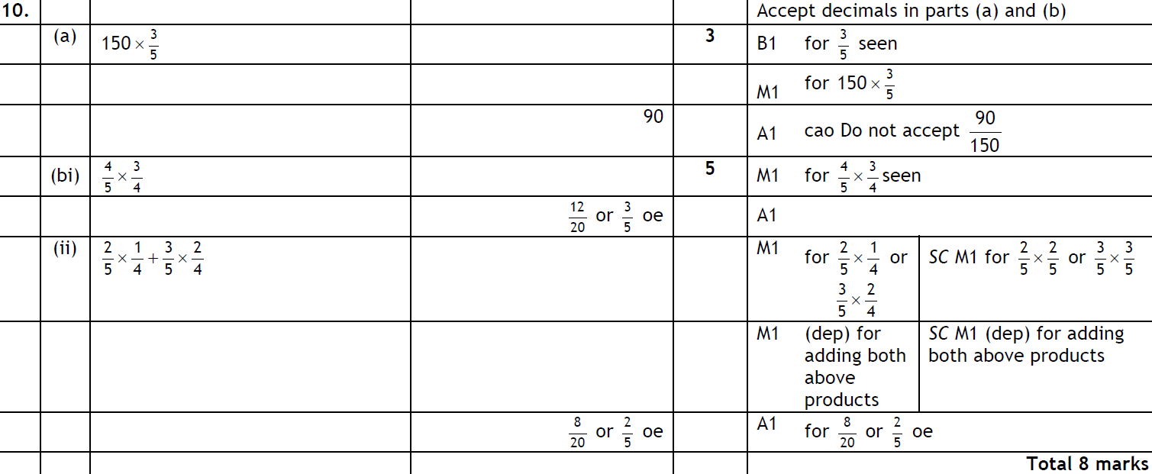
Multiple Events
May 2007 3H Q10
A
B (i)
B (ii)

Slide 36
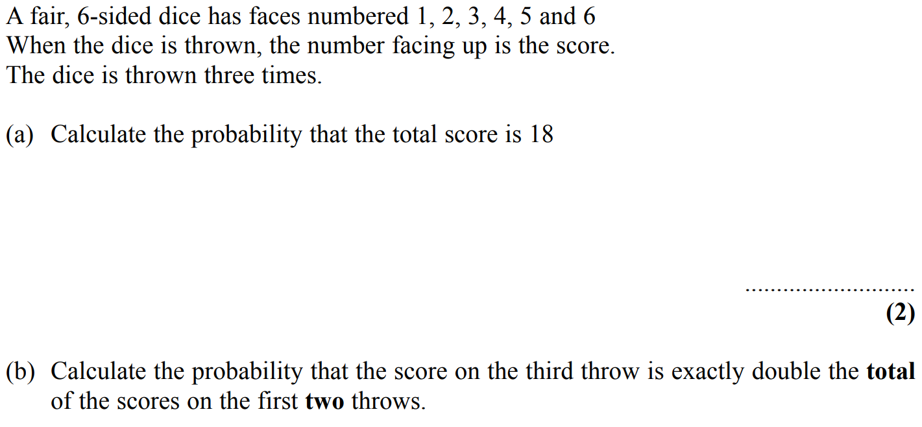
Multiple Events
May 2007 4H Q18

Slide 37
Multiple Events
May 2007 4H Q18
A
B

Slide 38
Multiple Events
Nov 2007 3H Q21

Slide 39
Multiple Events
Nov 2007 3H Q21
A

Slide 40
Multiple Events
Nov 2007 4H Q24

Slide 41
Multiple Events
Nov 2007 4H Q24
A

Slide 42
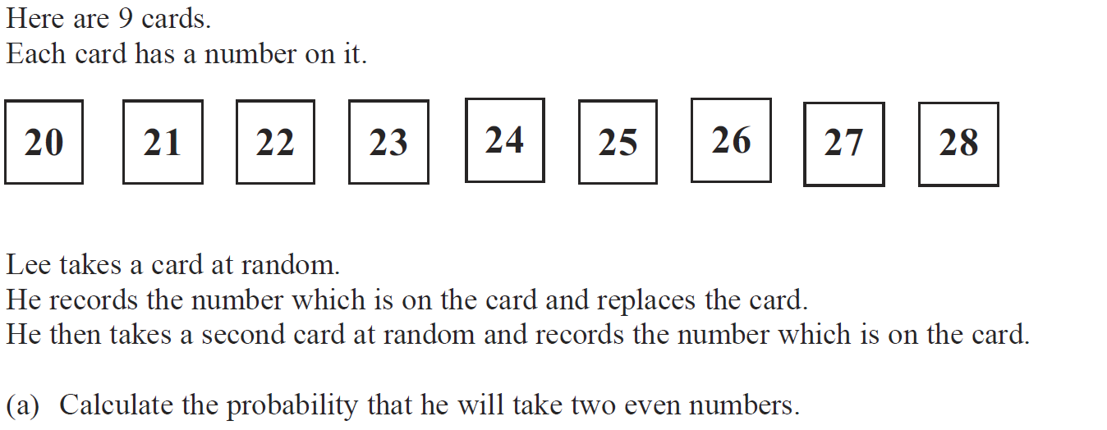
Multiple Events
May 2008 3H Q16

Slide 43
Multiple Events
May 2008 3H Q16
A
B

Slide 44
Multiple Events
Nov 2008 3H Q15

Slide 45
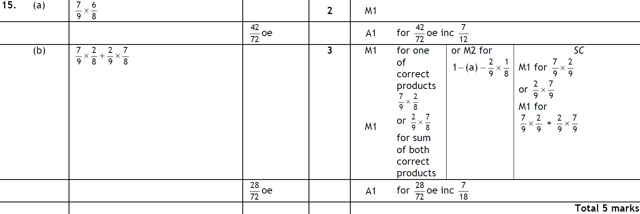
Multiple Events
Nov 2008 3H Q15
A
B

Slide 46
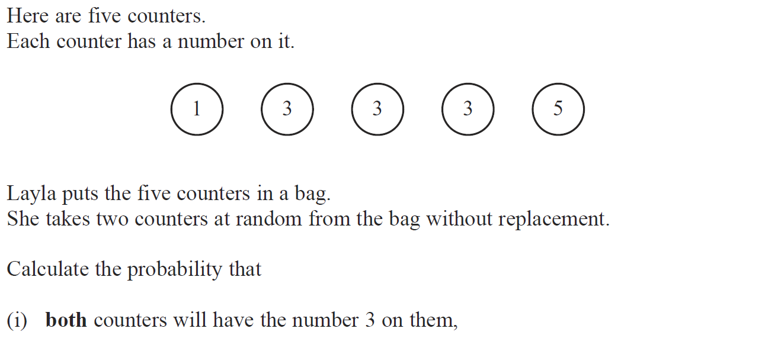
Multiple Events
May 2009 3H Q17

Slide 47
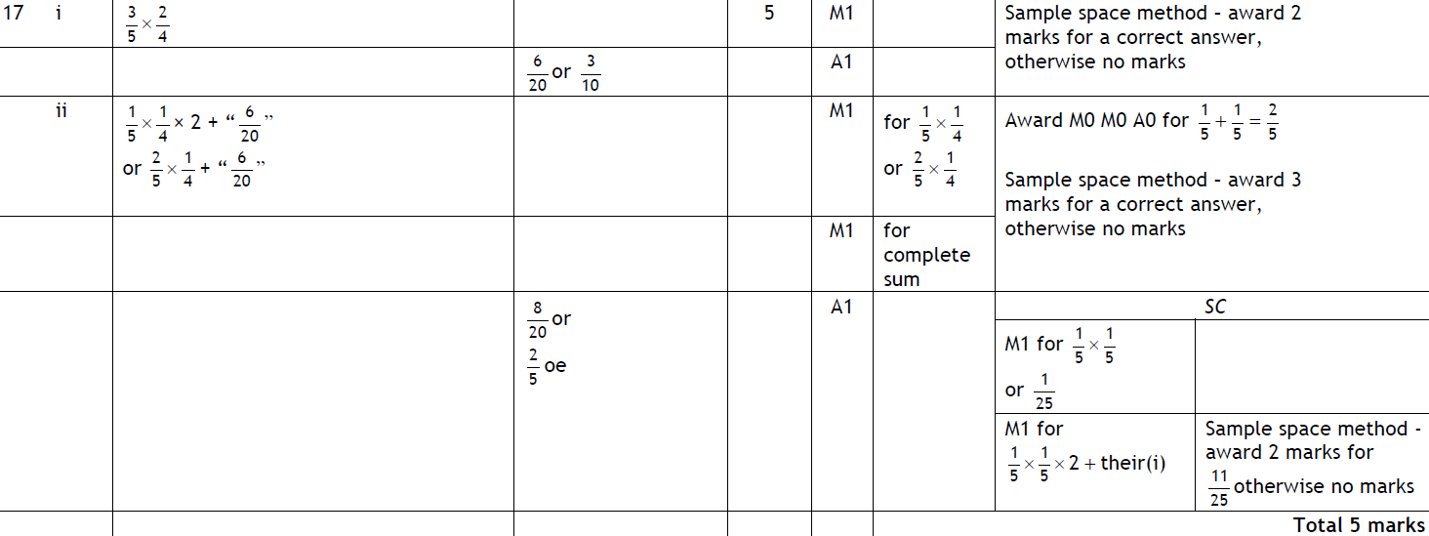
Multiple Events
May 2009 3H Q17
(i)
(ii)

Slide 48
Multiple Events
Nov 2009 3H Q20

Slide 49
Multiple Events
Nov 2009 3H Q20
A
B

Slide 50
Multiple Events
June 2010 3H Q19

Slide 51
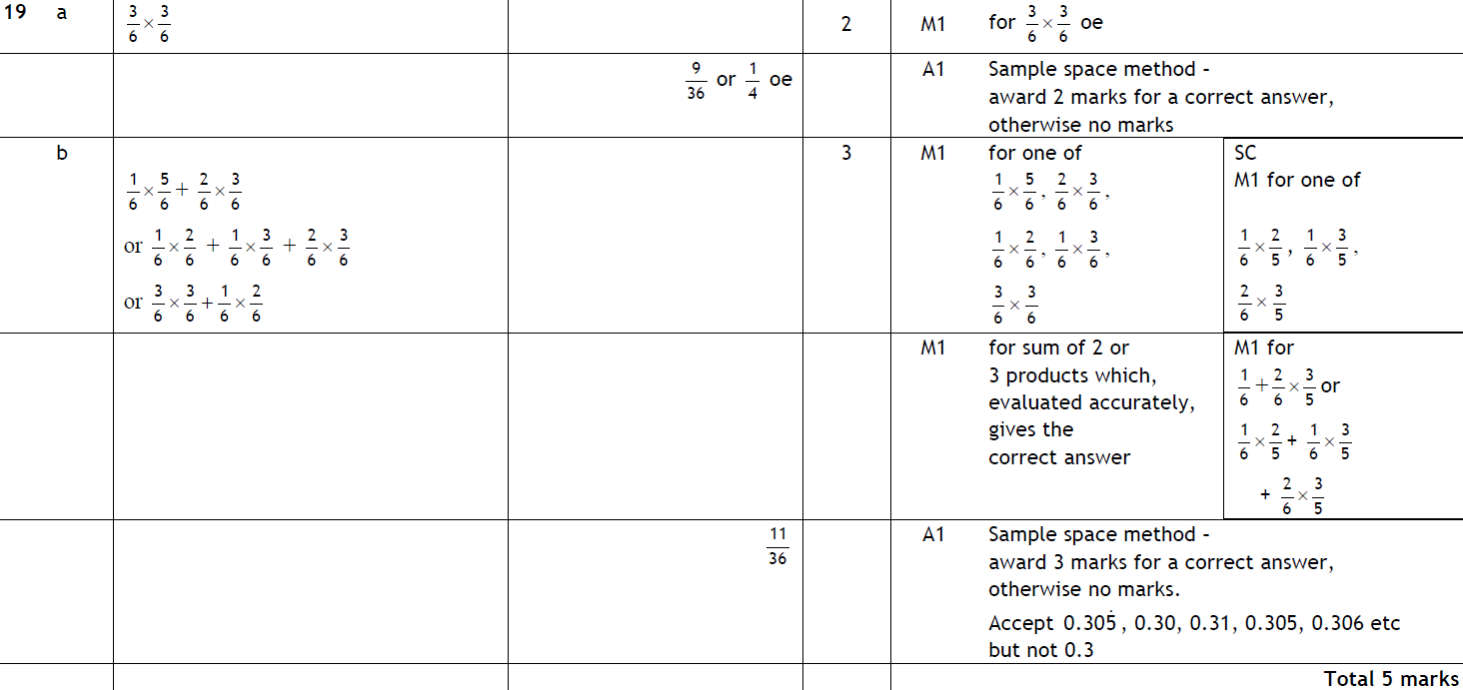
Multiple Events
June 2010 3H Q19
A
B

Slide 52
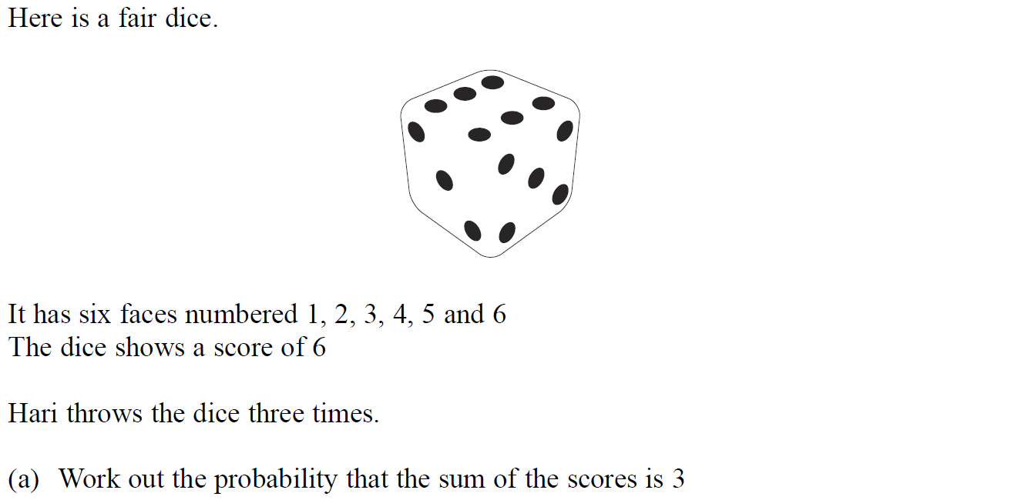
Multiple Events
Nov 2010 3H Q17

Slide 53
Multiple Events
Nov 2010 3H Q17
A
B

Slide 54
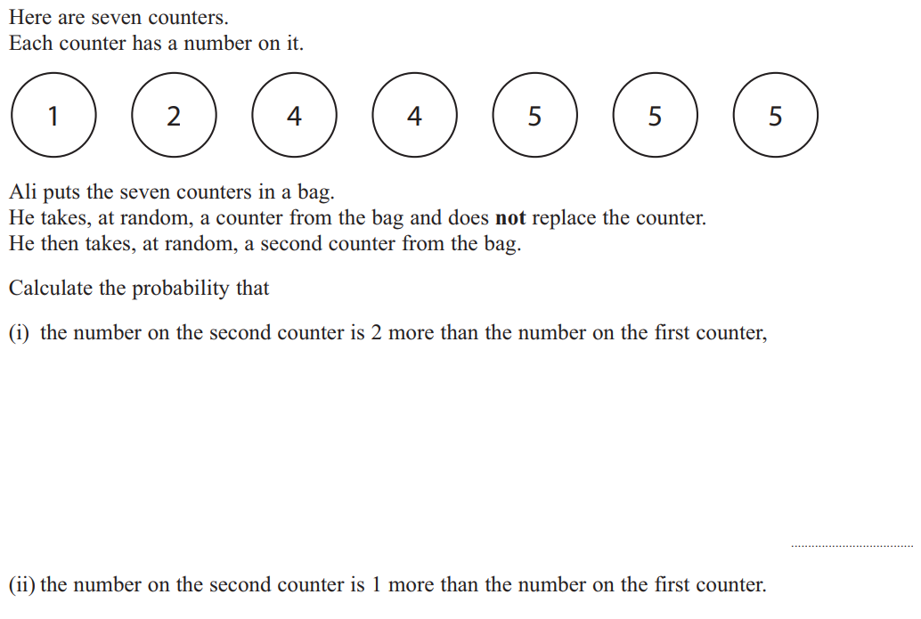
Multiple Events
June 2011 3H Q17

Slide 55
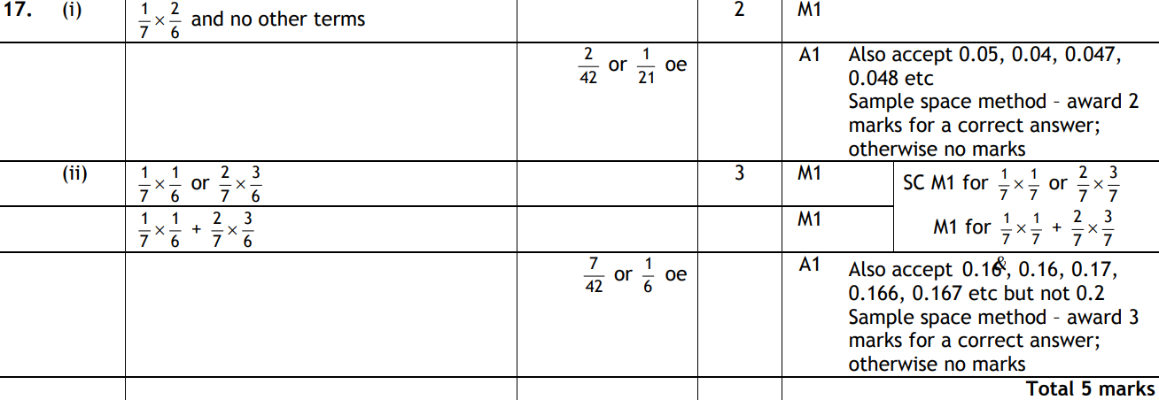
Multiple Events
June 2011 3H Q17
i
ii

Slide 56
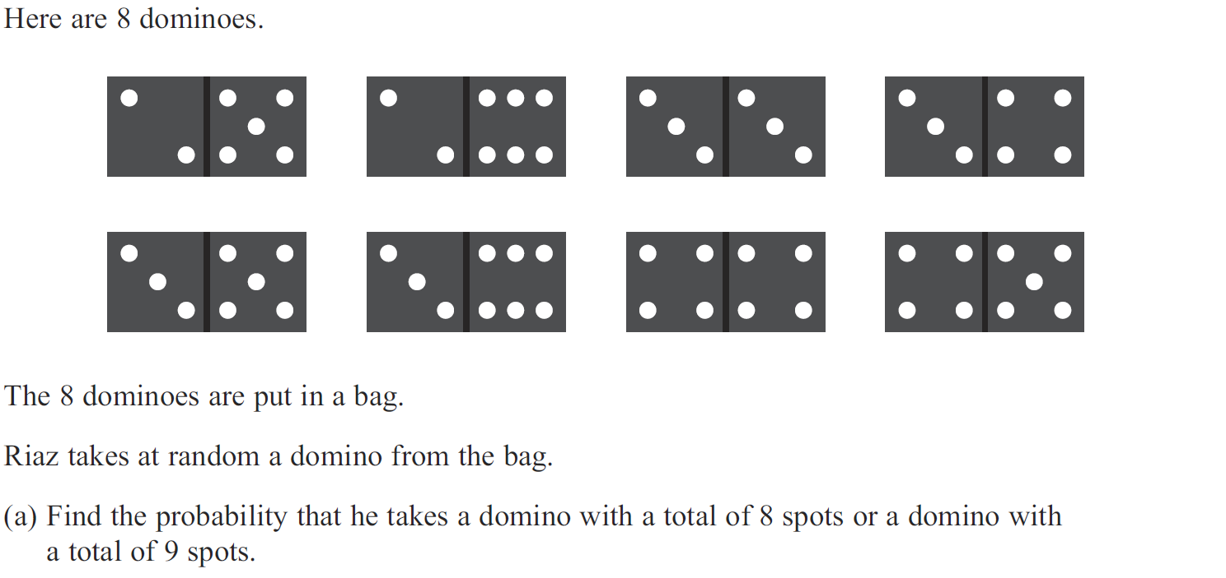
Multiple Events
Jan 2012 4H Q16

Slide 57
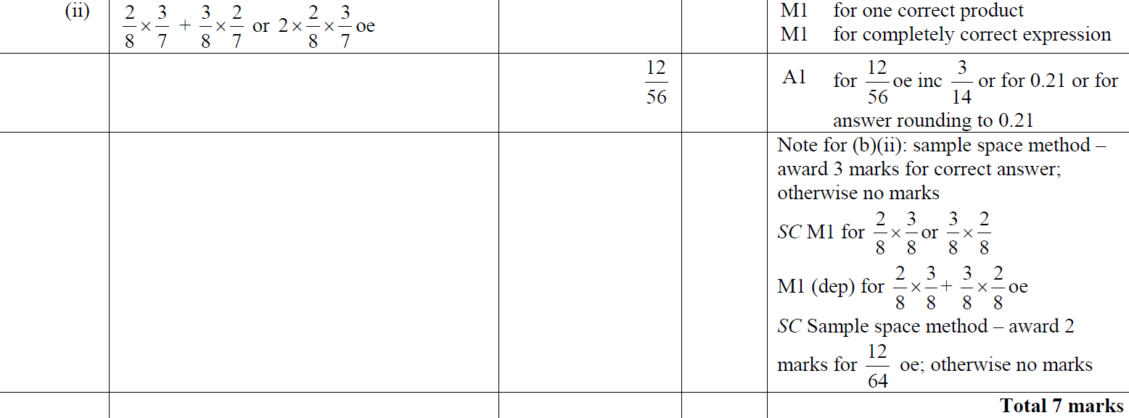
Multiple Events
Jan 2012 4H Q16
A
B (i)
B (ii)

Slide 58
Multiple Events
May 2012 3H Q10

Slide 59
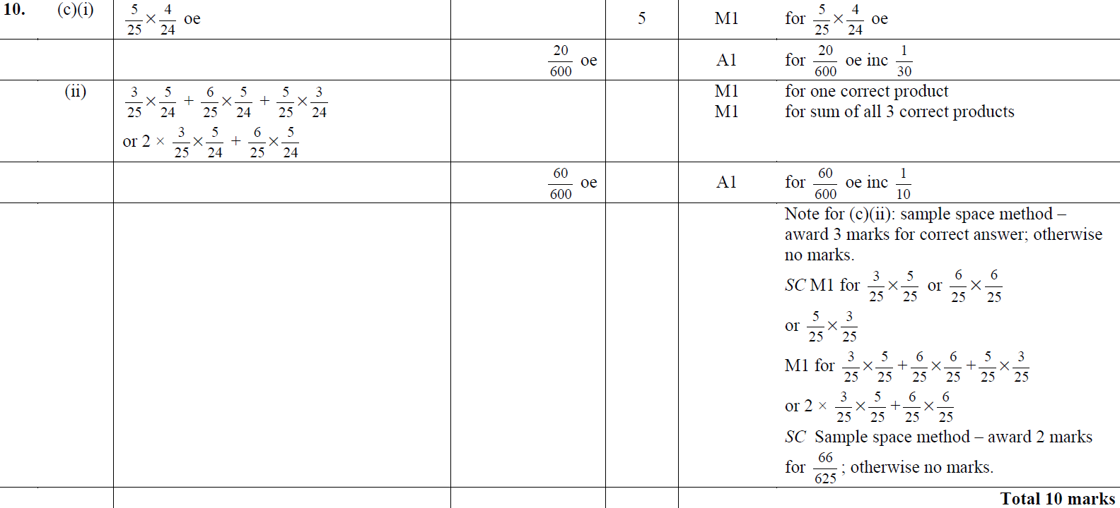
Multiple Events
May 2012 3H Q10
A
B
C (i)
C (ii)

Slide 60
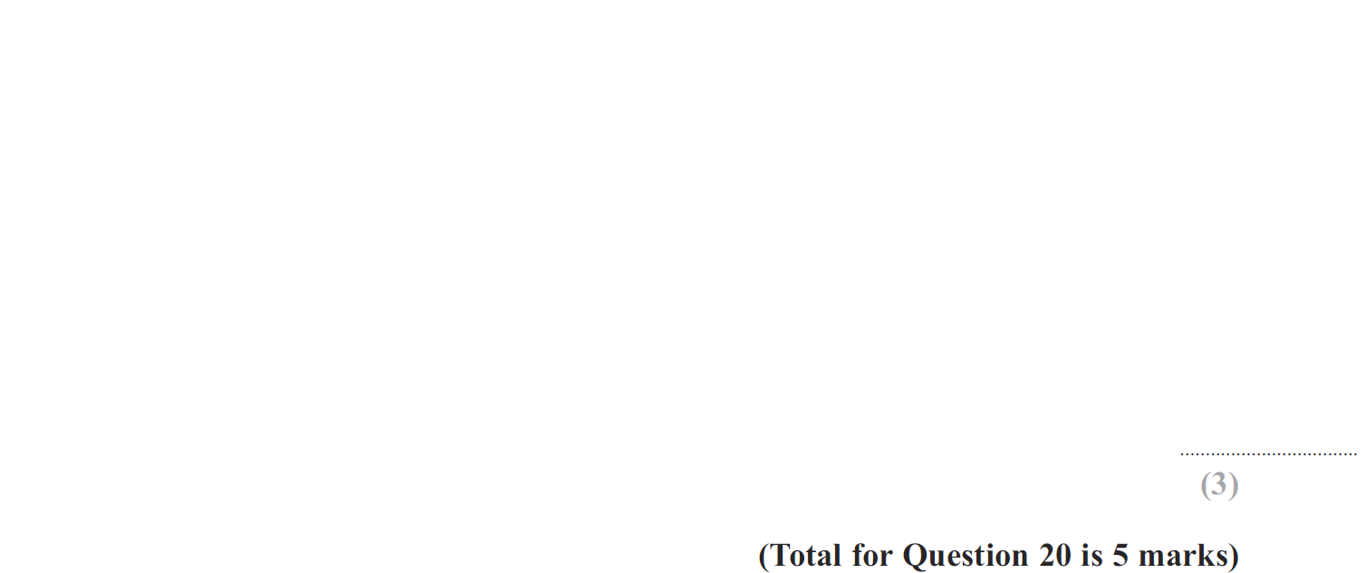
Multiple Events
Jan 2013 4H Q20

Slide 61
Multiple Events
Jan 2013 4H Q20
A
B

Slide 62
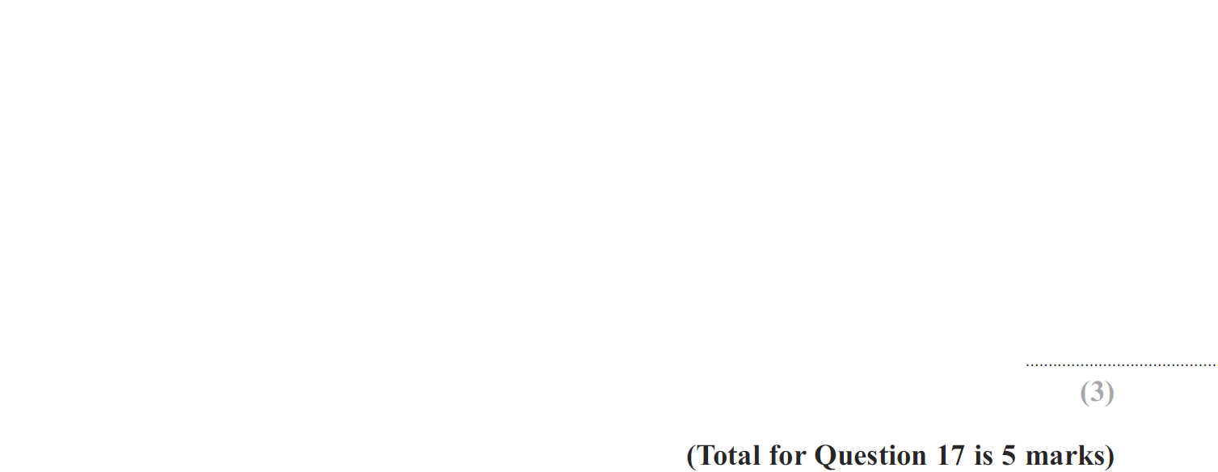
Multiple Events
May 2013 3H Q17

Slide 63
Multiple Events
May 2013 3H Q17
A
B

Slide 64
Multiple Events
May 2013 3HR Q21

Slide 65
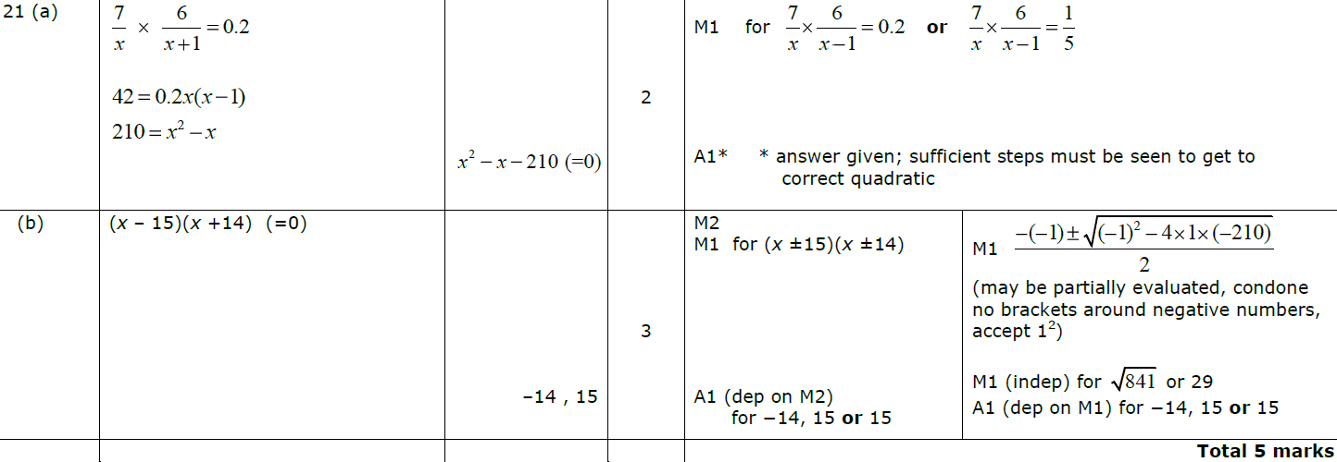
Multiple Events
May 2013 3HR Q21
A
B

Slide 66
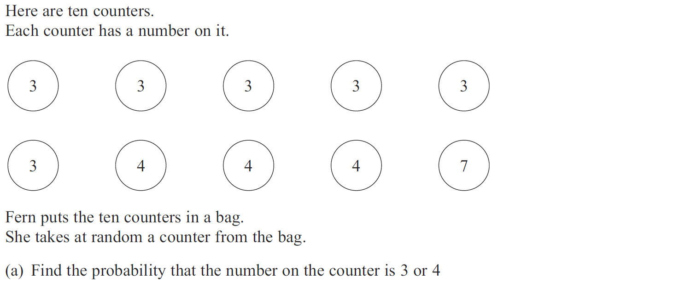
Multiple Events
May 2013 4HR Q18

Slide 67
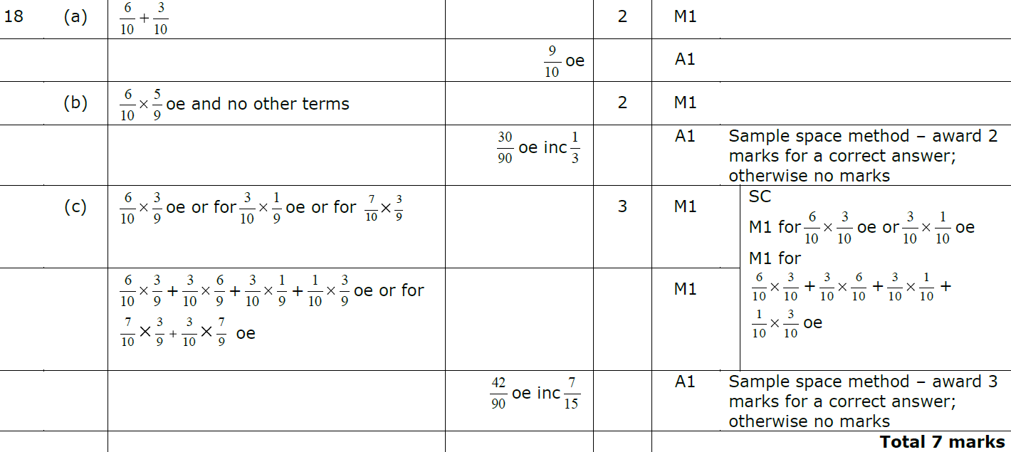
Multiple Events
May 2013 4HR Q18
A
B
C

Slide 68
Multiple Events
Jan 2014 3H Q13

Slide 69
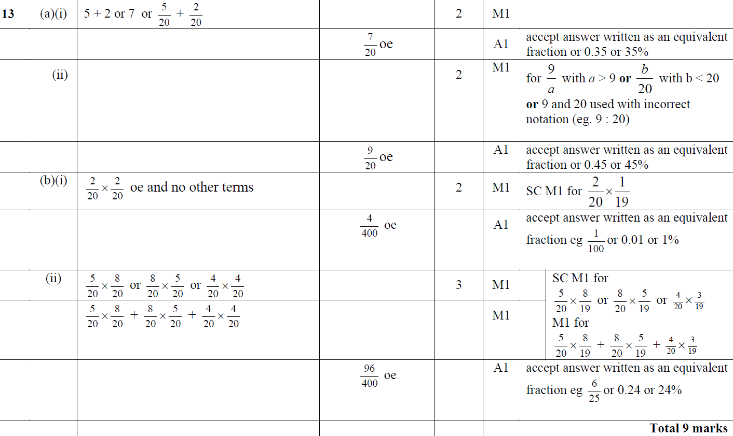
Multiple Events
Jan 2014 3H Q13
A (i)
A (ii)
B (i)
B (ii)

Slide 70
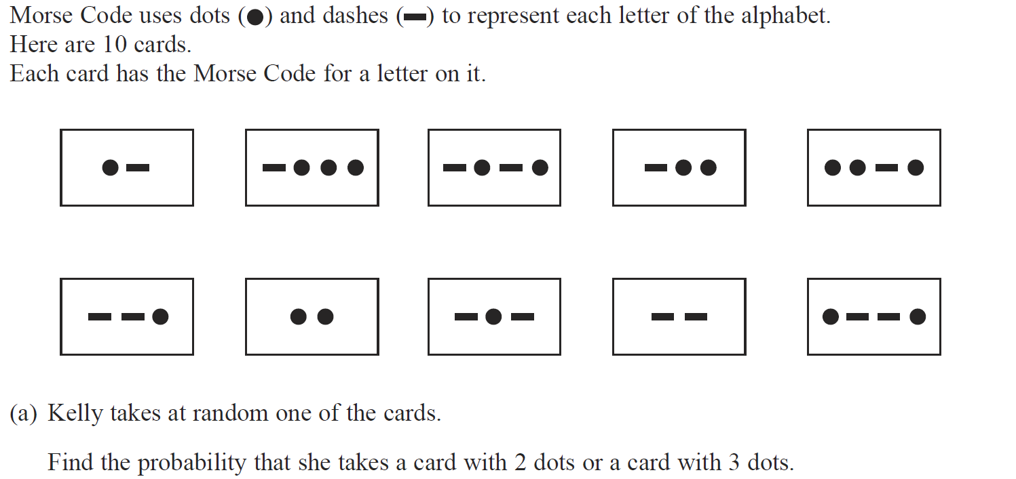
Multiple Events
Jan 2014 3HR Q8

Slide 71
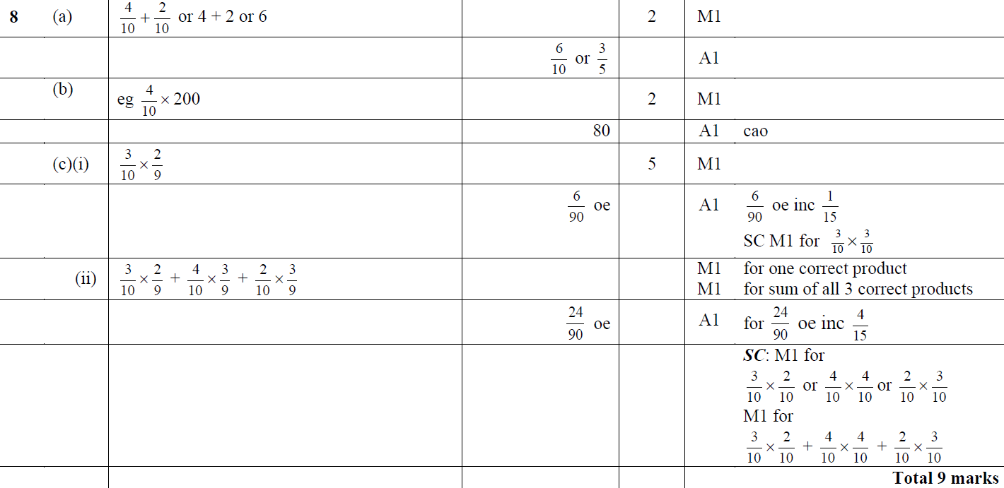
Multiple Events
Jan 2014 3HR Q8
A
B
C (i)
C (ii)

Slide 72
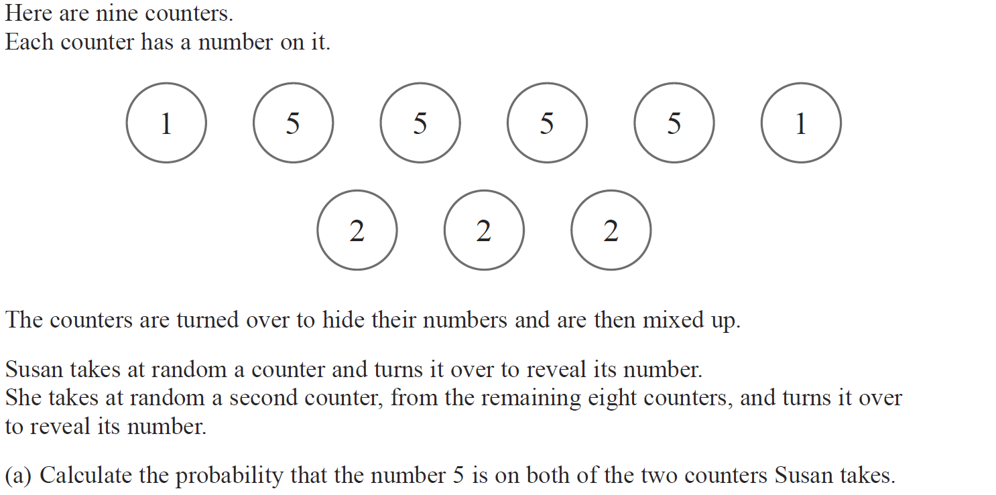
Multiple Events
May 2014 3H Q20

Slide 73
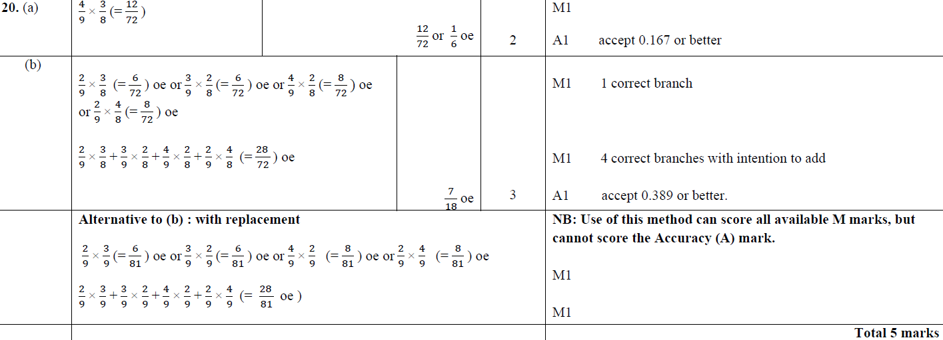
Multiple Events
May 2014 3H Q20
A
B

Slide 74
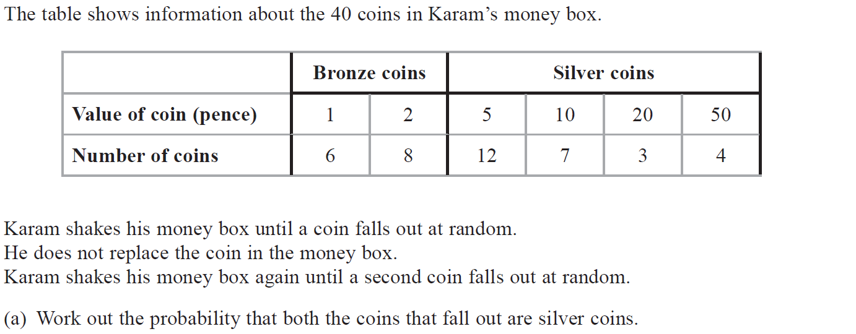
Multiple Events
May 2014 3HR Q17

Slide 75
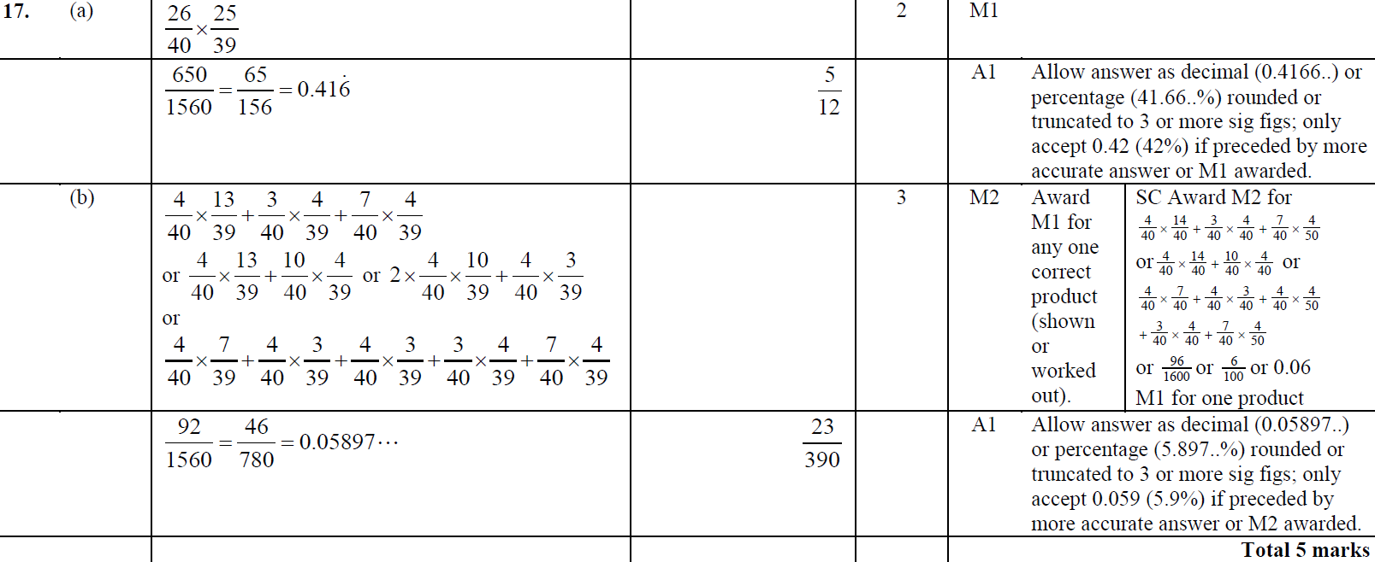
Multiple Events
May 2014 3HR Q17
A
B

Slide 76
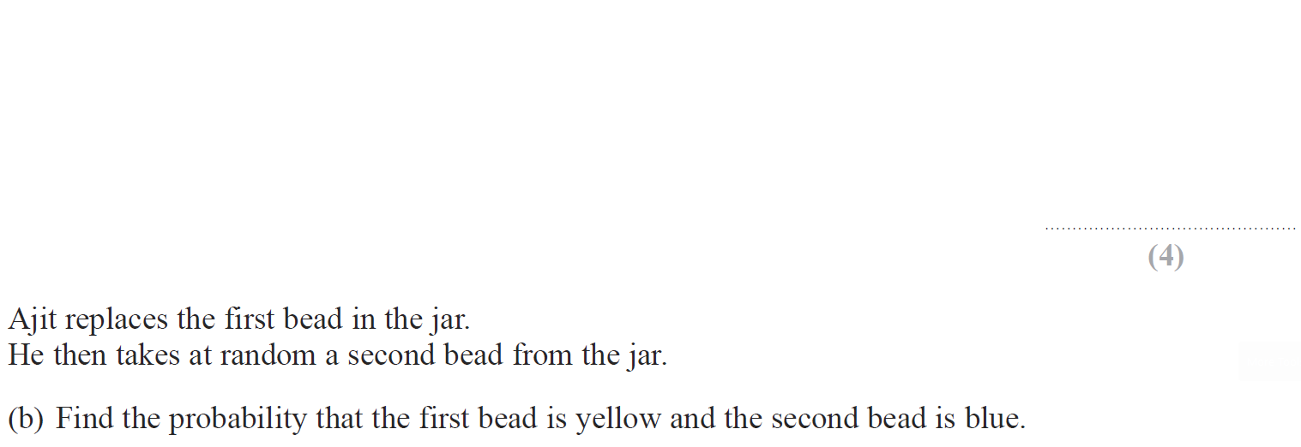
Multiple Events
Jan 2015 3H Q5

Slide 77
Multiple Events
Jan 2015 3H Q5
A (i)
A (ii)
B
C

Slide 78
Multiple Events
Jan 2015 3H Q16

Slide 79
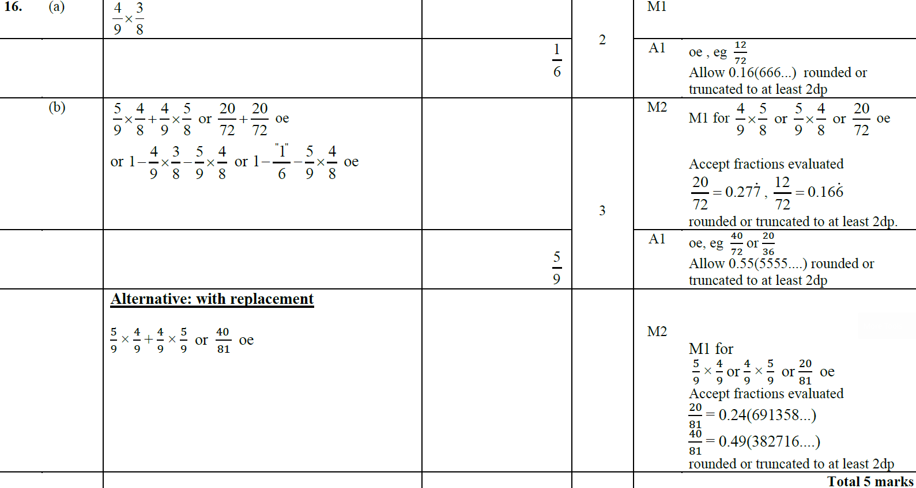
Multiple Events
Jan 2015 3H Q16
A
B

Slide 80
Multiple Events
Jan 2015 3HR Q22

Slide 81
Multiple Events
Jan 2015 3HR Q22
A
B

Slide 82
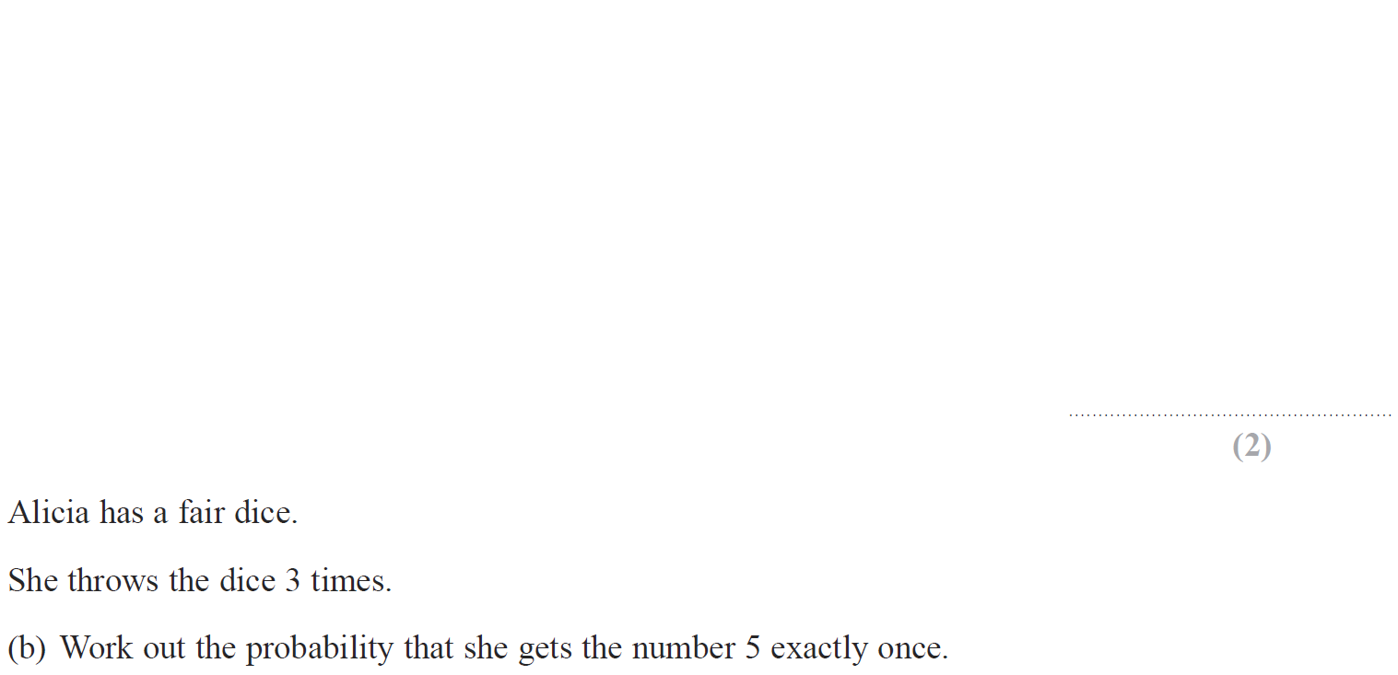
Multiple Events
May 2015 3H Q20

Slide 83
Multiple Events
May 2015 3H Q20
A
B

Slide 84
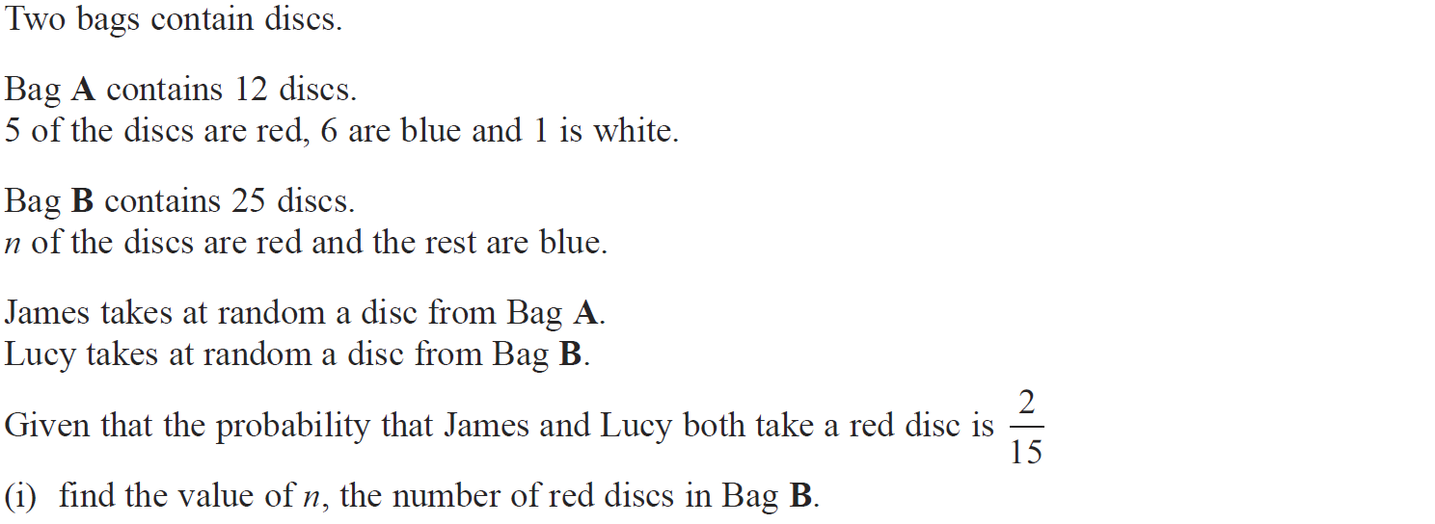
Multiple Events
May 2015 3HR Q17

Slide 85
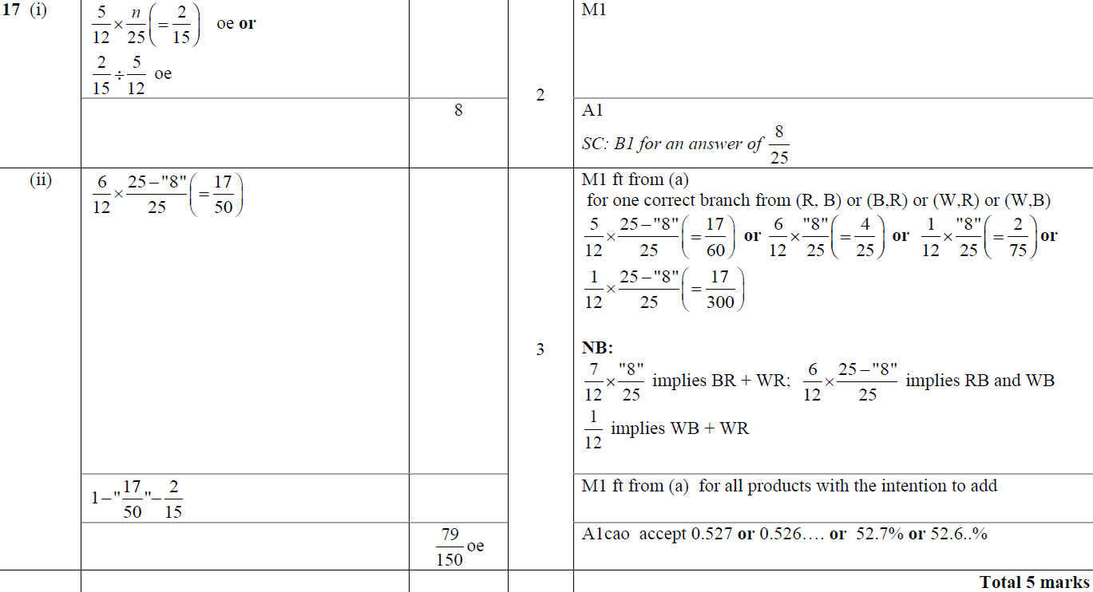
Multiple Events
May 2015 3HR Q17
(i)
(ii)

Slide 86
Multiple Events
June 2015 4HR Q16

Slide 87
Multiple Events
June 2015 4HR Q16
A

Slide 88
Multiple Events
Jan 2016 3H Q21

Slide 89
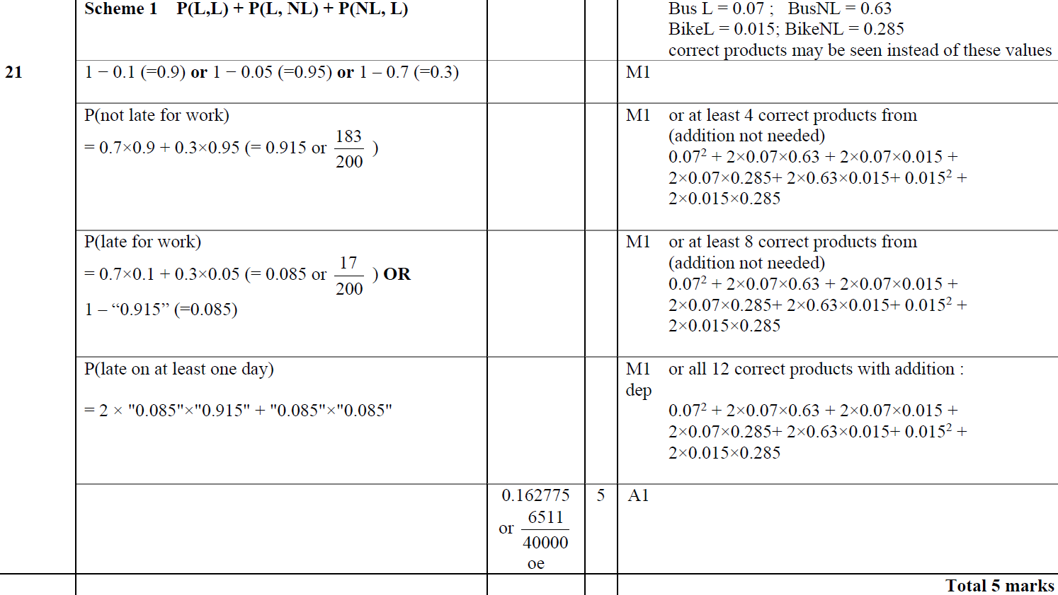
Multiple Events
Jan 2016 3H Q21
A

Slide 90
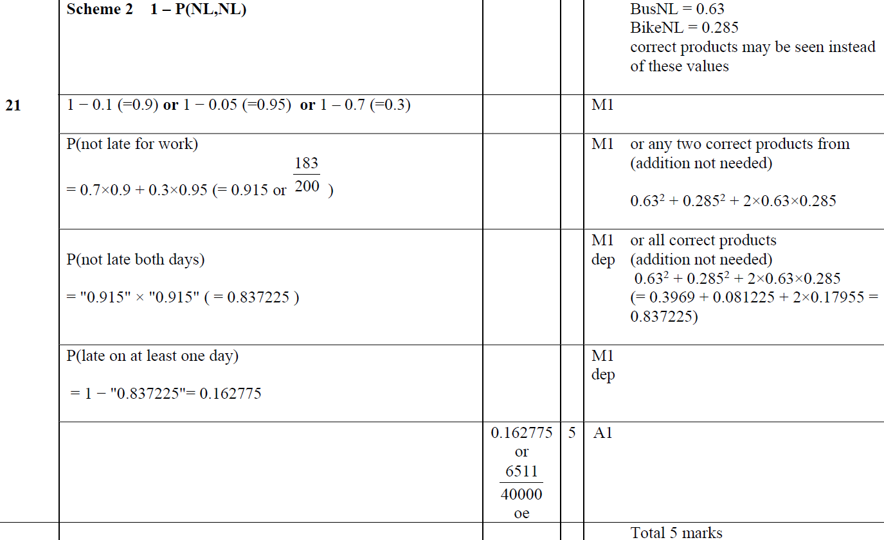
Multiple Events
Jan 2016 3H Q21
A

Slide 91
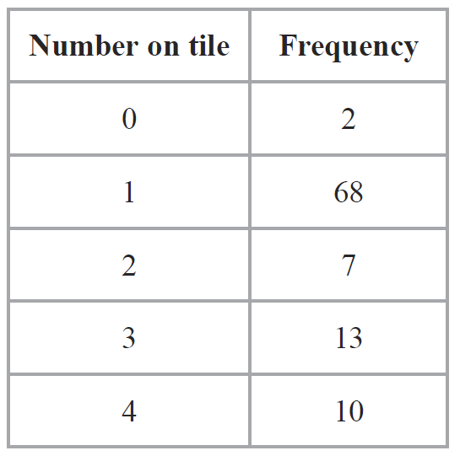
Multiple Events
Jan 2016 3HR Q18

Slide 92
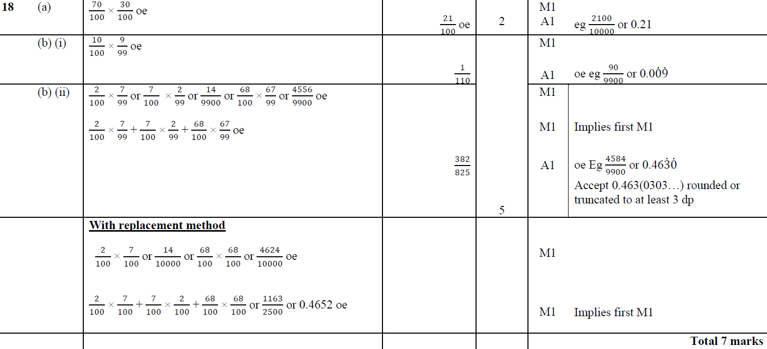
Multiple Events
Jan 2016 3HR Q18
A
B (i)
B (ii)

Slide 93
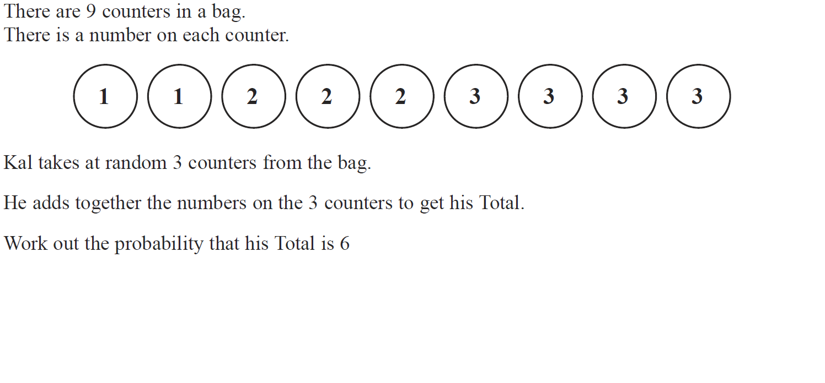
Multiple Events
May 2016 3H Q21

Slide 94
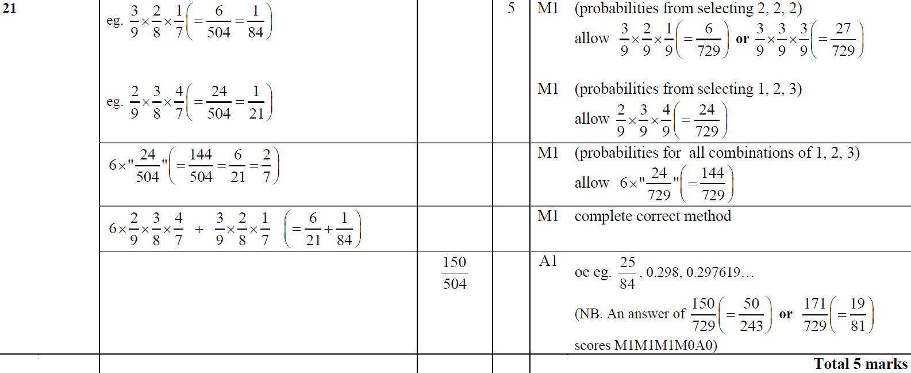
Multiple Events
May 2016 3H Q21
A

Slide 95
Multiple Events
June 2016 4HR Q15

Slide 96
Multiple Events
June 2016 4HR Q15
A
B

Slide 97
Multiple Events
Jan 2017 3H Q24

Slide 98
Multiple Events
Jan 2017 3H Q24
A

Slide 99
Multiple Events
Jan 2017 3HR Q22

Slide 100
Multiple Events
Jan 2017 3HR Q22
A

Slide 101
Multiple Events
May 2017 3H Q20

Slide 102
Multiple Events
May 2017 3H Q20
A

Slide 103
Multiple Events
June 2017 4HR Q16

Slide 104
Multiple Events
June 2017 4HR Q16
A
B

Slide 105
Multiple Events
Jan 2018 3H Q22

Slide 106
Multiple Events
Jan 2018 3H Q22
A

Slide 107
Multiple Events
Jan 2018 3HR Q18

Slide 108
Multiple Events
Jan 2018 3HR Q18
A
B

Slide 109
Multiple Events
May 2018 3H Q20

Slide 110
Multiple Events
May 2018 3H Q20
A

Slide 111
Multiple Events
May 2018 3HR Q18

Slide 112
Multiple Events
May 2018 3HR Q18
A
B

