Slide 1
Manipulating Formulae/ Changing the Subject
Manipulating Formulae/ Changing the Subject
Old Spec Q’s
SAM
2H Q13
June 2018
2H Q1
June 2018
2HR Q7
Jan 2019
2H Q12
Jan 2019
2HR Q10
June 2019
2H Q15

Slide 2
Manipulating Formulae/ Changing the Subject
SAM 2H Q13

Slide 3
Manipulating Formulae/ Changing the Subject
SAM 2H Q13
A

Slide 4
Manipulating Formulae/ Changing the Subject
June 2018 2H Q1

Slide 5
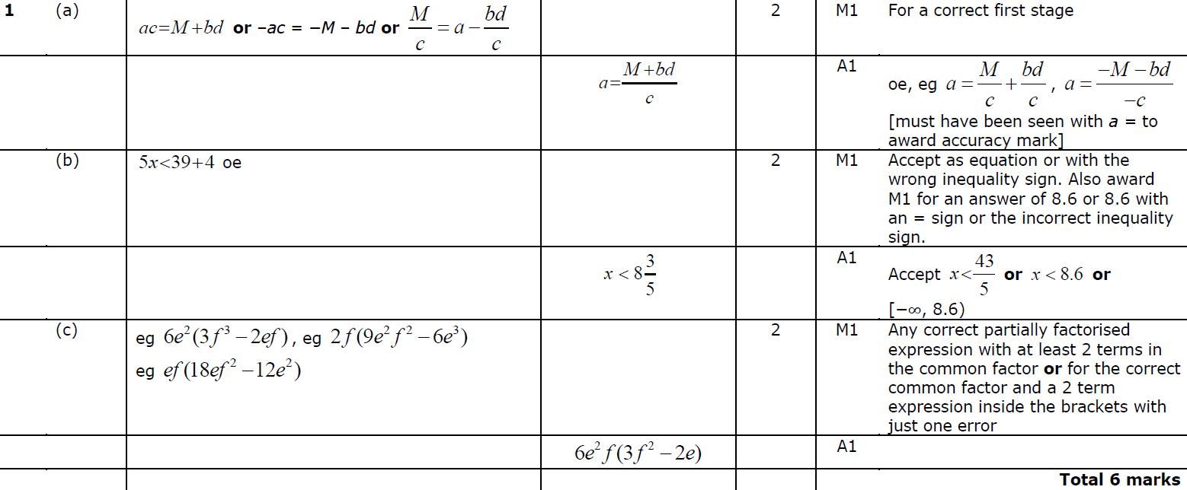
Manipulating Formulae/ Changing the Subject
June 2018 2H Q1
A
B
C

Slide 6
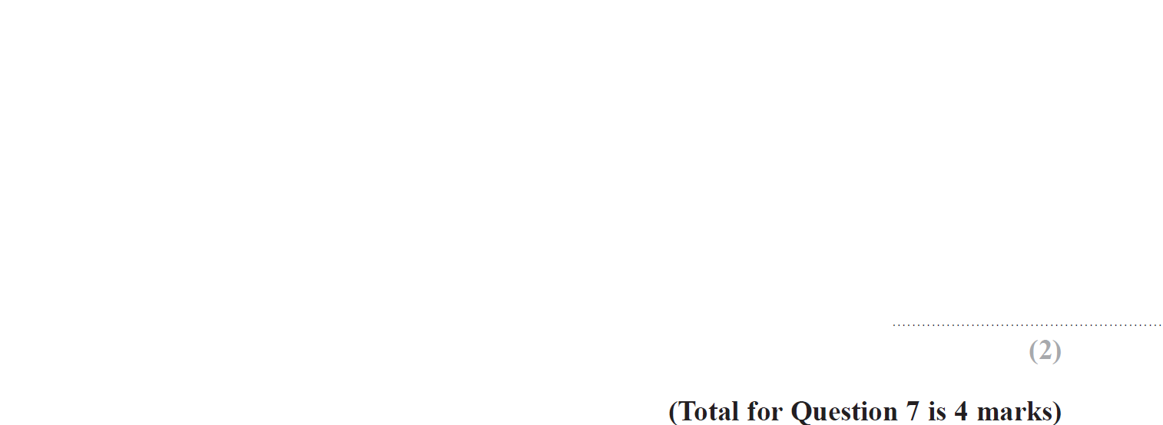
Manipulating Formulae/ Changing the Subject
June 2018 2HR Q7

Slide 7
Manipulating Formulae/ Changing the Subject
June 2018 2HR Q7
A
B

Slide 8
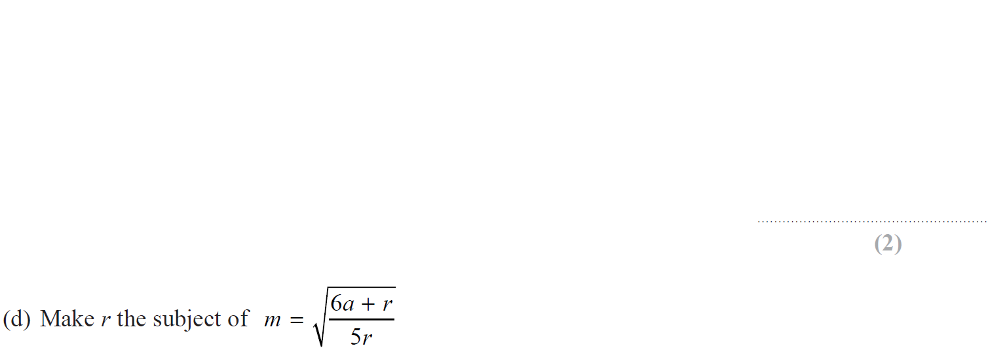
Manipulating Formulae/ Changing the Subject
Jan 2019 2H Q12

Slide 9
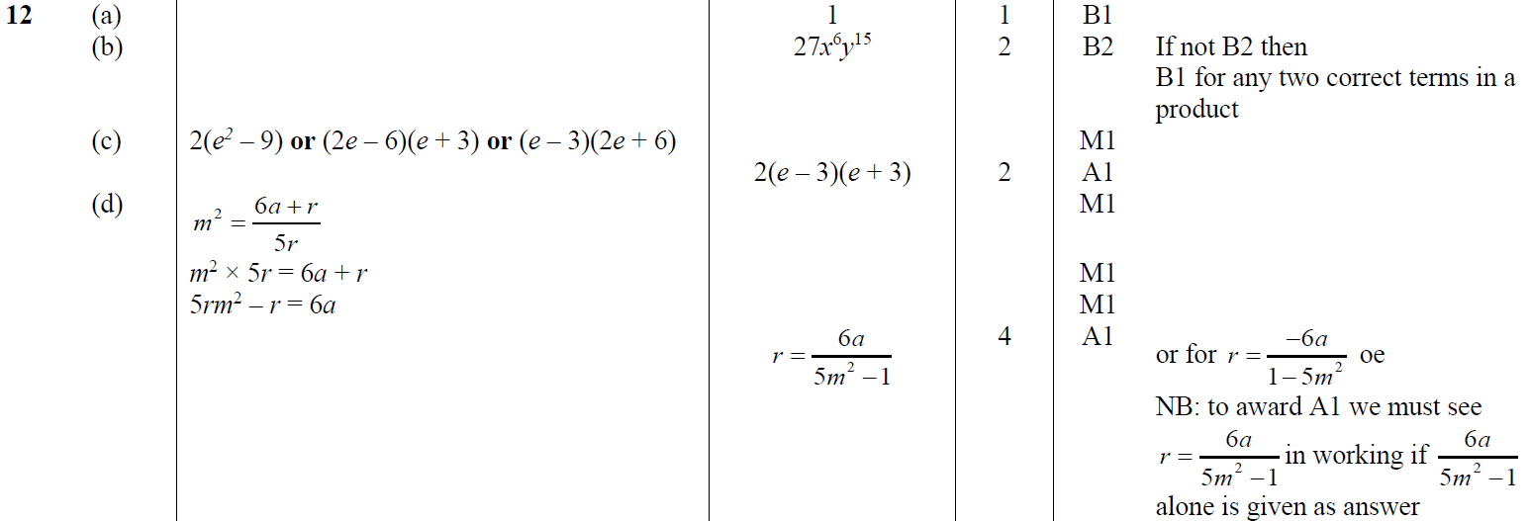
Manipulating Formulae/ Changing the Subject
Jan 2019 2H Q12
A
B
C
D

Slide 10
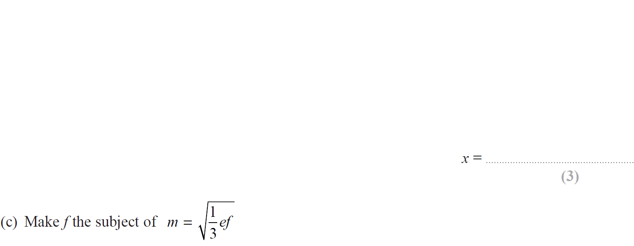
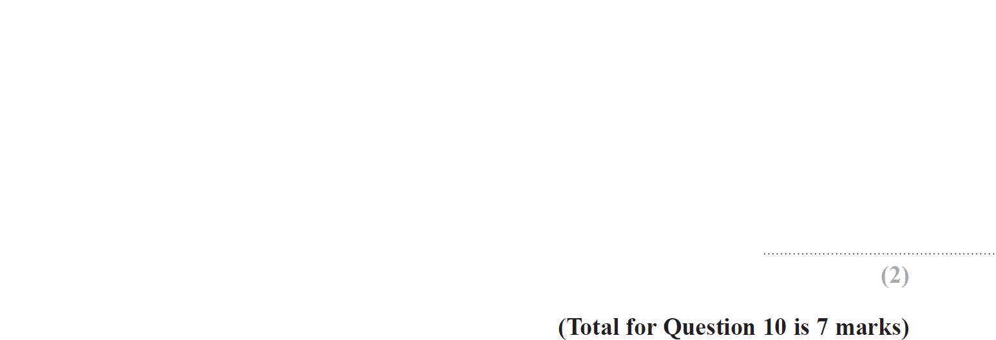
Manipulating Formulae/ Changing the Subject
Jan 2019 2HR Q10

Slide 11
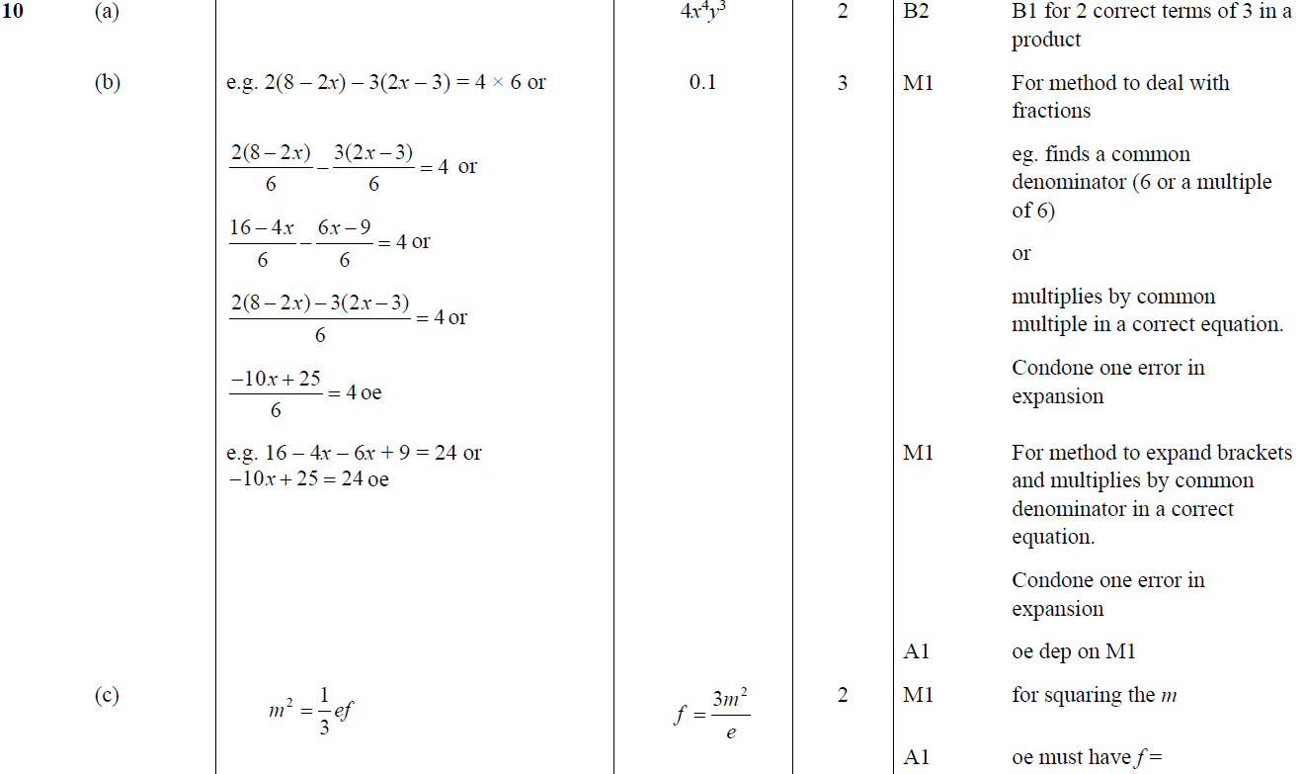
Manipulating Formulae/ Changing the Subject
Jan 2019 2HR Q10
A
B
C

Slide 12
Manipulating Formulae/ Changing the Subject
June 2019 2H Q15

Slide 13
Manipulating Formulae/ Changing the Subject
June 2019 2H Q15
A

Slide 14
Manipulating Formulae/ Changing the Subject
Manipulating Formulae/ Changing the Subject
New Spec Q’s
May 2004 4H Q8
Nov 2007 3H Q11
June 2011 3H Q15
Jan 2014 3H Q16
Jan 2016 4HR Q19
Jan 2018 3H Q17
Nov 2004 3H Q18
Nov 2007 4H Q26
June 2011 3H Q23
Jan 2014 3HR Q16
May 2016 3H Q18
June 2018 4HR Q16
Nov 2004 4H Q15
May 2008 3H Q8
June 2011 4H Q15
May 2014 3H Q17
May 2016 3HR Q12
May 2005 3H Q11
May 2009 3H Q13
Jan 2012 3H Q11
May 2014 4HR Q12
June 2016 4HR Q21
Nov 2005 3H Q8
Nov 2009 3H Q11
May 2012 4H Q10
Jan 2015 4H Q12
Jan 2017 3H Q19
May 2006 3H Q20
Nov 2009 4H Q17
Jan 2013 3H Q12
Jan 2015 4HR Q12
Jan 2017 3HR Q16
Nov 2006 4H Q4
Nov 2010 3H Q18
May 2013 3H Q22
May 2015 3HR Q9
May 2017 3H Q14
May 2007 3H Q14
Nov 2010 4H Q6
May 2013 3HR Q17
Jan 2016 3H Q12
May 2017 3HR Q16

Slide 15
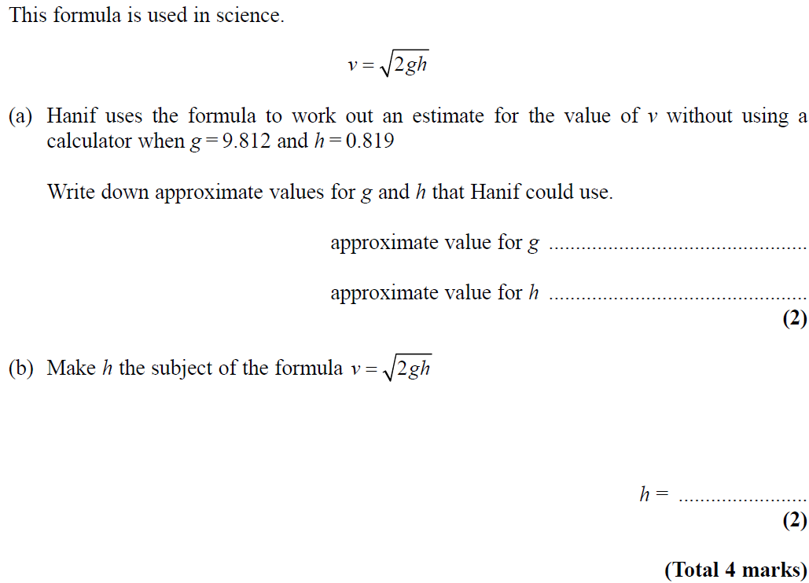
Manipulating Formulae/ Changing the Subject
May 2004 4H Q8

Slide 16
Manipulating Formulae/ Changing the Subject
May 2004 4H Q8
A
B

Slide 17
Manipulating Formulae/ Changing the Subject
Nov 2004 3H Q18

Slide 18
Manipulating Formulae/ Changing the Subject
Nov 2004 3H Q18
A

Slide 19
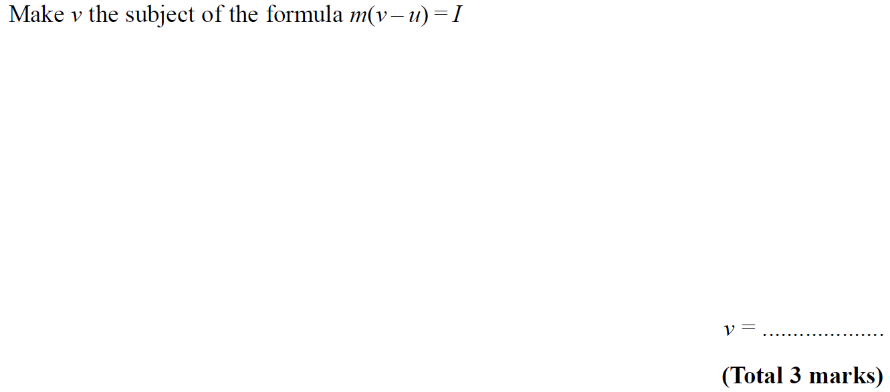
Manipulating Formulae/ Changing the Subject
Nov 2004 4H Q15

Slide 20
Manipulating Formulae/ Changing the Subject
Nov 2004 4H Q15
A

Slide 21
Manipulating Formulae/ Changing the Subject
May 2005 3H Q11

Slide 22
Manipulating Formulae/ Changing the Subject
May 2005 3H Q11
A

Slide 23
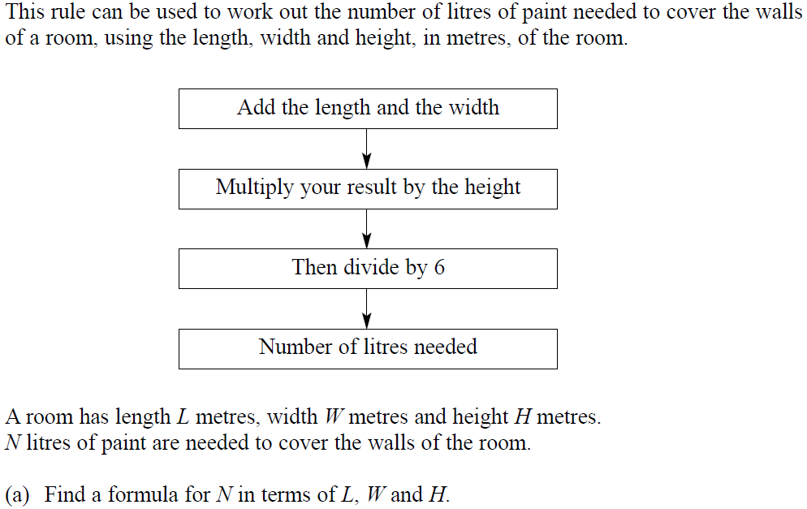
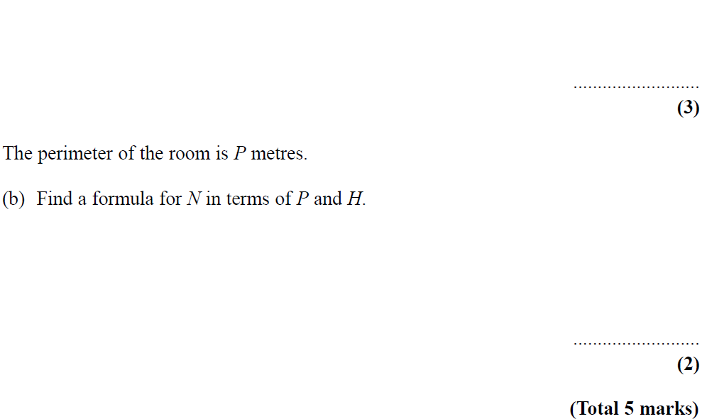
Manipulating Formulae/ Changing the Subject
Nov 2005 3H Q8

Slide 24
Manipulating Formulae/ Changing the Subject
Nov 2005 3H Q8
A
B

Slide 25
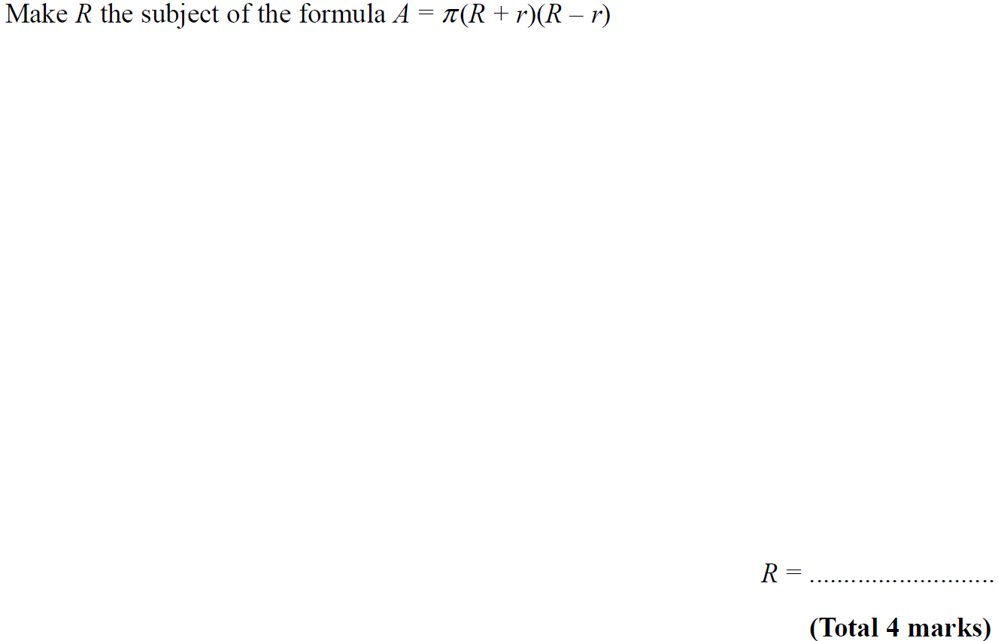
Manipulating Formulae/ Changing the Subject
May 2006 3H Q20

Slide 26
Manipulating Formulae/ Changing the Subject
May 2006 3H Q20
A

Slide 27
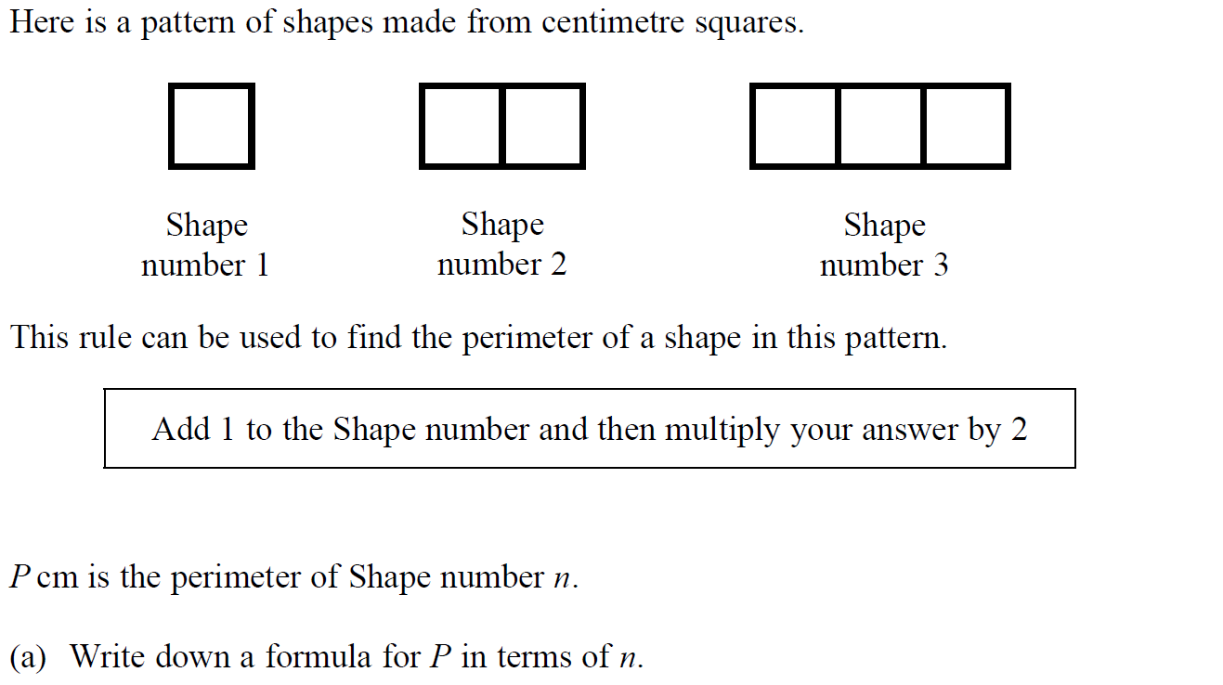
Manipulating Formulae/ Changing the Subject
Nov 2006 4H Q4

Slide 28
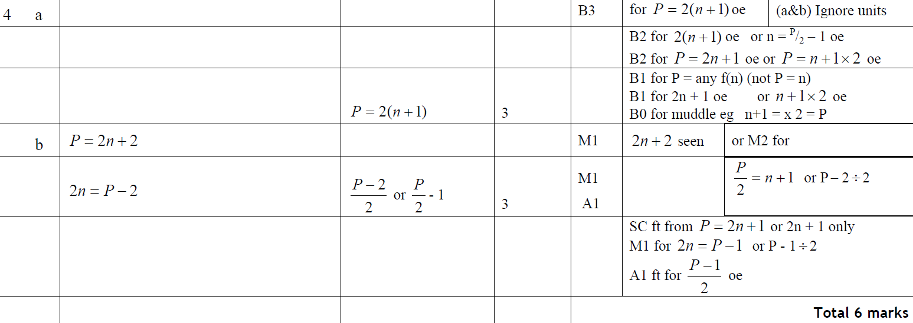
Manipulating Formulae/ Changing the Subject
Nov 2006 4H Q4
A
B

Slide 29
Manipulating Formulae/ Changing the Subject
May 2007 3H Q14

Slide 30
Manipulating Formulae/ Changing the Subject
May 2007 3H Q14
A
B (i)
B (ii)

Slide 31
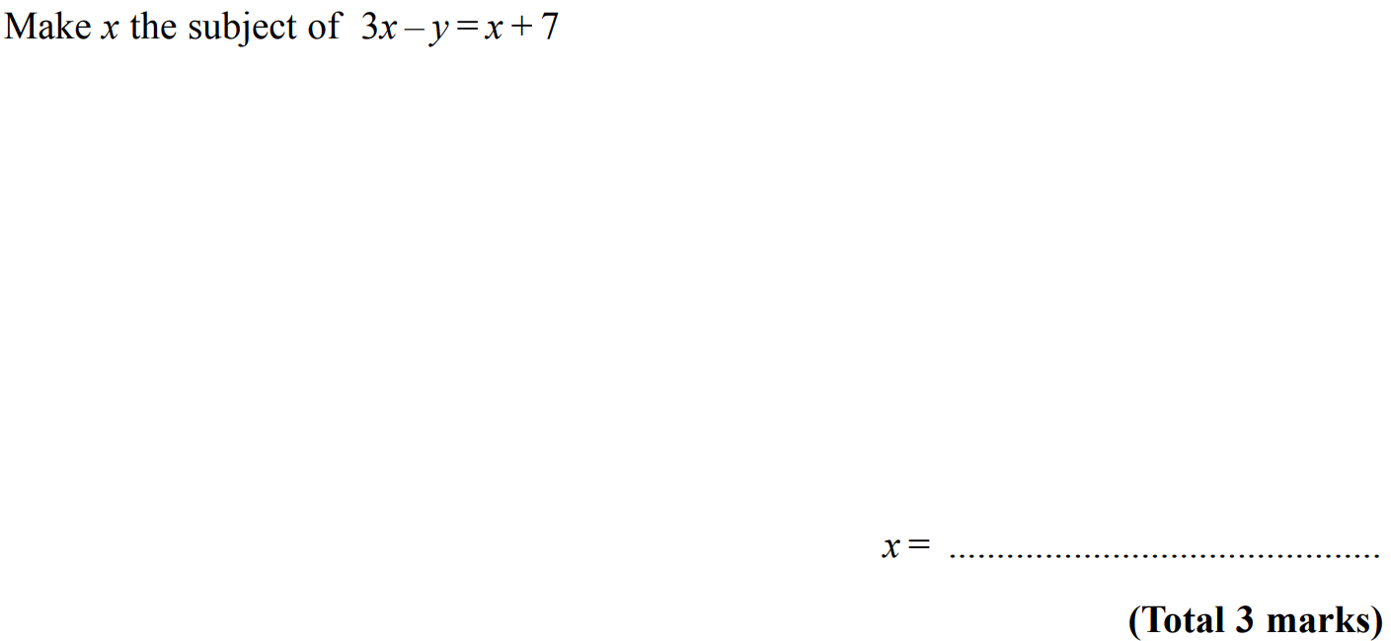
Manipulating Formulae/ Changing the Subject
Nov 2007 3H Q11

Slide 32
Manipulating Formulae/ Changing the Subject
Nov 2007 3H Q11
A

Slide 33
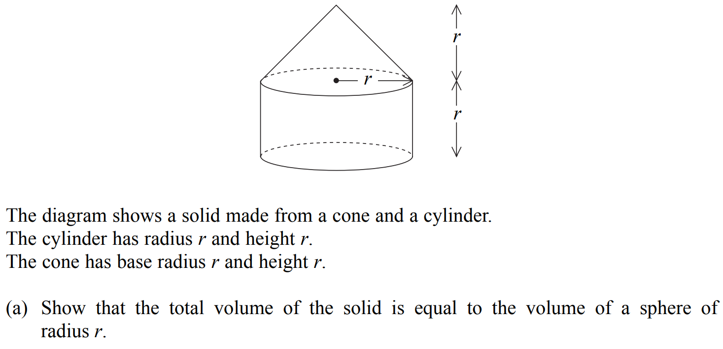
Manipulating Formulae/ Changing the Subject
Nov 2007 4H Q26

Slide 34
Manipulating Formulae/ Changing the Subject
Nov 2007 4H Q26
A
B

Slide 35
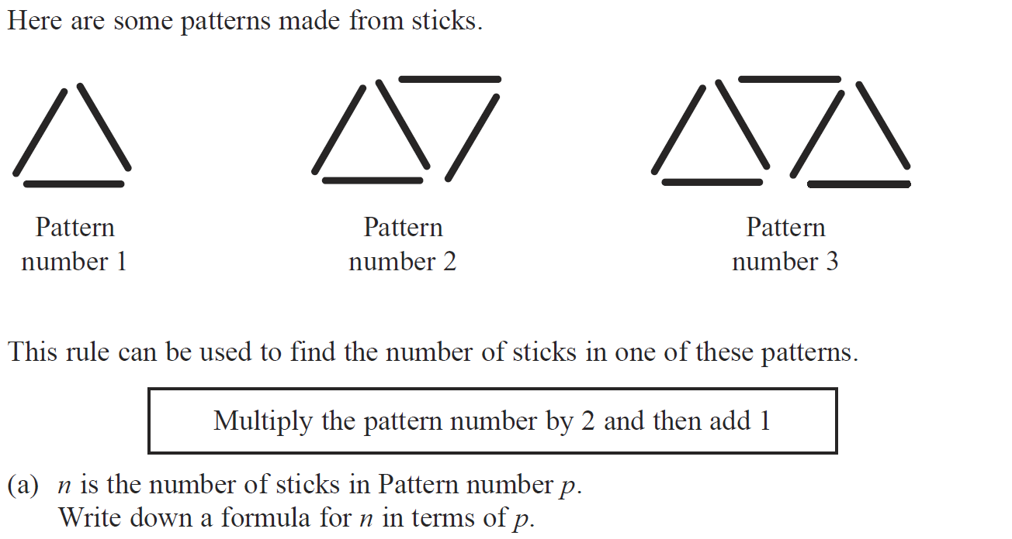
Manipulating Formulae/ Changing the Subject
May 2008 3H Q8

Slide 36
Manipulating Formulae/ Changing the Subject
May 2008 3H Q8
A
B

Slide 37
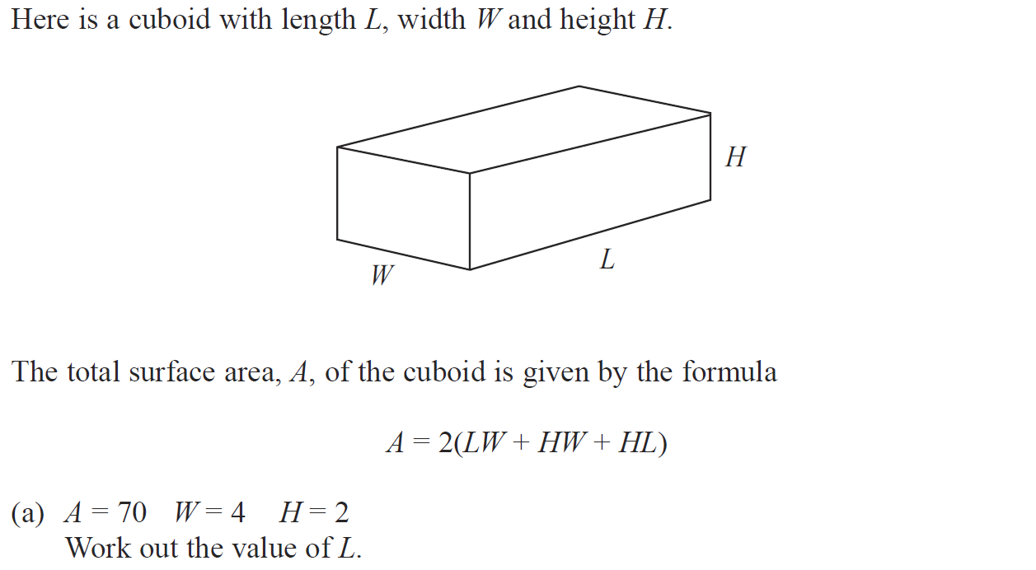
Manipulating Formulae/ Changing the Subject
May 2009 3H Q13

Slide 38
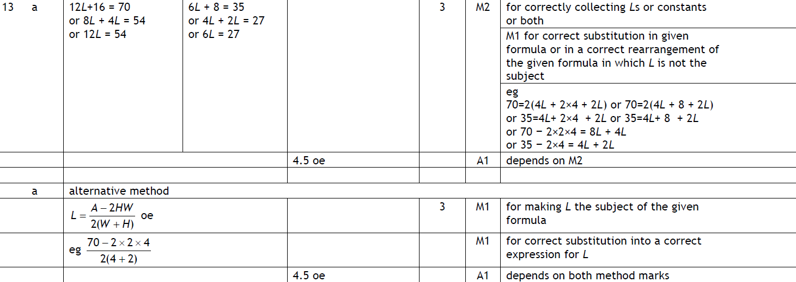
Manipulating Formulae/ Changing the Subject
May 2009 3H Q13
A
B

Slide 39
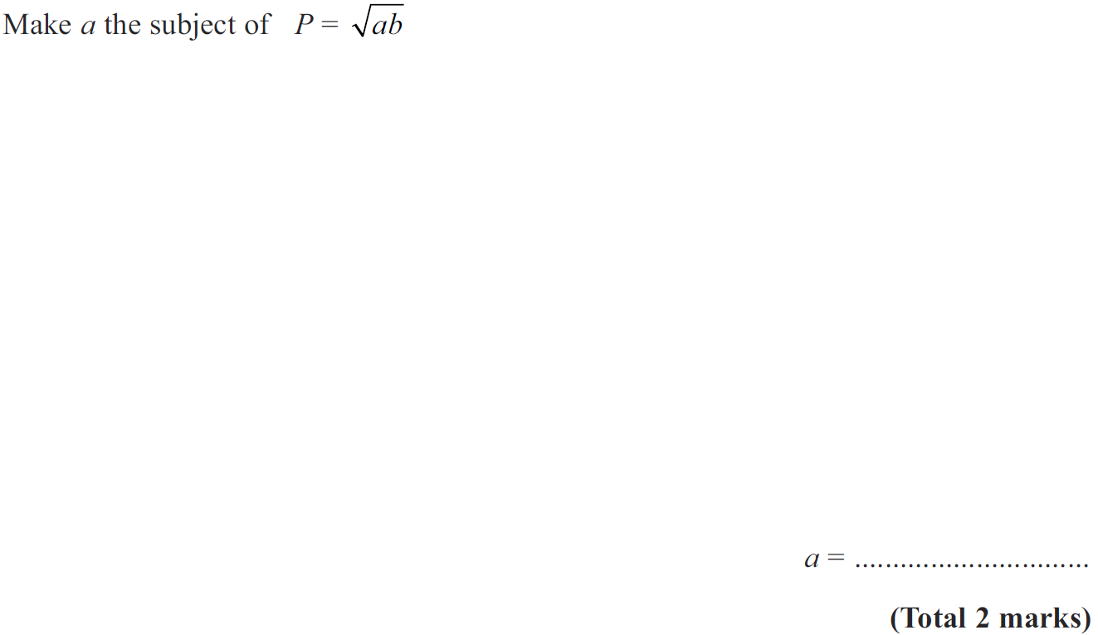
Manipulating Formulae/ Changing the Subject
Nov 2009 3H Q11

Slide 40
Manipulating Formulae/ Changing the Subject
Nov 2009 3H Q11
A

Slide 41
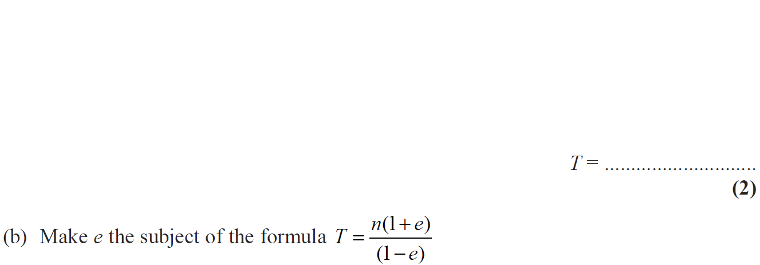
Manipulating Formulae/ Changing the Subject
Nov 2009 4H Q17

Slide 42
Manipulating Formulae/ Changing the Subject
Nov 2009 4H Q17
A
B

Slide 43
Manipulating Formulae/ Changing the Subject
Nov 2010 3H Q18

Slide 44
Manipulating Formulae/ Changing the Subject
Nov 2010 3H Q18
A

Slide 45
Manipulating Formulae/ Changing the Subject
Nov 2010 4H Q6

Slide 46
Manipulating Formulae/ Changing the Subject
Nov 2010 4H Q6
A
B
C

Slide 47
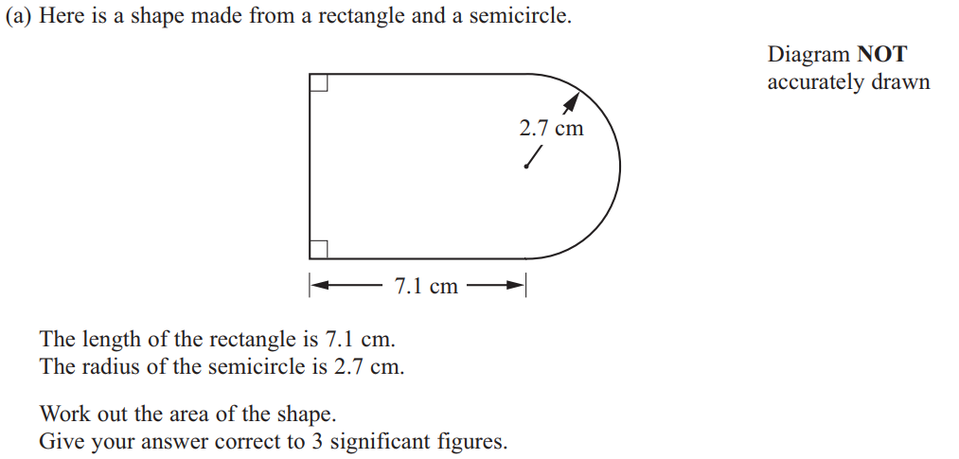
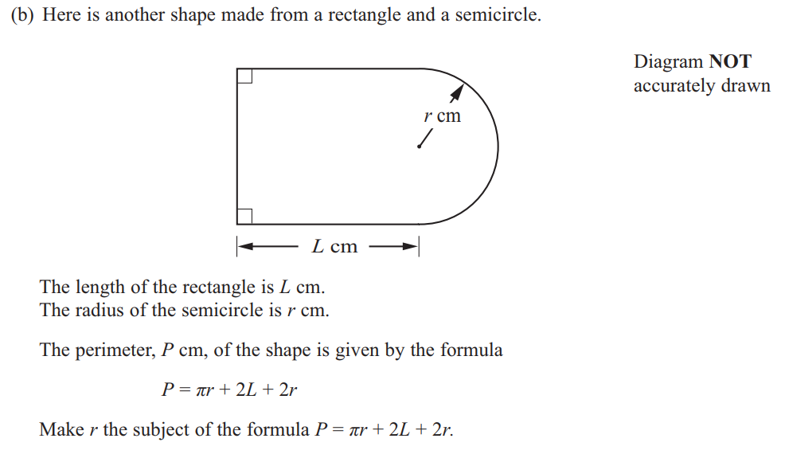
Manipulating Formulae/ Changing the Subject
June 2011 3H Q15

Slide 48
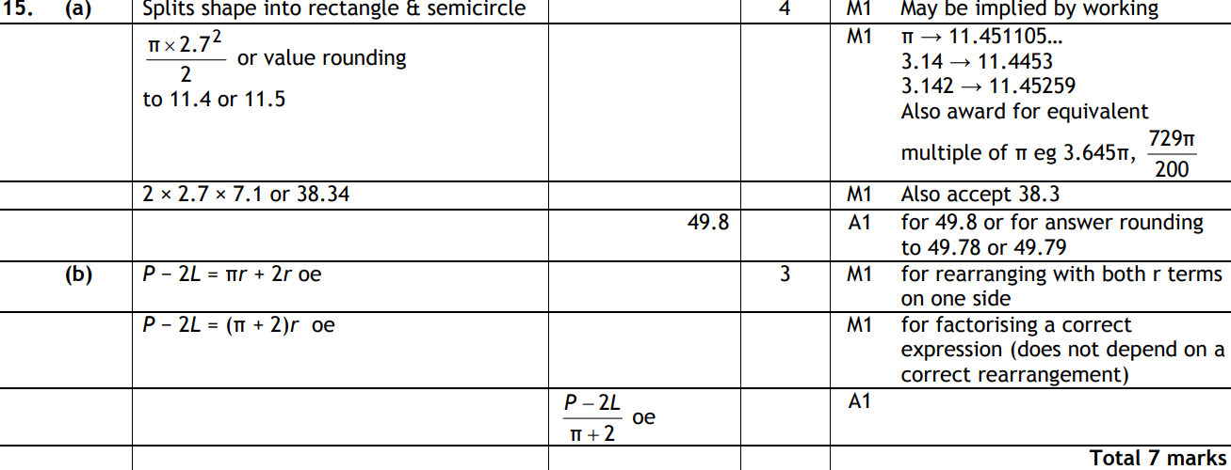
Manipulating Formulae/ Changing the Subject
June 2011 3H Q15
A
B

Slide 49
Manipulating Formulae/ Changing the Subject
June 2011 3H Q23

Slide 50
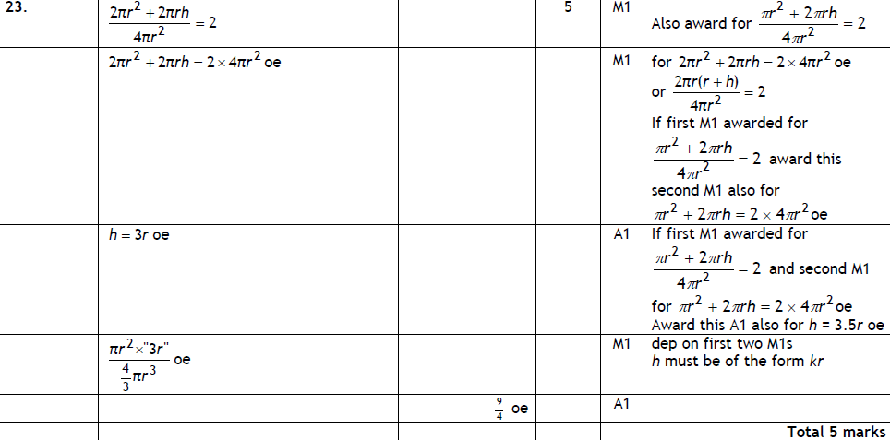
Manipulating Formulae/ Changing the Subject
June 2011 3H Q23
A

Slide 51
Manipulating Formulae/ Changing the Subject
June 2011 4H Q15

Slide 52
Manipulating Formulae/ Changing the Subject
June 2011 4H Q15
A
B
C
D

Slide 53
Manipulating Formulae/ Changing the Subject
Jan 2012 3H Q11

Slide 54
Manipulating Formulae/ Changing the Subject
Jan 2012 3H Q11
A

Slide 55
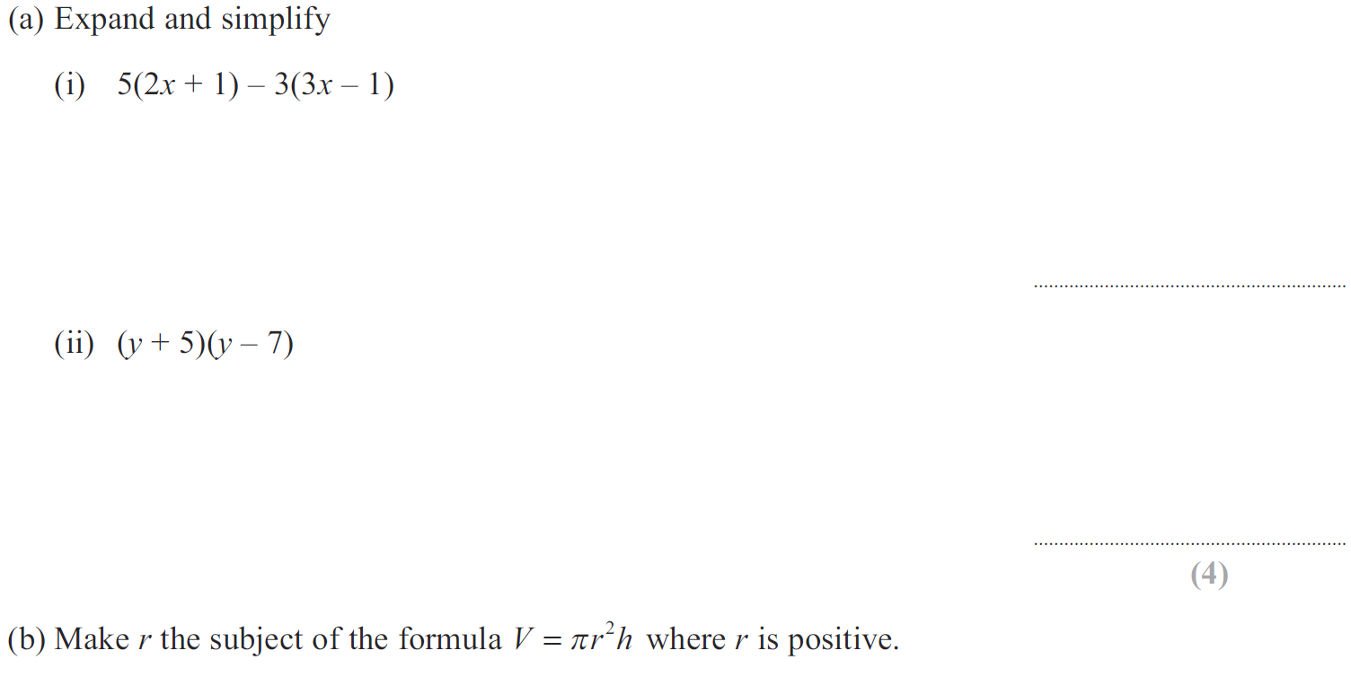
Manipulating Formulae/ Changing the Subject
May 2012 4H Q10

Slide 56
Manipulating Formulae/ Changing the Subject
May 2012 4H Q10
A (i)
A (ii)
B

Slide 57
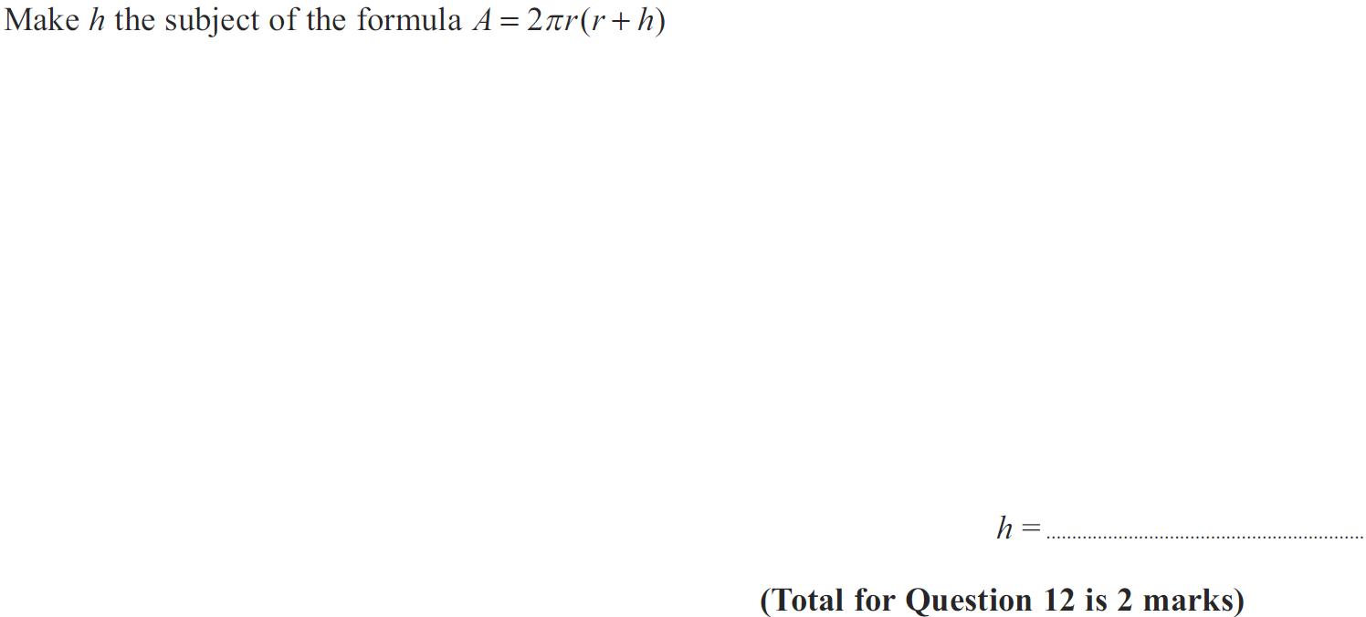
Manipulating Formulae/ Changing the Subject
Jan 2013 3H Q12

Slide 58
Manipulating Formulae/ Changing the Subject
Jan 2013 3H Q12
A

Slide 59
Manipulating Formulae/ Changing the Subject
May 2013 3H Q22

Slide 60
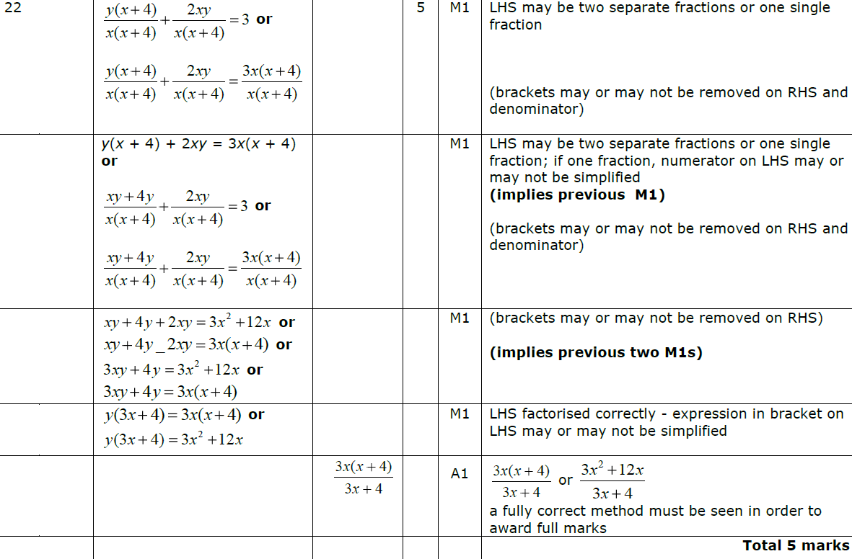
Manipulating Formulae/ Changing the Subject
May 2013 3H Q22
A

Slide 61
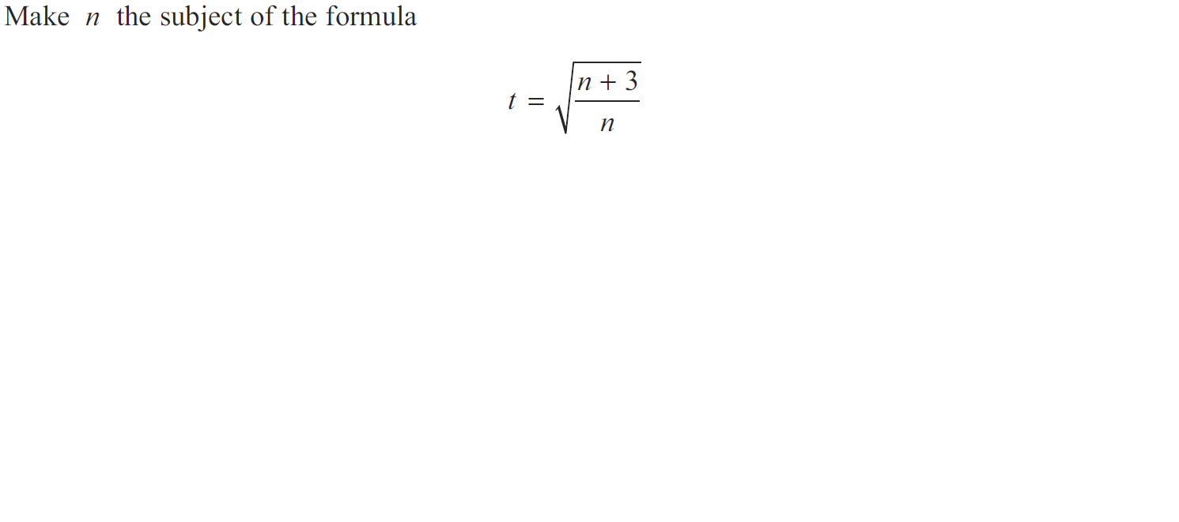
Manipulating Formulae/ Changing the Subject
May 2013 3HR Q17

Slide 62
Manipulating Formulae/ Changing the Subject
May 2013 3HR Q17
A

Slide 63
Manipulating Formulae/ Changing the Subject
Jan 2014 3H Q16

Slide 64
Manipulating Formulae/ Changing the Subject
Jan 2014 3H Q16
A

Slide 65
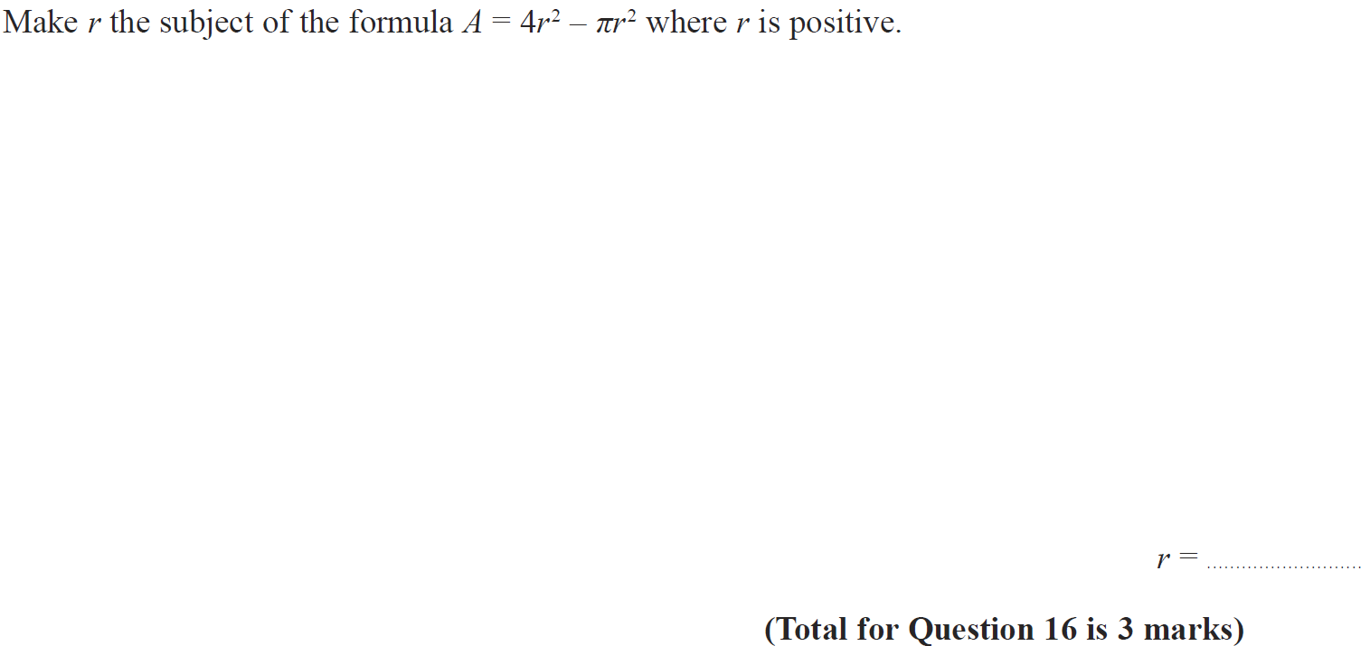
Manipulating Formulae/ Changing the Subject
Jan 2014 3HR Q16

Slide 66
Manipulating Formulae/ Changing the Subject
Jan 2014 3HR Q16
A

Slide 67
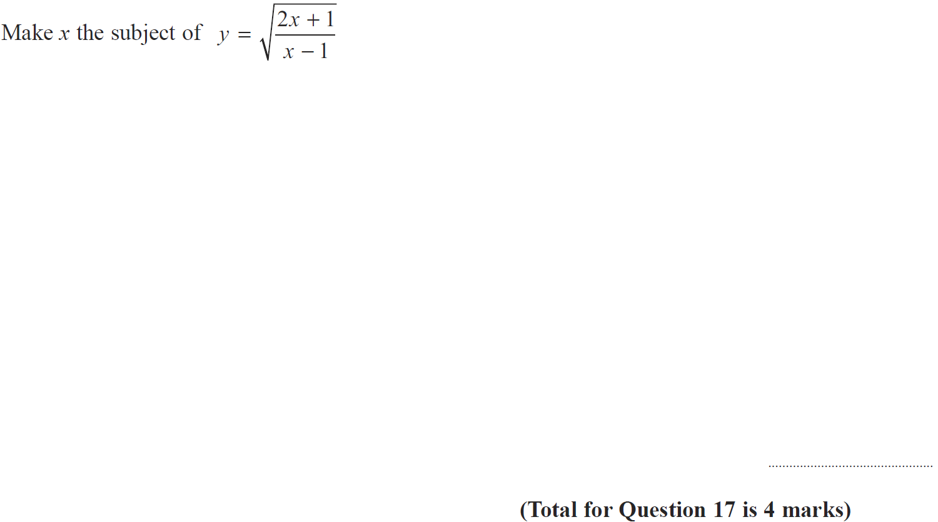
Manipulating Formulae/ Changing the Subject
May 2014 3H Q17

Slide 68
Manipulating Formulae/ Changing the Subject
May 2014 3H Q17
A

Slide 69
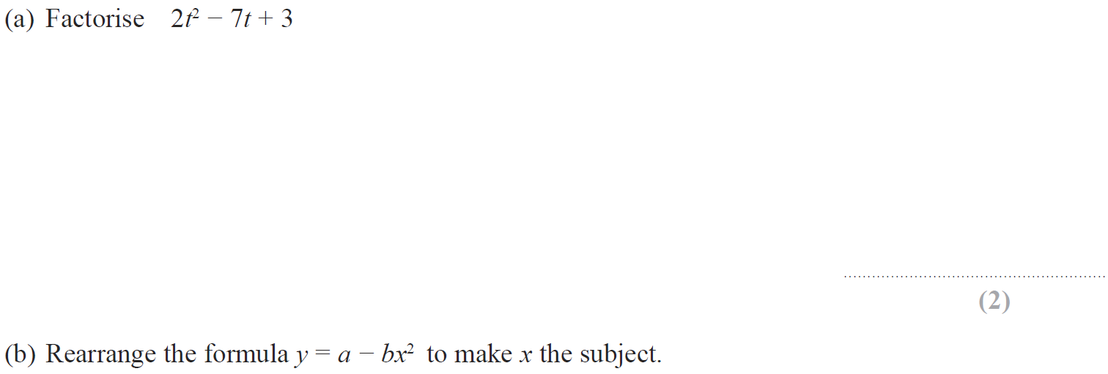
Manipulating Formulae/ Changing the Subject
May 2014 4HR Q12

Slide 70
Manipulating Formulae/ Changing the Subject
May 2014 4HR Q12
A
B

Slide 71
Manipulating Formulae/ Changing the Subject
Jan 2015 4H Q12

Slide 72
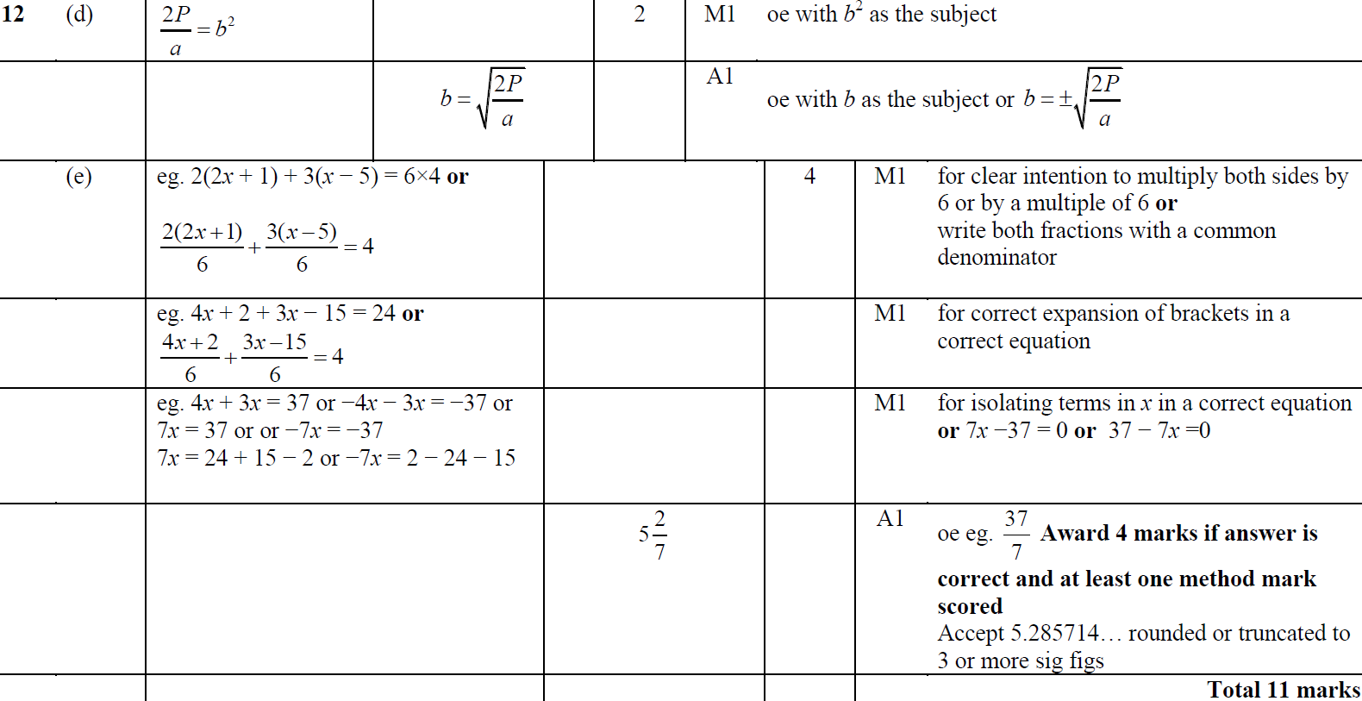
Manipulating Formulae/ Changing the Subject
Jan 2015 4H Q12
A
B
C
D
E

Slide 73
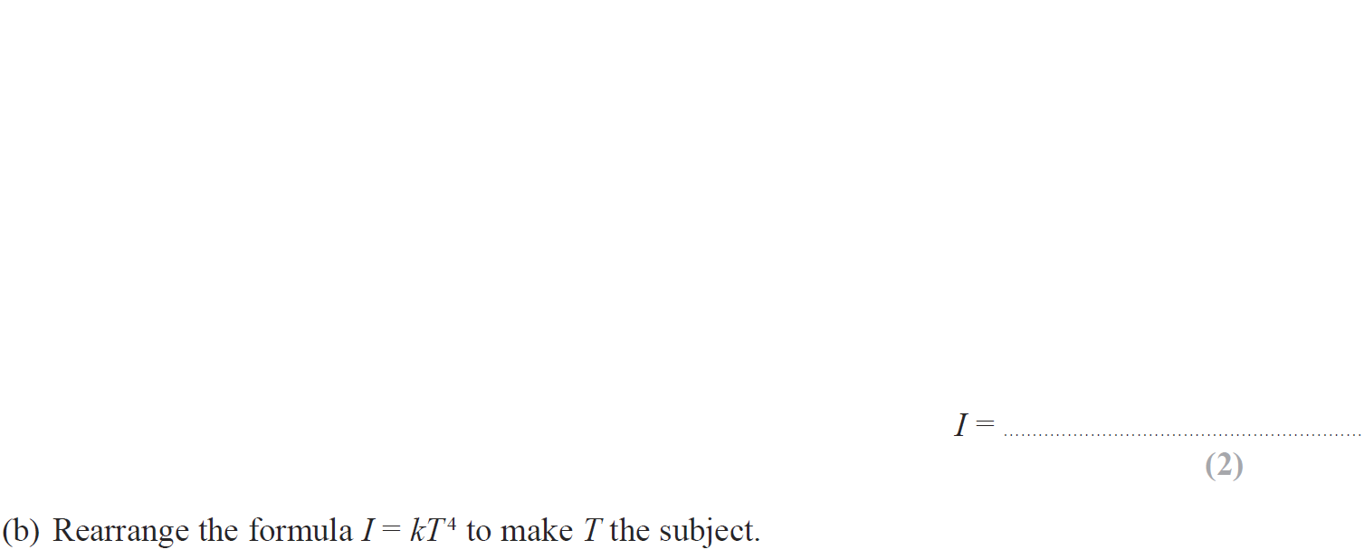
Manipulating Formulae/ Changing the Subject
Jan 2015 4HR Q12

Slide 74
Manipulating Formulae/ Changing the Subject
Jan 2015 4HR Q12
A
B

Slide 75
Manipulating Formulae/ Changing the Subject
May 2015 3HR Q9

Slide 76
Manipulating Formulae/ Changing the Subject
May 2015 3HR Q9
A

Slide 77
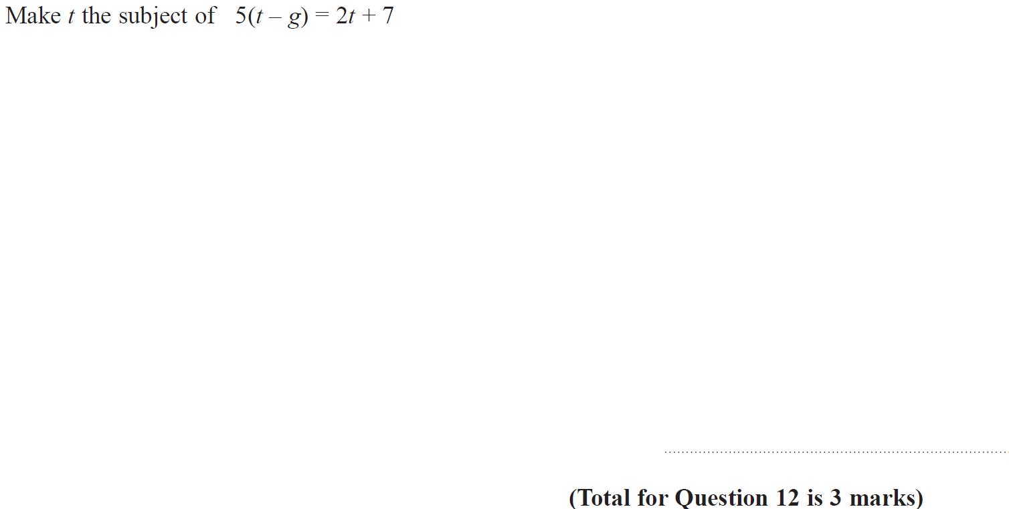
Manipulating Formulae/ Changing the Subject
Jan 2016 3H Q12

Slide 78
Manipulating Formulae/ Changing the Subject
Jan 2016 3H Q12
A

Slide 79
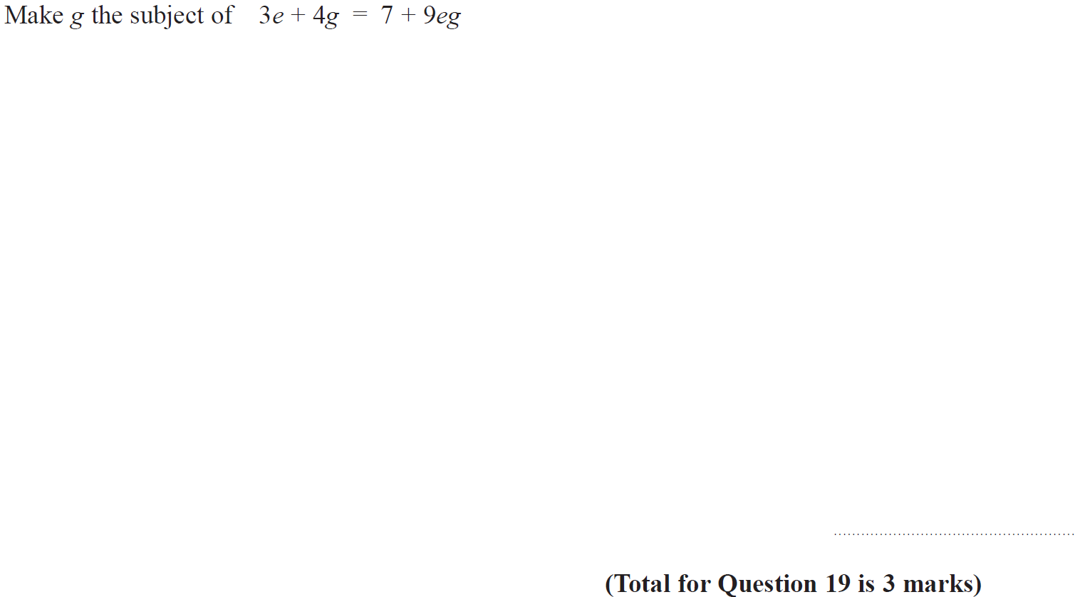
Manipulating Formulae/ Changing the Subject
Jan 2016 4HR Q19

Slide 80
Manipulating Formulae/ Changing the Subject
Jan 2016 4HR Q19
A

Slide 81
Manipulating Formulae/ Changing the Subject
May 2016 3H Q18

Slide 82
Manipulating Formulae/ Changing the Subject
May 2016 3H Q18
A

Slide 83
Manipulating Formulae/ Changing the Subject
May 2016 3HR Q12

Slide 84
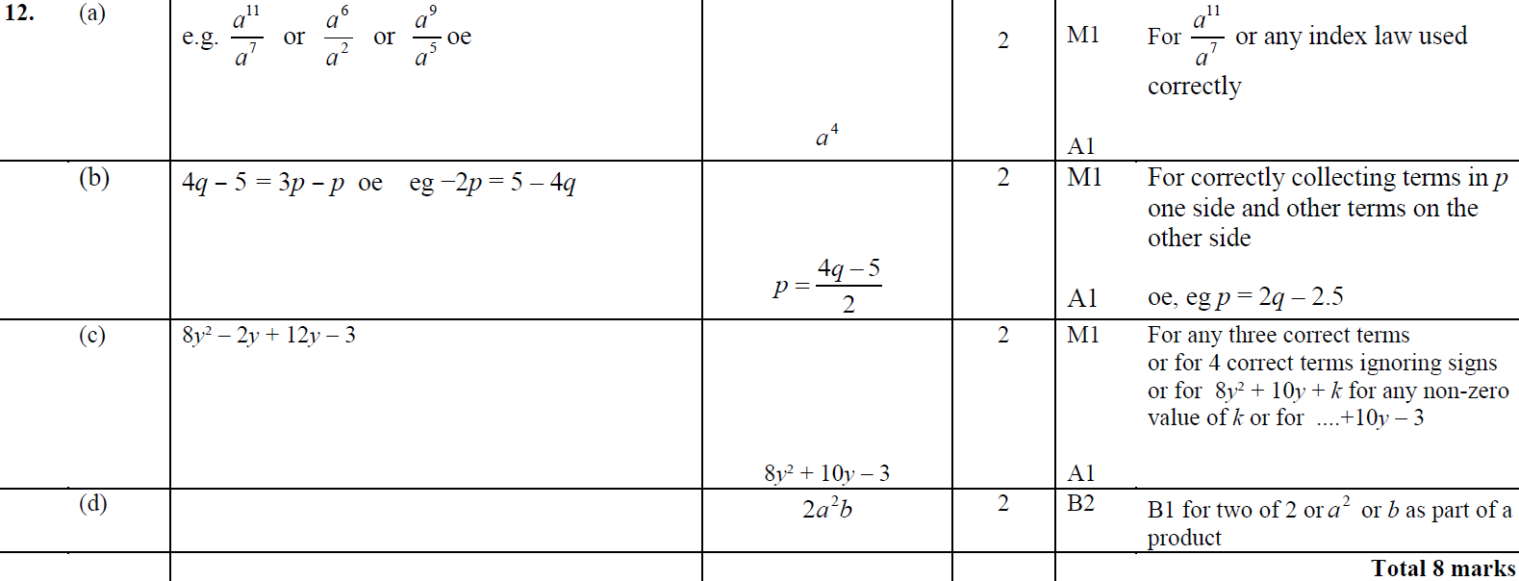
Manipulating Formulae/ Changing the Subject
May 2016 3HR Q12
A
B
C
D

Slide 85
Manipulating Formulae/ Changing the Subject
June 2016 4HR Q21

Slide 86
Manipulating Formulae/ Changing the Subject
June 2016 4HR Q21
A

Slide 87
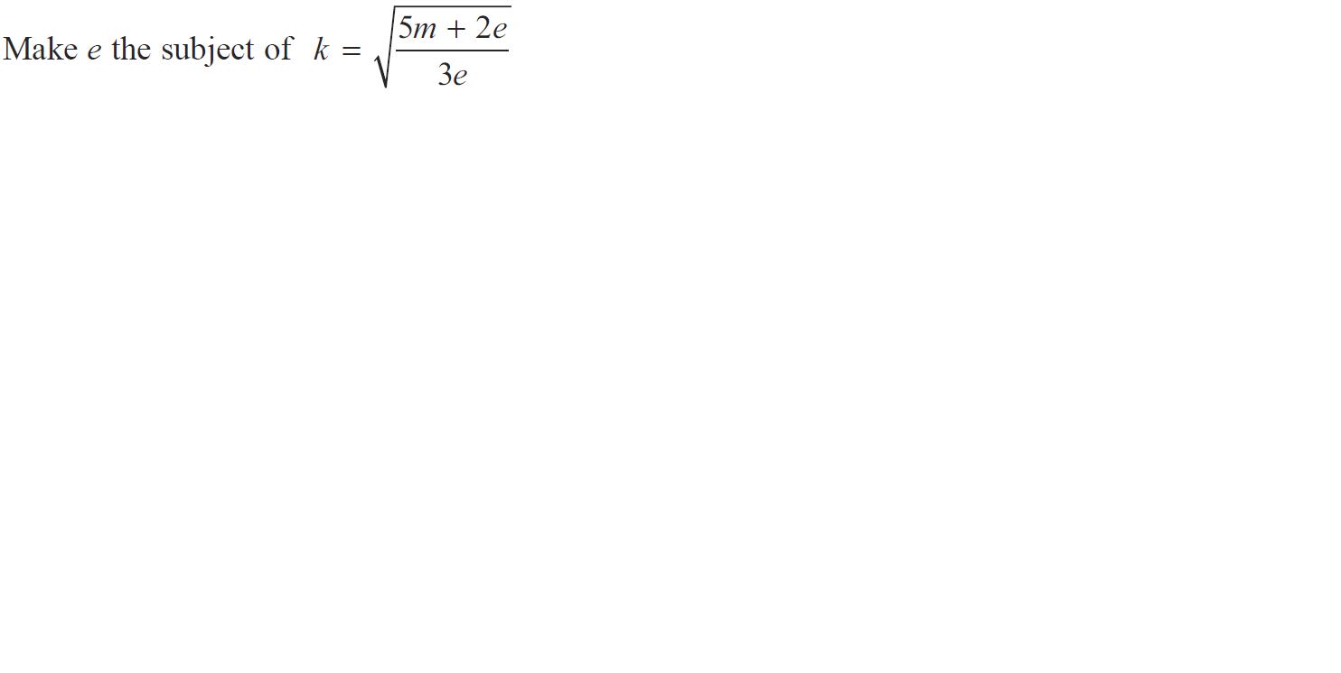
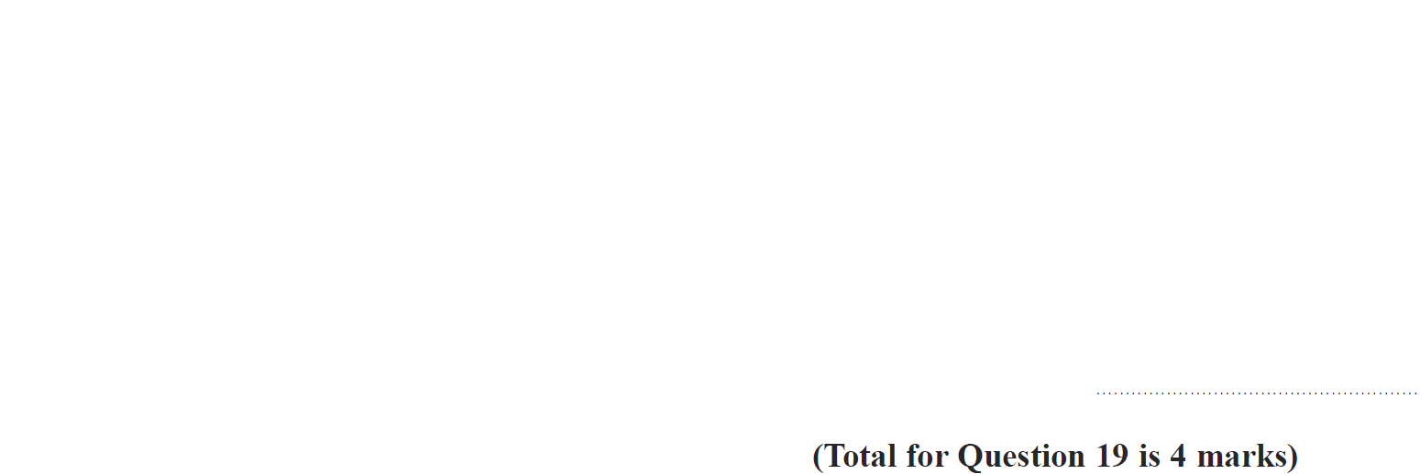
Manipulating Formulae/ Changing the Subject
Jan 2017 3H Q19

Slide 88
Manipulating Formulae/ Changing the Subject
Jan 2017 3H Q19
A

Slide 89
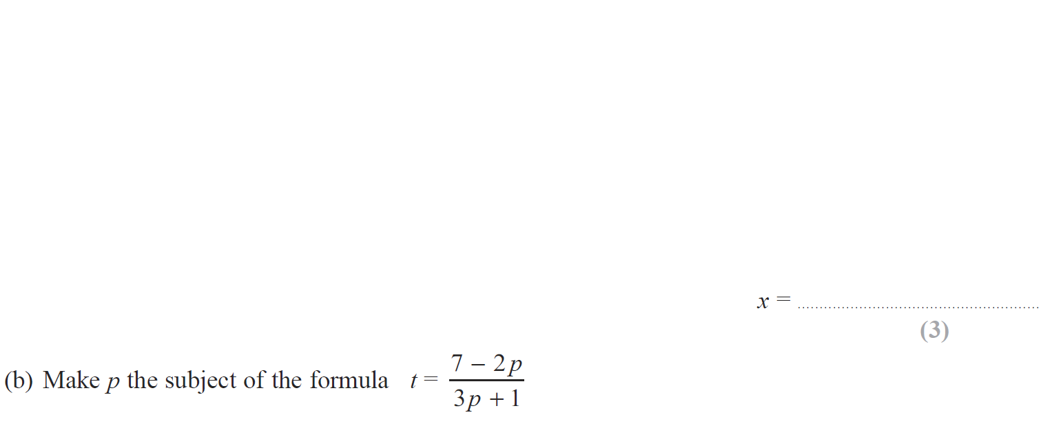
Manipulating Formulae/ Changing the Subject
Jan 2017 3HR Q16

Slide 90
Manipulating Formulae/ Changing the Subject
Jan 2017 3HR Q16
A
B

Slide 91
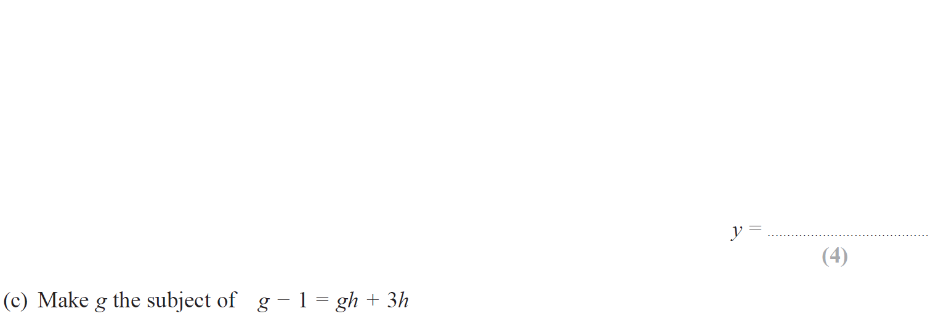
Manipulating Formulae/ Changing the Subject
May 2017 3H Q14

Slide 92
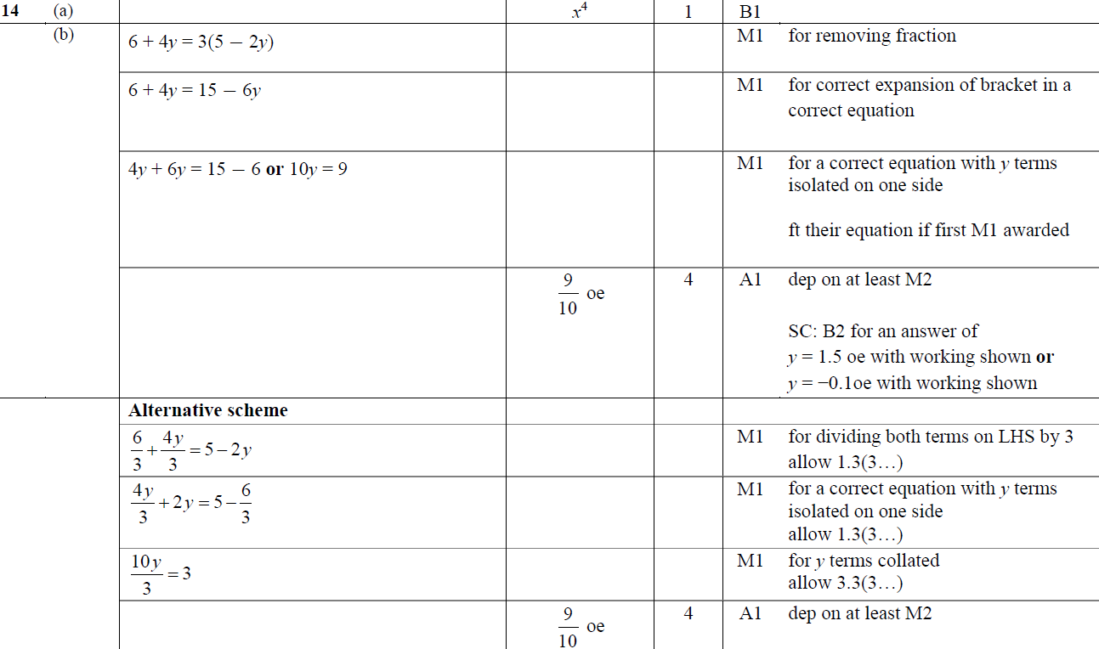
Manipulating Formulae/ Changing the Subject
May 2017 3H Q14
A
B
C

Slide 93
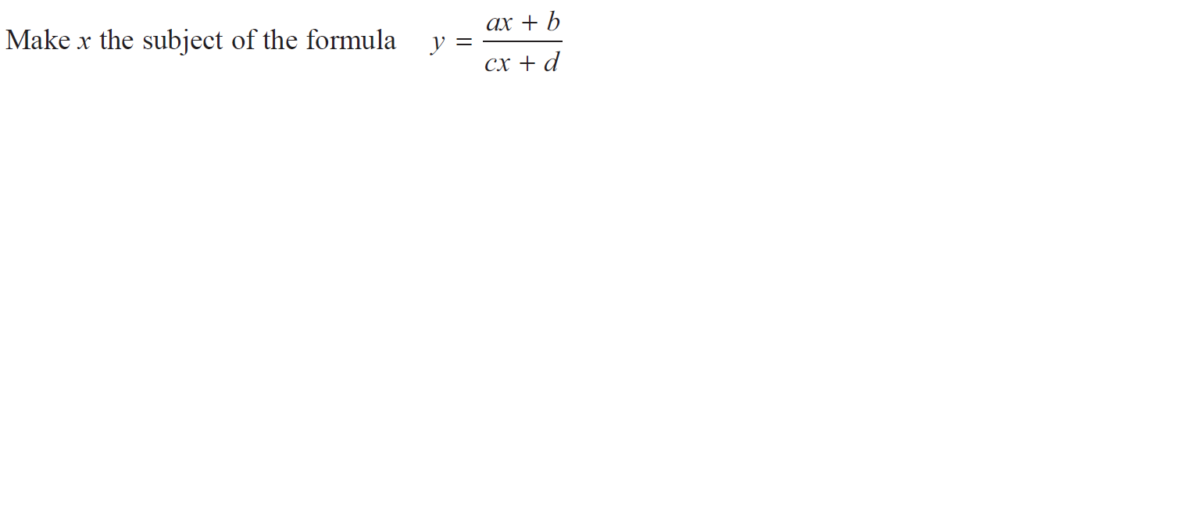
Manipulating Formulae/ Changing the Subject
May 2017 3HR Q16

Slide 94
Manipulating Formulae/ Changing the Subject
May 2017 3HR Q16
A

Slide 95
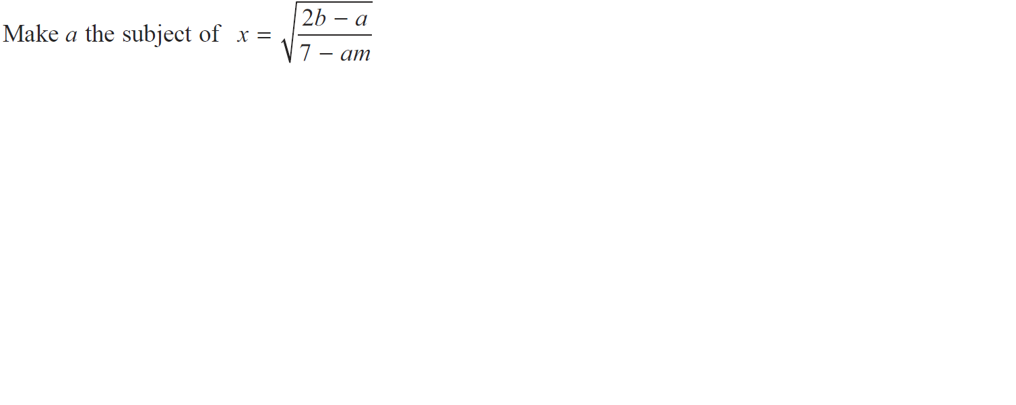
Manipulating Formulae/ Changing the Subject
Jan 2018 3H Q17

Slide 96
Manipulating Formulae/ Changing the Subject
Jan 2018 3H Q17
A

Slide 97
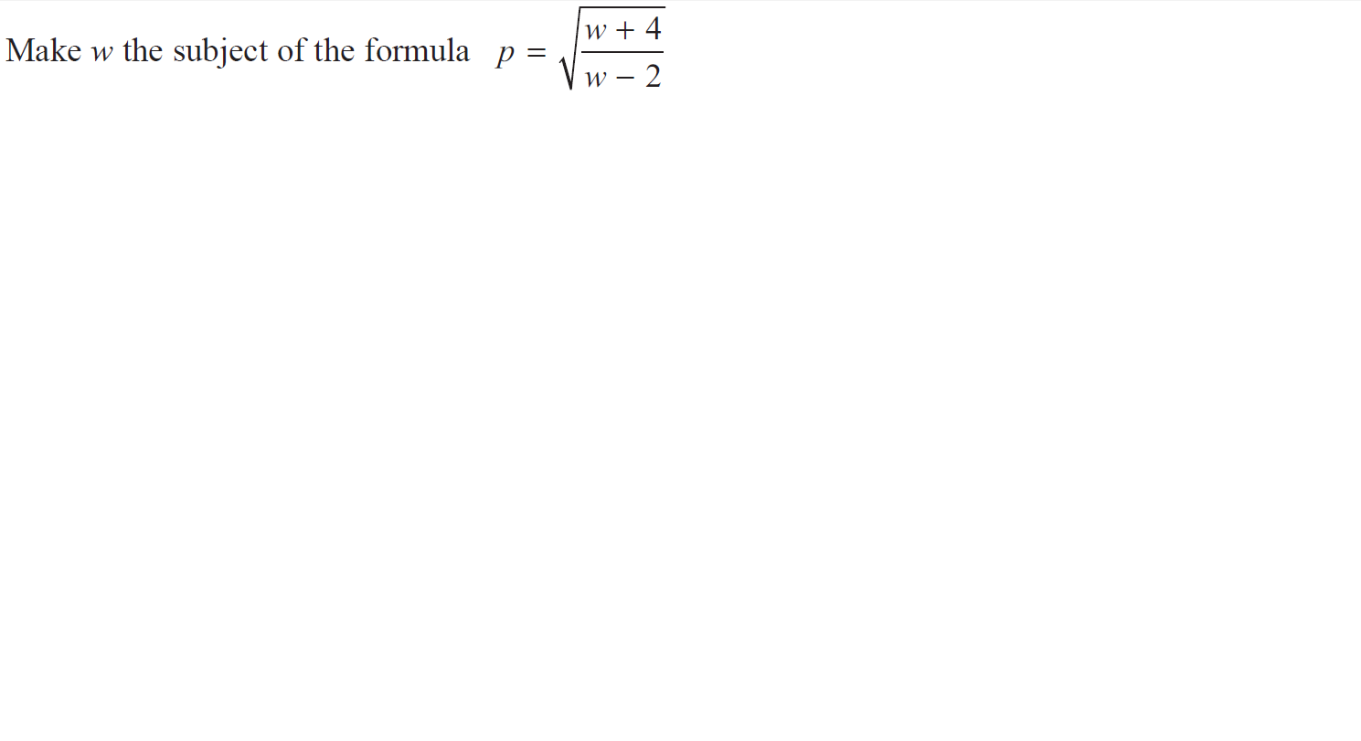
Manipulating Formulae/ Changing the Subject
June 2018 4HR Q16

Slide 98
Manipulating Formulae/ Changing the Subject
June 2018 4HR Q16
A

