Slide 1
Linear Graphs & Gradients
Linear Graphs & Gradients
SAM
1H Q25
May 2017
1H Q6
May 2018
1H Q19
Spec 1
1H Q23
May 2017
1H Q18
June 2018
2H Q3
Spec 1
2H Q23
June 2017
2H Q23
Nov 2018
2H Q6
Spec 1
3H Q3
Nov 2017
1H Q19
Nov 2018
2H Q18
Spec 1
3H Q7
Nov 2017
2H Q19
June 2019
2H Q2
Spec 2
1H Q22
May 2018
1H Q6
June 2019
2H Q16
Mainly Co-ordinates
With equation of circle and tangents

Slide 2
Linear Graphs & Gradients
SAM 1H Q25

Slide 3
Linear Graphs & Gradients
SAM 1H Q25
A

Slide 4
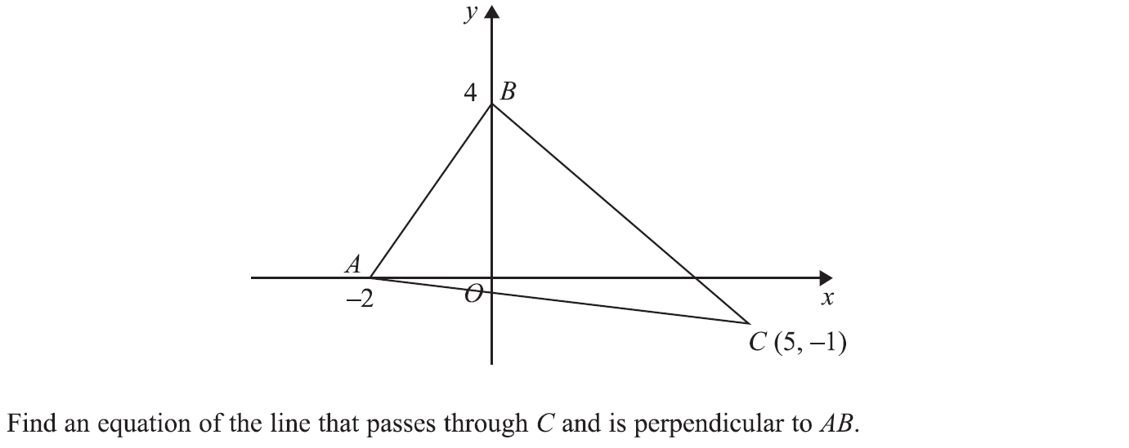
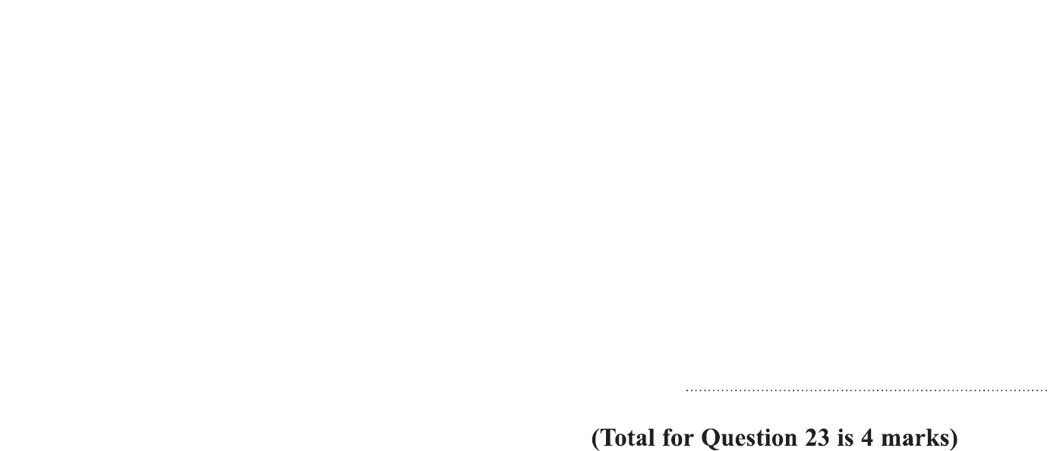
Linear Graphs & Gradients
Specimen Set 1 1H Q23

Slide 5
Linear Graphs & Gradients
Specimen Set 1 1H Q23
A

Slide 6
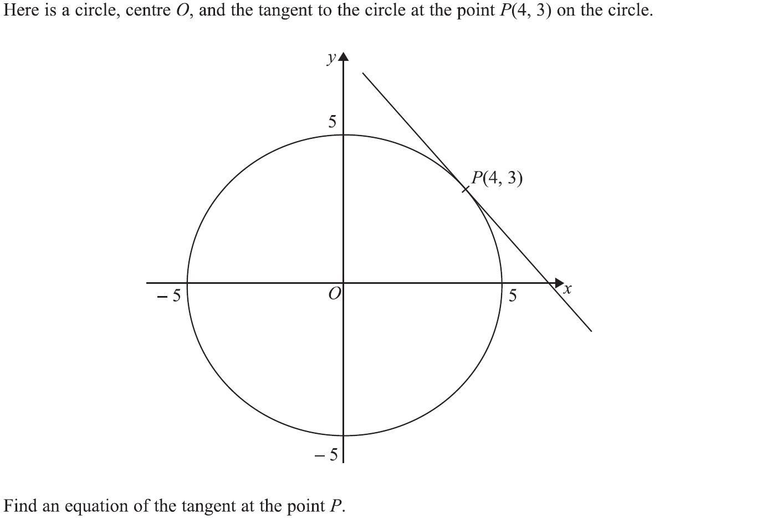
Linear Graphs & Gradients
Specimen Set 1 2H Q23

Slide 7
Linear Graphs & Gradients
Specimen Set 1 2H Q23
A

Slide 8
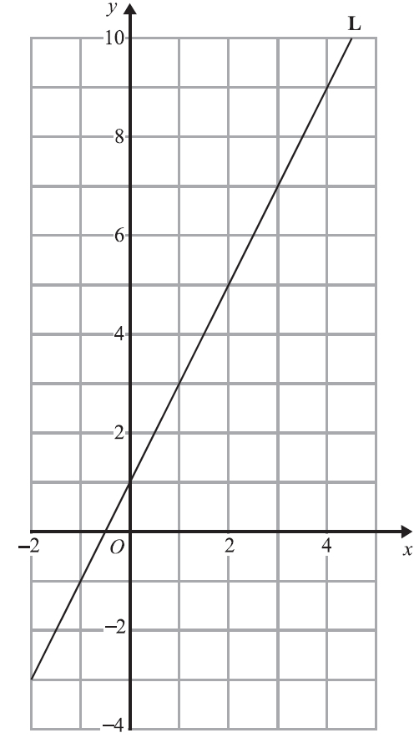
Linear Graphs & Gradients
Specimen Set 1 3H Q3

Slide 9
Linear Graphs & Gradients
Specimen Set 1 3H Q3
A

Slide 10
Linear Graphs & Gradients
Specimen Set 1 3H Q7

Slide 11
Linear Graphs & Gradients
Specimen Set 1 3H Q7
A

Slide 12
Linear Graphs & Gradients
Specimen Set 2 1H Q22

Slide 13
Linear Graphs & Gradients
Specimen Set 2 1H Q22
A

Slide 14
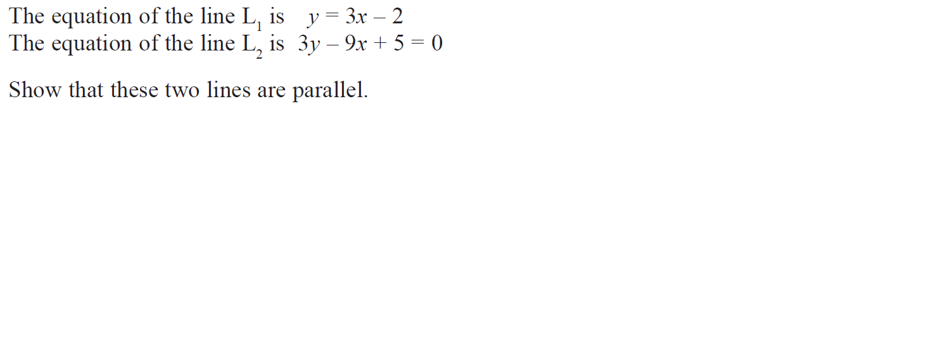
Linear Graphs & Gradients
May 2017 1H Q6

Slide 15
Linear Graphs & Gradients
May 2017 1H Q6
A

Slide 16
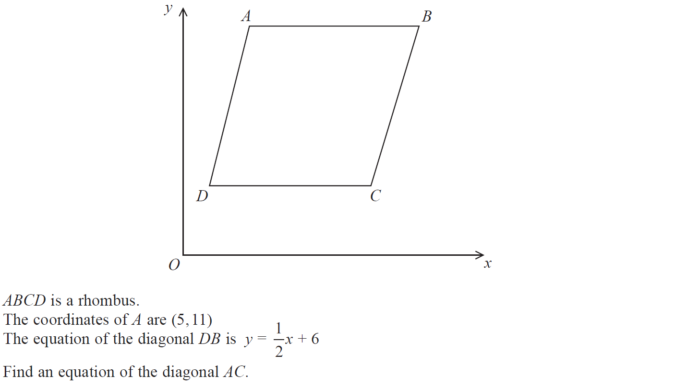
Linear Graphs & Gradients
May 2017 1H Q18

Slide 17
Linear Graphs & Gradients
May 2017 1H Q18
A

Slide 18
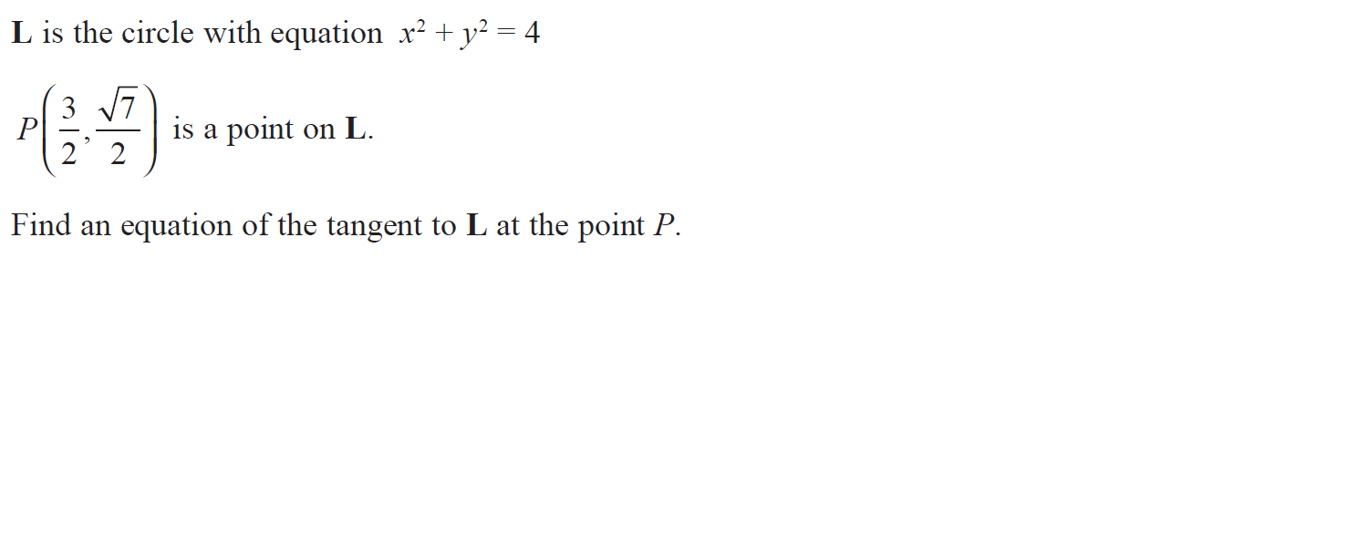
Linear Graphs & Gradients
June 2017 2H Q23

Slide 19
Linear Graphs & Gradients
June 2017 2H Q23
A

Slide 20
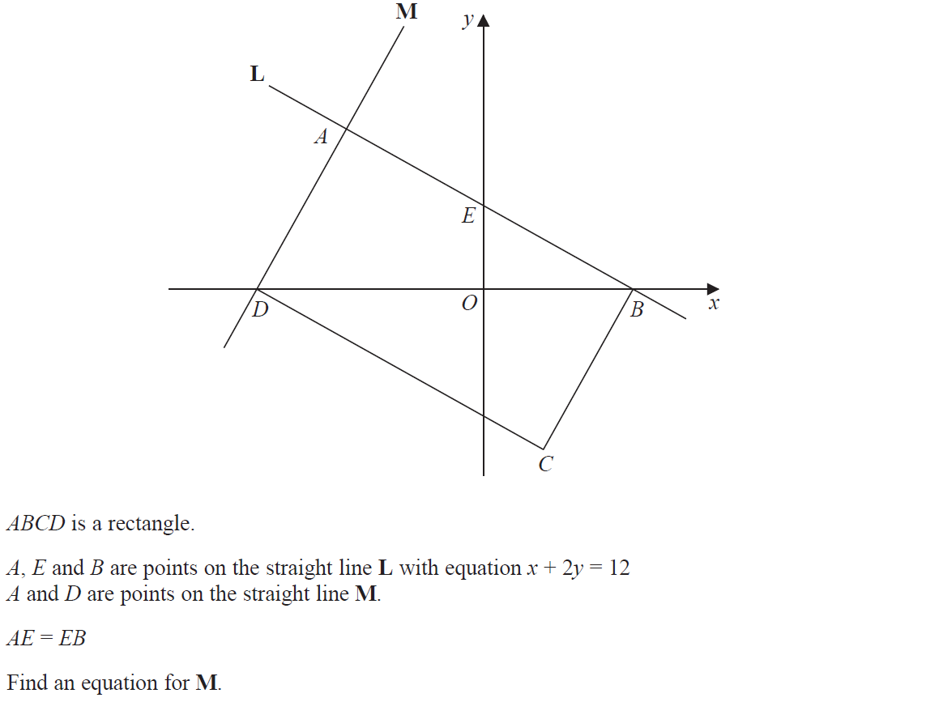
Linear Graphs & Gradients
Nov 2017 1H Q19

Slide 21
Linear Graphs & Gradients
Nov 2017 1H Q19
A

Slide 22
Linear Graphs & Gradients
Nov 2017 2H Q19

Slide 23
Linear Graphs & Gradients
Nov 2017 2H Q19
A

Slide 24
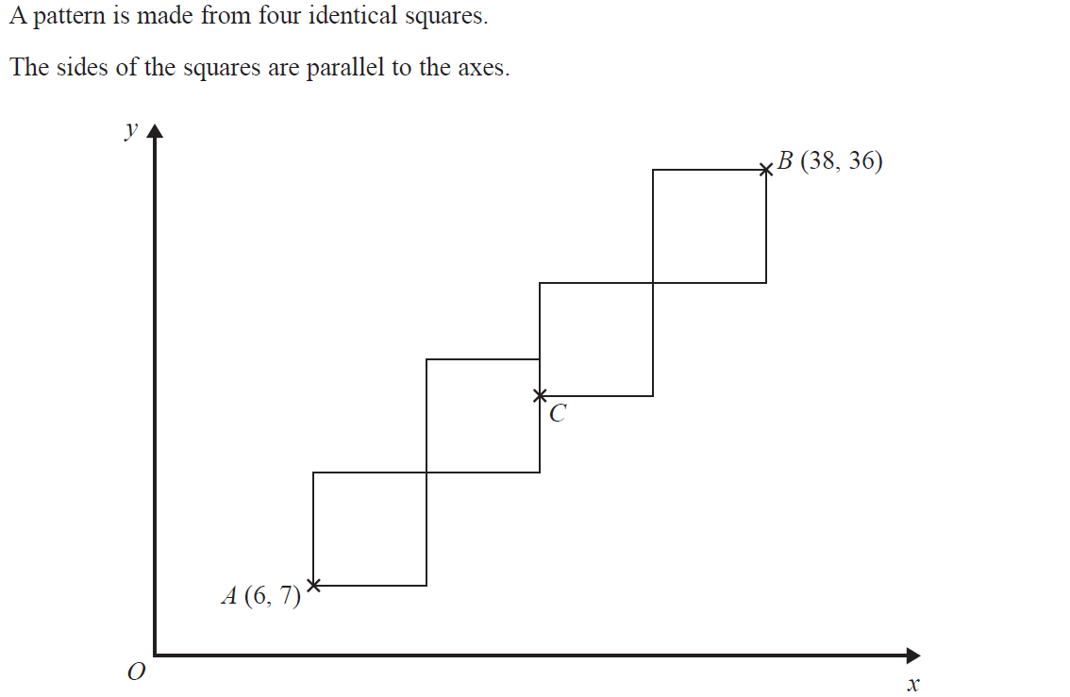
Linear Graphs & Gradients
May 2018 1H Q6

Slide 25
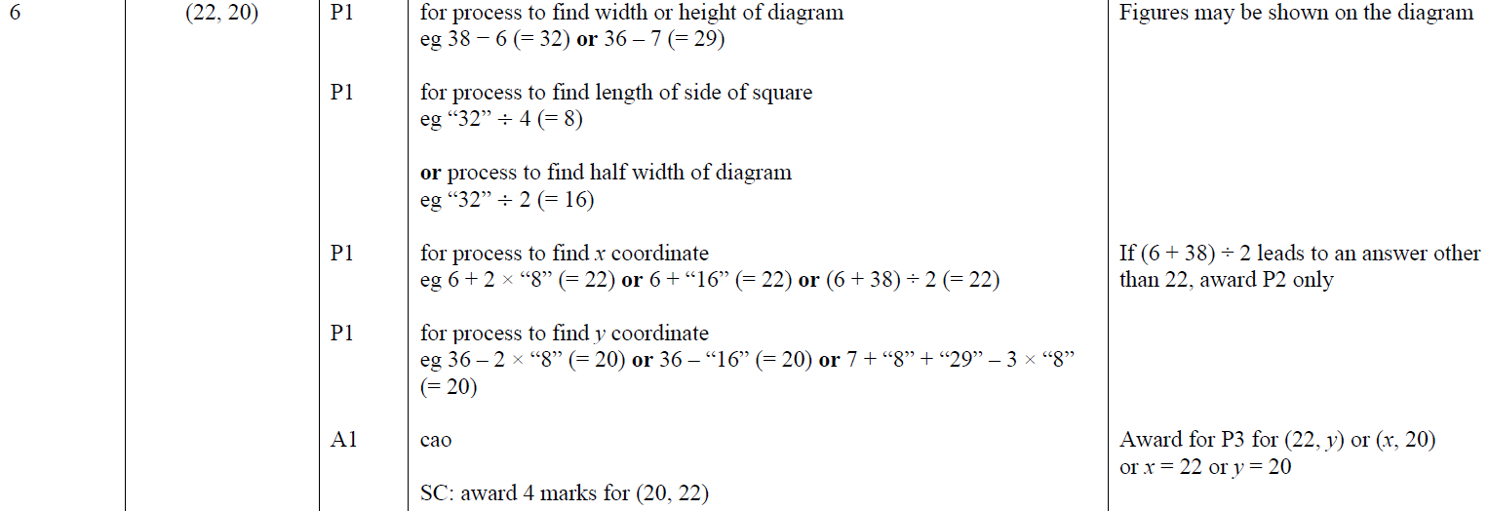
Linear Graphs & Gradients
May 2018 1H Q6
A

Slide 26
Linear Graphs & Gradients
May 2018 1H Q19

Slide 27
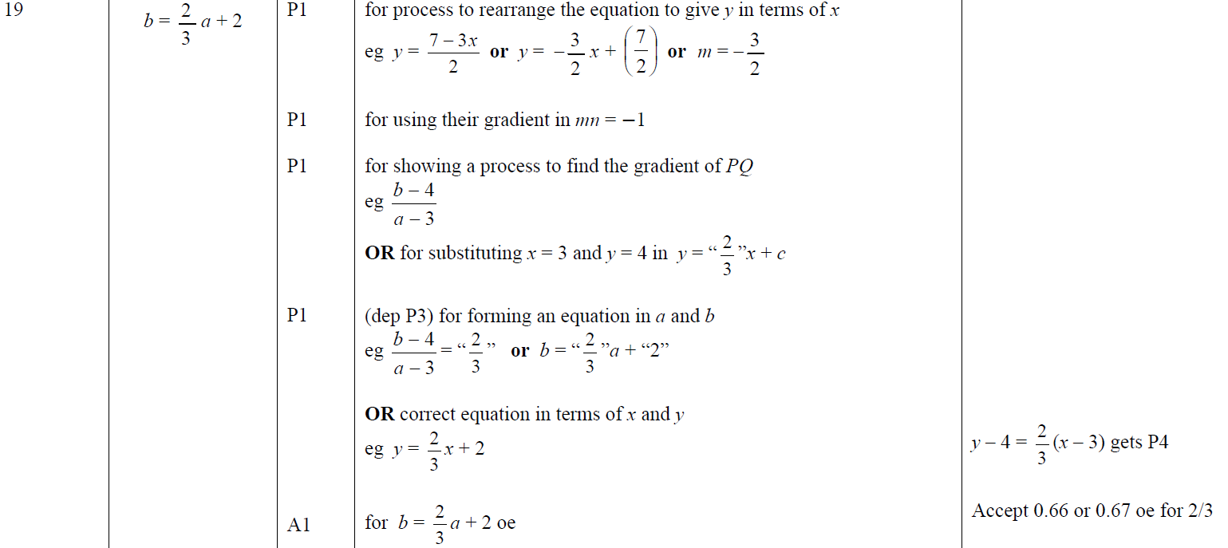
Linear Graphs & Gradients
May 2018 1H Q19
A

Slide 28
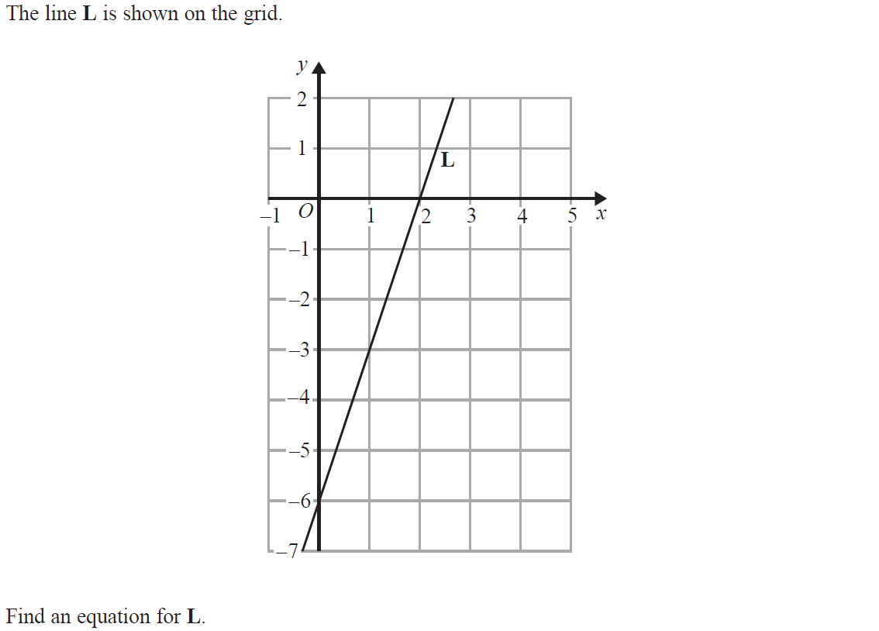
Linear Graphs & Gradients
June 2018 2H Q3

Slide 29
Linear Graphs & Gradients
June 2018 2H Q3
A

Slide 30
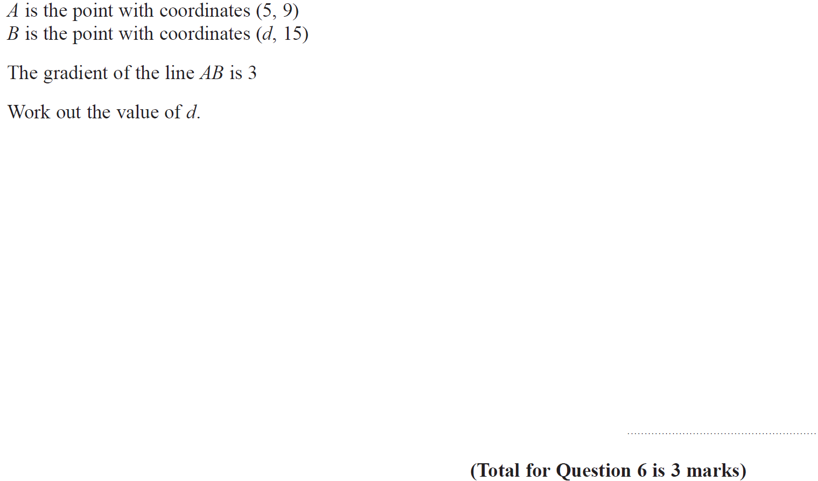
Linear Graphs & Gradients
Nov 2018 2H Q6

Slide 31
Linear Graphs & Gradients
Nov 2018 2H Q6
A

Slide 32
Linear Graphs & Gradients
Nov 2018 2H Q18

Slide 33
Linear Graphs & Gradients
Nov 2018 2H Q18
A

Slide 34
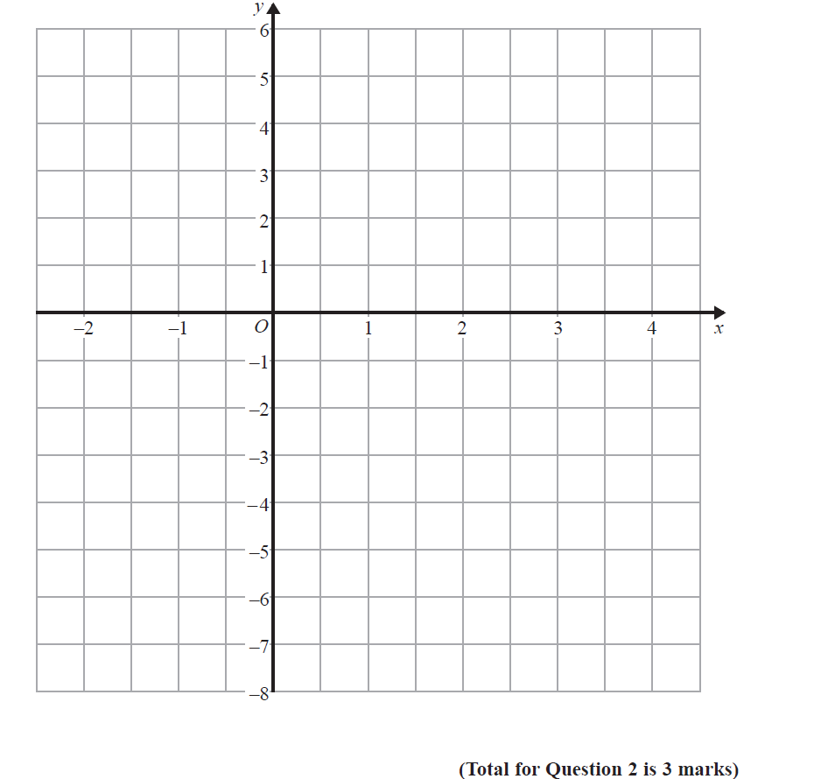
Linear Graphs & Gradients
June 2019 2H Q2

Slide 35
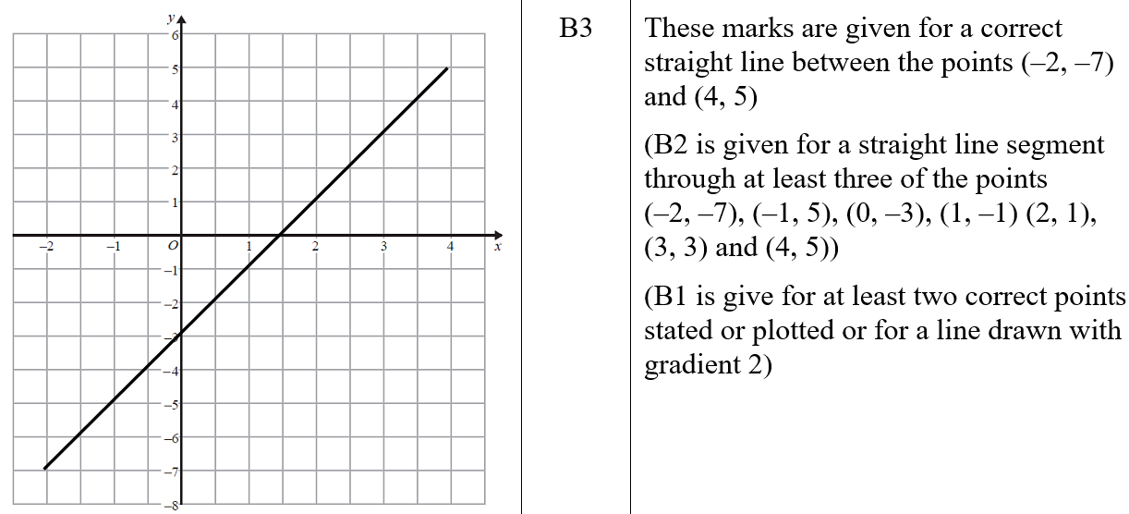
Linear Graphs & Gradients
June 2019 2H Q2
A
A SF

Slide 36
Linear Graphs & Gradients
June 2019 2H Q16

Slide 37
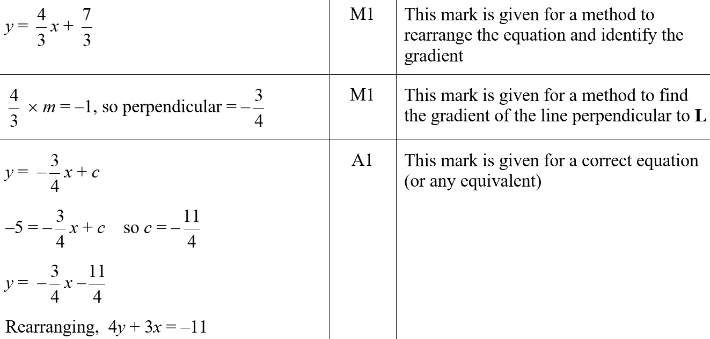
Linear Graphs & Gradients
June 2019 2H Q16
A
A SF

