Slide 1
Linear Inequalities
Linear Inequalities
May 2017
1H Q14
Nov 2017
3H Q23
June 2017
3H Q6
May 2018
1H Q5
SAM
1H Q8
1 Marker
Nov 2017
1H Q5
June 2018
3H Q2
Nov 2017
3H Q1
Nov 2018
3H Q10
Graphical

Slide 2
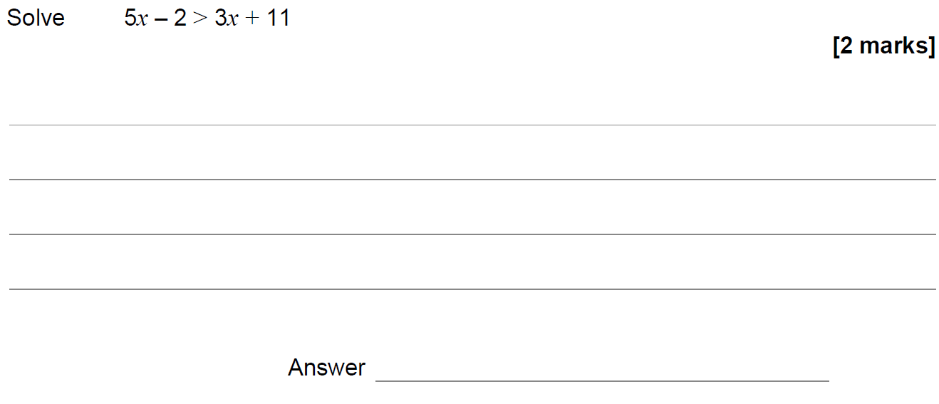
Linear Inequalities
SAM 1H Q8

Slide 3
Linear Inequalities
SAM 1H Q8
A

Slide 4
Linear Inequalities
May 2017 1H Q14

Slide 5
Linear Inequalities
May 2017 1H Q14
A

Slide 6
Linear Inequalities
June 2017 3H Q6

Slide 7
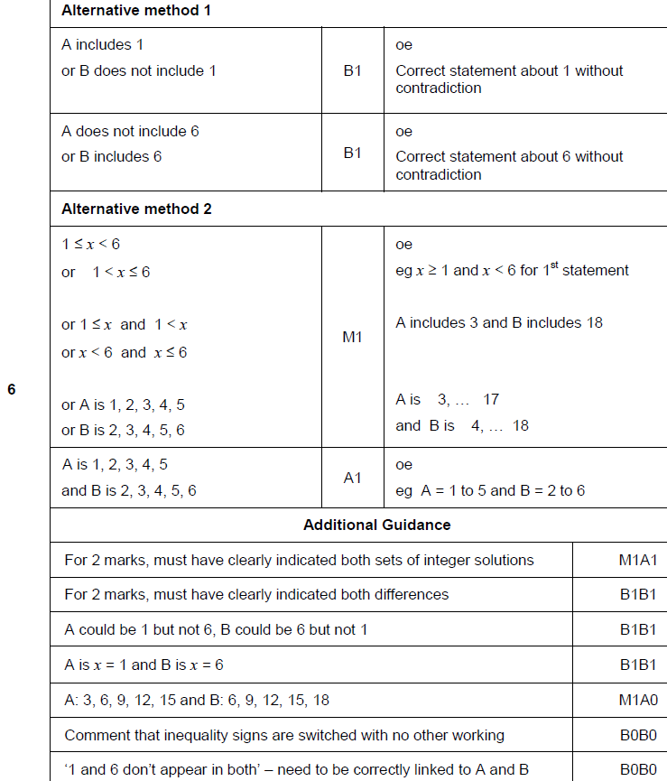
Linear Inequalities
June 2017 3H Q6
A

Slide 8
Linear Inequalities
Nov 2017 1H Q5

Slide 9
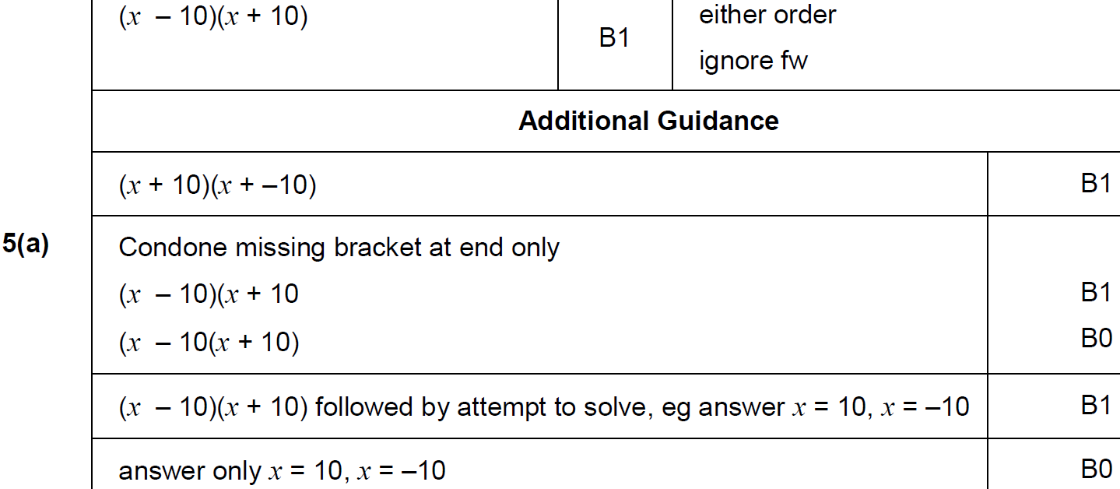
Linear Inequalities
Nov 2017 1H Q5
A

Slide 10
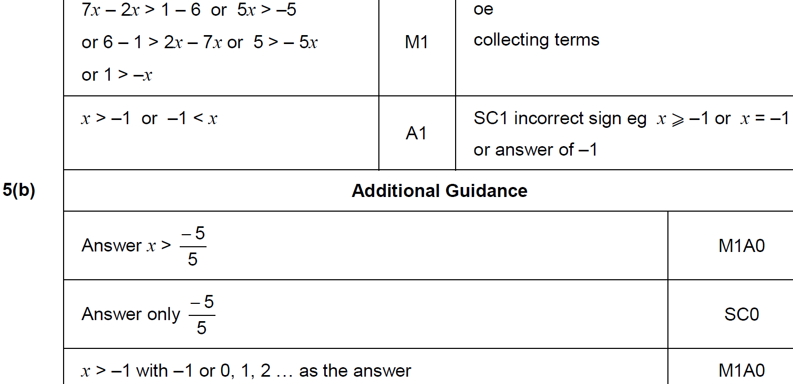
Linear Inequalities
Nov 2017 1H Q5
B

Slide 11
Linear Inequalities
Nov 2017 3H Q1

Slide 12
Linear Inequalities
Nov 2017 3H Q1
A

Slide 13
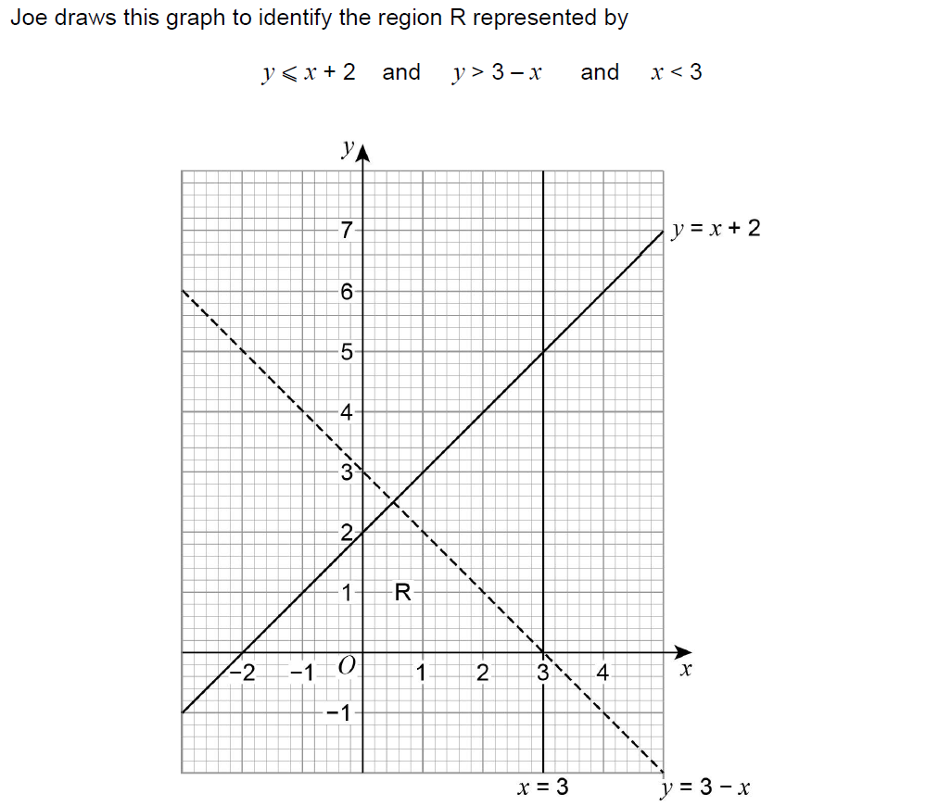
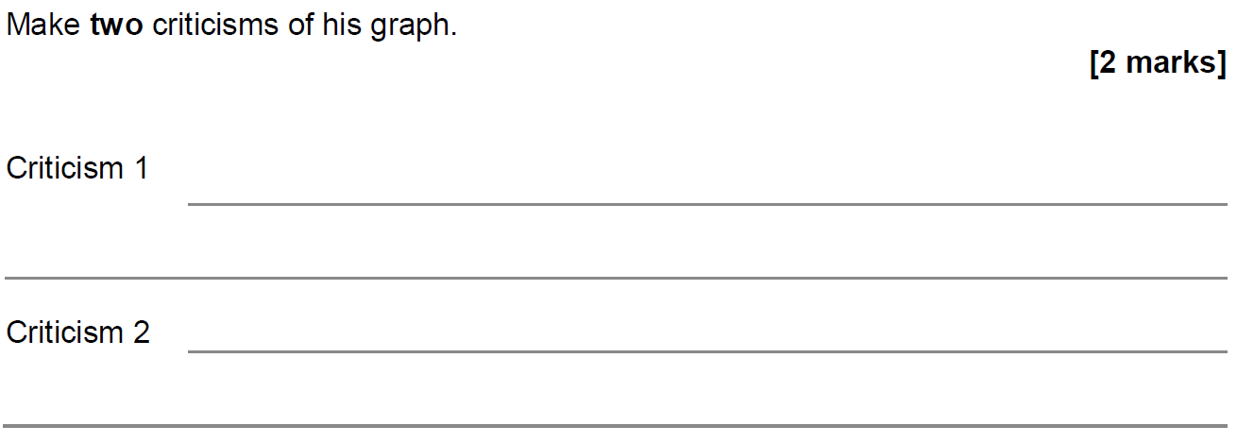
Linear Inequalities
Nov 2017 3H Q23

Slide 14
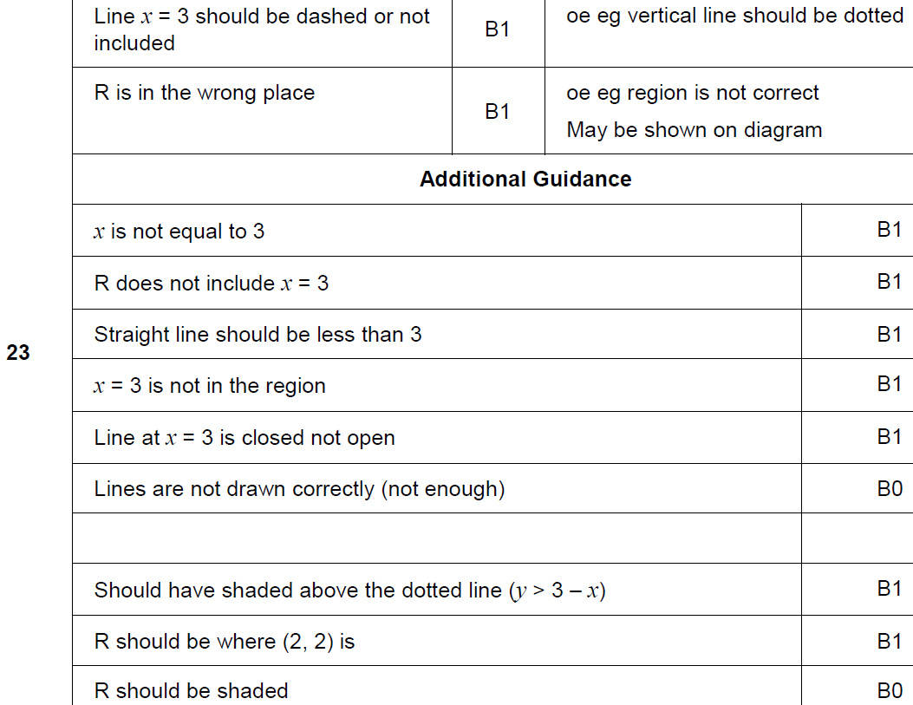
Linear Inequalities
Nov 2017 3H Q23
A

Slide 15
Linear Inequalities
May 2018 1H Q5
Solve 5(x + 3) < 60
[2 marks]

Slide 16
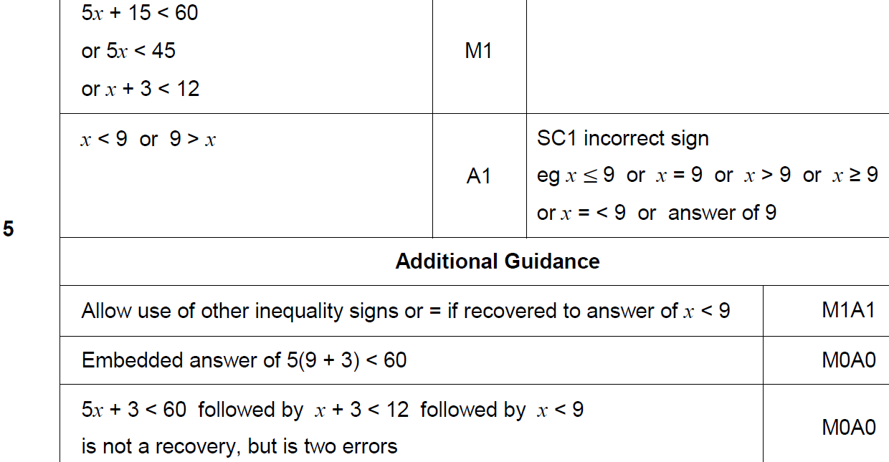
Linear Inequalities
May 2018 1H Q5
A

Slide 17
Linear Inequalities
June 2018 3H Q2

Slide 18
Linear Inequalities
June 2018 3H Q2
A

Slide 19
Linear Inequalities
Nov 2018 3H Q10

Slide 20
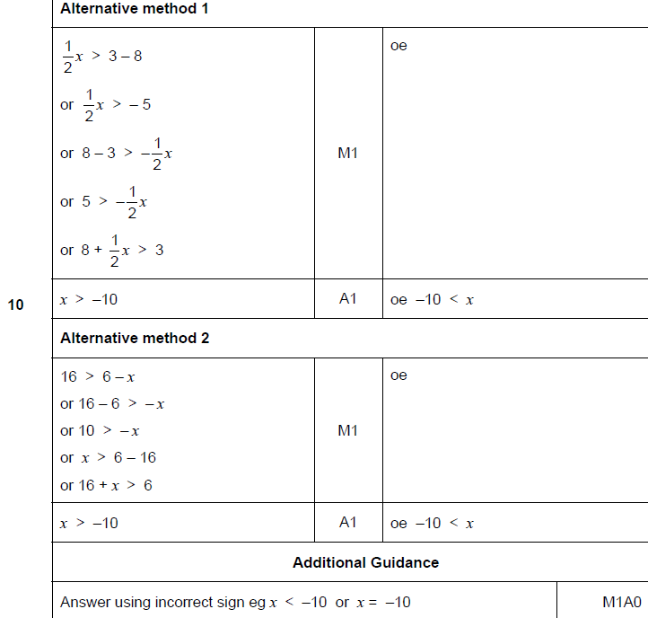
Linear Inequalities
Nov 2018 3H Q10
A

