Slide 1
Linear Inequalities
Linear Inequalities
June 2017
2H Q10
SAM
3H Q2
Nov 2017
3H Q18
Practice
3H Q3
June 2018
2H Q2
Nov 2018
2H Q14
Graphical

Slide 2
Linear Inequalities
SAM 3H Q2

Slide 3
Linear Inequalities
SAM 3H Q2
A (i)
A (ii)
B
C

Slide 4
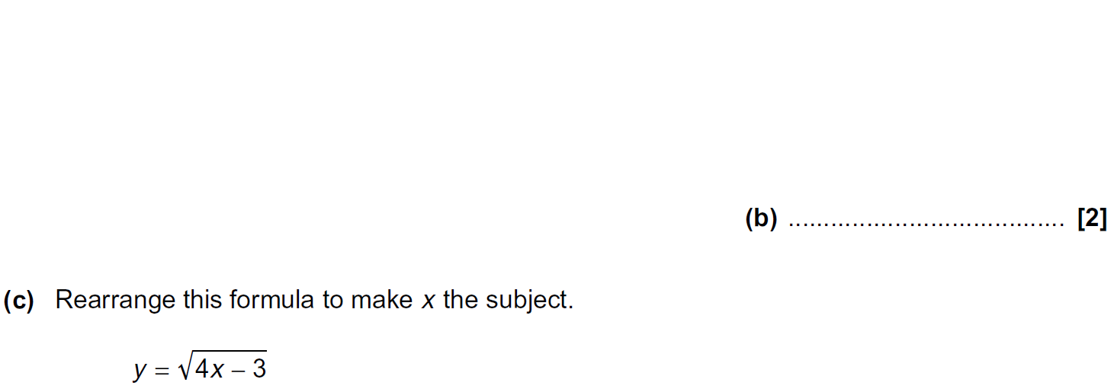
Linear Inequalities
Practice 3H Q3

Slide 5
Linear Inequalities
Practice 3H Q3
A
B
C

Slide 6
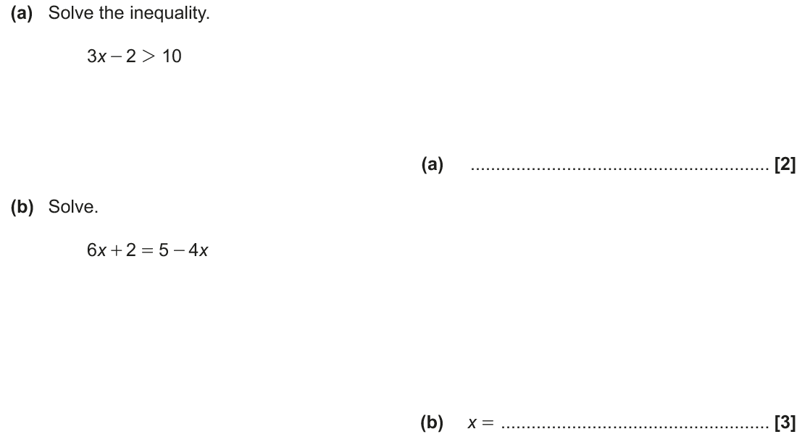
Linear Inequalities
June 2017 2H Q10

Slide 7
Linear Inequalities
June 2017 2H Q10
A
B

Slide 8
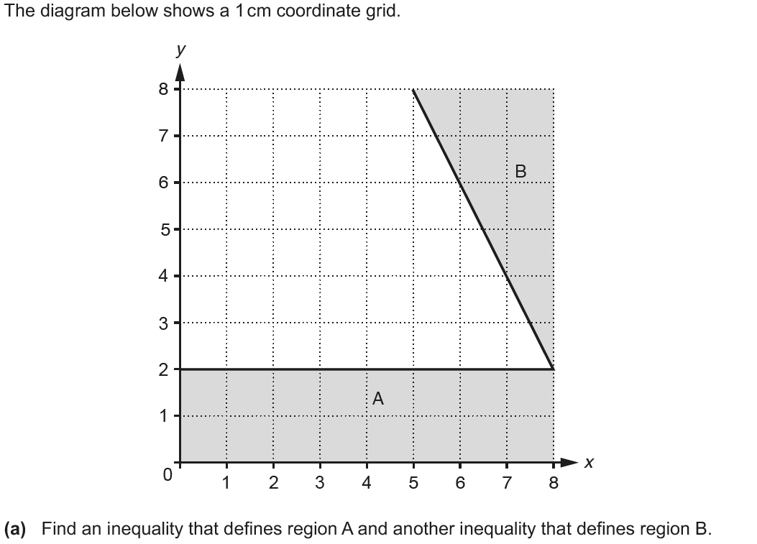
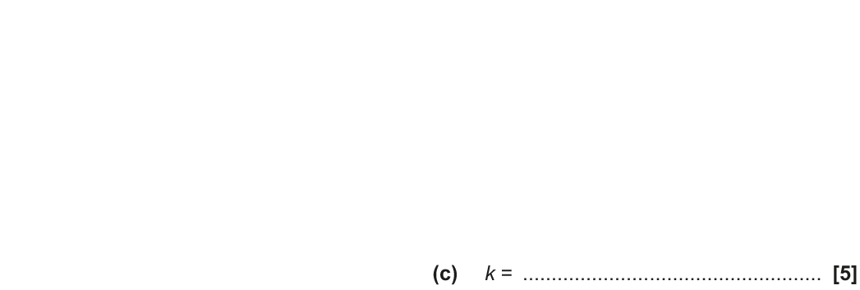
Linear Inequalities
Nov 2017 3H Q18
Show
Hide

Slide 9
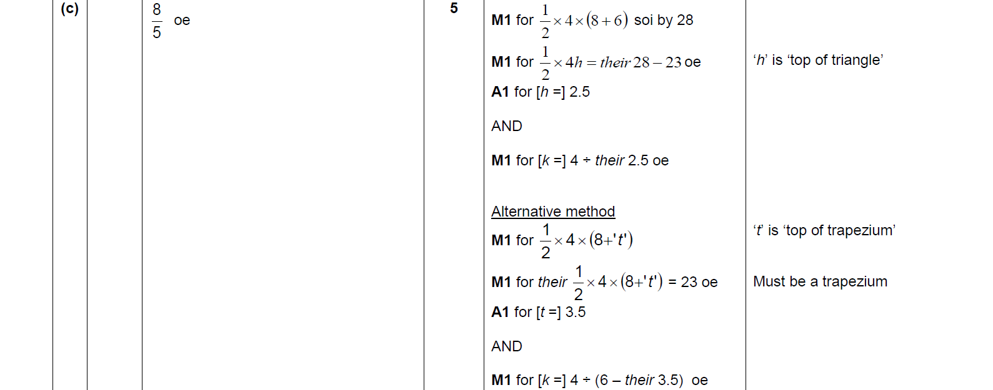
Linear Inequalities
Nov 2017 3H Q18
A
B
C

Slide 10
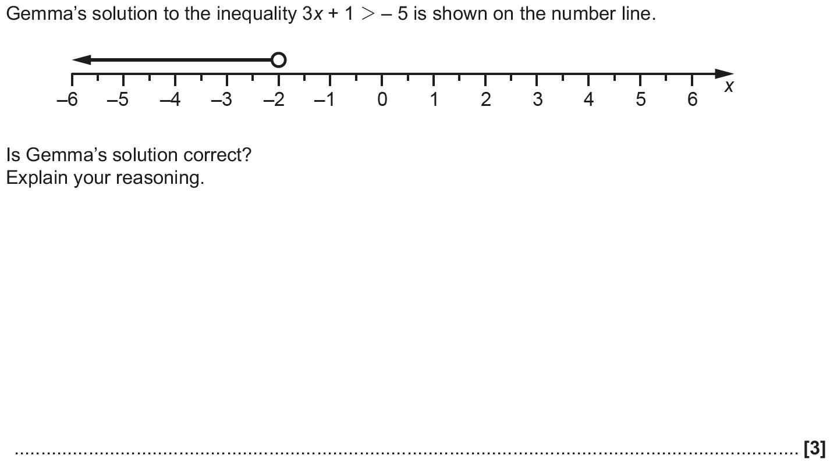
Linear Inequalities
June 2018 2H Q2

Slide 11
Linear Inequalities
June 2018 2H Q2
A

Slide 12
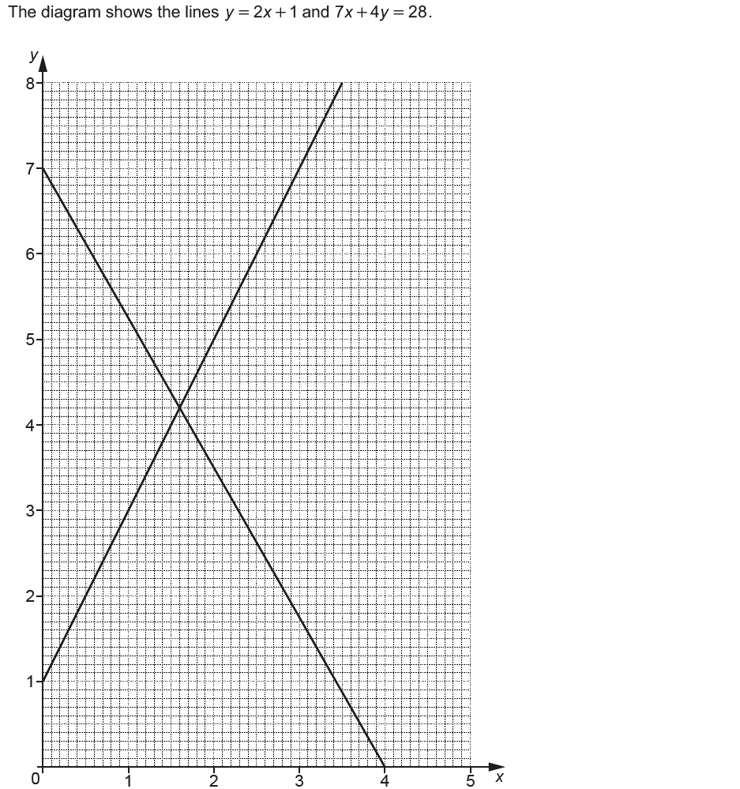
Linear Inequalities
Nov 2018 2H Q14

Slide 13
Linear Inequalities
Nov 2018 2H Q14
A

