Slide 1
Iterations
Iterations
June 2018
3H Q23
SAM
3H Q26
1 Marker
Nov 2018
3H Q22

Slide 2
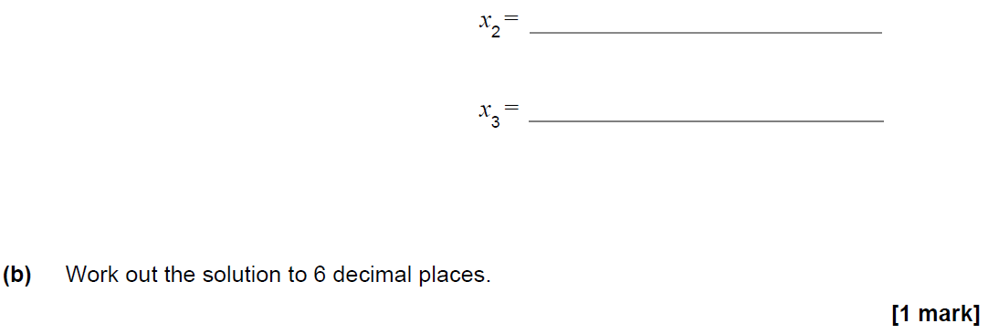
Iterations
SAM 3H Q26

Slide 3
Iterations
SAM 3H Q26
A
B

Slide 4
Iterations
June 2018 3H Q23

Slide 5
Iterations
June 2018 3H Q23
A

Slide 6
Iterations
Nov 2018 3H Q22

Slide 7
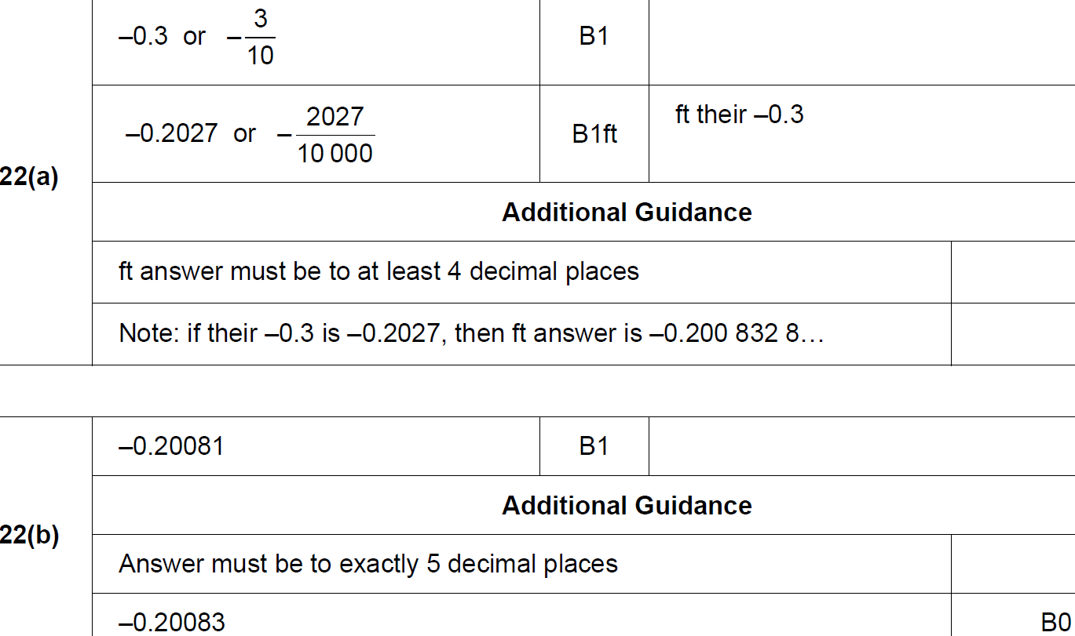
Iterations
Nov 2018 3H Q22
A
B

