Slide 1
Old Spec Q’s
Integration
Partial Fractions
Vol. of rev.
SAM
SAM 1 (i)
Mean values
2018
SAM 1 (ii)
2019
2019 1
2019 2 (i)
2019 2 (ii)
See also: Polar coordinates
See also: Hyperbolics

Slide 2
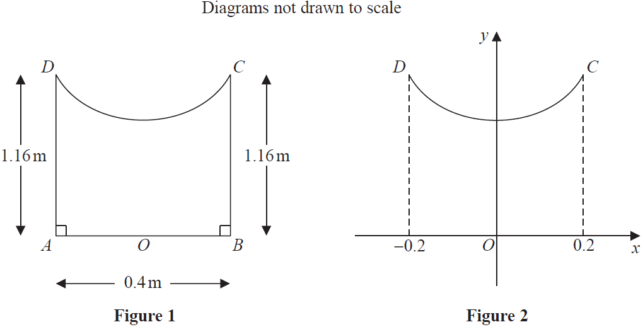
SAM

Slide 3
SAM
A
B
A notes
B notes

Slide 4
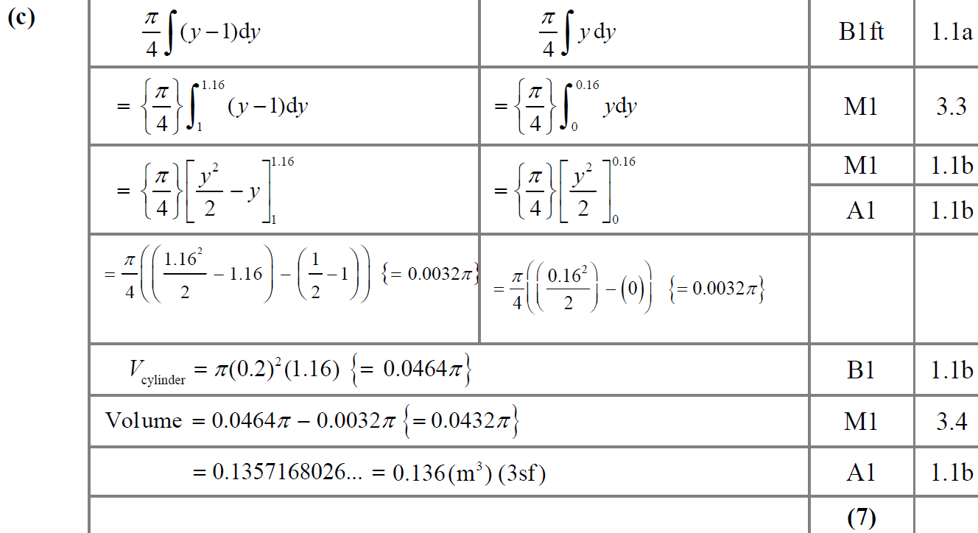
SAM
C

Slide 5
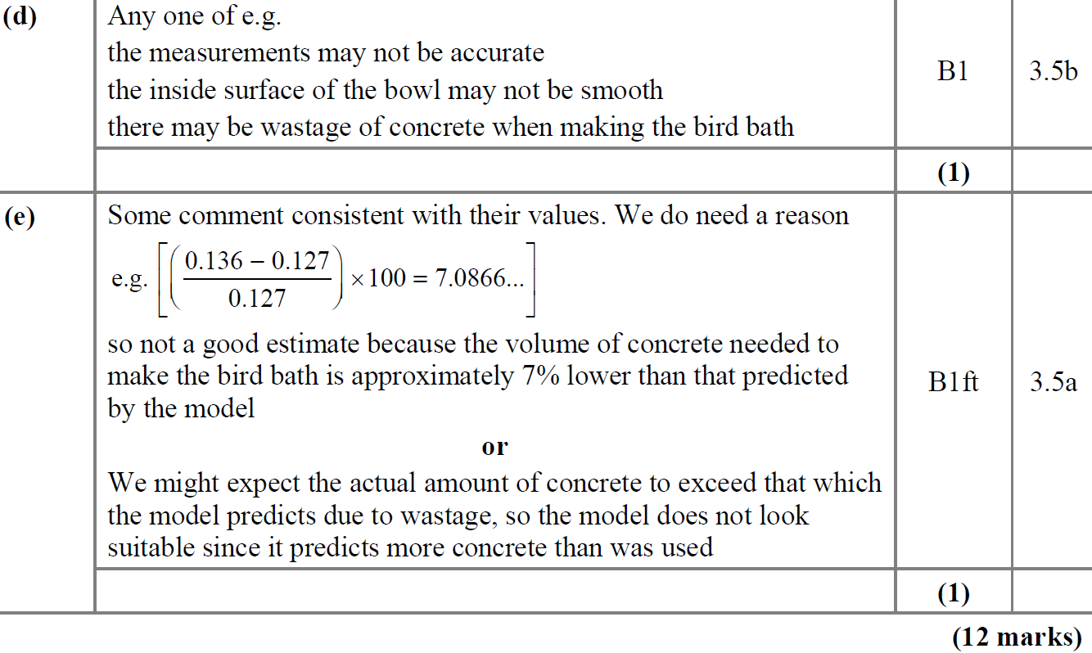
SAM
D
E

Slide 6
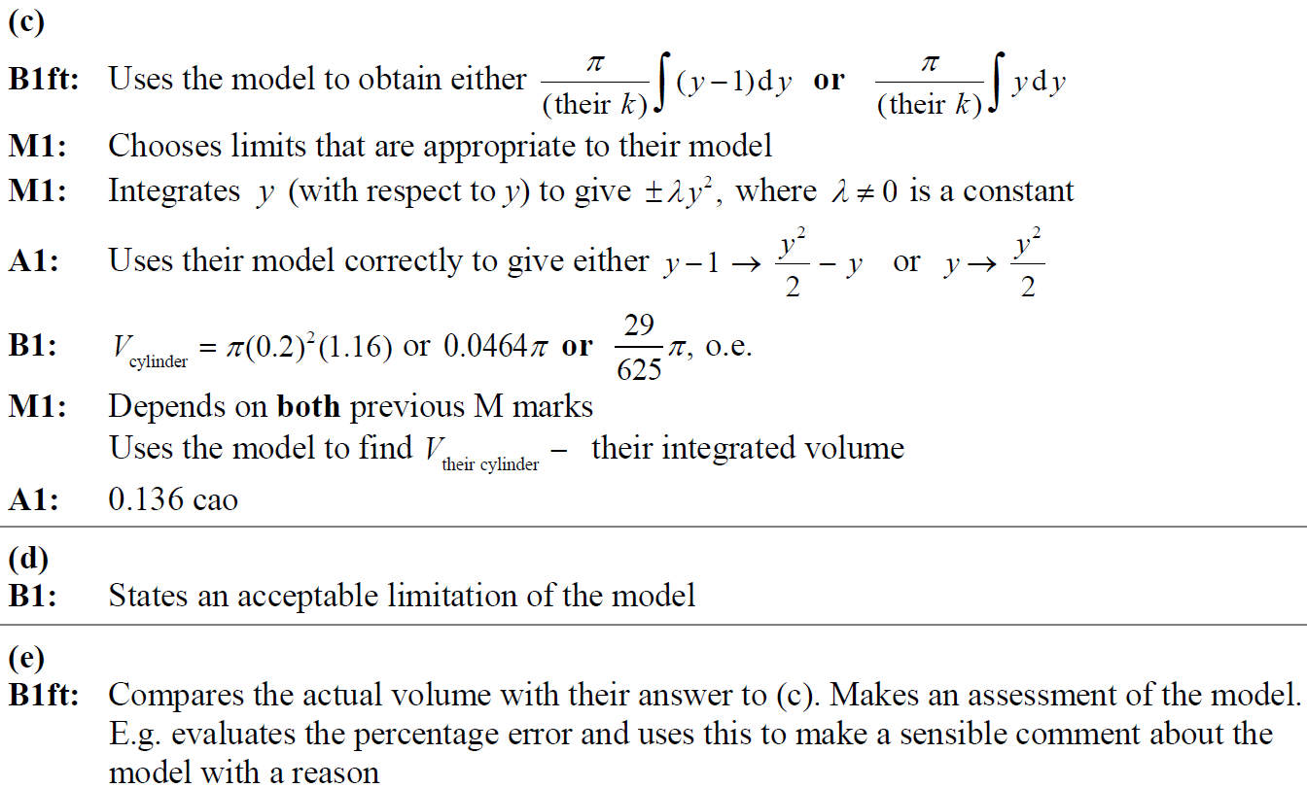
SAM
C notes
D notes
E notes

Slide 7
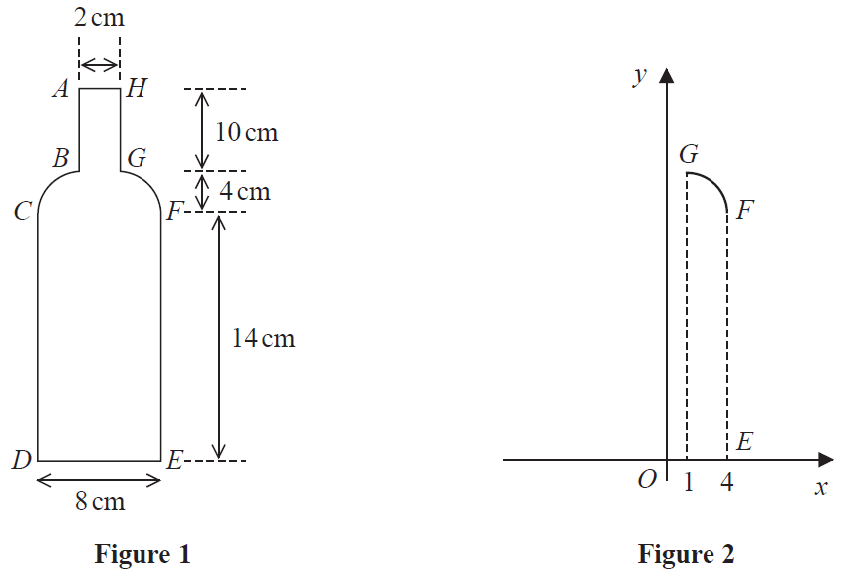
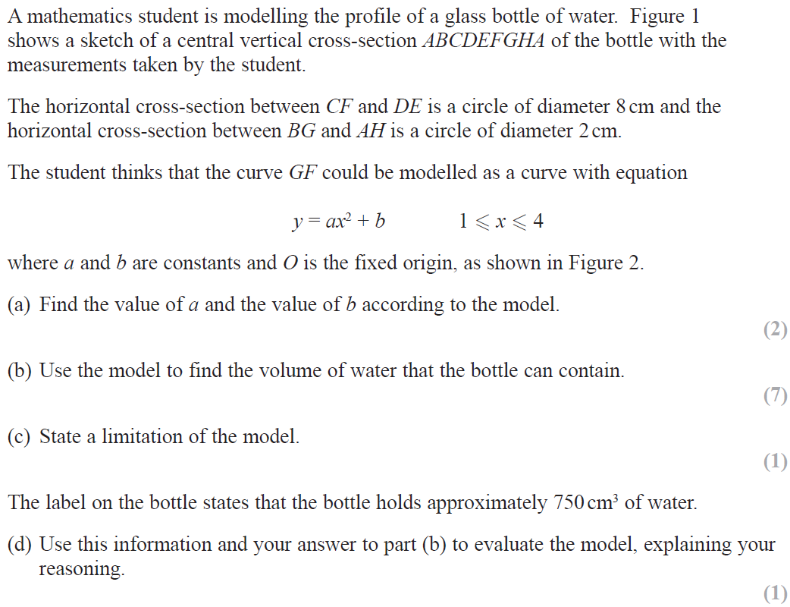
2018

Slide 8
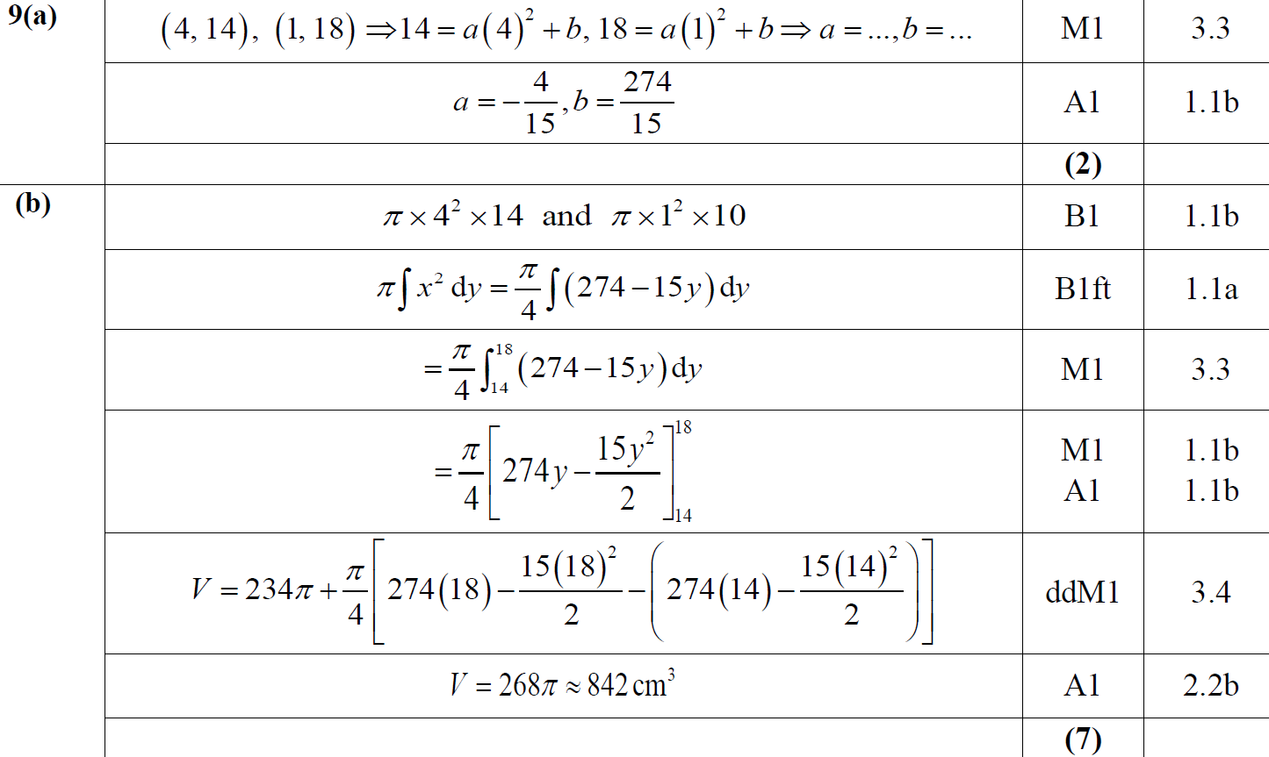
2018
A
B

Slide 9
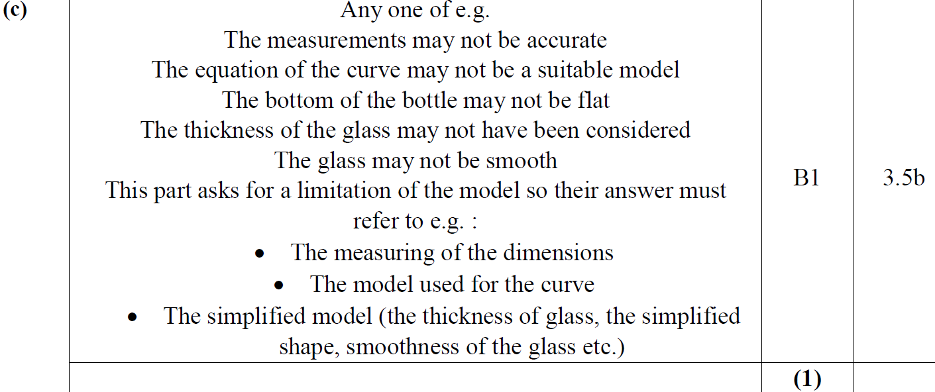
2018
C

Slide 10
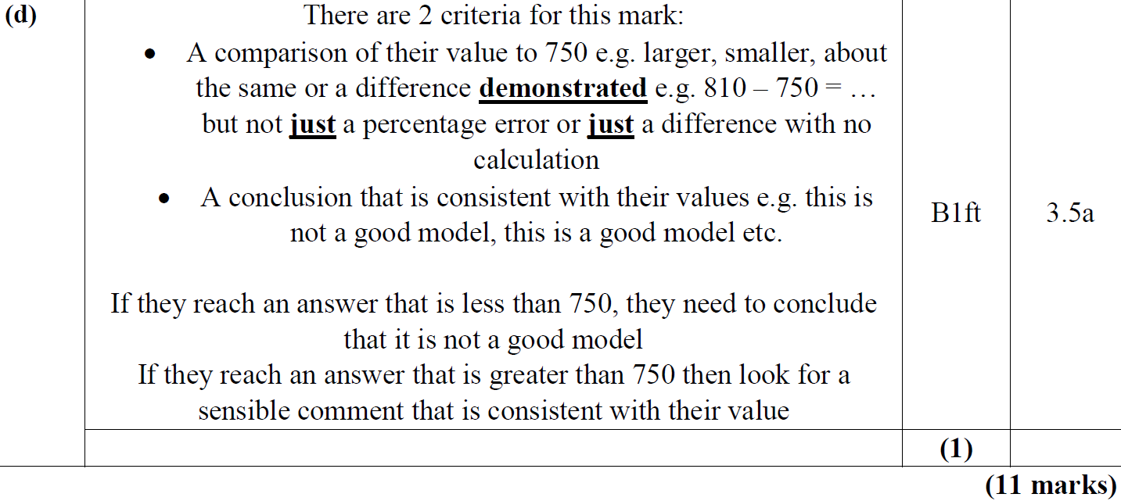
2018
D

Slide 11
2018
A notes
B notes

Slide 12
2018
A SF

Slide 13
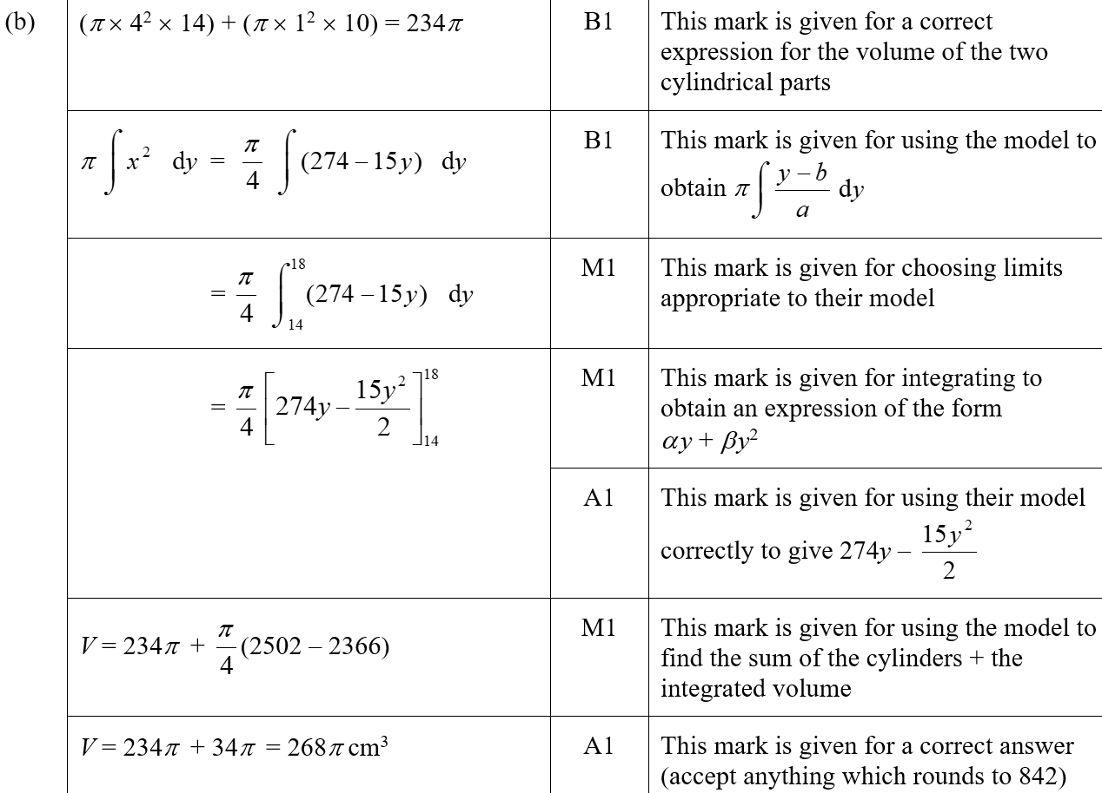
2018
B SF

Slide 14
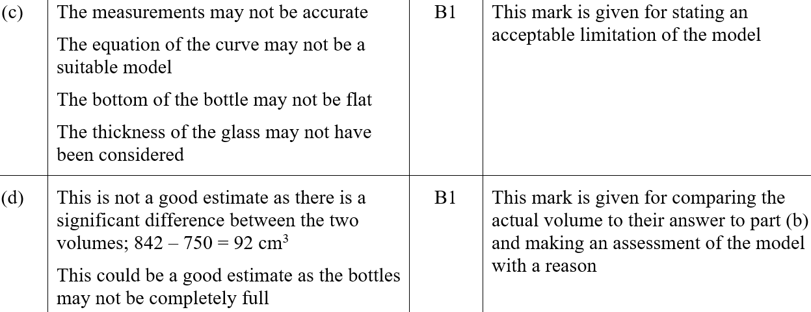
2018
C SF
D SF

Slide 15
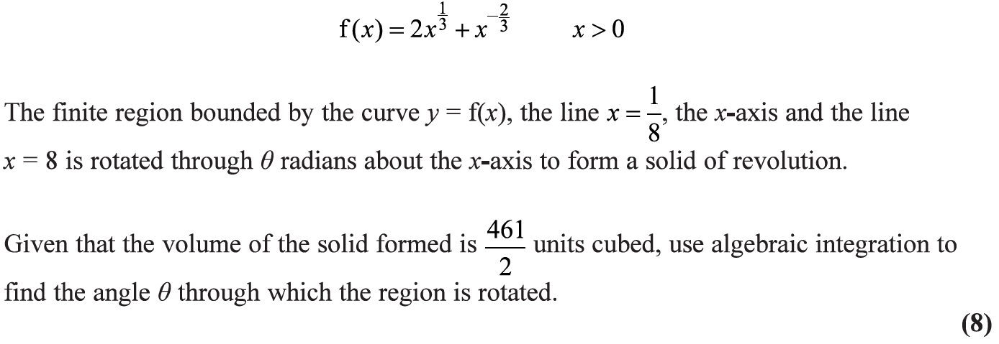
2019

Slide 16
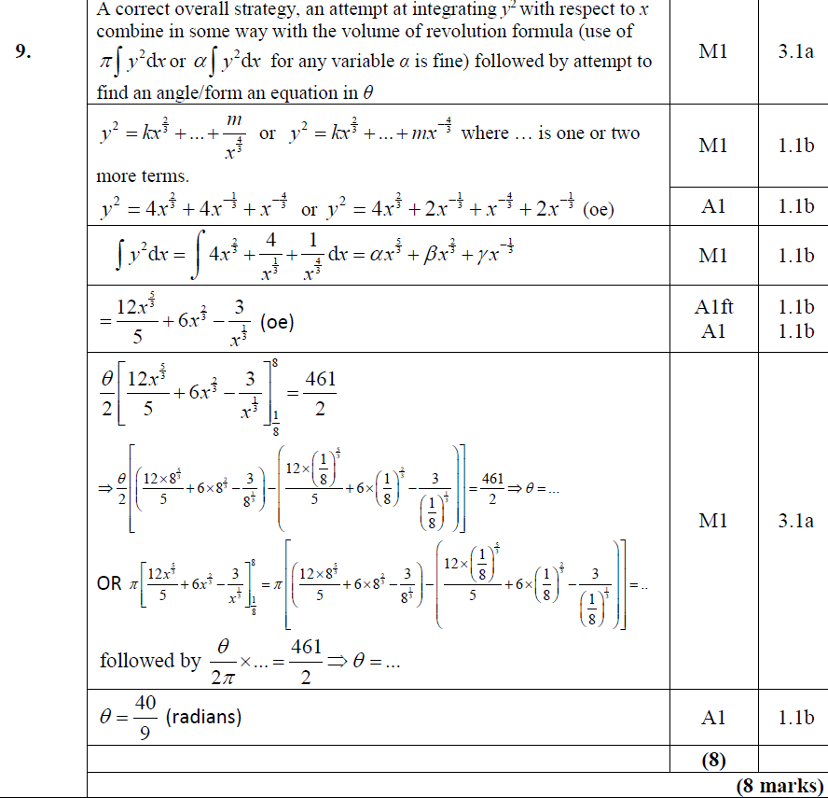
2019
A

Slide 17
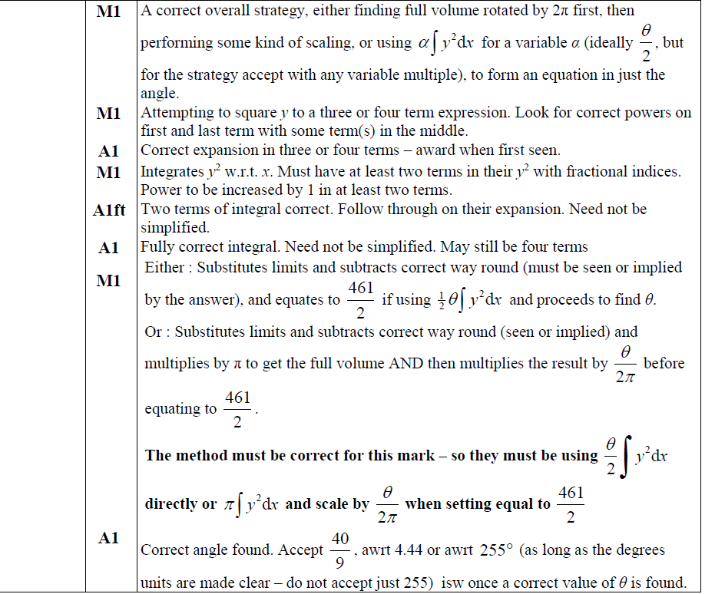
2019
A notes

Slide 18
2019
Special Case

Slide 19
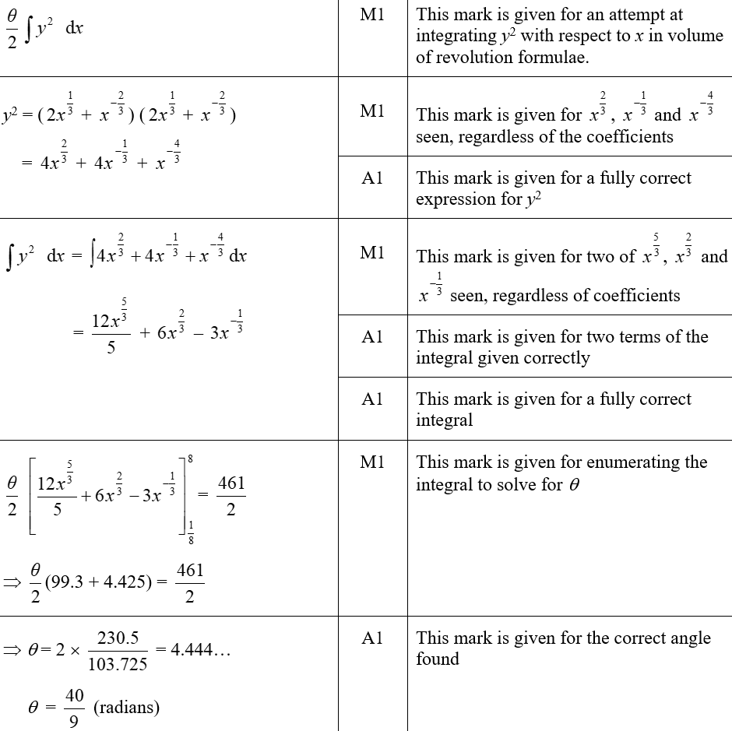
2019
A SF

Slide 20
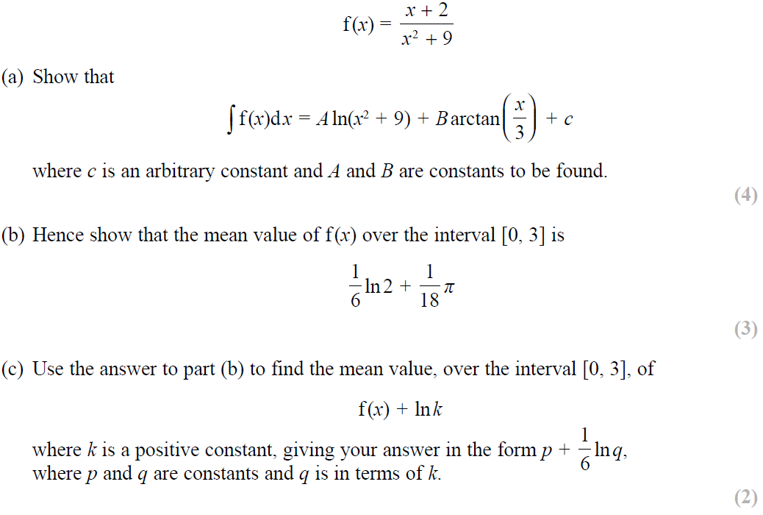
SAM Paper 1

Slide 21
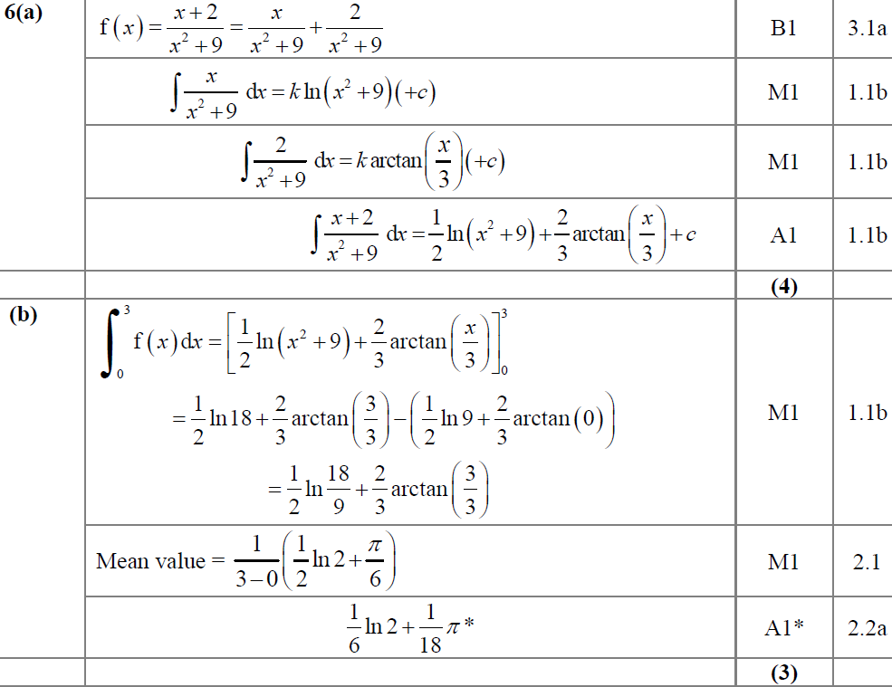
SAM Paper 1
A
B

Slide 22
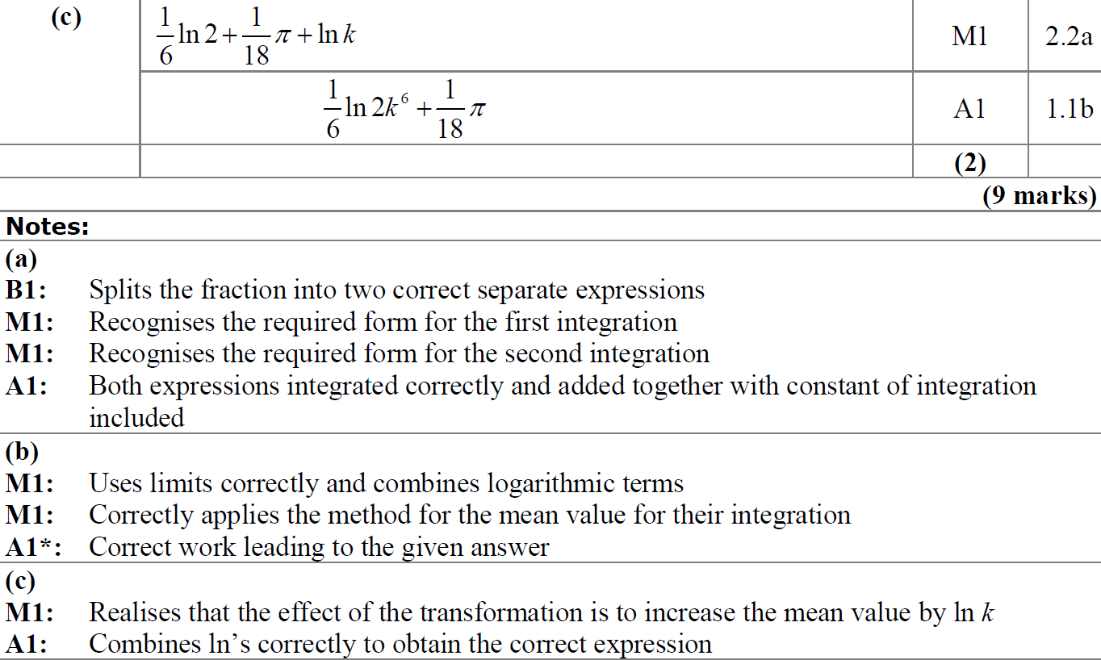
SAM Paper 1
C
A notes
B notes
C notes

Slide 23
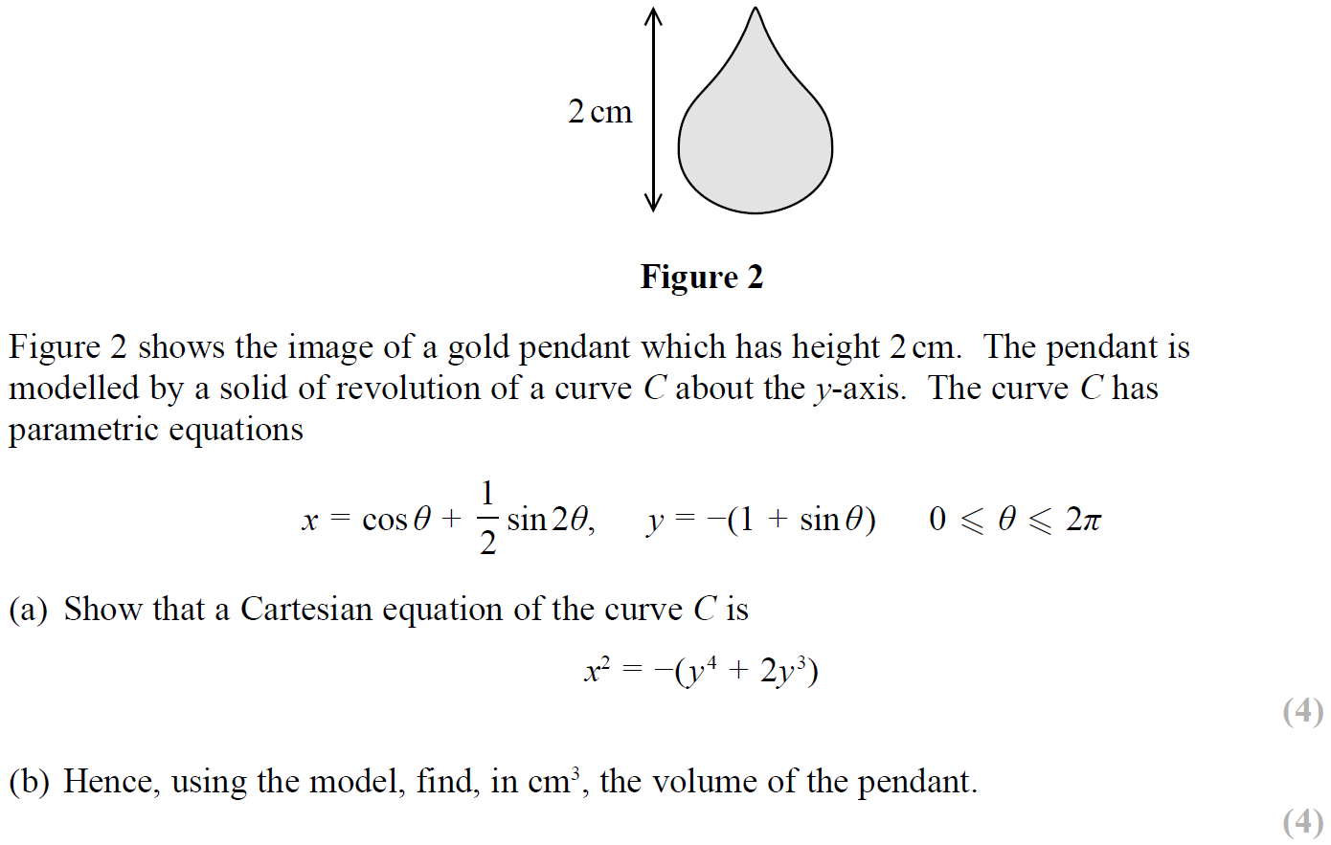
SAM Paper 1

Slide 24
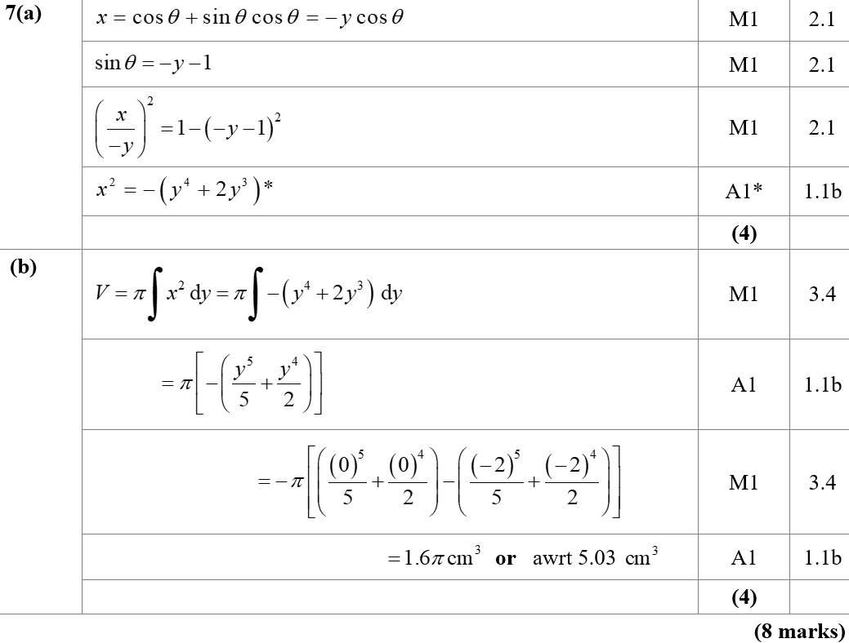
SAM Paper 1
A
B

Slide 25
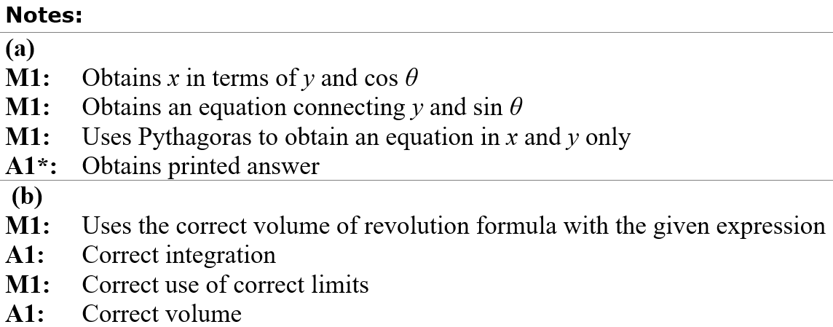
SAM Paper 1
A notes
B notes

Slide 26
2019 Paper 1

Slide 27
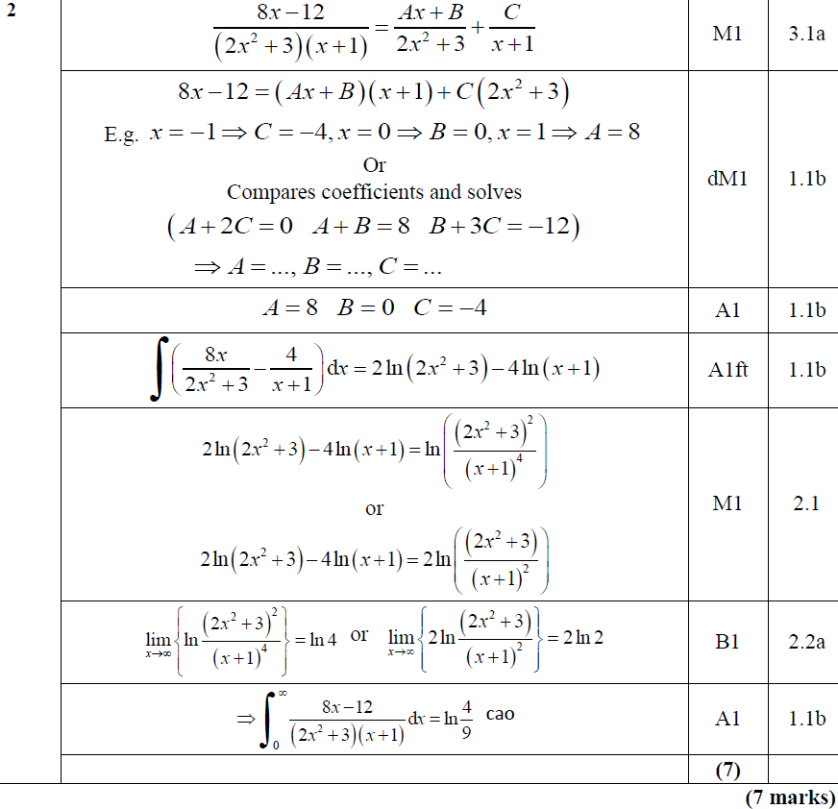
2019 Paper 1
A

Slide 28
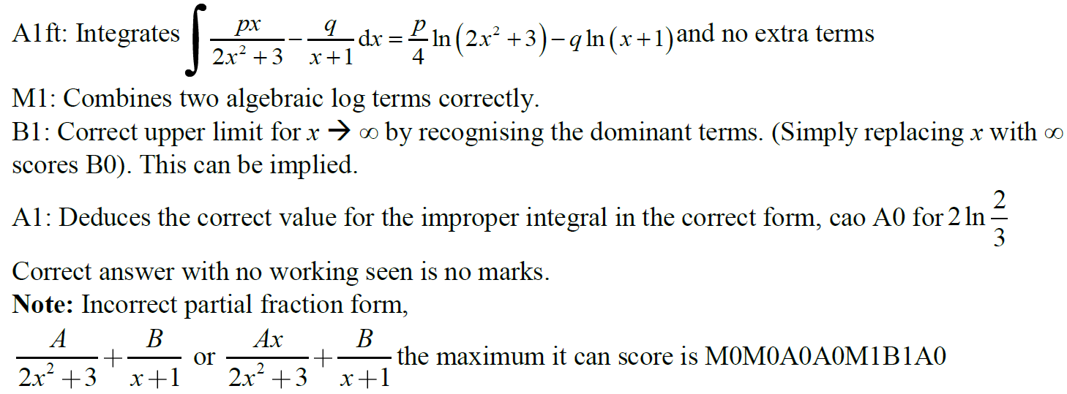
2019 Paper 1
A notes

Slide 29
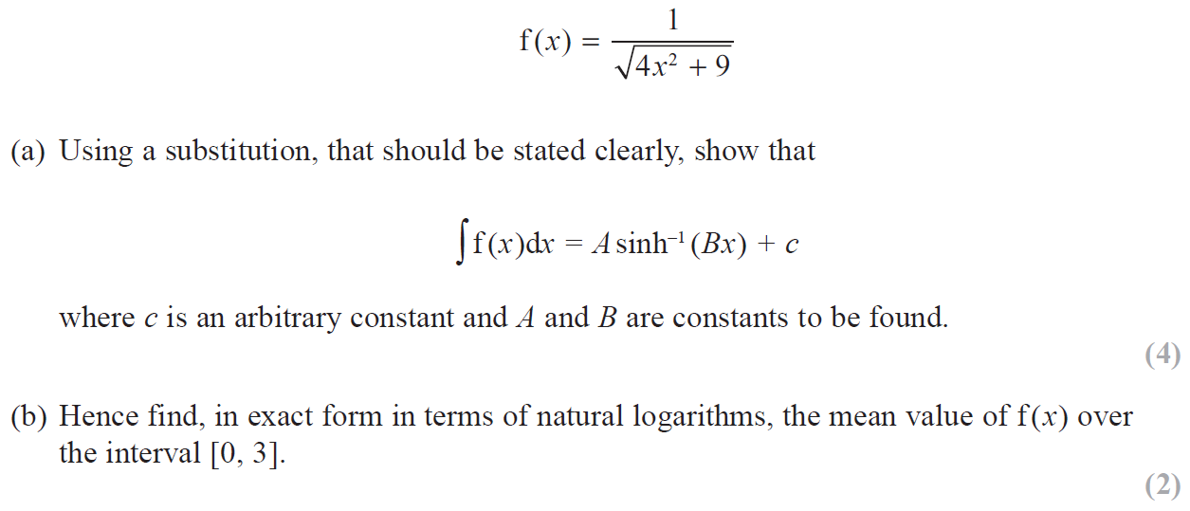
2019 Paper 2

Slide 30
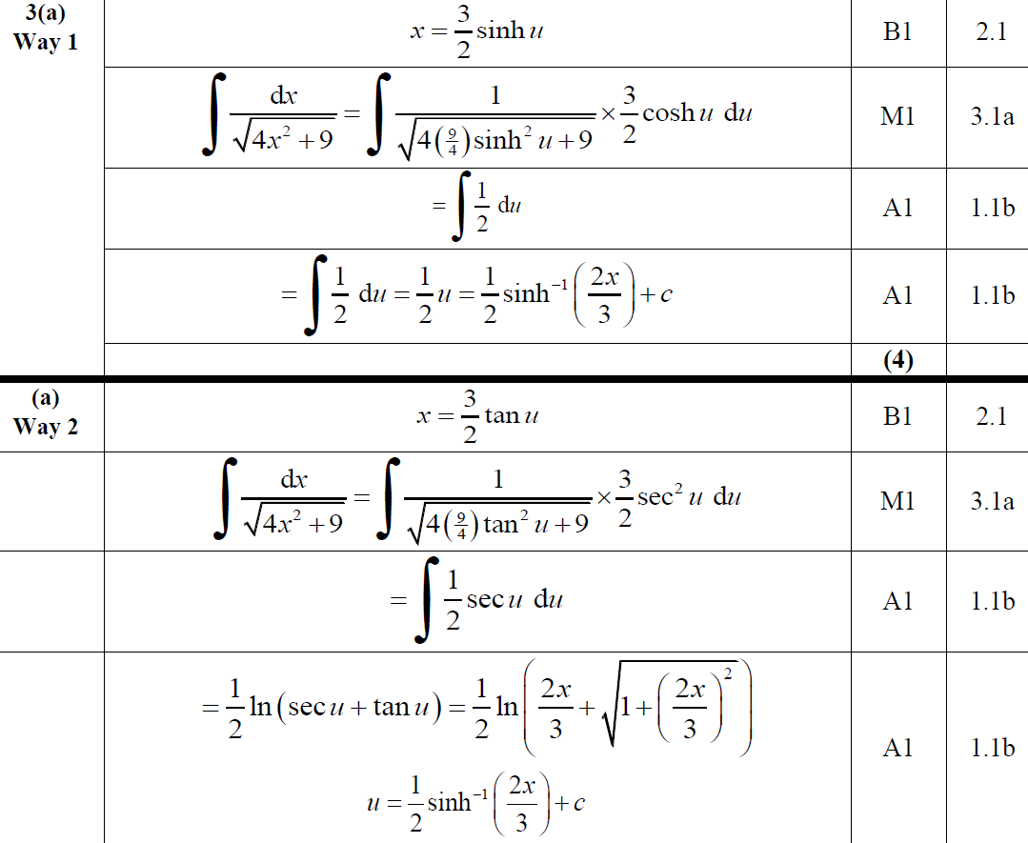
2019 Paper 2
A
A Alternative 1

Slide 31
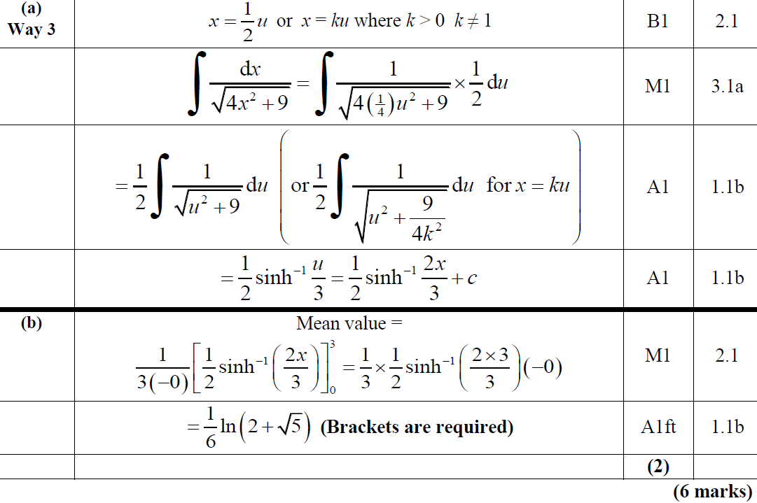
2019 Paper 2
A Alternative 2
B

Slide 32
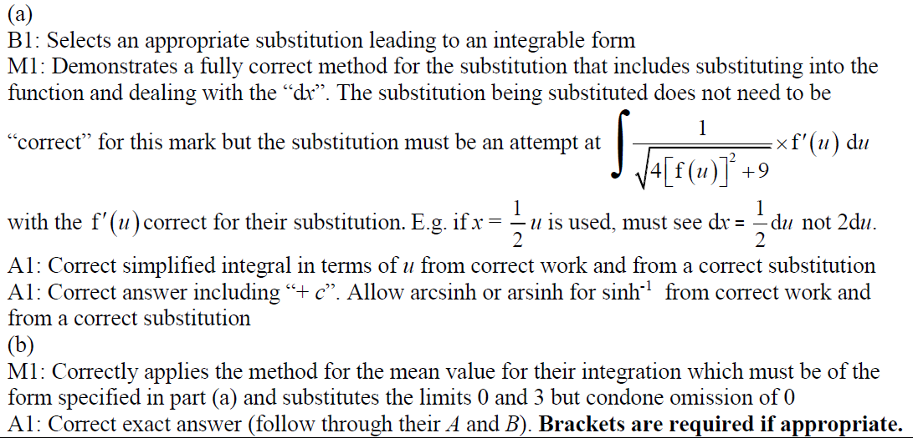
2019 Paper 2
A notes
B notes

Slide 33
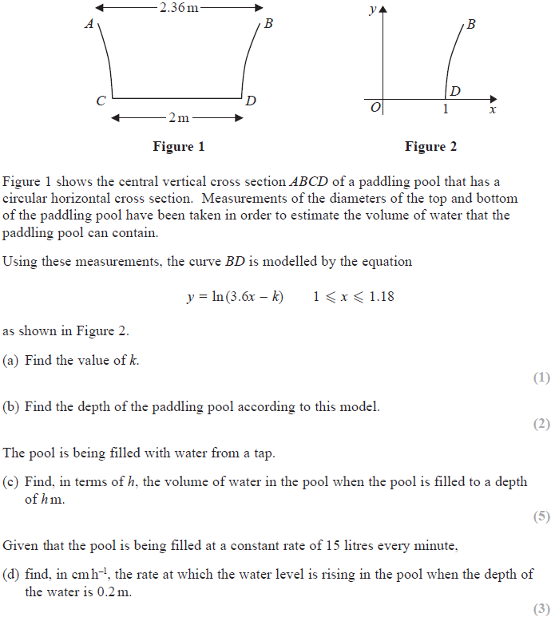
2019 Paper 2

Slide 34
2019 Paper 2
A
B

Slide 35
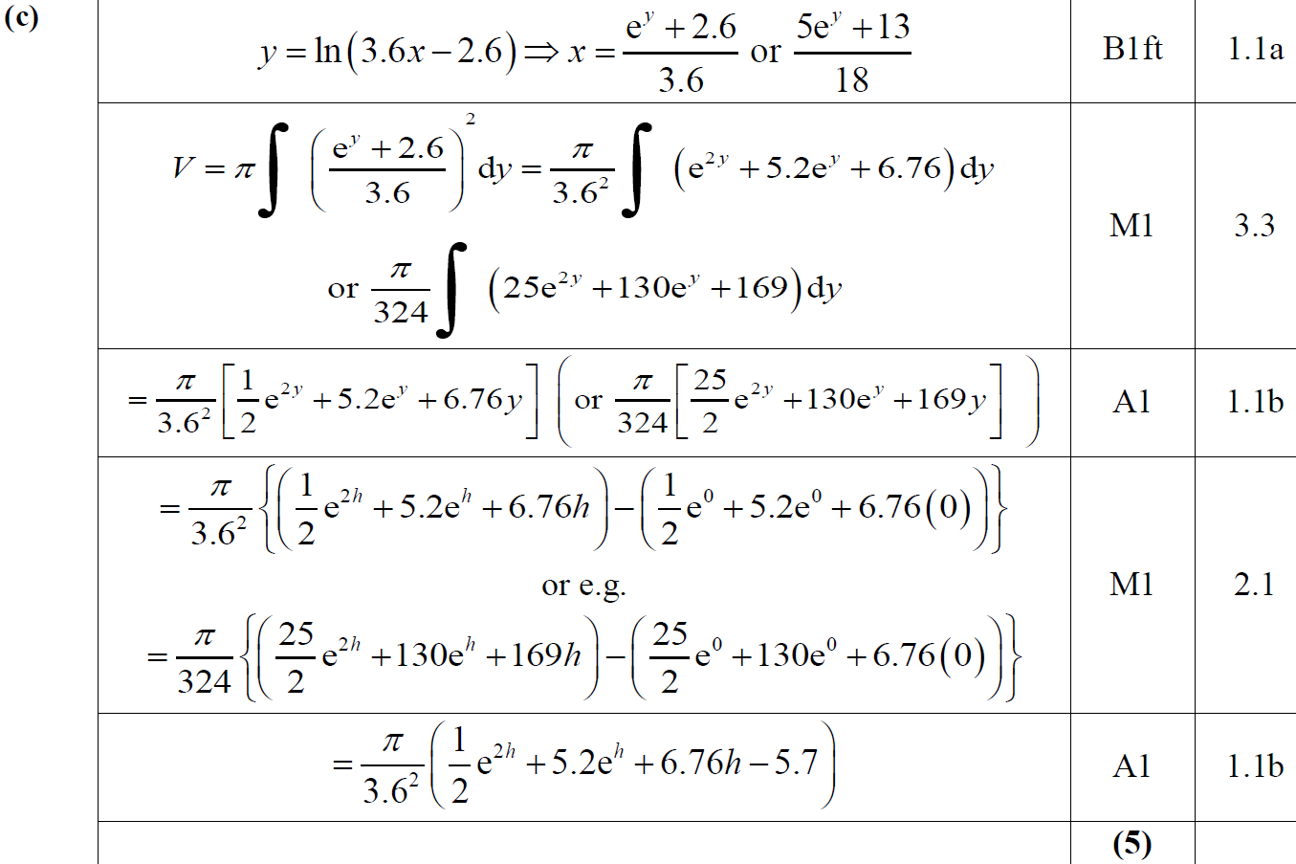
2019 Paper 2
C

Slide 36
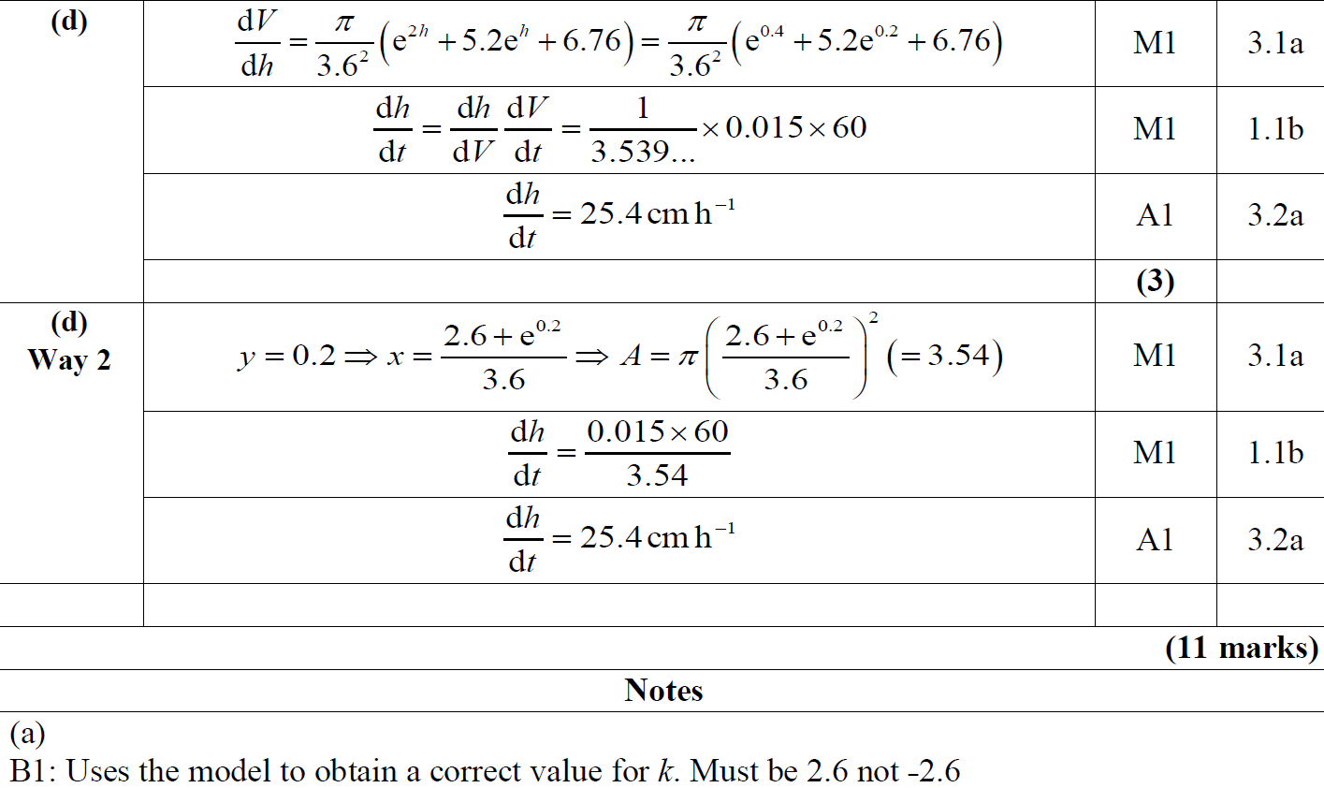
2019 Paper 2
D
A notes

Slide 37
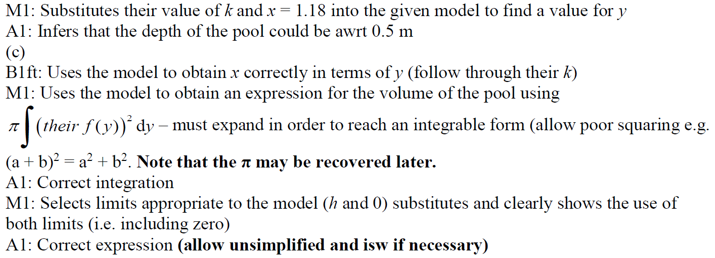
2019 Paper 2
B notes
C notes

Slide 38
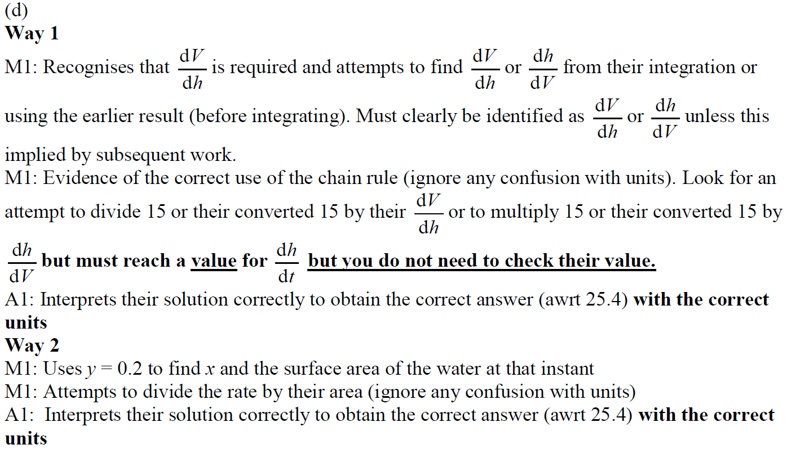
2019 Paper 2
D notes

Slide 39
New Spec Q’s
Old Spec Integration
Partial Fractions
C4 volumes of revolution
P5/ Old FP2
FP3
M3
Vol. of rev.
Jan 2006
June 2011
June 2002
June 2010
June 2009
Mean values
June 2006
Jan 2012
June 2005
June 2011
May 2014
Jan 2007
Jan 2013
June 2013 W
May 2015
June 2007 T
June 2013 T
June 2014 R
Jan 2008
June 2014
June 2017
Jan 2009
June 2015
June 2009
June 2016
Jan 2010 Sub
June 2017
Jan 2011
June 2018

Slide 40
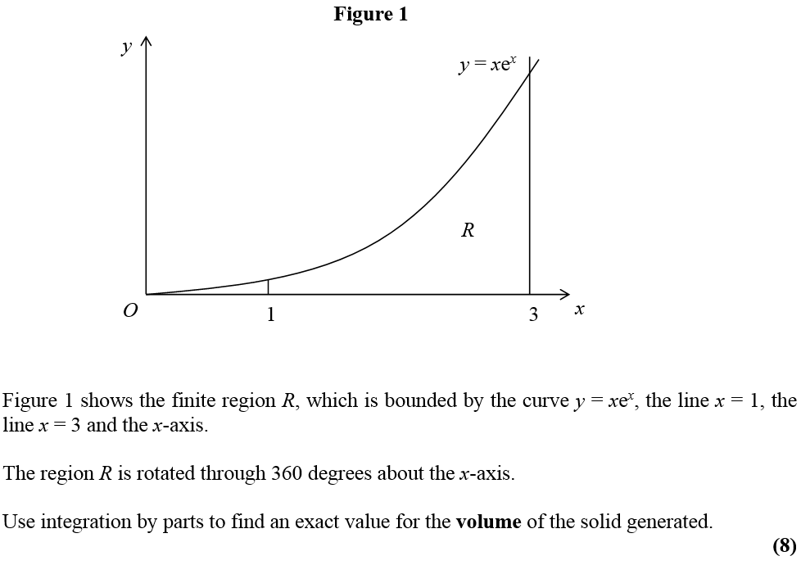
Jan 2006

Slide 41
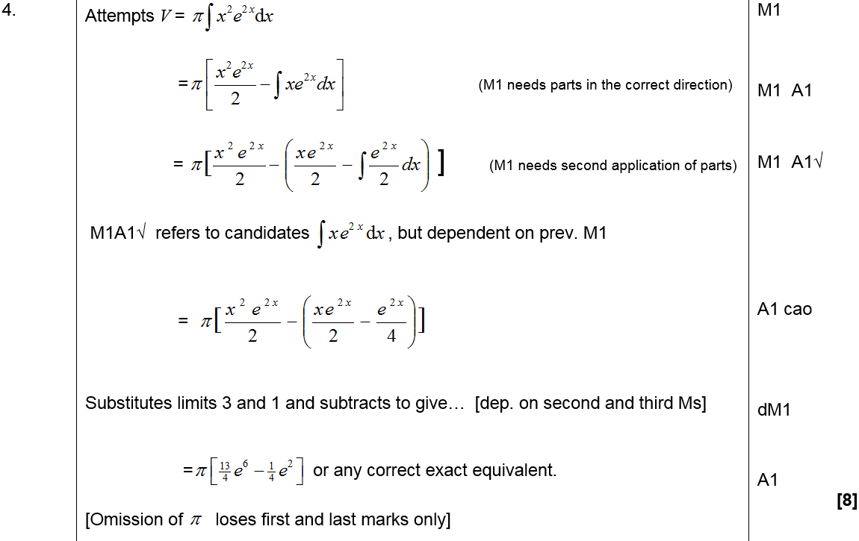
Jan 2006
A

Slide 42
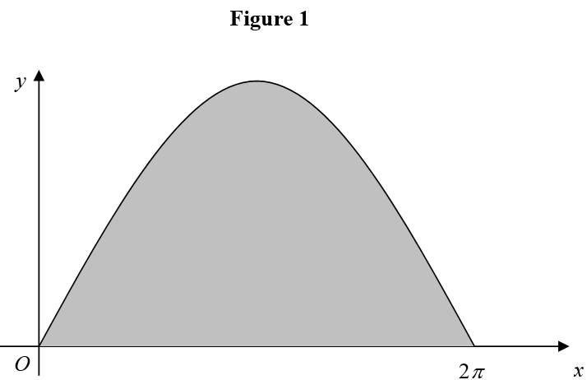
June 2006

Slide 43
June 2006
A

Slide 44
June 2006
B

Slide 45
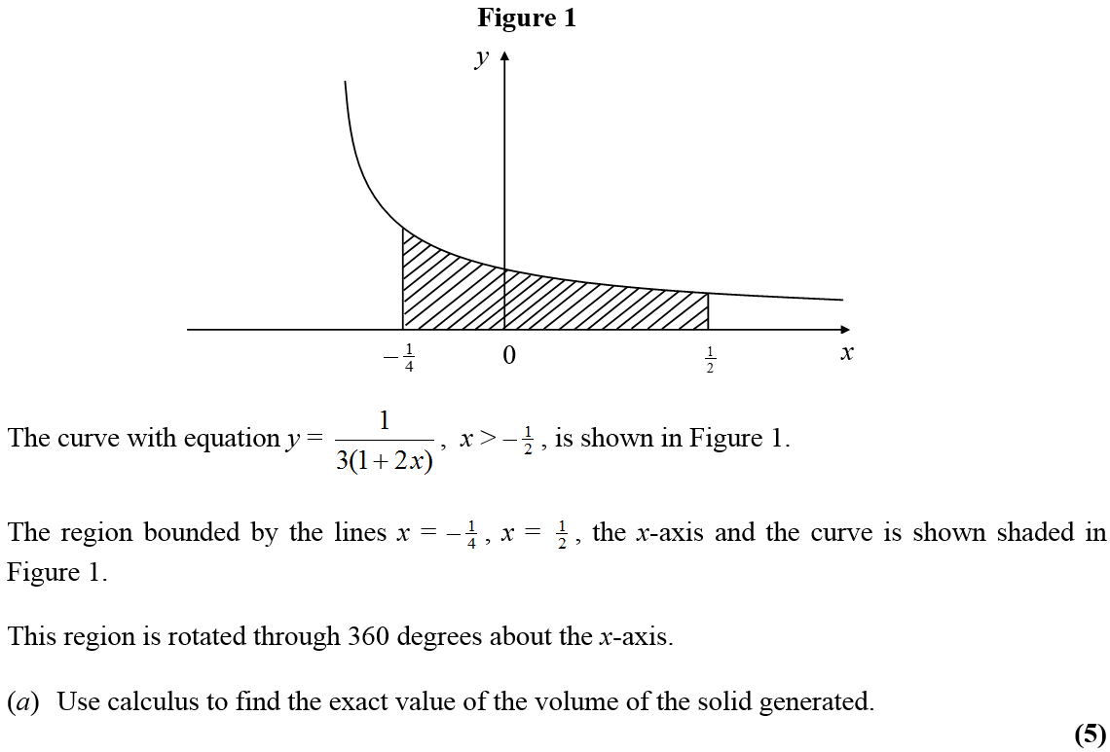
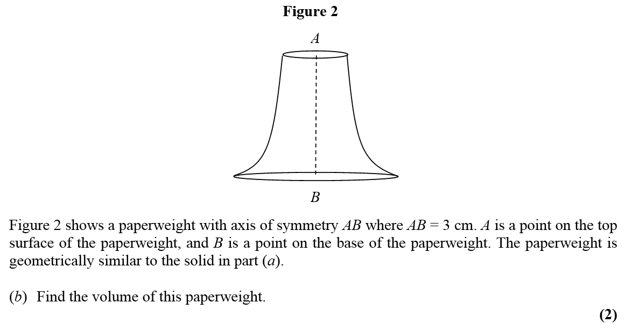
Jan 2007

Slide 46
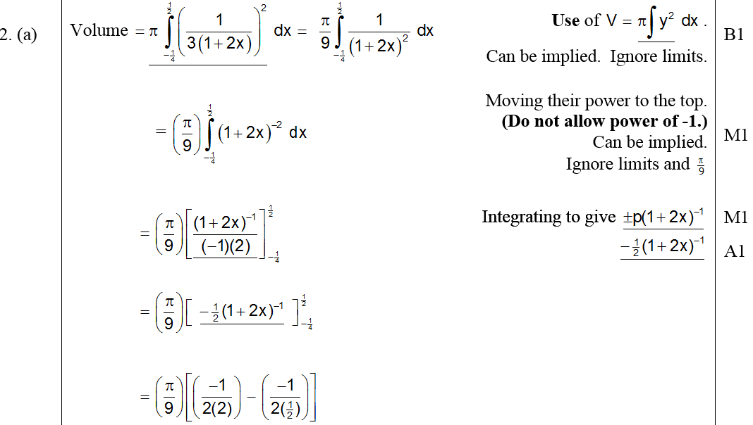
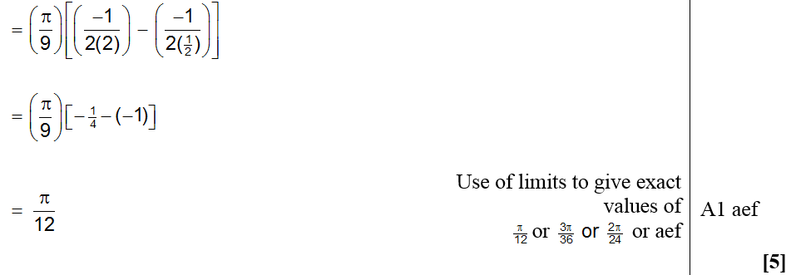
Jan 2007
A

Slide 47
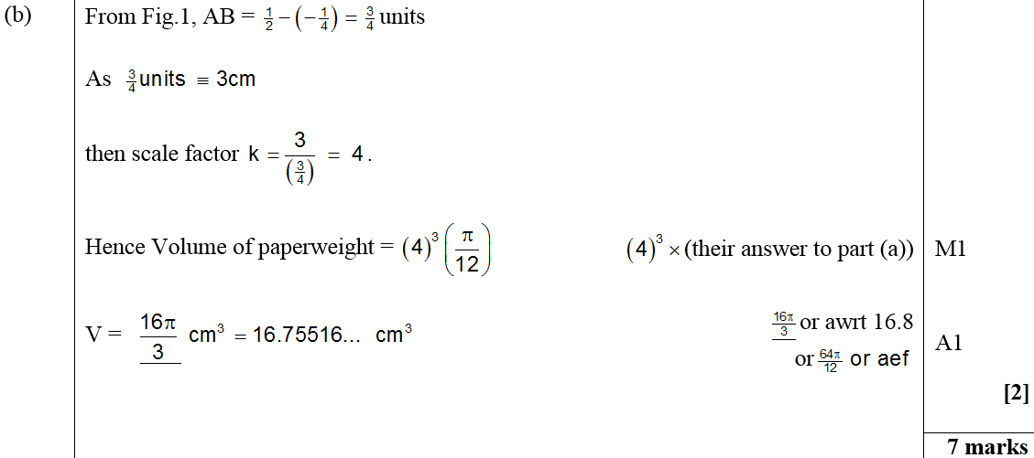
Jan 2007
B

Slide 48
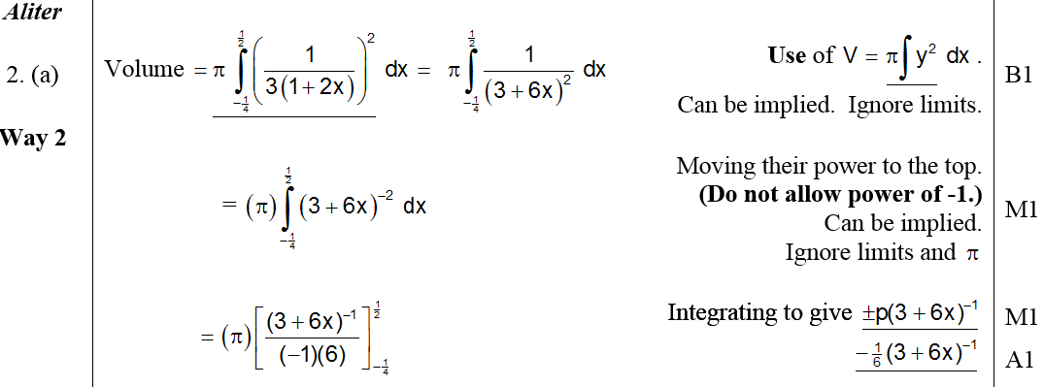
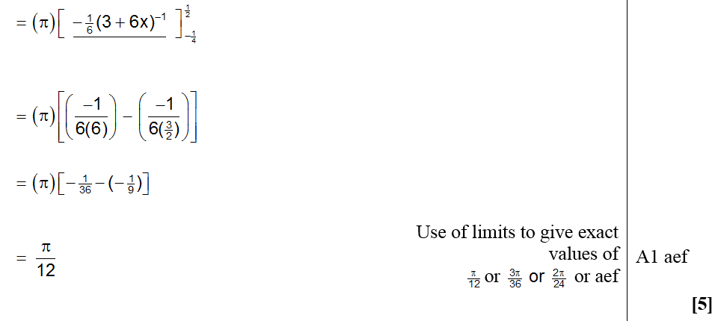
Jan 2007
Alternative A

Slide 49
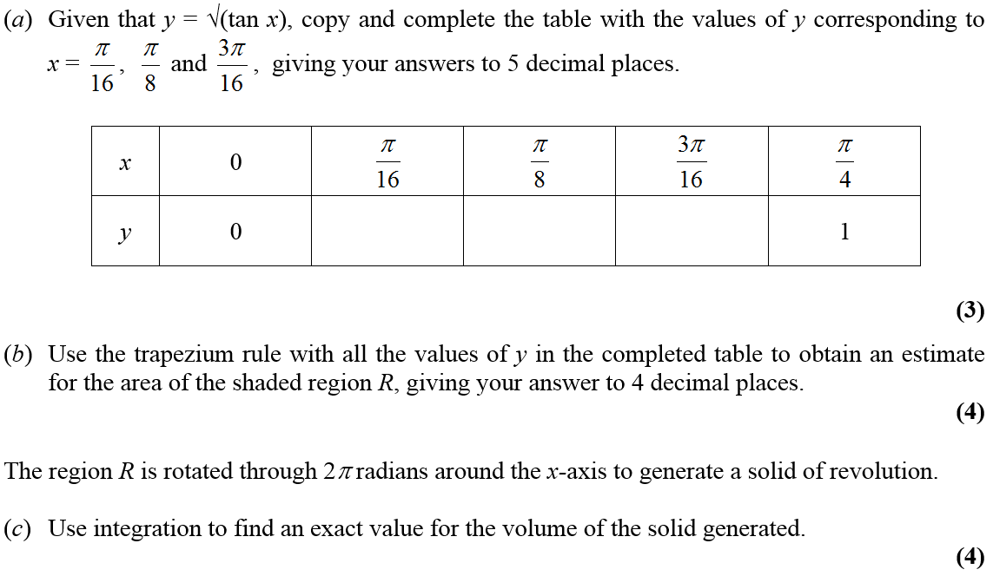
June 2007

Slide 50
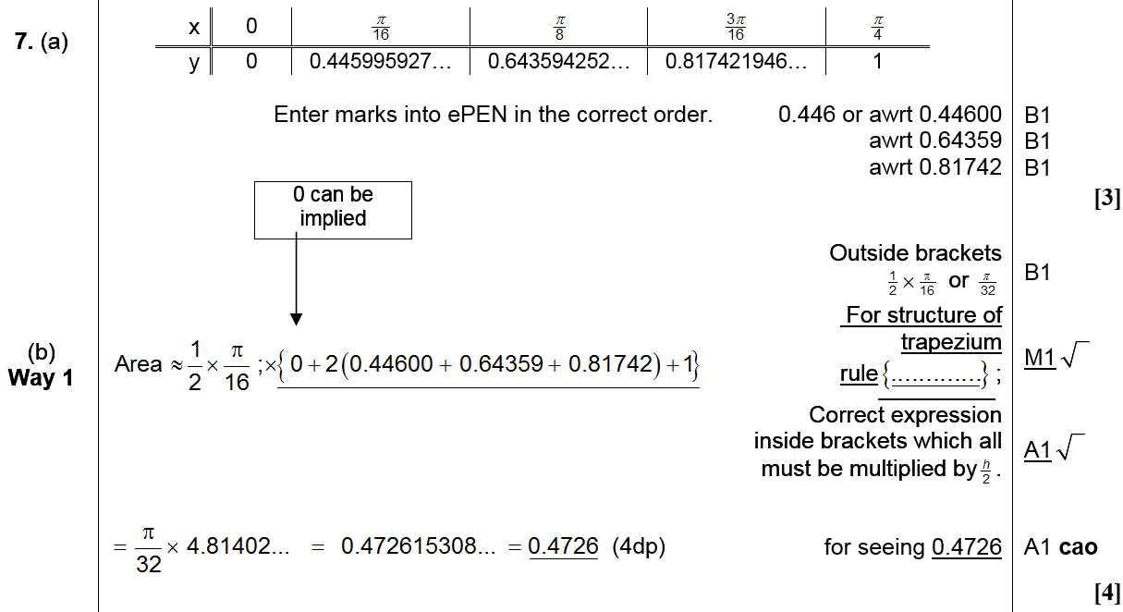
June 2007
A
B (Method 1)
A Notes

Slide 51
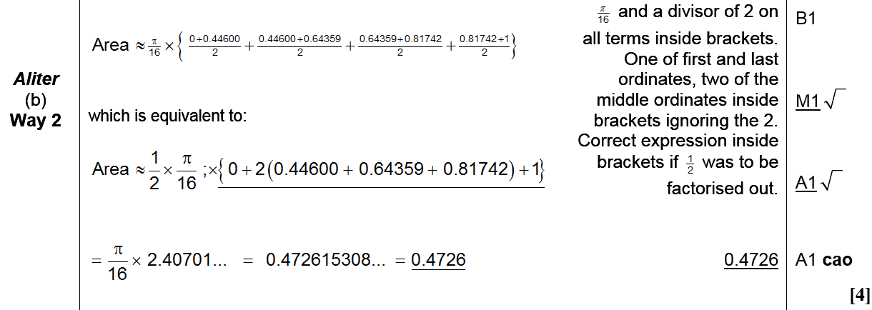
June 2007
B (Method 2)
B Notes

Slide 52
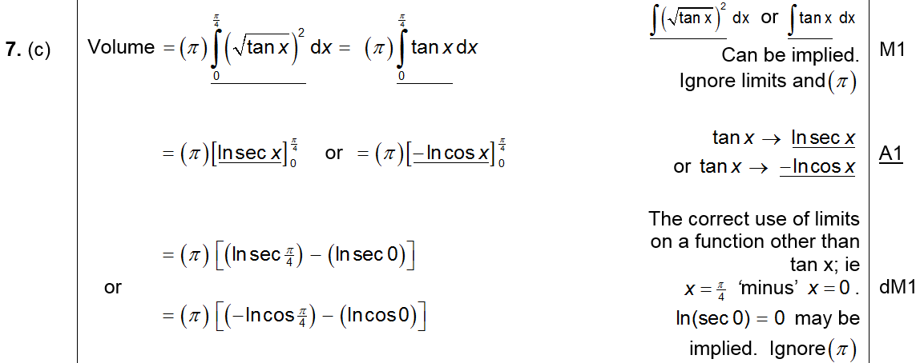
June 2007
C

Slide 53
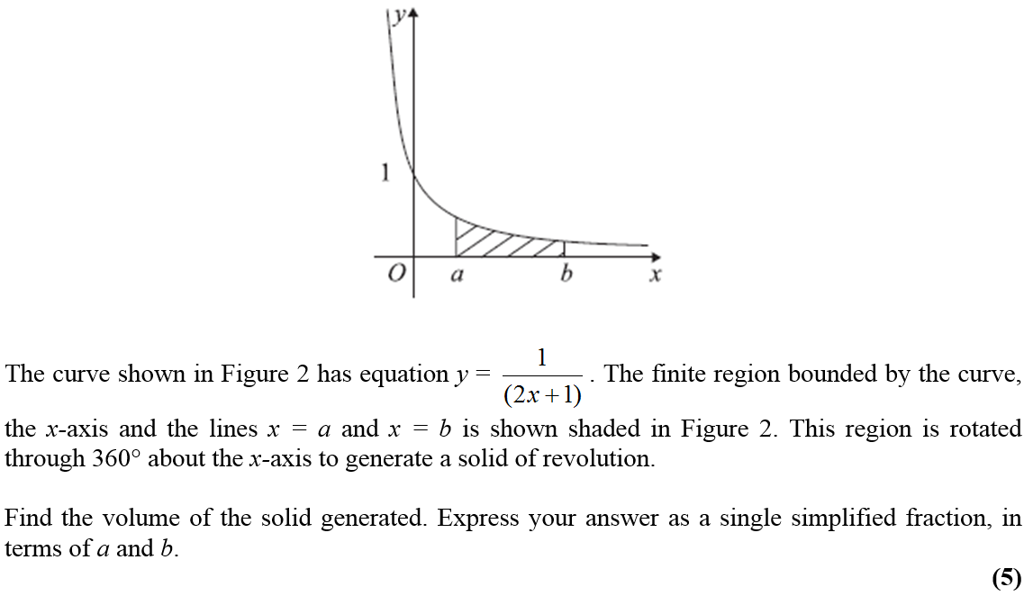
Jan 2008

Slide 54
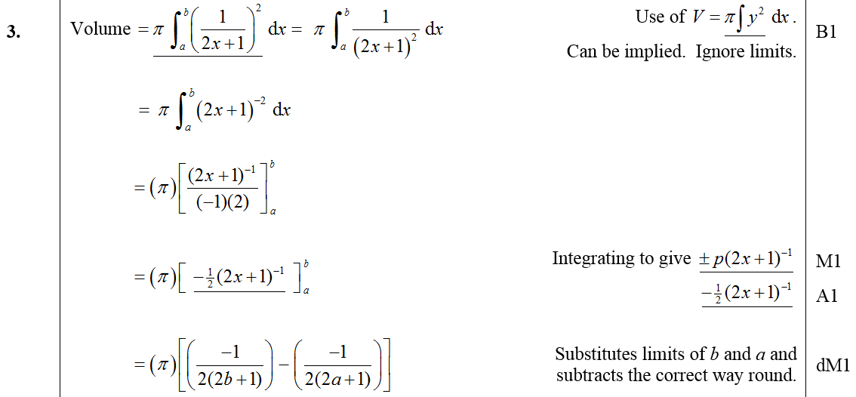
Jan 2008
A

Slide 55
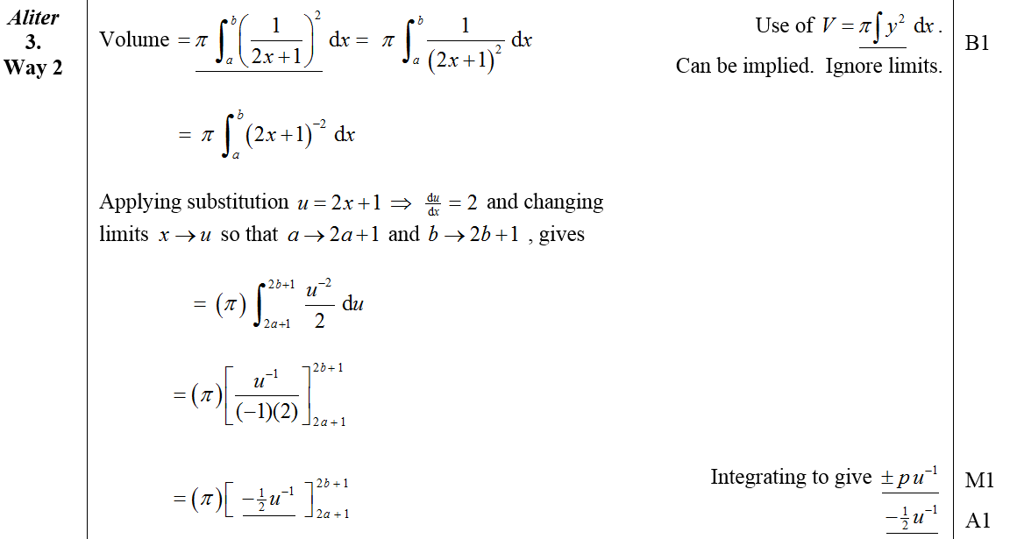
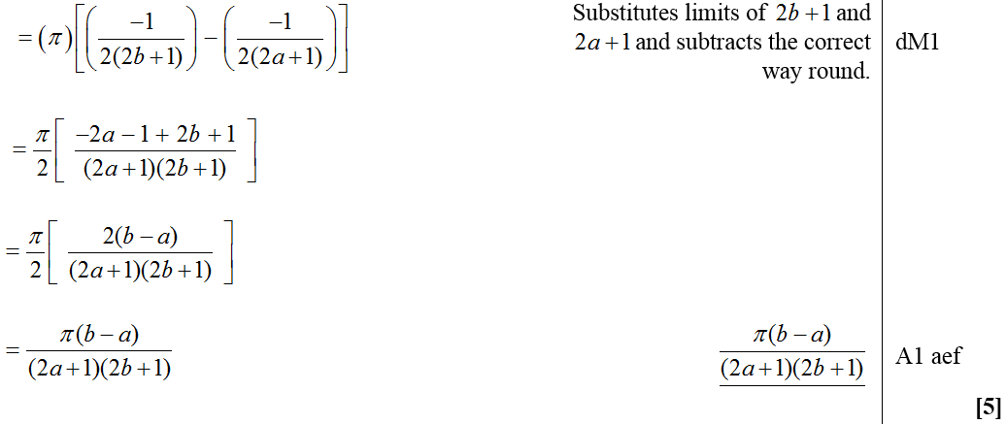
Jan 2008
Alternative A

Slide 56
Jan 2009

Slide 57
Jan 2009
A

Slide 58
Jan 2009
B

Slide 59
June 2009

Slide 60
June 2009
A
B

Slide 61
June 2009
C

Slide 62
Jan 2010

Slide 63
Jan 2010
A

Slide 64
Jan 2010
B

Slide 65
Jan 2011

Slide 66
Jan 2011
A
B

Slide 67
C
Jan 2011
Alternative C

Slide 68
June 2011

Slide 69
June 2011
A
B

Slide 70
June 2011
C

Slide 71
Jan 2012

Slide 72
Jan 2012
A
Note

Slide 73
Jan 2012
Working in x
Working in u

Slide 74
Jan 2013

Slide 75
Jan 2013
A

Slide 76
Jan 2013
B

Slide 77
June 2013

Slide 78
June 2013
A
B
C

Slide 79
June 2014

Slide 80
June 2014
A

Slide 81
June 2014
B

Slide 82
June 2015

Slide 83
June 2015
A

Slide 84
June 2015
B

Slide 85
June 2015
B Alternative

Slide 86
June 2015
A notes

Slide 87
June 2015
B notes

Slide 88
June 2015
B notes on volume of cone

Slide 89
June 2016

Slide 90
June 2016
A
B

Slide 91
June 2016
C

Slide 92
June 2016
C Alternative

Slide 93
June 2016
B notes
C notes

Slide 94
June 2016
notes on misreading in B and C

Slide 95
June 2017

Slide 96
June 2017
A

Slide 97
June 2017
A notes

Slide 98
June 2017
A Alternative

Slide 99
June 2018

Slide 100
June 2018
A
A notes

Slide 101
June 2018
B

Slide 102
June 2018
B Alternative

Slide 103
June 2018
B notes

Slide 104
June 2018
B Alternative notes

Slide 105
June 2002

Slide 106
June 2002
A
B

Slide 107
June 2005

Slide 108
June 2005
A
B

Slide 109
June 2010

Slide 110
June 2010
A

Slide 111
June 2011

Slide 112
June 2011
A
B

Slide 113
June 2013 Withdrawn

Slide 114
June 2013 Withdrawn
A

Slide 115
June 2013 Withdrawn
B

Slide 116
June 2014 Reserve

Slide 117
June 2014 Reserve
A
B
C

Slide 118
June 2017

Slide 119
June 2017
A

Slide 120
June 2017
A Alternative

Slide 121
June 2009

Slide 122
June 2009
A
B

Slide 123
May 2014

Slide 124
May 2014
A

Slide 125
May 2014
B

Slide 126
May 2014
B notes

Slide 127
May 2015

Slide 128
May 2015
A

Slide 129
May 2015
B

Slide 130
May 2015
B notes

