Slide 1
Old Spec Q’s
Matrices
Series
Induction
SAM
SAM 1
2018
SAM 2
2019
2019 1

Slide 2
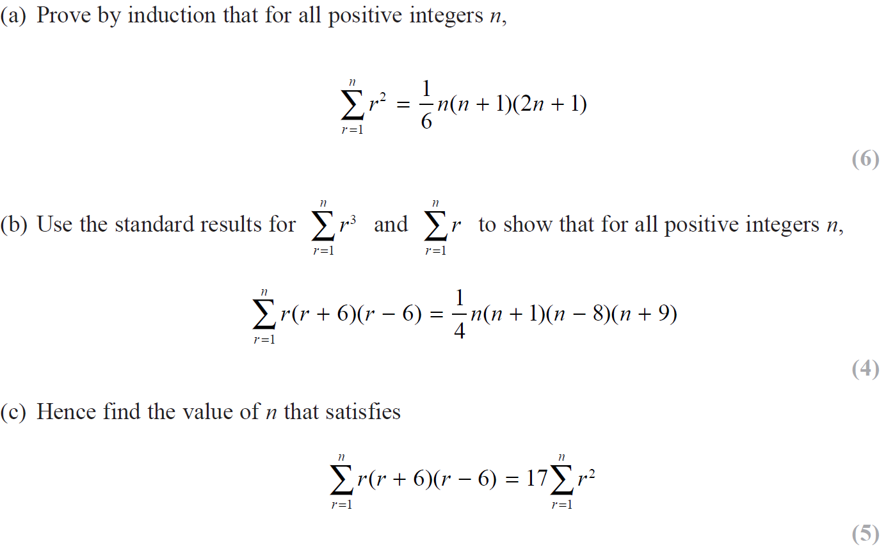
SAM

Slide 3
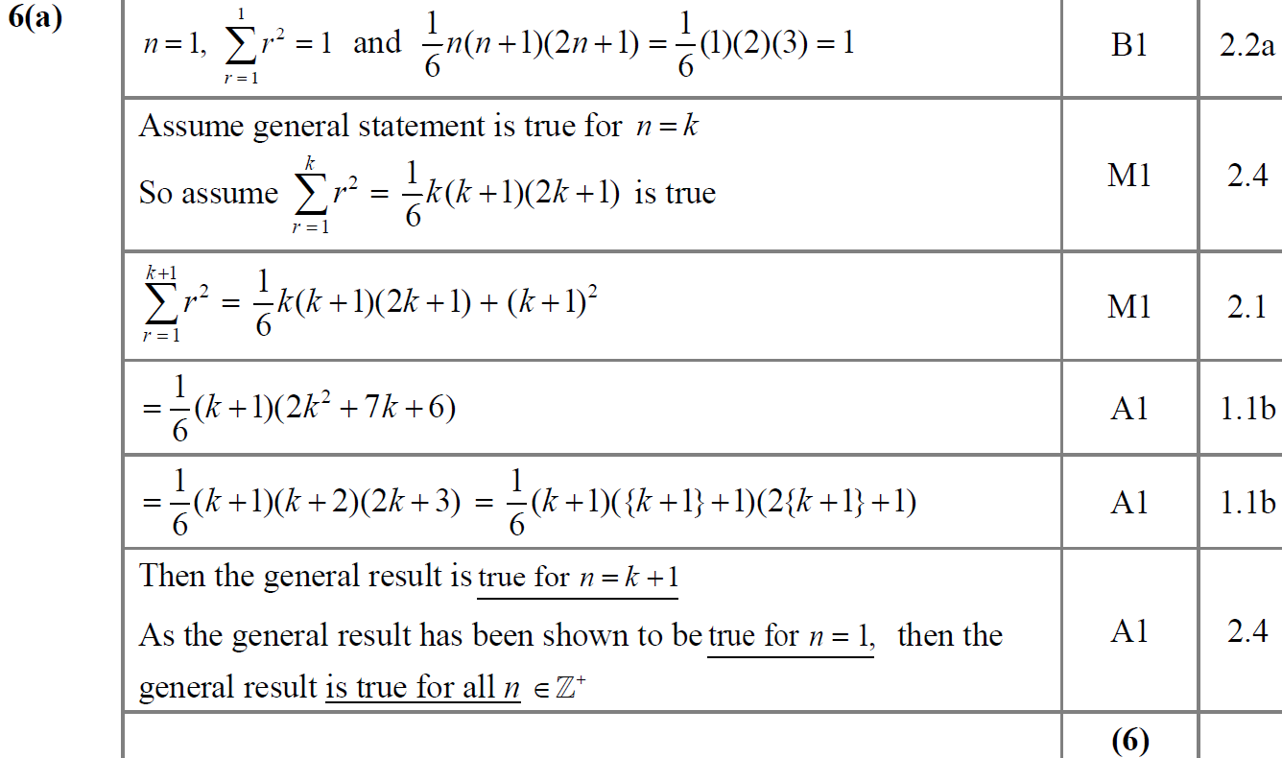
SAM
A

Slide 4
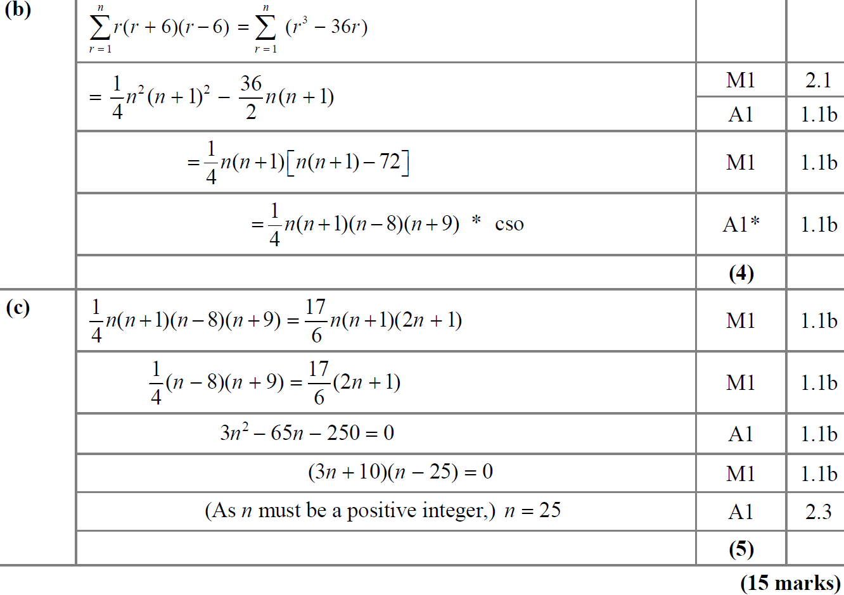
SAM
B
C

Slide 5
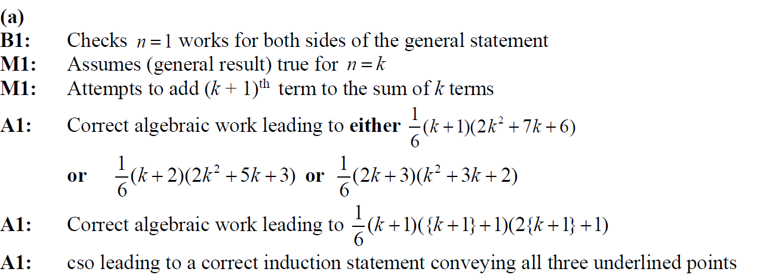
SAM
A notes

Slide 6
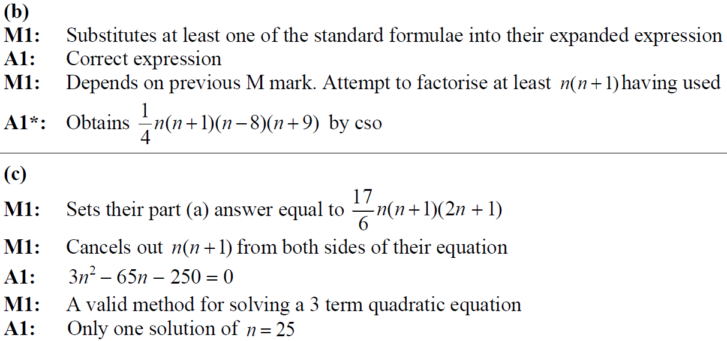
SAM
B notes
C notes

Slide 7
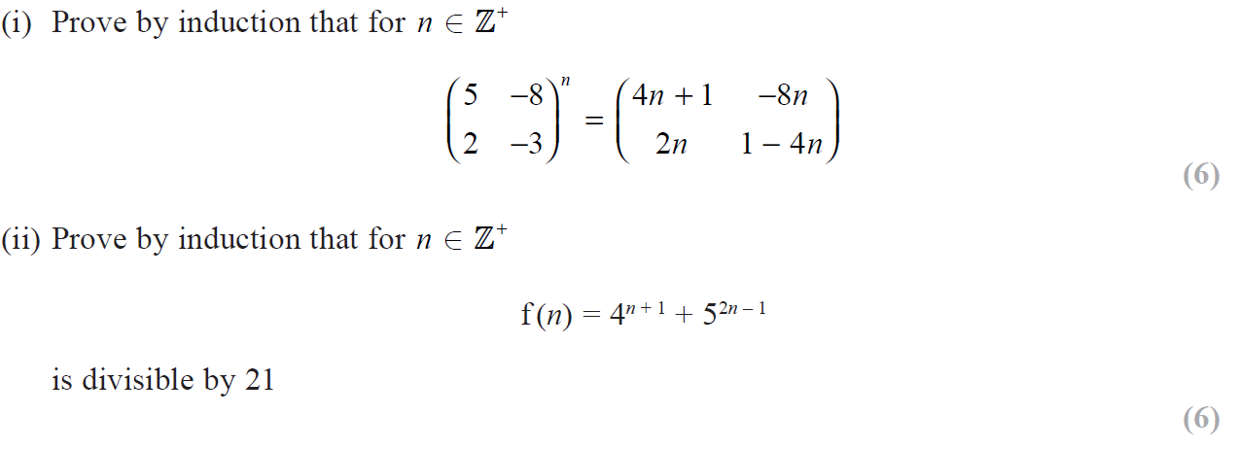
2018

Slide 8
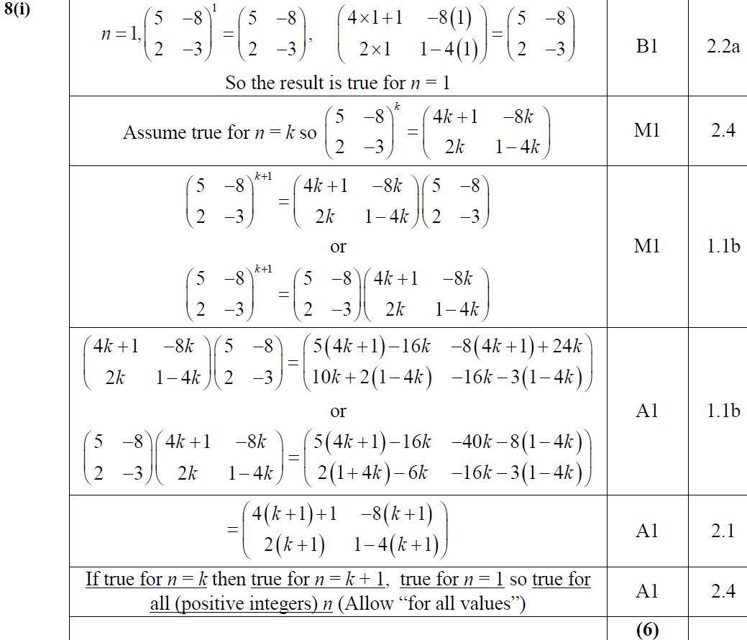
2018
(i)

Slide 9
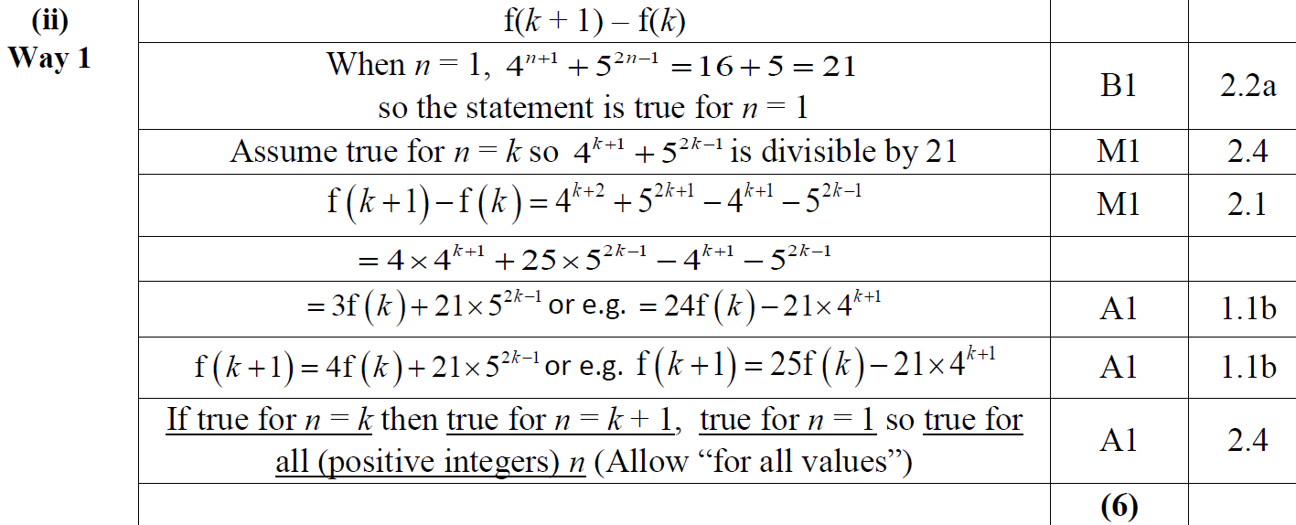
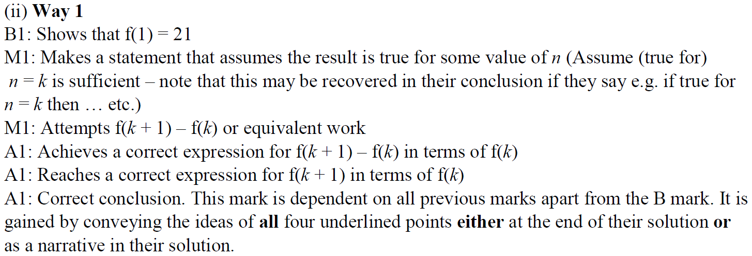
2018
(ii)

Slide 10
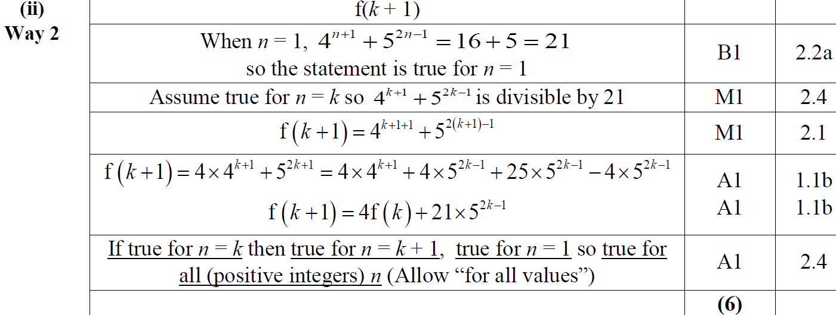
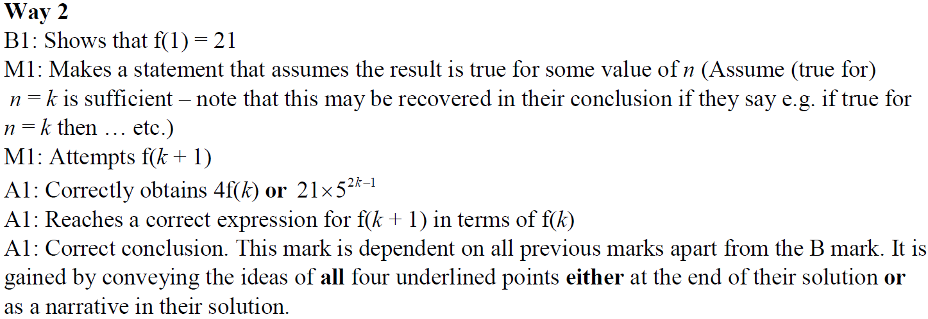
2018
(ii) Alternative 1

Slide 11
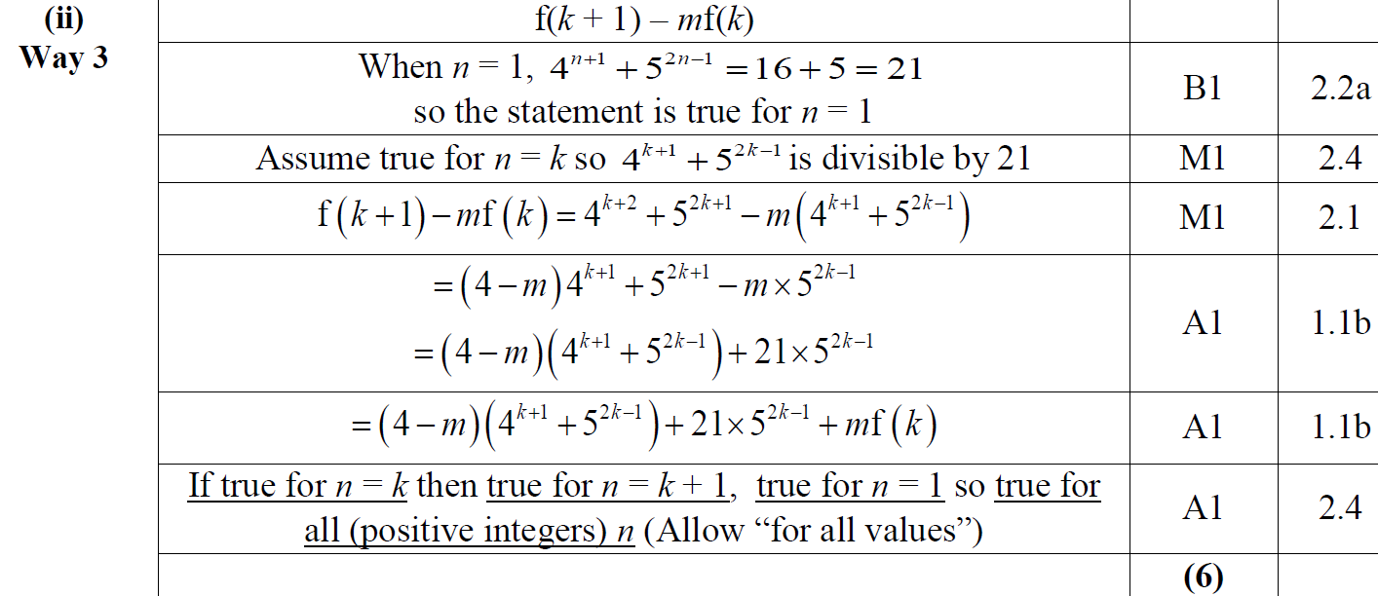
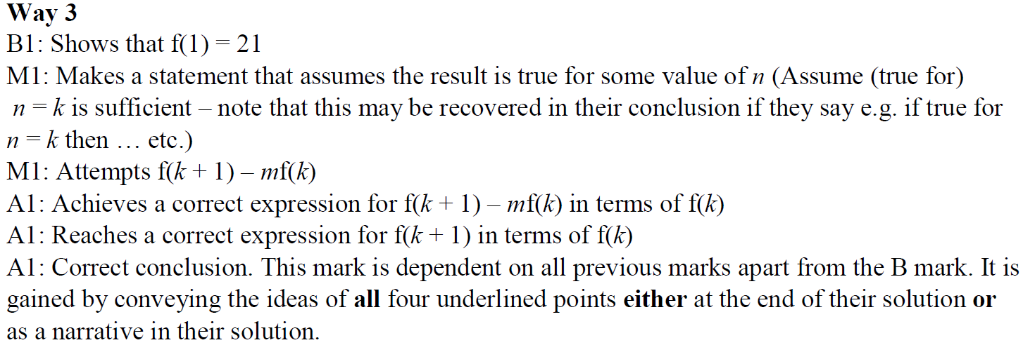
2018
(ii) Alternative 2

Slide 12
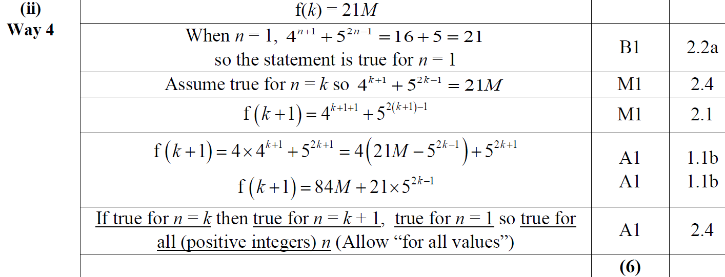
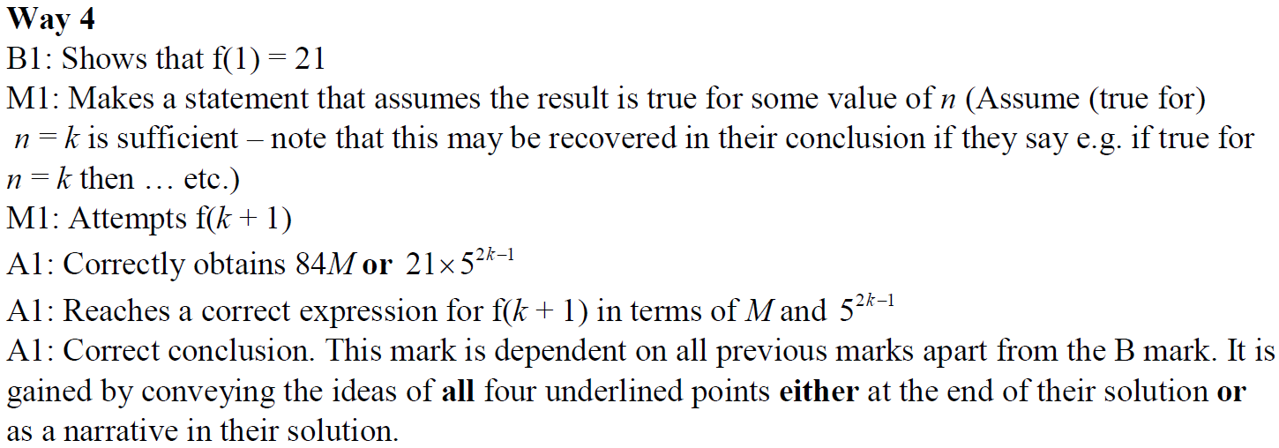
2018
(ii) Alternative 3

Slide 13
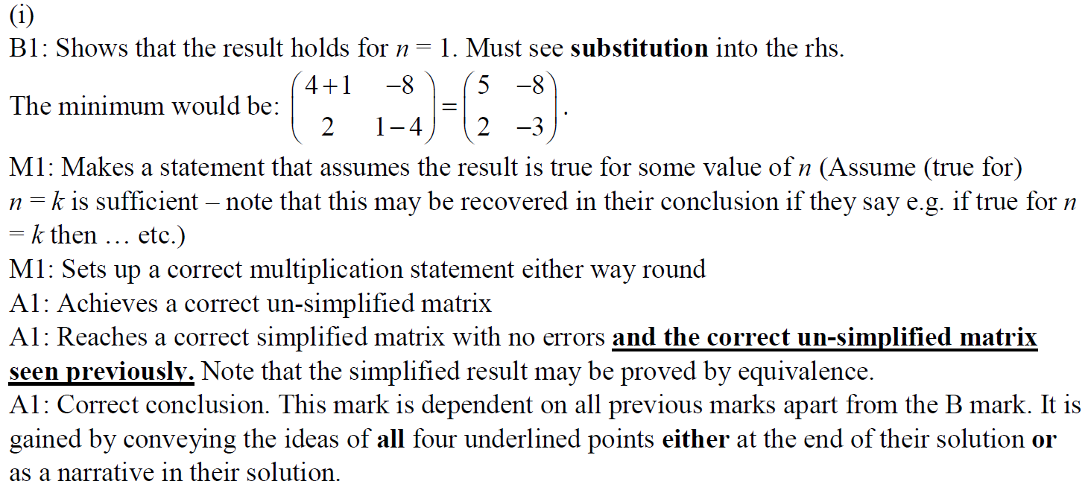
2018
(i) notes

Slide 14
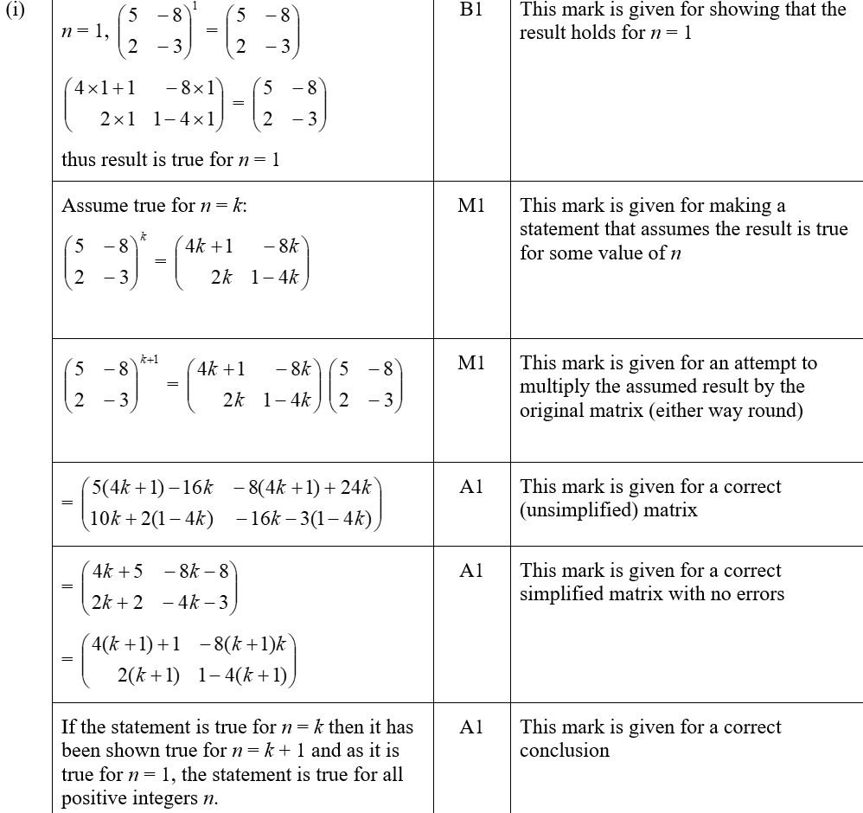
2018
(i) SF

Slide 15
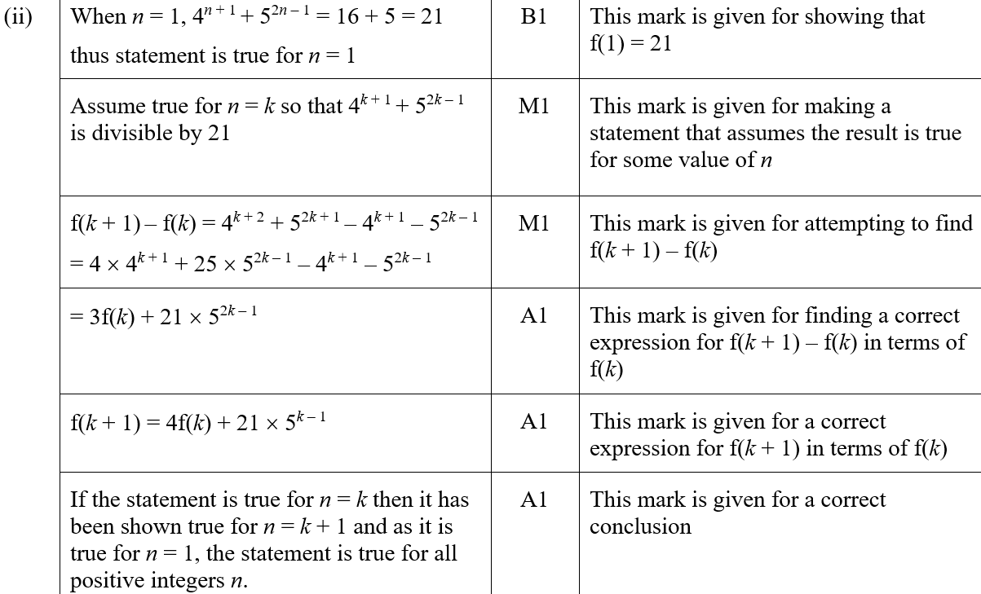
2018
(ii) SF

Slide 16
2019

Slide 17
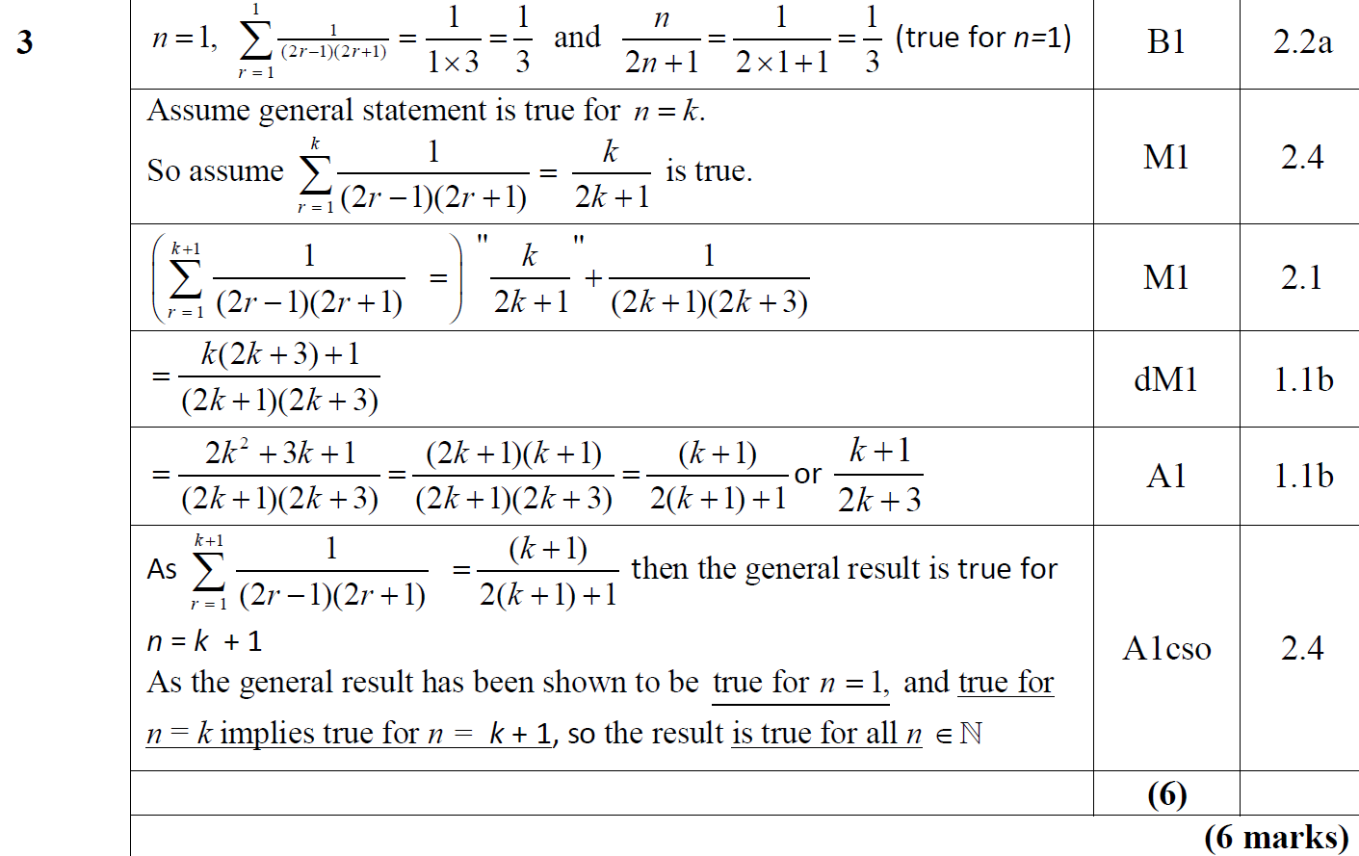
2019
A

Slide 18
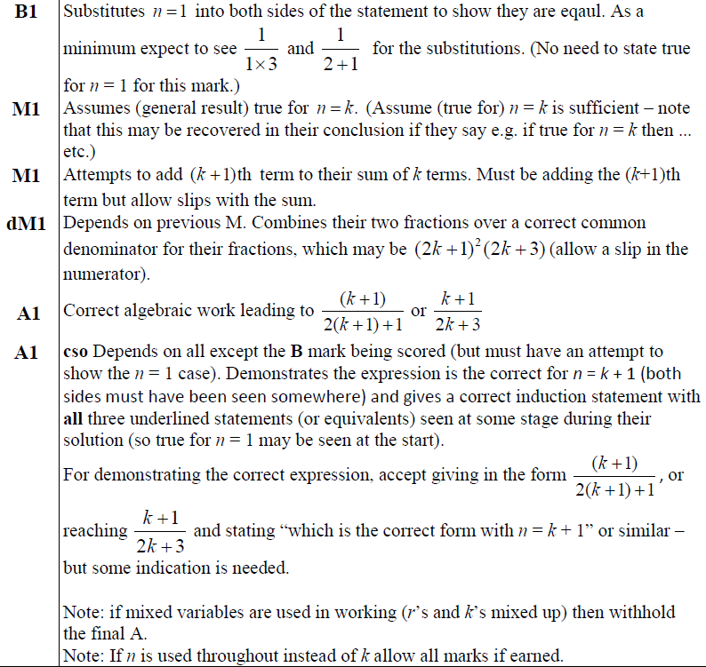
2019
A notes

Slide 19
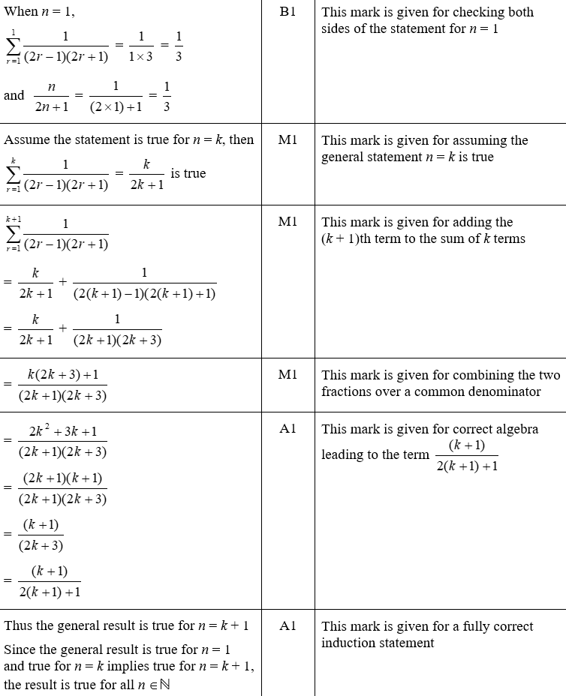
2019
A SF

Slide 20
SAM Paper 1

Slide 21
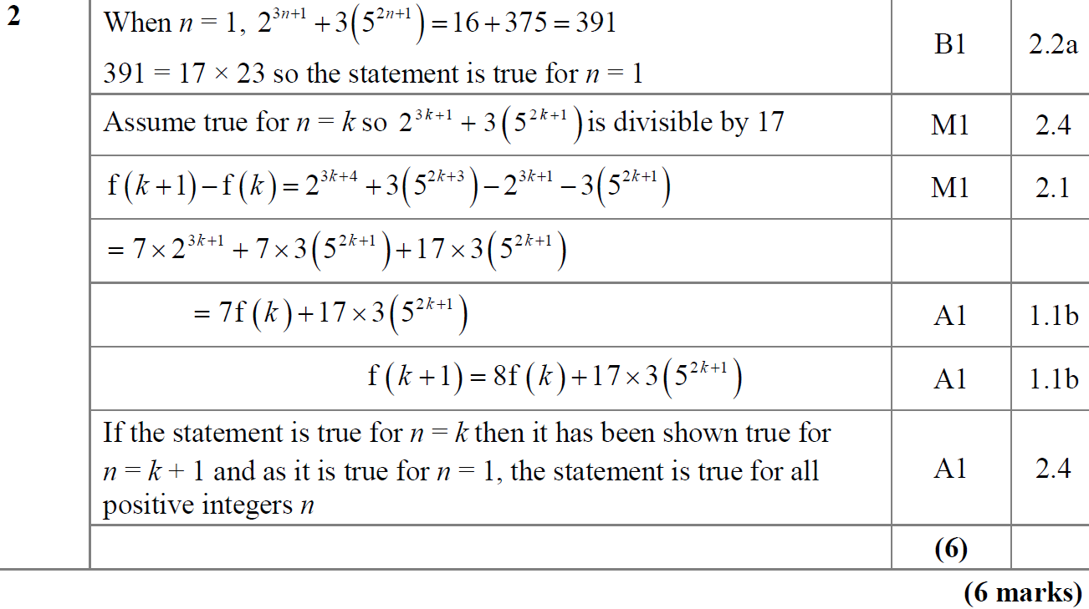
SAM Paper 1
A

Slide 22
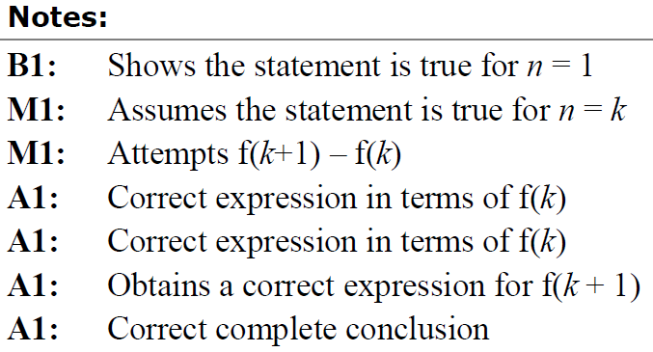
SAM Paper 1
A notes

Slide 23
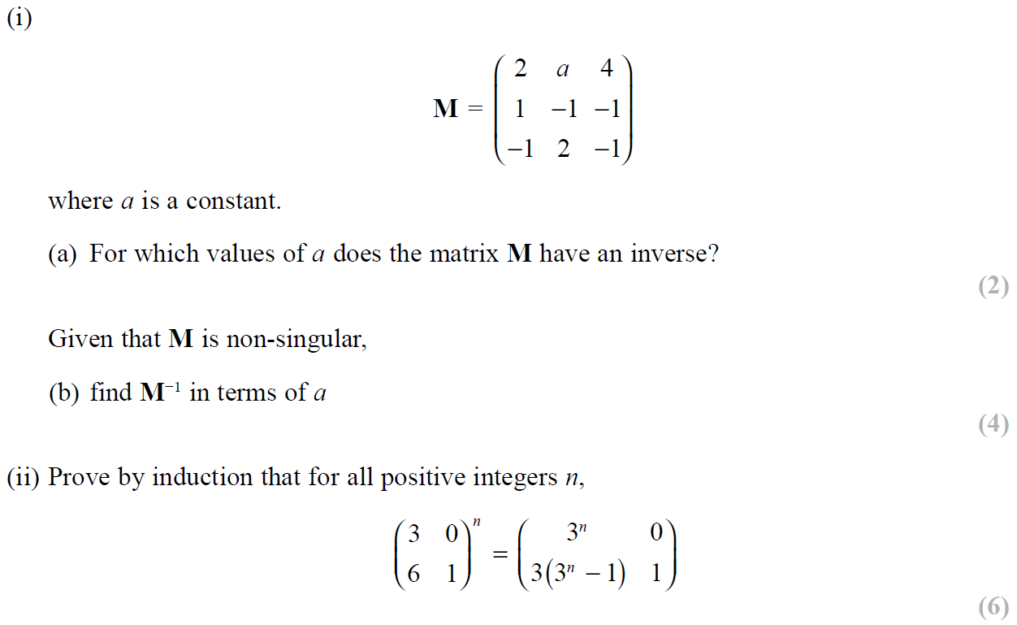
SAM Paper 2

Slide 24
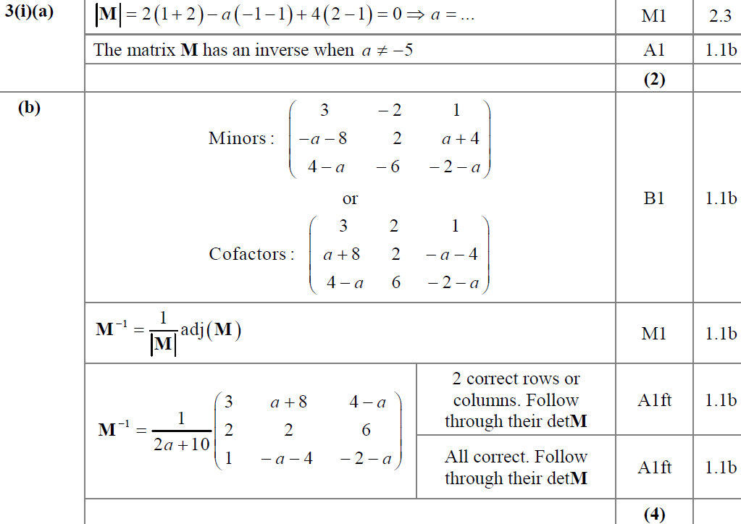
SAM Paper 2
(i) A
(i) B

Slide 25
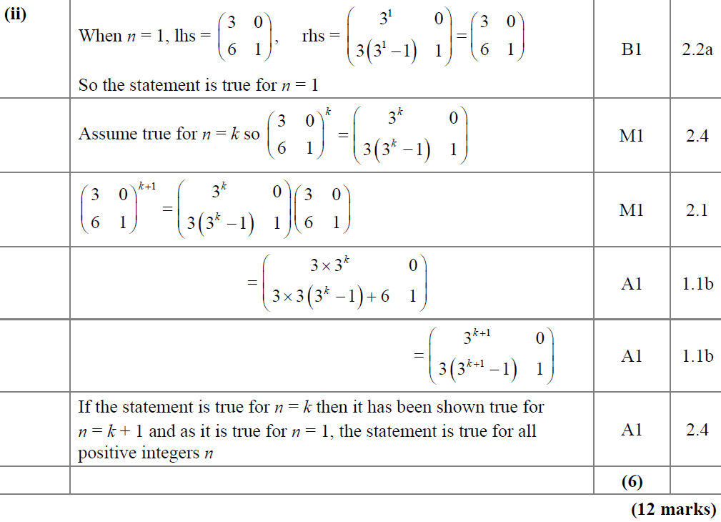
SAM Paper 2
(ii)

Slide 26
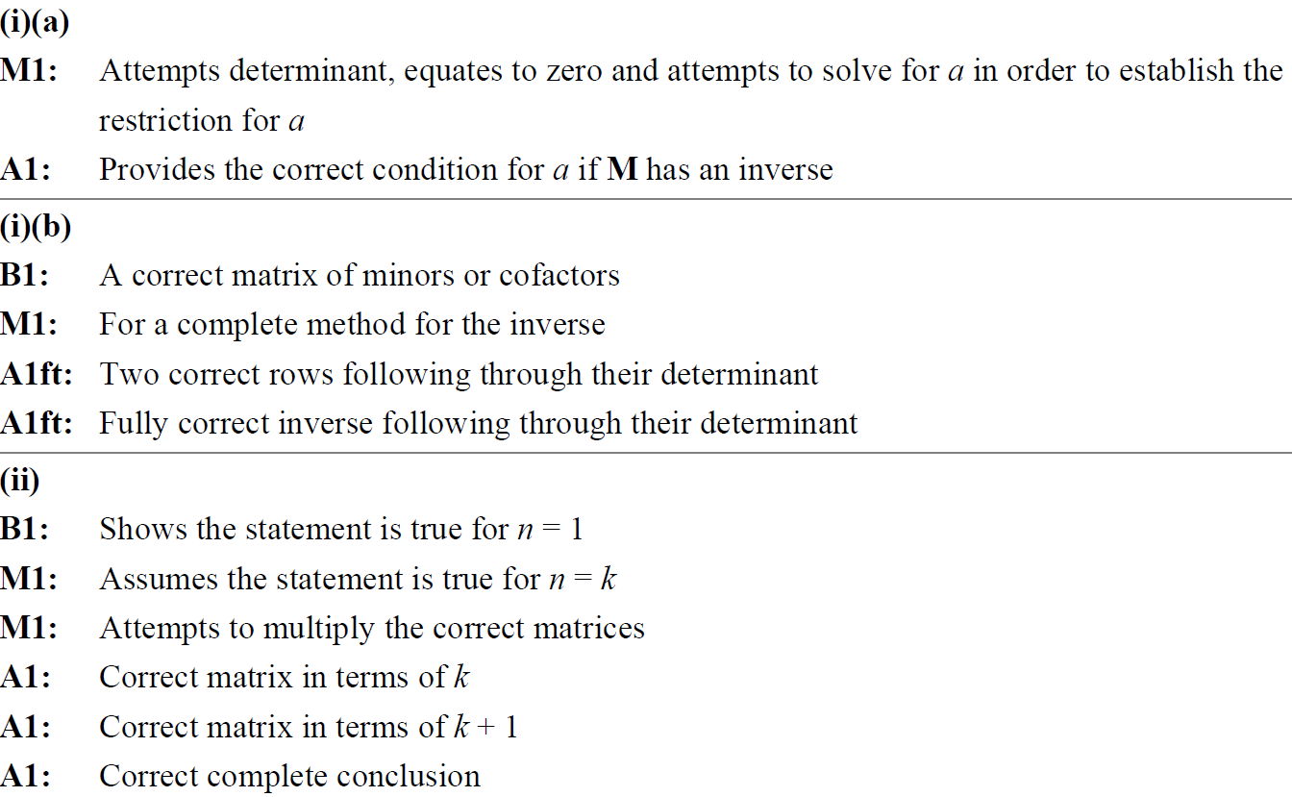
SAM Paper 2
(i) A notes
(i) B notes
(ii) notes

Slide 27
2019 Paper 1

Slide 28
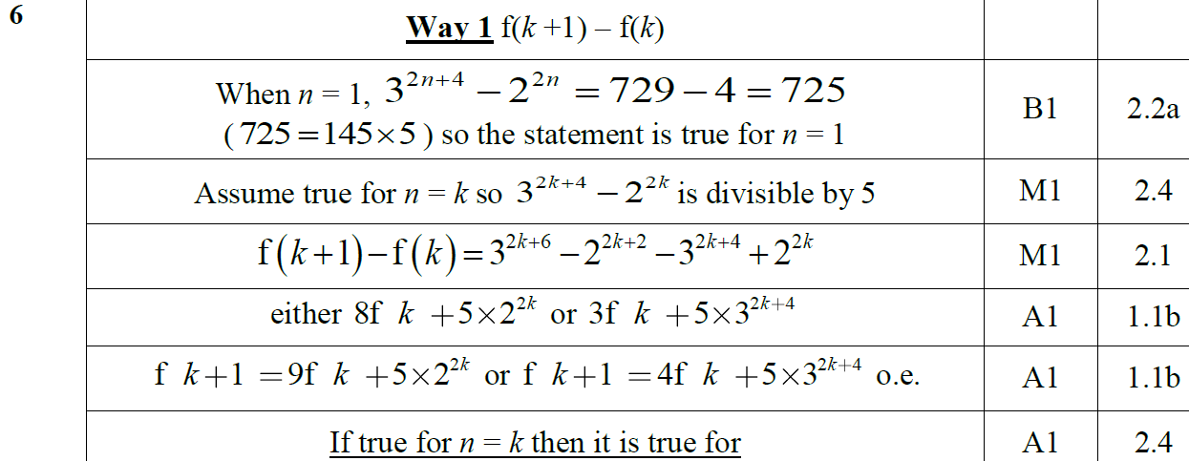
2019 Paper 1
A

Slide 29
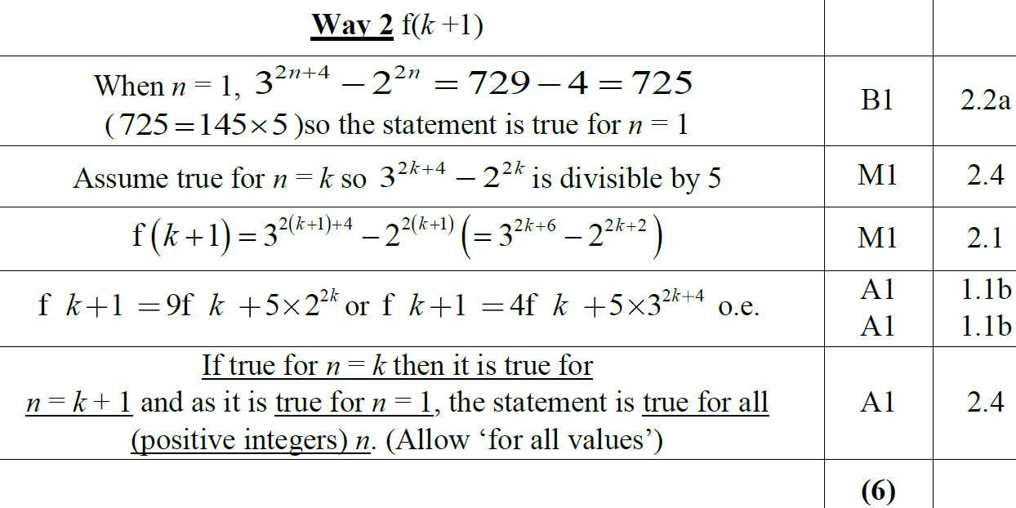
2019 Paper 1
A Alternative 1

Slide 30
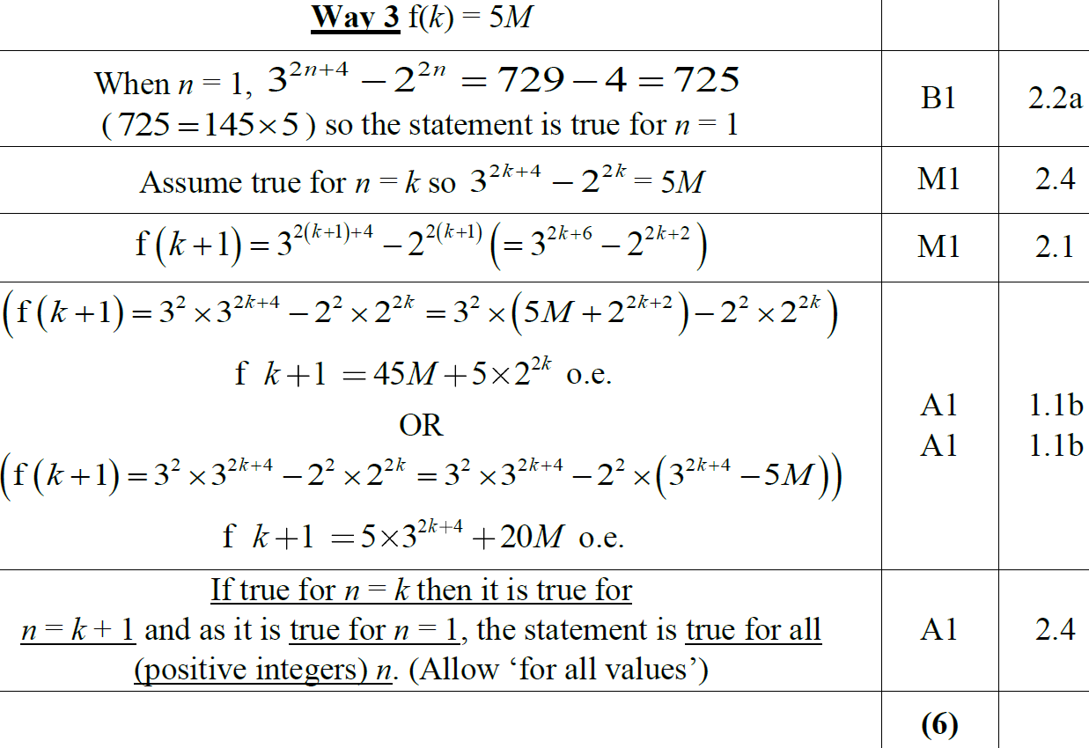
2019 Paper 1
A Alternative 2

Slide 31
2019 Paper 1
A Alternative 3

Slide 32
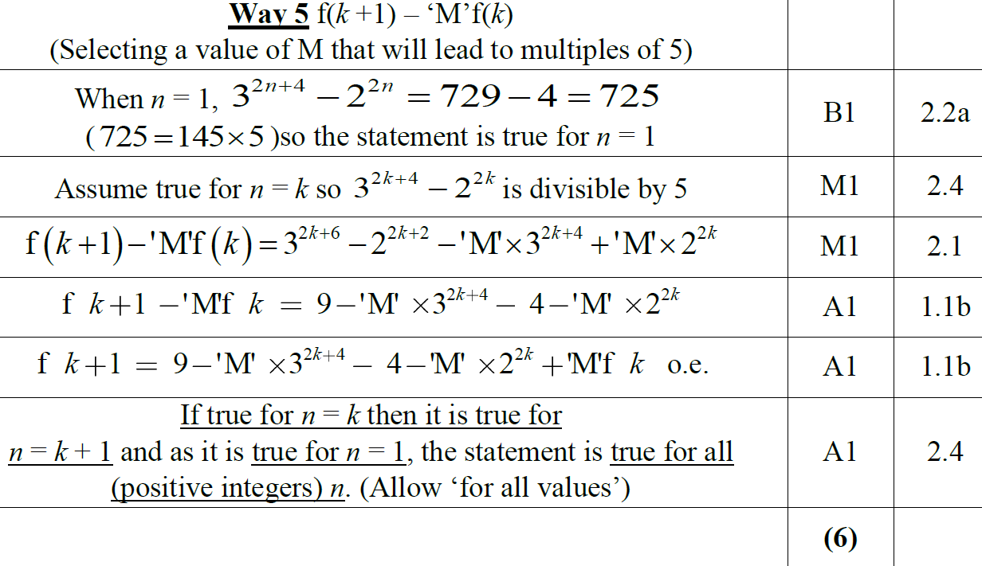
2019 Paper 1
A Alternative 4

Slide 33
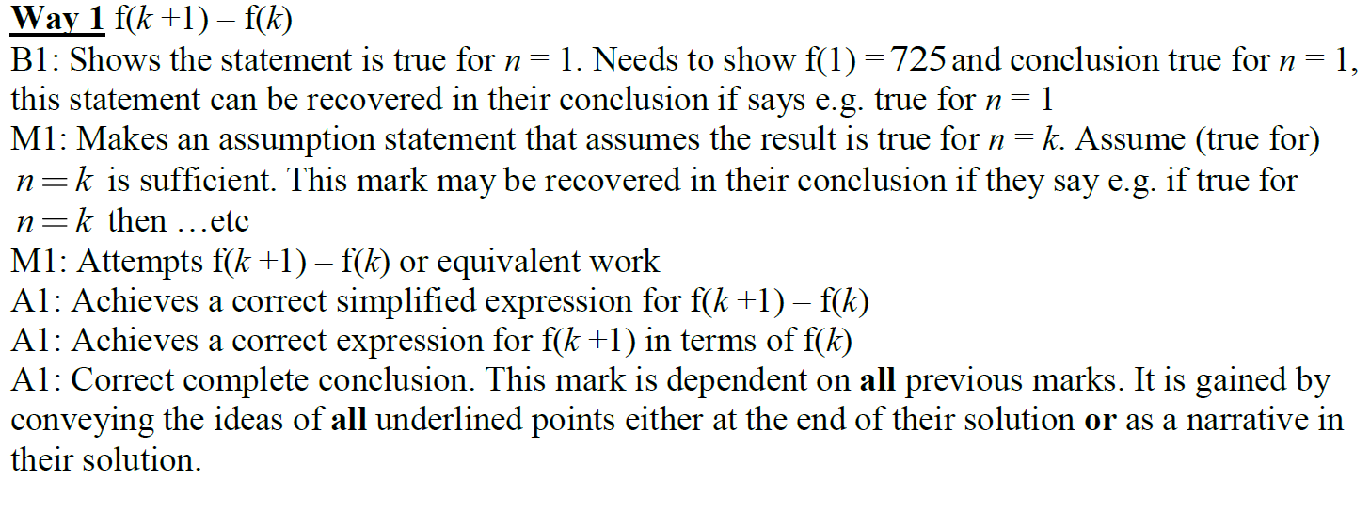
2019 Paper 1
A notes

Slide 34
2019 Paper 1
A Alternative 1 notes

Slide 35
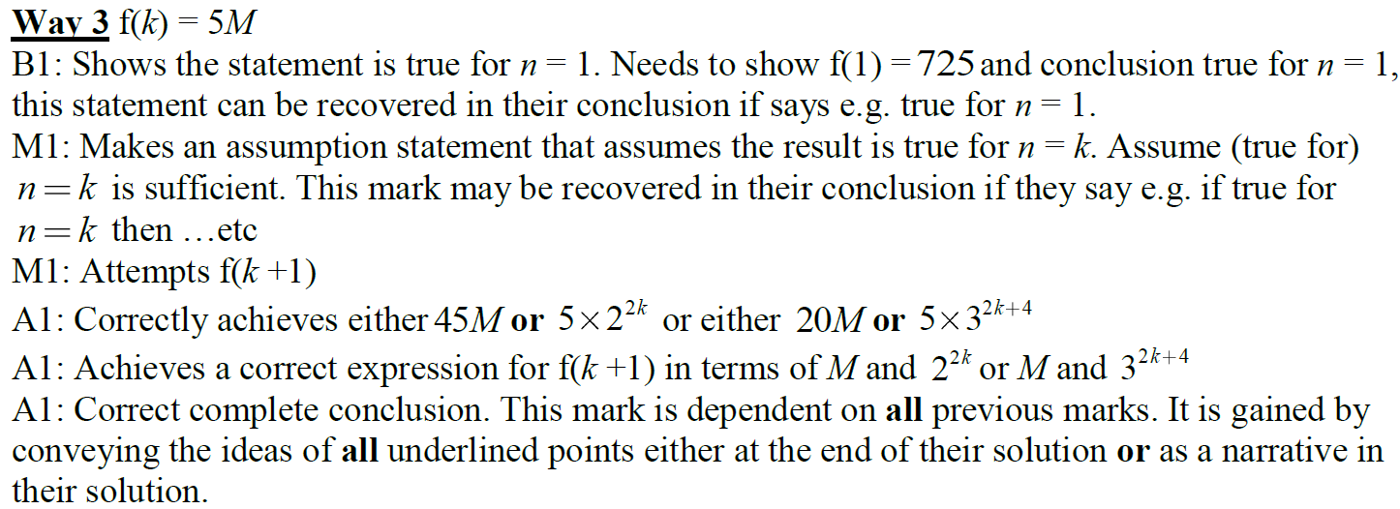
2019 Paper 1
A Alternative 2 notes

Slide 36
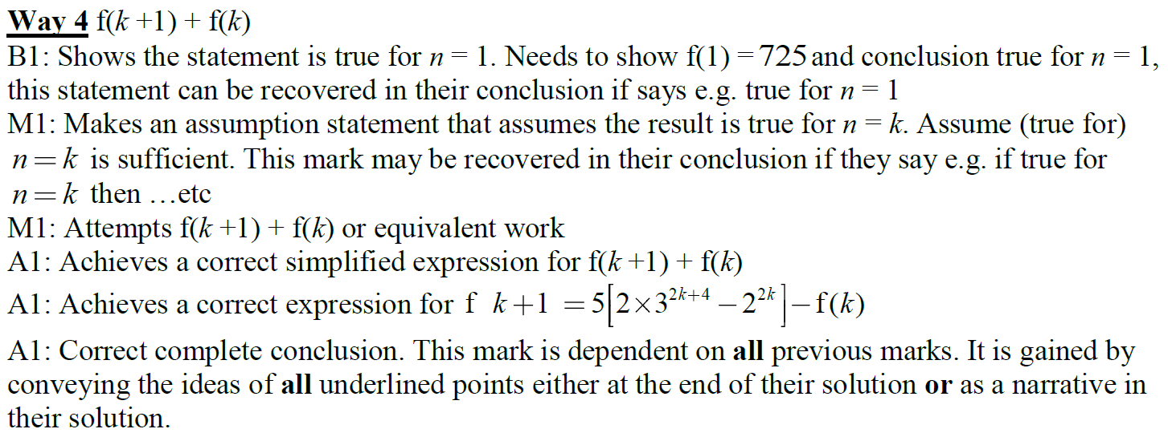
2019 Paper 1
A Alternative 3 notes

Slide 37
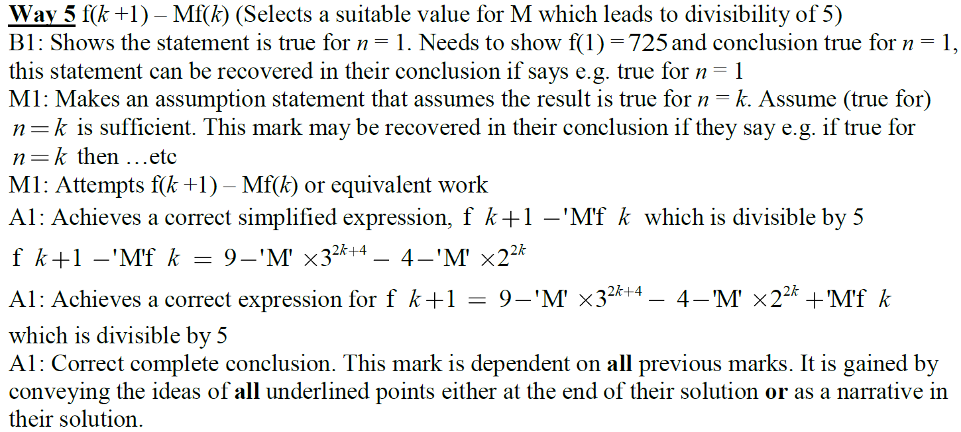
2019 Paper 1
A Alternative 4 notes

Slide 38
New Spec Q’s
Matrices
Series
Old Spec Induction
P6/ Old FP3
FP1
June 2002
June 2007 (i)
Jan 2009 (i)
Jan 2011
June 2013 R
June 2003
June 2007 (ii)
Jan 2009 (ii)
June 2011
June 2013 W
June 2004
June 2008
June 2009
Jan 2012 (i)
June 2014
June 2005
June 2009
Jan 2010 (i)
Jan 2012 (ii)
June 2014 R
Jan 2006
Feb 2010
Jan 2010 (ii)
June 2012
June 2015
June 2006
June 2010 (i)
Jan 2013
May 2016
June 2010 (ii)
June 2013
May 2017

Slide 39
June 2002

Slide 40
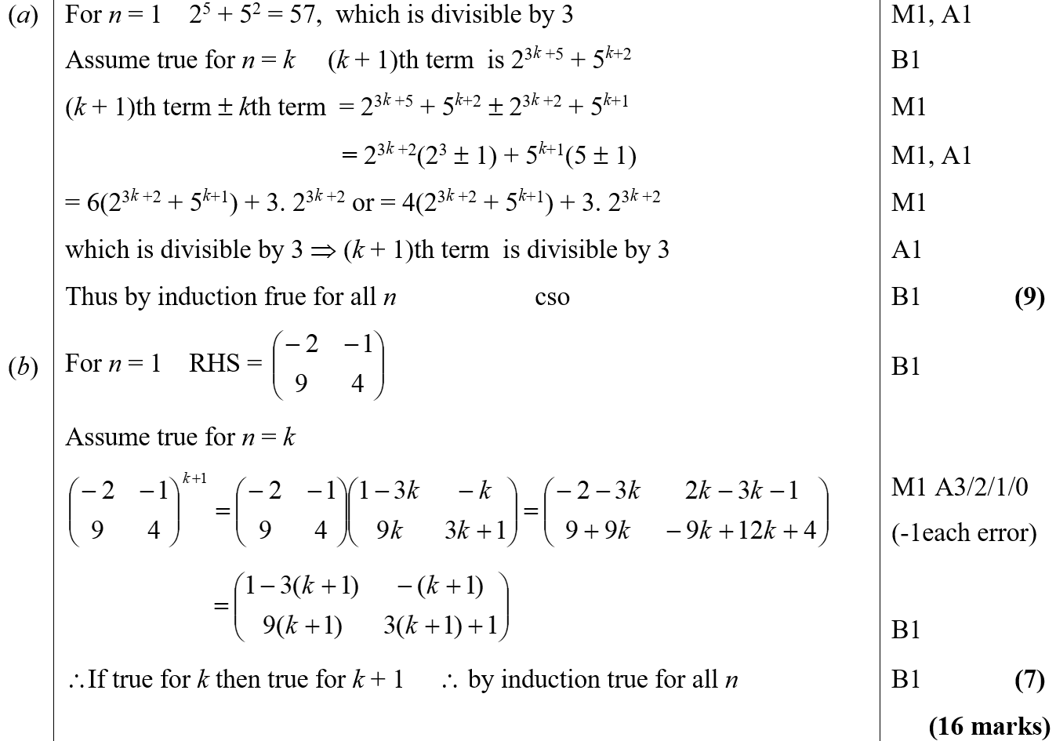
June 2002
A
B

Slide 41
June 2003

Slide 42
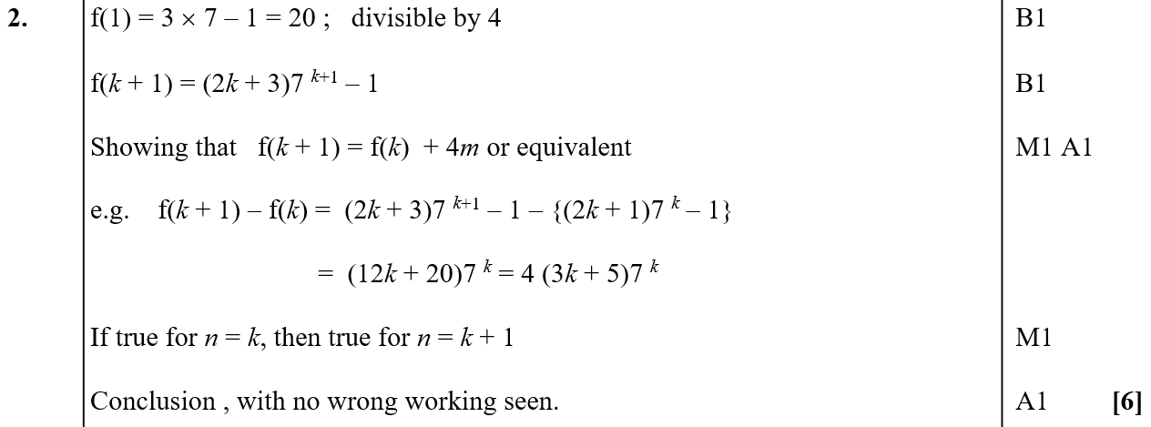
June 2003
A

Slide 43
June 2004

Slide 44
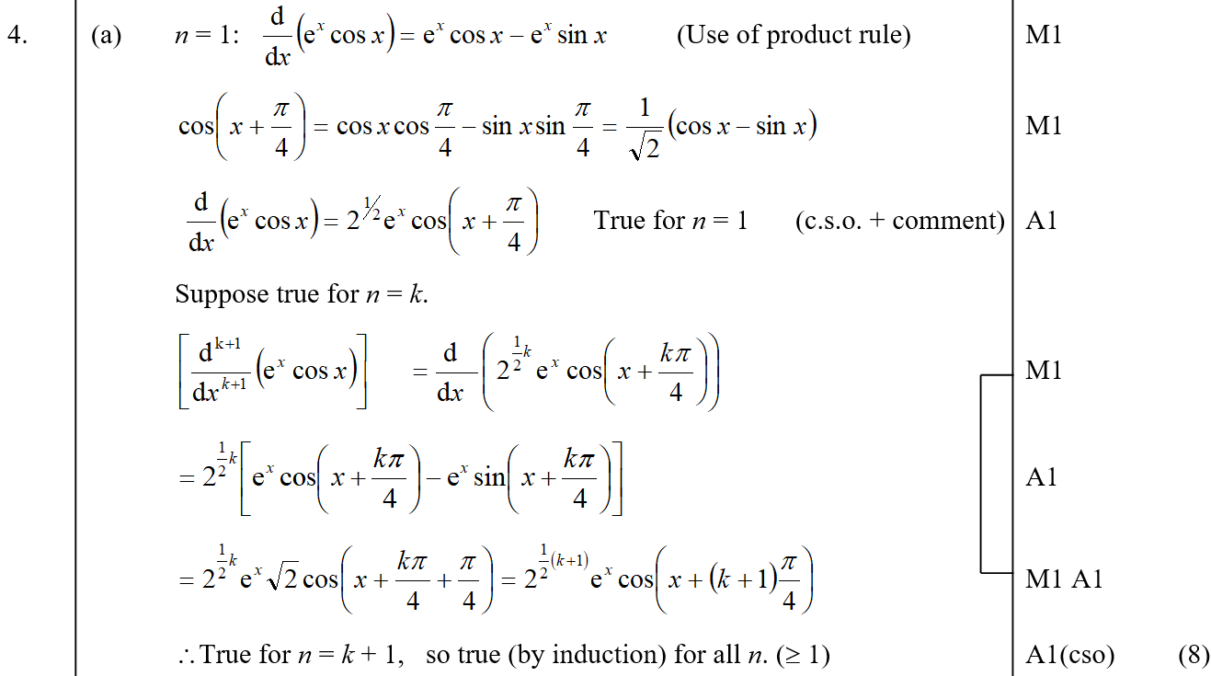
June 2004
A

Slide 45
June 2004
B

Slide 46
June 2005

Slide 47
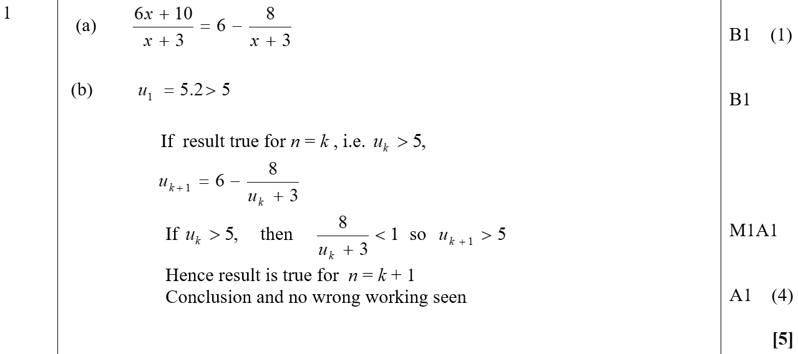
June 2005
A
B

Slide 48
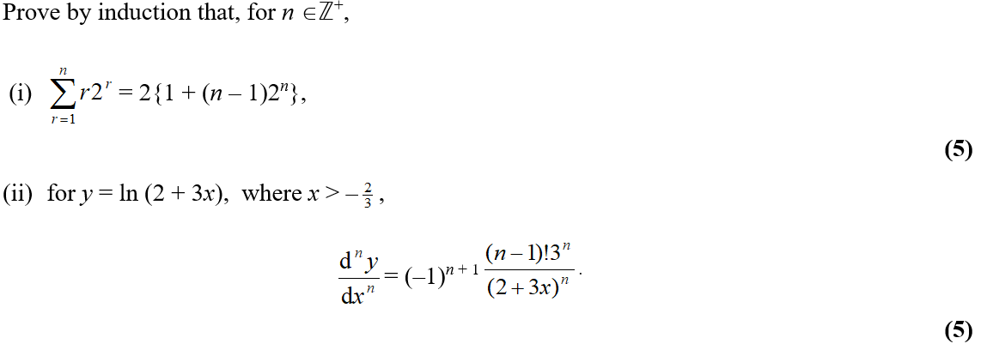
Jan 2006

Slide 49
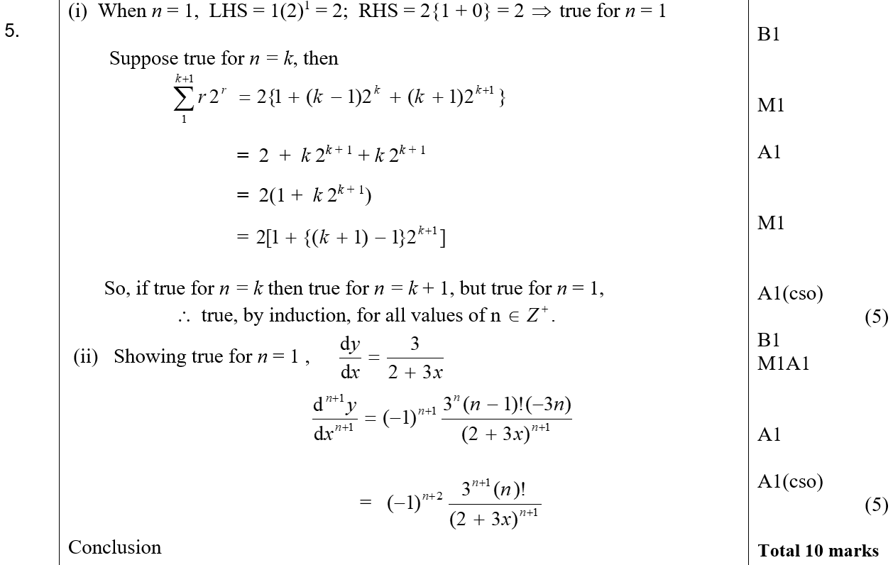
Jan 2006
(i)
(ii)

Slide 50
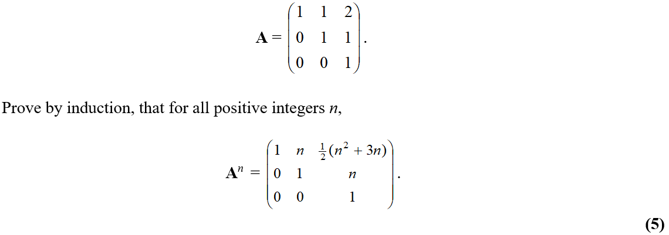
June 2006

Slide 51
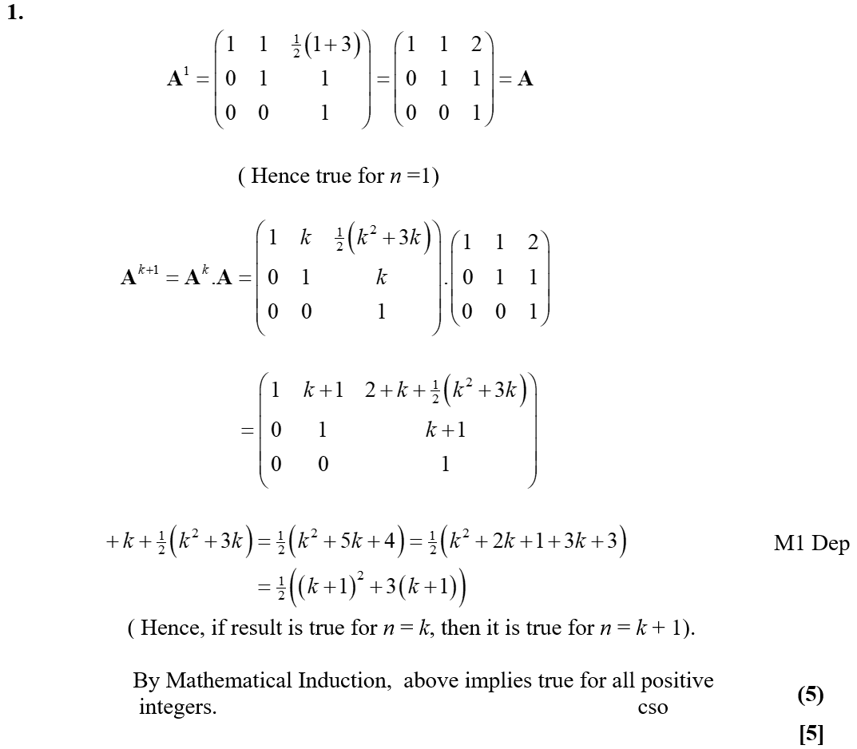
June 2006
A

Slide 52
June 2007

Slide 53
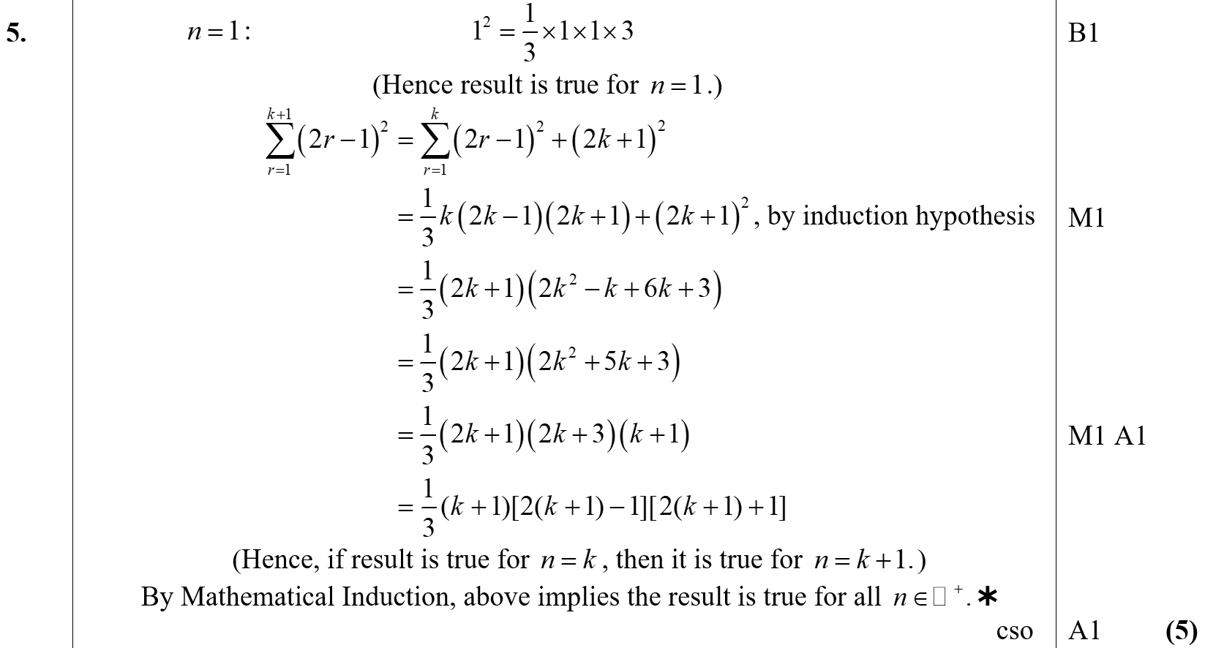
June 2007
A

Slide 54
June 2007

Slide 55
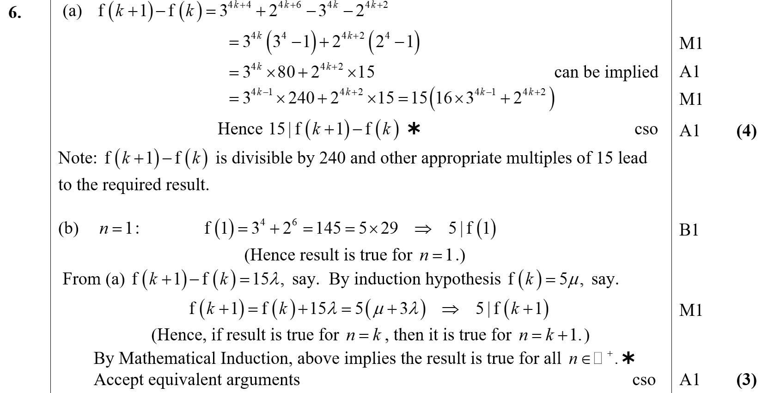
June 2007
A
B
C

Slide 56
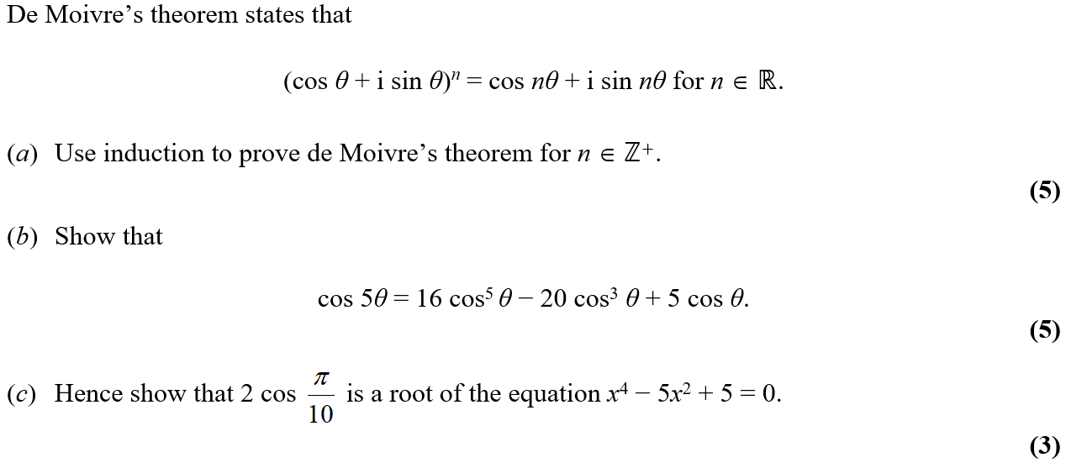
June 2008

Slide 57
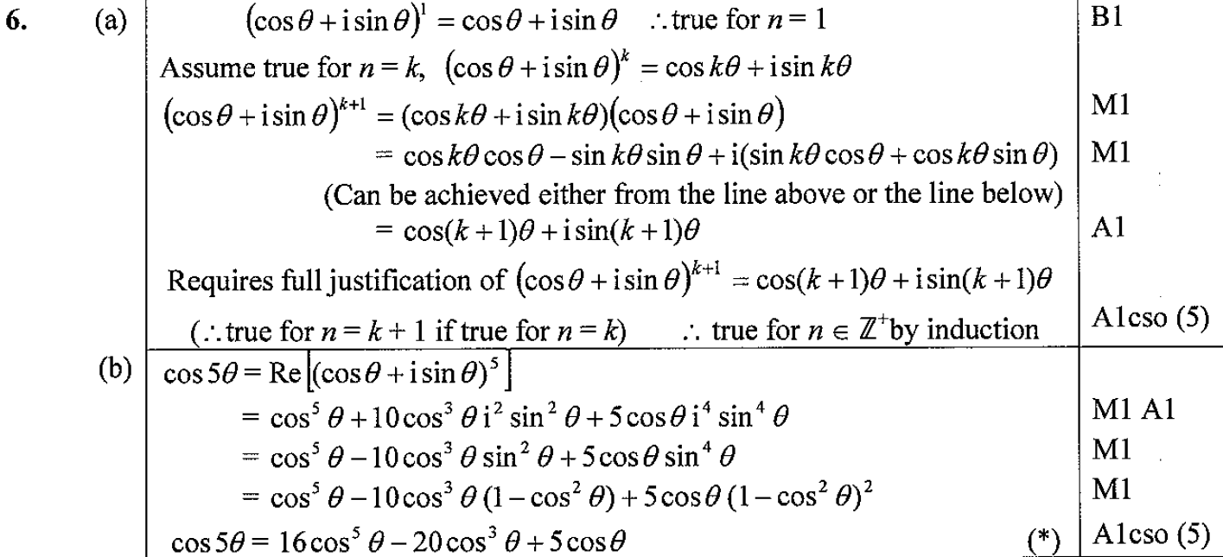
June 2008
A
B
C

Slide 58
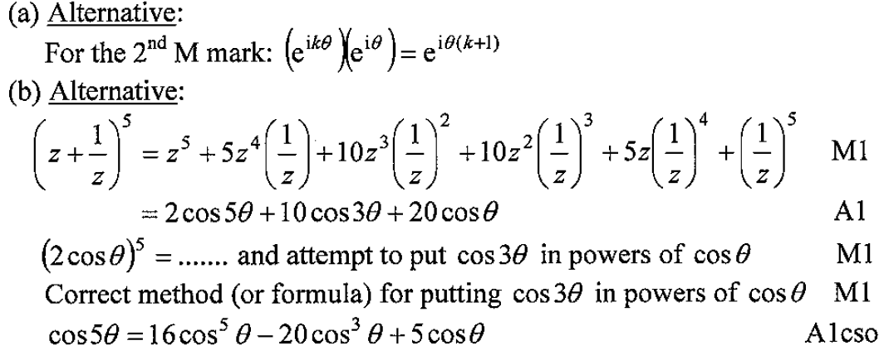
June 2008
A notes
B notes

Slide 59
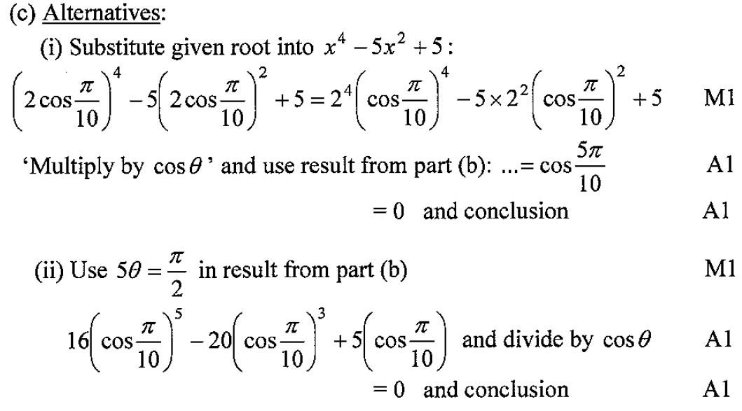
June 2008
C notes

Slide 60
June 2009

Slide 61
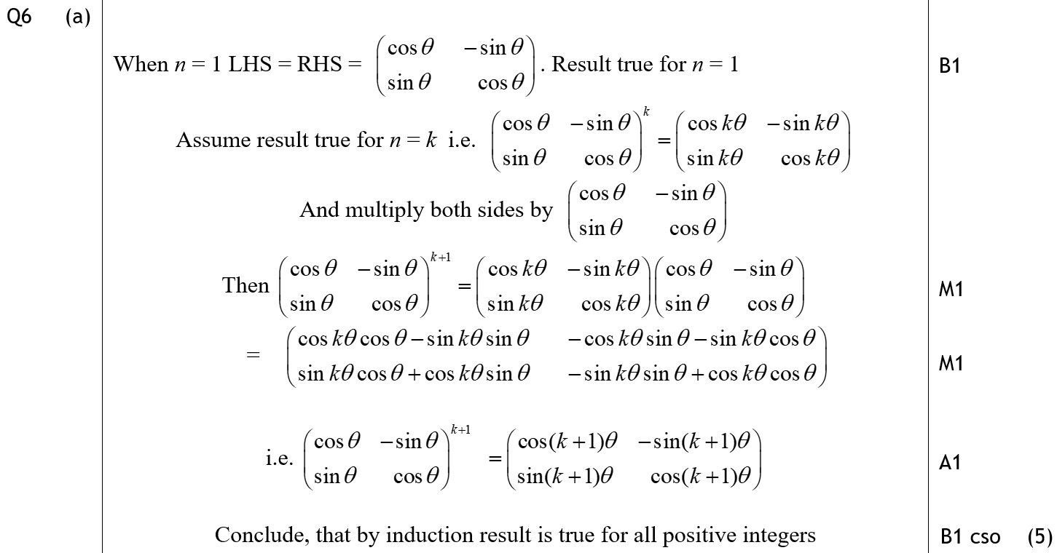
June 2009
A

Slide 62
June 2009
B

Slide 63
Feb 2010

Slide 64
Feb 2010
(i)

Slide 65
Feb 2010
(ii)

Slide 66
Jan 2009

Slide 67
Jan 2009
A

Slide 68
Jan 2009

Slide 69
Jan 2009
A

Slide 70
June 2009

Slide 71
June 2009
A
B

Slide 72
June 2009
A Alternative & notes
B Alternative & notes

Slide 73
Jan 2010

Slide 74
Jan 2010
A

Slide 75
Jan 2010

Slide 76
Jan 2010
A
B

Slide 77
Jan 2010
C
A notes
B notes
C notes

Slide 78
June 2010

Slide 79
June 2010
A
B

Slide 80
June 2010
A notes
B notes

Slide 81
June 2010

Slide 82
June 2010
A

Slide 83
June 2010
B
C

Slide 84
June 2010
A notes
B notes
C notes

Slide 85
Jan 2011

Slide 86
Jan 2011
A

Slide 87
June 2011

Slide 88
June 2011
A

Slide 89
June 2011
B

Slide 90
Jan 2012

Slide 91
Jan 2012
A

Slide 92
Jan 2012
B
C

Slide 93
Jan 2012

Slide 94
Jan 2012
A
B

Slide 95
June 2012

Slide 96
June 2012
A

Slide 97
Jan 2013

Slide 98
Jan 2013
A

Slide 99
Jan 2013
B

Slide 100
Jan 2013
A notes

Slide 101
Jan 2013
B notes

Slide 102
June 2013

Slide 103
June 2013
A

Slide 104
June 2013
B

Slide 105
June 2013 Reserve

Slide 106
June 2013 Reserve
A

Slide 107
June 2013 Reserve
B

Slide 108
June 2013 Withdrawn

Slide 109
June 2013 Withdrawn
A

Slide 110
June 2013 Withdrawn
A

Slide 111
June 2014

Slide 112
June 2014
A

Slide 113
June 2014
A Alternatives

Slide 114
June 2014 Reserve

Slide 115
June 2014 Reserve
A

Slide 116
June 2014 Reserve
B

Slide 117
June 2015

Slide 118
June 2015
(i)

Slide 119
June 2015
(ii)

Slide 120
June 2015
(i) notes
(ii) notes

Slide 121
May 2016

Slide 122
May 2016
(i)
(ii)

Slide 123
May 2016
(i) notes
(ii) notes

Slide 124
May 2017

Slide 125
May 2017
(i)

Slide 126
May 2017
(ii)

Slide 127
May 2017
(ii) Alternative 1

Slide 128
May 2017
(ii) Alternative 2

