Slide 1
Old Spec Q’s
Impulse and Momentum
SAM*
2019
*with conservation of energy

Slide 2
SAM

Slide 3
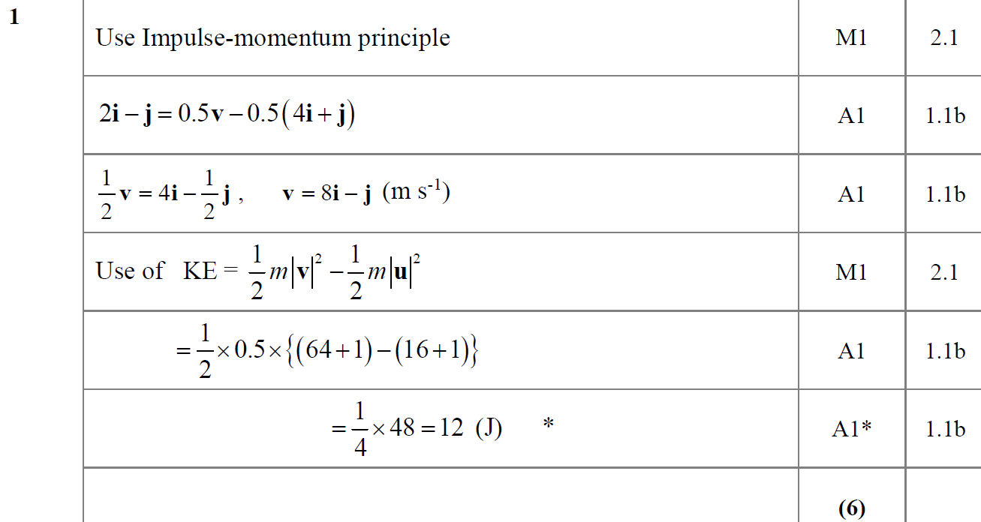
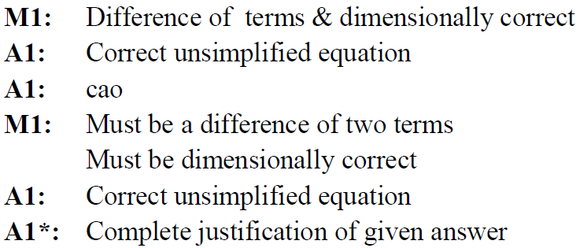
SAM
A
A notes

Slide 4
2019

Slide 5
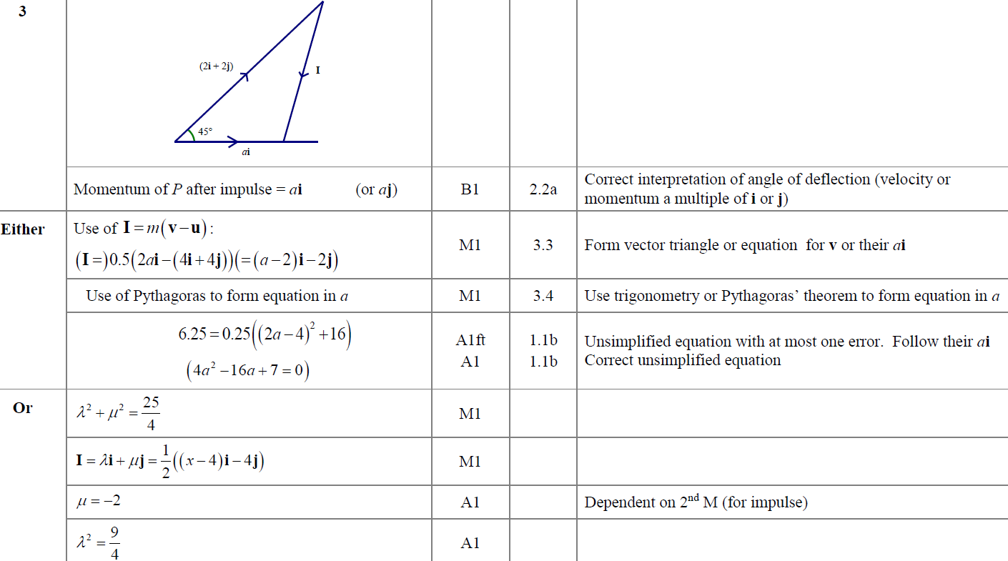
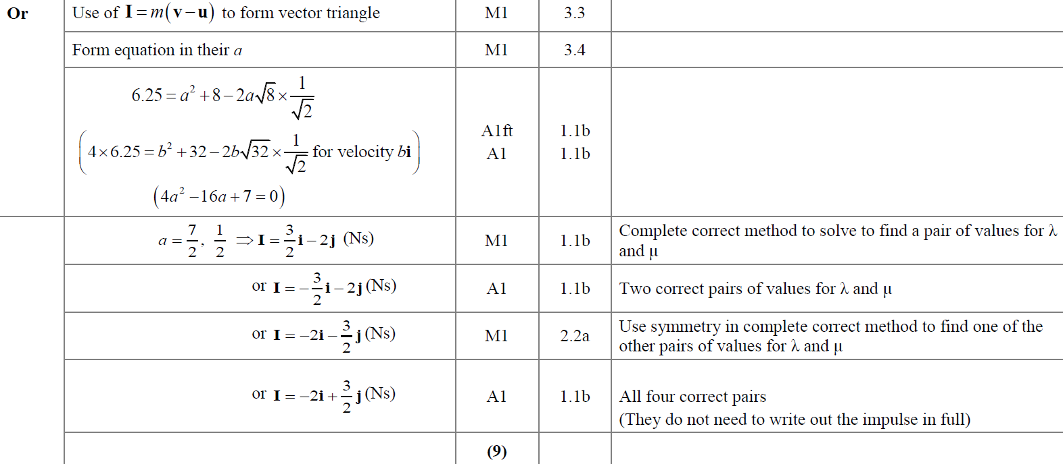
2019
A

Slide 6
New Spec Q’s
Old Spec Impulse and Momentum
June 2001
Jan 2007
Jan 2012
June 2018
note that many of these questions were taken from the old M2 course and therefore the lead in to the impulse part of the question may come from a variable acceleration scenario
Jan 2003*
Jan 2008
May 2012
June 2019
June 2003*
May 2008
June 2013
Jan 2004
May 2009
June 2014 (mainly collisions)
June 2004*
Jan 2010
June 2014 (R)
Jan 2005 (mainly collisions)
June 2010
June 2015
Jan 2006
Jan 2011
June 2016
June 2006
June 2011*
June 2017
*with conservation of energy

Slide 7
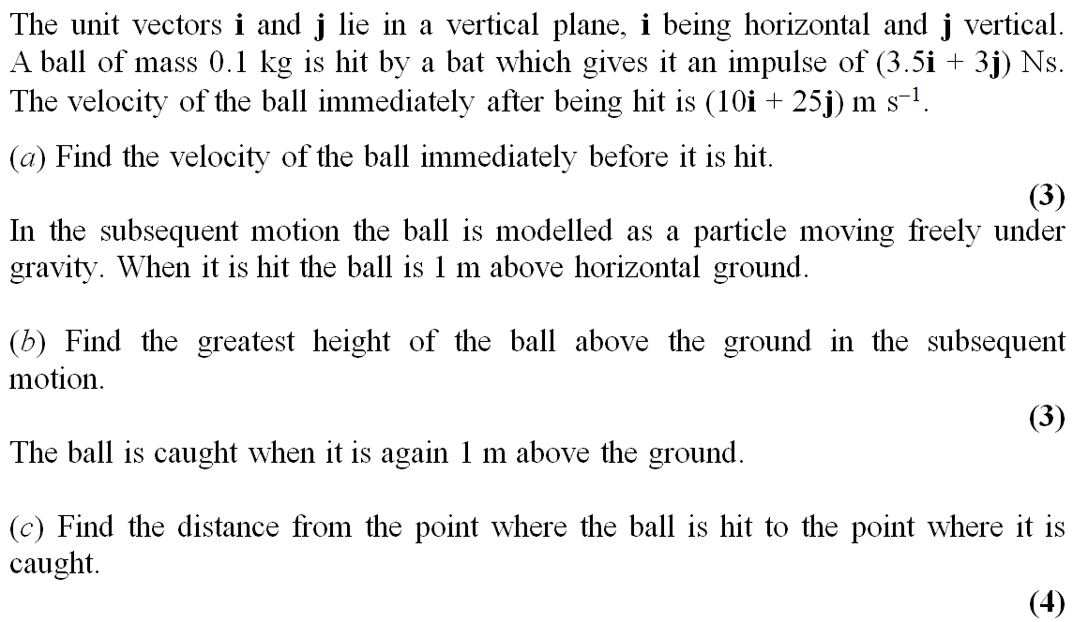
June 2001

Slide 8
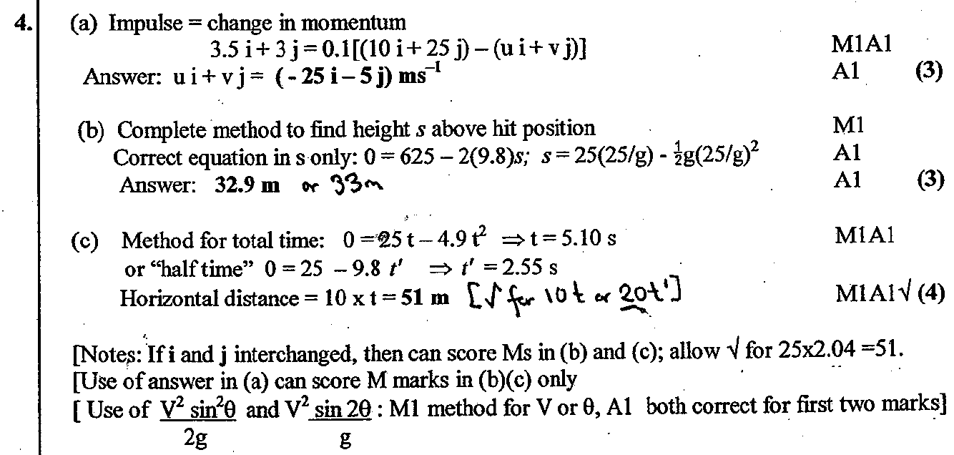
June 2001
A
B
C

Slide 9
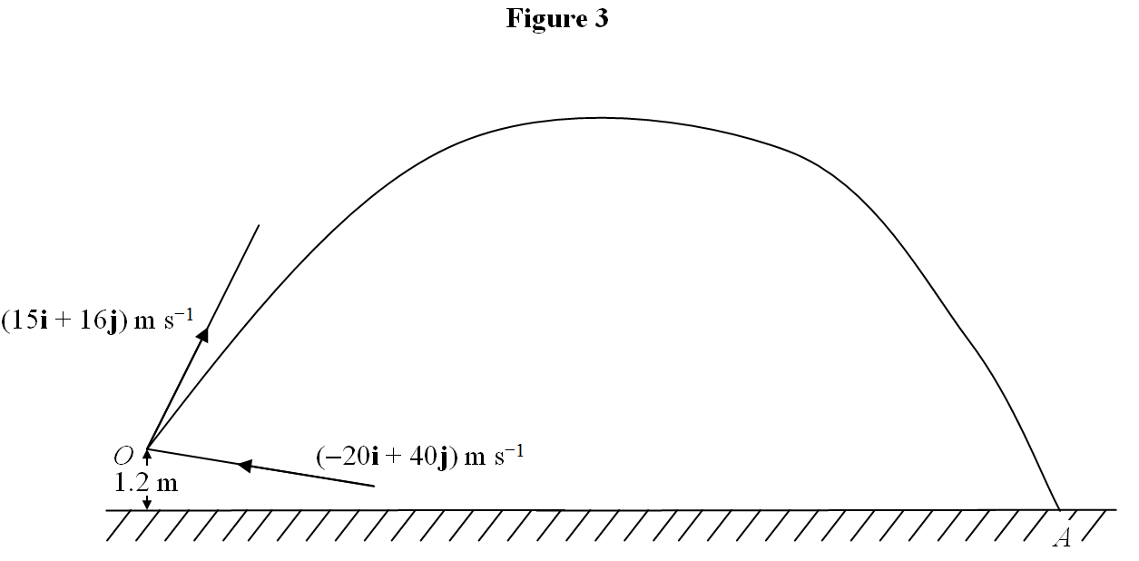
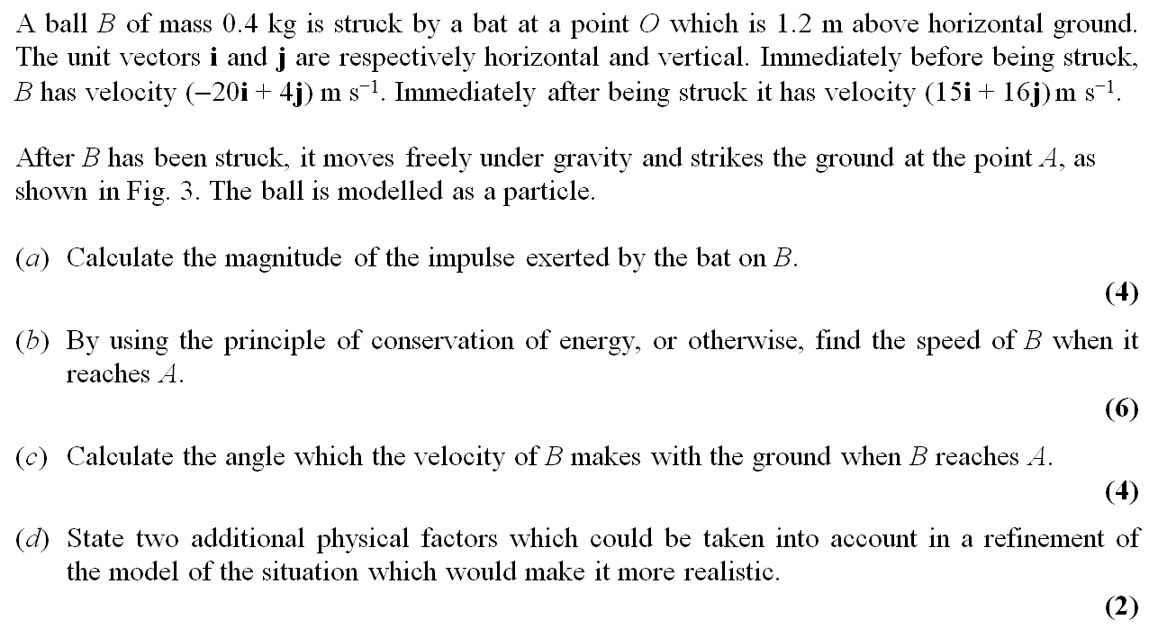
Jan 2003

Slide 10
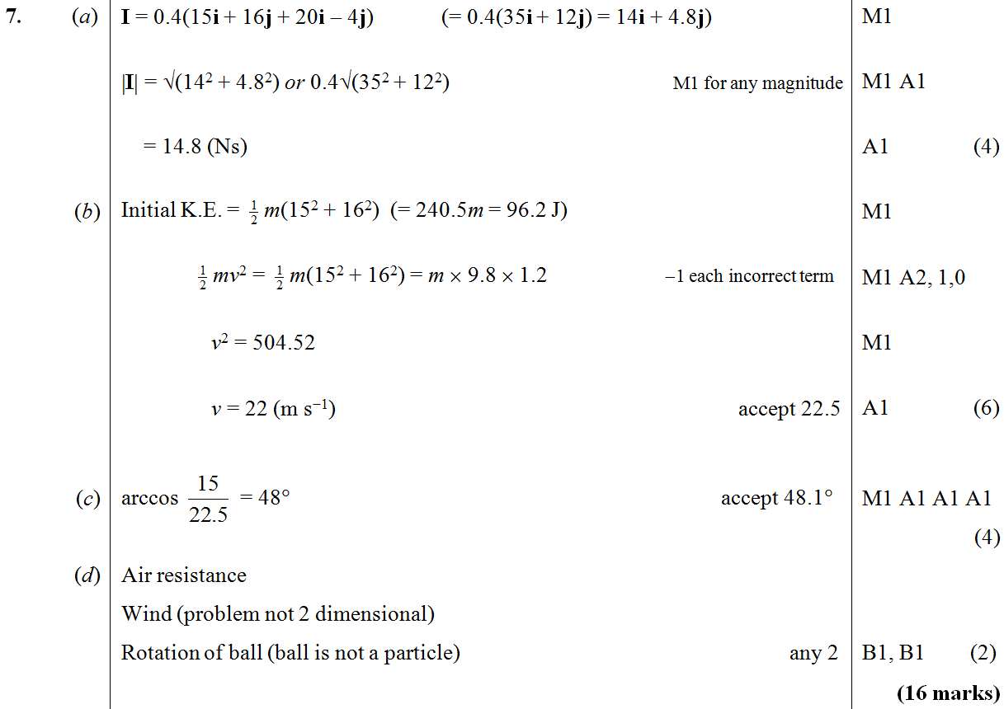
Jan 2003
A
B
C
D

Slide 11
Jan 2003
Alternative B
Alternative C

Slide 12
June 2003

Slide 13
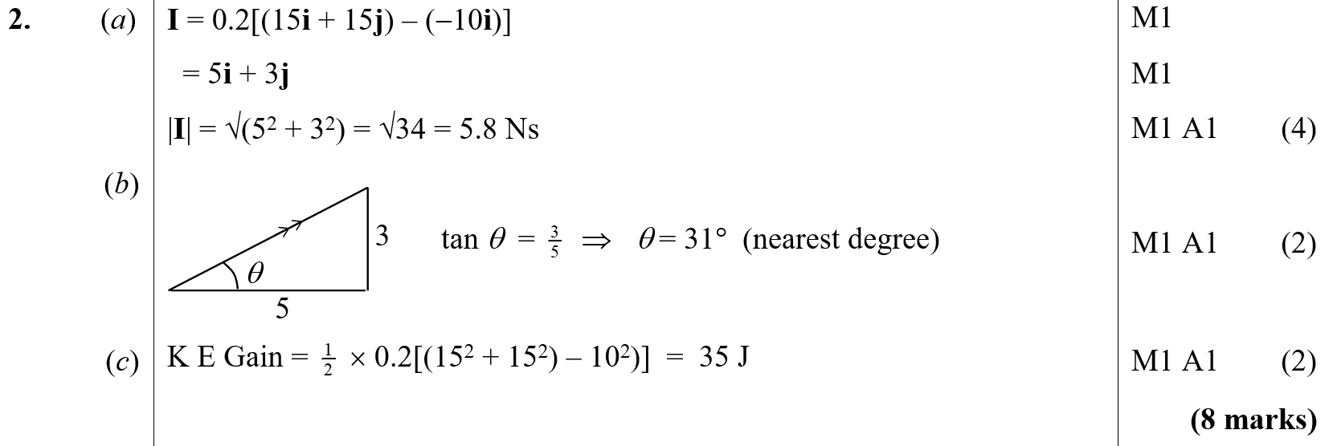
June 2003
A
B
C

Slide 14
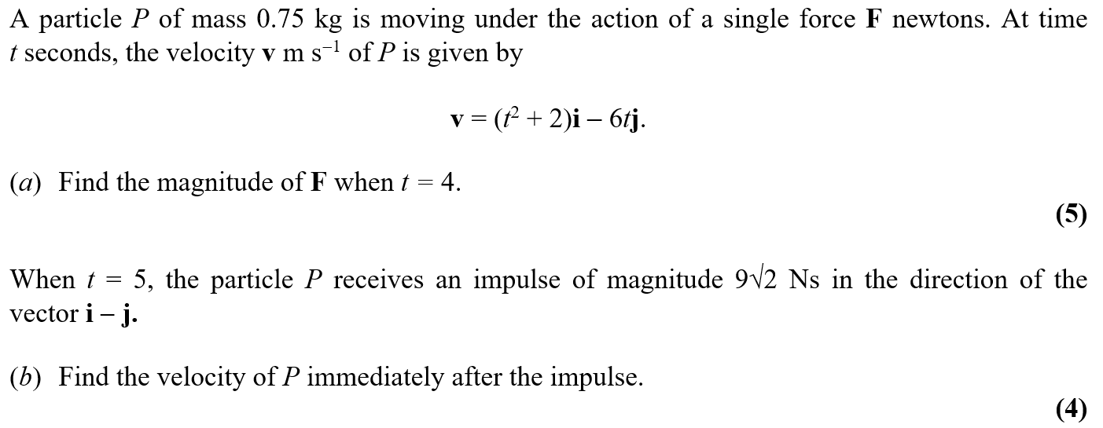
Jan 2004

Slide 15
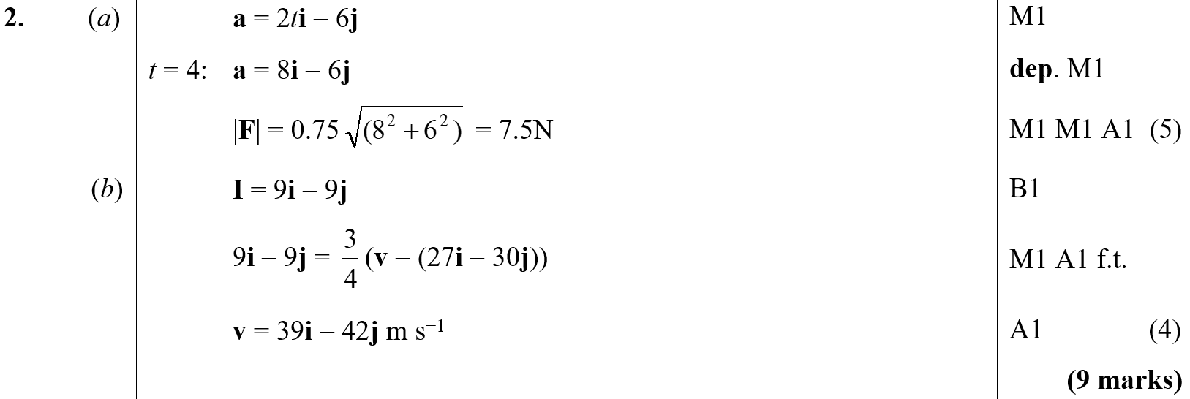
Jan 2004
A
B

Slide 16
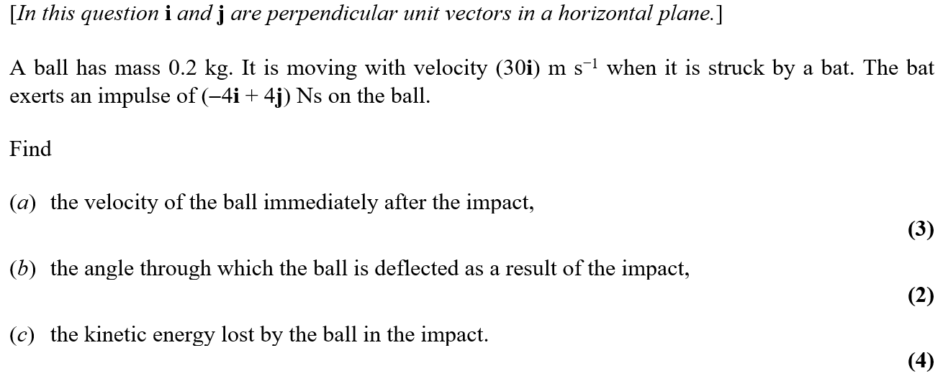
June 2004

Slide 17
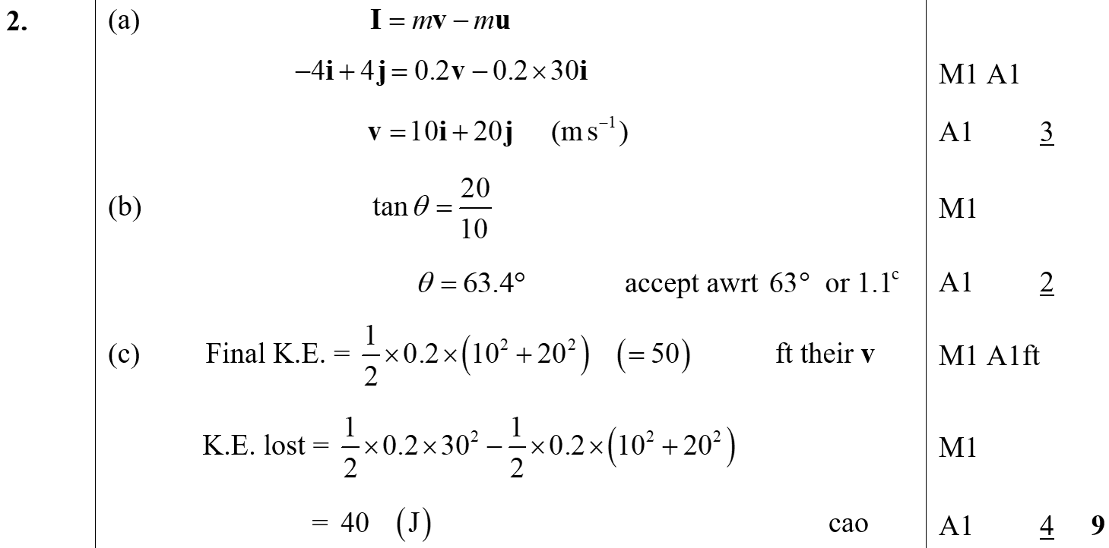
June 2004
A
B
C

Slide 18
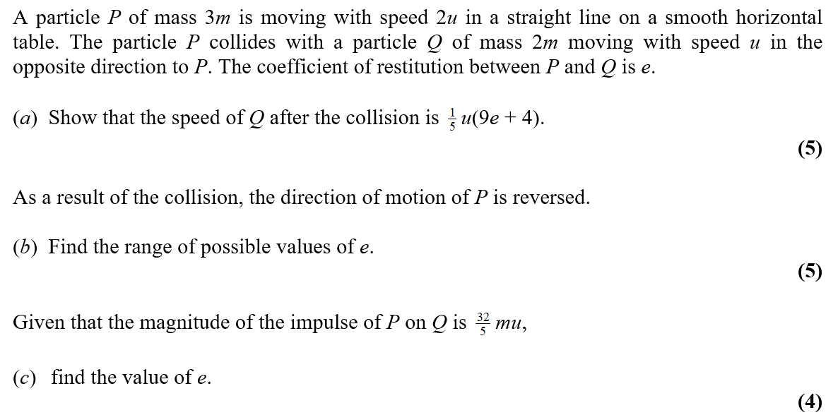
Jan 2005

Slide 19
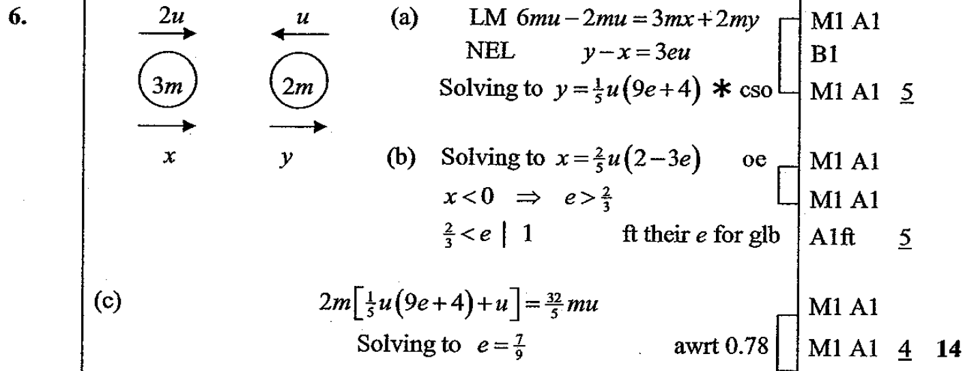
Jan 2005
A
B
C

Slide 20
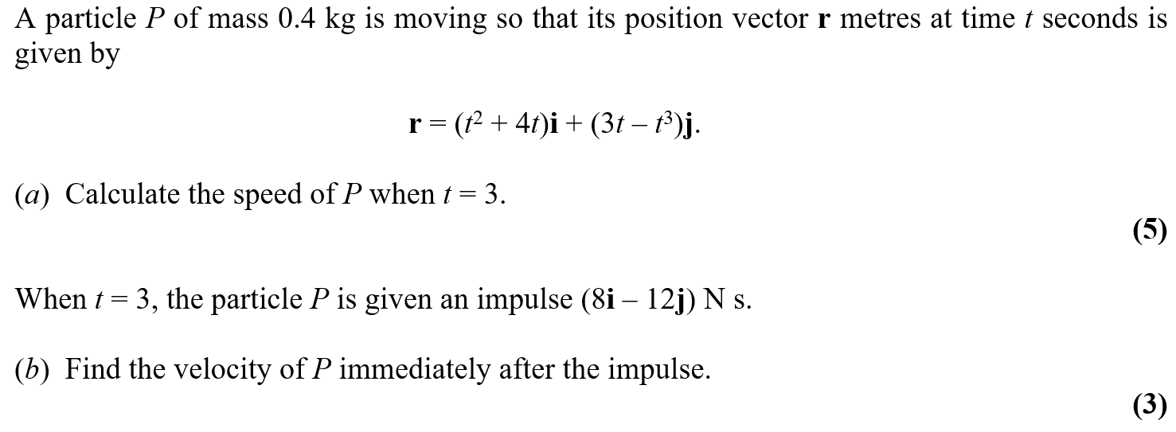
Jan 2006

Slide 21
Jan 2006
A
B

Slide 22
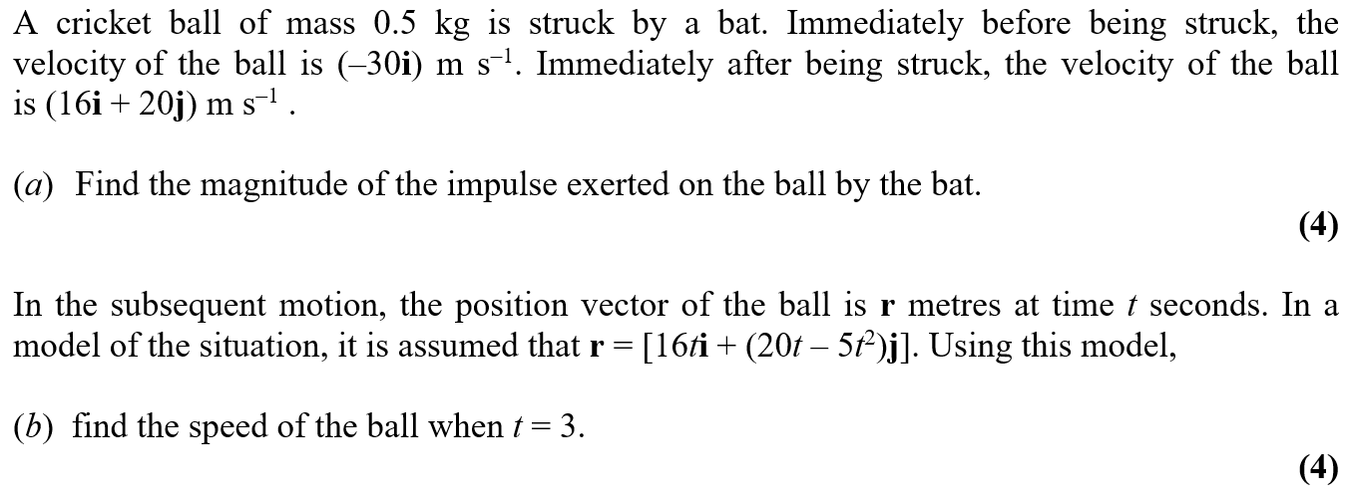
June 2006

Slide 23
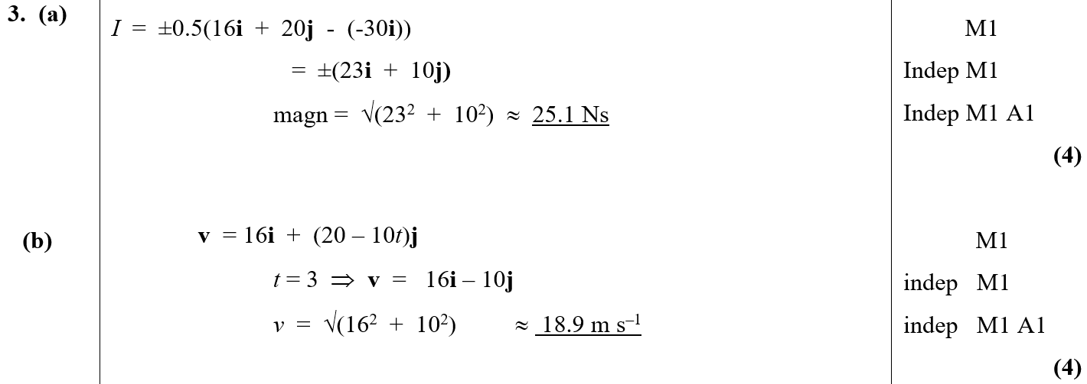
June 2006
A
B

Slide 24
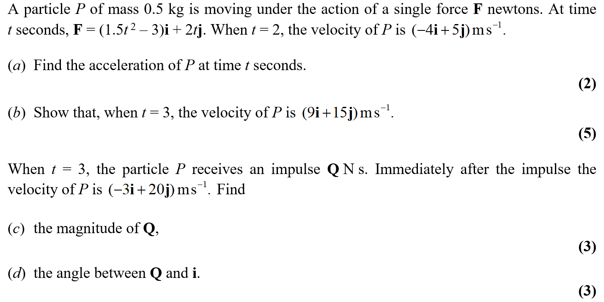
Jan 2007

Slide 25
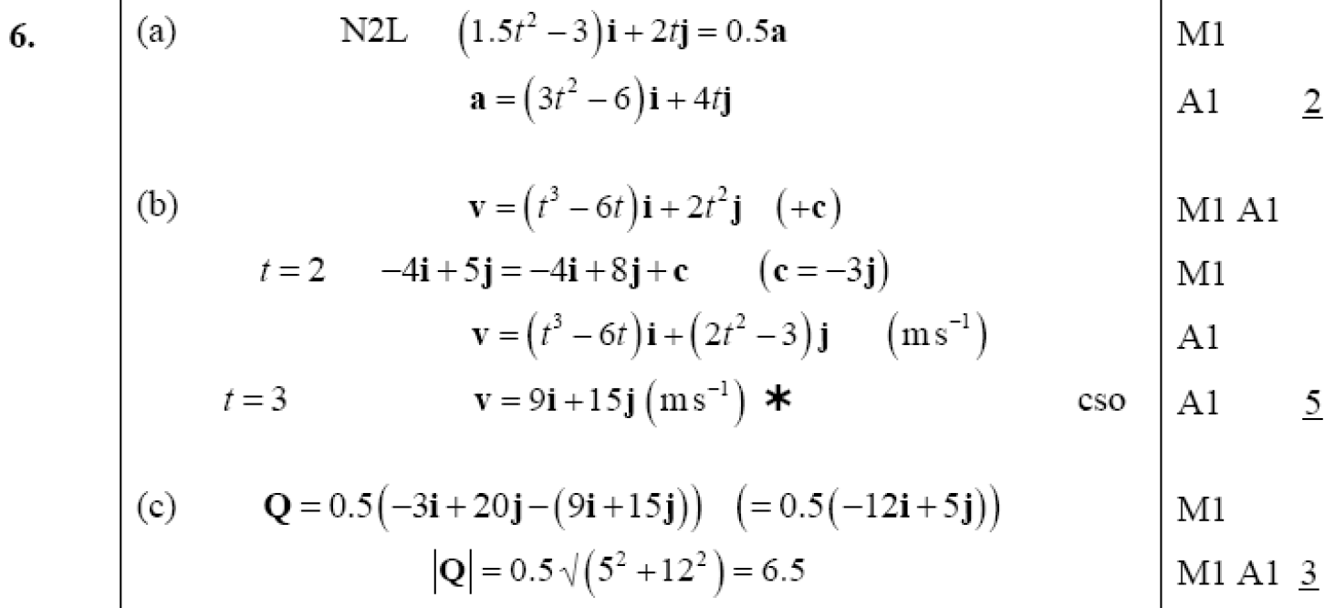
Jan 2007
A
B
C
D

Slide 26
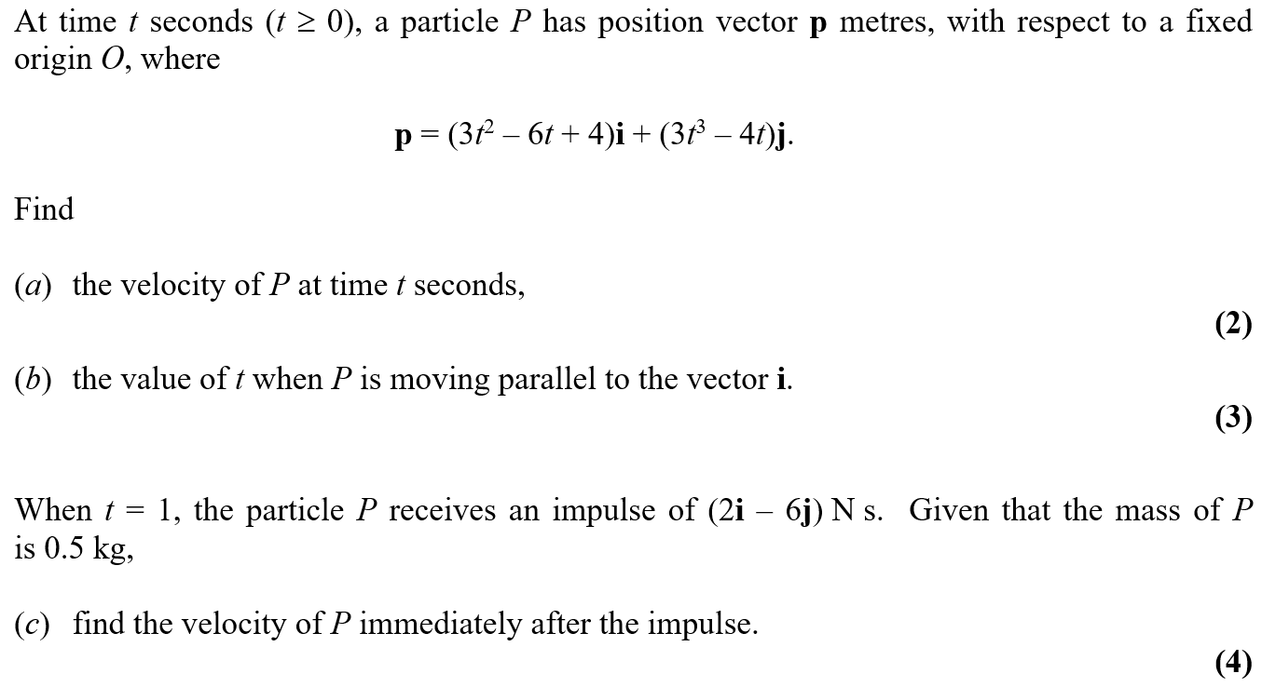
Jan 2008

Slide 27
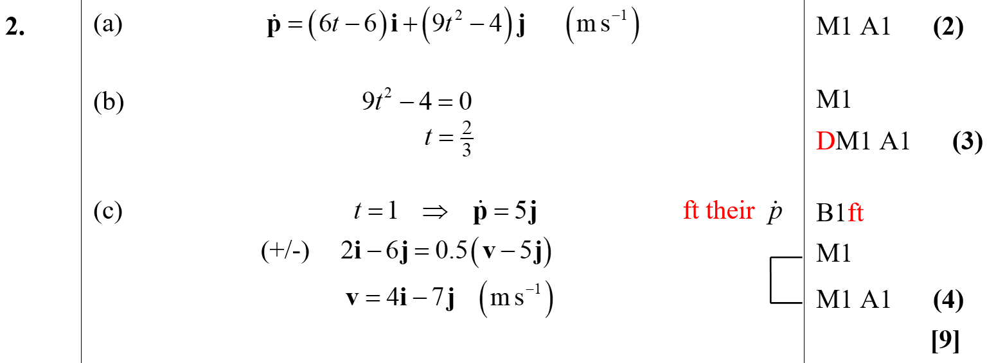
Jan 2008
A
B
C

Slide 28
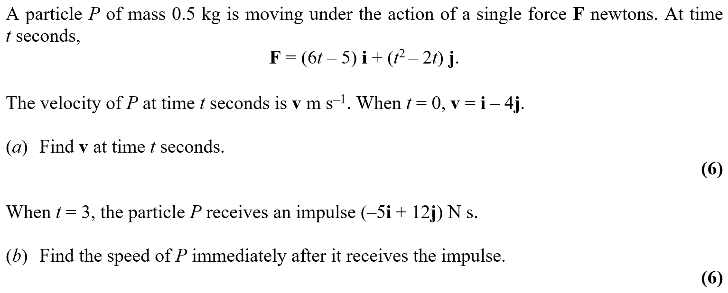
May 2008

Slide 29
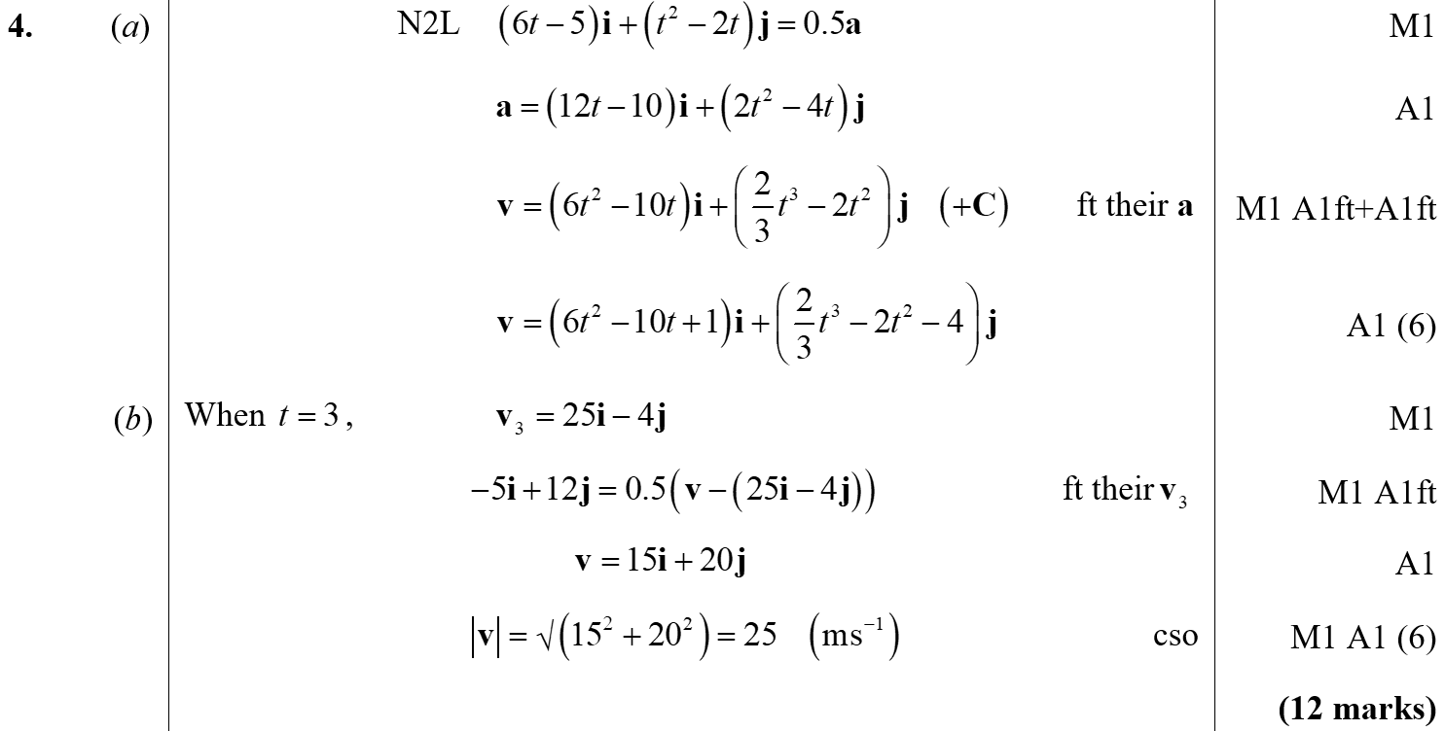
May 2008
A
B

Slide 30
May 2009

Slide 31
May 2009
A

Slide 32
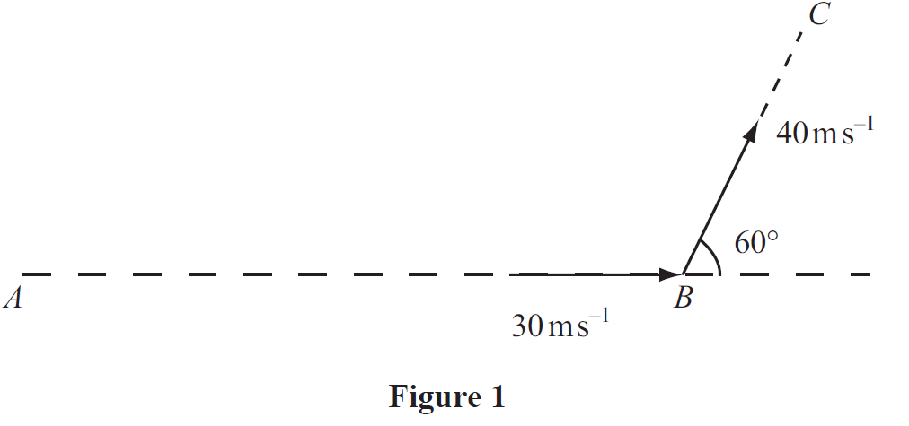
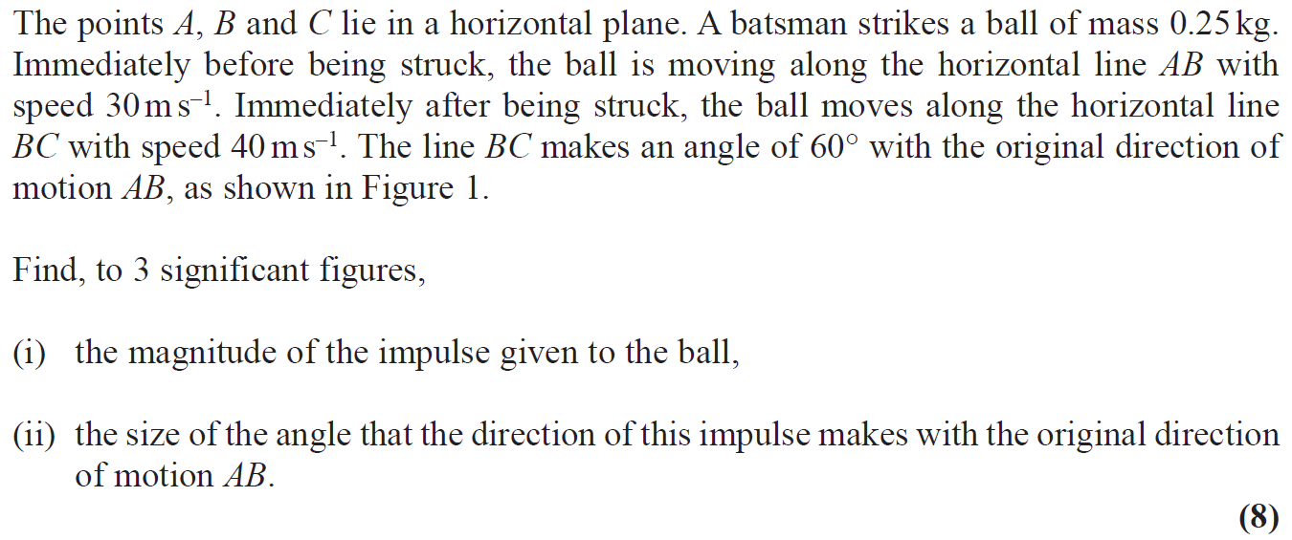
Jan 2010

Slide 33
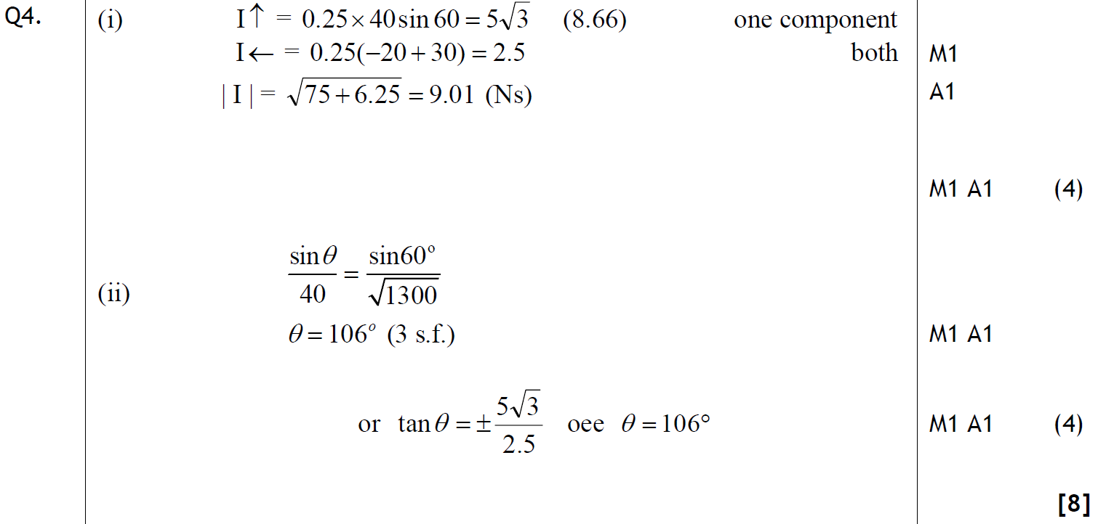
Jan 2010
(i)
(ii)

Slide 34
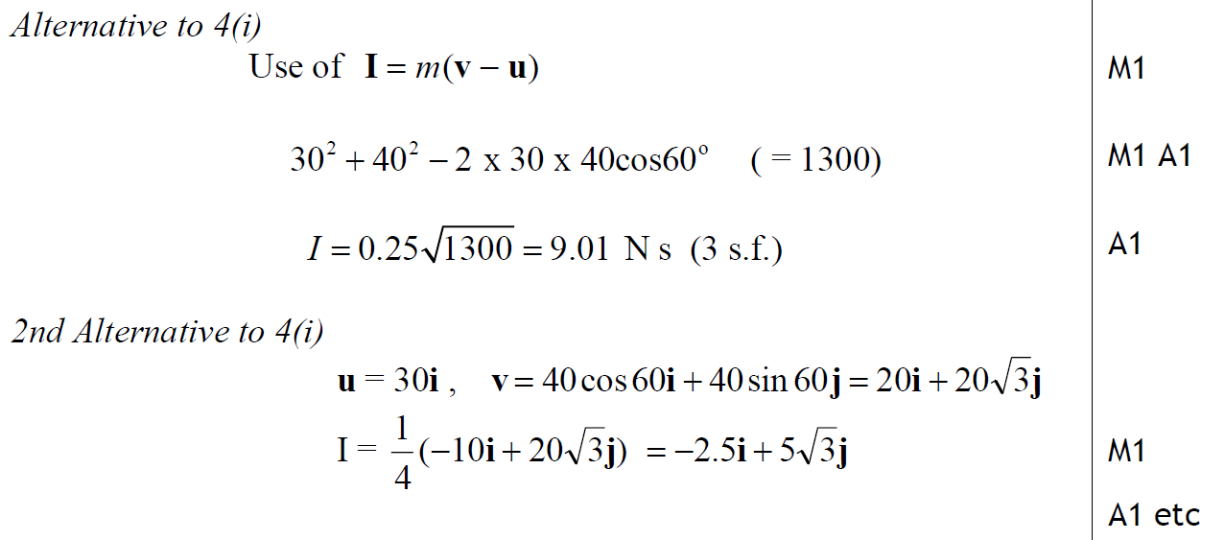
Jan 2010
Alternatives for (i)

Slide 35
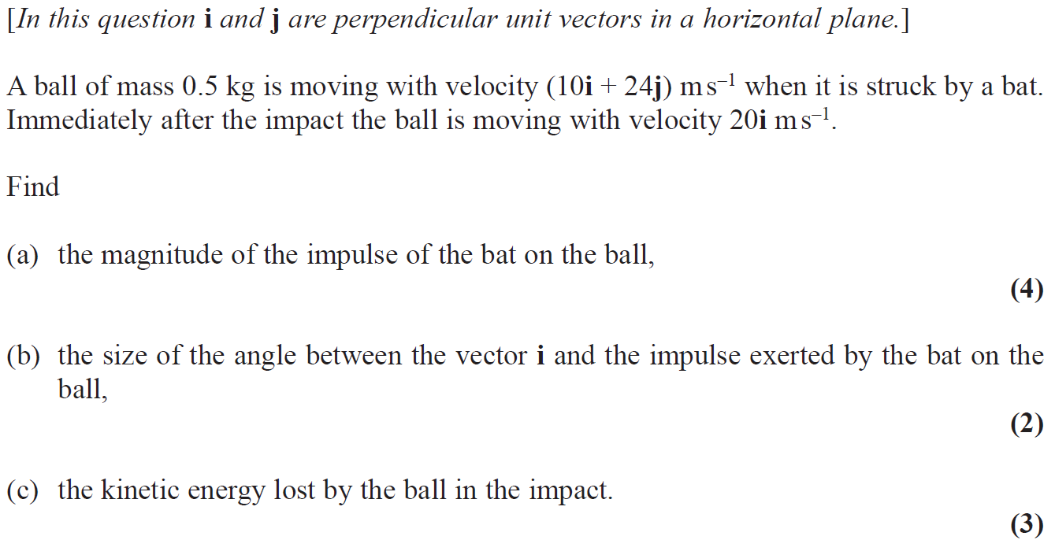
June 2010

Slide 36
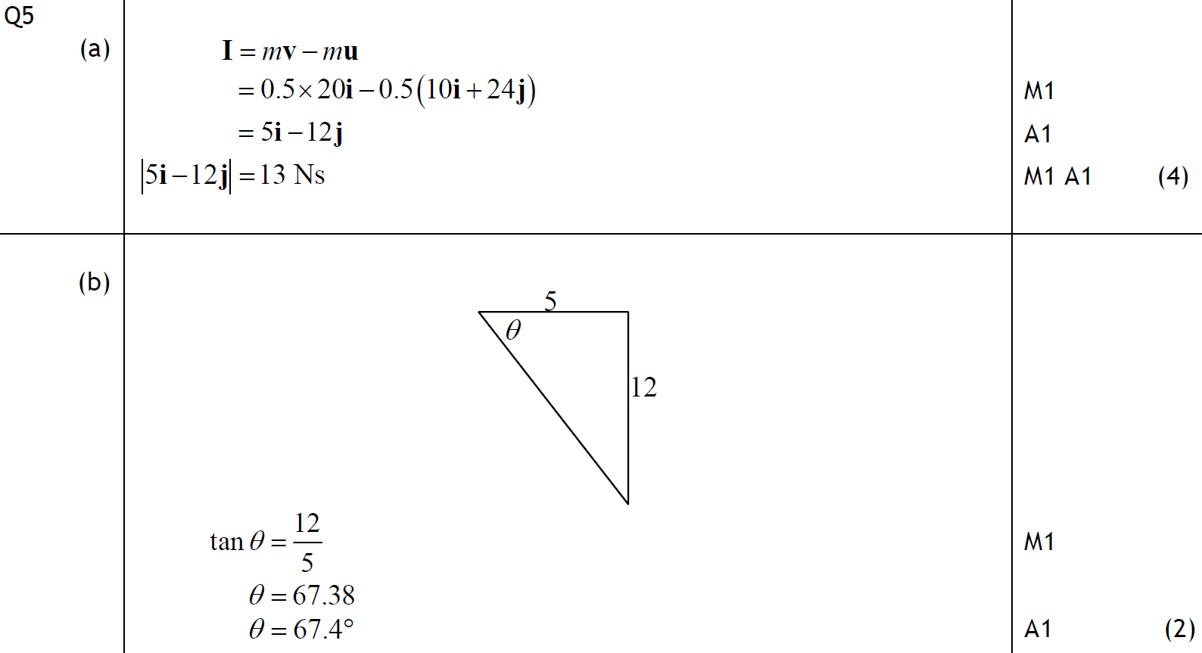
June 2010
A
B

Slide 37
June 2010
C

Slide 38
Jan 2011

Slide 39
Jan 2011
A

Slide 40
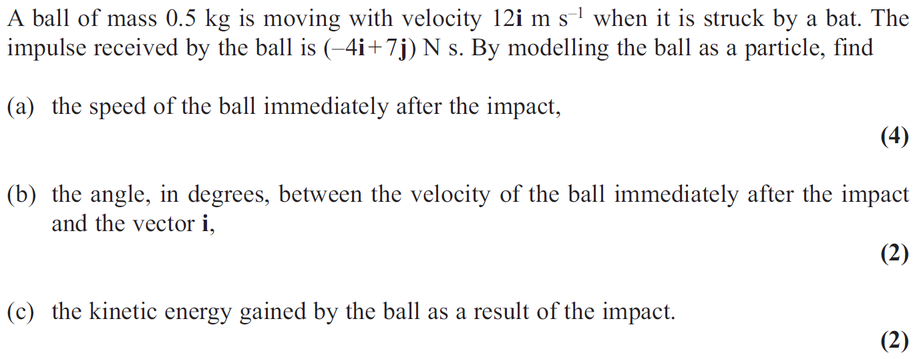
June 2011

Slide 41
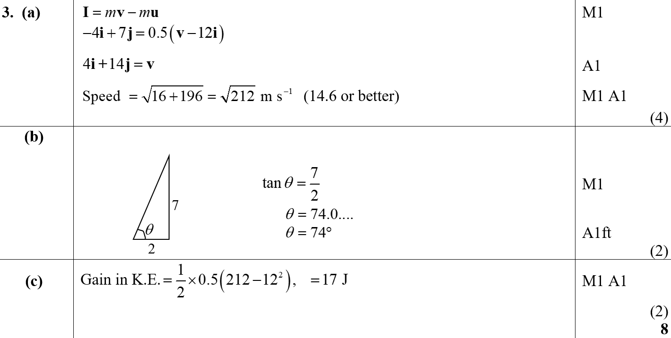
June 2011
A
B
C

Slide 42
Jan 2012

Slide 43
Jan 2012
A

Slide 44
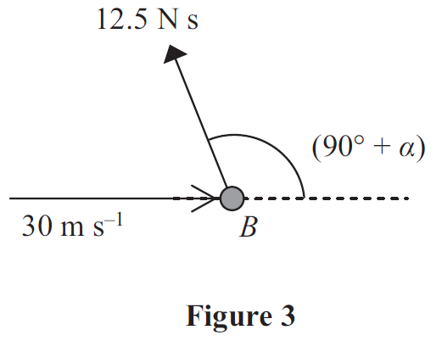
May 2012

Slide 45
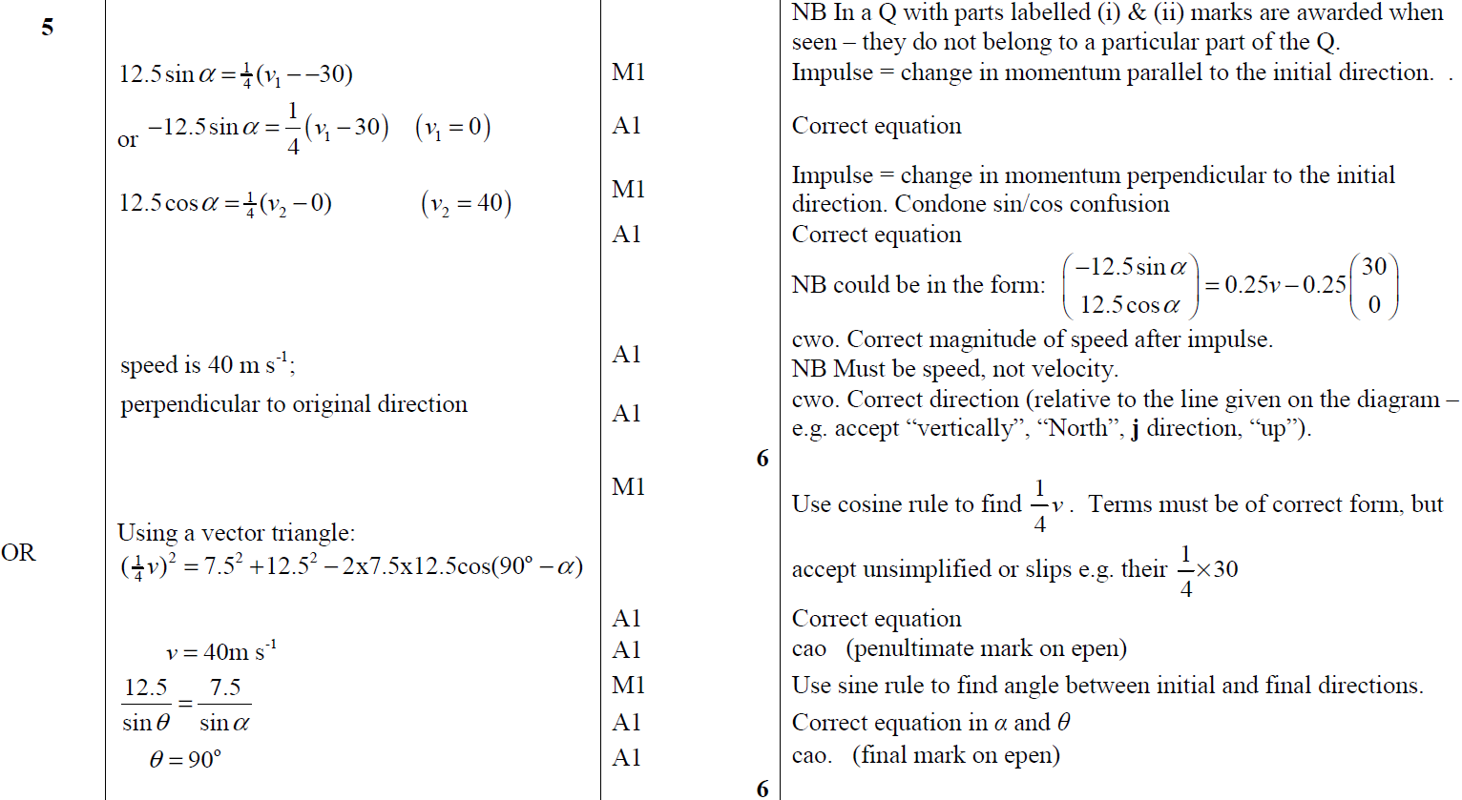
May 2012
A

Slide 46
June 2013

Slide 47
June 2013
A

Slide 48
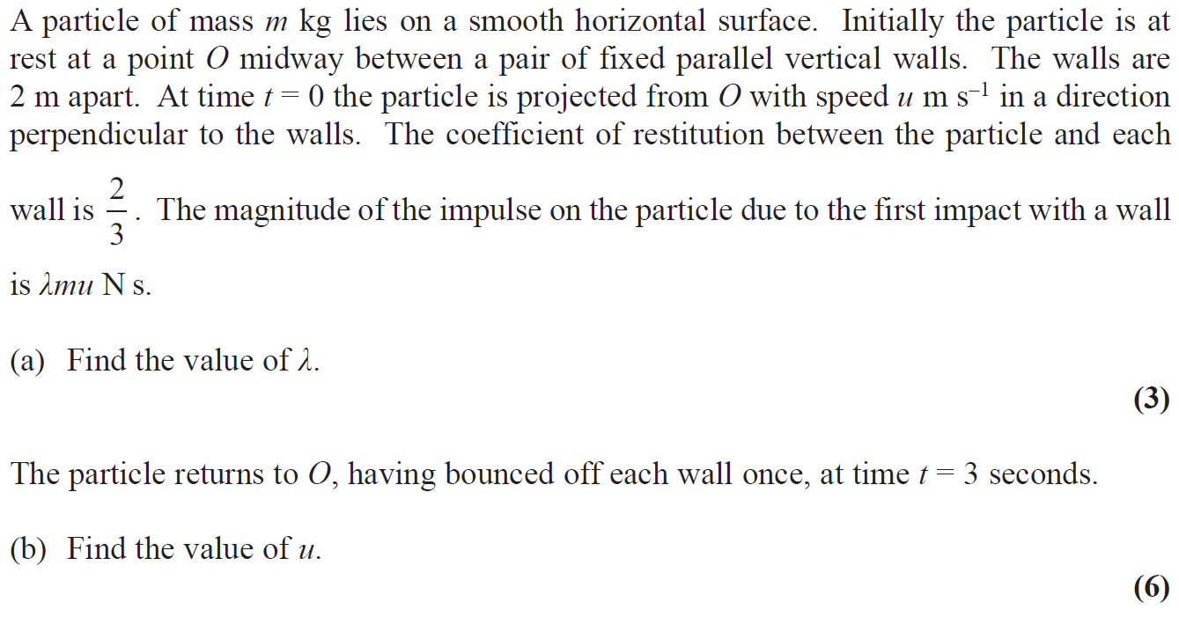
June 2014

Slide 49
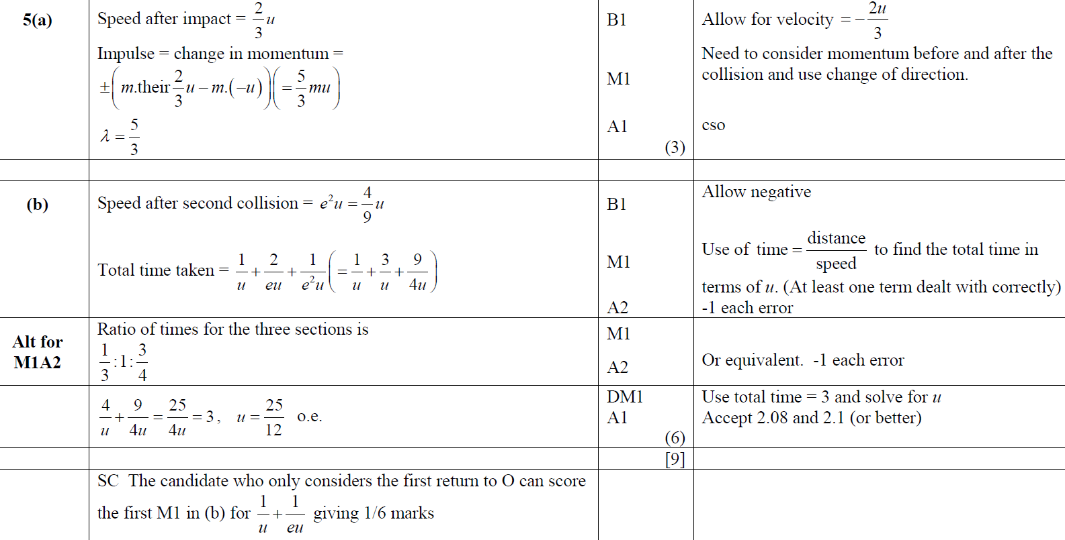
June 2014
A
B

Slide 50
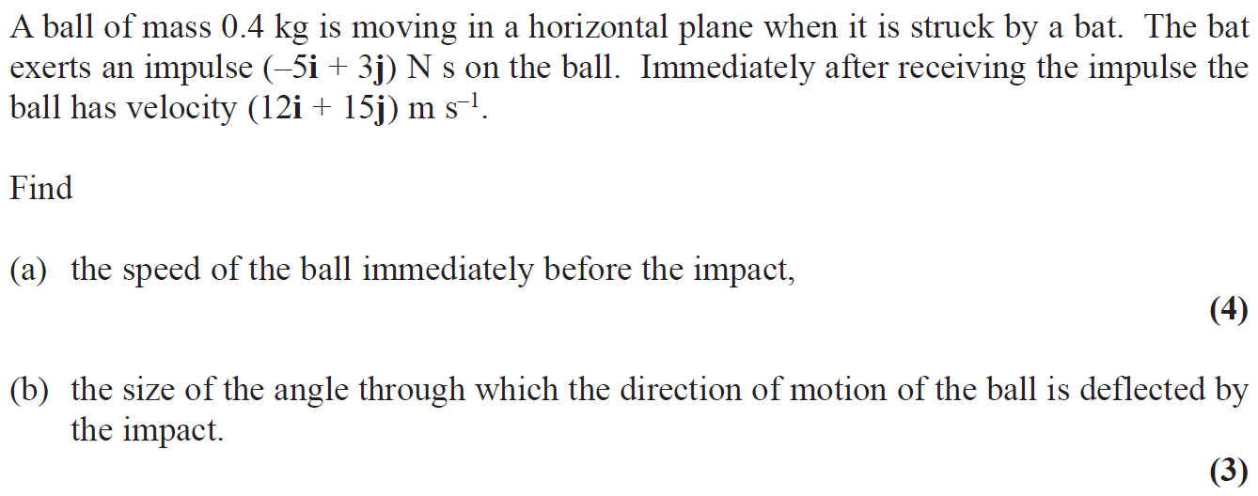
June 2014 (R)

Slide 51
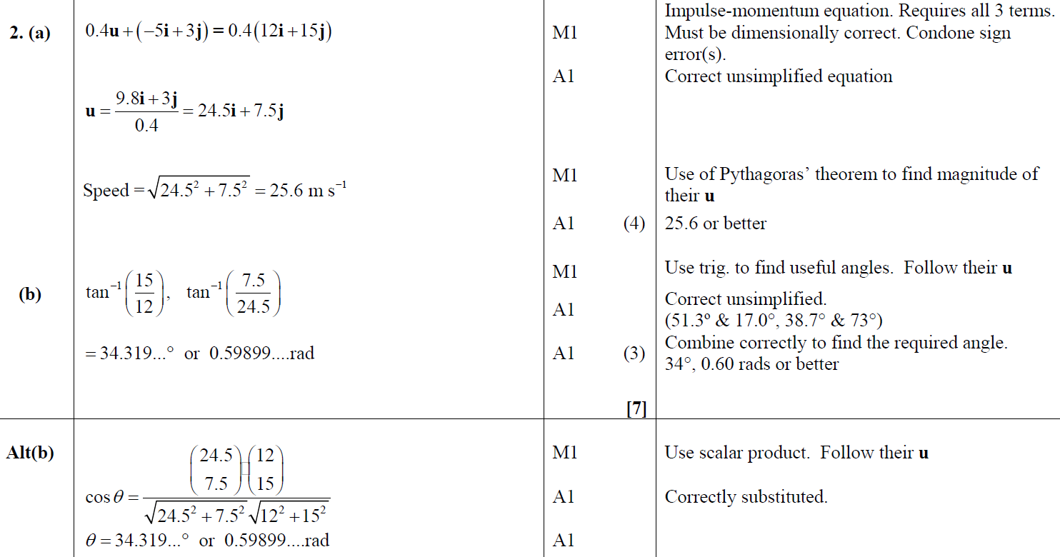
June 2014 (R)
A
B

Slide 52
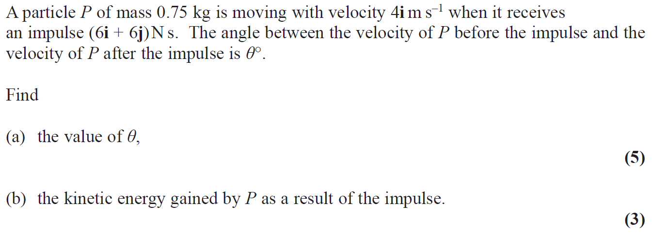
June 2015

Slide 53
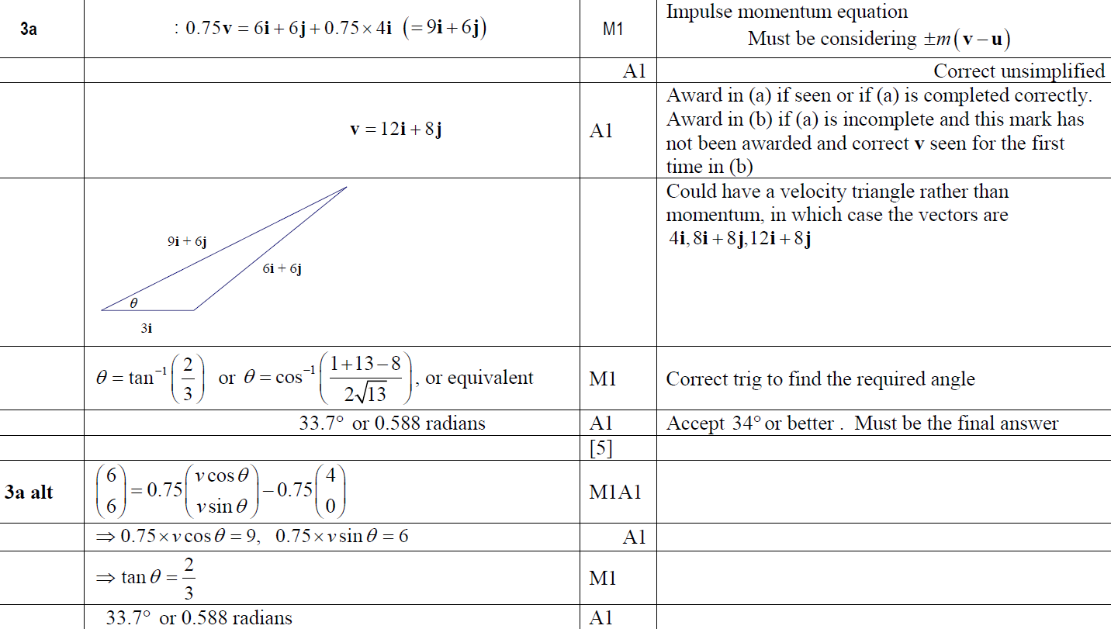
June 2015
A

Slide 54
June 2015
B

Slide 55
June 2016

Slide 56
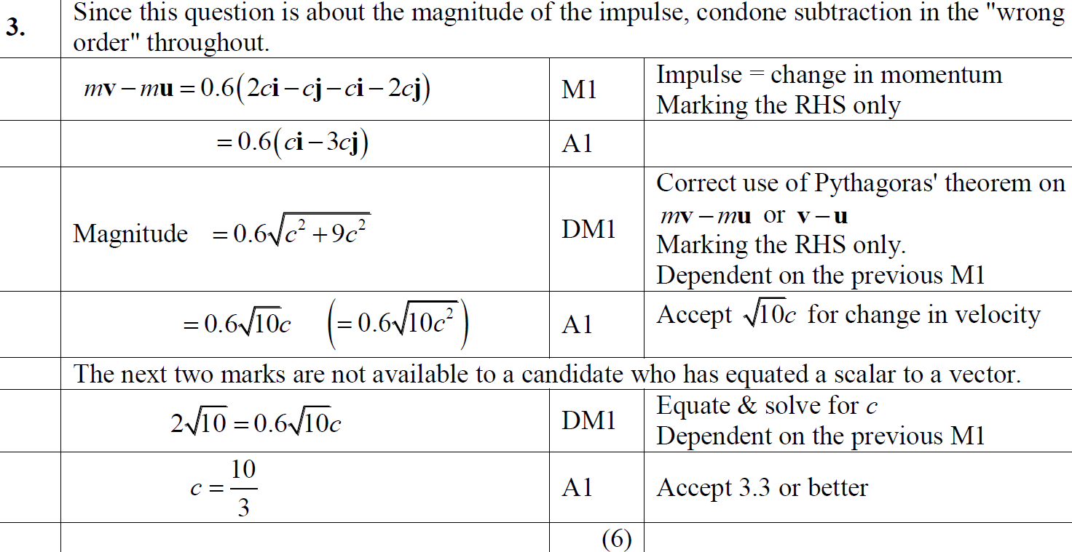
June 2016
A

Slide 57
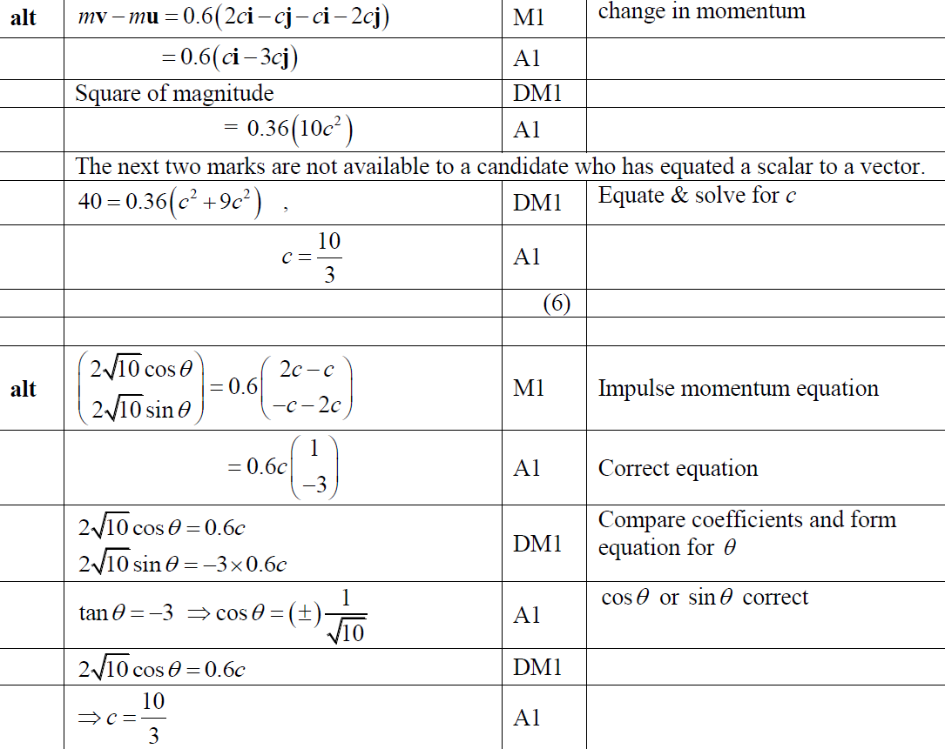
June 2016
A Alternative (i)
A Alternative (ii)

Slide 58
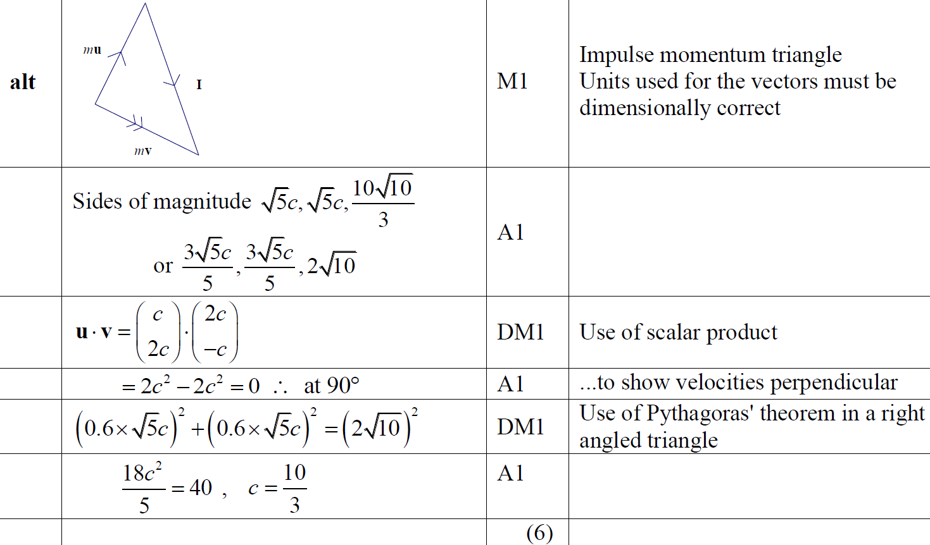
June 2016
A Alternative (iii)

Slide 59
June 2017

Slide 60
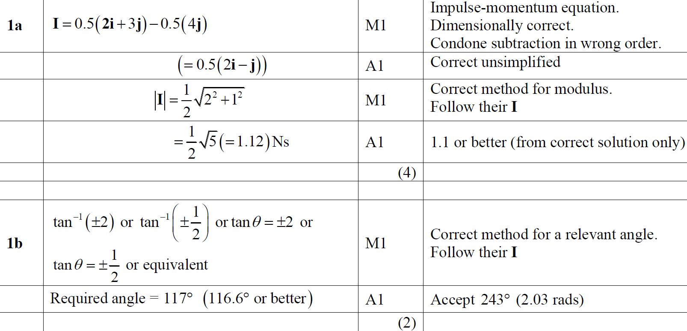
June 2017
A
B

Slide 61
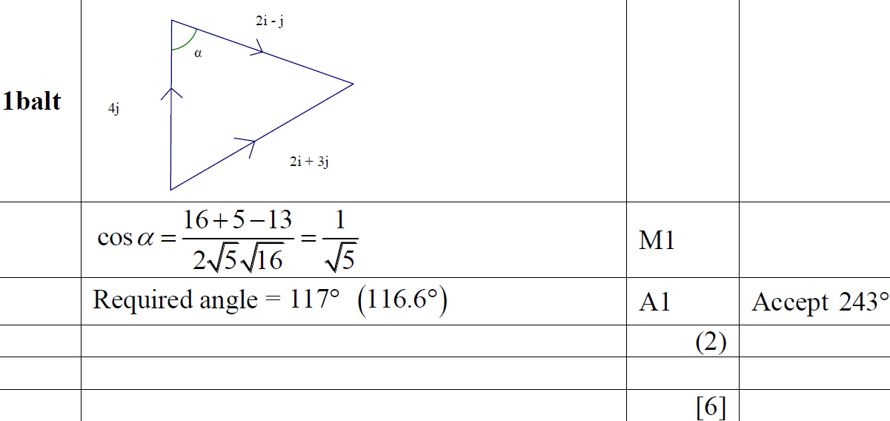
June 2017
B Alternative

Slide 62
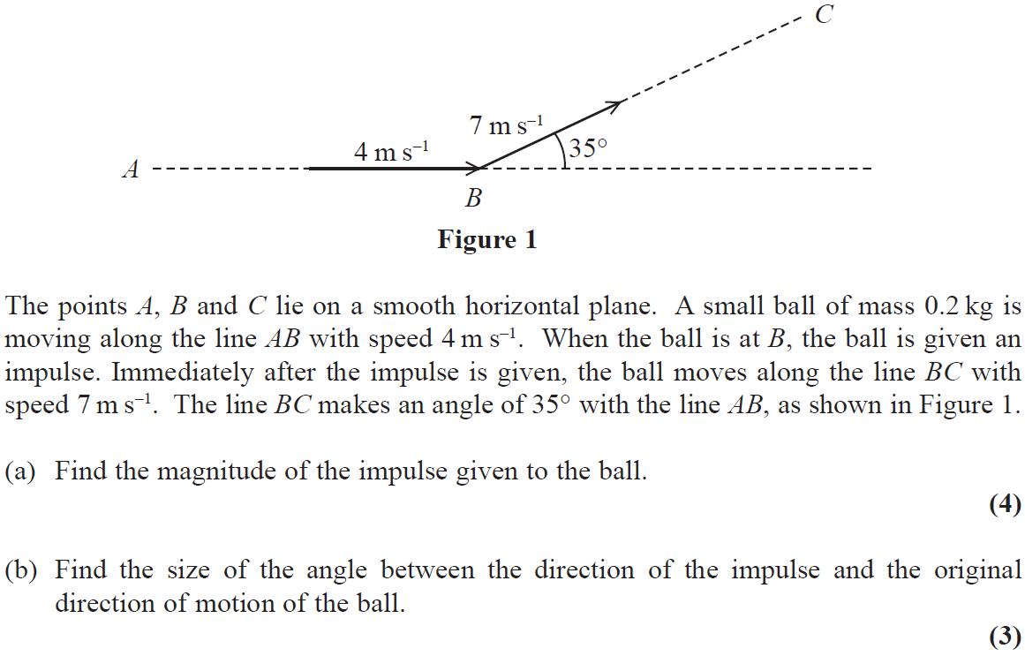
June 2018

Slide 63
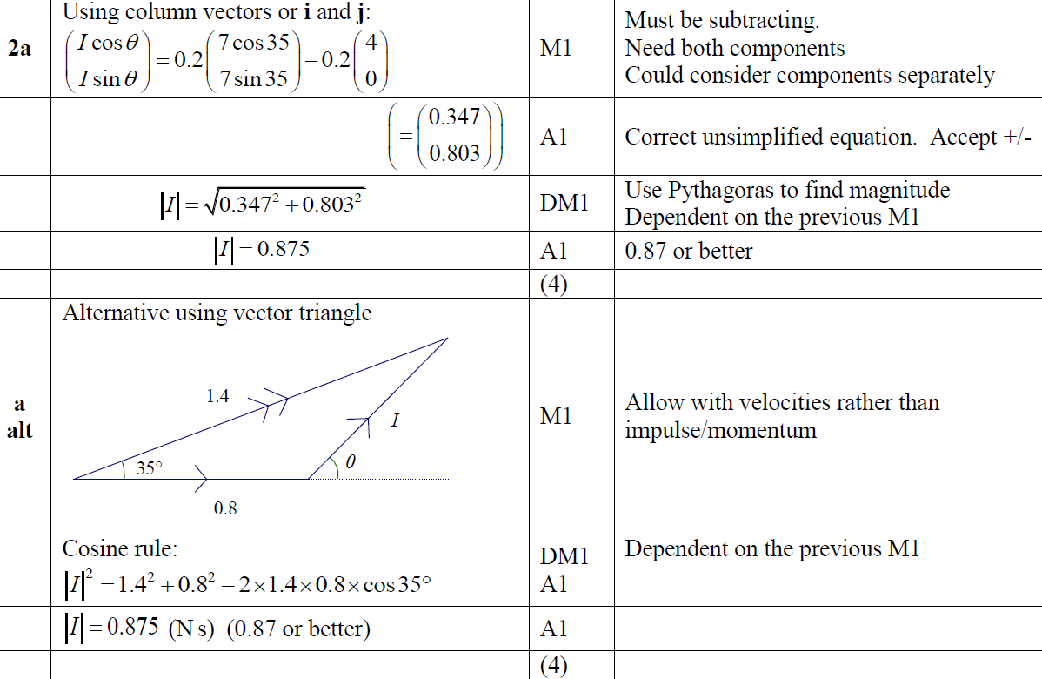
June 2018
A

Slide 64
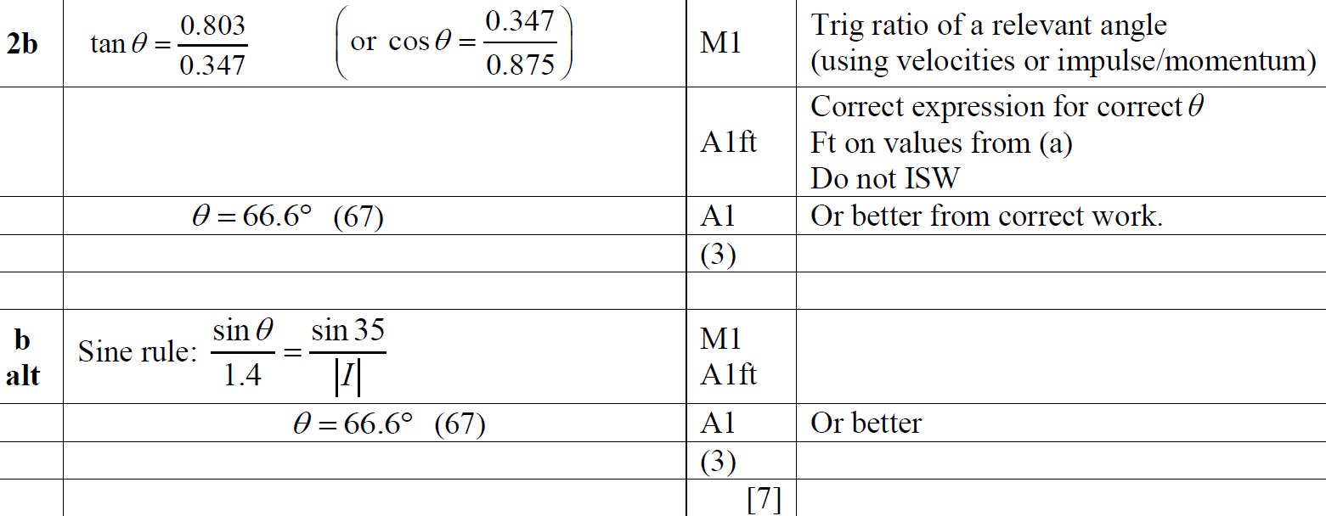
June 2018
B

Slide 65
June 2019

Slide 66
June 2019
A

Slide 67
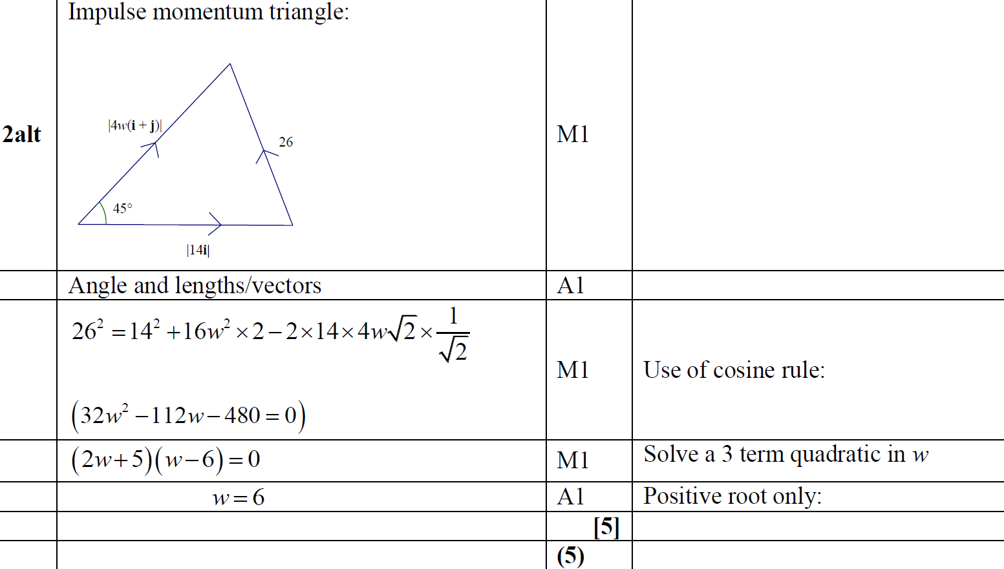
June 2019
A Alternative

