Slide 1
Old Spec Q’s
Hyperbolic Functions
SAM 2
2019 2
(i)
2019 2
(ii)

Slide 2
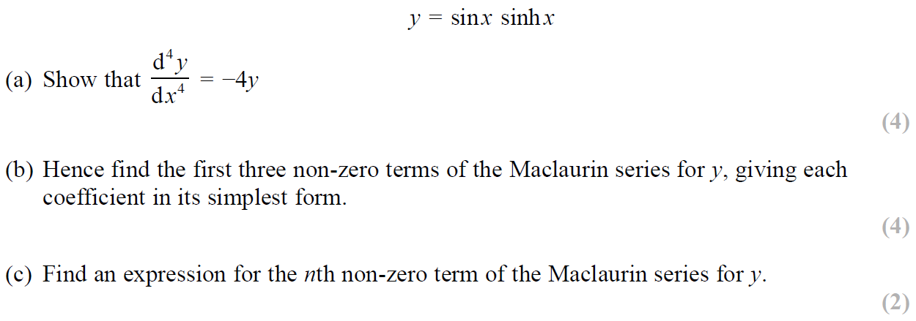
SAM Paper 2

Slide 3
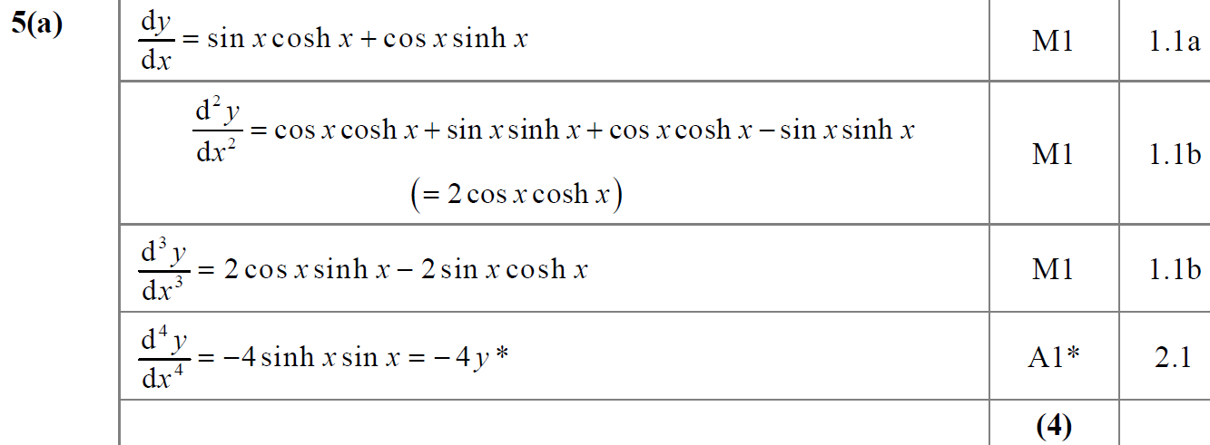
SAM Paper 2
A

Slide 4
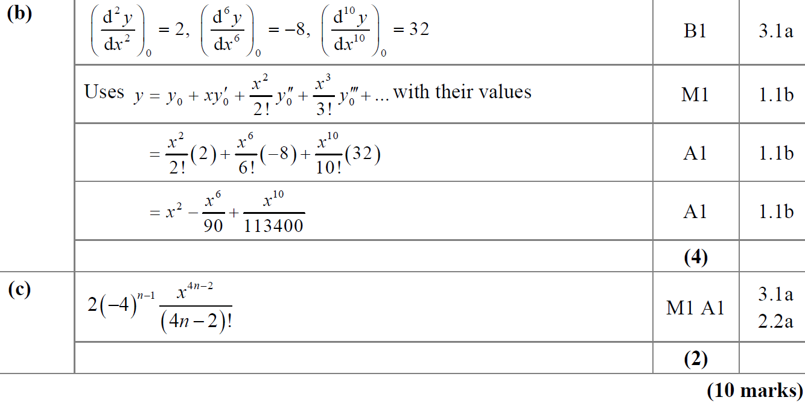
SAM Paper 2
B
C

Slide 5
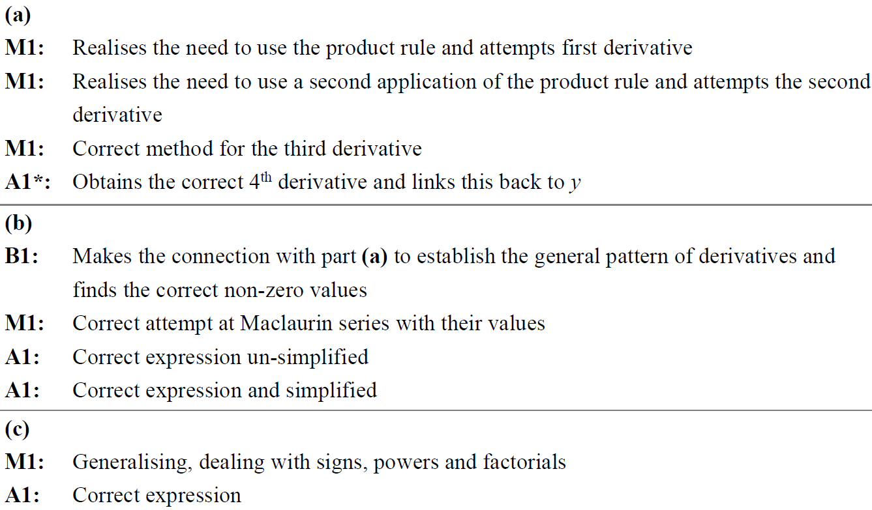
SAM Paper 2
A notes
B notes
C notes

Slide 6
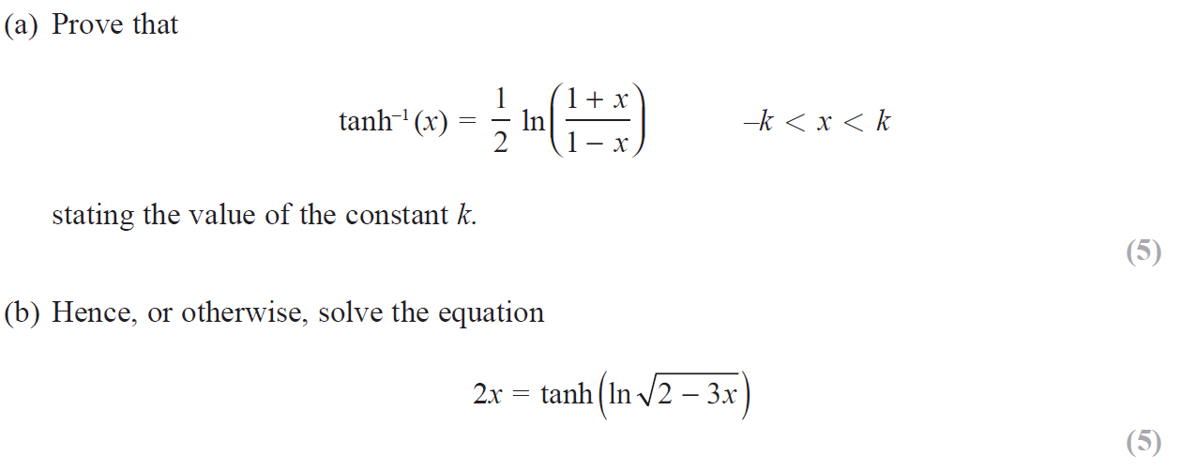
2019 Paper 2

Slide 7
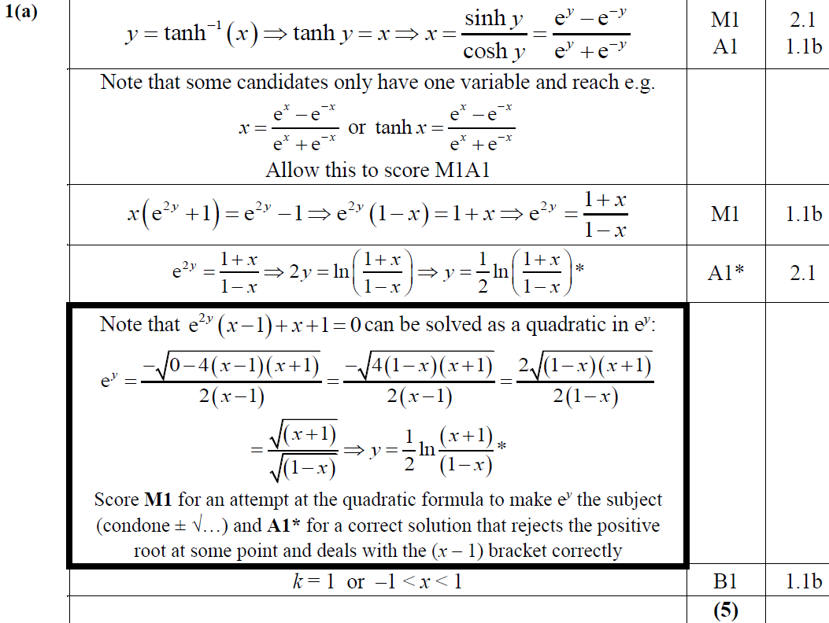
2019 Paper 2
A

Slide 8
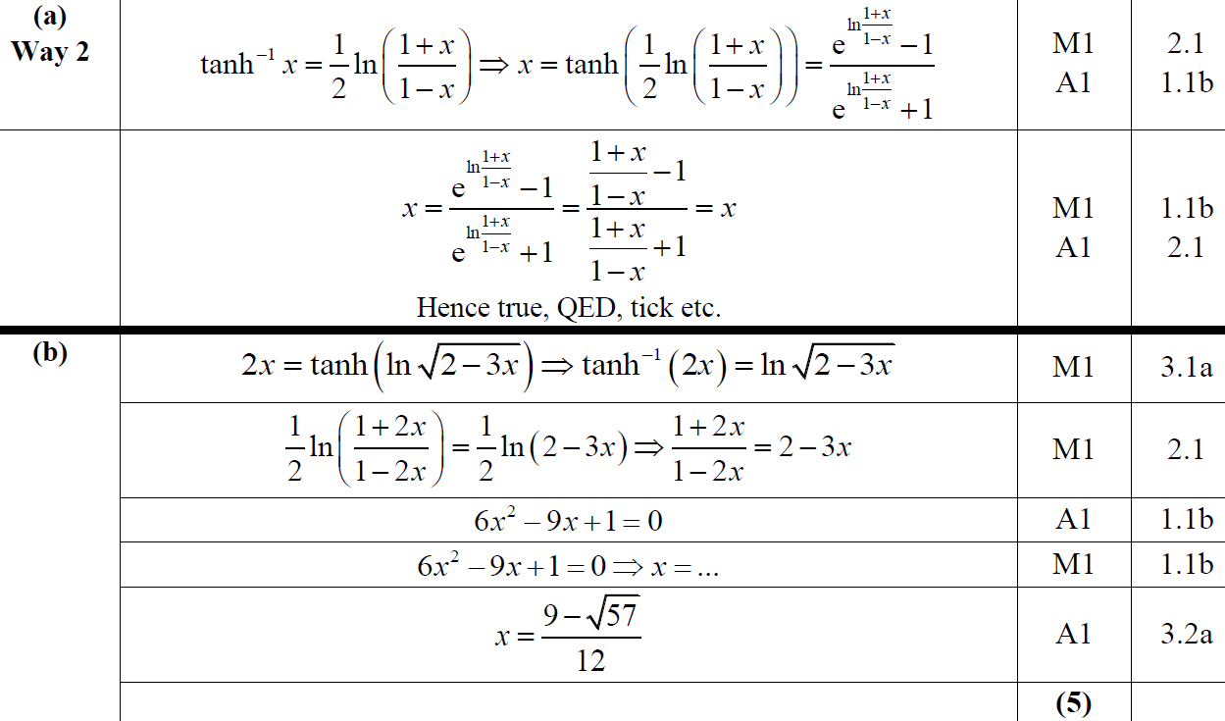
2019 Paper 2
A Alternative
B

Slide 9
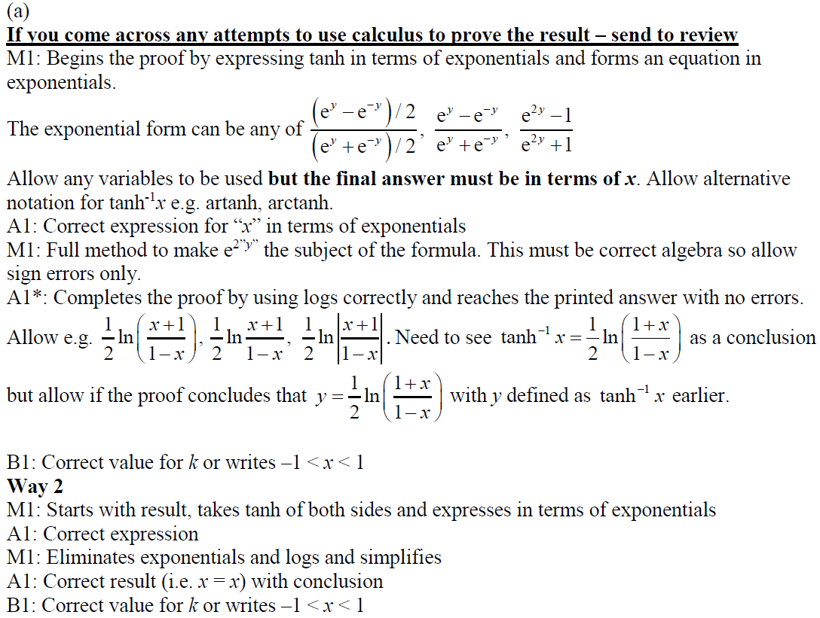
2019 Paper 2
A notes

Slide 10
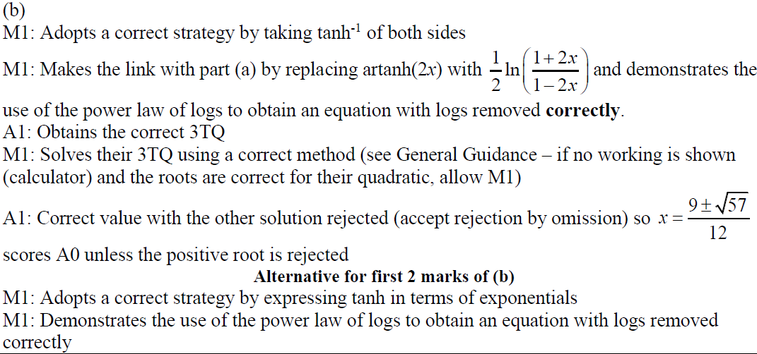
2019 Paper 2
A notes

Slide 11
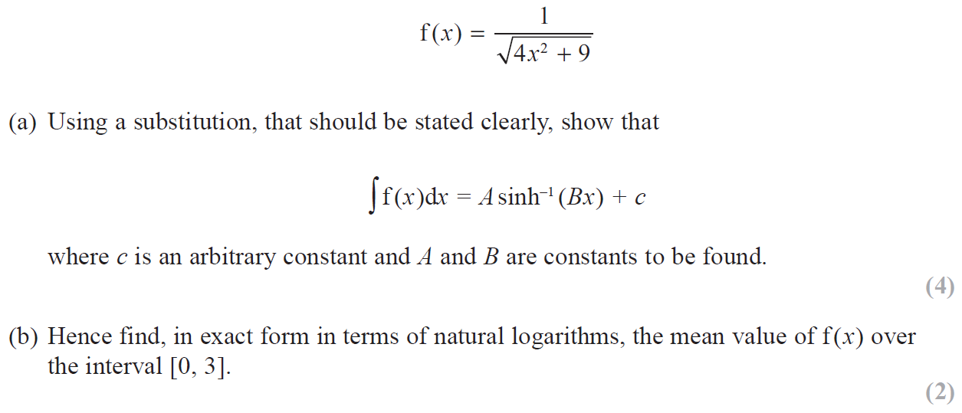
2019 Paper 2

Slide 12
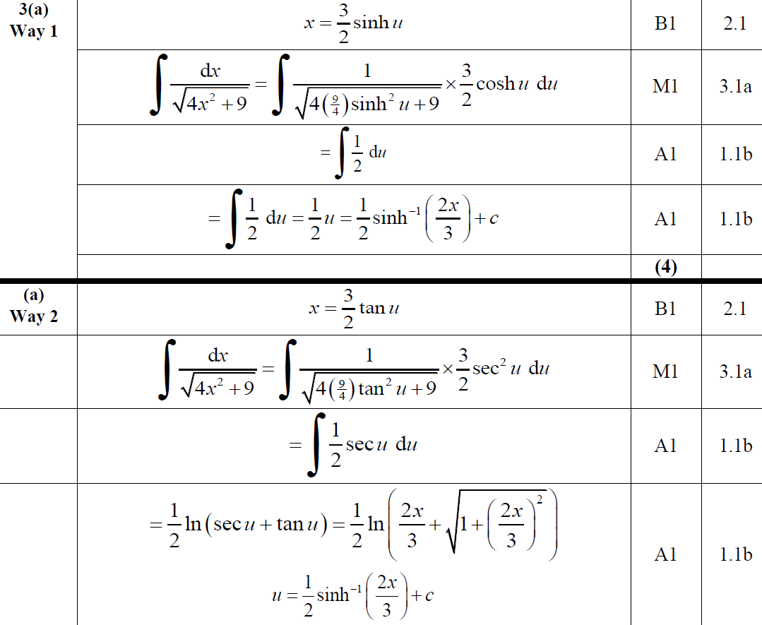
2019 Paper 2
A
A Alternative 1

Slide 13
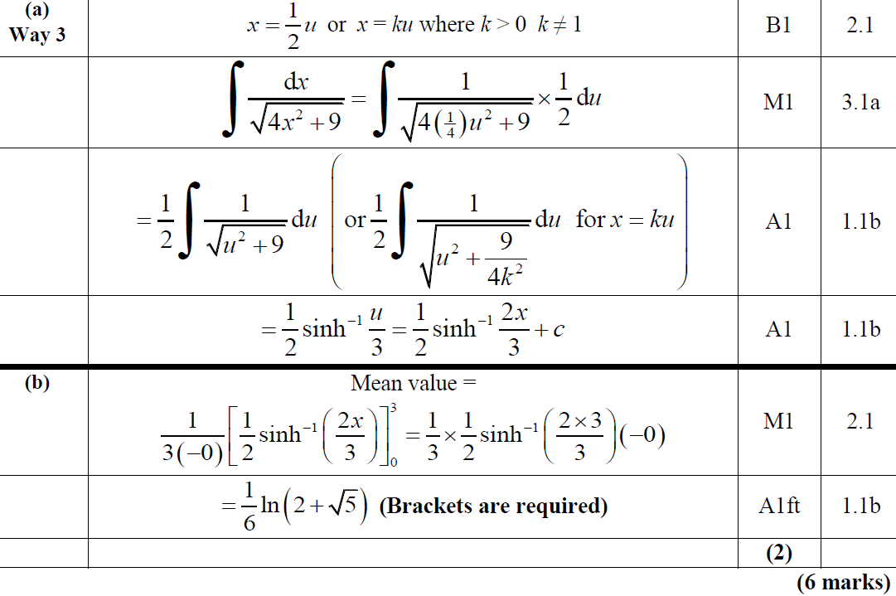
2019 Paper 2
A Alternative 2
B

Slide 14
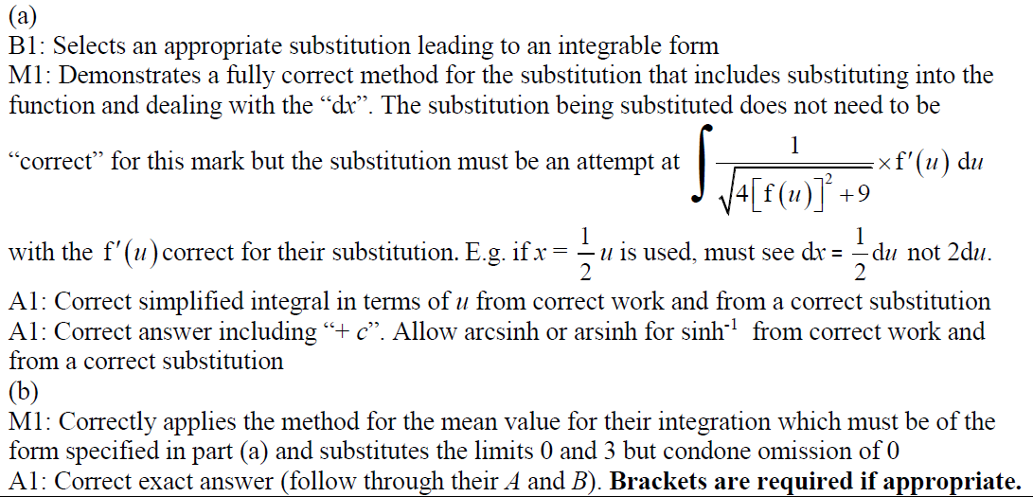
2019 Paper 2
A notes
B notes

Slide 15
New Spec Q’s
Differentiation
Integration
Old Spec Hyperbolics
P5/ Old FP2
P6/ FP3
June 2002 (i)
Jan 2006 (i)
June 2008 (i)
Feb 2010 (ii)
June 2011 (ii)
June 2014 (iii)
June 2017 (i)
June 2002 (ii)
Jan 2006 (ii)
June 2008 (ii)
Feb 2010 (iii)
June 2012 (i)
June 2014 R (i)
June 2017 (ii)
June 2003 (i)
Jan 2006 (iii)
June 2008 (iii)
June 2012 (ii)
June 2014 R (ii)
June 2018 (i)
June 2003 (ii)
June 2006 (i)
June 2008 (iv)
June 2002
June 2013 (i)
June 2014 R (iii)
June 2018 (ii)
June 2003 (iii)
June 2006 (ii)
June 2008 (v)
June 2009 (i)
June 2013 (ii)
June 2014 R (iv)
June 2018 (iii)
June 2004
June 2006 (iii)
June 2009 (i)
June 2009 (ii)
June 2013 R
June 2015 (i)
June 2019 (i)
June 2005 (i)
June 2007 (i)
June 2009 (ii)
June 2010 (i)
June 2013 W
June 2015 (ii)
June 2019 (ii)
June 2005 (ii)
June 2007 (ii)
June 2009 (iii)
June 2010 (ii)
June 2014 (i)
June 2016 (i)
June 2019 (iii)
June 2005 (iii)
June 2007 (iii)
Feb 2010 (i)
June 2011 (i)
June 2014 (ii)
June 2016 (ii)

Slide 16
June 2002

Slide 17
June 2002
A

Slide 18
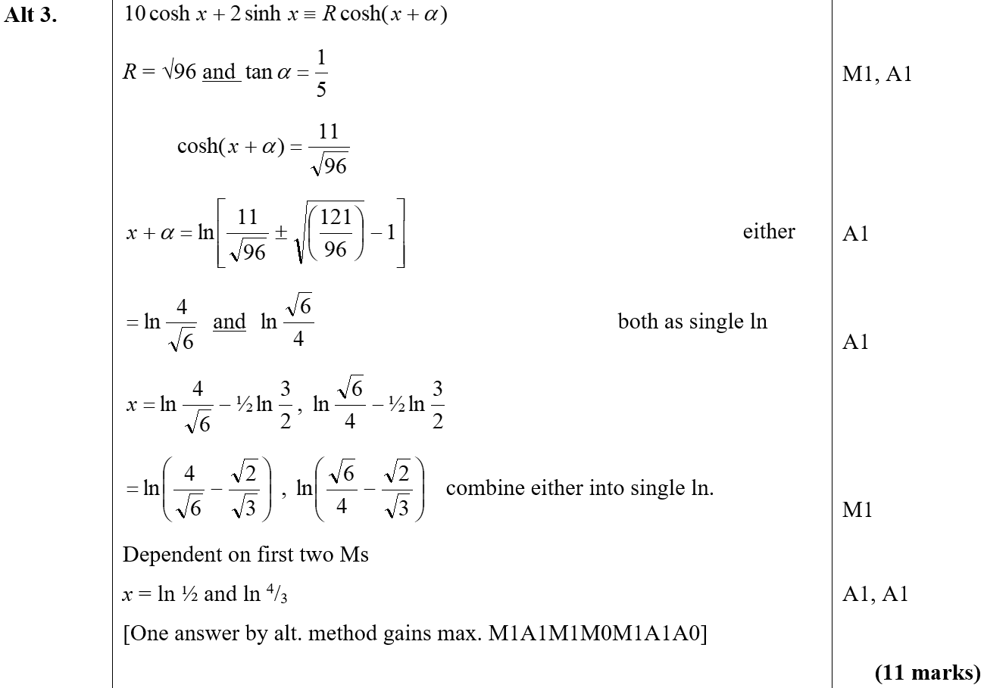
June 2002
A Alternative

Slide 19
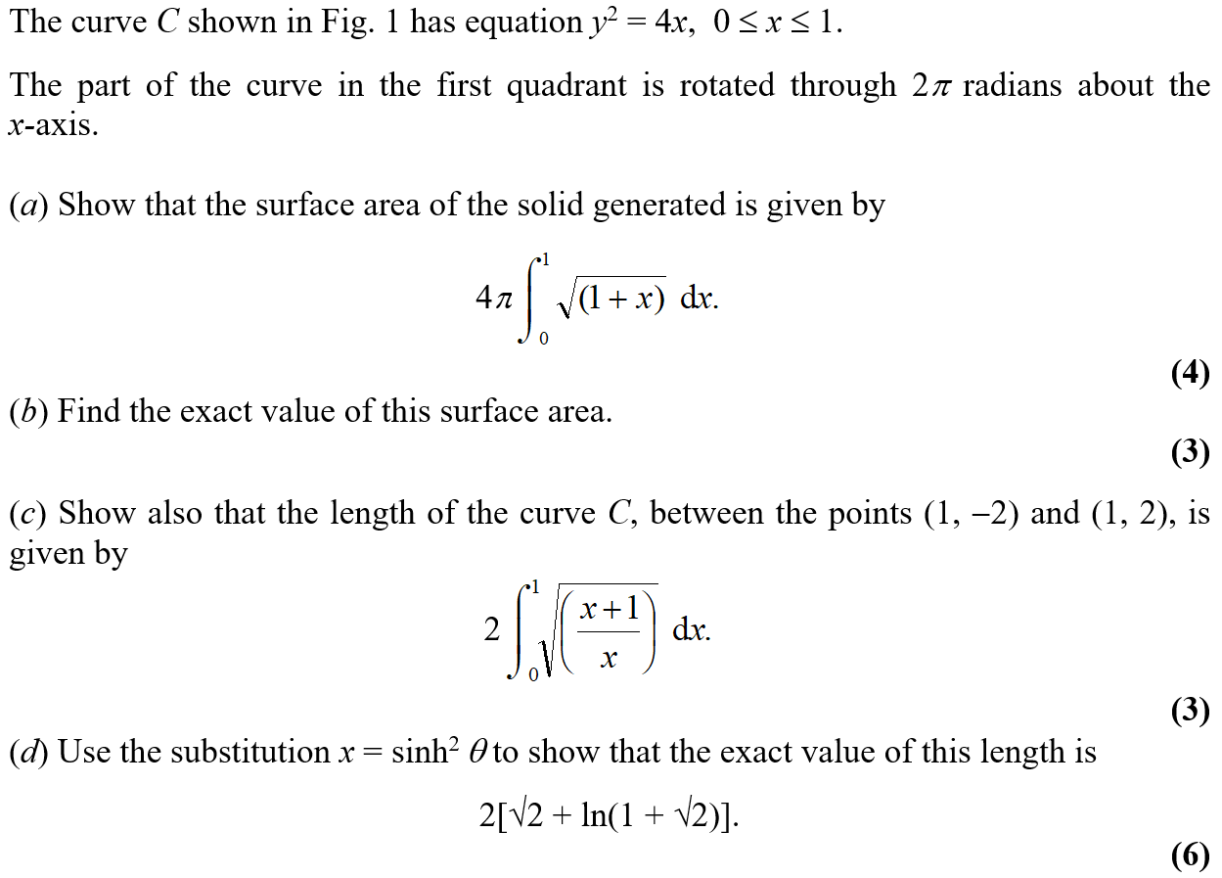
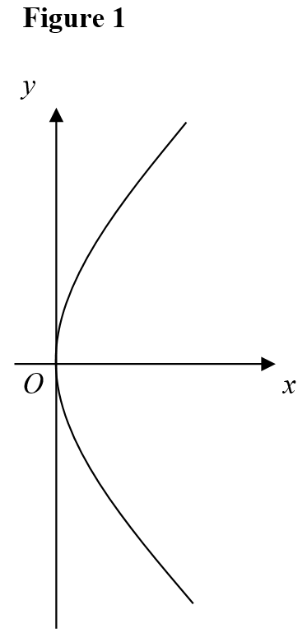
June 2002

Slide 20
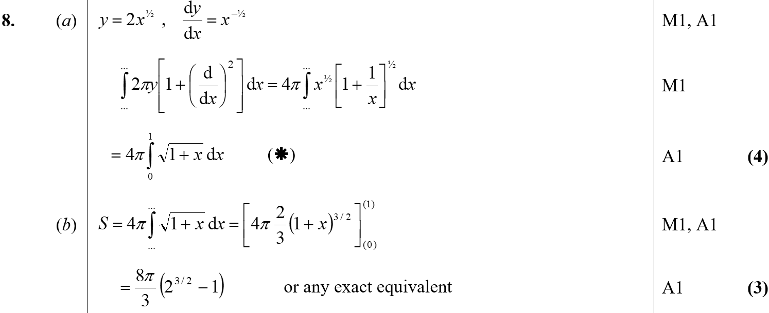
June 2002
A
B

Slide 21
June 2002
C

Slide 22
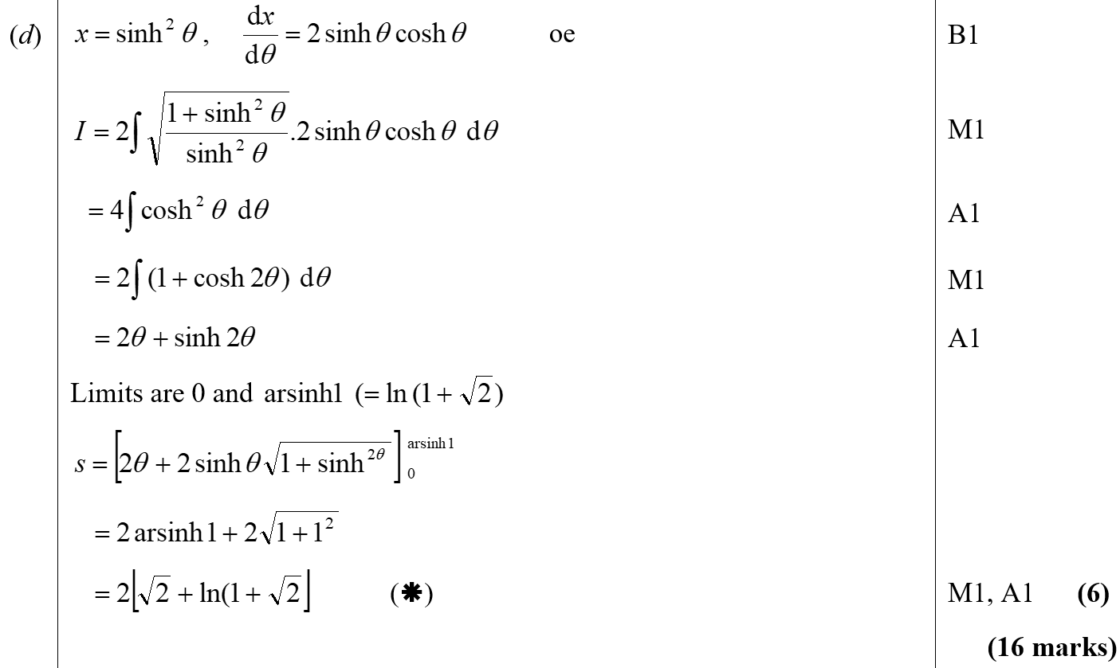
June 2002
D

Slide 23
June 2003

Slide 24
June 2003
A

Slide 25
June 2003

Slide 26
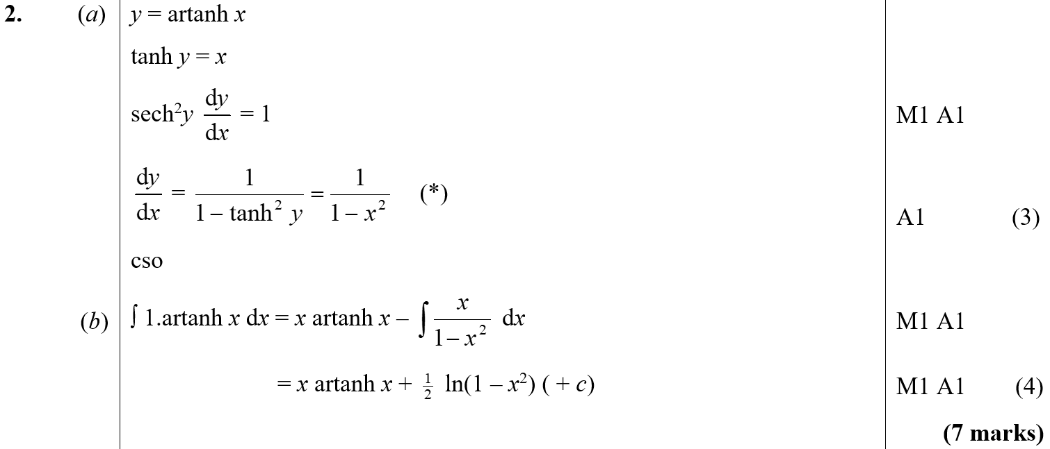
June 2003
A
B

Slide 27
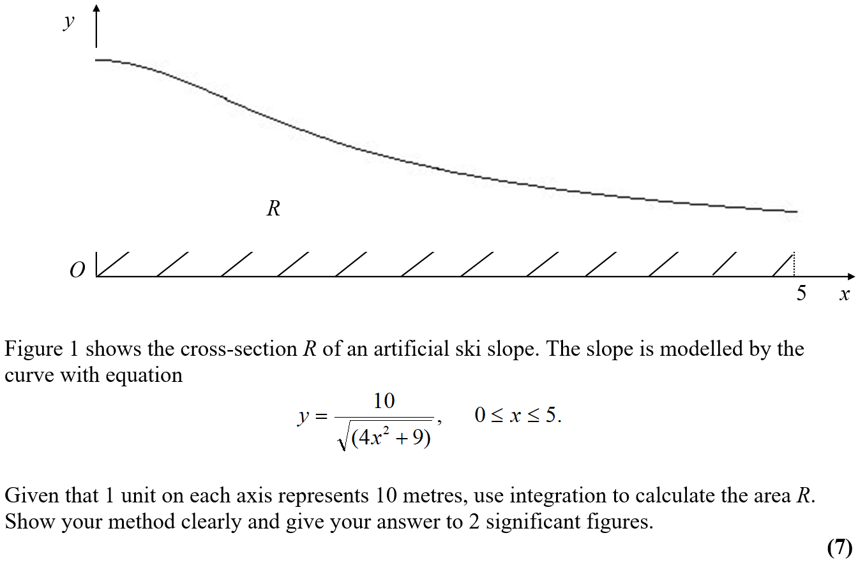
June 2003

Slide 28
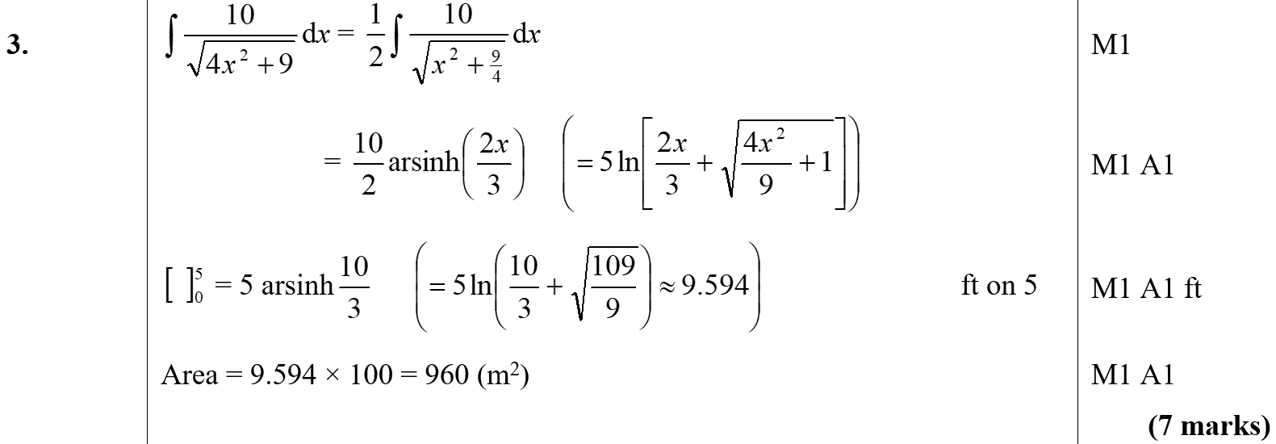
June 2003
A

Slide 29
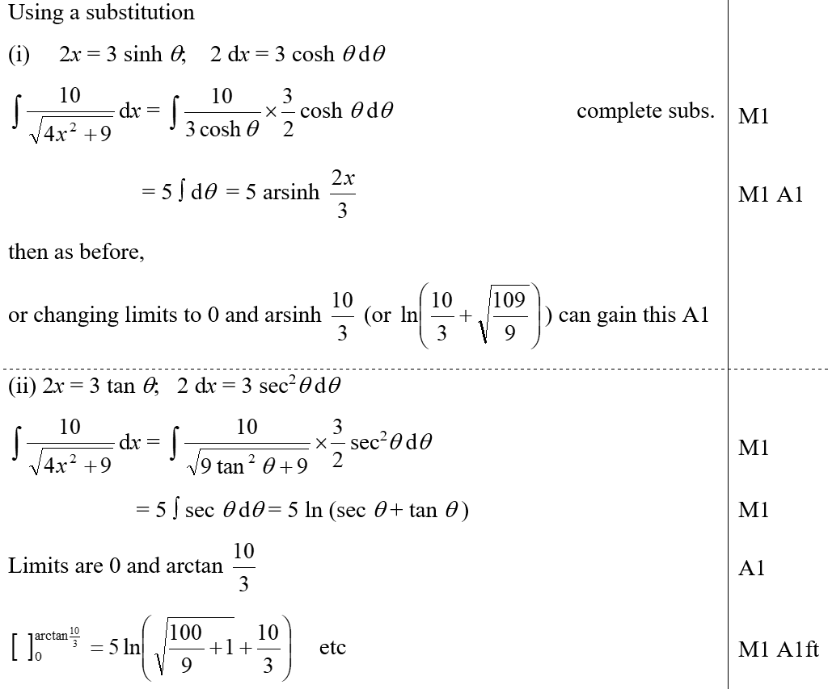
June 2003
A Alternatives

Slide 30
June 2004

Slide 31
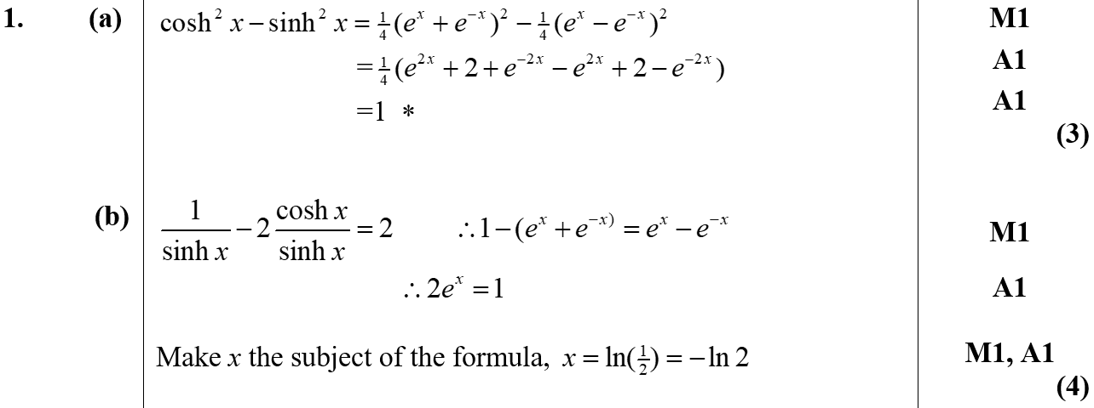
June 2004
A
B

Slide 32
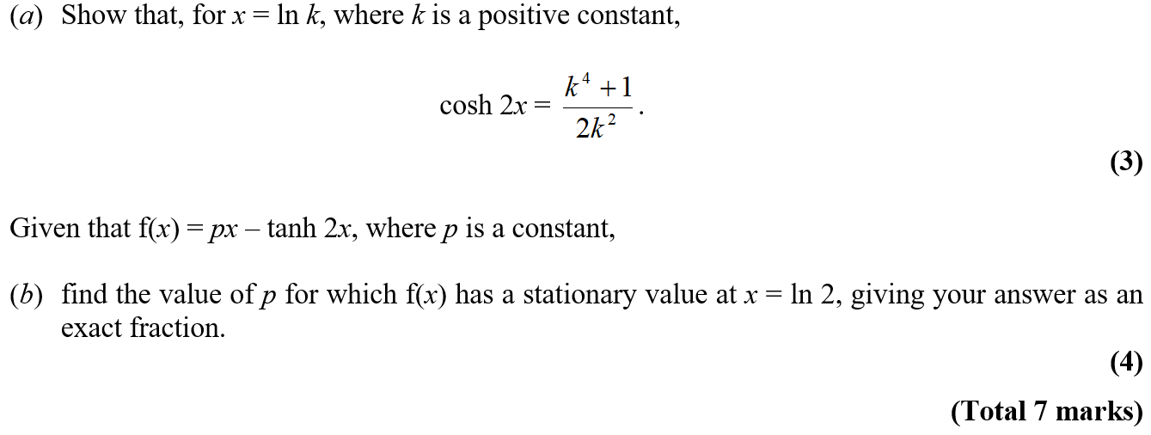
June 2005

Slide 33
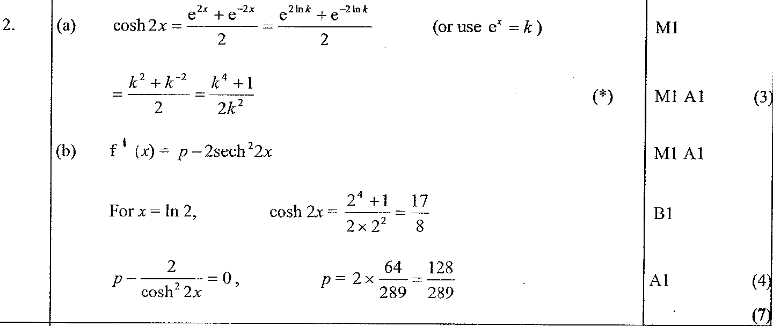
June 2005
A
B

Slide 34
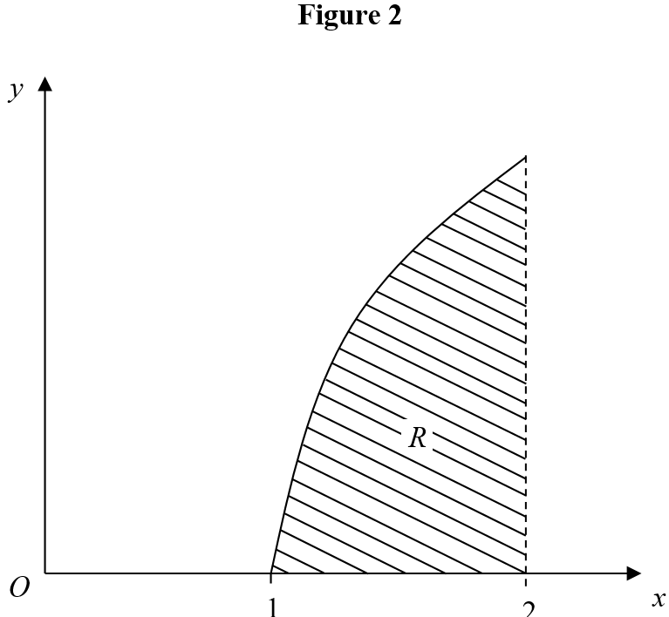
June 2005

Slide 35
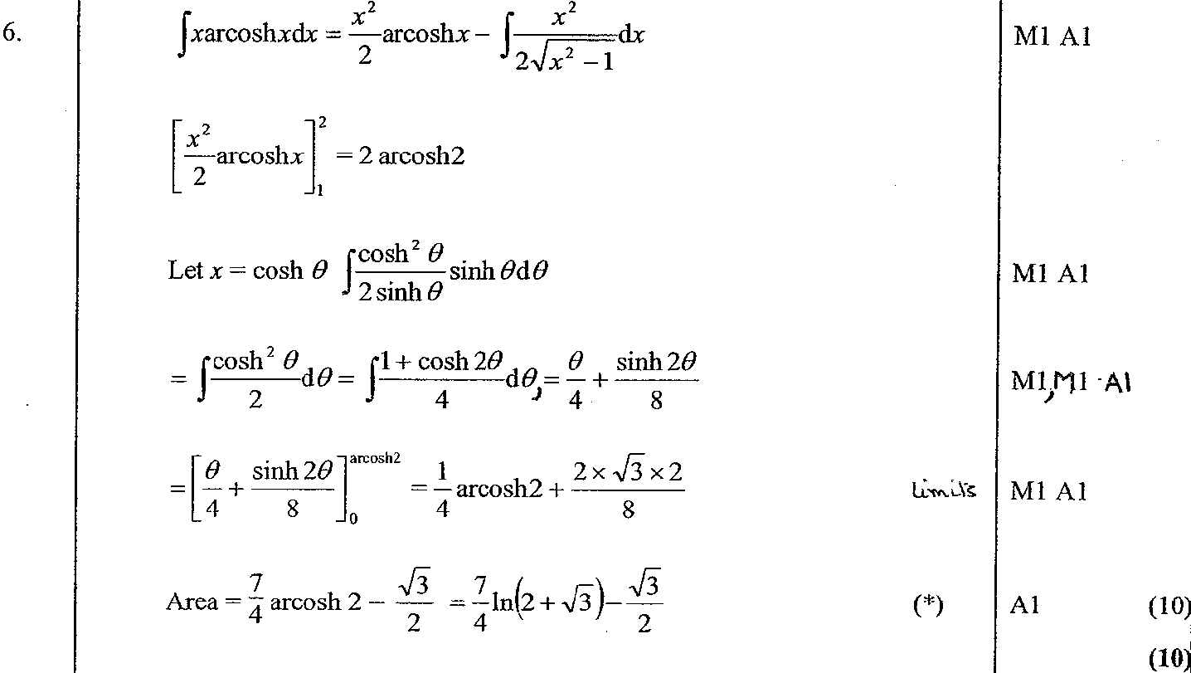
June 2005
A

Slide 36
June 2005

Slide 37
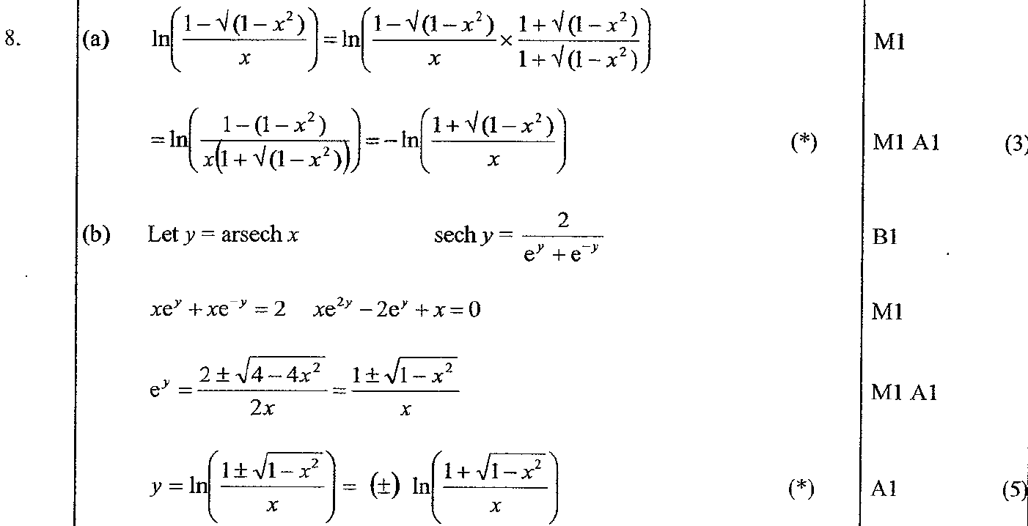
June 2005
A
B

Slide 38
June 2005
C

Slide 39
Jan 2006

Slide 40
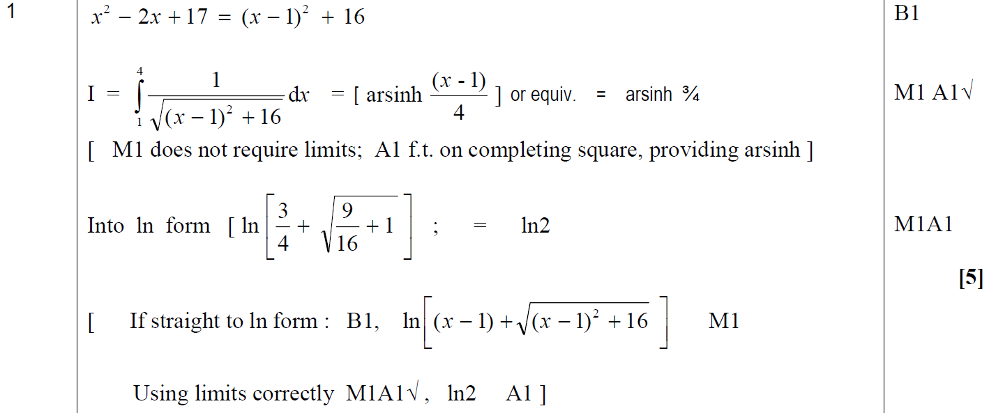
Jan 2006
A

Slide 41
Jan 2006

Slide 42
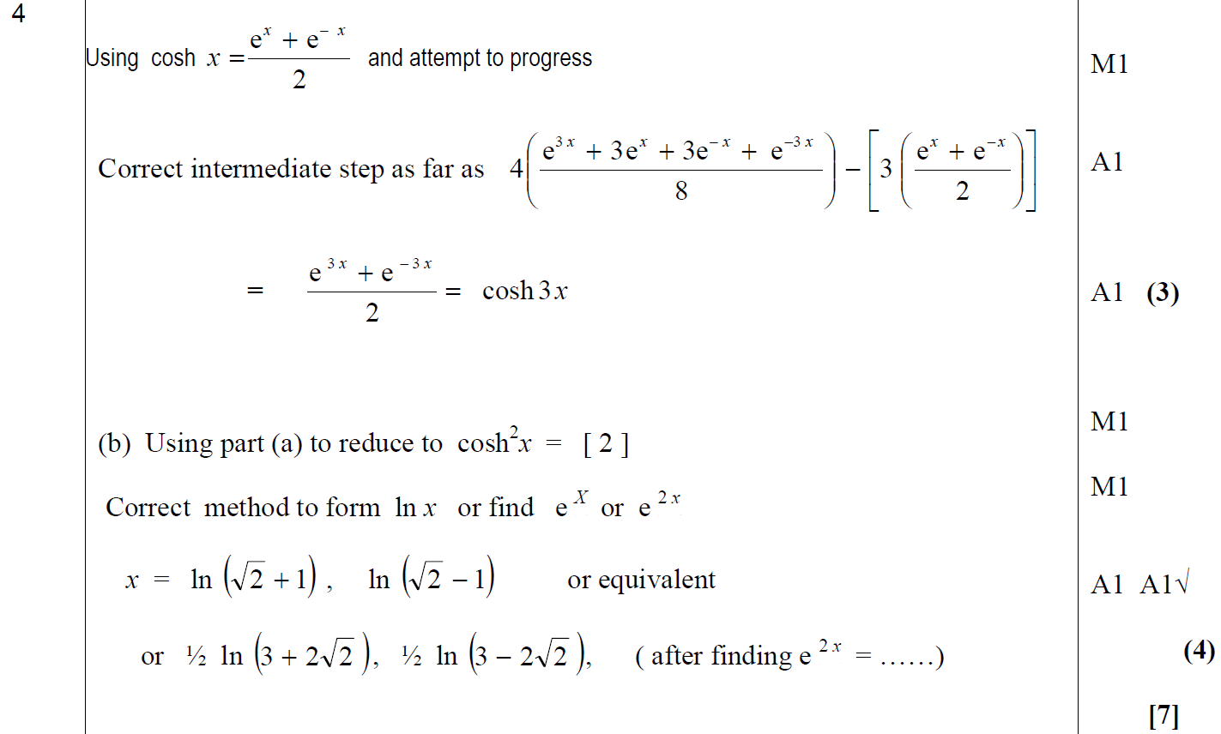
Jan 2006
A
B

Slide 43
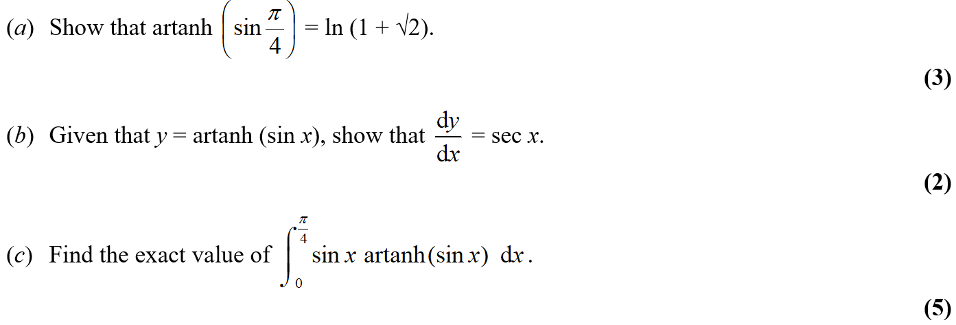
Jan 2006

Slide 44
Jan 2006
A
B

Slide 45
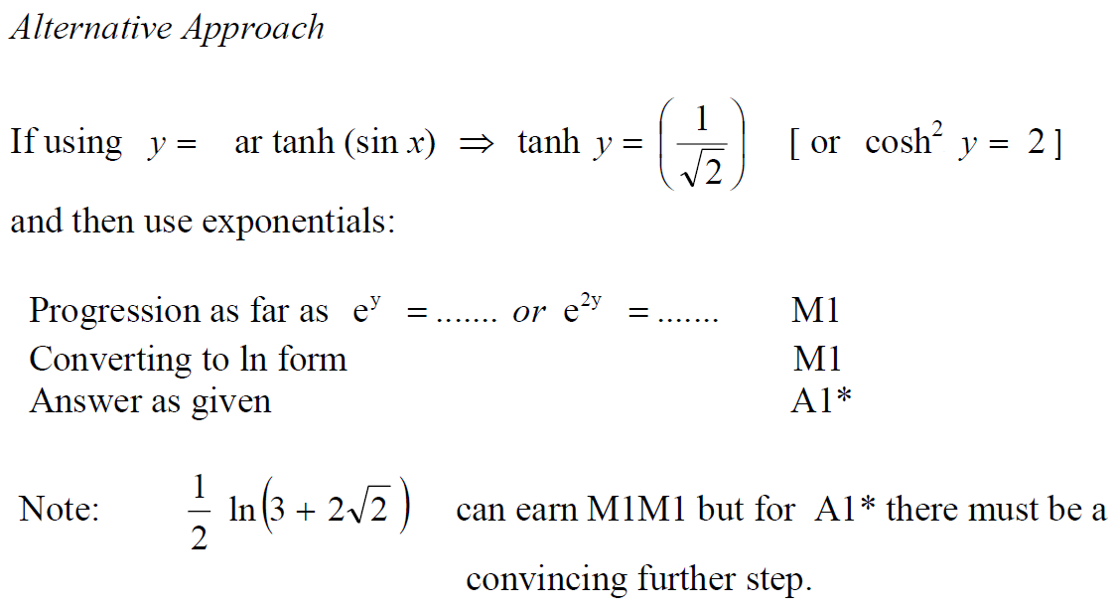
Jan 2006
C
A Alternative

Slide 46
June 2006

Slide 47
June 2006
A

Slide 48
June 2006

Slide 49
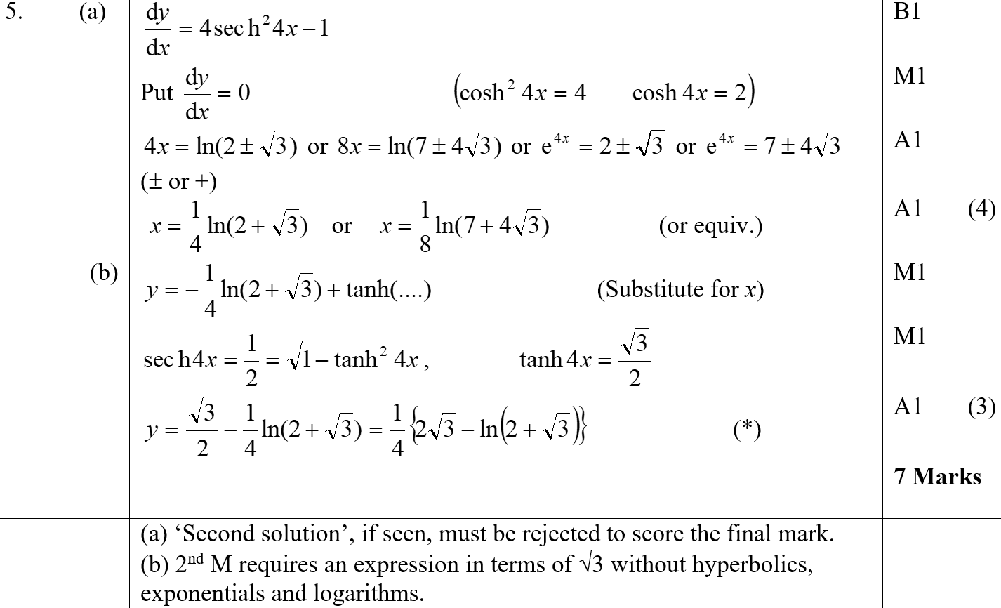
June 2006
A
B

Slide 50
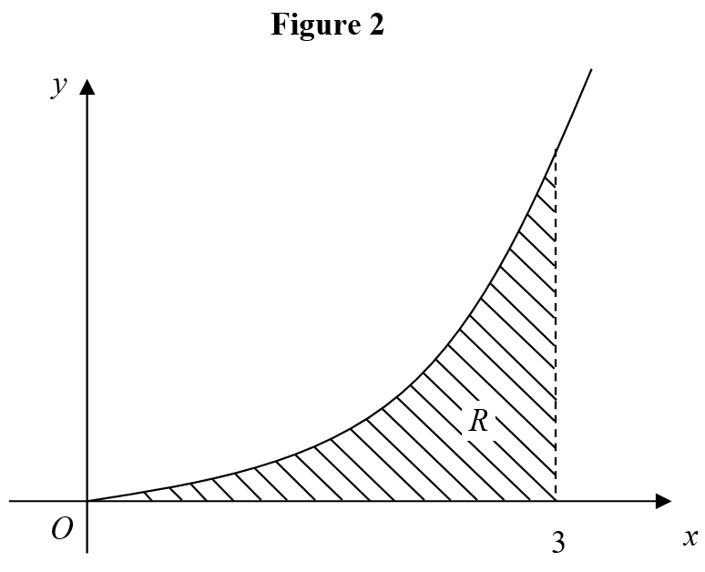
June 2006

Slide 51
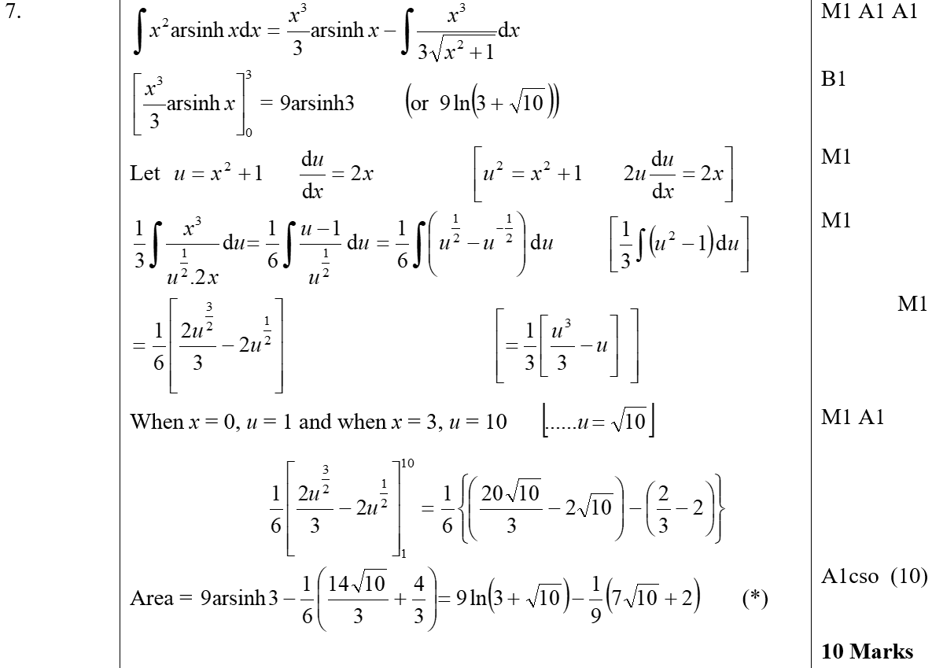
June 2006
A

Slide 52
June 2006
A notes

Slide 53
June 2007

Slide 54
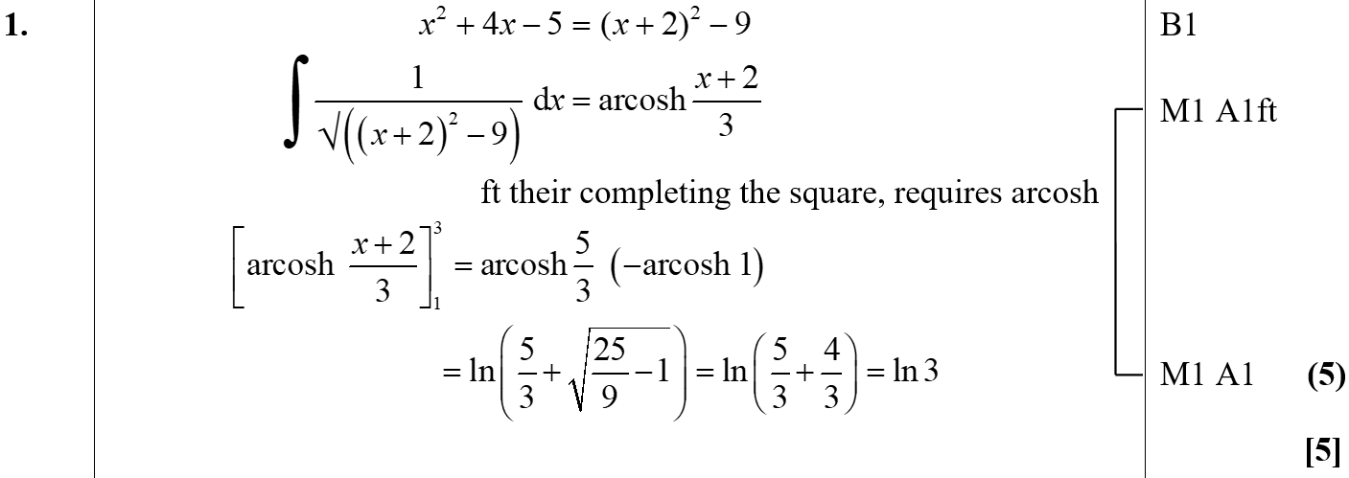
June 2007
A

Slide 55
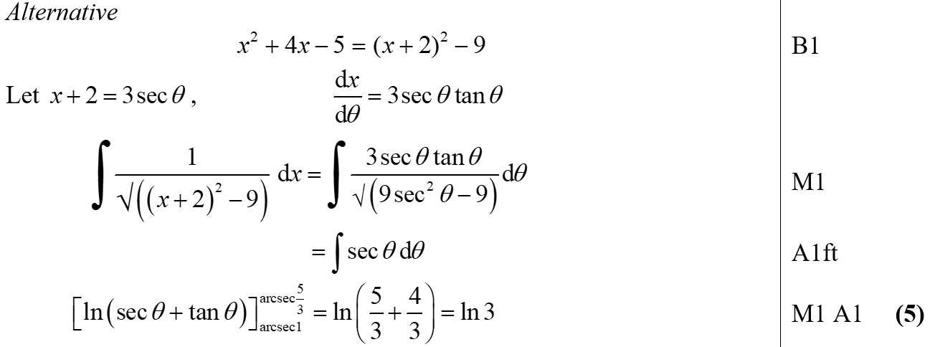
June 2007
A notes

Slide 56
June 2007

Slide 57
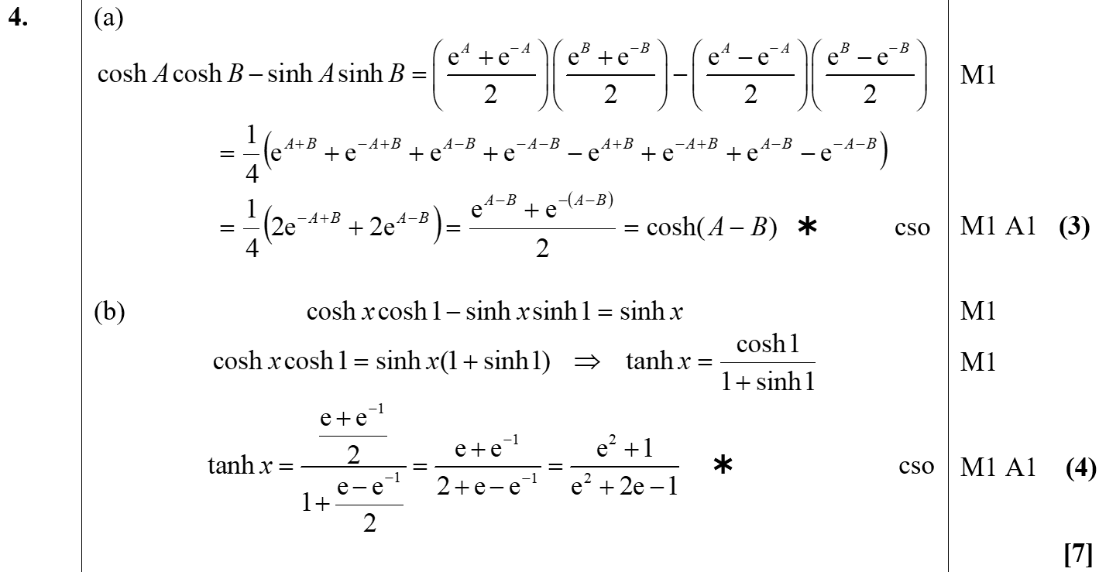
June 2007
A
B

Slide 58
June 2007
B Alternative

Slide 59
June 2008

Slide 60
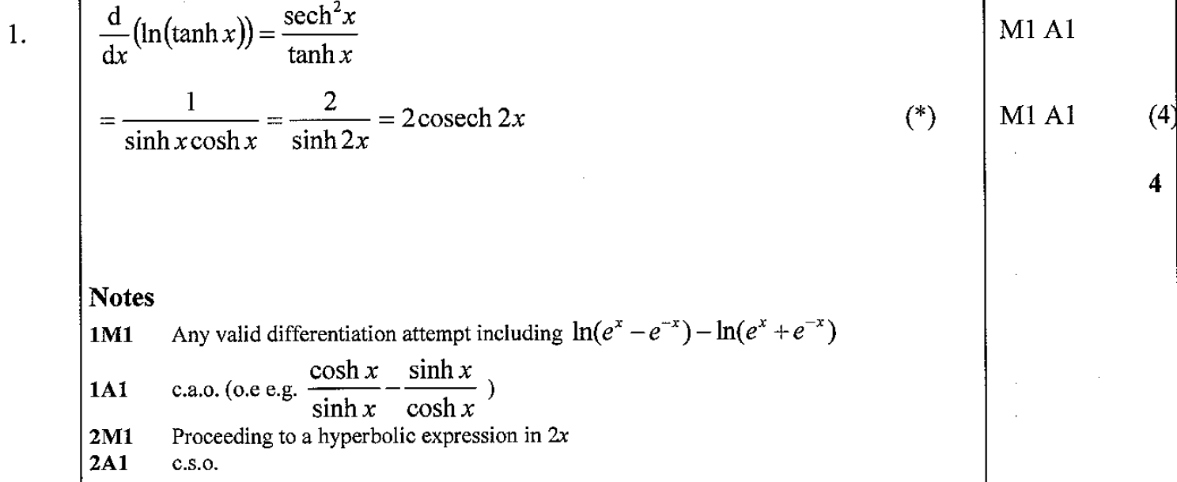
June 2008
A

Slide 61
June 2008

Slide 62
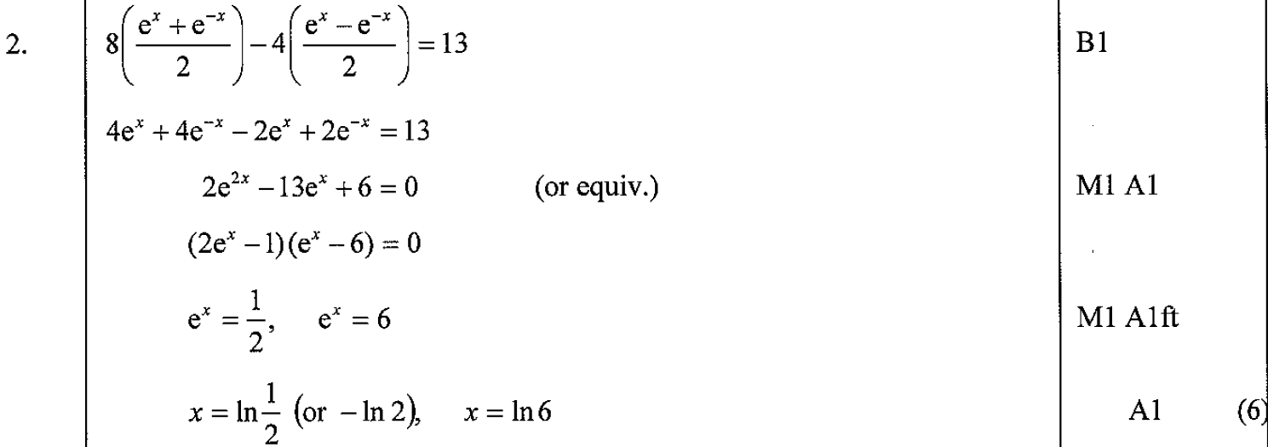
June 2008
A

Slide 63
June 2008

Slide 64
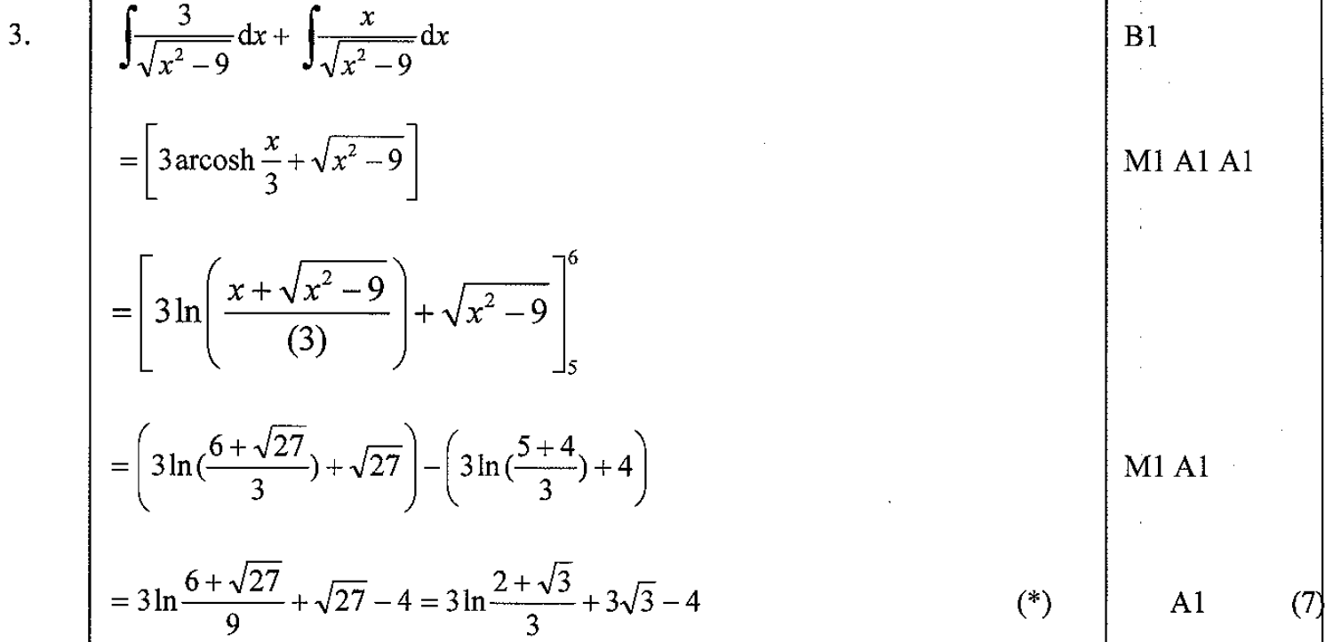
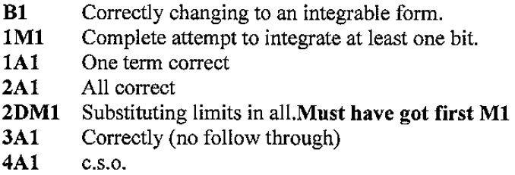
June 2008
A

Slide 65
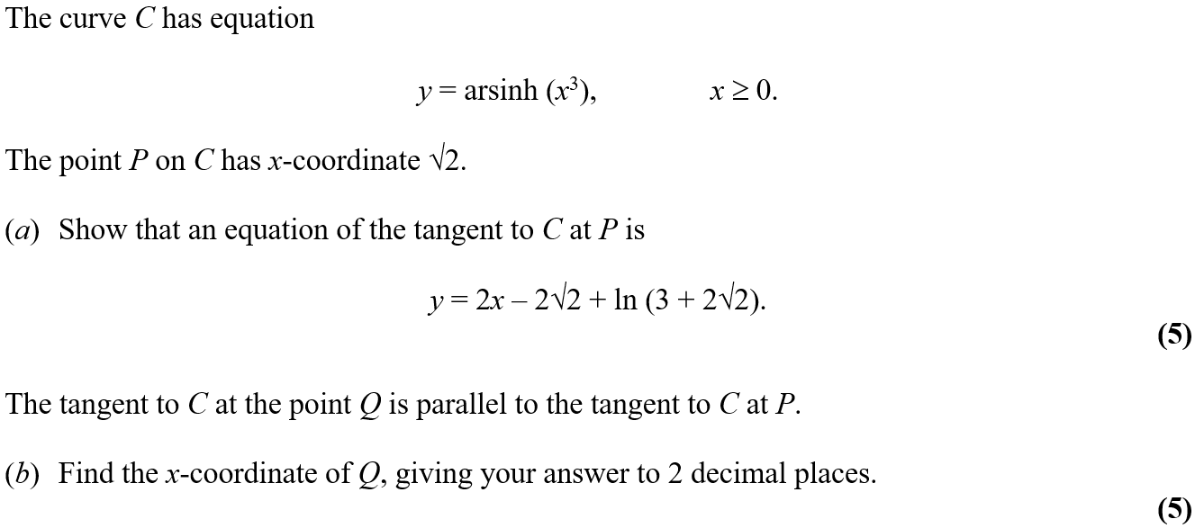
June 2008

Slide 66
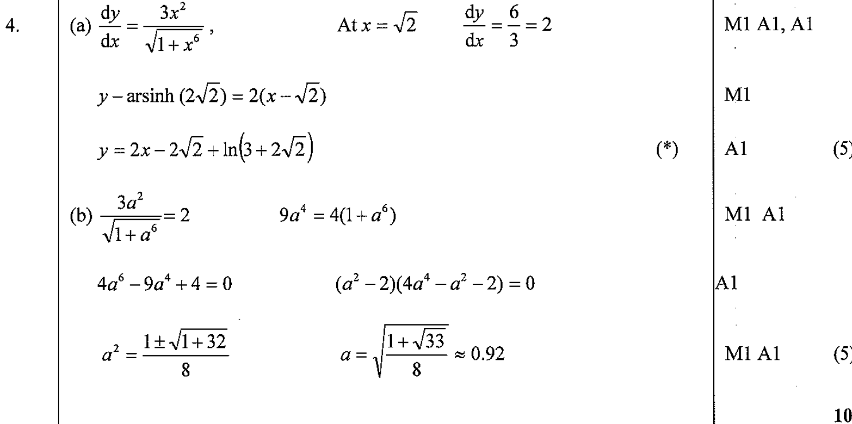
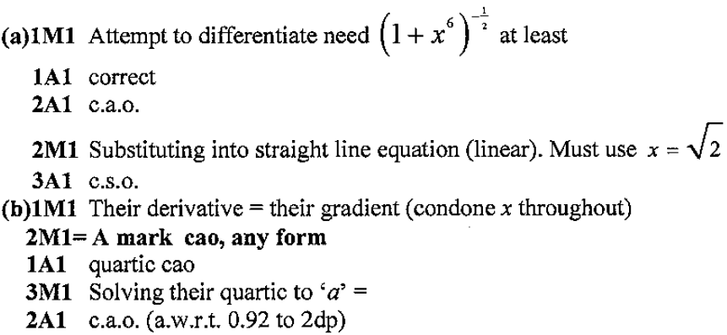
June 2008
A

Slide 67
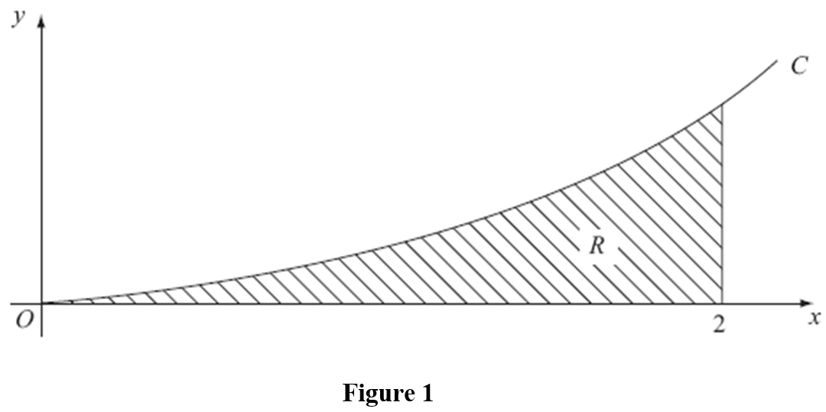
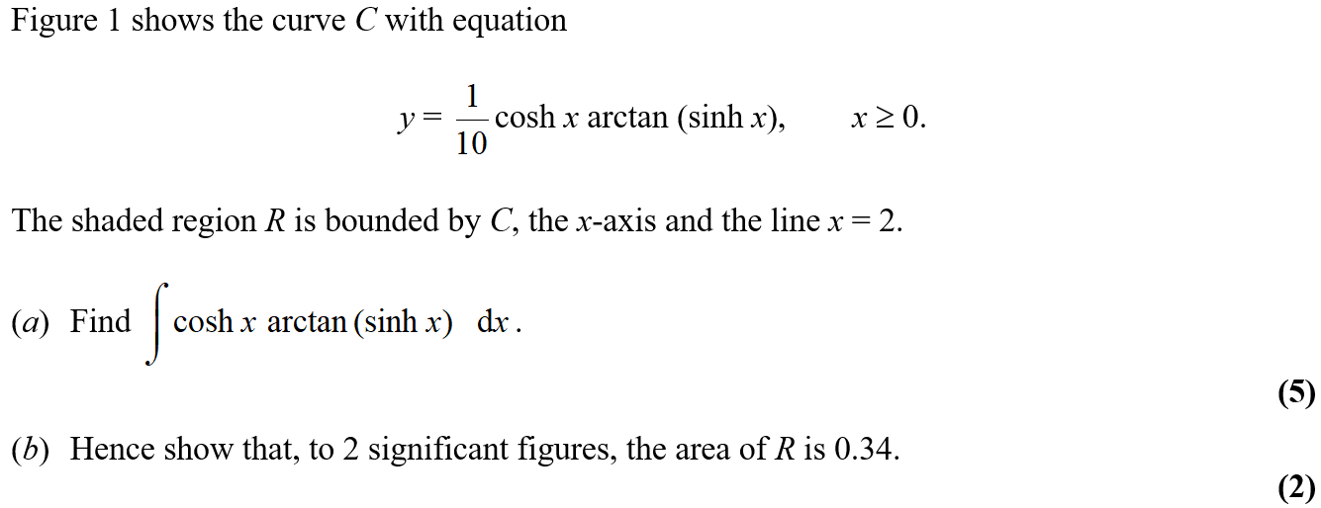
June 2008

Slide 68
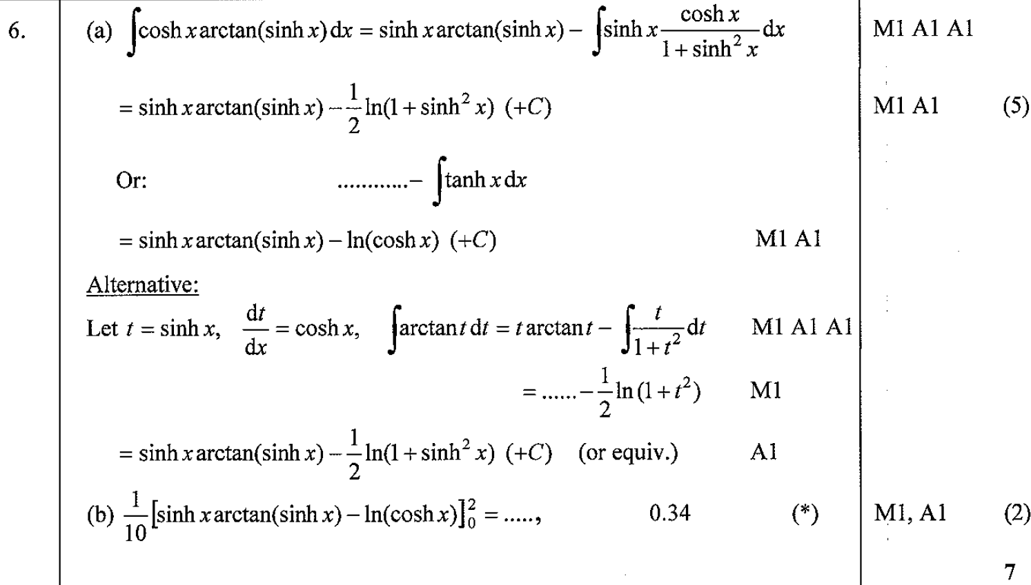
June 2008
A

Slide 69
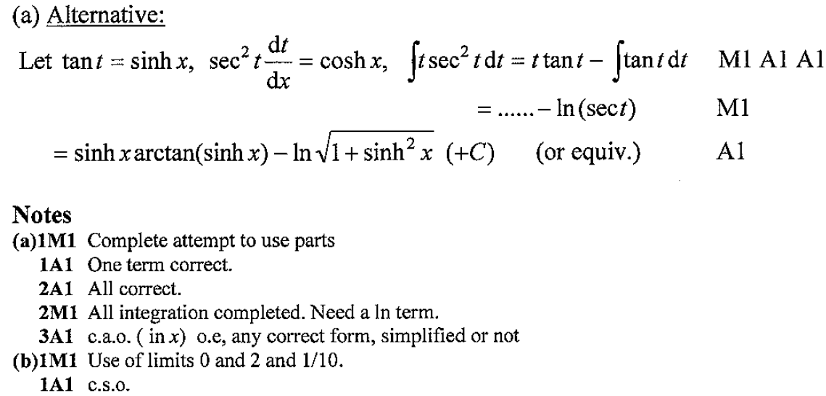
June 2008
A Alternative
A notes
B notes

Slide 70
June 2009

Slide 71
June 2009
A

Slide 72
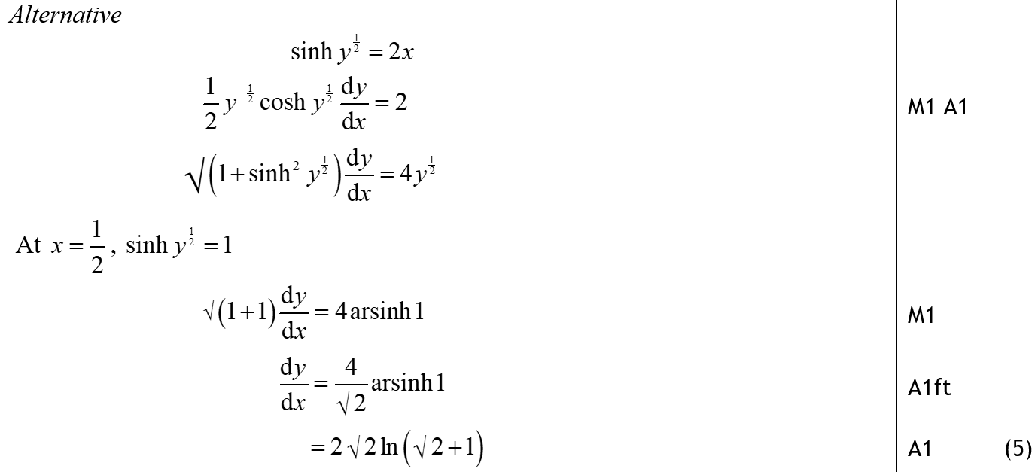
June 2009
A Alternative

Slide 73
June 2009

Slide 74
June 2009
A
B

Slide 75
June 2009

Slide 76
June 2009
A

Slide 77
Feb 2010

Slide 78
Feb 2010
A
B

Slide 79
Feb 2010

Slide 80
Feb 2010
A

Slide 81
Feb 2010
B

Slide 82
Feb 2010

Slide 83
Feb 2010
A

Slide 84
Feb 2010
B

Slide 85
Feb 2010
A Alternative

Slide 86
June 2007

Slide 87
June 2007
A
B

Slide 88
June 2007
A Alternative

Slide 89
June 2007
B Alternative

Slide 90
June 2002

Slide 91
June 2002
A

Slide 92
June 2009

Slide 93
June 2009
A (i)

Slide 94
June 2009

Slide 95
June 2009
A
B
A Alternative

Slide 96
June 2009
B Alternative

Slide 97
June 2010

Slide 98
June 2010
A
B

Slide 99
June 2010

Slide 100
June 2010
A
B

Slide 101
June 2011

Slide 102
June 2011
A (i)
A (ii)
B

Slide 103
June 2011

Slide 104
June 2011
A
B

Slide 105
June 2012

Slide 106
June 2012
A
B
A notes
B notes

Slide 107
June 2012

Slide 108
June 2012
A
B
C

Slide 109
June 2012
A notes
B notes
C notes

Slide 110
June 2013

Slide 111
June 2013
A
B

Slide 112
June 2013
A Alternative
B Alternative

Slide 113
June 2013

Slide 114
June 2013
A

Slide 115
June 2014 Reserve

Slide 116
June 2014 Reserve
A

Slide 117
June 2014 Reserve
B

Slide 118
June 2013 Withdrawn

Slide 119
June 2013 Withdrawn
A
B

Slide 120
June 2013 Withdrawn
Alternative B

Slide 121
June 2014

Slide 122
June 2014
A
B

Slide 123
June 2014
B by parts methods

Slide 124
June 2014

Slide 125
June 2014
A

Slide 126
June 2014
B
B Alternative

Slide 127
June 2014
other B Alternatives

Slide 128
June 2014

Slide 129
June 2014
A
A Alternative 1

Slide 130
June 2014
A Alternative 2

Slide 131
June 2014 Reserve

Slide 132
June 2014 Reserve
A

Slide 133
June 2014 Reserve
A Alternatives

Slide 134
June 2014 Reserve

Slide 135
June 2014 Reserve
A
B
C

Slide 136
June 2014 Reserve

Slide 137
June 2014 Reserve
A

Slide 138
June 2014 Reserve
B

Slide 139
June 2014 Reserve

Slide 140
June 2014 Reserve
A
B
C

Slide 141
June 2014 Reserve
D

Slide 142
June 2015

Slide 143
June 2015
A

Slide 144
June 2015
B

Slide 145
June 2015

Slide 146
June 2015
A
B

Slide 147
June 2015
B Notes & Alternatives

Slide 148
June 2016

Slide 149
June 2016
A

Slide 150
June 2016
B

Slide 151
June 2016
A Alternative 1
A Alternative 2

Slide 152
June 2016
A Alternative 3

Slide 153
June 2016
A Alternative 4

Slide 154
June 2016
A Alternative 5
A Alternative 6

Slide 155
June 2016
B Alternative 1

Slide 156
June 2016
B Alternative 2

Slide 157
June 2016

Slide 158
June 2016
i
ii a

Slide 159
June 2016
ii b

Slide 160
June 2016
(i) may see
(i) substitution method 1

Slide 161
June 2016
(i) substitution method 2
(i) substitution method 3

Slide 162
June 2017

Slide 163
June 2017
A

Slide 164
June 2017
A Alternative 1
A Alternative 2

Slide 165
June 2017
Special Case

Slide 166
June 2017

Slide 167
June 2017
A

Slide 168
June 2017
B

Slide 169
June 2017
B Alternative

Slide 170
June 2018

Slide 171
June 2018
A

Slide 172
June 2018
B

Slide 173
June 2018
B Alternative

Slide 174
June 2018

Slide 175
June 2018
A

Slide 176
June 2018
B

Slide 177
June 2018
C

Slide 178
June 2018
B Alternatives

Slide 179
June 2018
C Alternative

Slide 180
June 2018

Slide 181
June 2018
A
B

Slide 182
June 2018
C

Slide 183
June 2018
C Notes

Slide 184
June 2019

Slide 185
June 2019
A
A Alternative 1

Slide 186
June 2019
A Alternative 2
A Notes

Slide 187
June 2019

Slide 188
June 2019
A
B

Slide 189
June 2019
A Alternative 1

Slide 190
June 2019
A Alternative 2

Slide 191
June 2019
A Alternative 3

Slide 192
June 2019

Slide 193
June 2019
A
A Notes

Slide 194
June 2019
B
B Notes

