Slide 1
Old Spec Q’s
Elastic Springs, Strings & Hooke’s Law
SAM
2019

Slide 2
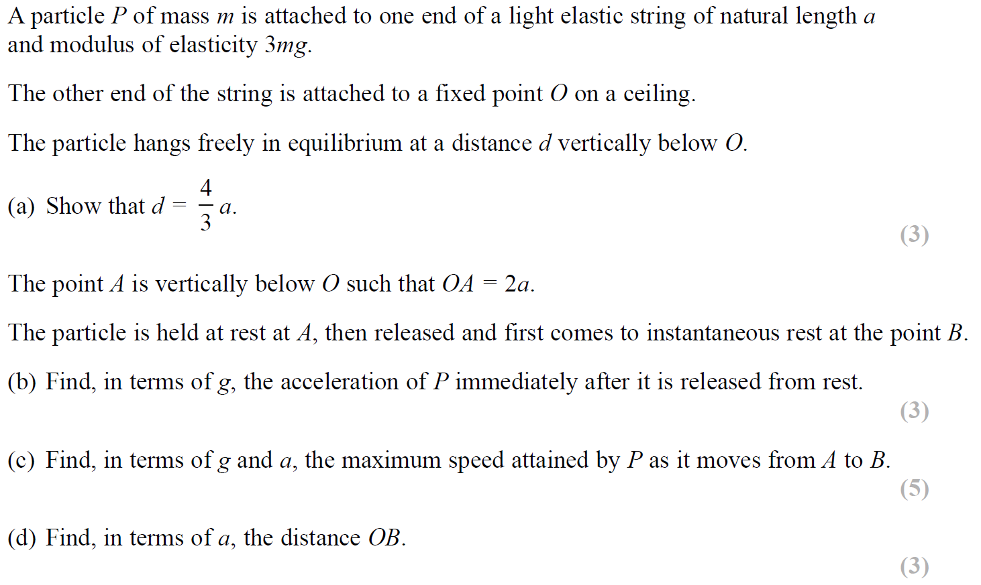
SAM

Slide 3
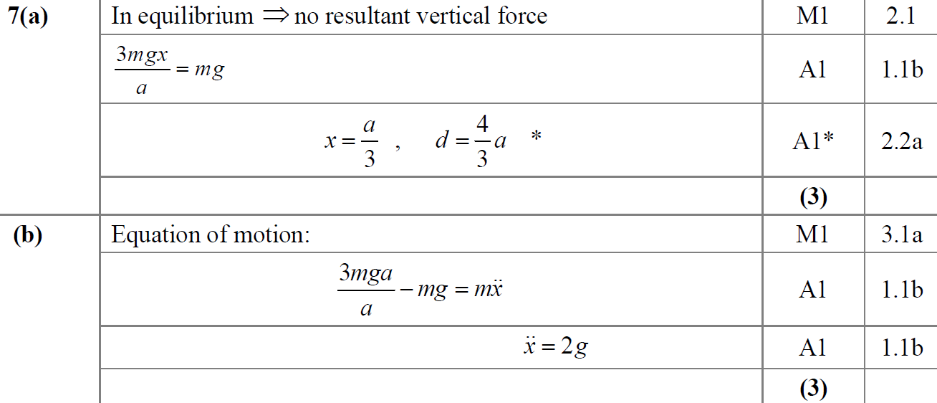
SAM
A
B

Slide 4
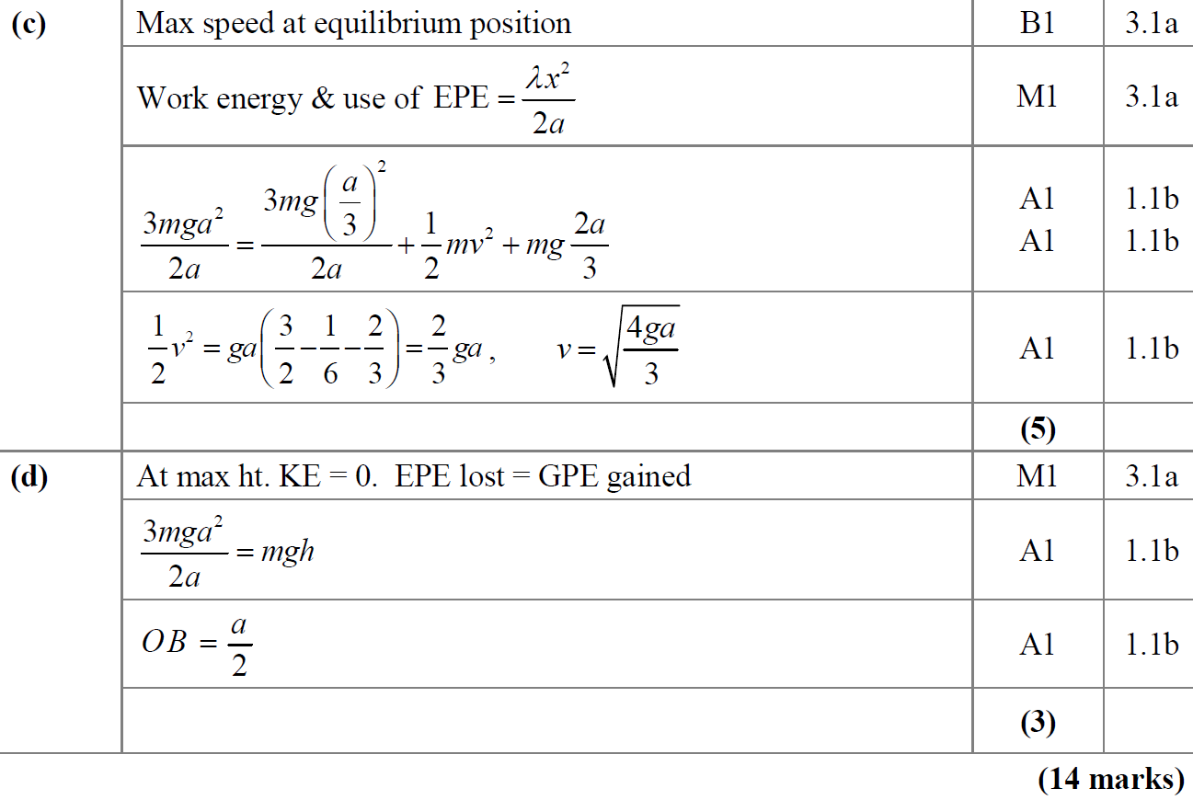
SAM
C
D

Slide 5
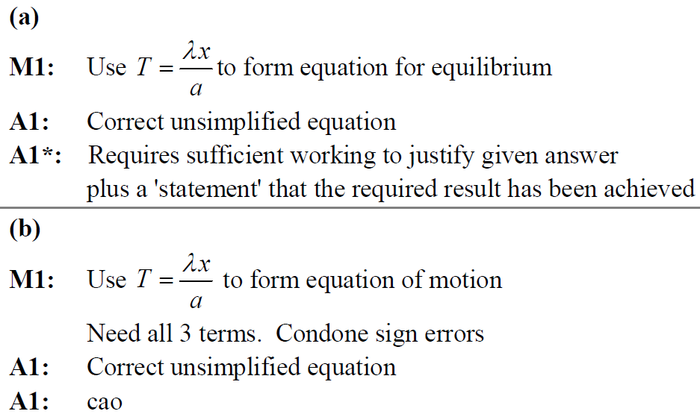
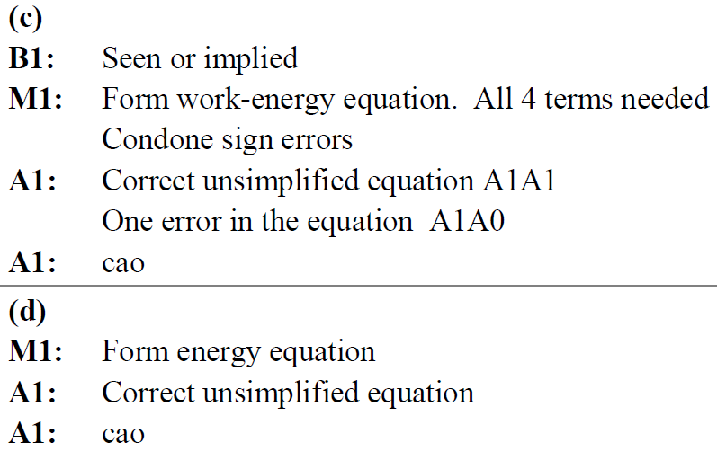
SAM
A notes
B notes
C notes
D notes

Slide 6
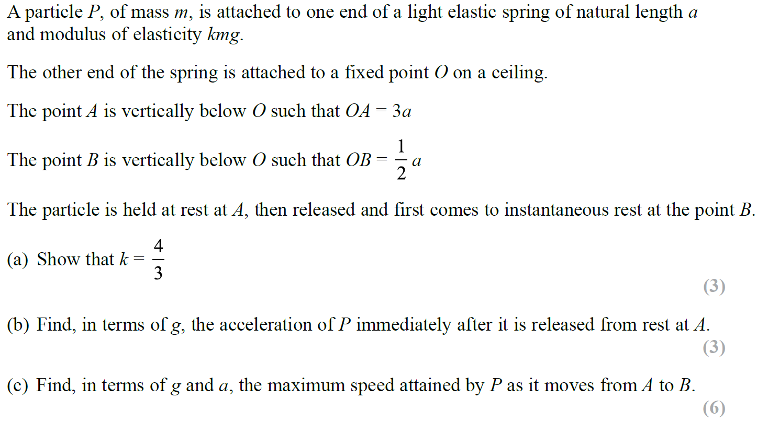
2019

Slide 7
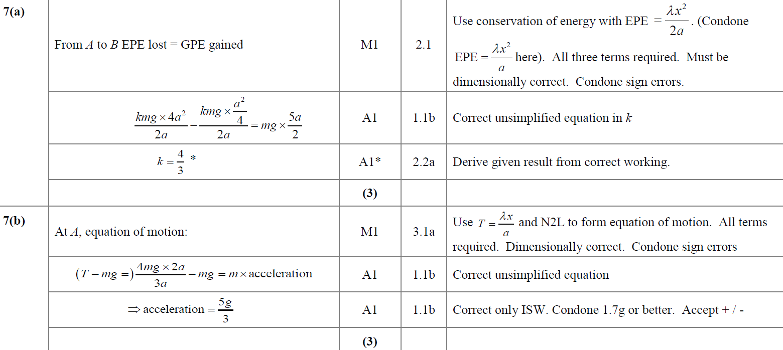
2019
A
B

Slide 8
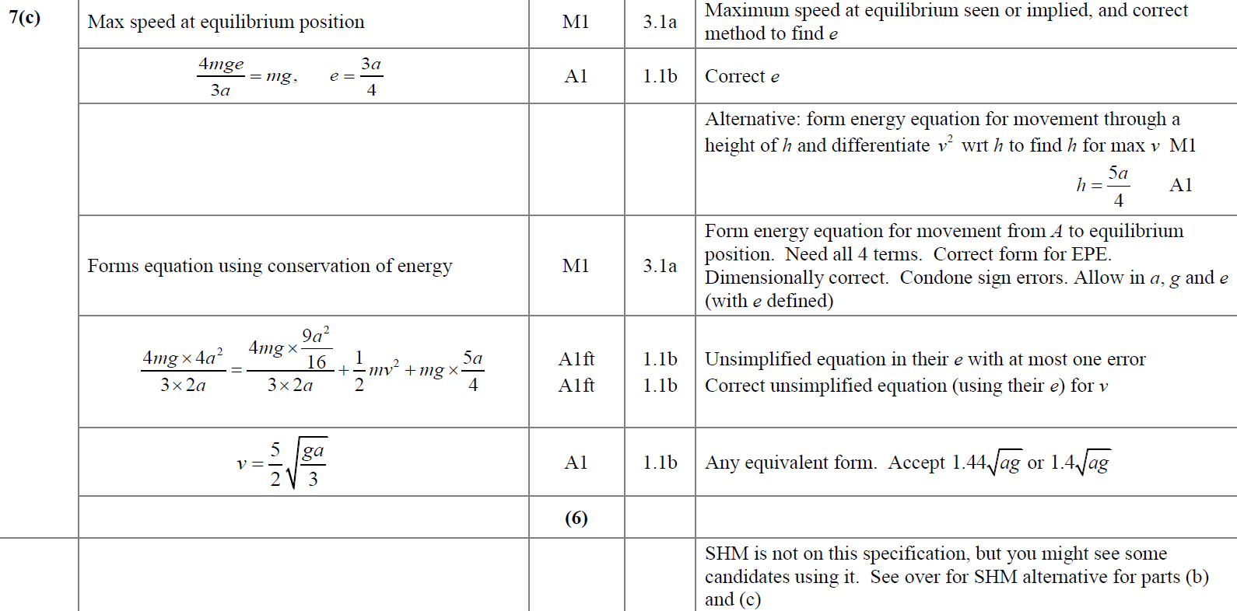
2019
C

Slide 9
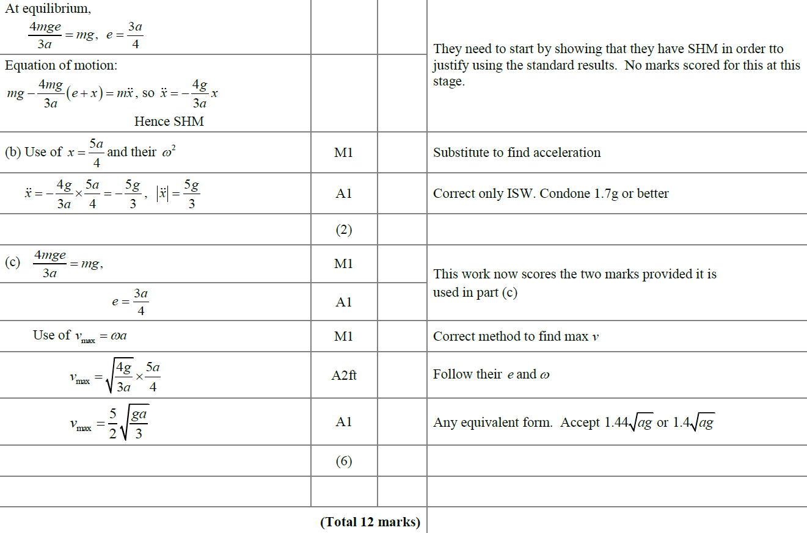
2019
B & C Alternative (SHM)

Slide 10
New Spec Q’s
Old Spec Elastic Springs, Strings & Hooke’s Law
June 2001
Jan 2004
June 2007
Jan 2010 (i)
Jan 2013
May 2015 (i)
Jan 2002 (i)
May 2004
Jan 2008 (i)
Jan 2010 (ii)
June 2013 (i)
May 2015 (i) a only
Jan 2002 (ii)
June 2005 (i)
Jan 2008 (ii)
June 2010
June 2013 (ii) a only
May 2016
May 2002
June 2005 (ii)
June 2008
Jan 2011
June 2013 (withdrawn)
May 2017
Jan 2003 (i)
Jan 2006
Jan 2009 (i)
June 2011
June 2013 (R)
May 2018
Jan 2003 (ii)
June 2006
Jan 2009 (ii)
Jan 2012
May 2014
May 2019 (i)
May 2003
Jan 2007
June 2009
June 2012 (ignore c & d)
May 2014 (R)
May 2019 (ii) a only
ignore harmonic motion parts (I included a couple, but not all of these questions from old M3 papers)

Slide 11
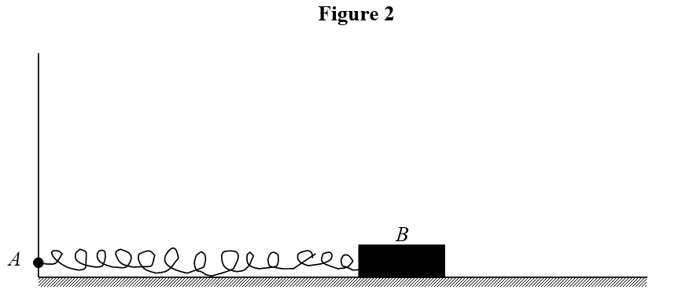
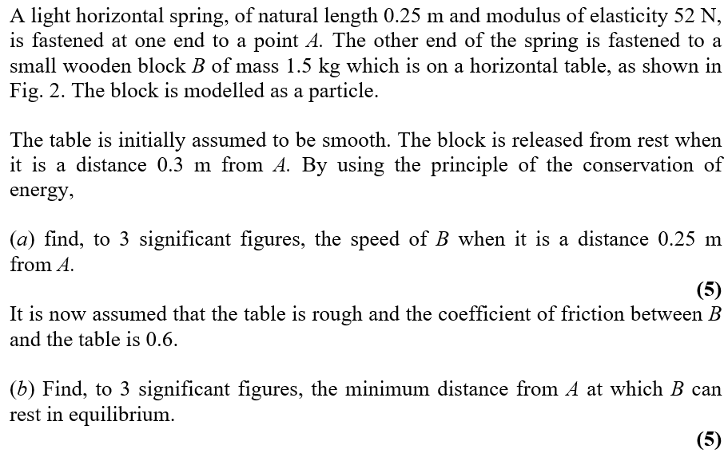
June 2001

Slide 12
June 2001
A
B

Slide 13
Jan 2002

Slide 14
Jan 2002
A
B

Slide 15
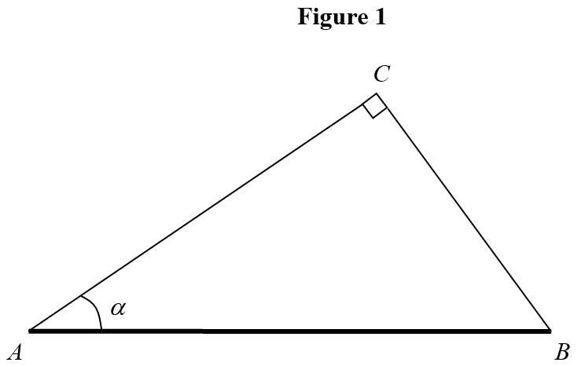
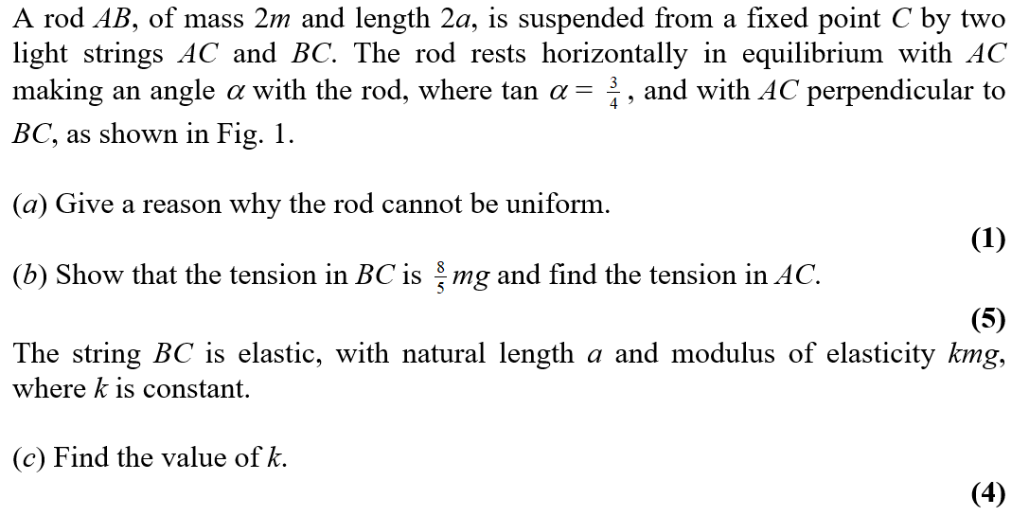
Jan 2002

Slide 16
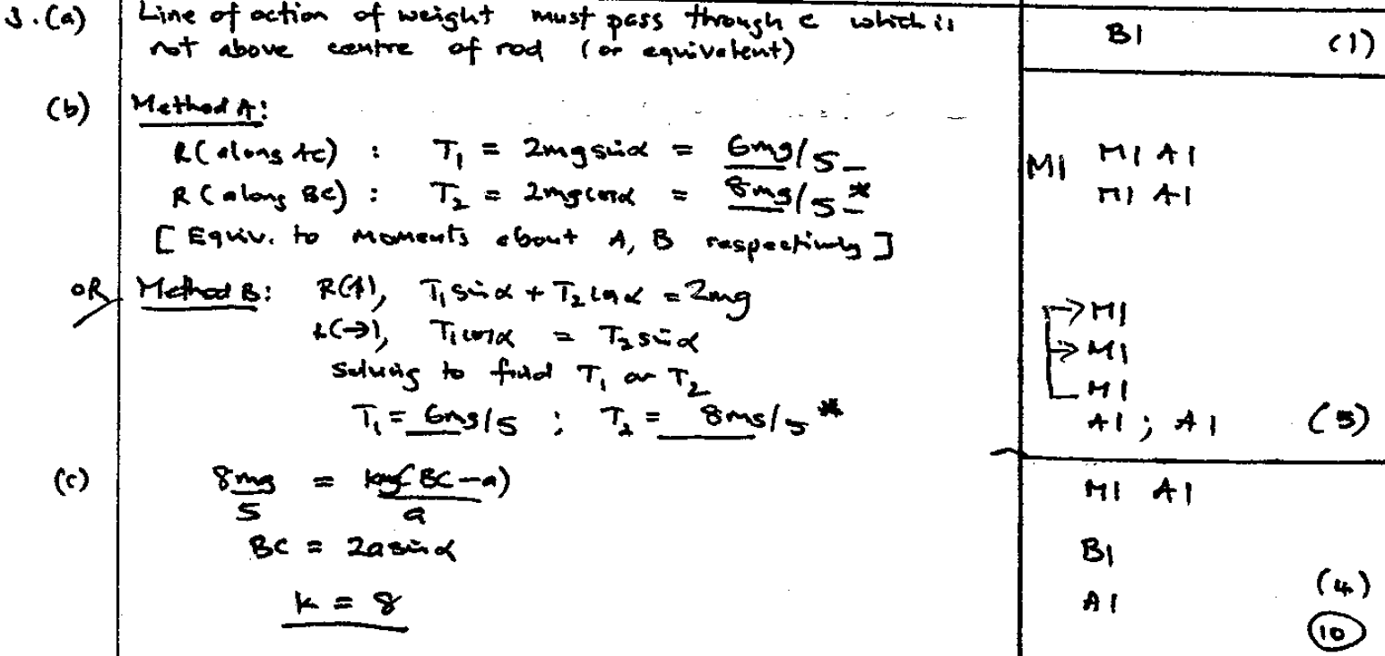
Jan 2002
A
B
C

Slide 17
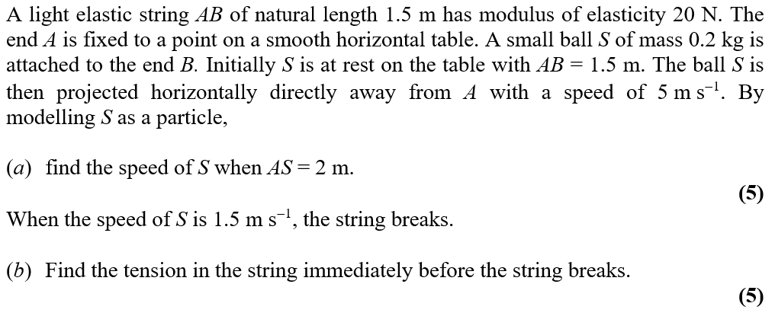
May 2002

Slide 18
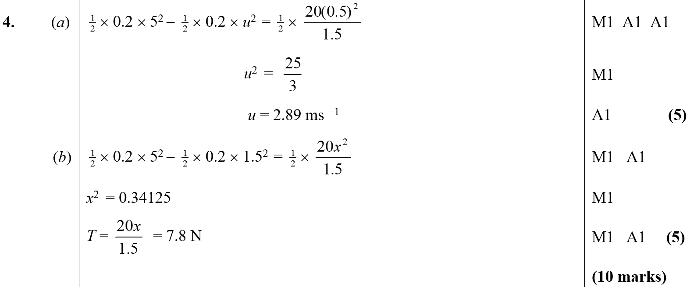
May 2002
A
B

Slide 19
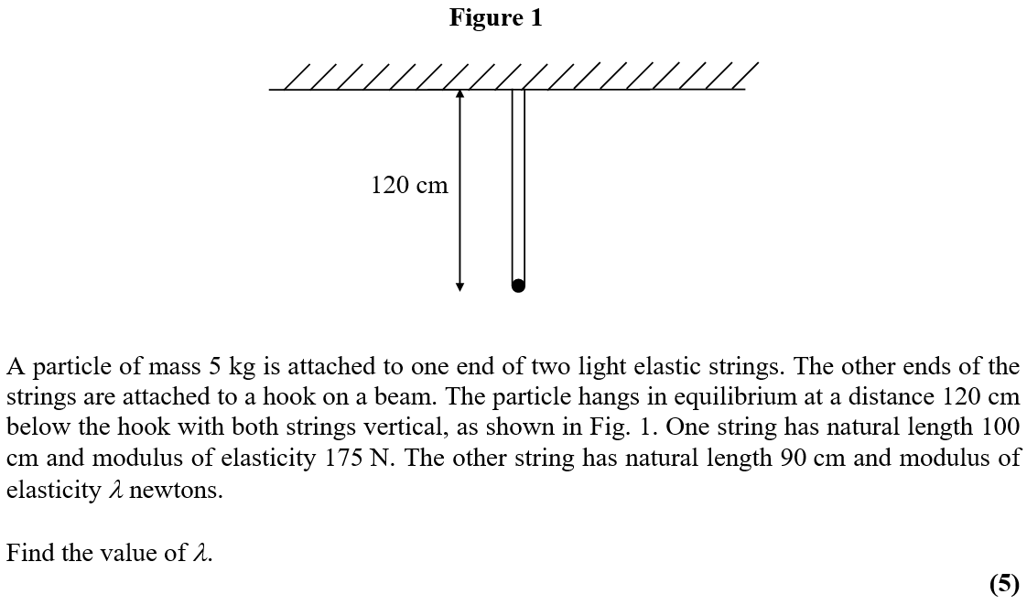
Jan 2003

Slide 20
Jan 2003
A

Slide 21
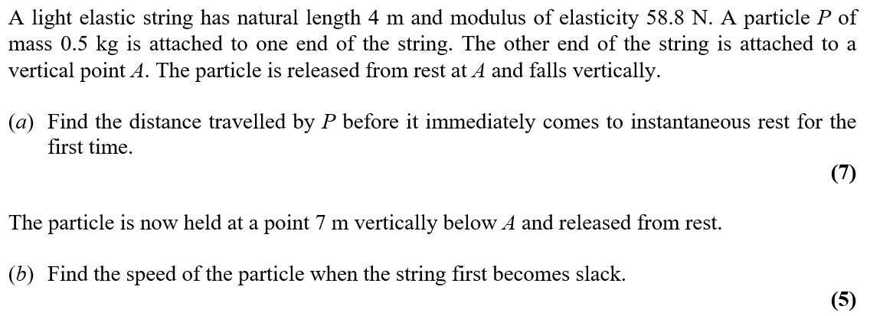
Jan 2003

Slide 22
Jan 2003
A
B

Slide 23
May 2003

Slide 24
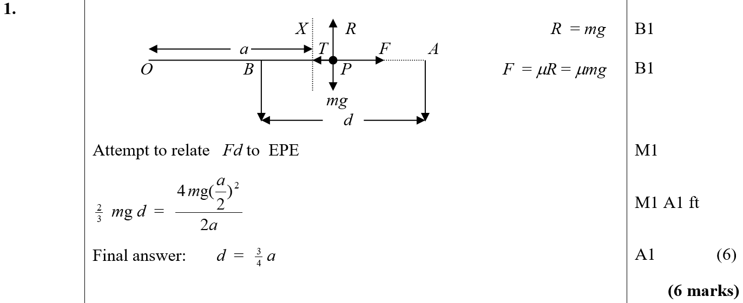
May 2003
A

Slide 25
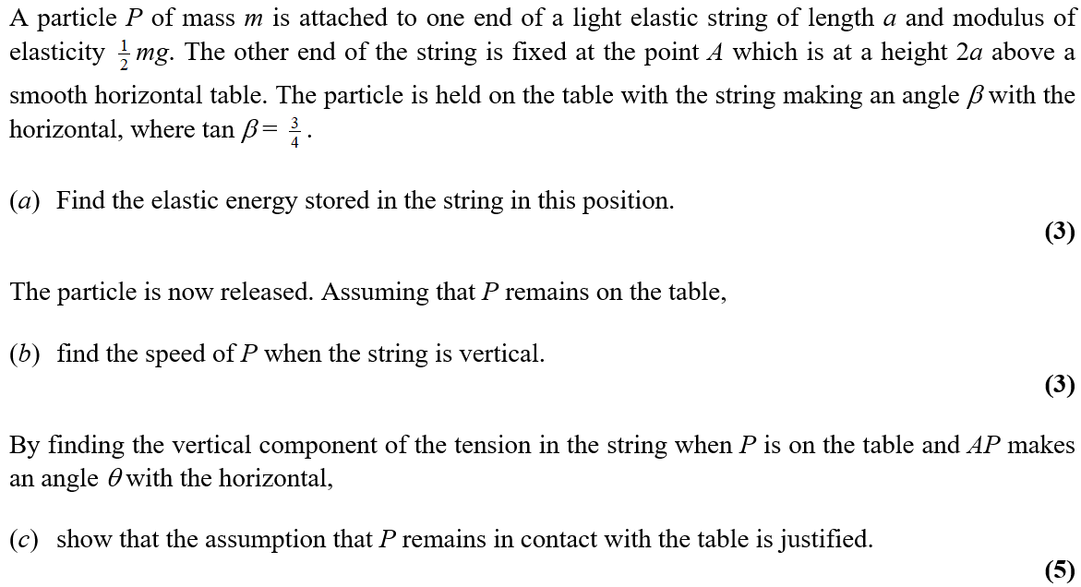
Jan 2004

Slide 26
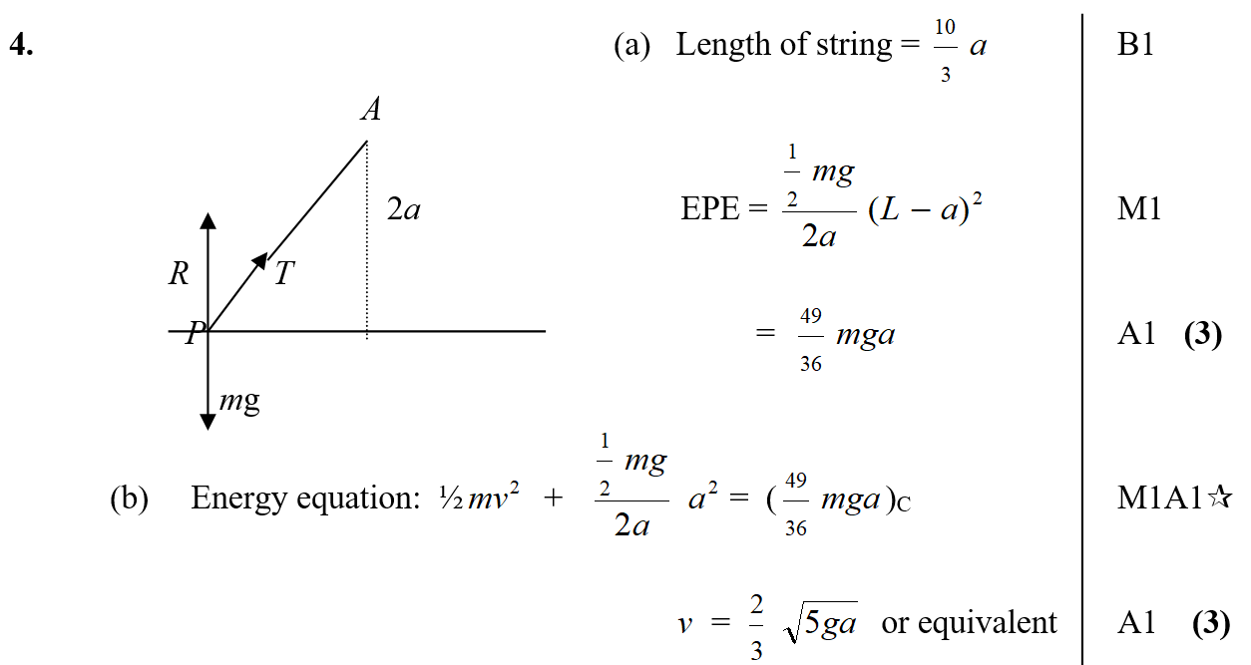
Jan 2004
A
B

Slide 27
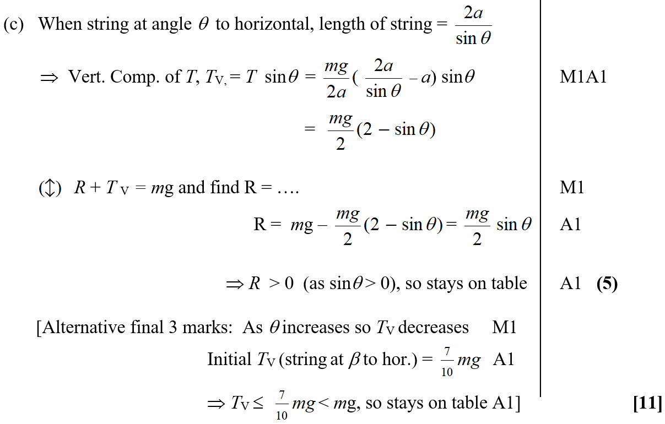
Jan 2004
C

Slide 28
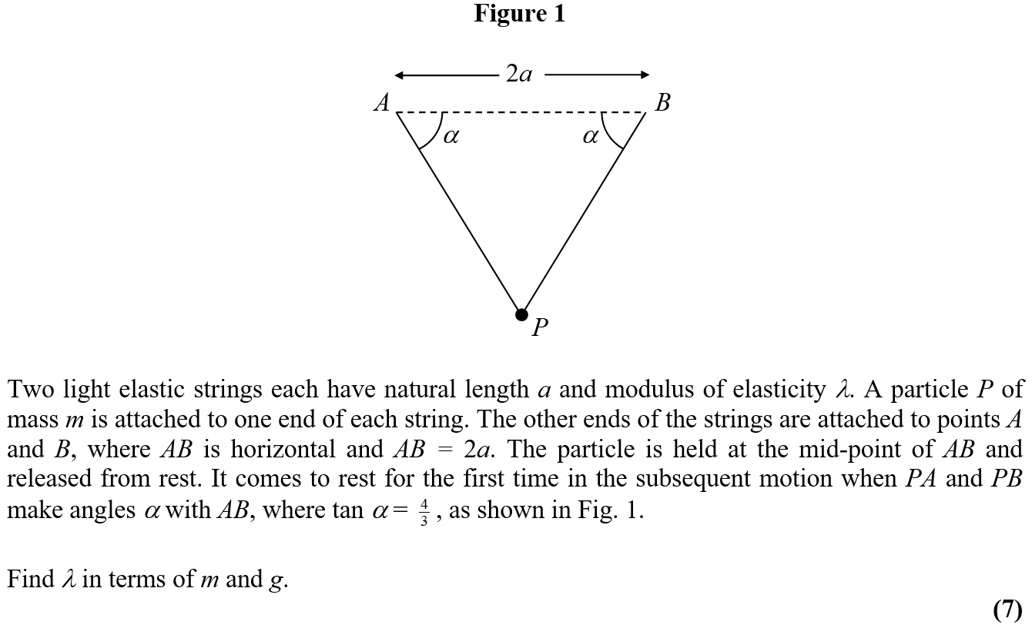
May 2004

Slide 29
May 2004
A

Slide 30
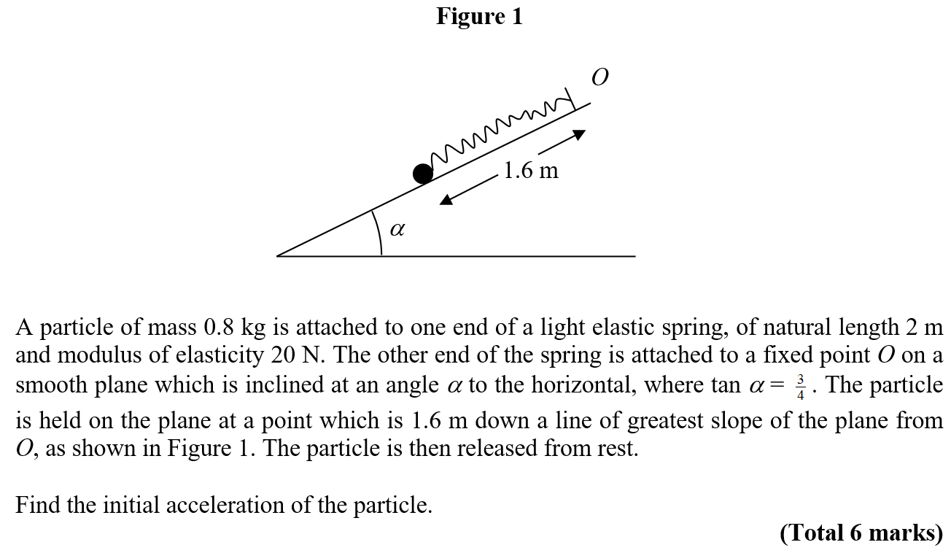
June 2005

Slide 31
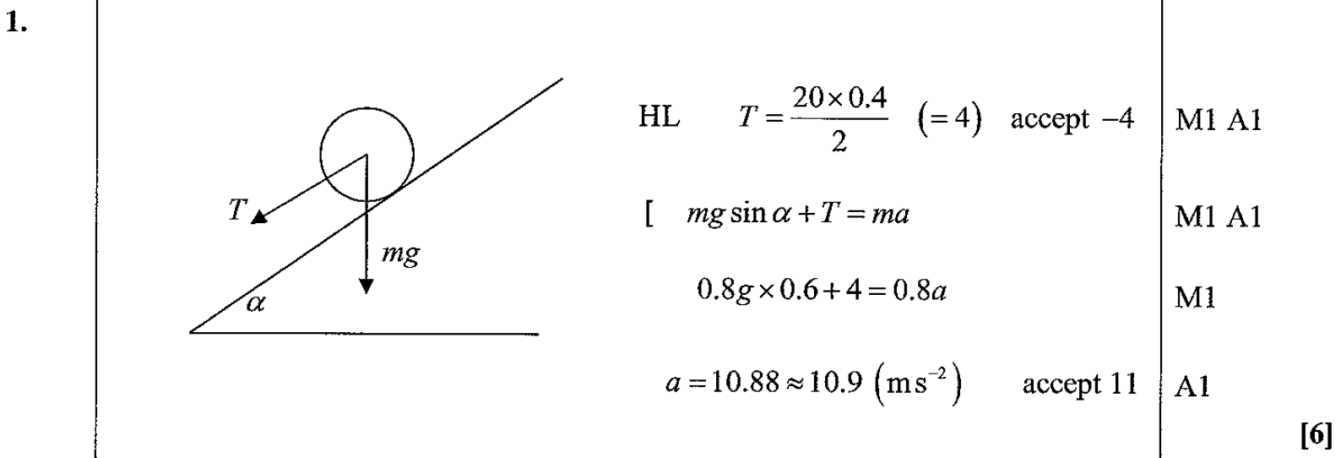
June 2005
A

Slide 32
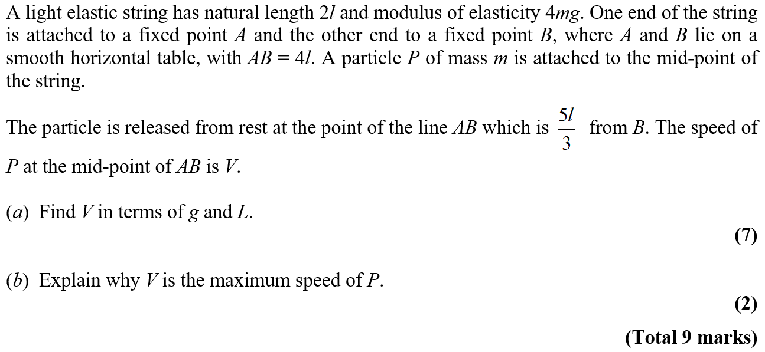
June 2005

Slide 33
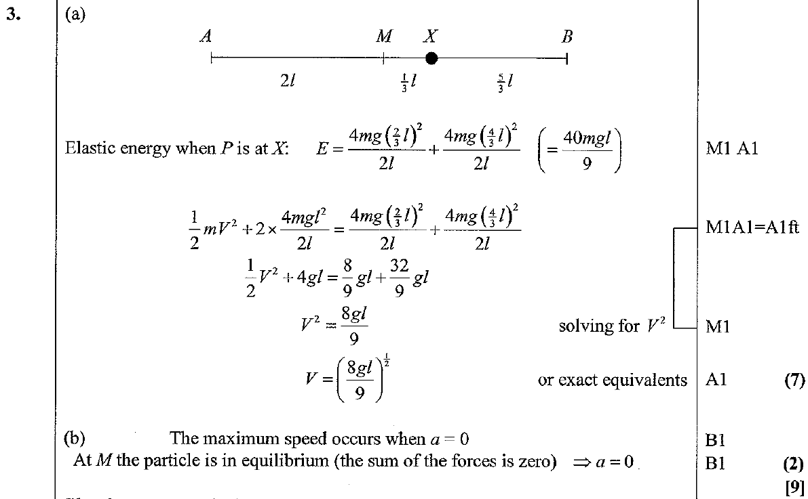
June 2005
A
B

Slide 34
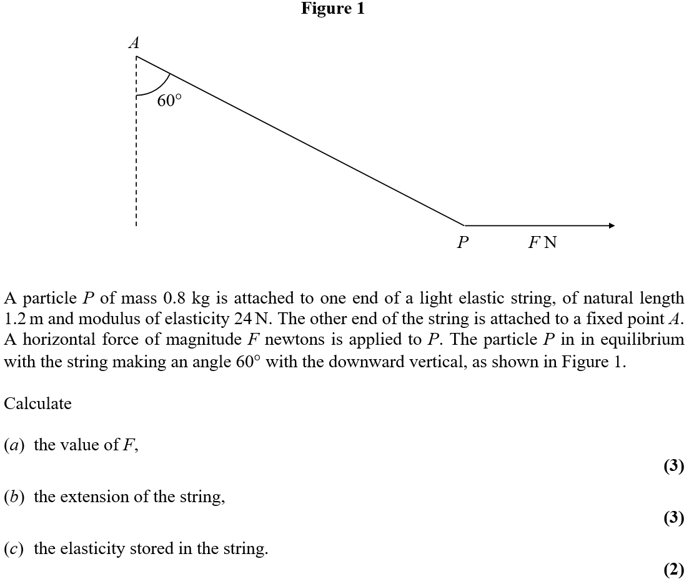
Jan 2006

Slide 35
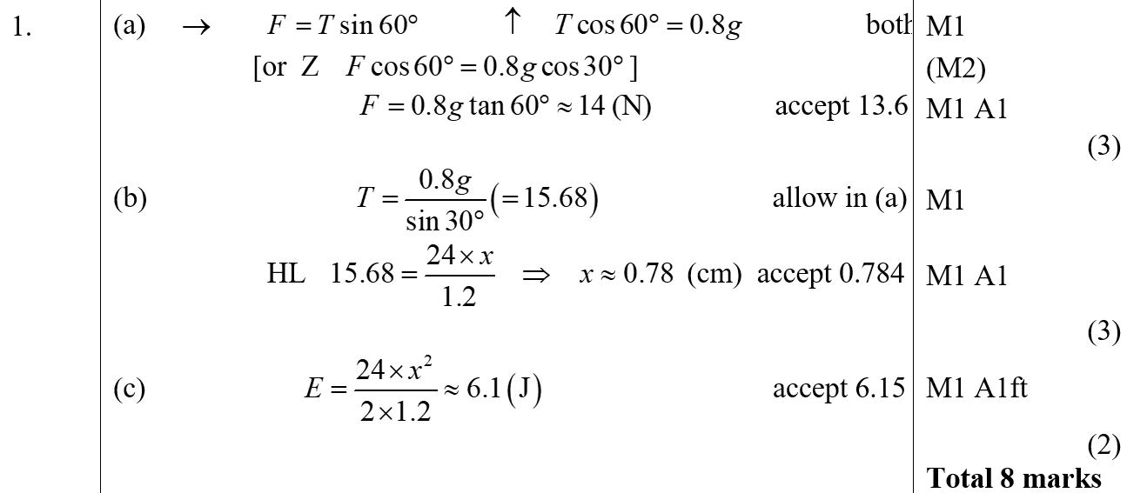
Jan 2006
A
B
C

Slide 36
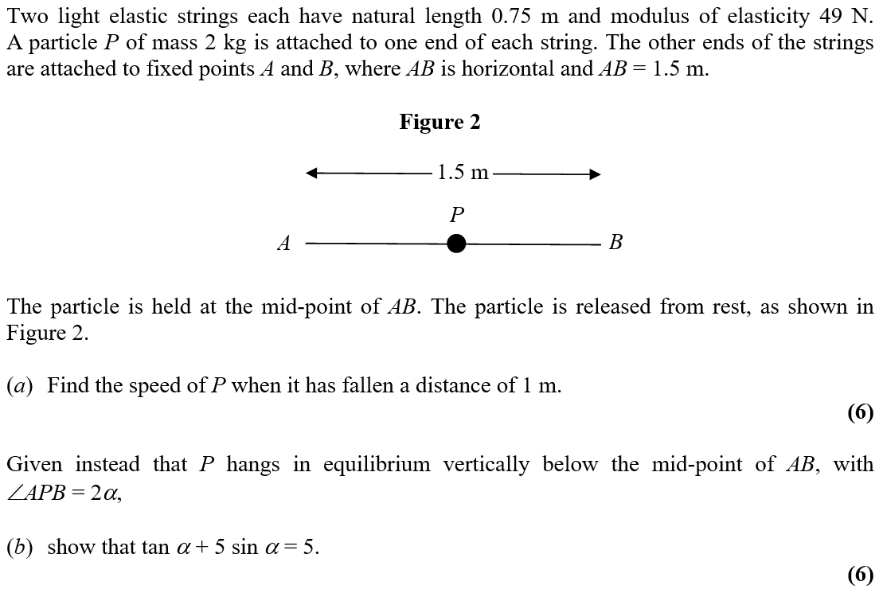
June 2006

Slide 37
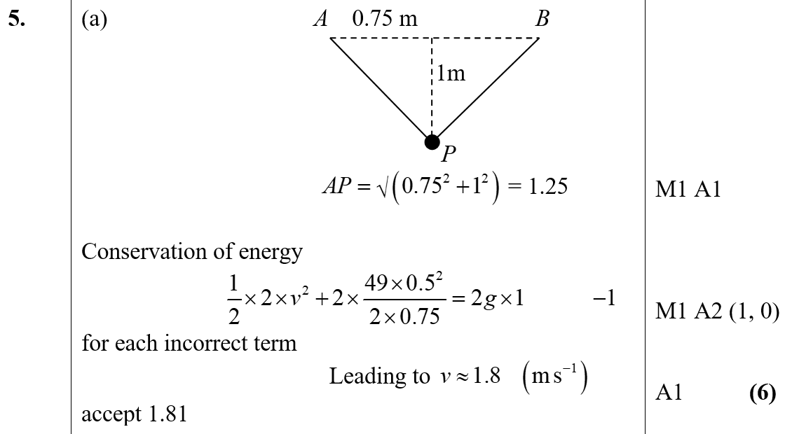
June 2006
A

Slide 38
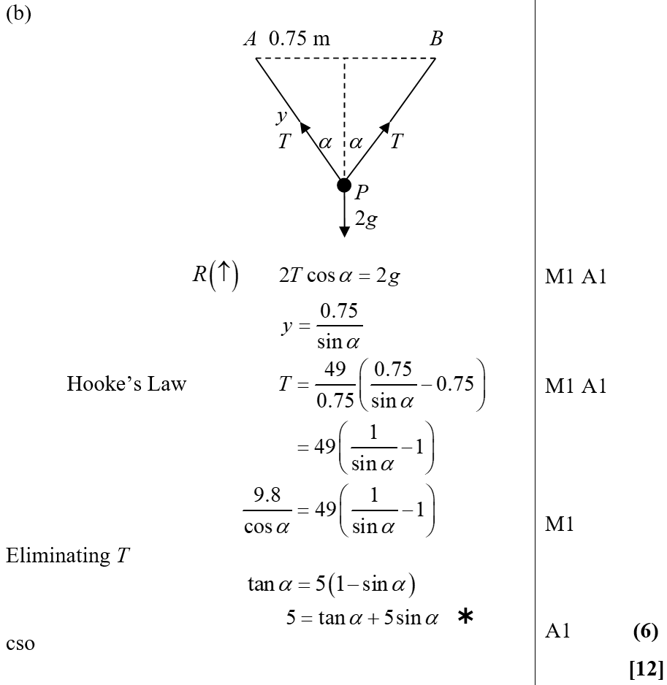
June 2006
B

Slide 39
Jan 2007

Slide 40
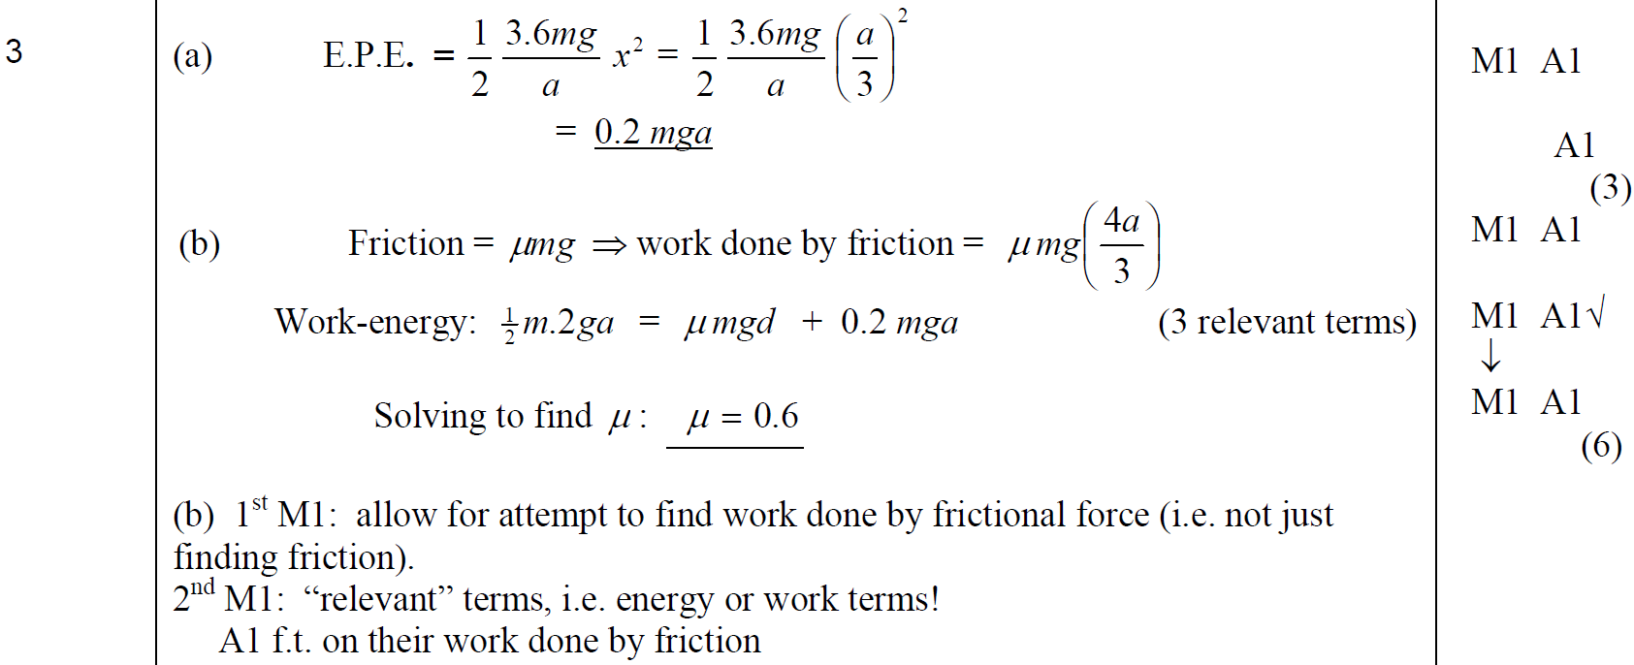
Jan 2007
A
B

Slide 41
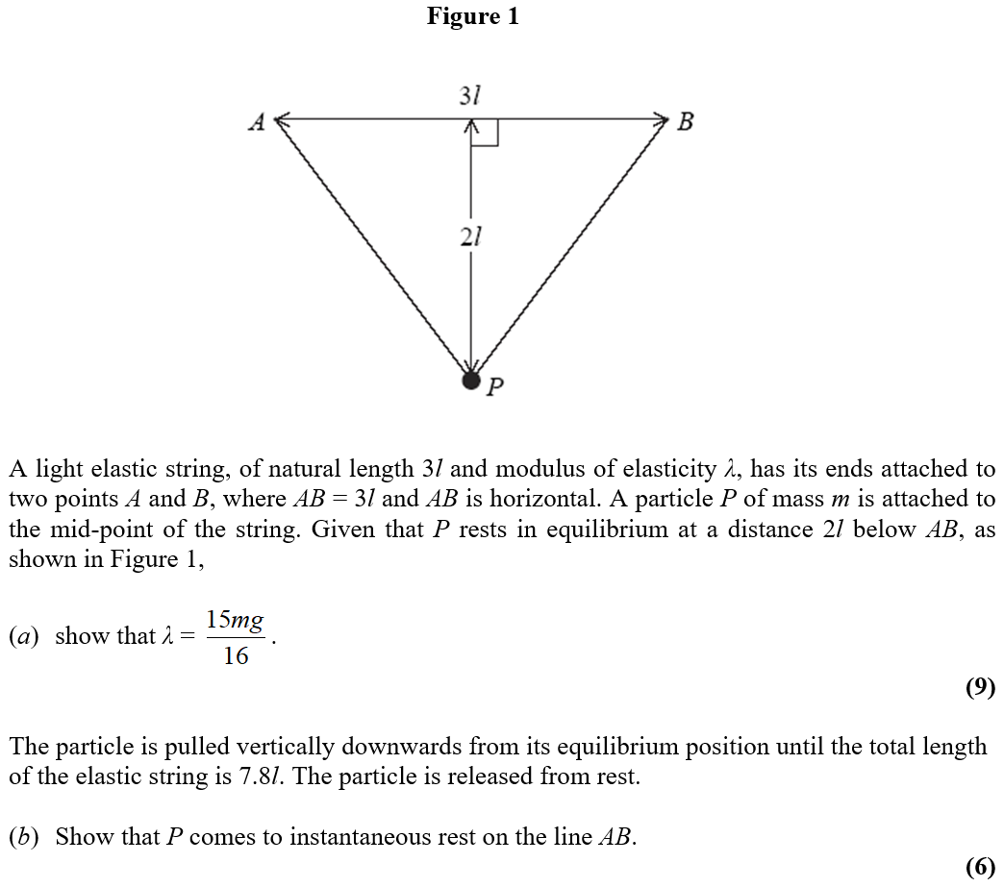
June 2007

Slide 42
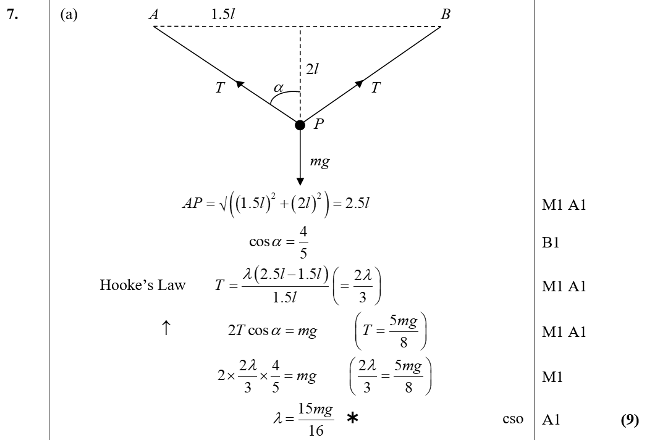
June 2007
A

Slide 43
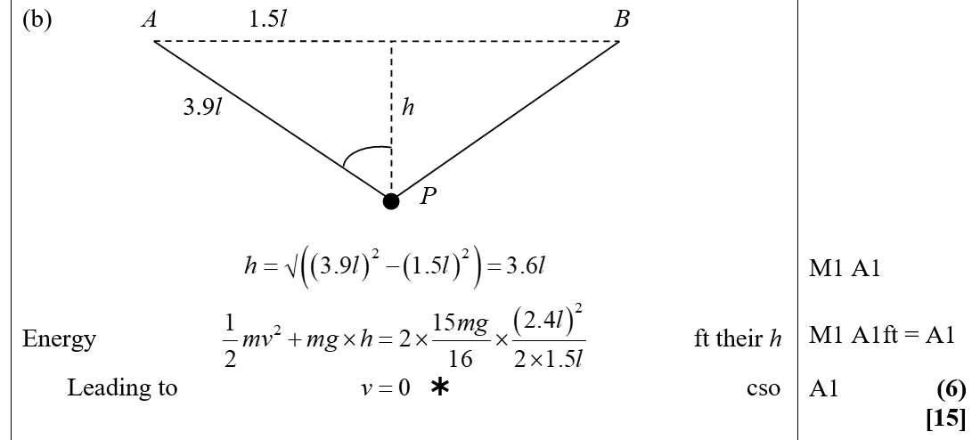
June 2007
B

Slide 44
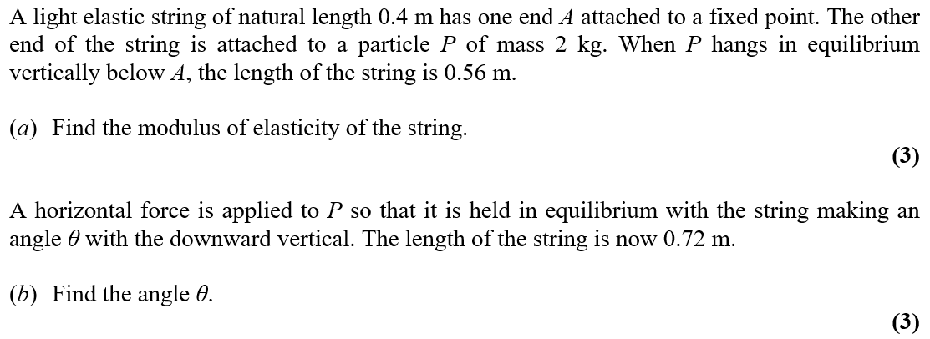
Jan 2008

Slide 45
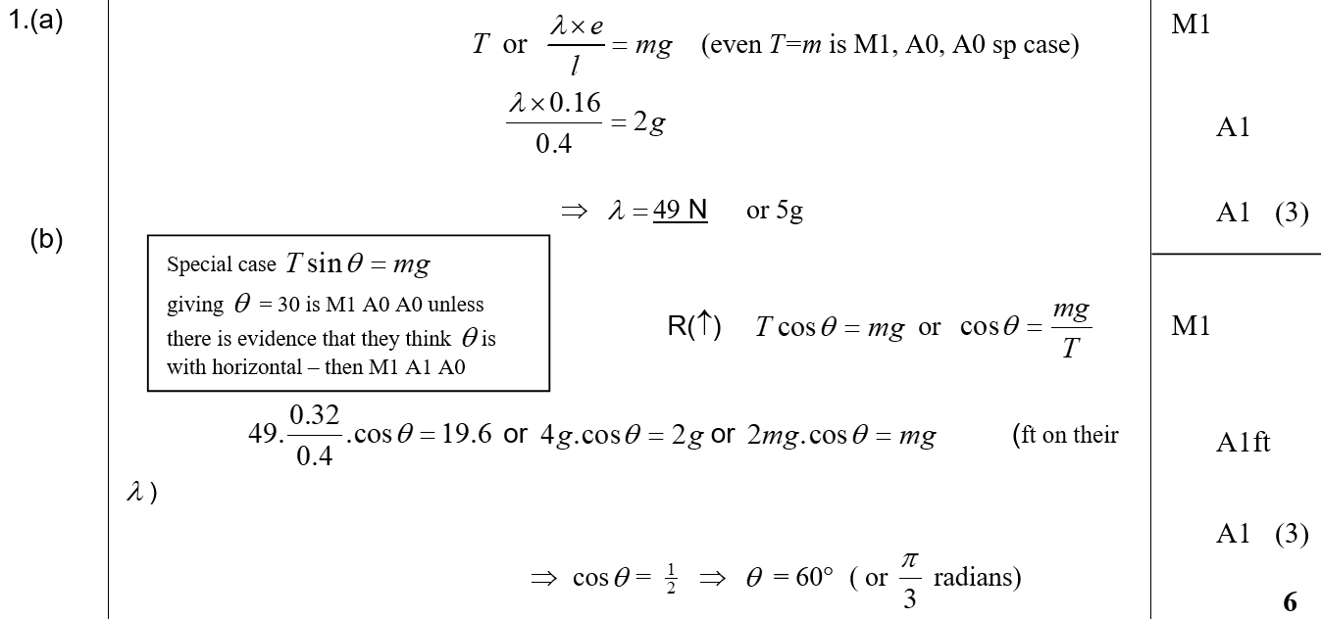
Jan 2008
A
B

Slide 46
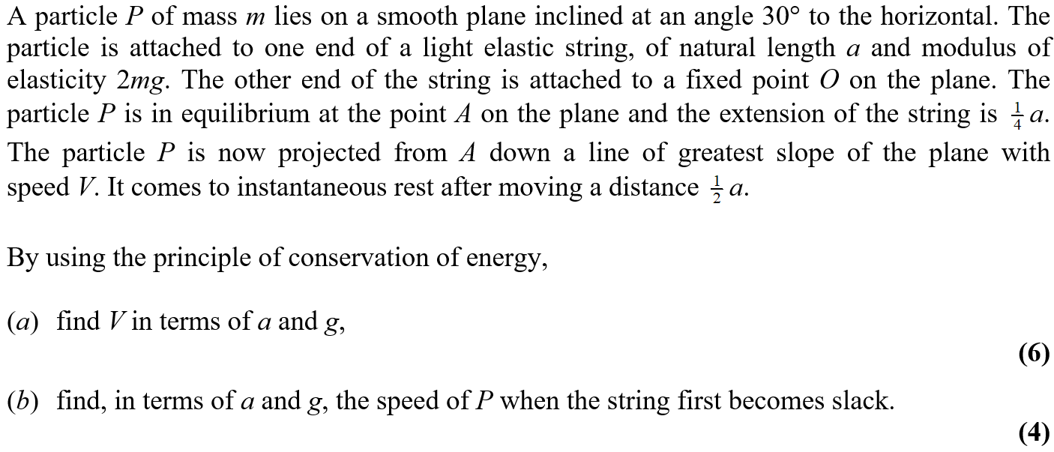
Jan 2008

Slide 47
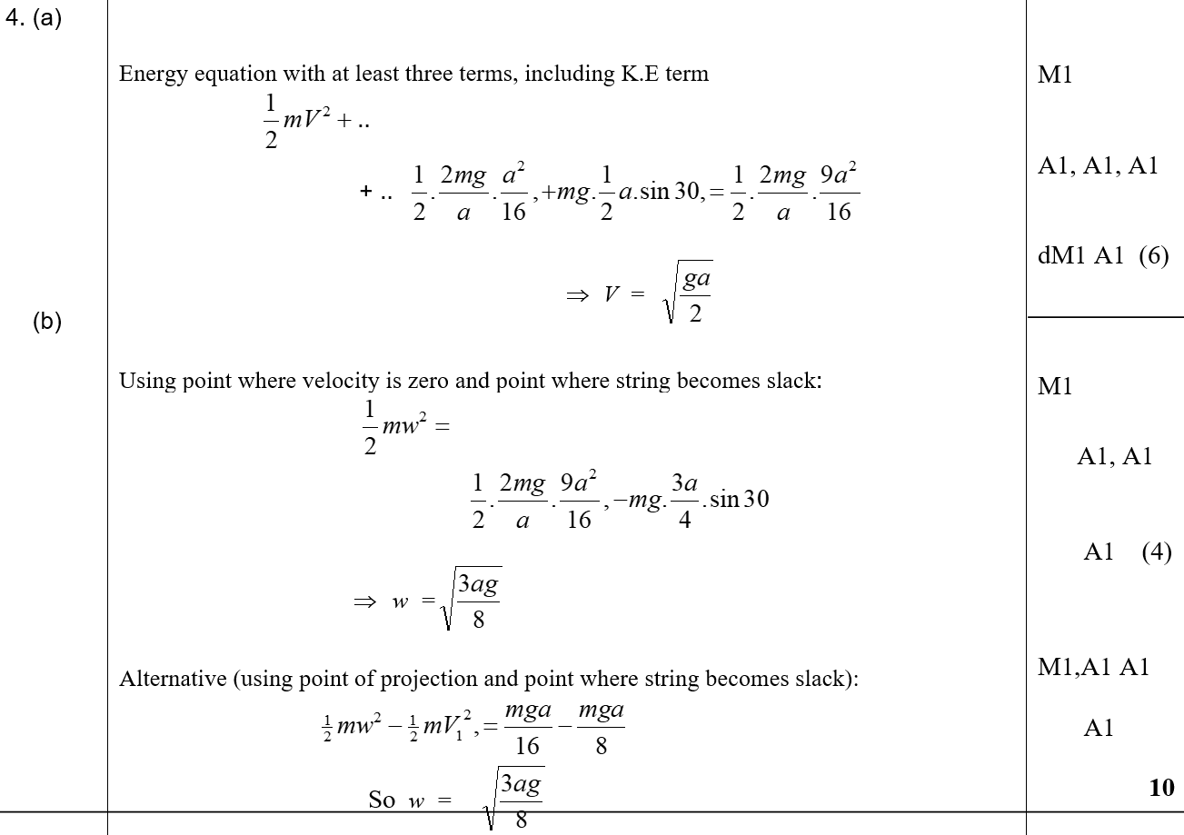
Jan 2008
A
B

Slide 48
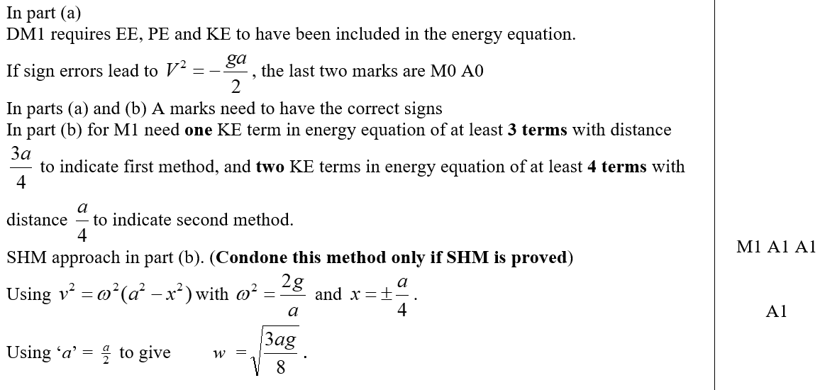
Jan 2008
notes

Slide 49
June 2008

Slide 50
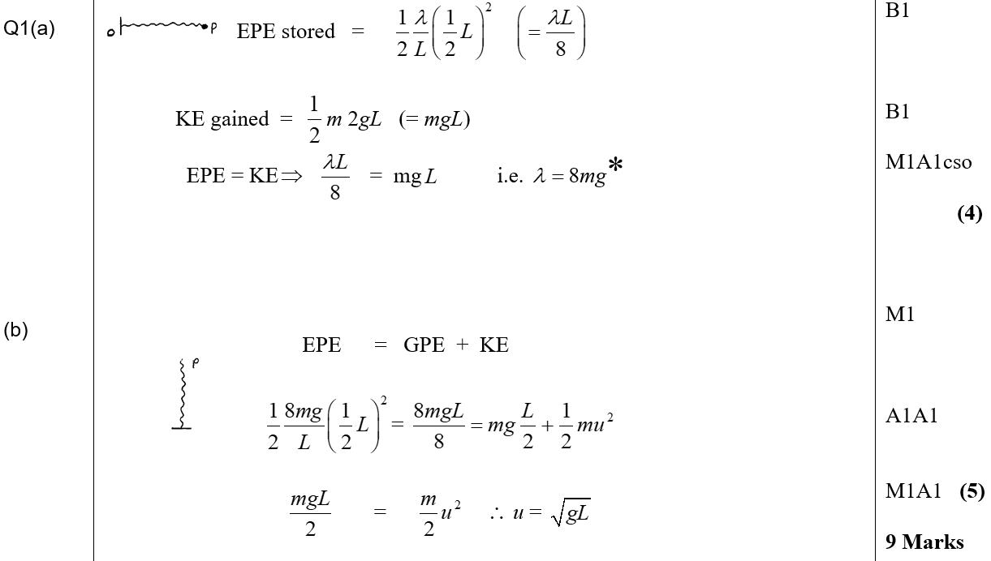
June 2008
A
B

Slide 51
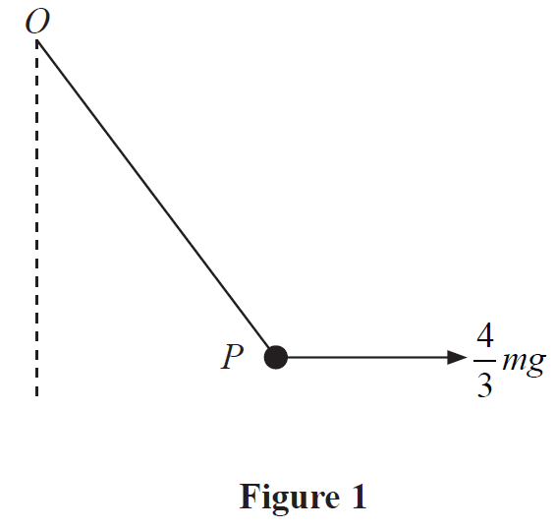
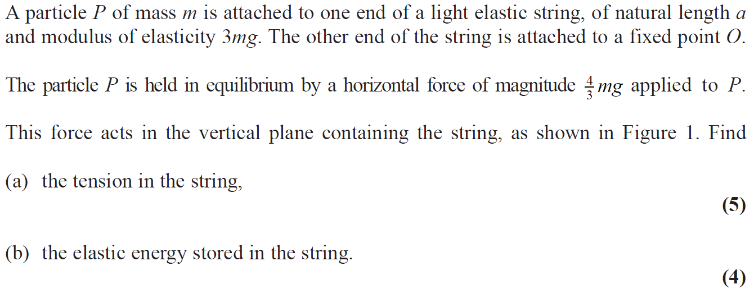
Jan 2009

Slide 52
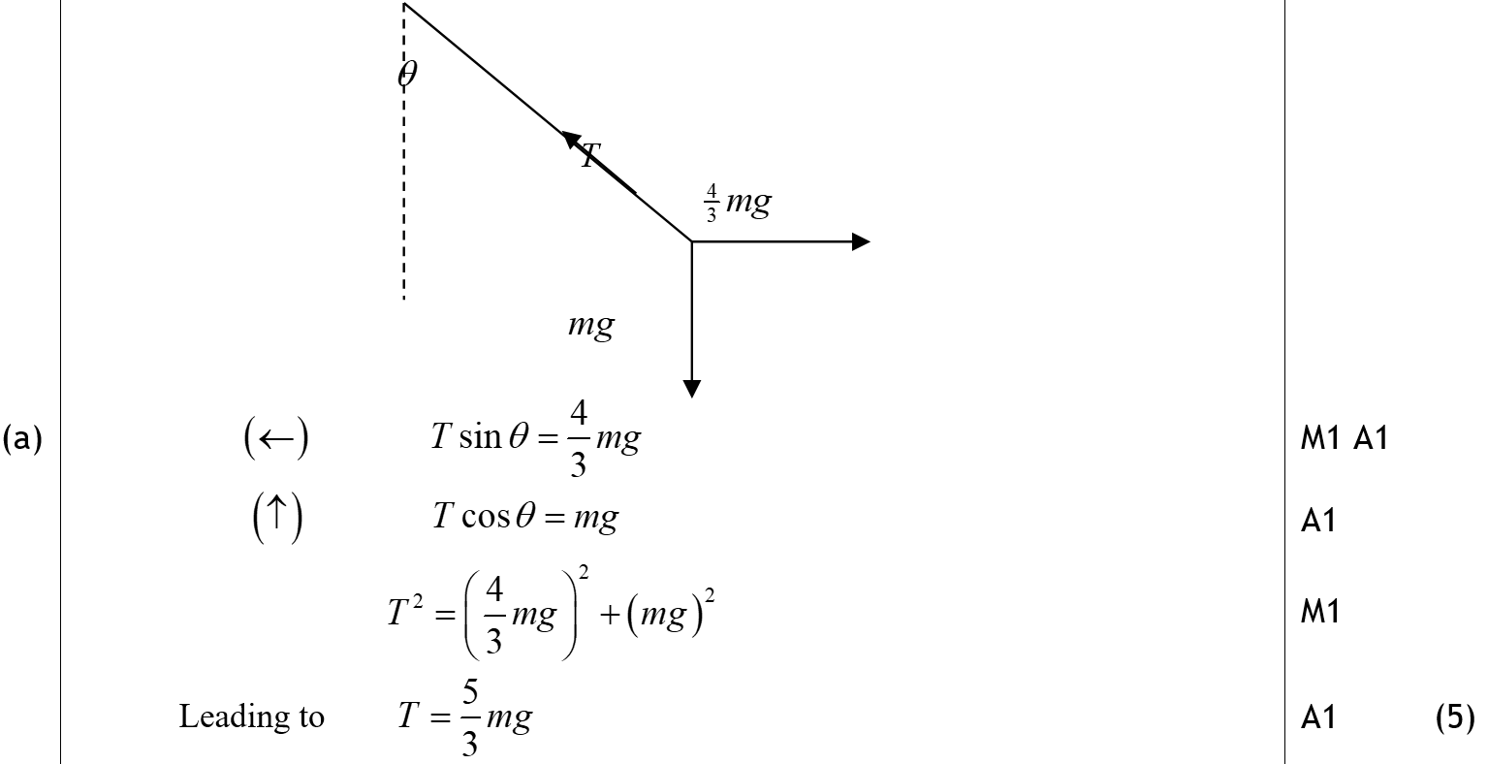
Jan 2009
A

Slide 53
Jan 2009
B

Slide 54
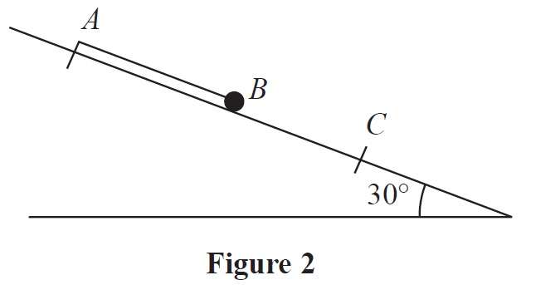
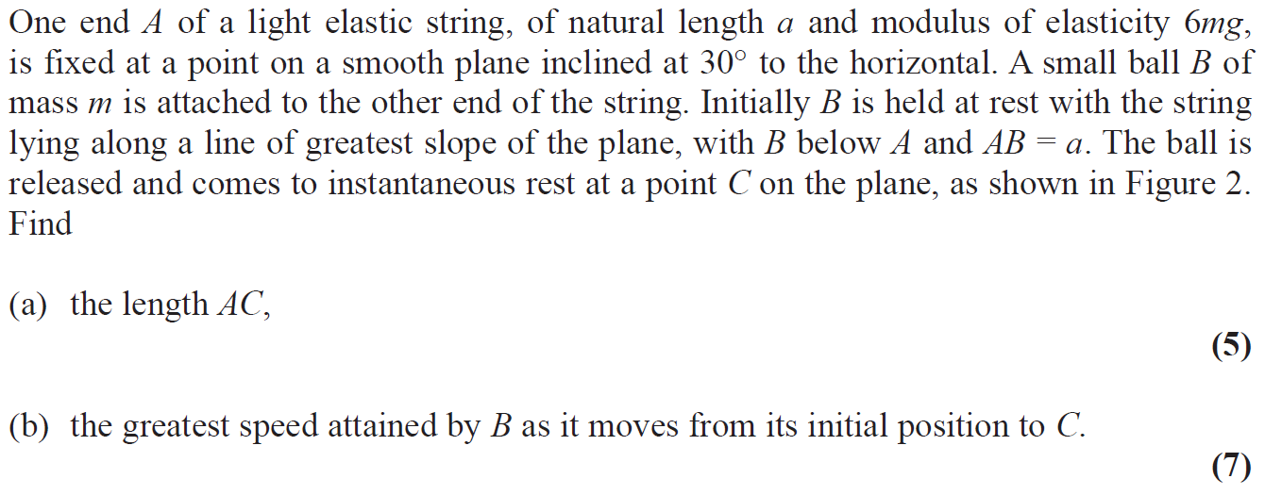
Jan 2009

Slide 55
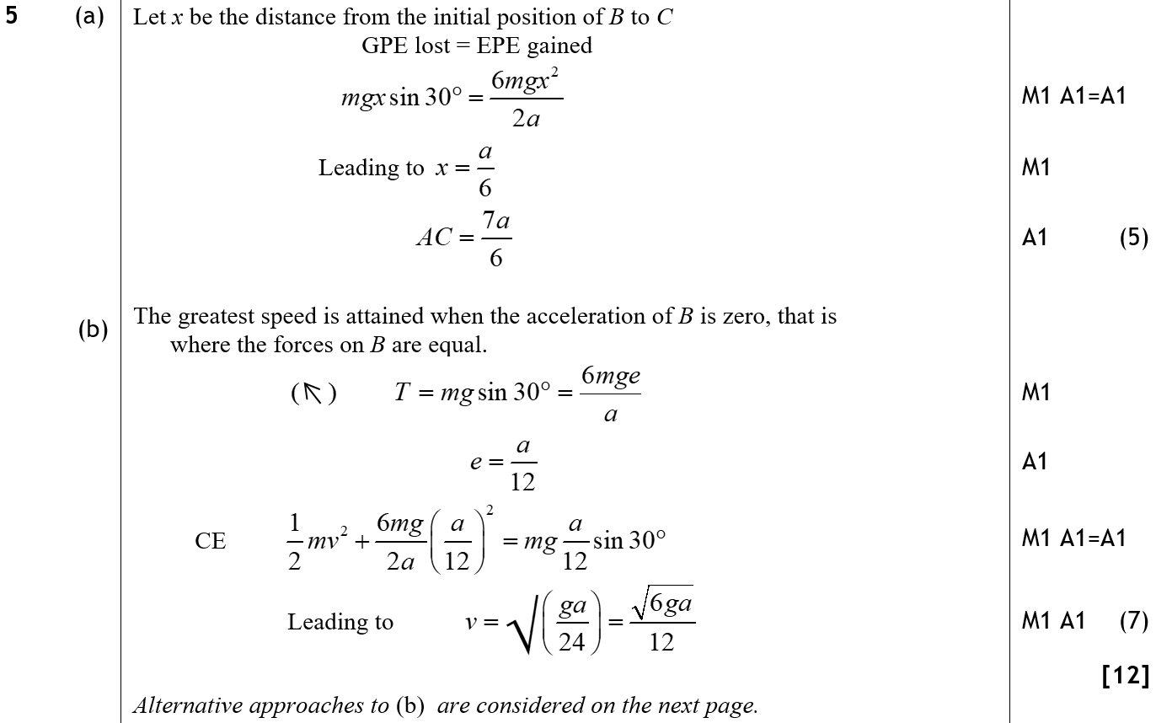
Jan 2009
A
B

Slide 56
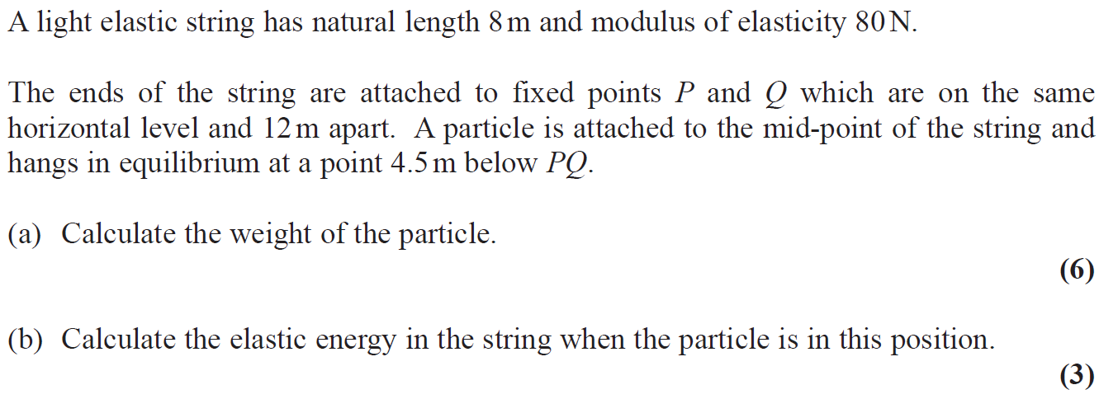
June 2009

Slide 57
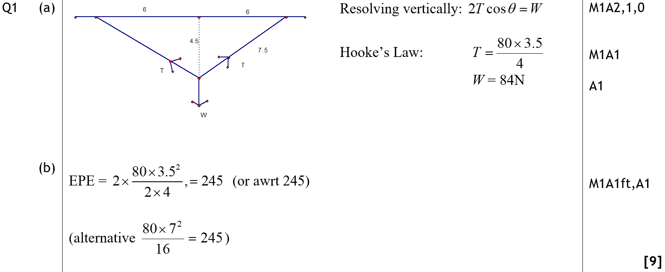
June 2009
A
B

Slide 58
Jan 2010

Slide 59
Jan 2010
A

Slide 60
Jan 2010

Slide 61
Jan 2010
A
B
C

Slide 62
Jan 2010
B Alternative

Slide 63
Jan 2010
B & C Alternatives

Slide 64
June 2010

Slide 65
June 2010
A

Slide 66
Jan 2011

Slide 67
Jan 2011
A

Slide 68
Jan 2011
B

Slide 69
June 2011

Slide 70
June 2011
A

Slide 71
June 2011
B
C

Slide 72
Jan 2012

Slide 73
Jan 2012
A

Slide 74
June 2012 (ignore part c & d)

Slide 75
June 2012
A
B

Slide 76
June 2012
C
D

Slide 77
Jan 2013

Slide 78
Jan 2013
A
B

Slide 79
Jan 2013
C

Slide 80
June 2013

Slide 81
June 2013
A

Slide 82
June 2013
B

Slide 83
June 2013
A notes

Slide 84
June 2013
B notes

Slide 85
June 2013 (part a only)

Slide 86
June 2013
A
B

Slide 87
June 2013
C

Slide 88
June 2013
A notes
B notes

Slide 89
June 2013
C notes

Slide 90
June 2013 (withdrawn)

Slide 91
June 2013 (withdrawn)
A

Slide 92
June 2013 (R)

Slide 93
June 2013 (R)
A
B

Slide 94
May 2014

Slide 95
May 2014
A
B

Slide 96
May 2014
A notes
B notes

Slide 97
May 2014
further notes

Slide 98
May 2014
A Alternative
B Alternative

Slide 99
May 2014 (R)

Slide 100
May 2014 (R)
A
B

Slide 101
May 2014 (R)
A notes
B notes

Slide 102
May 2015

Slide 103
May 2015
A
B

Slide 104
May 2015
A notes
B notes

Slide 105
May 2015 (part a only)

Slide 106
May 2015
A
B
C

Slide 107
May 2015
D
A notes
B notes

Slide 108
May 2015
C notes
D notes

Slide 109
May 2016

Slide 110
May 2016
A
B
A notes

Slide 111
May 2016
A Alternative (i)
A Alternative (ii)
B notes

Slide 112
May 2017

Slide 113
May 2017
A
B
C

Slide 114
May 2017
A notes
B notes
C notes

Slide 115
May 2018

Slide 116
May 2018
A

Slide 117
May 2018
A notes

Slide 118
May 2019

Slide 119
May 2019
A
B

Slide 120
May 2019
A notes
B notes
B Alternatives

Slide 121
May 2019 (part a only)

Slide 122
May 2019
A
B

Slide 123
May 2019
C

Slide 124
May 2019
A notes
B notes
C notes

