Slide 1
Graphical Transformations
Graphical Transformations
June 2017 3H Q20
Edexcel
SAM
2H Q19
May 2018 1H Q18
AQA
Spec 1
3H Q16
Nov 2018 1H Q18
OCR
Spec 2
2H Q19
June 2019 3H Q15

Slide 2
Graphical Transformations
Graphical Transformations
June 2017
2H Q27
Edexcel
May 2018
1H Q29
AQA
SAM
3H Q27
1 Marker
Nov 2018
2H Q24
OCR
Nov 2018
3H Q20
Trig

Slide 3
Graphical Transformations
Graphical Transformations
Edexcel
AQA
Practice
2H Q13
Nov 2018
3H Q18
OCR
Trig

Slide 4
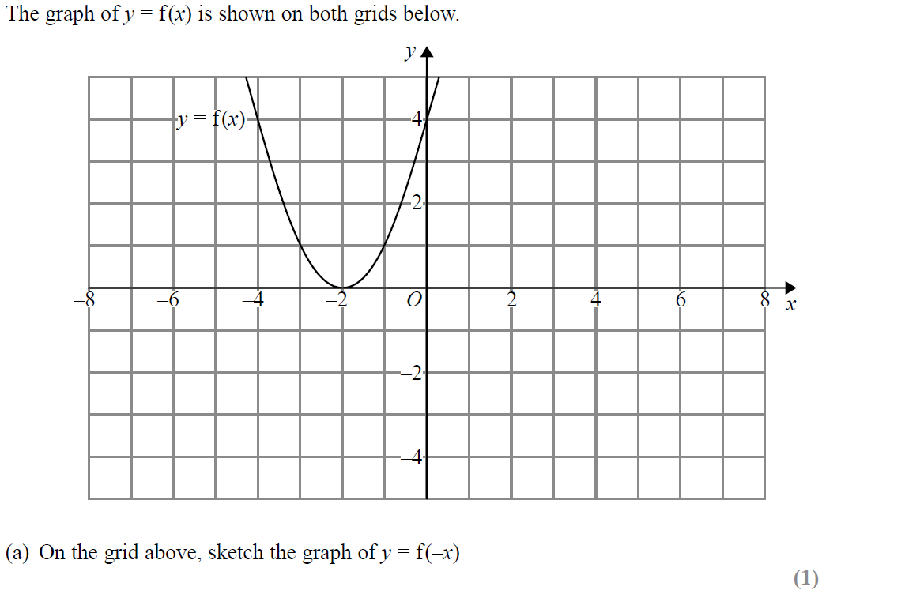
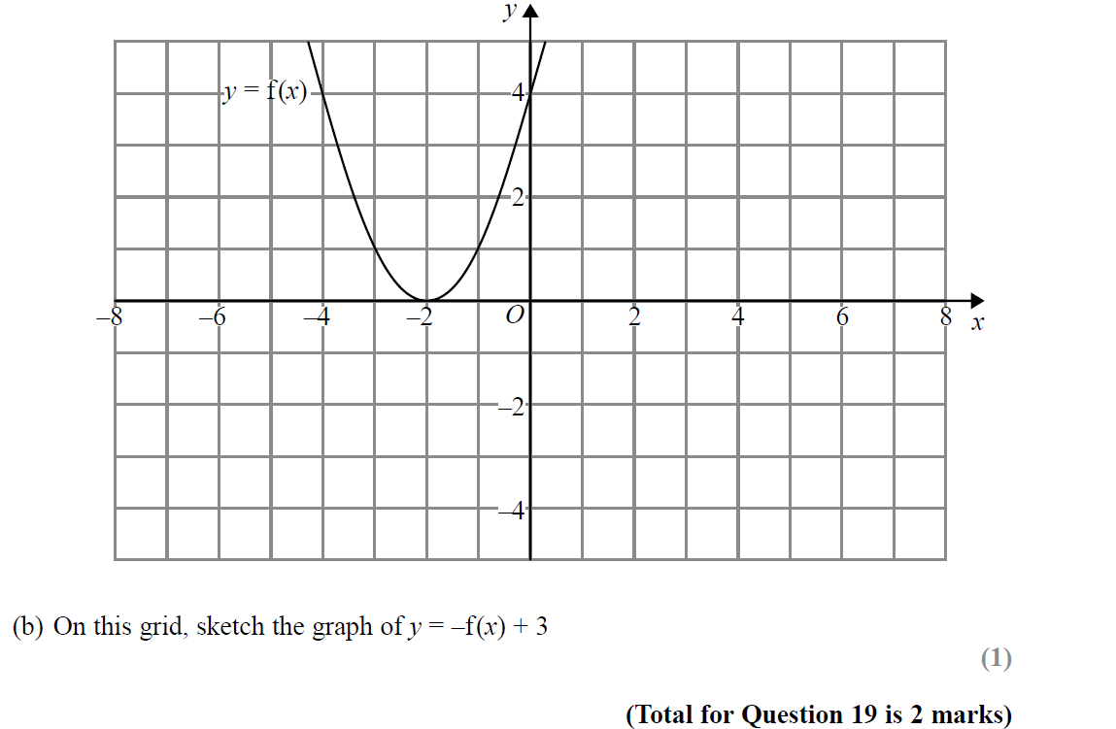
Graphical Transformations
SAM 2H Q19
Reveal Graph (a)
Reveal Graph (b)

Slide 5
Graphical Transformations
SAM 2H Q19
A
B
I think this should be (-2,3)

Slide 6
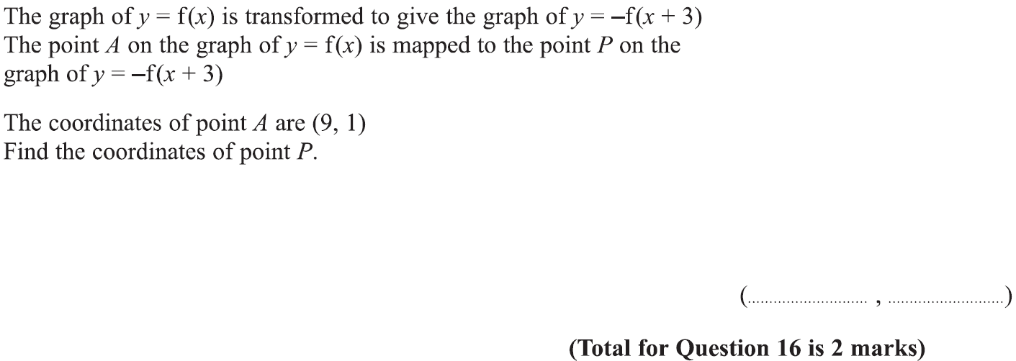
Graphical Transformations
Specimen Set 1 3H Q16

Slide 7
Graphical Transformations
Specimen Set 1 3H Q16
A

Slide 8
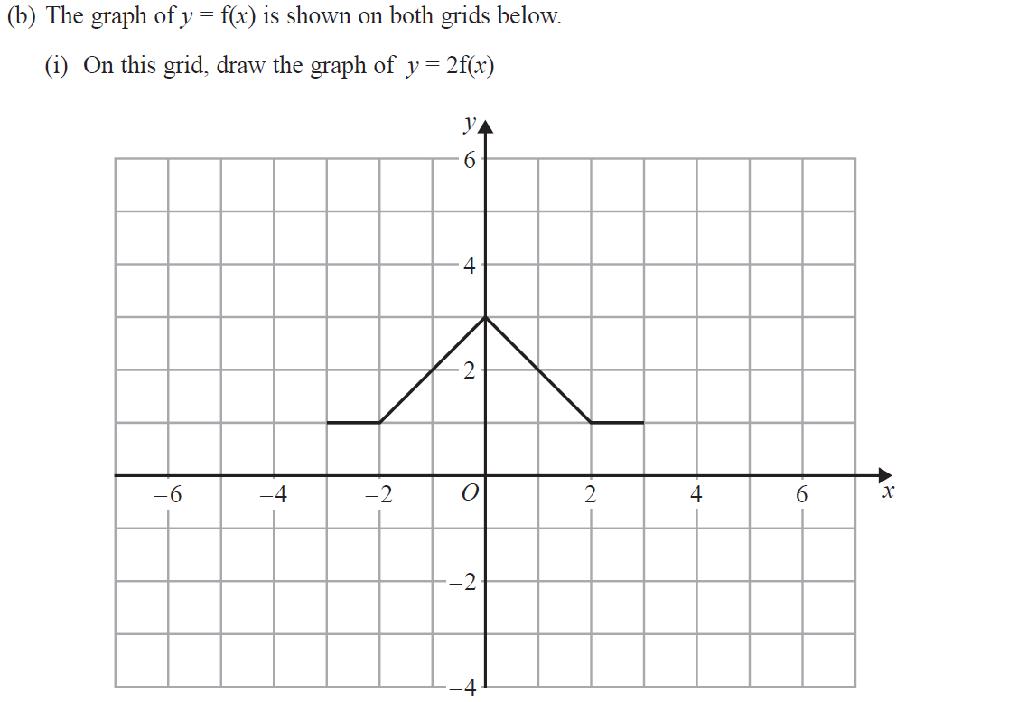
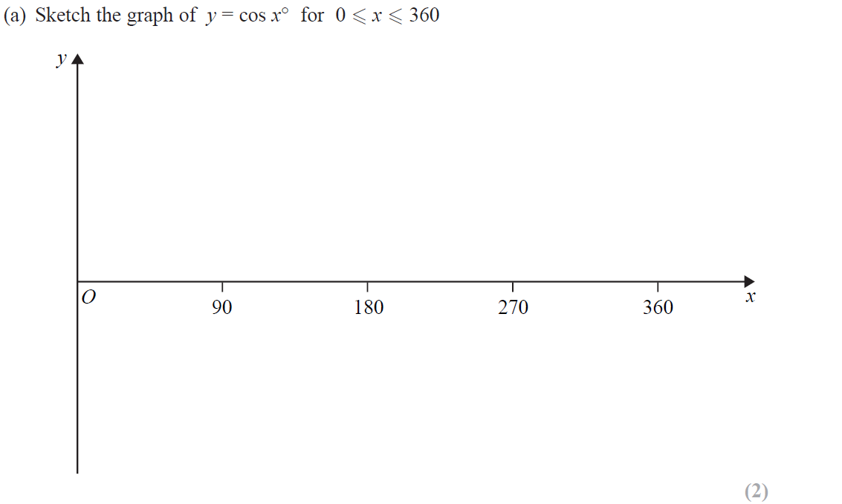
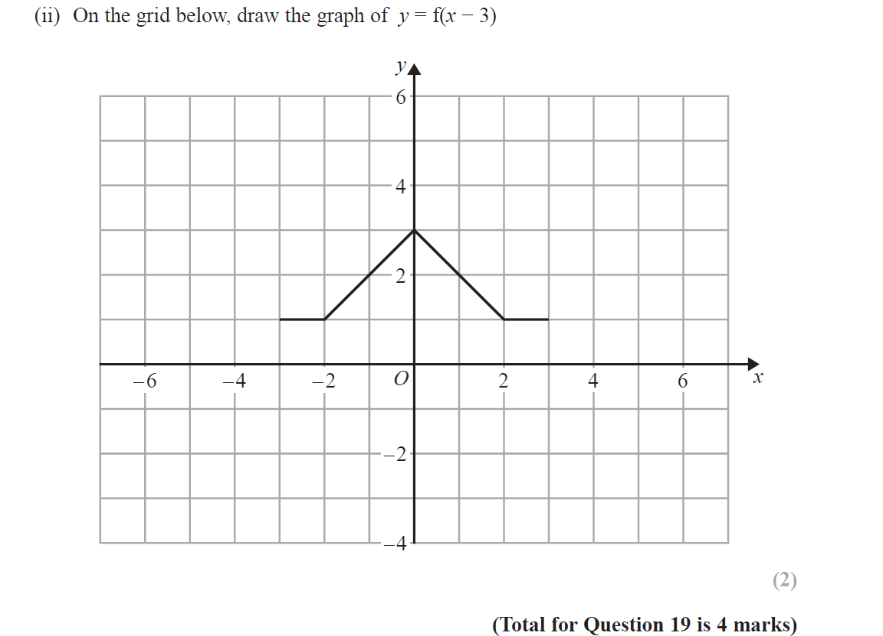
Graphical Transformations
Specimen Set 2 2H Q19
Reveal Graph (i)
Reveal Graph (ii)

Slide 9
Graphical Transformations
Specimen Set 2 2H Q19
A
B

Slide 10
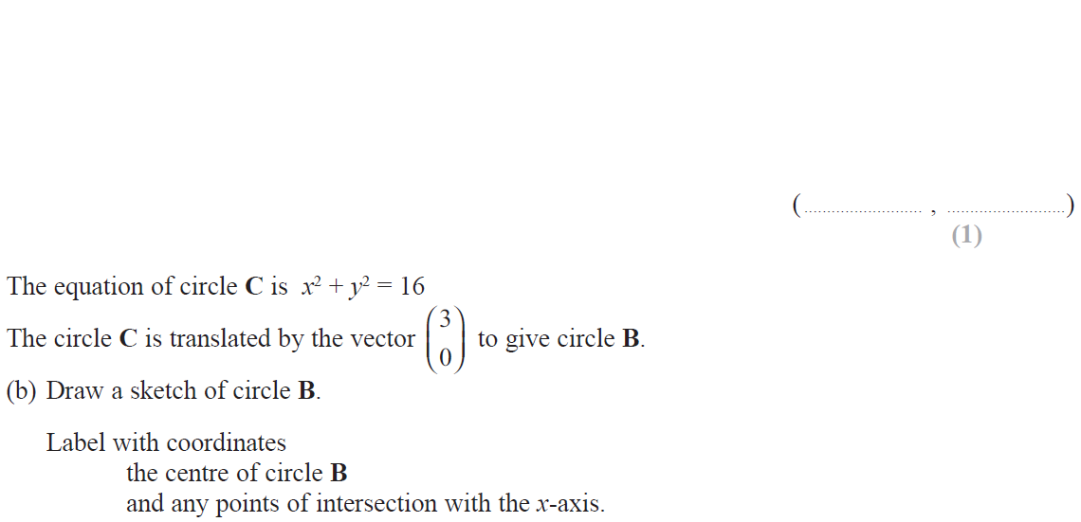
Graphical Transformations
June 2017 3H Q20

Slide 11
Graphical Transformations
June 2017 3H Q20
A
B

Slide 12
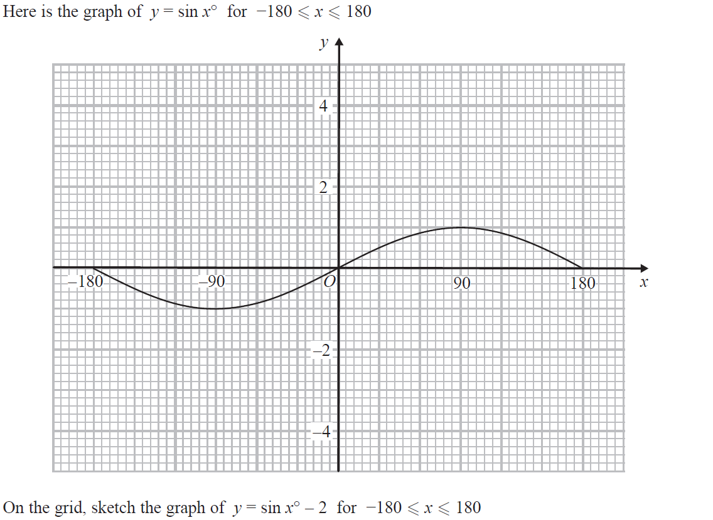
Graphical Transformations
May 2018 1H Q18
Reveal Graph

Slide 13
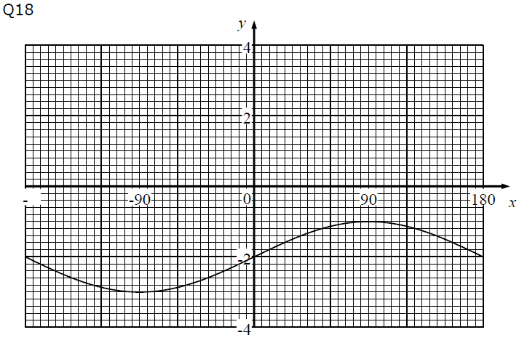
Graphical Transformations
May 2018 1H Q18
A

Slide 14
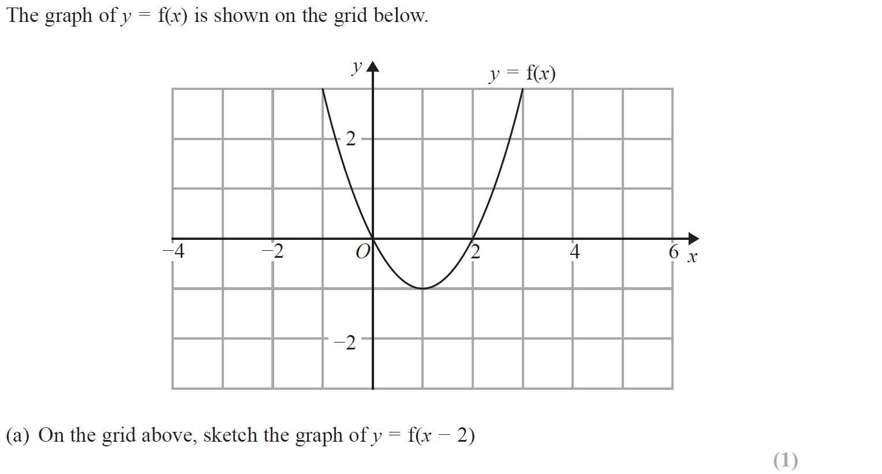
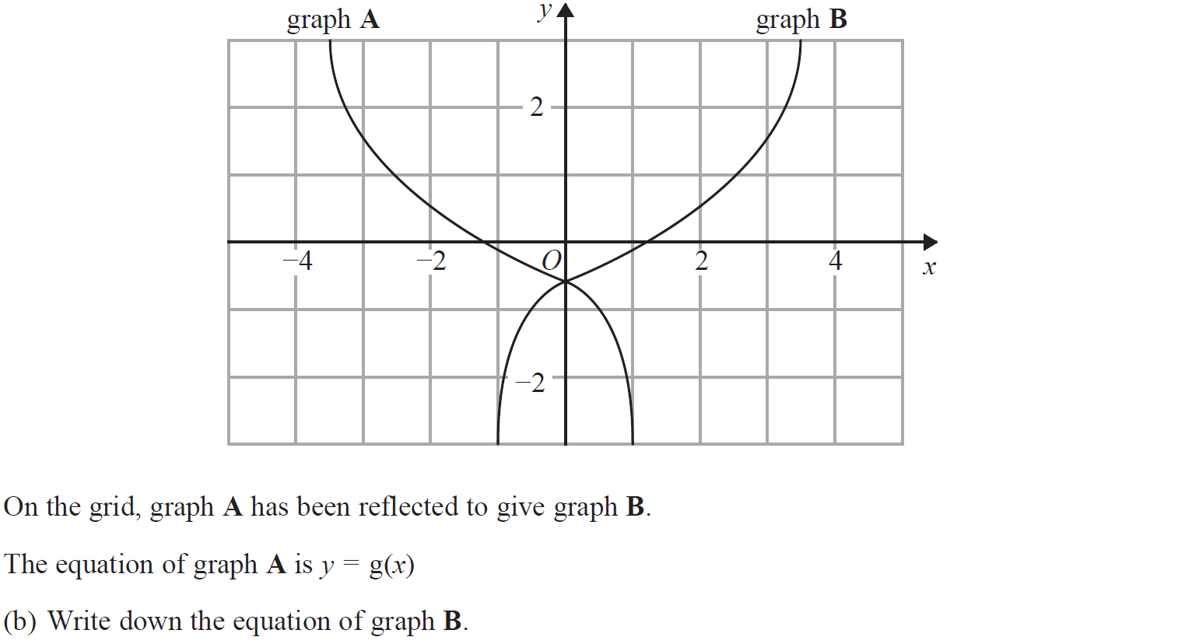
Graphical Transformations
Nov 2018 1H Q18
Reveal Graph (a)

Slide 15
Graphical Transformations
Nov 2018 1H Q18
A
B

Slide 16
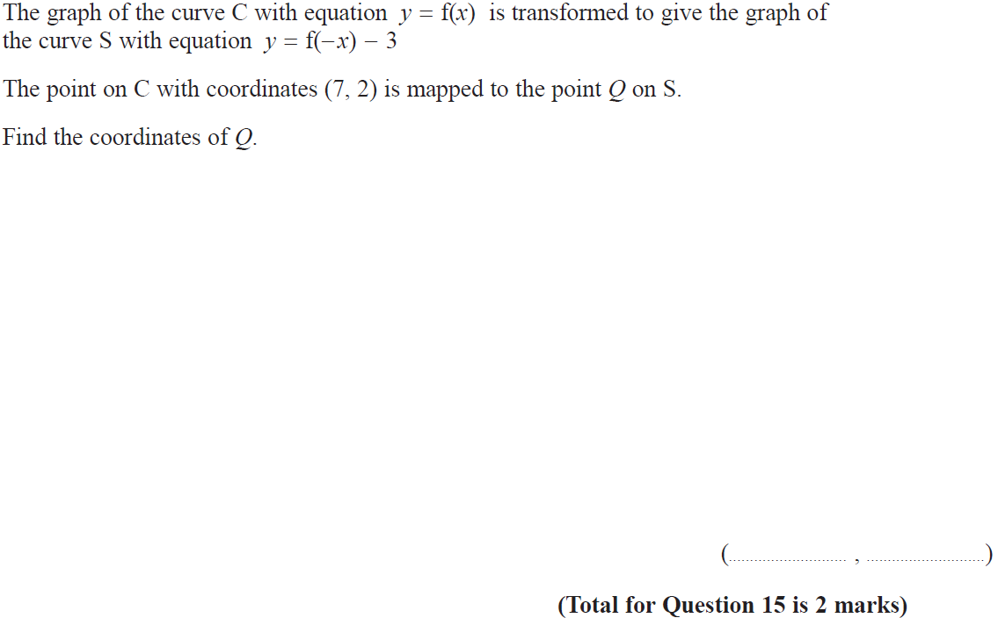
Graphical Transformations
June 2019 3H Q15

Slide 17
Graphical Transformations
June 2019 3H Q15
A
A SF

Slide 18
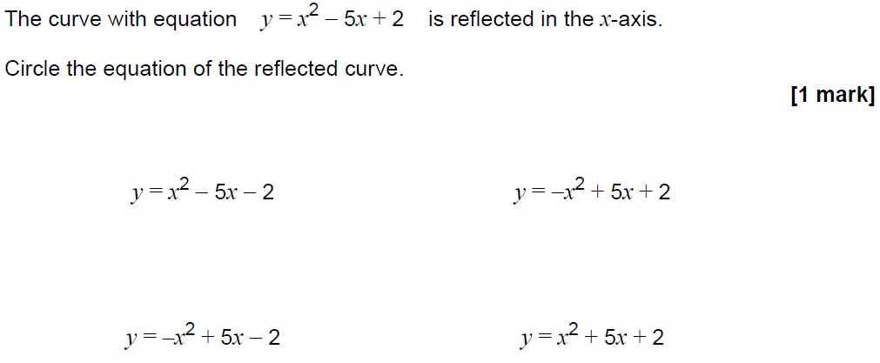
Graphical Transformations
SAM 3H Q27

Slide 19
Graphical Transformations
SAM 3H Q27
A

Slide 20
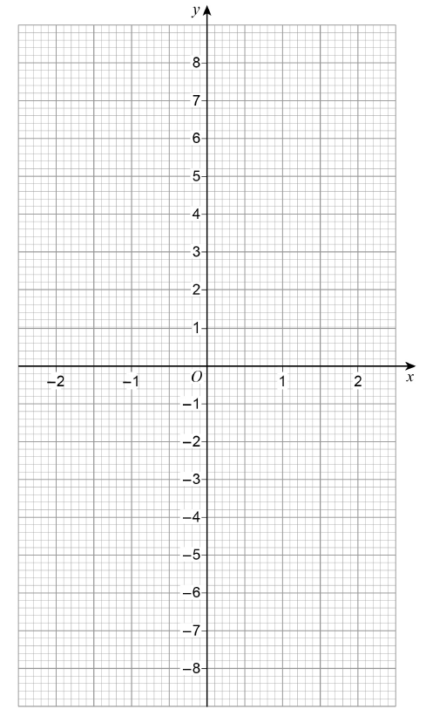
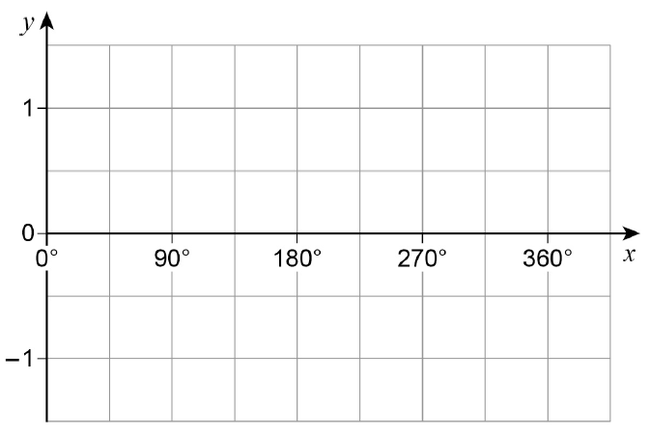
Graphical Transformations
June 2017 2H Q27

Slide 21
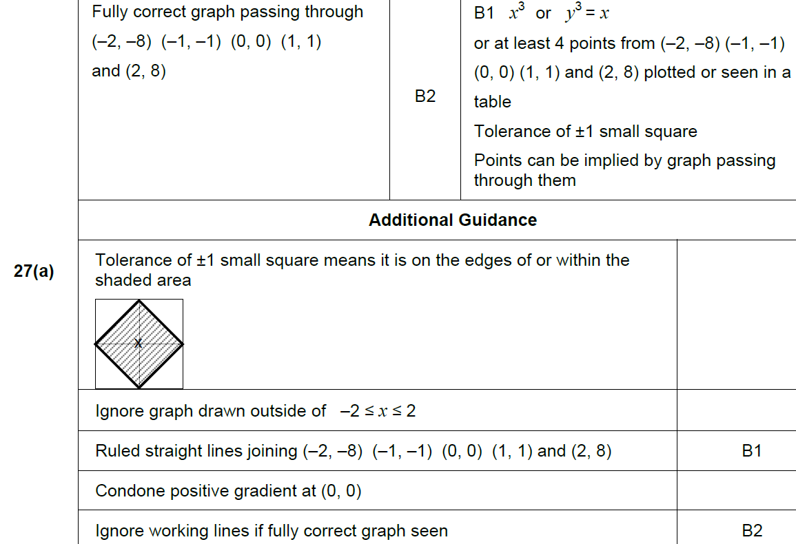
Graphical Transformations
June 2017 2H Q27
A

Slide 22
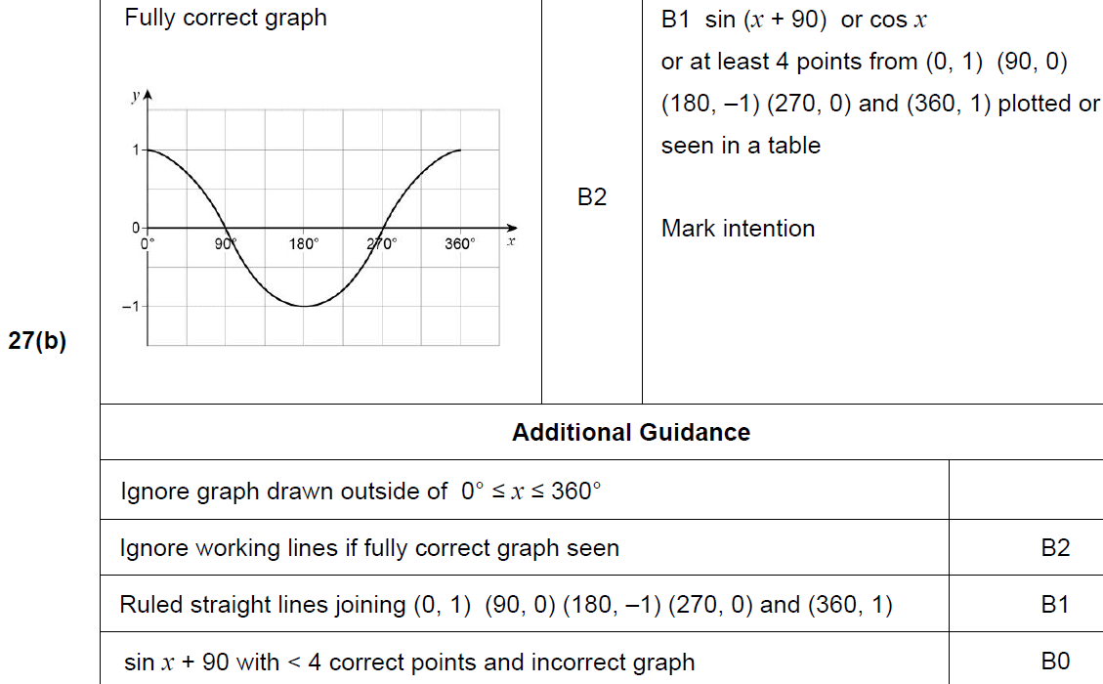
Graphical Transformations
June 2017 2H Q27
B

Slide 23
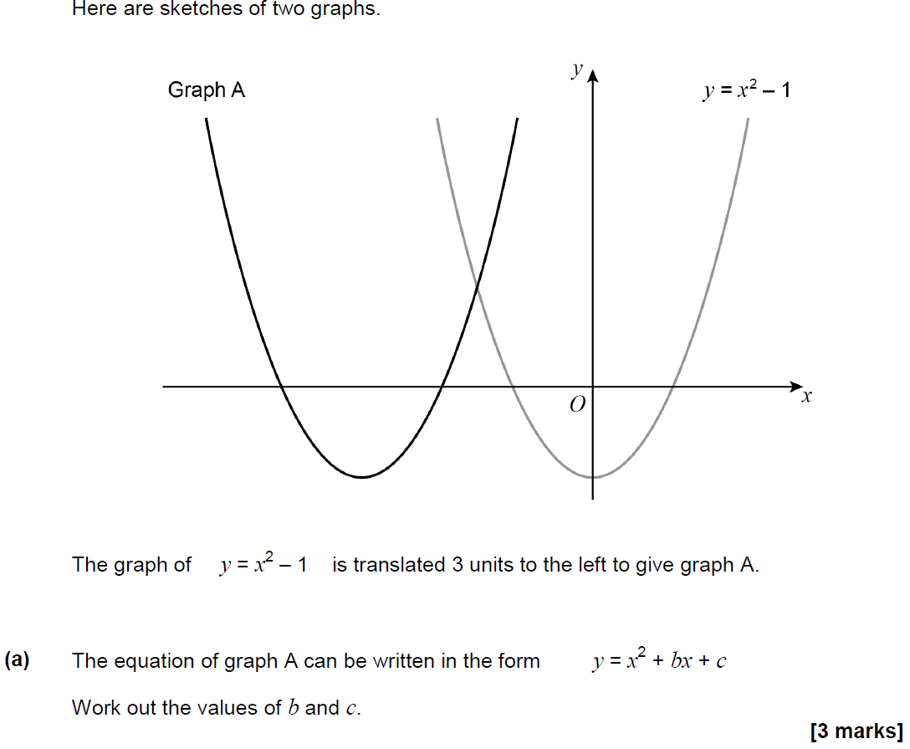
Graphical Transformations
May 2018 1H Q29

Slide 24
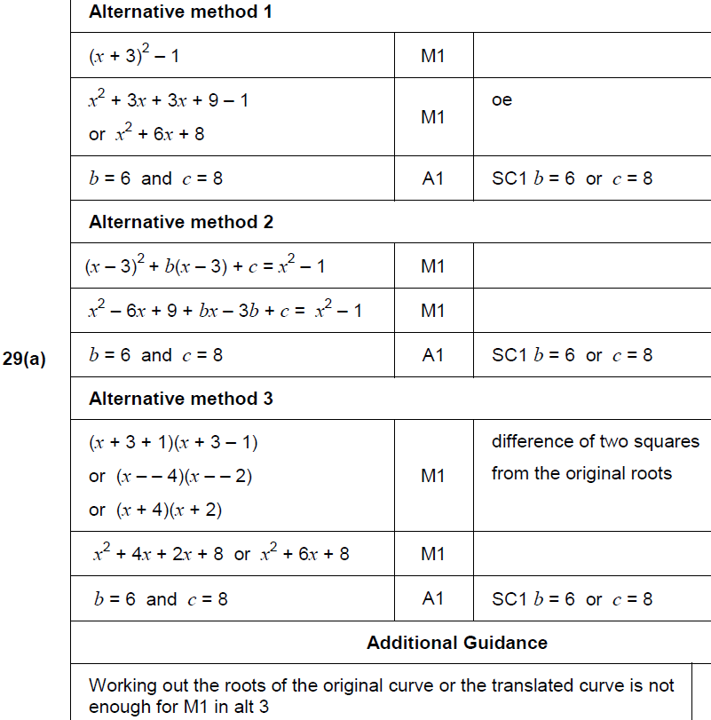
Graphical Transformations
May 2018 1H Q29
A

Slide 25
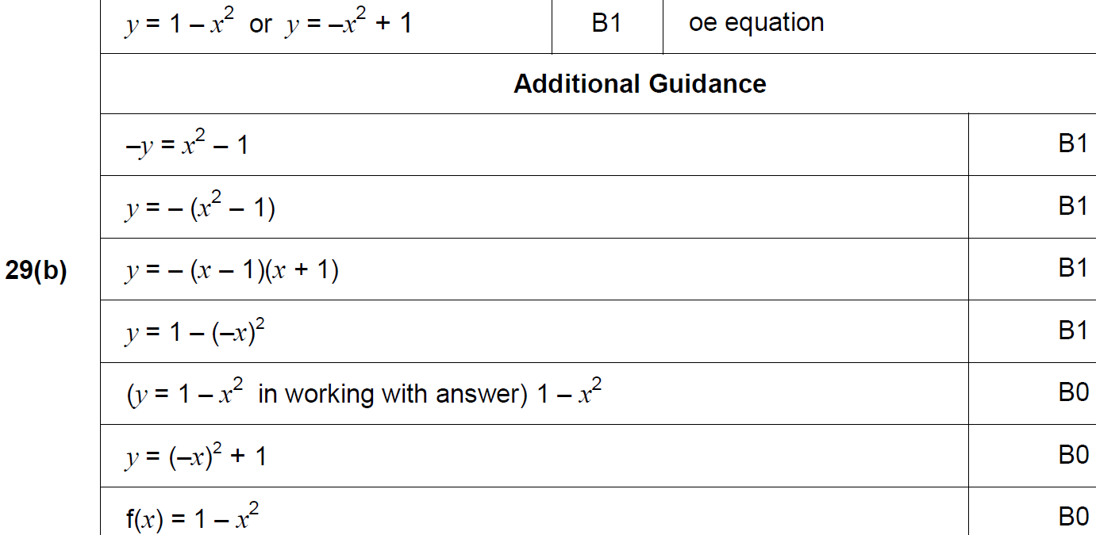
Graphical Transformations
May 2018 1H Q29
B

Slide 26
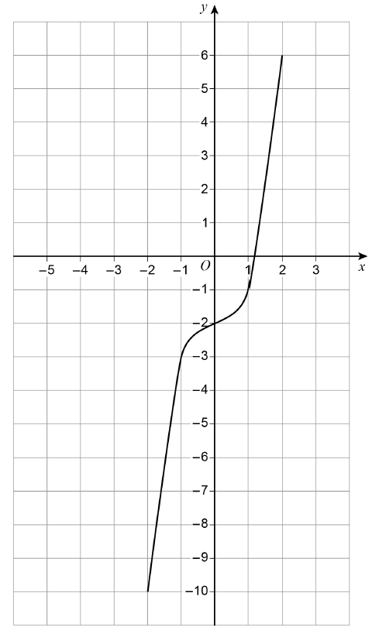
Graphical Transformations
Nov 2018 2H Q24
Here is a sketch of y = f(x)
The curve passes through the points
(–2, –10) (–1, –3) (0, –2) (1, –1) (2, 6)
On the grid, sketch the curve y = f(x + 2)
[2 marks]

Slide 27
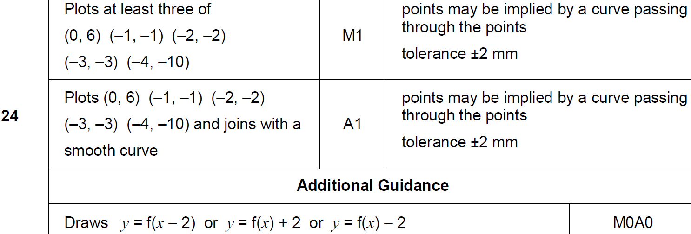
Graphical Transformations
Nov 2018 2H Q24
A

Slide 28
Graphical Transformations
Nov 2018 3H Q20

Slide 29
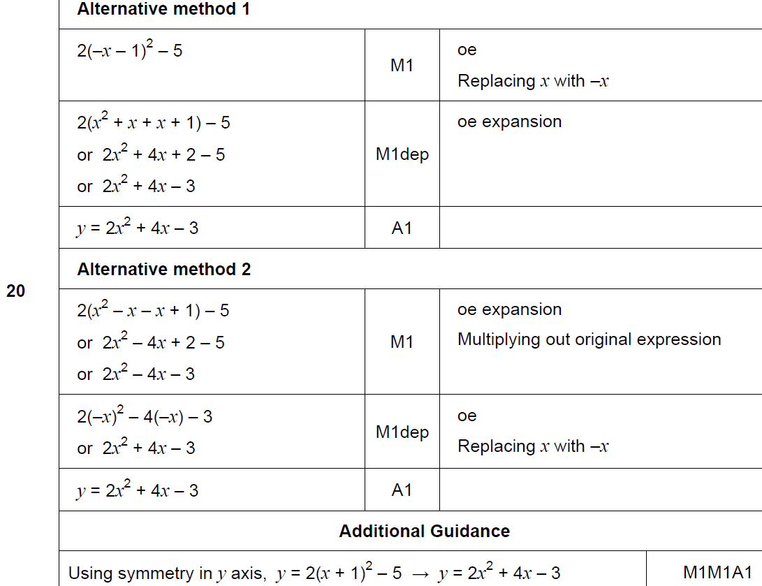
Graphical Transformations
Nov 2018 3H Q20
A

Slide 30
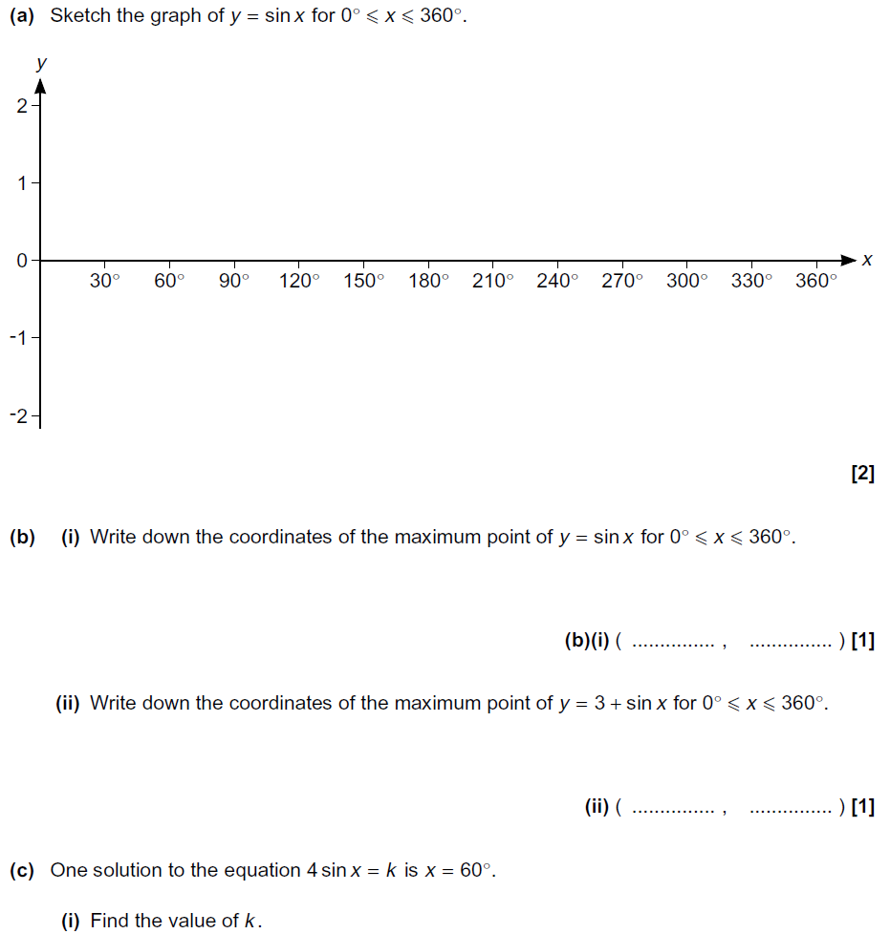
Graphical Transformations
Practice 2H Q13
Show Graph

Slide 31
Graphical Transformations
Practice 2H Q13
A
B (i)
B (ii)
C (i)
C (ii)

Slide 32
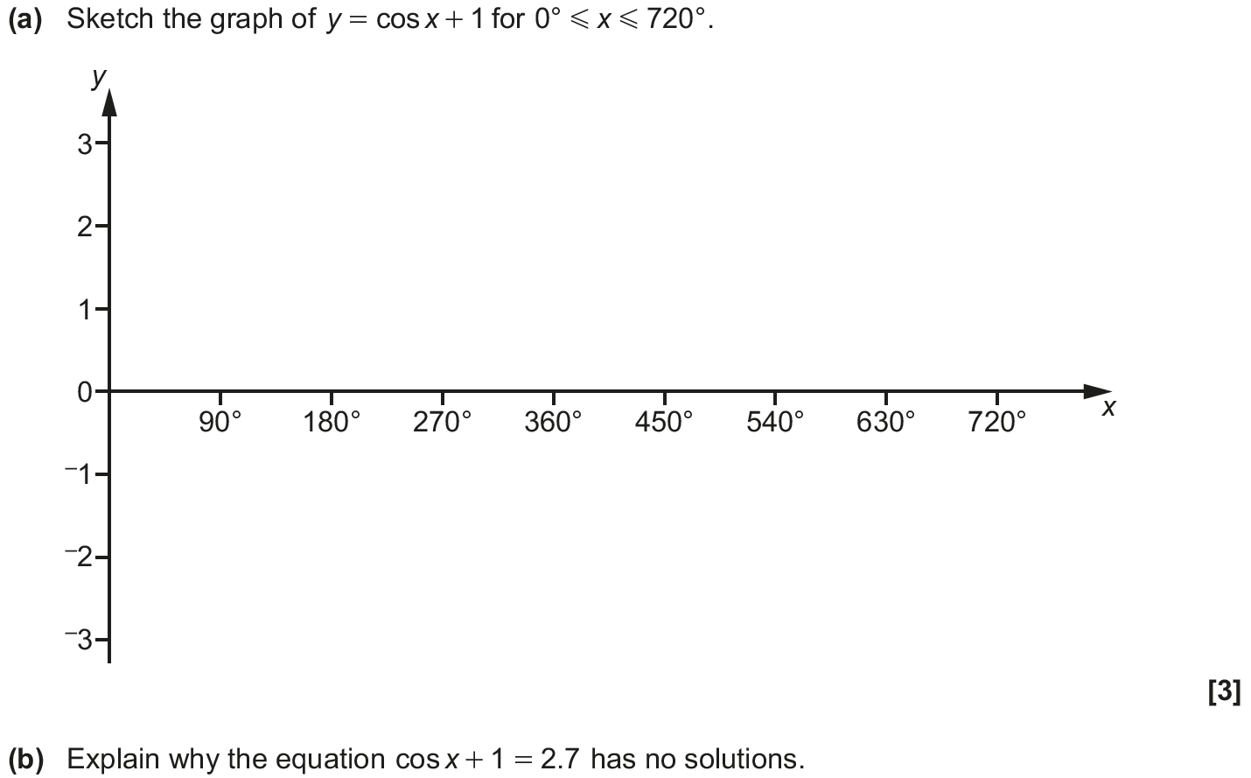
Graphical Transformations
Nov 2018 3H Q18

Slide 33
Graphical Transformations
Nov 2018 3H Q18
A
B

