Slide 1
Forming Equations
Forming Equations
Old Spec Q’s
May 2018 1H Q16
Jan 2019 1H Q5
Jan 2019 1H Q20
Jan 2019 2H Q5
Jan 2019 2H Q15
Jan 2019 1HR Q6

Slide 2
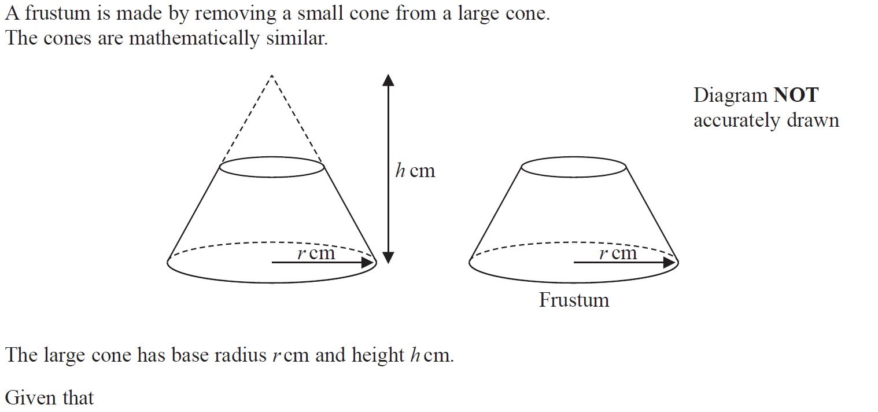
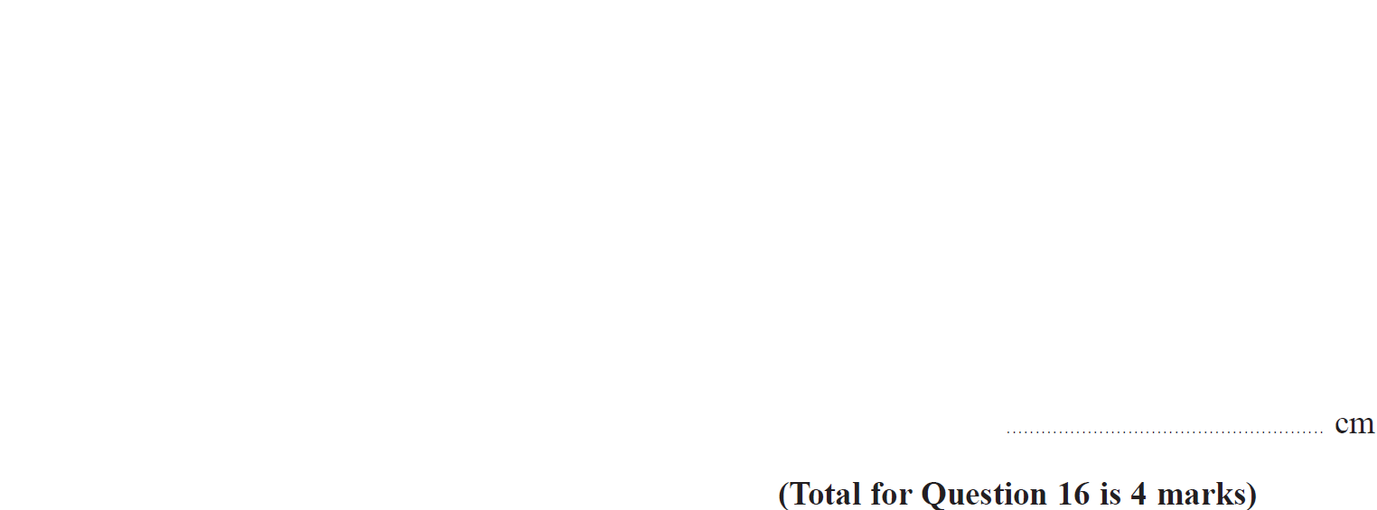
Forming Equations
May 2018 1H Q16

Slide 3
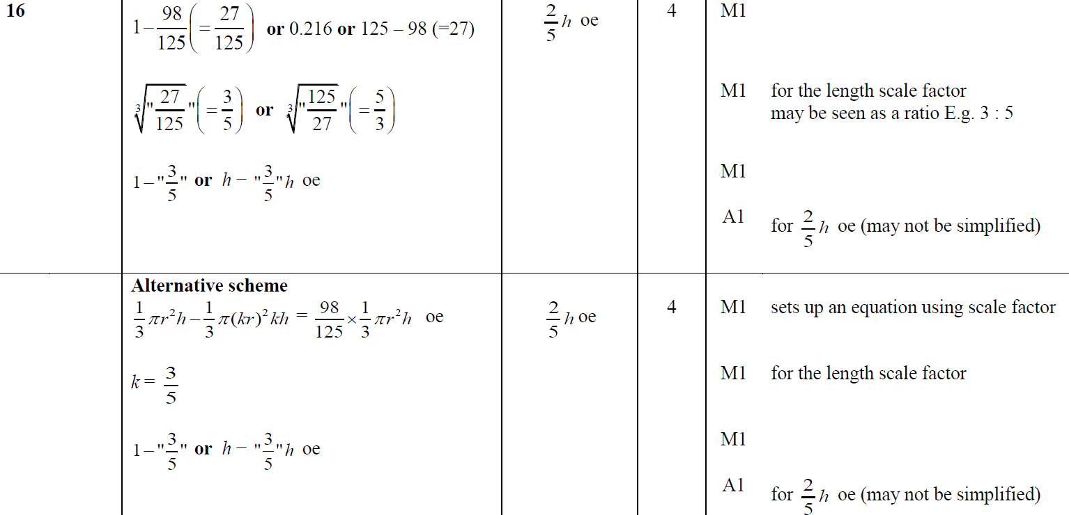
Forming Equations
May 2018 1H Q16
A

Slide 4
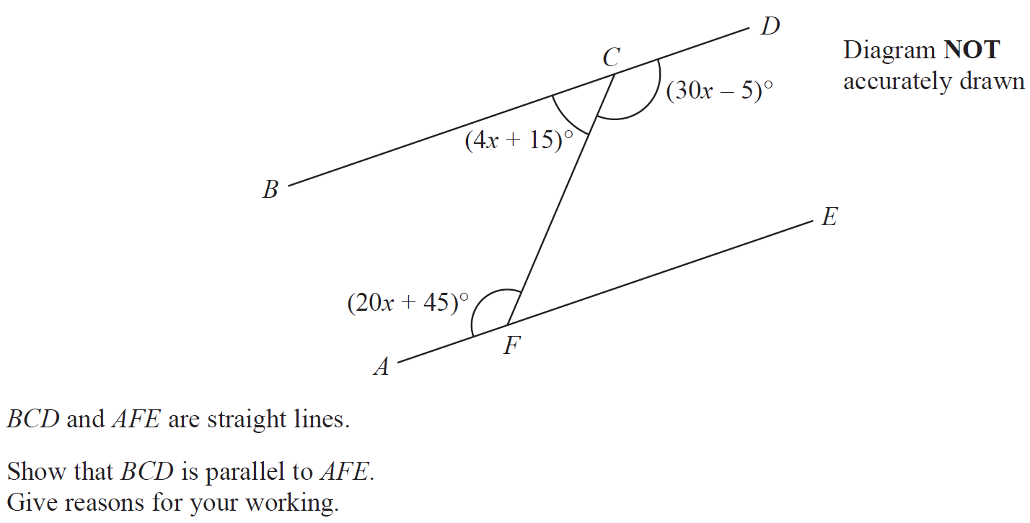
Forming Equations
Jan 2019 1H Q5

Slide 5
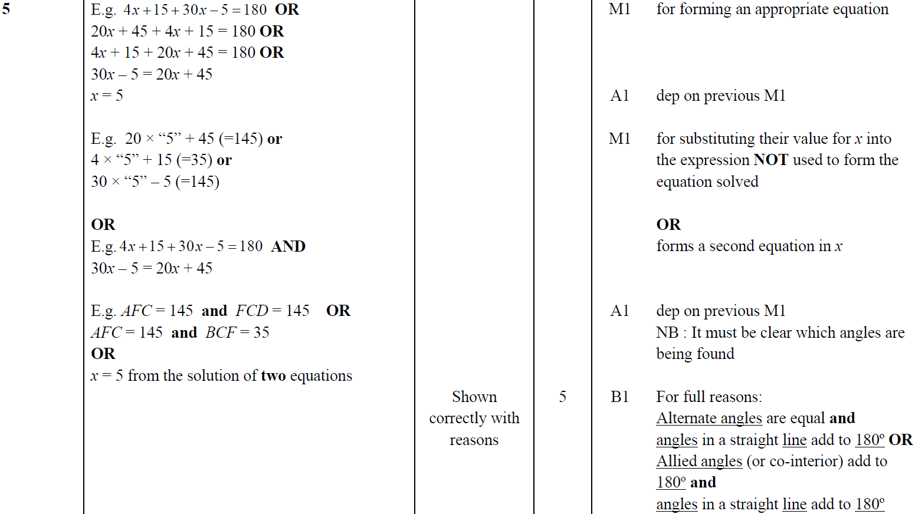
Forming Equations
Jan 2019 1H Q5
A

Slide 6
Forming Equations
Jan 2019 1H Q20

Slide 7
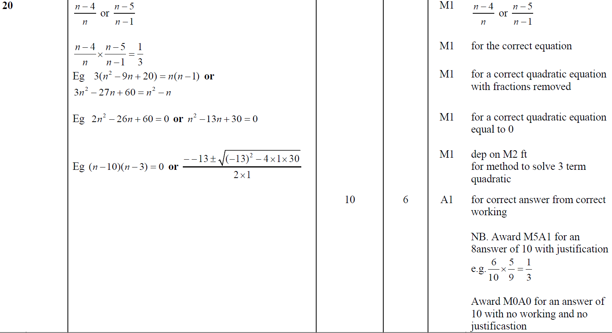
Forming Equations
Jan 2019 1H Q20
A

Slide 8
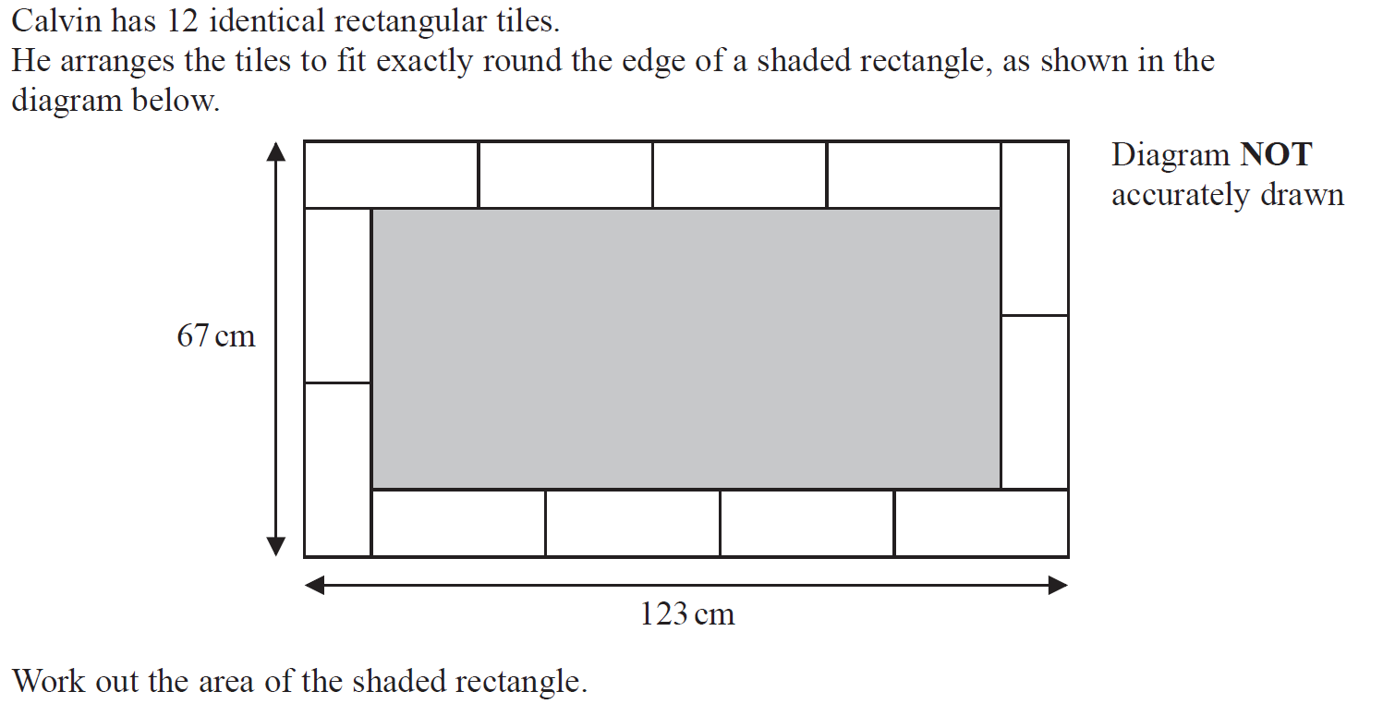
Forming Equations
Jan 2019 2H Q5

Slide 9
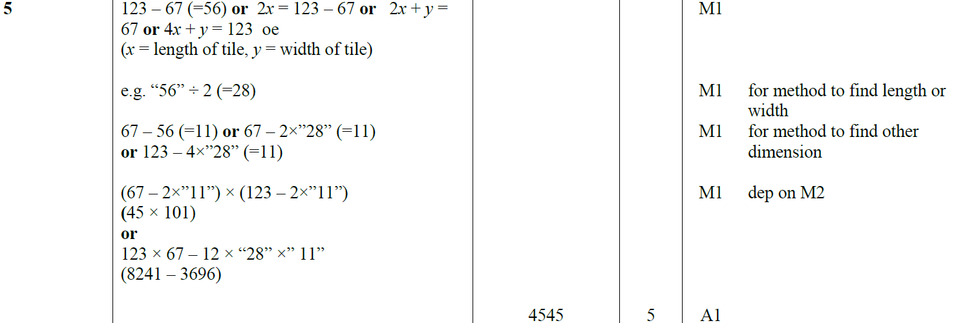
Forming Equations
Jan 2019 2H Q5
A

Slide 10
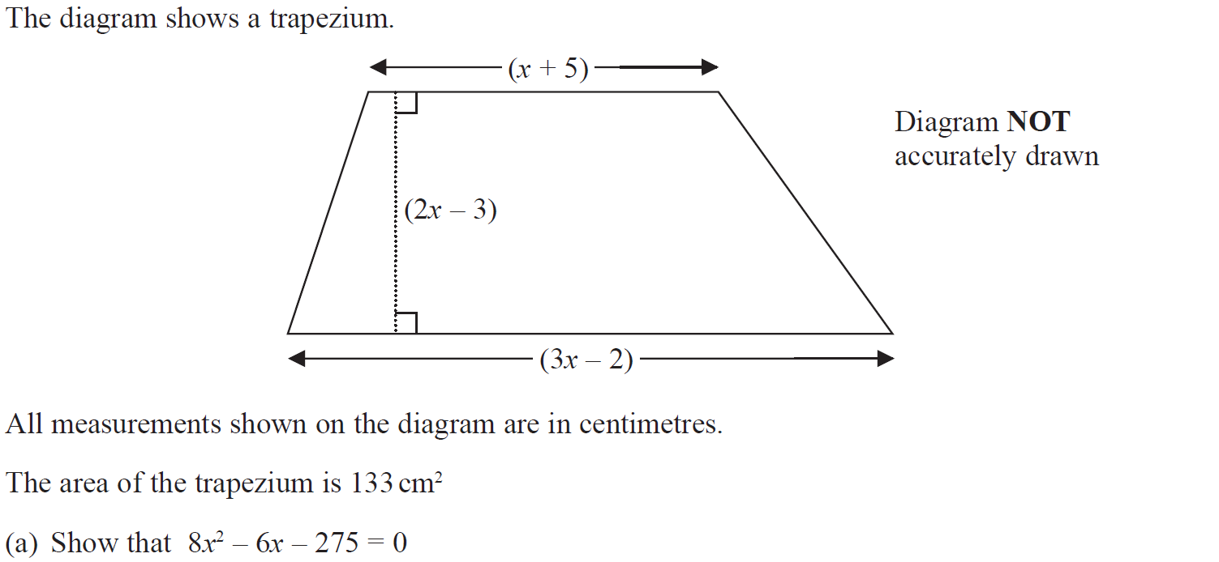
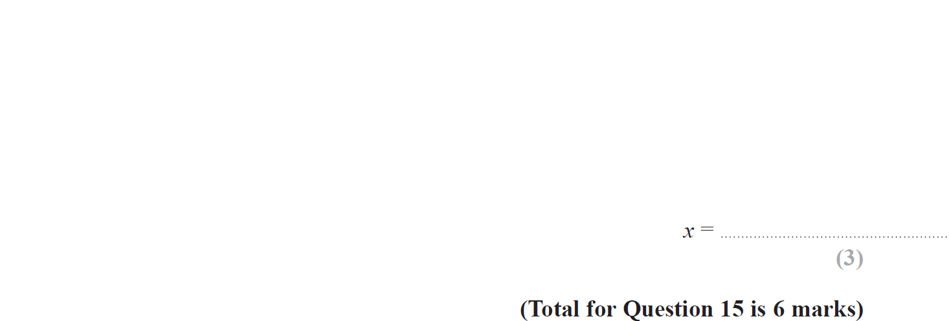
Forming Equations
Jan 2019 2H Q15

Slide 11
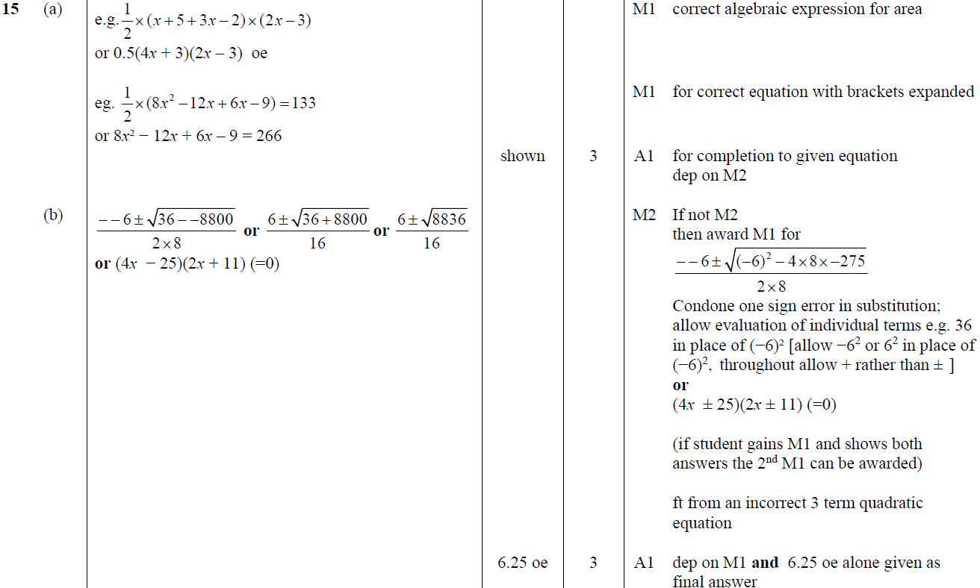
Forming Equations
Jan 2019 2H Q15
A
B

Slide 12
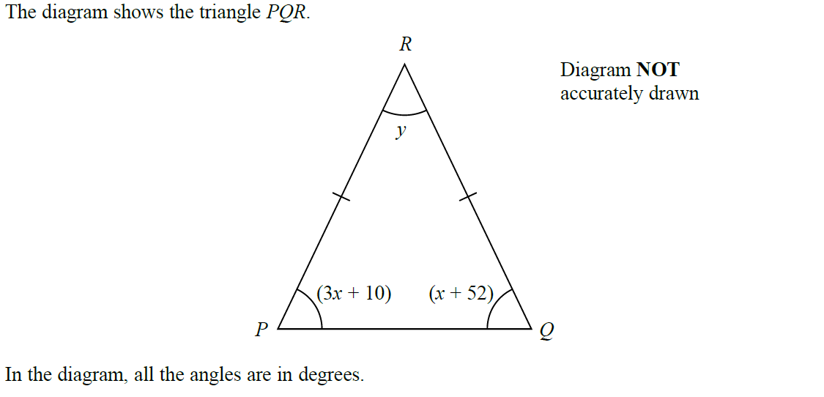
Forming Equations
Jan 2019 1HR Q6

Slide 13
Forming Equations
Jan 2019 1HR Q6
A

Slide 14
Forming Equations
Forming Equations
New Spec Q’s
May 2004 4H Q3
Nov 2009 3H Q5
May 2014 3H Q14
Jan 2016 3H Q22
Jan 2018 3HR Q22
May 2004 4H Q13
June 2010 4H Q7
May 2014 4HR Q9
May 2016 3H Q2
May 2018 3H Q5
Nov 2005 3H Q8
June 2011 3H Q10
Jan 2015 4H Q8
Jan 2017 4H Q6
June 2018 4H Q7
May 2006 4H Q3
Jan 2012 3H Q8
Jan 2015 4H Q21
Jan 2017 4HR Q8
June 2018 4H Q18
Nov 2006 3H Q2
Jan 2012 3H Q14
Jan 2015 4HR Q2
June 2017 4H Q5
June 2018 4H Q20
Nov 2006 3H Q21
Jan 2013 3H Q2
June 2015 4H Q6
June 2017 4H Q6
May 2018 3HR Q7
May 2007 4H Q1
May 2013 3H Q5
June 2015 4H Q22
Jan 2018 3H Q9
Nov 2007 3H Q3
May 2013 4HR Q9
May 2015 3HR Q11
Jan 2018 4H Q1
June 2009 4H Q2
Jan 2014 4H Q15
Jan 2016 3H Q19
Jan 2018 3HR Q13

Slide 15
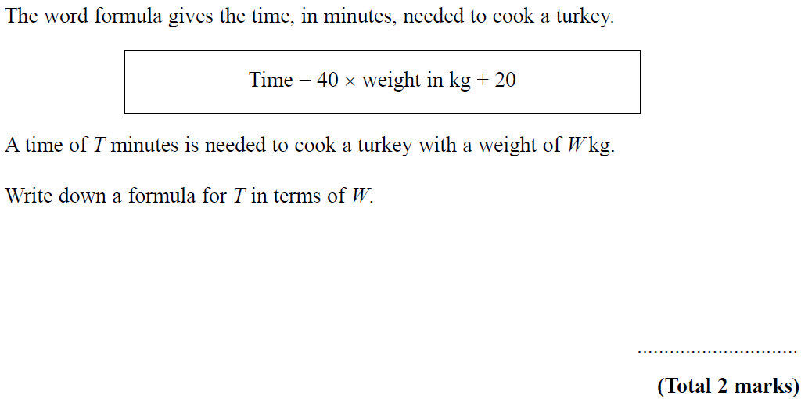
Forming Equations
May 2004 4H Q3

Slide 16
Forming Equations
May 2004 4H Q3
A

Slide 17
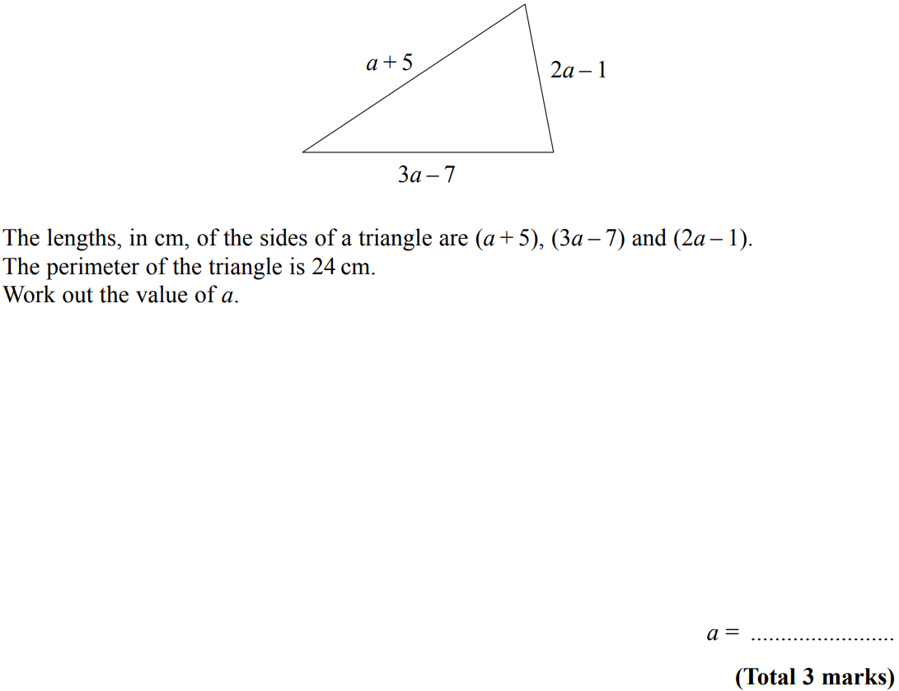
Forming Equations
May 2004 4H Q13

Slide 18
Forming Equations
May 2004 4H Q13
A

Slide 19
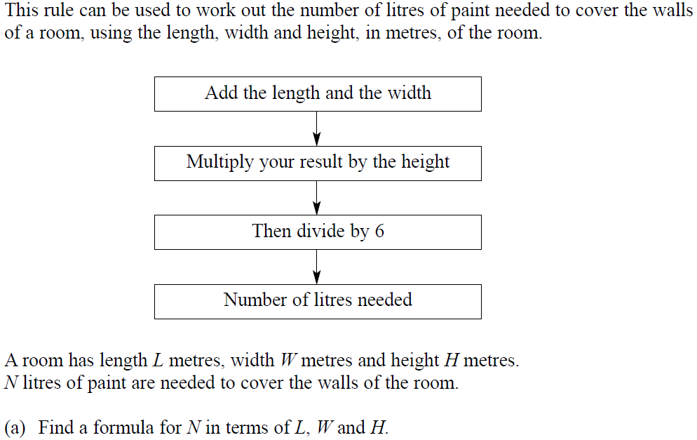
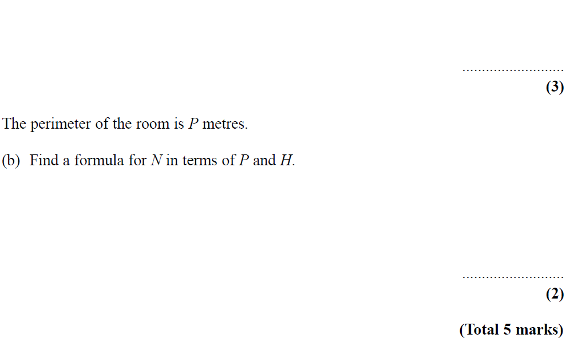
Forming Equations
Nov 2005 3H Q8

Slide 20
Forming Equations
Nov 2005 3H Q8
A
B

Slide 21
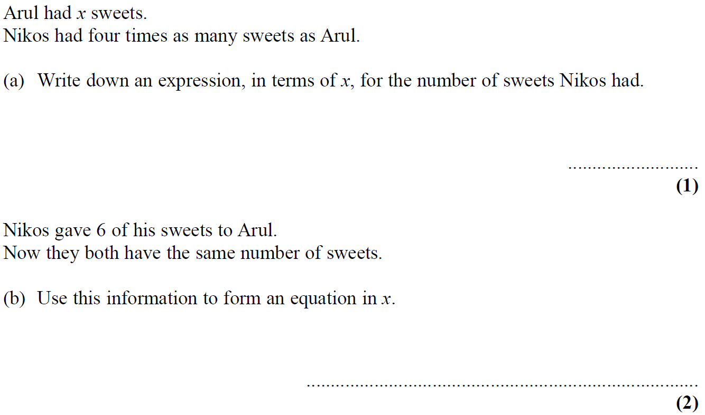
Forming Equations
May 2006 4H Q3

Slide 22
Forming Equations
May 2006 4H Q3
A
B
C

Slide 23
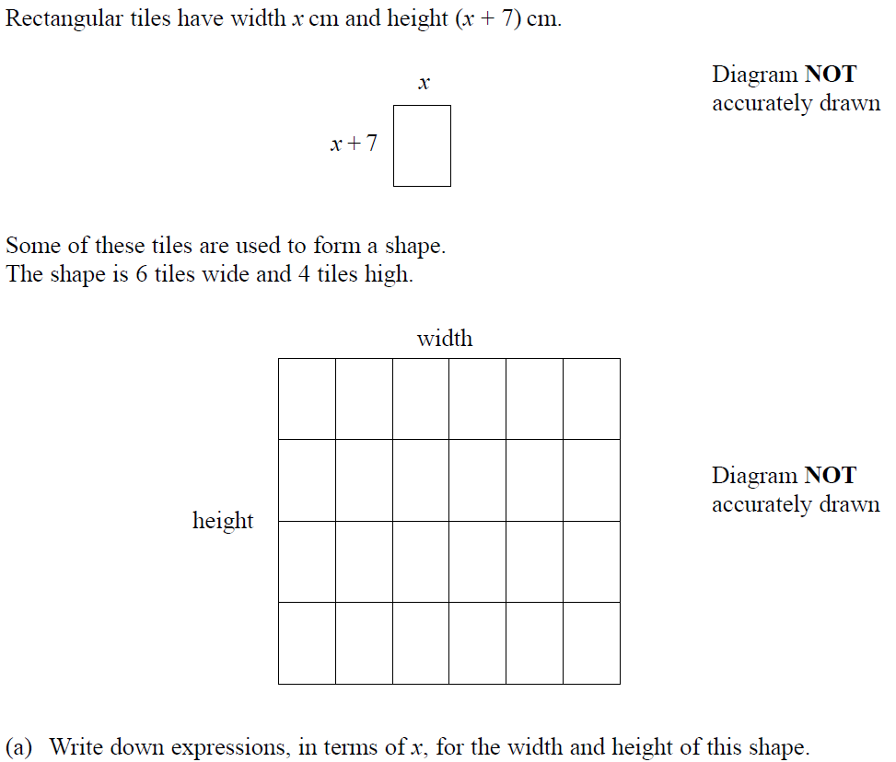
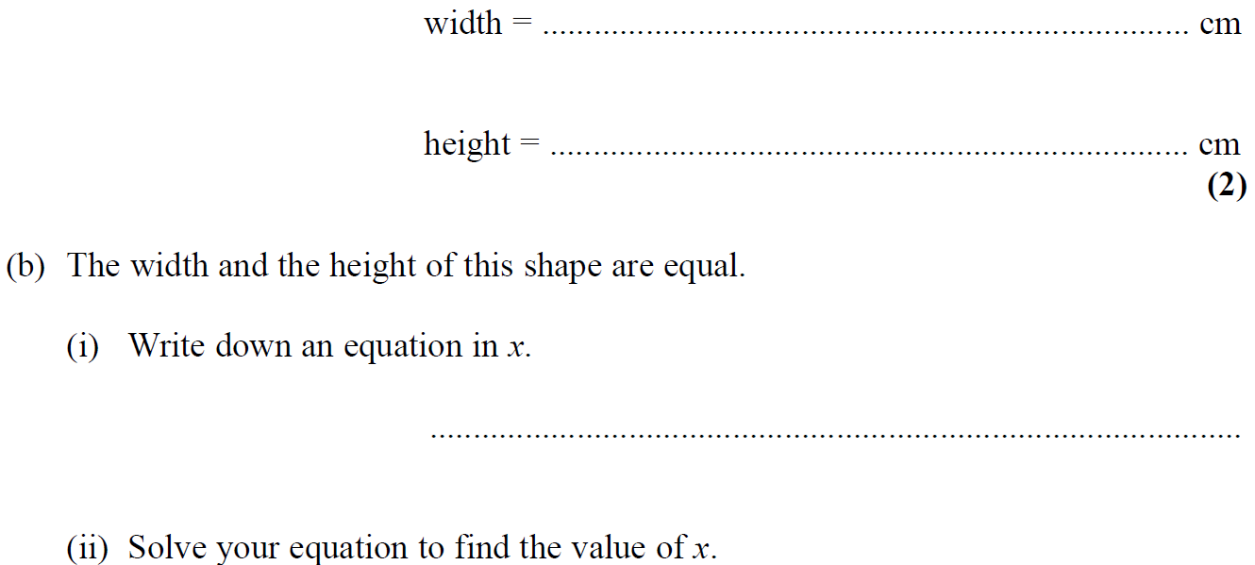
Forming Equations
Nov 2006 3H Q2

Slide 24
Forming Equations
Nov 2006 3H Q2
A
B (i)
B (ii)

Slide 25
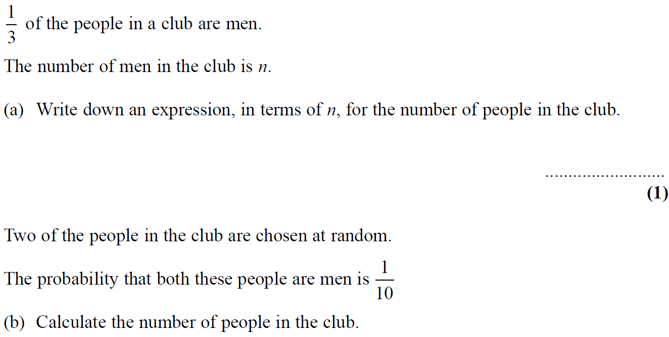
Forming Equations
Nov 2006 3H Q21

Slide 26
Forming Equations
Nov 2006 3H Q21
A
B

Slide 27
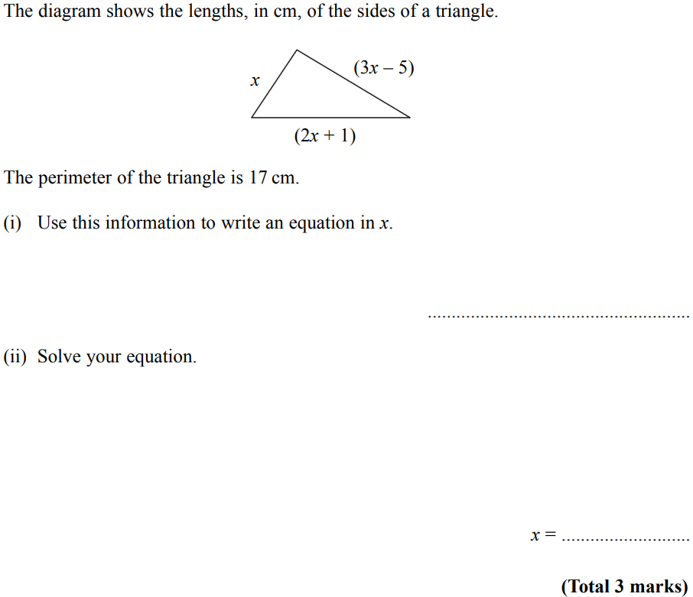
Forming Equations
May 2007 4H Q1

Slide 28
Forming Equations
May 2007 4H Q1
A

Slide 29
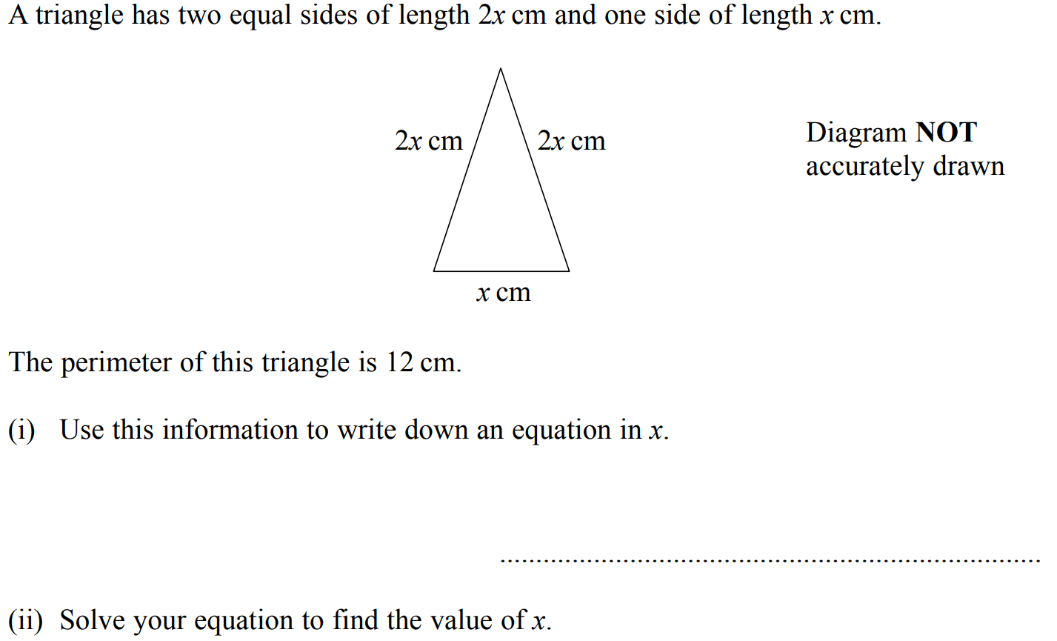
Forming Equations
Nov 2007 3H Q3

Slide 30
Forming Equations
Nov 2007 3H Q3
(i)
(ii)

Slide 31
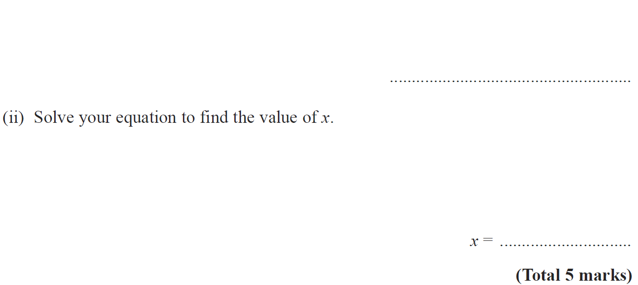
Forming Equations
June 2009 4H Q2

Slide 32
Forming Equations
June 2009 4H Q2
(i)
(ii)

Slide 33
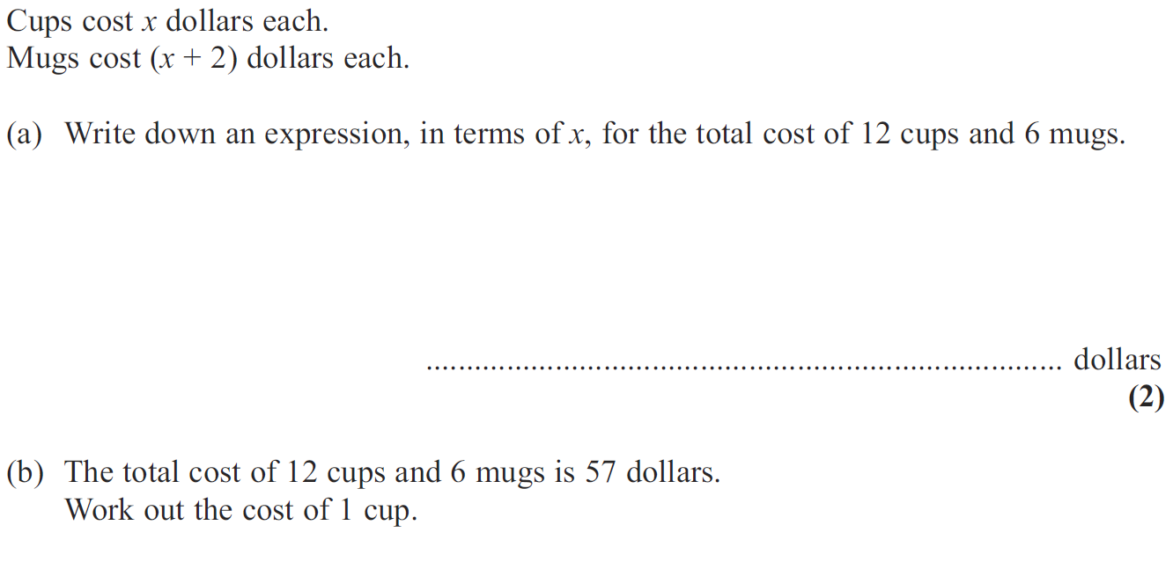
Forming Equations
Nov 2009 3H Q5

Slide 34
Forming Equations
Nov 2009 3H Q5
A
B

Slide 35
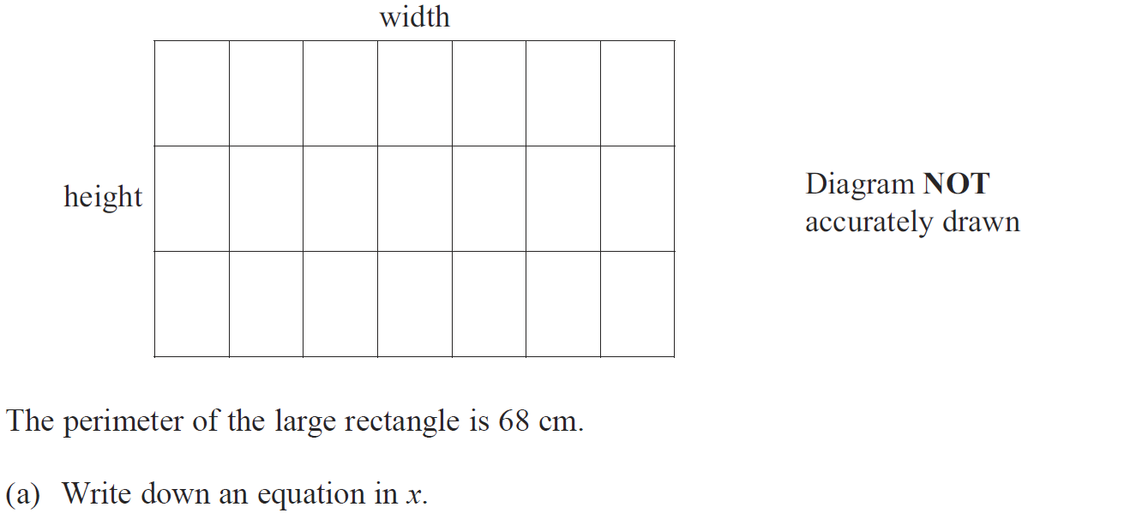
Forming Equations
June 2010 4H Q7

Slide 36
Forming Equations
June 2010 4H Q7
A
B

Slide 37
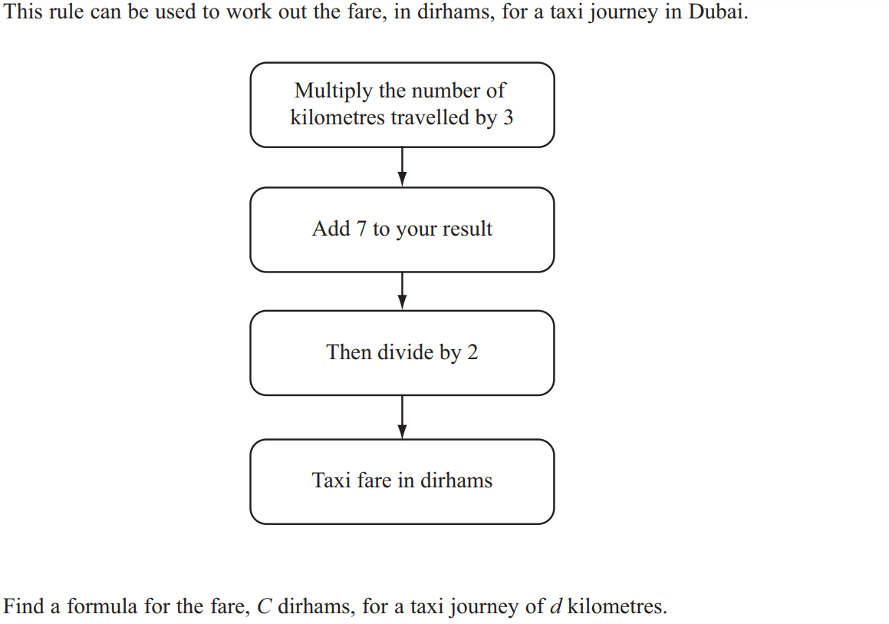
Forming Equations
June 2011 3H Q10

Slide 38
Forming Equations
June 2011 3H Q10
A

Slide 39
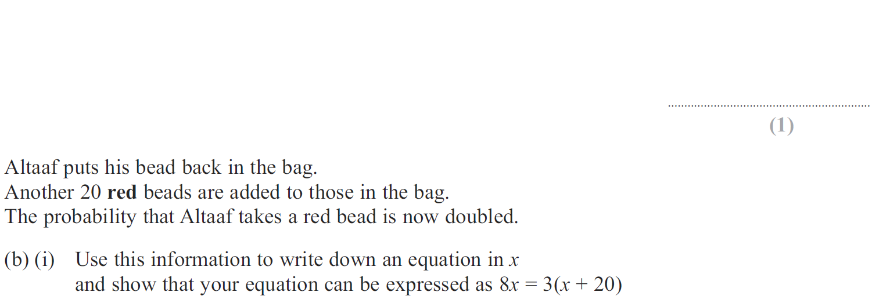
Forming Equations
Jan 2012 3H Q8

Slide 40
Forming Equations
Jan 2012 3H Q8
A
B (i)
B (ii)

Slide 41
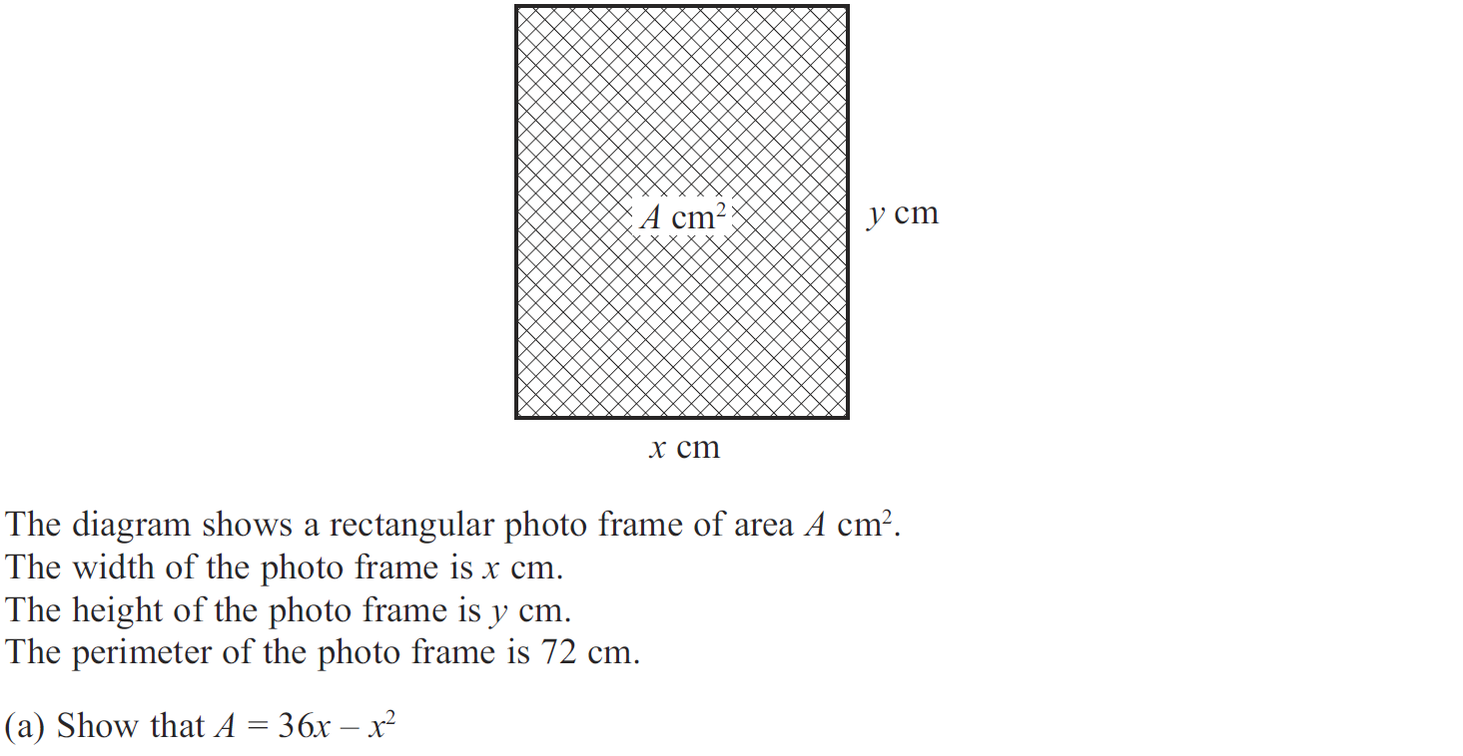
Forming Equations
Jan 2012 3H Q14

Slide 42
Forming Equations
Jan 2012 3H Q14
A
B
C

Slide 43
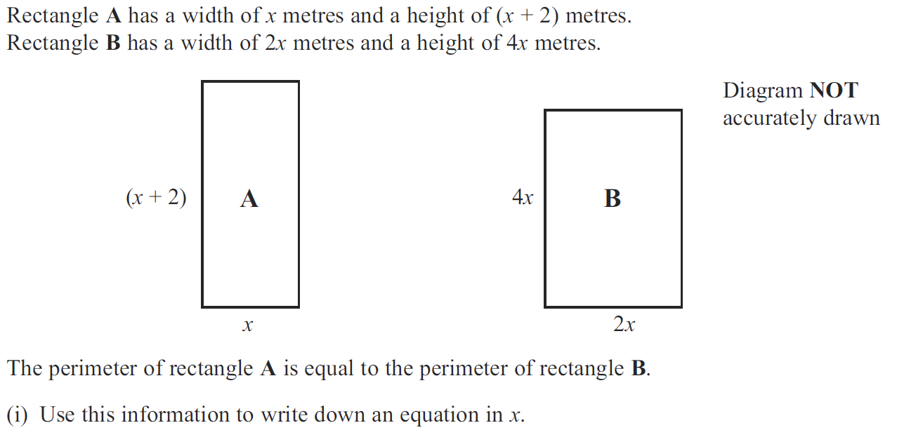
Forming Equations
Jan 2013 3H Q2

Slide 44
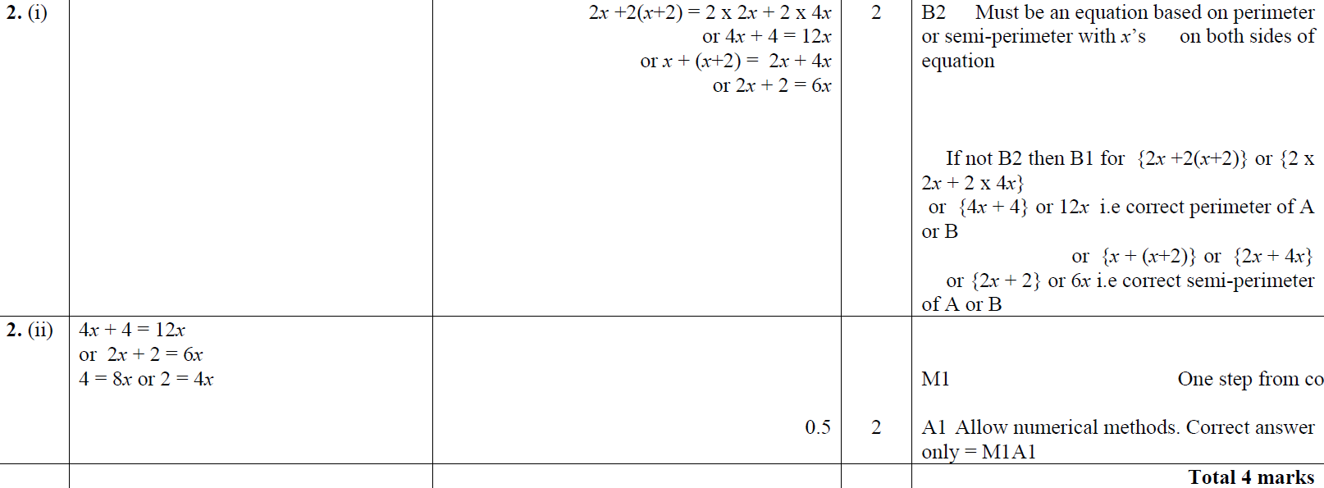
Forming Equations
Jan 2013 3H Q2
(i)
(ii)

Slide 45
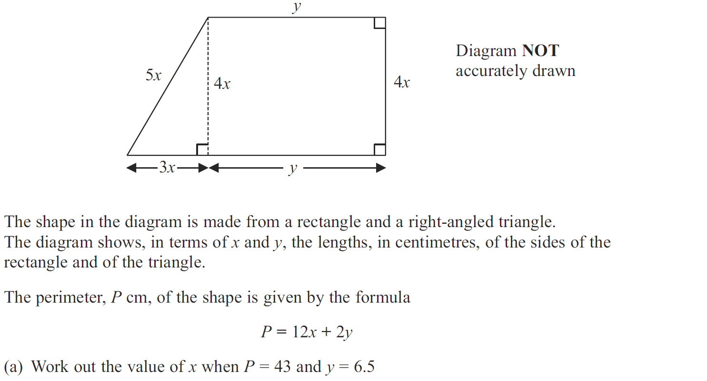
Forming Equations
May 2013 3H Q5

Slide 46
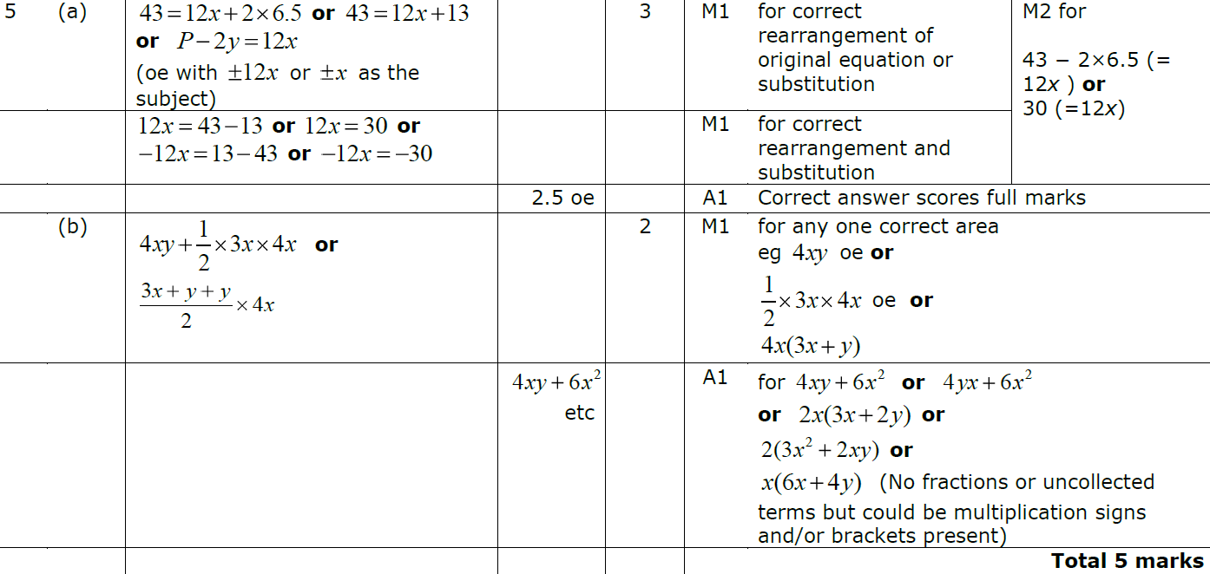
Forming Equations
May 2013 3H Q5
A
B

Slide 47
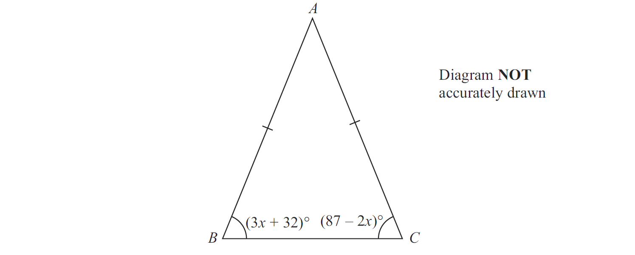
Forming Equations
May 2013 4HR Q9

Slide 48
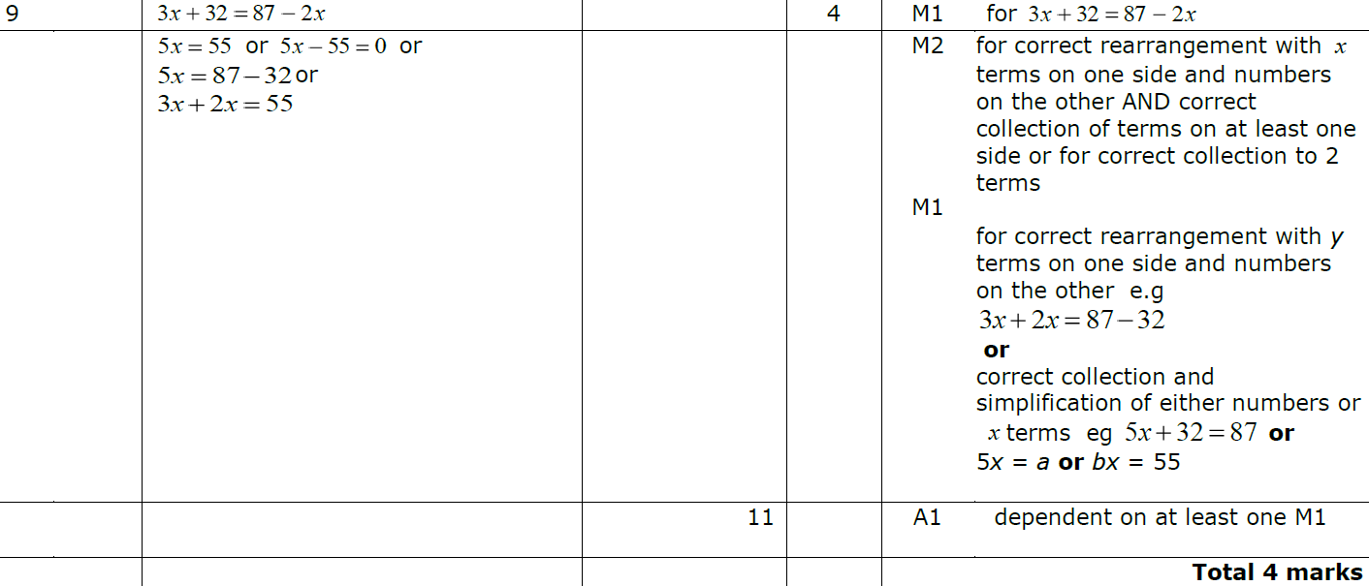
Forming Equations
May 2013 4HR Q9
A

Slide 49
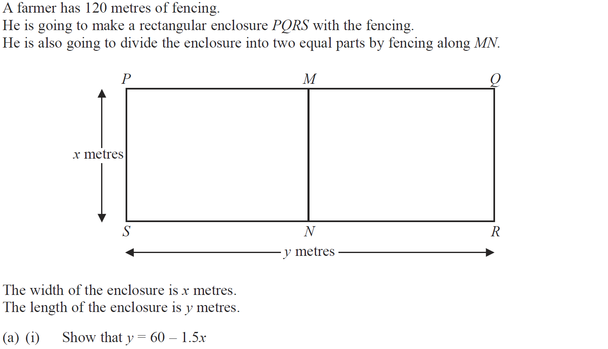
Forming Equations
Jan 2014 4H Q15

Slide 50
Forming Equations
Jan 2014 4H Q15
A (i)
A (ii)
B
C

Slide 51
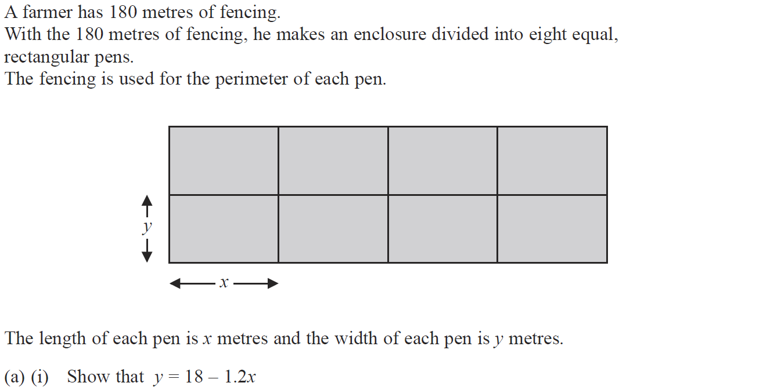
Forming Equations
May 2014 3H Q14

Slide 52
Forming Equations
May 2014 3H Q14
A (i)
A (ii)
B
C

Slide 53
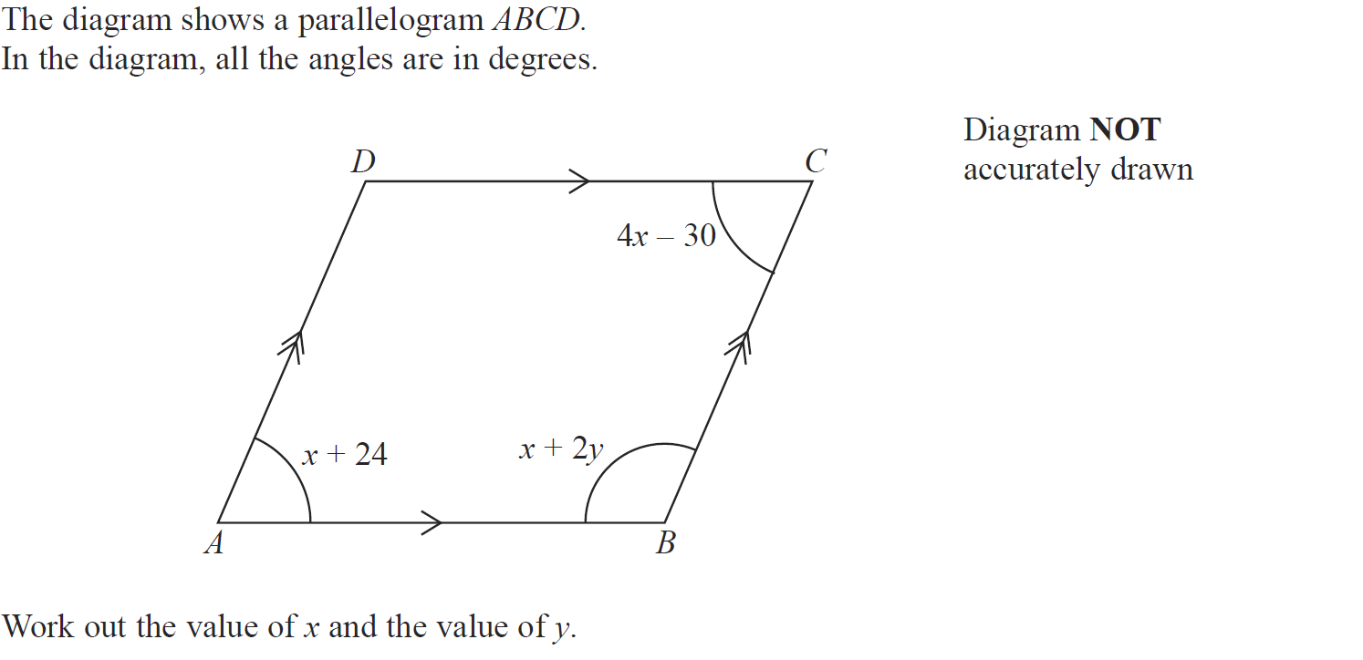
Forming Equations
May 2014 4HR Q9

Slide 54
Forming Equations
May 2014 4HR Q9
A

Slide 55
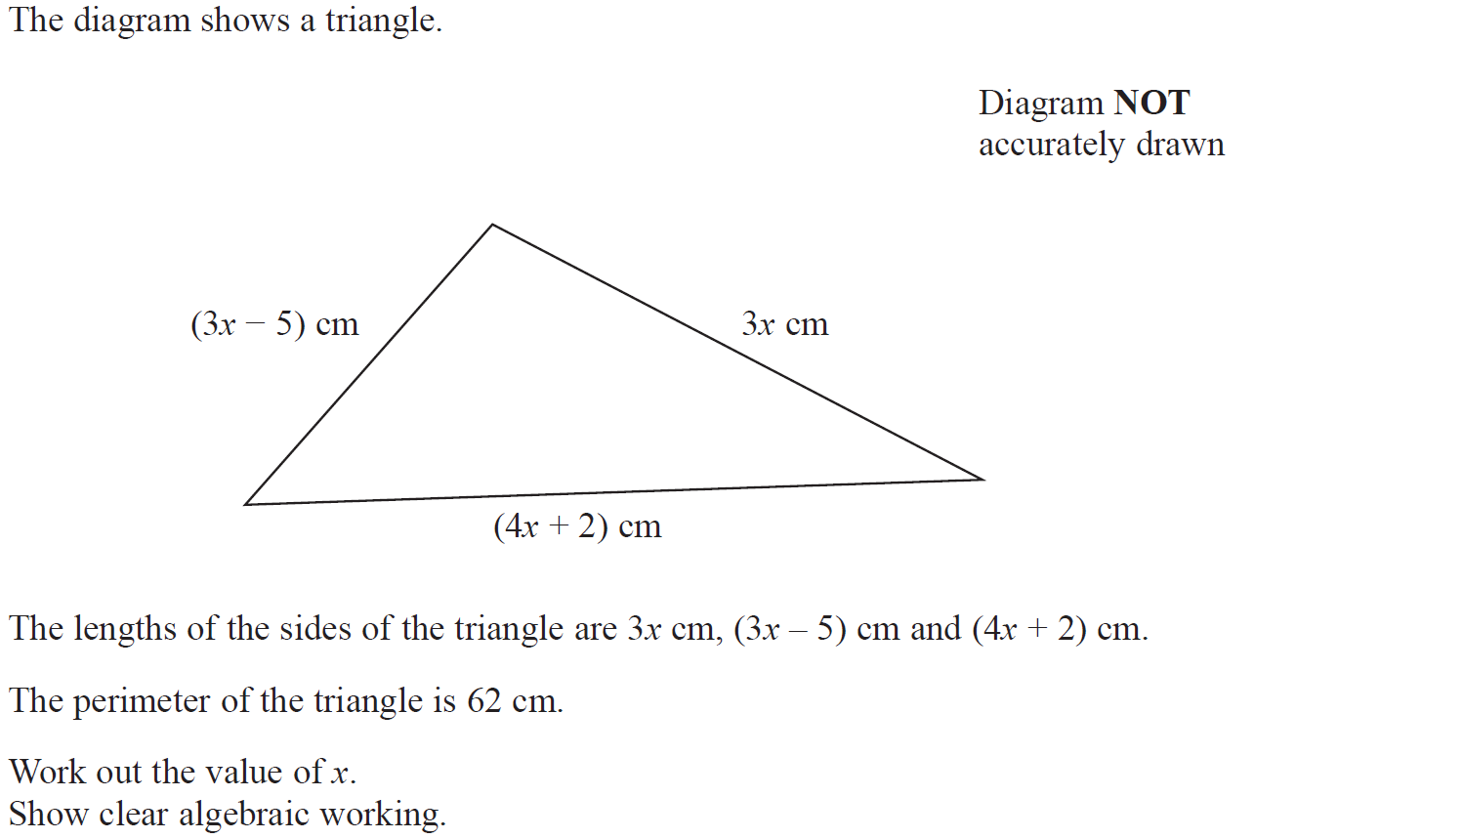
Forming Equations
Jan 2015 4H Q8

Slide 56
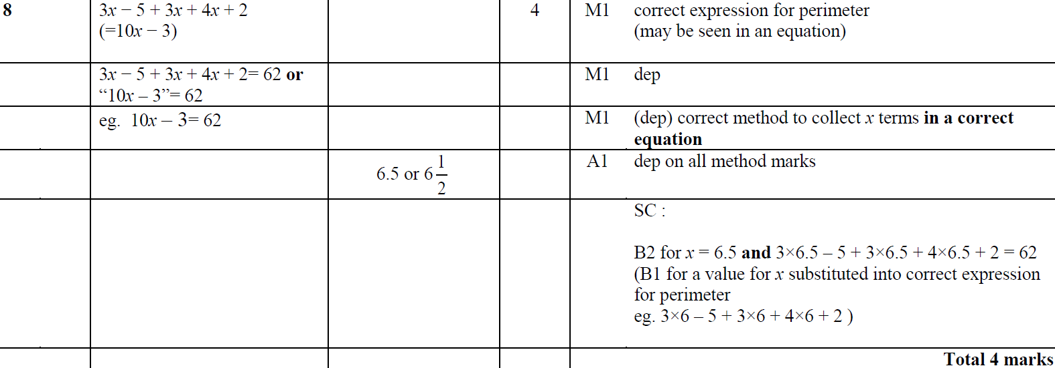
Forming Equations
Jan 2015 4H Q8
A

Slide 57
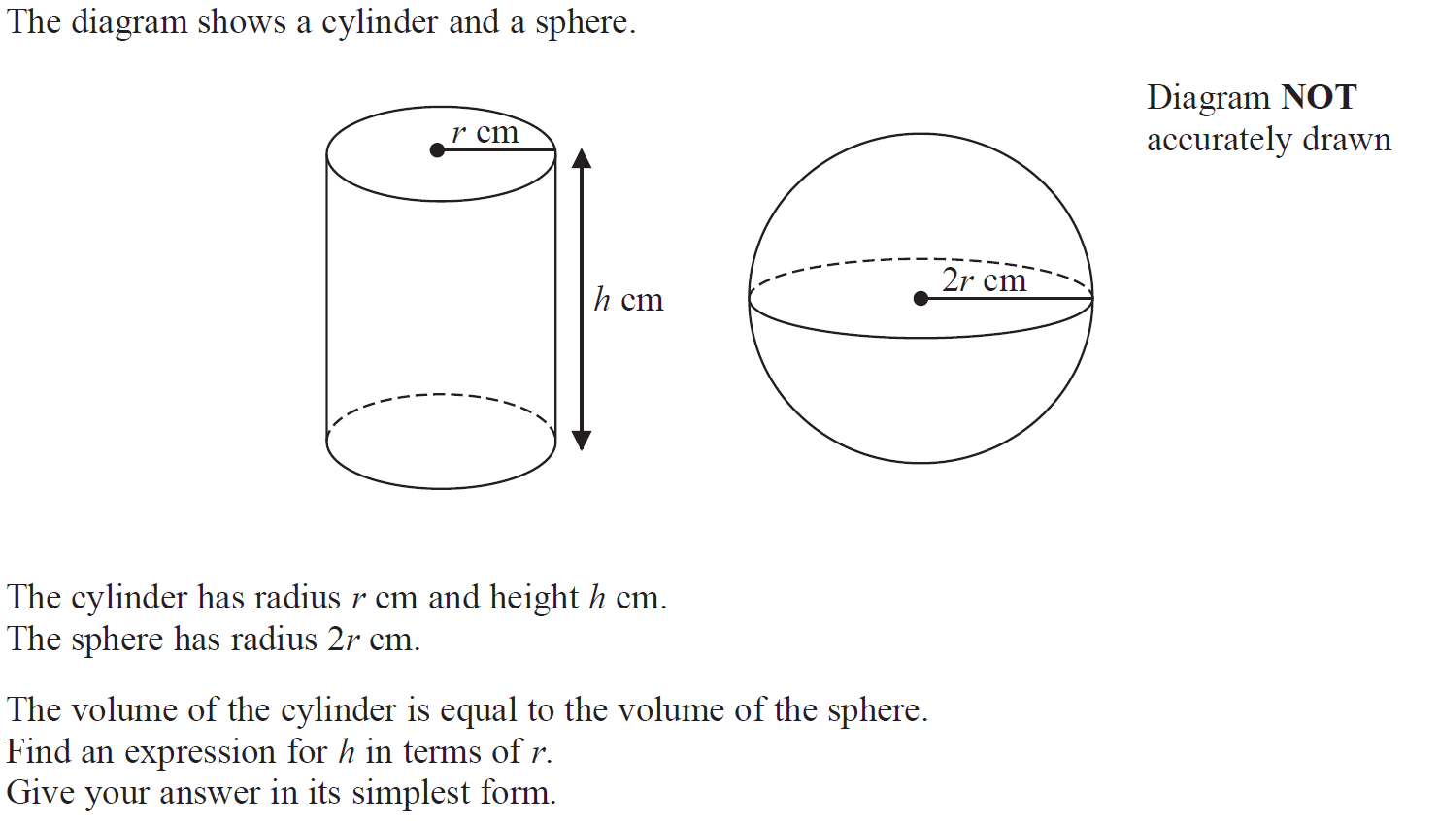
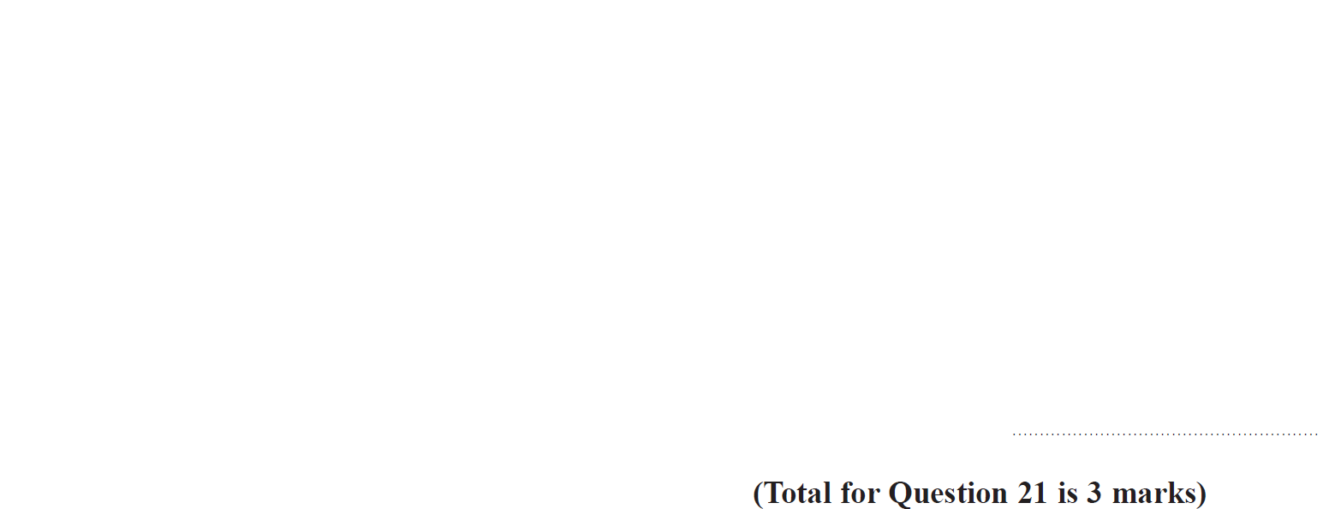
Forming Equations
Jan 2015 4H Q21

Slide 58
Forming Equations
Jan 2015 4H Q21
A

Slide 59
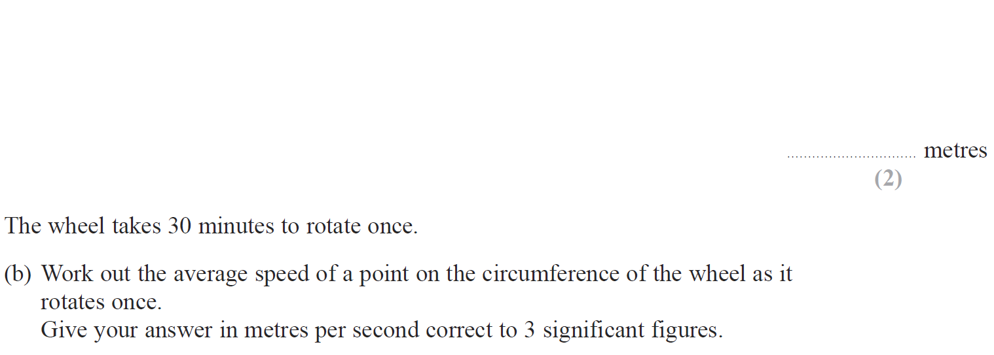
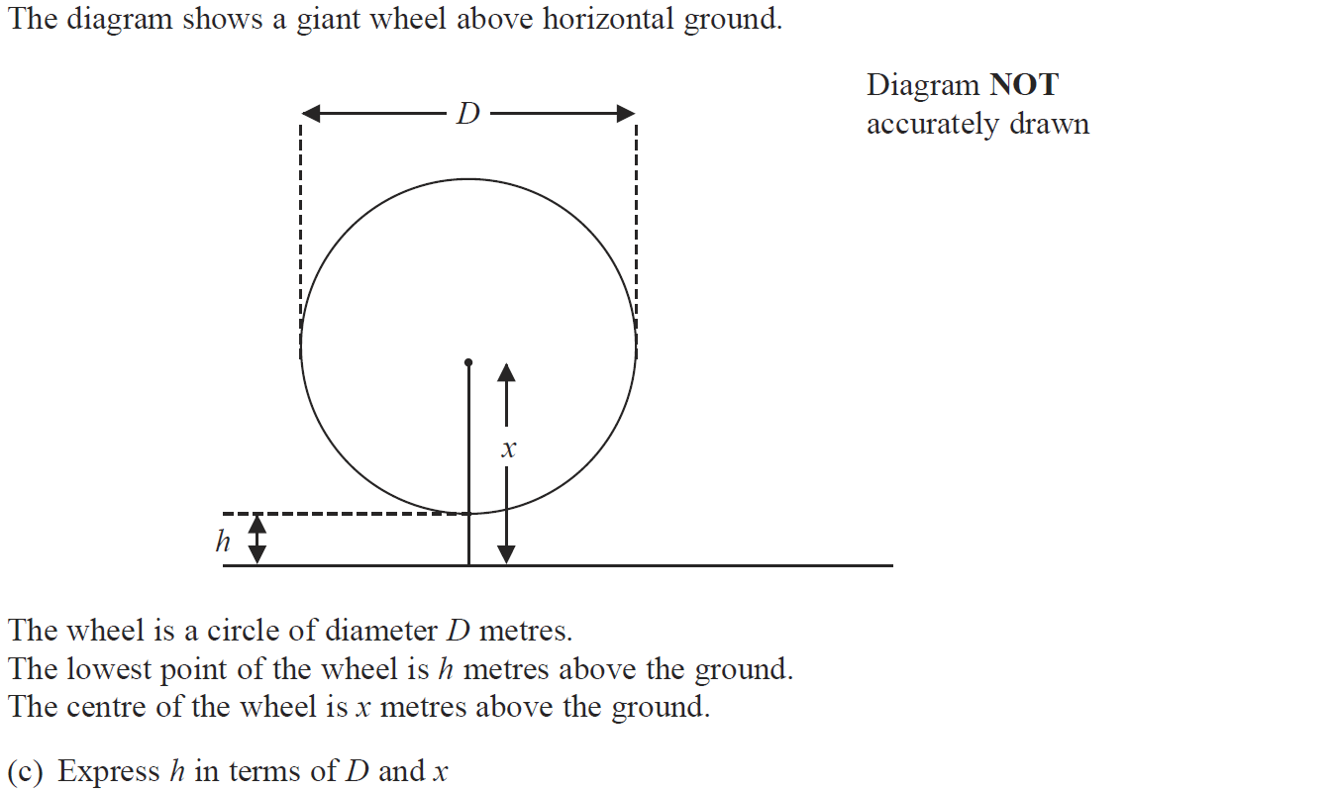
Forming Equations
Jan 2015 4HR Q2

Slide 60
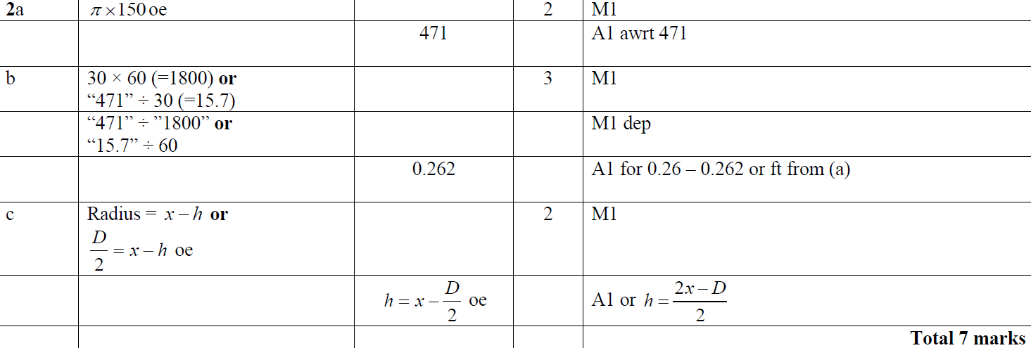
Forming Equations
Jan 2015 4HR Q2
A
B
C

Slide 61
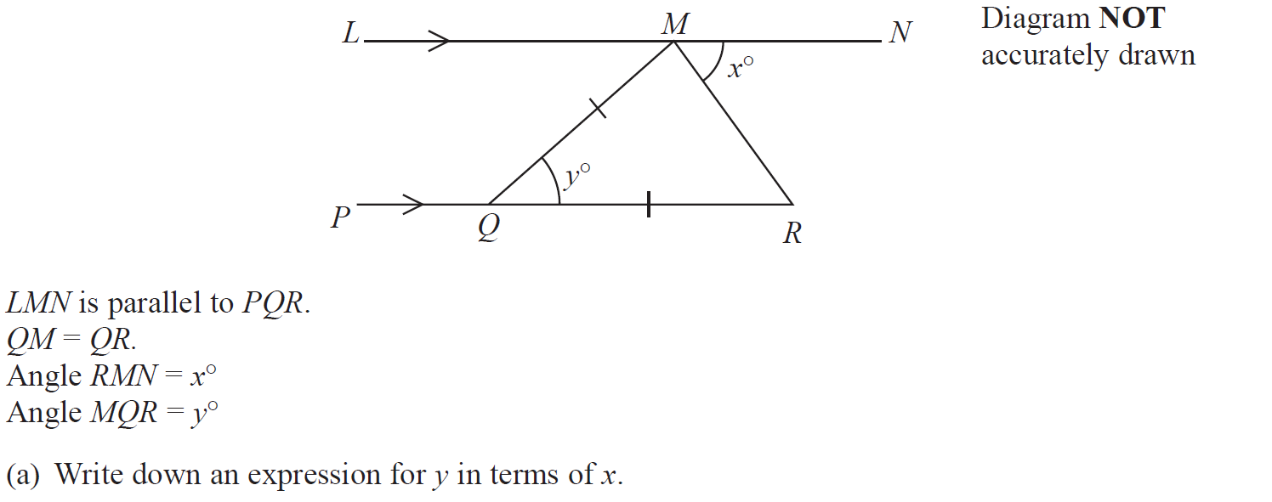
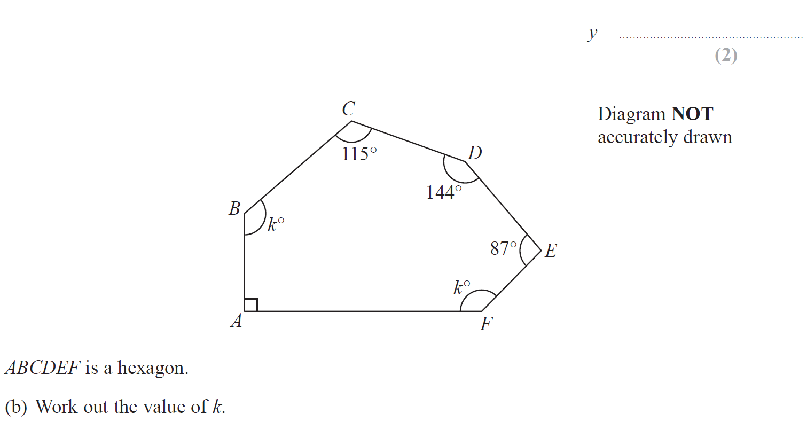
Forming Equations
June 2015 4H Q6

Slide 62
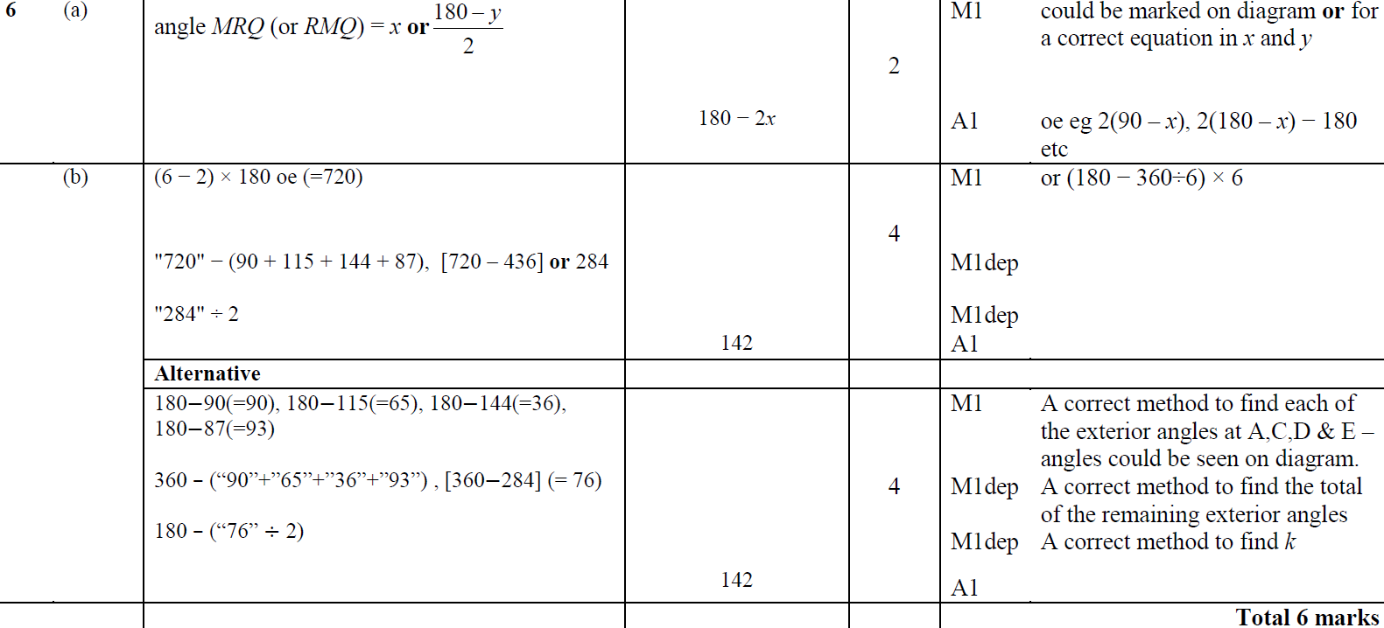
Forming Equations
June 2015 4H Q6
A
B

Slide 63
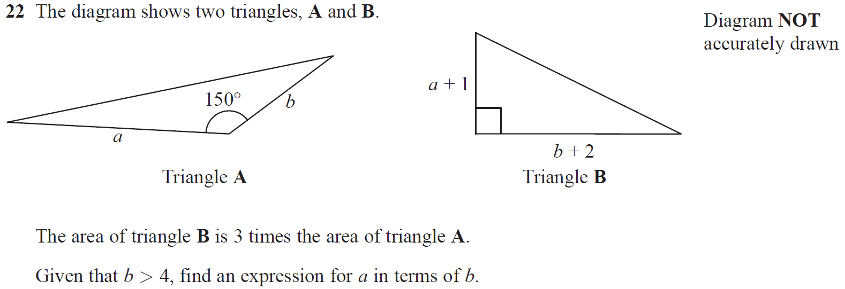
Forming Equations
June 2015 4H Q22

Slide 64
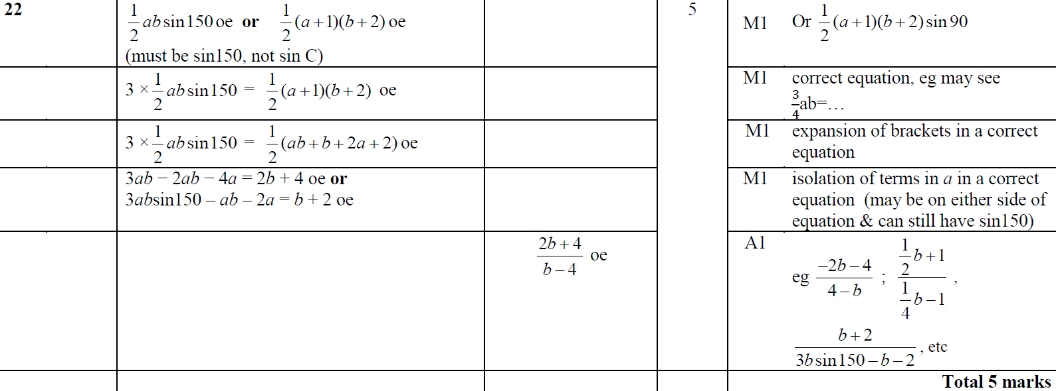
Forming Equations
June 2015 4H Q22
A

Slide 65
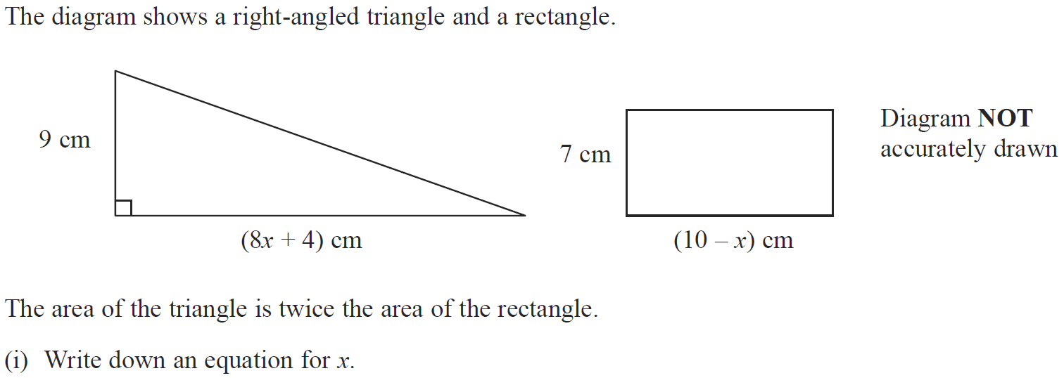
Forming Equations
May 2015 3HR Q11

Slide 66
Forming Equations
May 2015 3HR Q11
(i)
(ii)

Slide 67
Forming Equations
Jan 2016 3H Q19

Slide 68
Forming Equations
Jan 2016 3H Q19
A

Slide 69
Forming Equations
Jan 2016 3H Q22

Slide 70
Forming Equations
Jan 2016 3H Q22
A

Slide 71
Forming Equations
May 2016 3H Q2

Slide 72
Forming Equations
May 2016 3H Q2
A
B

Slide 73
Forming Equations
Jan 2017 4H Q6

Slide 74
Forming Equations
Jan 2017 4H Q6
A
B

Slide 75
Forming Equations
Jan 2017 4HR Q8

Slide 76
Forming Equations
Jan 2017 4HR Q8
A

Slide 77
Forming Equations
June 2017 4H Q5

Slide 78
Forming Equations
June 2017 4H Q5
A
B

Slide 79
Forming Equations
June 2017 4H Q6

Slide 80
Forming Equations
June 2017 4H Q6
A

Slide 81
Forming Equations
Jan 2018 3H Q9

Slide 82
Forming Equations
Jan 2018 3H Q9
A

Slide 83
Forming Equations
Jan 2018 4H Q1

Slide 84
Forming Equations
Jan 2018 4H Q1
A

Slide 85
Forming Equations
Jan 2018 3HR Q13

Slide 86
Forming Equations
Jan 2018 3HR Q13
A

Slide 87
Forming Equations
Jan 2018 3HR Q22

Slide 88
Forming Equations
Jan 2018 3HR Q22
A

Slide 89
Forming Equations
May 2018 3H Q5

Slide 90
Forming Equations
May 2018 3H Q5
A
B

Slide 91
Forming Equations
June 2018 4H Q7

Slide 92
Forming Equations
June 2018 4H Q7
A
B (i)
B (ii)
B (iii)
C

Slide 93
Forming Equations
June 2018 4H Q18

Slide 94
Forming Equations
June 2018 4H Q18
A

Slide 95
Forming Equations
June 2018 4H Q20

Slide 96
Forming Equations
June 2018 4H Q20
A

Slide 97
Forming Equations
May 2018 3HR Q7

Slide 98
Forming Equations
May 2018 3HR Q7
A (i)
A (ii)
B

