Slide 1
Old Spec Q’s
First Order Differentials
int. factor
SAM 1
2019 1

Slide 2
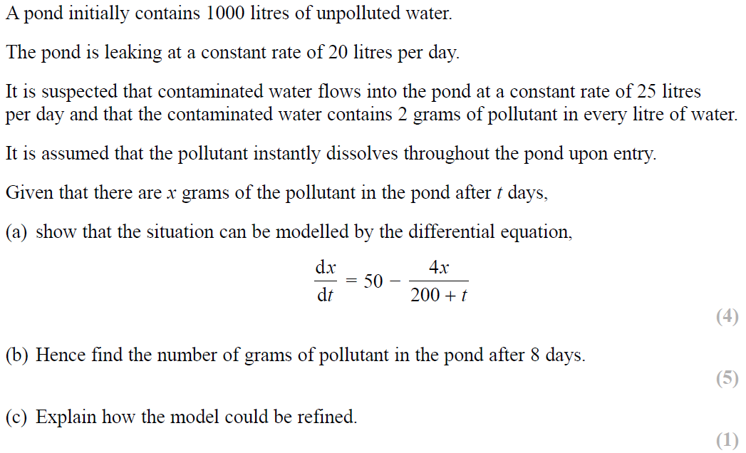
SAM Paper 1

Slide 3
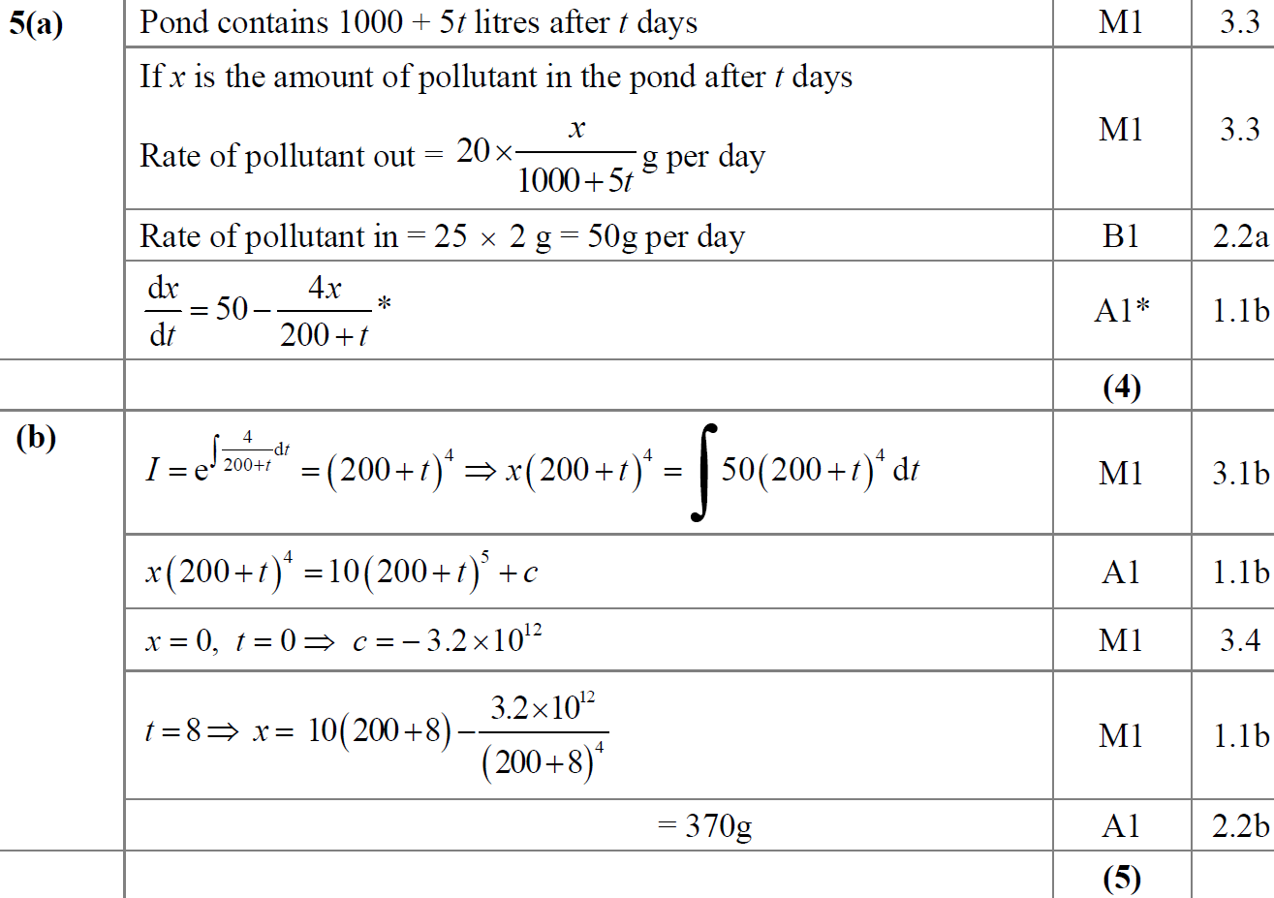
SAM Paper 1
A
B

Slide 4
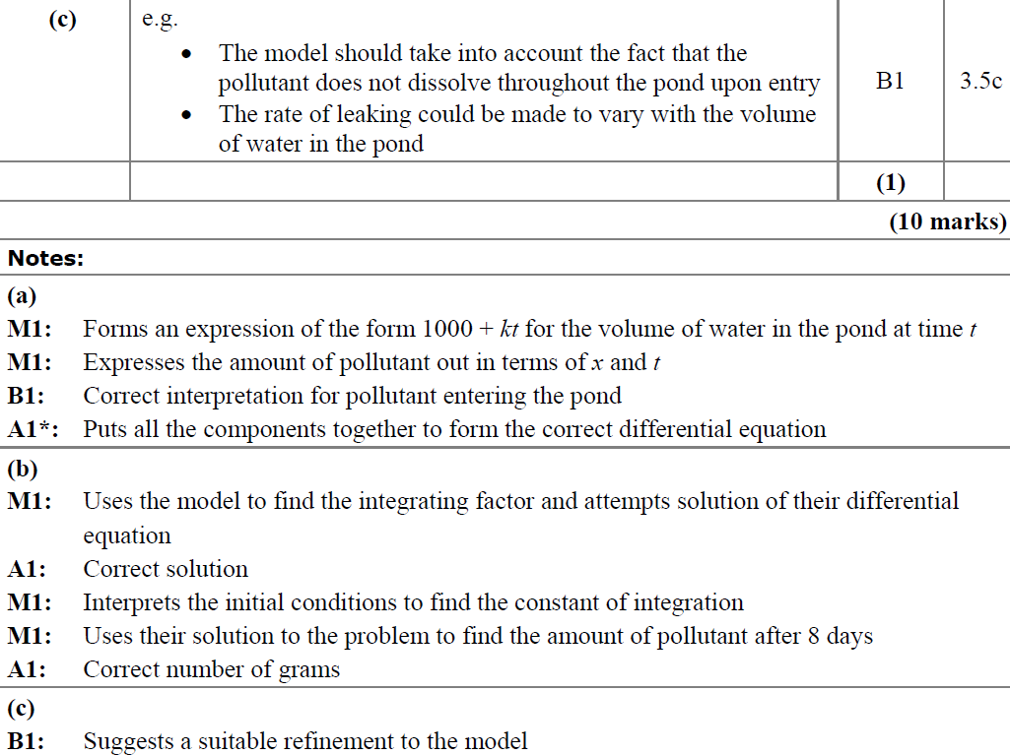
SAM Paper 1
C
A notes
B notes
C notes

Slide 5
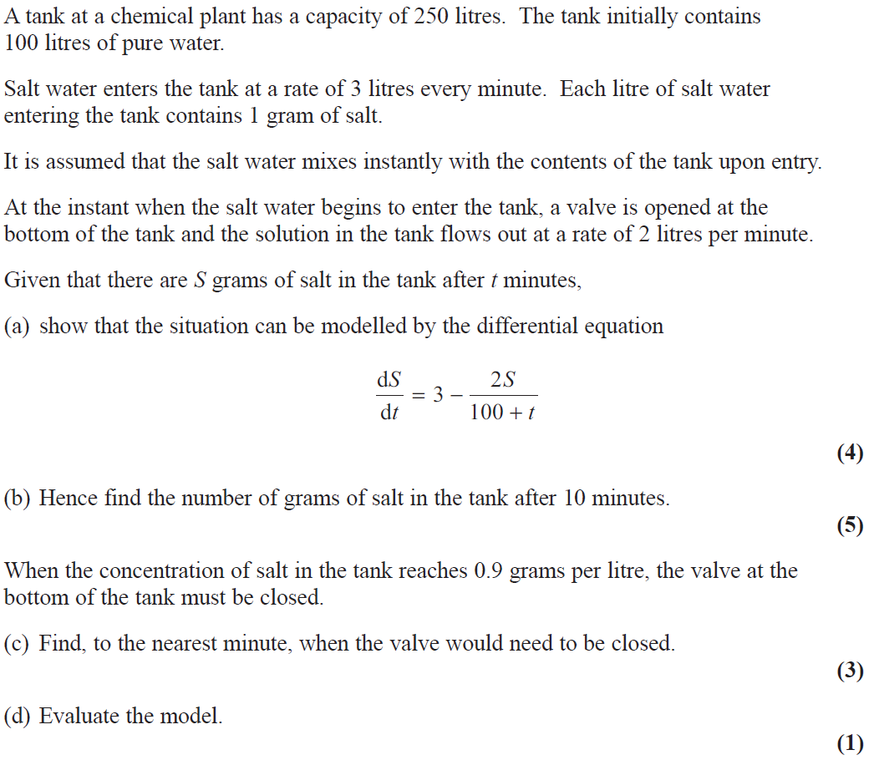
2019 Paper 1

Slide 6
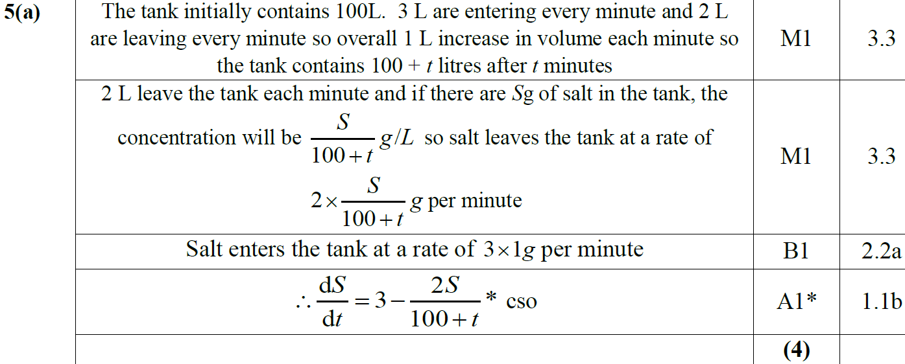
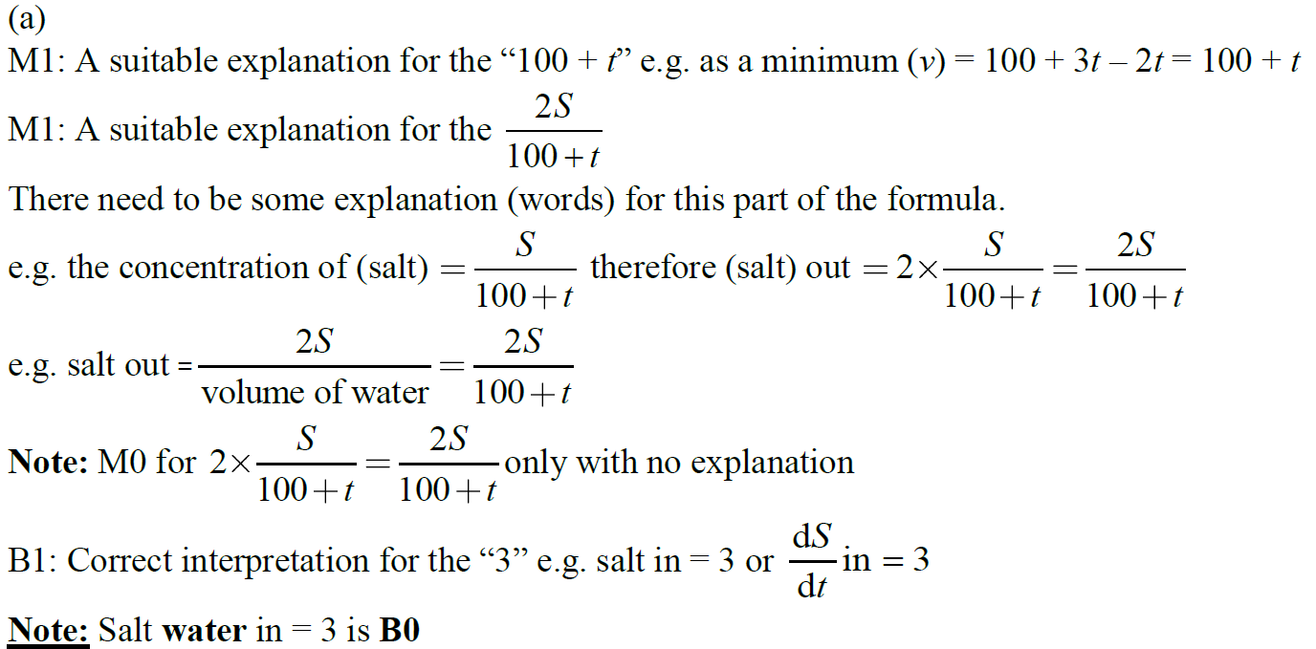
2019 Paper 1
A

Slide 7
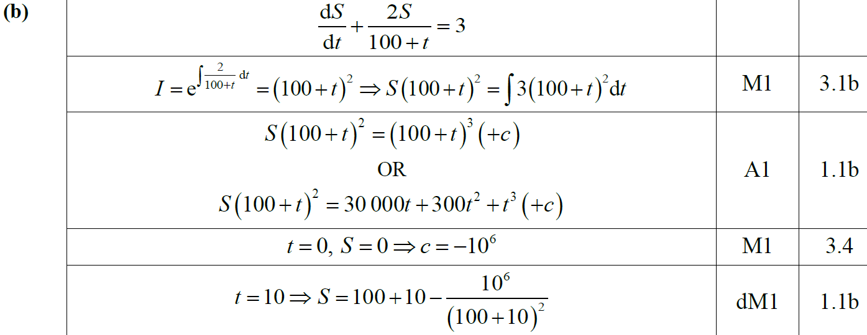
2019 Paper 1
B

Slide 8
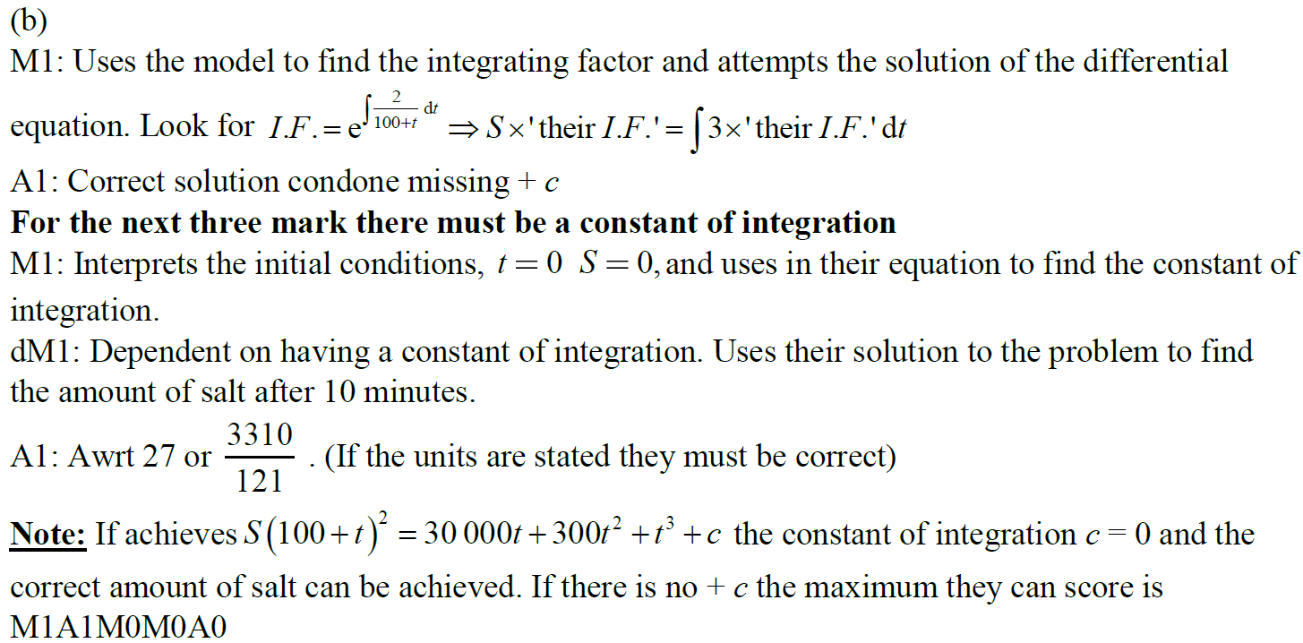
2019 Paper 1
B notes

Slide 9
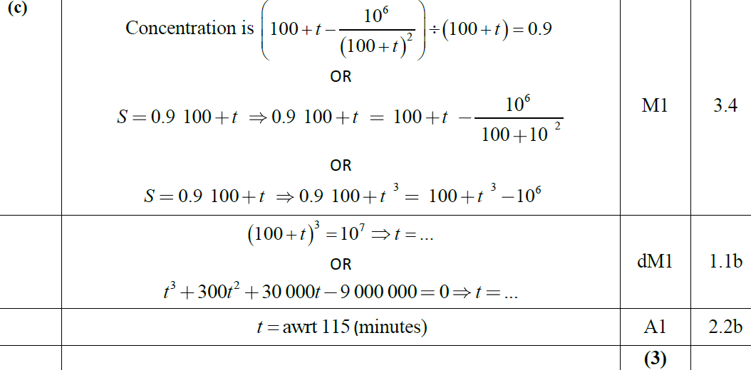
2019 Paper 1
C

Slide 10
2019 Paper 1
D

Slide 11
New Spec Q’s
int. factor
Old Spec First Order Differentials
P4/ Old FP1
FP2
M3
M4
Jan 2002
June 2006
June 2009
June 2014 R
M3 & M4 modelling (all contain element not in Core Spec)
June 2002
Jan 2007
June 2010
June 2015
June 2001
June 2002
June 2013 R
Jan 2003
June 2007
June 2011
June 2016
June 2009
June 2003
June 2019
June 2003
Jan 2008
June 2012
June 2017
June 2004
Jan 2004
June 2008
June 2013
June 2018
Jan 2006
June 2004
Jan 2009
June 2013 R
June 2019
June 2006
Jan 2005
June 2009
June 2013 W
June 2007
June 2005
Jan 2010
June 2014
June 2012
Jan 2006
reduce with substitution part (ignore as not in this spec yet)

Slide 12
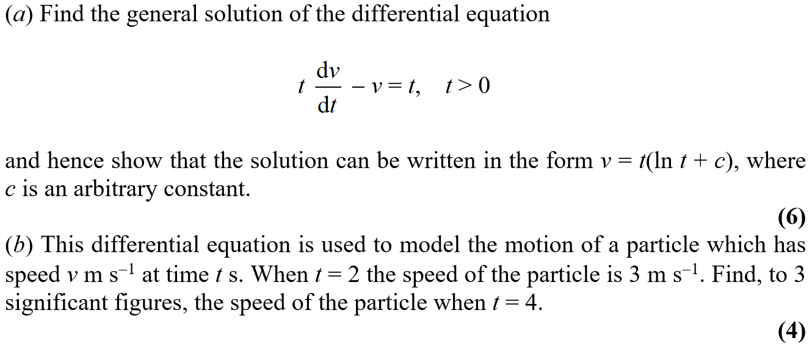
Jan 2002

Slide 13
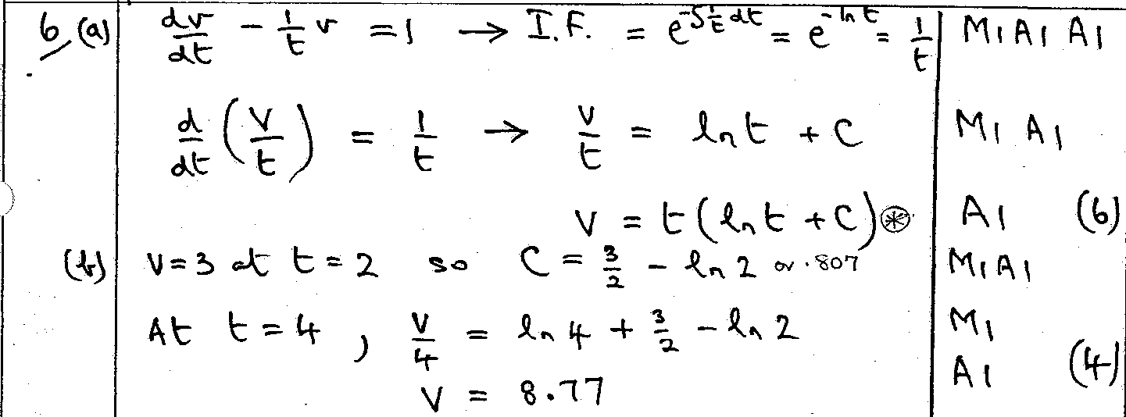
Jan 2002
A
B

Slide 14
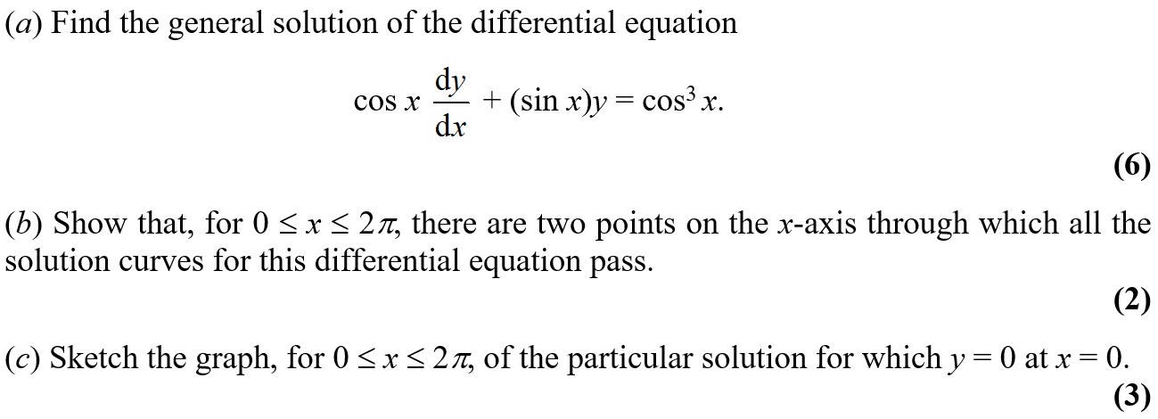
June 2002

Slide 15
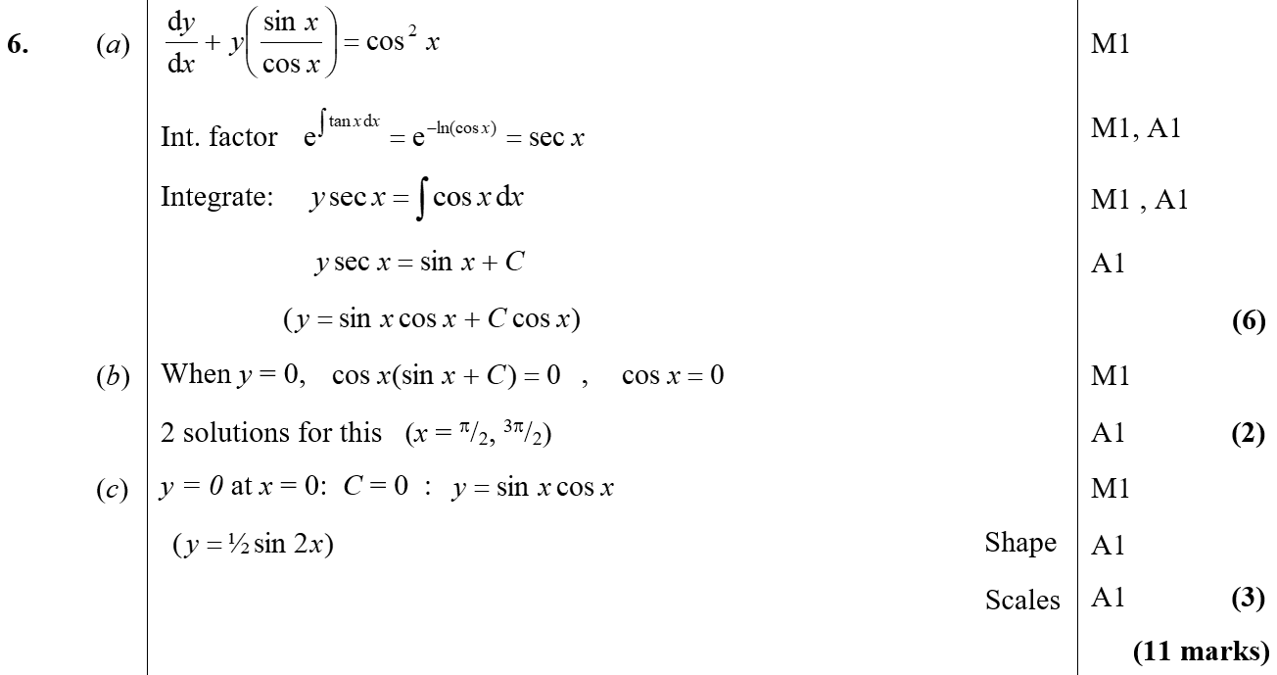
June 2002
A
B
C

Slide 16
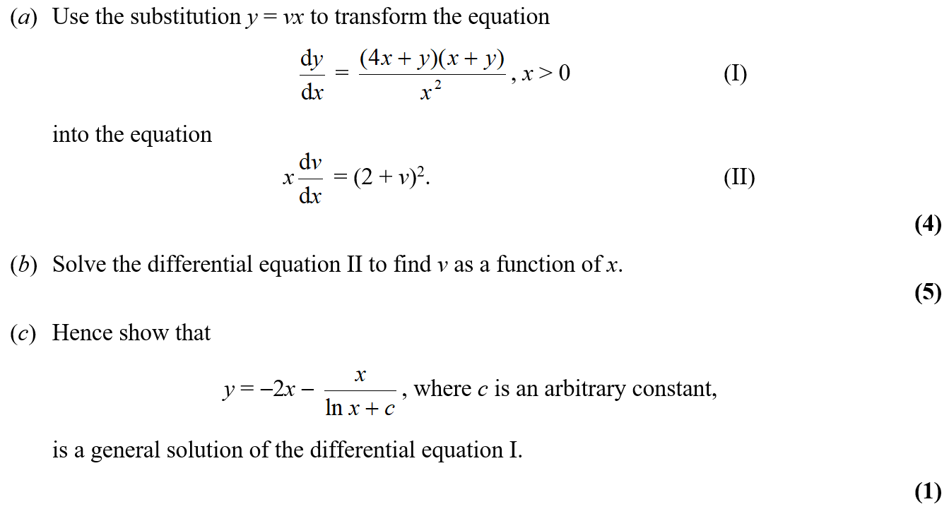
Jan 2003

Slide 17
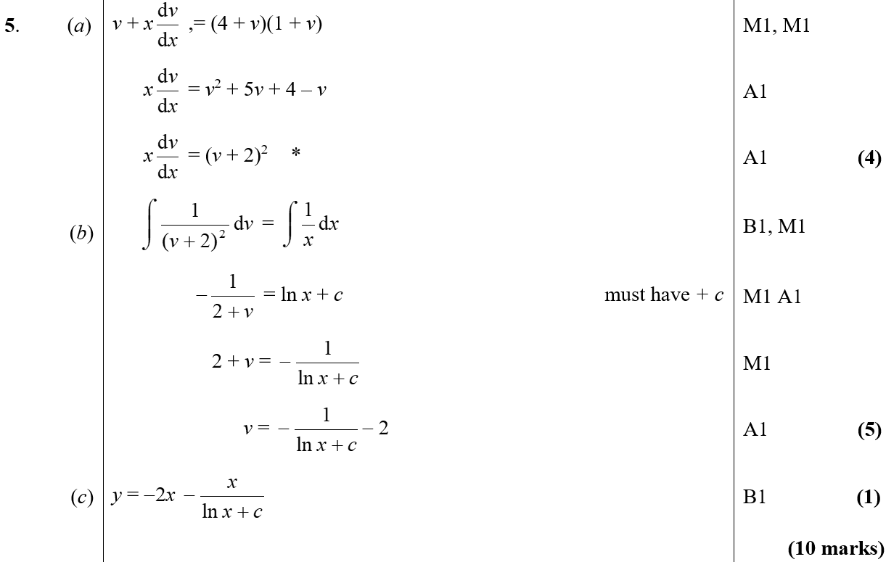
Jan 2003
A
B
C

Slide 18
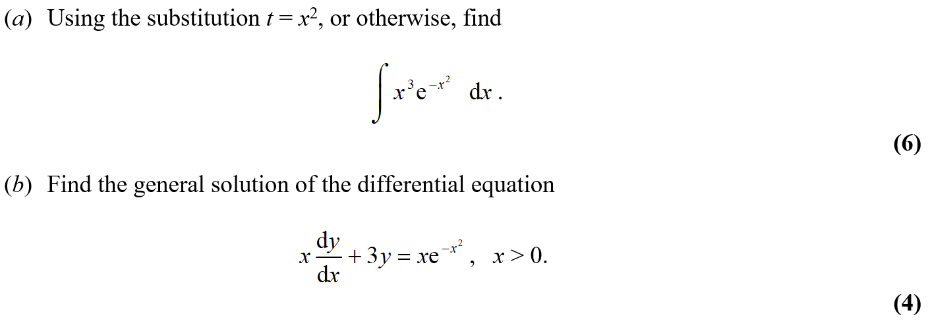
June 2003

Slide 19
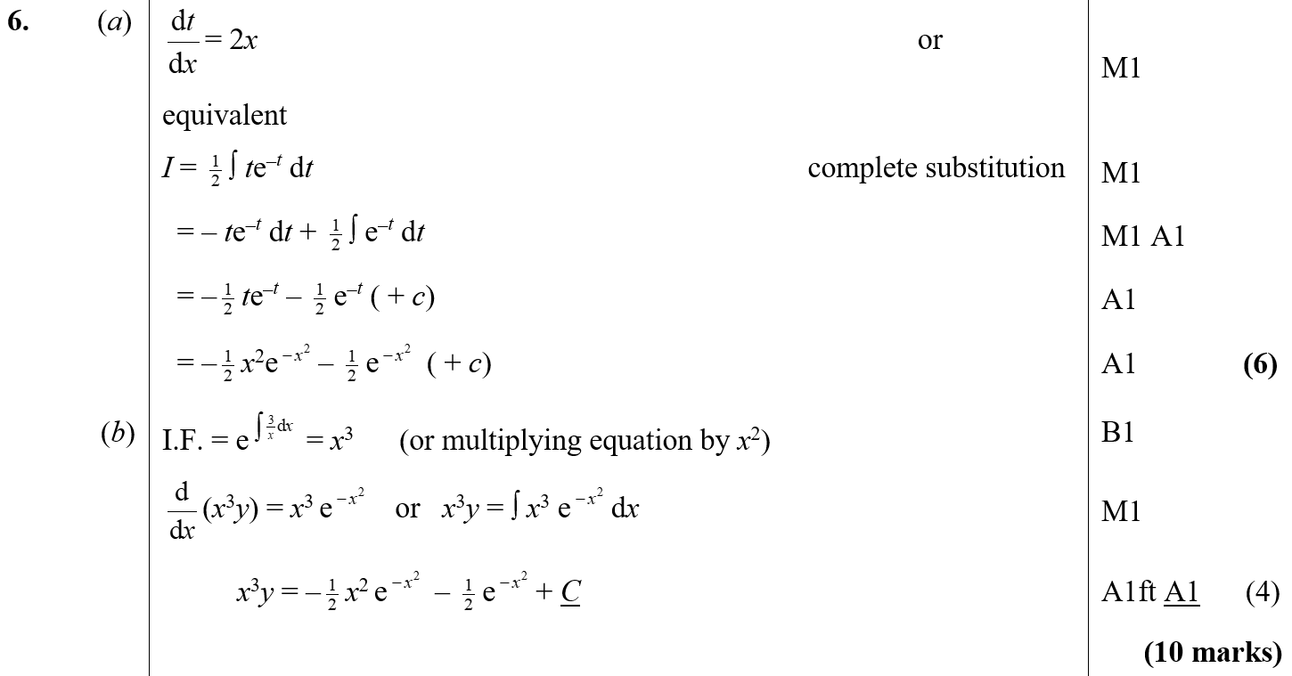
June 2003
A
B

Slide 20
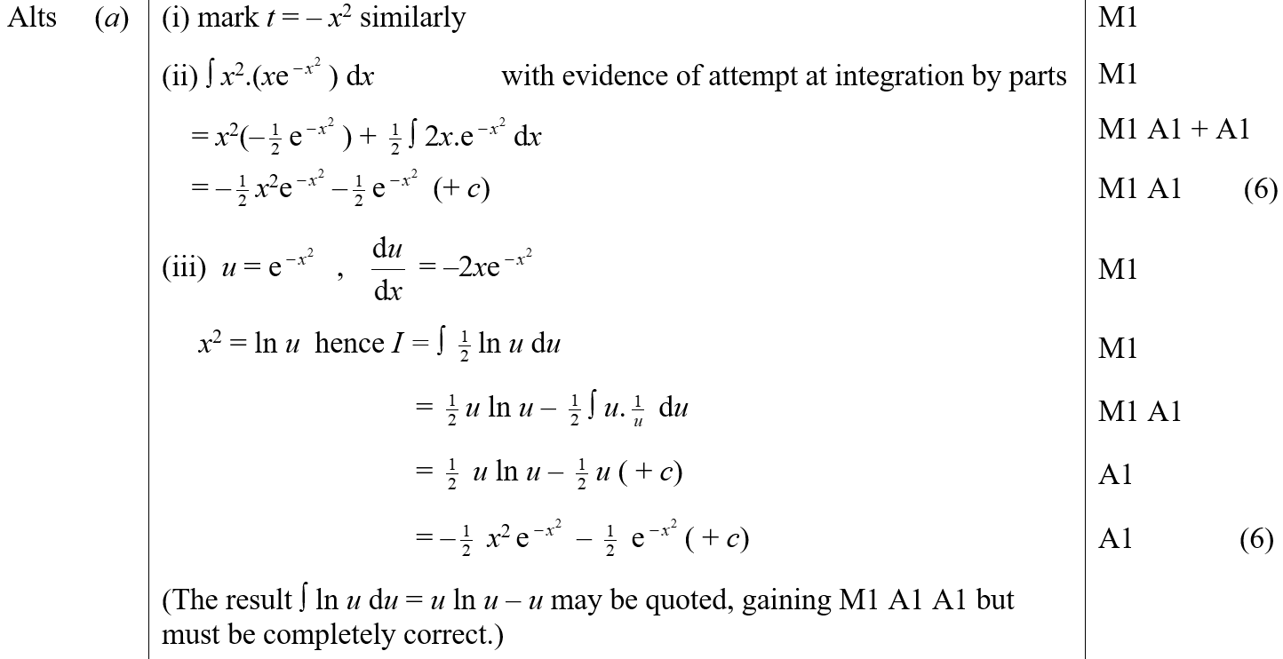
June 2003
A Alternatives

Slide 21
Jan 2004

Slide 22
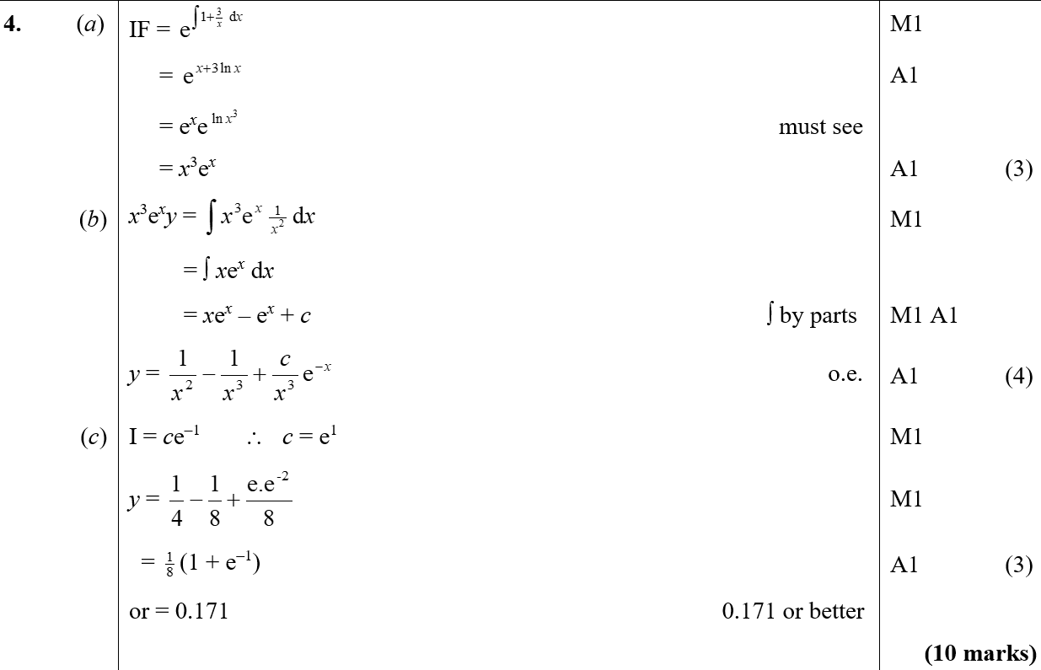
Jan 2004
A
B
C

Slide 23
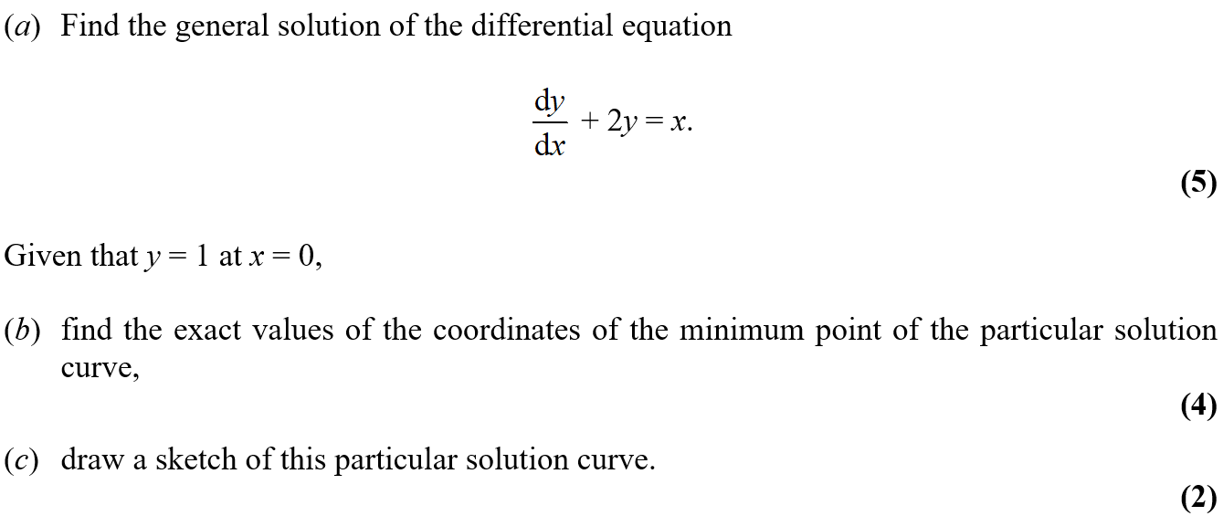
June 2004

Slide 24
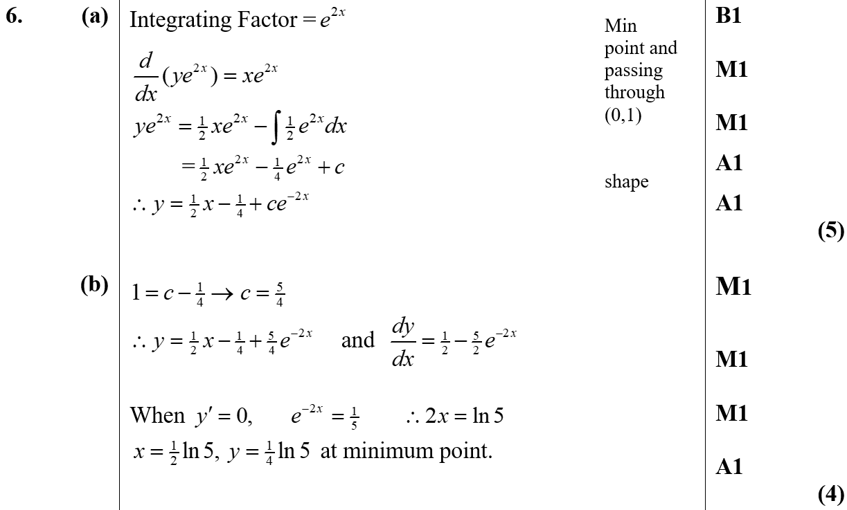
June 2004
A
B

Slide 25
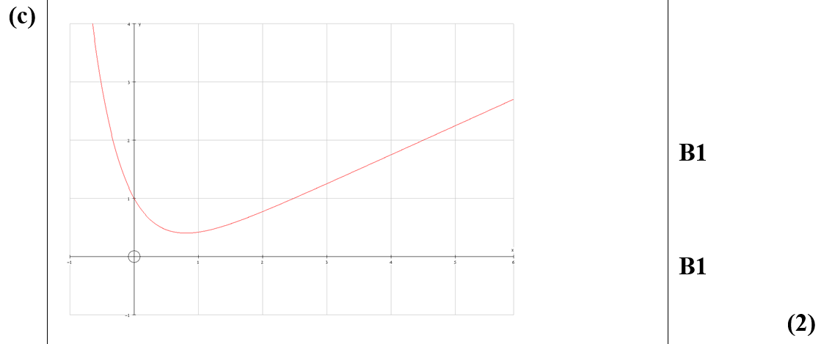
June 2004
C

Slide 26
Jan 2005

Slide 27
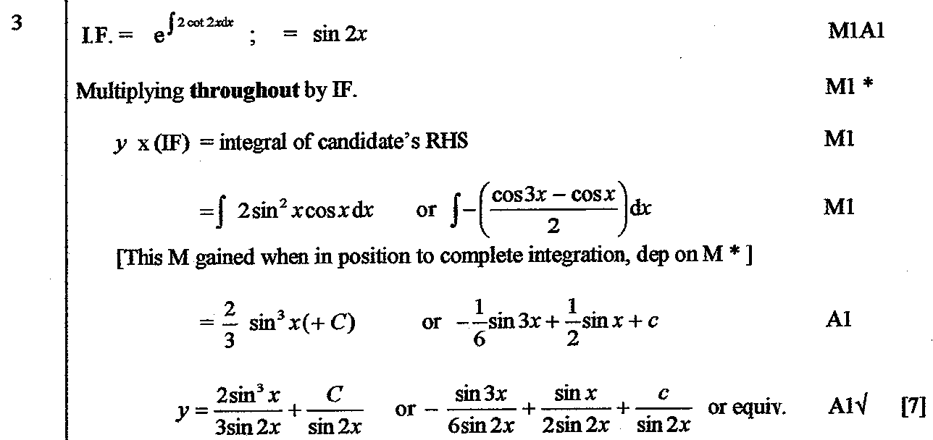
Jan 2005
A

Slide 28
June 2005

Slide 29
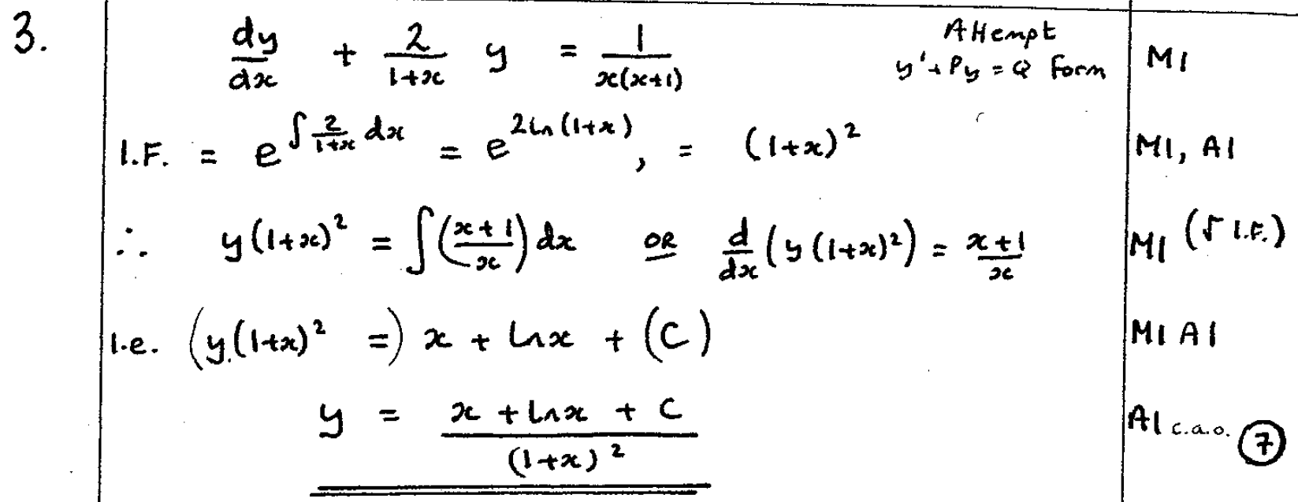
June 2005
A

Slide 30
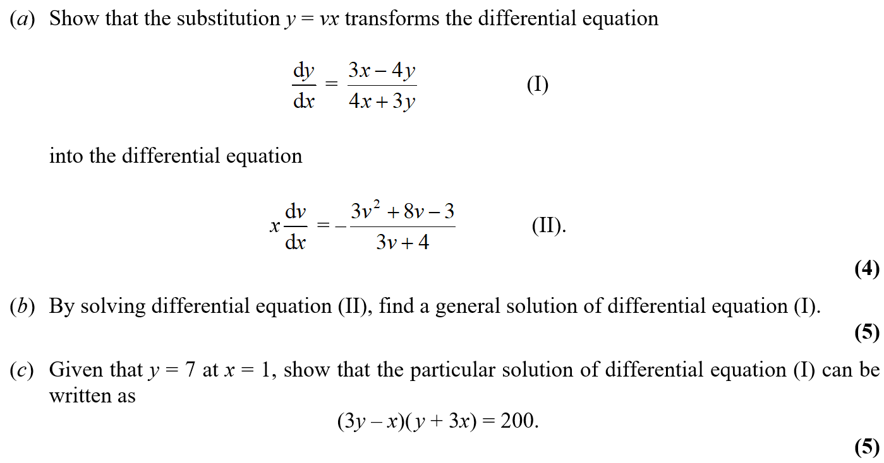
Jan 2006

Slide 31
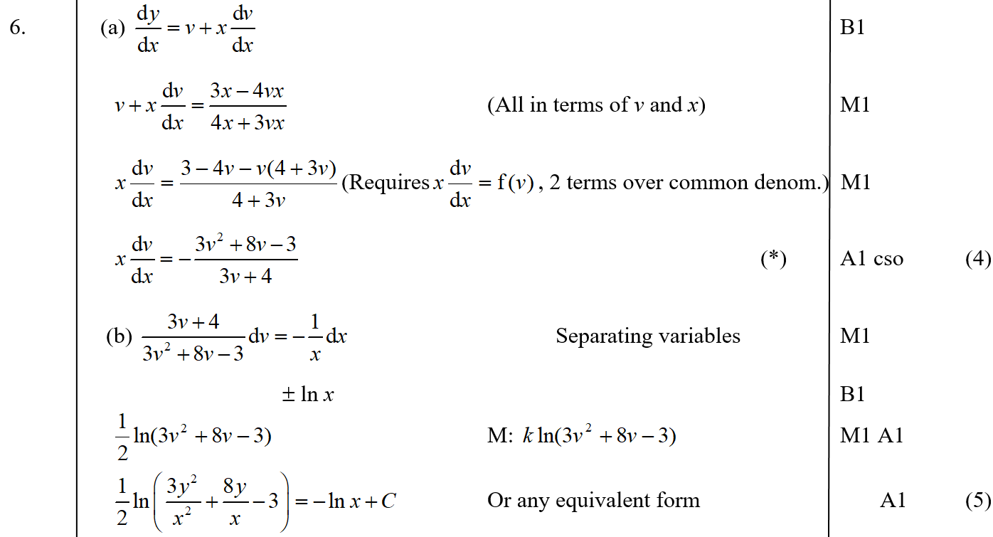
Jan 2006
A
B

Slide 32
Jan 2006
C

Slide 33
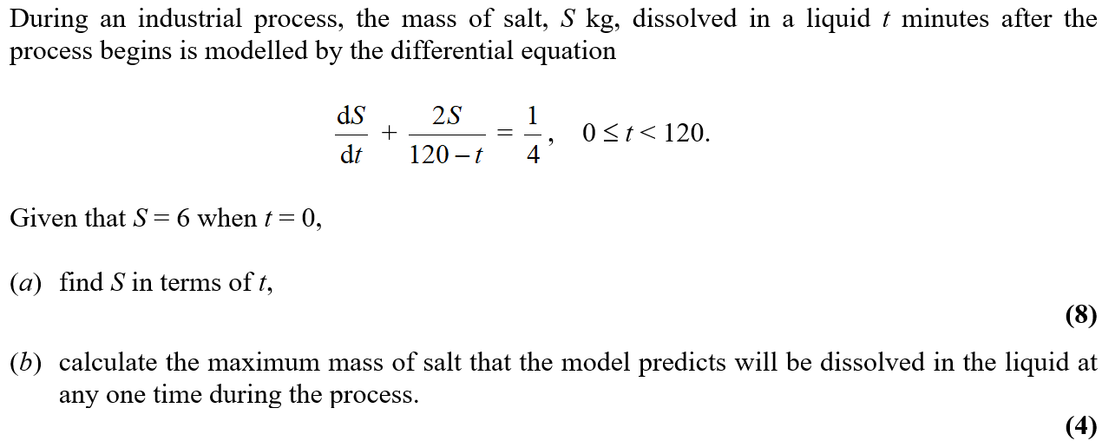
June 2006

Slide 34
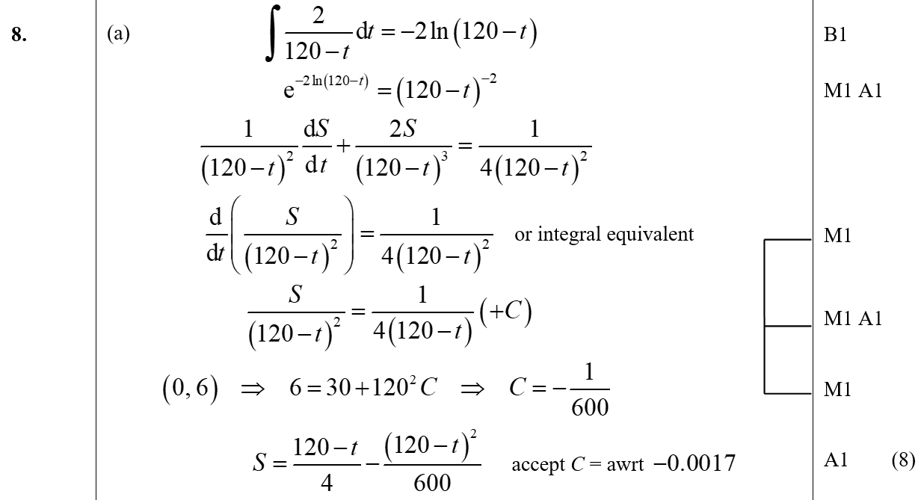
June 2006
A

Slide 35
June 2006
B

Slide 36
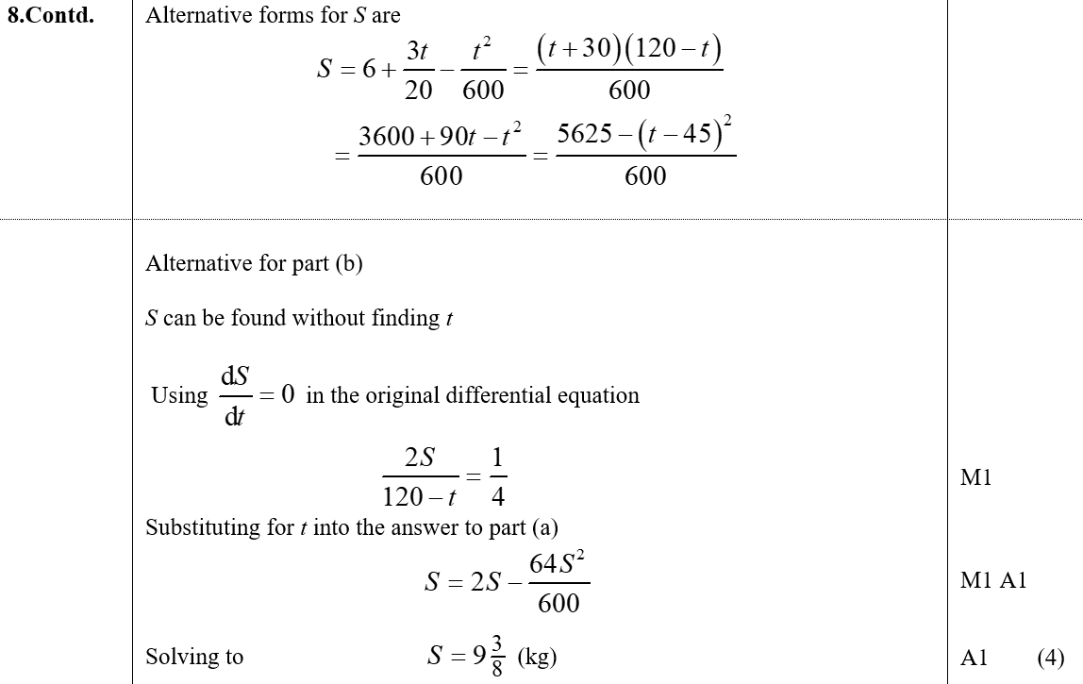
June 2006
B Alternative

Slide 37
Jan 2007

Slide 38
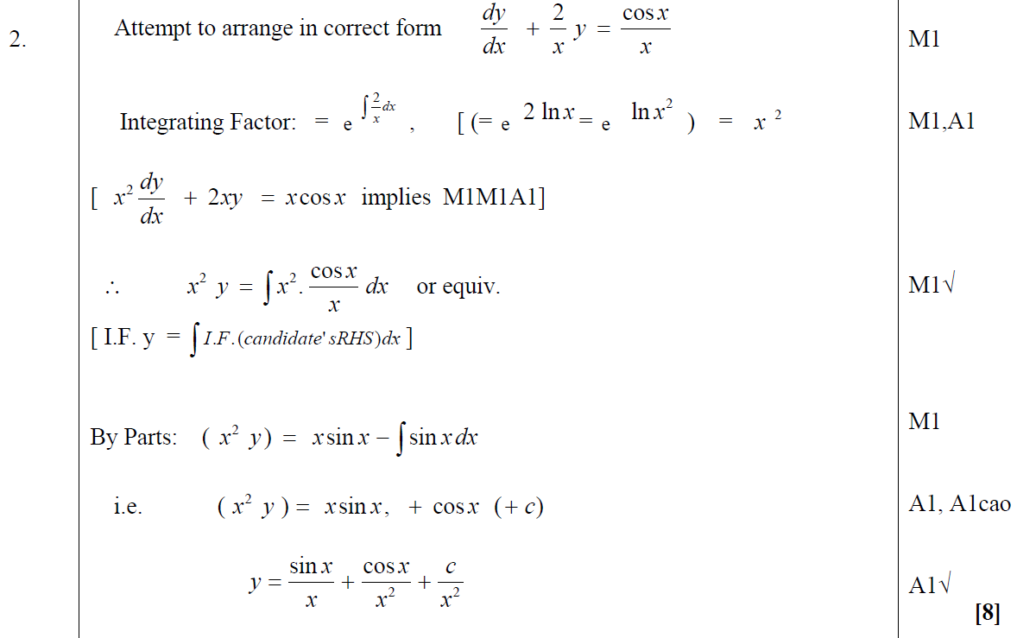
Jan 2007
A

Slide 39
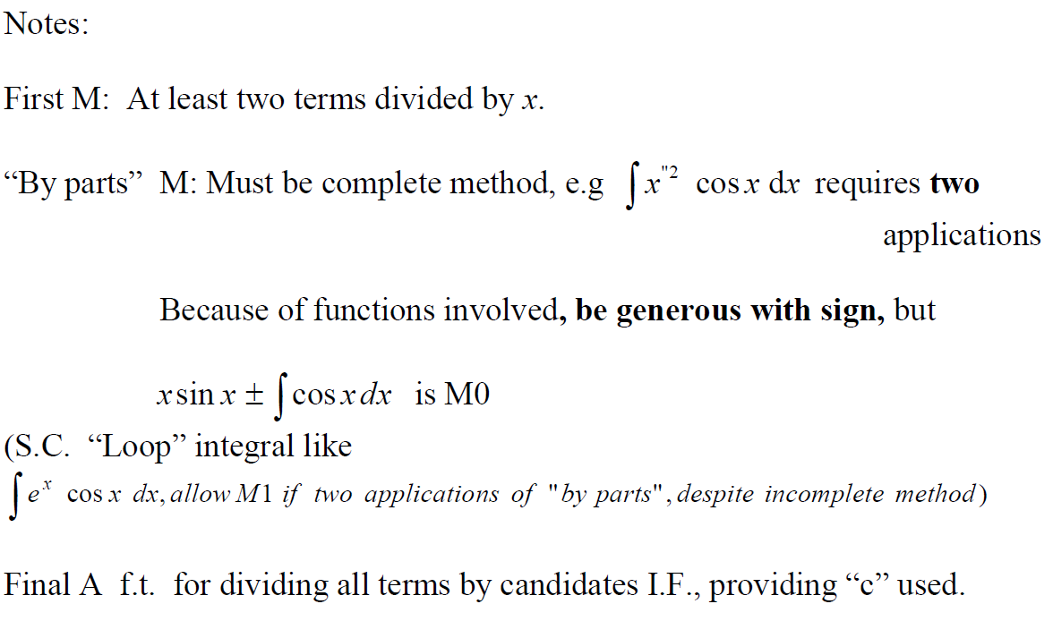
Jan 2007
A notes

Slide 40
June 2007

Slide 41
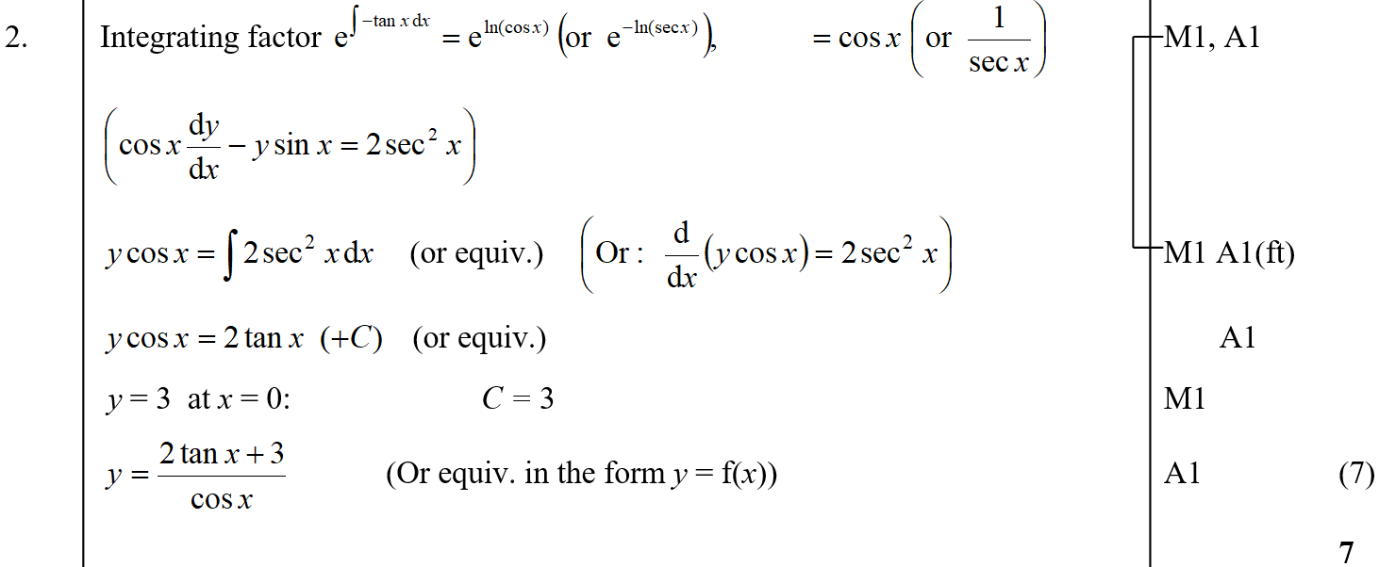
June 2007
A

Slide 42
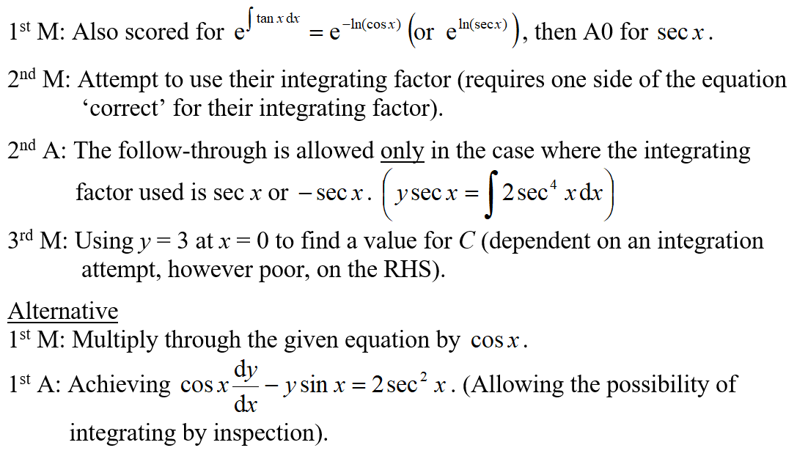
June 2007
A notes

Slide 43
Jan 2008

Slide 44
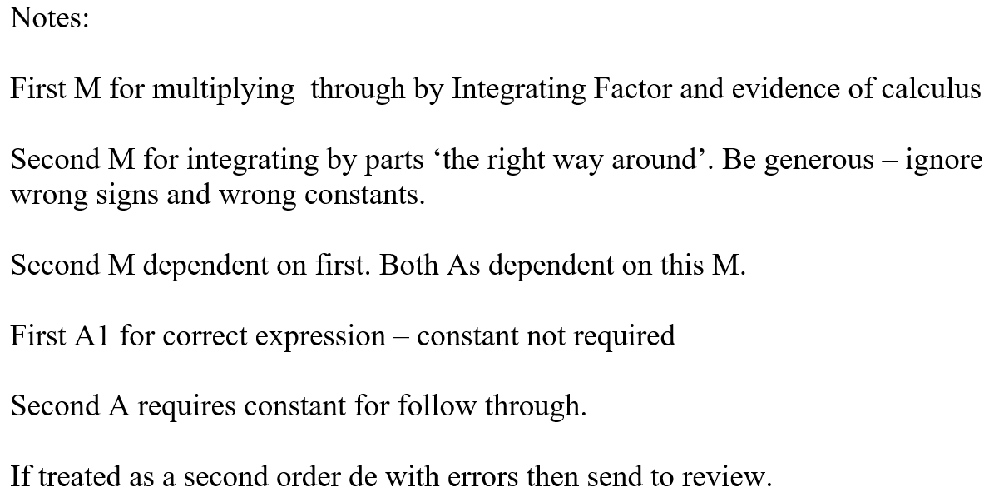
Jan 2008
A

Slide 45
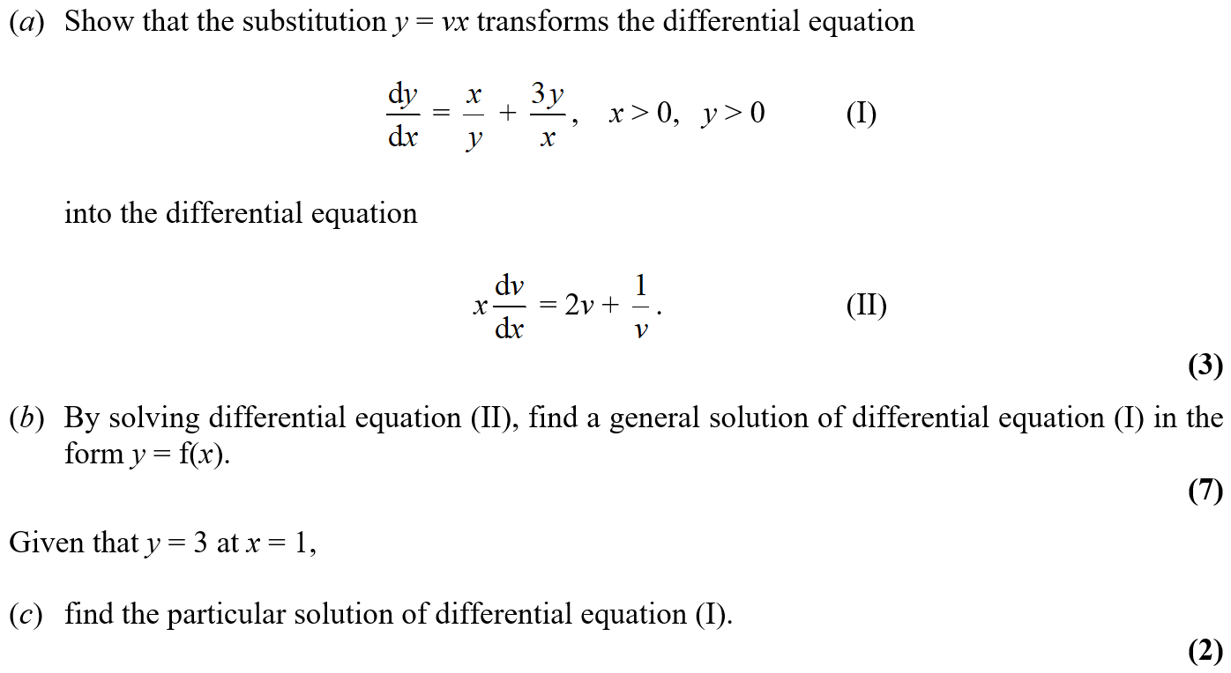
June 2008

Slide 46
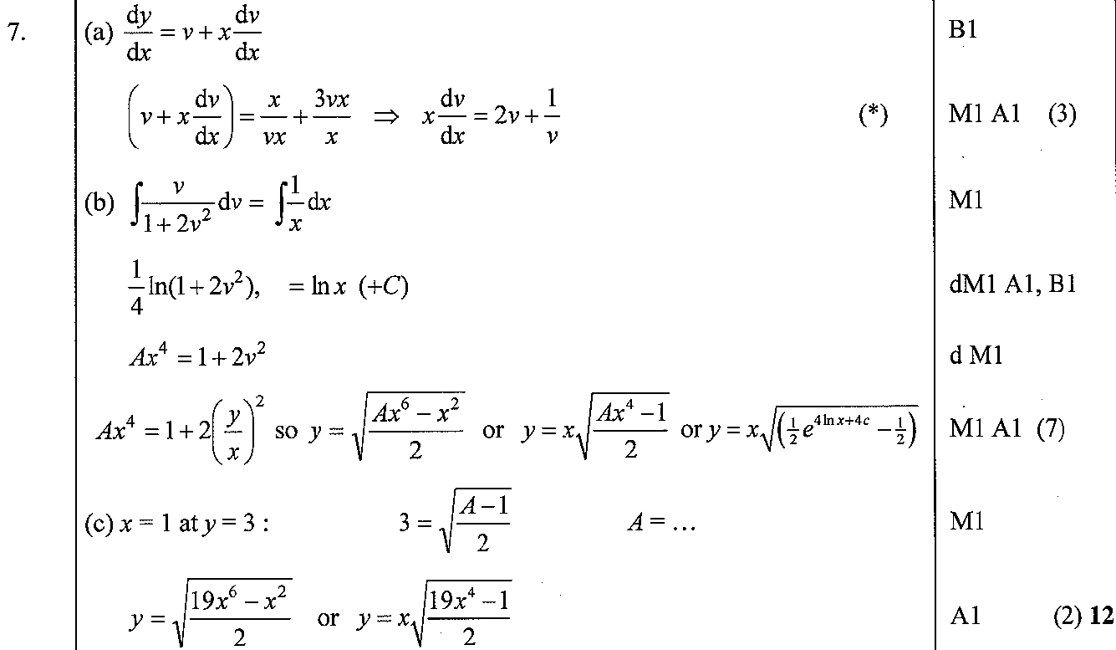
June 2008
A
B
C

Slide 47
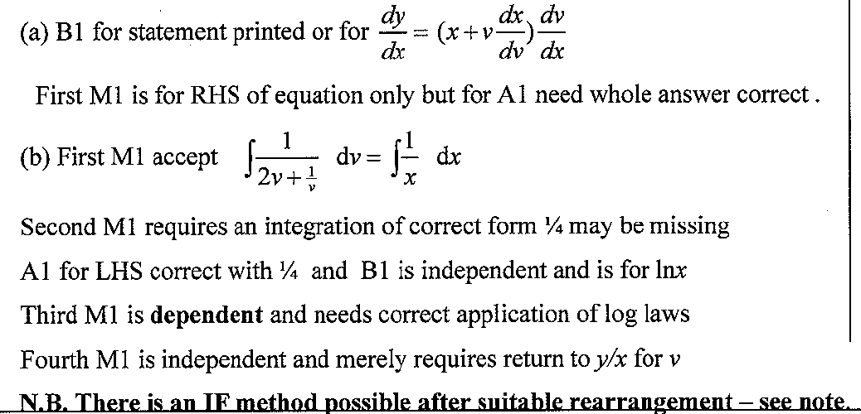
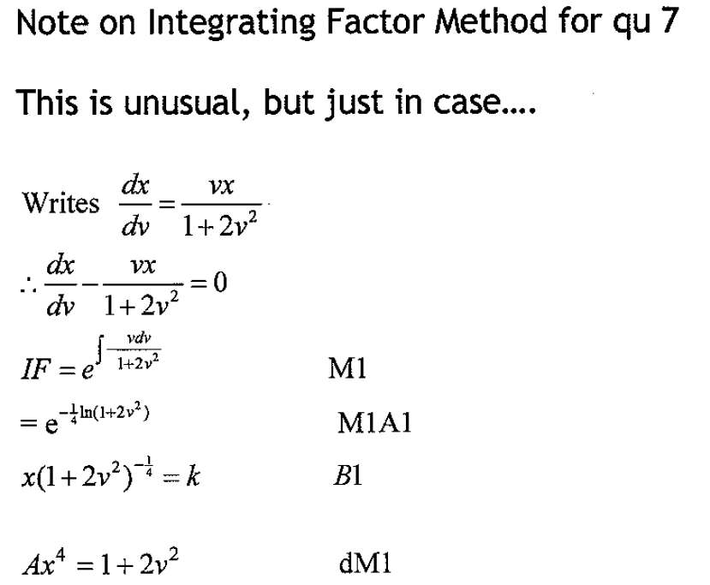
June 2008
A notes
B notes

Slide 48
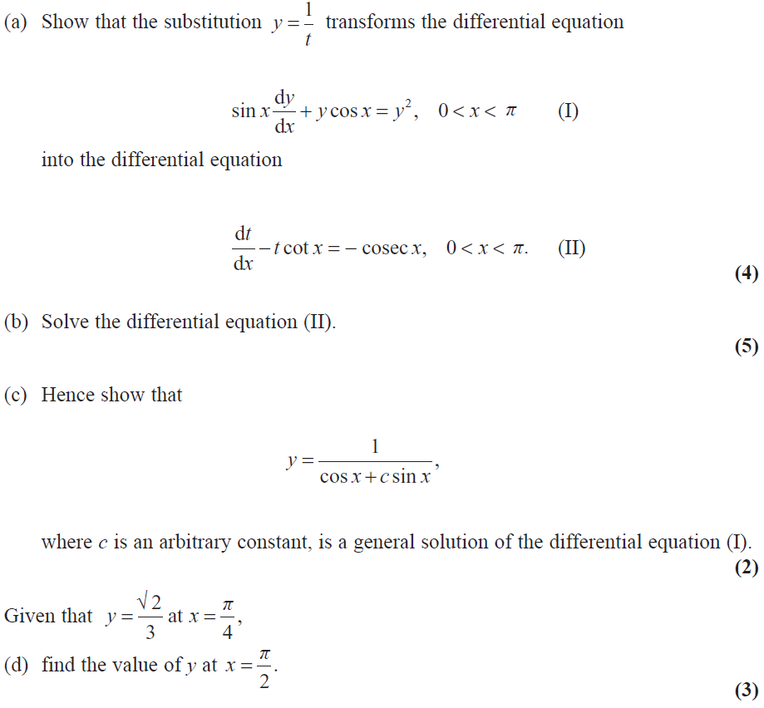
Jan 2009

Slide 49
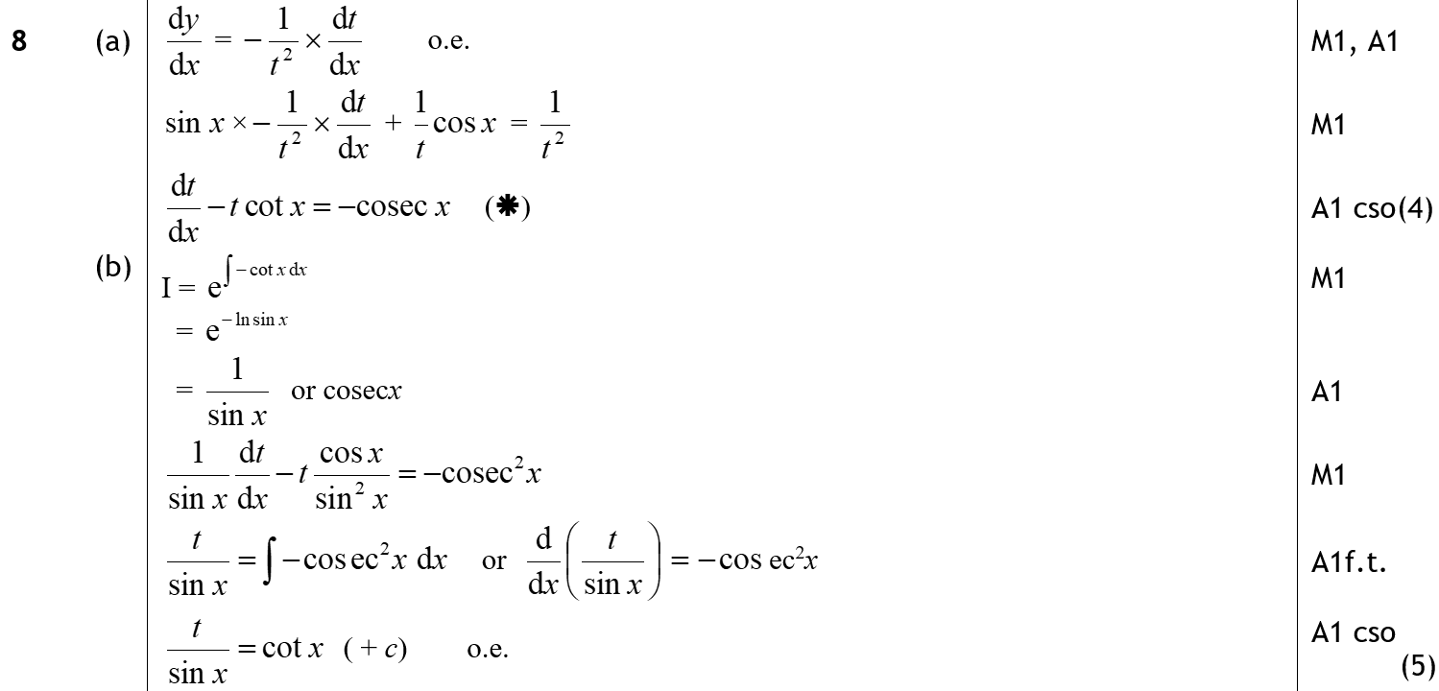
Jan 2009
A
B

Slide 50
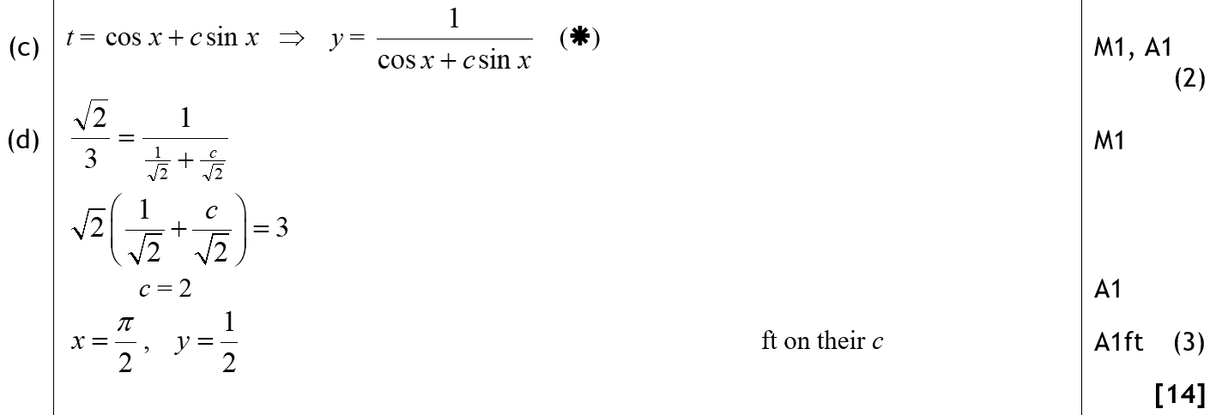
Jan 2009
C
D

Slide 51
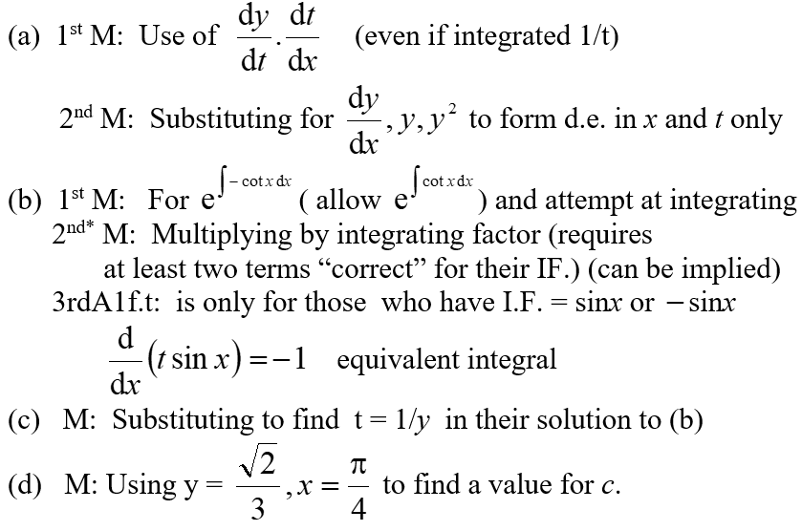
Jan 2009
A notes
B notes
C notes
D notes

Slide 52
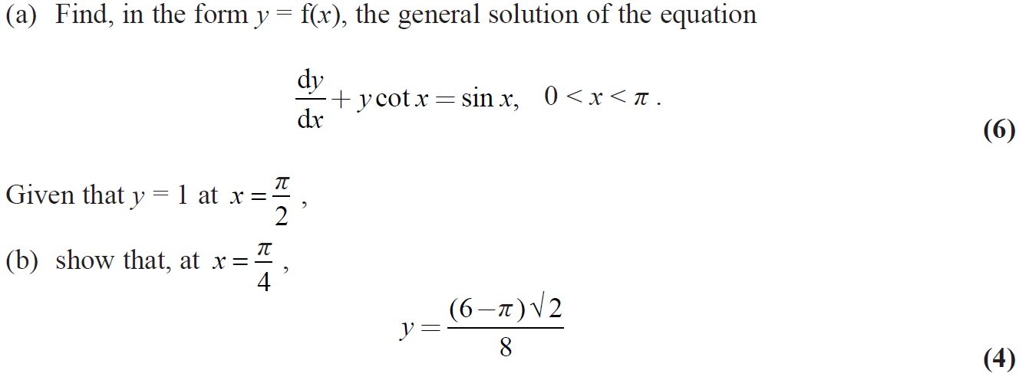
June 2009

Slide 53
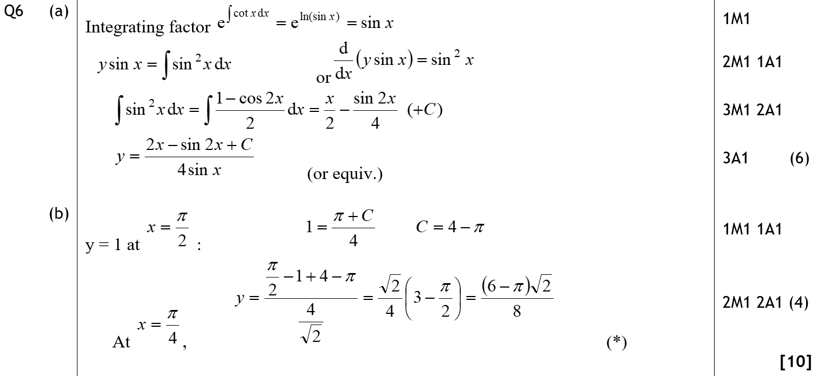
June 2009
A
B

Slide 54
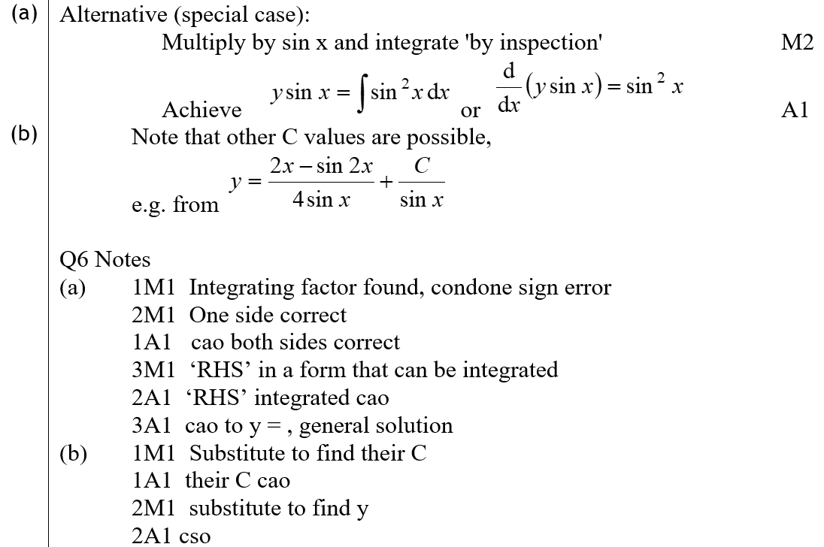
June 2009
A Alternative
B Alternative
A notes
B notes

Slide 55
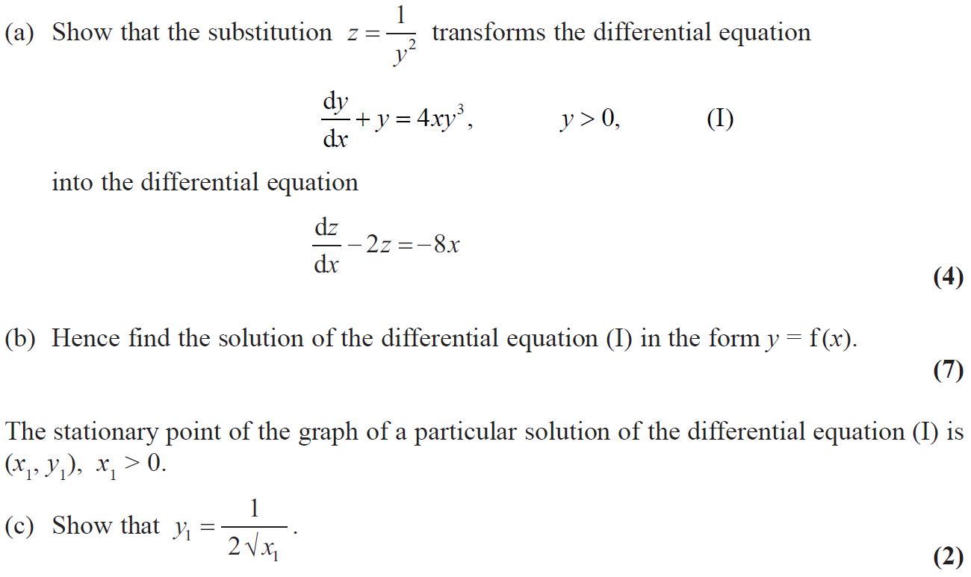
Jan 2010

Slide 56
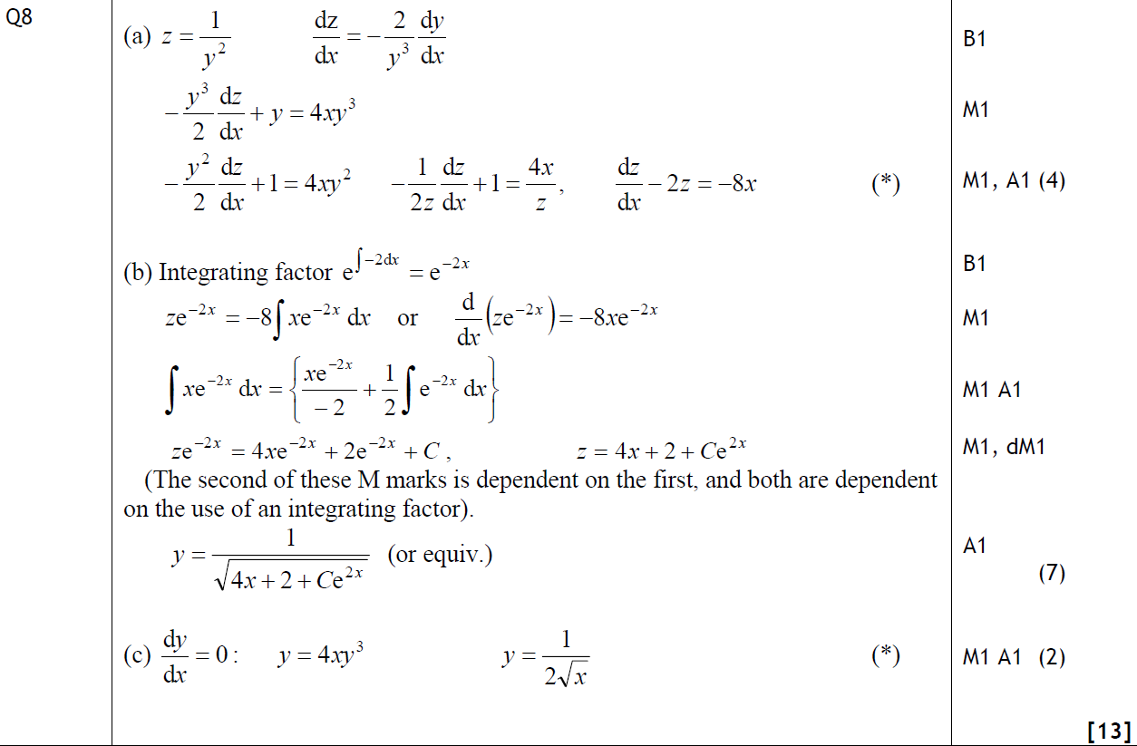
Jan 2010
A
B
C

Slide 57
Jan 2010
B Alternative

Slide 58
June 2009

Slide 59
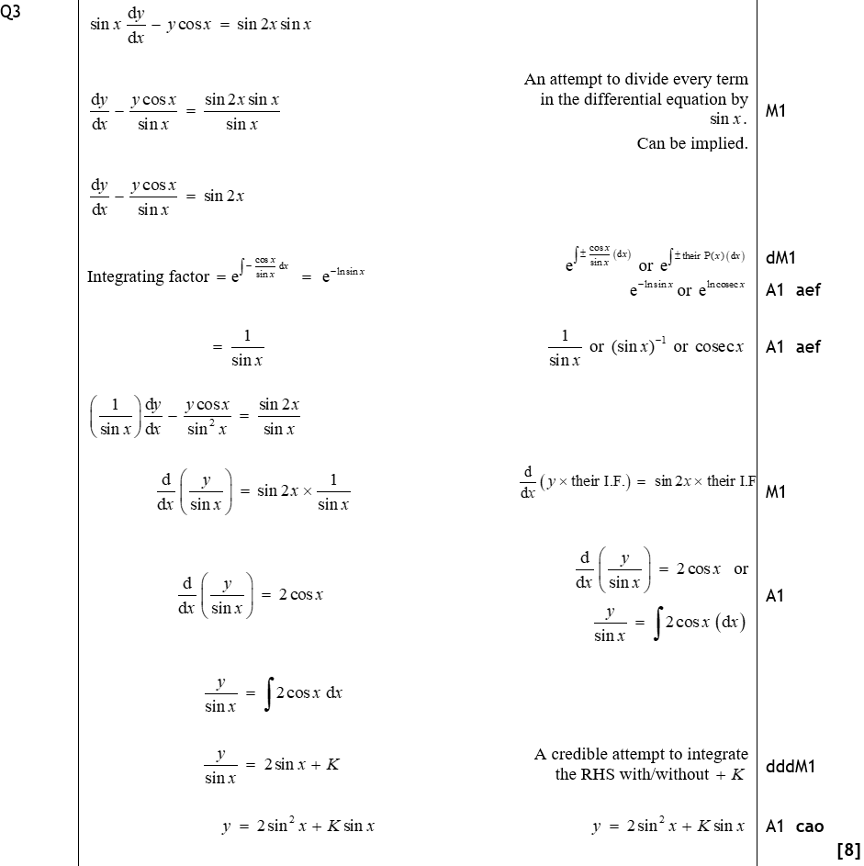
June 2009
A

Slide 60
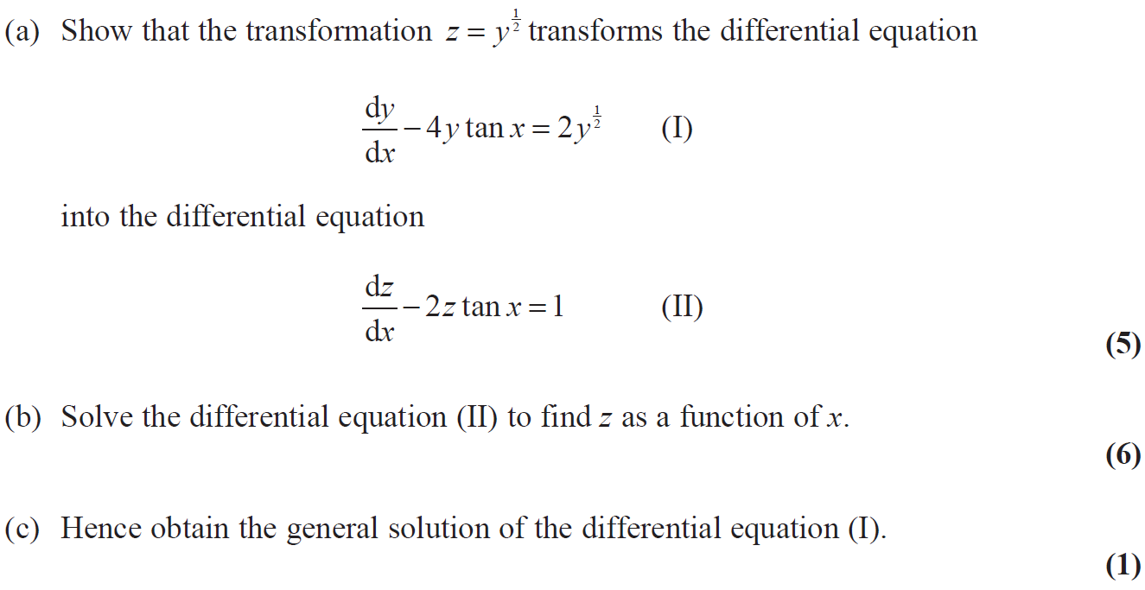
June 2010

Slide 61
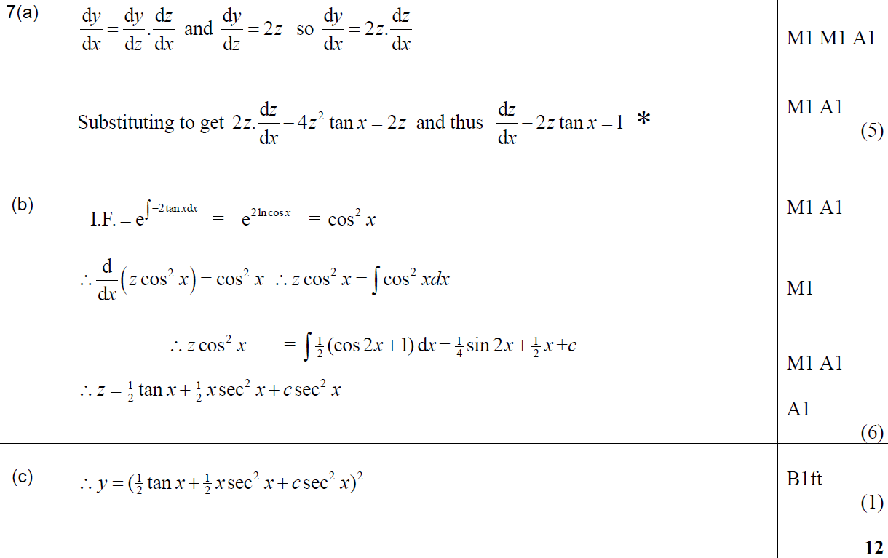
June 2010
A
B
C

Slide 62
June 2011

Slide 63
June 2011
A

Slide 64
June 2012

Slide 65
June 2012
A
B

Slide 66
June 2012
C
A notes
B notes
C notes

Slide 67
June 2013

Slide 68
June 2013
A
B

Slide 69
June 2013
C

Slide 70
June 2013
A notes
B notes

Slide 71
June 2013
C notes

Slide 72
June 2013 Reserve

Slide 73
June 2013 Reserve
A

Slide 74
June 2013 Reserve
B

Slide 75
June 2013 Reserve
A notes

Slide 76
June 2013 Reserve
B notes

Slide 77
June 2013 Reserve
B Alternative & notes

Slide 78
June 2013 Withdrawn

Slide 79
June 2013 Withdrawn
A

Slide 80
June 2014

Slide 81
June 2014
A

Slide 82
June 2014
A Alternatives

Slide 83
June 2014
B

Slide 84
June 2014 Reserve

Slide 85
June 2014 Reserve
A

Slide 86
June 2014 Reserve
B

Slide 87
June 2014 Reserve
A notes

Slide 88
June 2015

Slide 89
June 2015
A

Slide 90
June 2015
A Alternatives & notes

Slide 91
June 2016

Slide 92
June 2016
(i) A

Slide 93
June 2016
(i) A Alternative
(i) B

Slide 94
June 2016
(ii)

Slide 95
June 2016
(ii) Alternative

Slide 96
June 2017

Slide 97
June 2017
A

Slide 98
June 2017
B

Slide 99
June 2018

Slide 100
June 2018
A

Slide 101
June 2018
B

Slide 102
June 2018
B Alternative

Slide 103
June 2018
C

Slide 104
June 2019

Slide 105
June 2019
A

Slide 106
June 2019
A Alternatives

Slide 107
June 2019
B
C

Slide 108
June 2019
B notes
C notes

Slide 109
June 2001

Slide 110
June 2001
A

Slide 111
June 2009

Slide 112
June 2009
A
B
C

Slide 113
June 2002

Slide 114
June 2002
A
B

Slide 115
June 2002
C

Slide 116
June 2003

Slide 117
June 2003
A
B

Slide 118
June 2004

Slide 119
June 2004
A
B

Slide 120
June 2004
C

Slide 121
Jan 2006

Slide 122
Jan 2006
A
B

Slide 123
June 2006

Slide 124
June 2006
A
B

Slide 125
June 2007

Slide 126
June 2007
A

Slide 127
June 2007
B

Slide 128
June 2012

Slide 129
June 2012
A
B

Slide 130
June 2012
B Alternative
C

Slide 131
June 2013 Reserve

Slide 132
June 2013 Reserve
A
B

Slide 133
June 2019

Slide 134
June 2019
A
B

Slide 135
June 2019
C

