Slide 1
FDPR mixed context
FDPR mixed context
May 2017
1H Q25
Nov 2017
3H Q2
June 2017
2H Q1
May 2018
1H Q16
1 Marker
SAM
3H Q3
June 2017
2H Q17
May 2018
1H Q23
Nov 2017
2H Q1
June 2018
3H Q1
Fractions
Decimals
Percentages
Ratios

Slide 2
FDPR mixed context
SAM 3H Q3

Slide 3
FDPR mixed context
SAM 3H Q3
A

Slide 4
FDPR mixed context
May 2017 1H Q25

Slide 5
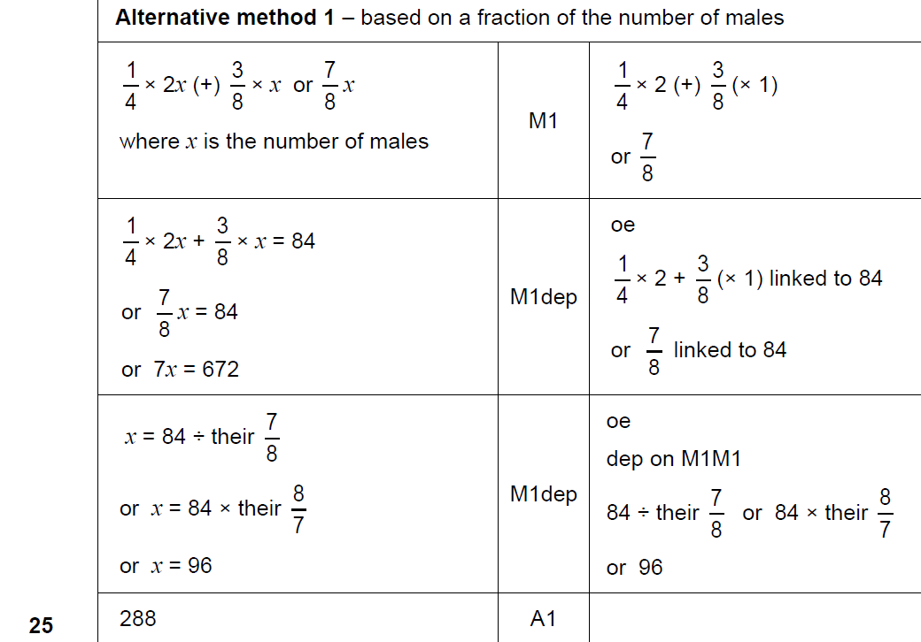
FDPR mixed context
May 2017 1H Q25
A

Slide 6
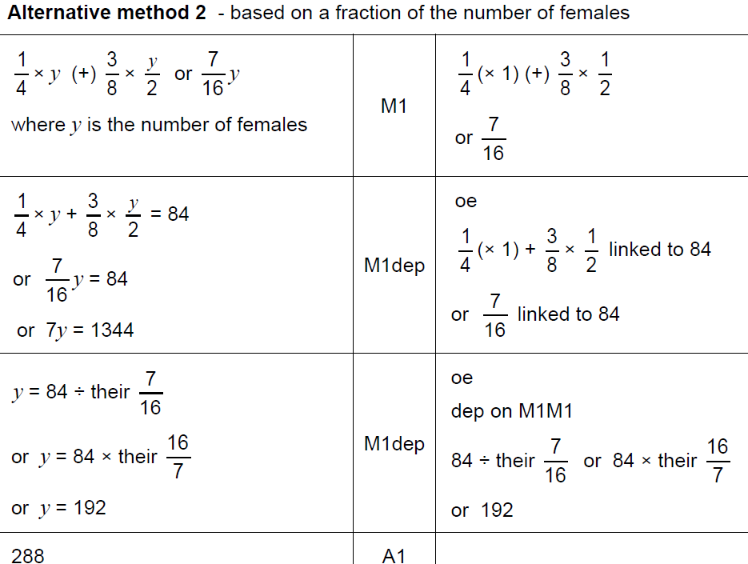
FDPR mixed context
May 2017 1H Q25
A Alternative 1

Slide 7
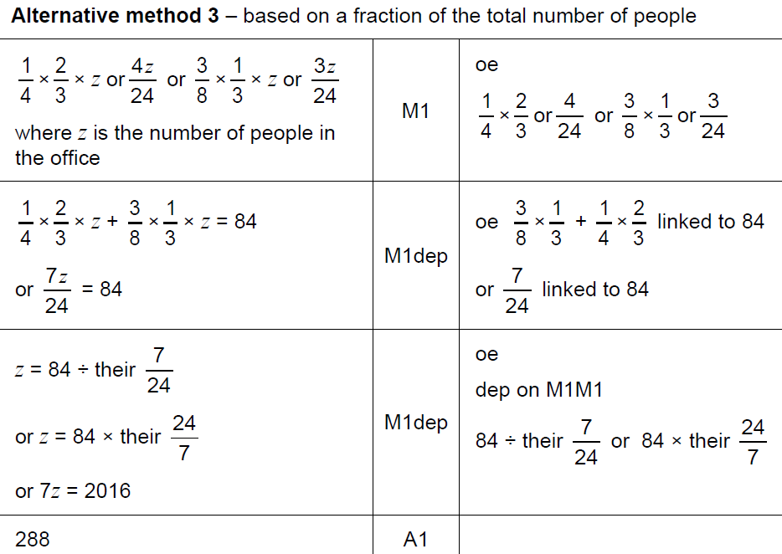
FDPR mixed context
May 2017 1H Q25
A Alternative 2

Slide 8
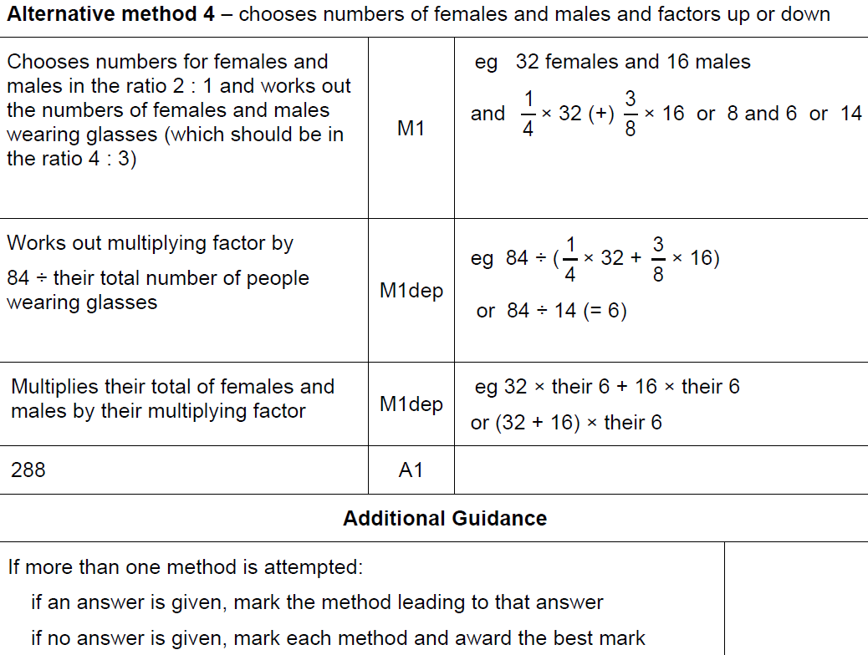
FDPR mixed context
May 2017 1H Q25
A Alternative 3

Slide 9
FDPR mixed context
June 2017 2H Q1

Slide 10
FDPR mixed context
June 2017 2H Q1
A

Slide 11
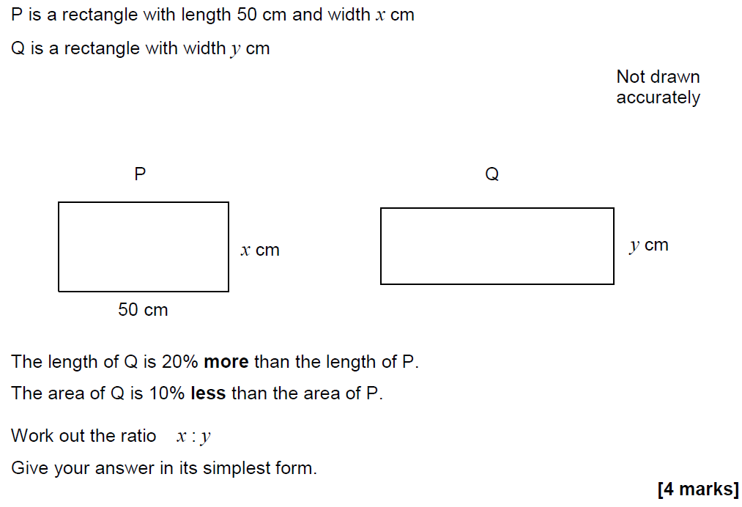
FDPR mixed context
June 2017 2H Q17

Slide 12
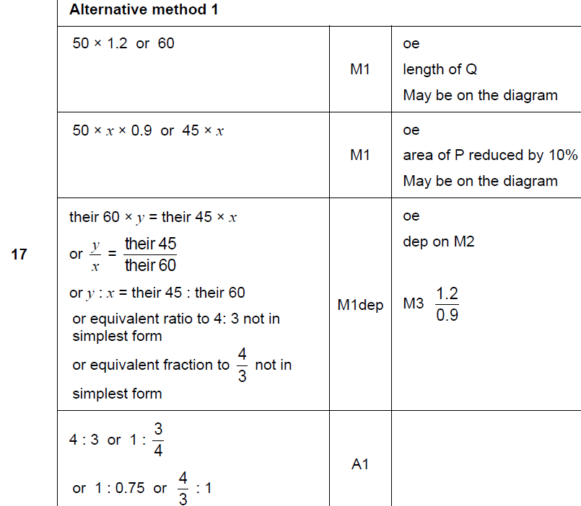
FDPR mixed context
June 2017 2H Q17
A

Slide 13
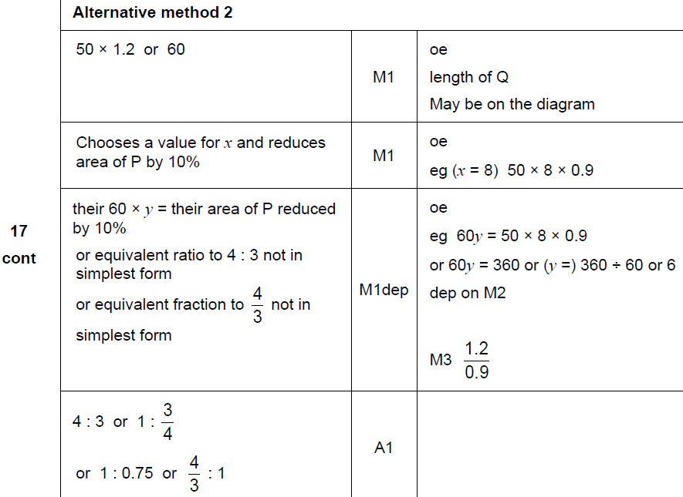
FDPR mixed context
June 2017 2H Q17
A Alternative

Slide 14
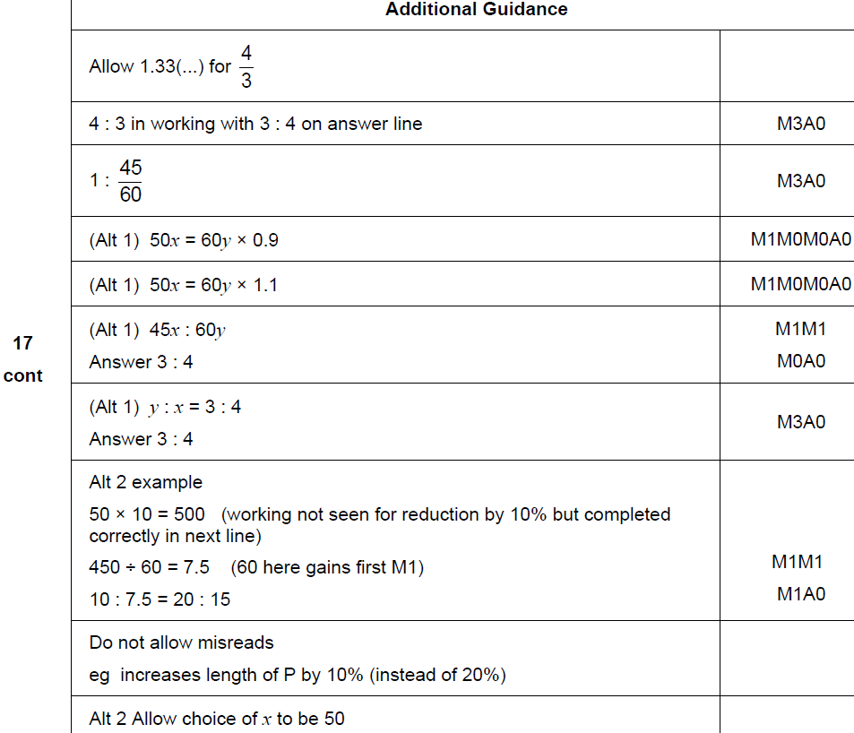
FDPR mixed context
June 2017 2H Q17
A notes

Slide 15
FDPR mixed context
Nov 2017 2H Q1

Slide 16
FDPR mixed context
Nov 2017 2H Q1
A

Slide 17
FDPR mixed context
Nov 2017 3H Q2

Slide 18
FDPR mixed context
Nov 2017 3H Q2
A

Slide 19
FDPR mixed context
May 2018 1H Q16

Slide 20
FDPR mixed context
May 2018 1H Q16
A

Slide 21
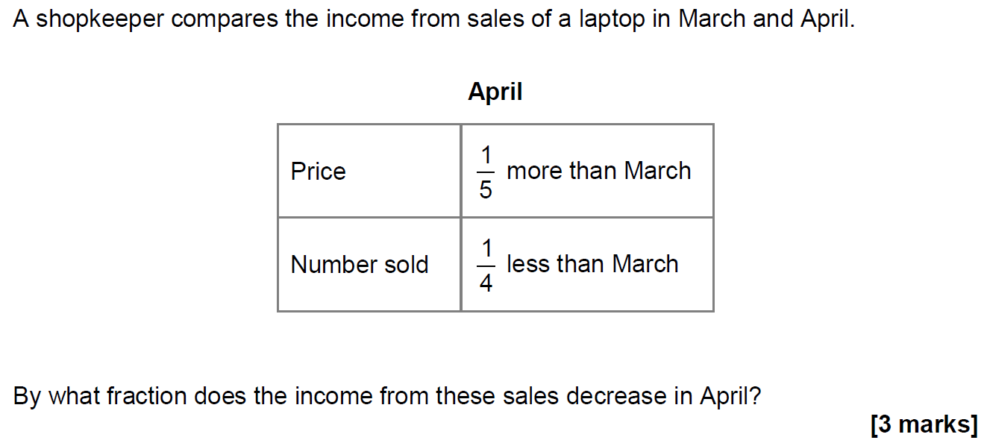
FDPR mixed context
May 2018 1H Q23

Slide 22
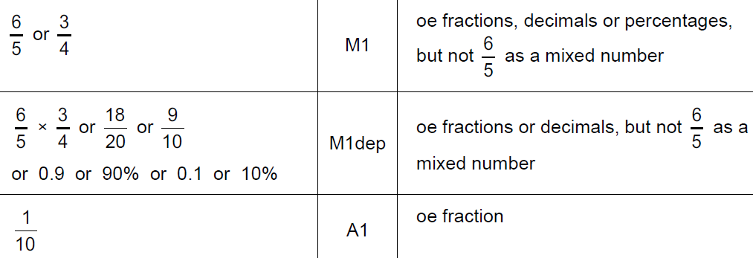
FDPR mixed context
May 2018 1H Q23
A

Slide 23
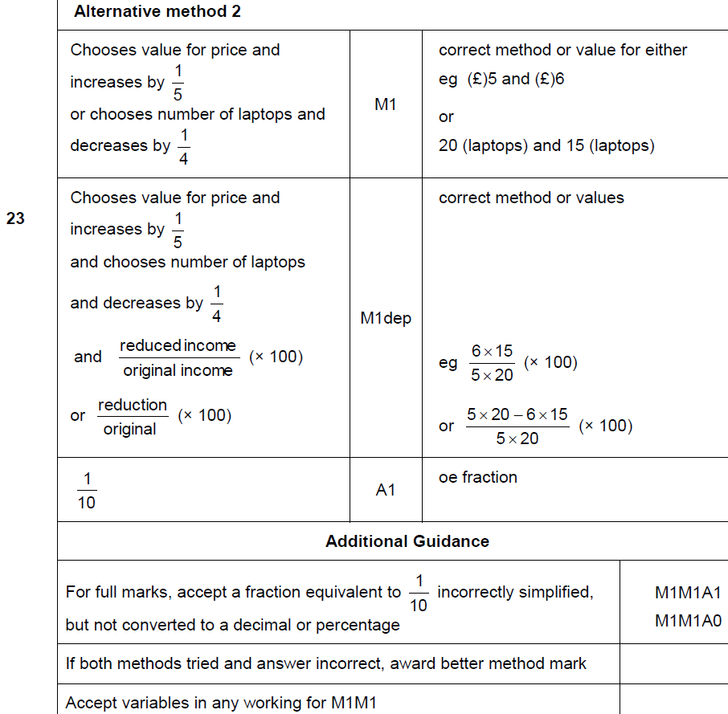
FDPR mixed context
May 2018 1H Q23
A Alternative & notes

Slide 24
FDPR mixed context
June 2018 3H Q1

Slide 25
FDPR mixed context
June 2018 3H Q1
A

