Slide 1
Direct & Inverse Proportion
Direct & Inverse Proportion
Old Spec Q’s
SAM
2H Q16
June 2018
2H Q16
Jan 2019
1H Q14
June 2019
2H Q17

Slide 2
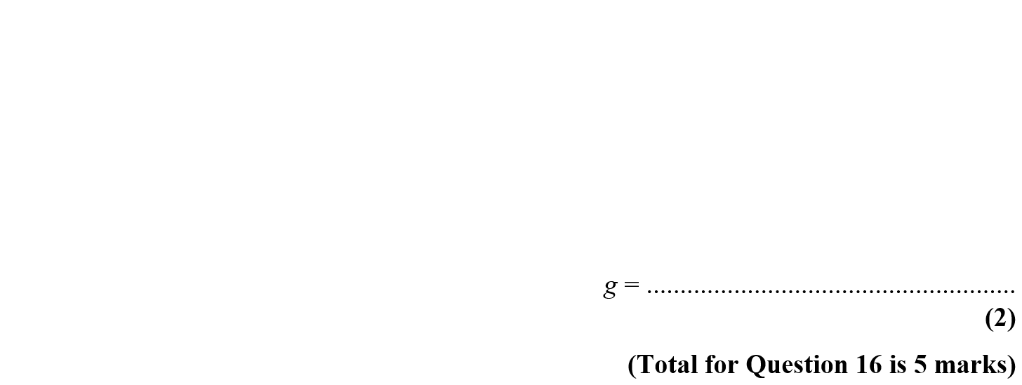
Direct & Inverse Proportion
SAM 2H Q16

Slide 3
Direct & Inverse Proportion
SAM 2H Q16
A
B

Slide 4
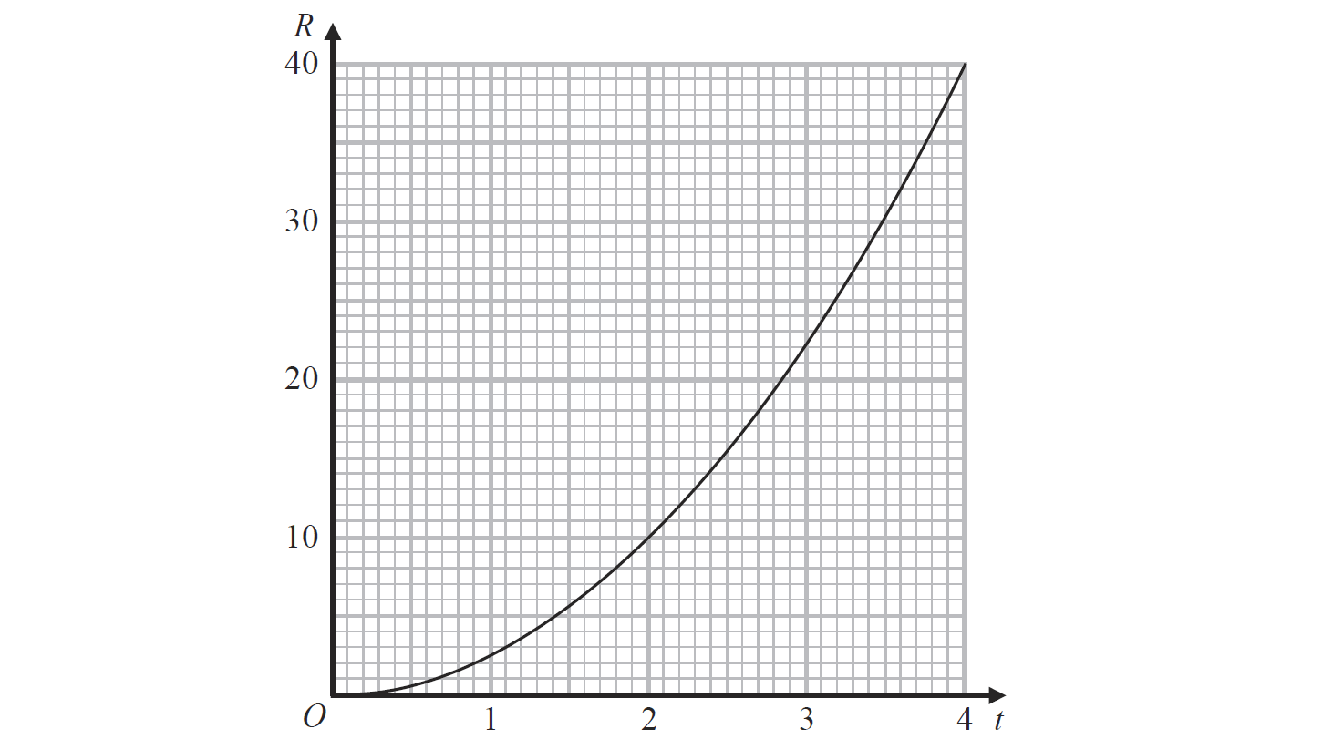
Direct & Inverse Proportion
June 2018 2H Q16

Slide 5
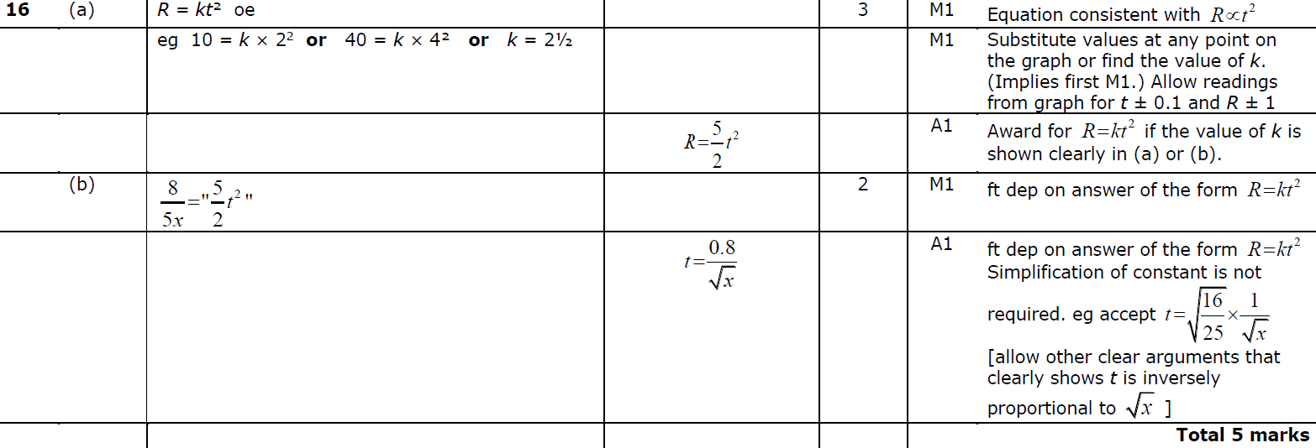
Direct & Inverse Proportion
June 2018 2H Q16
A
B

Slide 6
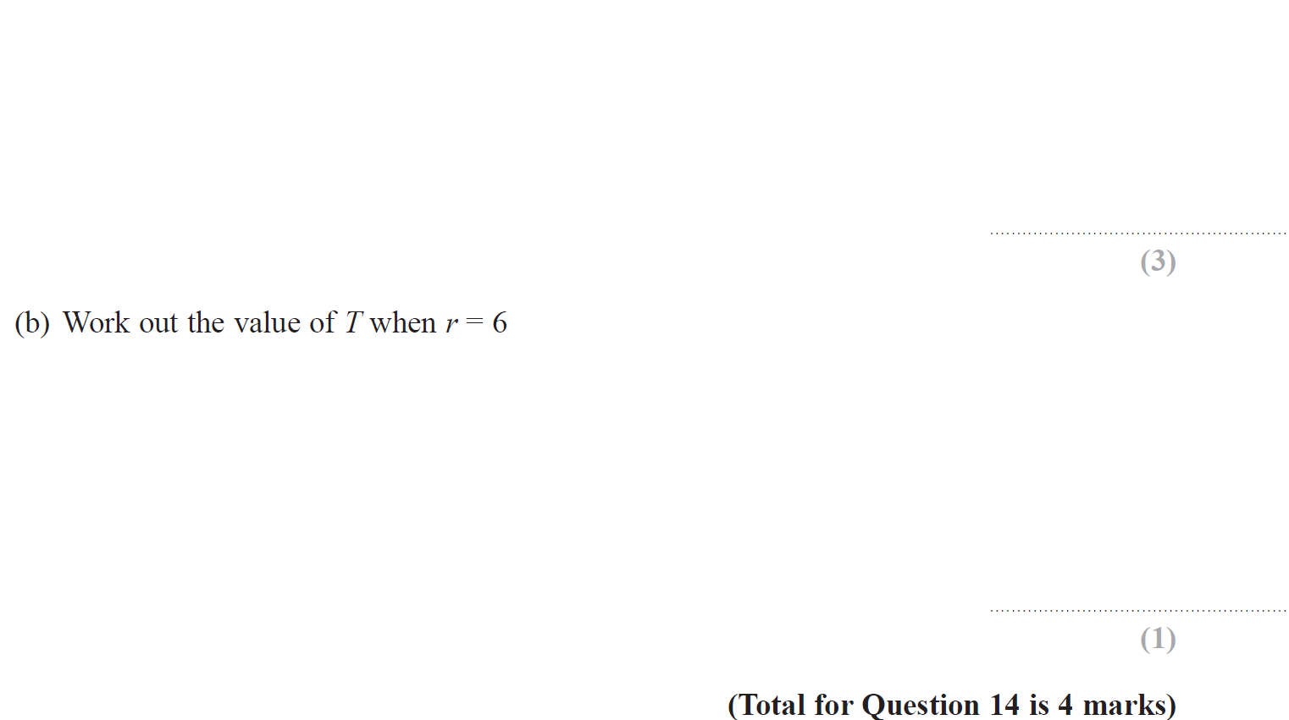
Direct & Inverse Proportion
Jan 2019 1H Q14

Slide 7
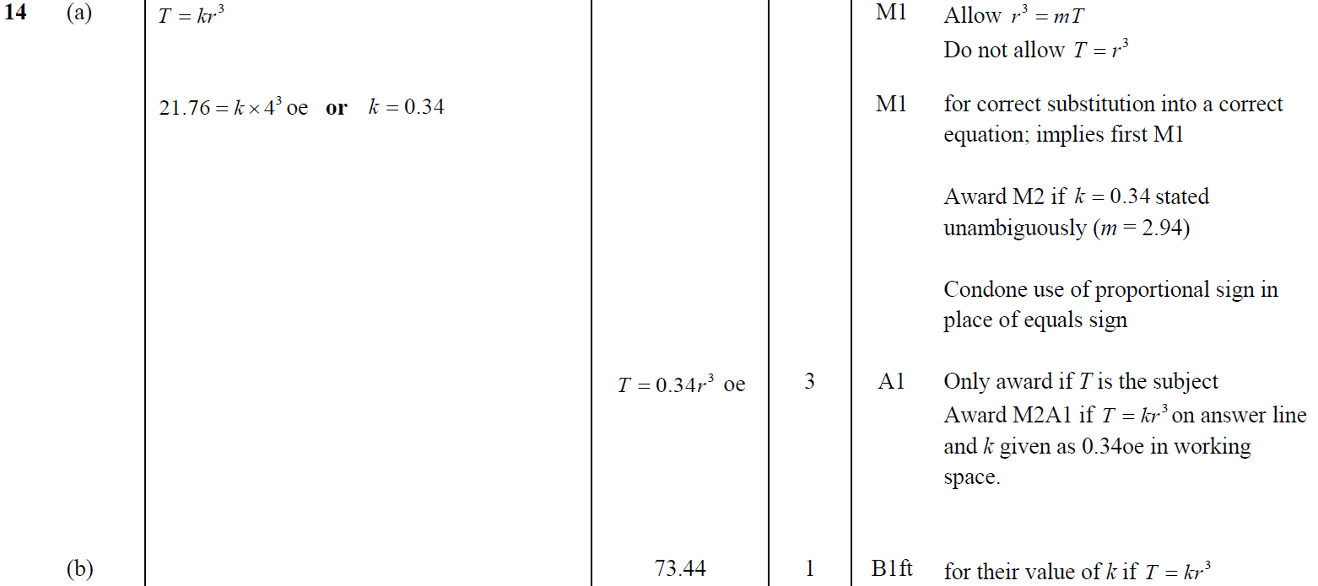
Direct & Inverse Proportion
Jan 2019 1H Q14
A
B

Slide 8
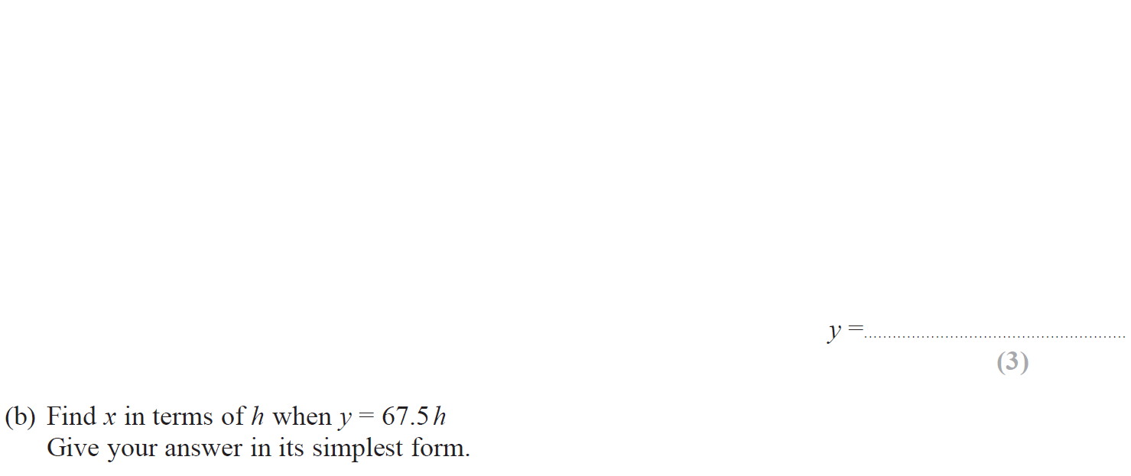
Direct & Inverse Proportion
June 2019 2H Q17

Slide 9
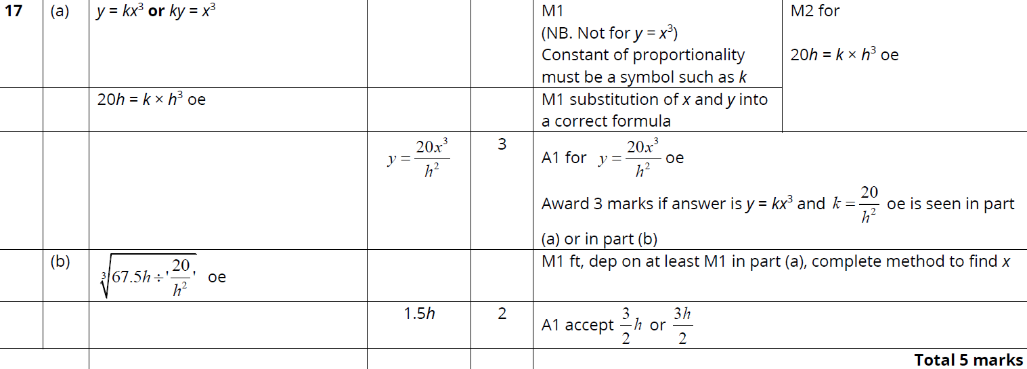
Direct & Inverse Proportion
June 2019 2H Q17
A
B

Slide 10
Direct & Inverse Proportion
Direct & Inverse Proportion
New Spec Q’s
May 2004
3H Q17
June 2010
3H Q15
Jan 2014 4HR Q16
June 2016 4H Q13
Nov 2004
4H Q16
Nov 2010
4H Q16
May 2014 4H Q17
Jan 2017 3H Q14
Nov 2005
3H Q7
June 2011 3H Q19
Jan 2015 3H Q17
Jan 2017 4HR Q13
May 2006
4H Q15
Jan 2012 3H Q15
Jan 2015 3HR Q20
May 2017 3H Q15
May 2007
3H Q15
Jan 2013 4H Q21
May 2015 3H Q22
June 2017 4HR Q18
Nov 2007
3H Q19
May 2013 4H Q16
June 2015 4HR Q14
Jan 2018 4H Q15
May 2008
3H Q16
May 2013 4HR Q17
Jan 2016 4H Q18
Jan 2018 4HR Q14
Nov 2009
3H Q21
Jan 2014 3H Q14
Jan 2016 4HR Q16
June 2018 4H Q16

Slide 11
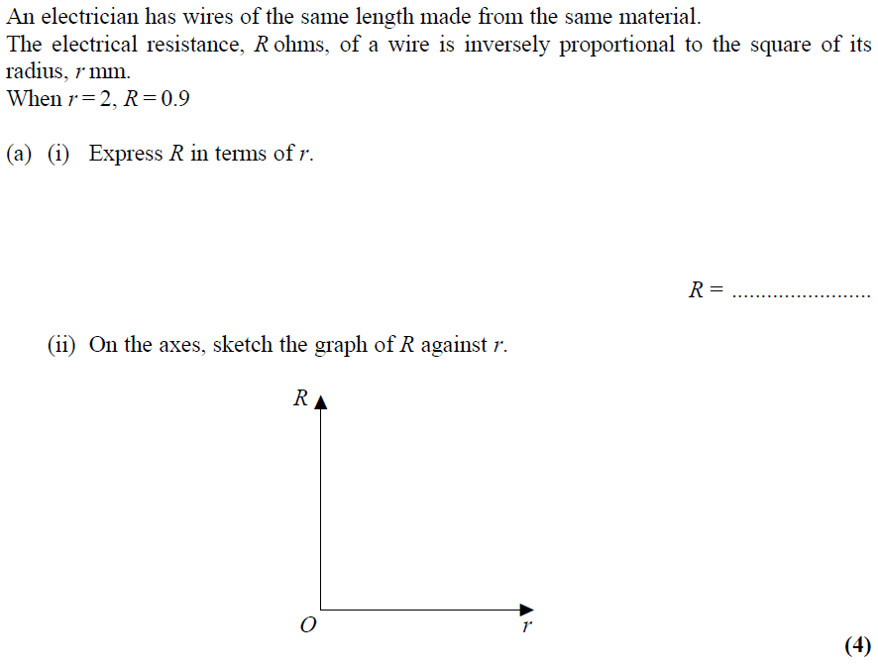
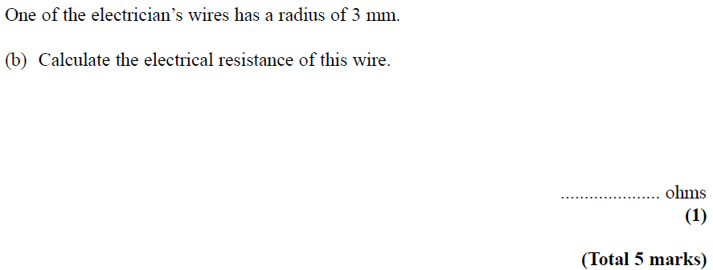
Direct & Inverse Proportion
May 2004 3H Q17

Slide 12
Direct & Inverse Proportion
May 2004 3H Q17
A (i)
A (ii)
B

Slide 13
Direct & Inverse Proportion
Nov 2004 4H Q16

Slide 14
Direct & Inverse Proportion
Nov 2004 4H Q16
A
B

Slide 15
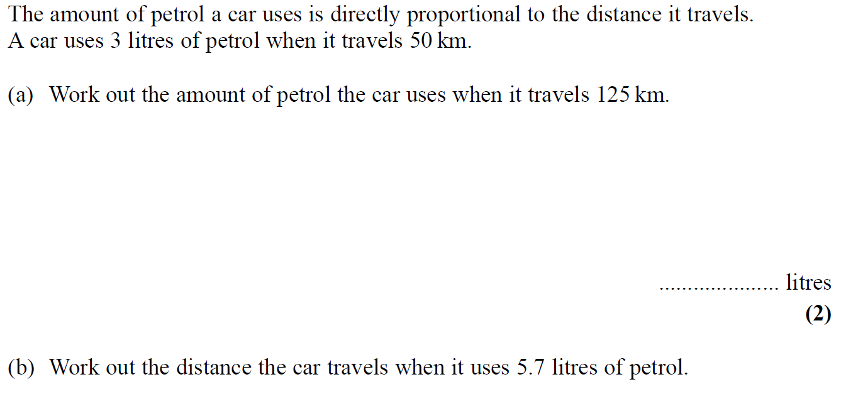
Direct & Inverse Proportion
Nov 2005 3H Q7

Slide 16
Direct & Inverse Proportion
Nov 2005 3H Q7
A
B

Slide 17
Direct & Inverse Proportion
May 2006 4H Q15

Slide 18
Direct & Inverse Proportion
May 2006 4H Q15
A
B
C

Slide 19
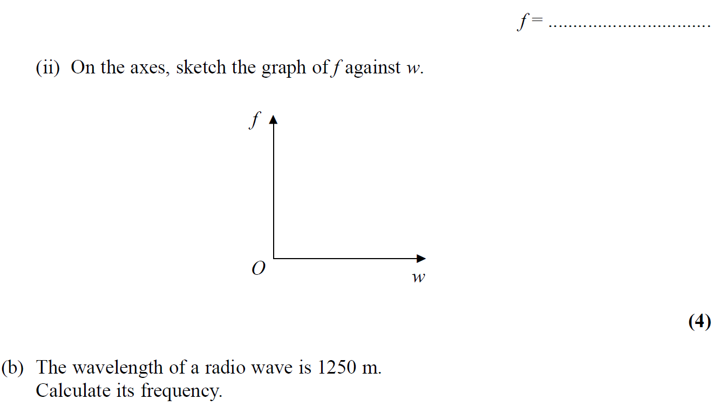
Direct & Inverse Proportion
May 2007 3H Q15

Slide 20
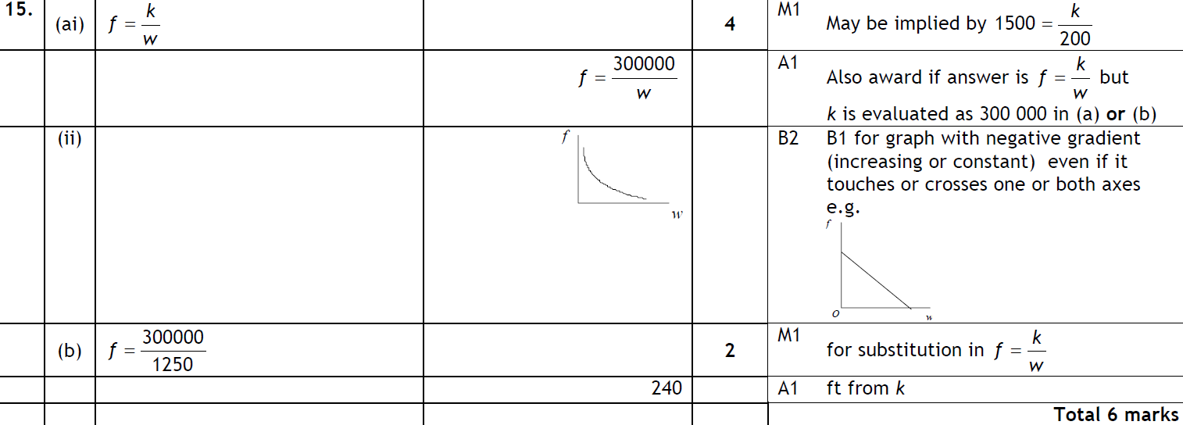
Direct & Inverse Proportion
May 2007 3H Q15
A (i)
A (ii)
B

Slide 21
Direct & Inverse Proportion
Nov 2007 3H Q19

Slide 22
Direct & Inverse Proportion
Nov 2007 3H Q19
A
B
C

Slide 23
Direct & Inverse Proportion
May 2008 3H Q17

Slide 24
Direct & Inverse Proportion
May 2008 3H Q17
A
B
C

Slide 25
Direct & Inverse Proportion
Nov 2009 3H Q21

Slide 26
Direct & Inverse Proportion
Nov 2009 3H Q21
A
B

Slide 27
Direct & Inverse Proportion
June 2010 3H Q15

Slide 28
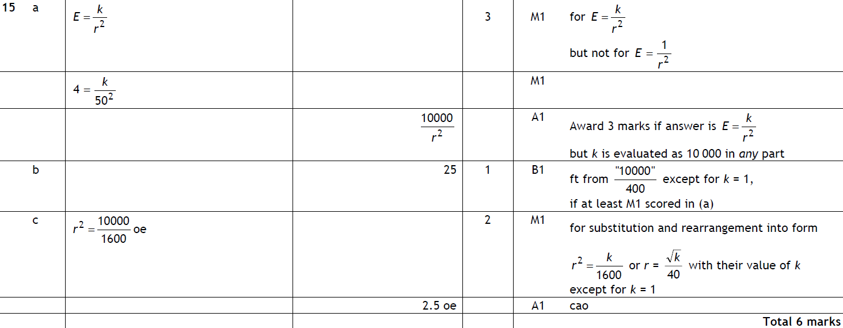
Direct & Inverse Proportion
June 2010 3H Q15
A
B
C

Slide 29
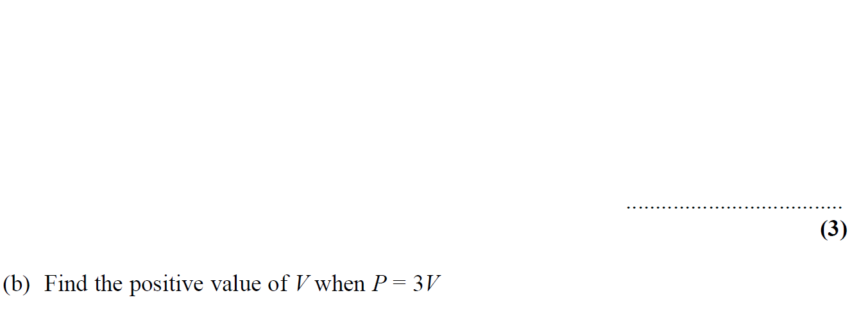
Direct & Inverse Proportion
Nov 2010 4H Q16

Slide 30
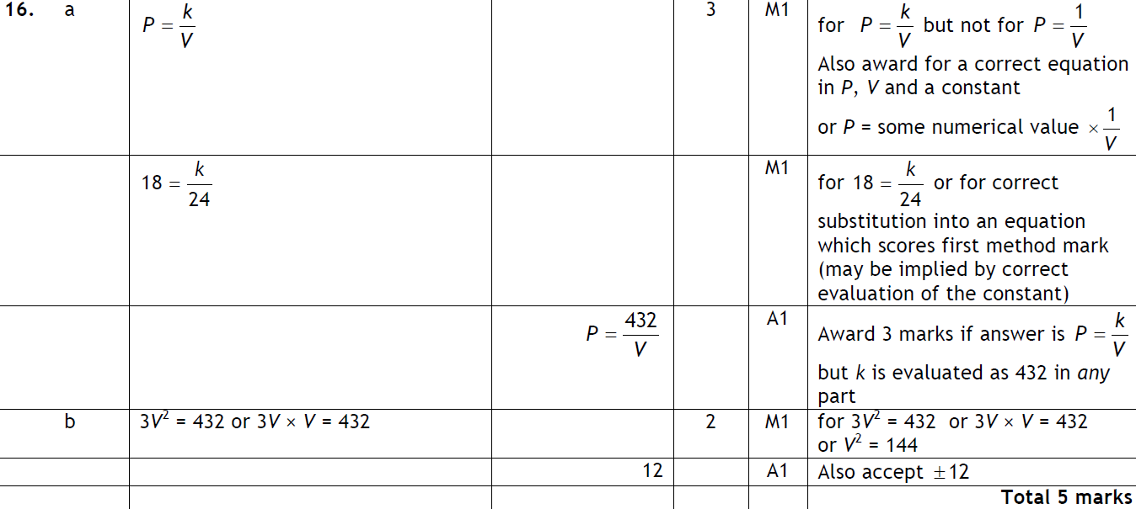
Direct & Inverse Proportion
Nov 2010 4H Q16
A
B

Slide 31
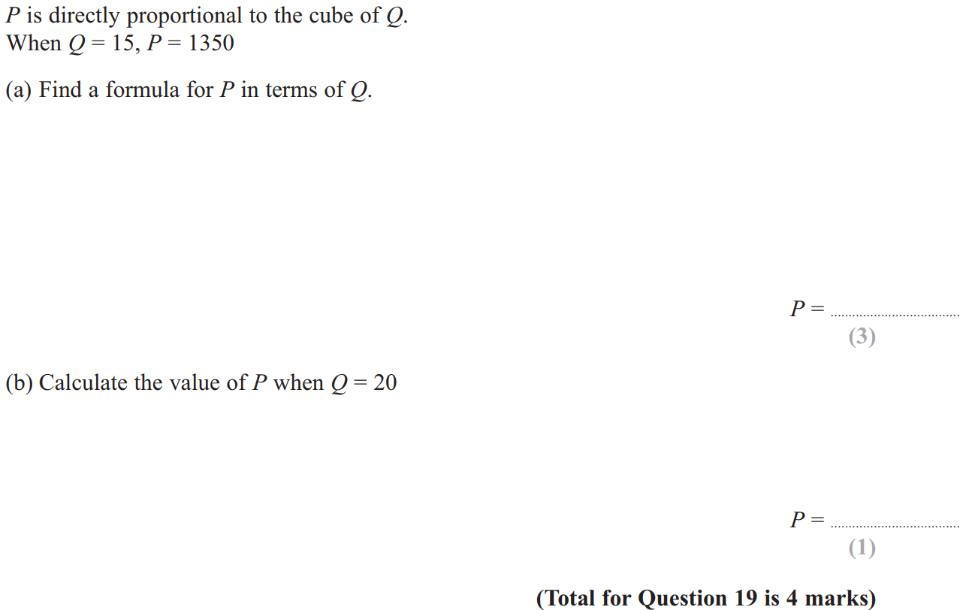
Direct & Inverse Proportion
June 2011 3H Q19

Slide 32
Direct & Inverse Proportion
June 2011 3H Q19
A
B

Slide 33
Direct & Inverse Proportion
Jan 2012 3H Q15

Slide 34
Direct & Inverse Proportion
Jan 2012 3H Q15
A
B
C

Slide 35
Direct & Inverse Proportion
Jan 2013 4H Q21

Slide 36
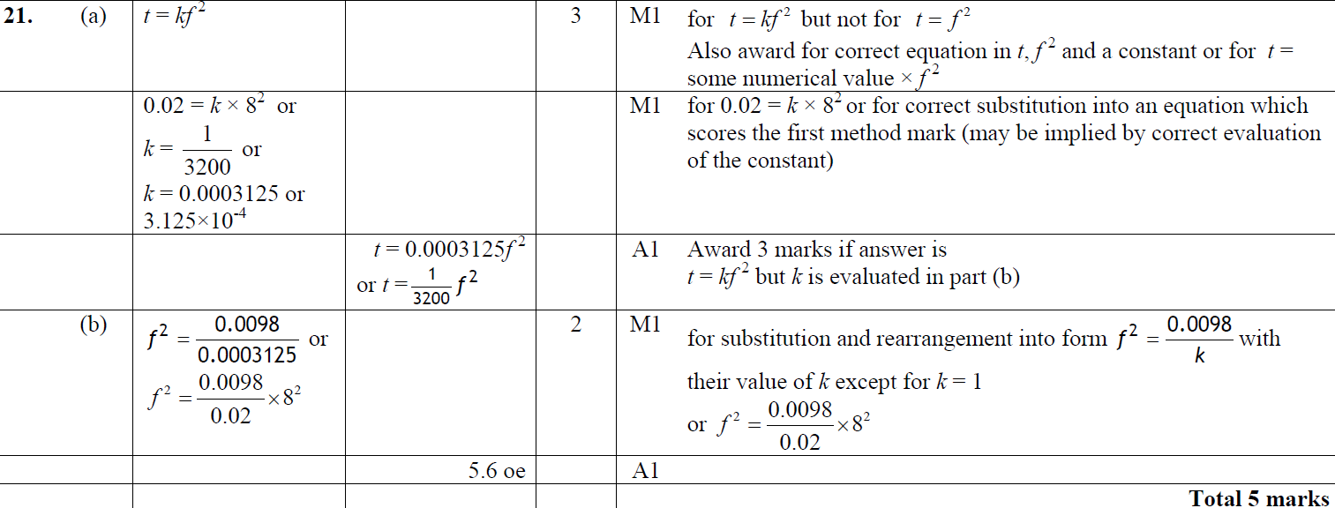
Direct & Inverse Proportion
Jan 2013 4H Q21
A
B

Slide 37
Direct & Inverse Proportion
May 2013 4H Q16

Slide 38
Direct & Inverse Proportion
May 2013 4H Q16
A
B
C

Slide 39
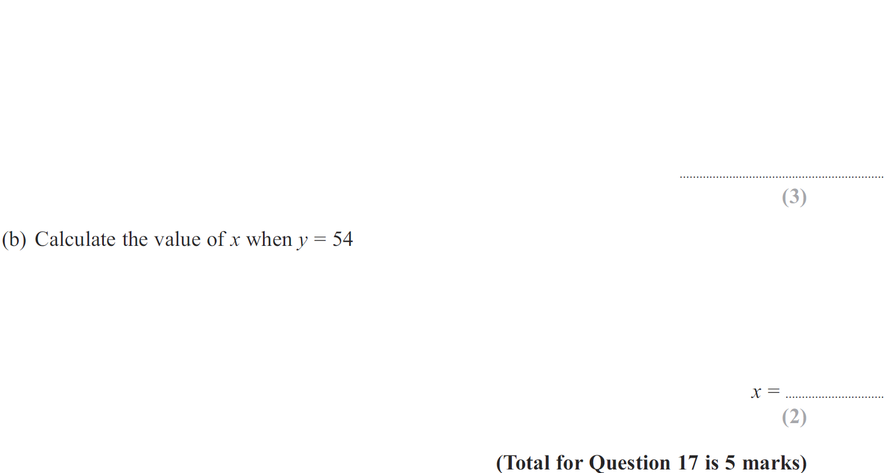
Direct & Inverse Proportion
May 2013 4HR Q17

Slide 40
Direct & Inverse Proportion
May 2013 4HR Q17
A
B

Slide 41
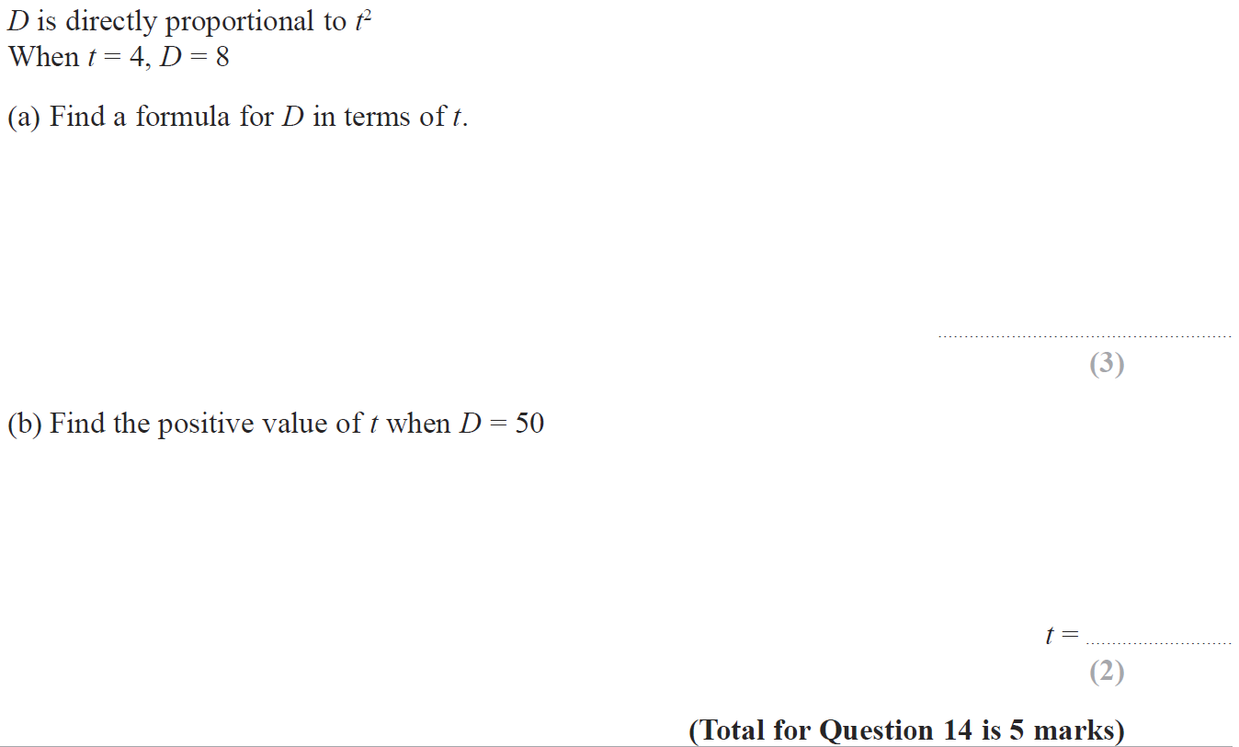
Direct & Inverse Proportion
Jan 2014 3H Q14

Slide 42
Direct & Inverse Proportion
Jan 2014 3H Q14
A
B

Slide 43
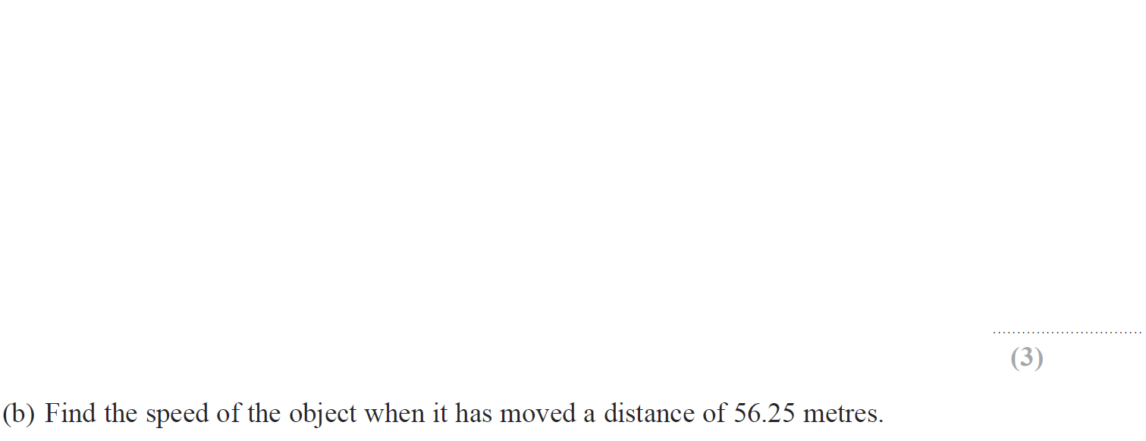
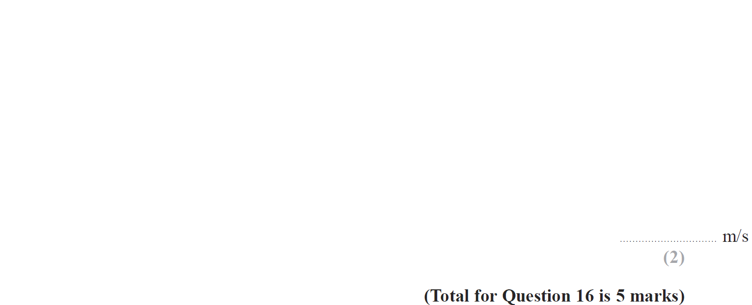
Direct & Inverse Proportion
Jan 2014 4HR Q16

Slide 44
Direct & Inverse Proportion
Jan 2014 4HR Q16
A
B

Slide 45
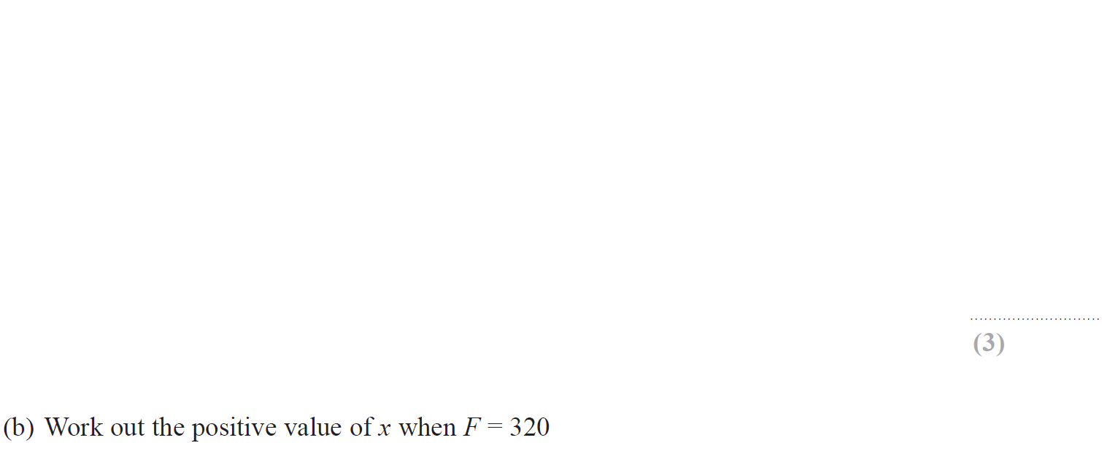
Direct & Inverse Proportion
May 2014 4H Q17

Slide 46
Direct & Inverse Proportion
May 2014 4H Q17
A
B

Slide 47
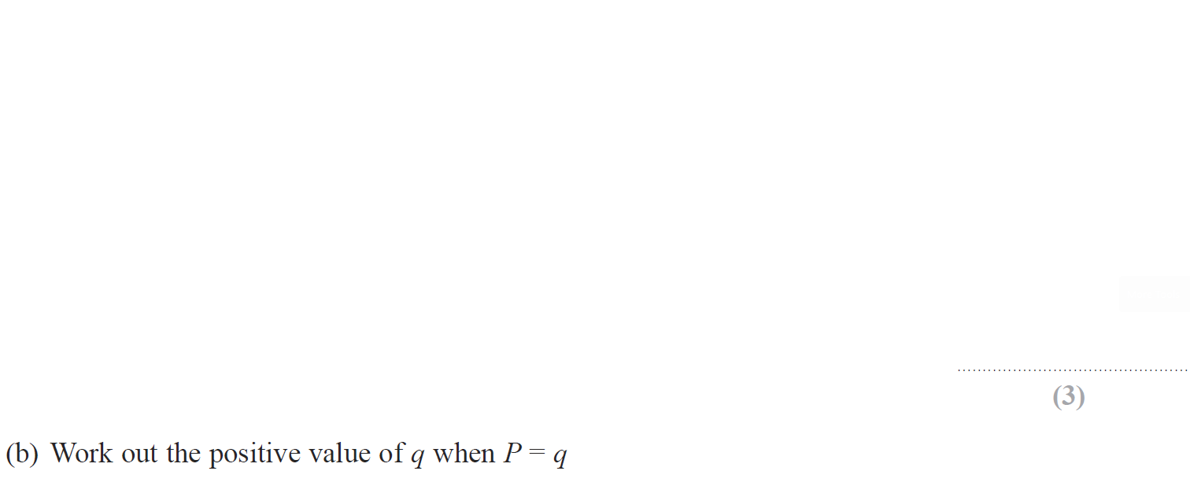
Direct & Inverse Proportion
Jan 2015 3H Q17

Slide 48
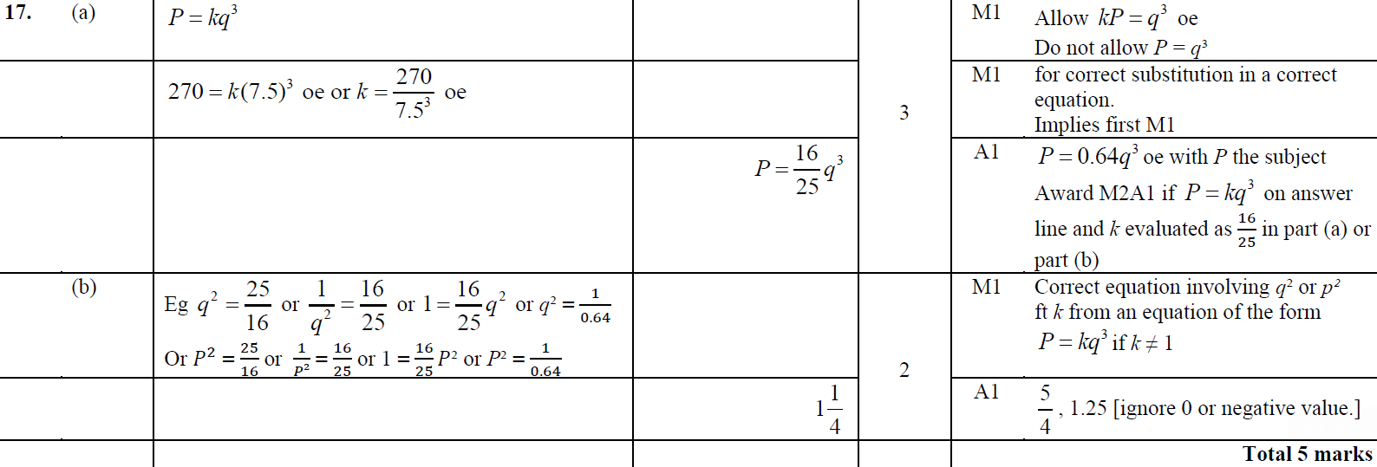
Direct & Inverse Proportion
Jan 2015 3H Q17
A
B

Slide 49
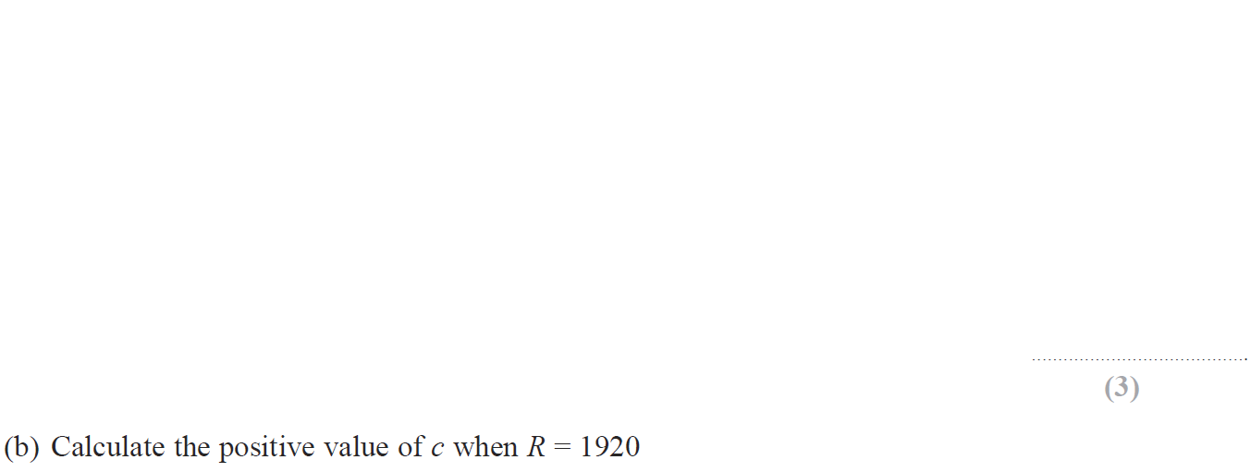
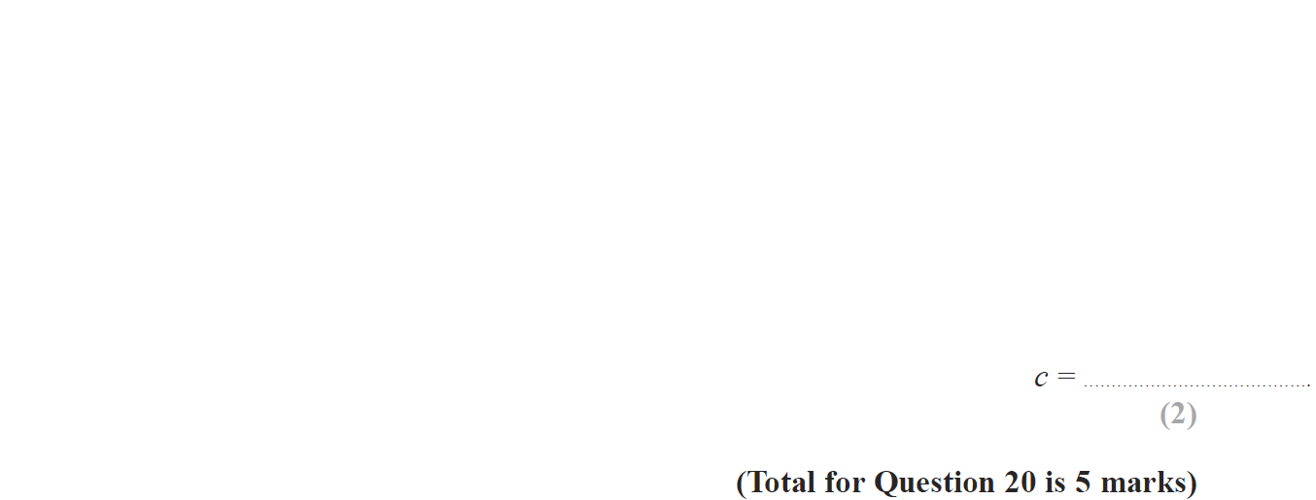
Direct & Inverse Proportion
Jan 2015 3HR Q20

Slide 50
Direct & Inverse Proportion
Jan 2015 3HR Q20
A
B

Slide 51
Direct & Inverse Proportion
May 2015 3H Q22

Slide 52
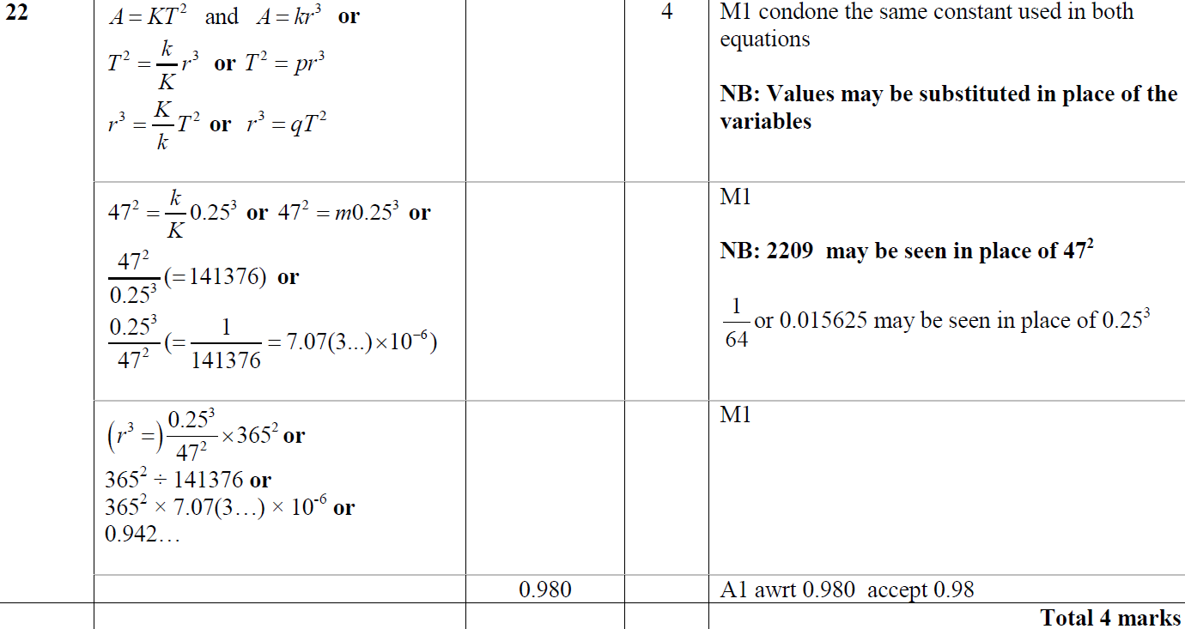
Direct & Inverse Proportion
May 2015 3H Q22
A

Slide 53
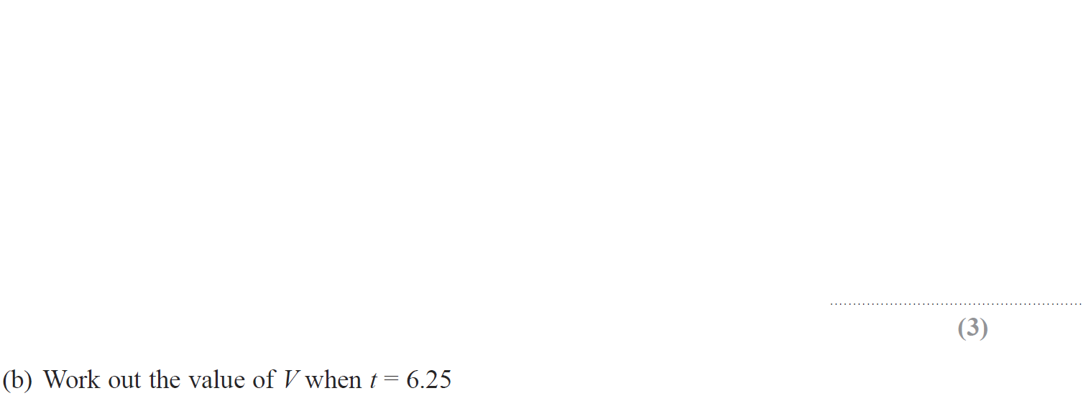
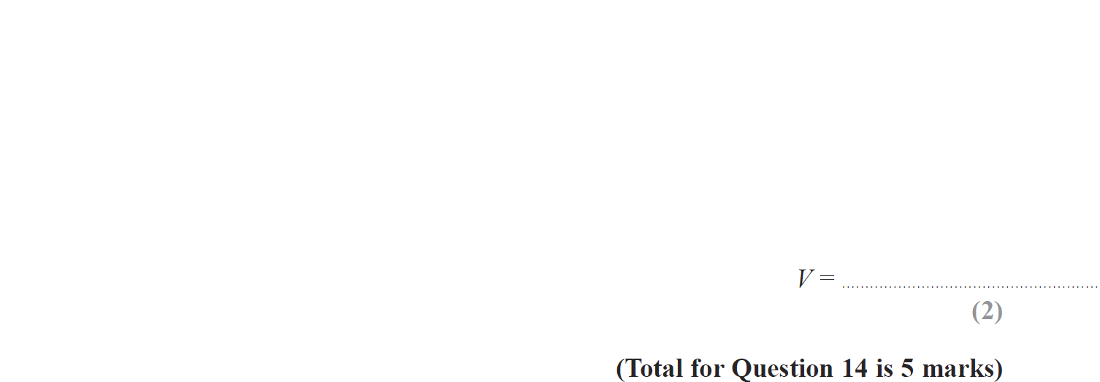
Direct & Inverse Proportion
June 2015 4HR Q14

Slide 54
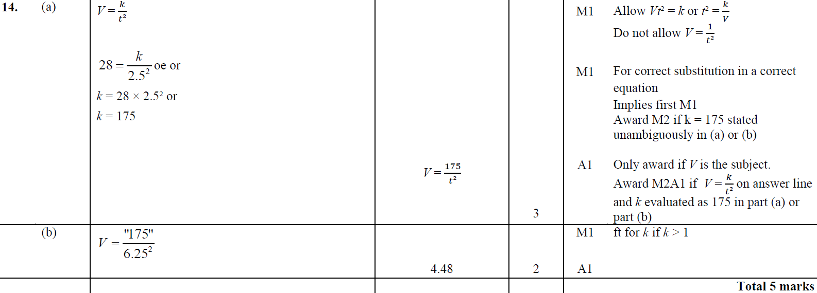
Direct & Inverse Proportion
June 2015 4HR Q14
A
B

Slide 55
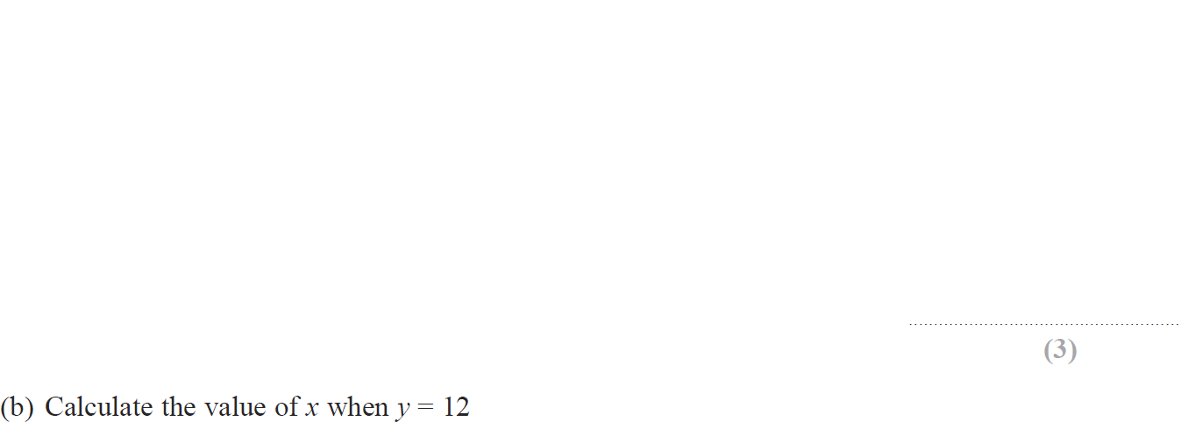
Direct & Inverse Proportion
Jan 2016 4H Q18

Slide 56
Direct & Inverse Proportion
Jan 2016 4H Q18
A
B

Slide 57
Direct & Inverse Proportion
Jan 2016 4HR Q16

Slide 58
Direct & Inverse Proportion
Jan 2016 4HR Q16
A

Slide 59
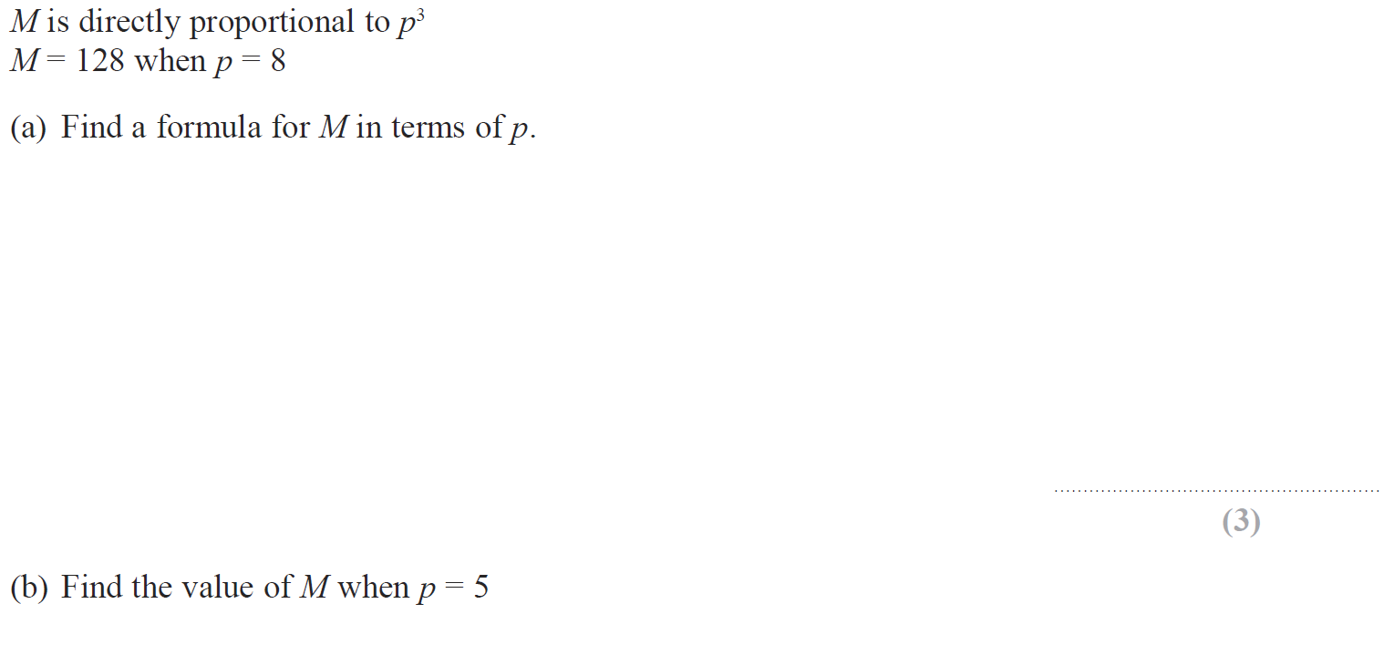
Direct & Inverse Proportion
June 2016 4H Q13

Slide 60
Direct & Inverse Proportion
June 2016 4H Q13
A
B

Slide 61
Direct & Inverse Proportion
Jan 2017 3H Q14

Slide 62
Direct & Inverse Proportion
Jan 2017 3H Q14
A
B

Slide 63
Direct & Inverse Proportion
Jan 2017 4HR Q13

Slide 64
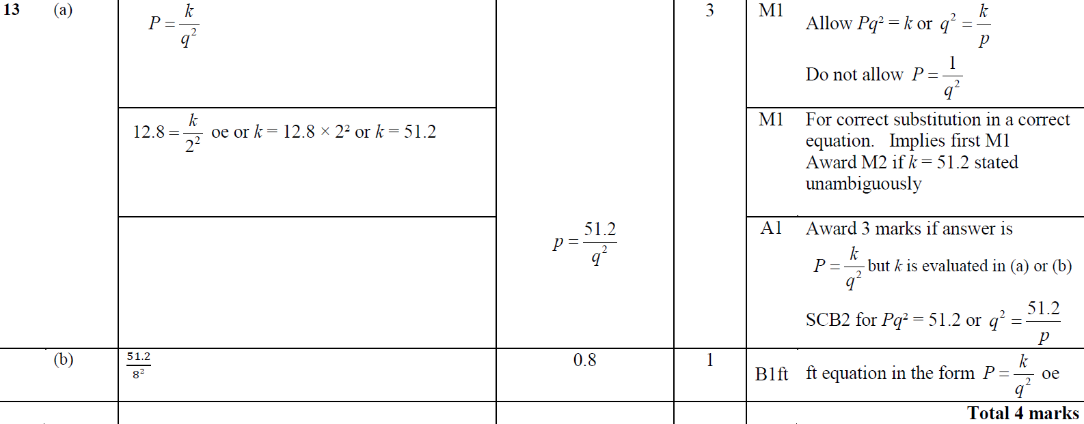
Direct & Inverse Proportion
Jan 2017 4HR Q13
A
B

Slide 65
Direct & Inverse Proportion
May 2017 3H Q15

Slide 66
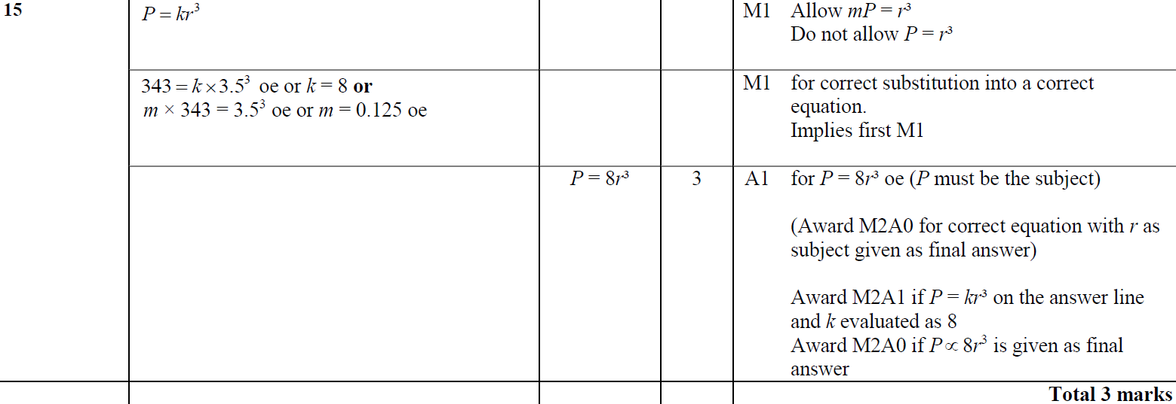
Direct & Inverse Proportion
May 2017 3H Q15
A

Slide 67
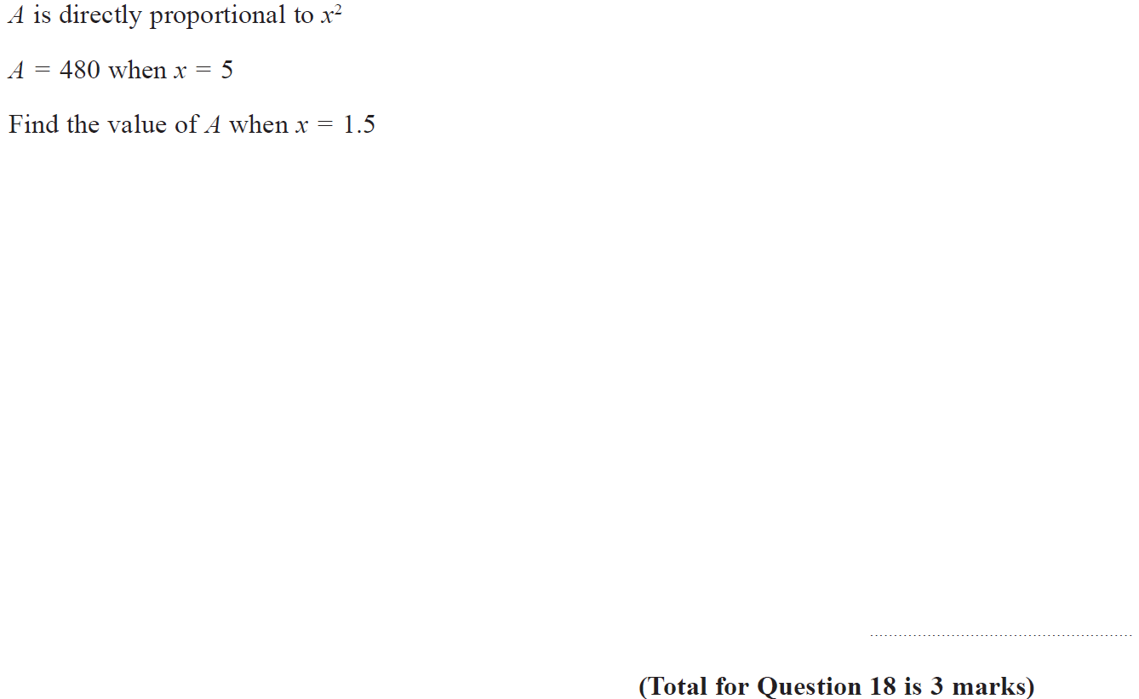
Direct & Inverse Proportion
June 2017 4HR Q18

Slide 68
Direct & Inverse Proportion
June 2017 4HR Q18
A

Slide 69
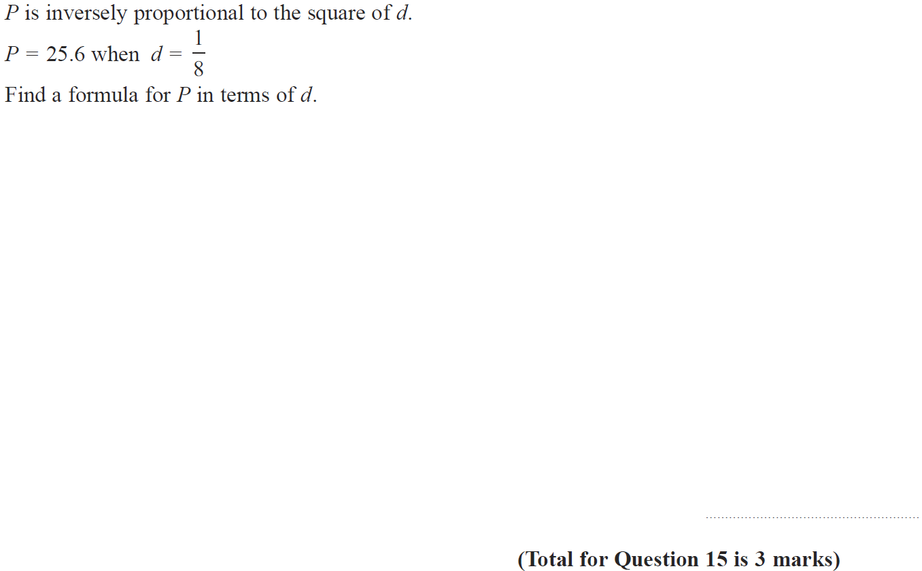
Direct & Inverse Proportion
Jan 2018 4H Q15

Slide 70
Direct & Inverse Proportion
Jan 2018 4H Q15
A

Slide 71
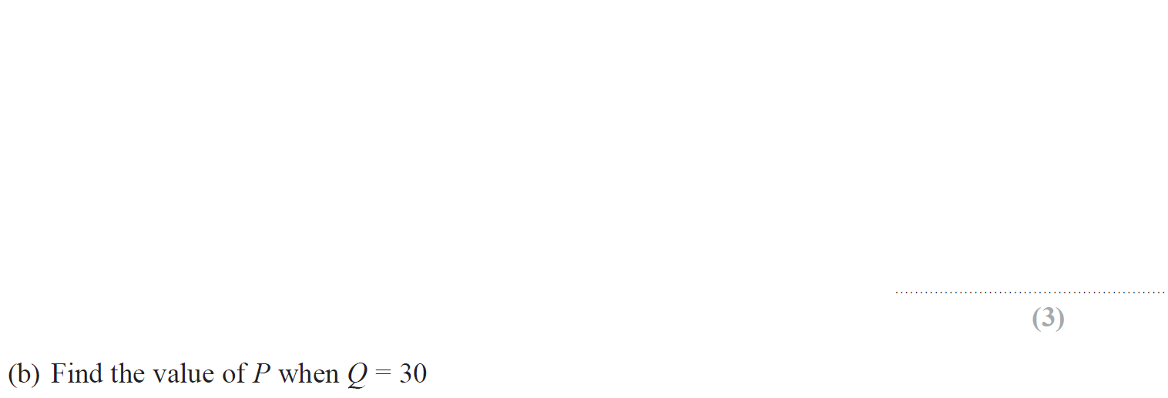
Direct & Inverse Proportion
Jan 2018 4HR Q14

Slide 72
Direct & Inverse Proportion
Jan 2018 4HR Q14
A
B

Slide 73
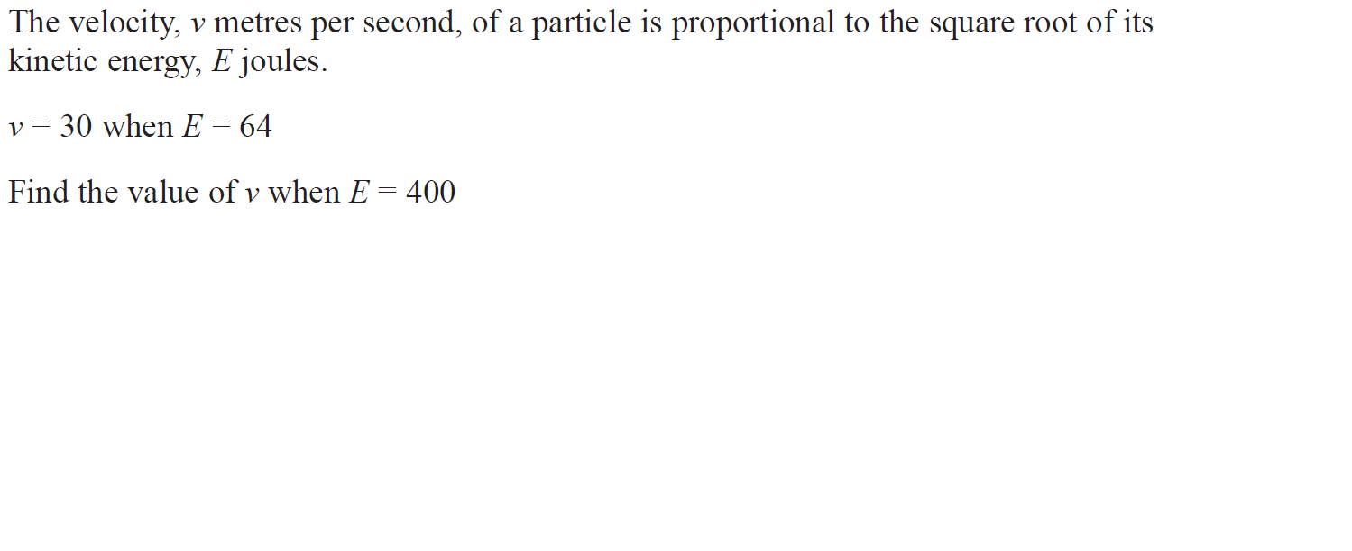
Direct & Inverse Proportion
June 2018 4H Q16

Slide 74
Direct & Inverse Proportion
June 2018 4H Q16
A

