Slide 1
Old Spec Q’s
Differentiation
SAM 2
2019 2
See also: Hyperbolics

Slide 2
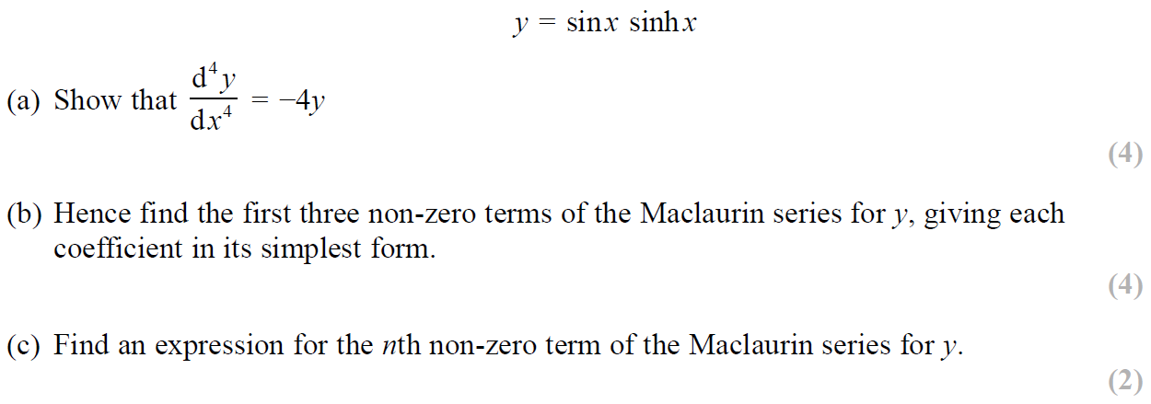
SAM Paper 2

Slide 3
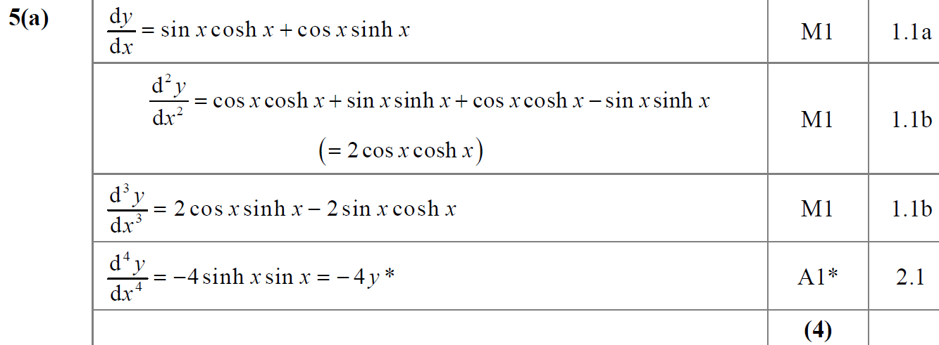
SAM Paper 2
A

Slide 4
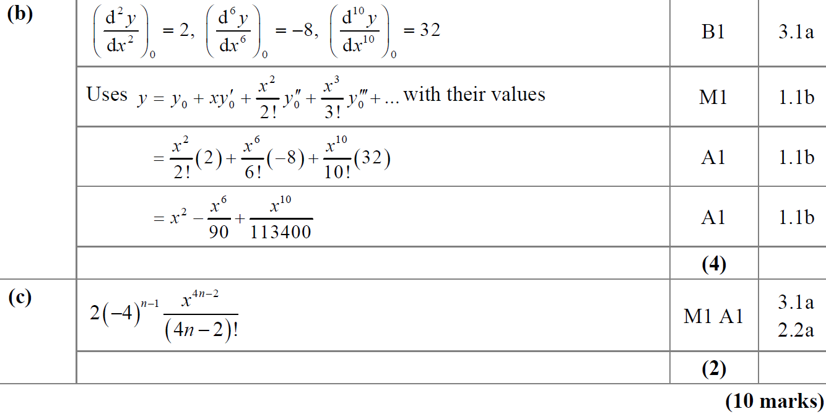
SAM Paper 2
B
C

Slide 5
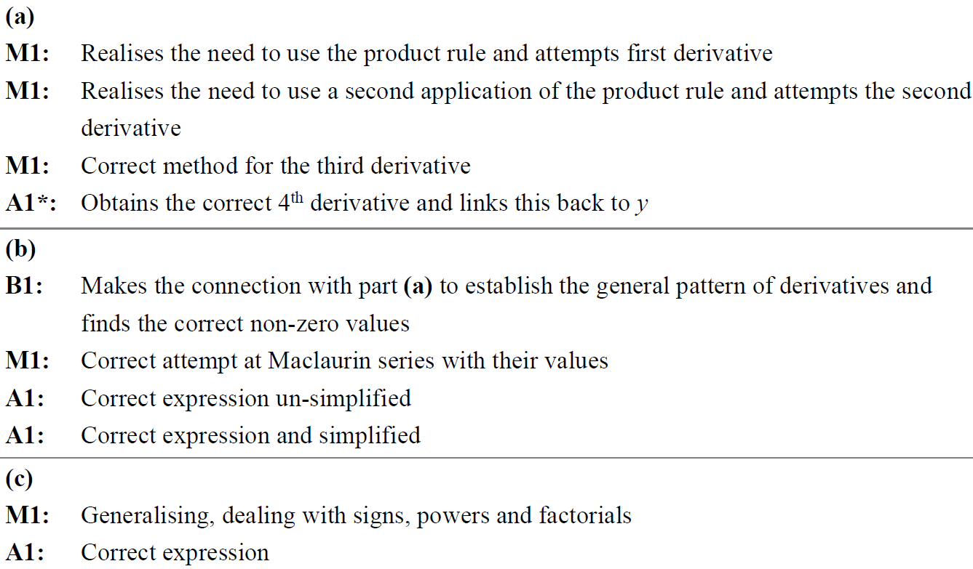
SAM Paper 2
A notes
B notes
C notes

Slide 6
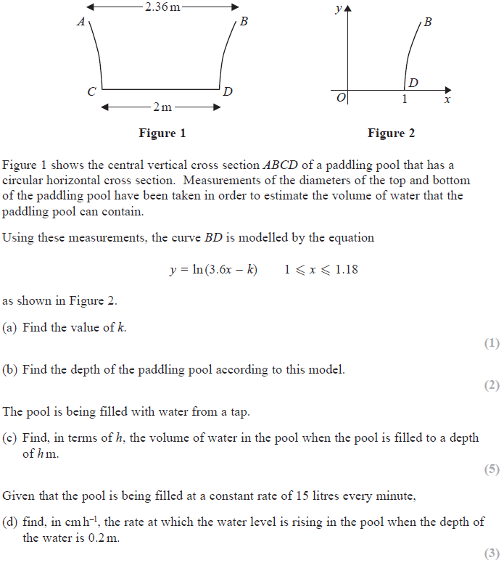
2019 Paper 2

Slide 7
2019 Paper 2
A
B

Slide 8
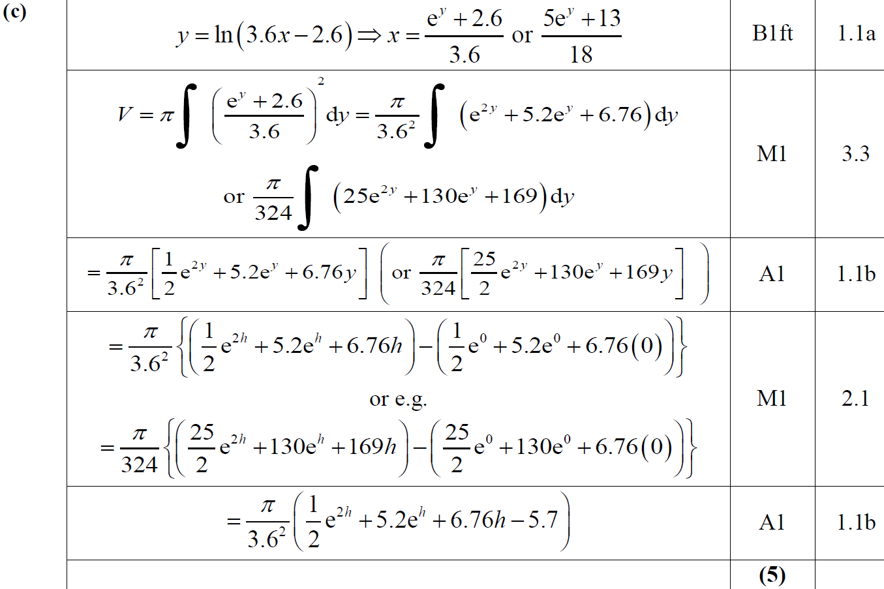
2019 Paper 2
C

Slide 9
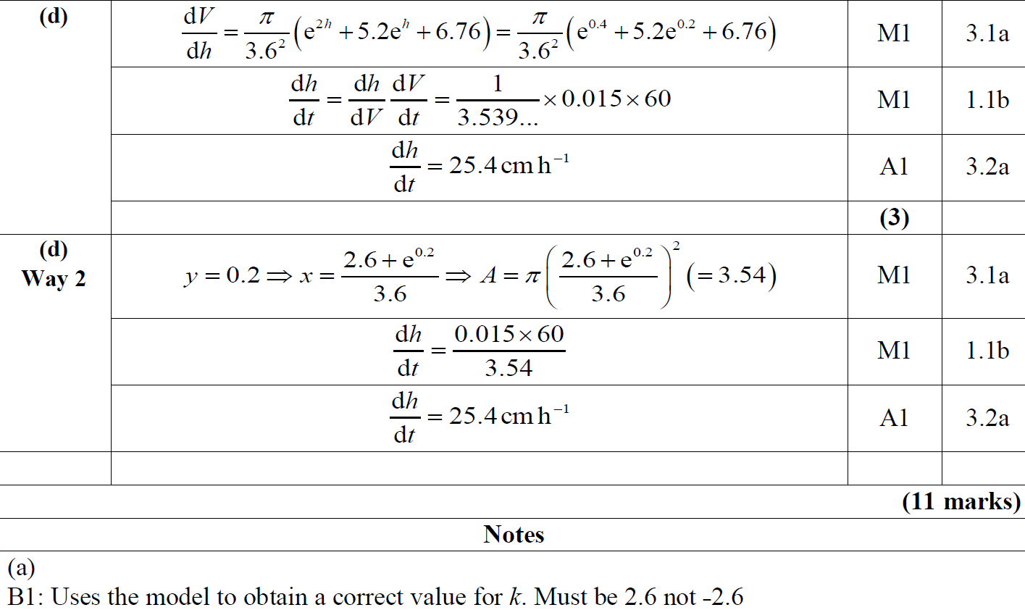
2019 Paper 2
D
A notes

Slide 10
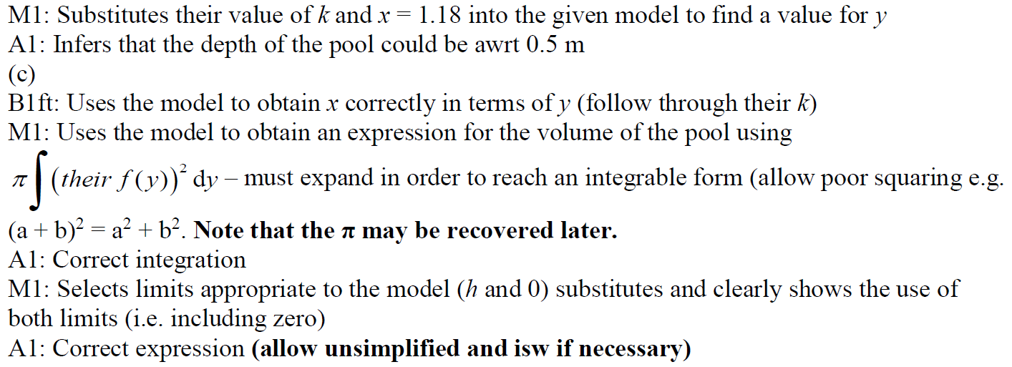
2019 Paper 2
B notes
C notes

Slide 11
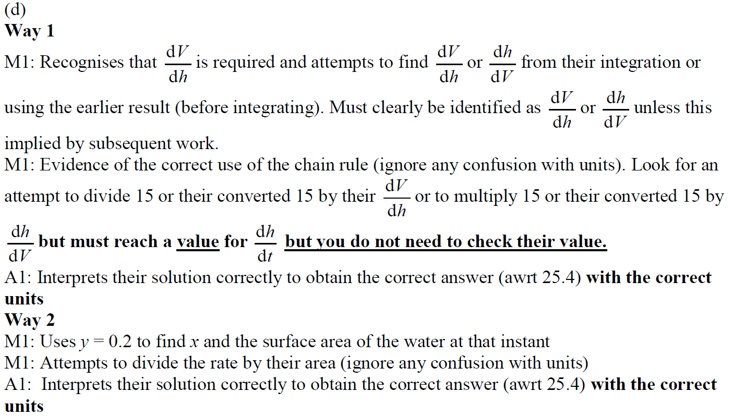
2019 Paper 2
D notes

Slide 12
New Spec Q’s
Old Spec Differentiation
P5/ Old FP2
P6/ Old FP3
FP2 (most are Taylor)
June 2002
June 2004
June 2013 W
June 2003
June 2014
Feb 2010
June 2017

Slide 13
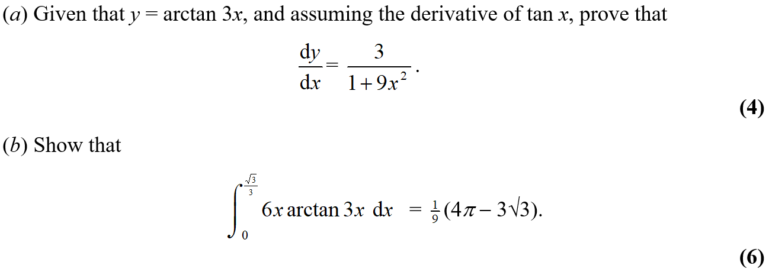
June 2002

Slide 14
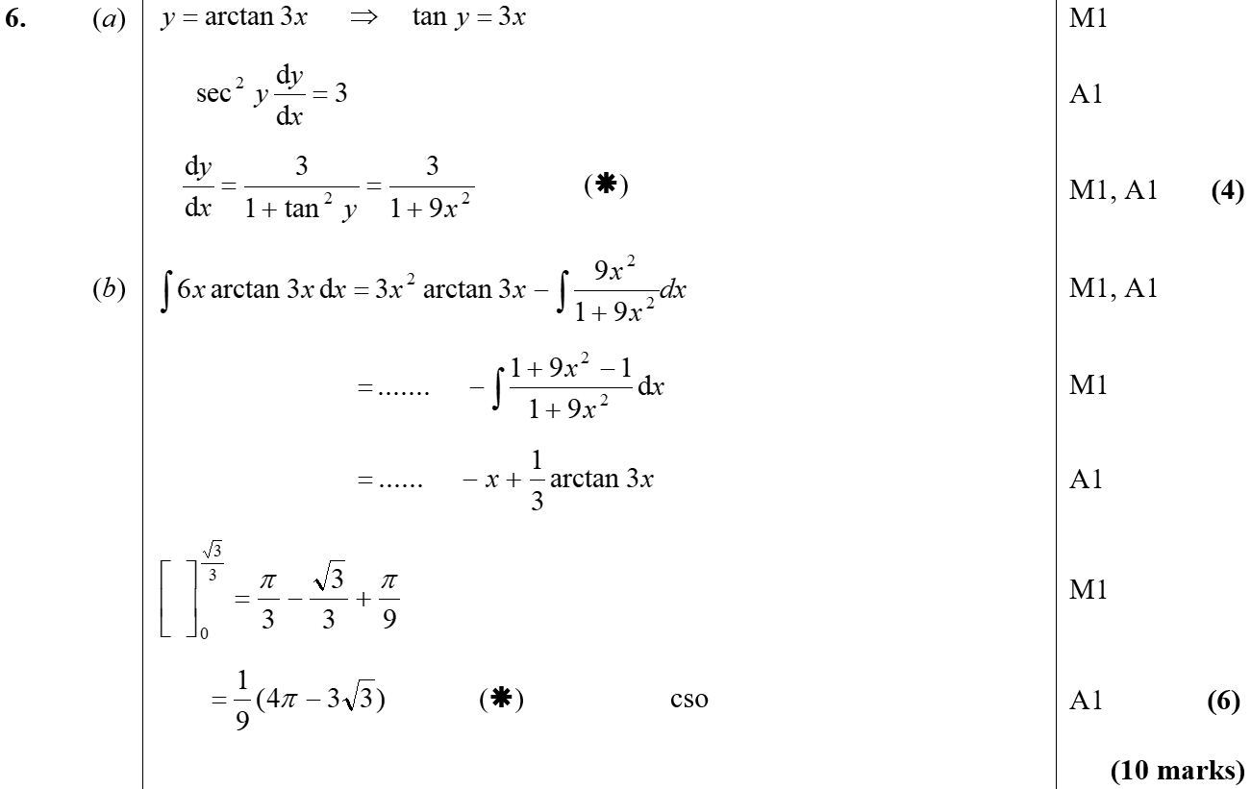
June 2002
A
B

Slide 15
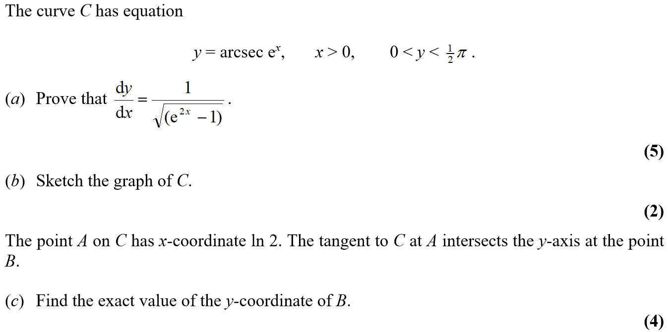
June 2003

Slide 16
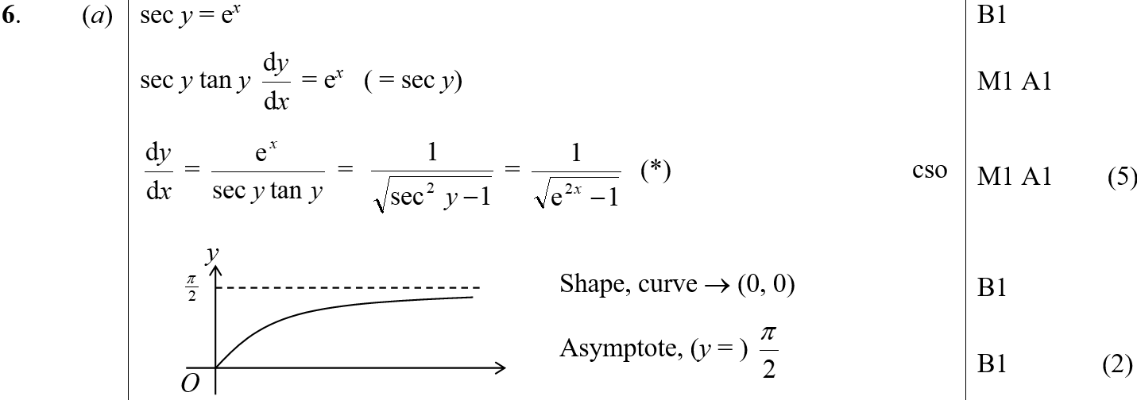
June 2003
A
B
A Alternative

Slide 17
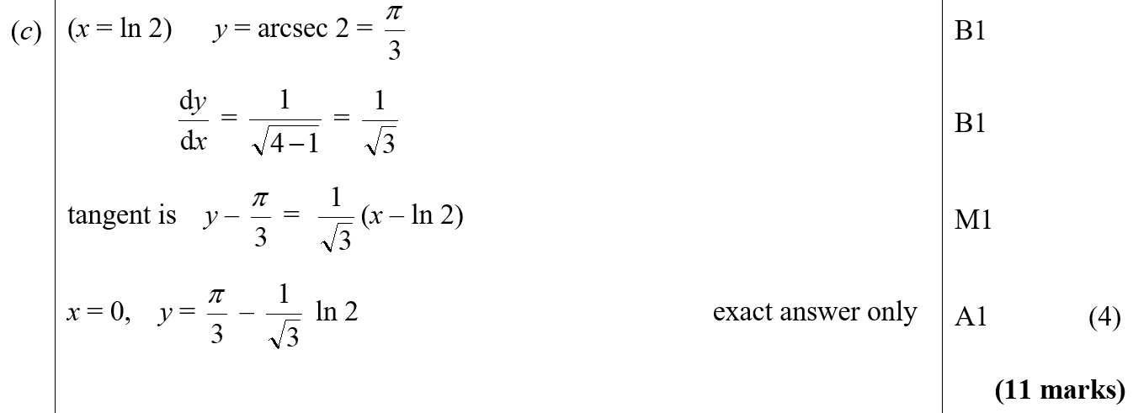
June 2003
C

Slide 18
Feb 2010

Slide 19
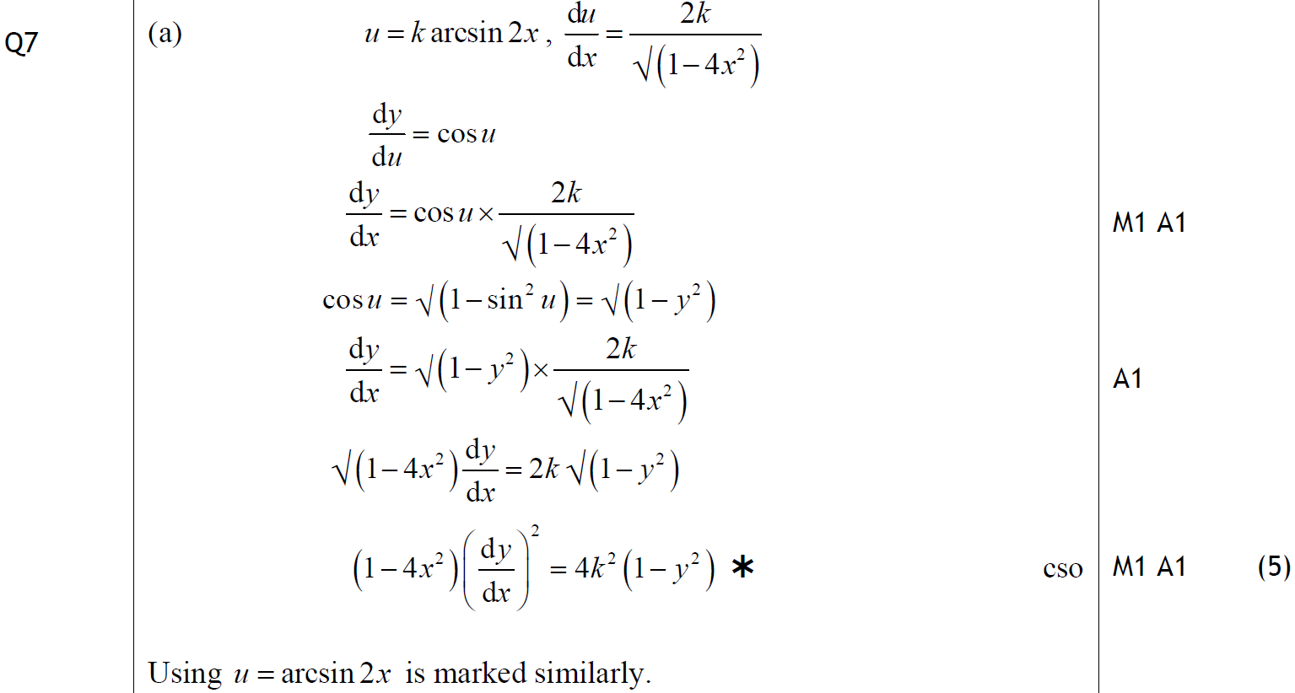
Feb 2010
A

Slide 20
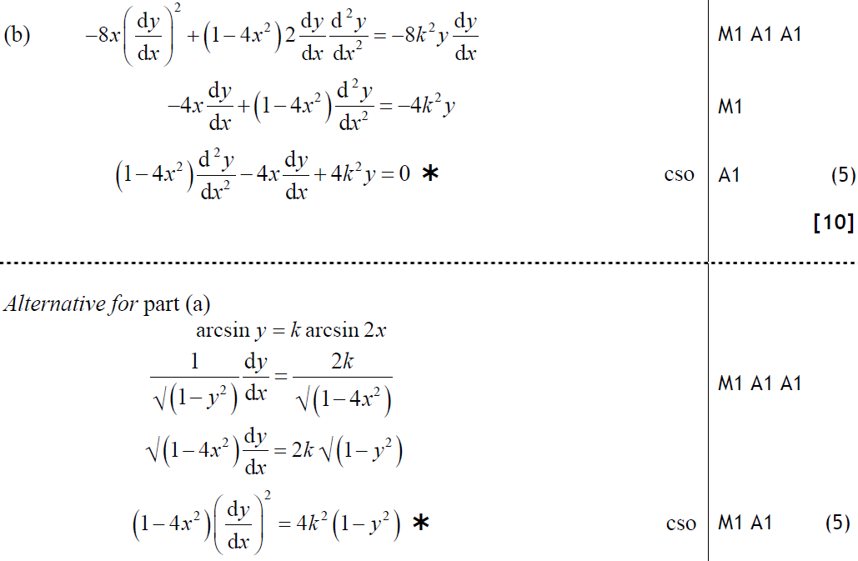
Feb 2010
B
A Alternative

Slide 21
June 2004

Slide 22
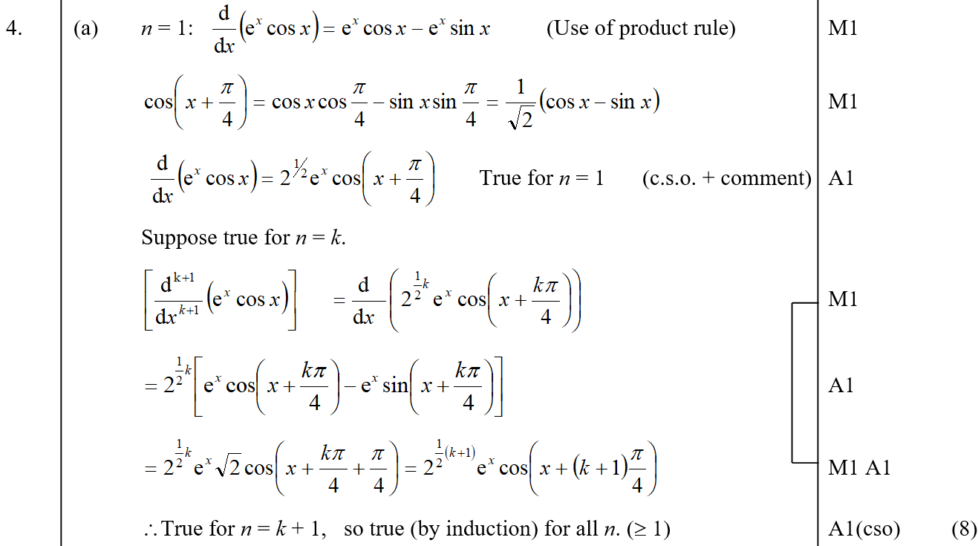
June 2004
A

Slide 23
June 2004
B

Slide 24
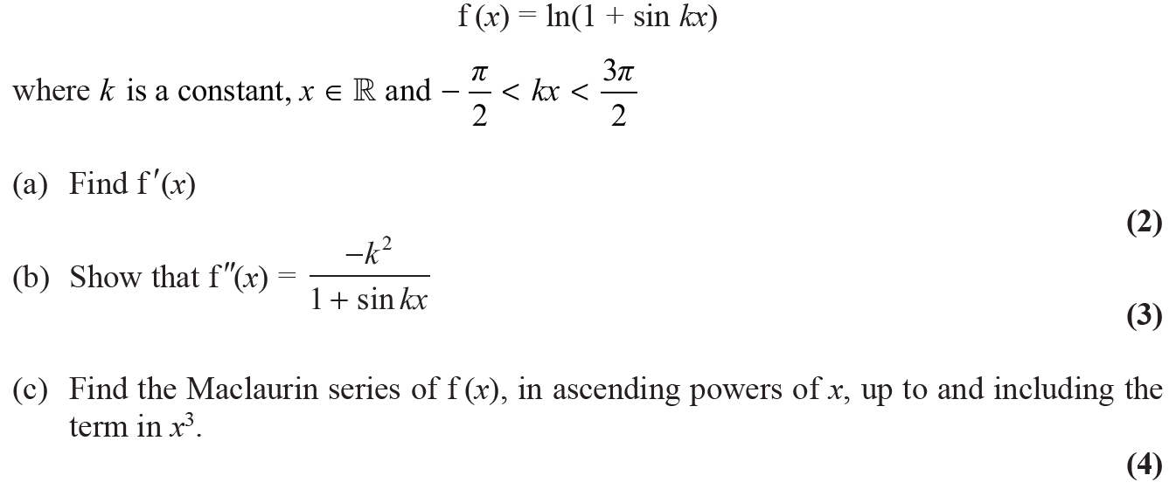
June 2013 Withdrawn

Slide 25
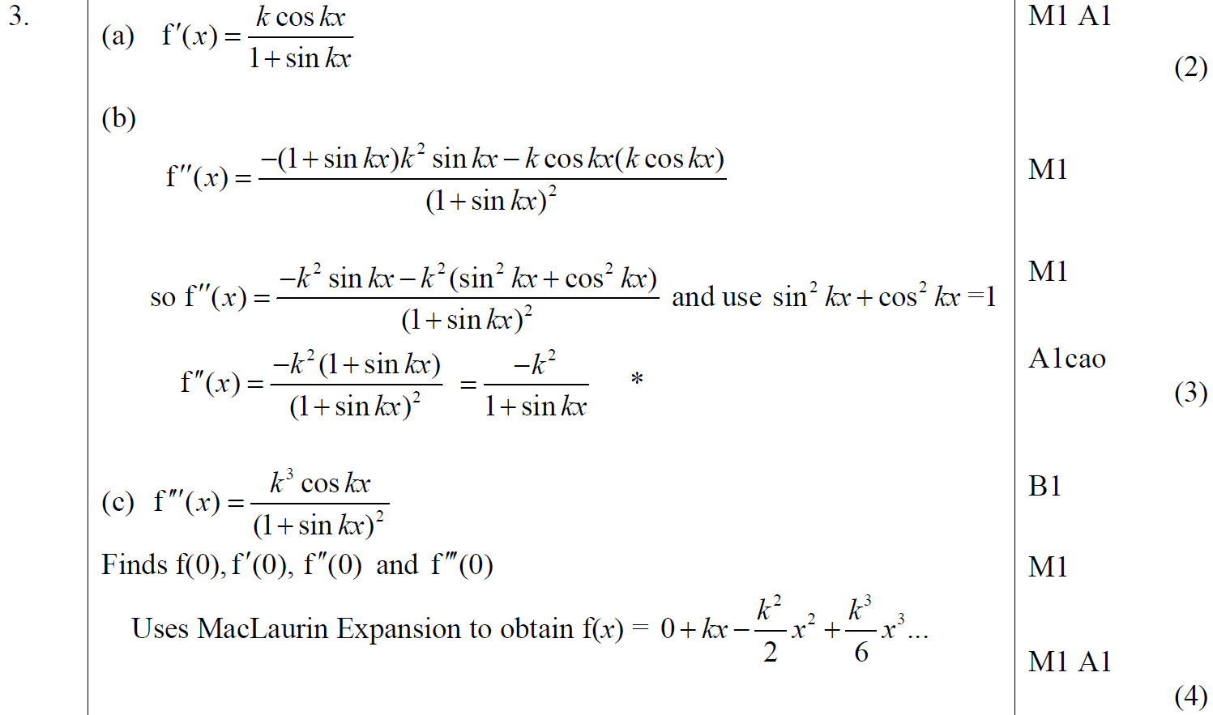
June 2013 Withdrawn
A
B
C

Slide 26
June 2014

Slide 27
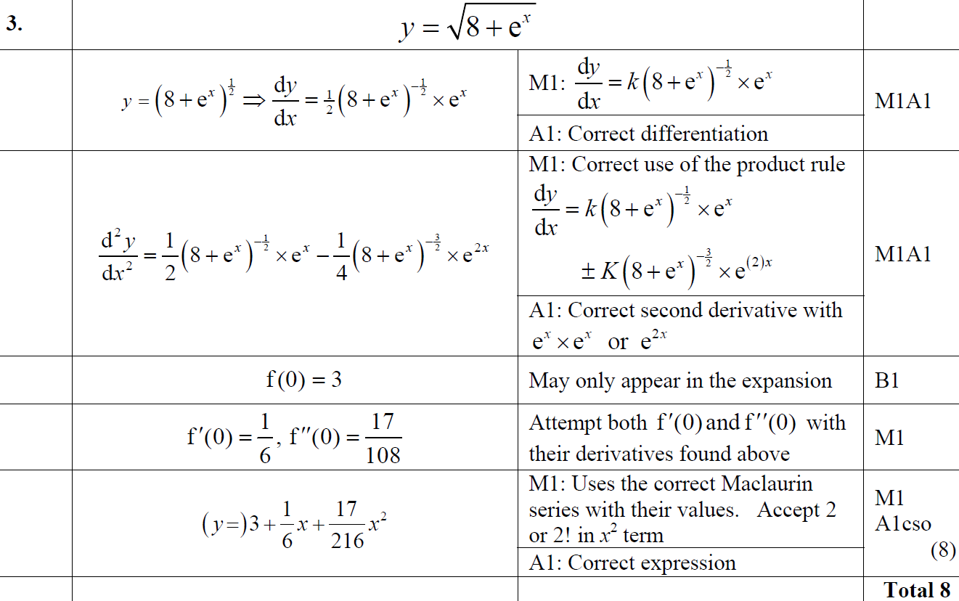
June 2014
A

Slide 28
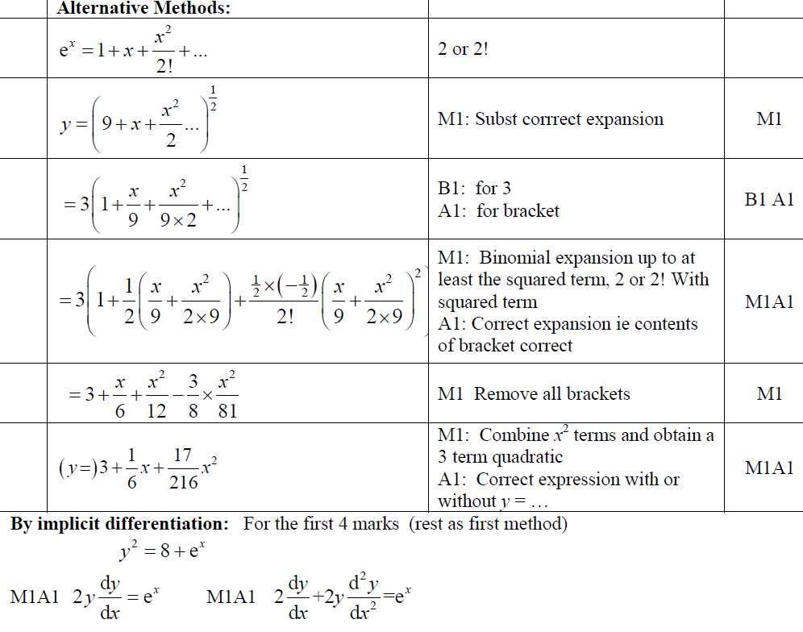
June 2014
A Alternatives

Slide 29
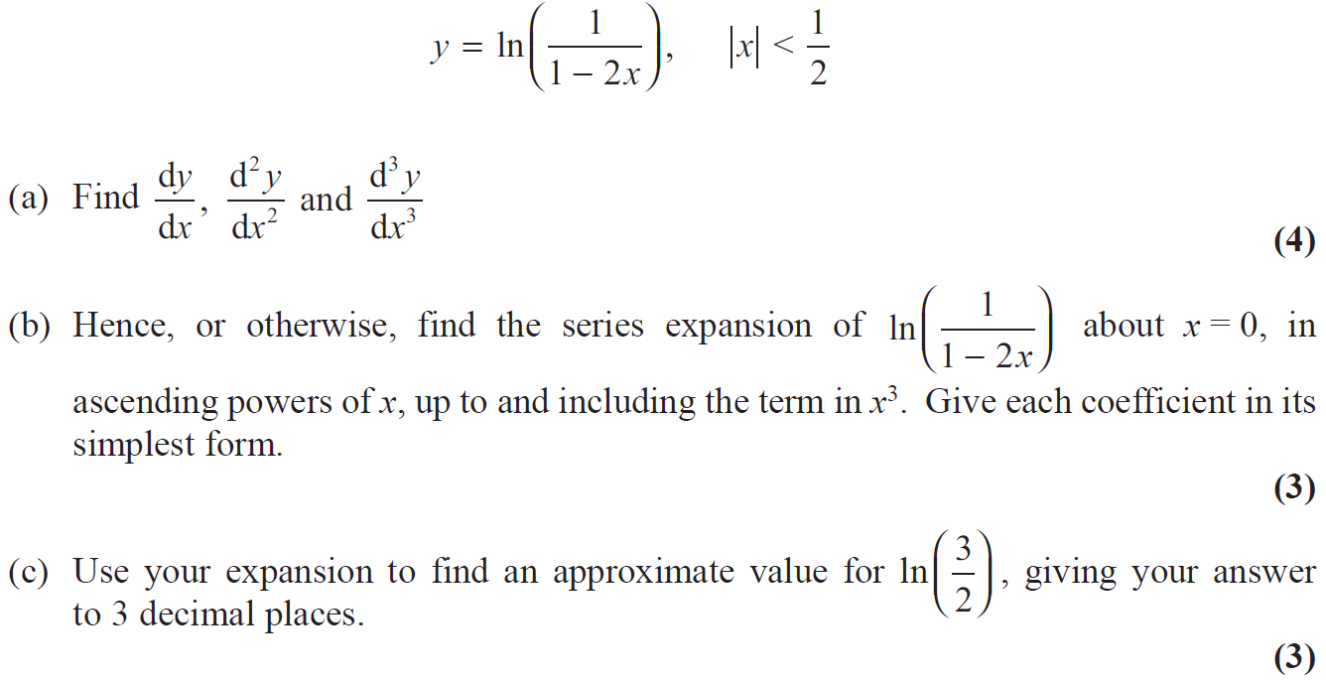
June 2017

Slide 30
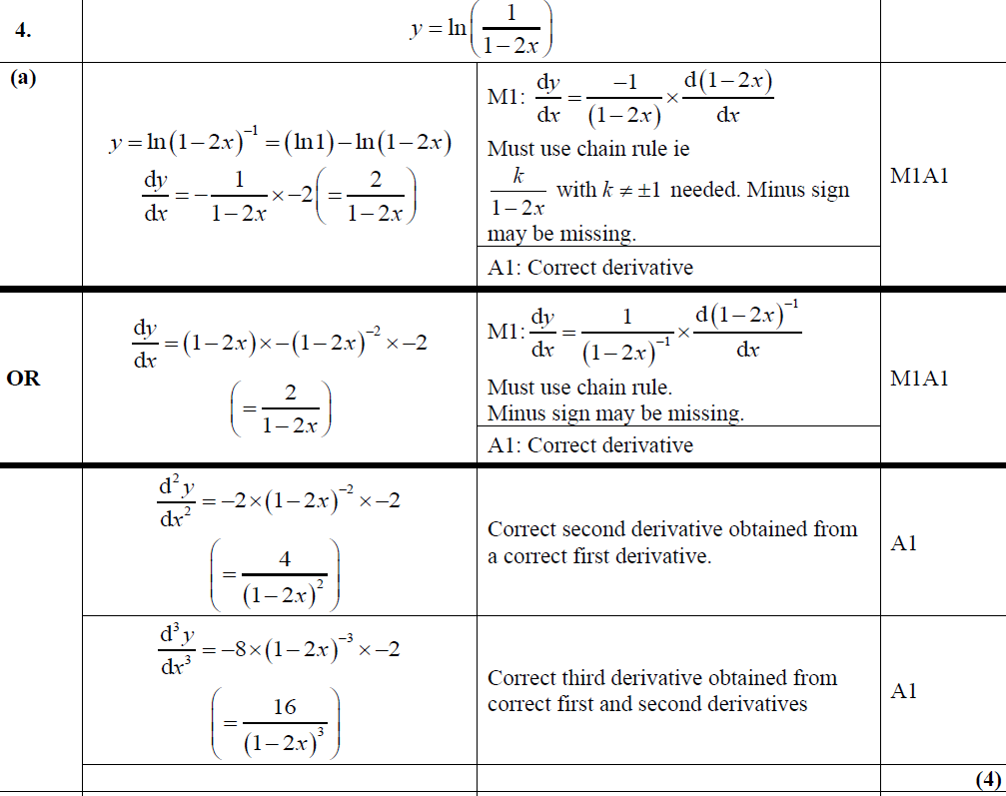
June 2017
A

Slide 31
June 2017
A Alternative

Slide 32
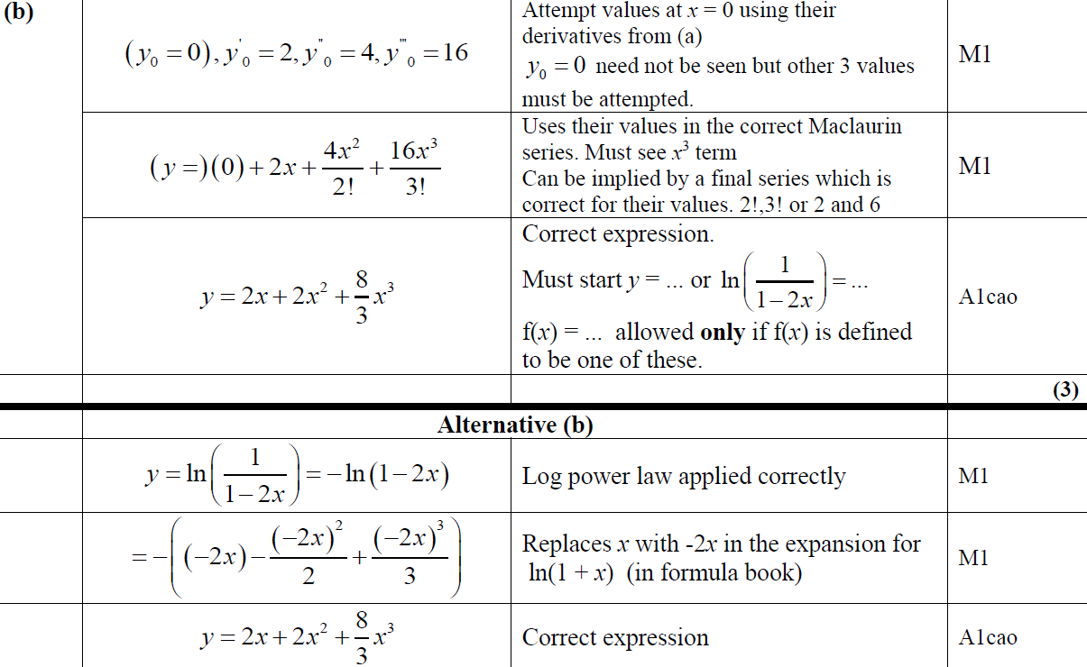
June 2017
A

Slide 33
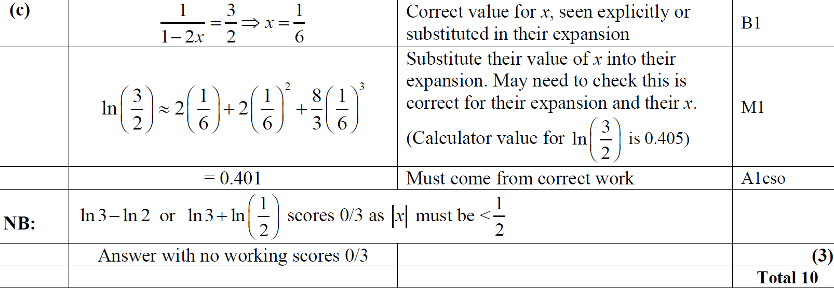
June 2017
C

