Slide 1
Old Spec Q’s
De Moivre’s Theorem
SAM 2
2019 2

Slide 2
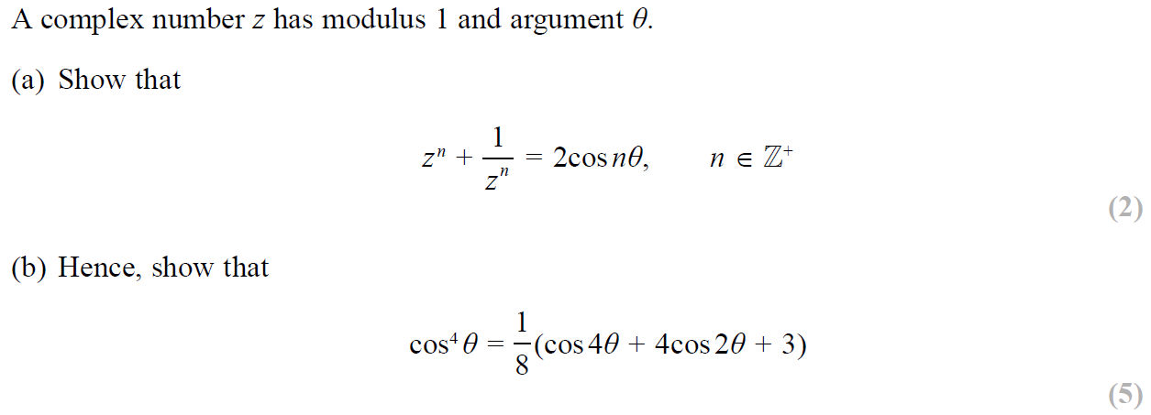
SAM Paper 2

Slide 3
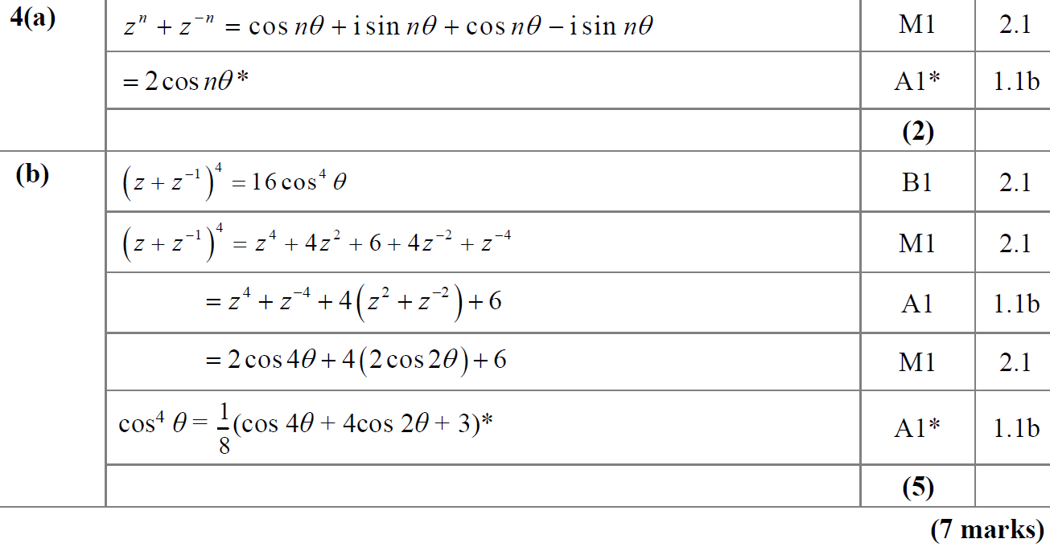
SAM Paper 2
A
B

Slide 4
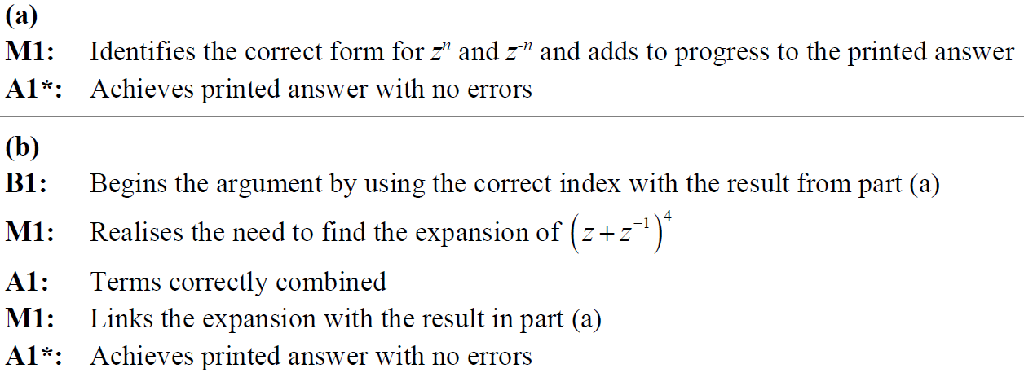
SAM Paper 2
A
B

Slide 5
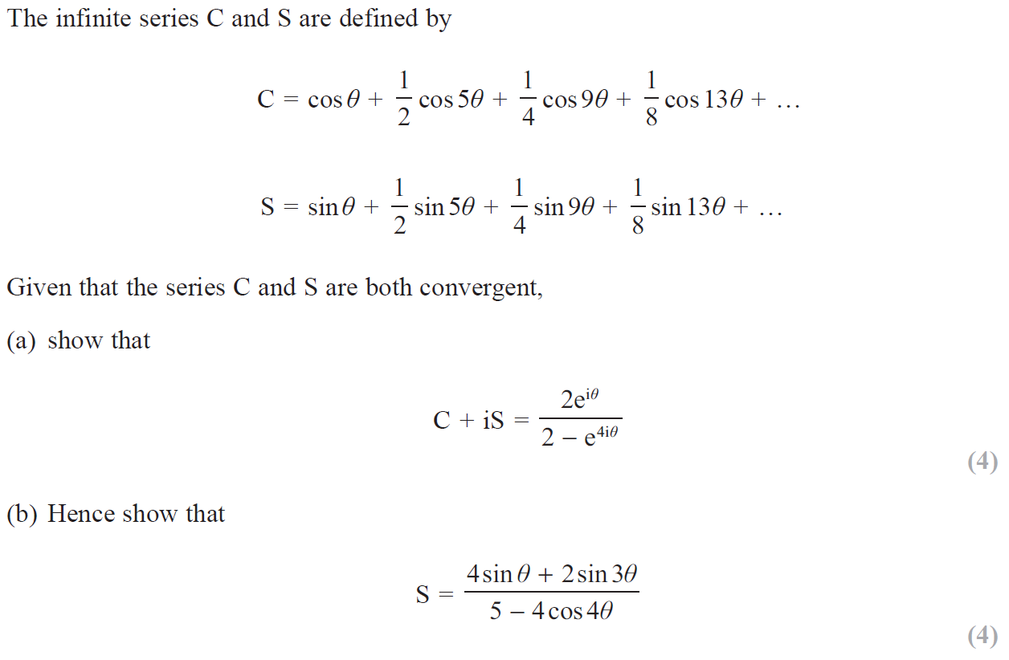
2019 Paper 2

Slide 6
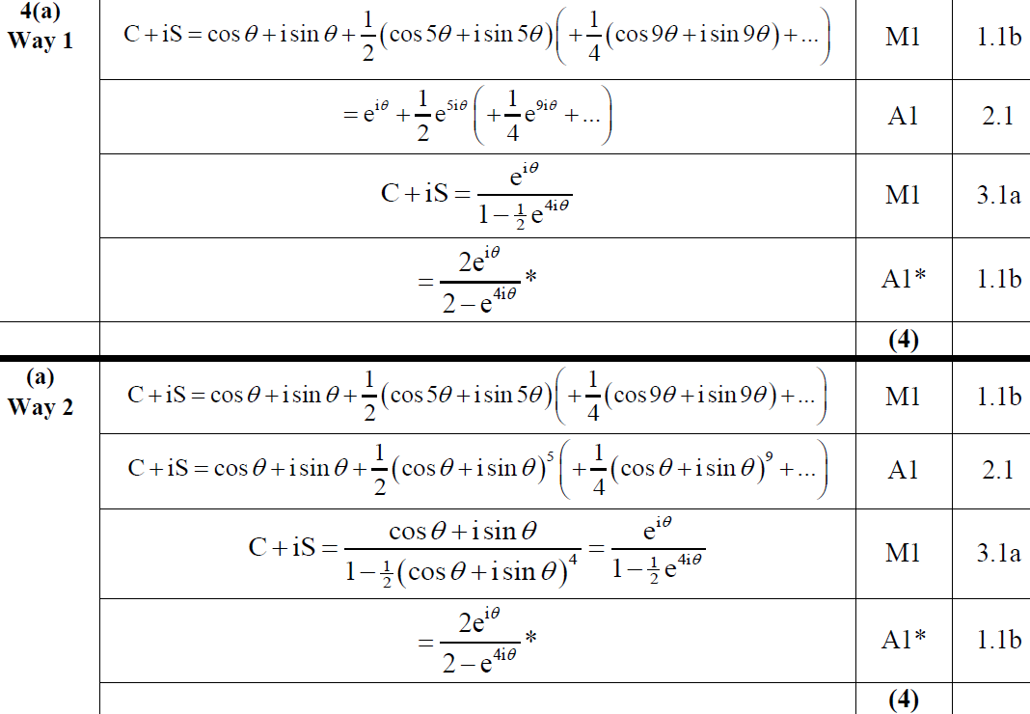
2019 Paper 2
A

Slide 7
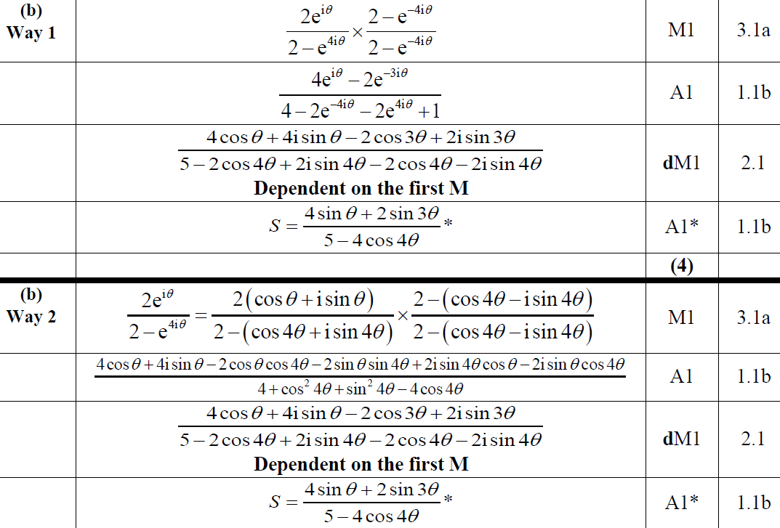
2019 Paper 2
B

Slide 8
2019 Paper 2
A notes
B notes

Slide 9
New Spec Q’s
Old Spec De Moivre’s Theorem
P6/ Old FP3
FP2
June 2002
June 2009
June 2014 R
June 2005
June 2010
June 2015
Jan 2006
June 2011
June 2016 (i)
June 2006
June 2012
June 2016 (ii)
June 2007
June 2013
June 2017
June 2008
June 2013 R
June 2018
June 2009
June 2013 W
June 2019
Feb 2010
June 2014

Slide 10
June 2002

Slide 11
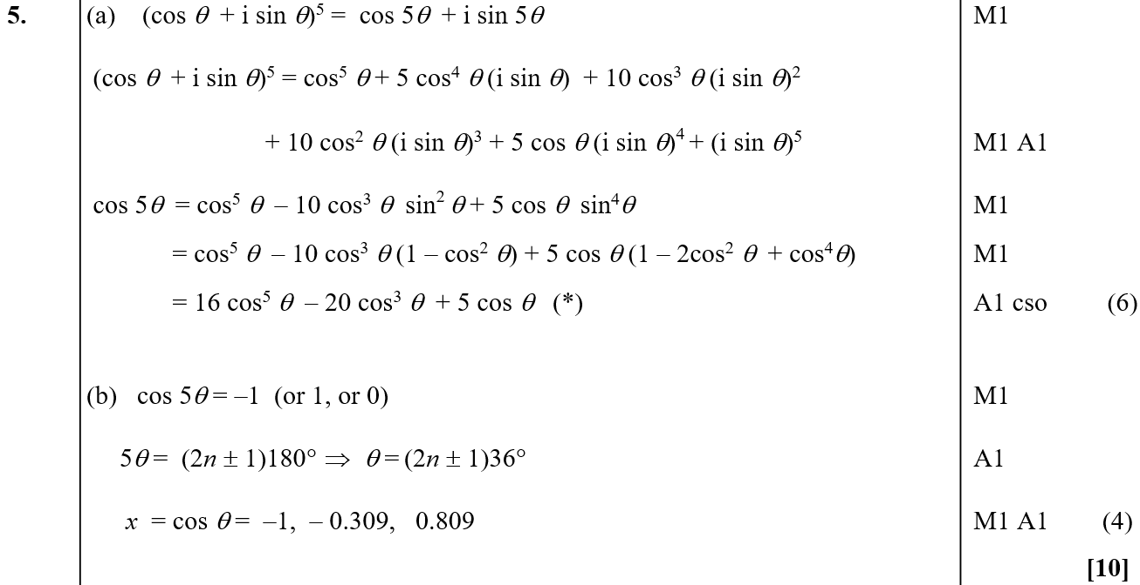
June 2002
A
B

Slide 12
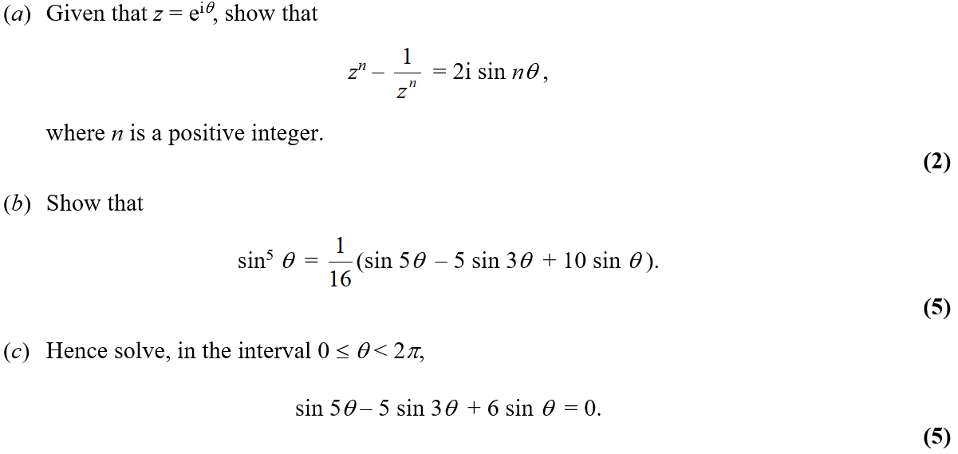
June 2005

Slide 13
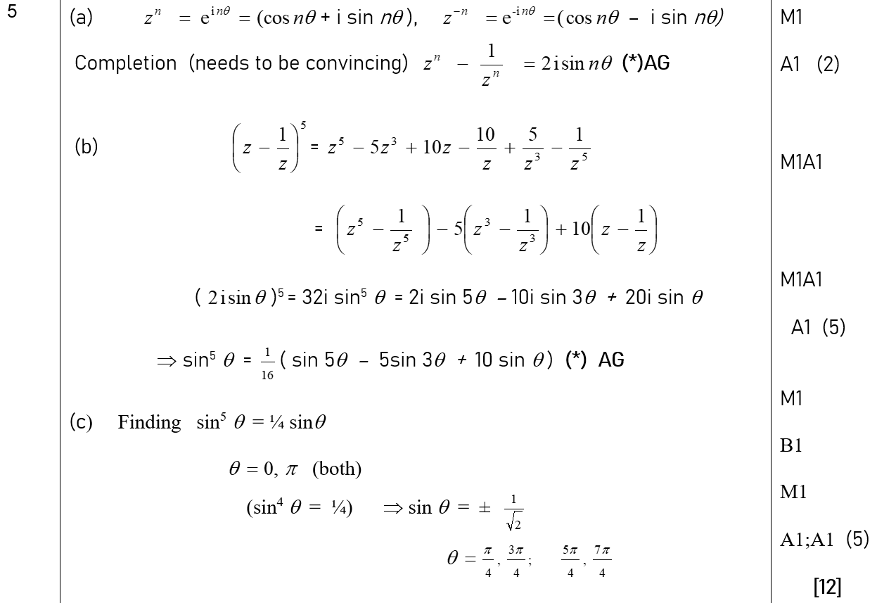
June 2005
A
B
C

Slide 14
Jan 2006

Slide 15
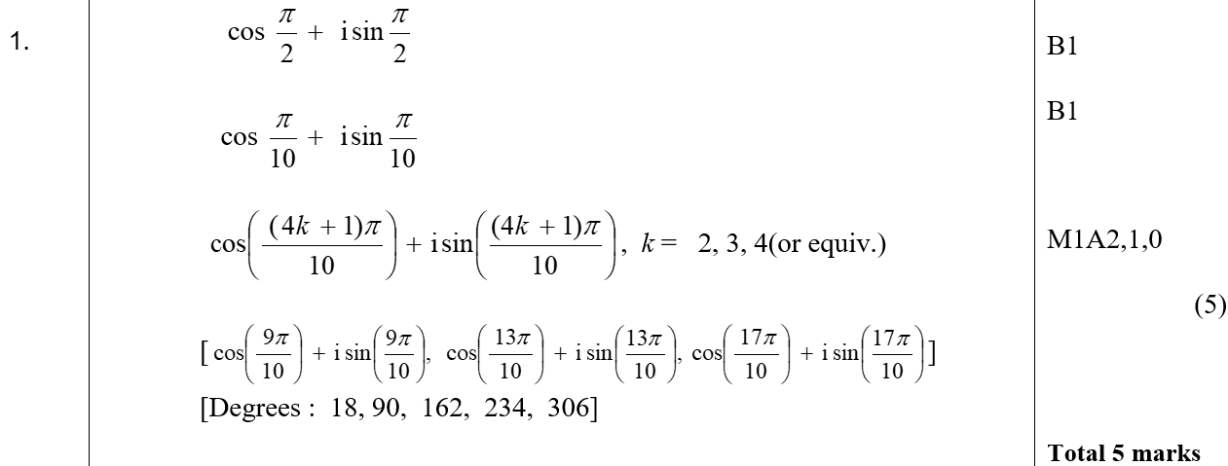
Jan 2006
A

Slide 16
June 2006

Slide 17
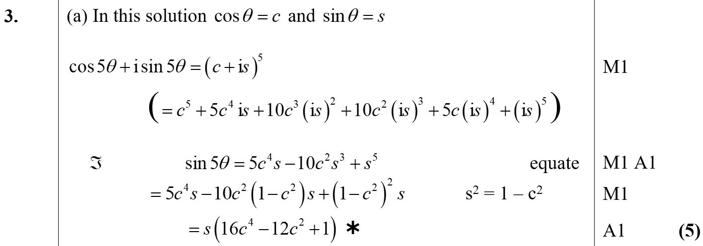
June 2006
A

Slide 18
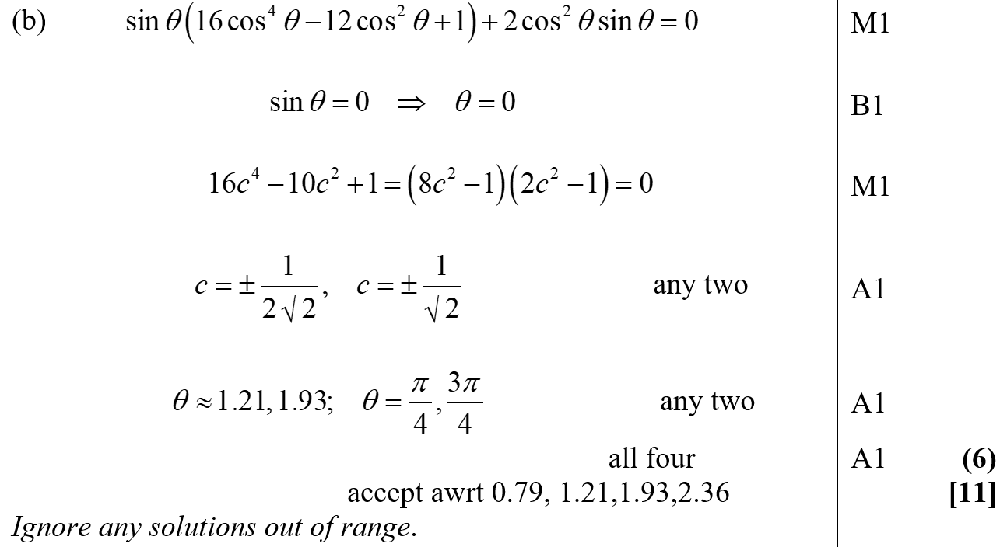
June 2006
B

Slide 19
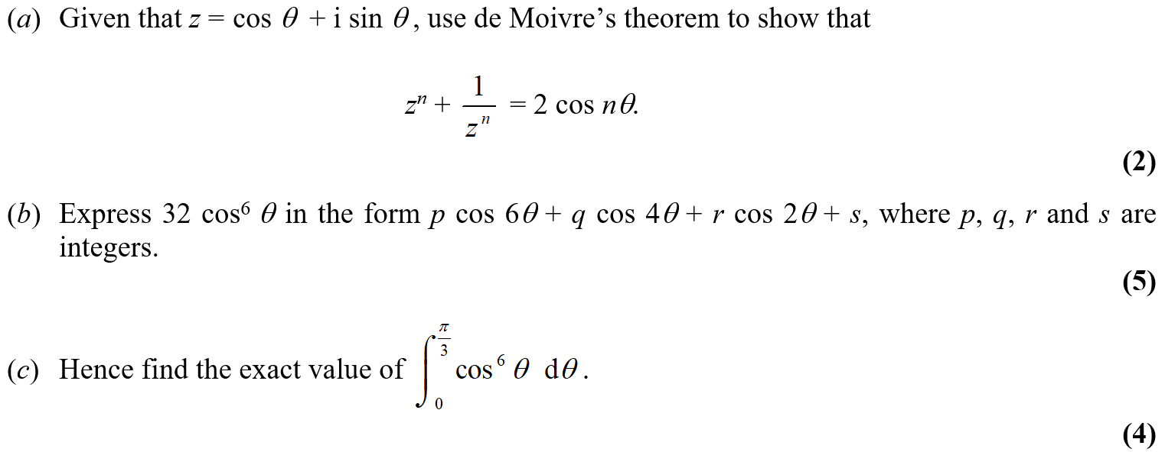
June 2007

Slide 20
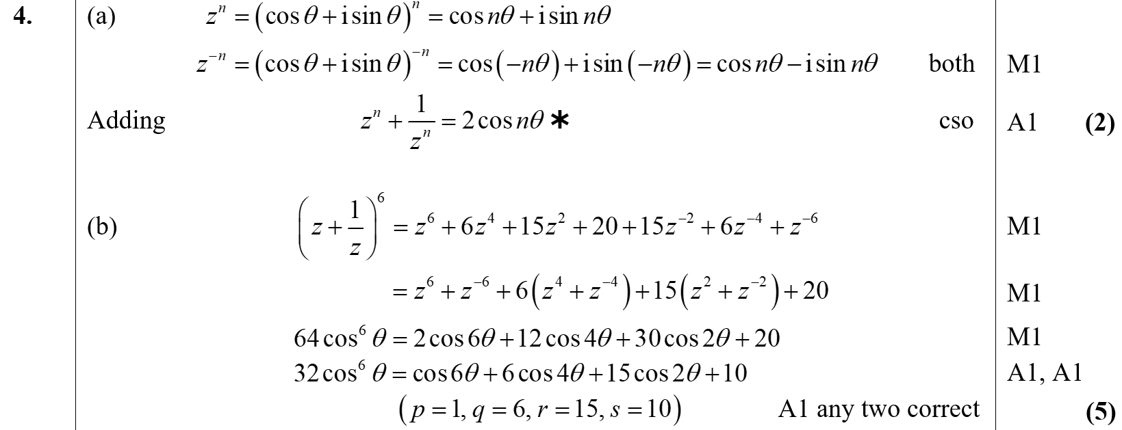
June 2007
A
B

Slide 21
June 2007
C

Slide 22
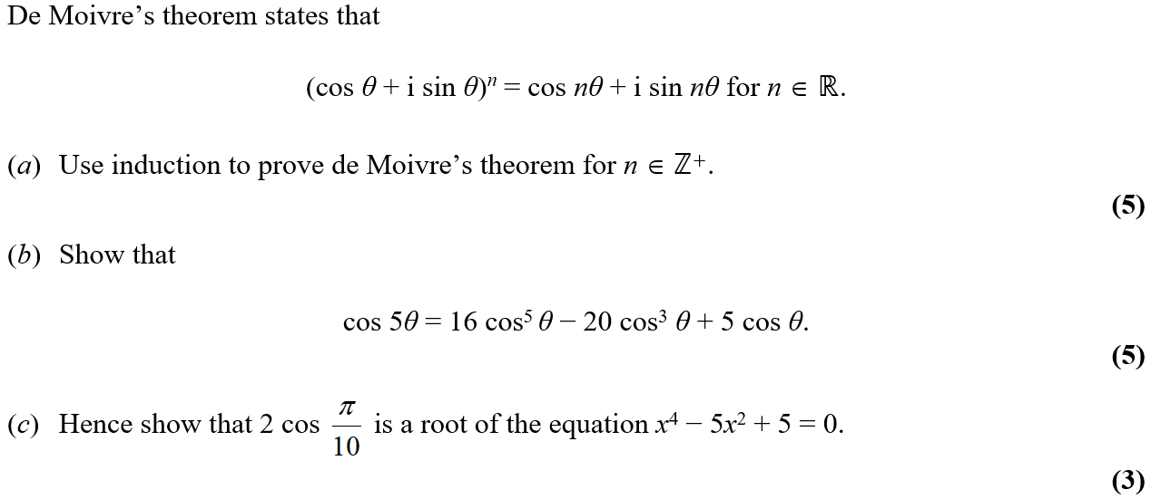
June 2008

Slide 23
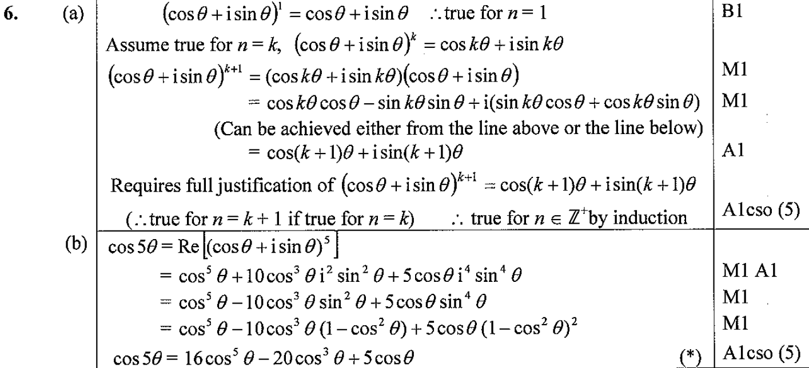
June 2008
A
B
C

Slide 24
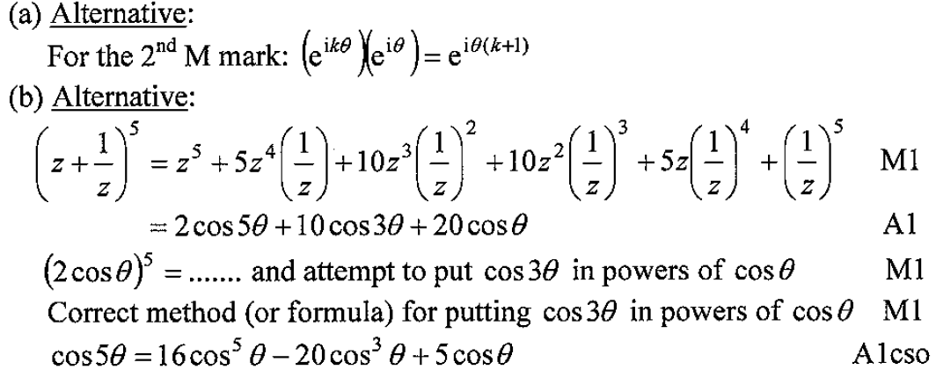
June 2008
A notes
B notes

Slide 25
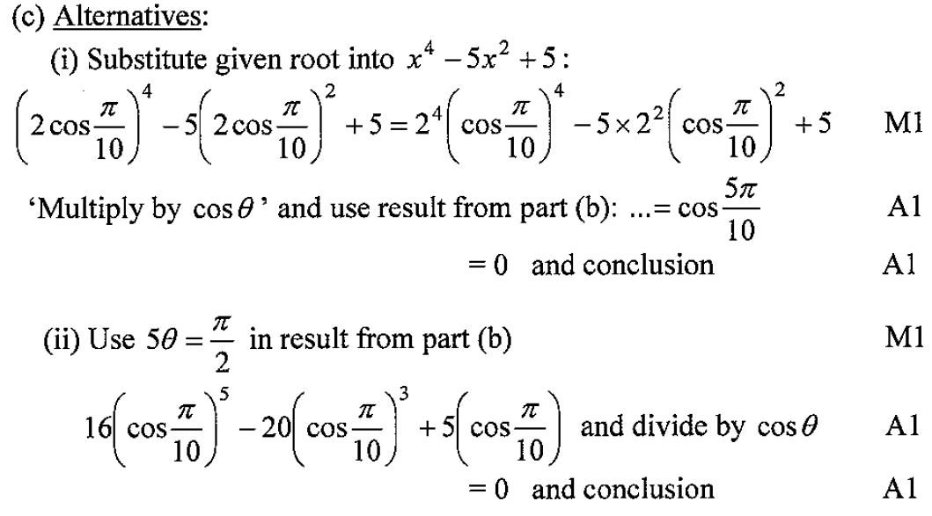
June 2008
C notes

Slide 26
June 2009

Slide 27
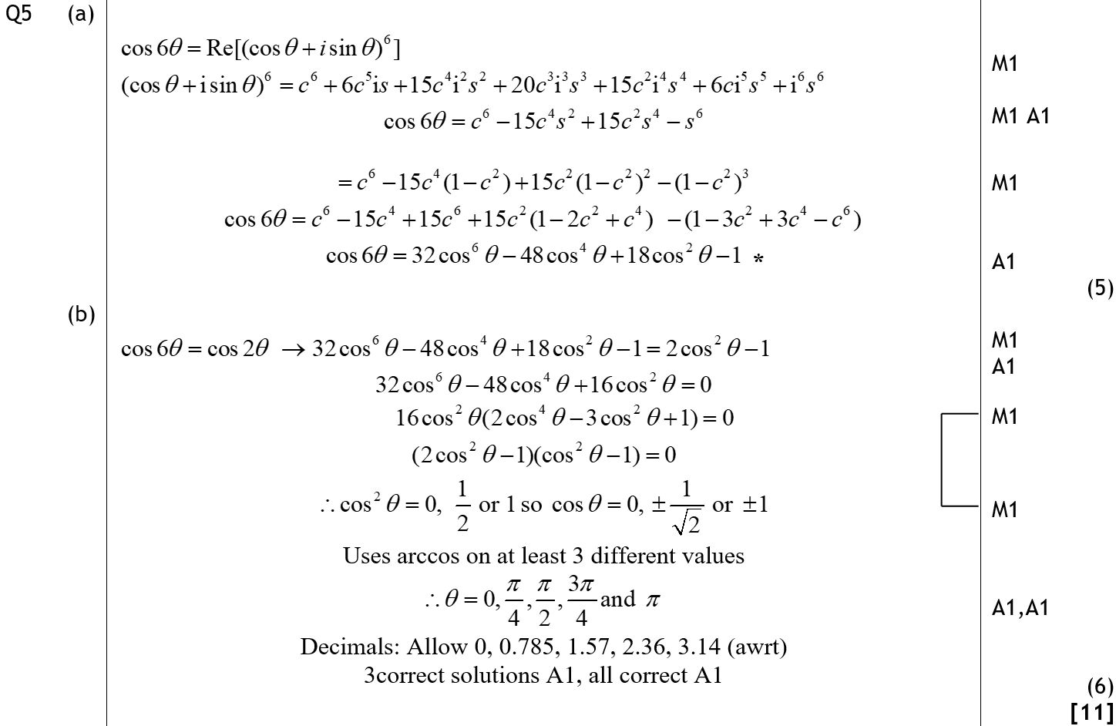
June 2009
A
B

Slide 28
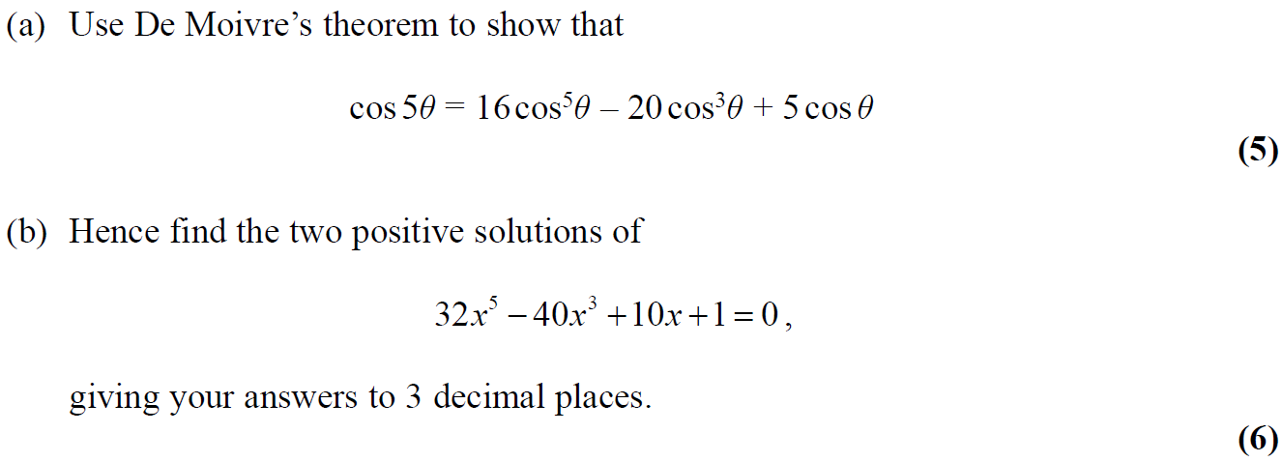
Feb 2010

Slide 29
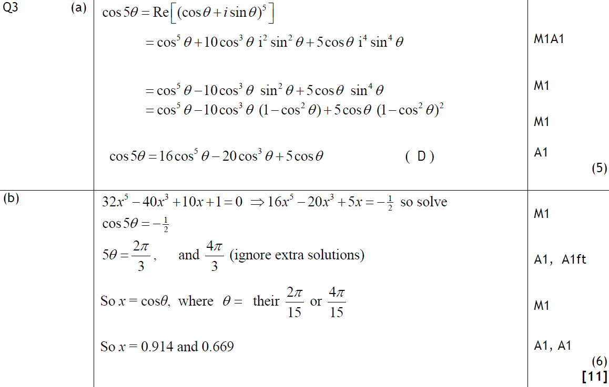
Feb 2010
A
B

Slide 30
June 2009

Slide 31
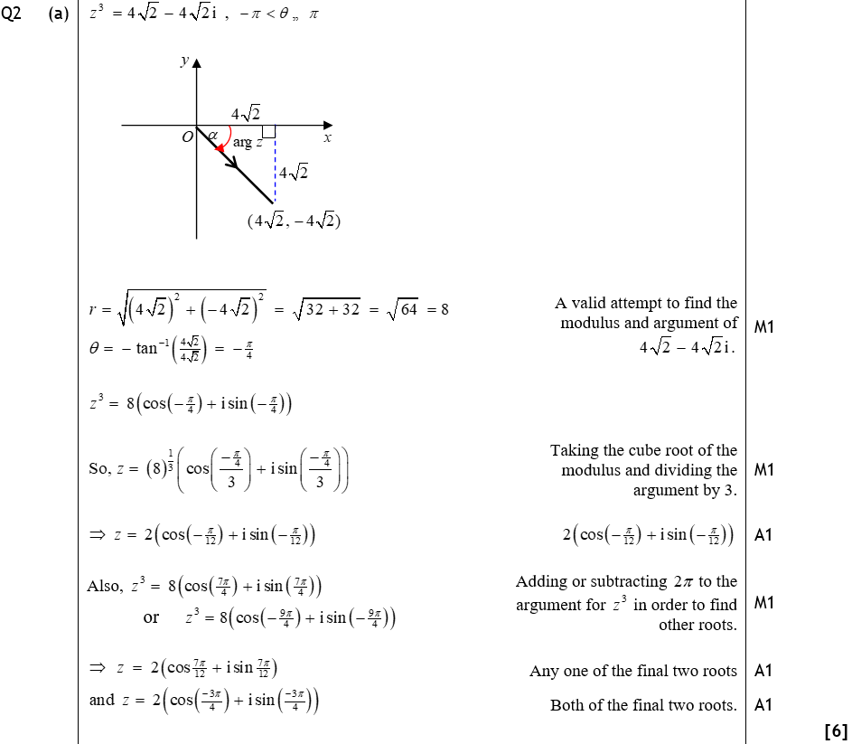
June 2009
A

Slide 32
June 2009
Special Cases

Slide 33
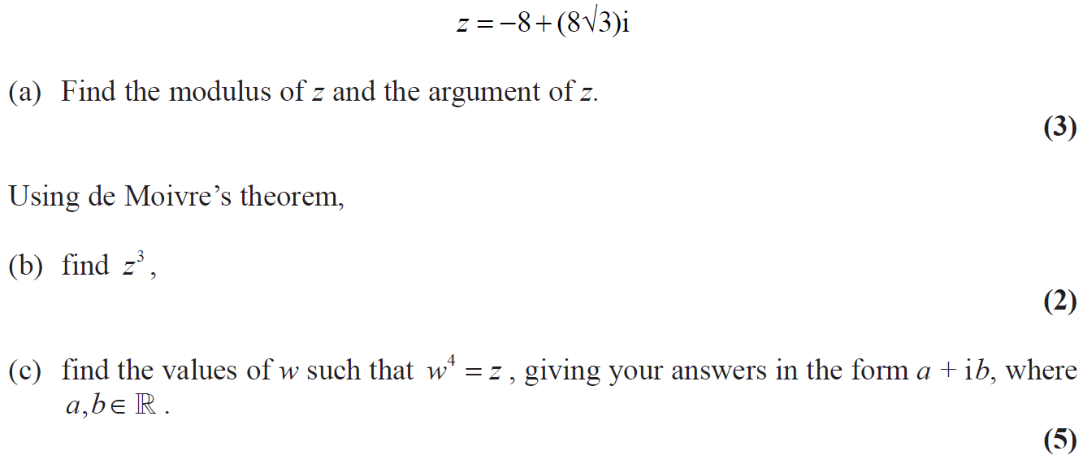
June 2010

Slide 34
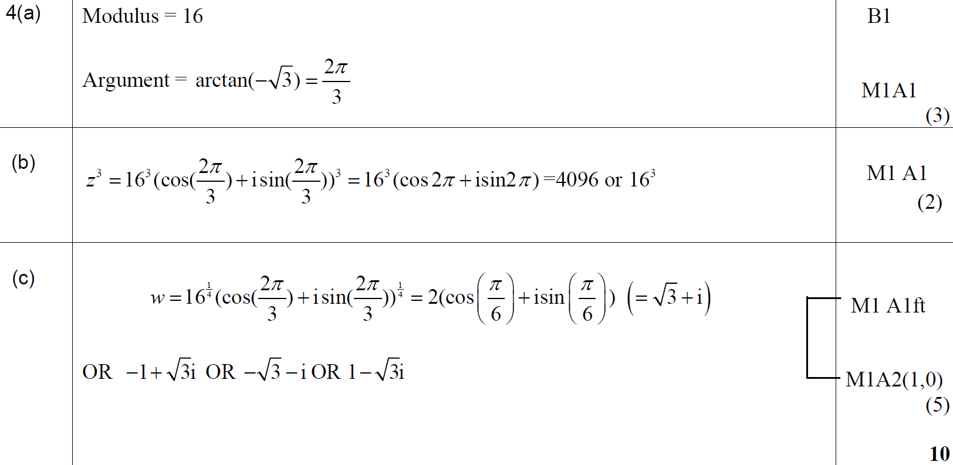
June 2010
A
B
C

Slide 35
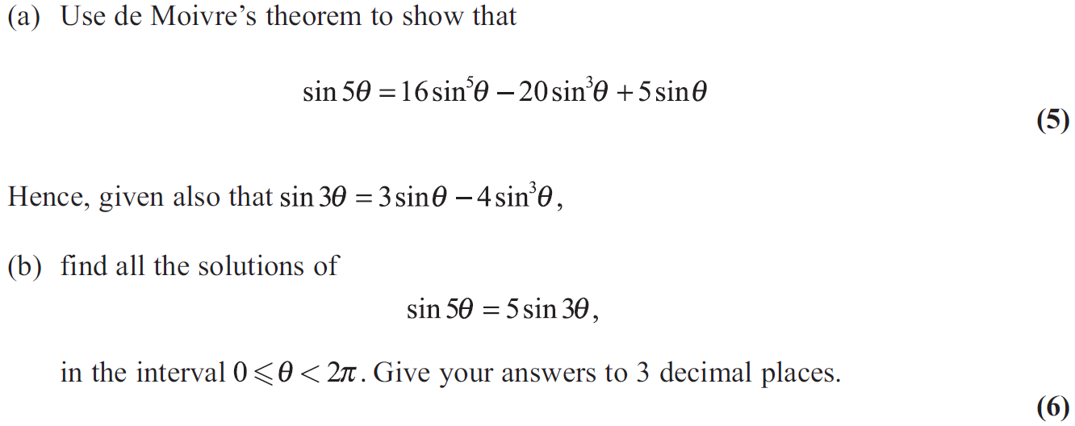
June 2011

Slide 36
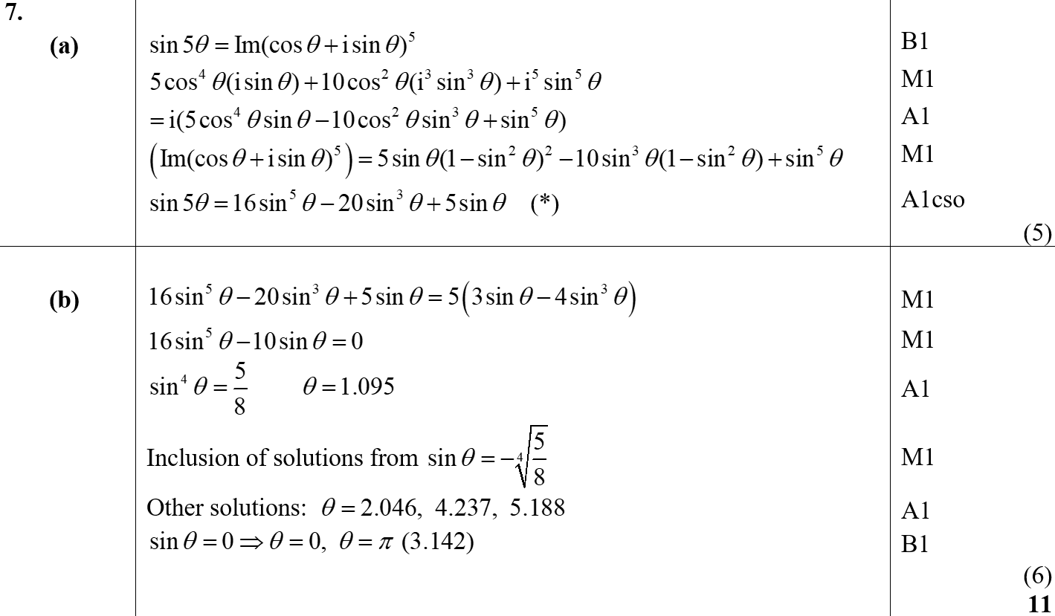
June 2011
A
B

Slide 37
June 2012

Slide 38
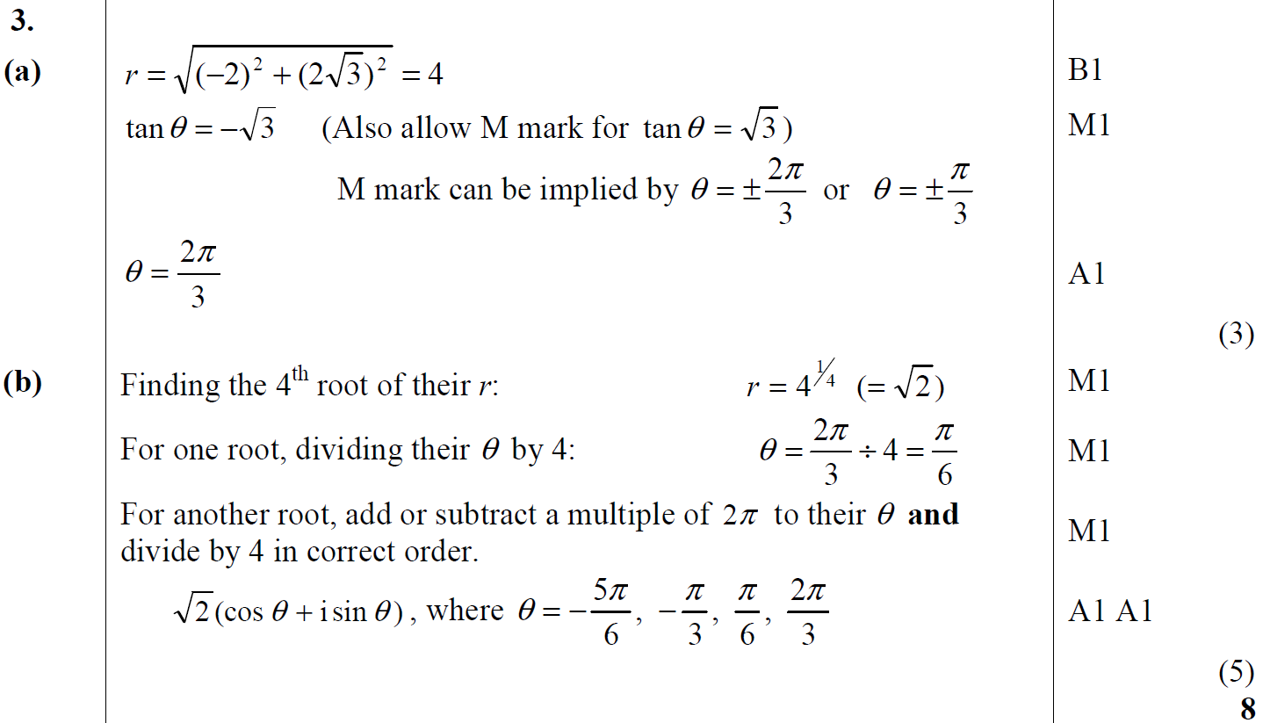
June 2012
A
B
A notes
B notes

Slide 39
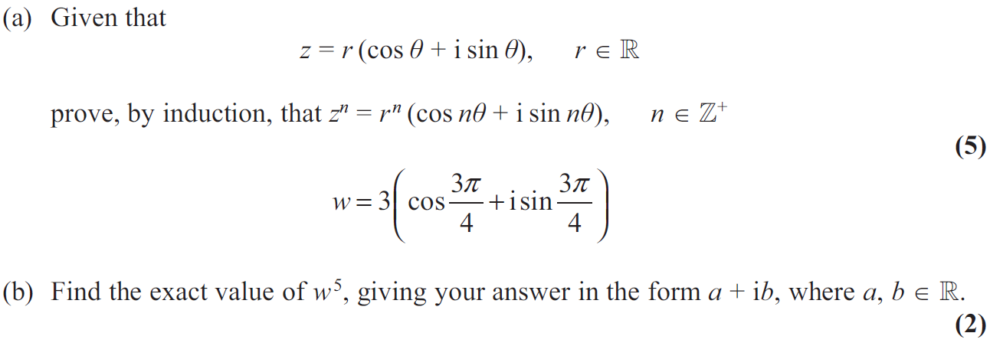
June 2013

Slide 40
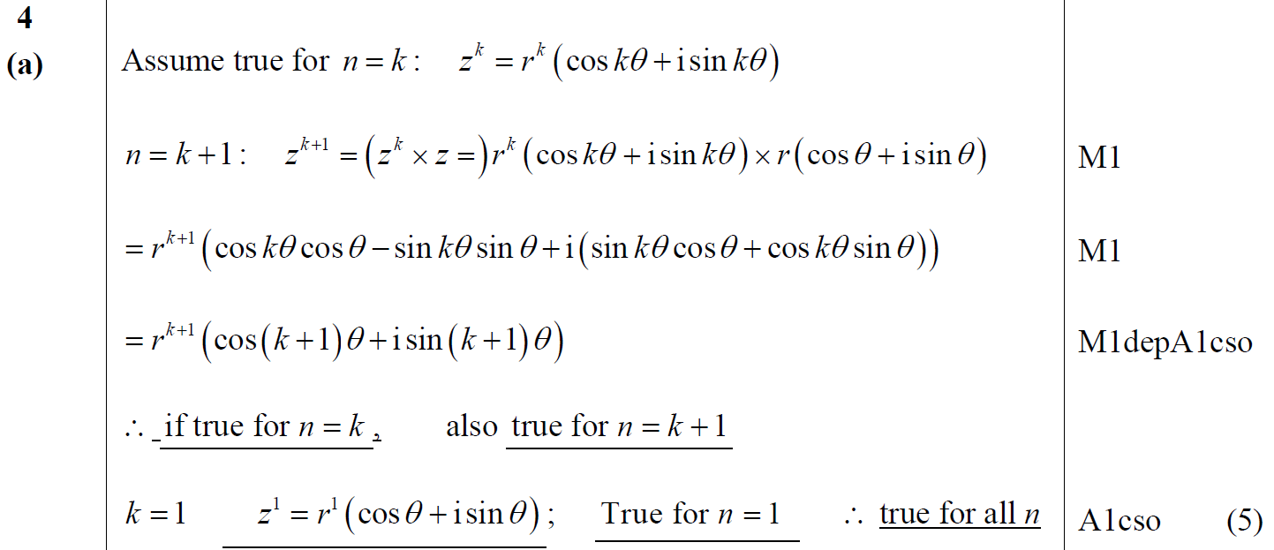
June 2013
A

Slide 41
June 2013
B

Slide 42
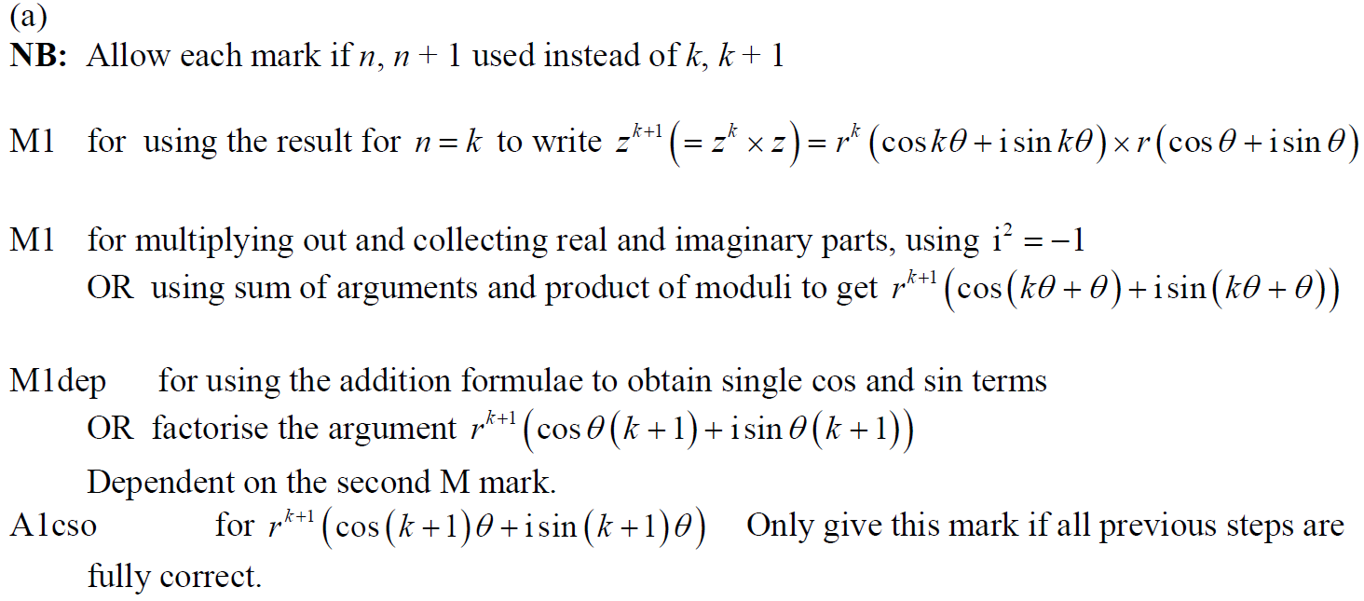
June 2013
A notes

Slide 43
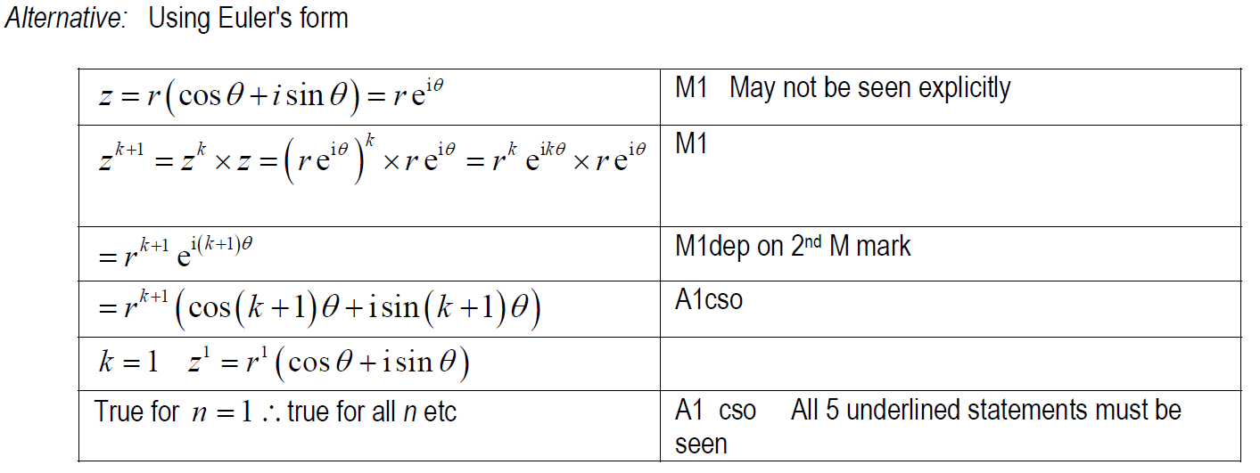
June 2013
A Alternative

Slide 44
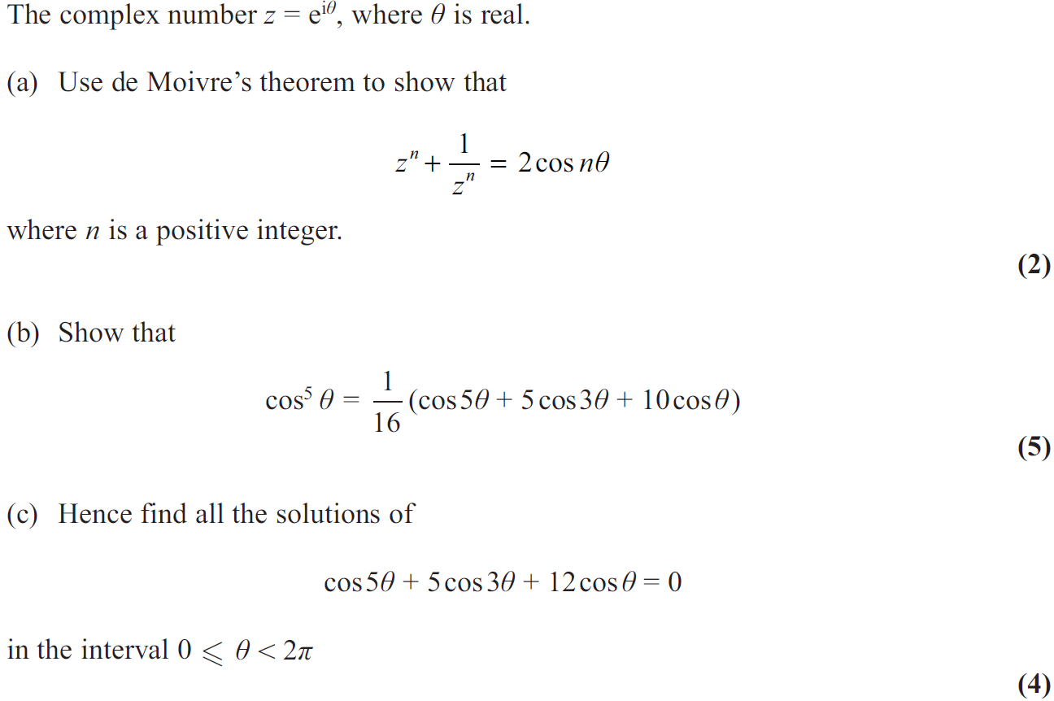
June 2013 Reserve

Slide 45
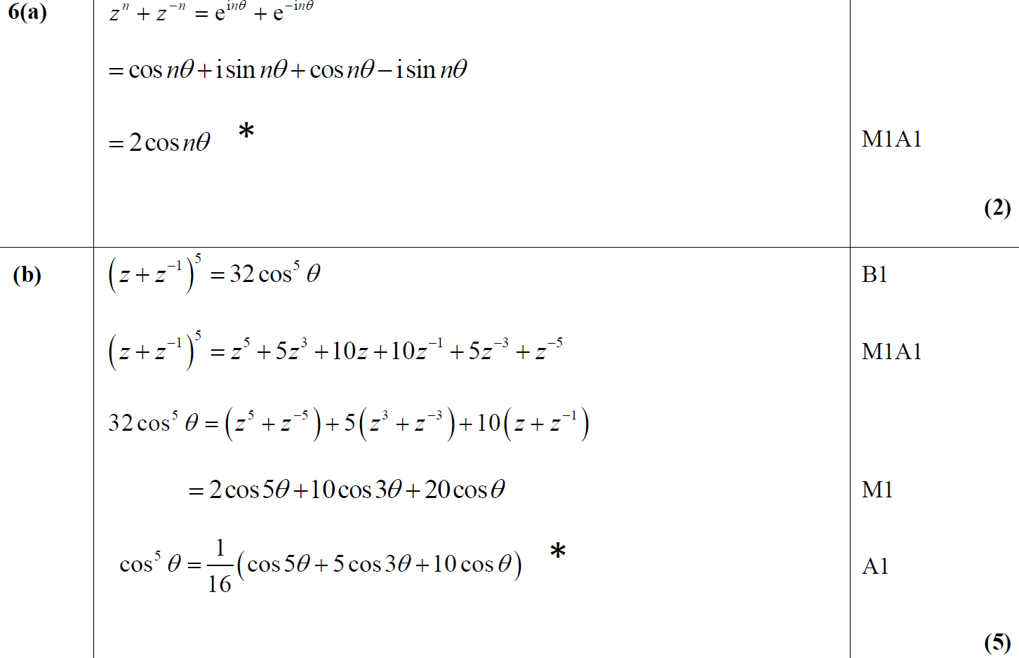
June 2013 Reserve
A
B

Slide 46
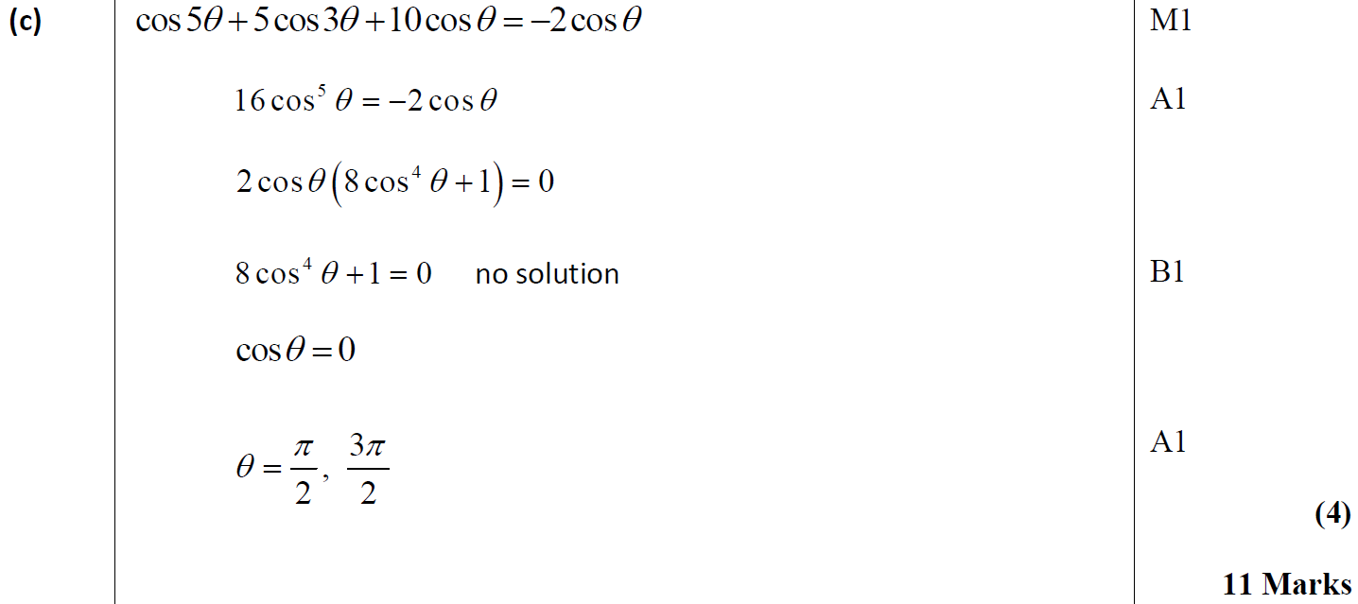
June 2013 Reserve
C

Slide 47
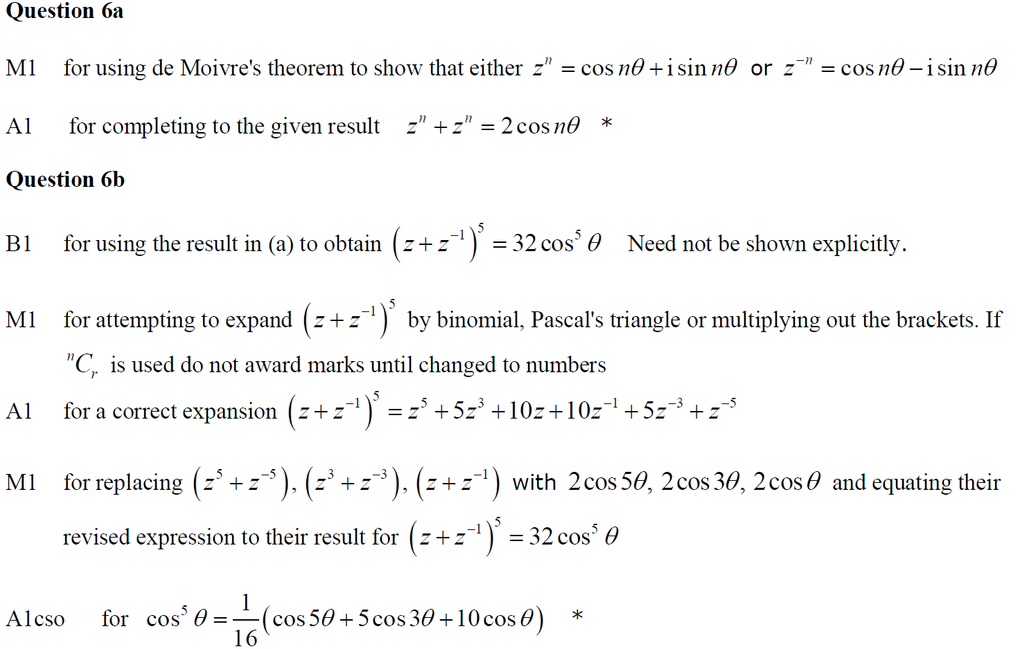
June 2013 Reserve
A notes
B notes

Slide 48
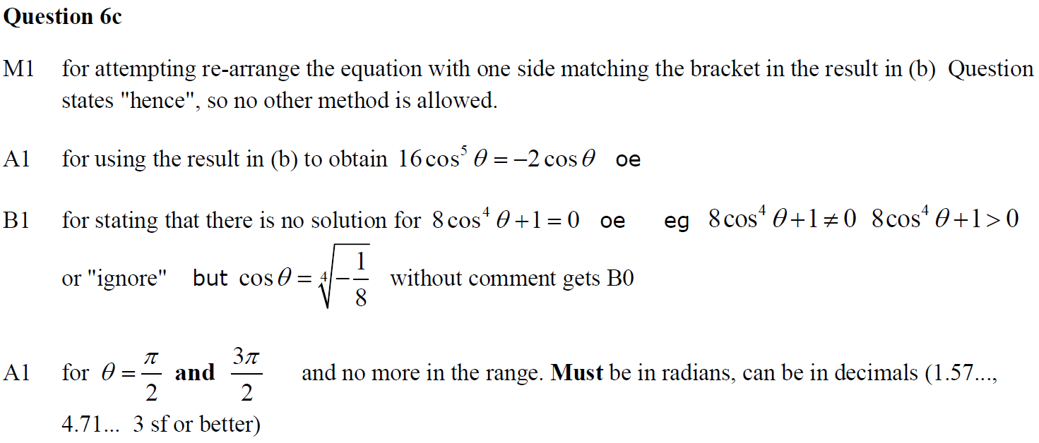
June 2013 Reserve
C notes

Slide 49
June 2013 Withdrawn

Slide 50
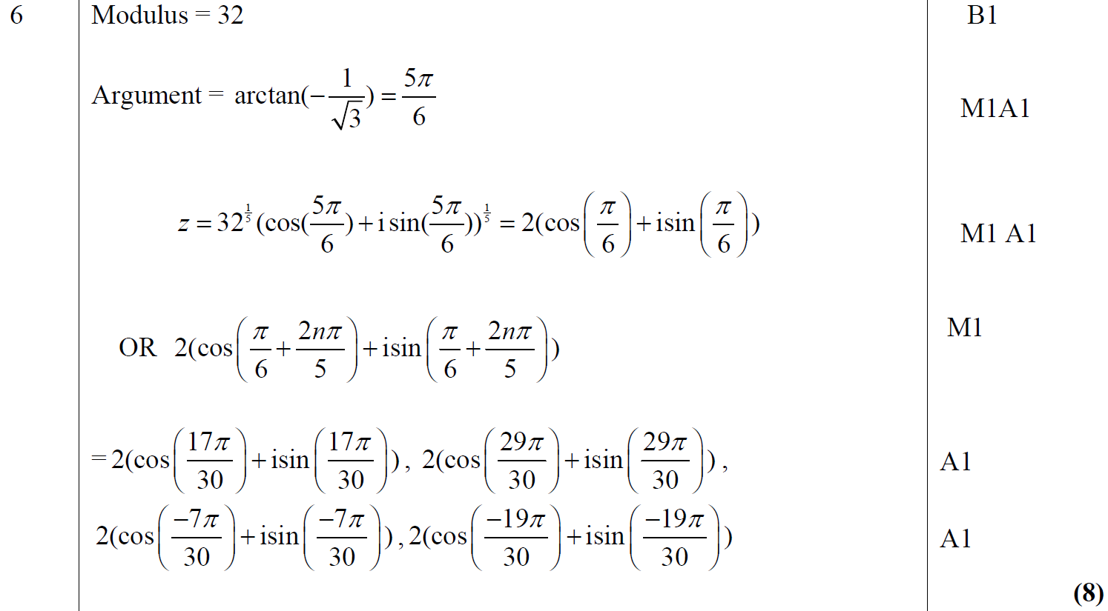
June 2013 Withdrawn
A

Slide 51
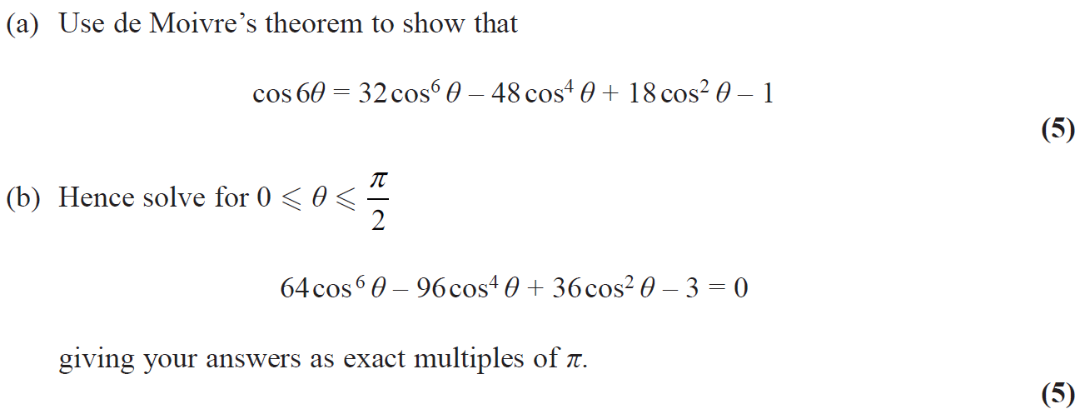
June 2014

Slide 52
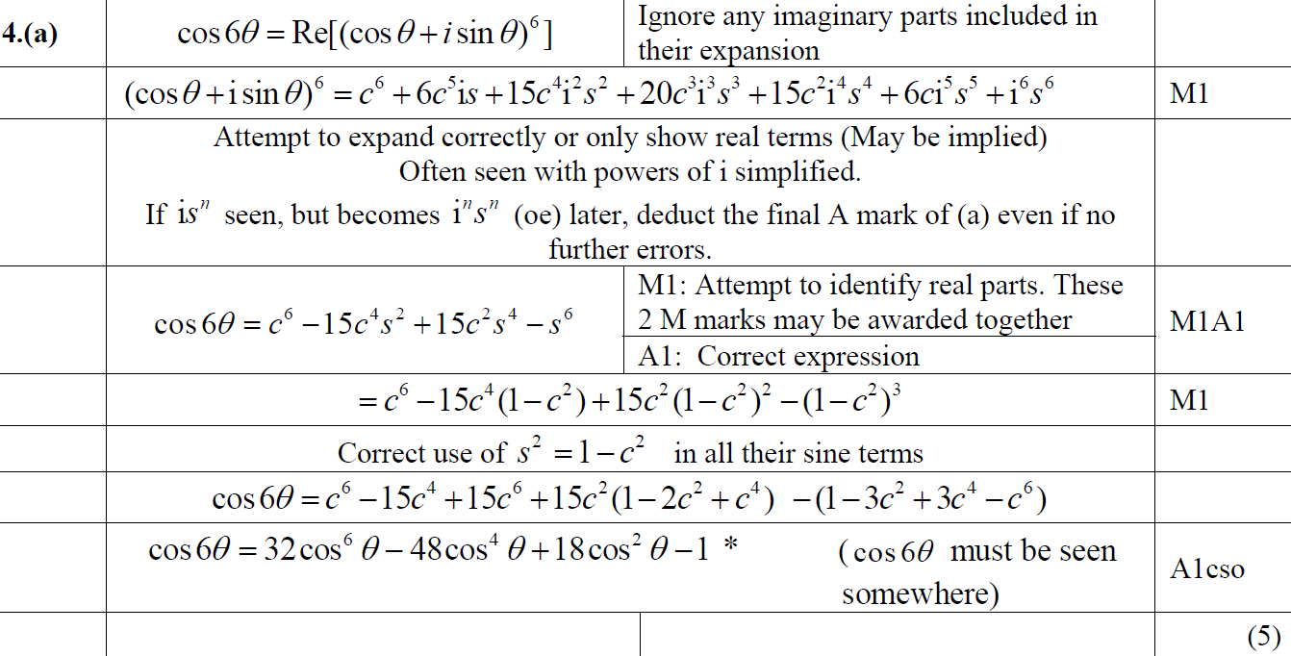
June 2014
A

Slide 53
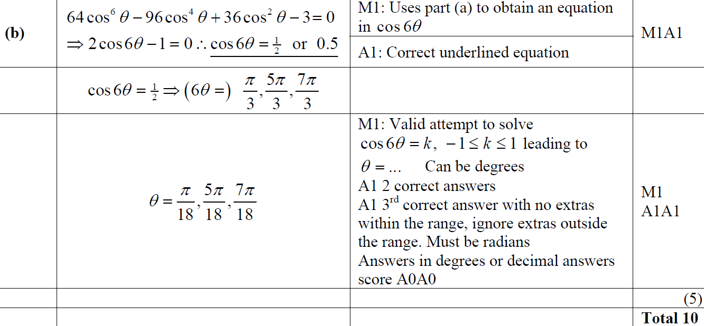
June 2014
B

Slide 54
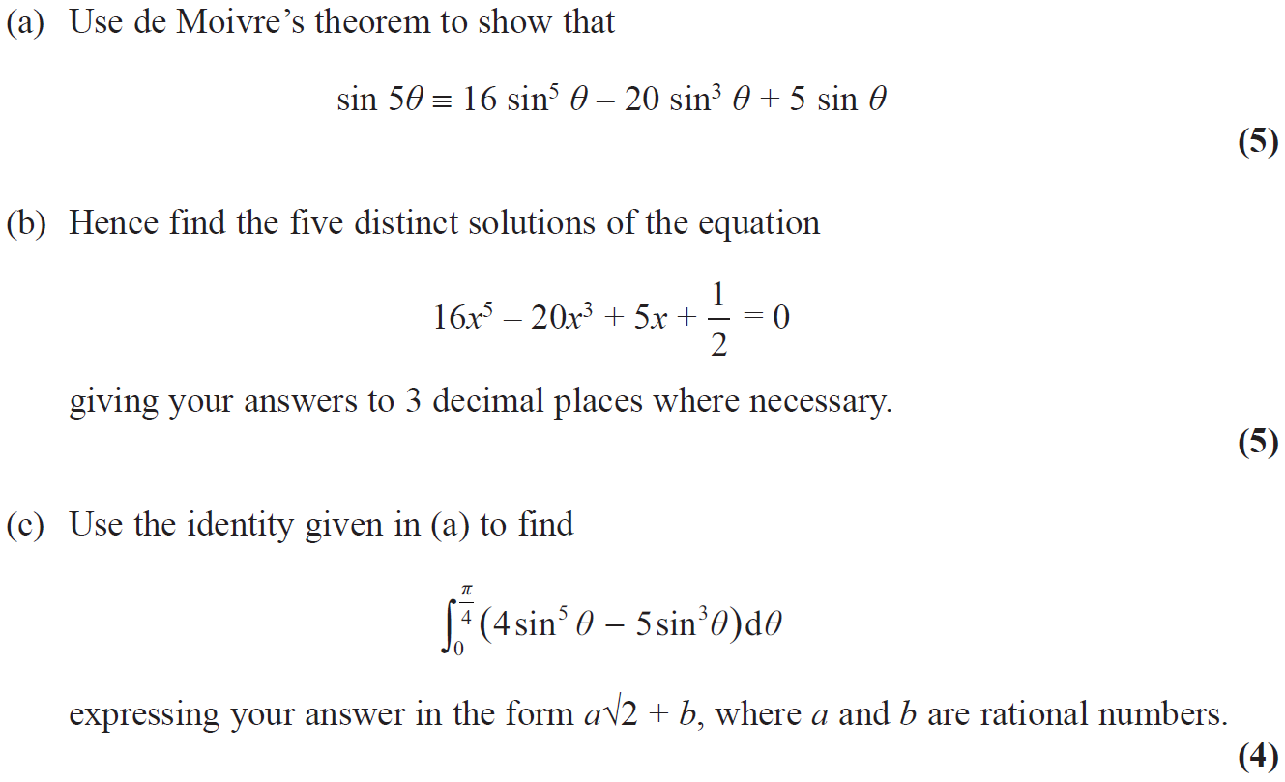
June 2014 Reserve

Slide 55
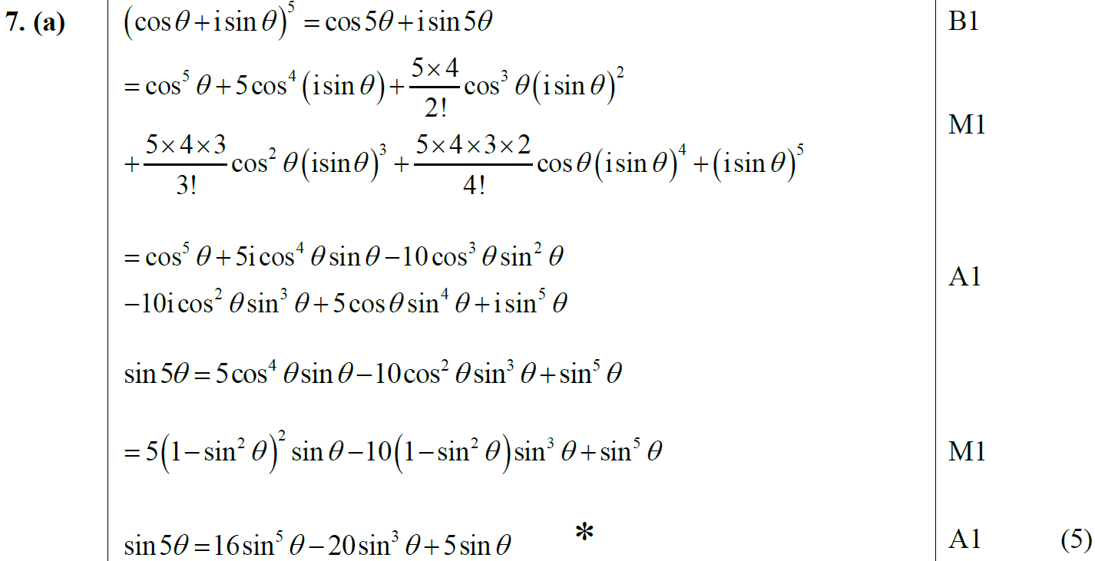
June 2014 Reserve
A

Slide 56
June 2014 Reserve
B

Slide 57
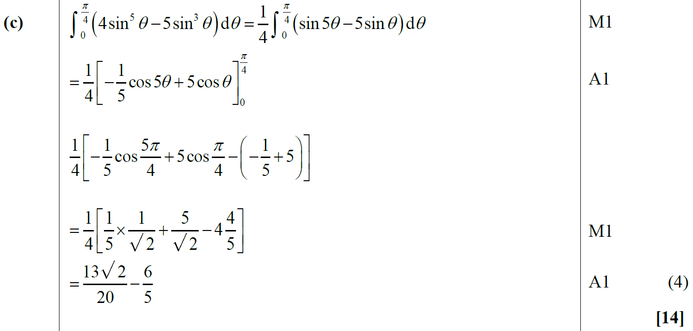
June 2014 Reserve
C

Slide 58
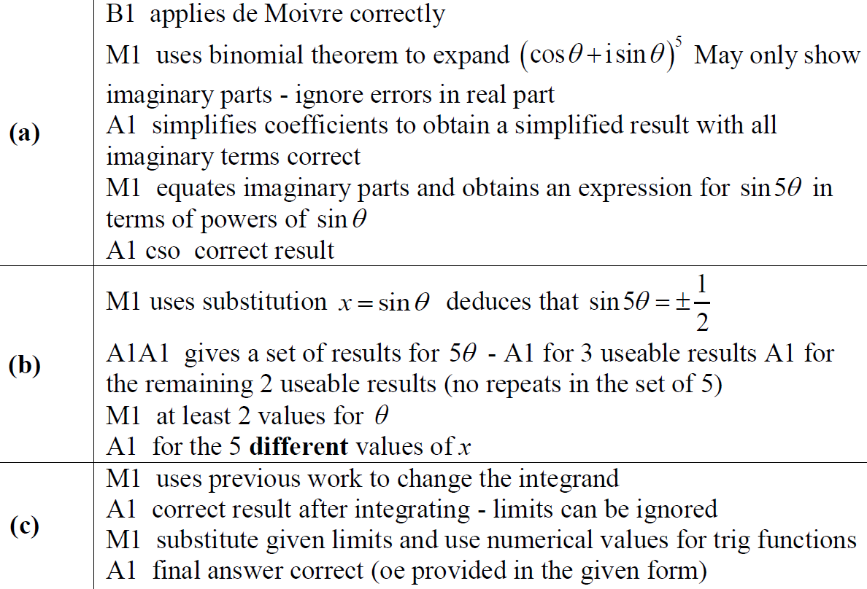
June 2014 Reserve
A notes
B notes
C notes

Slide 59
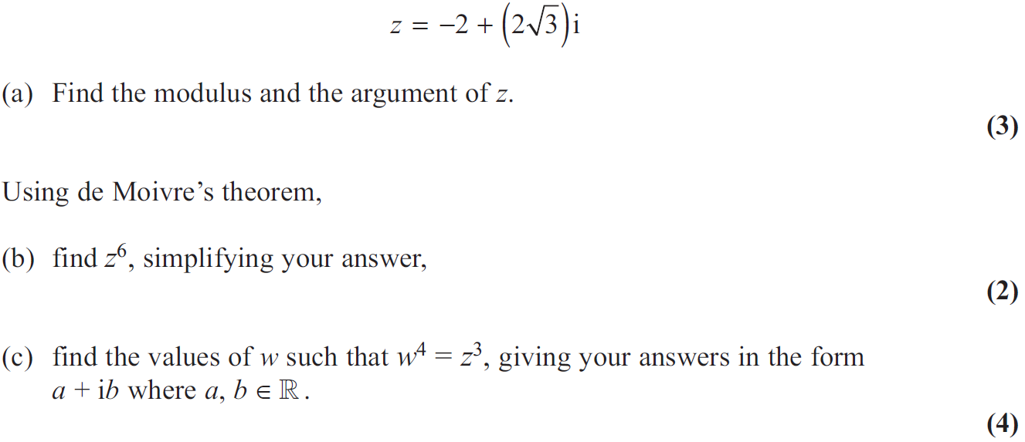
June 2015

Slide 60
June 2015
A
B
A notes
B notes

Slide 61
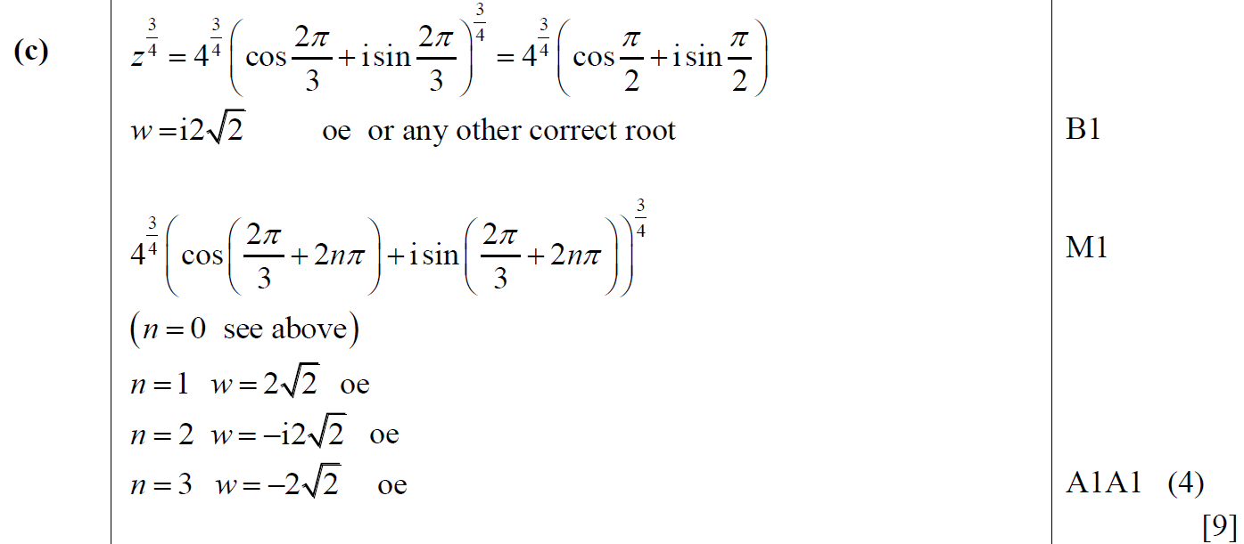
June 2015
C

Slide 62
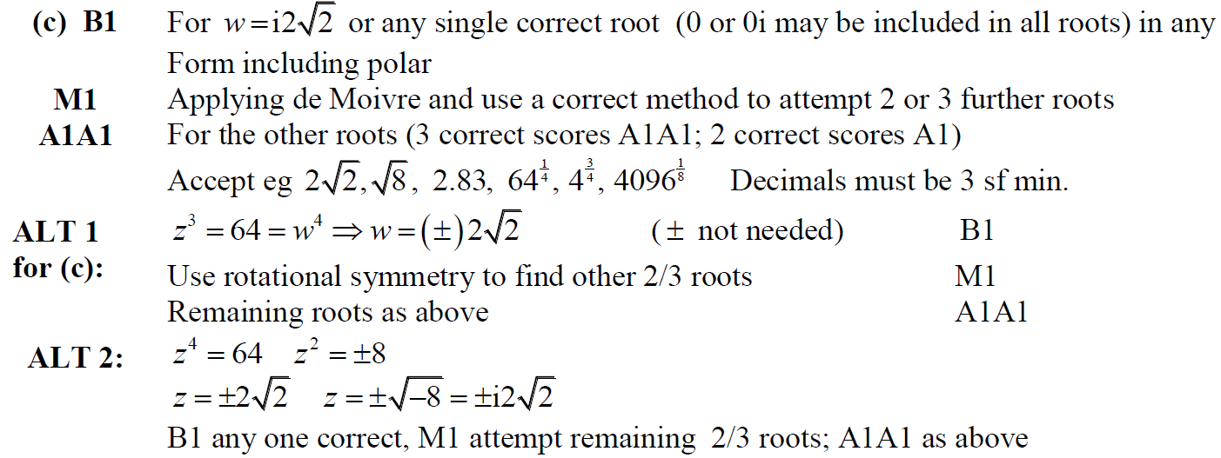
June 2015
C notes

Slide 63
June 2016

Slide 64
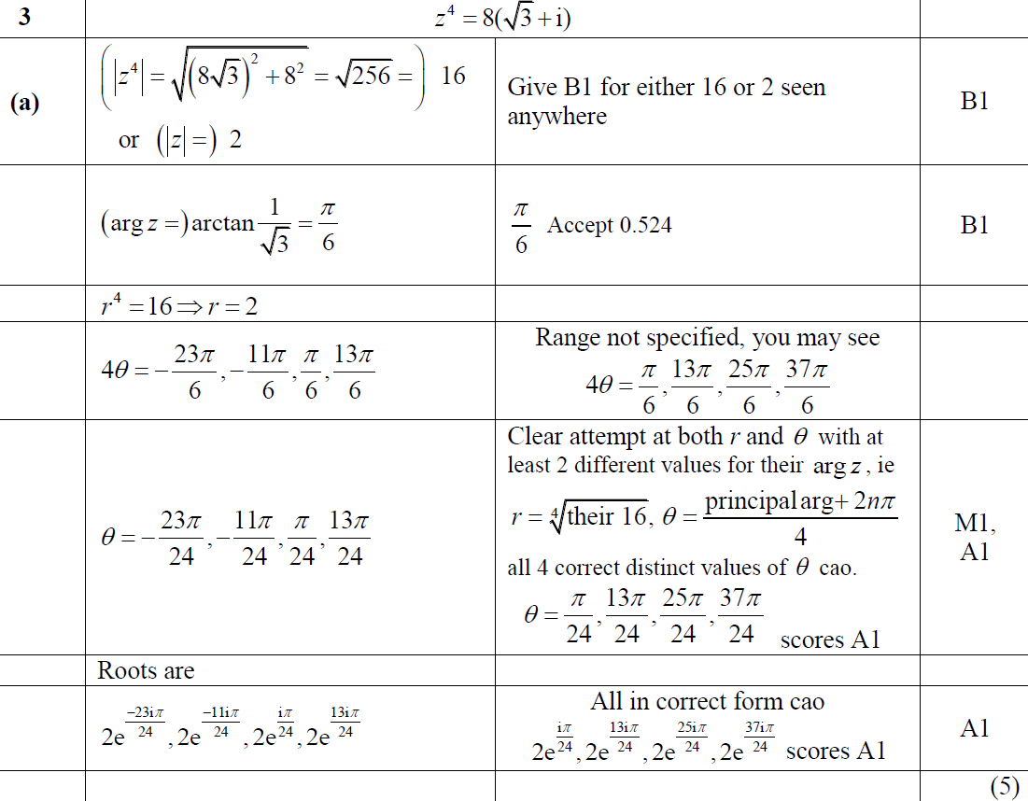
June 2016
A

Slide 65
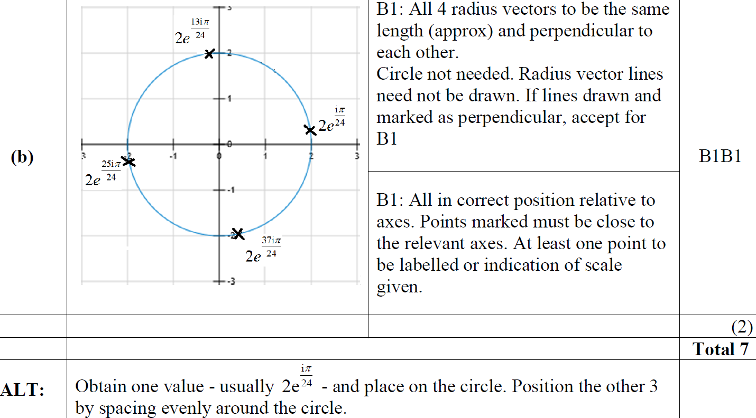
June 2016
B

Slide 66
June 2016

Slide 67
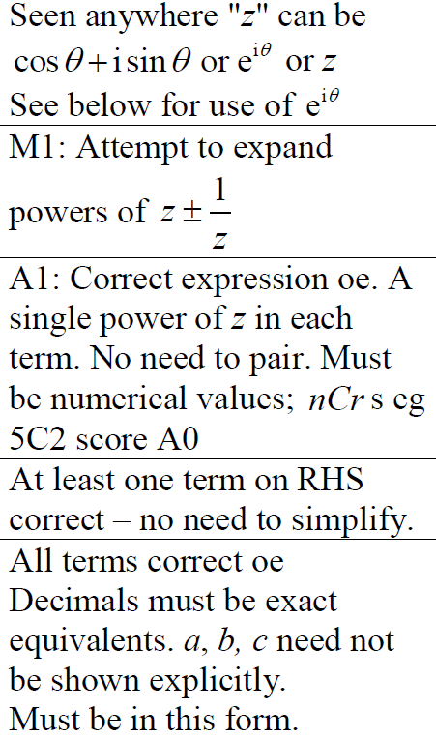
June 2016
A

Slide 68
June 2016
A Alternative 1

Slide 69
June 2016
A Alternative 2

Slide 70
June 2016
A Alternative 3

Slide 71
June 2016
B

Slide 72
June 2017

Slide 73
June 2017
A

Slide 74
June 2018

Slide 75
June 2018
A (i)
A (ii)

Slide 76
June 2018
B

Slide 77
June 2019

Slide 78
June 2019
A

Slide 79
June 2019
A Alternative & notes

Slide 80
June 2019
B

Slide 81
June 2019
C

