Slide 1
Cumulative Frequency
Cumulative Frequency
Old Spec Q’s
SAM
2H Q12
May 2018
1H Q10
June 2018
2HR Q11
Jan 2019
1H Q9
Jan 2019
1HR Q14
June 2019
2H Q13

Slide 2
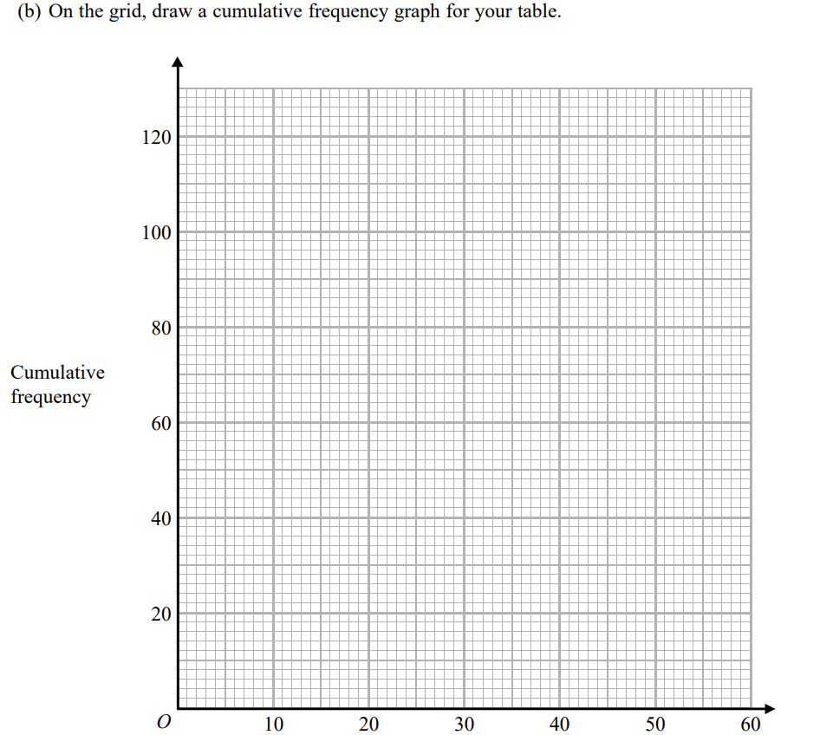
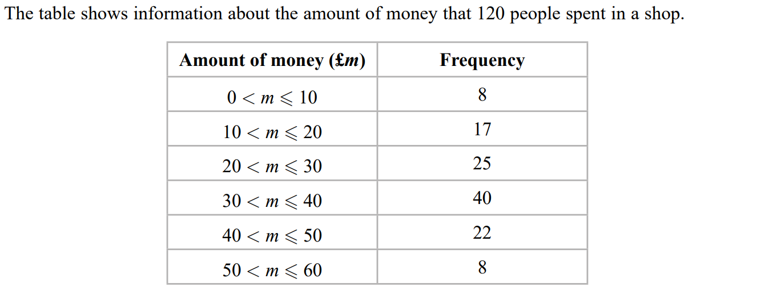
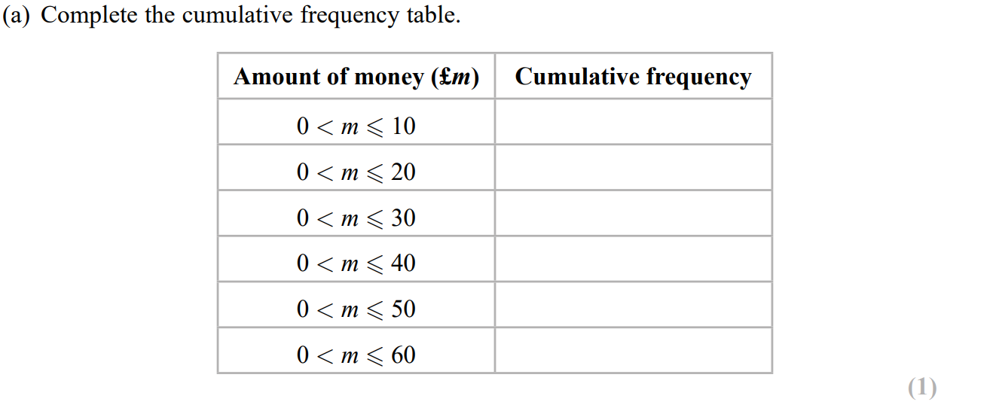
Cumulative Frequency
SAM 2H Q12
Reveal graph

Slide 3
Cumulative Frequency
SAM 2H Q12
A
B
C

Slide 4
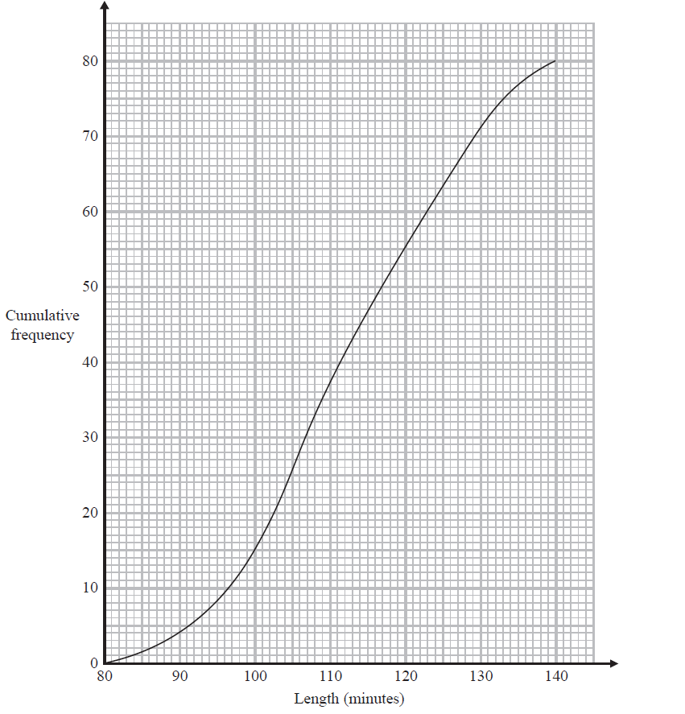
Cumulative Frequency
May 2018 1H Q10

Slide 5
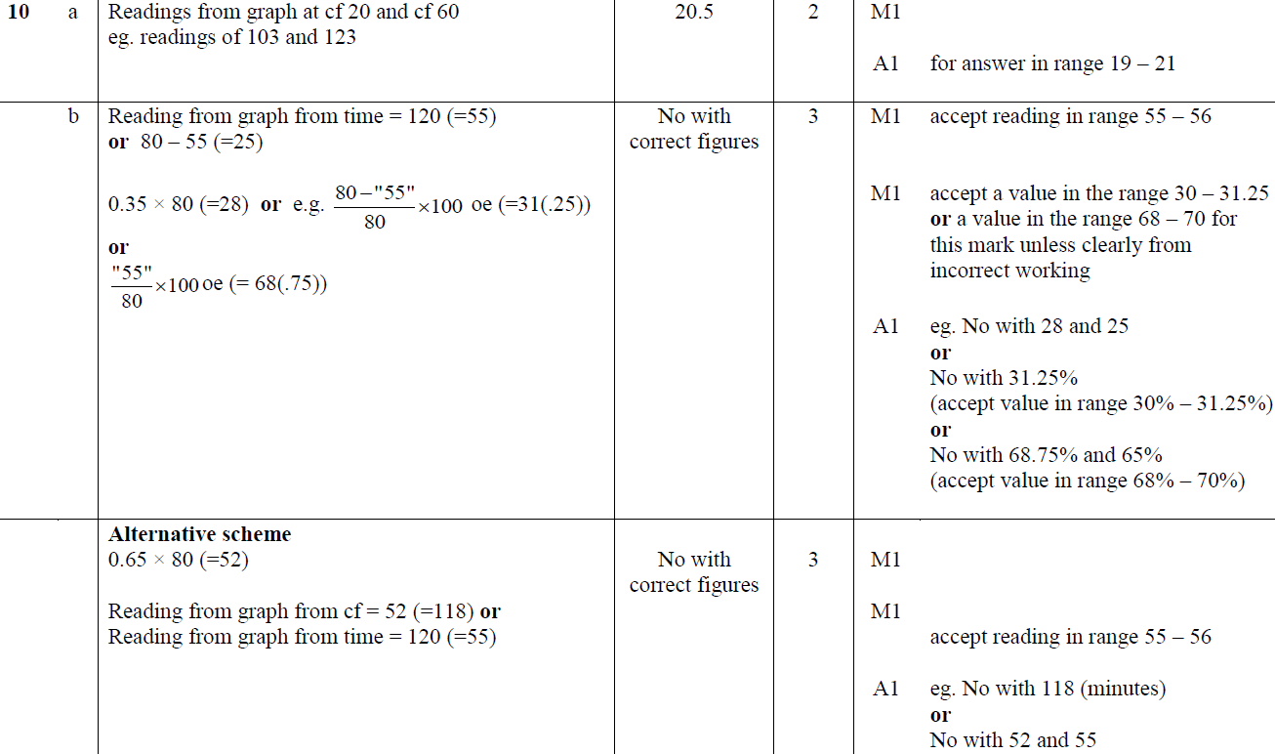
Cumulative Frequency
May 2018 1H Q10
A
B

Slide 6
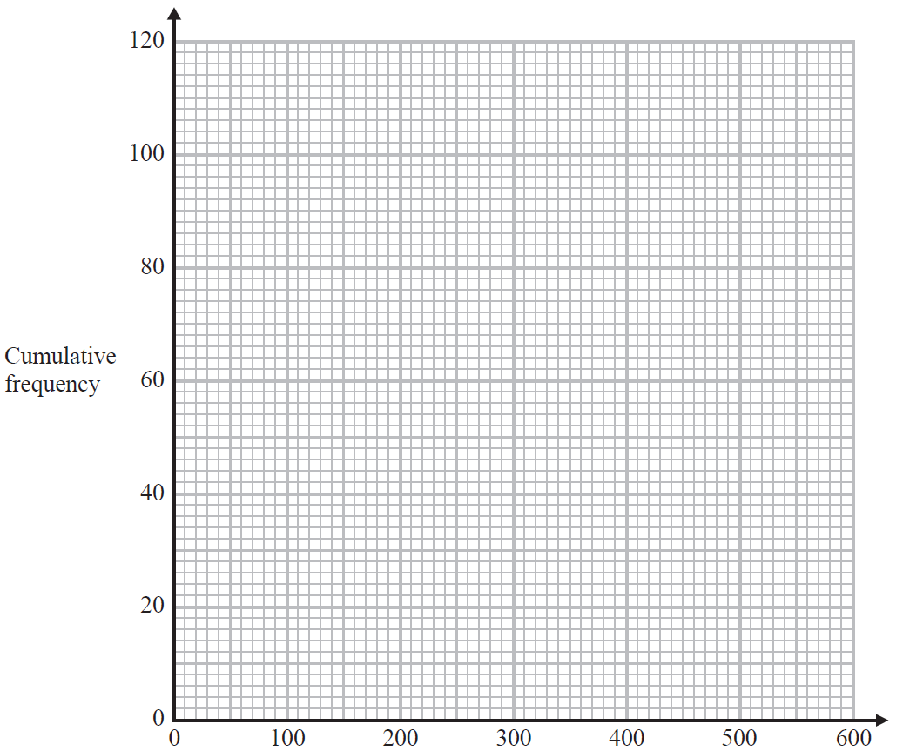
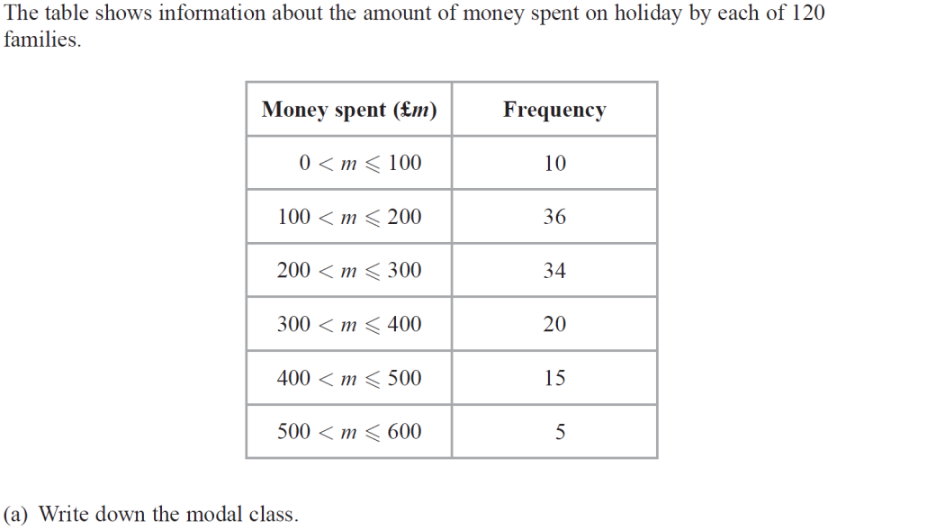
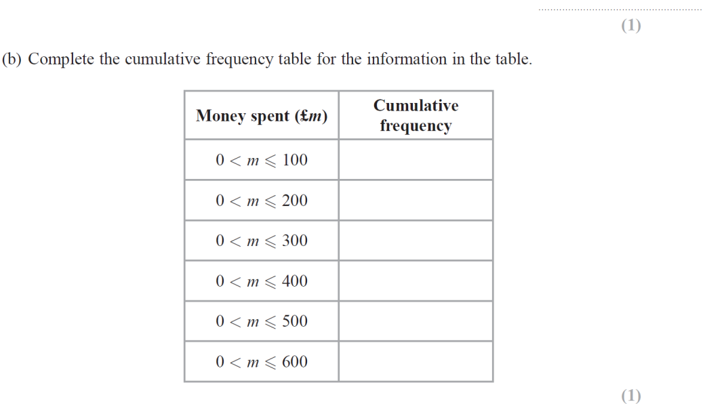
Cumulative Frequency
June 2018 2HR Q11
Reveal graph

Slide 7
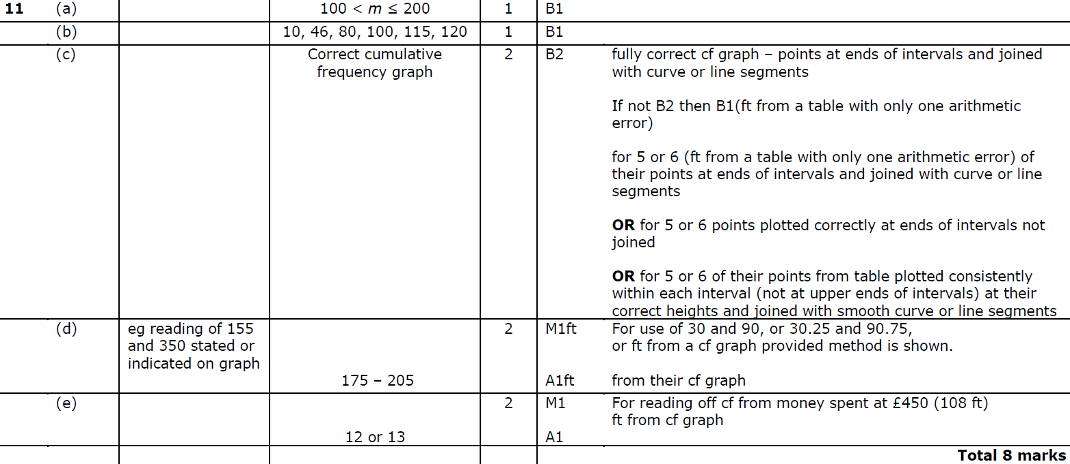
Cumulative Frequency
June 2018 2HR Q11
A
B
C
D
E

Slide 8
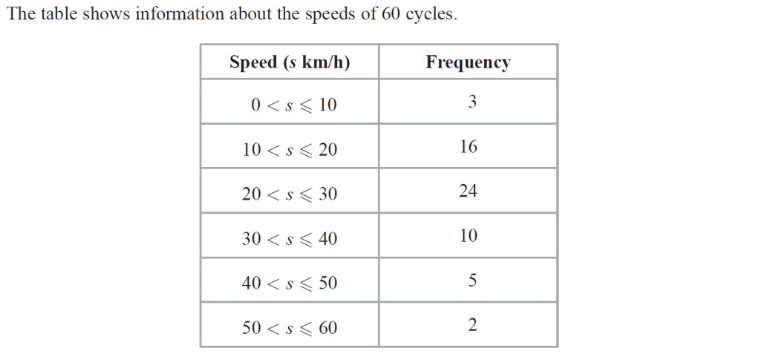
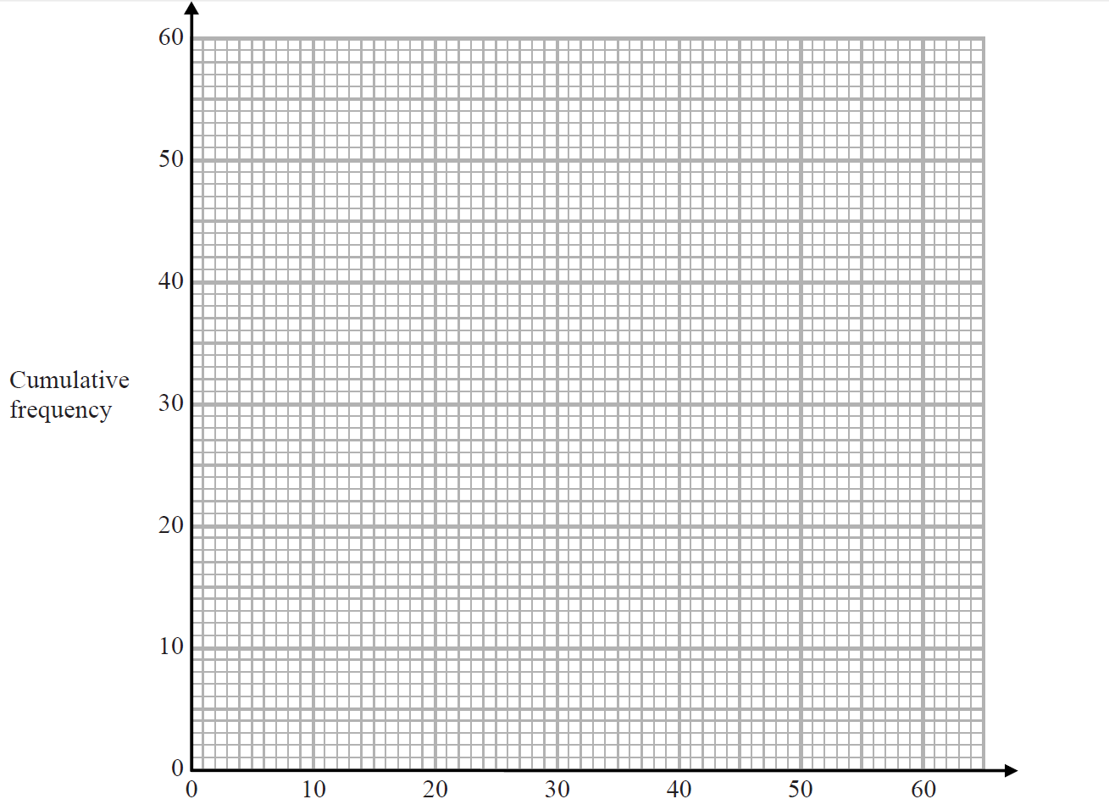
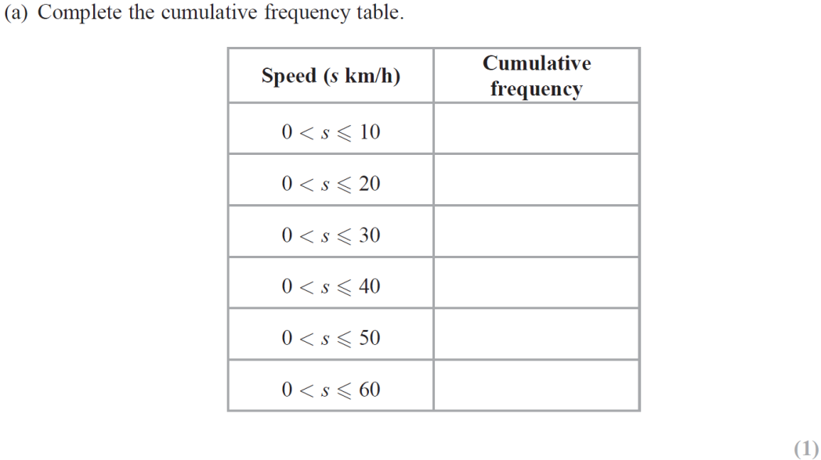
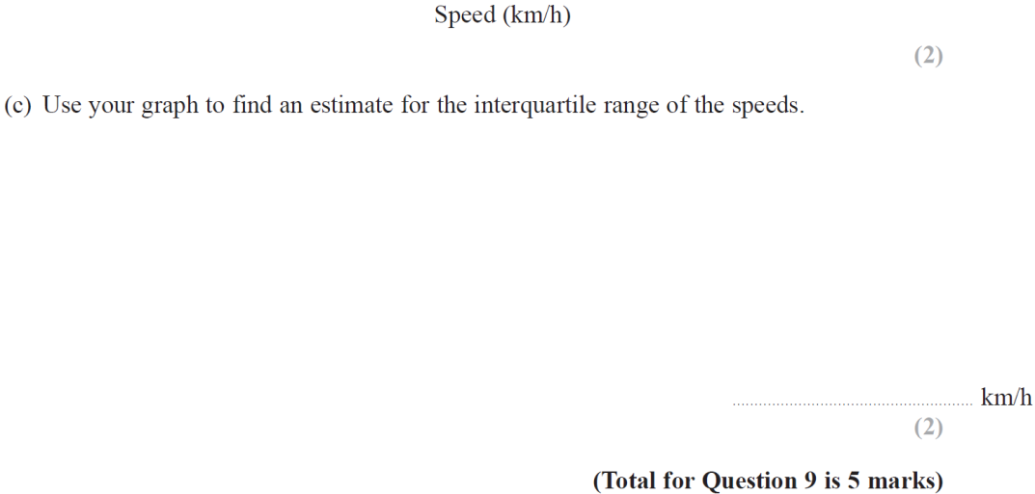
Cumulative Frequency
Jan 2019 1H Q9
Reveal graph

Slide 9
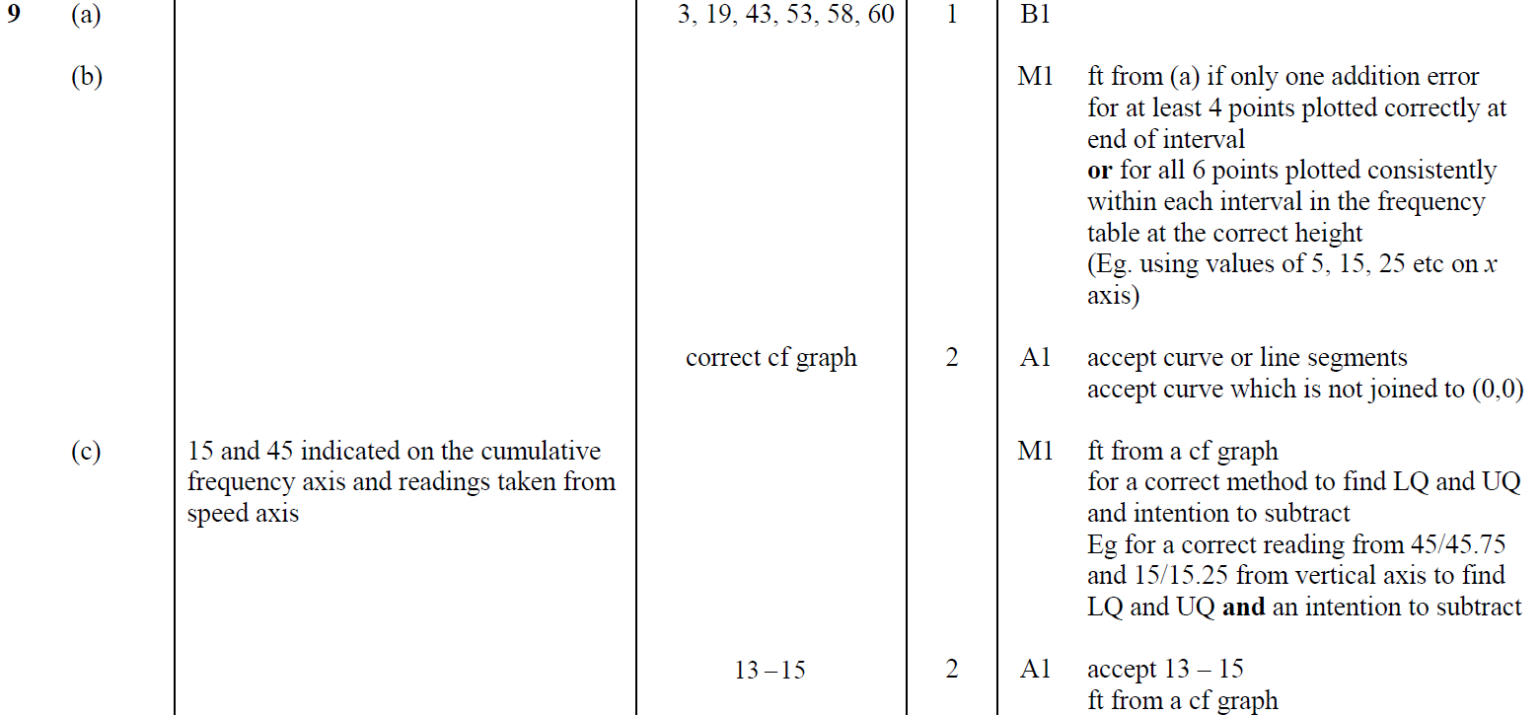
Cumulative Frequency
Jan 2019 1H Q9
A
B
C

Slide 10
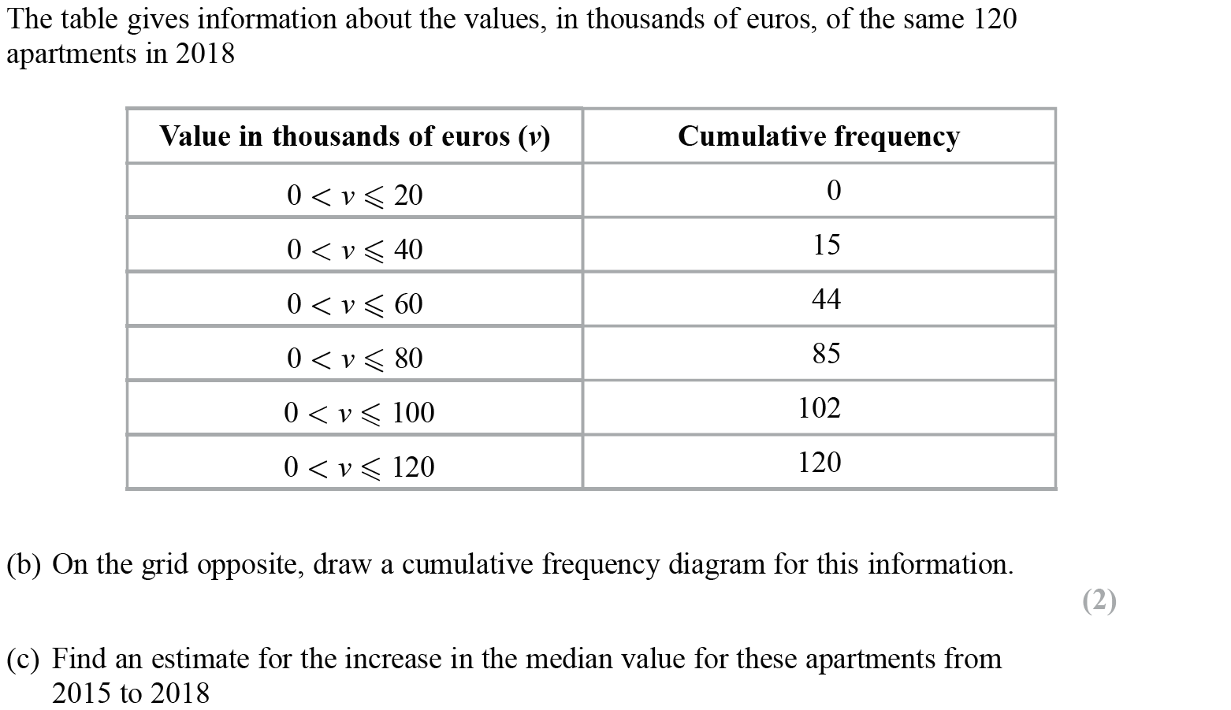
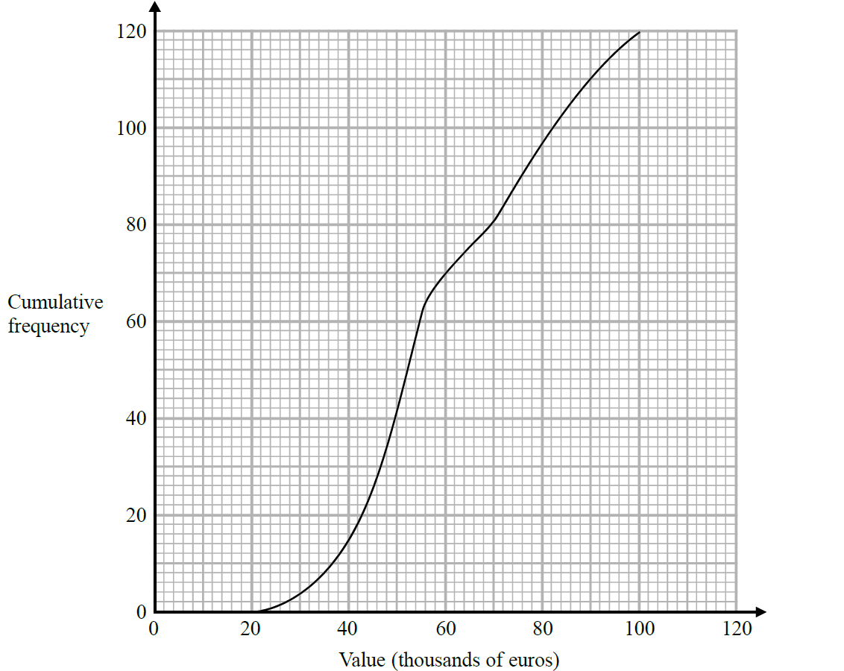
Cumulative Frequency
Jan 2019 1HR Q14
Reveal graph

Slide 11
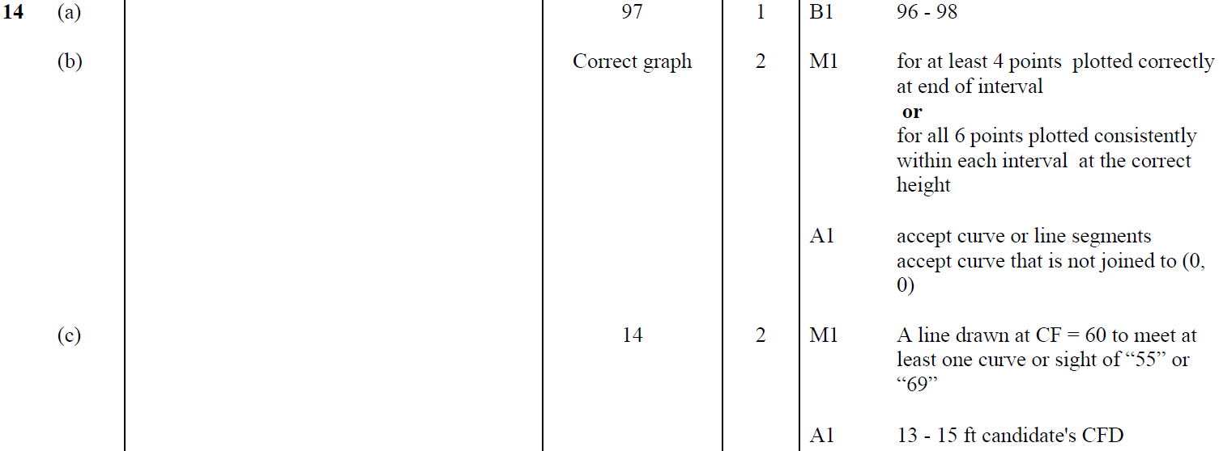
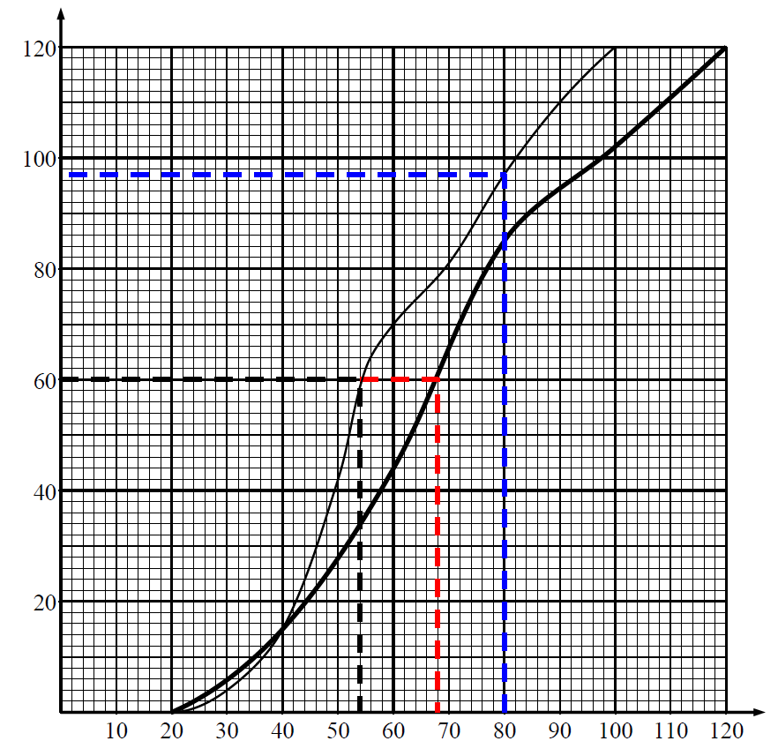
Cumulative Frequency
Jan 2019 1HR Q14
A
B
C
Diagram

Slide 12
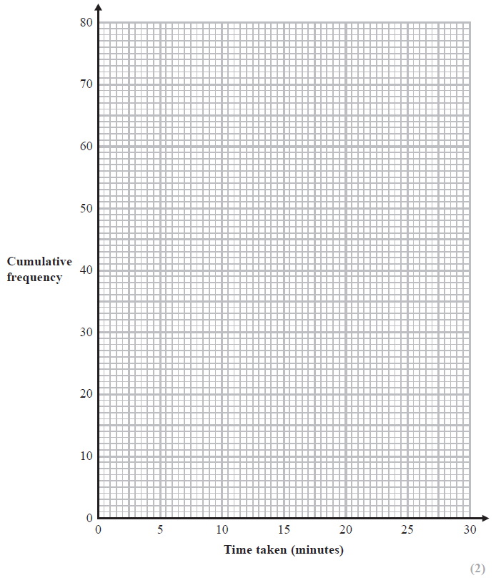
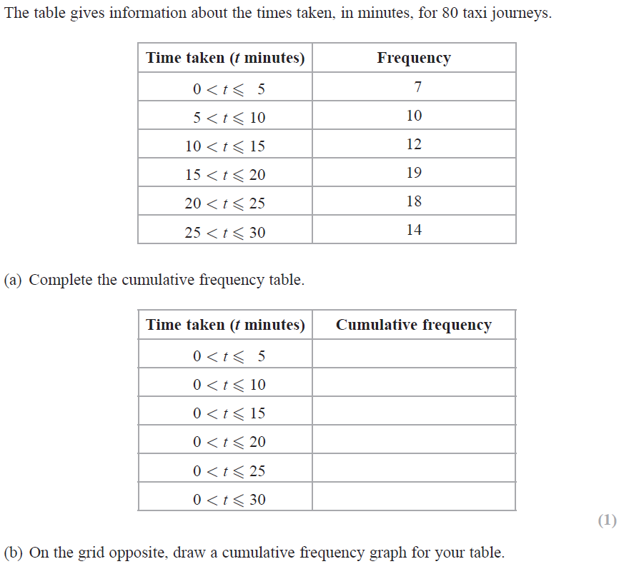
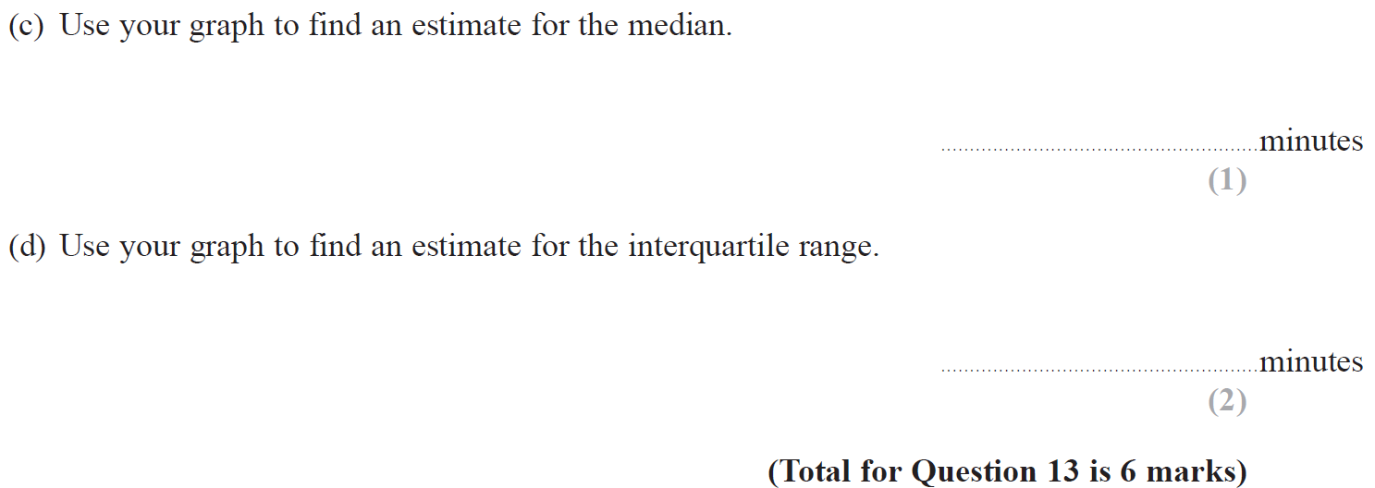
Cumulative Frequency
June 2019 2H Q13
Reveal graph

Slide 13
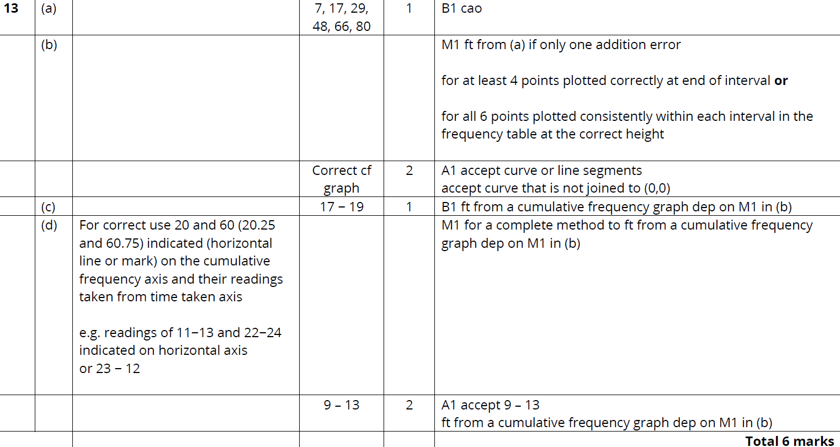
Cumulative Frequency
June 2019 2H Q13
A
B
C
D

Slide 14
Cumulative Frequency
Cumulative Frequency
New Spec Q’s
May 2004
3H Q9
May 2008
3H Q11
May 2012 3H Q12
Jan 2015 3H Q13
Jan 2017 3H Q11
Nov 2004
4H Q10
Nov 2008
3H Q11
Jan 2013 4H Q16
Jan 2015 3HR Q16
Jan 2017 3HR Q12
May 2005
3H Q10
May 2009
3H Q10
May 2013 3H Q12
June 2015 4H Q10
May 2017 3H Q11
Nov 2005
3H Q12
Nov 2009
3H Q16
May 2013 4HR Q10
May 2015 3HR Q12
May 2017 3HR Q12
May 2006
4H Q11
June 2010
3H Q6
Jan 2014 3H Q8
Jan 2016 4H Q15
Jan 2018 4H Q12
Nov 2006
4H Q16
Nov 2010
3H Q11
Jan 2014 3HR Q10
Jan 2016 3HR Q14
Jan 2018 3HR Q16
May 2007
3H Q12
June 2011 3H Q11
May 2014 3H Q11
May 2016 3H Q11
May 2018 3H Q10
Nov 2007
4H Q16
Jan 2012 4H Q14
May 2014 3HR Q10
June 2016 4HR Q12
May 2018 3HR Q13

Slide 15
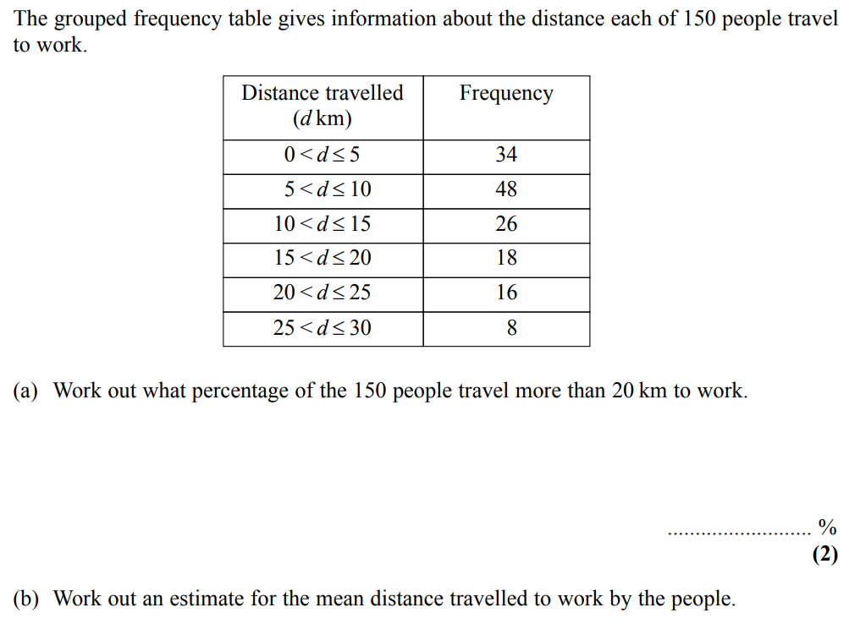
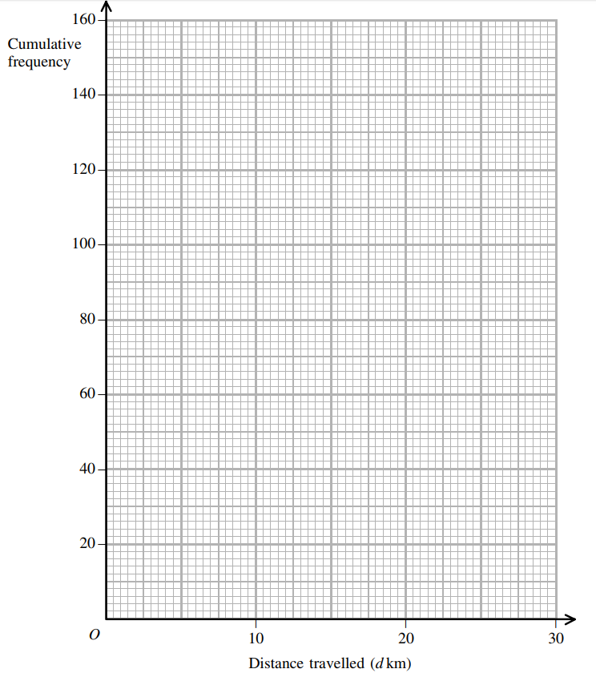
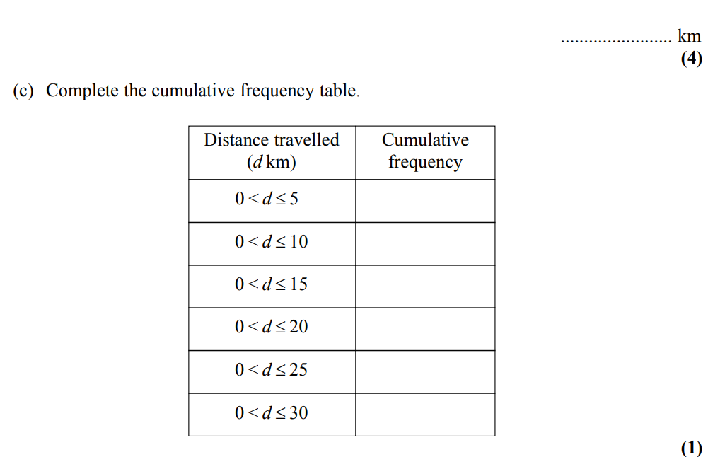
Cumulative Frequency
May 2004 3H Q9
Show Graph
Hide Graph

Slide 16
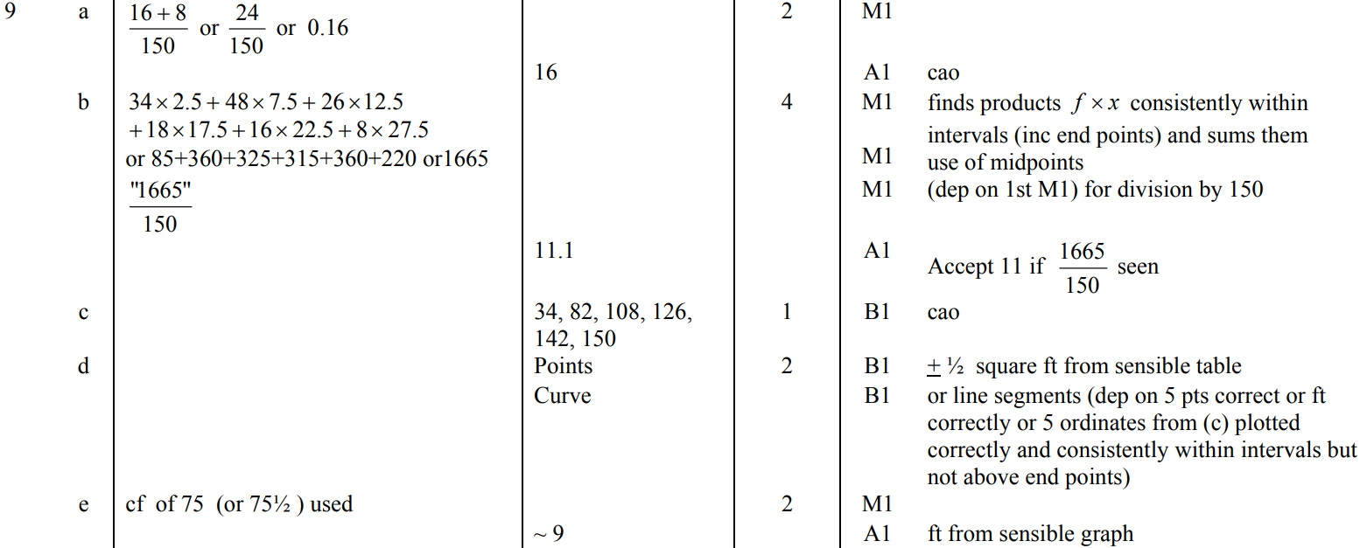
Cumulative Frequency
May 2004 3H Q9
A
B
C
D
E

Slide 17
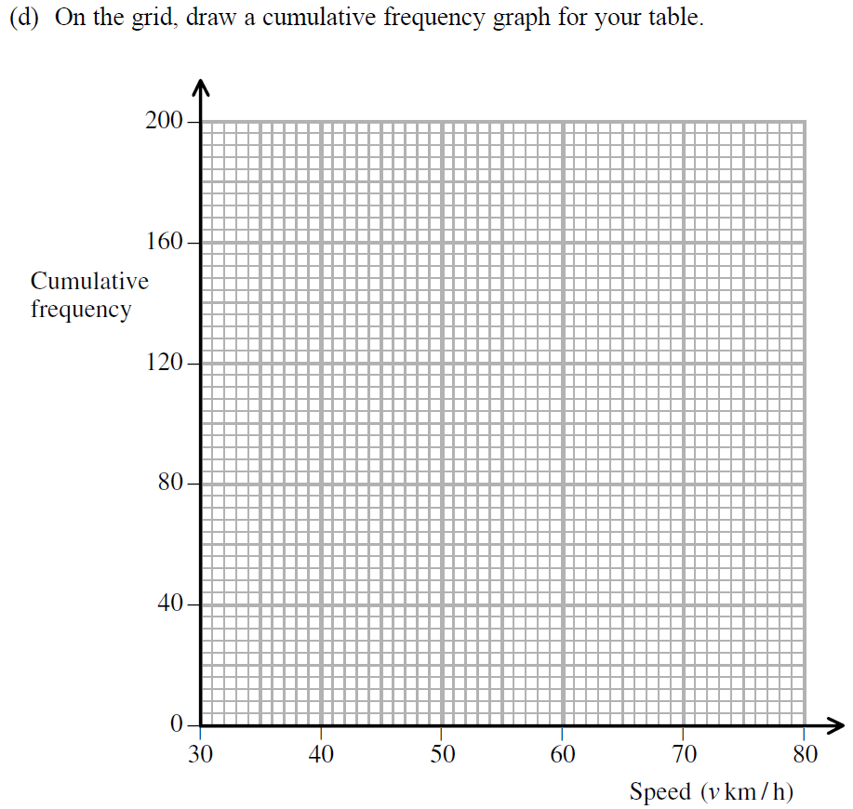
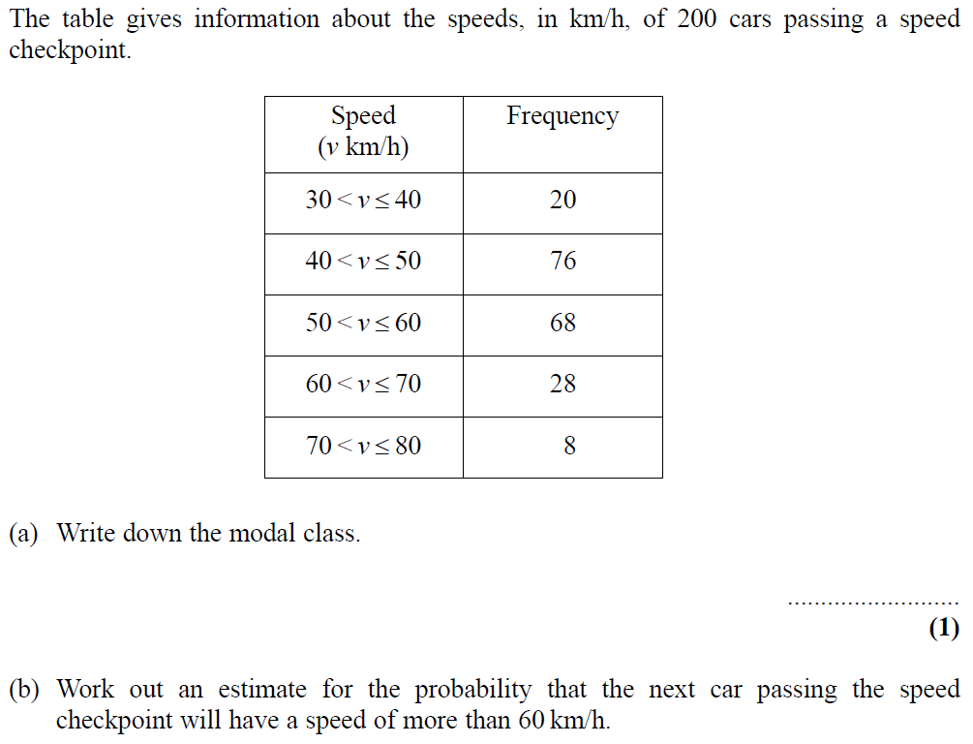
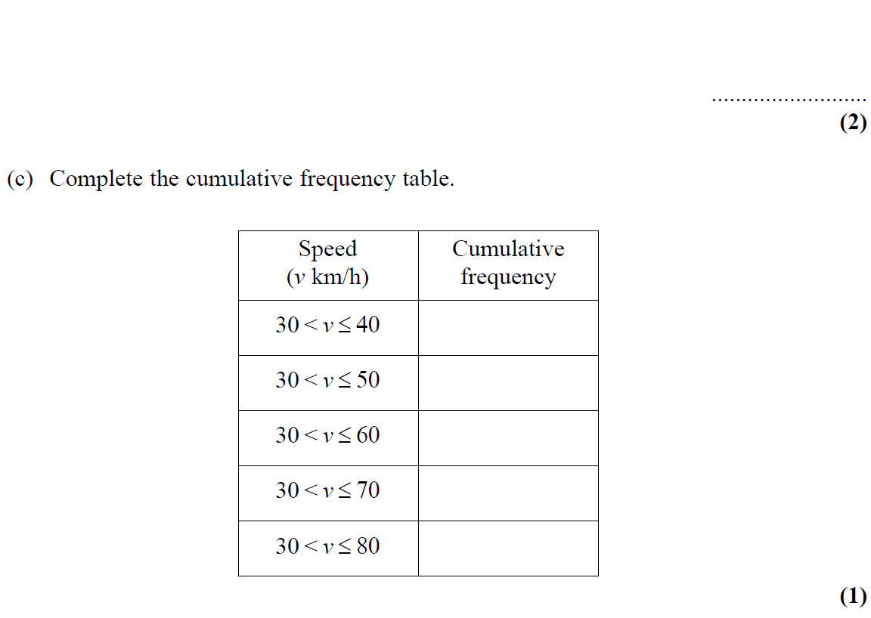
Cumulative Frequency
Nov 2004 4H Q10
Show Graph
Hide Graph

Slide 18
Cumulative Frequency
Nov 2004 4H Q10
A
B
C
D
E

Slide 19
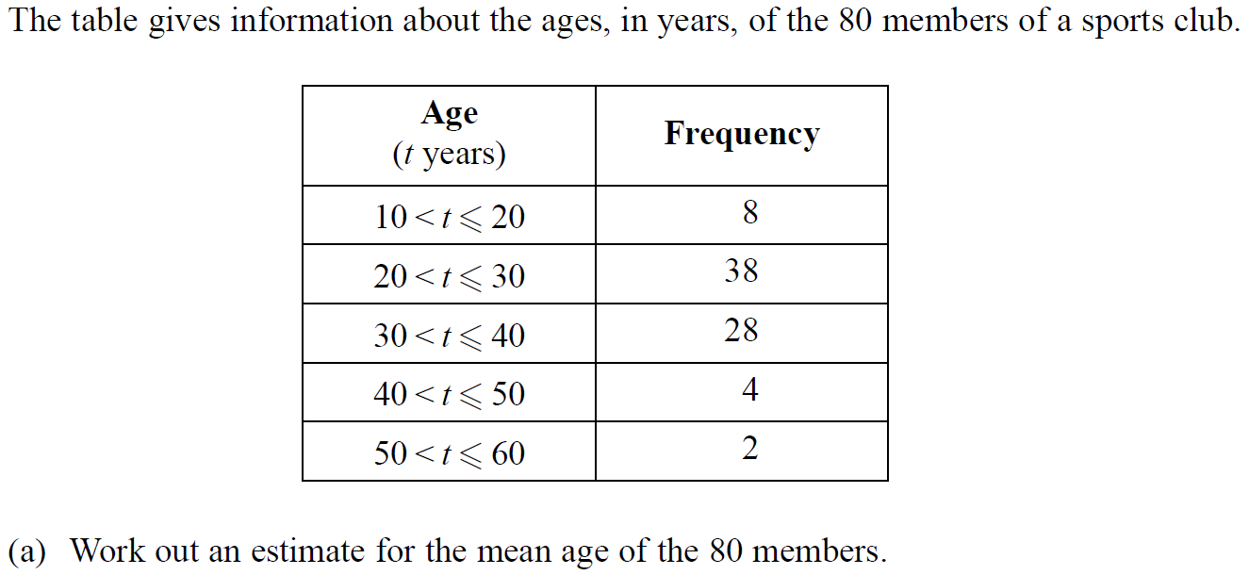
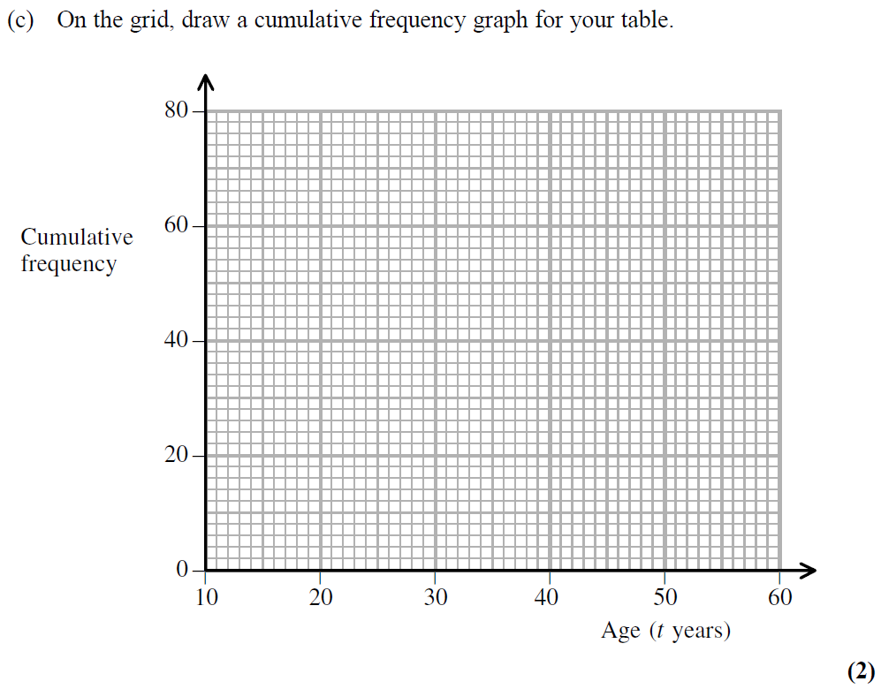
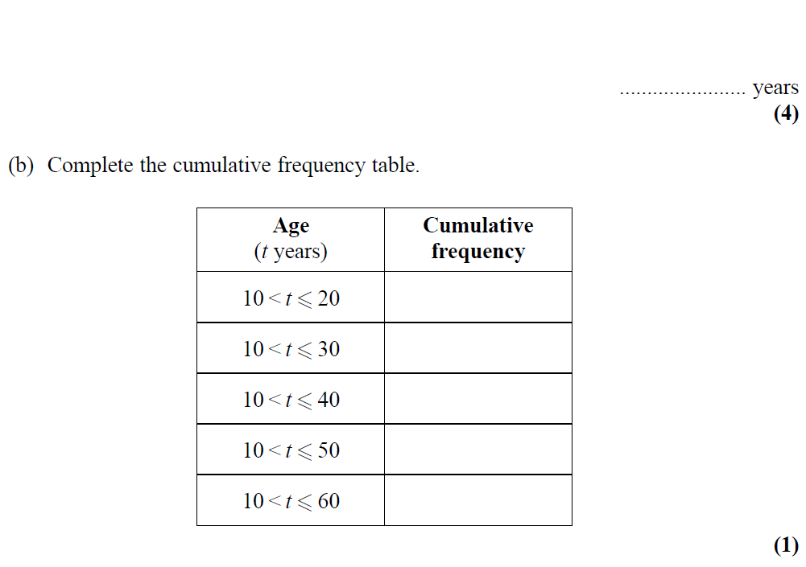
Cumulative Frequency
May 2005 3H Q10
Show Graph
Hide Graph

Slide 20
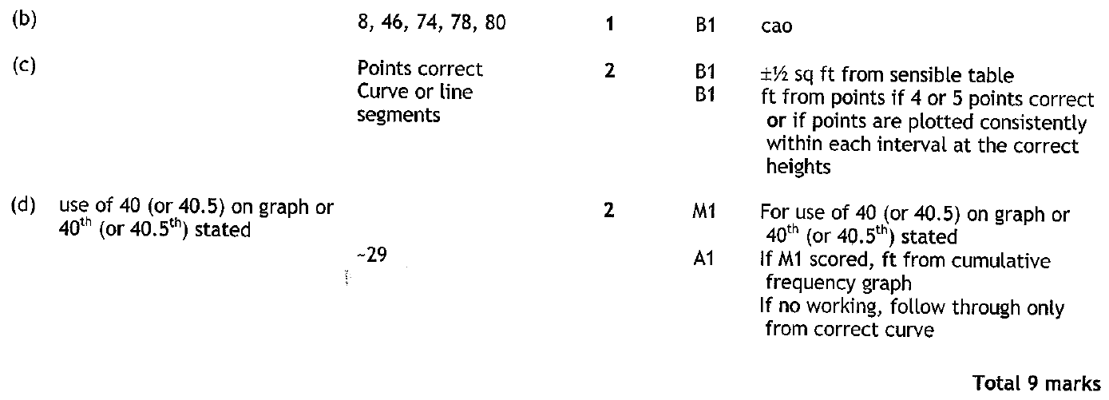
Cumulative Frequency
May 2005 3H Q10
A
B
C
D

Slide 21
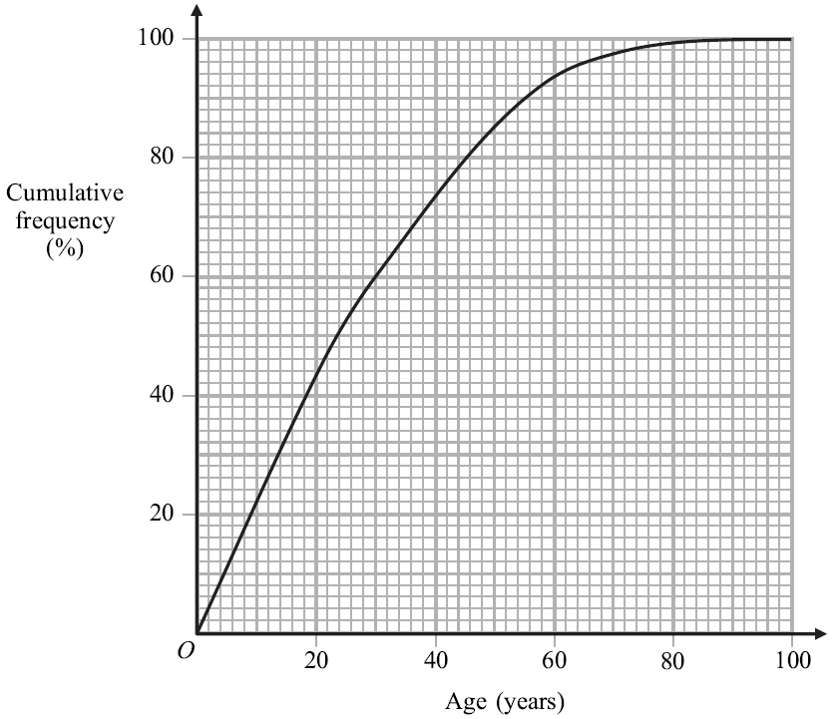
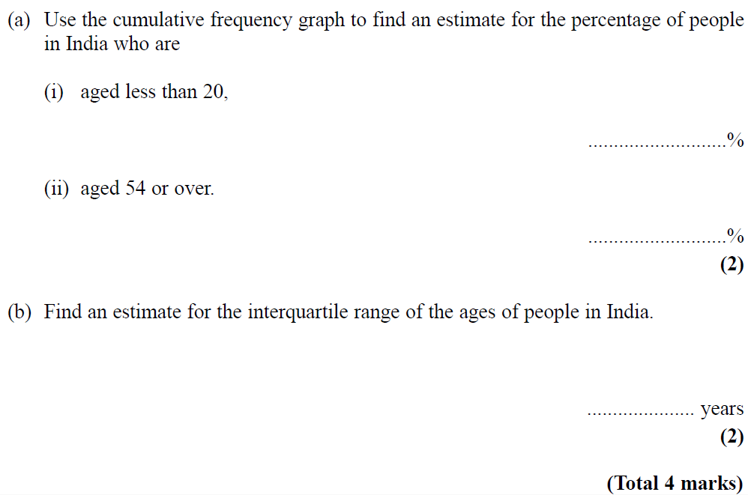
Cumulative Frequency
Nov 2005 3H Q12

Slide 22
Cumulative Frequency
Nov 2005 3H Q12
A (i)
A(ii)
B

Slide 23
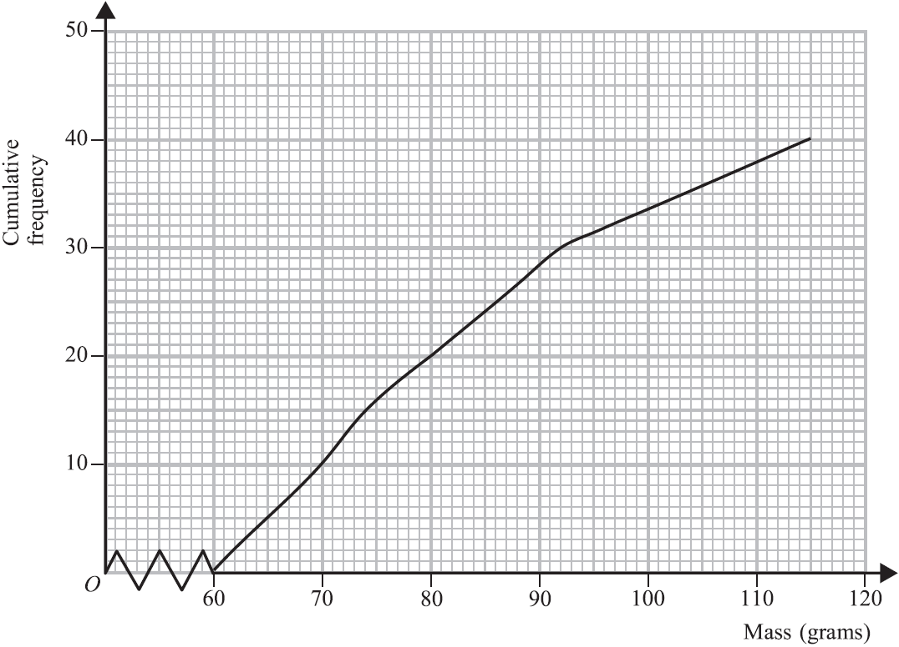
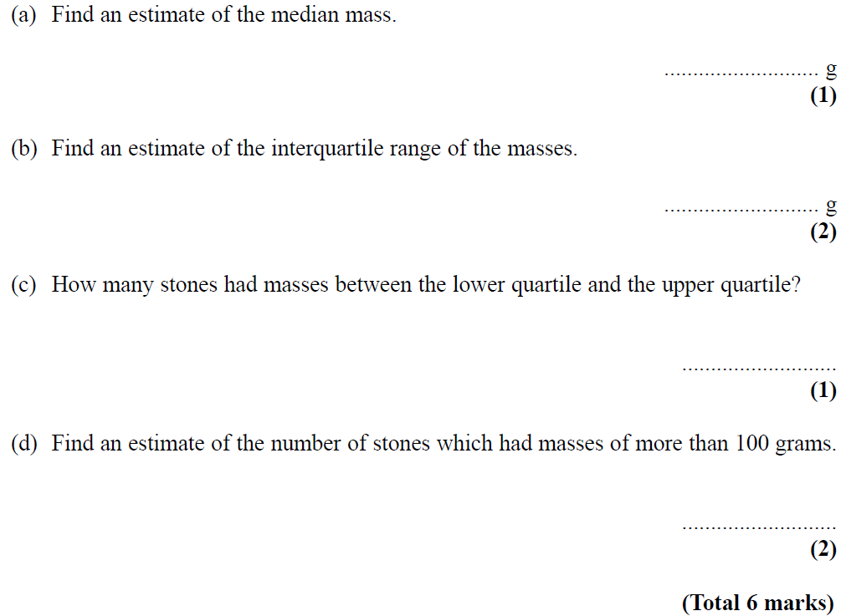
Cumulative Frequency
May 2006 4H Q11

Slide 24
Cumulative Frequency
May 2006 4H Q11
A
B
C
D

Slide 25
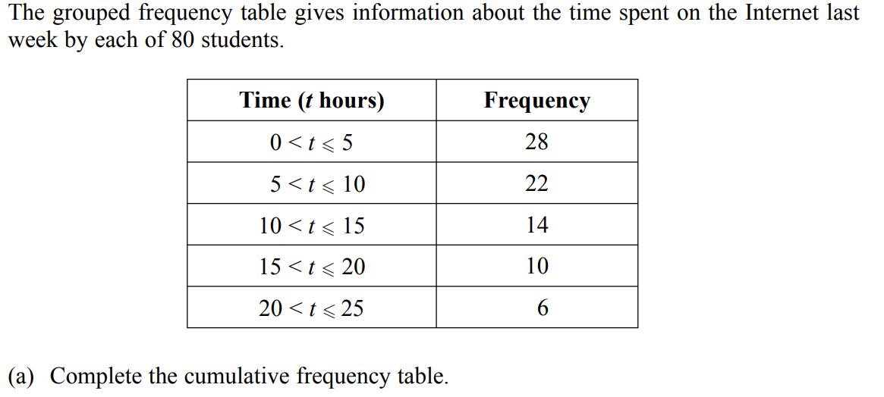
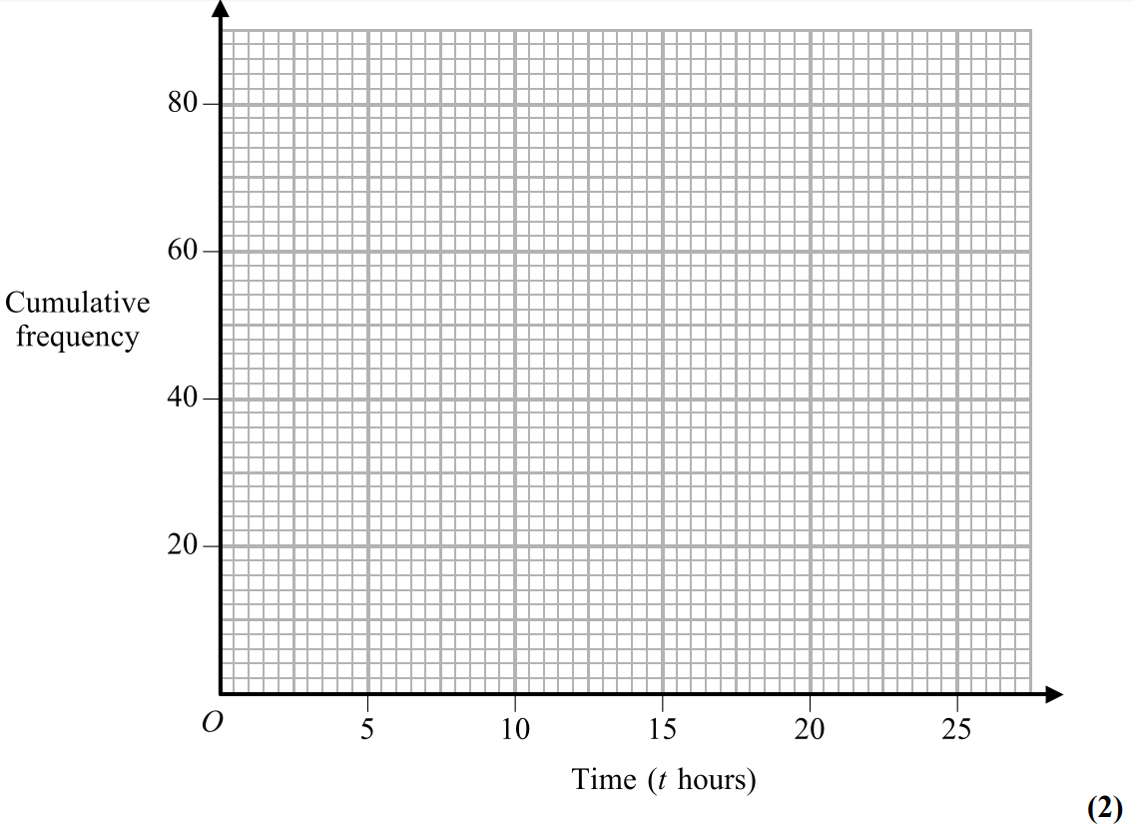
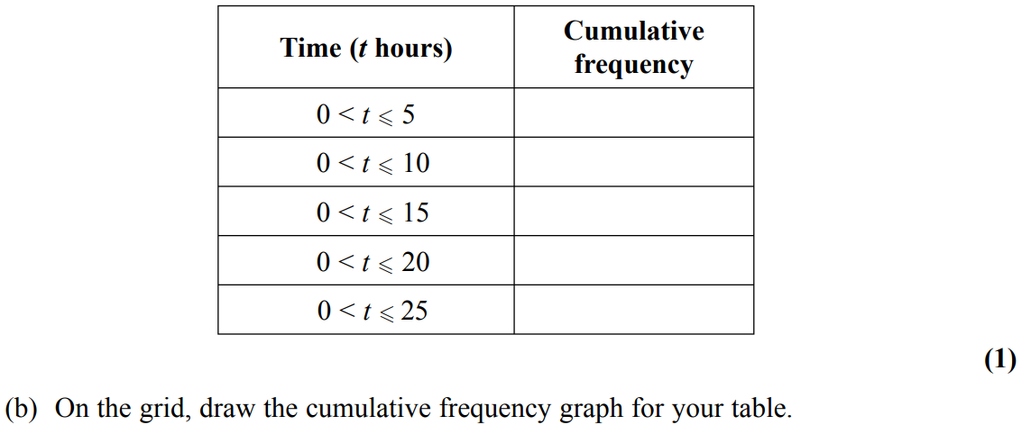
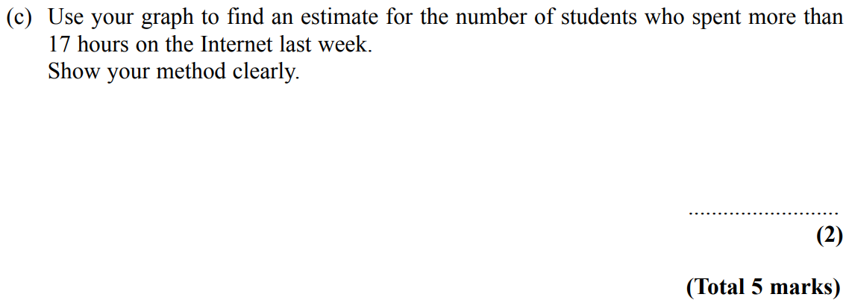
Cumulative Frequency
Nov 2006 4H Q16
Show Graph
Hide Graph

Slide 26
Cumulative Frequency
Nov 2006 4H Q16
A
B
C

Slide 27
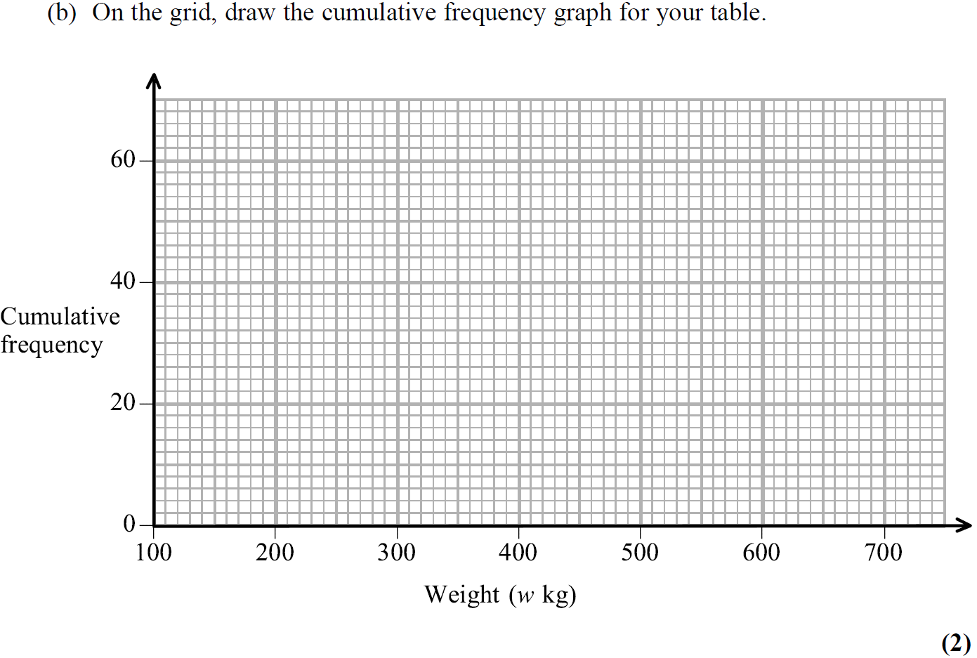
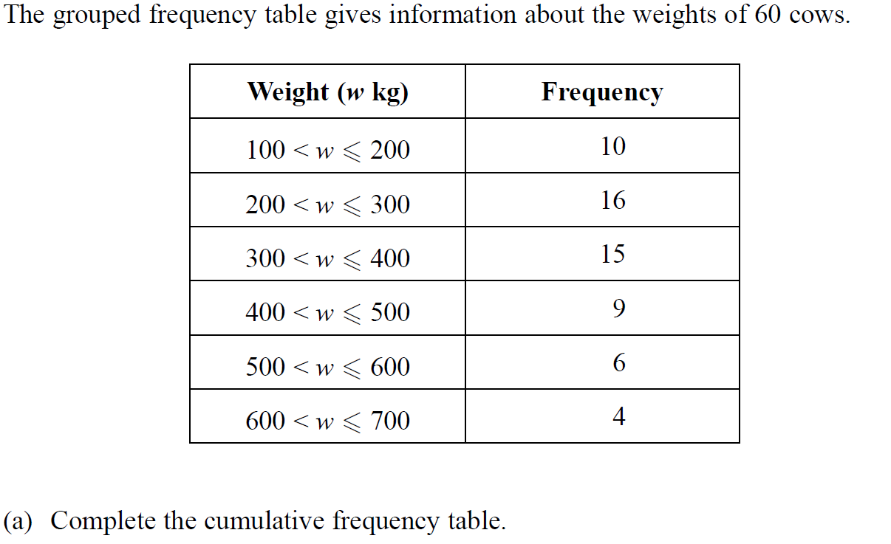
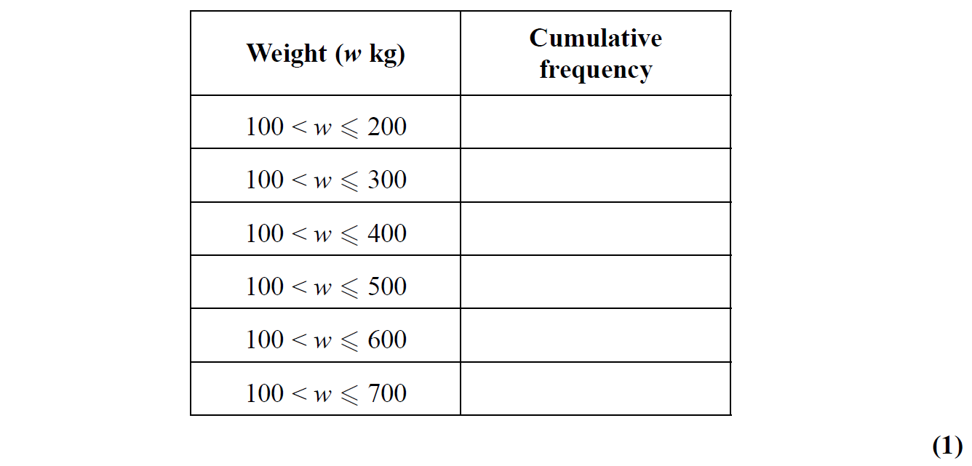
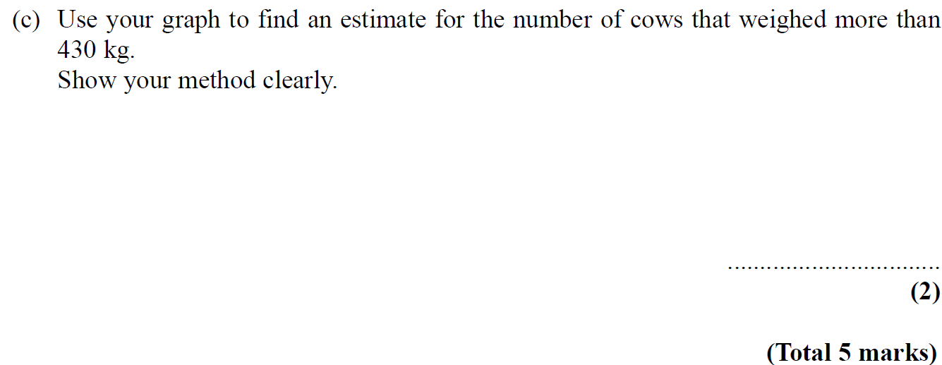
Cumulative Frequency
May 2007 3H Q12
Show Graph
Hide Graph

Slide 28
Cumulative Frequency
May 2007 3H Q12
A
B
C

Slide 29
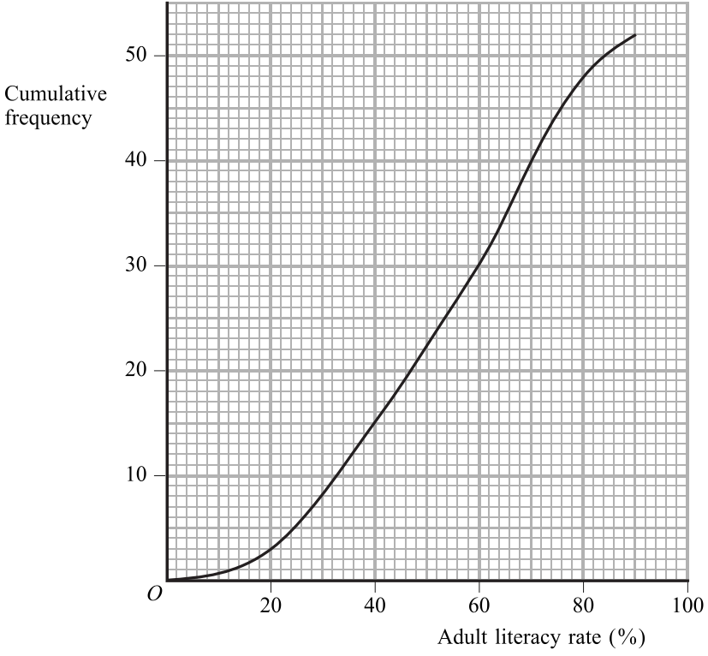
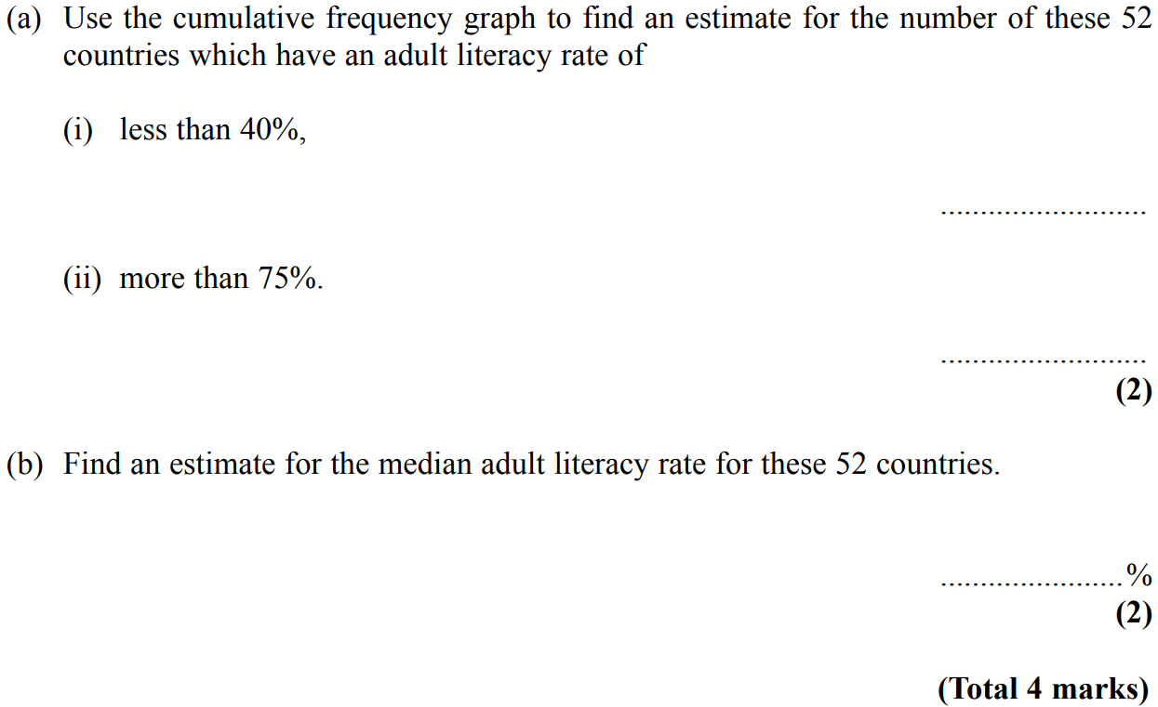
Cumulative Frequency
Nov 2007 4H Q16

Slide 30
Cumulative Frequency
Nov 2007 4H Q16
A (i)
A (ii)
B

Slide 31
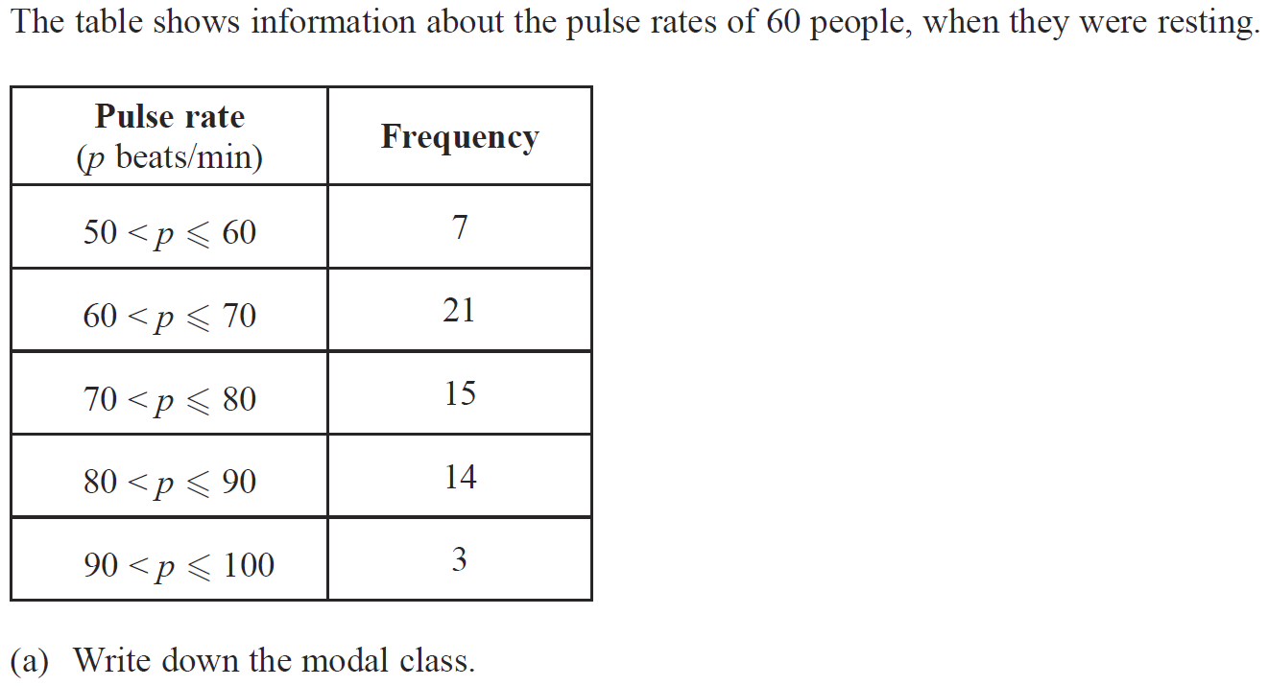
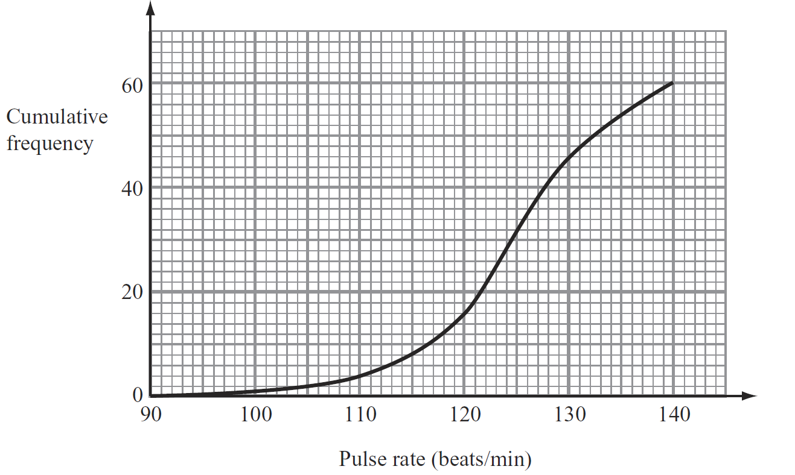
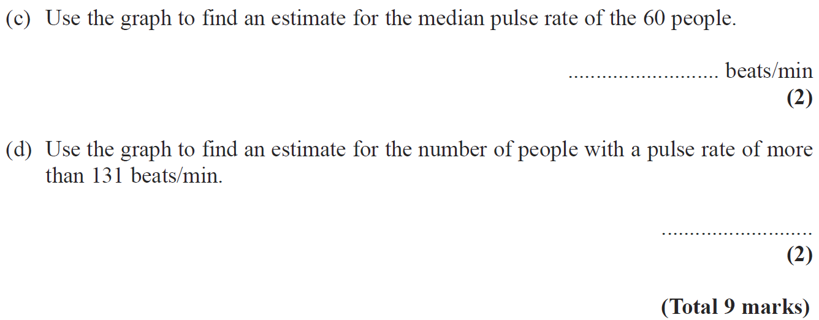
Cumulative Frequency
May 2008 3H Q11

Slide 32
Cumulative Frequency
May 2008 3H Q11
A
B
C
D

Slide 33
Cumulative Frequency
Nov 2008 3H Q11
Show Graph
Hide Graph

Slide 34
Cumulative Frequency
Nov 2008 3H Q11
A
B
C

Slide 35
Cumulative Frequency
May 2009 3H Q10

Slide 36
Cumulative Frequency
May 2009 3H Q10
A
B
C

Slide 37
Cumulative Frequency
Nov 2009 3H Q16

Slide 38
Cumulative Frequency
Nov 2009 3H Q16
A
B

Slide 39
Cumulative Frequency
June 2010 3H Q6
Show Graph
Hide Graph

Slide 40
Cumulative Frequency
June 2010 3H Q6
A
B
C
D
E

Slide 41
Cumulative Frequency
Nov 2010 3H Q11

Slide 42
Cumulative Frequency
Nov 2010 3H Q11
A
B
C

Slide 43
Cumulative Frequency
June 2011 3H Q11
Show Graph
Hide Graph

Slide 44
Cumulative Frequency
June 2011 3H Q11
A
B
C
D

Slide 45
Cumulative Frequency
Jan 2012 4H Q14
Show Graph
Hide Graph

Slide 46
Cumulative Frequency
Jan 2012 4H Q14
A
B
C

Slide 47
Cumulative Frequency
May 2012 3H Q12

Slide 48
Cumulative Frequency
May 2012 3H Q12
A
B

Slide 49
Cumulative Frequency
Jan 2013 4H Q16
Show Graph
Hide Graph

Slide 50
Cumulative Frequency
Jan 2013 4H Q16
A
B
C

Slide 51
Cumulative Frequency
May 2013 3H Q12
Show Graph
Hide Graph

Slide 52
Cumulative Frequency
May 2013 3H Q12
A
B

Slide 53
Cumulative Frequency
May 2013 4HR Q10
Show Graph
Hide Graph

Slide 54
Cumulative Frequency
May 2013 4HR Q10
A
B
C

Slide 55
Cumulative Frequency
Jan 2014 3H Q8

Slide 56
Cumulative Frequency
Jan 2014 3H Q8
A
B
C
D

Slide 57
Cumulative Frequency
Jan 2014 3HR Q10
Show Graph
Hide Graph

Slide 58
Cumulative Frequency
Jan 2014 3HR Q10
A
B
C

Slide 59
Cumulative Frequency
May 2014 3H Q11
Show Graph
Hide Graph

Slide 60
Cumulative Frequency
May 2014 3H Q11
A
B
C
D
E

Slide 61
Cumulative Frequency
May 2014 3HR Q10

Slide 62
Cumulative Frequency
May 2014 3HR Q10
A
B
C

Slide 63
Cumulative Frequency
Jan 2015 3H Q13

Slide 64
Cumulative Frequency
Jan 2015 3H Q13
A
B

Slide 65
Cumulative Frequency
Jan 2015 3HR Q16
Show Graph
Hide Graph

Slide 66
Cumulative Frequency
Jan 2015 3HR Q16
A
B
C

Slide 67
Cumulative Frequency
June 2015 4H Q10

Slide 68
Cumulative Frequency
June 2015 4H Q10
A
B

Slide 69
Cumulative Frequency
May 2015 3HR Q12
Show Graph
Hide Graph

Slide 70
Cumulative Frequency
May 2015 3HR Q12
A
B
C

Slide 71
Cumulative Frequency
Jan 2016 4H Q15
Show Graph
Hide Graph

Slide 72
Cumulative Frequency
Jan 2016 4H Q15
A
B
C

Slide 73
Cumulative Frequency
Jan 2016 3HR Q14
Show Graph
Hide Graph

Slide 74
Cumulative Frequency
Jan 2016 3HR Q14
A
B

Slide 75
Cumulative Frequency
May 2016 3H Q11
Show Graph
Hide Graph

Slide 76
Cumulative Frequency
May 2016 3H Q11
A
B
C
D

Slide 77
Cumulative Frequency
June 2016 3HR Q12
Show Graph
Hide Graph

Slide 78
Cumulative Frequency
June 2016 3HR Q12
A
B
C (i)
C (ii)

Slide 79
Cumulative Frequency
Jan 2017 3H Q11
Show Graph
Hide Graph

Slide 80
Cumulative Frequency
Jan 2017 3H Q11
A
B
C
D

Slide 81
Cumulative Frequency
Jan 2017 3HR Q12
Show Graph
Hide Graph

Slide 82
Cumulative Frequency
Jan 2017 3HR Q12
A
B
C

Slide 83
Cumulative Frequency
May 2017 3H Q11
Show Graph
Hide Graph

Slide 84
Cumulative Frequency
May 2017 3H Q11
A
B
C
D

Slide 85
Cumulative Frequency
May 2017 3HR Q12
Show Graph
Hide Graph

Slide 86
Cumulative Frequency
May 2017 3HR Q12
A
B
C
D

Slide 87
Cumulative Frequency
Jan 2018 4H Q12

Slide 88
Cumulative Frequency
Jan 2018 4H Q12
A
B

Slide 89
Cumulative Frequency
Jan 2018 3HR Q16

Slide 90
Cumulative Frequency
Jan 2018 3HR Q16
A
B
C

Slide 91
Cumulative Frequency
May 2018 3H Q10
Show Graph
Hide Graph

Slide 92
Cumulative Frequency
May 2018 3H Q10
A
B
C
D
E

Slide 93
Cumulative Frequency
May 2018 3HR Q13

Slide 94
Cumulative Frequency
May 2018 3HR Q13
A
B

