Slide 1
Compound Measures
Compound Measures
Old Spec Q’s
NTSQ
Q2
NTSQ
Q10
SAM
2H Q3
Jan 2019
1HR Q5
NTSQ
Q3
NTSQ
Q11
June 2018
2H Q11
May 2019
1H Q6
NTSQ
Q4
NTSQ
Q12
May 2018
1HR Q9
June 2019
2H Q8
NTSQ
Q5
NTSQ
Q13
May 2018
1HR Q11
NTSQ
Q6
NTSQ
Q14
May 2018
1HR Q22
NTSQ
Q7
NTSQ
Q15
May 2018
2HR Q2
NTSQ
Q8
NTSQ
Q16
May 2018
2HR Q5
NTSQ
Q9
SAM
1H Q1
Jan 2019
2H Q8

Slide 2
Compound Measures
NTSQ Q2

Slide 3
Compound Measures
NTSQ Q2
A

Slide 4
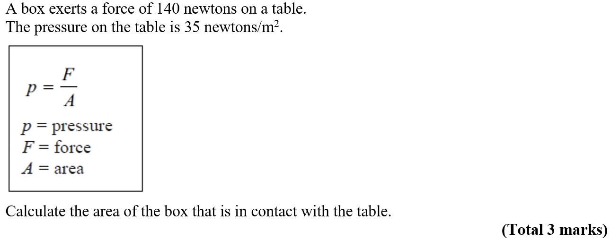
Compound Measures
NTSQ Q3

Slide 5
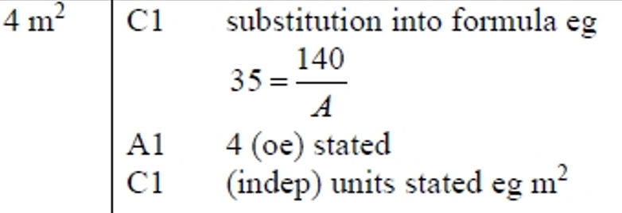
Compound Measures
NTSQ Q3
A

Slide 6
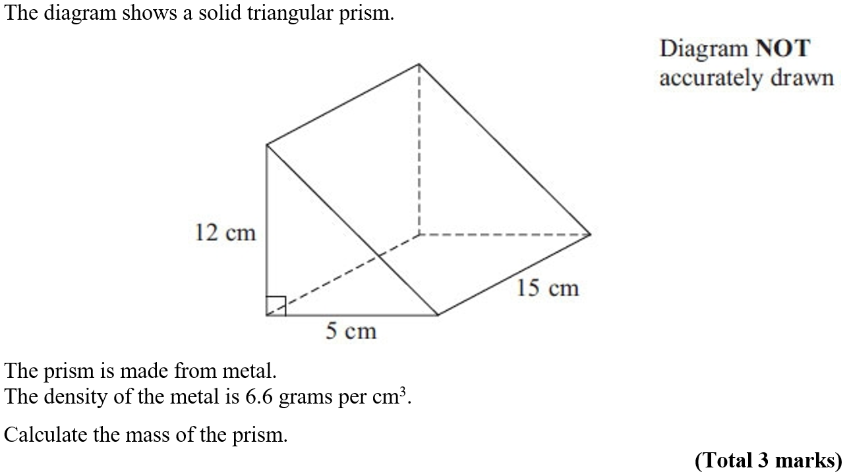
Compound Measures
NTSQ Q4

Slide 7
Compound Measures
NTSQ Q4
A

Slide 8
Compound Measures
NTSQ Q5

Slide 9
Compound Measures
NTSQ Q5
A

Slide 10
Compound Measures
NTSQ Q6

Slide 11
Compound Measures
NTSQ Q6
A

Slide 12
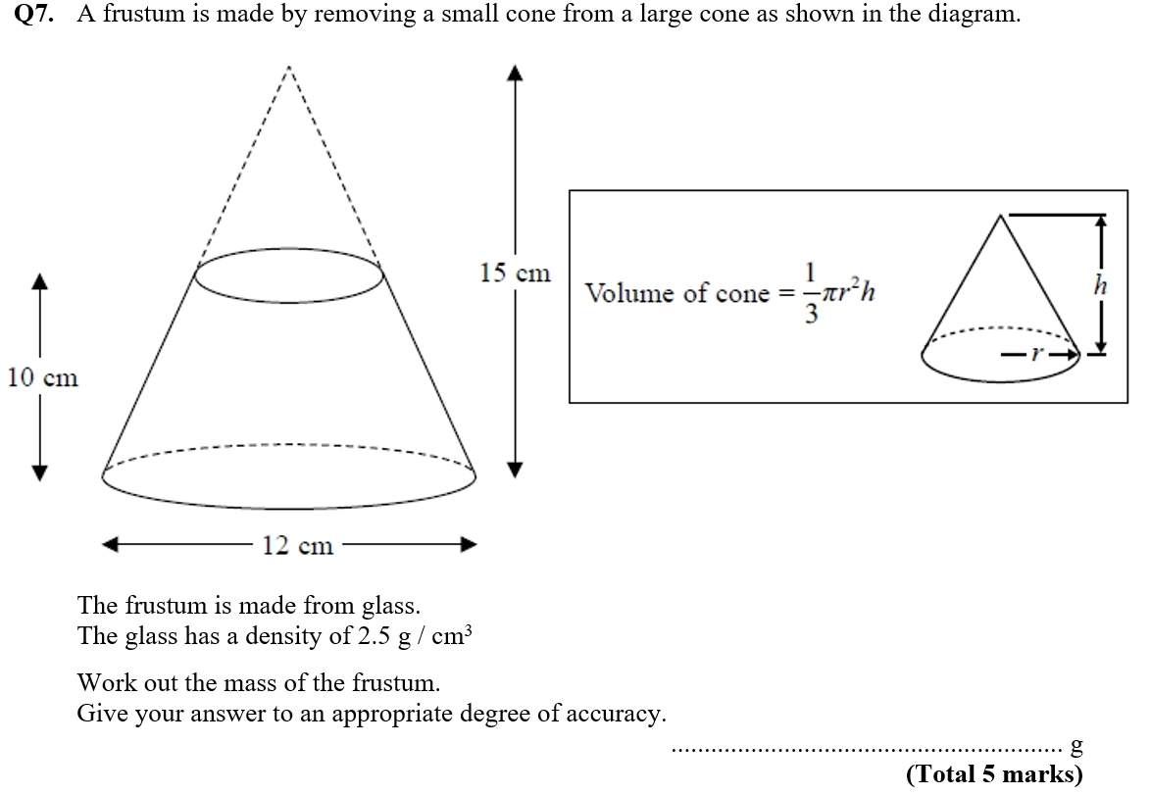
Compound Measures
NTSQ Q7

Slide 13
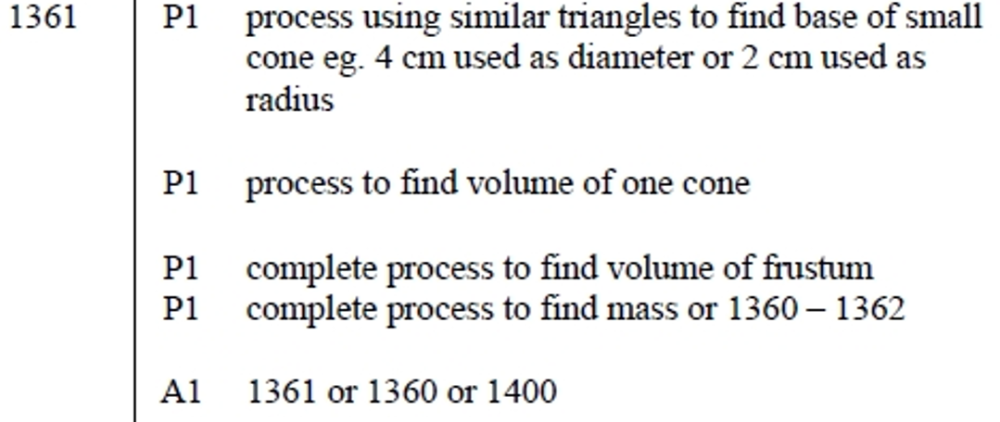
Compound Measures
NTSQ Q7
A

Slide 14
Compound Measures
NTSQ Q8

Slide 15
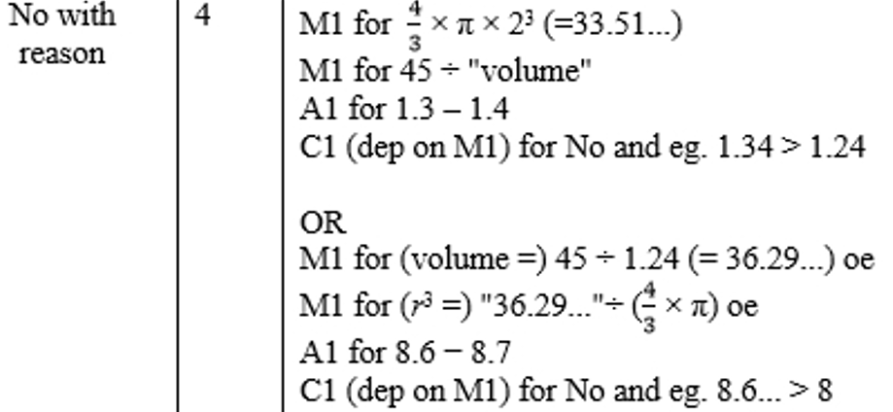
Compound Measures
NTSQ Q8
A

Slide 16
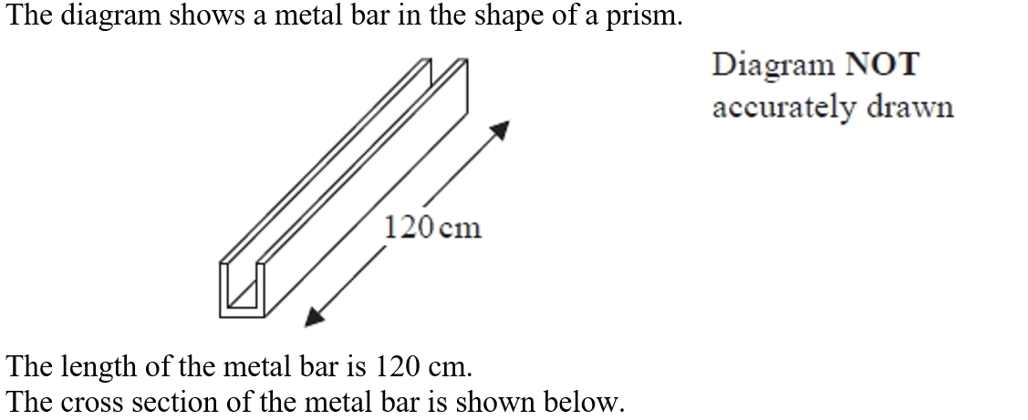
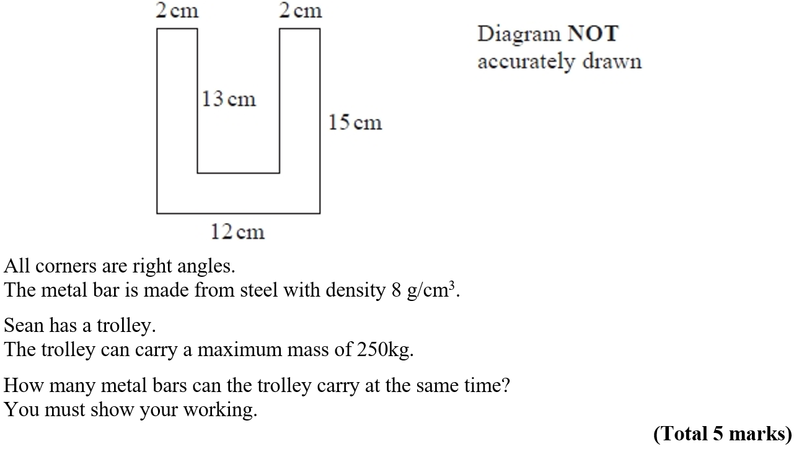
Compound Measures
NTSQ Q9

Slide 17
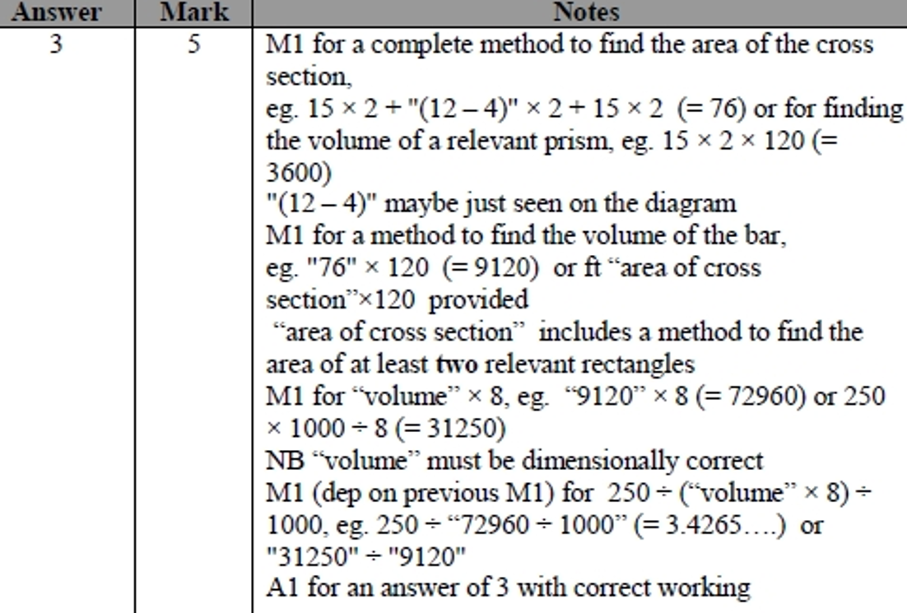
Compound Measures
NTSQ Q9
A

Slide 18
Compound Measures
NTSQ Q10

Slide 19
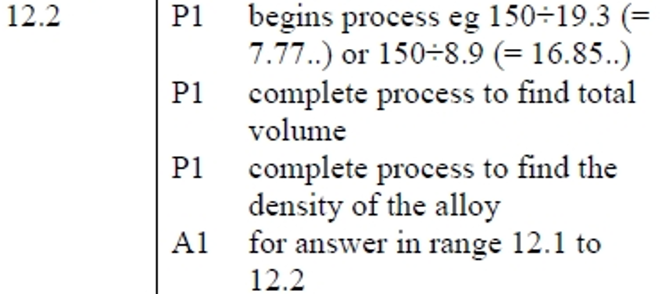
Compound Measures
NTSQ Q10
A

Slide 20
Compound Measures
NTSQ Q11

Slide 21
Compound Measures
NTSQ Q11
A

Slide 22
Compound Measures
NTSQ Q12

Slide 23
Compound Measures
NTSQ Q12
A

Slide 24
Compound Measures
NTSQ Q13

Slide 25
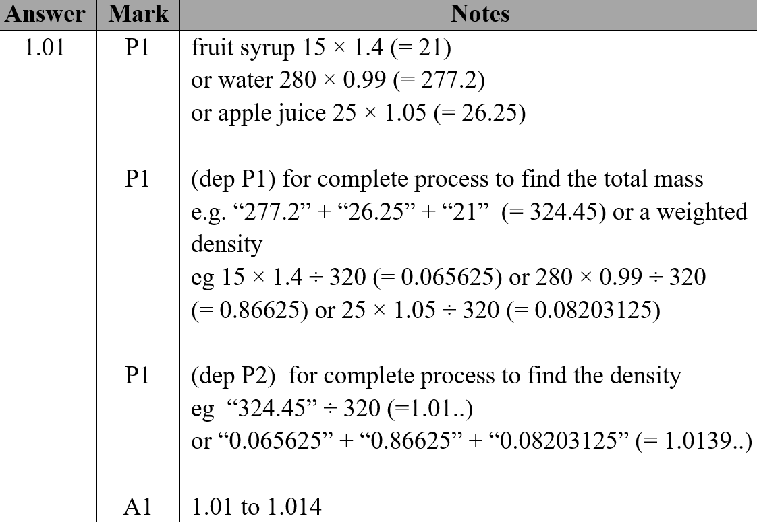
Compound Measures
NTSQ Q13
A

Slide 26
Compound Measures
NTSQ Q14

Slide 27
Compound Measures
NTSQ Q14
A

Slide 28
Compound Measures
NTSQ Q15

Slide 29
Compound Measures
NTSQ Q15
A

Slide 30
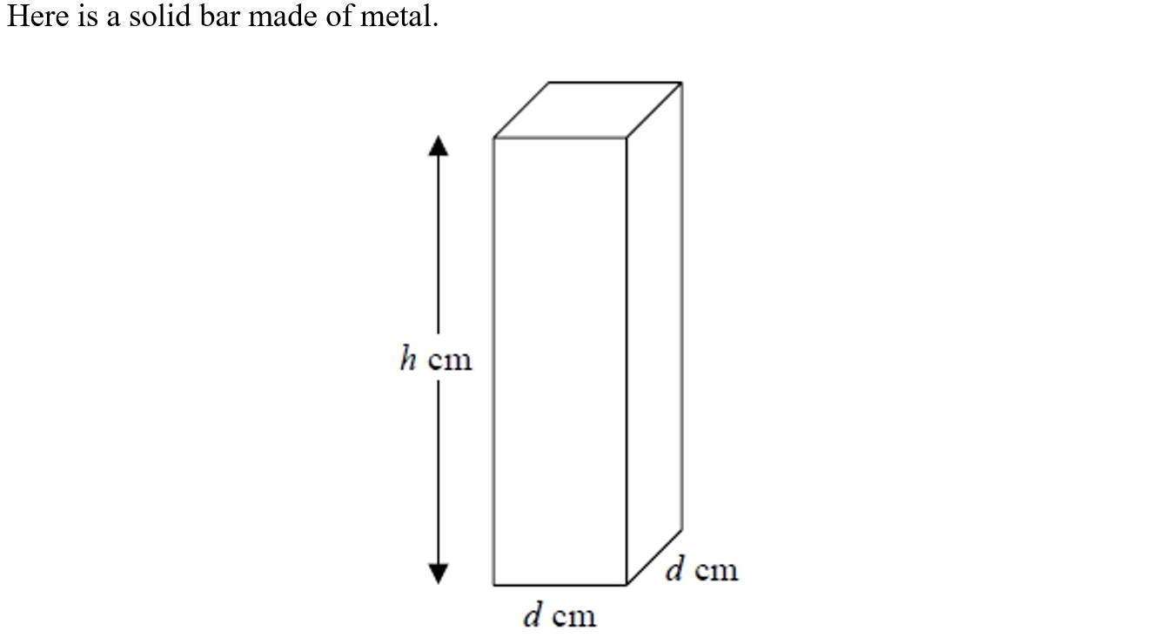
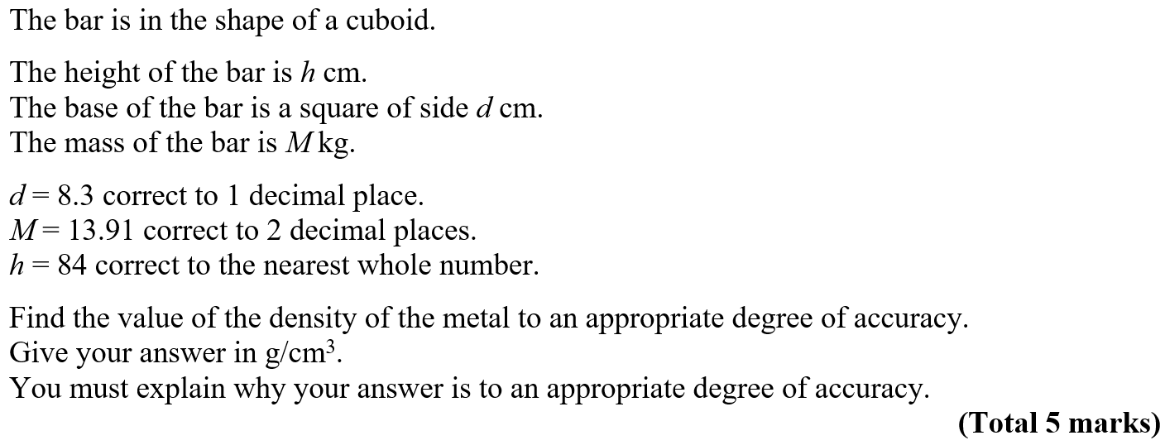
Compound Measures
NTSQ Q16

Slide 31
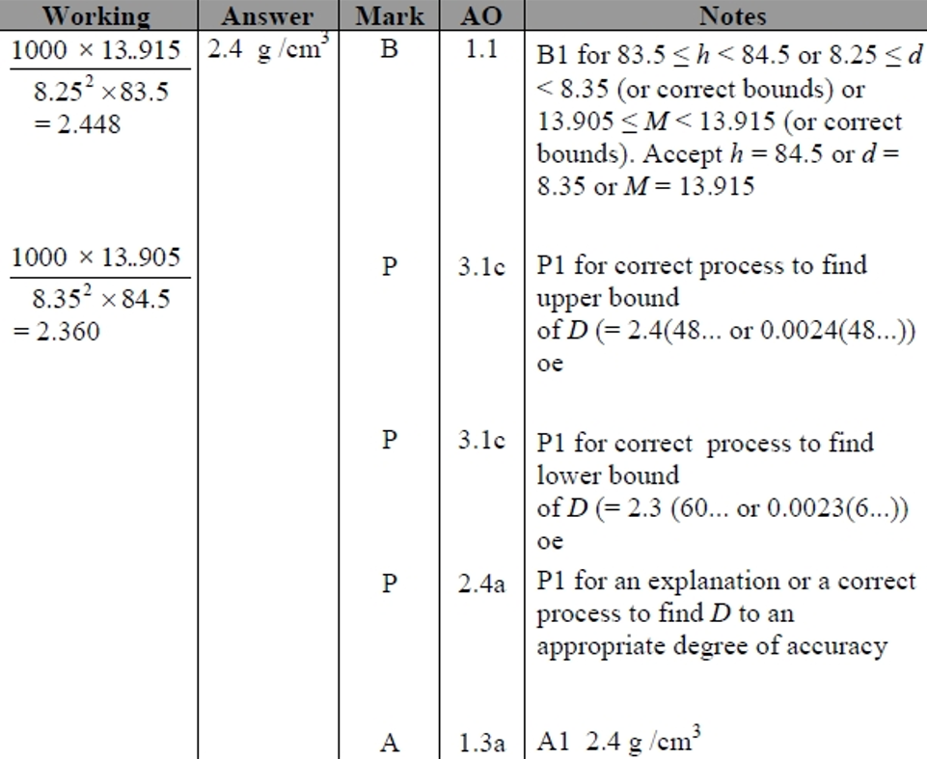
Compound Measures
NTSQ Q16
A

Slide 32
Compound Measures
SAM 1H Q1

Slide 33
Compound Measures
SAM 1H Q1
A

Slide 34
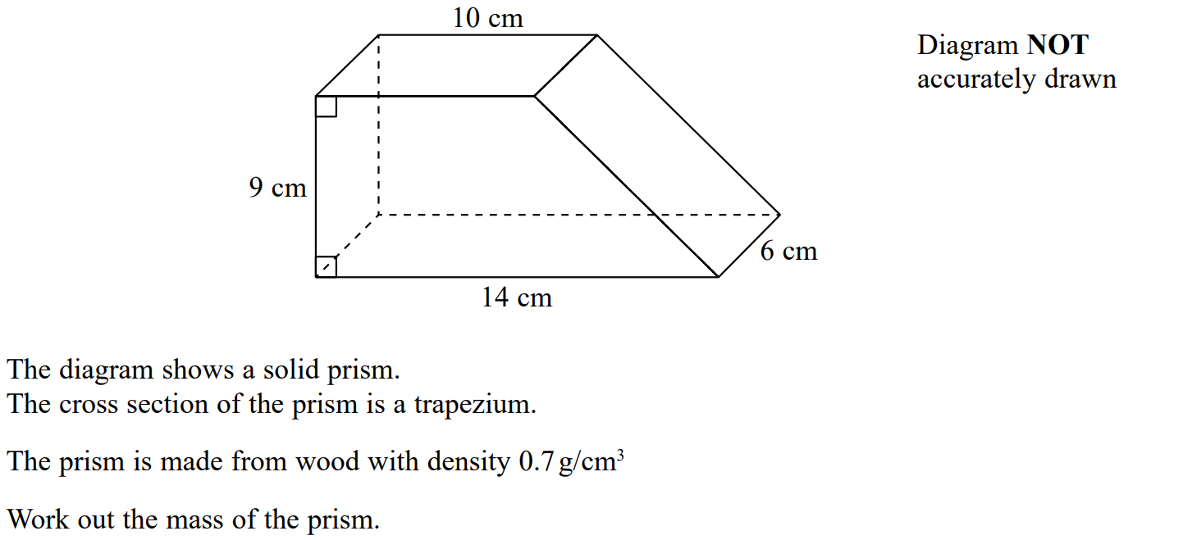
Compound Measures
SAM 2H Q3

Slide 35
Compound Measures
SAM 2H Q3
A

Slide 36
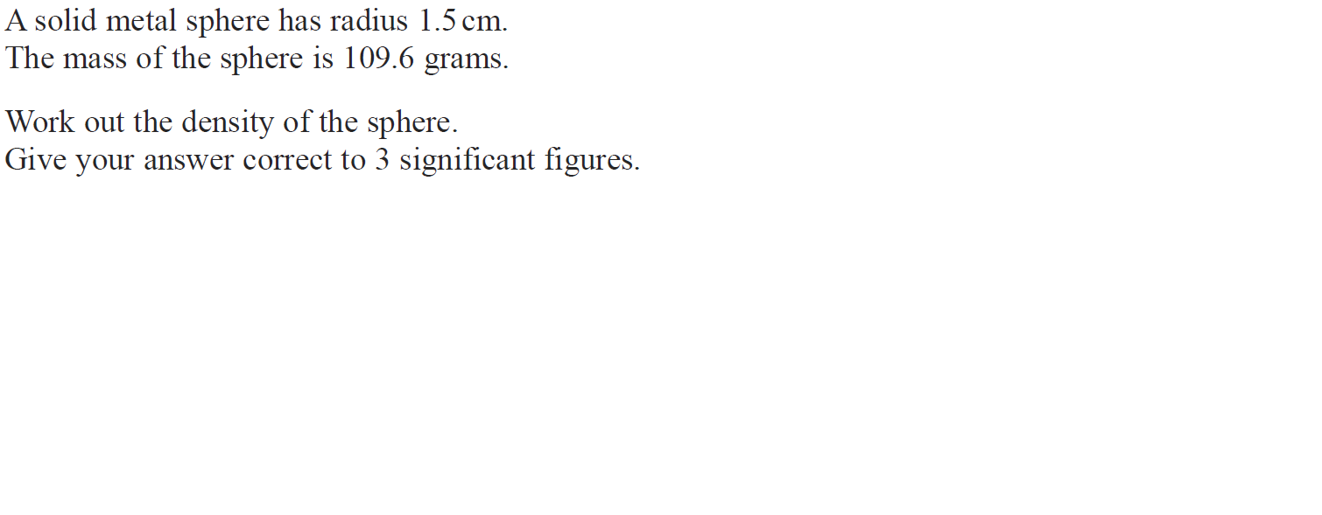
Compound Measures
June 2018 2H Q11

Slide 37
Compound Measures
June 2018 2H Q11
A

Slide 38
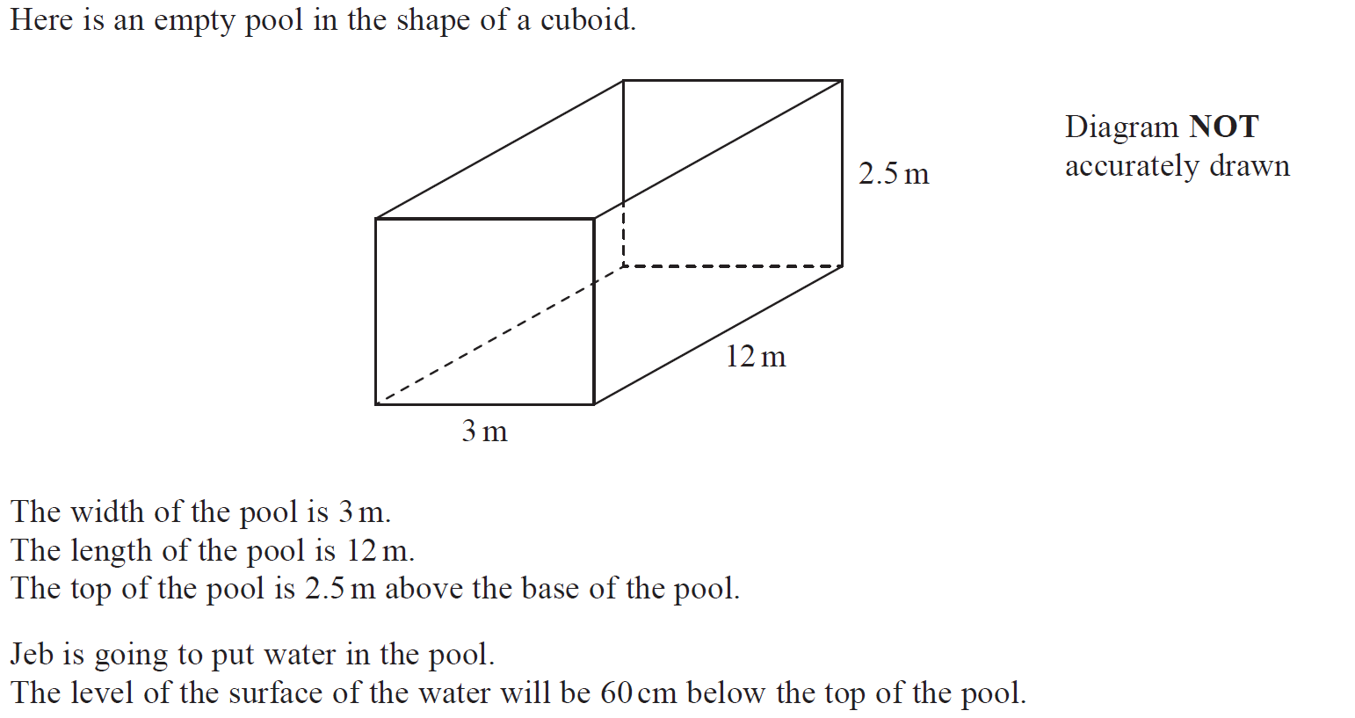
Compound Measures
May 2018 1HR Q9

Slide 39
Compound Measures
May 2018 1HR Q9
A

Slide 40
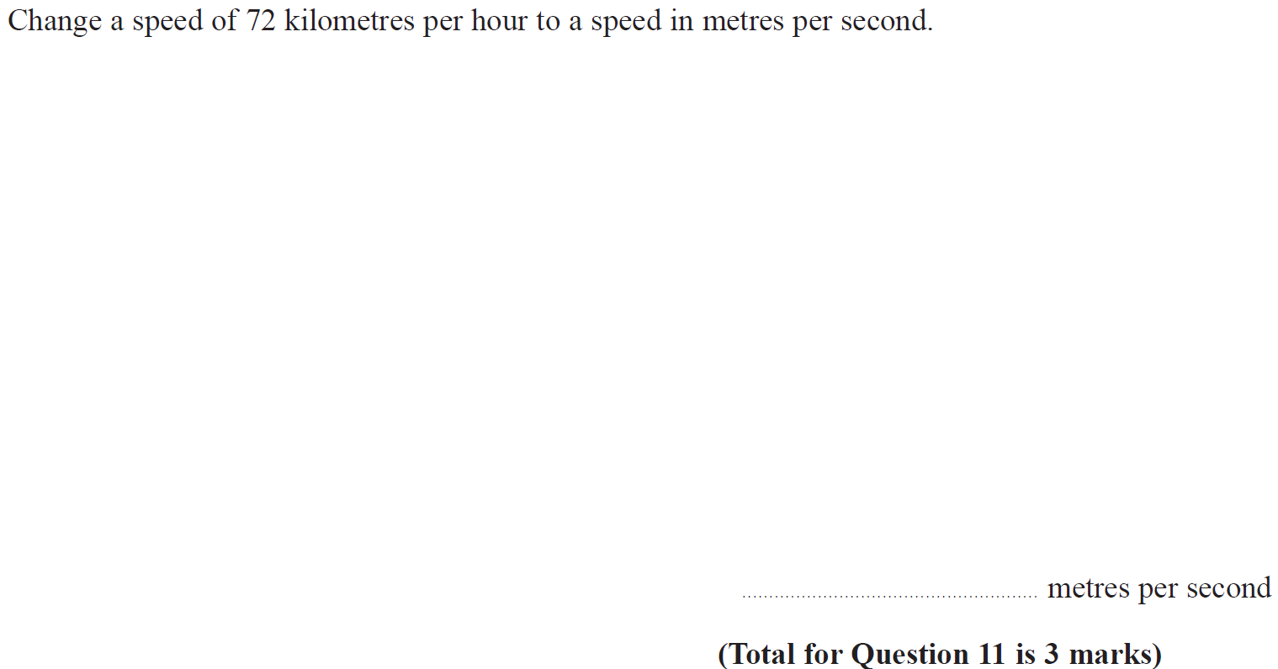
Compound Measures
May 2018 1HR Q11

Slide 41
Compound Measures
May 2018 1HR Q11
A

Slide 42
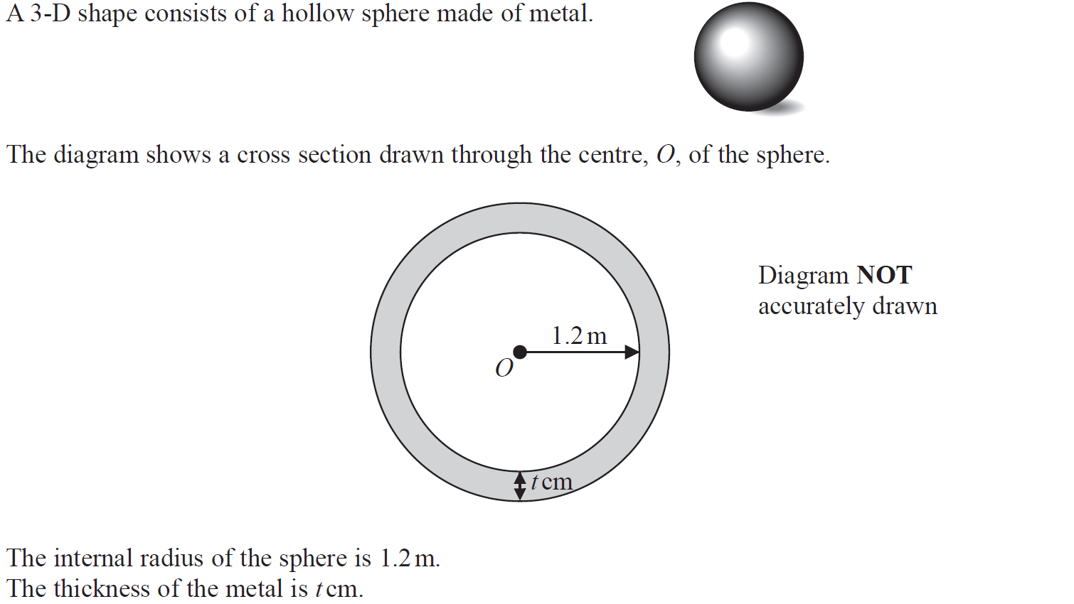
Compound Measures
May 2018 1HR Q22

Slide 43
Compound Measures
May 2018 1HR Q22
A

Slide 44
Compound Measures
June 2018 2HR Q2

Slide 45
Compound Measures
June 2018 2HR Q2
A

Slide 46
Compound Measures
June 2018 2HR Q5

Slide 47
Compound Measures
June 2018 2HR Q5
A

Slide 48
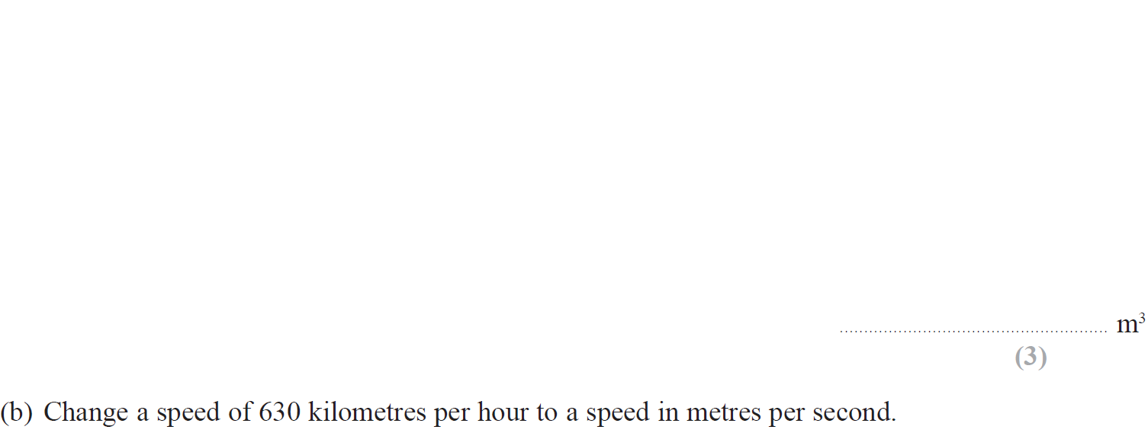
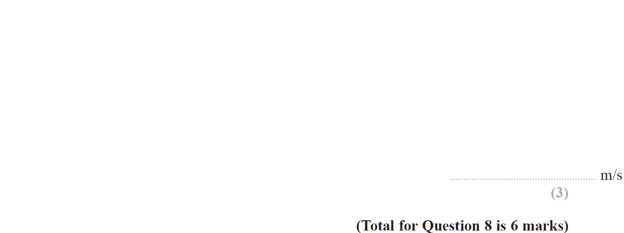
Compound Measures
Jan 2019 2H Q8

Slide 49
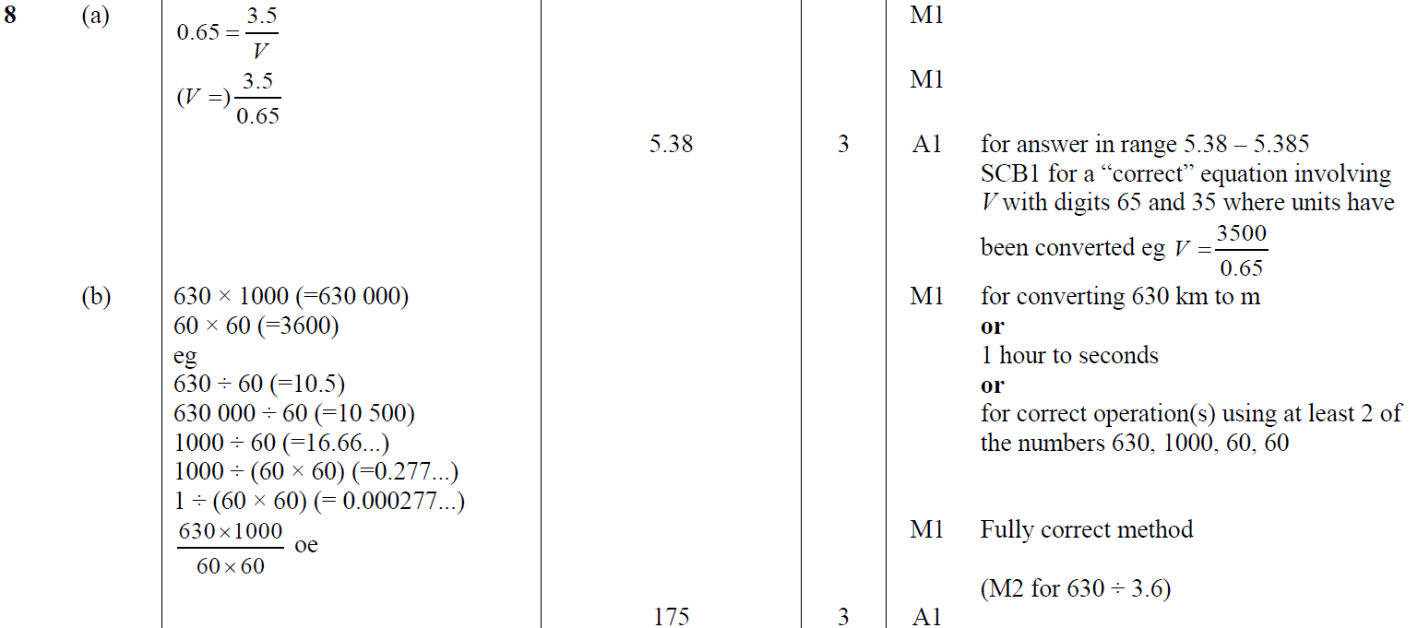
Compound Measures
Jan 2019 2H Q8
A
B

Slide 50
Compound Measures
Jan 2019 1HR Q5

Slide 51
Compound Measures
Jan 2019 1HR Q5
A

Slide 52
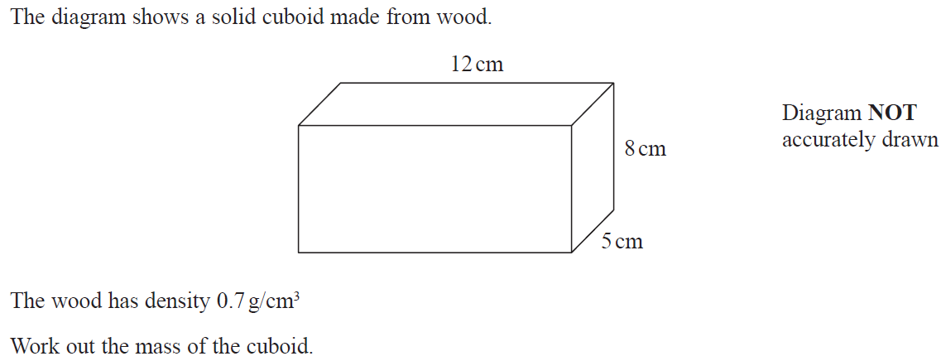
Compound Measures
May 2019 1H Q6

Slide 53
Compound Measures
May 2019 1H Q6
A

Slide 54
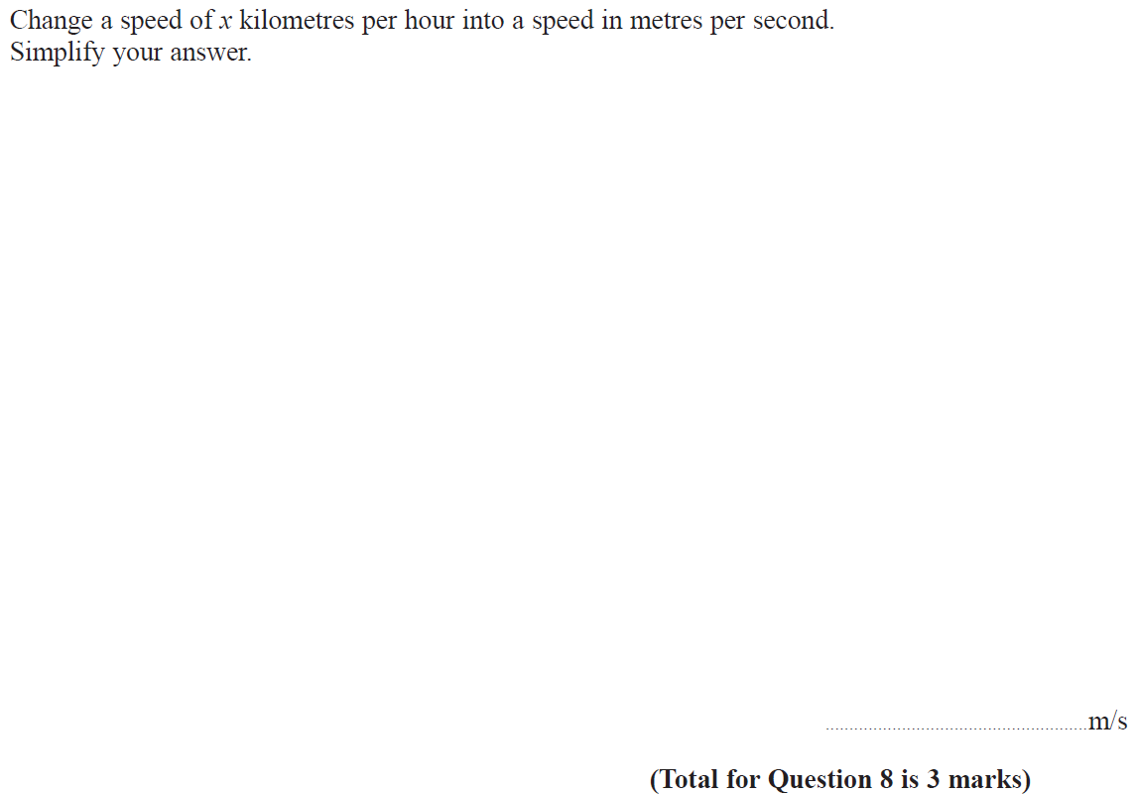
Compound Measures
June 2019 2H Q8

Slide 55
Compound Measures
June 2019 2H Q8
A

Slide 56
Compound Measures
Compound Measures
New Spec Q’s
May 2004
4H Q2
Nov 2010
4H Q2
Jan 2014 4H Q11
Jan 2016 4HR Q9
May 2018 3H Q3
May 2006
3H Q10
June 2011 4H Q4
Jan 2014 4HR Q11
June 2016 4HR Q3
June 2018 4HR Q6
Nov 2006
4H Q5
Jan 2012 4H Q2
May 2014 3H Q19
Jan 2017 3H Q1
May 2007
3H Q7
Jan 2013 3H Q3
May 2014 4HR Q2
Jan 2017 3HR Q4
Nov 2008
4H Q4
Jan 2013 4H Q24
Jan 2015 4H Q18
June 2017 4H Q20
May 2009
3H Q2
May 2013 4H Q3
Jan 2015 3HR Q2
May 2017 3HR Q4
Nov 2009
3H Q23
May 2013 3HR Q2
June 2015 4HR Q2
Jan 2018 4H Q2
June 2010
4H Q4
Jan 2014 3H Q2
Jan 2016 3H Q2
Jan 2018 3HR Q13

Slide 57
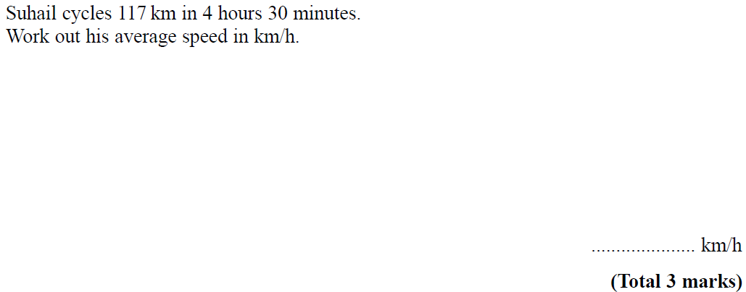
Compound Measures
May 2004 4H Q2

Slide 58
Compound Measures
May 2004 4H Q2
A

Slide 59
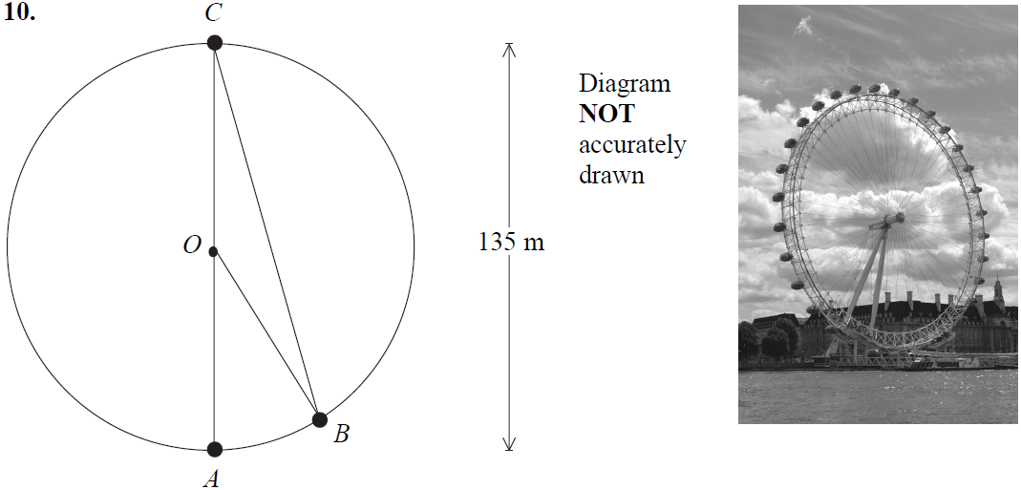
Compound Measures
May 2006 3H Q10

Slide 60
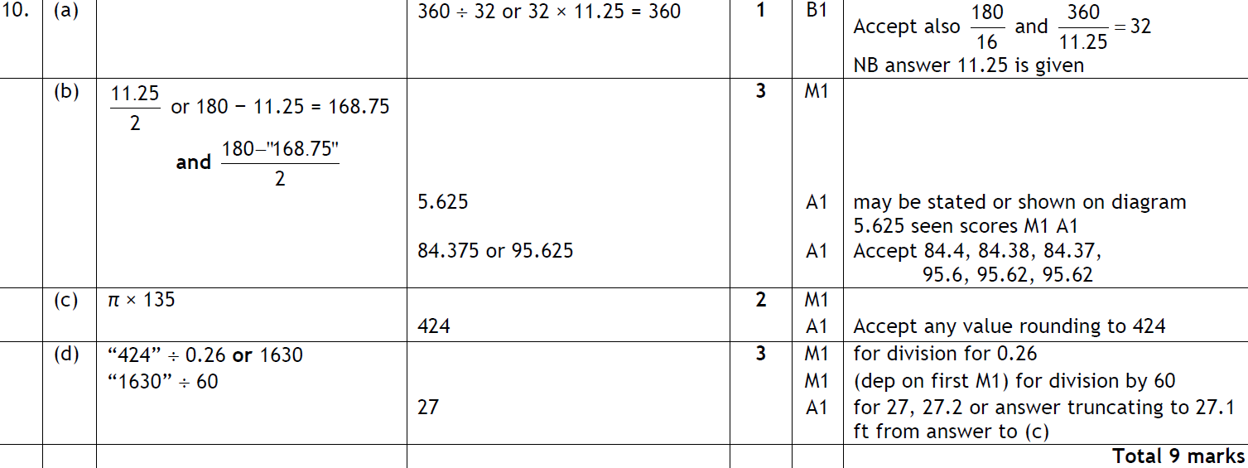
Compound Measures
May 2006 3H Q10
A
B
C
D

Slide 61
Compound Measures
Nov 2006 4H Q5

Slide 62
Compound Measures
Nov 2006 4H Q5
A

Slide 63
Compound Measures
May 2007 3H Q7

Slide 64
Compound Measures
May 2007 3H Q7
A
B

Slide 65
Compound Measures
Nov 2008 4H Q4

Slide 66
Compound Measures
Nov 2008 4H Q4
A

Slide 67
Compound Measures
May 2009 3H Q2

Slide 68
Compound Measures
May 2009 3H Q2
A

Slide 69
Compound Measures
Nov 2009 3H Q23

Slide 70
Compound Measures
Nov 2009 3H Q23
A

Slide 71
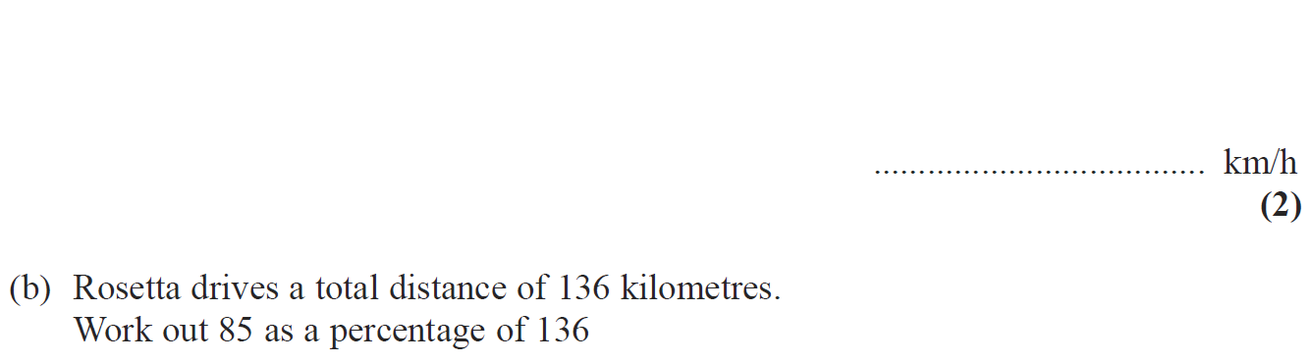
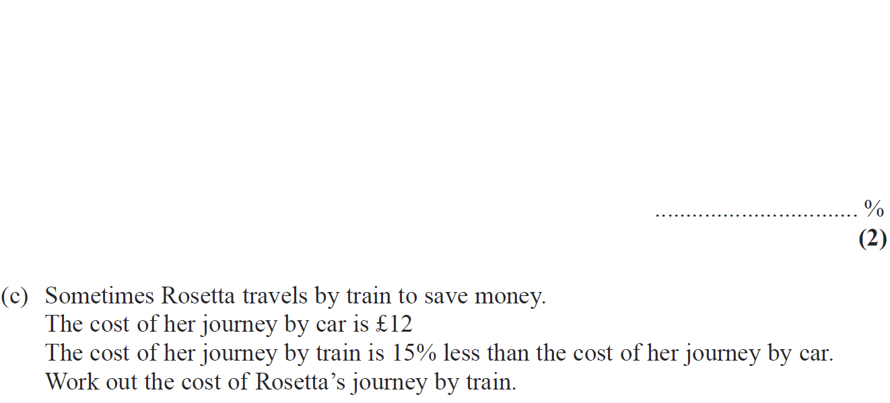
Compound Measures
June 2010 4H Q4

Slide 72
Compound Measures
June 2010 4H Q4
A
B
C

Slide 73
Compound Measures
Nov 2010 4H Q2

Slide 74
Compound Measures
Nov 2010 4H Q2
A

Slide 75
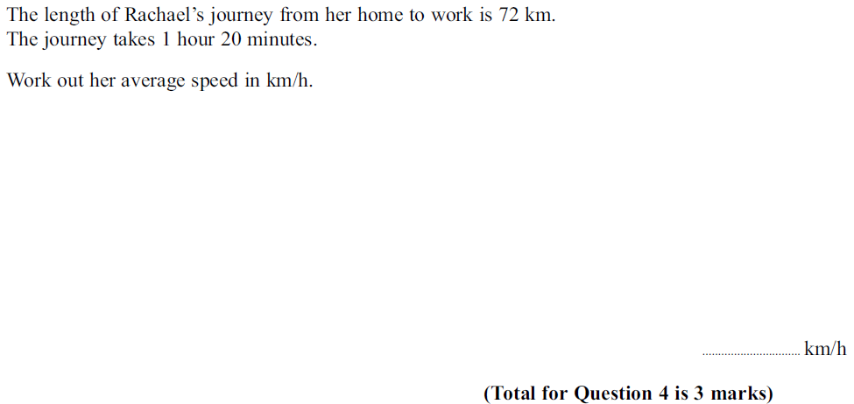
Compound Measures
June 2011 4H Q4

Slide 76
Compound Measures
June 2011 4H Q4
A

Slide 77
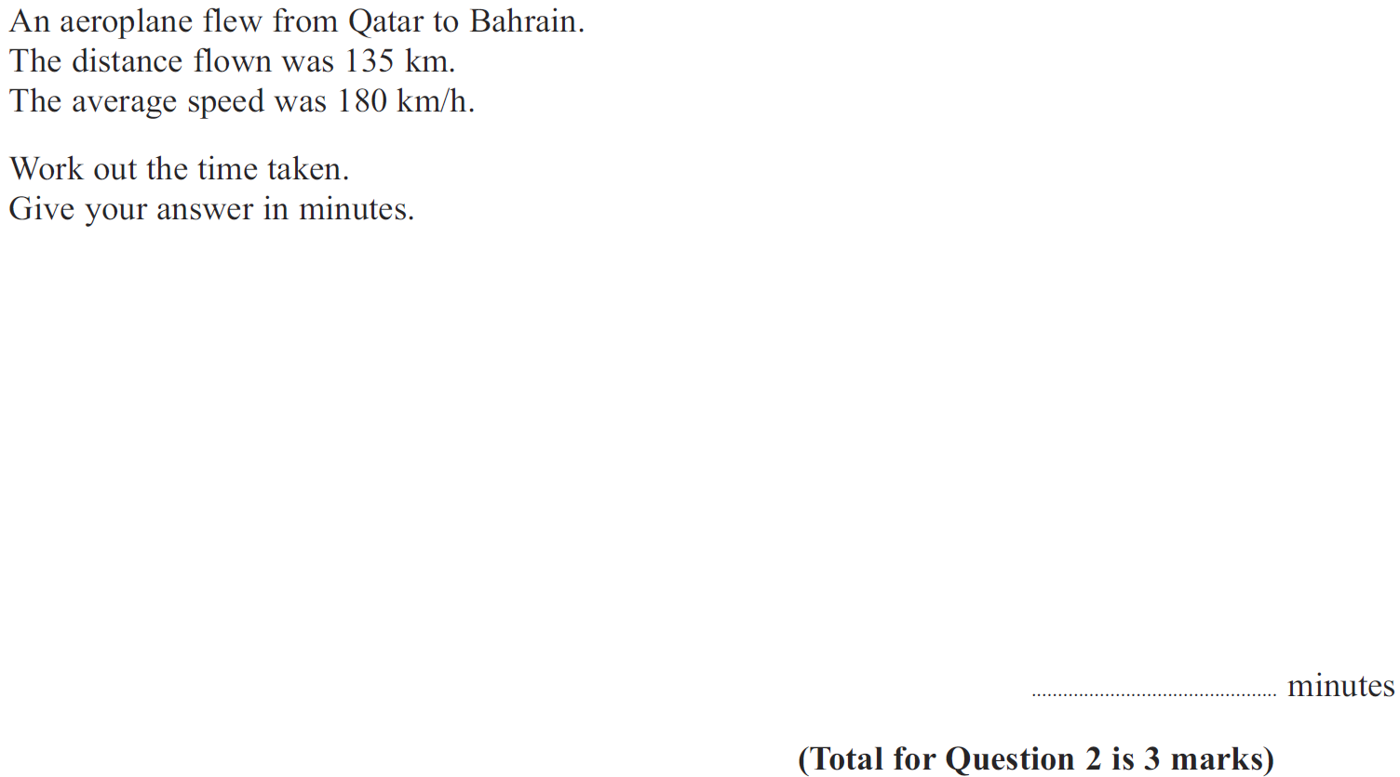
Compound Measures
Jan 2012 4H Q2

Slide 78
Compound Measures
Jan 2012 4H Q2
A

Slide 79
Compound Measures
Jan 2013 3H Q3

Slide 80
Compound Measures
Jan 2013 3H Q3
A
B
C
D

Slide 81
Compound Measures
Jan 2013 4H Q24

Slide 82
Compound Measures
Jan 2013 4H Q24
A

Slide 83
Compound Measures
May 2013 4H Q3

Slide 84
Compound Measures
May 2013 4H Q3
A

Slide 85
Compound Measures
May 2013 3HR Q2

Slide 86
Compound Measures
May 2013 3HR Q2
A

Slide 87
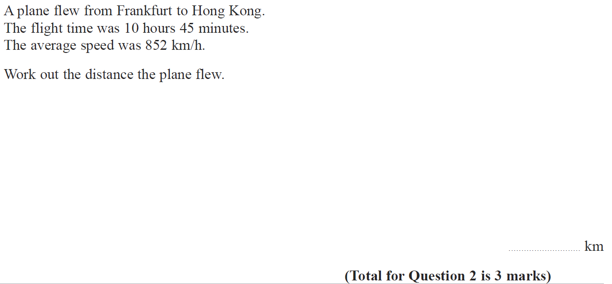
Compound Measures
Jan 2014 3H Q2

Slide 88
Compound Measures
Jan 2014 3H Q2
A

Slide 89
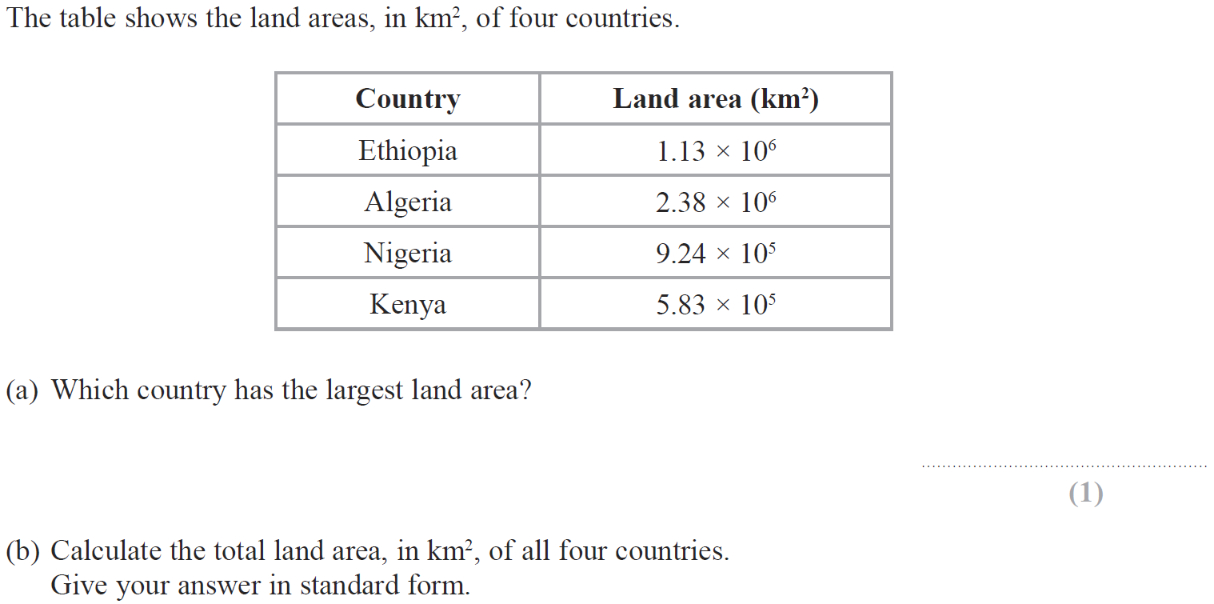
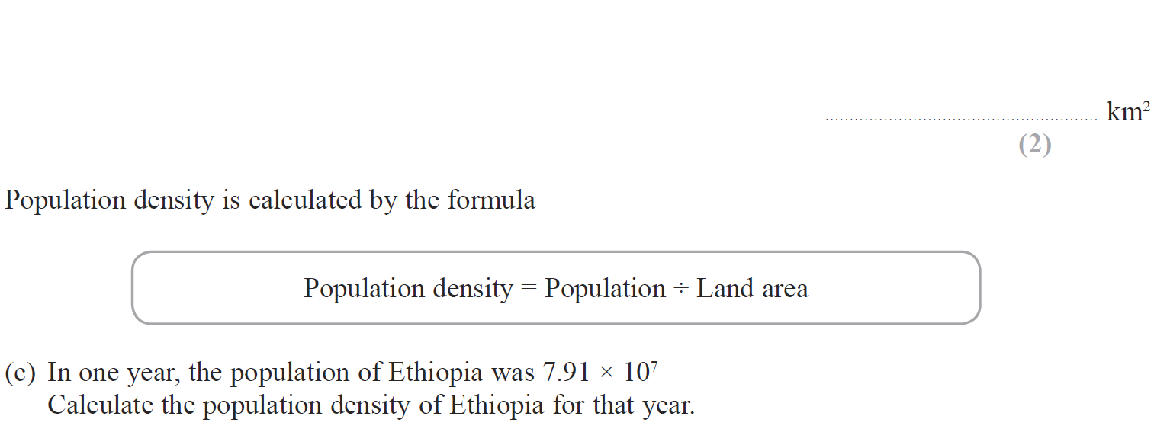
Compound Measures
Jan 2014 4H Q11

Slide 90
Compound Measures
Jan 2014 4H Q11
A
B
C

Slide 91
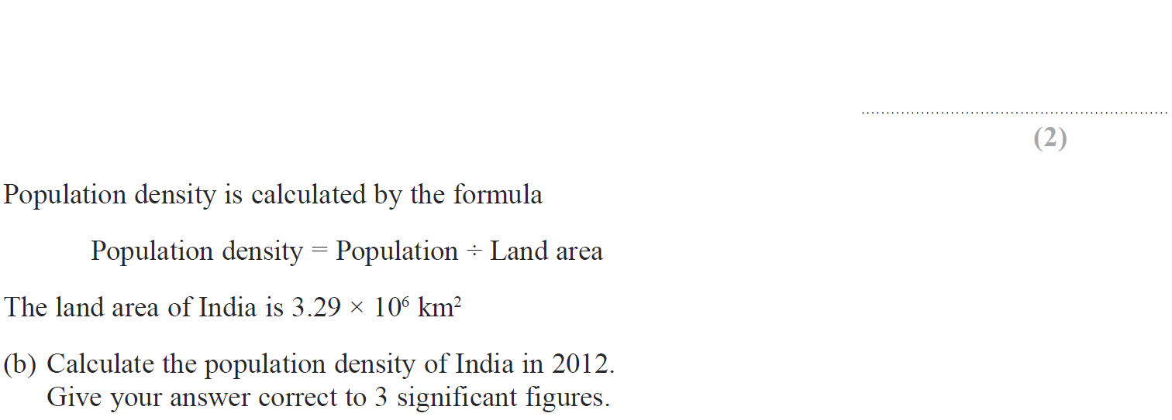
Compound Measures
Jan 2014 4HR Q11

Slide 92
Compound Measures
Jan 2014 4HR Q11
A
B

Slide 93
Compound Measures
May 2014 3H Q19

Slide 94
Compound Measures
May 2014 3H Q19
A

Slide 95
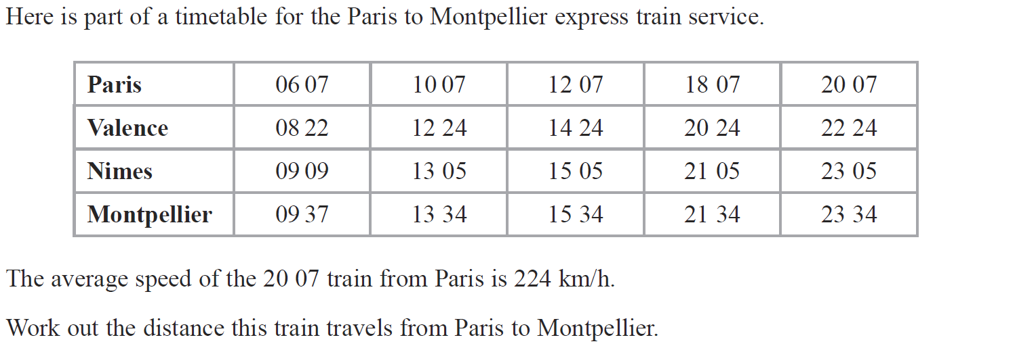
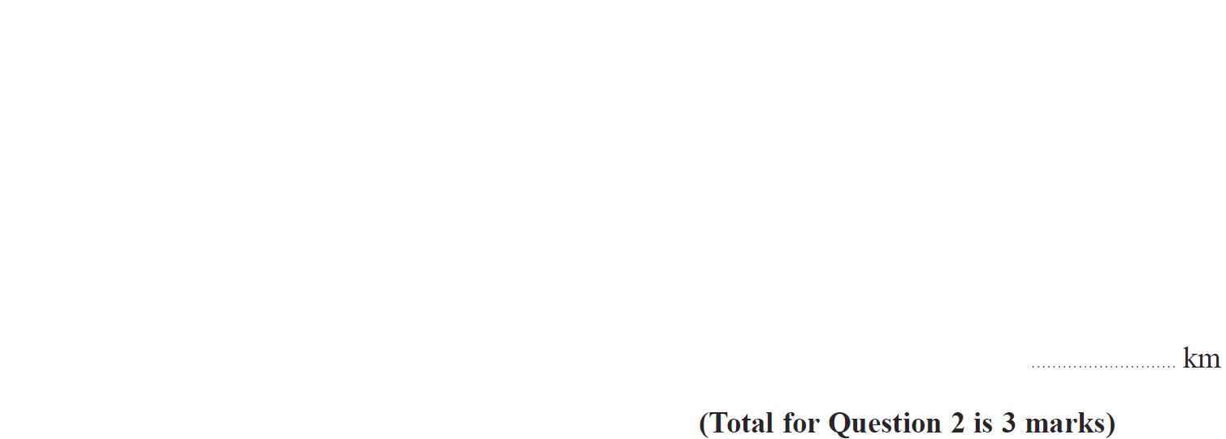
Compound Measures
May 2014 4HR Q2

Slide 96
Compound Measures
May 2014 4HR Q2
A

Slide 97
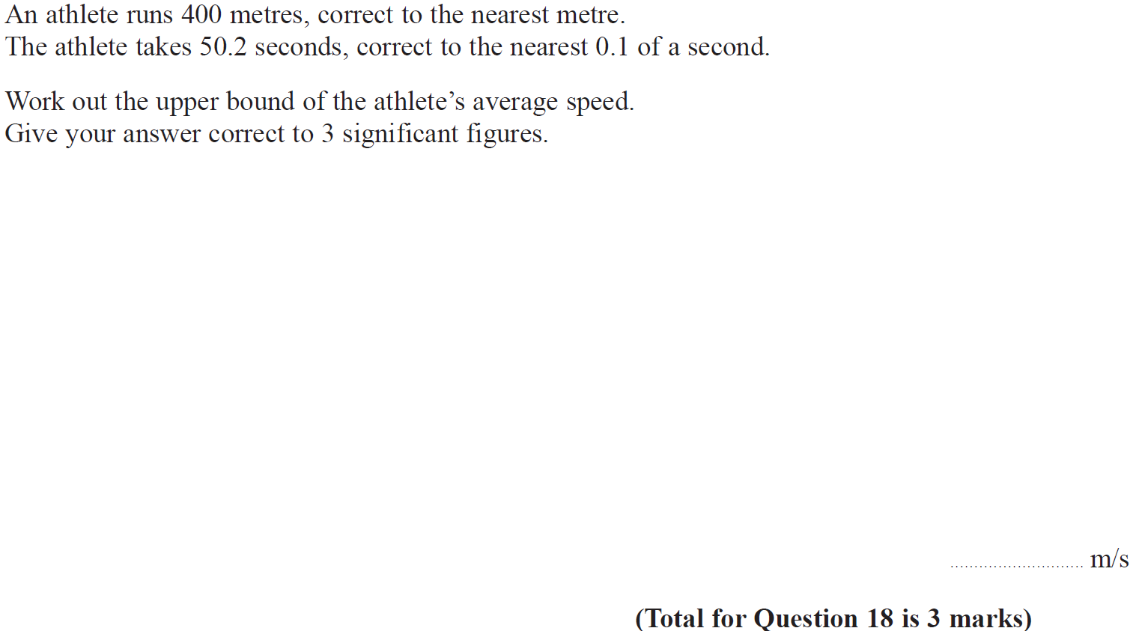
Compound Measures
Jan 2015 4H Q18

Slide 98
Compound Measures
Jan 2015 4H Q18
A

Slide 99
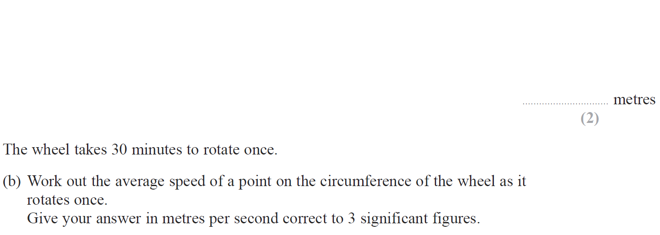
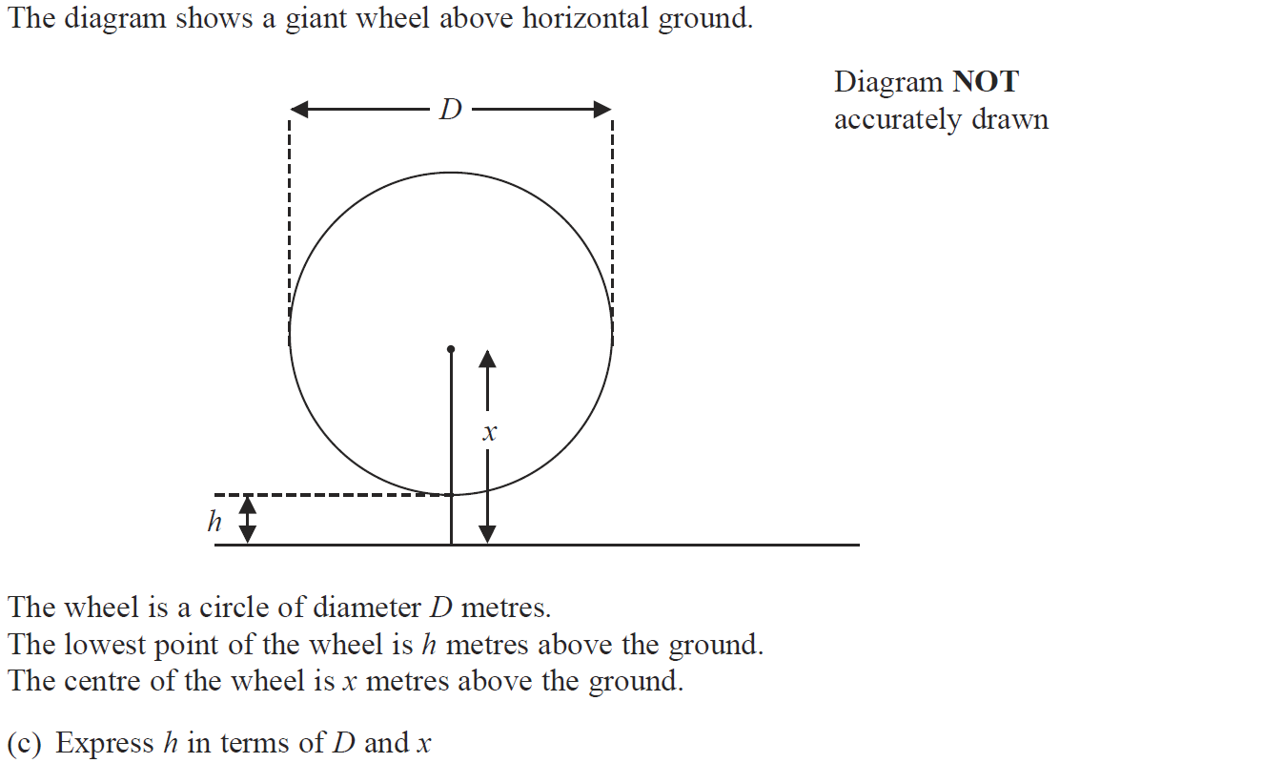
Compound Measures
Jan 2015 4HR Q2

Slide 100
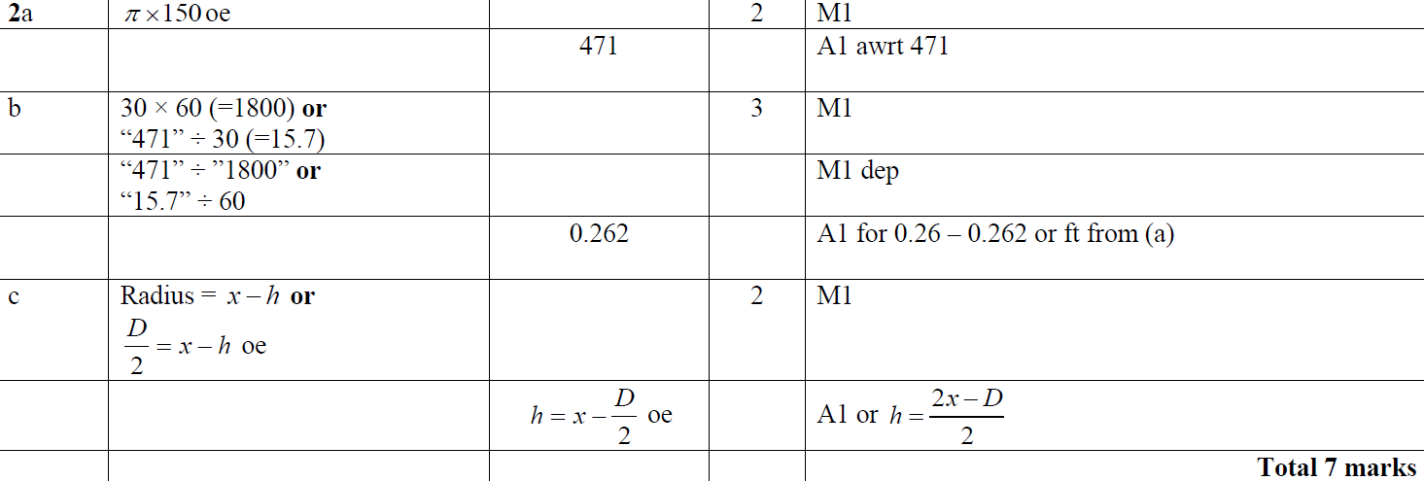
Compound Measures
Jan 2015 4HR Q2
A
B
C

Slide 101
Compound Measures
June 2015 4HR Q2

Slide 102
Compound Measures
June 2015 4HR Q2
A

Slide 103
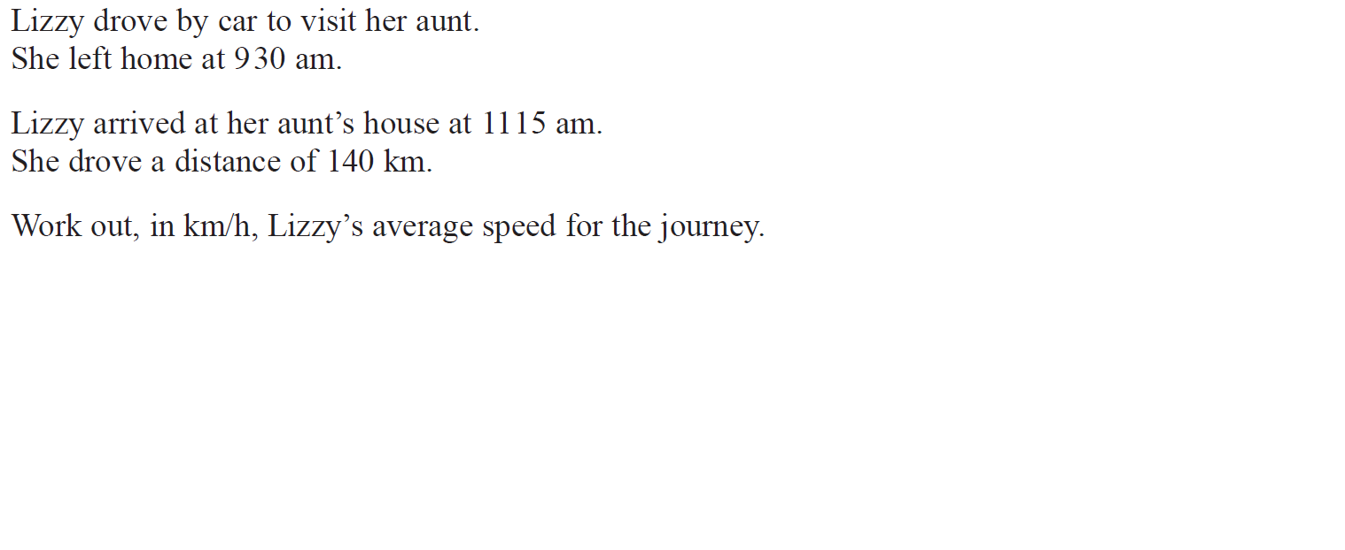
Compound Measures
Jan 2016 3H Q2

Slide 104
Compound Measures
Jan 2016 3H Q2
A

Slide 105
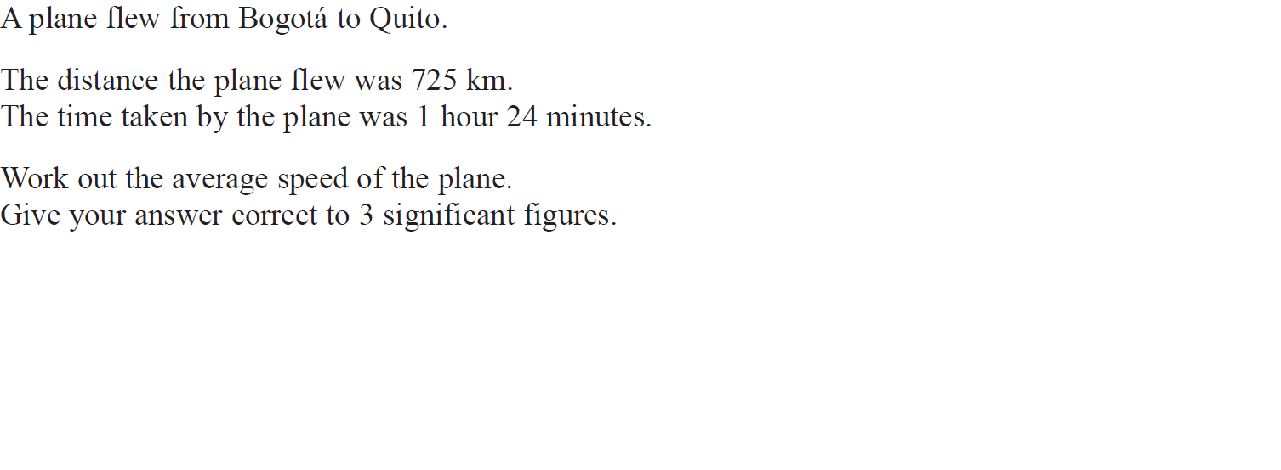
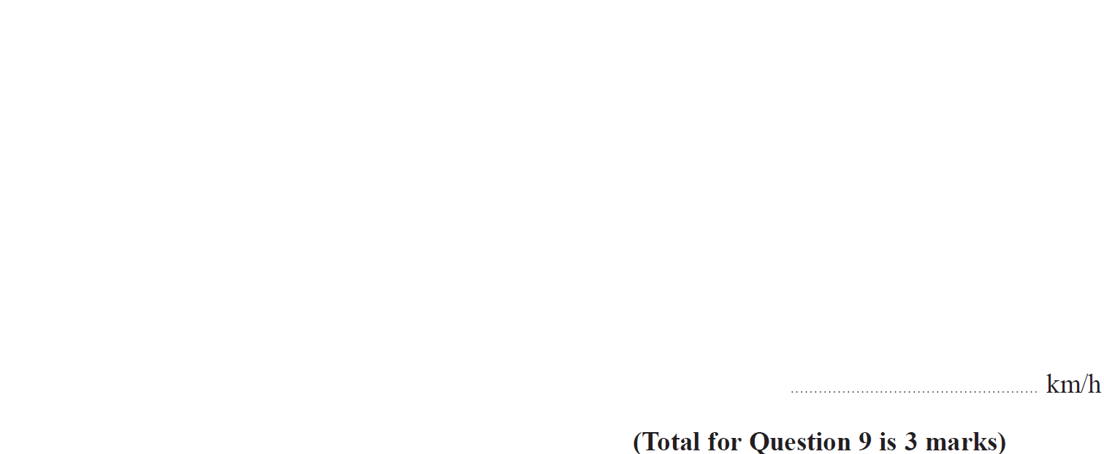
Compound Measures
Jan 2016 4HR Q9

Slide 106
Compound Measures
Jan 2016 4HR Q9
A

Slide 107
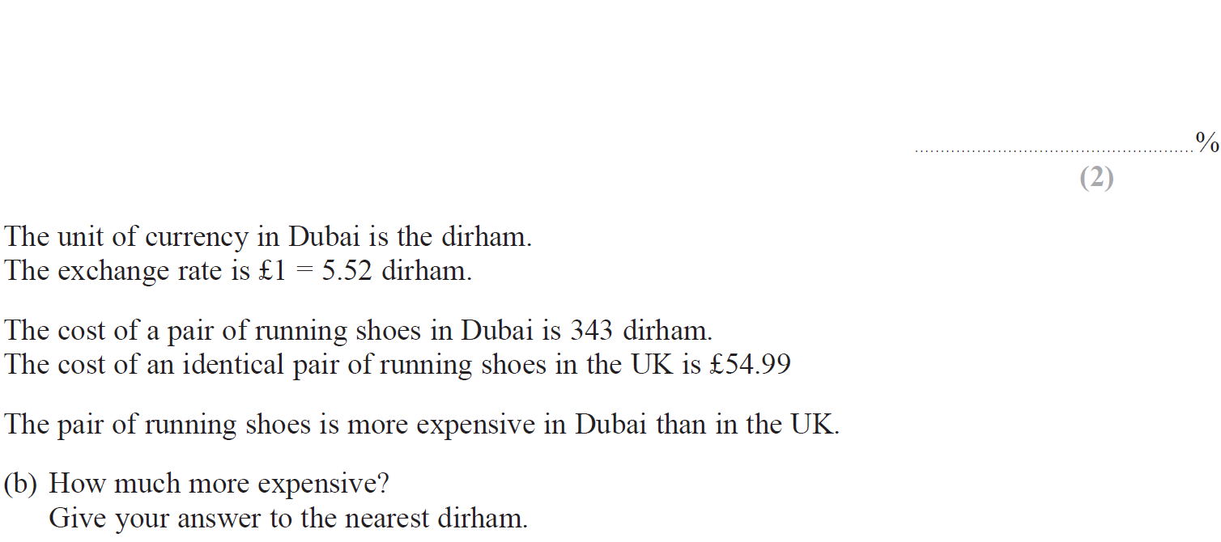
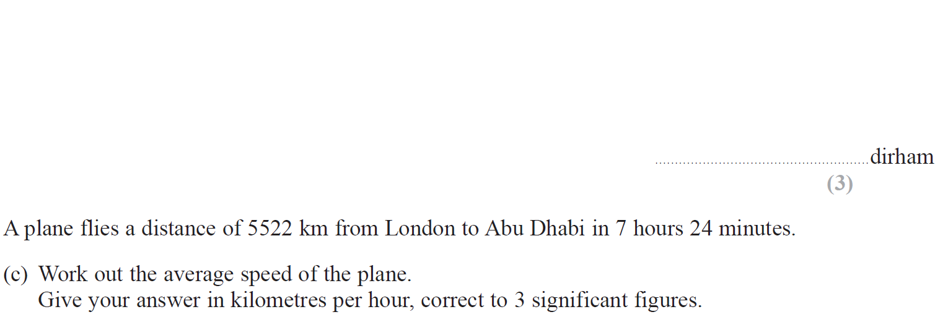
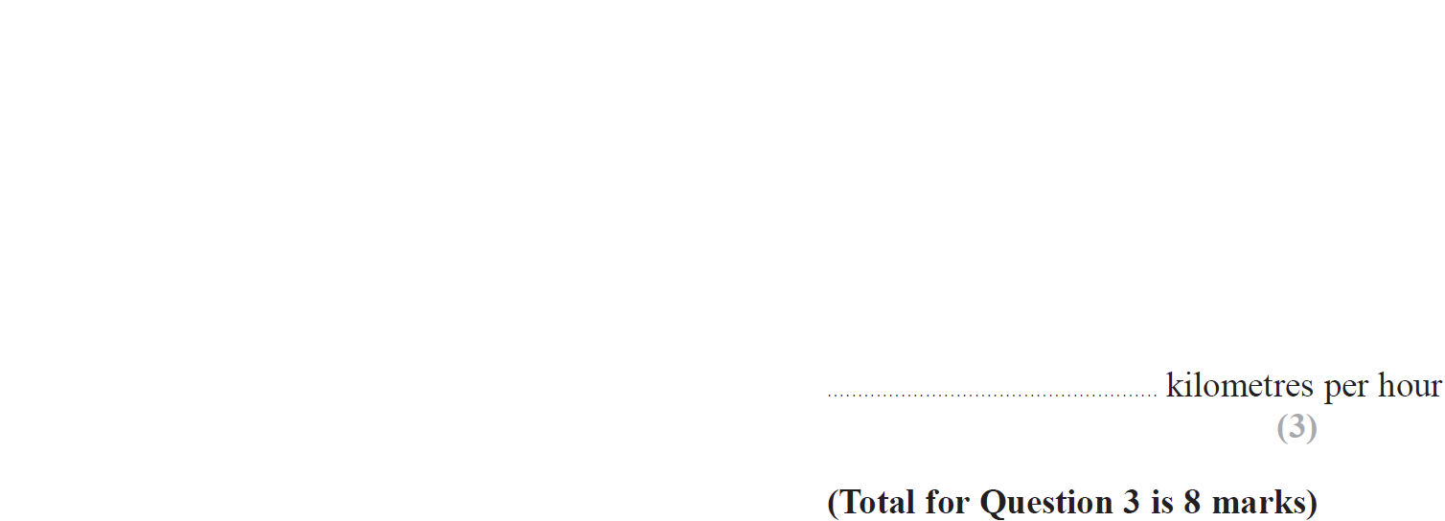
Compound Measures
June 2016 4HR Q3

Slide 108
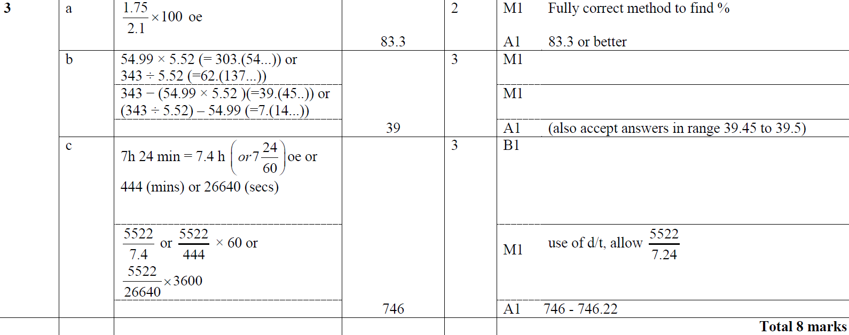
Compound Measures
June 2016 4HR Q3
A
B
C

Slide 109
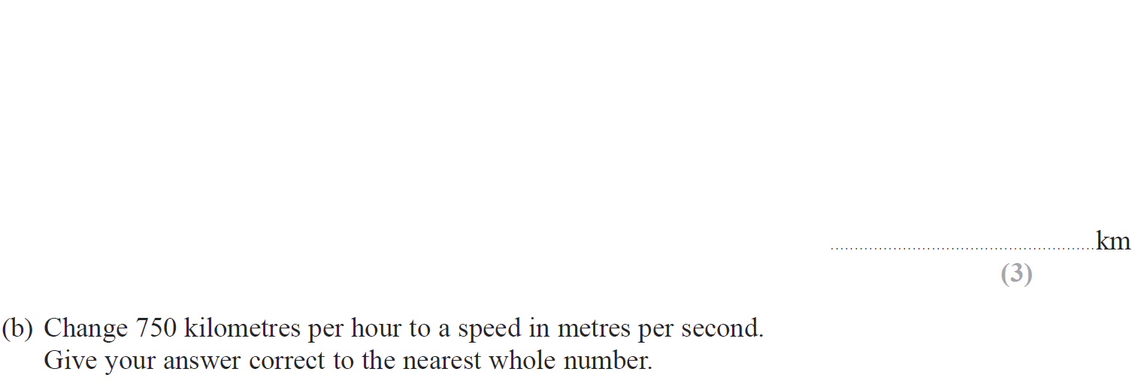
Compound Measures
Jan 2017 3H Q1

Slide 110
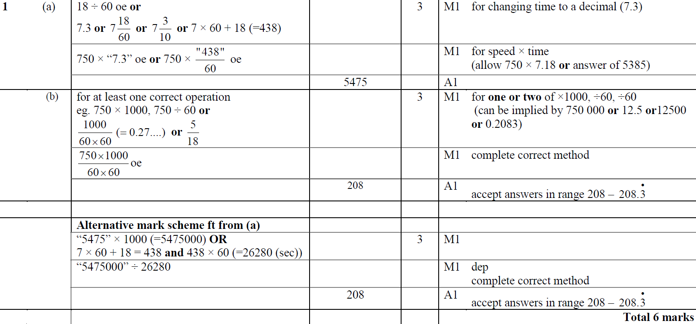
Compound Measures
Jan 2017 3H Q1
A
B

Slide 111
Compound Measures
Jan 2017 3HR Q4

Slide 112
Compound Measures
Jan 2017 3HR Q4
A

Slide 113
Compound Measures
June 2017 4H Q20

Slide 114
Compound Measures
June 2017 4H Q20
A

Slide 115
Compound Measures
May 2017 3HR Q4

Slide 116
Compound Measures
May 2017 3HR Q4
A
B
C

Slide 117
Compound Measures
Jan 2018 4H Q2

Slide 118
Compound Measures
Jan 2018 4H Q2
A

Slide 119
Compound Measures
Jan 2018 3HR Q13

Slide 120
Compound Measures
Jan 2018 3HR Q13
A

Slide 121
Compound Measures
May 2018 3H Q3

Slide 122
Compound Measures
May 2018 3H Q3
A
B
C

Slide 123
Compound Measures
June 2018 4HR Q6

Slide 124
Compound Measures
June 2018 4HR Q6
A

