Slide 1
Old Spec Q’s
Argand Locus
Complex Numbers
SAM
SAM 2
2018
2019 2
2019
See also: Roots of Polynomials

Slide 2
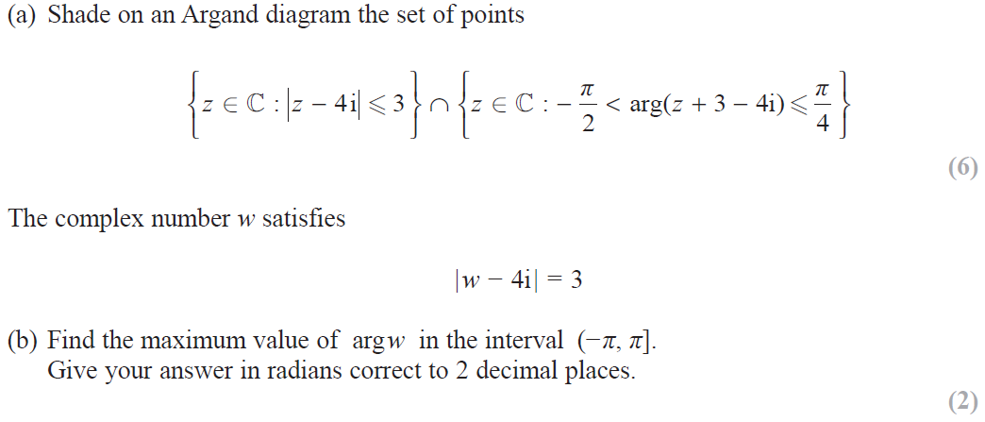
SAM

Slide 3
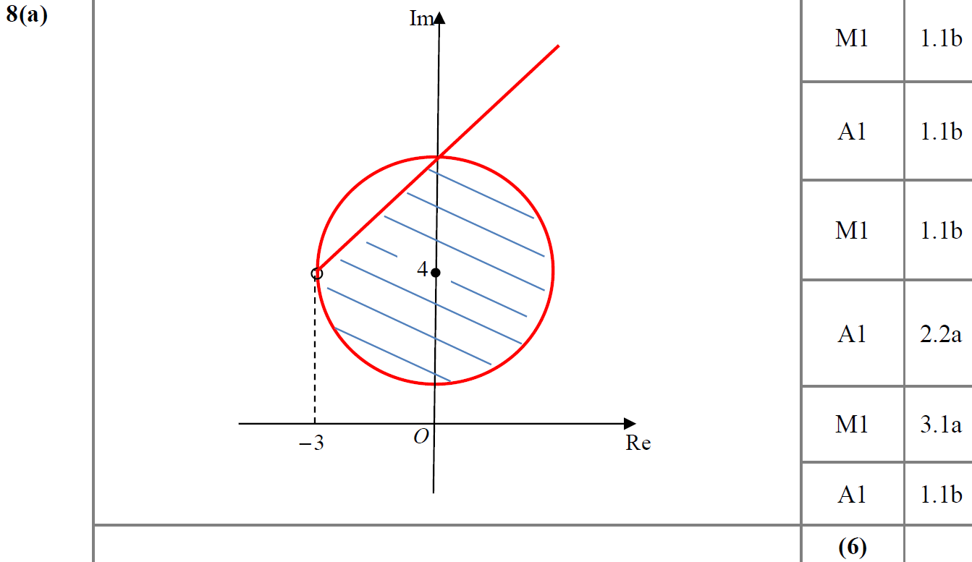
SAM
A

Slide 4
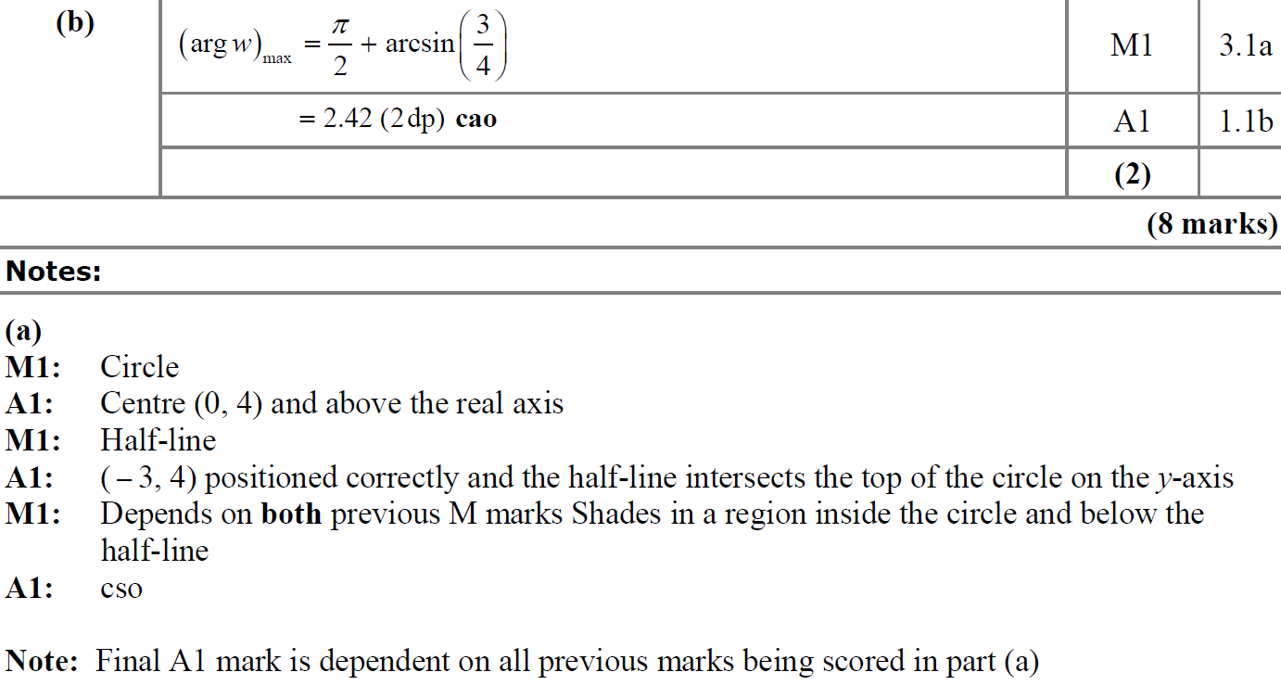
SAM
B
A notes
B notes

Slide 5
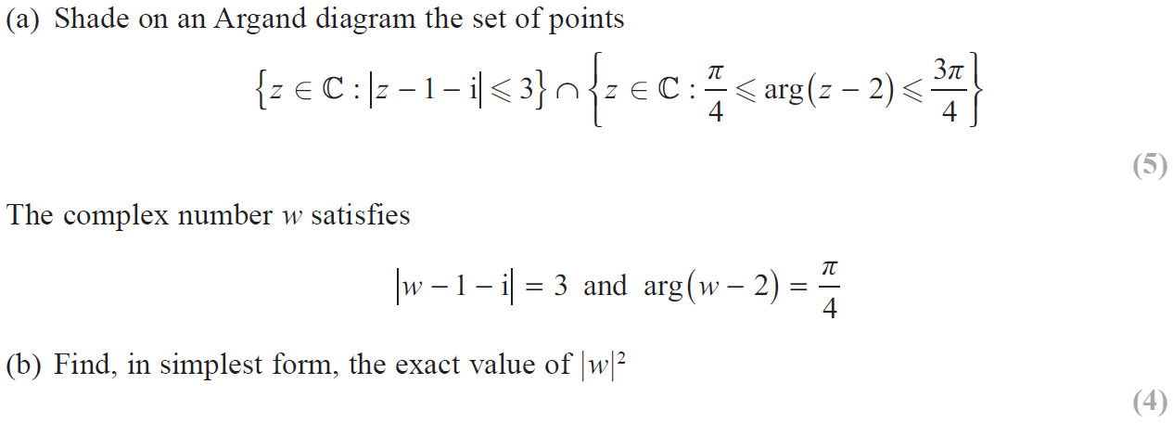
2018

Slide 6
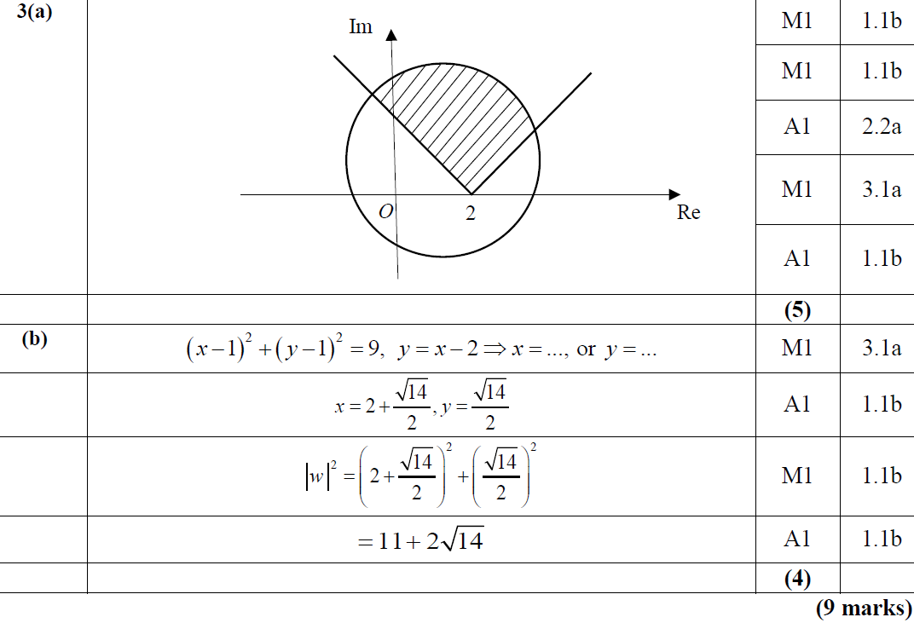
2018
A
B

Slide 7
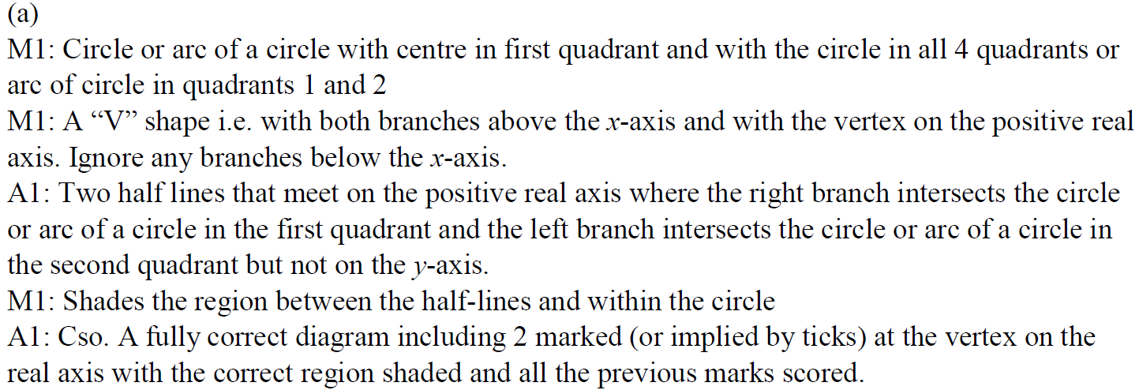
2018
A

Slide 8
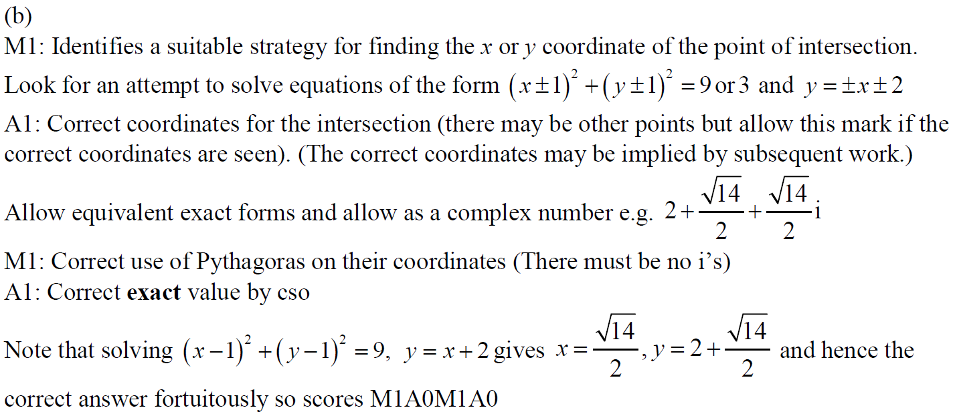
2018
B

Slide 9
2018
A Example marking 1 & 2

Slide 10
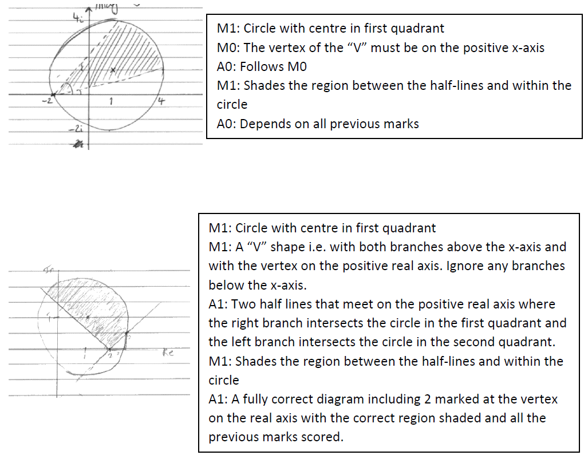
2018
A Example marking 3 & 4

Slide 11
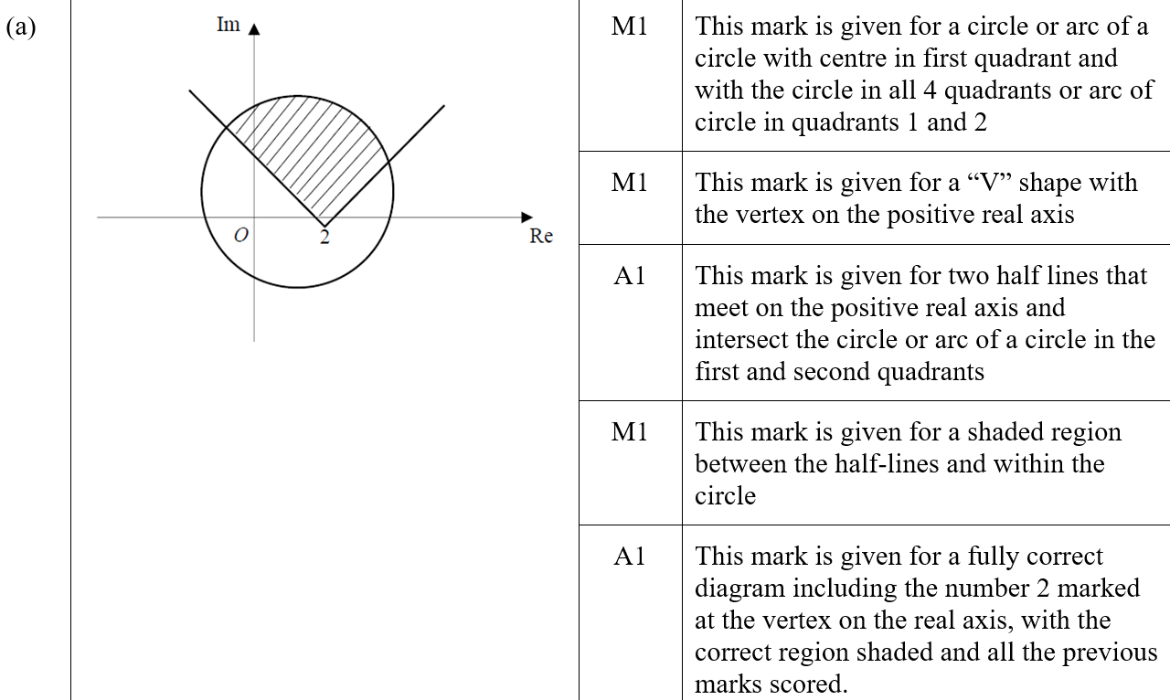
2018
A SF

Slide 12
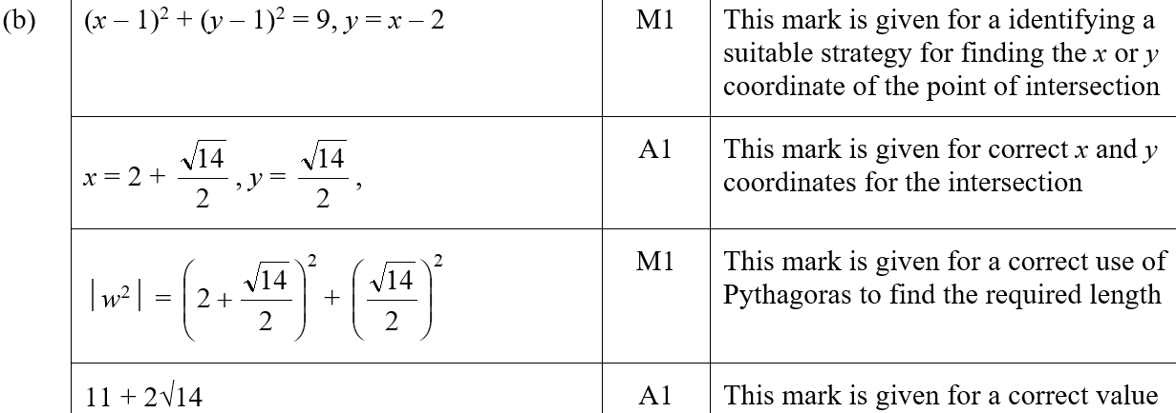
2018
B SF

Slide 13
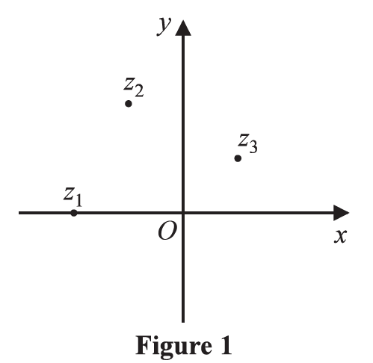
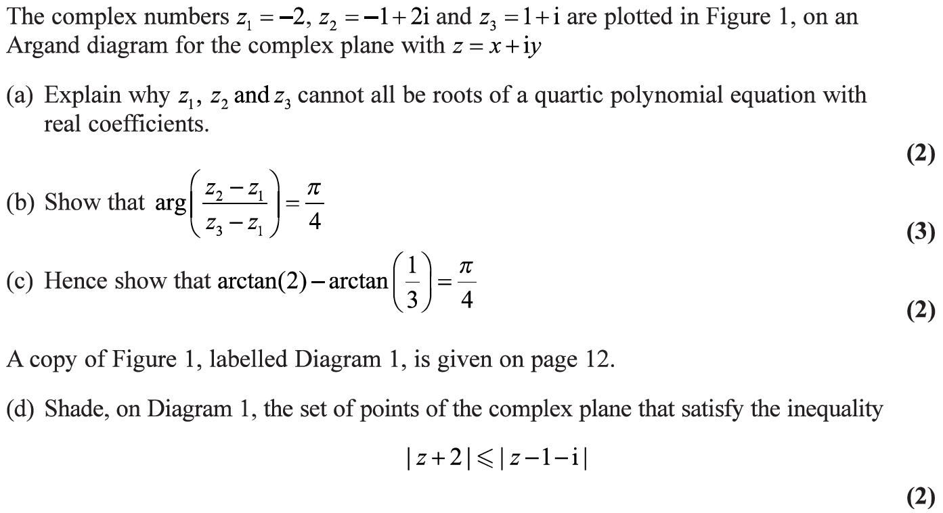
2019

Slide 14
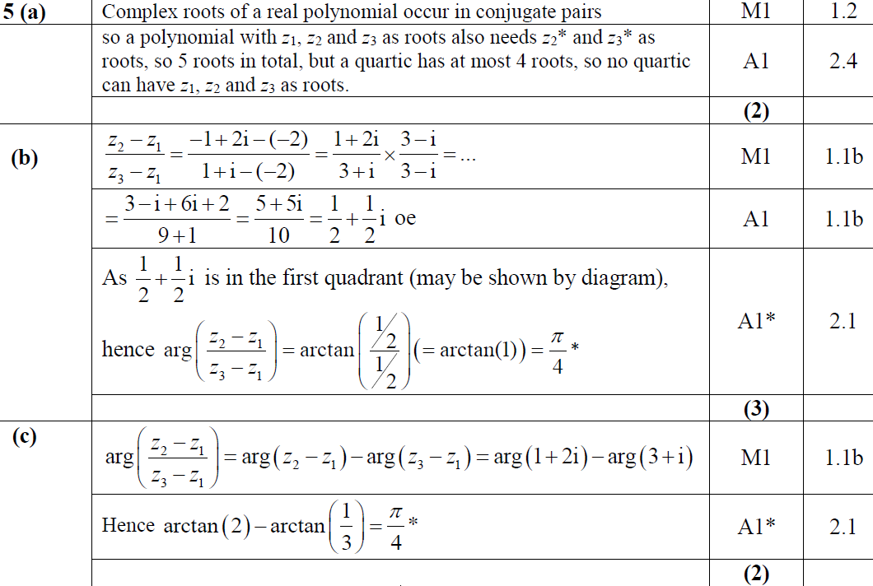
2019
A
B
C

Slide 15
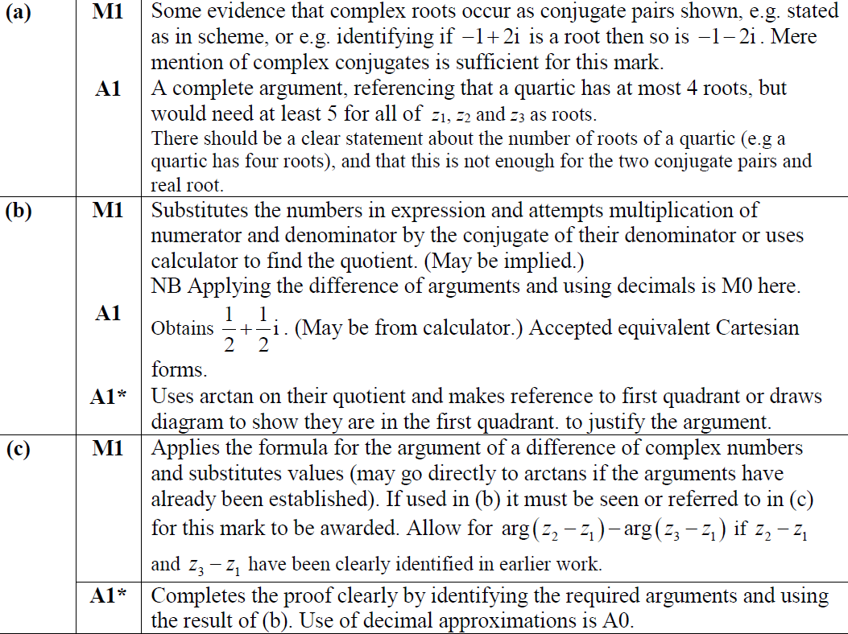
2019
A notes
B notes
C notes

Slide 16
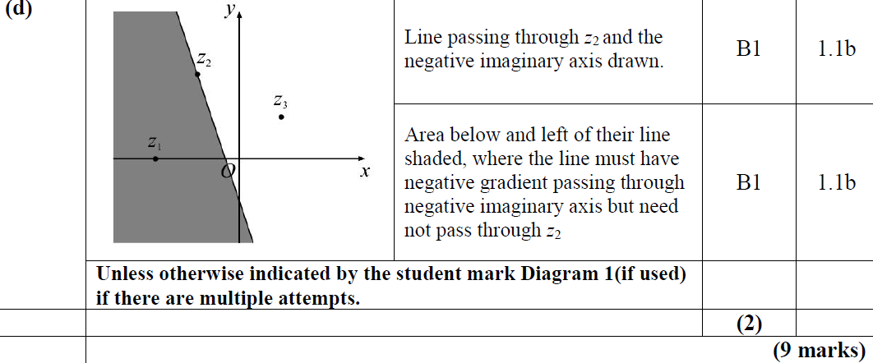
2019
D

Slide 17
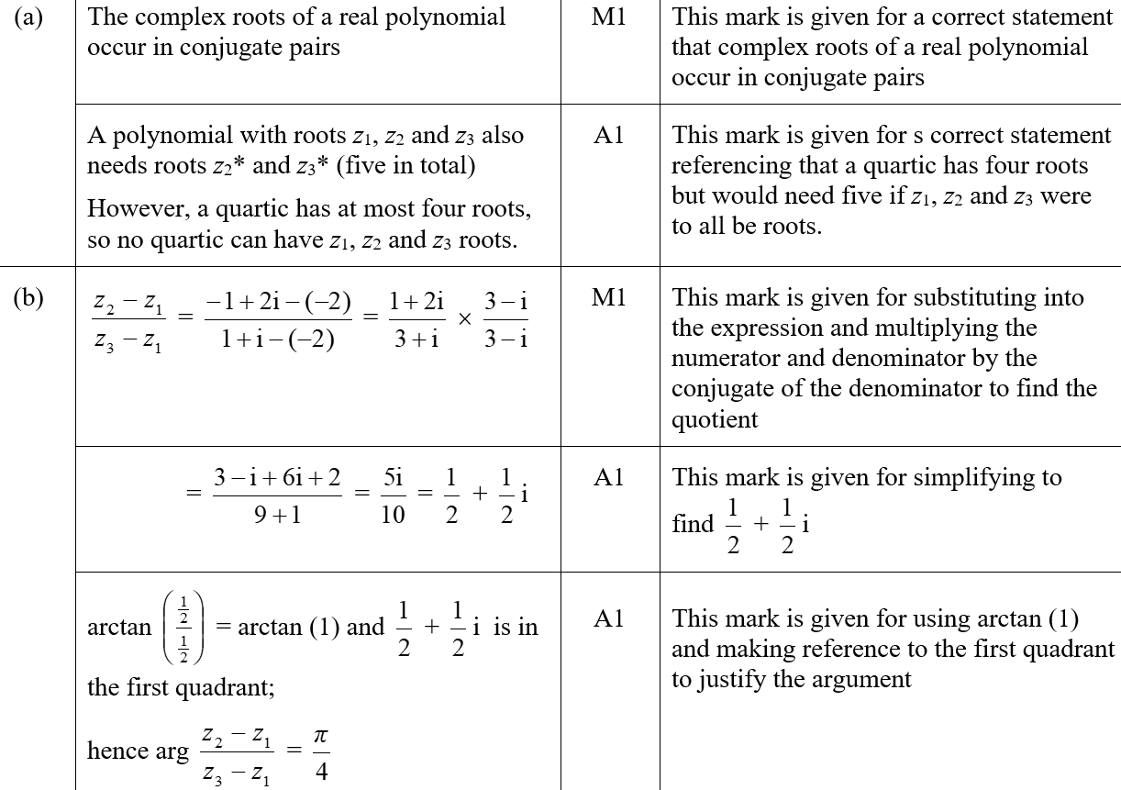
2019
A SF
B SF

Slide 18
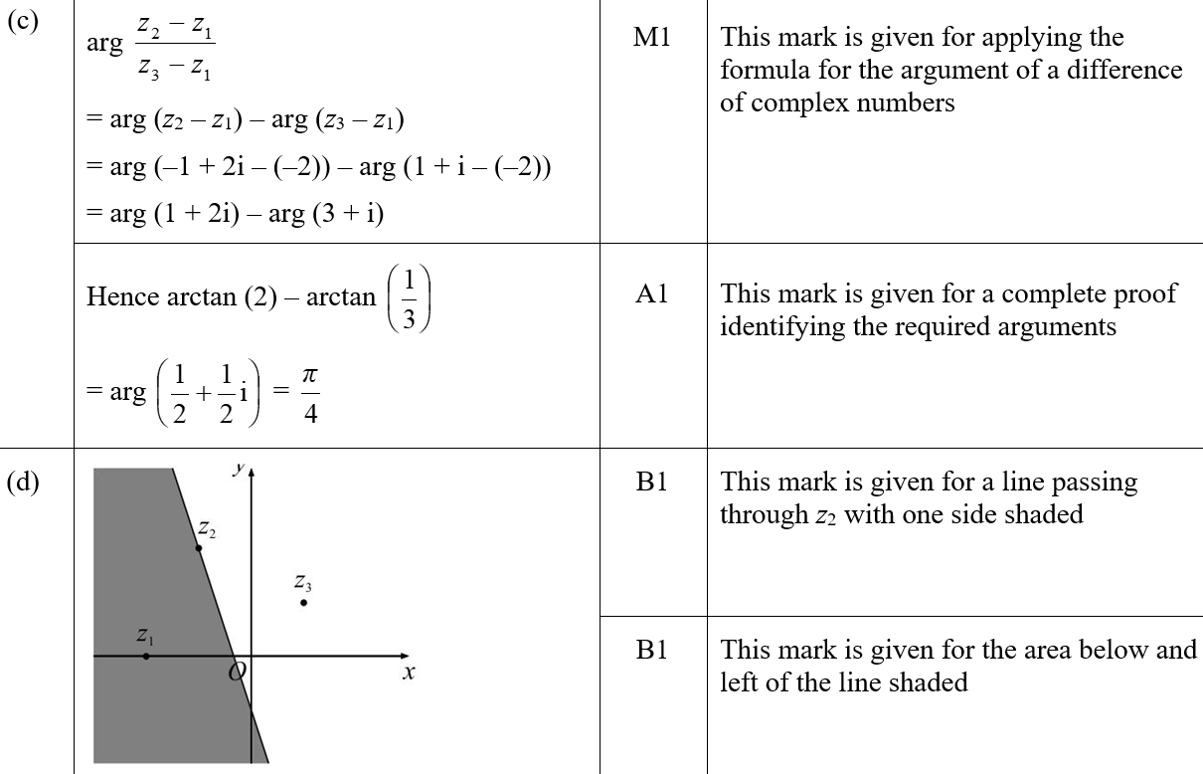
2019
C SF
D SF

Slide 19
SAM Paper 2

Slide 20
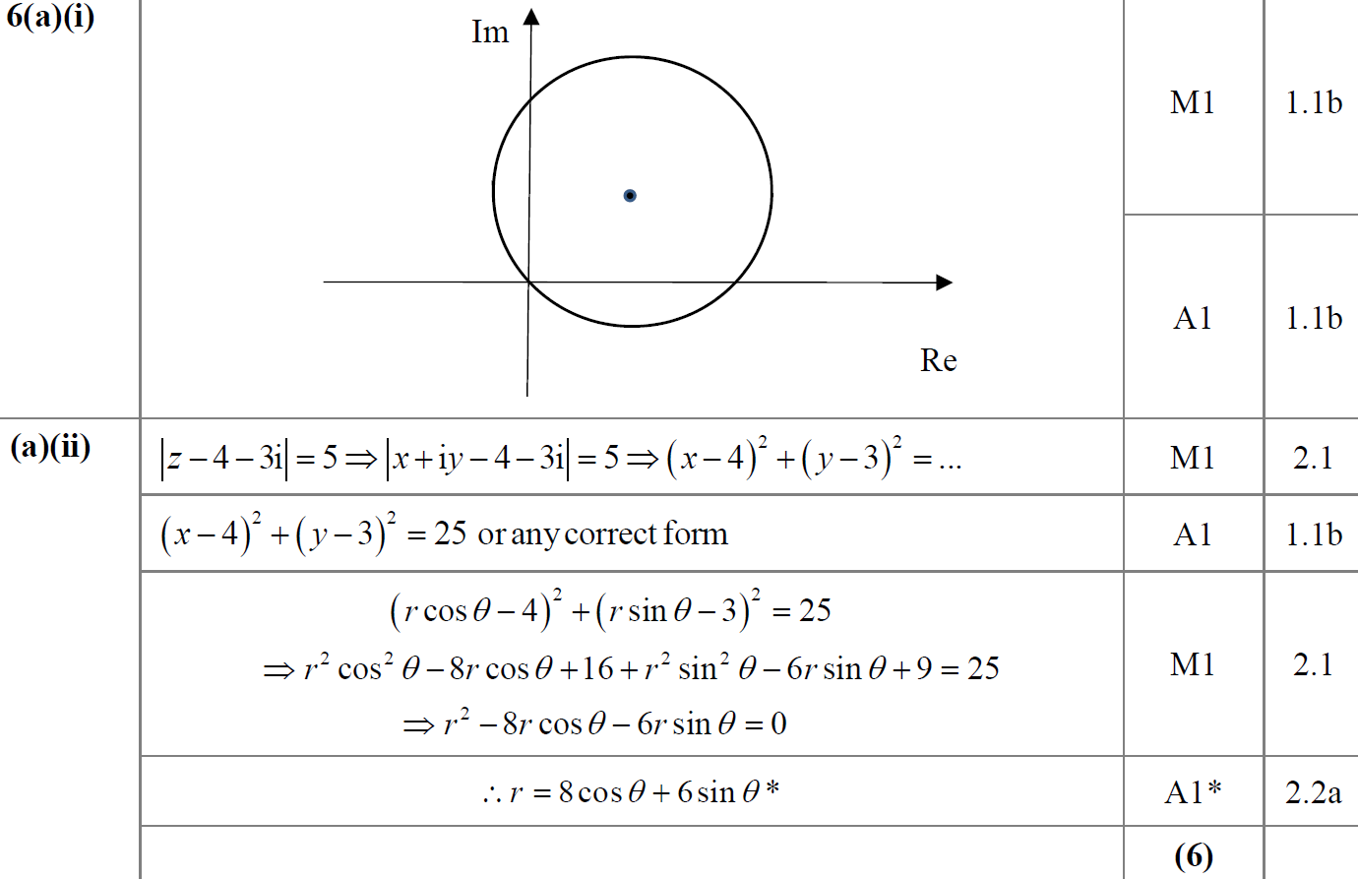
SAM Paper 2
A (i)
A (ii)

Slide 21
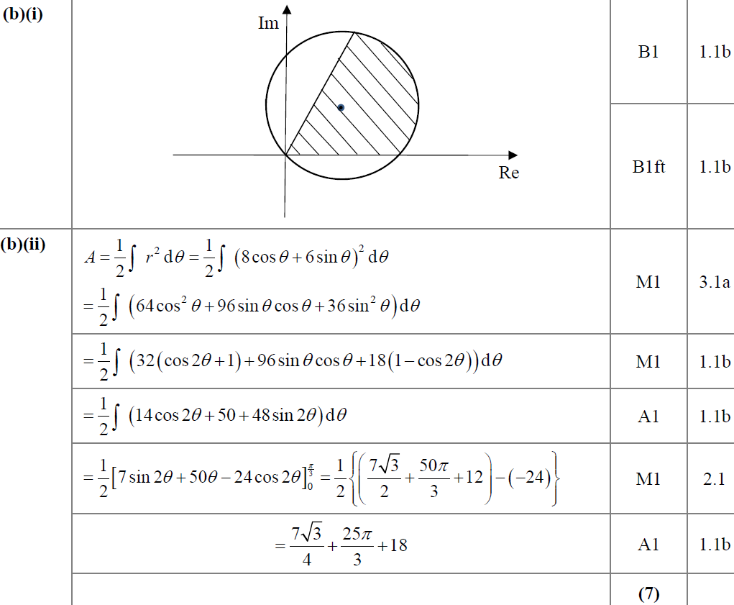
SAM Paper 2
B (i)
B (ii)

Slide 22
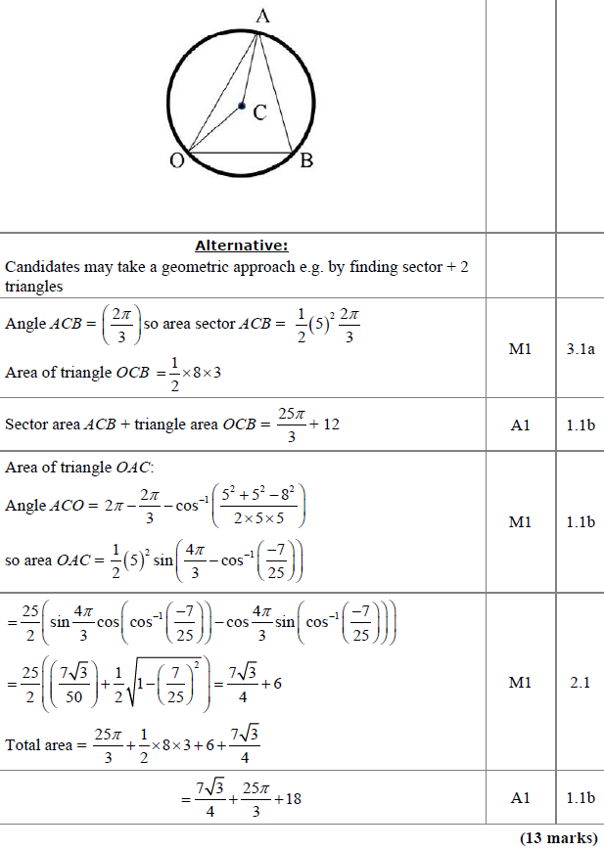
SAM Paper 2
B (ii) Alternative

Slide 23
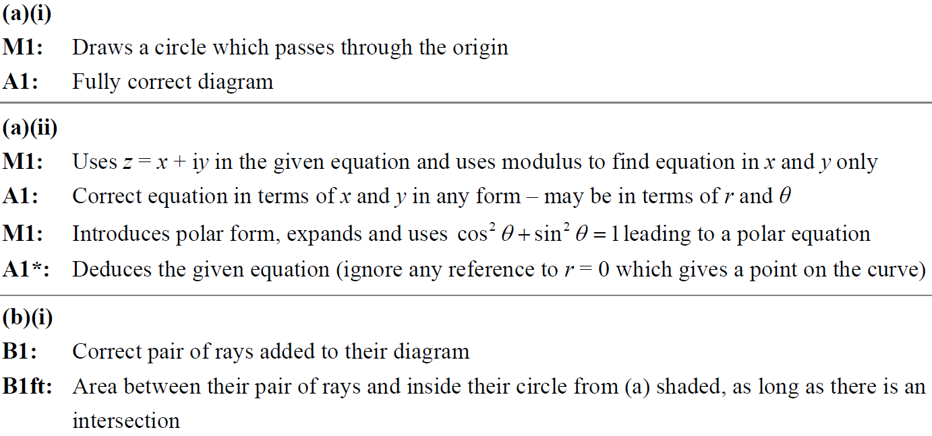
SAM Paper 2
A (i)
A (ii)
B (i)

Slide 24
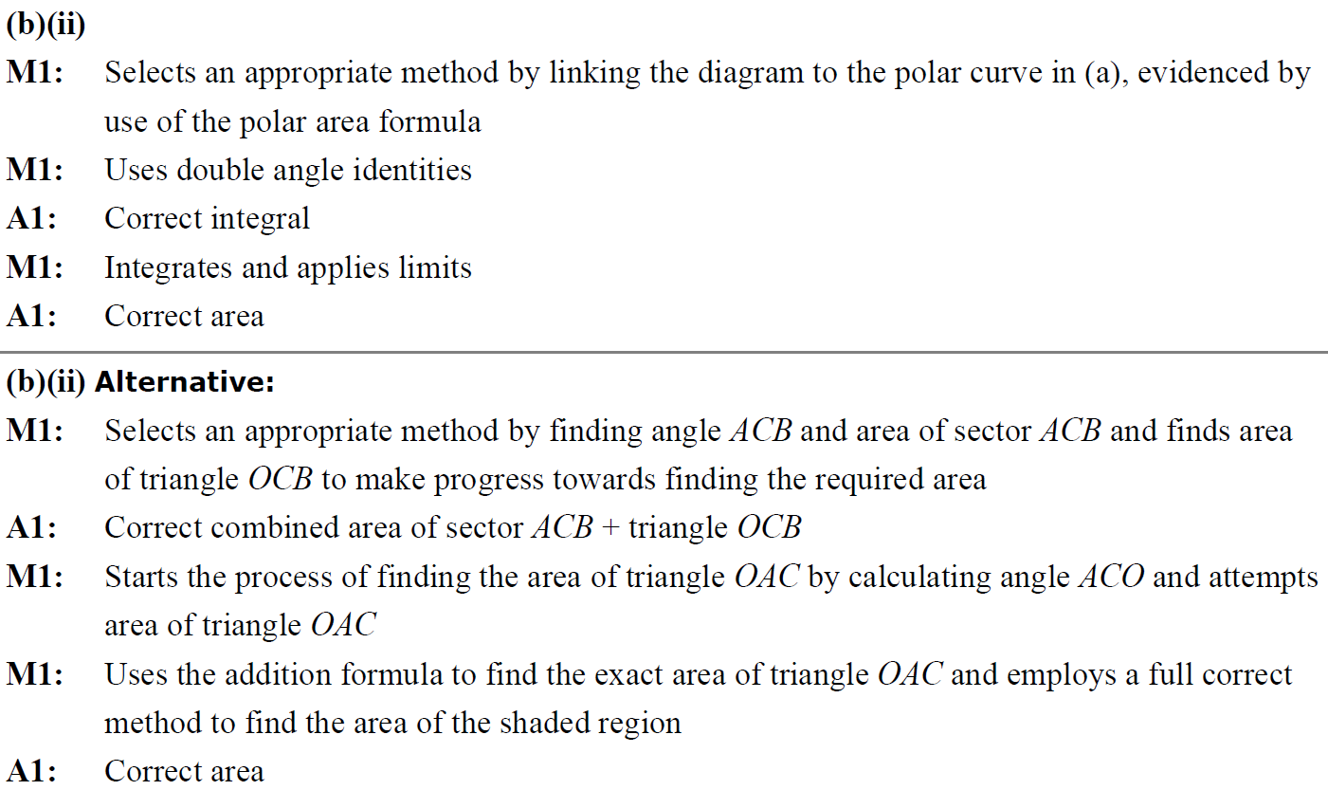
SAM Paper 2
B (ii) notes

Slide 25
2019 Paper 2

Slide 26
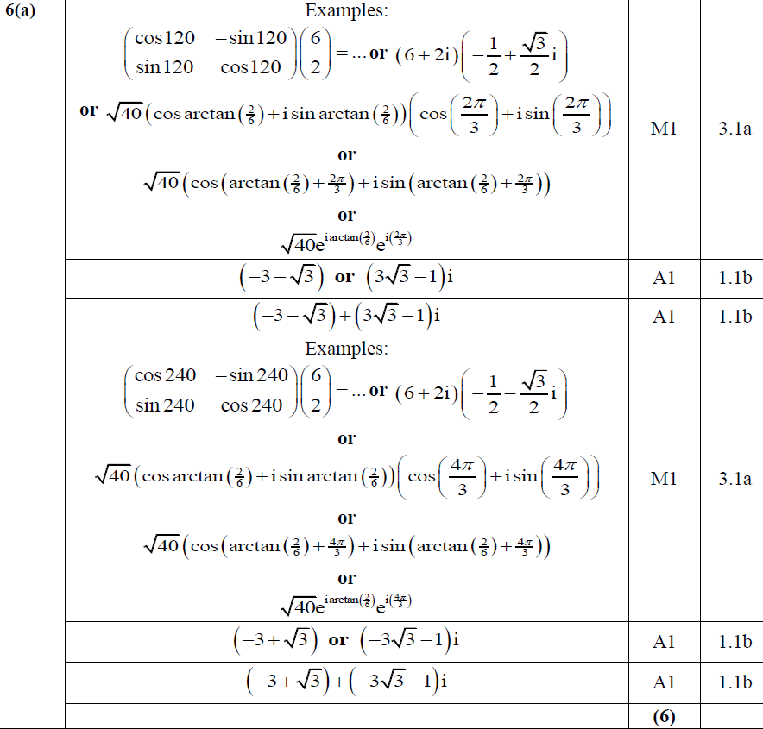
2019 Paper 2
A

Slide 27
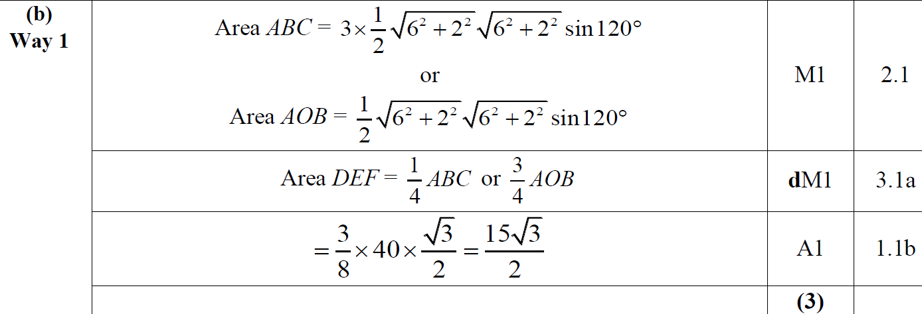
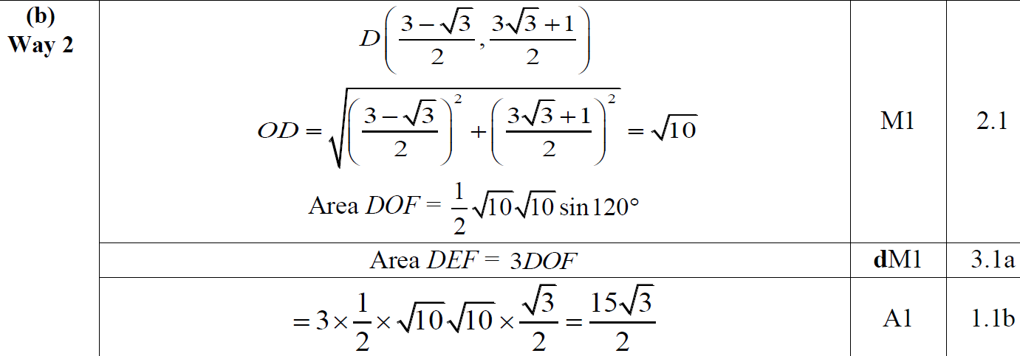
2019 Paper 2
B
B Alternative 1

Slide 28
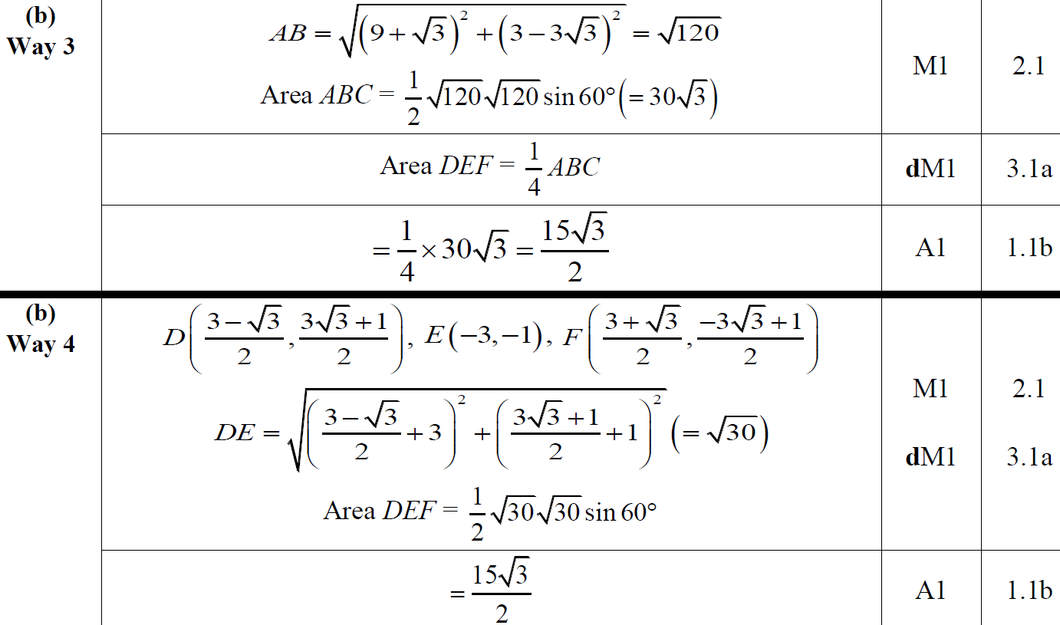
2019 Paper 2
B Alternative 2
B Alternative 3

Slide 29
2019 Paper 2
B Alternative 4

Slide 30
2019 Paper 2
A notes

Slide 31
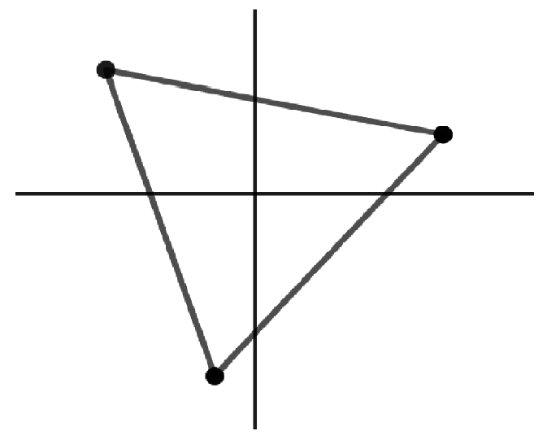
2019 Paper 2
B general notes

Slide 32
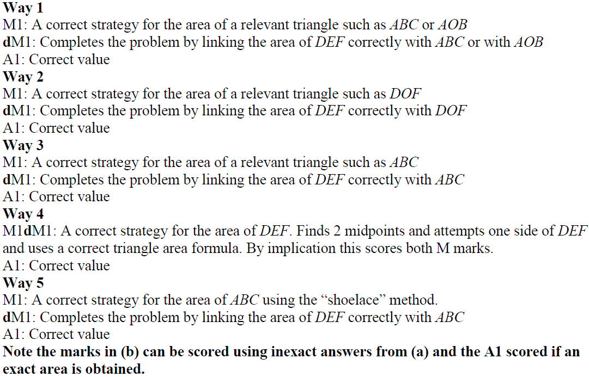
2019 Paper 2
B notes

Slide 33
New Spec Q’s
Argand Locus
Old Spec Complex Numbers
P4/ Old FP1
P6/ Old FP3
FP1
FP2
Jan 2002
Jan 2006
June 2002
Jan 2009
Jan 2012
June 2014 R
June 2010
June 2002
June 2006
June 2003
June 2009
June 2012
June 2015
June 2011
Jan 2003 (i)
Jan 2007
June 2005
Jan 2010
Jan 2013
May 2016 (i)
June 2012
Jan 2003 (ii)
June 2007
Jan 2006
June 2010
June 2013
May 2016 (ii)
June 2013
June 2003
Jan 2008
June 2006
Jan 2011 (i)
June 2013 R (i)
May 2017
June 2013 W
Jan 2004
June 2008
June 2008
Jan 2011 (ii)
June 2013 R (ii)
All questions after this required w-plane transformations
June 2004
Jan 2009
June 2009
June 2011 (i)
June 2013 W
Jan 2005
June 2009
Feb 2010
June 2011 (ii)
June 2014
June 2005
Jan 2010
w-plane transformation part (ignore as not in this spec yet)

Slide 34
Jan 2002

Slide 35
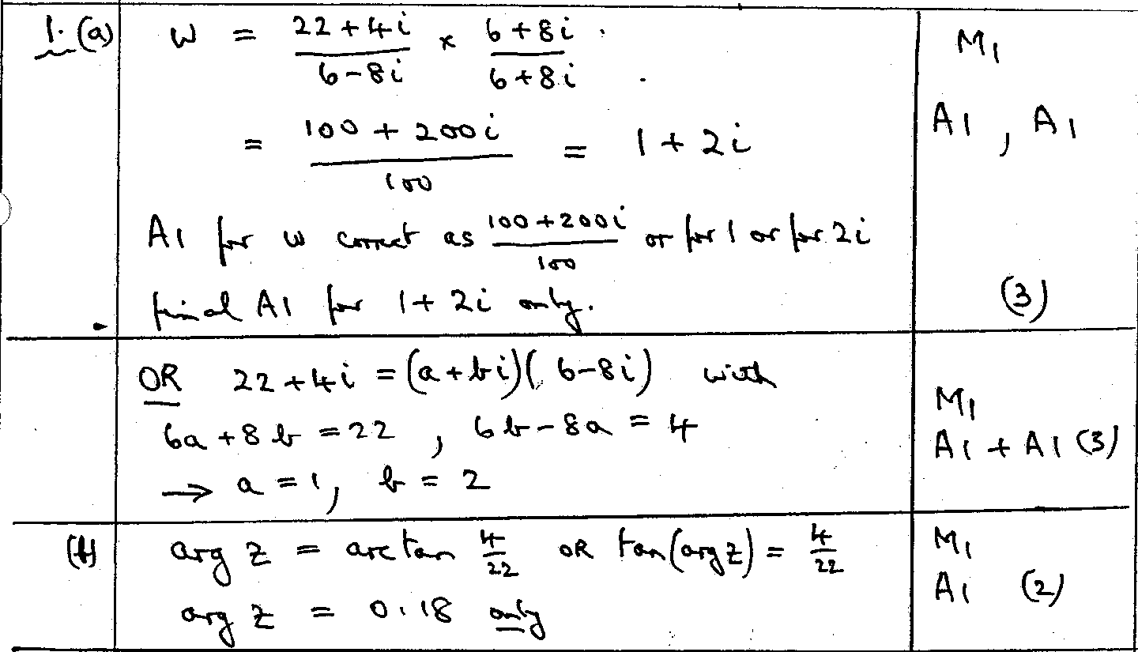
Jan 2002
A

Slide 36
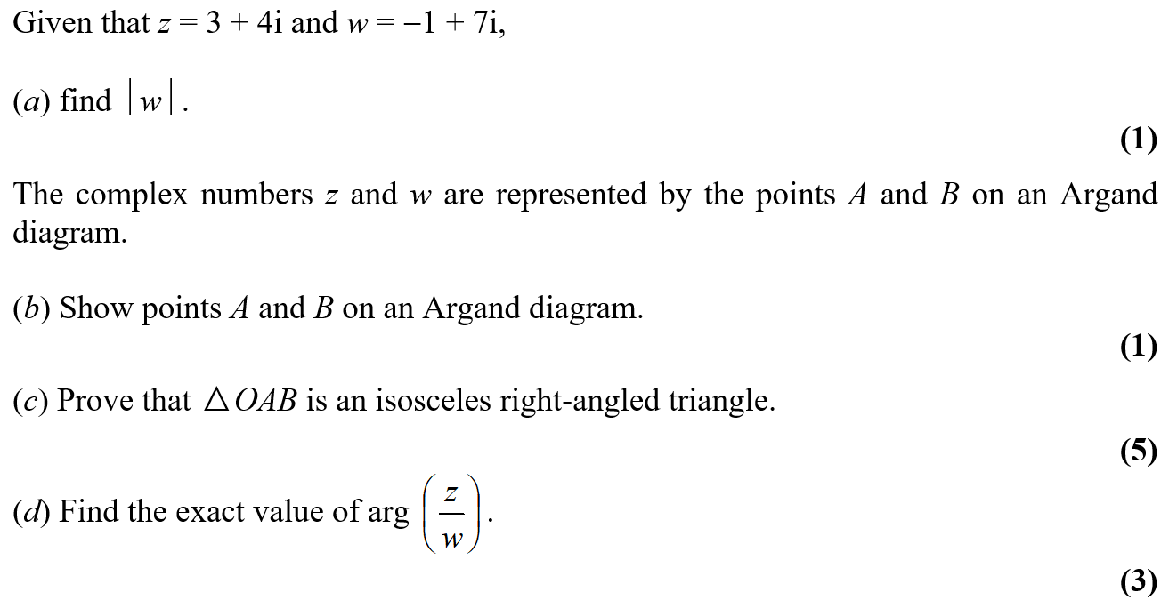
June 2002

Slide 37
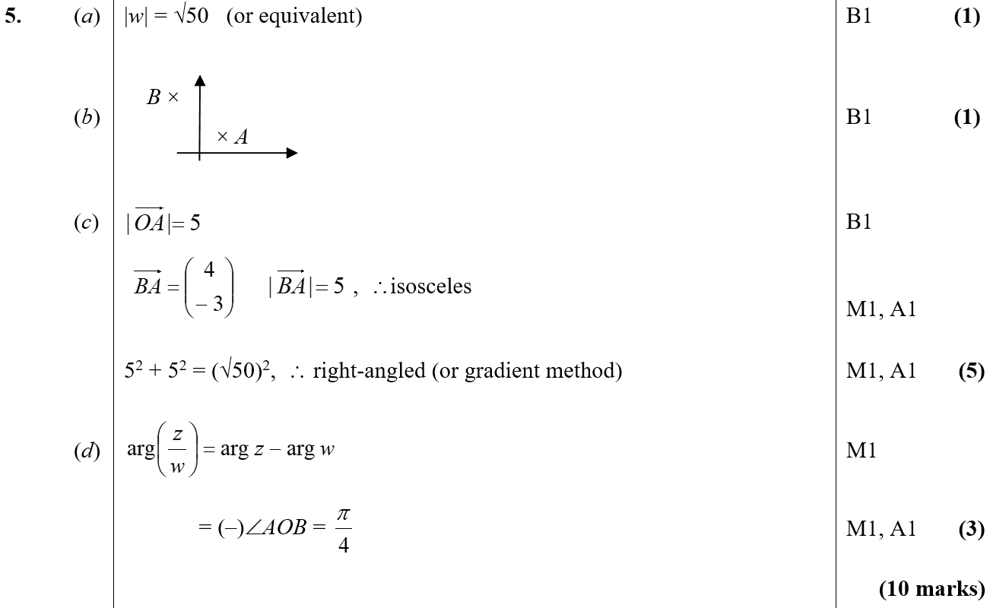
June 2002
A
B
C
D

Slide 38
Jan 2003

Slide 39
Jan 2003
A

Slide 40
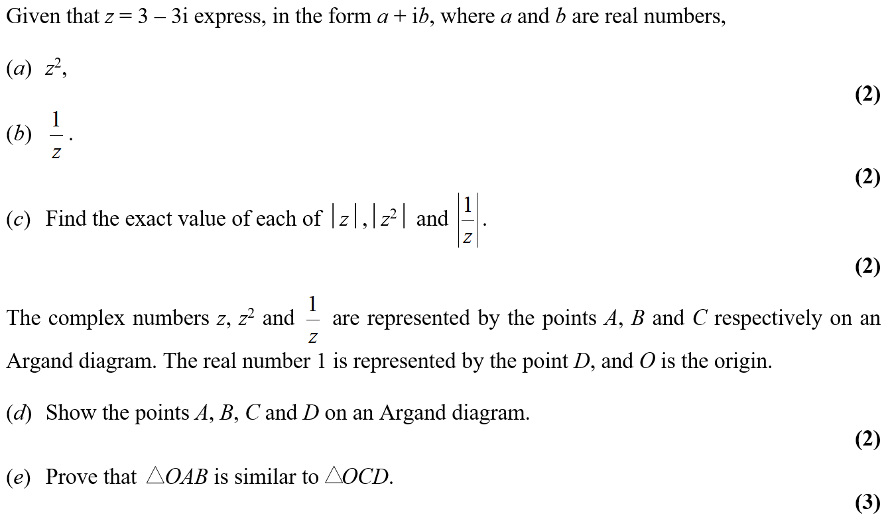
Jan 2003

Slide 41
Jan 2003
A
B
C

Slide 42
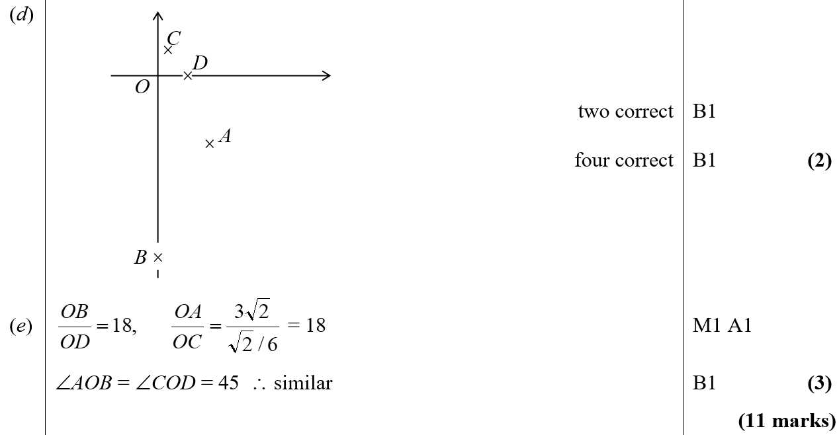
Jan 2003
D
E

Slide 43
June 2003

Slide 44
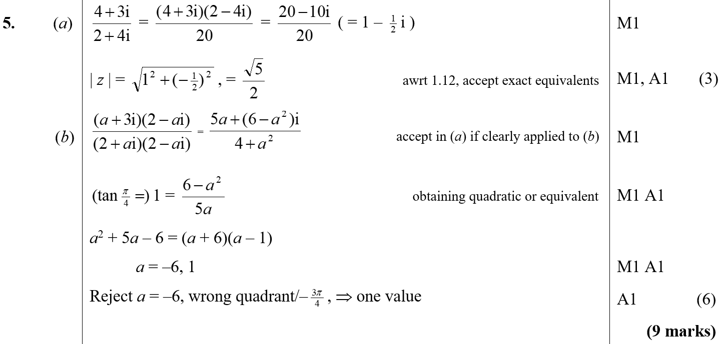
June 2003
A
B

Slide 45
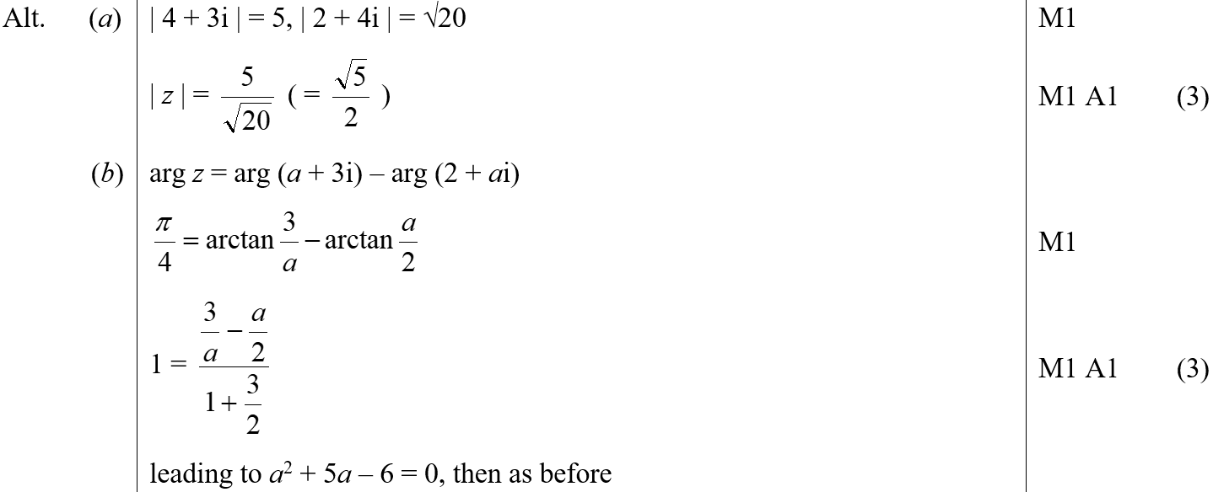
June 2003
A Alternative
B Alternative

Slide 46
Jan 2004

Slide 47
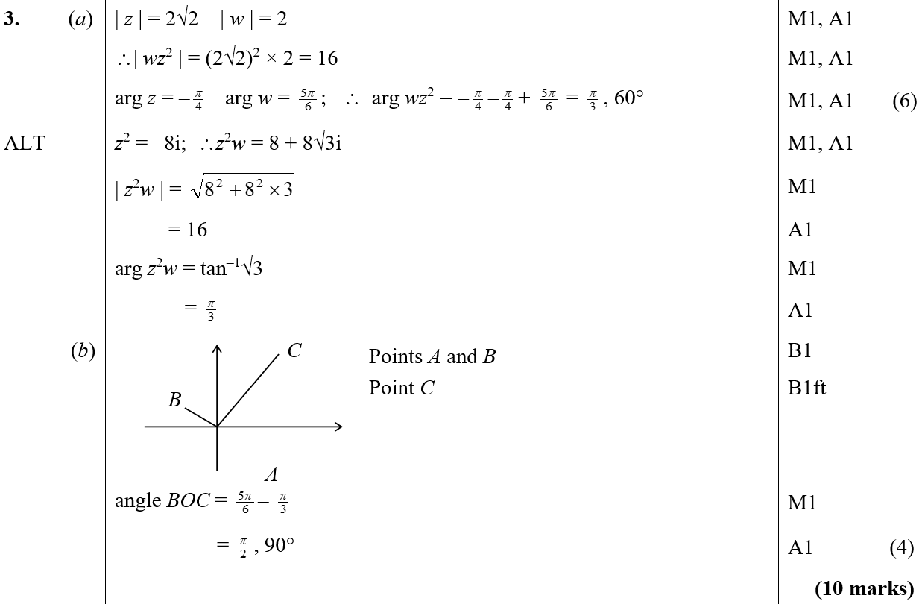
Jan 2004
A
B

Slide 48
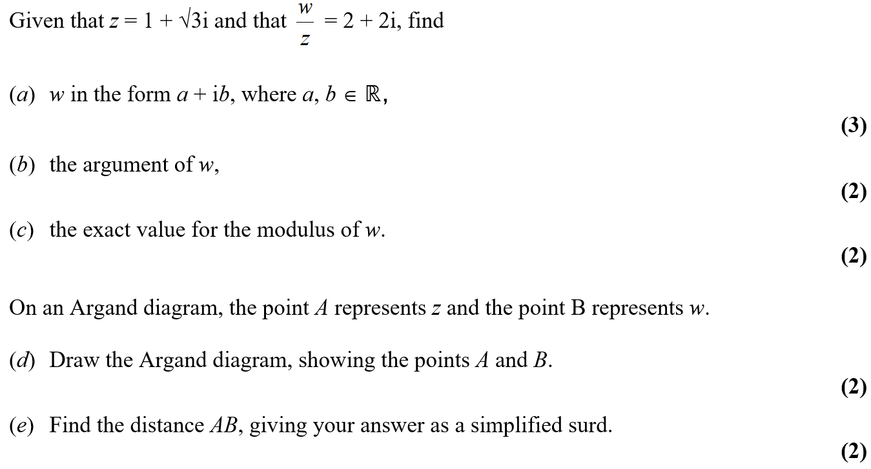
June 2004

Slide 49
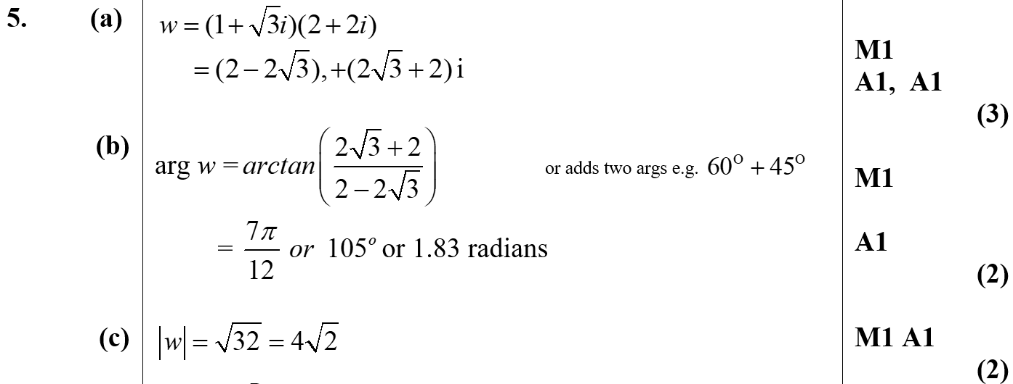
June 2004
A
B
C

Slide 50
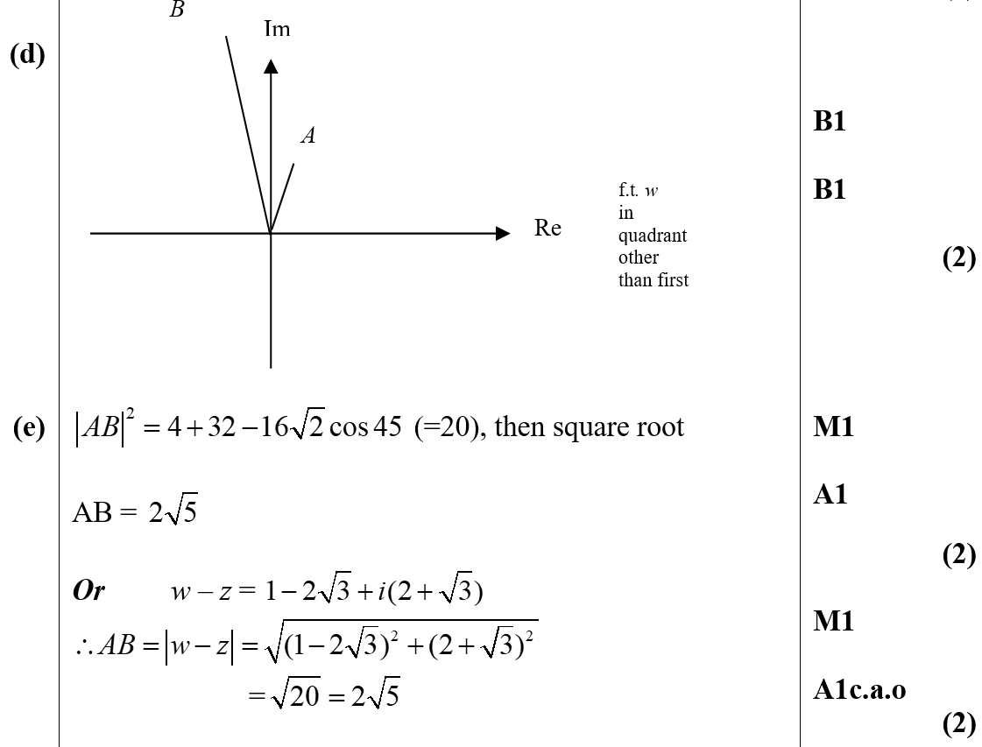
June 2004
D
E

Slide 51
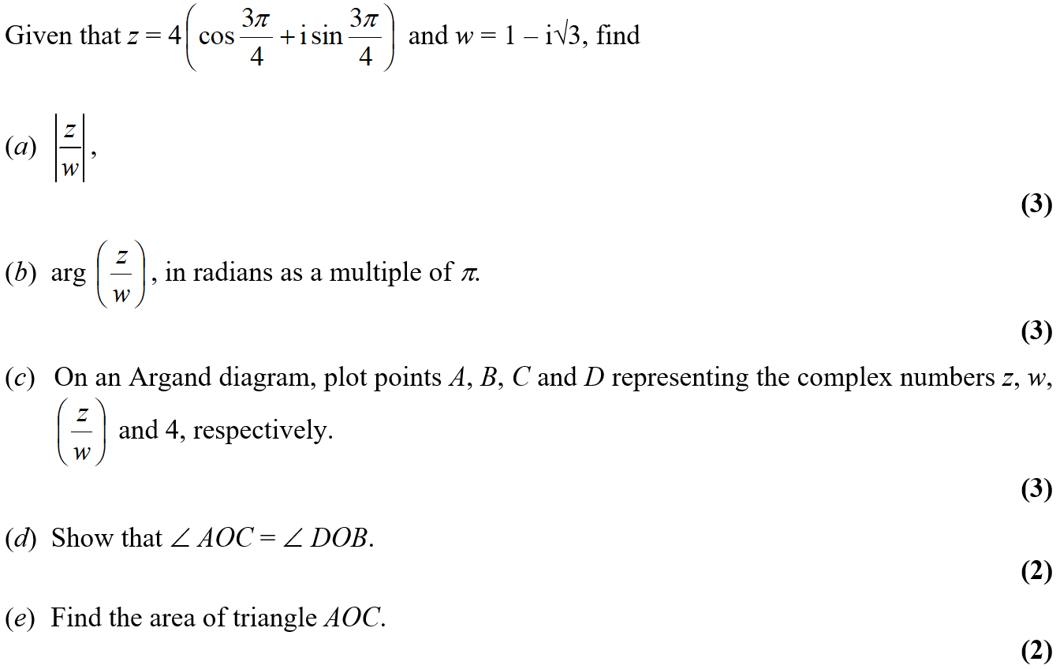
Jan 2005

Slide 52
Jan 2005
A
B

Slide 53
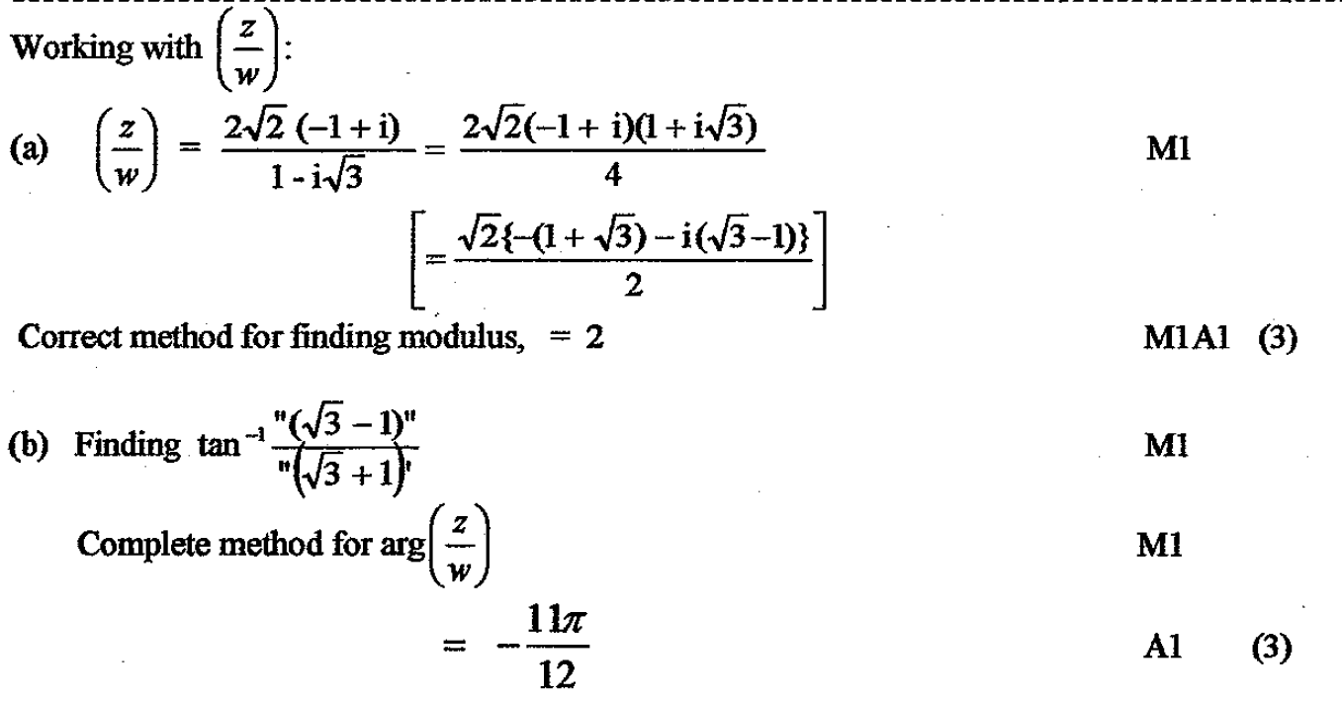
Jan 2005
A Alternative
B Alternative

Slide 54
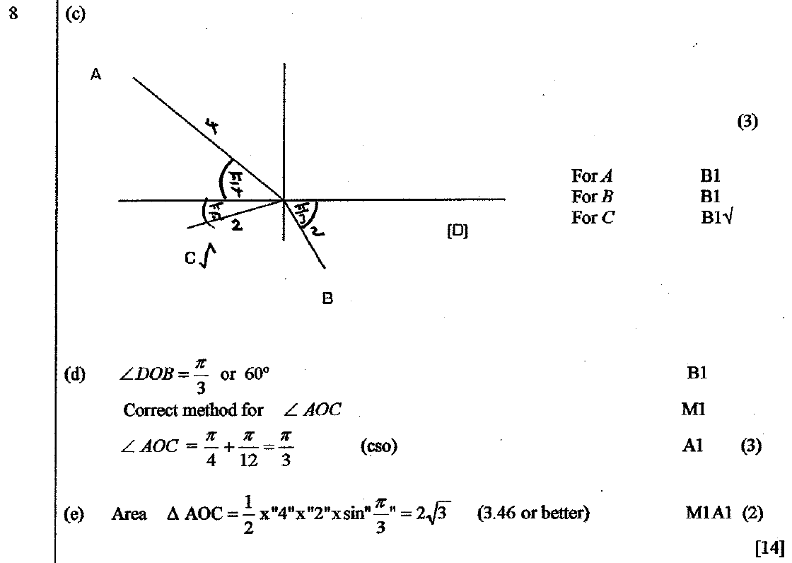
Jan 2005
C
D
E

Slide 55
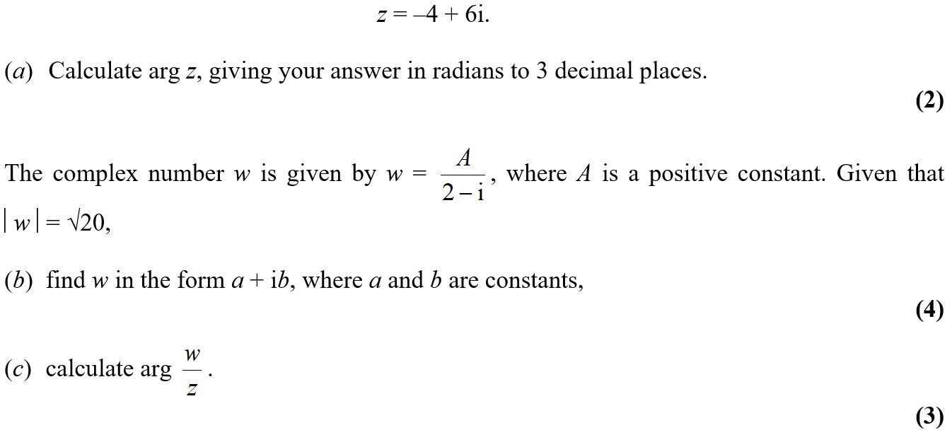
June 2005

Slide 56
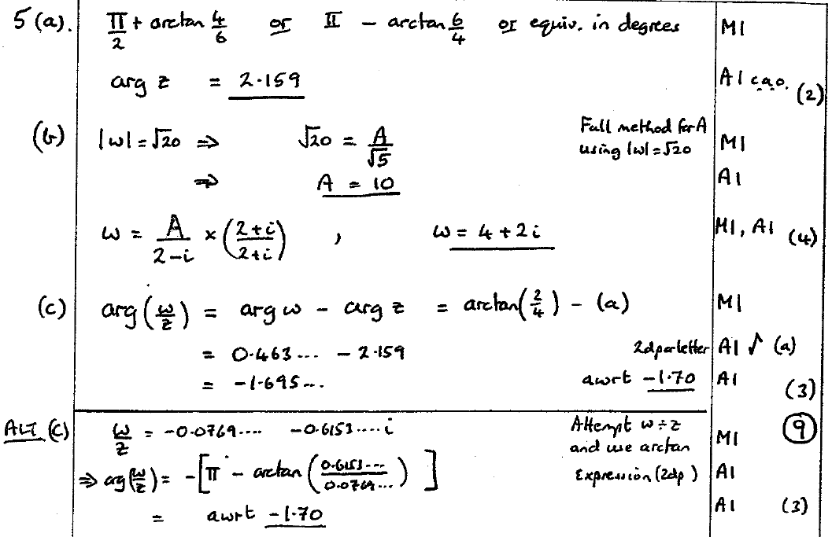
June 2005
A
B
C

Slide 57
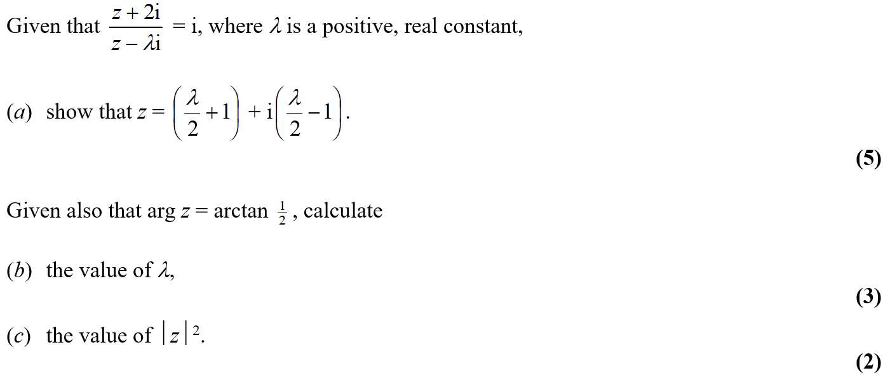
Jan 2006

Slide 58
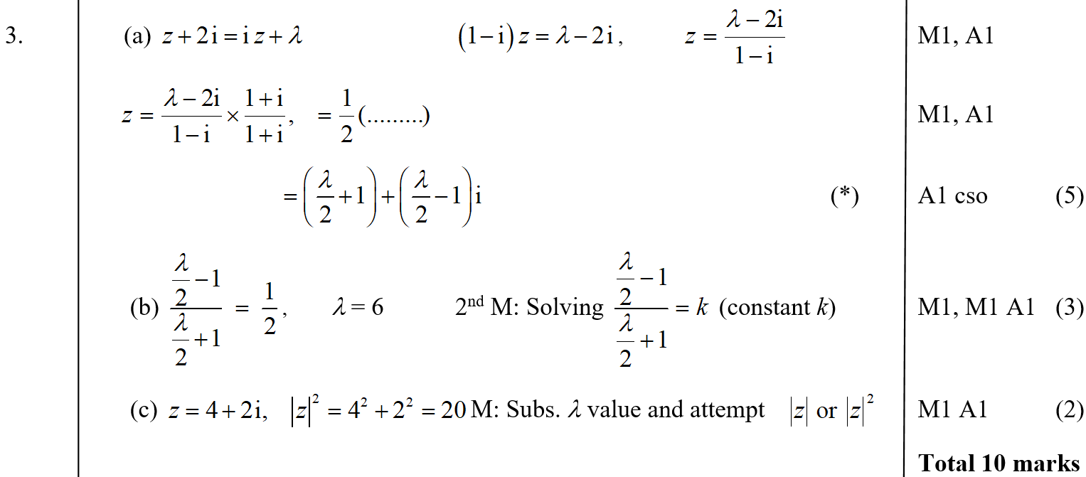
Jan 2006
A
B
C

Slide 59
June 2006

Slide 60
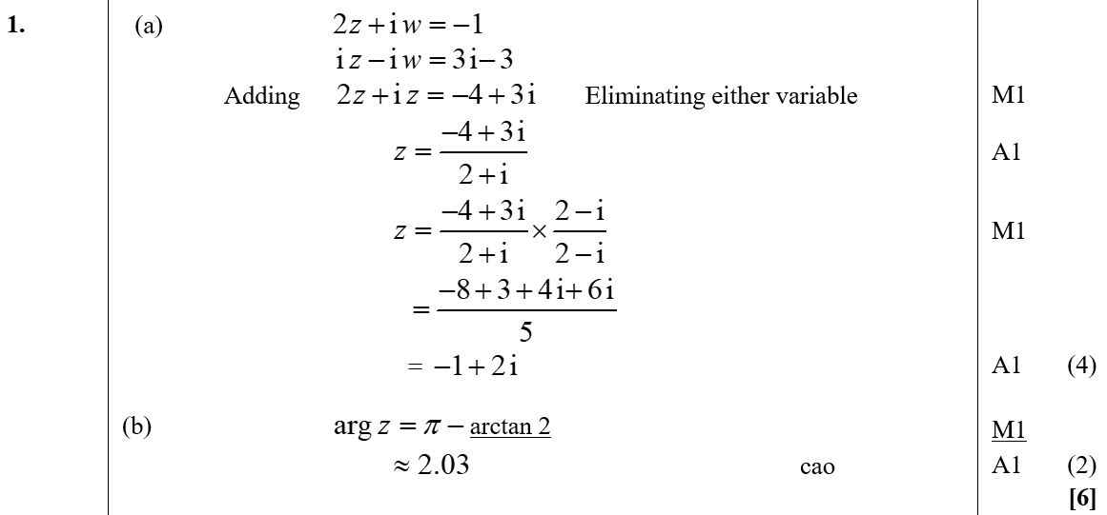
June 2006
A
B

Slide 61
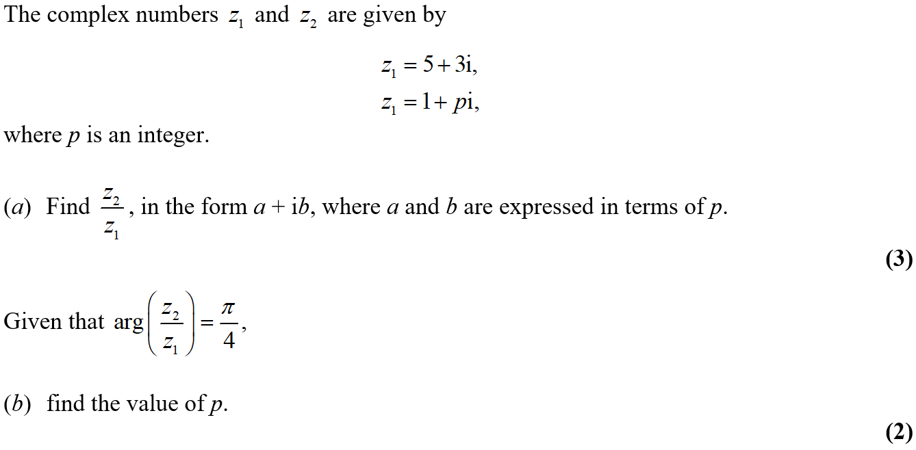
Jan 2007

Slide 62
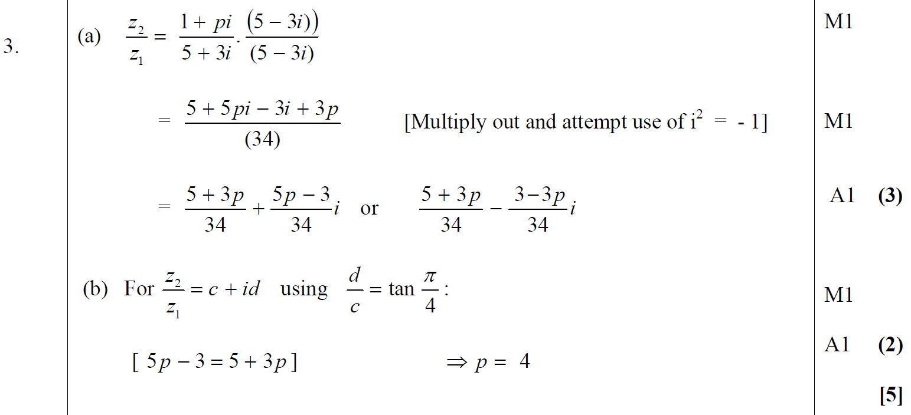
Jan 2007
A
B

Slide 63
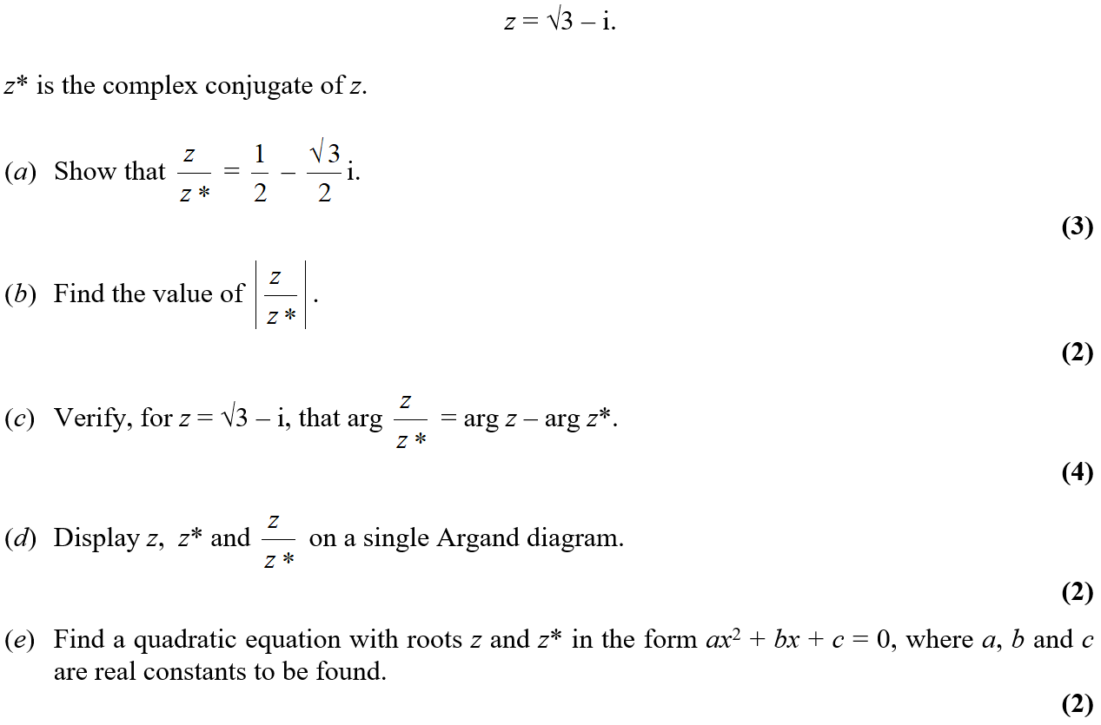
June 2007

Slide 64
June 2007
A
B
C

Slide 65
June 2007
D
E
A notes
B notes
C notes
D notes

Slide 66
Jan 2008

Slide 67
Jan 2008
A
B
C
D

Slide 68
Jan 2008
A notes
B notes
C notes
D notes

Slide 69
June 2008

Slide 70
June 2008
A
B

Slide 71
June 2008
B notes
A Alternative
B Alternative

Slide 72
Jan 2009

Slide 73
Jan 2009
A
B
C

Slide 74
Jan 2009
D
E
A notes
B notes
C notes
D notes
E notes

Slide 75
June 2009

Slide 76
June 2009
A
B
C
D

Slide 77
June 2009
A Alternative
C Alternative
A notes
B notes
C notes
D notes

Slide 78
Jan 2010

Slide 79
Jan 2010
A
B
C

Slide 80
June 2002

Slide 81
June 2002
A
B

Slide 82
June 2003

Slide 83
June 2003
(i) A
(i) B
(ii) A
(ii) B

Slide 84
June 2005

Slide 85
June 2005
A
B

Slide 86
June 2005
C

Slide 87
Jan 2006

Slide 88
Jan 2006
A
B

Slide 89
Jan 2006
C

Slide 90
June 2006

Slide 91
June 2006
A

Slide 92
June 2006
A Alternative

Slide 93
June 2006
B
C

Slide 94
June 2008

Slide 95
June 2008
A
C
A notes

Slide 96
June 2008
B

Slide 97
June 2009

Slide 98
June 2009
A
B

Slide 99
Feb 2010

Slide 100
Feb 2010
A
B

Slide 101
Feb 2010
C
D

Slide 102
Jan 2009

Slide 103
Jan 2009
A
B
C
D
E

Slide 104
Jan 2009
A notes
B notes
C notes
D notes
E notes

Slide 105
June 2009

Slide 106
June 2009
A
B
C
D

Slide 107
June 2009
D Alternative
A notes
B notes
C notes
D notes

Slide 108
Jan 2010

Slide 109
Jan 2010
A
B
C
A notes
B notes
C notes

Slide 110
June 2010

Slide 111
June 2010
A
B
C

Slide 112
June 2010
D
A notes
B notes
C notes

Slide 113
Jan 2011

Slide 114
Jan 2011
A

Slide 115
Jan 2011
B

Slide 116
Jan 2011

Slide 117
Jan 2011
A
B

Slide 118
Jan 2011
C
D

Slide 119
June 2011

Slide 120
June 2011
A
B
C

Slide 121
June 2011
D

Slide 122
June 2011

Slide 123
June 2011
A

Slide 124
Jan 2012

Slide 125
Jan 2012
A
B
C

Slide 126
June 2012

Slide 127
June 2012
A
B

Slide 128
June 2012
C
D

Slide 129
Jan 2013

Slide 130
Jan 2013
A
B
C
D

Slide 131
Jan 2013
C Alternative
D Alternative
A notes
B notes
C notes
D notes

Slide 132
June 2013

Slide 133
June 2013
A
B

Slide 134
June 2013
C
D

Slide 135
June 2013 Reserve

Slide 136
June 2013 Reserve
A
B

Slide 137
June 2013 Reserve

Slide 138
June 2013 Reserve
A
B
C

Slide 139
June 2013 Reserve
D
C notes

Slide 140
June 2013 Withdrawn

Slide 141
June 2013 Withdrawn
A
B
C

Slide 142
June 2013 Withdrawn
A notes
B notes
C notes

Slide 143
June 2014

Slide 144
June 2014
A

Slide 145
June 2014
B

Slide 146
June 2014 Reserve

Slide 147
June 2014 Reserve
A
B

Slide 148
June 2014 Reserve
A Alternative

Slide 149
June 2015

Slide 150
June 2015
A
B
C

Slide 151
June 2015
A notes
B notes
C notes

Slide 152
May 2016

Slide 153
May 2016
A
B
C

Slide 154
May 2016
C Alternatives

Slide 155
May 2016
A notes
B notes
C notes

Slide 156
May 2016

Slide 157
May 2016
A
B
C
D

Slide 158
May 2016
E
A notes
B notes
C notes
D notes

Slide 159
May 2017

Slide 160
May 2017
(i) A

Slide 161
May 2017
(i) B
(ii)

Slide 162
June 2010

Slide 163
June 2010
A
B
C

Slide 164
June 2011

Slide 165
June 2011
A
B
C

Slide 166
June 2012

Slide 167
June 2012
A

Slide 168
June 2012
B

Slide 169
June 2012
C

Slide 170
June 2013

Slide 171
June 2013
A
B
C
D

Slide 172
June 2013
A notes
B notes
C notes

Slide 173
June 2013
D notes

Slide 174
June 2013 Withdrawn

Slide 175
June 2013 Withdrawn
A

Slide 176
June 2013 Withdrawn
B
C

