Slide 1
Collisions:
Two Spheres Oblique Impact
Old Spec Q’s
SAM
2019

Slide 2
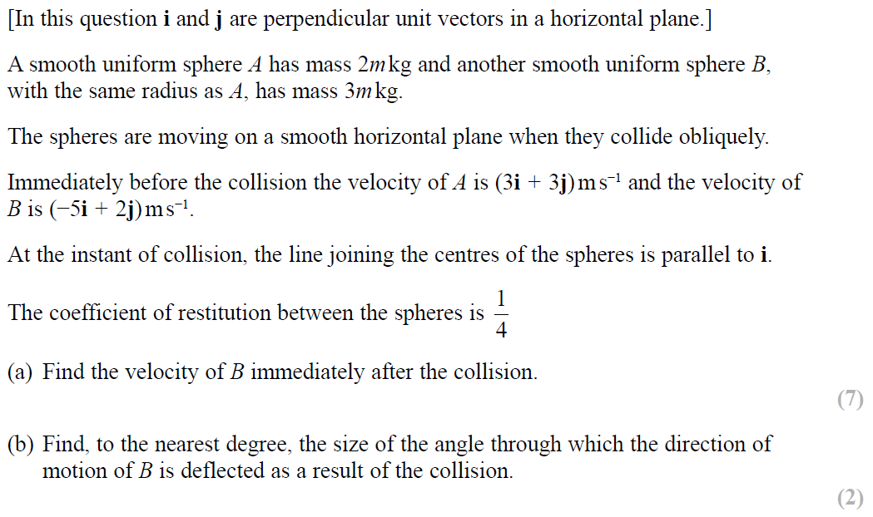
SAM

Slide 3
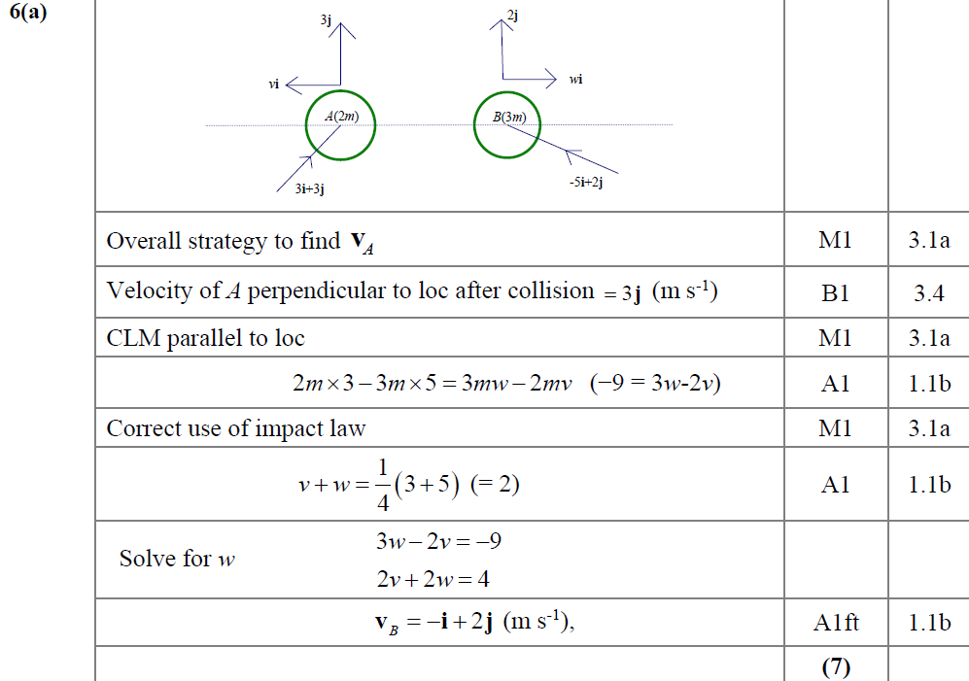
SAM
A

Slide 4
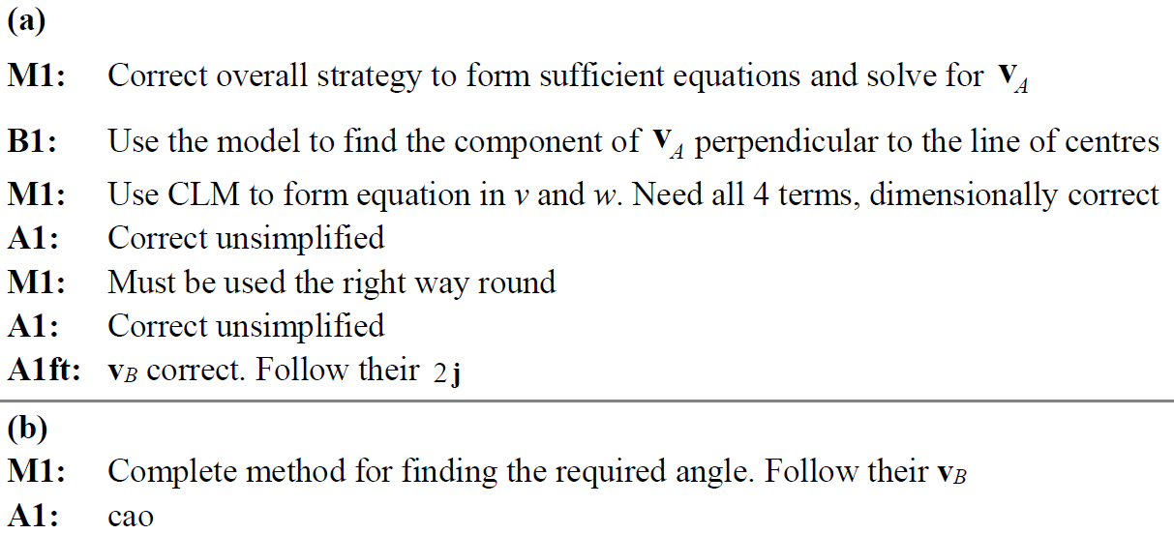
SAM
B
A notes
B notes

Slide 5
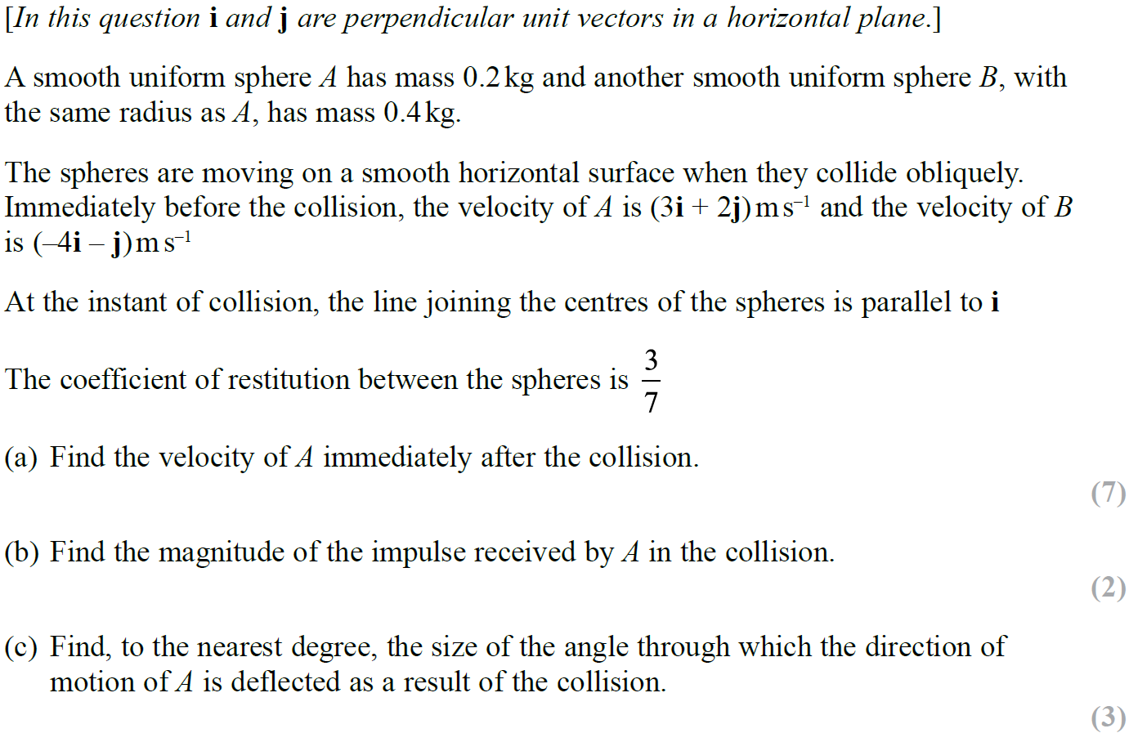
2019

Slide 6
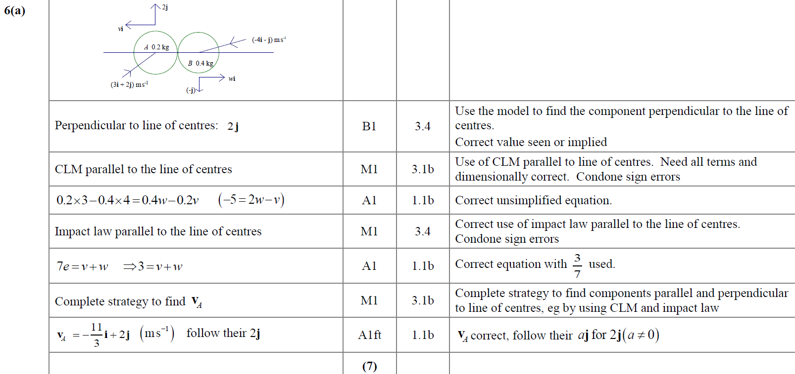
2019
A

Slide 7
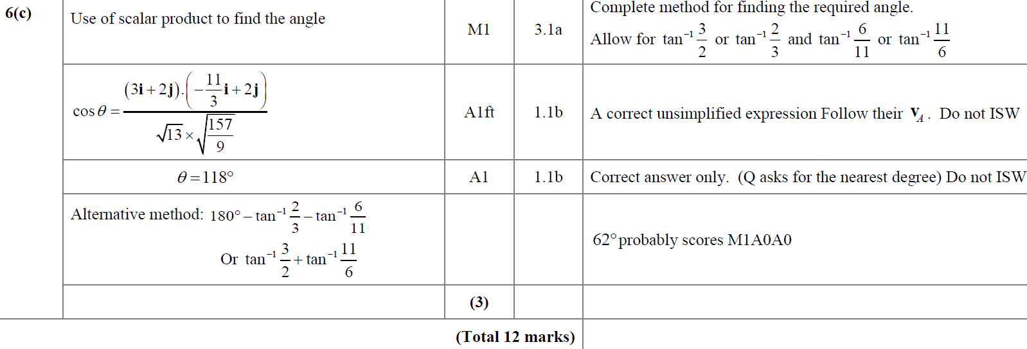
2019
B
C

Slide 8
Old Spec Collisions:
Two Spheres Oblique Impact
New Spec Q’s
M2 (very basic)
M4
June 2004
Jan 2002
June 2004
June 2008
June 2013 (R)
June 2018
June 2002
Jan 2005
June 2009
June 2014
June 2019
Jan 2003
June 2005
June 2010
June 2014 (R)
June 2003
Jan 2006
June 2011
June 2015
Jan 2004 (i)
June 2006
June 2012
June 2016
Jan 2004 (ii)
June 2007
June 2013
June 2017

Slide 9
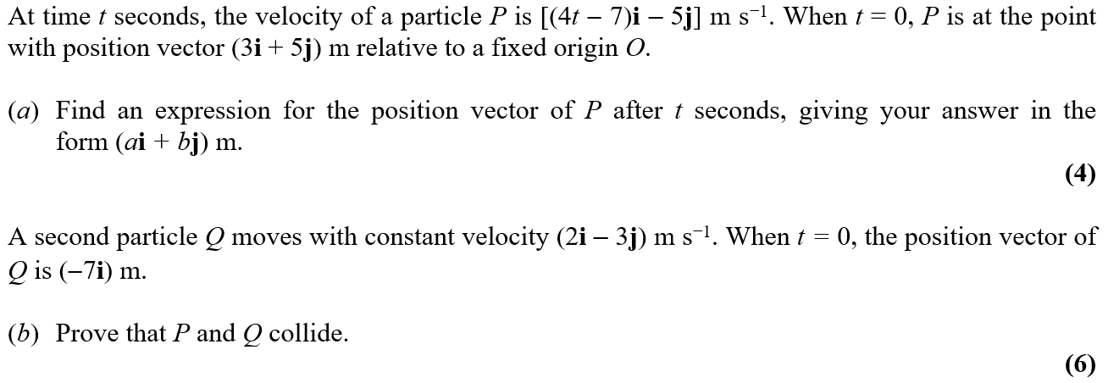
June 2004

Slide 10
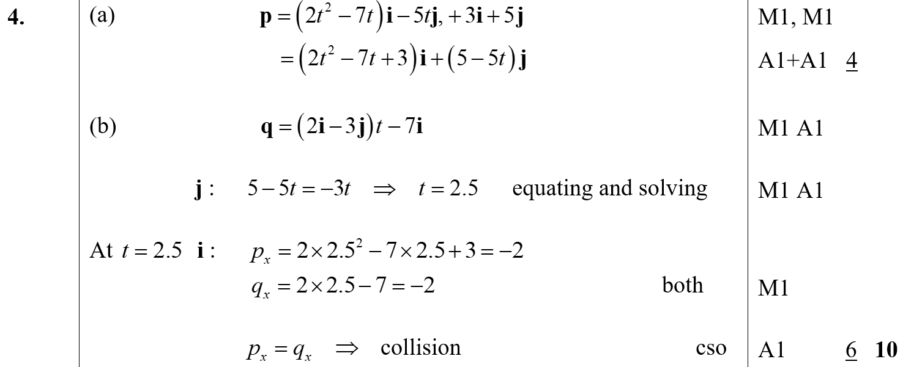
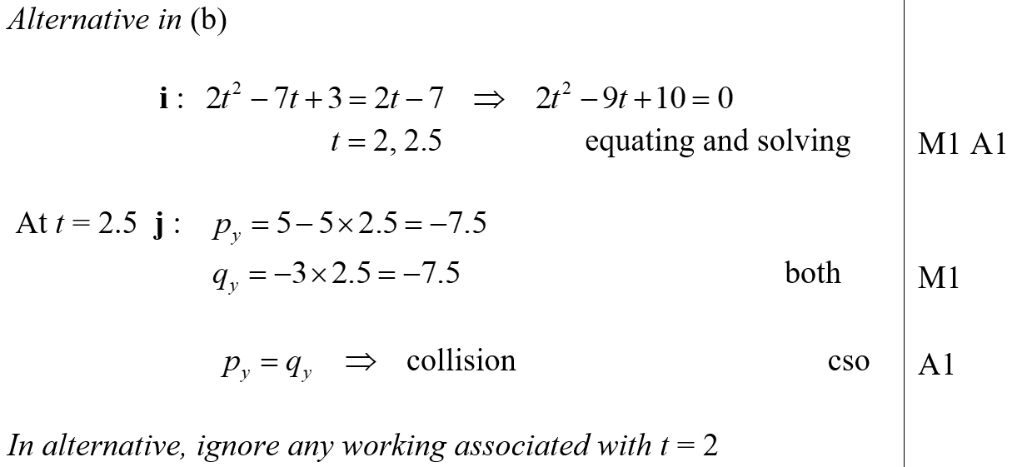
June 2004
A
B
B Alternative

Slide 11
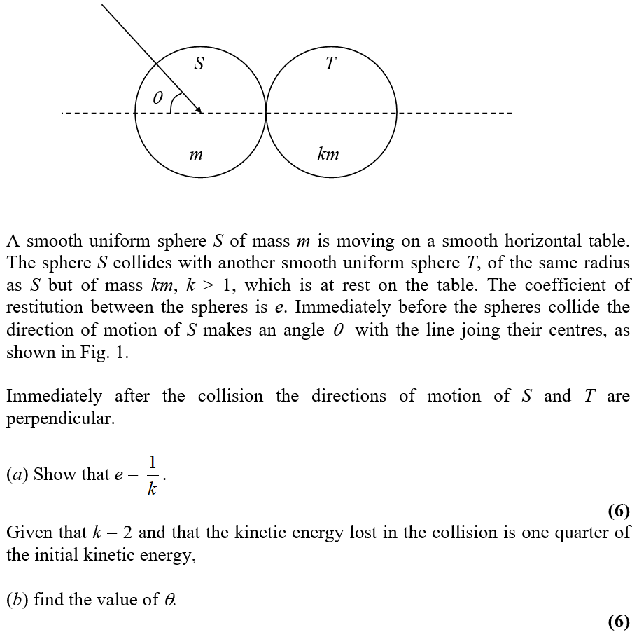
Jan 2002

Slide 12
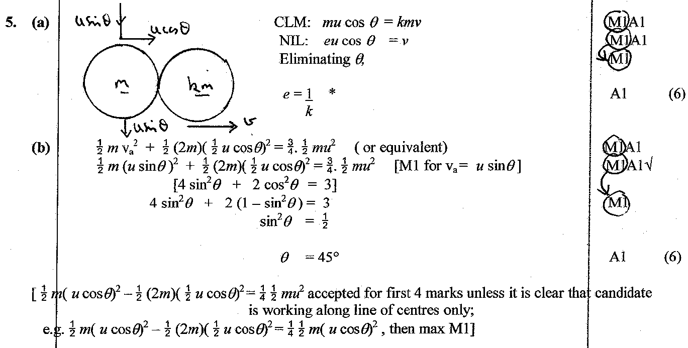
Jan 2002
A
B

Slide 13
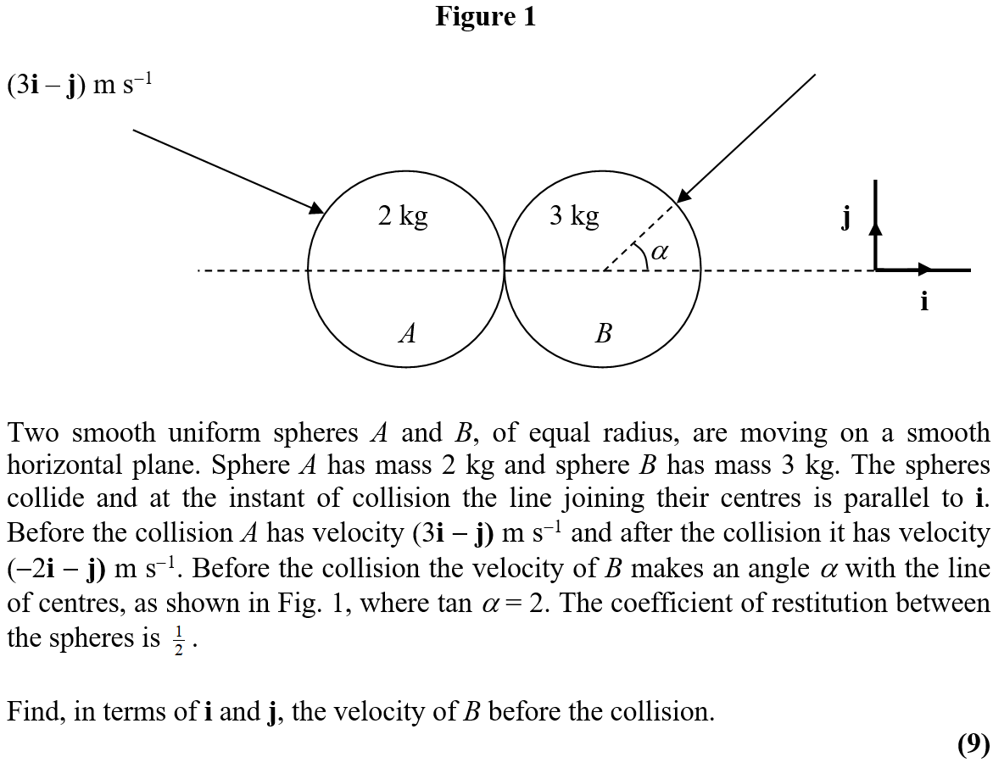
June 2002

Slide 14
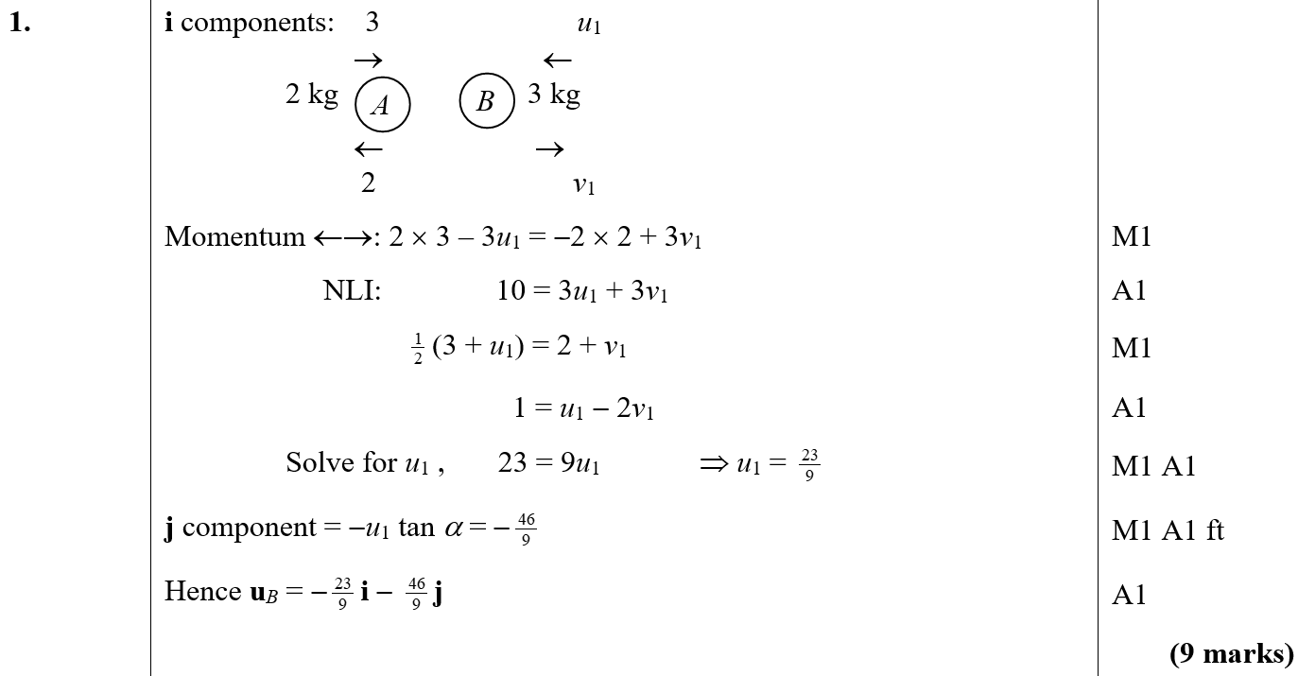
June 2002
A

Slide 15
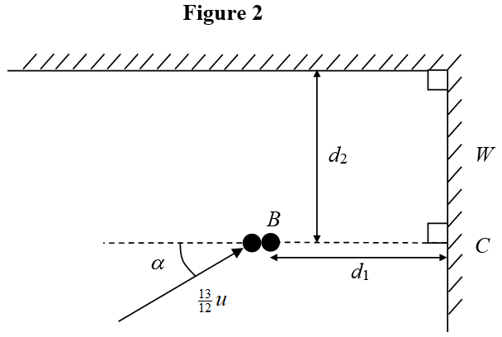
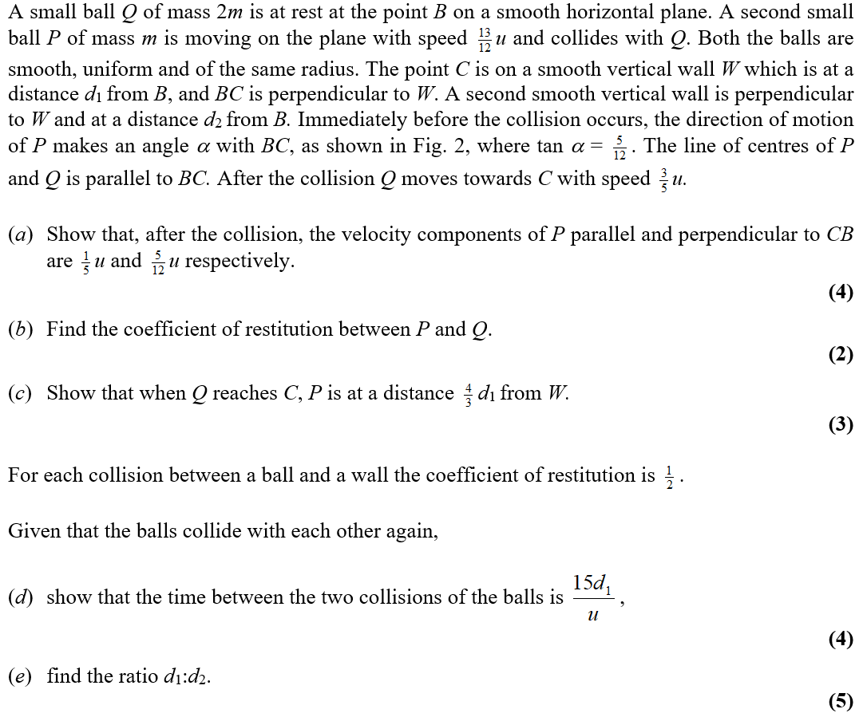
Jan 2003

Slide 16
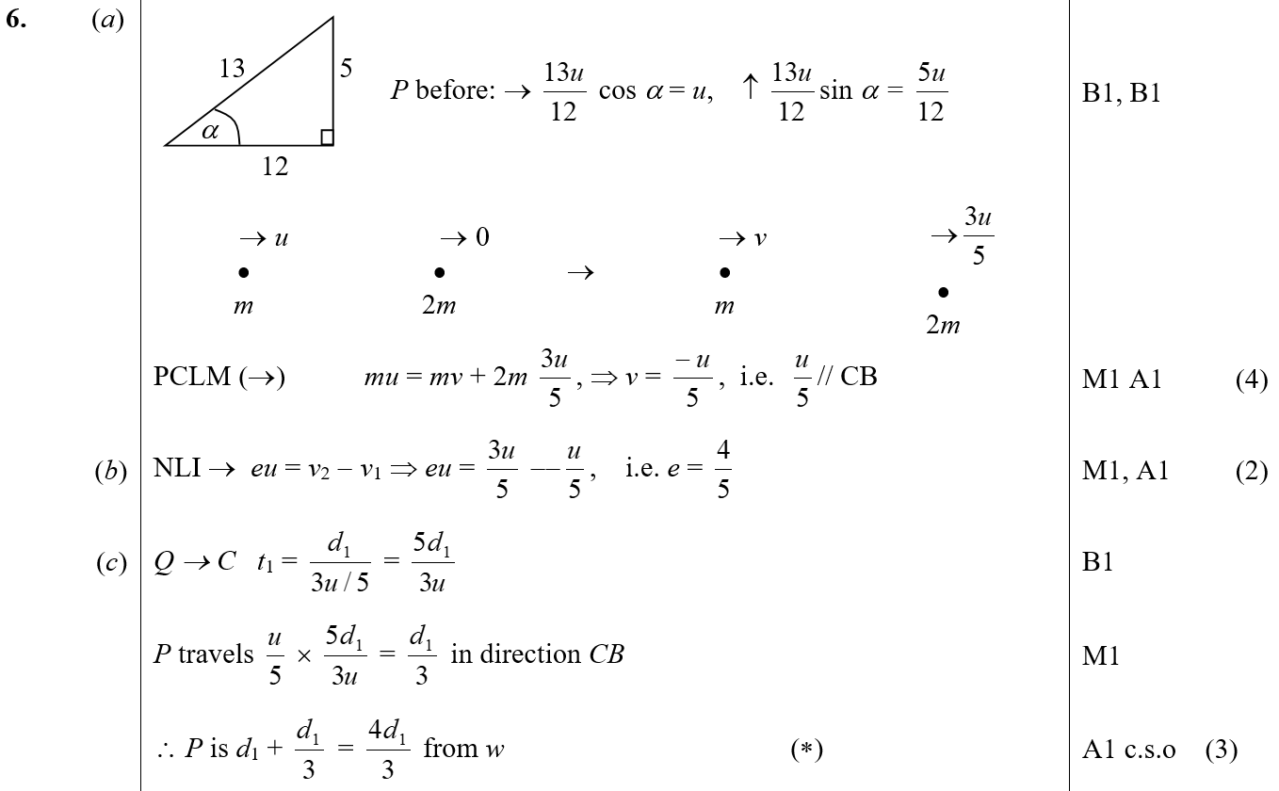
Jan 2003
A
B
C

Slide 17
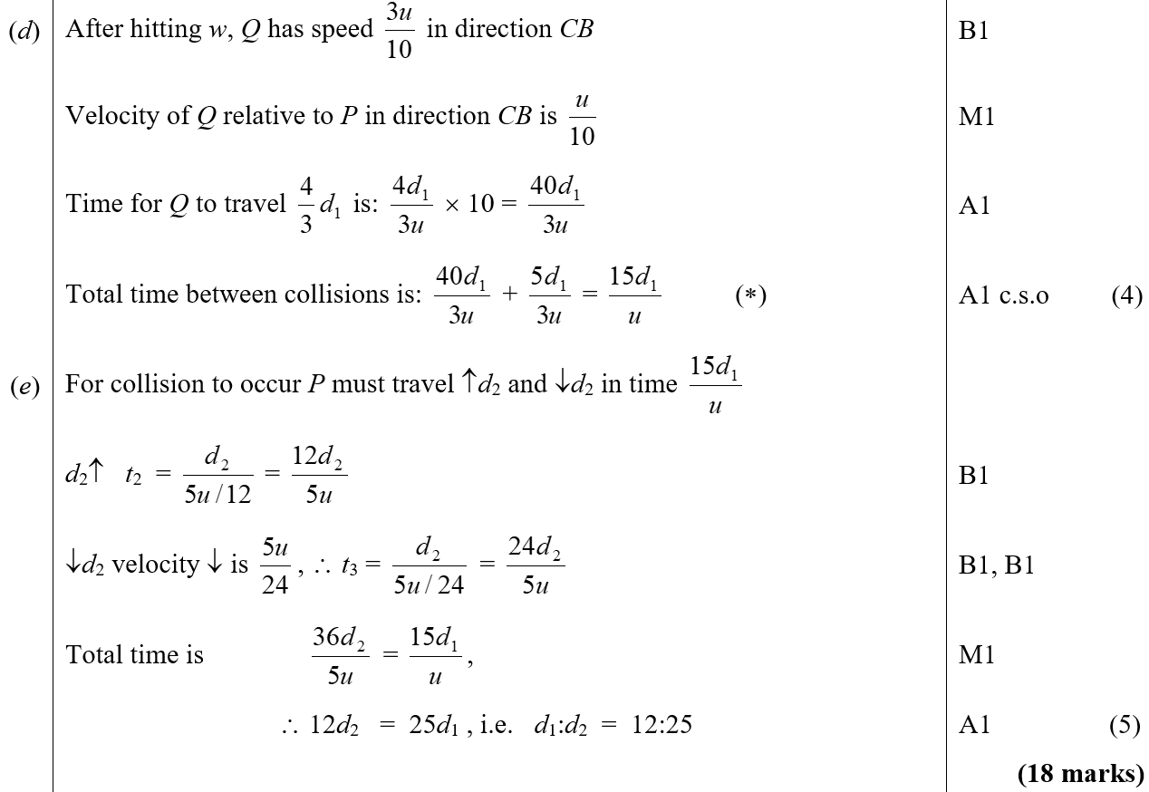
Jan 2003
D
E

Slide 18
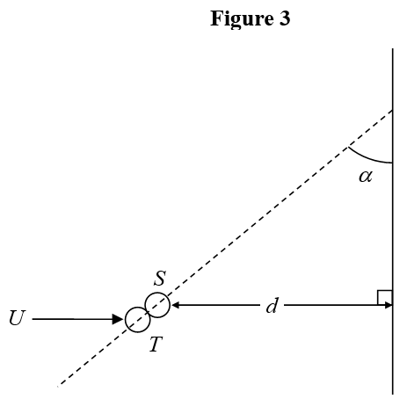
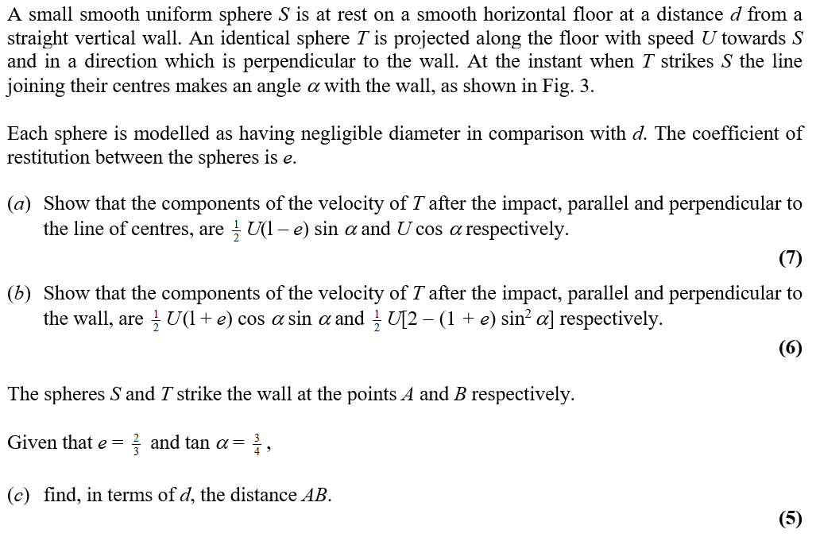
June 2003

Slide 19
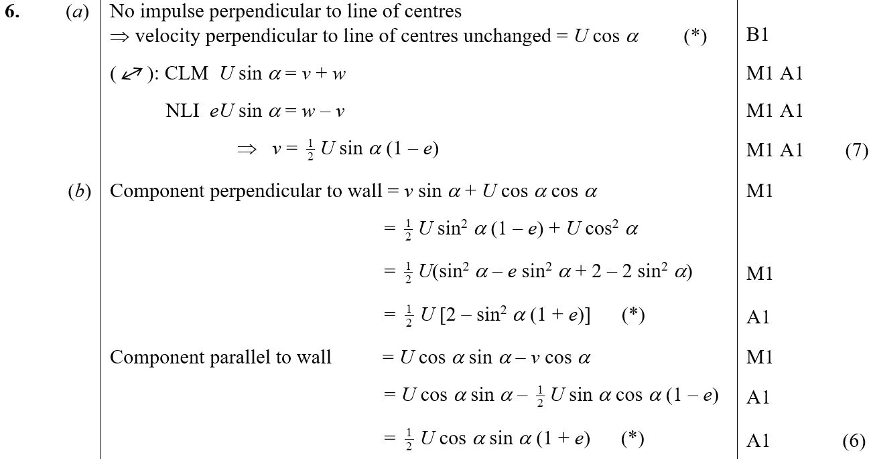
June 2003
A
B

Slide 20
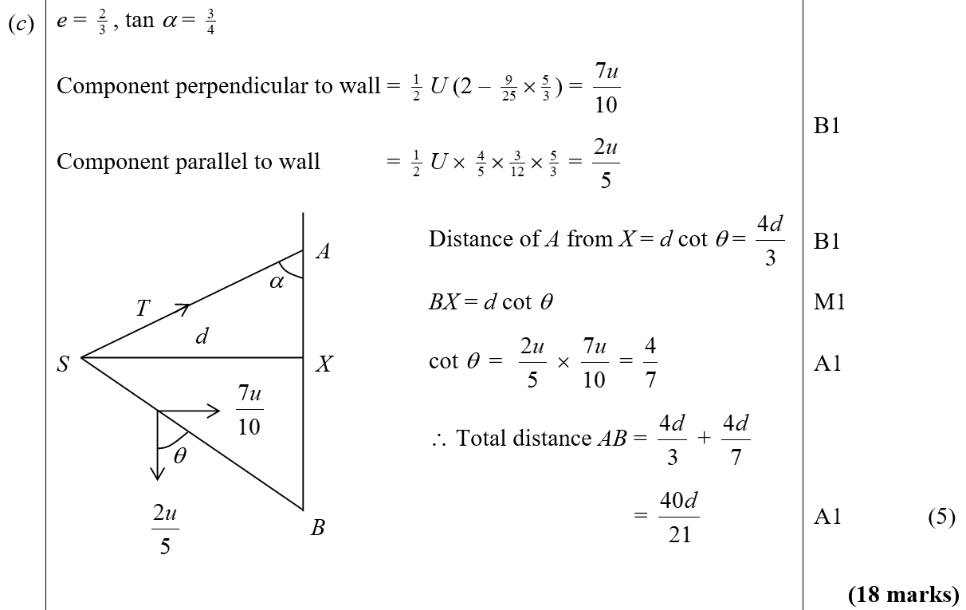
June 2003
C

Slide 21
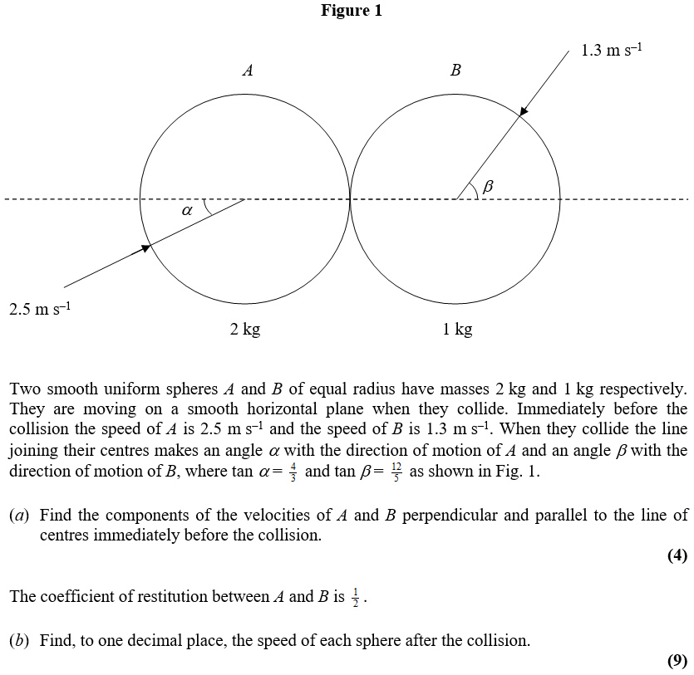
Jan 2004

Slide 22
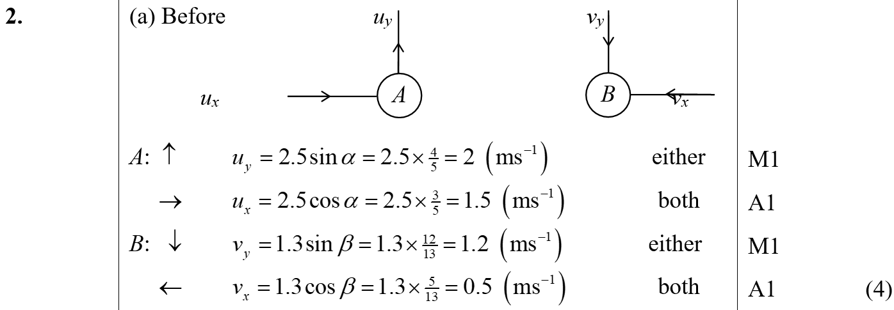
Jan 2004
A

Slide 23
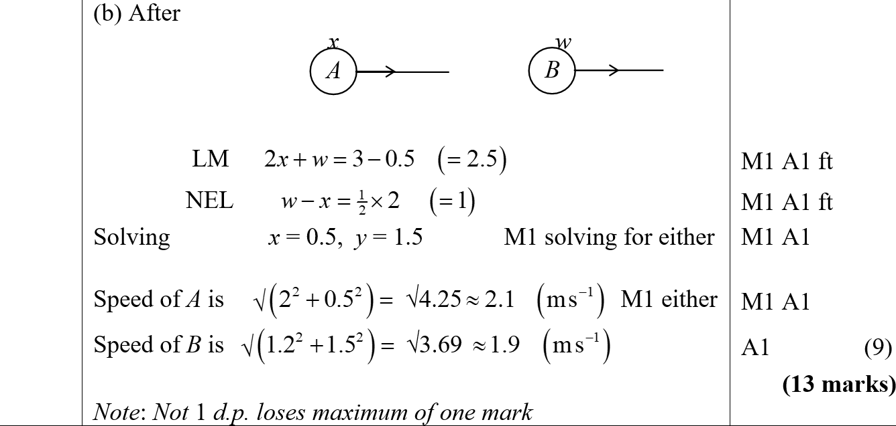
Jan 2004
B

Slide 24
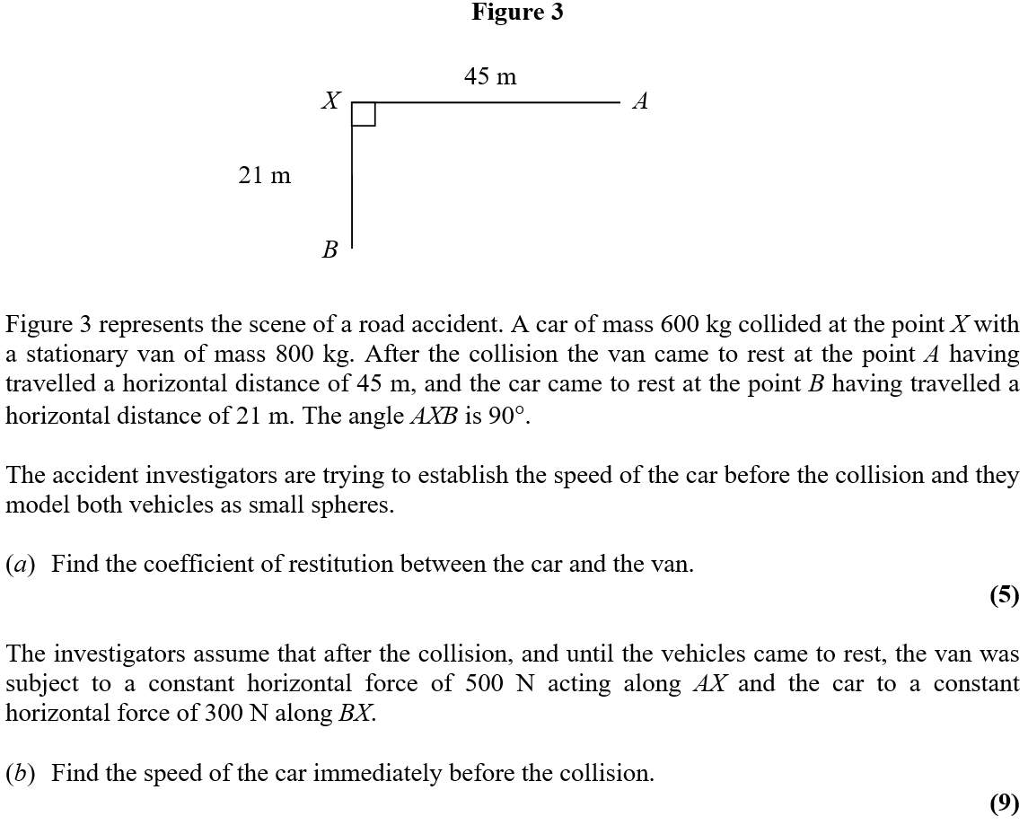
Jan 2004

Slide 25
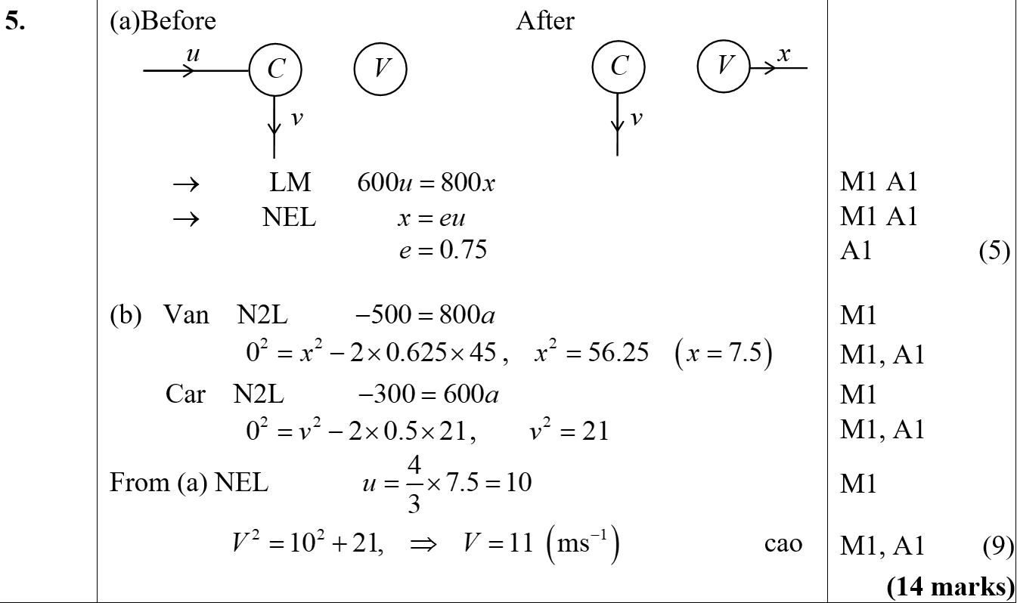
Jan 2004
A
B

Slide 26
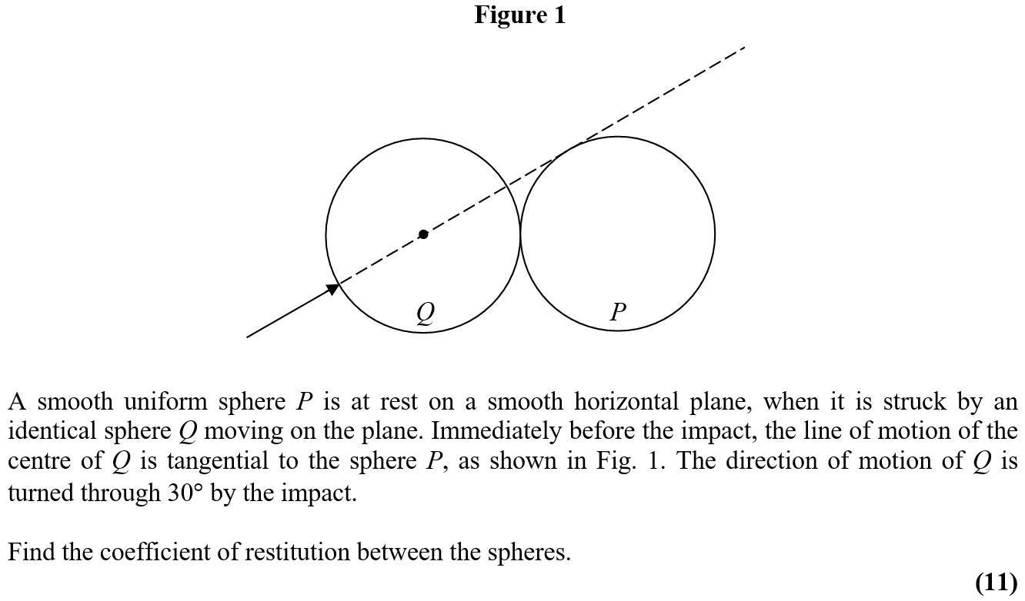
June 2004

Slide 27
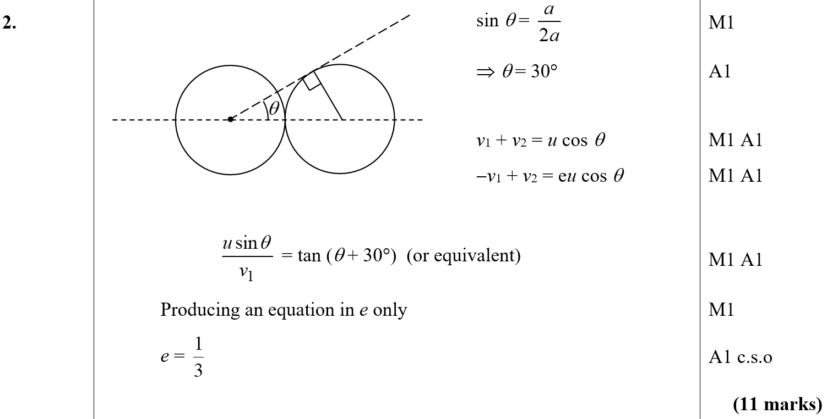
June 2004
A

Slide 28
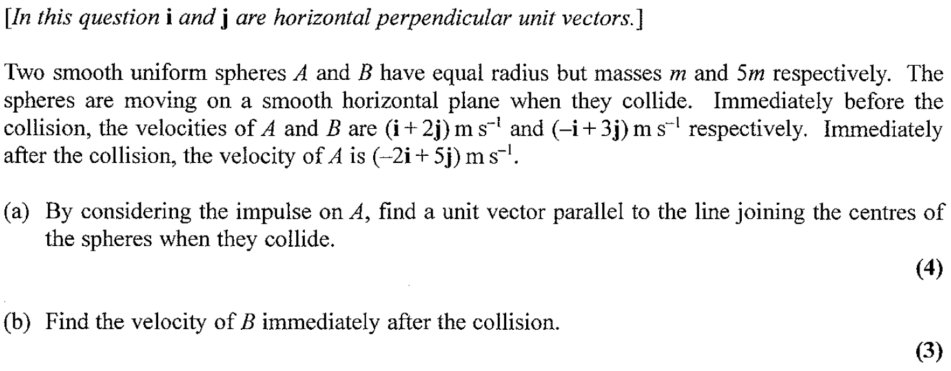
Jan 2005

Slide 29
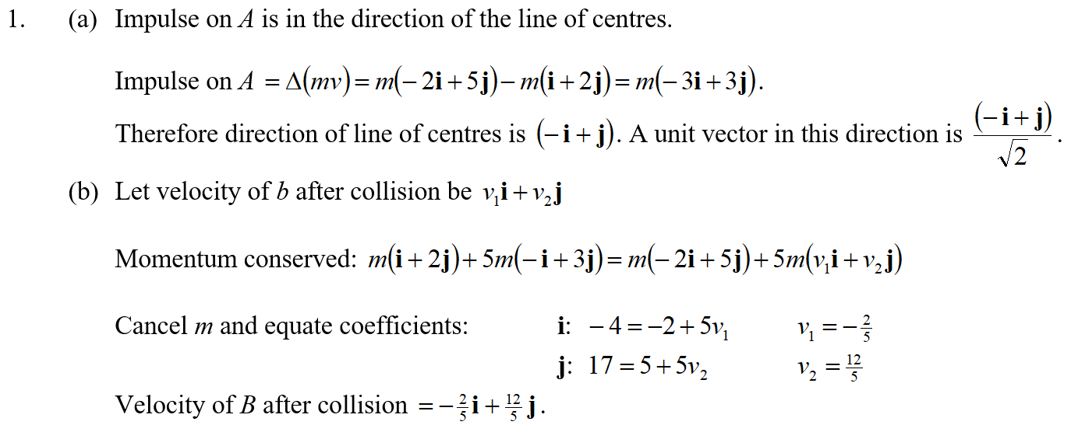
Jan 2005
A
B

Slide 30
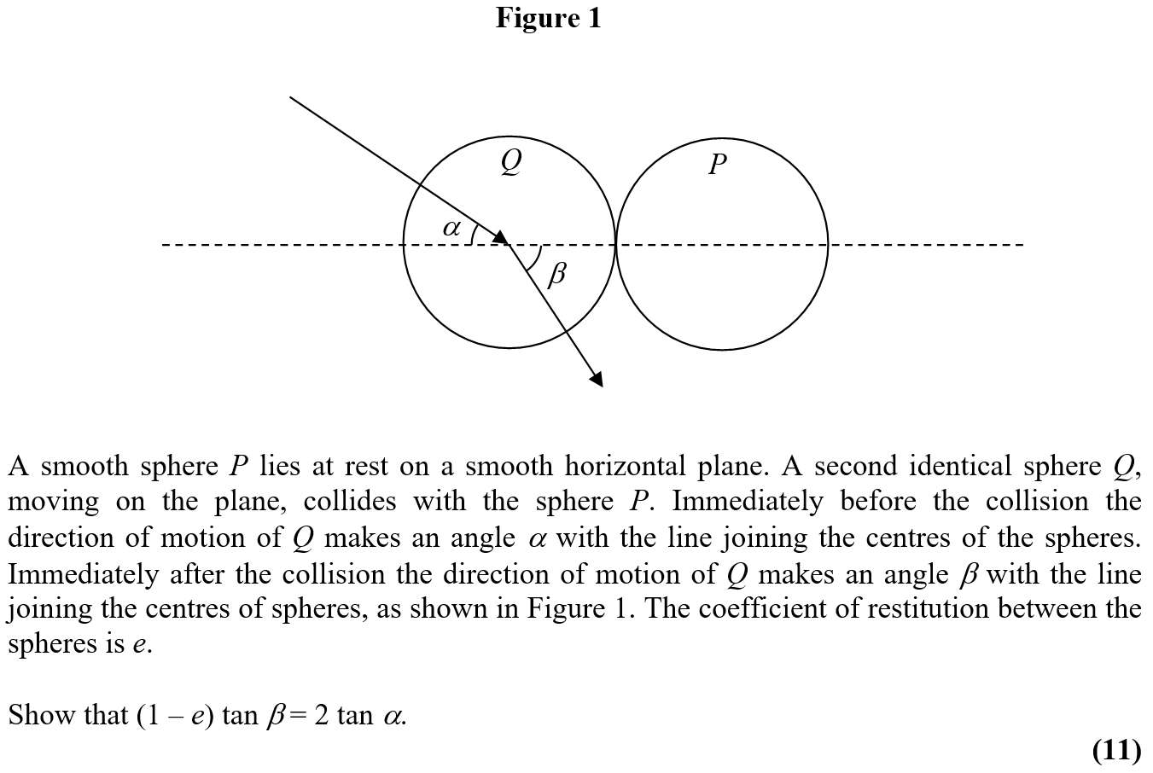
June 2005

Slide 31
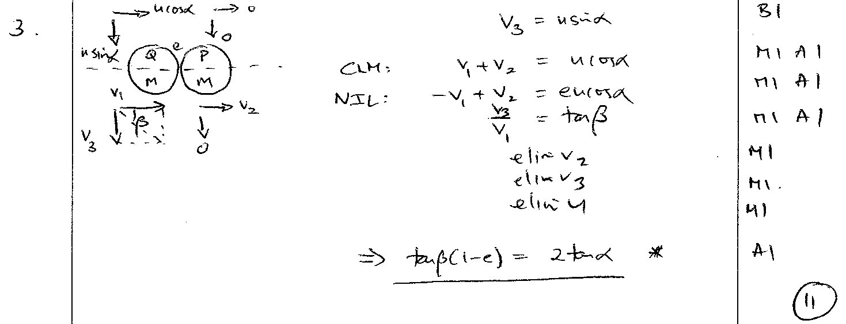
June 2005
A

Slide 32
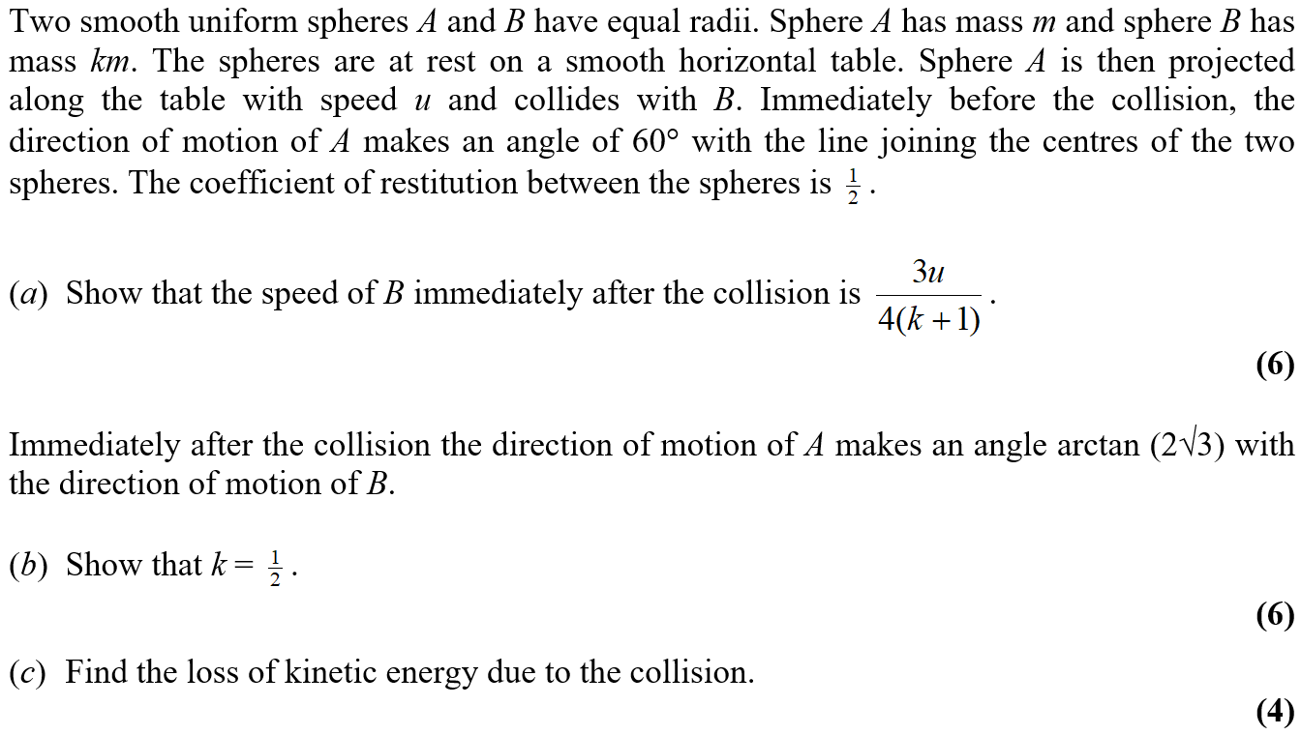
Jan 2006

Slide 33
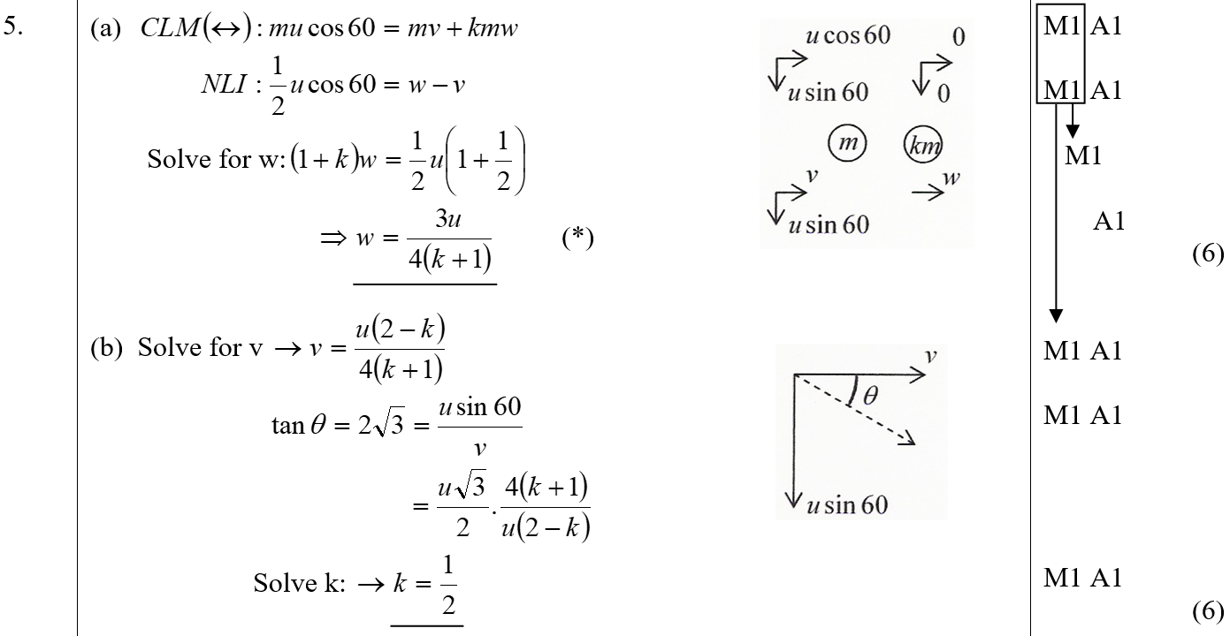
Jan 2006
A
B

Slide 34
Jan 2006
C

Slide 35
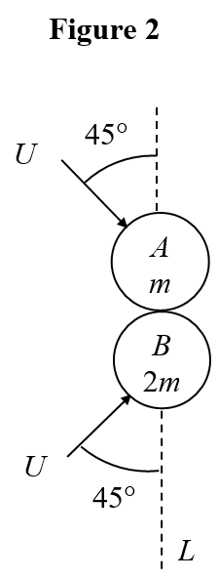
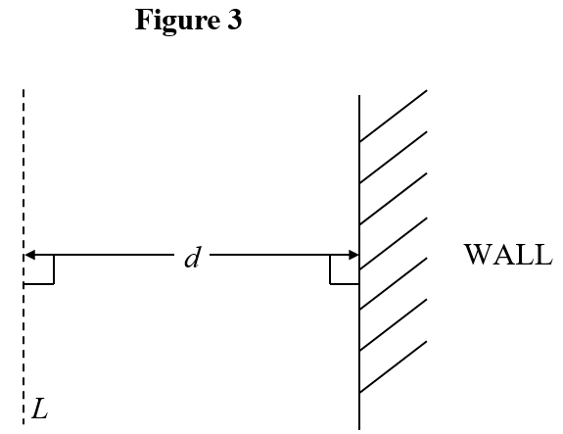
June 2006

Slide 36
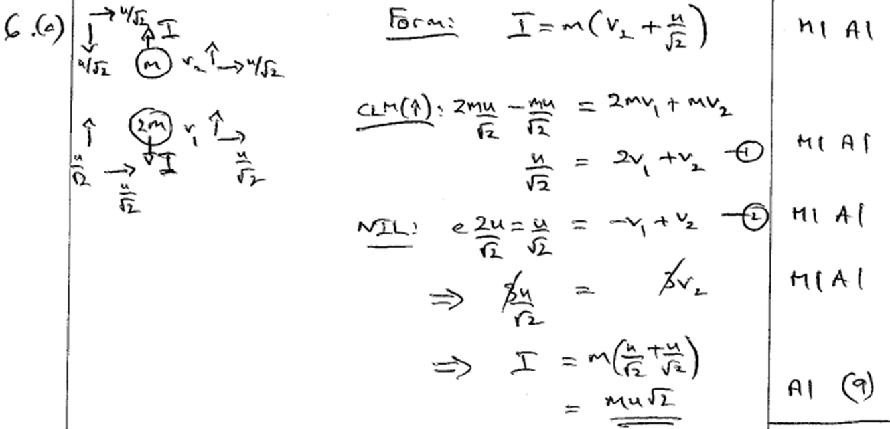
June 2006
A

Slide 37
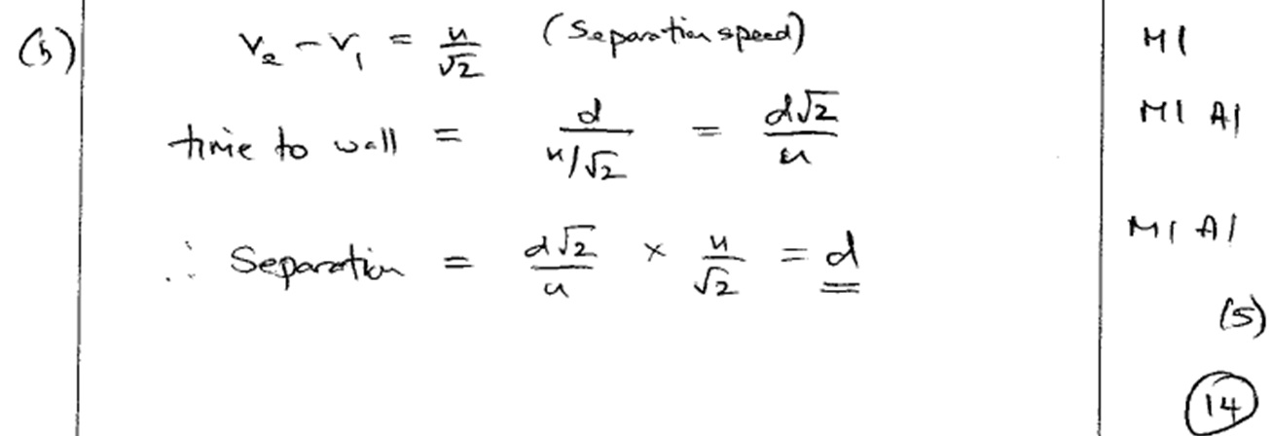
June 2006
B

Slide 38
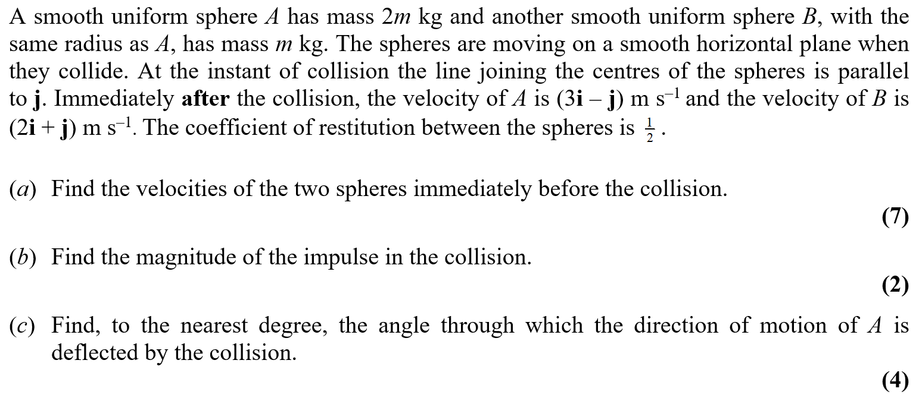
June 2007

Slide 39
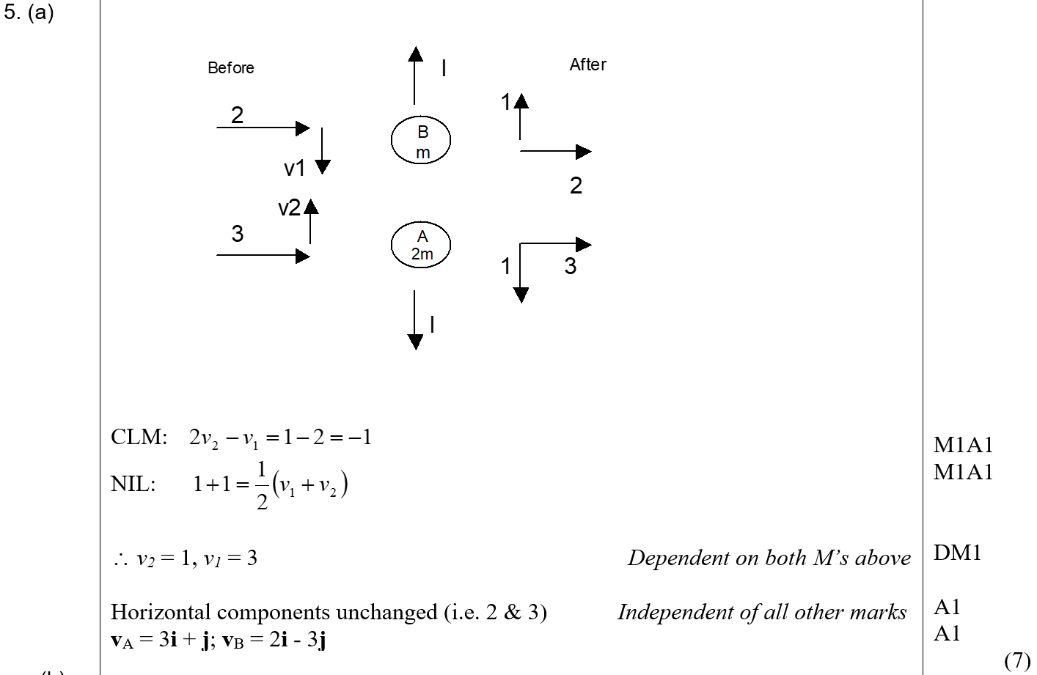
June 2007
A

Slide 40
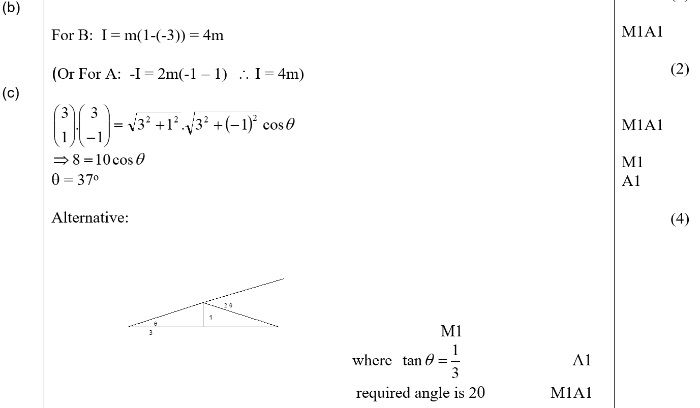
June 2007
B
C

Slide 41
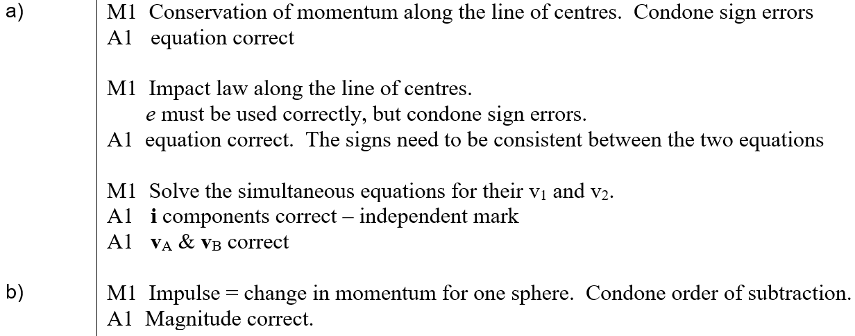
June 2007
A notes
B notes

Slide 42
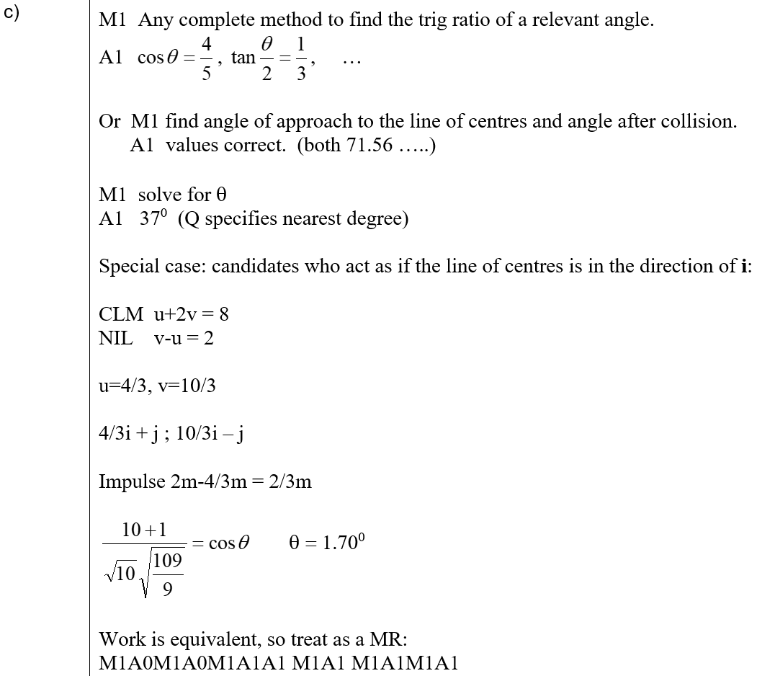
June 2007
C notes

Slide 43
June 2008

Slide 44
June 2008
A

Slide 45
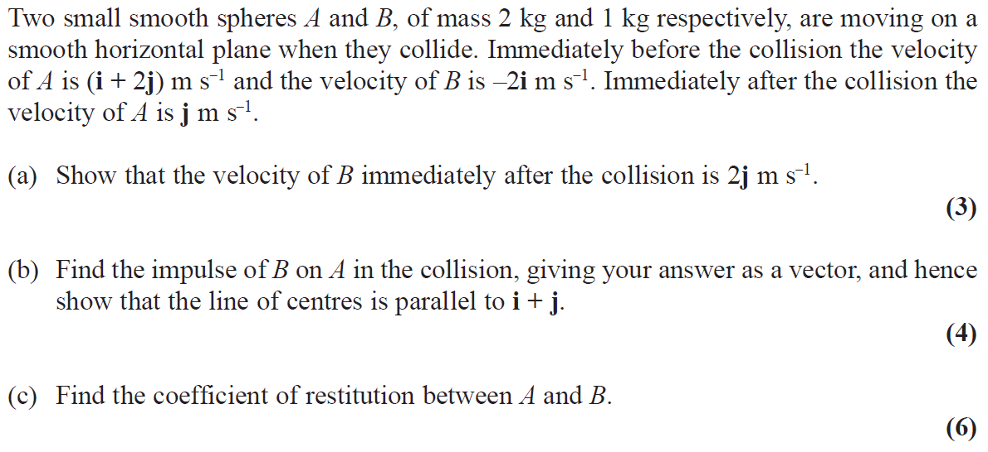
June 2009

Slide 46
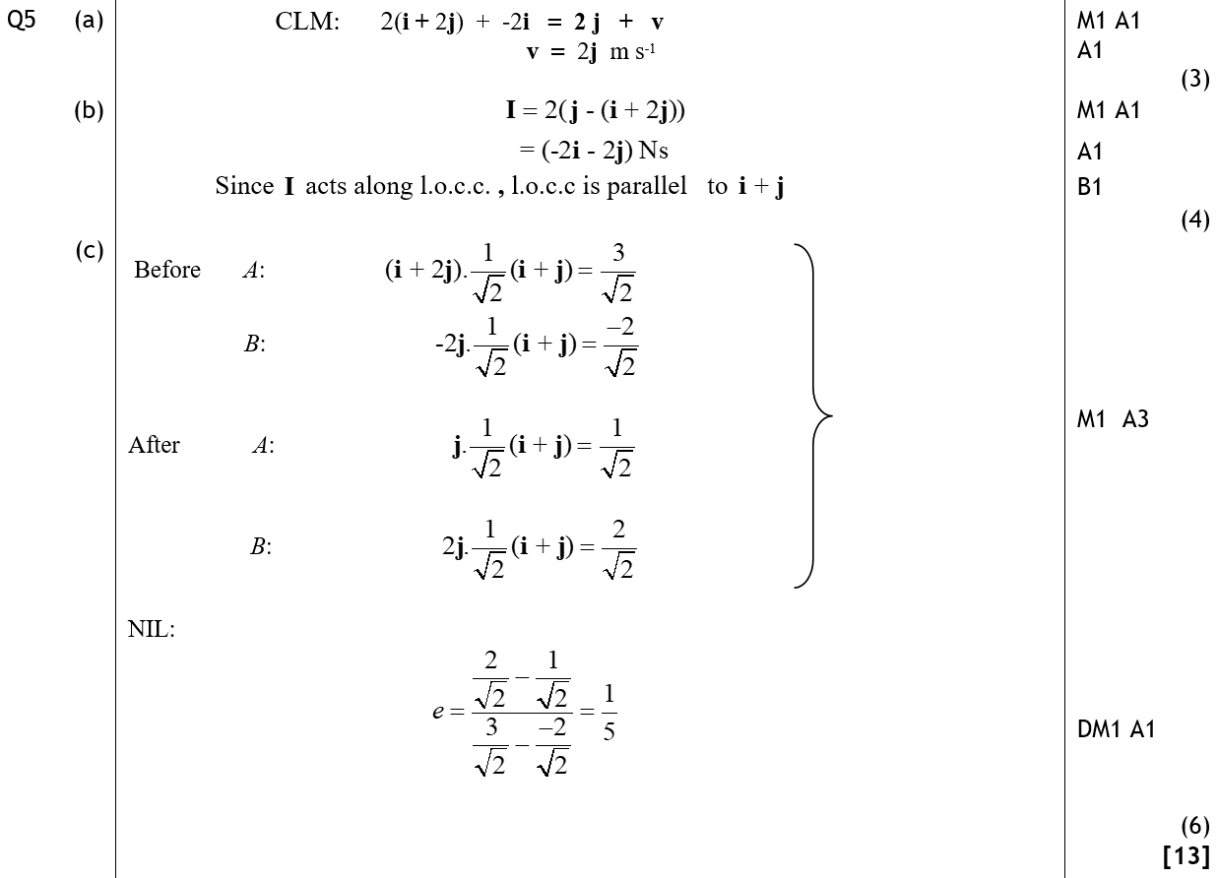
June 2009
A
B
C

Slide 47
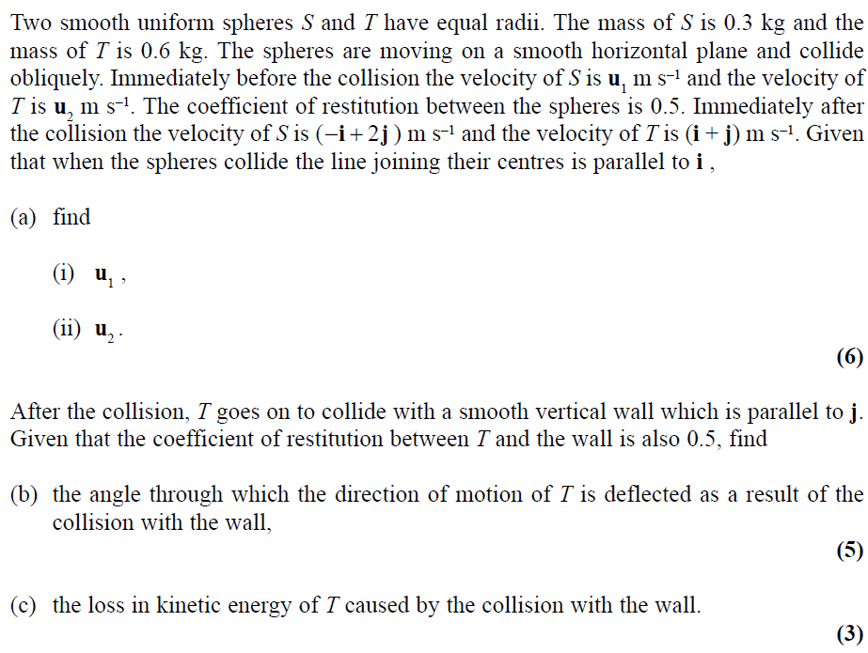
June 2010

Slide 48
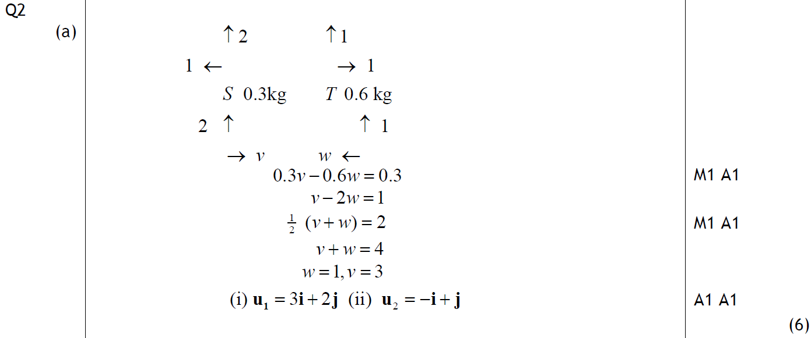
June 2010
A

Slide 49
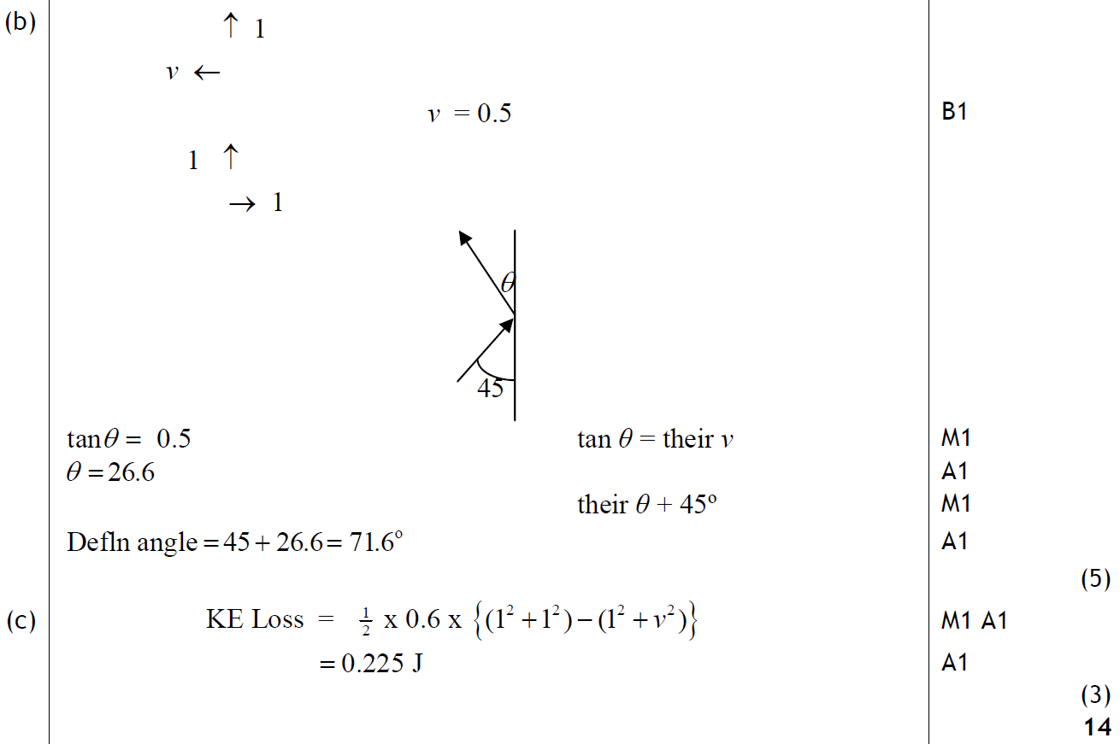
June 2010
B
C

Slide 50
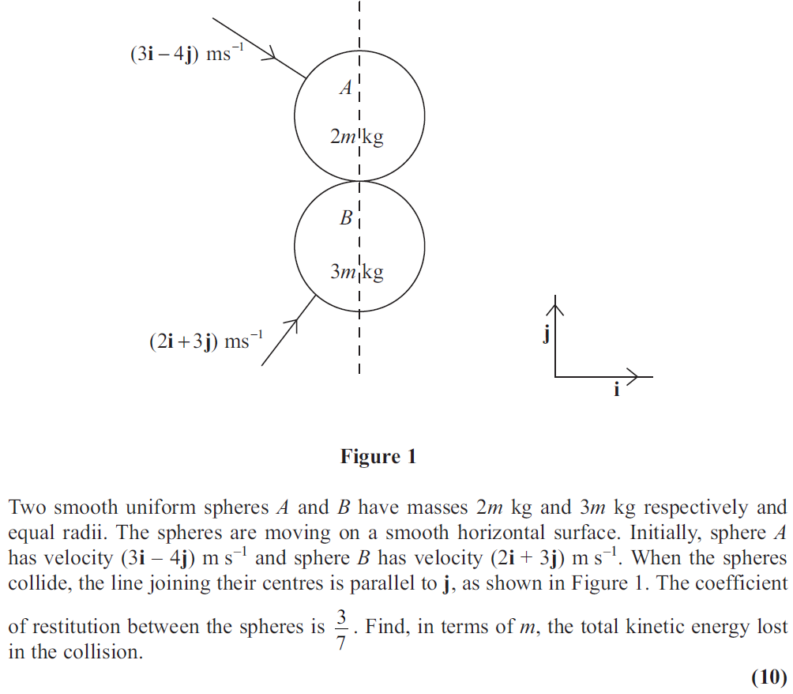
June 2011

Slide 51
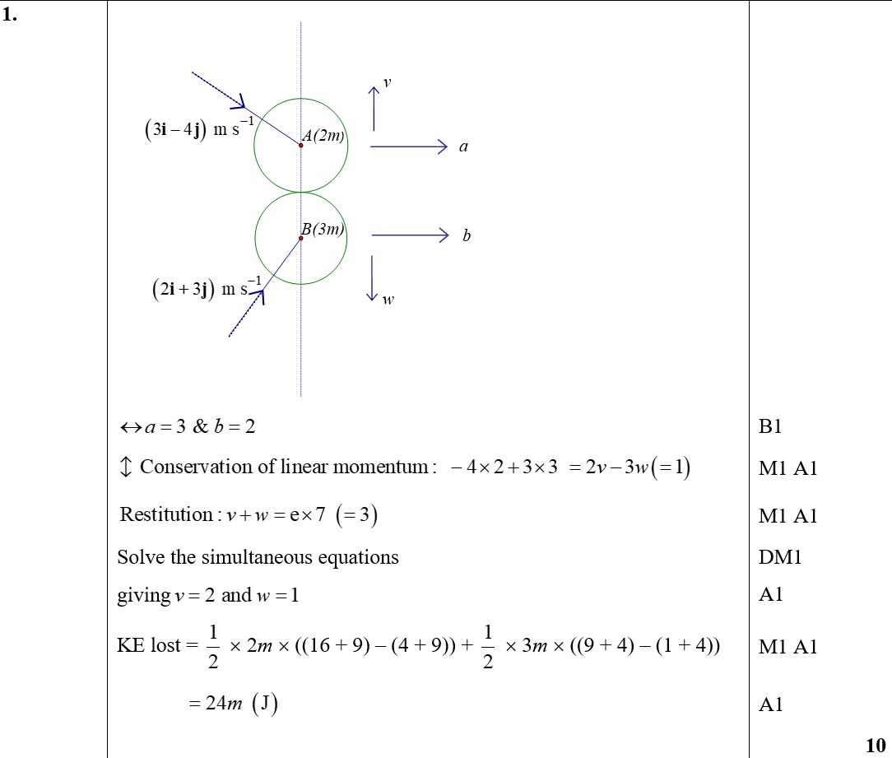
June 2011
A

Slide 52
June 2012

Slide 53
June 2012
A

Slide 54
June 2012
B

Slide 55
June 2013

Slide 56
June 2013
A

Slide 57
June 2013 (R)

Slide 58
June 2013 (R)
A
B

Slide 59
June 2014

Slide 60
June 2014
A

Slide 61
June 2014
B

Slide 62
June 2014 (R)

Slide 63
June 2014 (R)
A
B

Slide 64
June 2015

Slide 65
June 2015
A

Slide 66
June 2015
A Alternative

Slide 67
June 2016

Slide 68
June 2016
A

Slide 69
June 2017

Slide 70
June 2017
A

Slide 71
June 2017
B

Slide 72
June 2018

Slide 73
June 2018
A
B

Slide 74
June 2018
C

Slide 75
June 2018
C Alternative

Slide 76
June 2019

Slide 77
June 2019
A

Slide 78
June 2019
B
C

