Slide 1
Collisions:
Two Spheres Direct Impact
Old Spec Q’s
SAM*
SAM
2018*
2019
2019 (i)
2019 (ii)
includes kinetic energy
*also includes one sphere direct impact

Slide 2
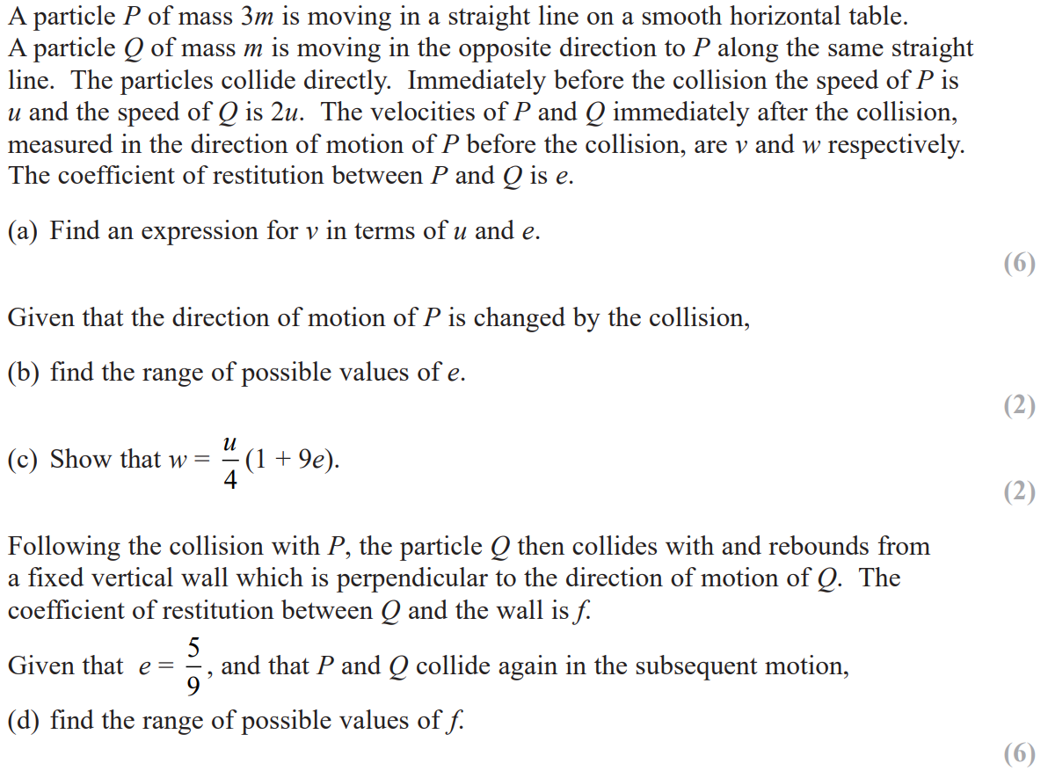
SAM

Slide 3
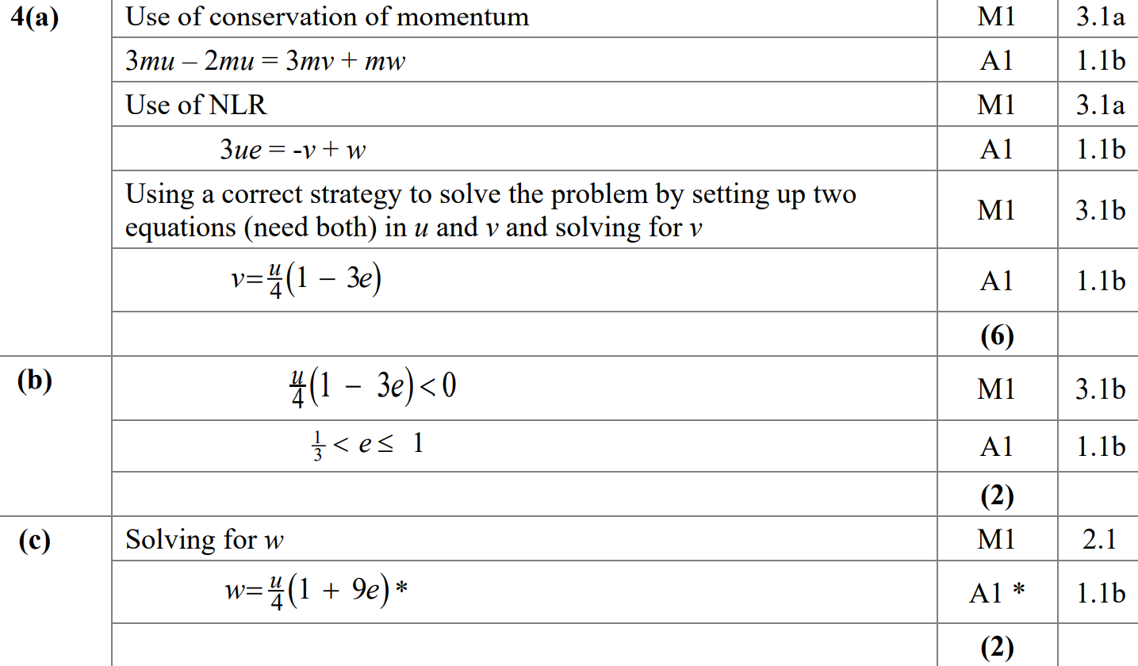
SAM
A
B
C

Slide 4
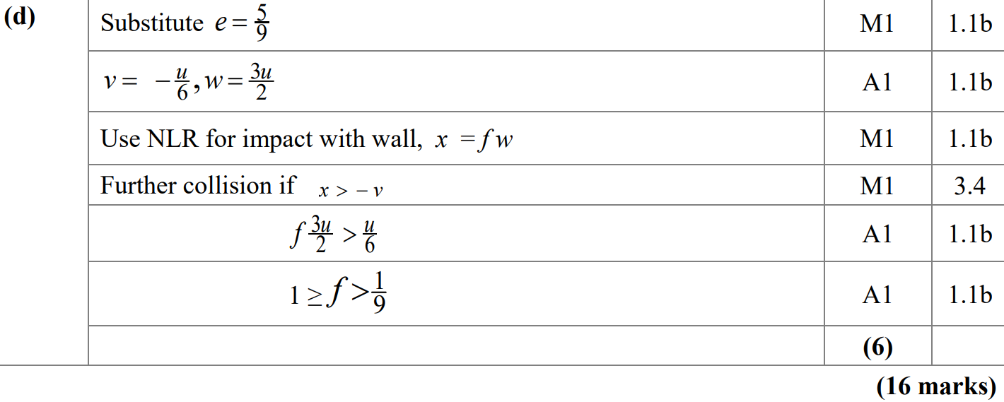
SAM
D

Slide 5
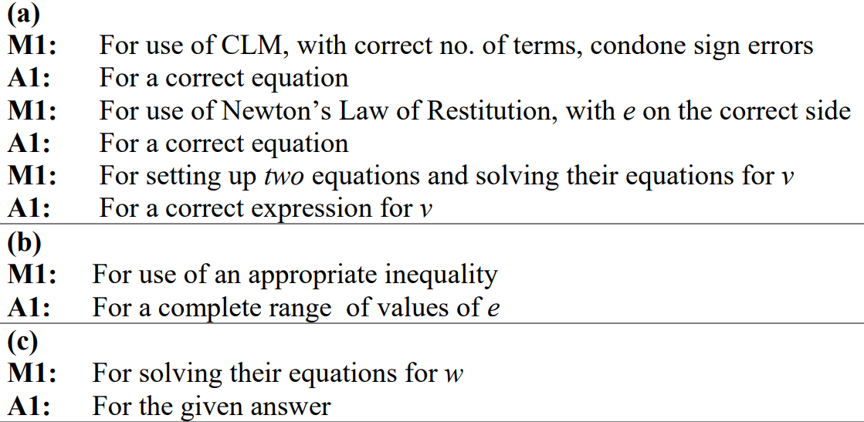
SAM
A notes
B notes
C notes
D notes

Slide 6
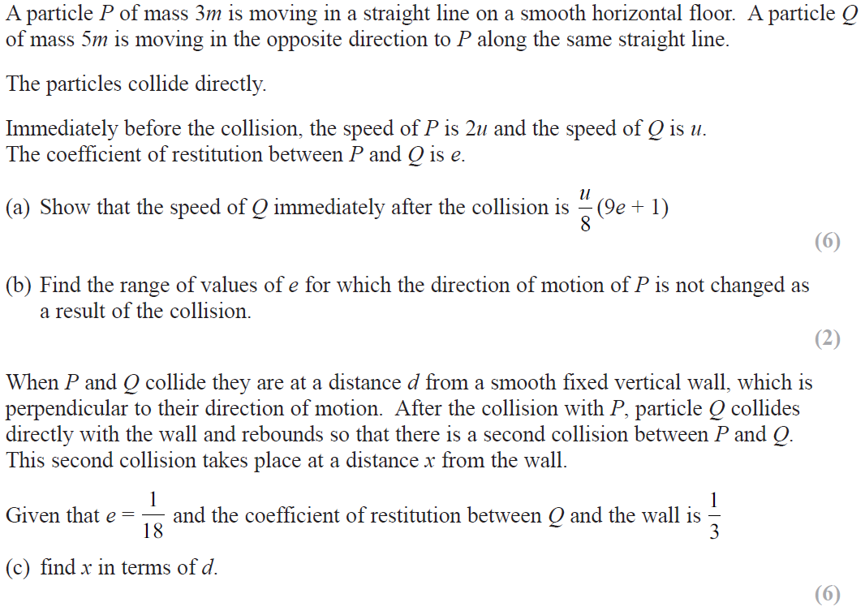
2018

Slide 7
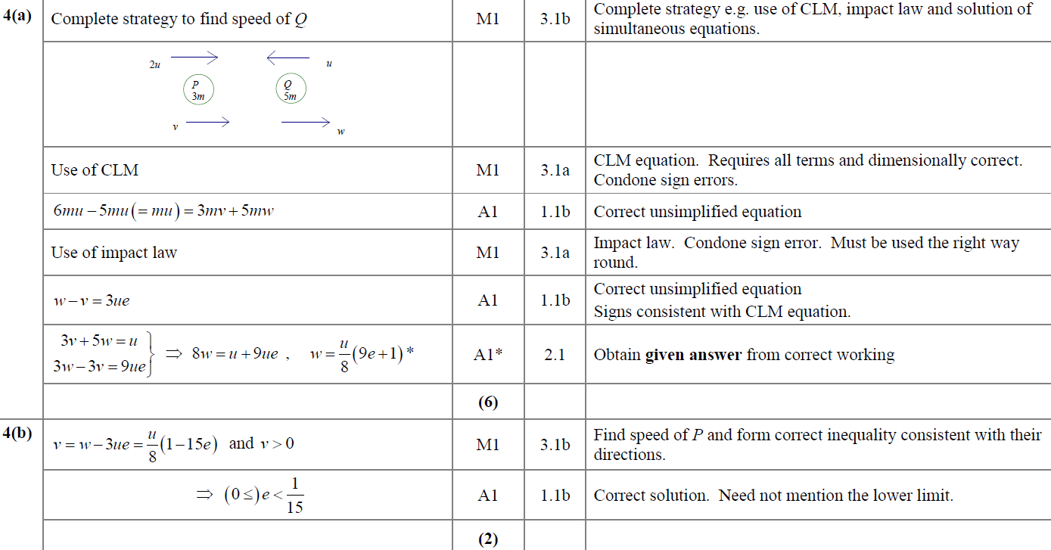
2018
A
B

Slide 8
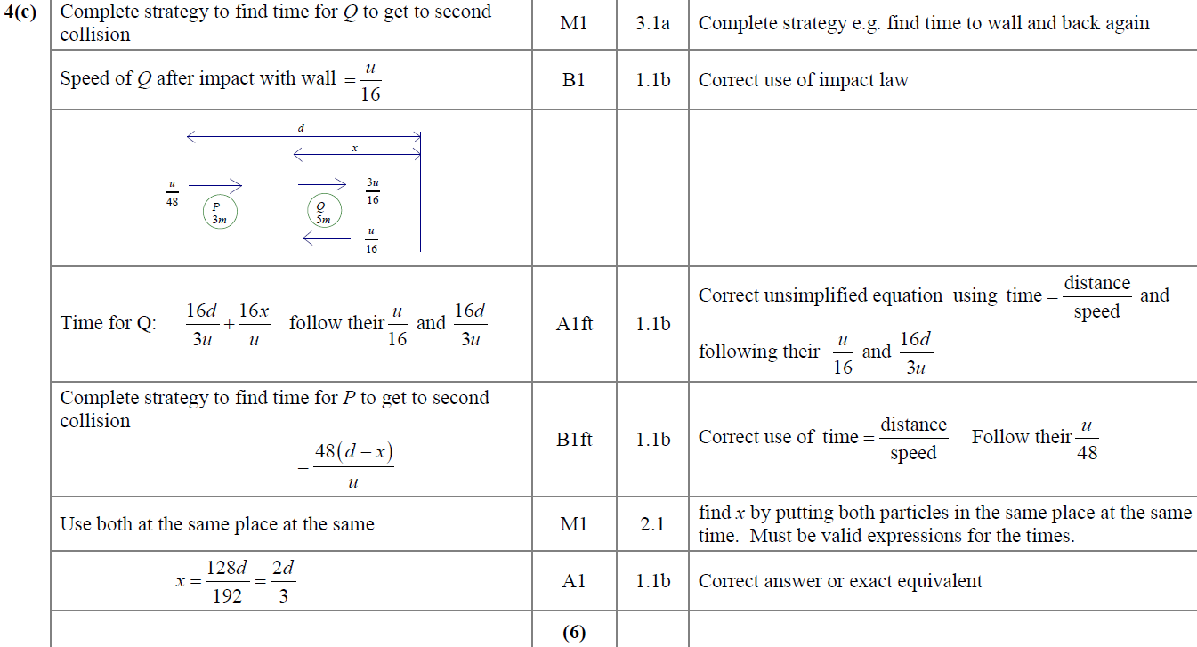
2018
C

Slide 9
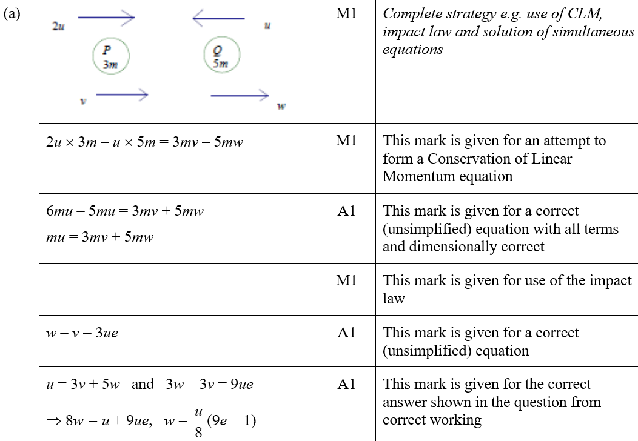
2018
A (SF)

Slide 10
2018
B (SF)

Slide 11
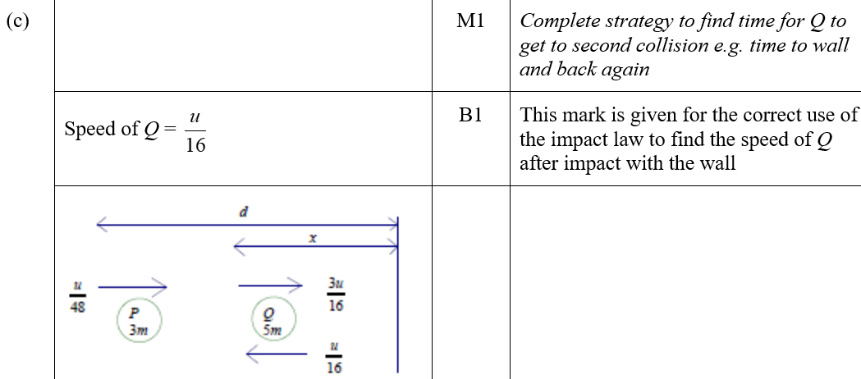
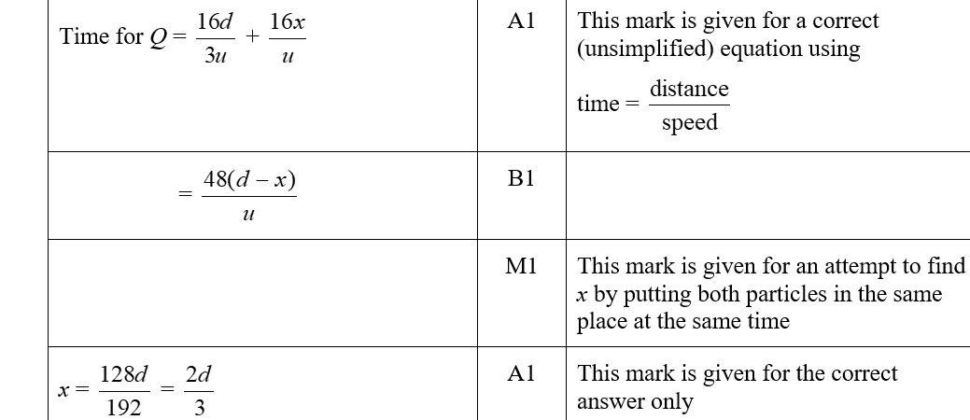
2018
C (SF)

Slide 12
2019

Slide 13
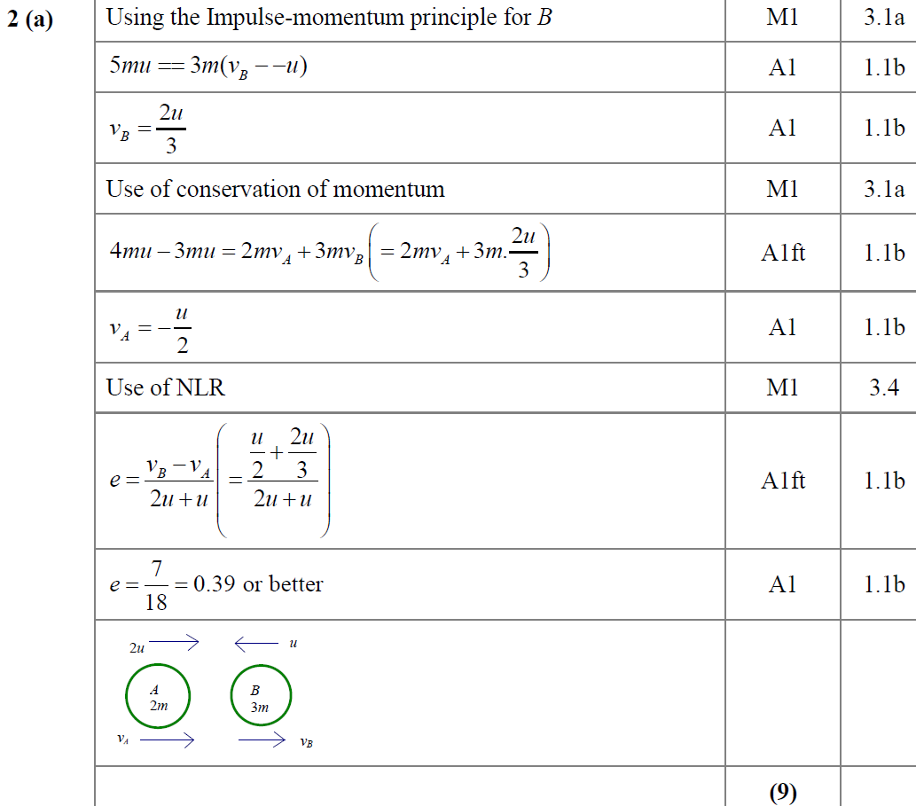
2019
A

Slide 14
2019
B
B notes

Slide 15
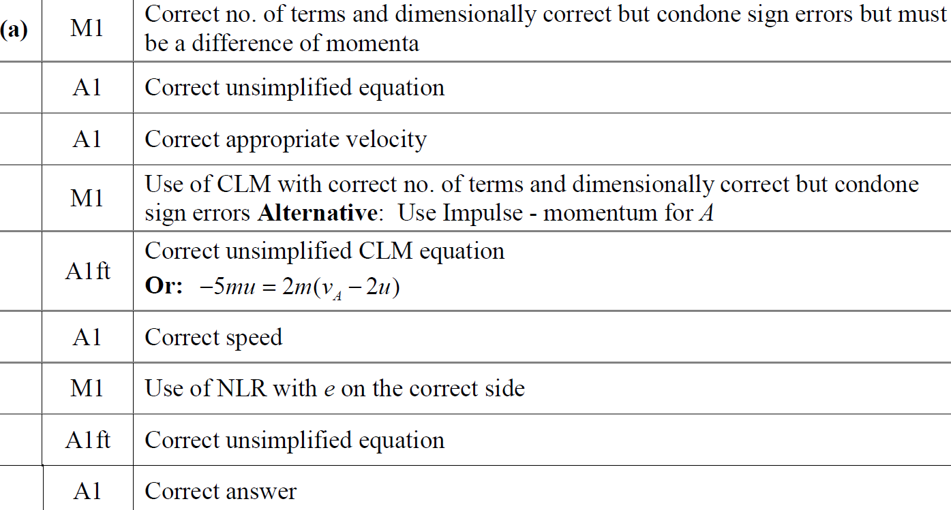
2019
A notes

Slide 16
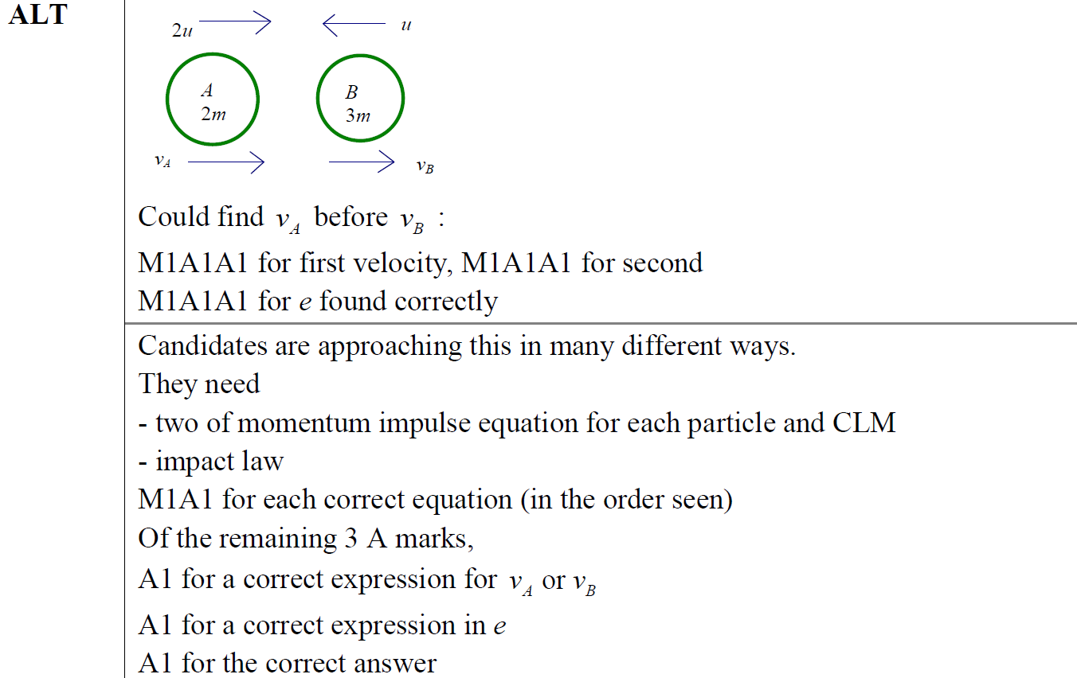
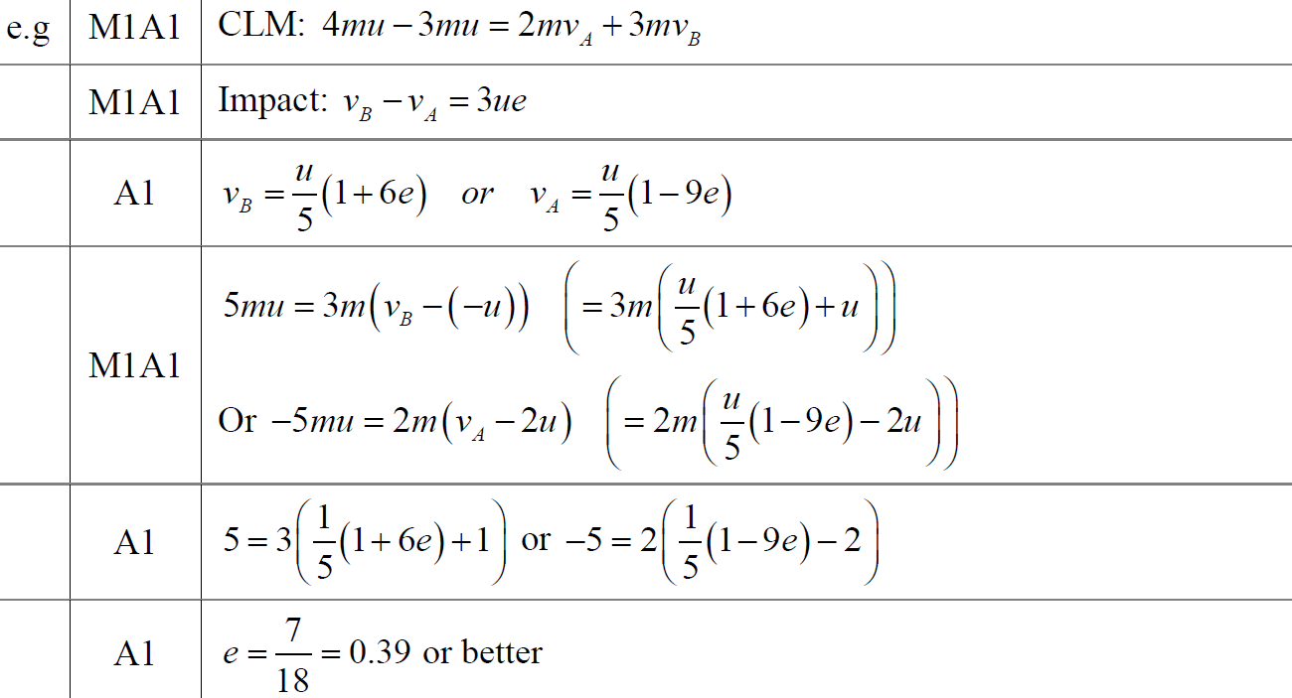
2019
A Alternative

Slide 17
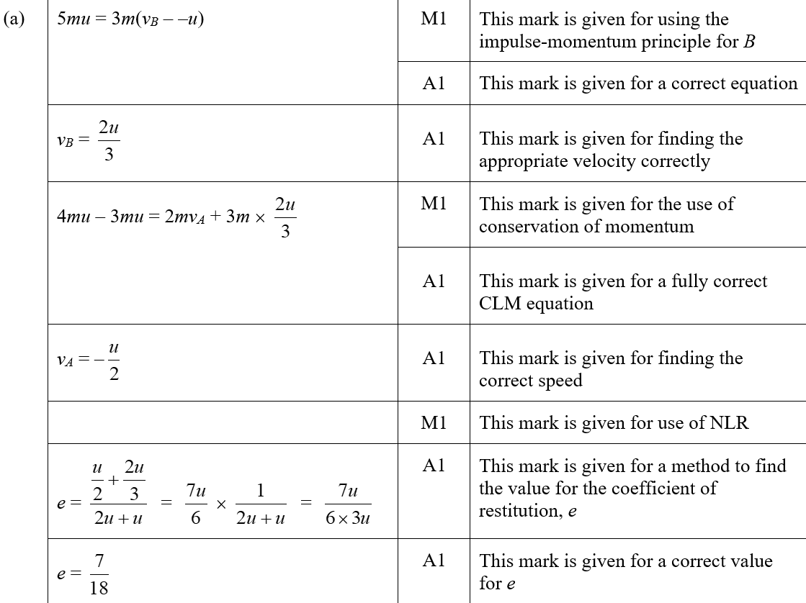
2019
A (SF)

Slide 18
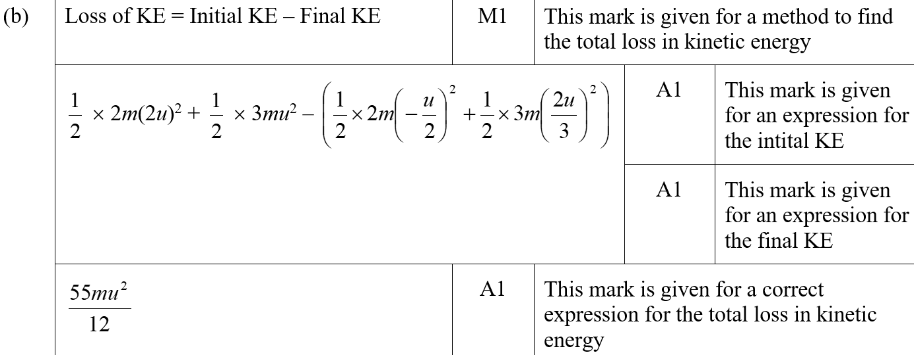
2019
B (SF)

Slide 19
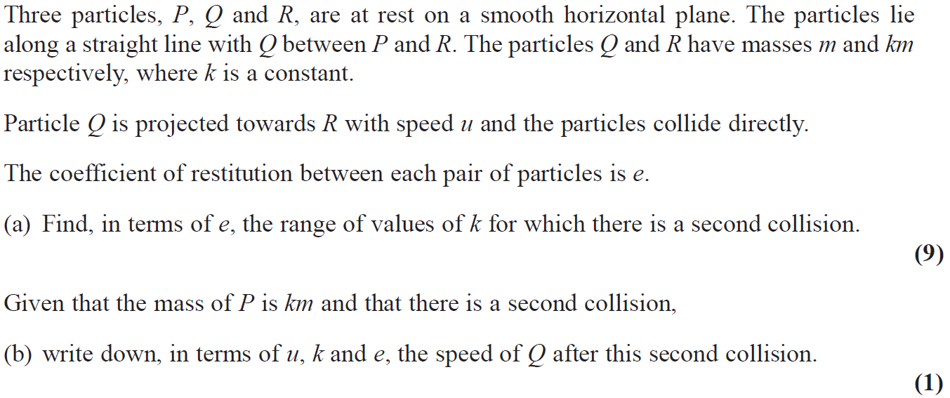
2019

Slide 20
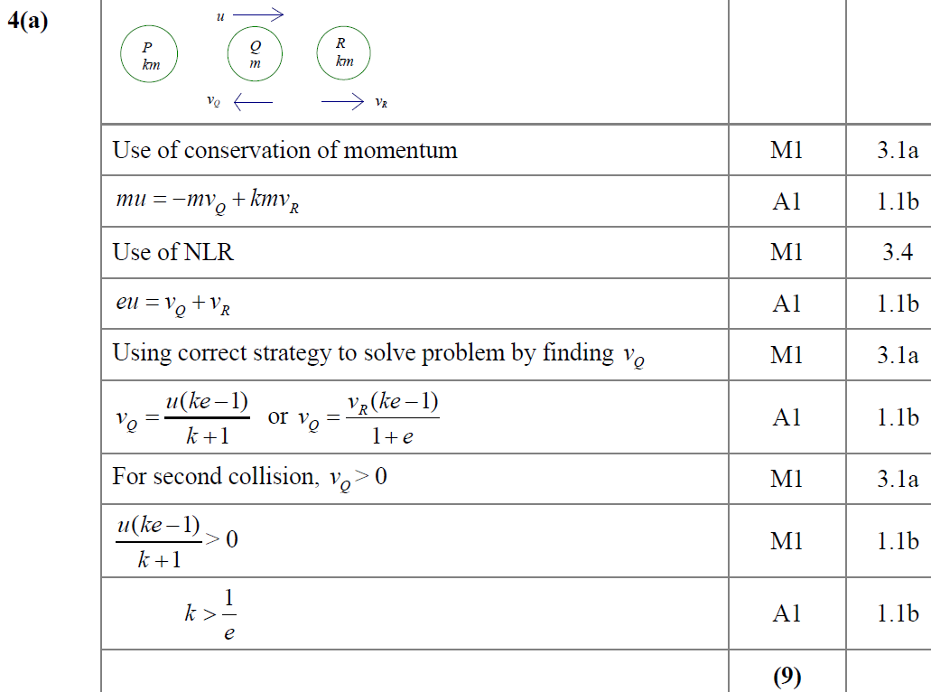
2019
A

Slide 21
2019
B
B notes

Slide 22
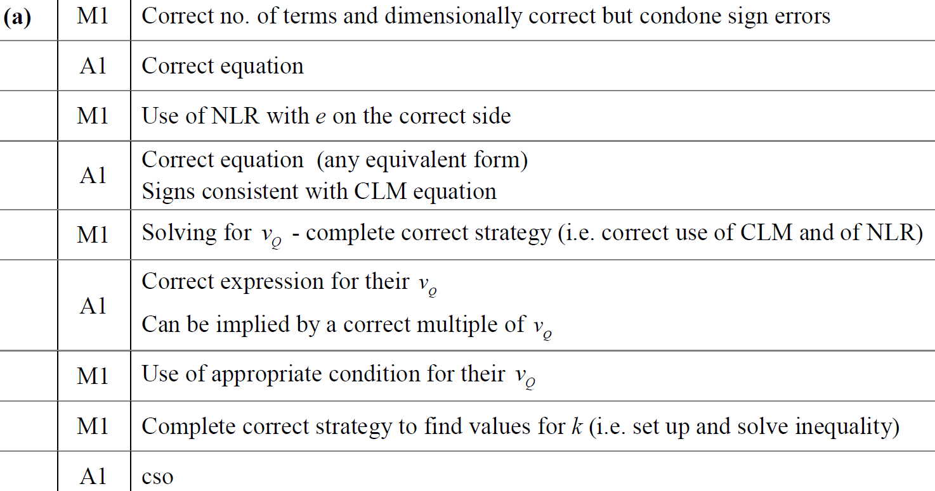
2019
A notes

Slide 23
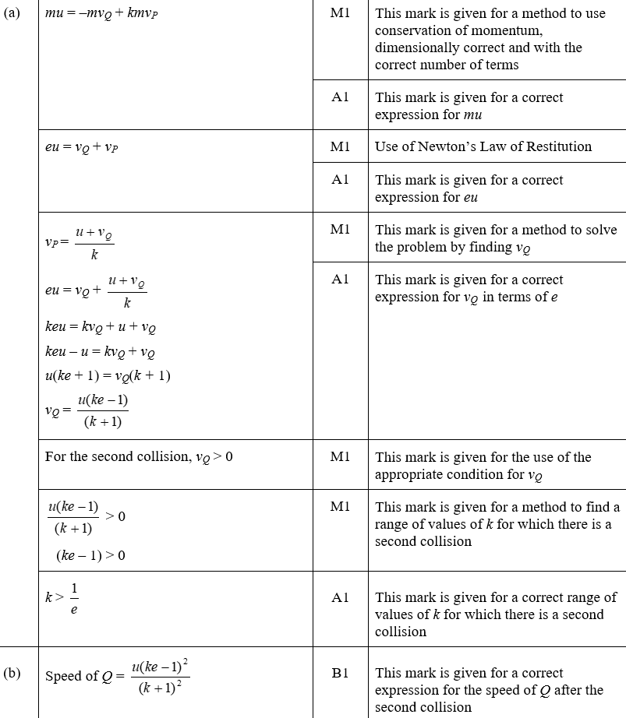
2019
A (SF)
B (SF)

Slide 24
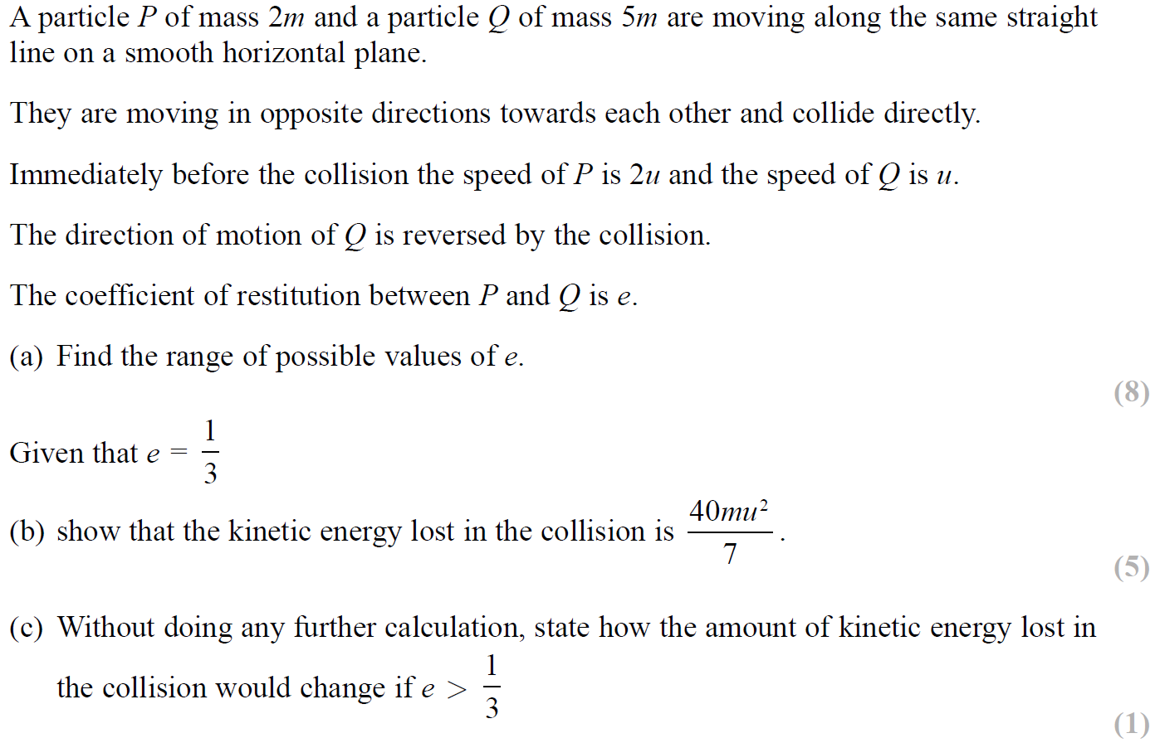
SAM

Slide 25
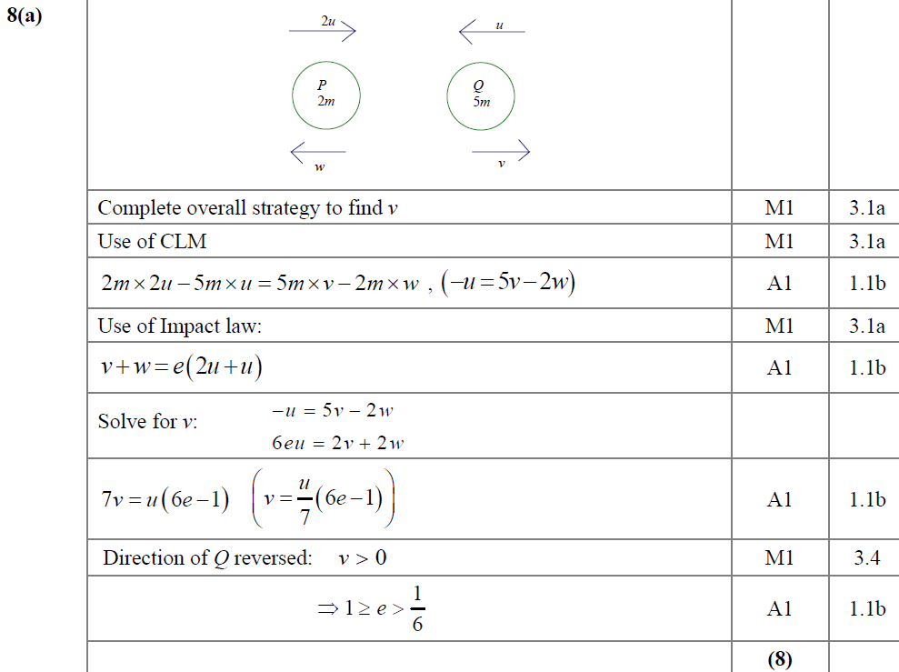
SAM
A

Slide 26
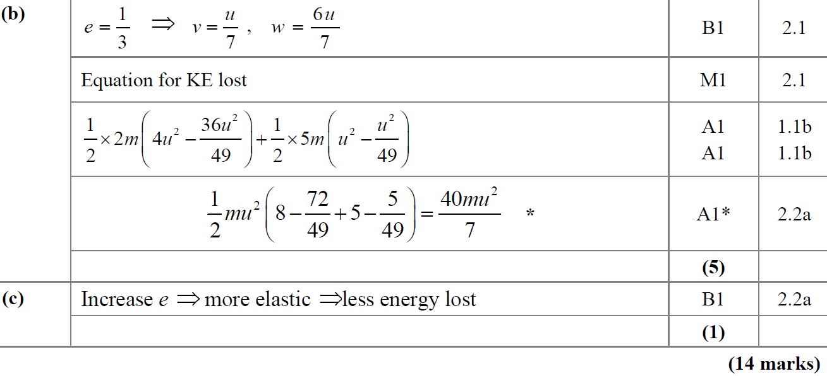
SAM
B
C

Slide 27
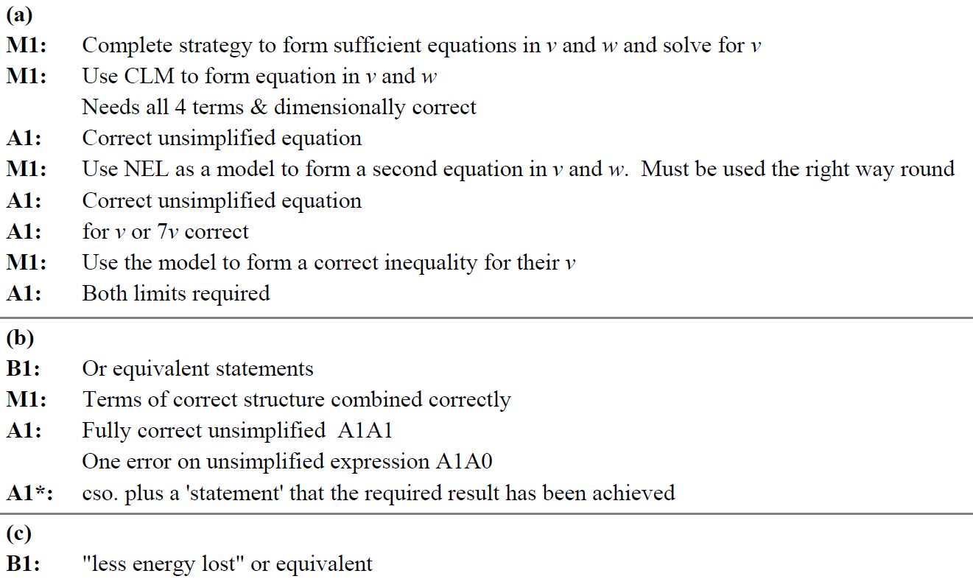
SAM
A notes
B notes
C notes

Slide 28
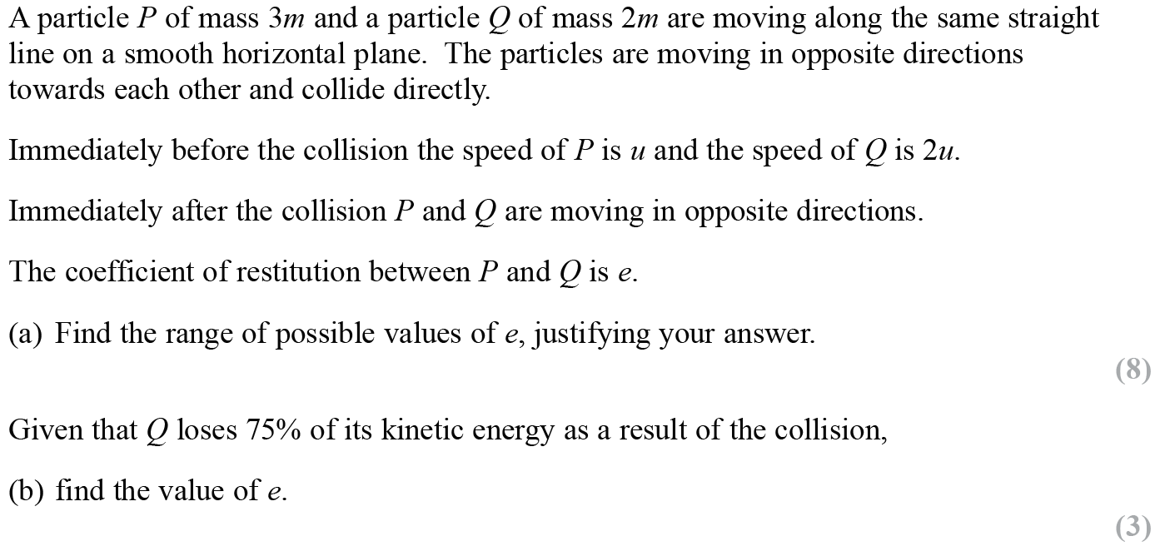
2019

Slide 29
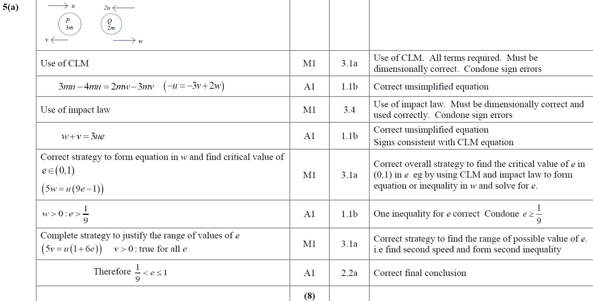
2019
A

Slide 30
2019
B

Slide 31
Old Spec Collisions:
Two Spheres Direct Impact
New Spec Q’s
M1 Q’s (no e)
M2 Q’s
Jan 2006
Jan 2011
June 2001
Jan 2007
May 2012
June 2006
May 2011
Jan 2002
June 2007
Jan 2013
June 2002*
Jan 2008
June 2013
Jan 2007
Jan 2012
Jan 2003*
May 2008
June 2013 (R)
June 2007
May 2012
June 2003
Jan 2009*
June 2014 (R)
Jan 2008
Jan 2013
Jan 2004
May 2009
June 2015
May 2008
May 2013
June 2004*
Jan 2010
June 2016*
Jan 2009
June 2015
Jan 2005 (with impulse)
June 2010
June 2017*
May 2009
June 2017
June 2005
Jan 2011
June 2018
Jan 2006*
June 2011
June 2019*
Jan 2010
June 2018
includes kinetic energy
June 2006*
Jan 2012
May 2010
*also includes one sphere direct impact

Slide 32
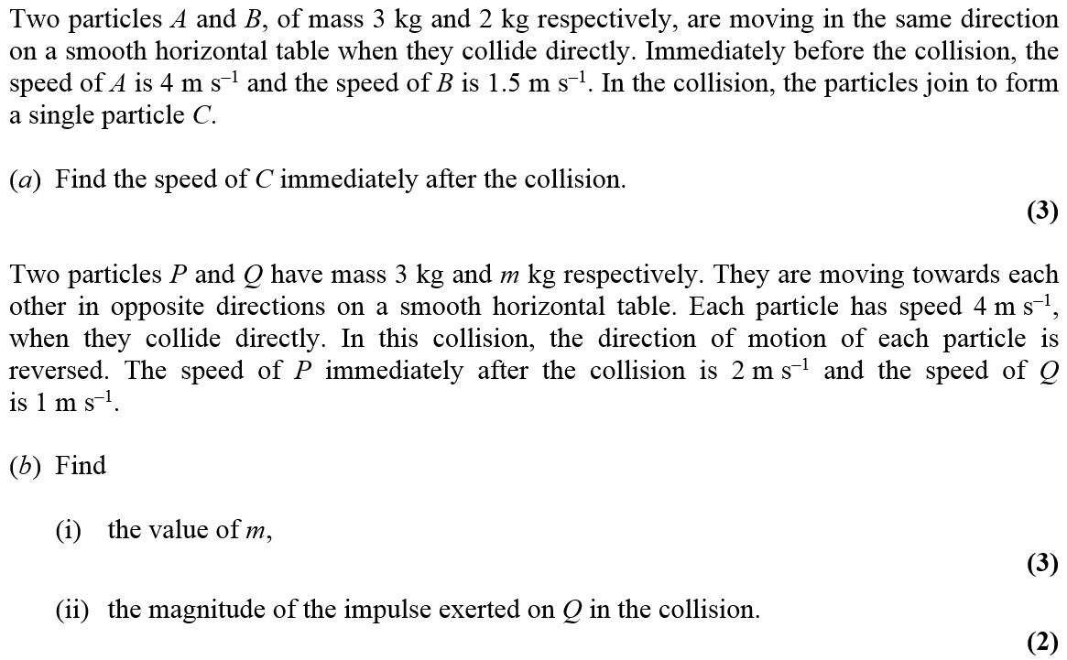
Jan 2006

Slide 33
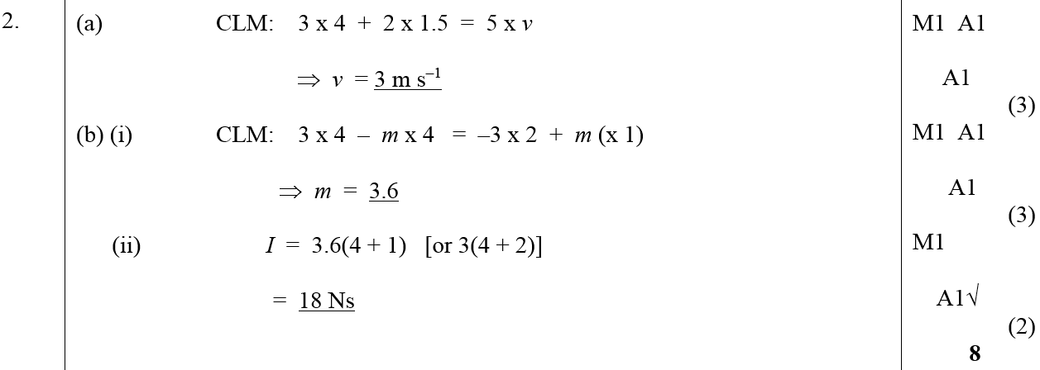
Jan 2006
A
B (i)
B (ii)

Slide 34
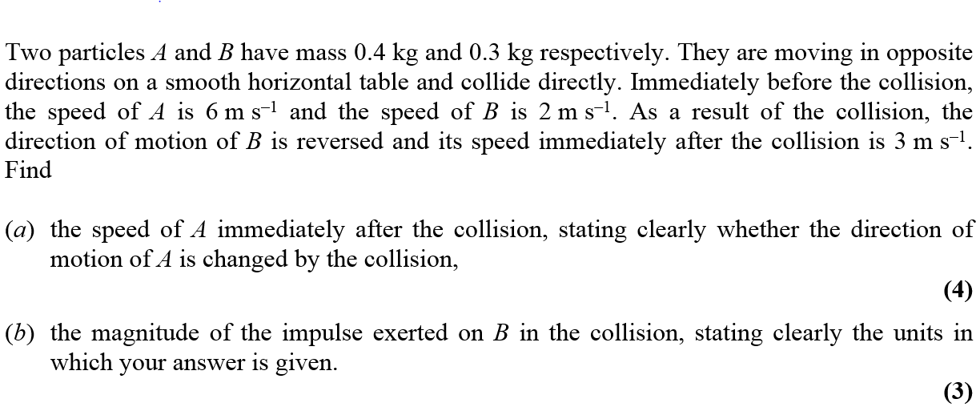
June 2006

Slide 35
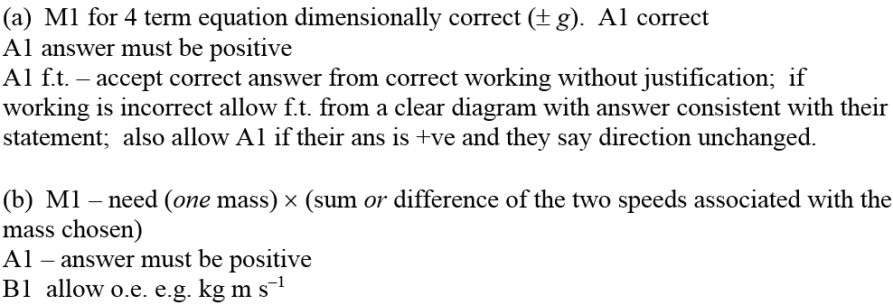
June 2006
A
B
A Notes
B Notes

Slide 36
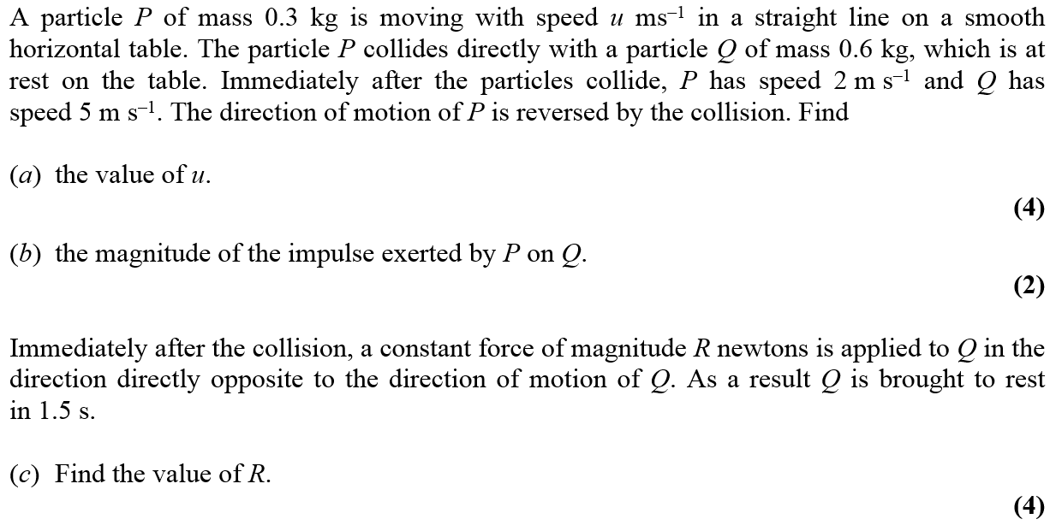
Jan 2007

Slide 37
Jan 2007
A
B
C

Slide 38
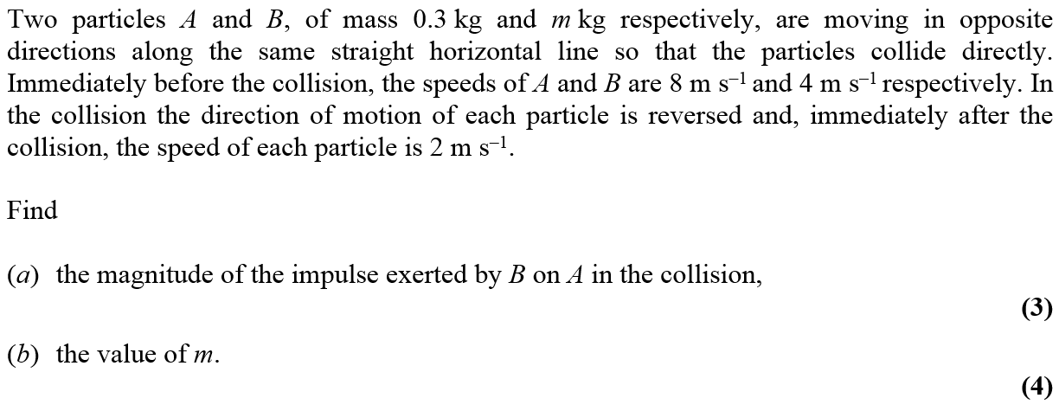
June 2007

Slide 39
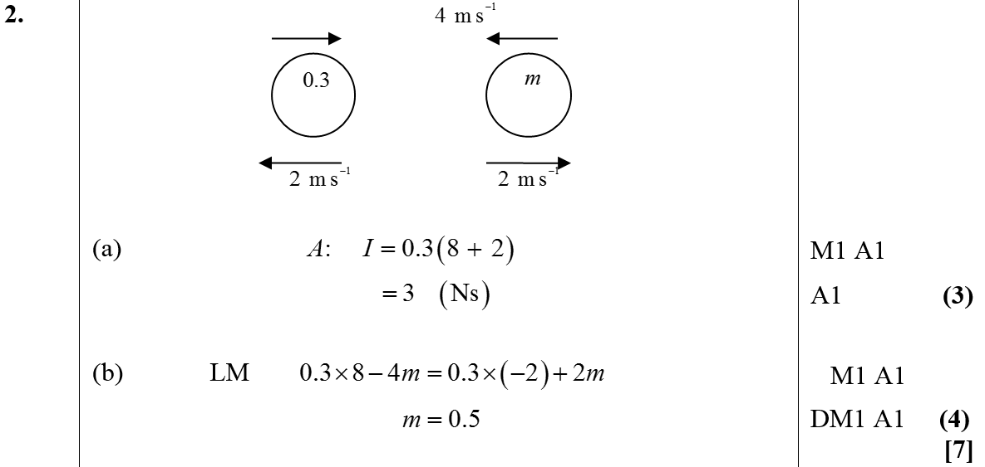
June 2007
A
B
Alternative B

Slide 40
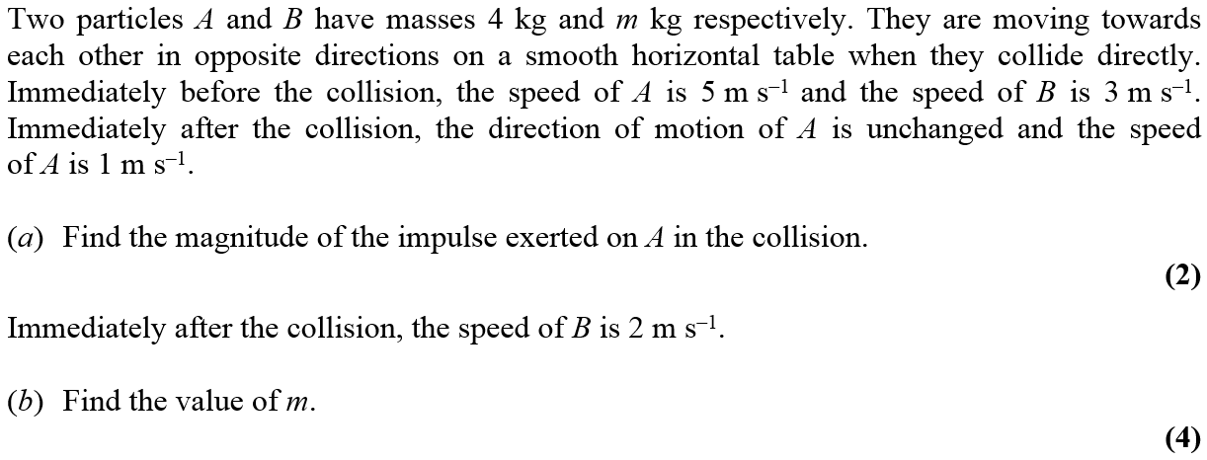
Jan 2008

Slide 41
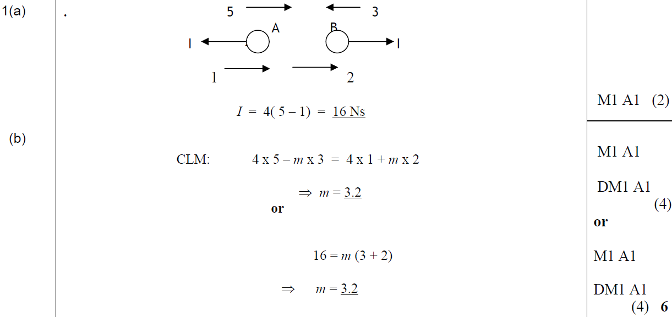
Jan 2008
A
B

Slide 42
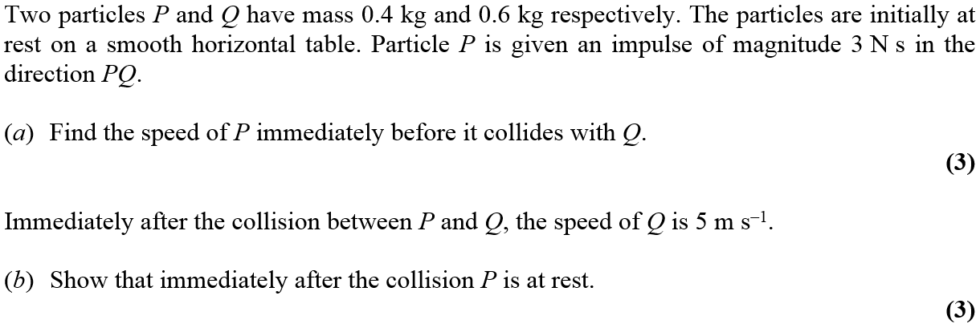
May 2008

Slide 43
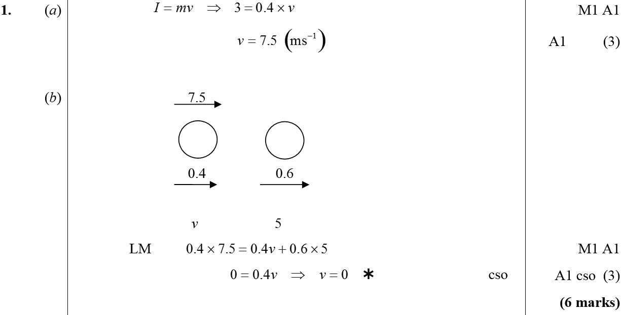
May 2008
A
B

Slide 44
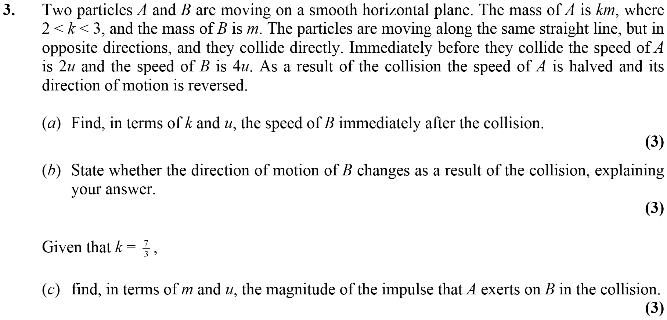
Jan 2009

Slide 45
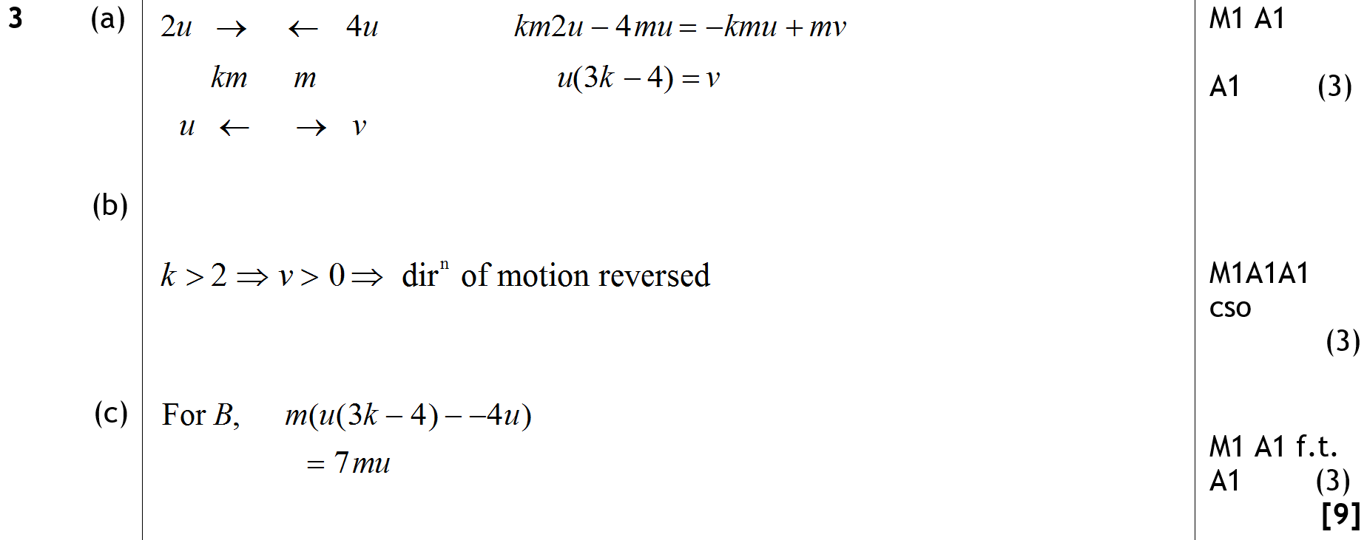
Jan 2009
A
B
C

Slide 46
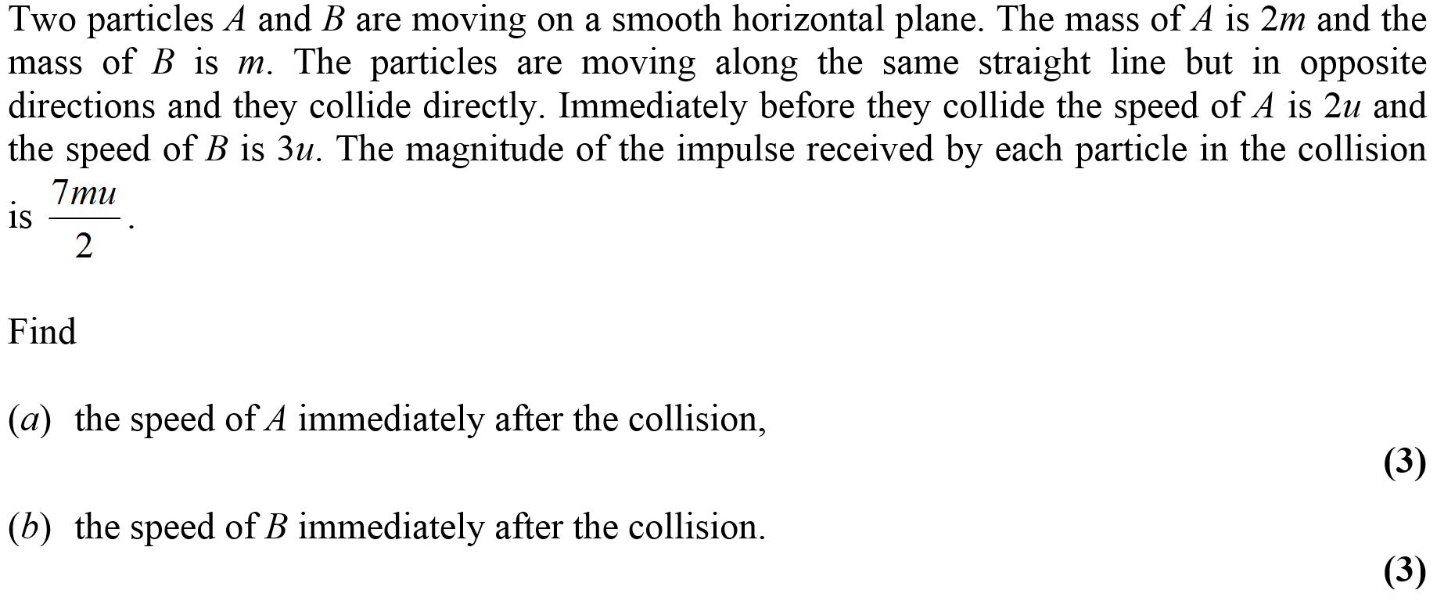
May 2009

Slide 47
May 2009
A
B

Slide 48
Jan 2010

Slide 49
Jan 2010
A
B
Alternative B

Slide 50
May 2010

Slide 51
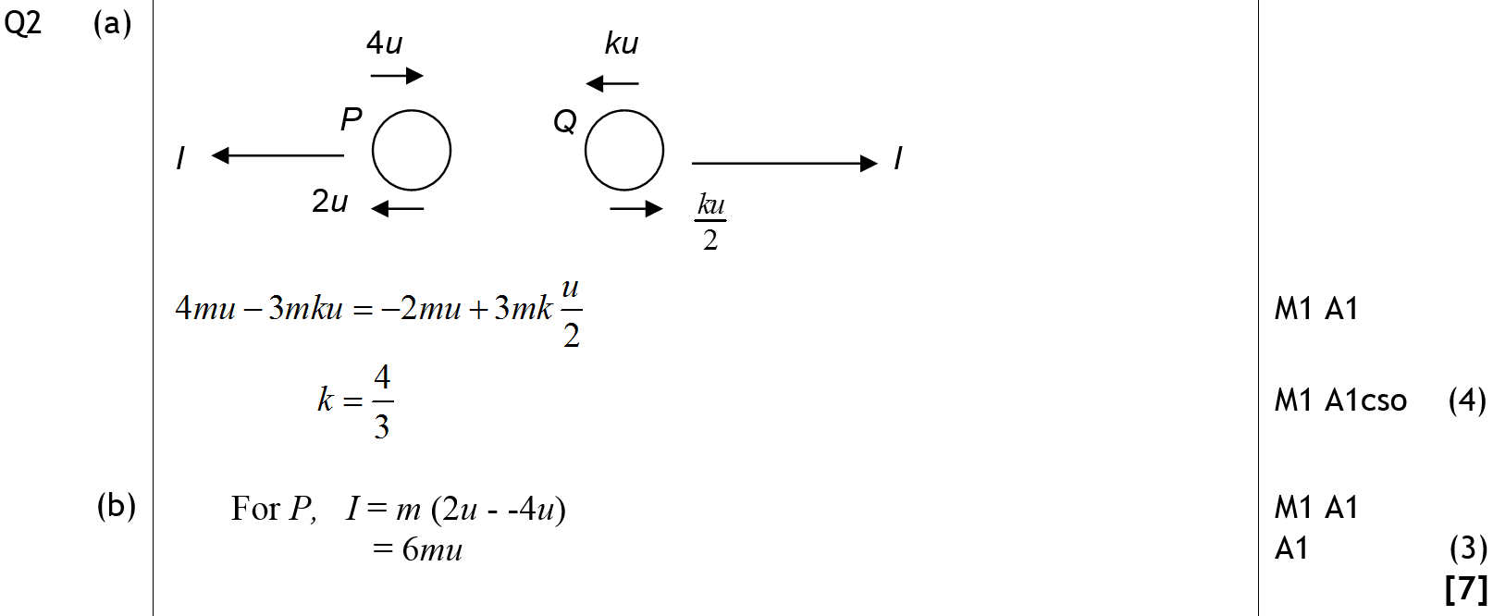
May 2010
A
B

Slide 52
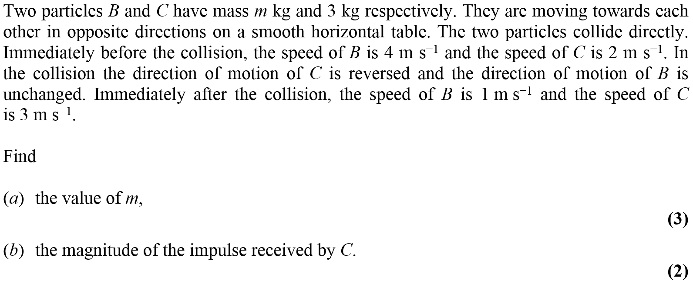
Jan 2011

Slide 53
Jan 2011
A
B

Slide 54
May 2011

Slide 55
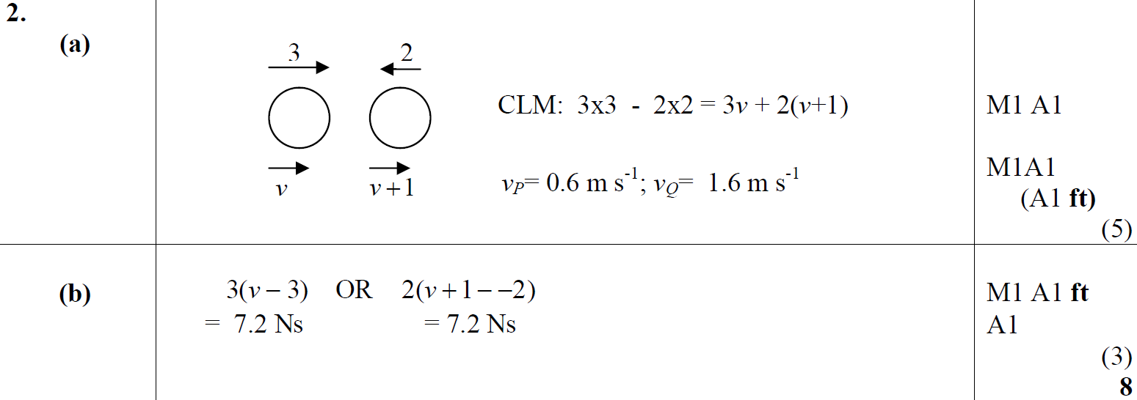
May 2011
A
B

Slide 56
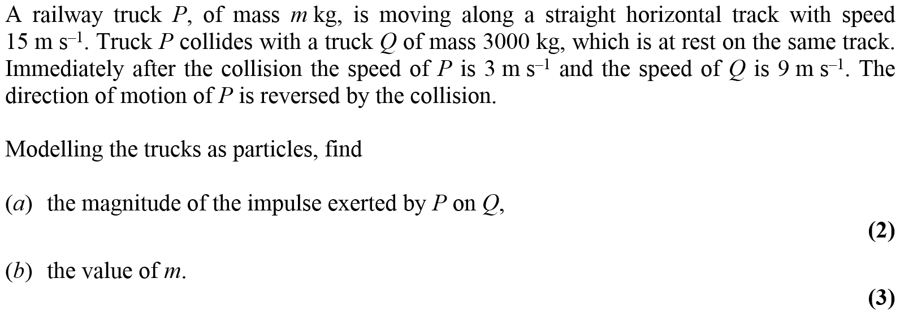
Jan 2012

Slide 57
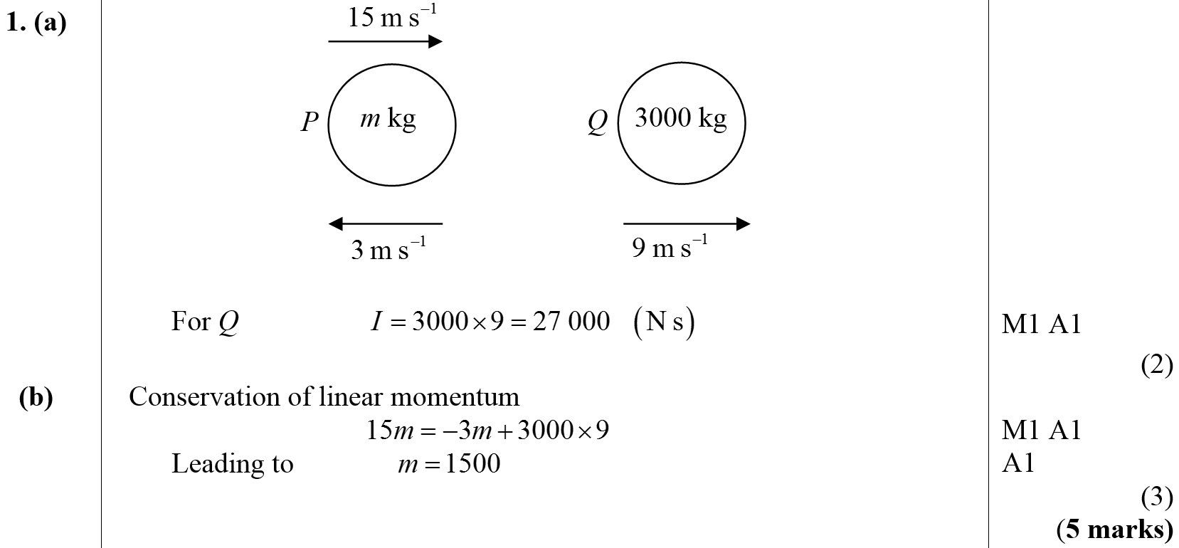
Jan 2012
A
B

Slide 58
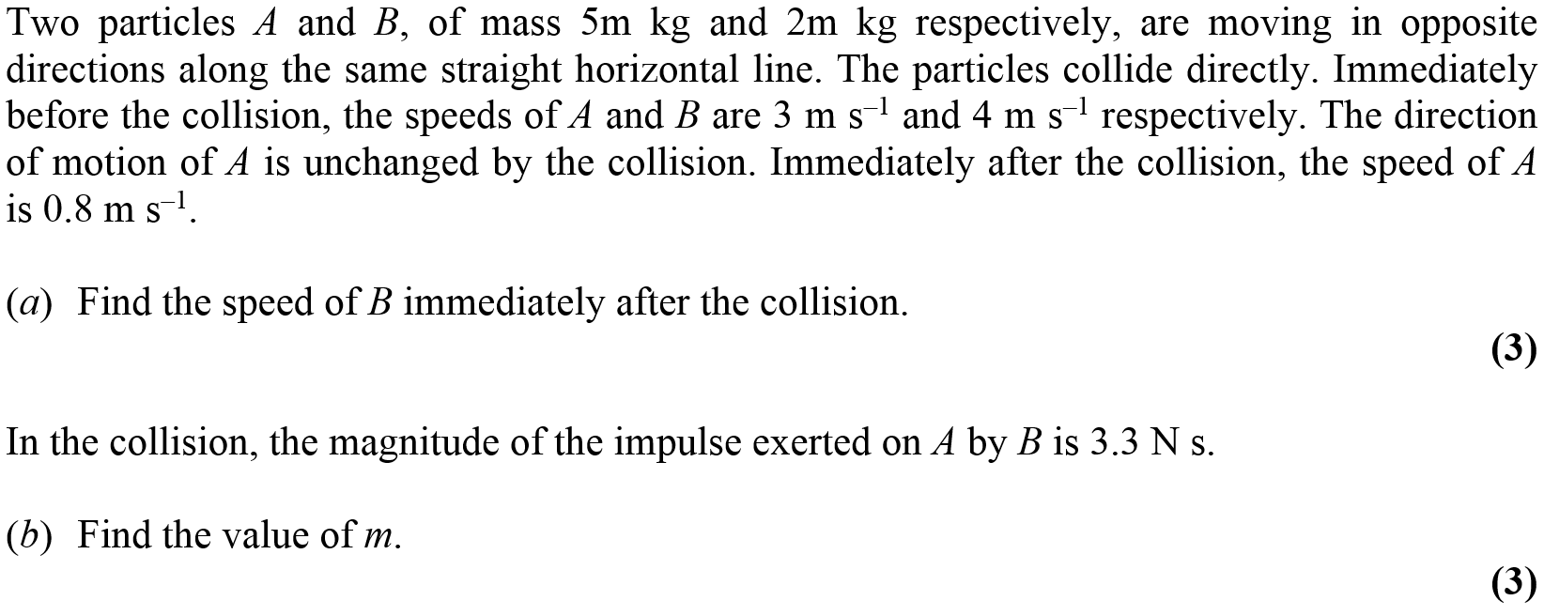
May 2012

Slide 59
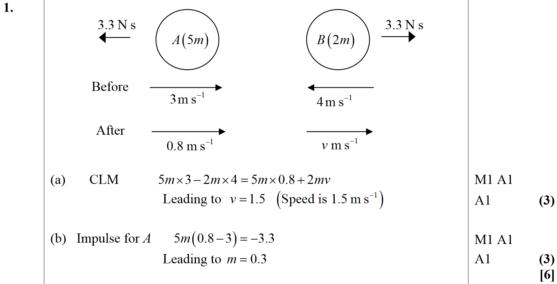
May 2012
A
B

Slide 60
Jan 2013

Slide 61
Jan 2013
A
B

Slide 62
May 2013

Slide 63
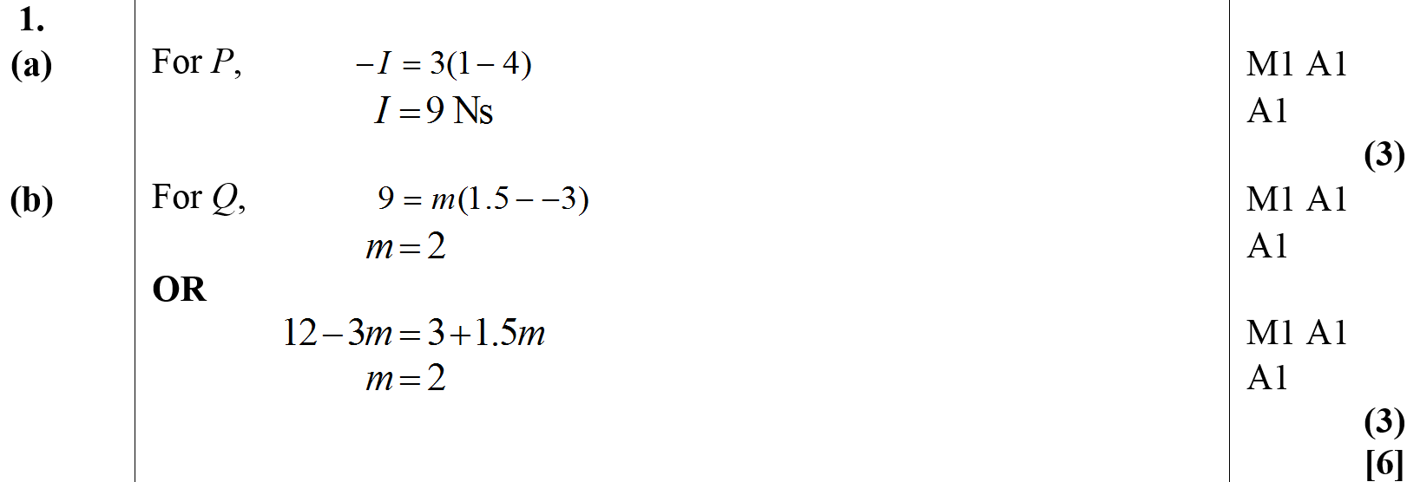
May 2013
A
B

Slide 64
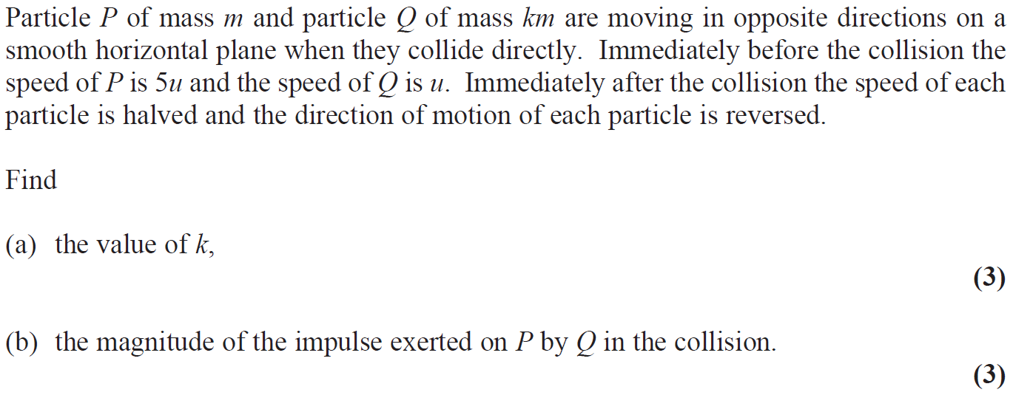
June 2015

Slide 65
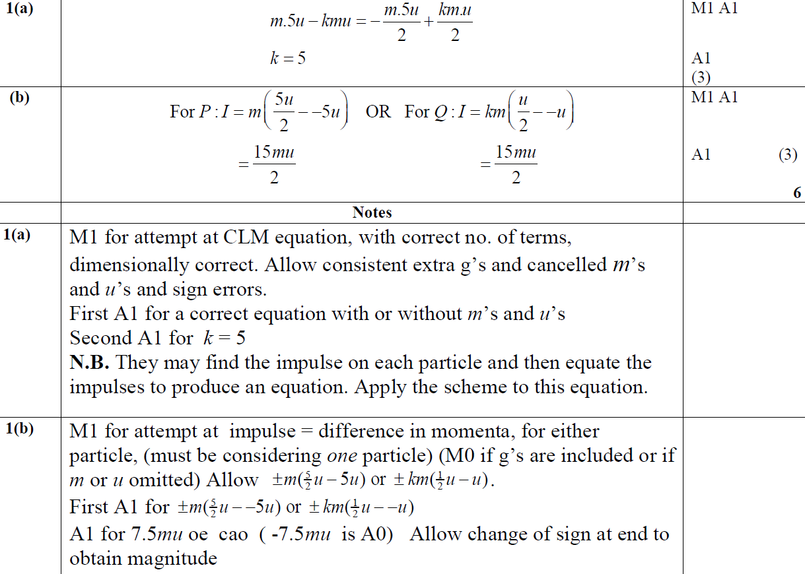
June 2015
A
B
A notes
B notes

Slide 66
June 2017

Slide 67
June 2017
A
B
C

Slide 68
June 2017
A notes
B notes
C notes

Slide 69
June 2018

Slide 70
June 2018
A
B
B Alternative

Slide 71
June 2018
A notes

Slide 72
June 2018
B notes
B Alternative notes

Slide 73
June 2001

Slide 74
June 2001
A
B
C

Slide 75
Jan 2002

Slide 76
Jan 2002
A
B
C
D

Slide 77
June 2002

Slide 78
June 2002
A
B

Slide 79
Jan 2003

Slide 80
Jan 2003
A
B
C

Slide 81
June 2003

Slide 82
June 2003
A
B
C

Slide 83
Jan 2004

Slide 84
Jan 2004
A
B
C
D

Slide 85
June 2004

Slide 86
June 2004
A
B
C

Slide 87
Jan 2005

Slide 88
Jan 2005
A
B
C

Slide 89
June 2005

Slide 90
June 2005
A
B

Slide 91
Jan 2006

Slide 92
Jan 2006
A

Slide 93
Jan 2006
B
C

Slide 94
June 2006

Slide 95
June 2006
A

Slide 96
June 2006
B
C

Slide 97
Jan 2007

Slide 98
Jan 2007
A & B
C
D

Slide 99
June 2007

Slide 100
June 2007
A
B
C

Slide 101
June 2007
A notes
B notes
C notes

Slide 102
Jan 2008

Slide 103
Jan 2008
A
B

Slide 104
Jan 2008
C

Slide 105
May 2008

Slide 106
May 2008
A
B

Slide 107
Jan 2009

Slide 108
Jan 2009
A
B

Slide 109
Jan 2009
C

Slide 110
Jan 2009
D

Slide 111
May 2009

Slide 112
May 2009
A
B
C

Slide 113
Jan 2010

Slide 114
Jan 2010
A

Slide 115
June 2010

Slide 116
June 2010
A (i)
A (ii)
B

Slide 117
June 2010
C

Slide 118
Jan 2011

Slide 119
Jan 2011
A

Slide 120
Jan 2011
B

Slide 121
June 2011

Slide 122
June 2011
A

Slide 123
Jan 2012

Slide 124
Jan 2012
A

Slide 125
Jan 2012
B
C

Slide 126
May 2012

Slide 127
May 2012
A
B

Slide 128
Jan 2013

Slide 129
Jan 2013
A

Slide 130
Jan 2013
B
C

Slide 131
June 2013

Slide 132
June 2013
A
B
C

Slide 133
June 2013 (R)

Slide 134
June 2013 (R)
A
B

Slide 135
June 2014 (R)

Slide 136
June 2014 (R)
A
B

Slide 137
June 2014 (R)
C

Slide 138
June 2015

Slide 139
June 2015
A

Slide 140
June 2015
A Alterntive
B

Slide 141
June 2016

Slide 142
June 2016
A

Slide 143
June 2016
B
C

Slide 144
June 2017

Slide 145
June 2017
A
B

Slide 146
June 2017
C
C Alternative

Slide 147
June 2018

Slide 148
June 2018
A

Slide 149
June 2018
B

Slide 150
June 2018
B Alternative (i)

Slide 151
June 2018
B Alternative (ii)

Slide 152
June 2018
B Alternative (iii)

Slide 153
June 2018
B Alternative (iv)

Slide 154
June 2019

Slide 155
June 2019
A

