Slide 1
Collisions:
One Sphere Oblique Impact
Old Spec Q’s
SAM
2019

Slide 2
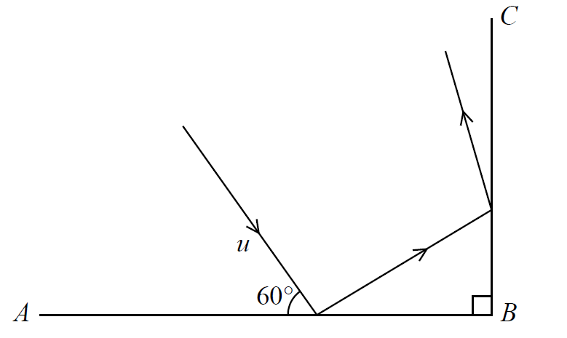
SAM

Slide 3
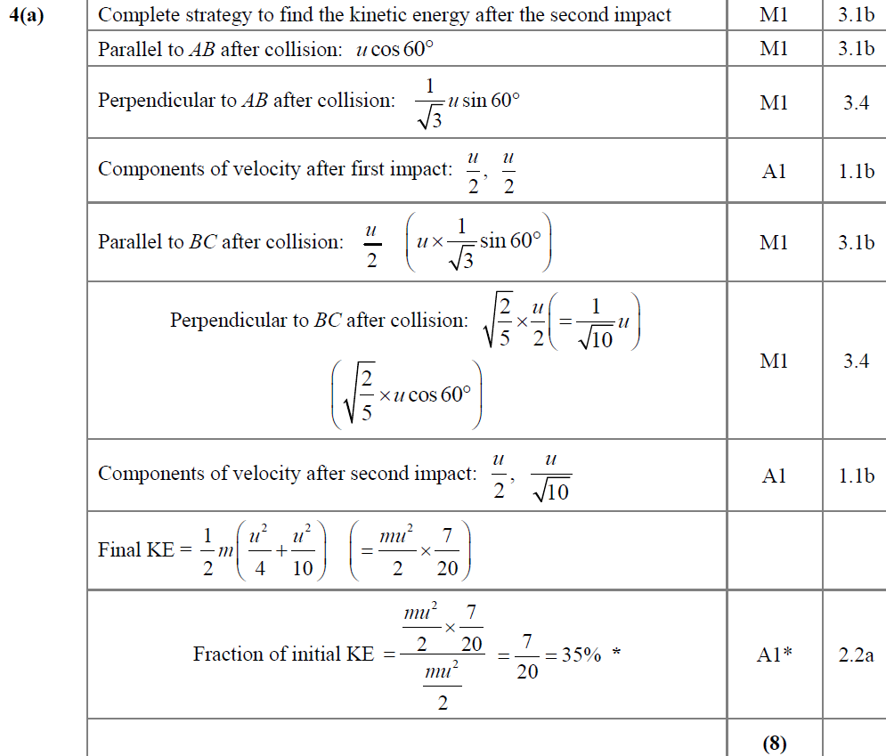
SAM
A

Slide 4
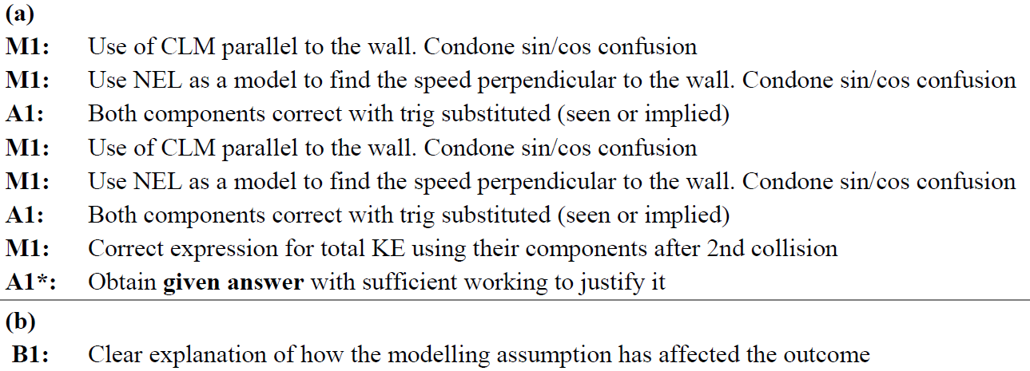
SAM
B
A notes
B notes

Slide 5
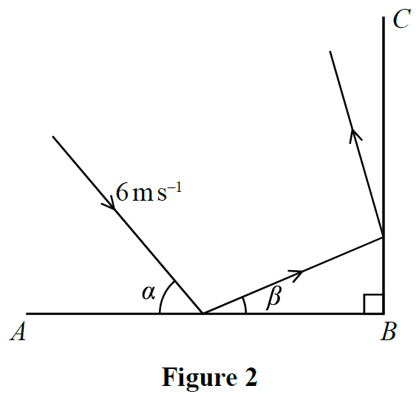
2019

Slide 6
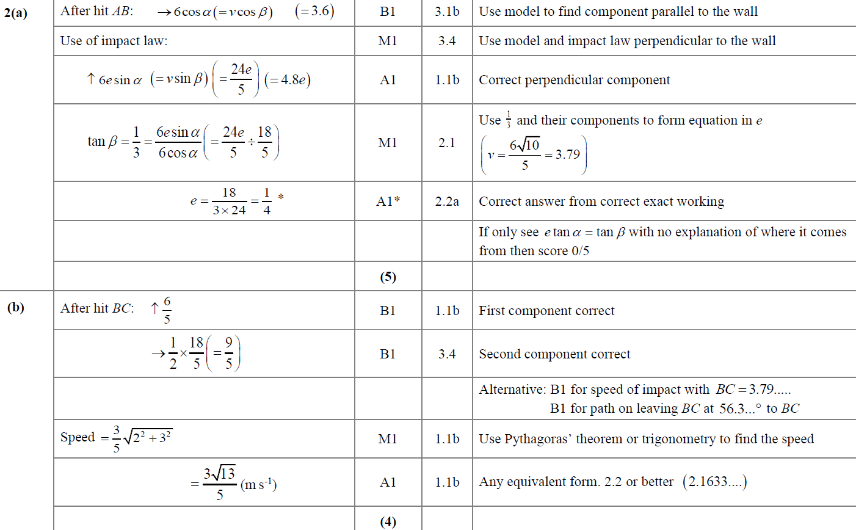
2019
A
B

Slide 7
2019
C

Slide 8
Old Spec Collisions:
One Sphere Oblique Impact
New Spec Q’s
Jan 2002
June 2007
June 2013
June 2016
Jan 2003
June 2008
June 2013 (R)
June 2017
Jan 2005
June 2009
June 2014
June 2018
June 2005
June 2010
June 2014 (R)
June 2019
June 2006
June 2011
June 2015

Slide 9
Jan 2002

Slide 10
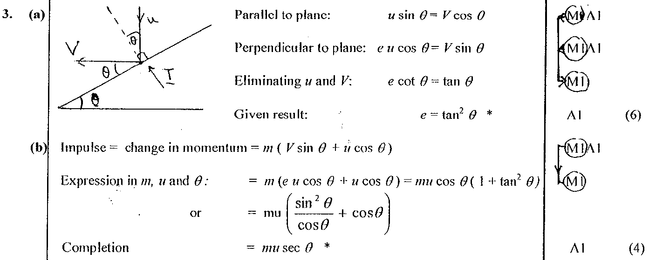
Jan 2002
A
B

Slide 11
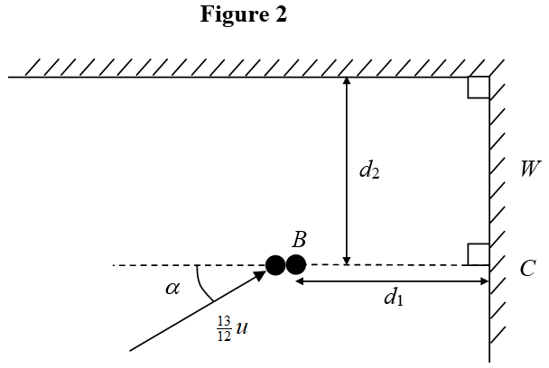
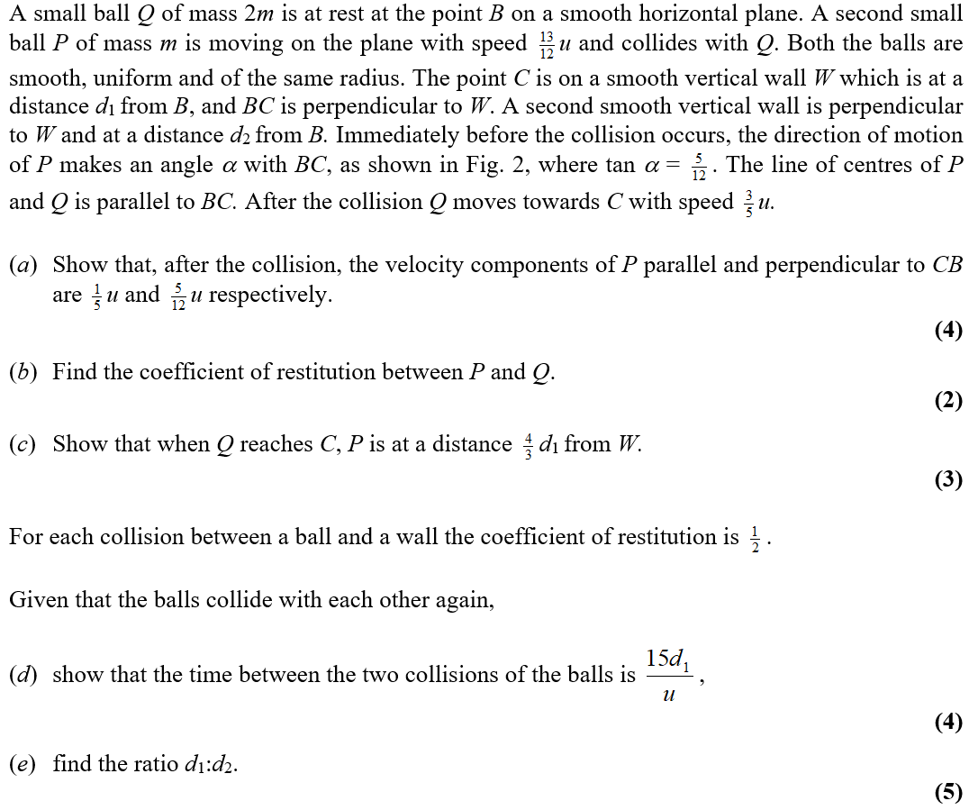
Jan 2003

Slide 12
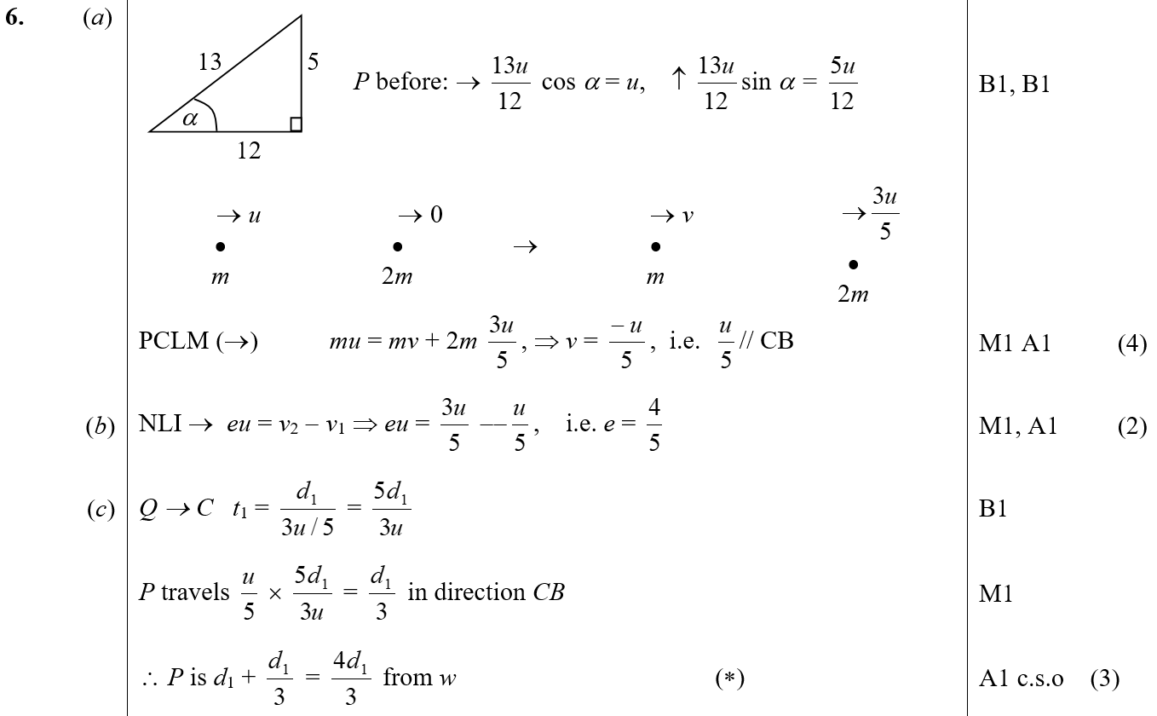
Jan 2003
A
B
C

Slide 13
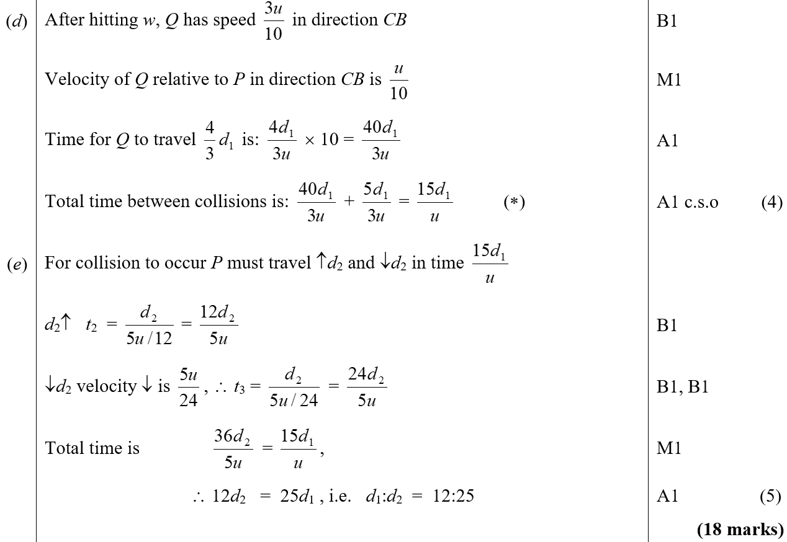
Jan 2003
D
E

Slide 14
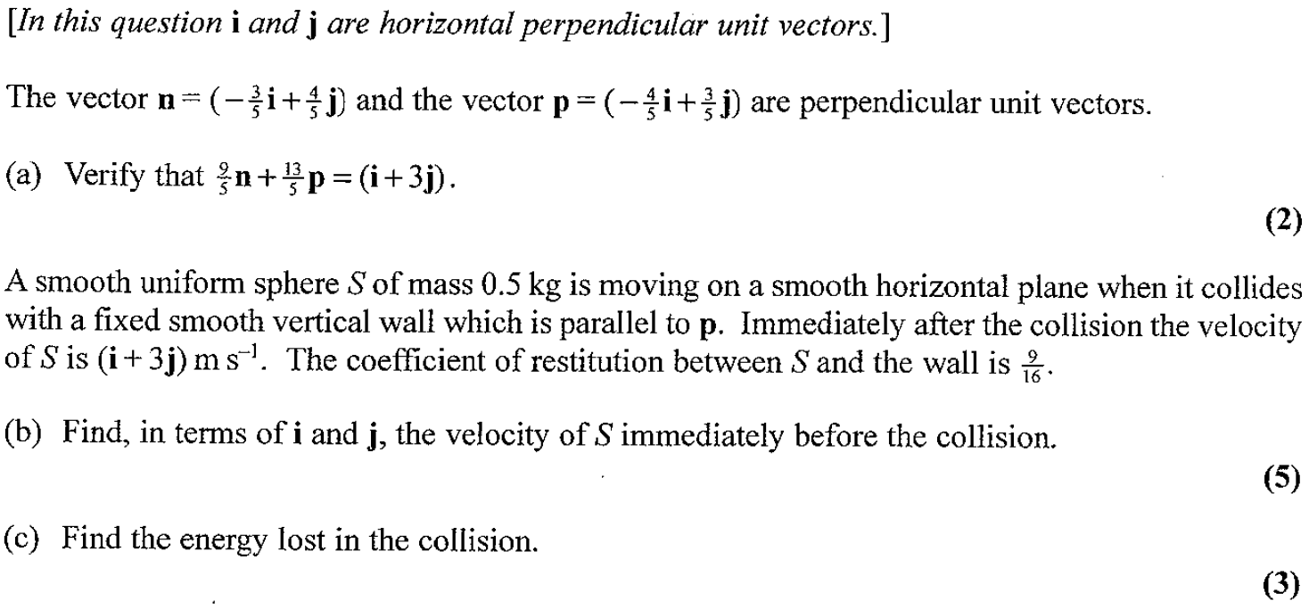
Jan 2005

Slide 15
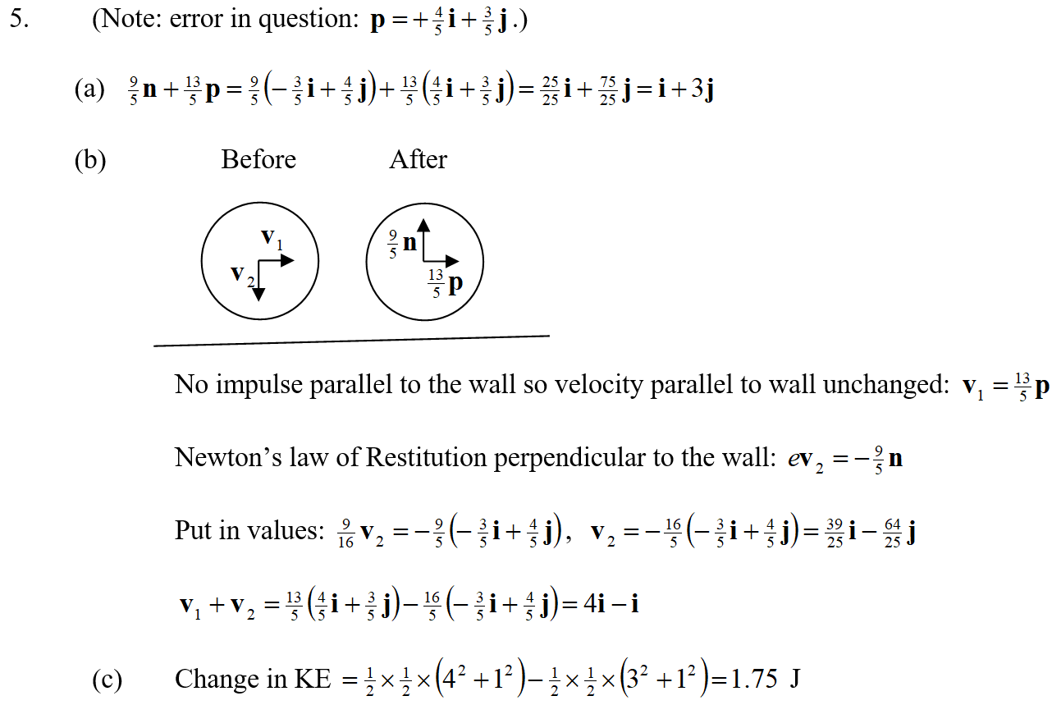
Jan 2005
A
B
C

Slide 16
June 2005

Slide 17
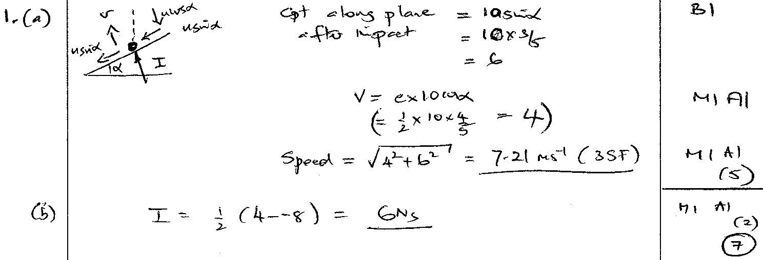
June 2005
A
B

Slide 18
June 2006

Slide 19
June 2006
A

Slide 20
June 2007

Slide 21
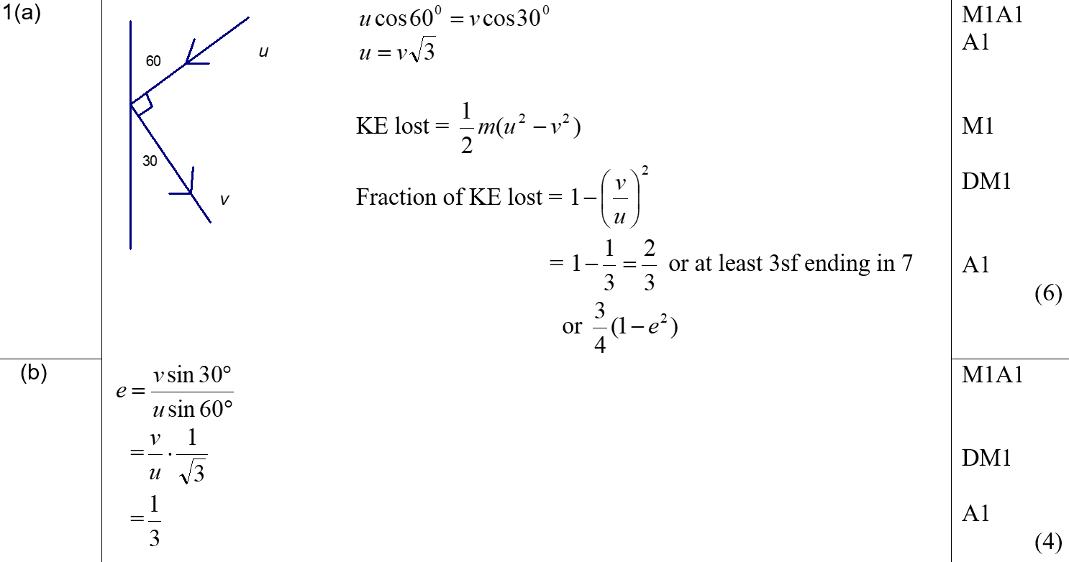
June 2007
A
B

Slide 22
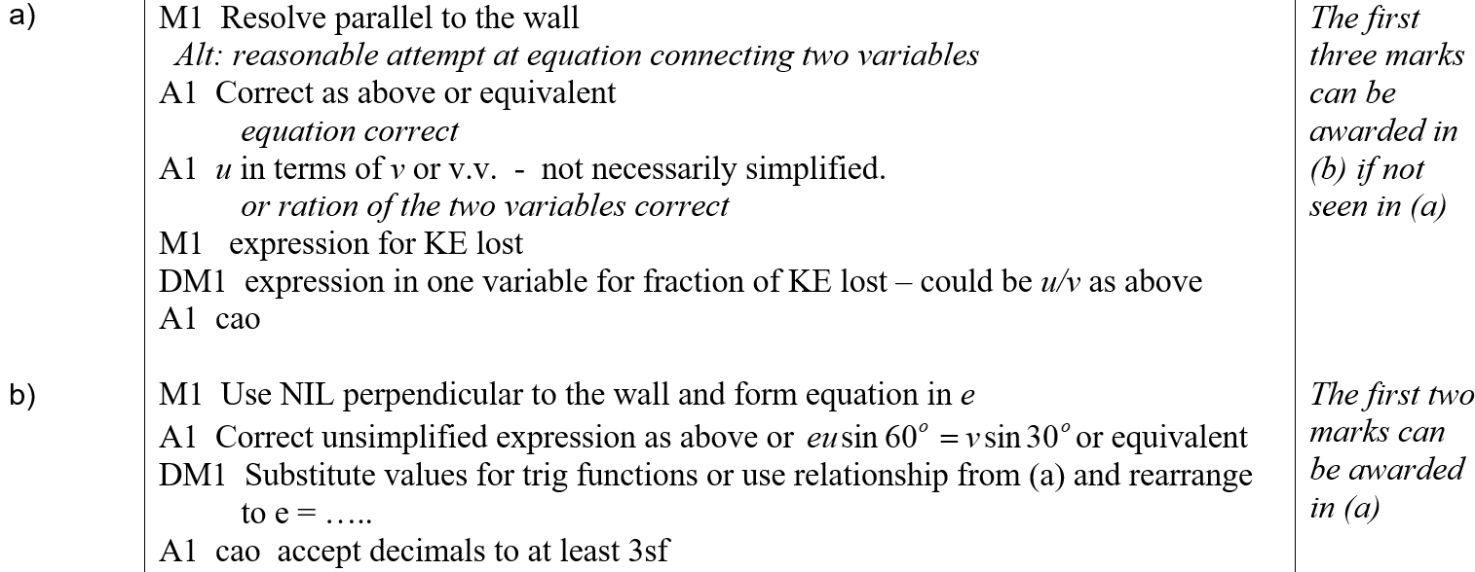
June 2007
A notes
B notes

Slide 23
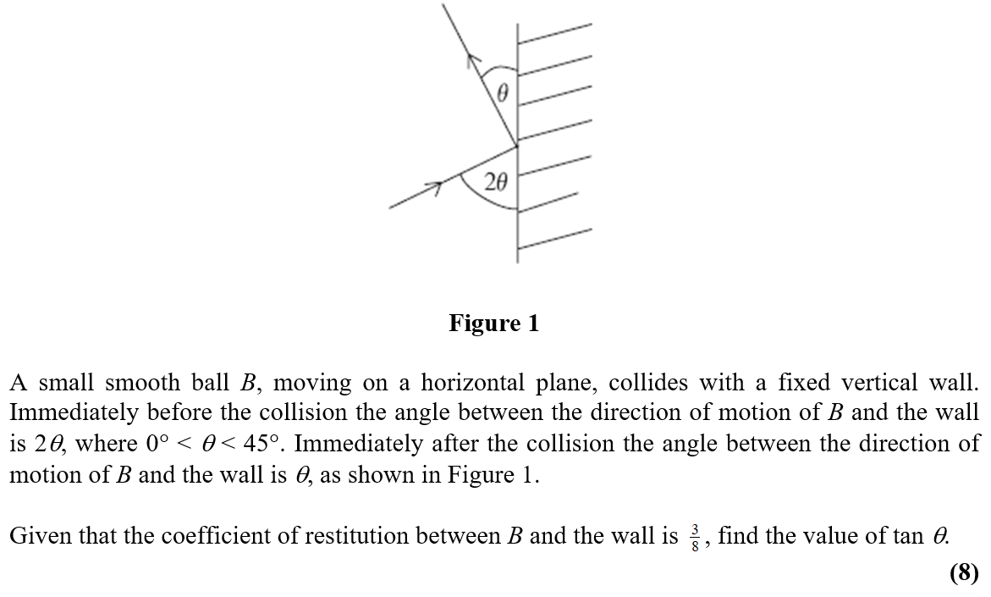
June 2008

Slide 24
June 2008
A

Slide 25
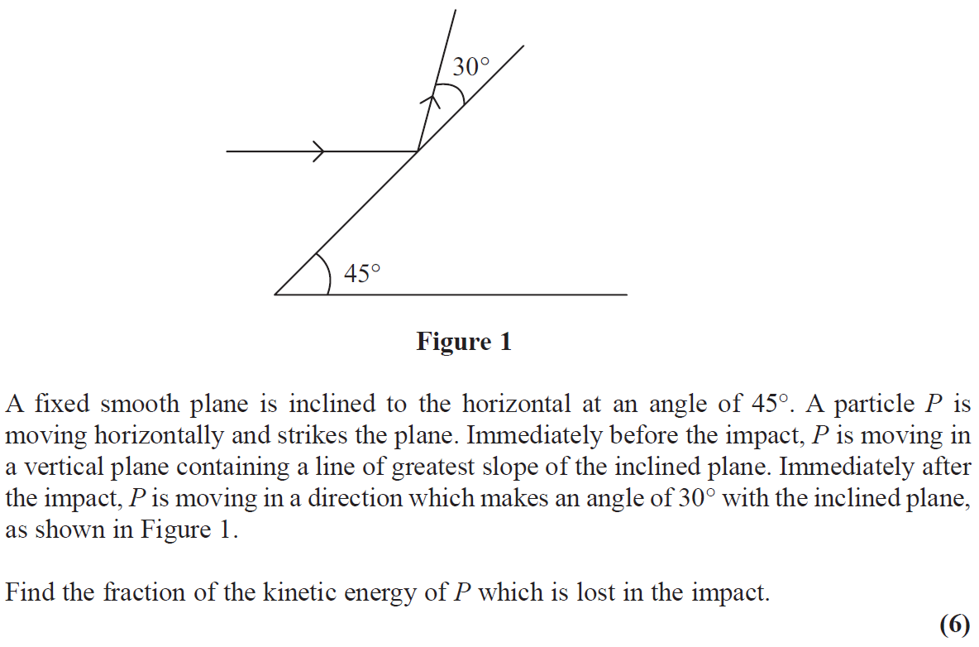
June 2009

Slide 26
June 2009
A

Slide 27
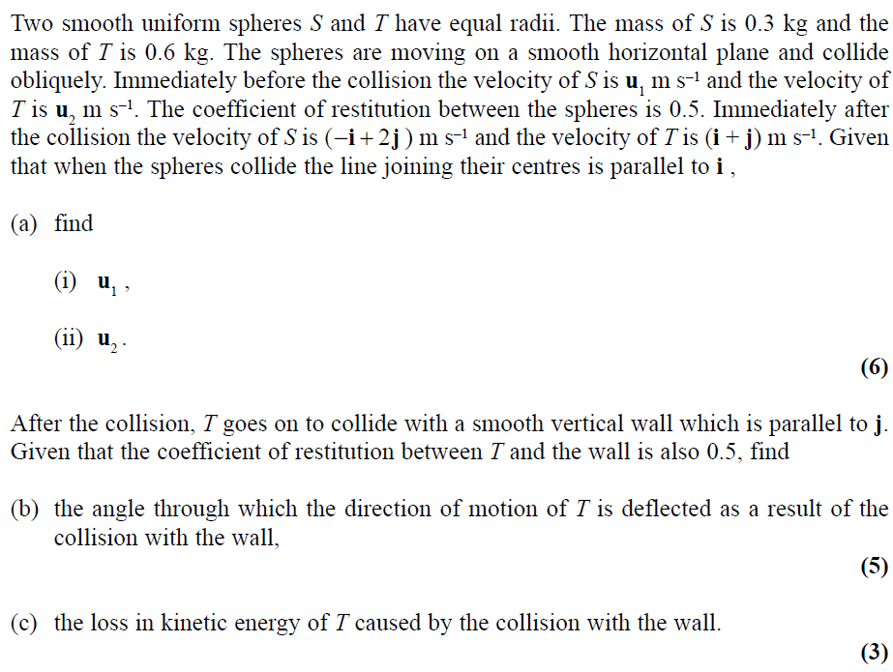
June 2010

Slide 28
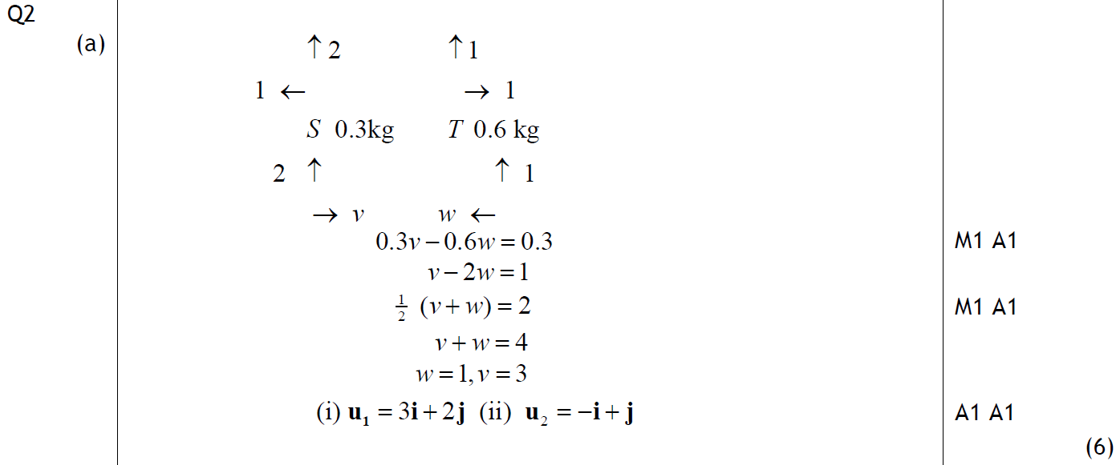
June 2010
A

Slide 29
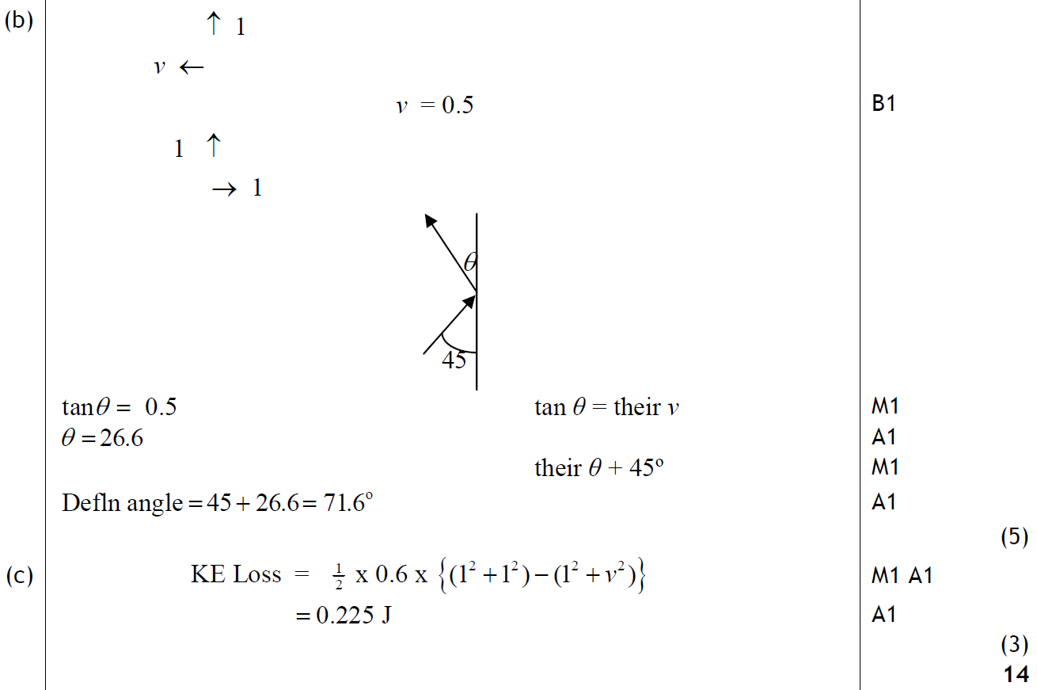
June 2010
B
C

Slide 30
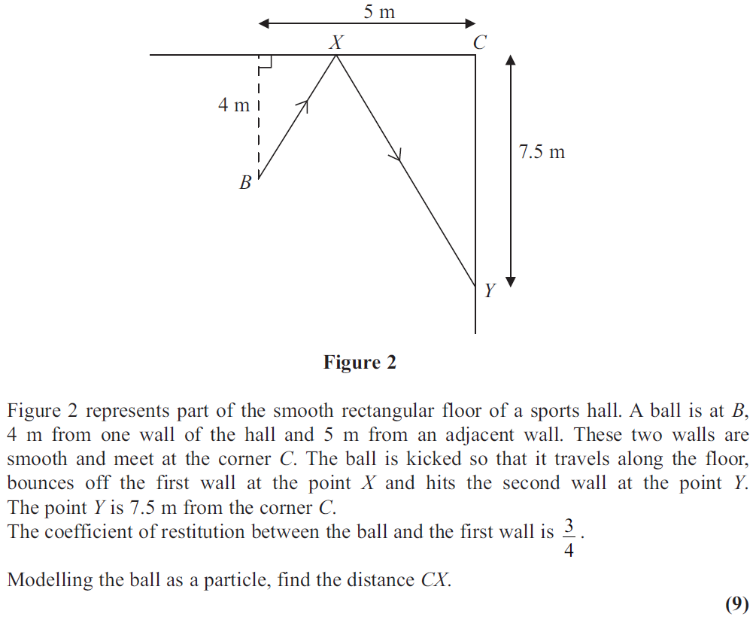
June 2011

Slide 31
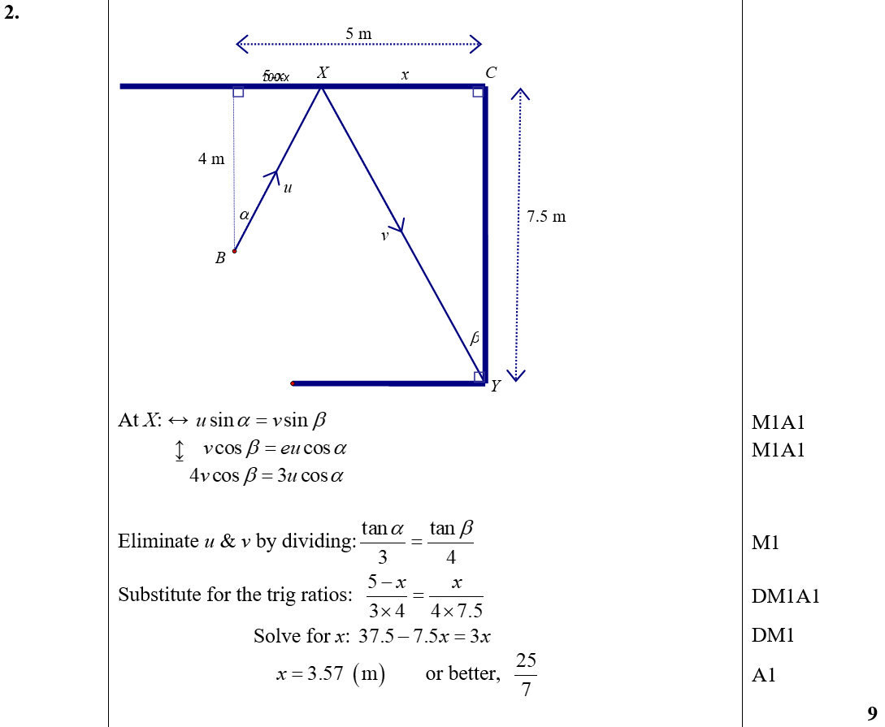
June 2011
A

Slide 32
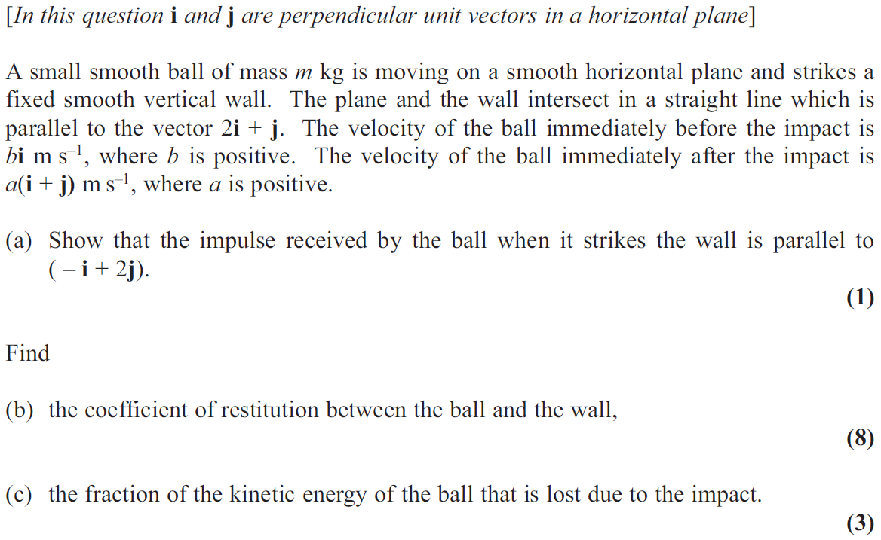
June 2013

Slide 33
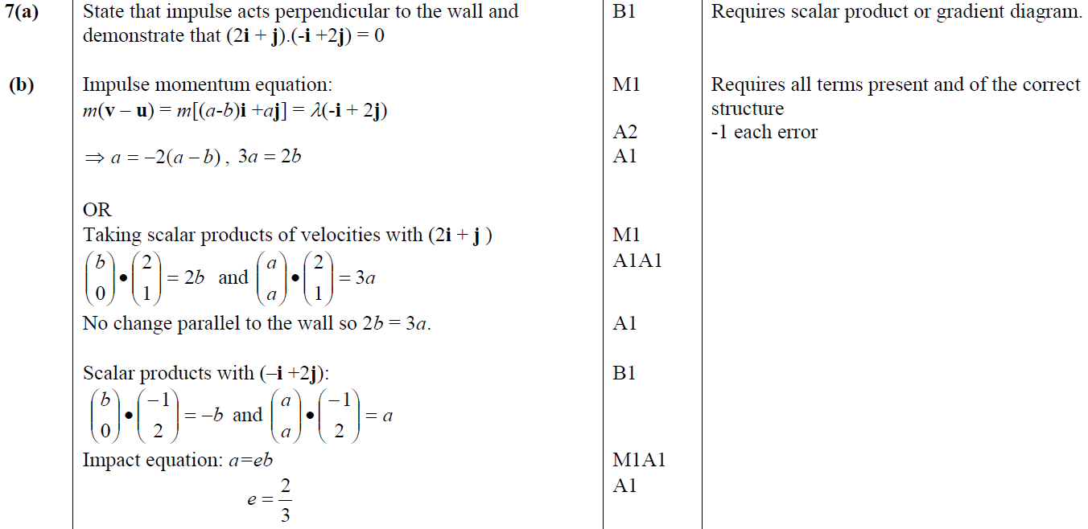
June 2013
A
B

Slide 34
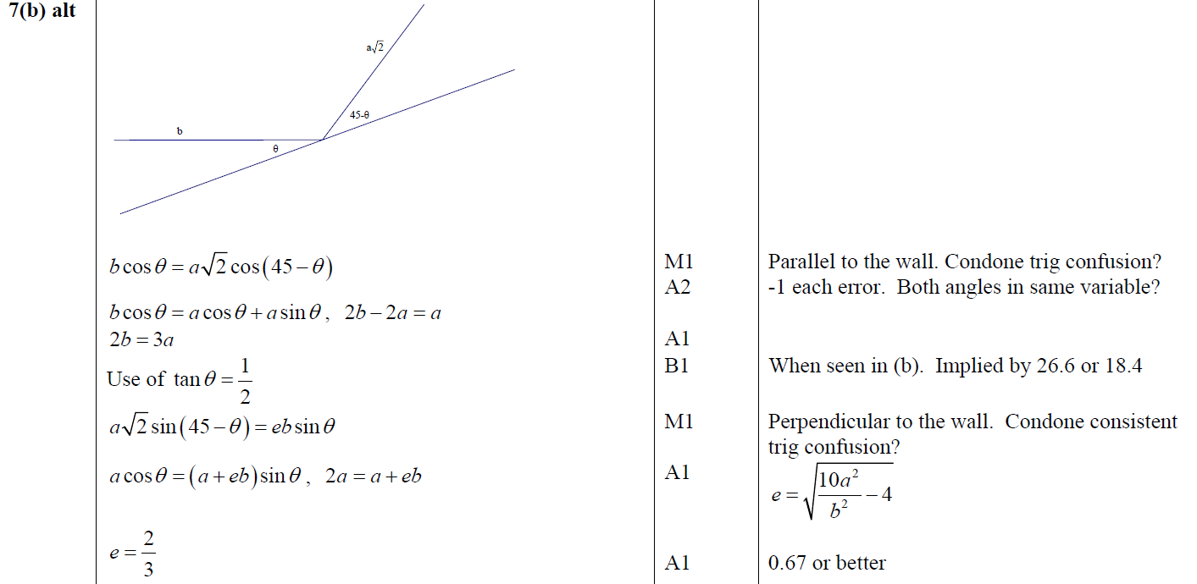
June 2013
B Alternative
C

Slide 35
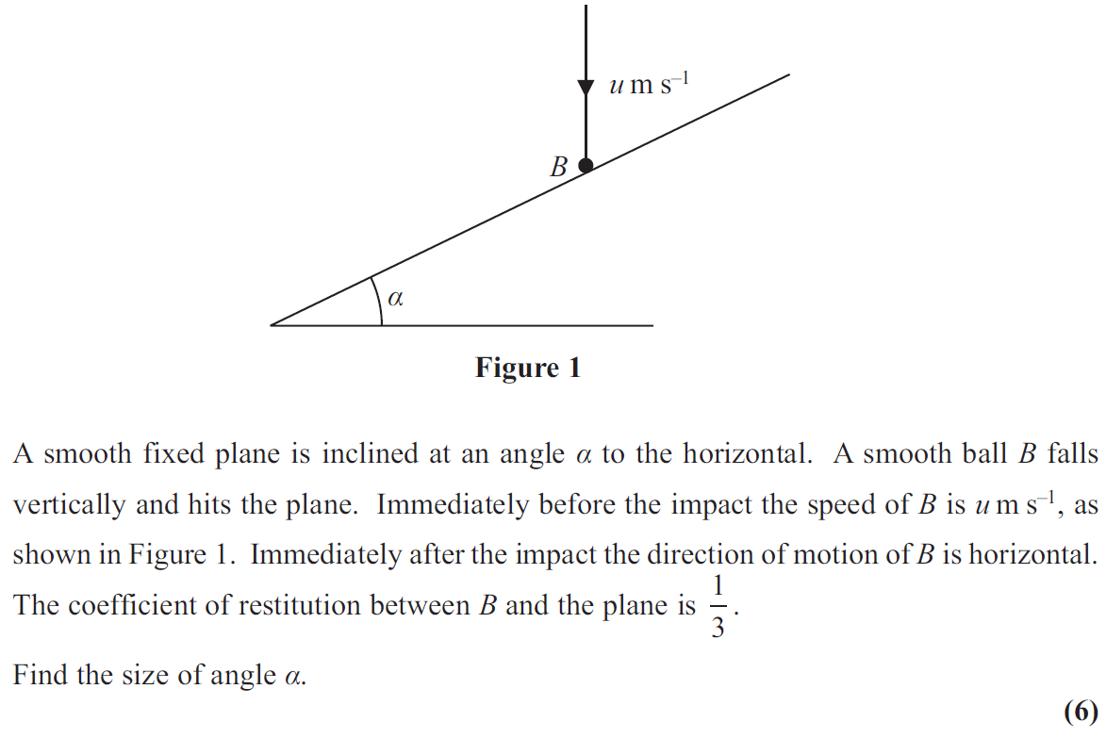
June 2013 (R)

Slide 36
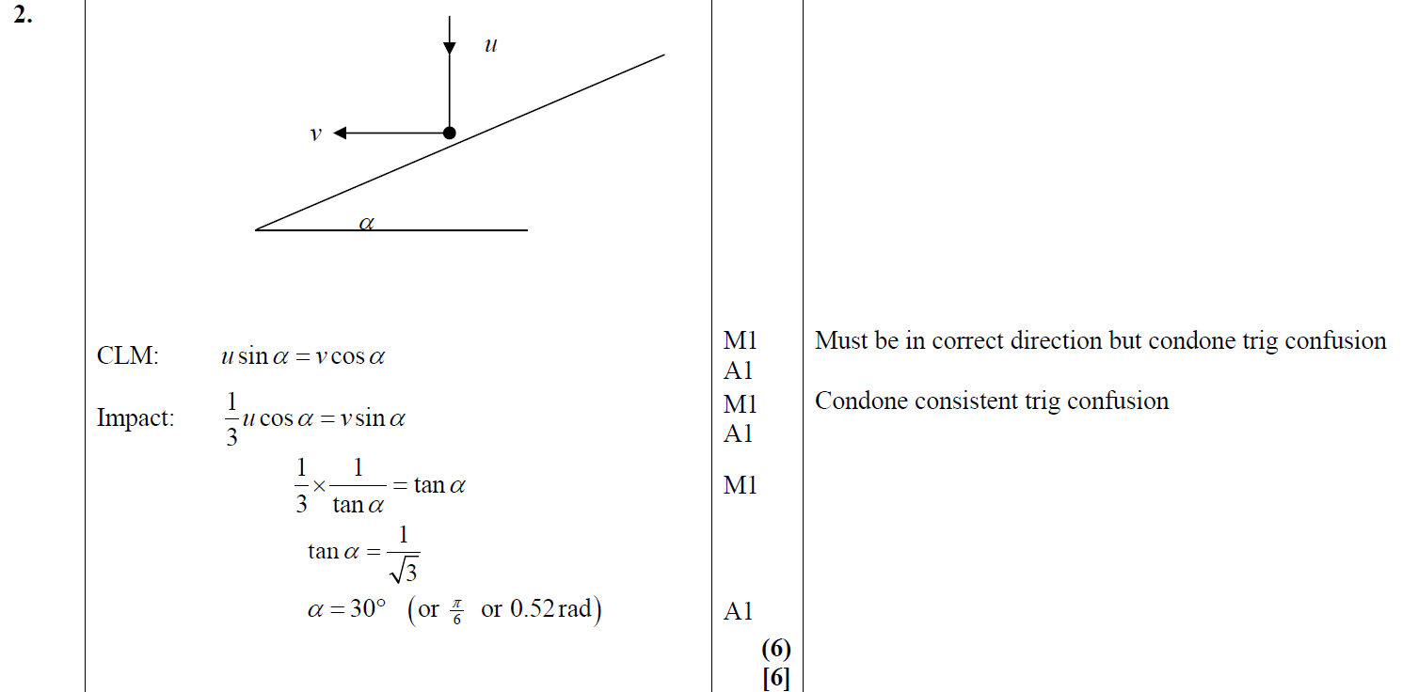
June 2013 (R)
A

Slide 37
June 2014

Slide 38
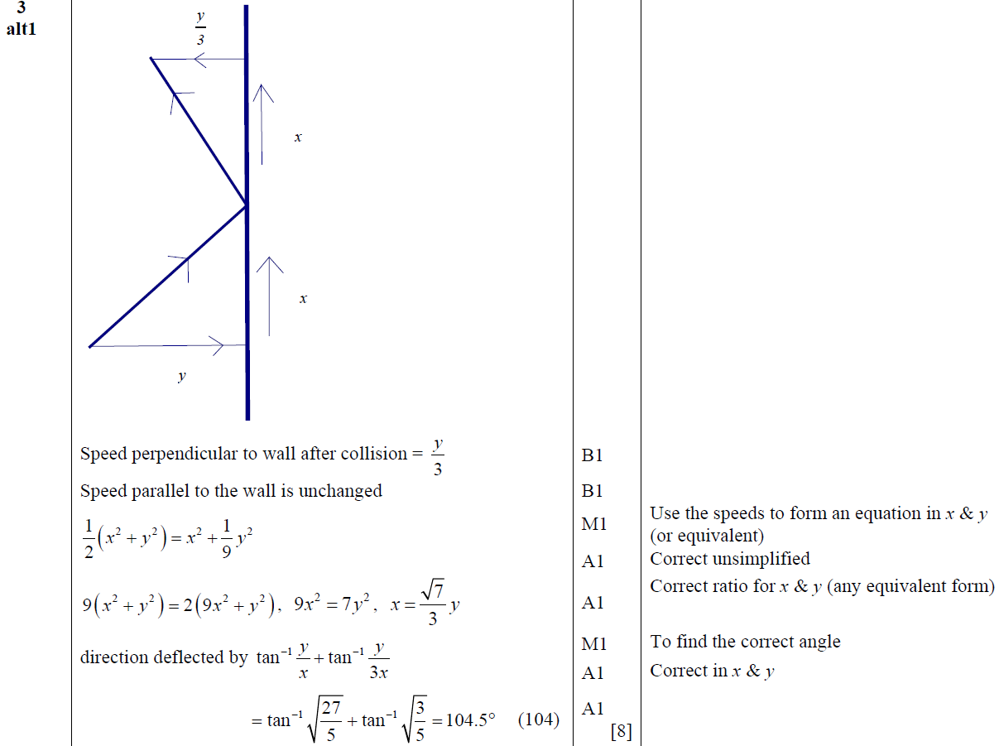
June 2014
A

Slide 39
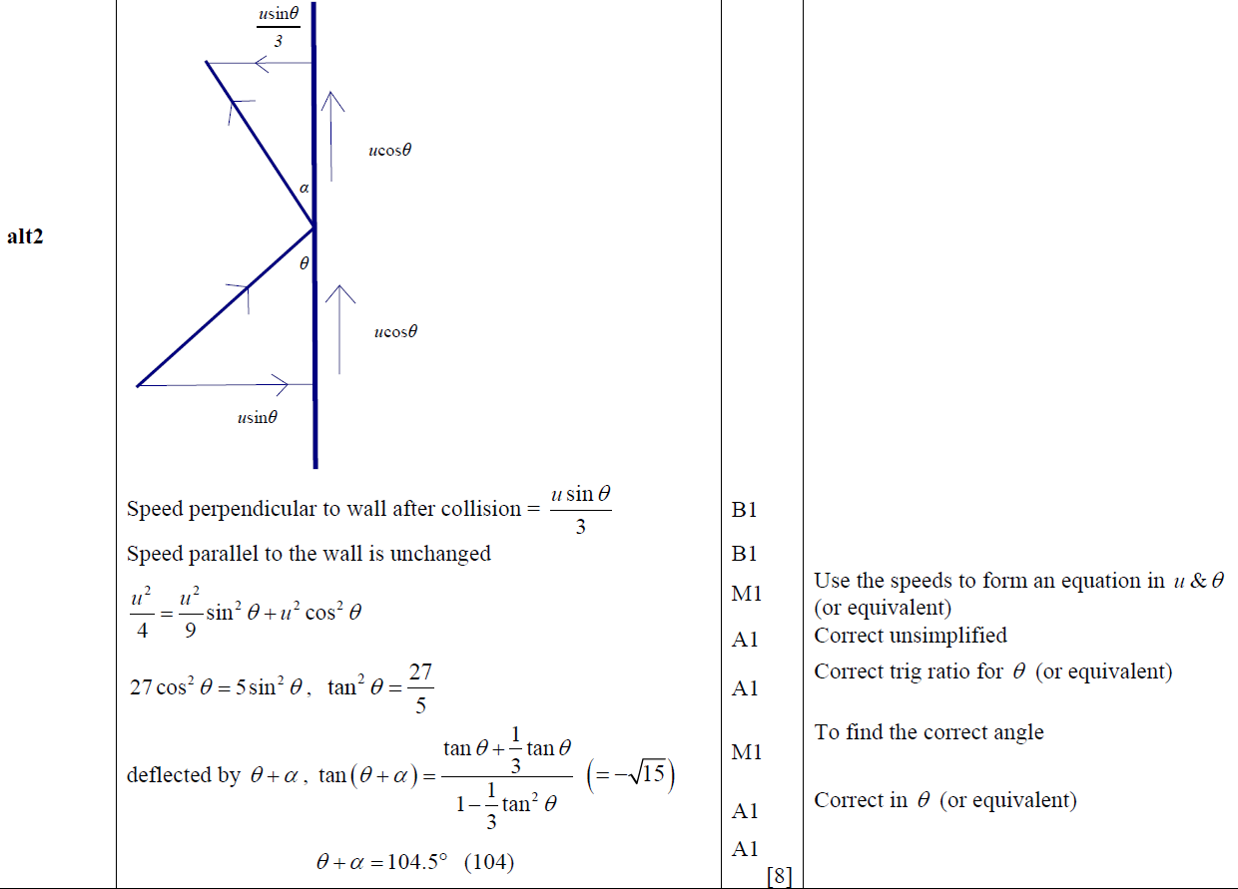
June 2014
A Alternative

Slide 40
June 2014 (R)

Slide 41
June 2014 (R)
A

Slide 42
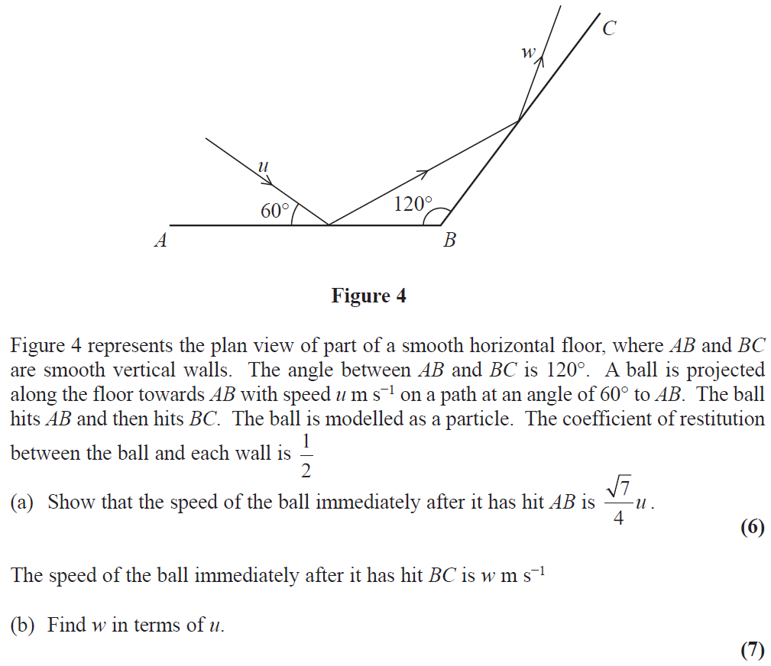
June 2015

Slide 43
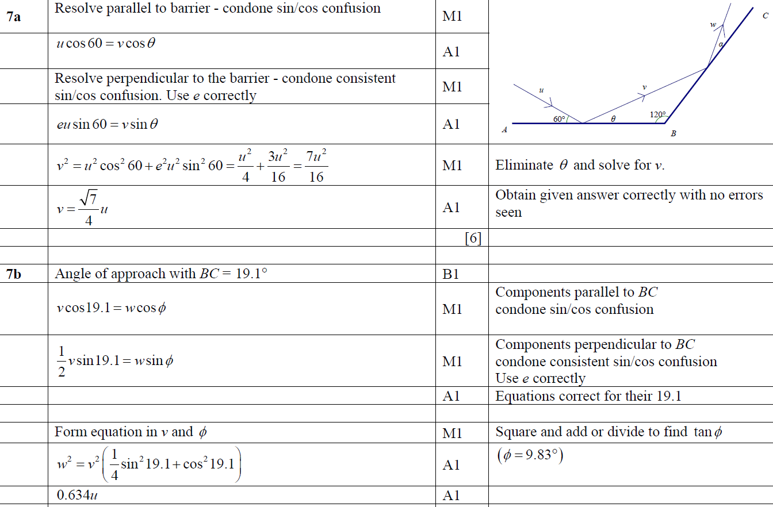
June 2015
A
B

Slide 44
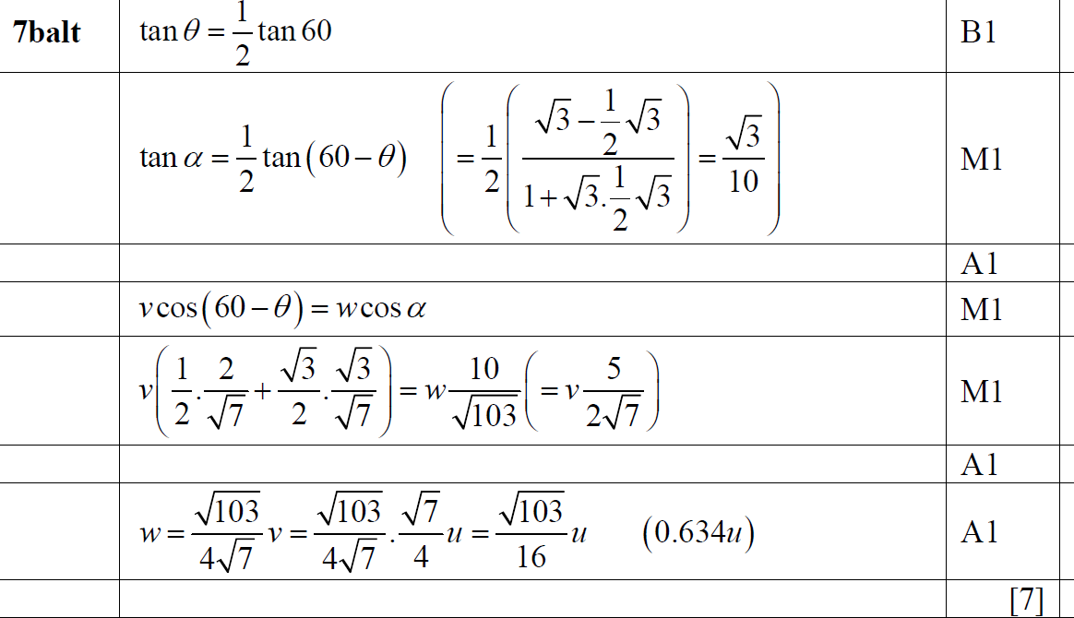
June 2015
B Alternative

Slide 45
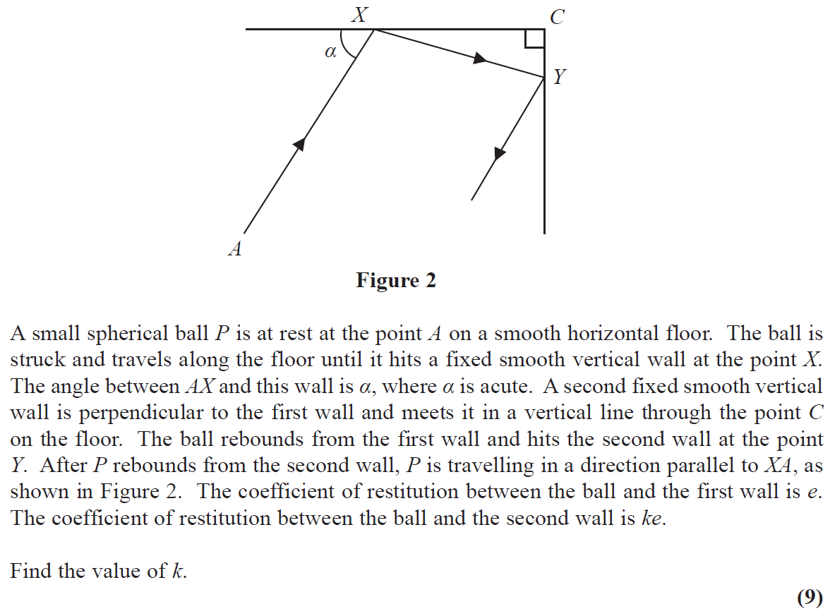
June 2016

Slide 46
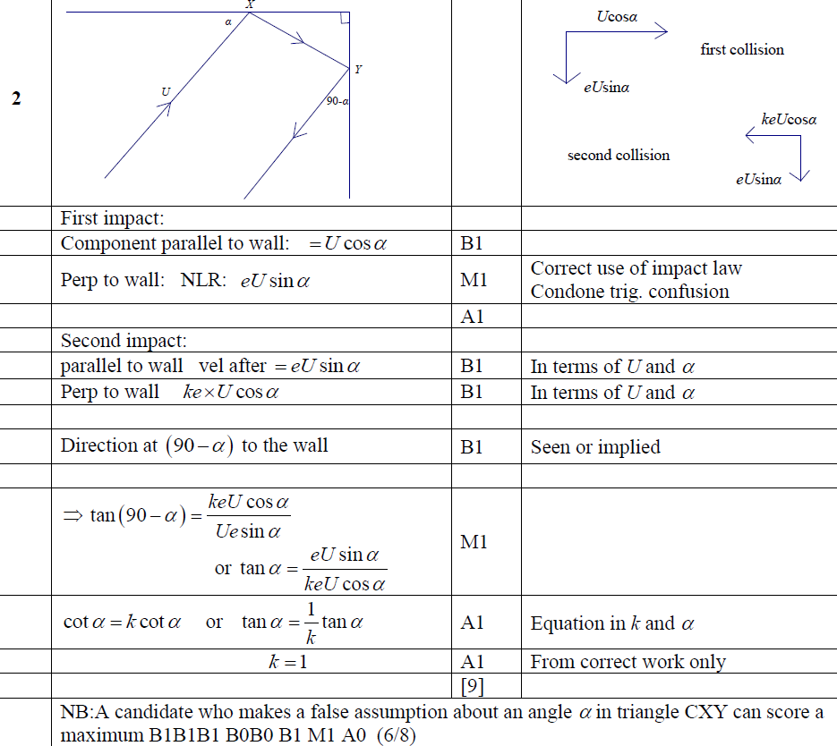
June 2016
A

Slide 47
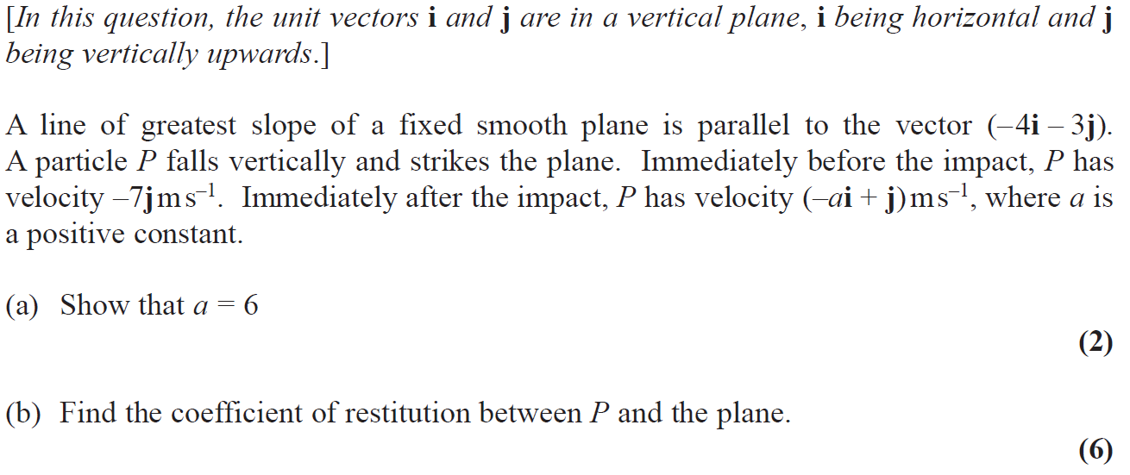
June 2017

Slide 48
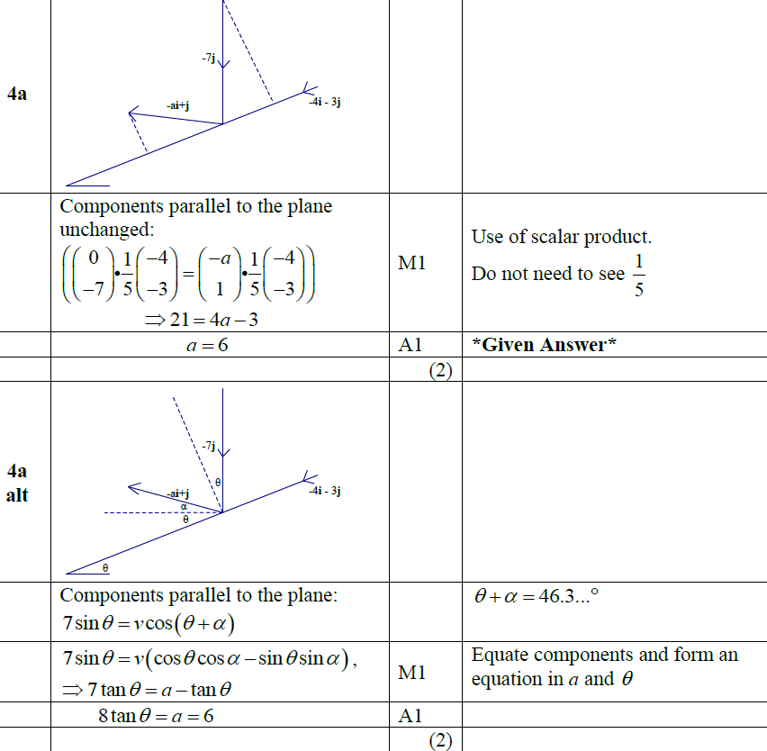
June 2017
A

Slide 49
June 2017
A

Slide 50
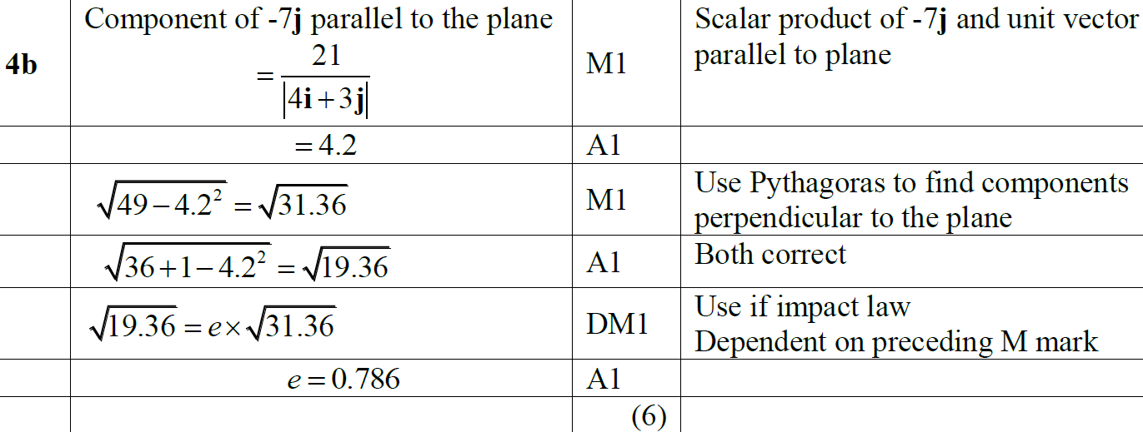
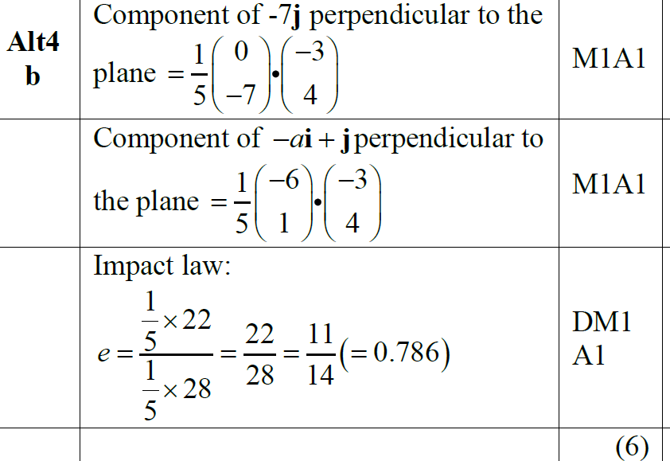
June 2017
B
B Alternative (i)

Slide 51
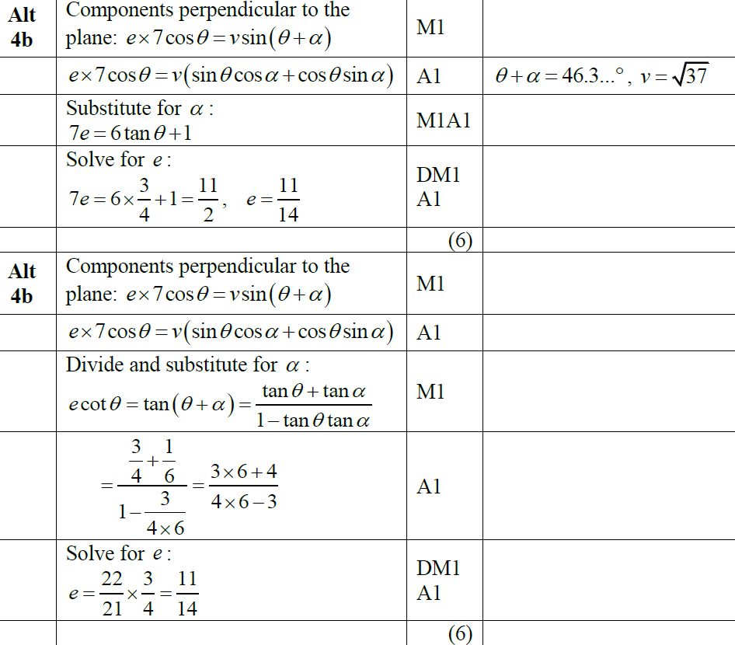
June 2017
More B Alternatives

Slide 52
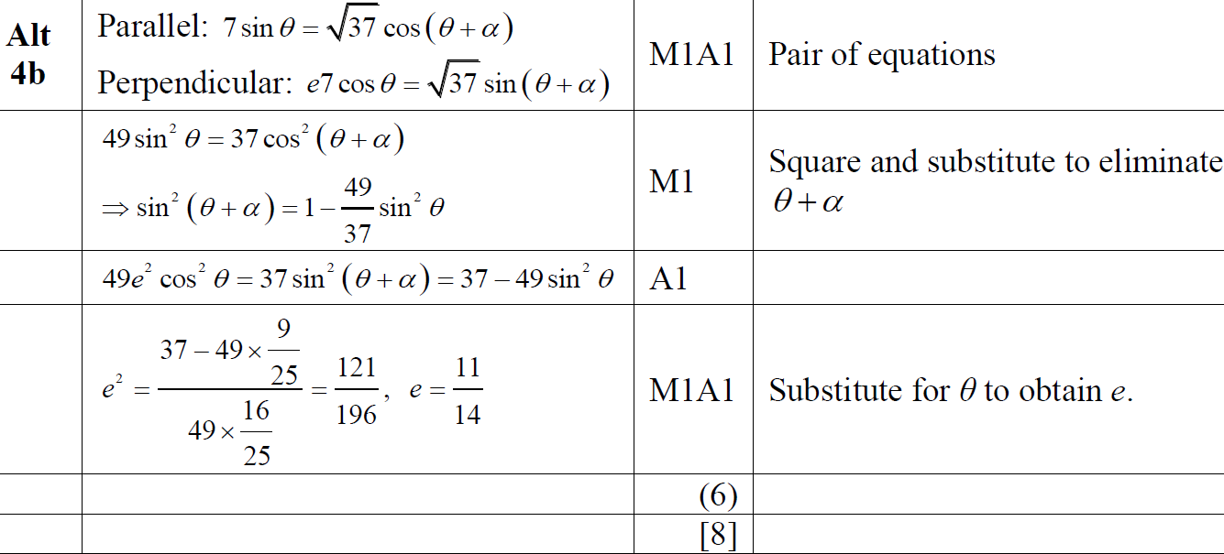
June 2017
Another B Alternative

Slide 53
June 2018

Slide 54
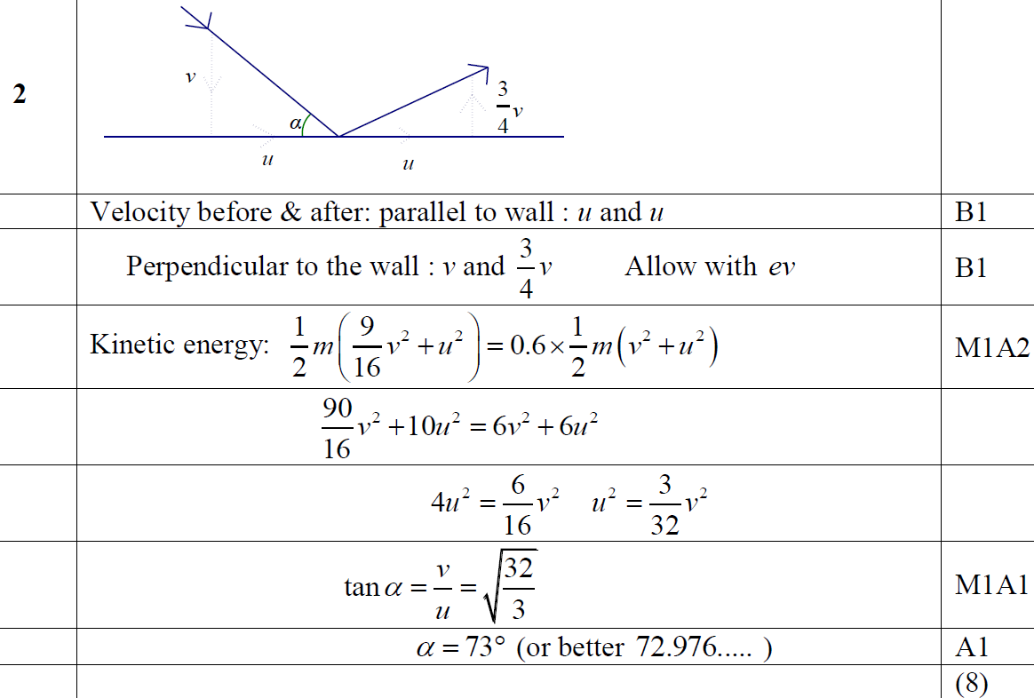
June 2018
A

Slide 55
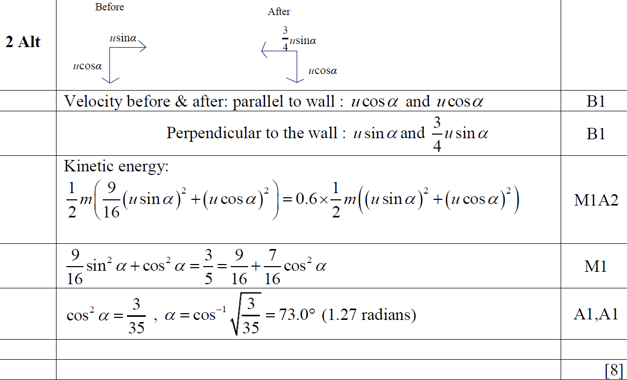
June 2018
A Alternative

Slide 56
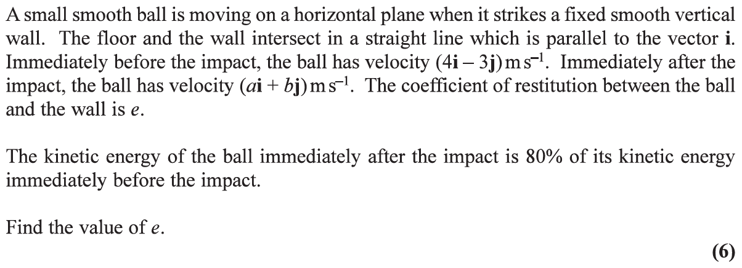
June 2019

Slide 57
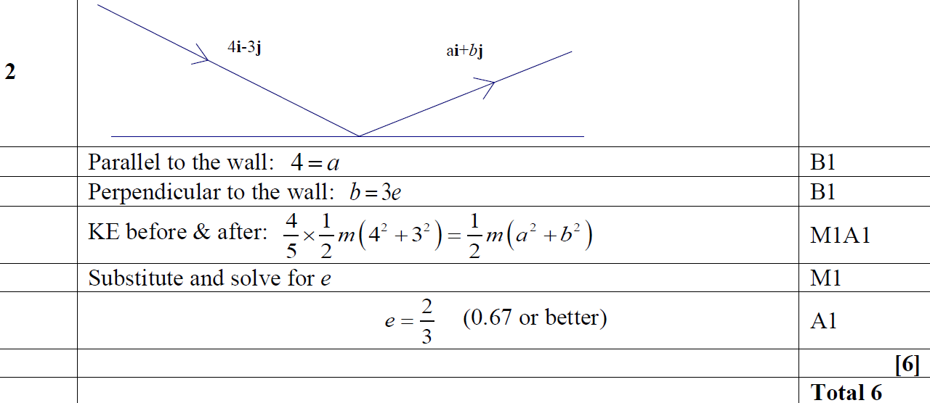
June 2019
A

