Slide 1
Collisions:
One Sphere Direct Impact
Old Spec Q’s
SAM
SAM
2018*
2019
*no coefficient of restitution, mainly coe & impulse

Slide 2
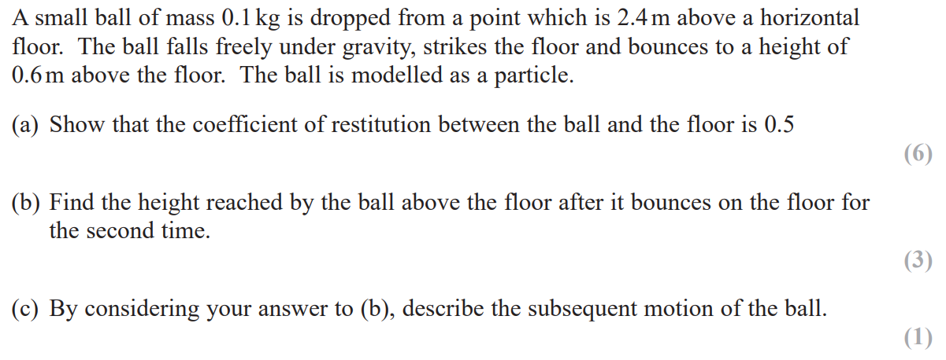
SAM

Slide 3
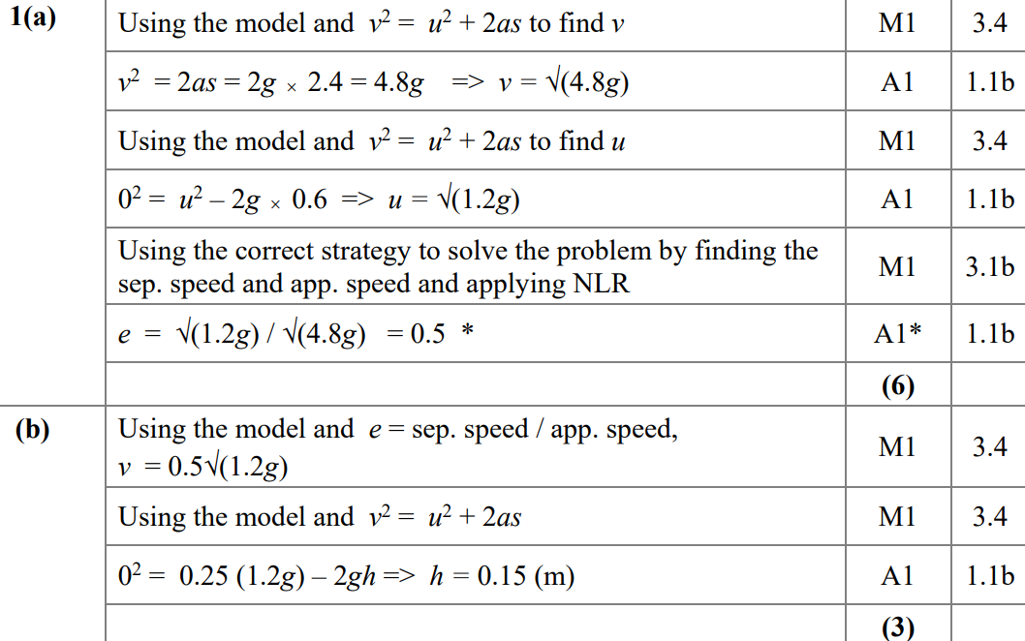
SAM
A
B

Slide 4
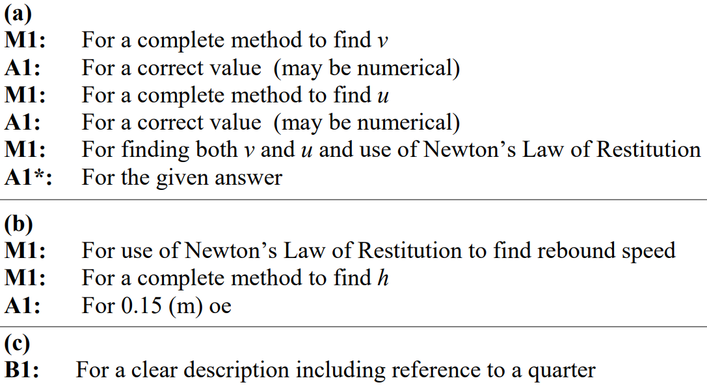
SAM
C
A notes
B notes
C notes

Slide 5
2018

Slide 6
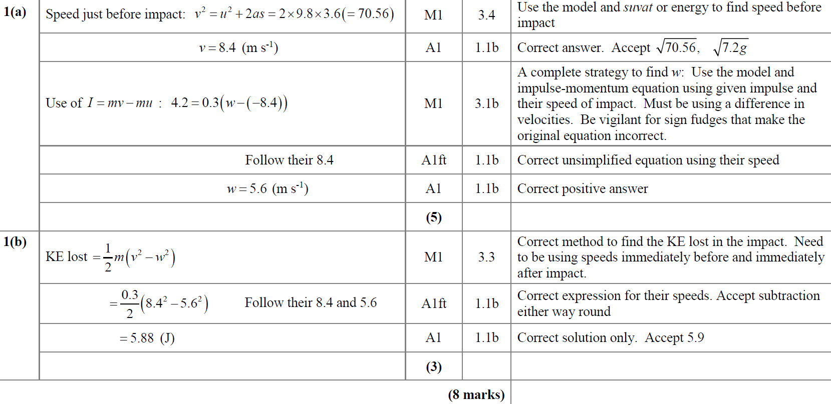
2018
A
B

Slide 7
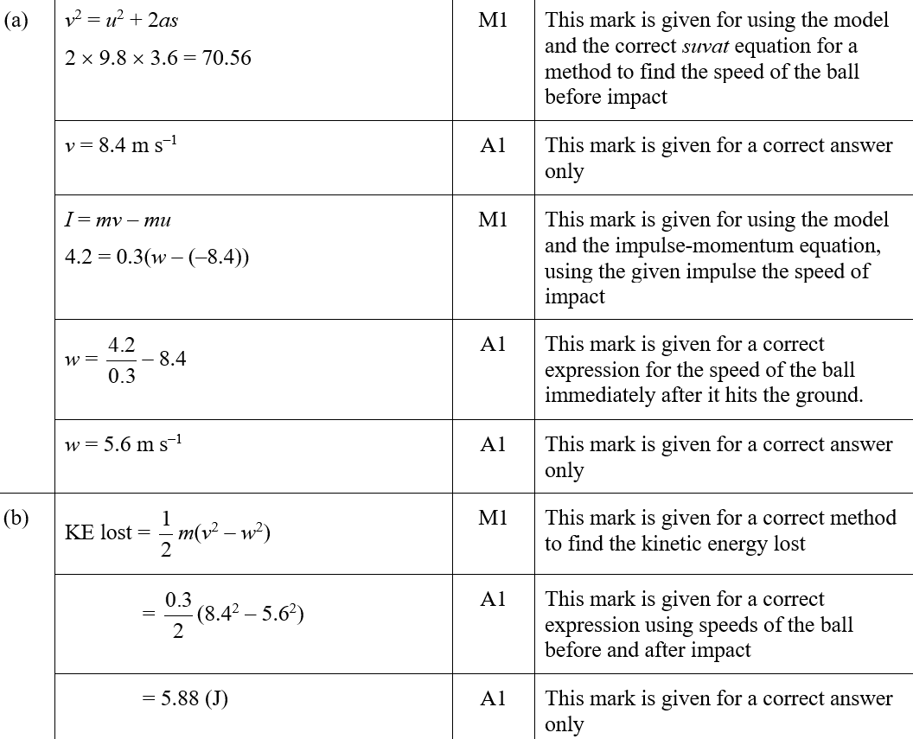
2018
A (SF)
B (SF)

Slide 8
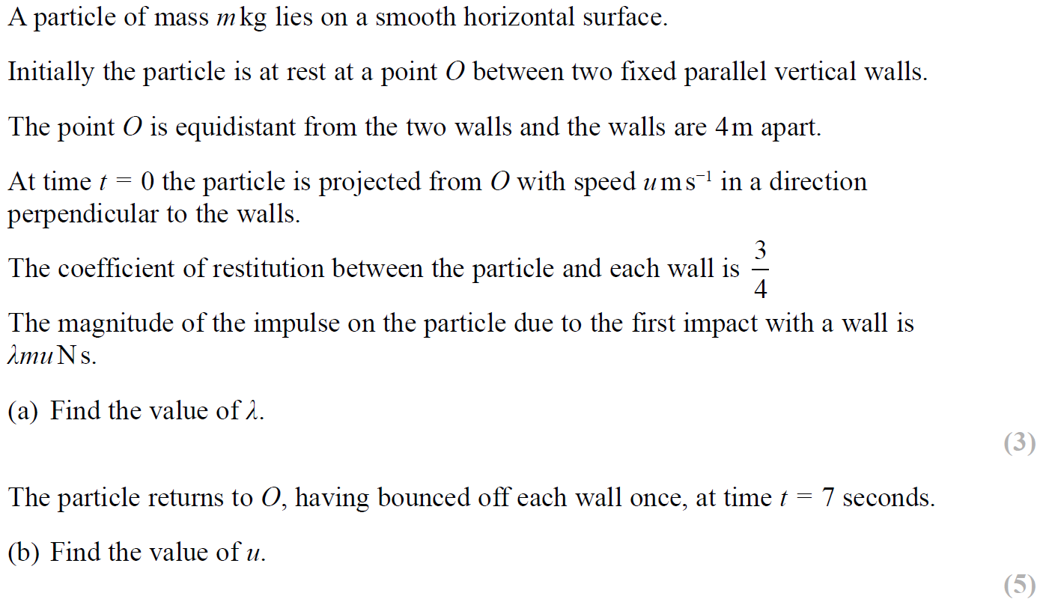
SAM

Slide 9
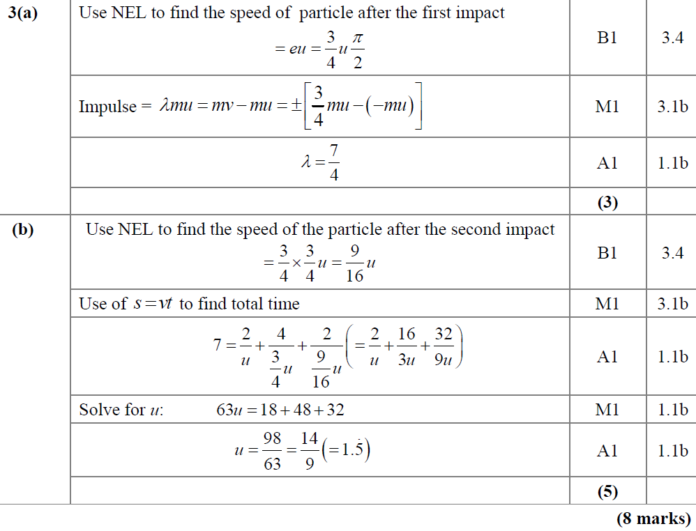
SAM
A
B

Slide 10
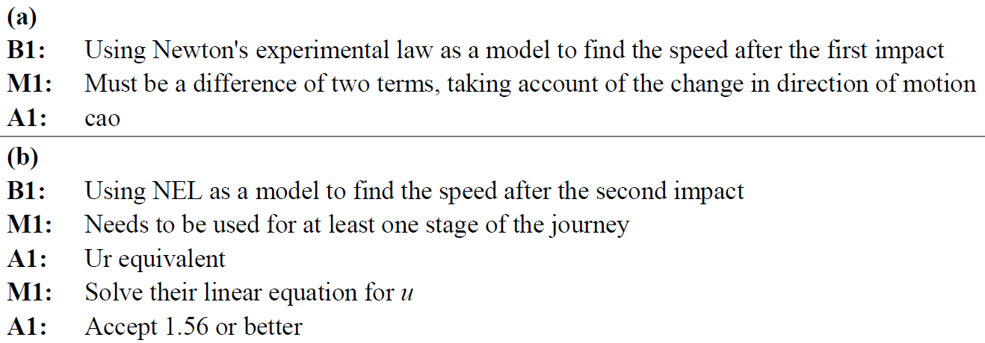
SAM
A notes
B notes

Slide 11
2019

Slide 12
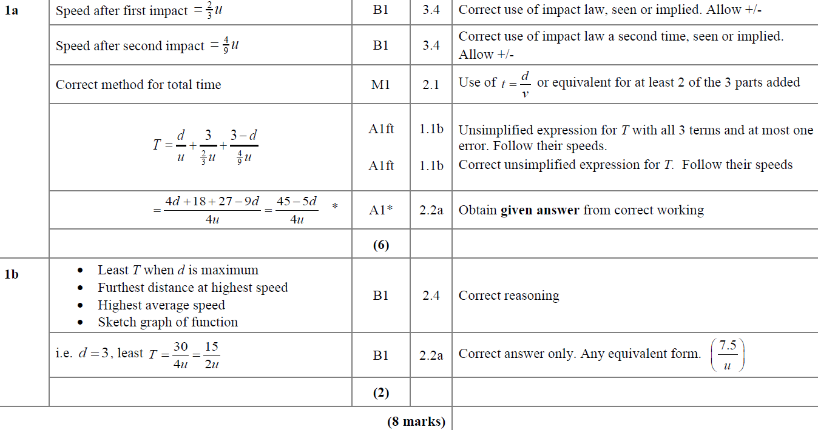
2019
A
B

Slide 13
Collisions:
One Sphere Direct Impact
New Spec Q’s
M1 Q’s (no e)
M2 Q’s
June 2016
June 2014
June 2018

Slide 14
June 2016

Slide 15
June 2016
A

Slide 16
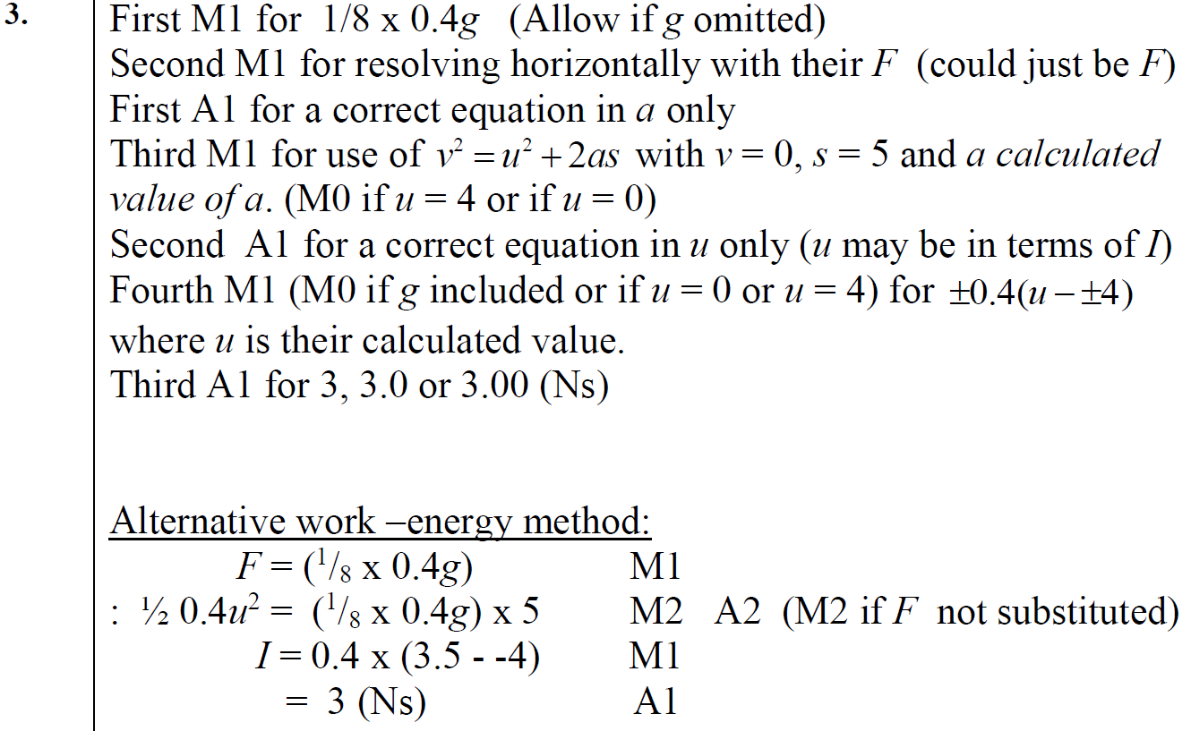
June 2016
A notes

Slide 17
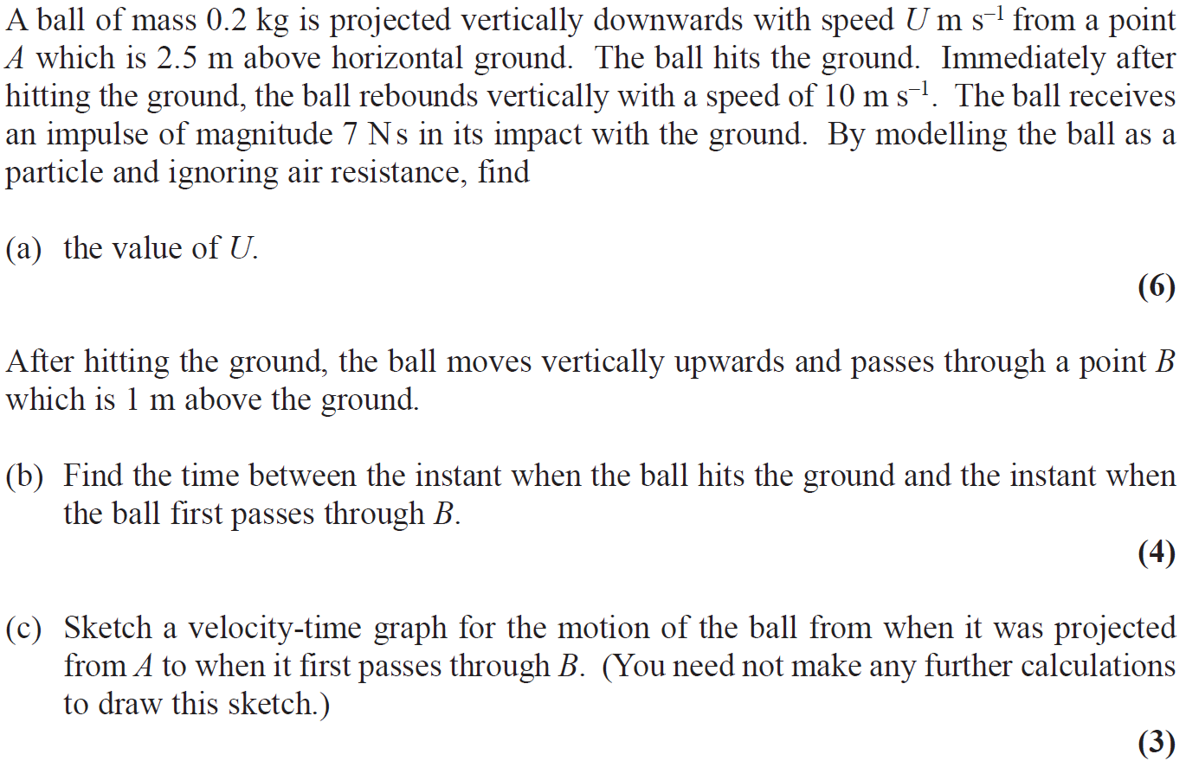
June 2018

Slide 18
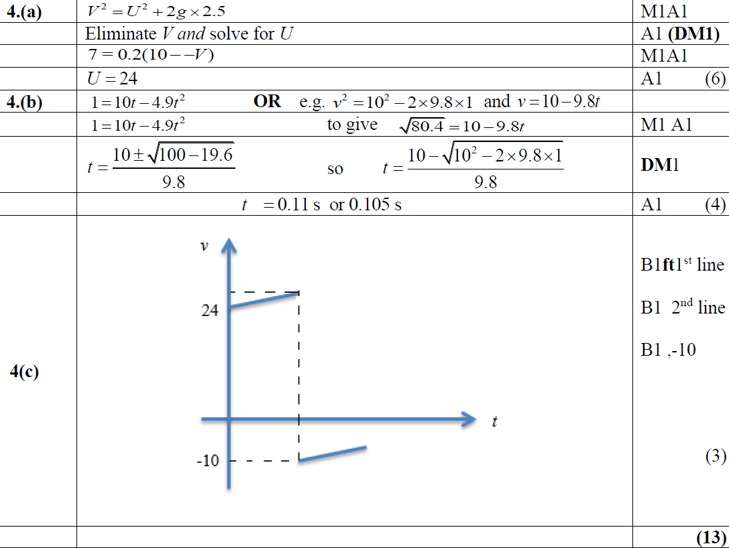
June 2018
A
B
C

Slide 19
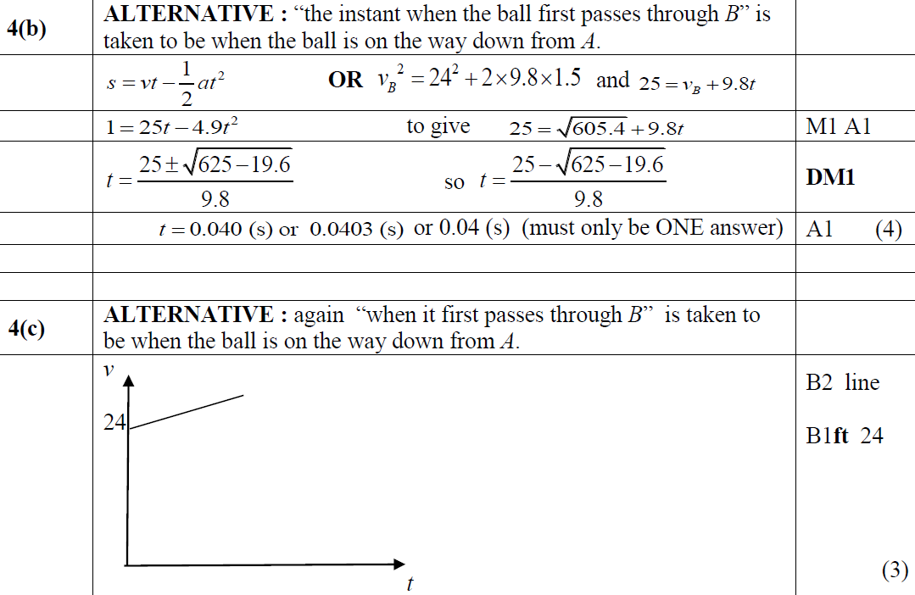
June 2018
B Alternative
C Alternative

Slide 20
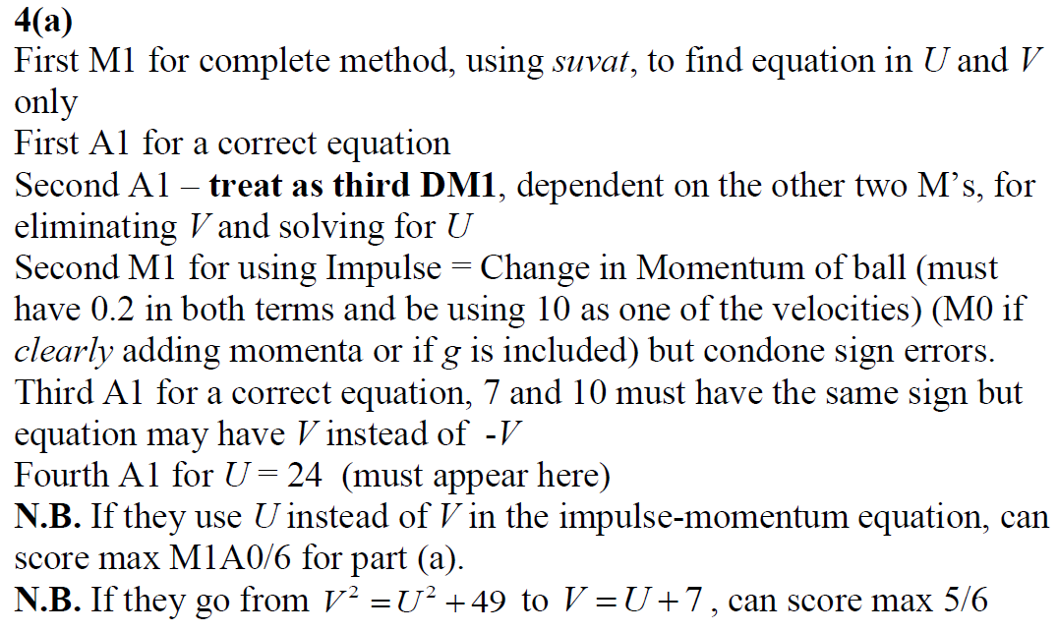
June 2018
A Notes

Slide 21
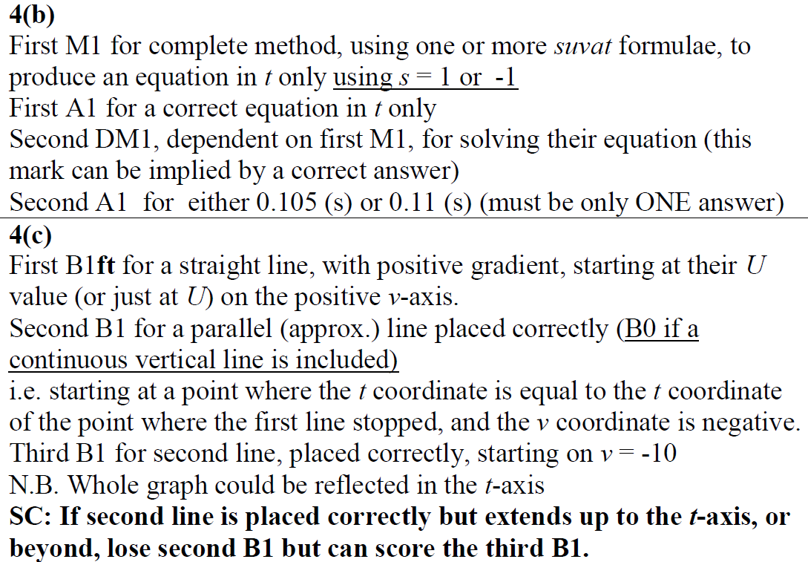
June 2018
B Notes
C Notes

Slide 22
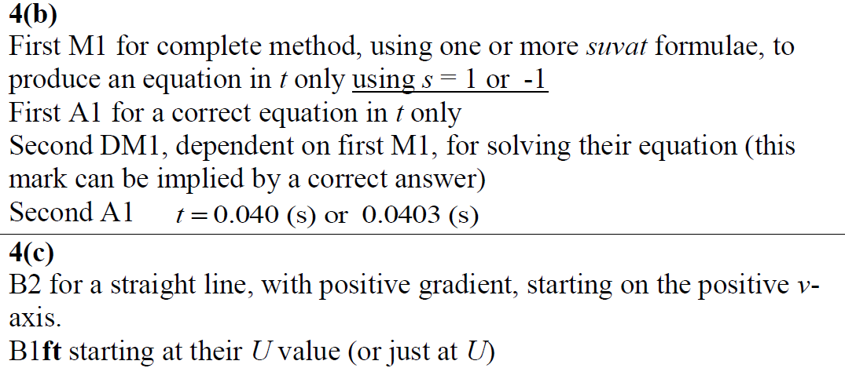
June 2018
B Further Notes
C Further Notes

Slide 23
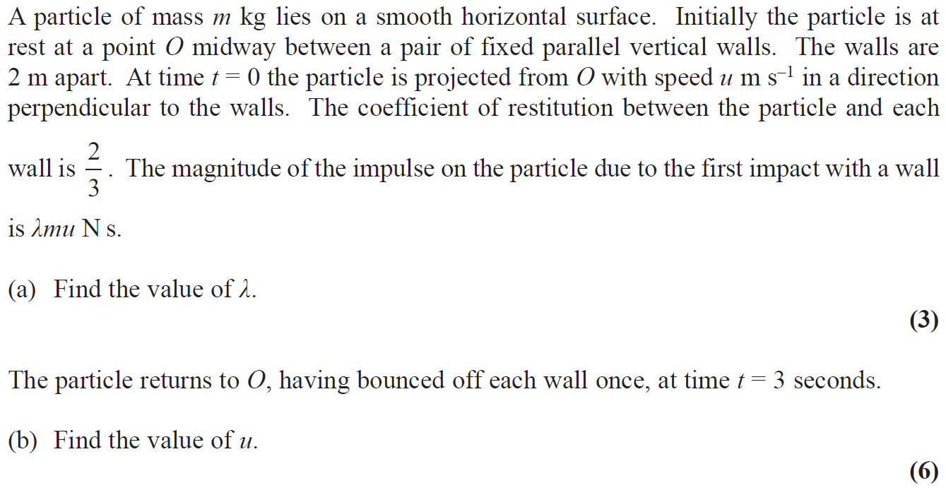
June 2014

Slide 24
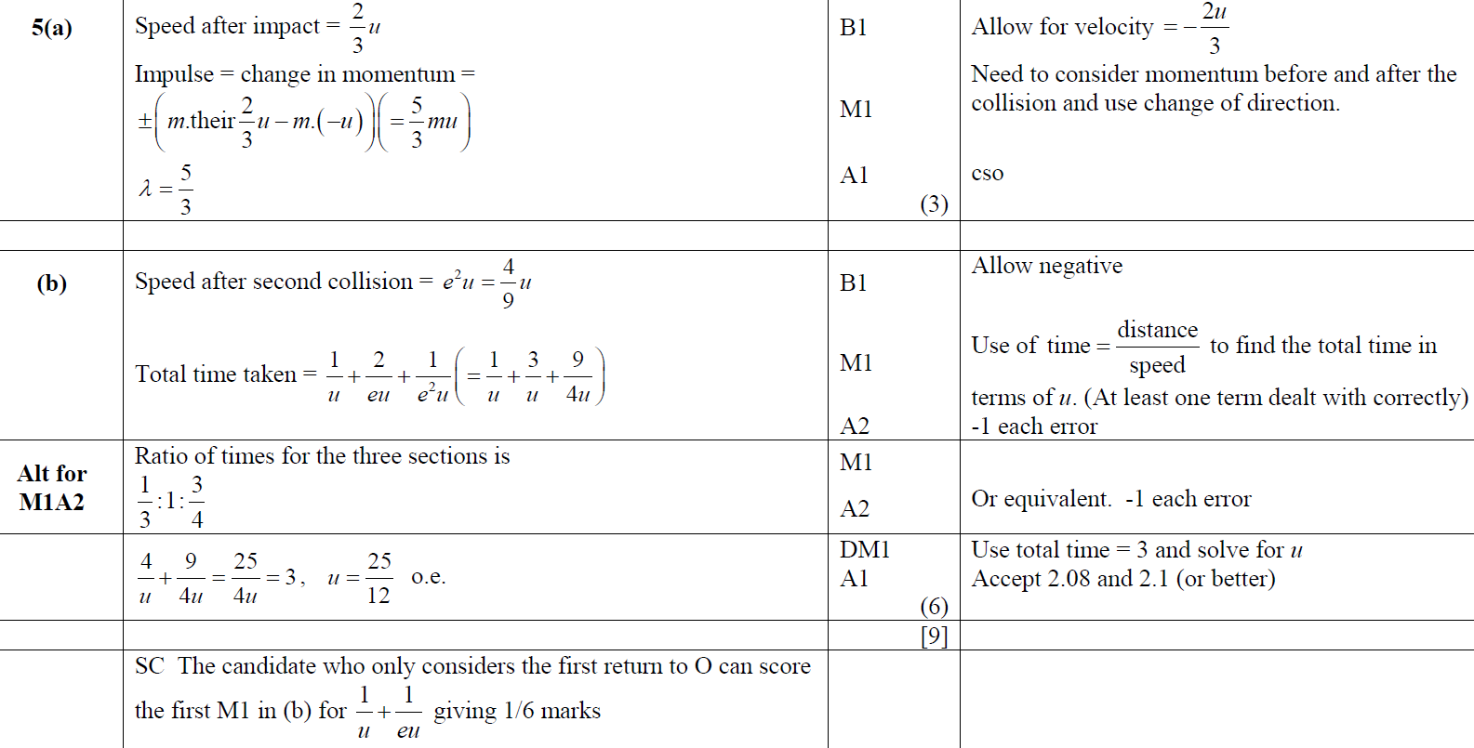
June 2014
A
B

