Slide 1
Basic Trigonometry
Basic Trigonometry
June 2017
2H Q21*
Nov 2018
2H Q13*
June 2017
3H Q7
Nov 2018
3H Q6
Edexcel
SAM
2H Q2
June 2017
3H Q18
Nov 2018
3H Q12
AQA
SAM
3H Q16
Nov 2017
2H Q7
June 2019
2H Q5
OCR
Spec 1
3H Q9
Nov 2017
2H Q20
June 2019
2H Q19
June 2018
2H Q18
June 2019
3H Q21
June 2018
3H Q5
3D
*May use Pythagoras instead

Slide 2
Basic Trigonometry
Basic Trigonometry
SAM
1H Q13
June 2017
2H Q7
Nov 2017
3H Q27
Edexcel
SAM
2H Q14
June 2017
3H Q25
June 2018
2H Q19
AQA
1 Marker
SAM
2H Q24
Nov 2017
2H Q9
June 2018
3H Q25
OCR
SAM
3H Q15
Nov 2017
2H Q17
Nov 2018
3H Q11
3D
*May use Pythagoras instead

Slide 3
Basic Trigonometry
Basic Trigonometry
May 2017
1H Q7
June 2018
2H Q11
Edexcel
SAM
2H Q17
June 2017
3H Q18
June 2018
3H Q12
AQA
Practice
1H Q11
Nov 2017
1H Q14
Nov 2018
1H Q20
OCR
Practice
3H Q2*
Nov 2017
2H Q8
Nov 2018
2H Q13
May 2018
1H Q8
3D
*May use Pythagoras instead

Slide 4
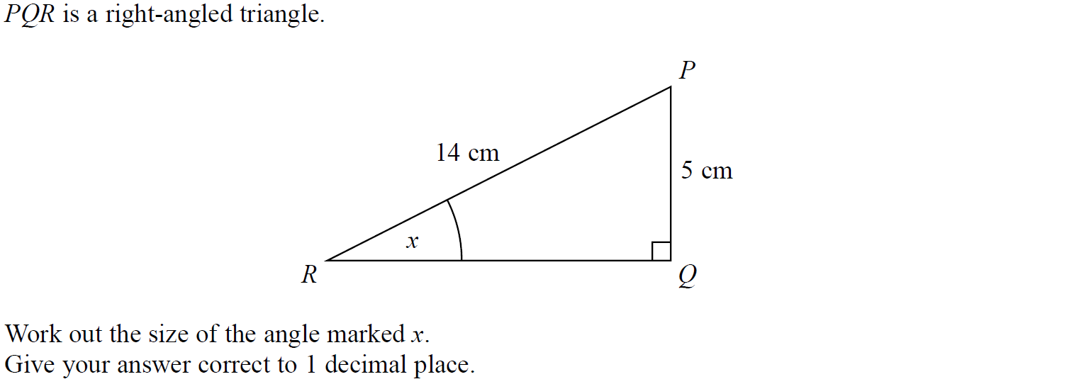
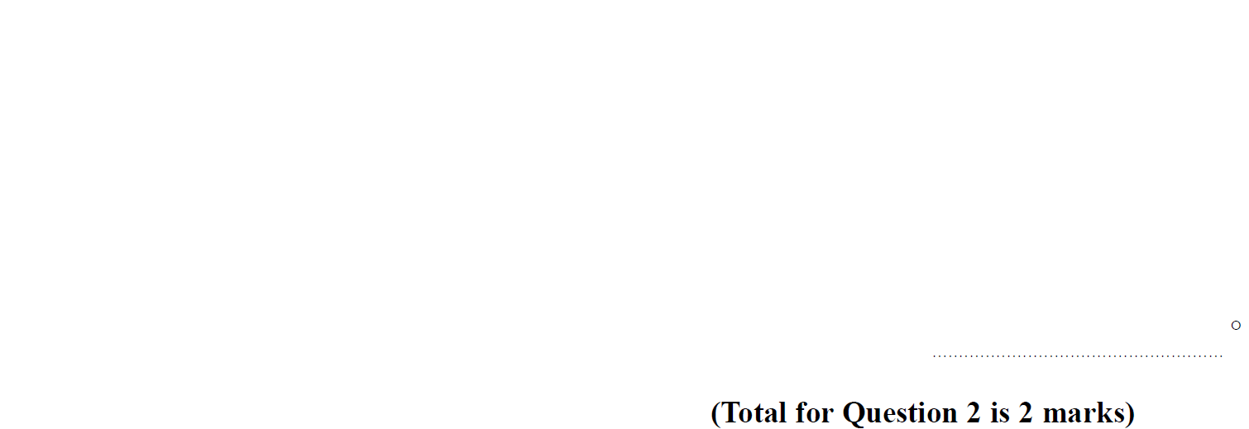
Basic Trigonometry
SAM 2H Q2

Slide 5
Basic Trigonometry
SAM 2H Q2
A

Slide 6
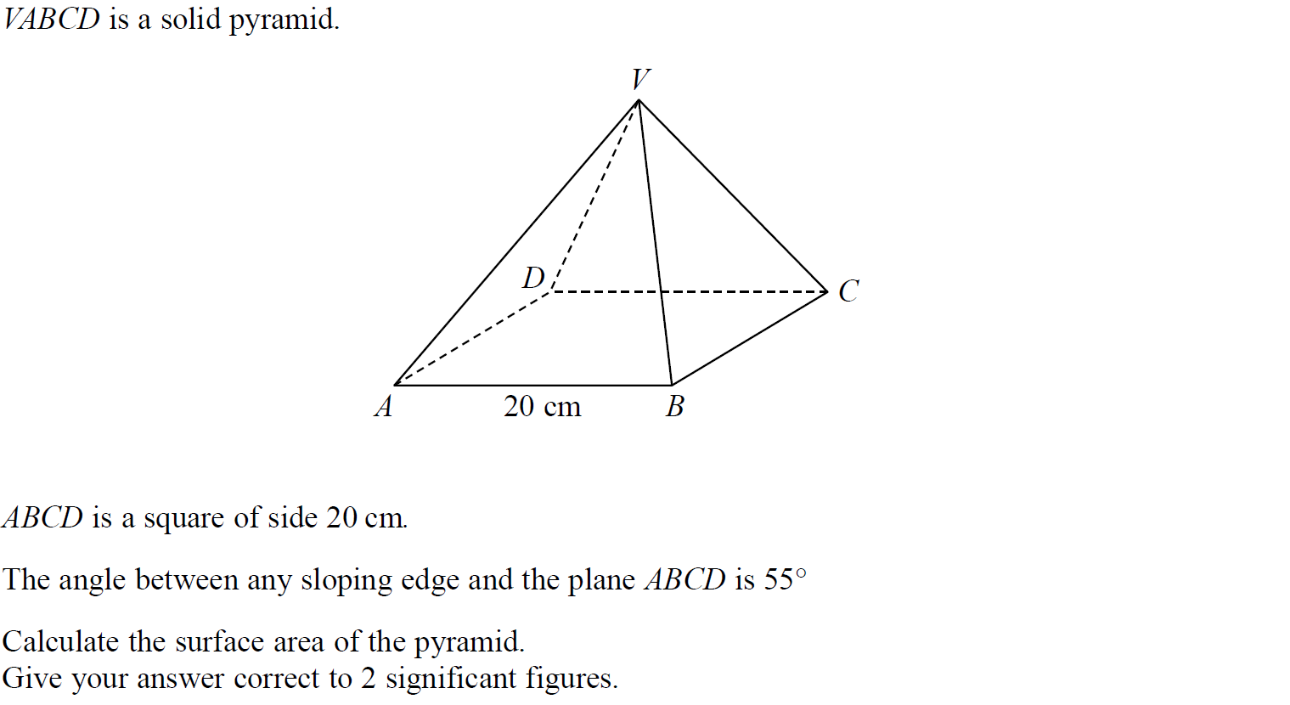
Basic Trigonometry
SAM 3H Q16

Slide 7
Basic Trigonometry
SAM 3H Q16
A

Slide 8
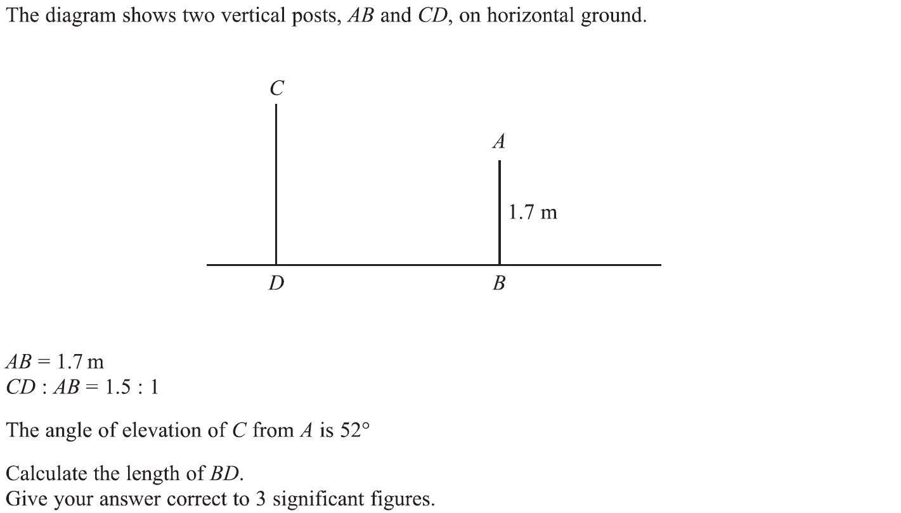
Basic Trigonometry
Specimen Set 1 3H Q9

Slide 9
Basic Trigonometry
Specimen Set 1 3H Q9
A

Slide 10
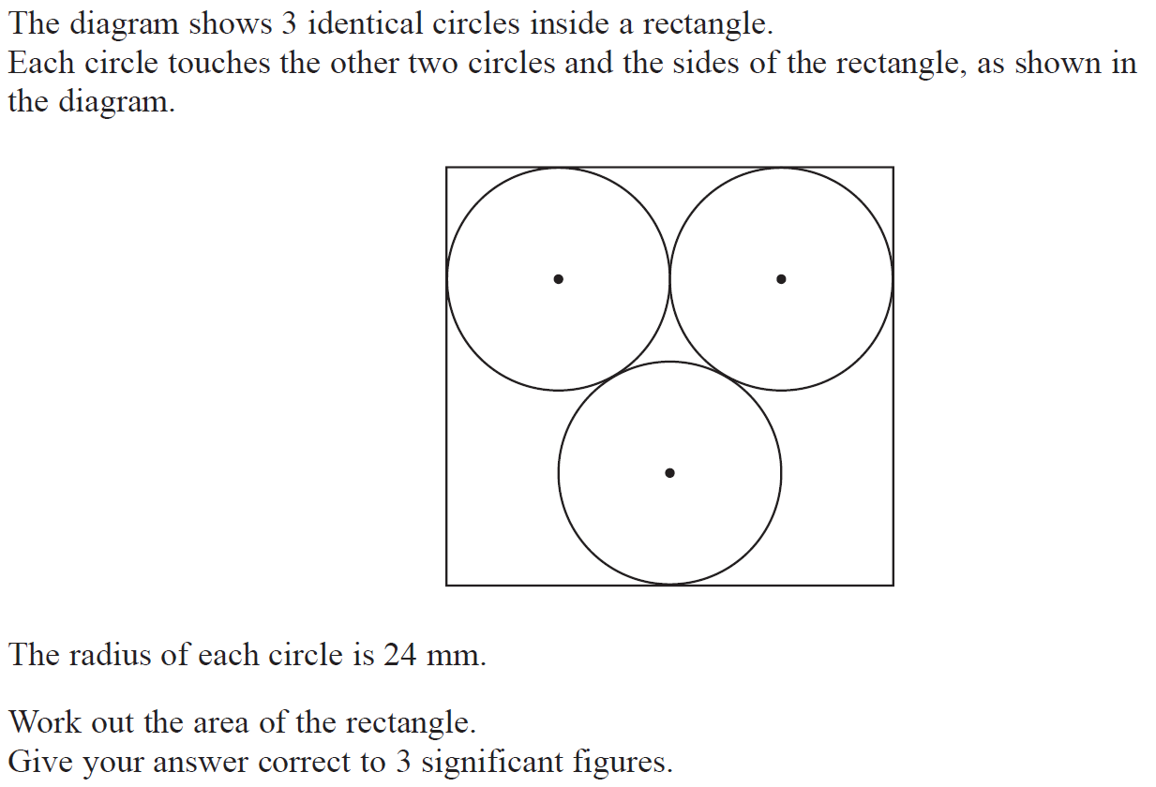
Basic Trigonometry
June 2017 2H Q21

Slide 11
Basic Trigonometry
June 2017 2H Q21
A

Slide 12
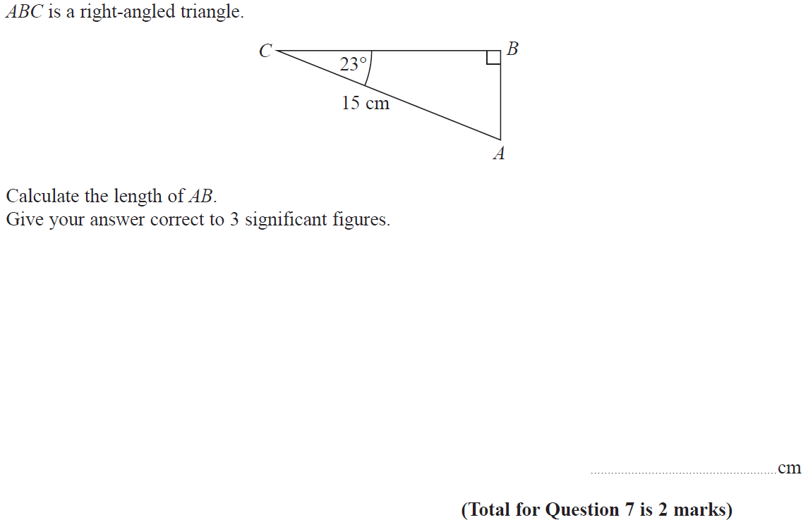
Basic Trigonometry
June 2017 3H Q7

Slide 13
Basic Trigonometry
June 2017 3H Q7
A

Slide 14
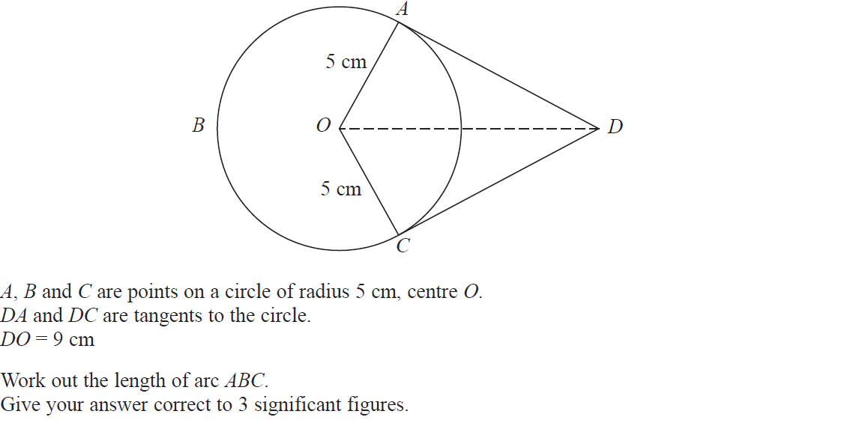
Basic Trigonometry
June 2017 3H Q18

Slide 15
Basic Trigonometry
June 2017 3H Q18
A

Slide 16
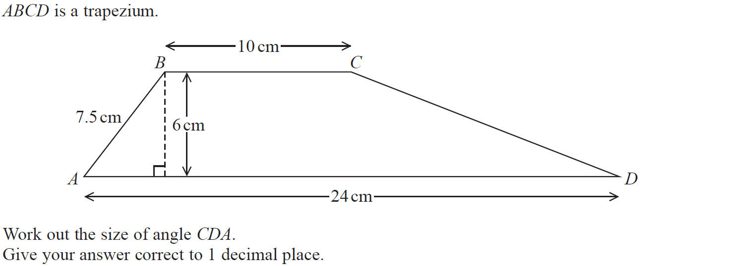
Basic Trigonometry
Nov 2017 2H Q7

Slide 17
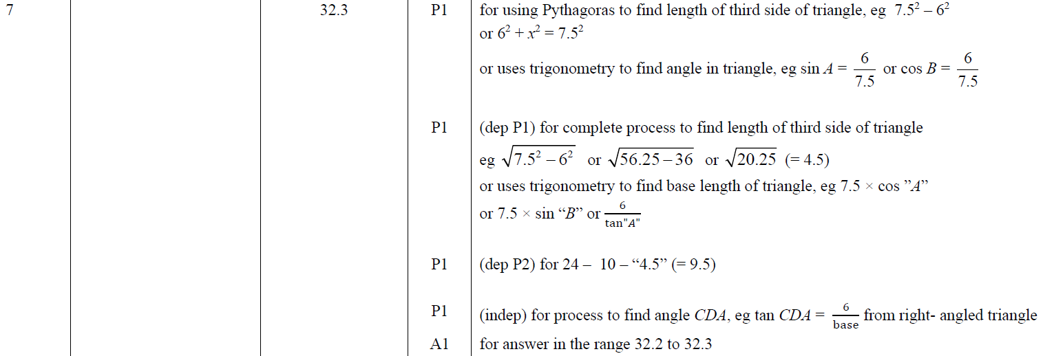
Basic Trigonometry
Nov 2017 2H Q7
A

Slide 18
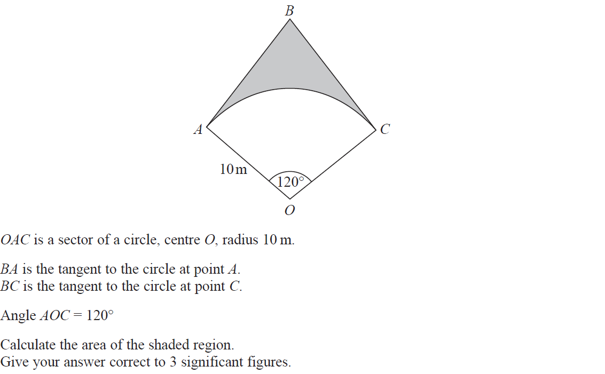
Basic Trigonometry
Nov 2017 2H Q20

Slide 19
Basic Trigonometry
Nov 2017 2H Q20
A

Slide 20
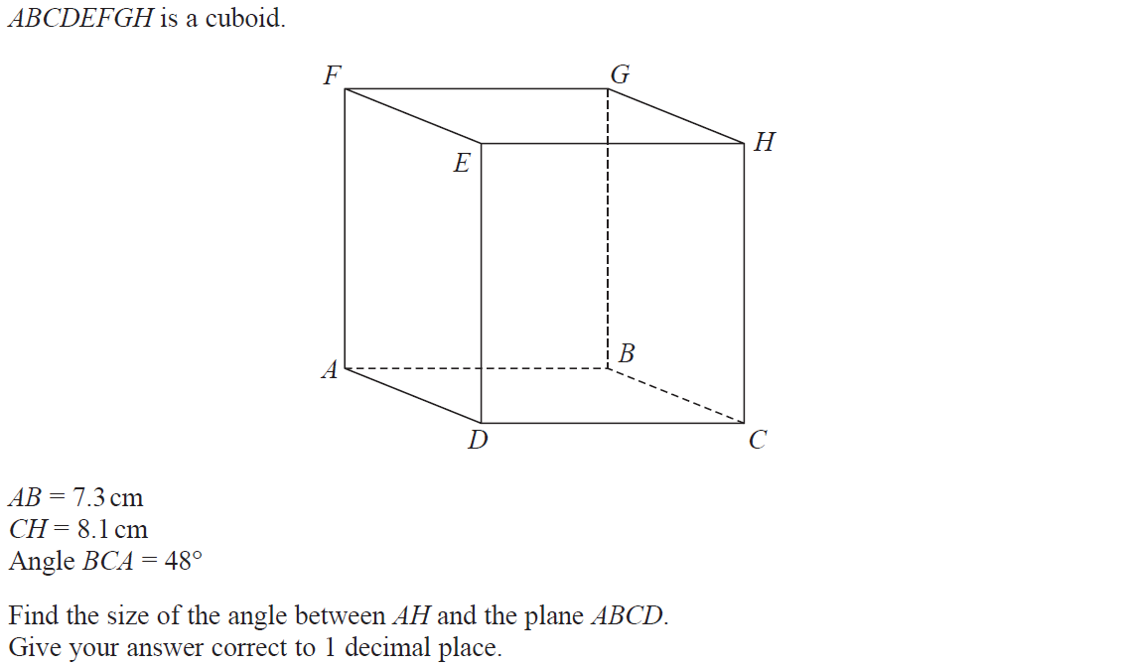
Basic Trigonometry
June 2018 2H Q18

Slide 21
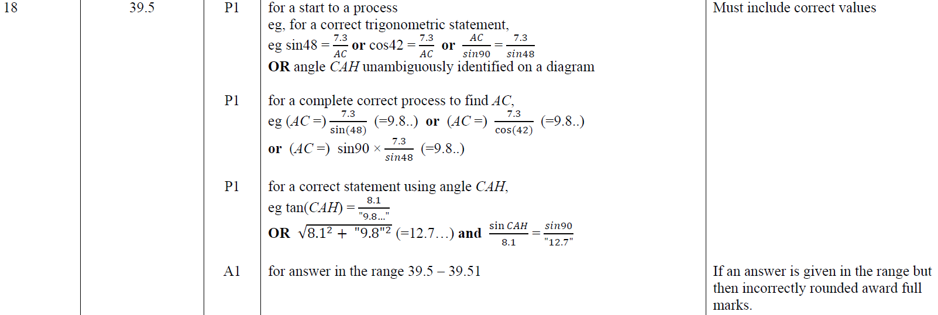
Basic Trigonometry
June 2018 2H Q18
A

Slide 22
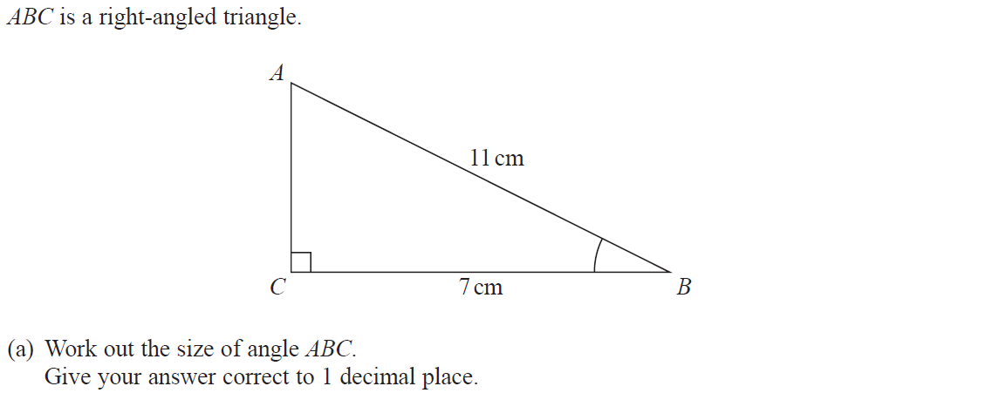
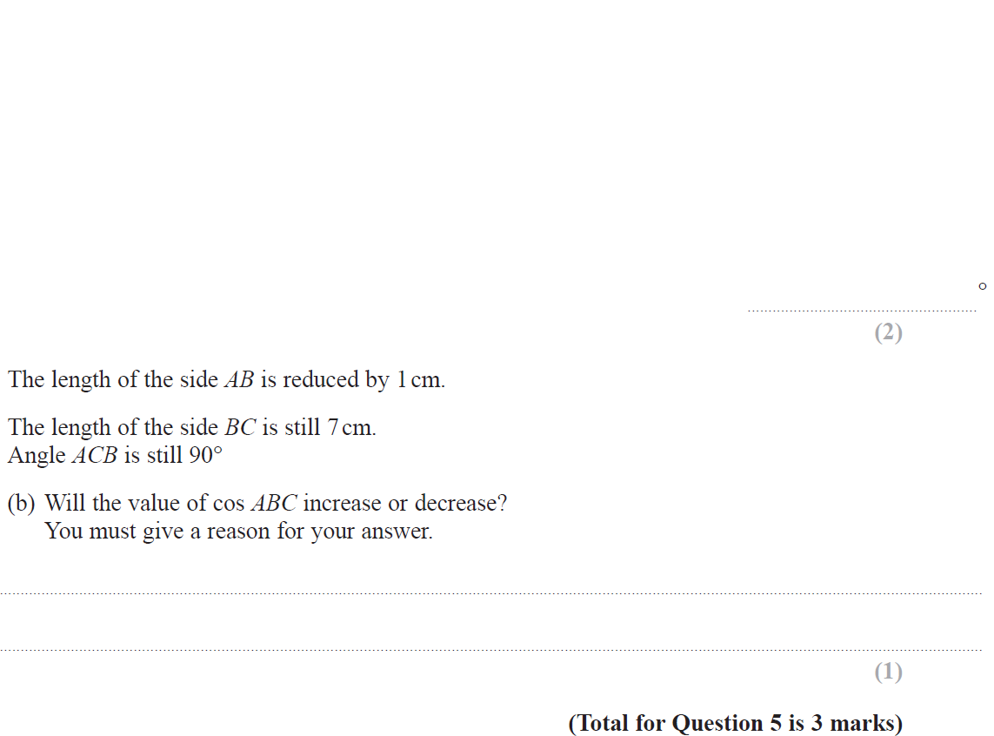
Basic Trigonometry
June 2018 3H Q5

Slide 23
Basic Trigonometry
June 2018 3H Q5
A
B

Slide 24
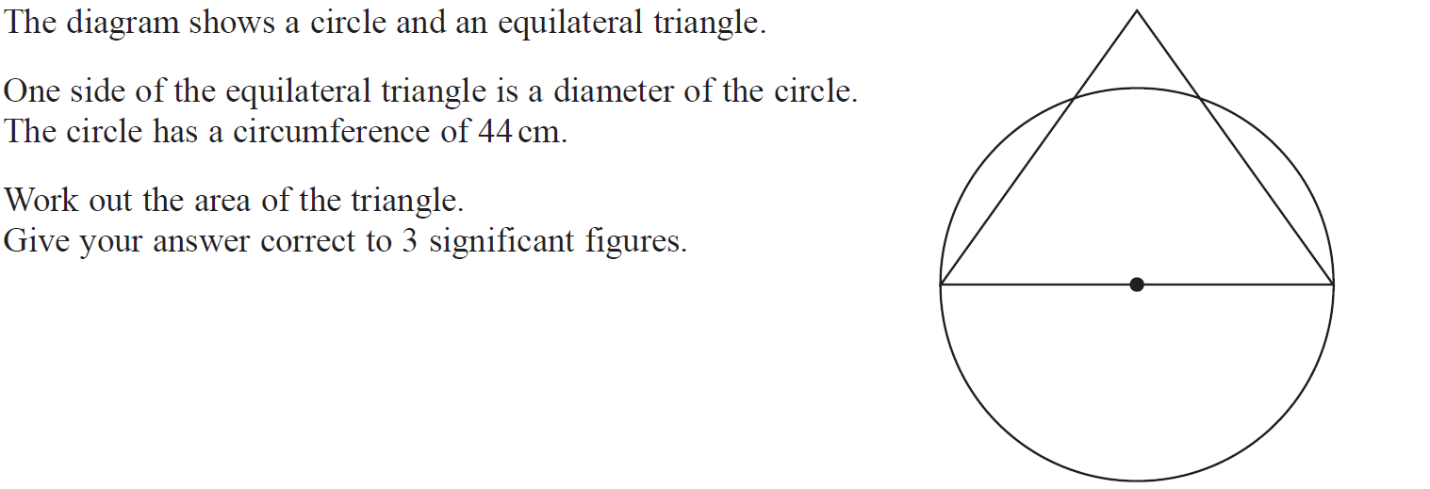
Basic Trigonometry
Nov 2018 2H Q13

Slide 25
Basic Trigonometry
Nov 2018 2H Q13
A

Slide 26
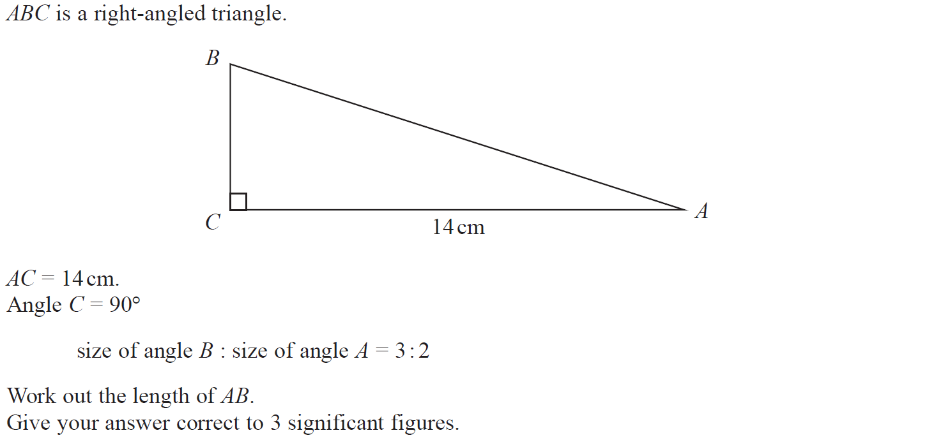
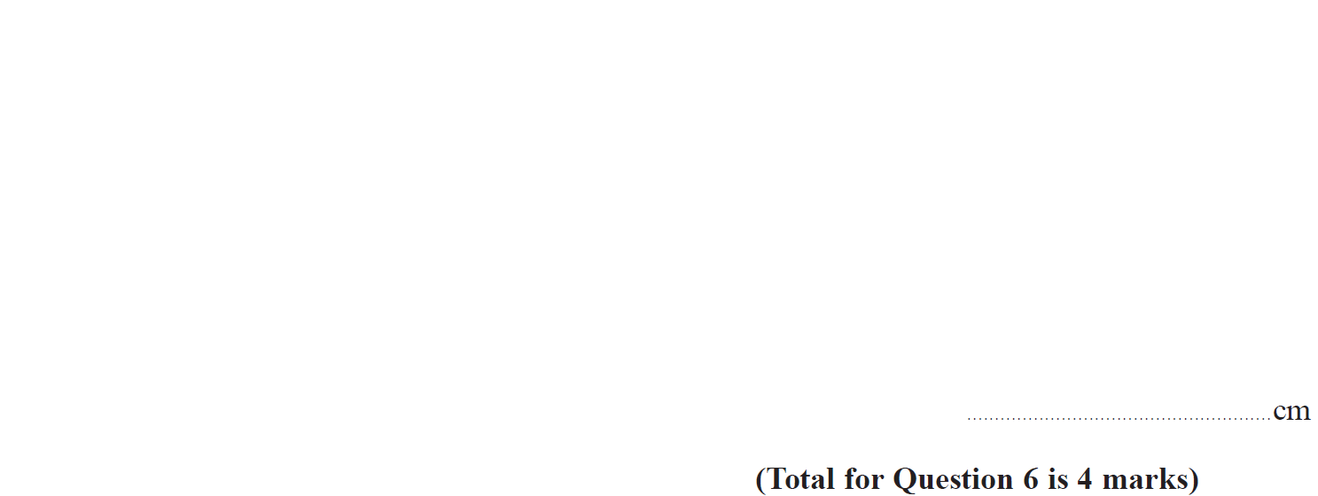
Basic Trigonometry
Nov 2018 3H Q6

Slide 27
Basic Trigonometry
Nov 2018 3H Q6
A

Slide 28
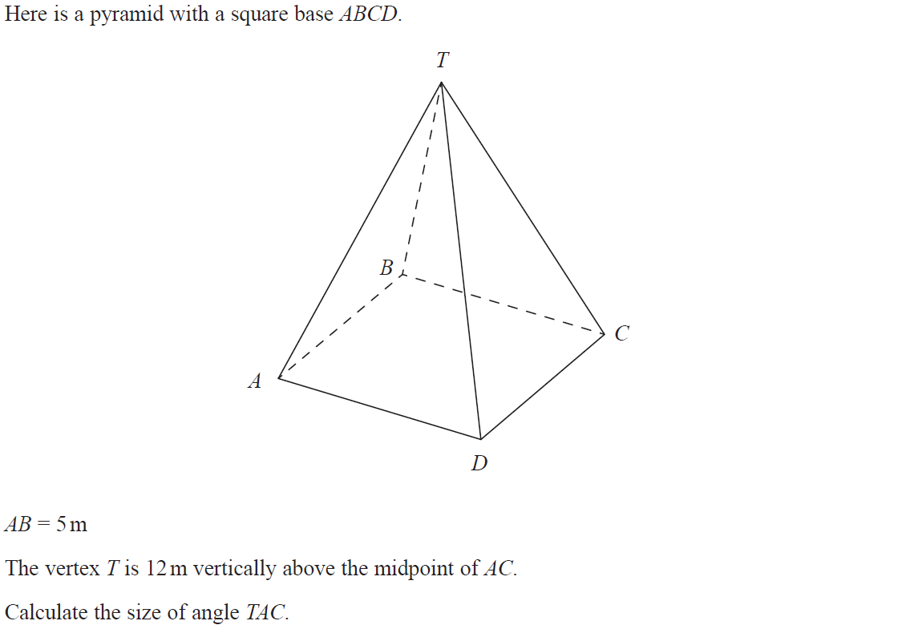
Basic Trigonometry
Nov 2018 3H Q12

Slide 29
Basic Trigonometry
Nov 2018 3H Q12
A

Slide 30
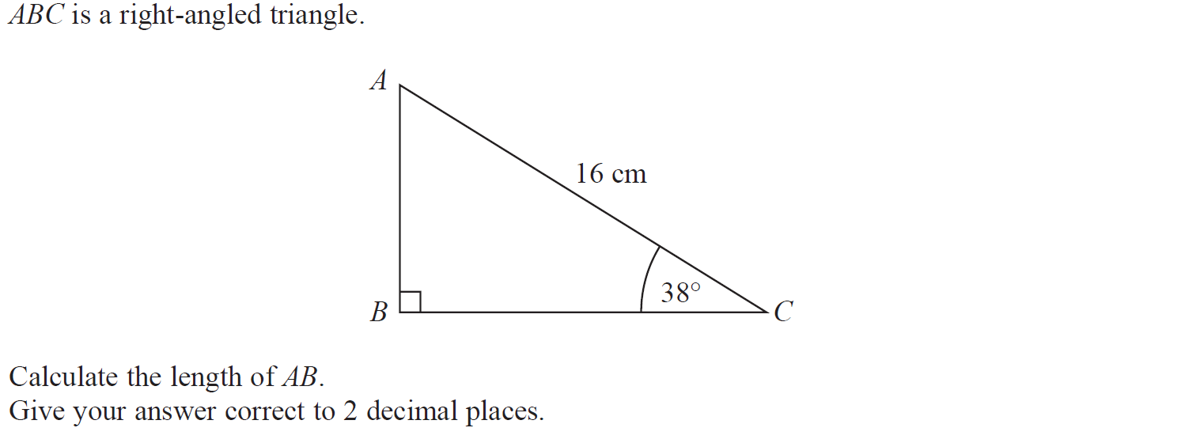
Basic Trigonometry
June 2019 2H Q5

Slide 31
Basic Trigonometry
June 2019 2H Q5
A
A SF

Slide 32
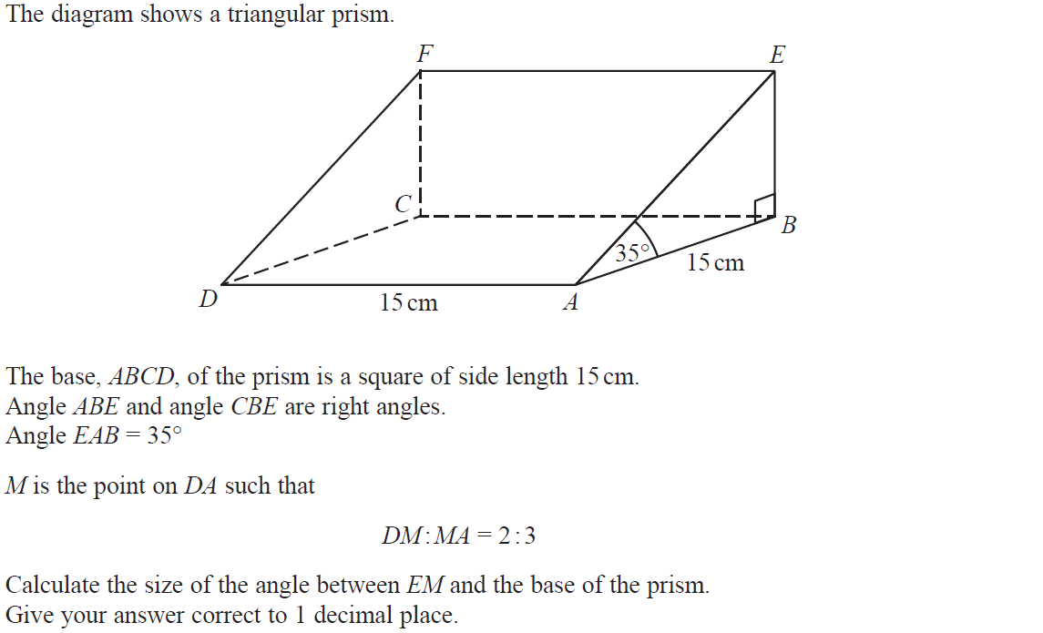
Basic Trigonometry
June 2019 2H Q19

Slide 33
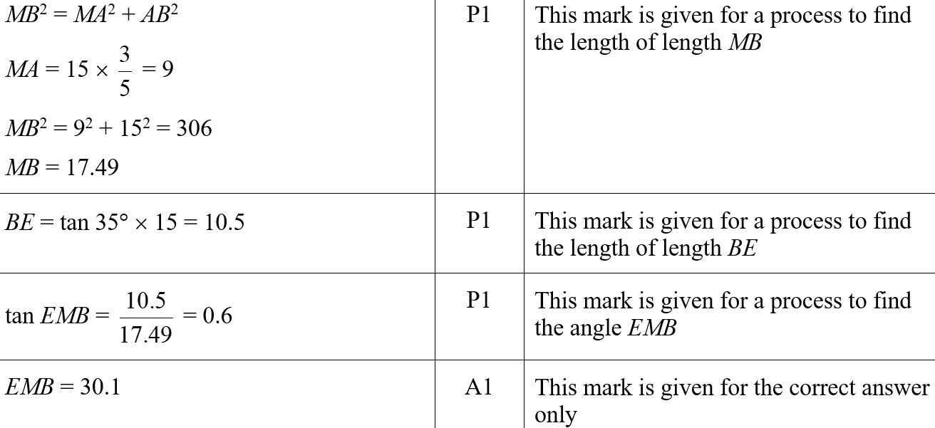
Basic Trigonometry
June 2019 2H Q19
A
A SF

Slide 34
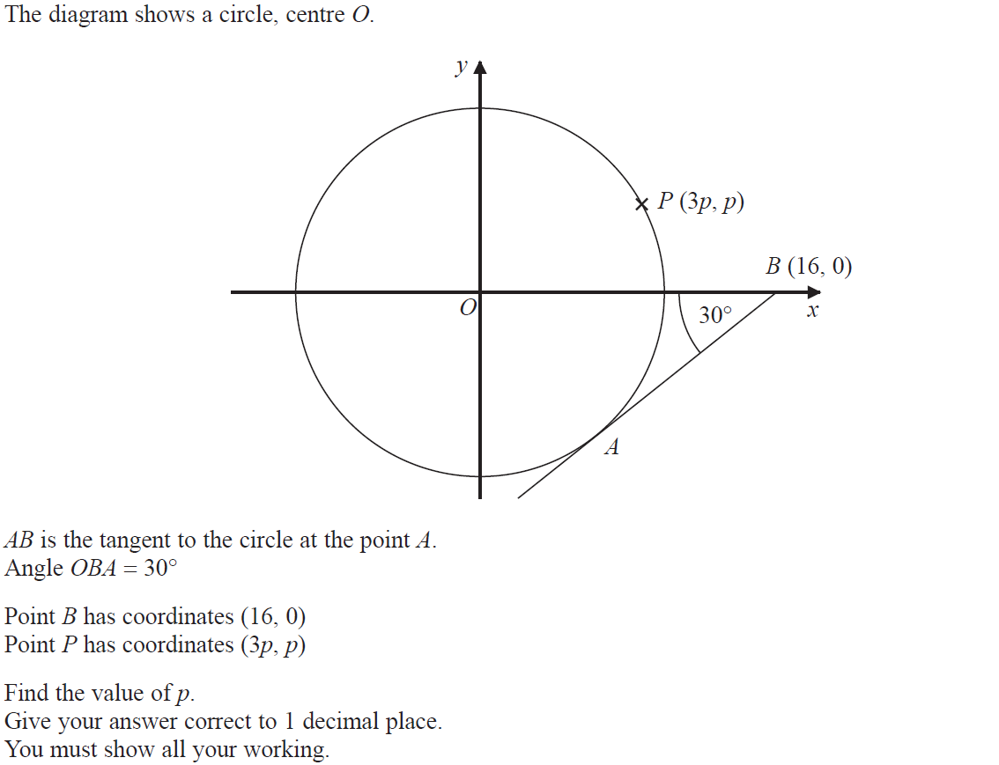
Basic Trigonometry
June 2019 3H Q21

Slide 35
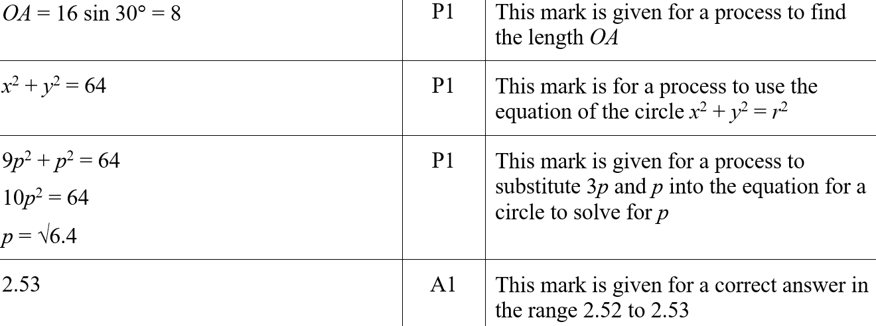
Basic Trigonometry
June 2019 3H Q21
A
A SF

Slide 36
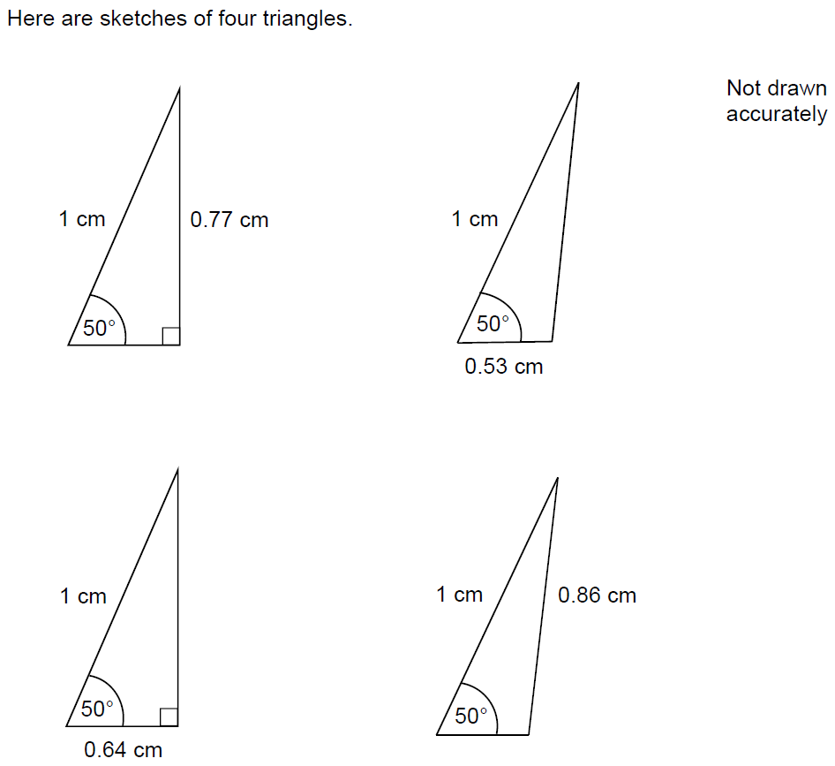
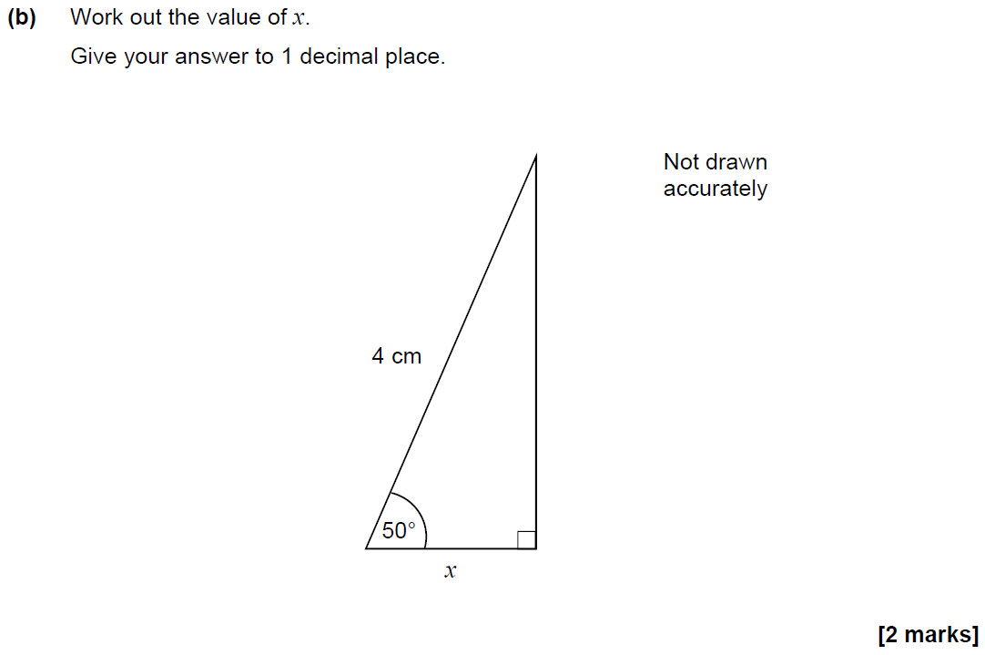
Basic Trigonometry
SAM 1H Q13

Slide 37
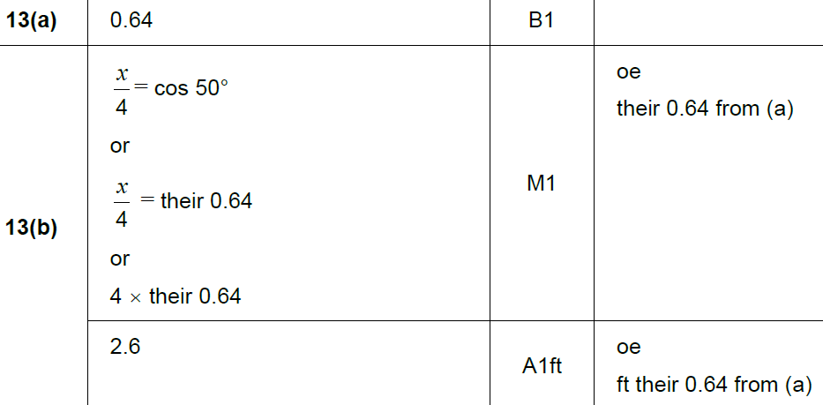
Basic Trigonometry
SAM 1H Q13
A
B

Slide 38
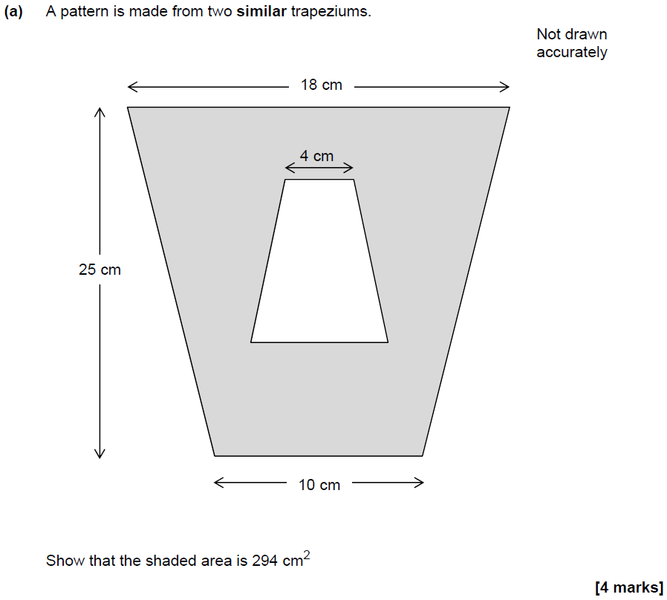
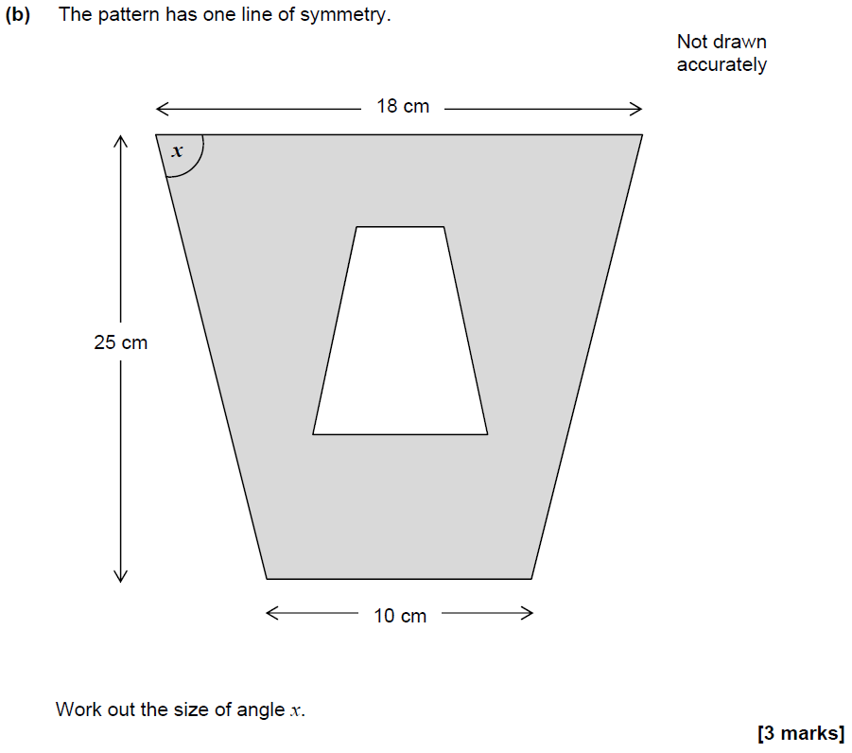
Basic Trigonometry
SAM 2H Q14

Slide 39
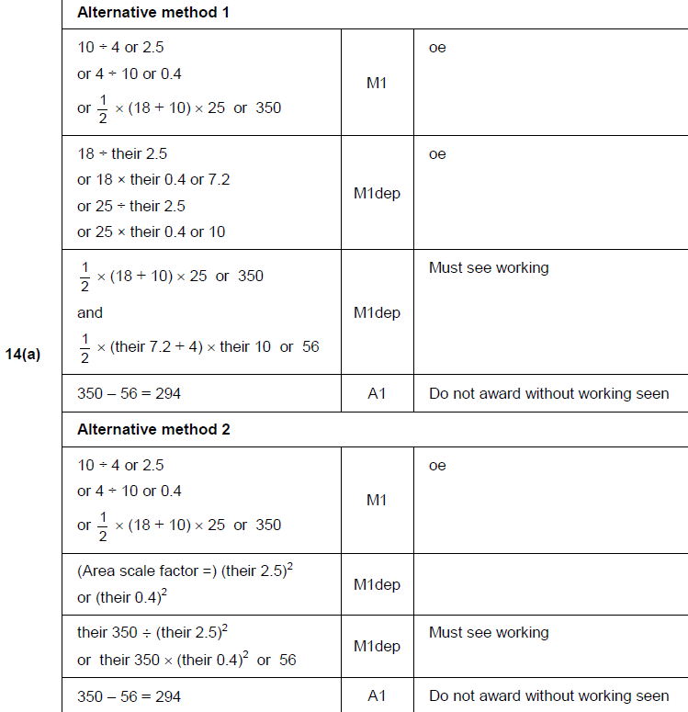
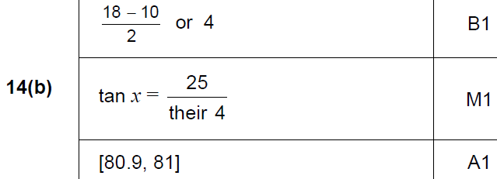
Basic Trigonometry
SAM 2H Q14
A
B

Slide 40
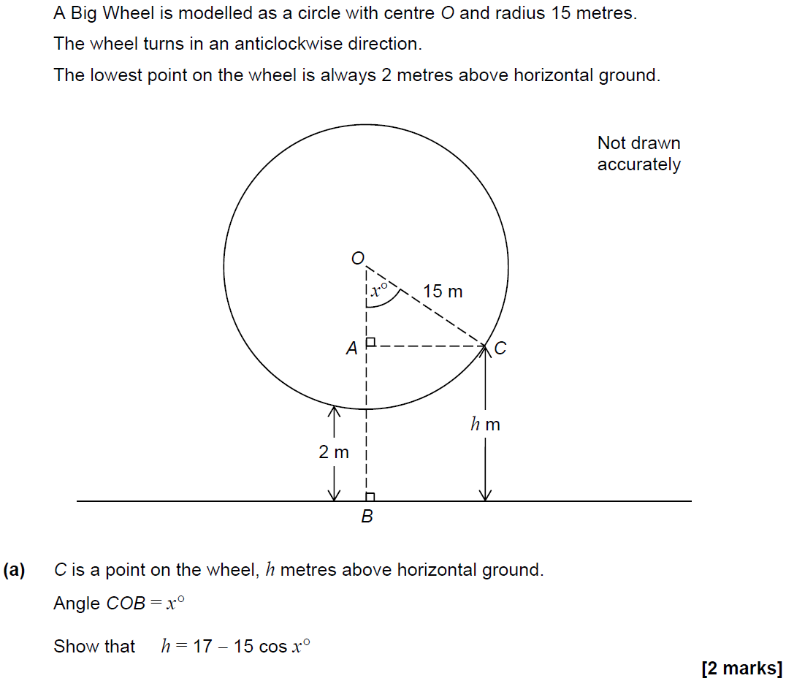
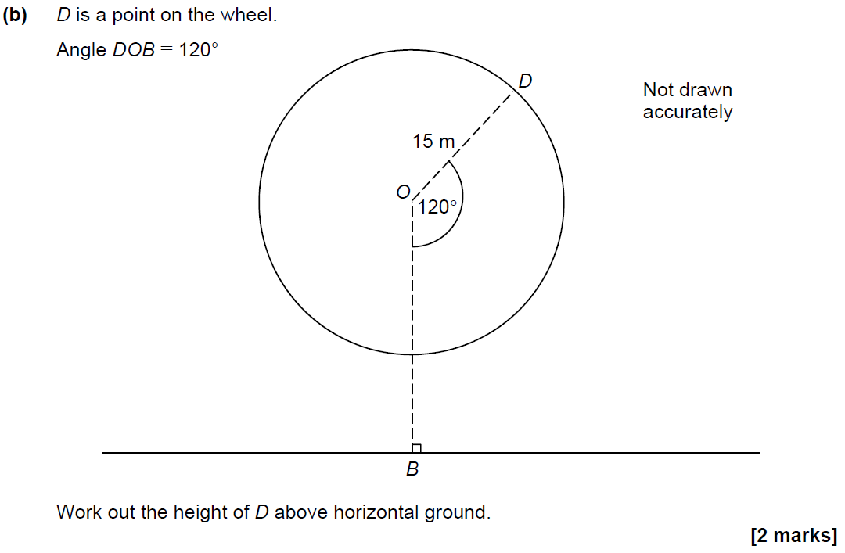
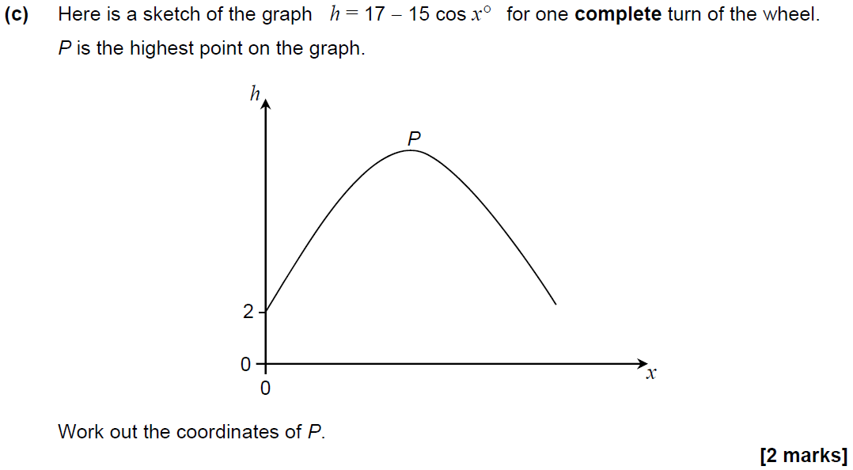
Basic Trigonometry
SAM 2H Q24

Slide 41
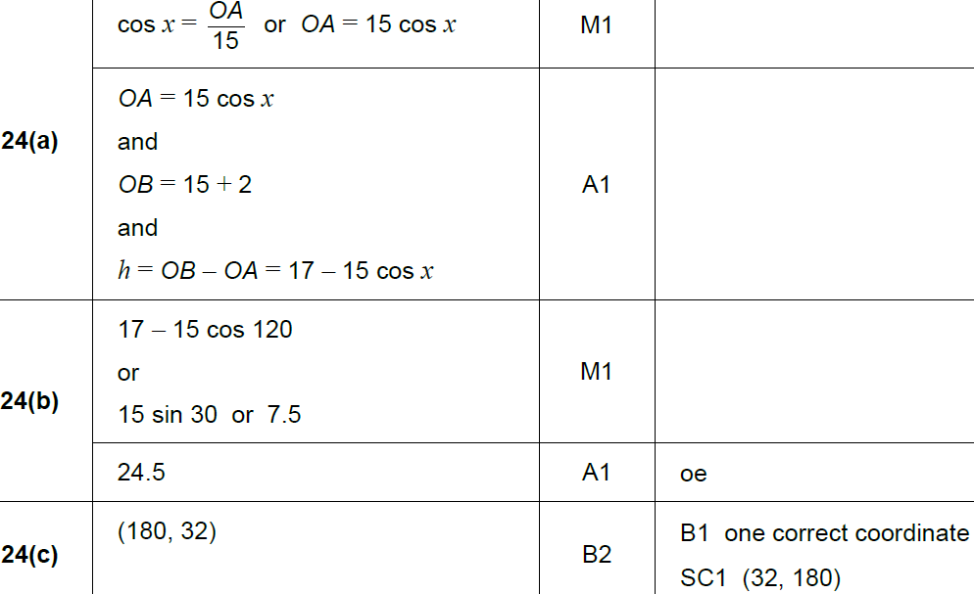
Basic Trigonometry
SAM 2H Q24
A
B
C

Slide 42
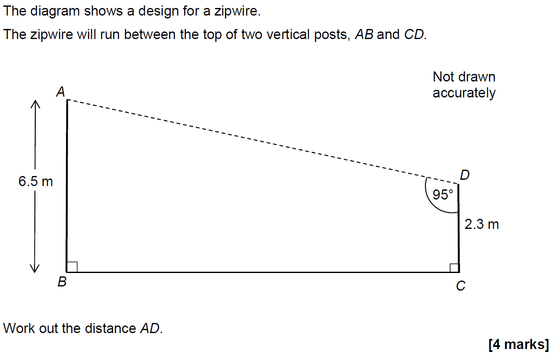
Basic Trigonometry
SAM 3H Q15

Slide 43
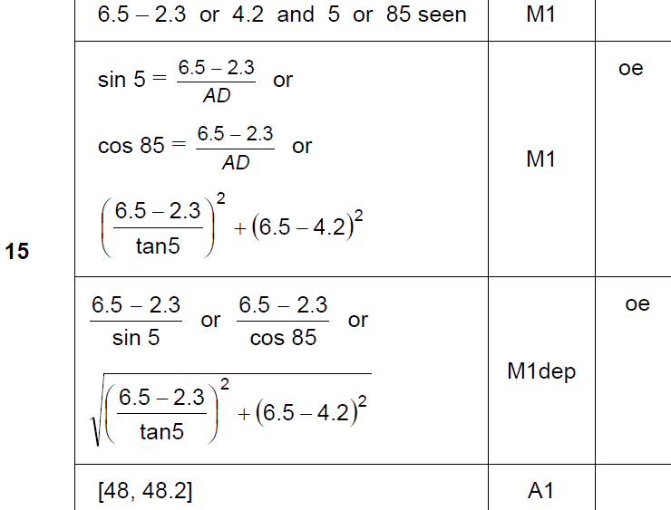
Basic Trigonometry
SAM 3H Q15
A

Slide 44
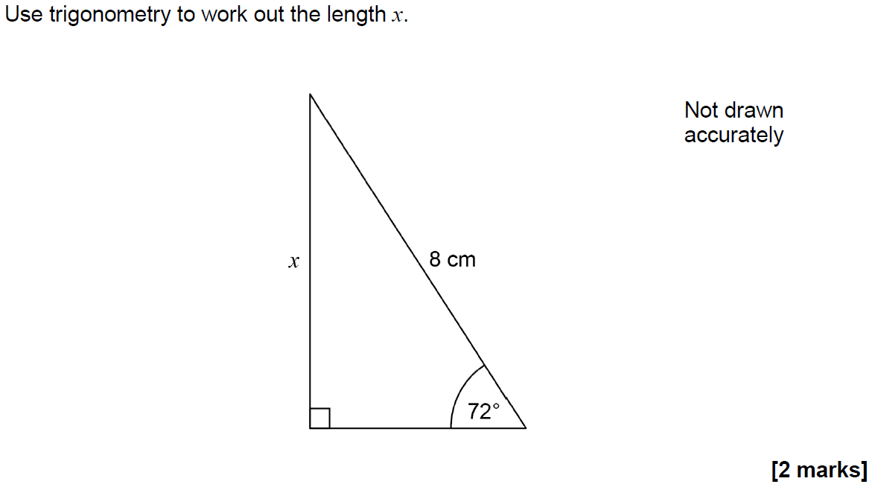
Basic Trigonometry
June 2017 2H Q7

Slide 45
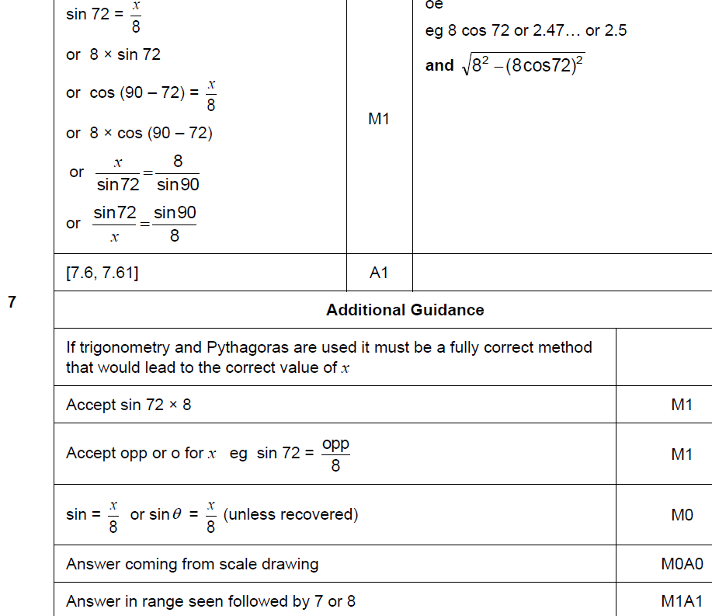
Basic Trigonometry
June 2017 2H Q7
A

Slide 46
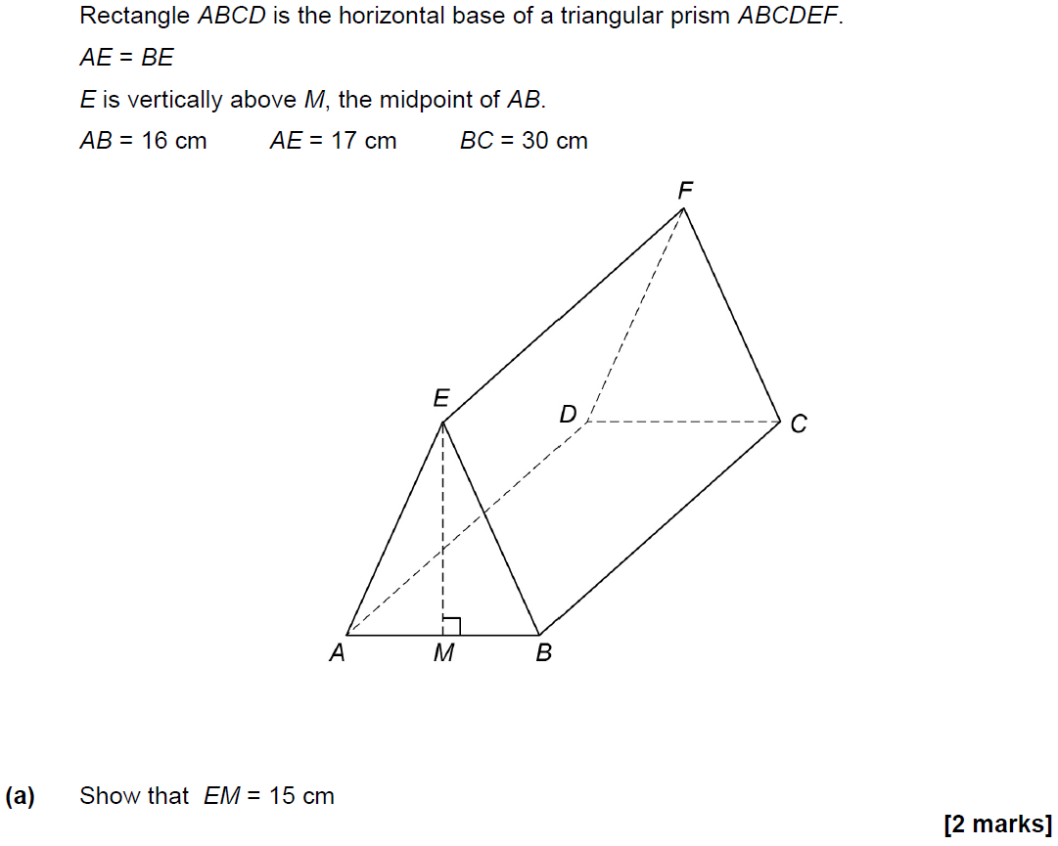
Basic Trigonometry
June 2017 3H Q25

Slide 47
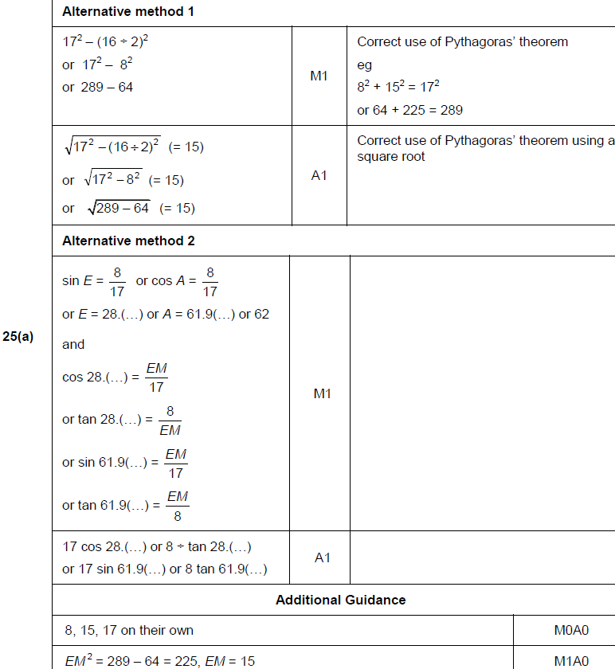
Basic Trigonometry
June 2017 3H Q25
A

Slide 48
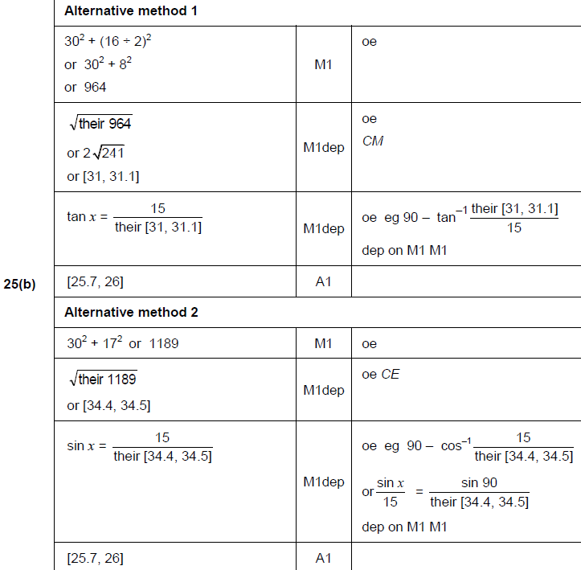
Basic Trigonometry
June 2017 3H Q25
B

Slide 49
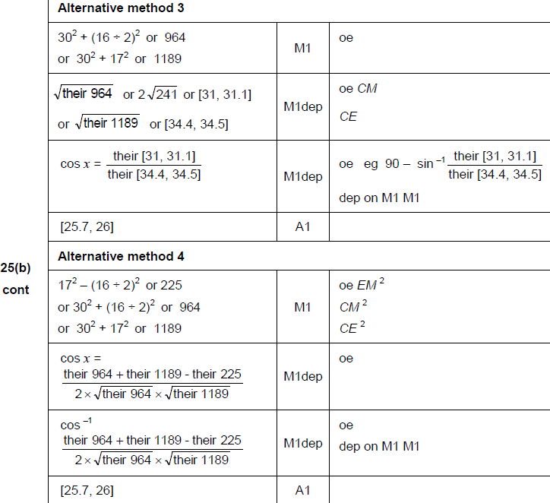
Basic Trigonometry
June 2017 3H Q25
B Alternatives

Slide 50
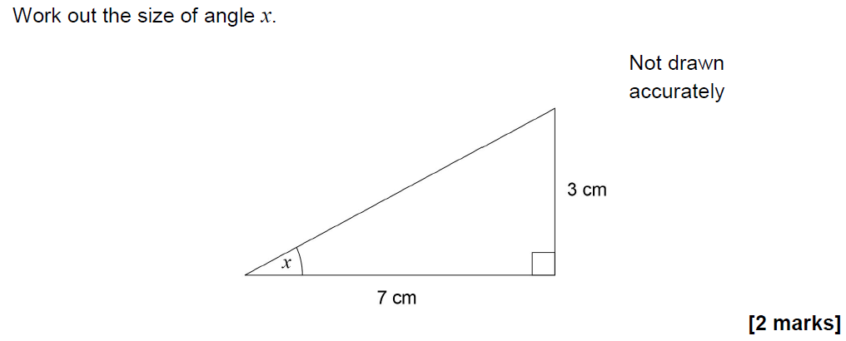
Basic Trigonometry
Nov 2017 2H Q9

Slide 51
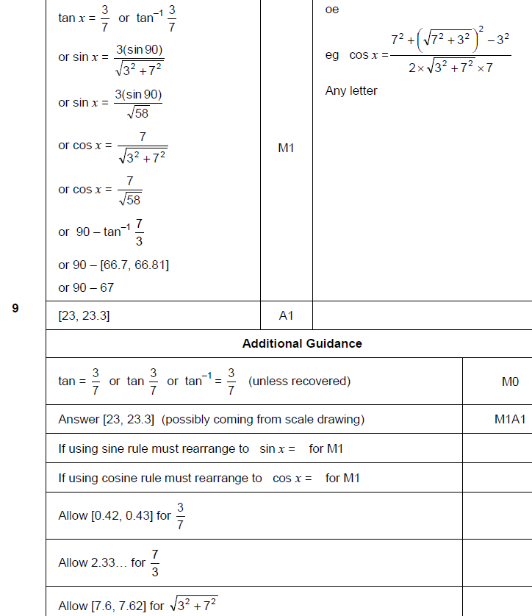
Basic Trigonometry
Nov 2017 2H Q9
A

Slide 52
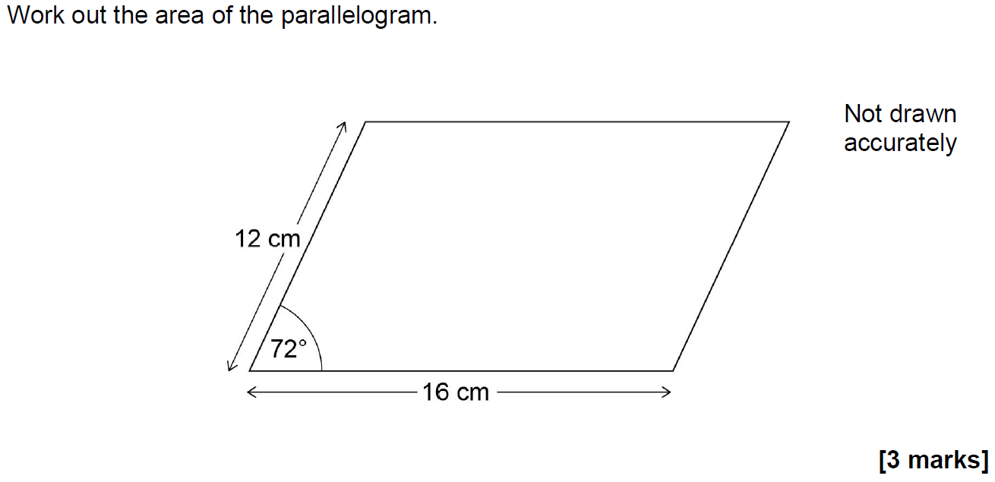
Basic Trigonometry
Nov 2017 2H Q17

Slide 53
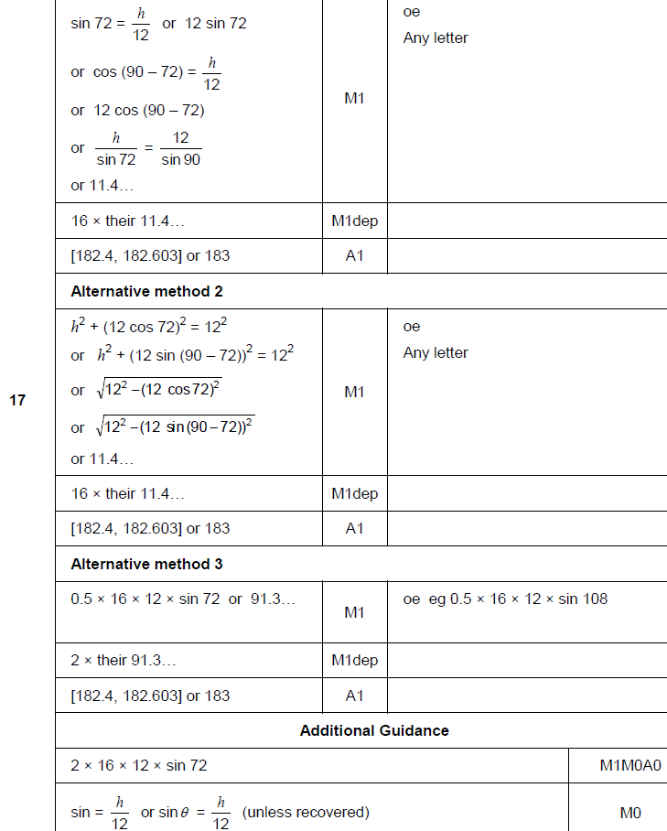
Basic Trigonometry
Nov 2017 2H Q17
A

Slide 54
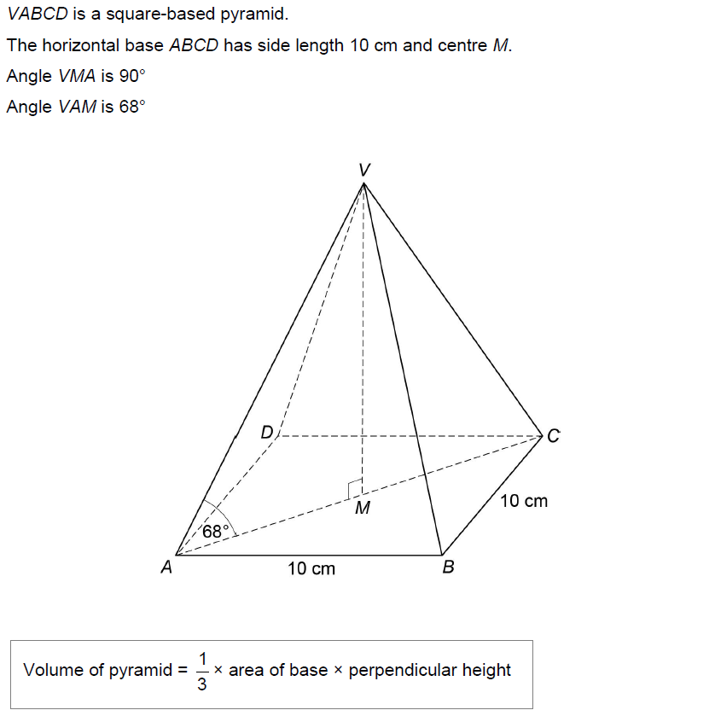
Basic Trigonometry
Nov 2017 3H Q27
Work out the volume of the pyramid.
[6 marks]

Slide 55
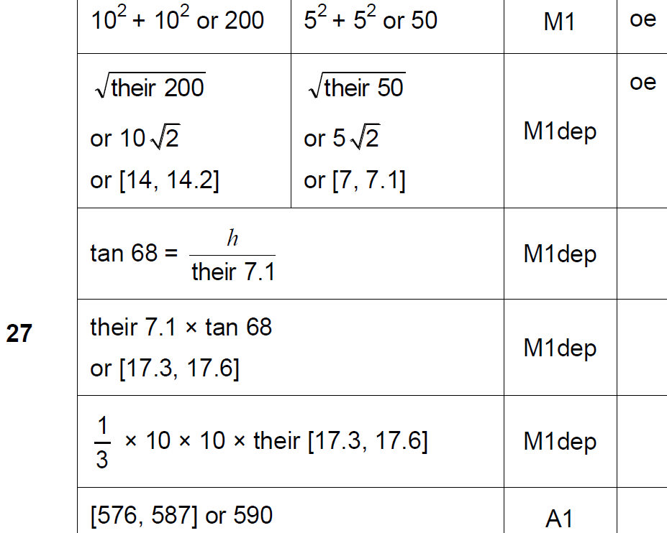
Basic Trigonometry
Nov 2017 3H Q27
A

Slide 56
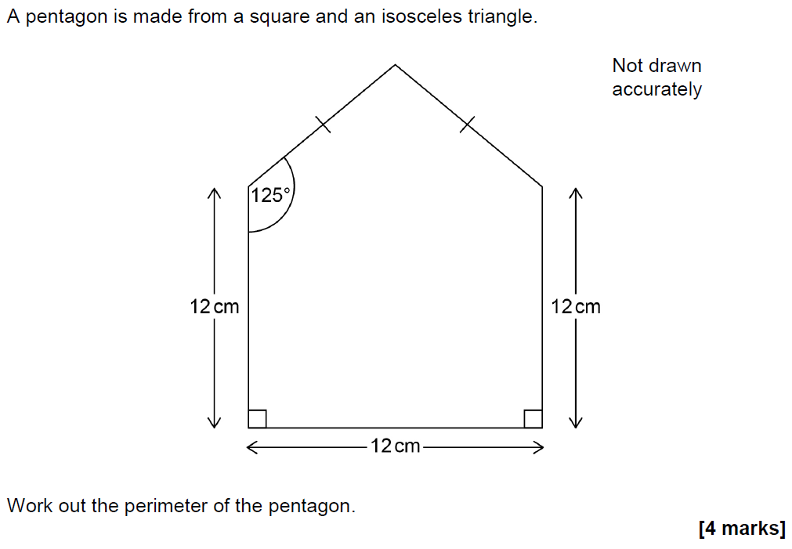
Basic Trigonometry
June 2018 2H Q19

Slide 57
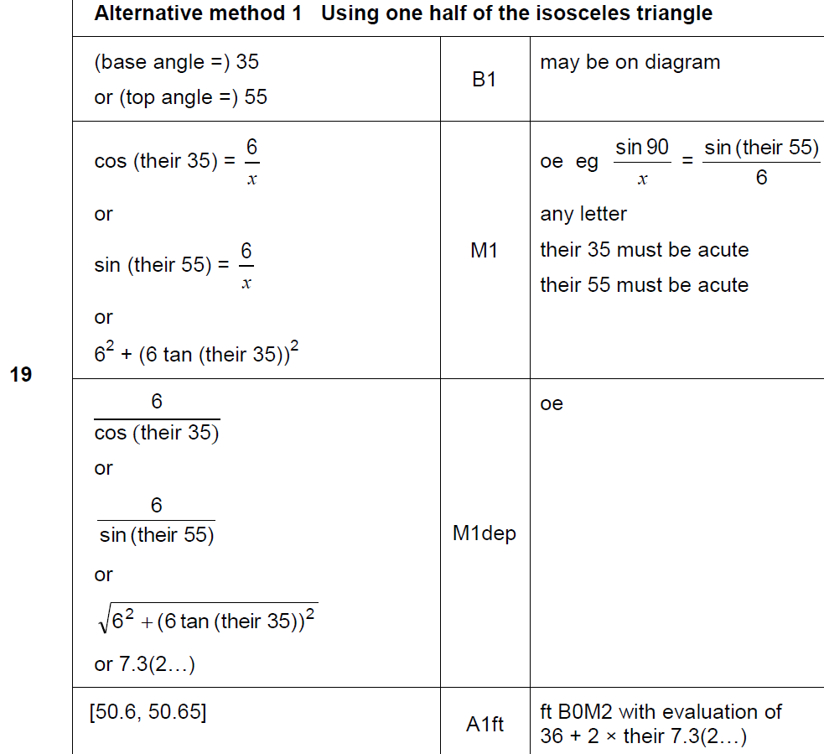
Basic Trigonometry
June 2018 2H Q19
A

Slide 58
Basic Trigonometry
June 2018 2H Q19
A Alternative & notes

Slide 59
Basic Trigonometry
June 2018 3H Q25

Slide 60
Basic Trigonometry
June 2018 3H Q25
A

Slide 61
Basic Trigonometry
June 2018 3H Q25
B

Slide 62
Basic Trigonometry
June 2018 3H Q25
B Alternative

Slide 63
Basic Trigonometry
Nov 2018 3H Q11

Slide 64
Basic Trigonometry
Nov 2018 3H Q11
A

Slide 65
Basic Trigonometry
SAM 2H Q17

Slide 66
Basic Trigonometry
SAM 2H Q17
A
B

Slide 67
Basic Trigonometry
Practice 1H Q11

Slide 68
Basic Trigonometry
Practice 1H Q11
A

Slide 69
Basic Trigonometry
Practice 3H Q2

Slide 70
Basic Trigonometry
Practice 3H Q2
A

Slide 71
Basic Trigonometry
May 2017 1H Q7

Slide 72
Basic Trigonometry
May 2017 1H Q7
A
B

Slide 73
Basic Trigonometry
June 2017 3H Q18

Slide 74
Basic Trigonometry
June 2017 3H Q18
A
B

Slide 75
Basic Trigonometry
Nov 2017 1H Q14

Slide 76
Basic Trigonometry
Nov 2017 1H Q14
A

Slide 77
Basic Trigonometry
Nov 2017 2H Q8

Slide 78
Basic Trigonometry
Nov 2017 2H Q8
A
B

Slide 79
Basic Trigonometry
May 2018 1H Q8

Slide 80
Basic Trigonometry
May 2018 1H Q8
A

Slide 81
Basic Trigonometry
June 2018 2H Q11

Slide 82
Basic Trigonometry
June 2018 2H Q11
A

Slide 83
Basic Trigonometry
June 2018 3H Q12

Slide 84
Basic Trigonometry
June 2018 3H Q12
A

Slide 85
Basic Trigonometry
Nov 2018 1H Q20

Slide 86
Basic Trigonometry
Nov 2018 1H Q20
A

Slide 87
Basic Trigonometry
Nov 2018 2H Q13

Slide 88
Basic Trigonometry
Nov 2018 2H Q13
A
B

