Slide 1
Using a Calculator/ BIDMAS
Using a Calculator / BIDMAS
Old Spec Q’s
No Q’s to date

Slide 2
Using a Calculator/ BIDMAS
Using a Calculator / BIDMAS
New Spec Q’s
May 2004
4H Q1
May 2008
3H Q1
May 2013 3H Q2
May 2017 3H Q5
Nov 2004
4H Q5
Nov 2008
3H Q1
May 2014 3H Q1
June 2017 4HR Q3
May 2005
3H Q1
Nov 2009
4H Q1
Jan 2015 3H Q3
Jan 2018 3H Q2
Nov 2005
3H Q1
Nov 2010
4H Q1
Jan 2015 3HR Q2
May 2018 3H Q1
May 2006
4H Q6
June 2011 3H Q1
May 2015 3HR Q3
May 2018 3HR Q1
Nov 2006
4H Q1
Jan 2012 4H Q1
Jan 2016 4H Q1
May 2007
3H Q1
May 2012 4H Q1
Jan 2016 3HR Q1
Nov 2007
4H Q1
Jan 2013 4H Q1
Jan 2017 4H Q4

Slide 3
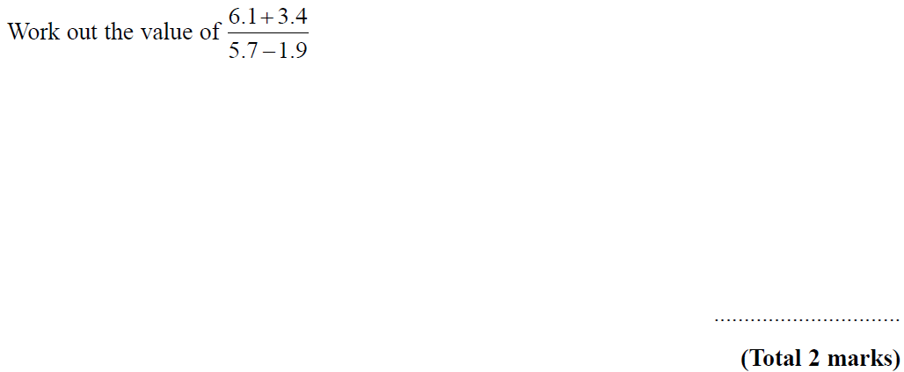
Using a Calculator / BIDMAS
May 2004 4H Q1

Slide 4
Using a Calculator / BIDMAS
May 2004 4H Q1
A

Slide 5
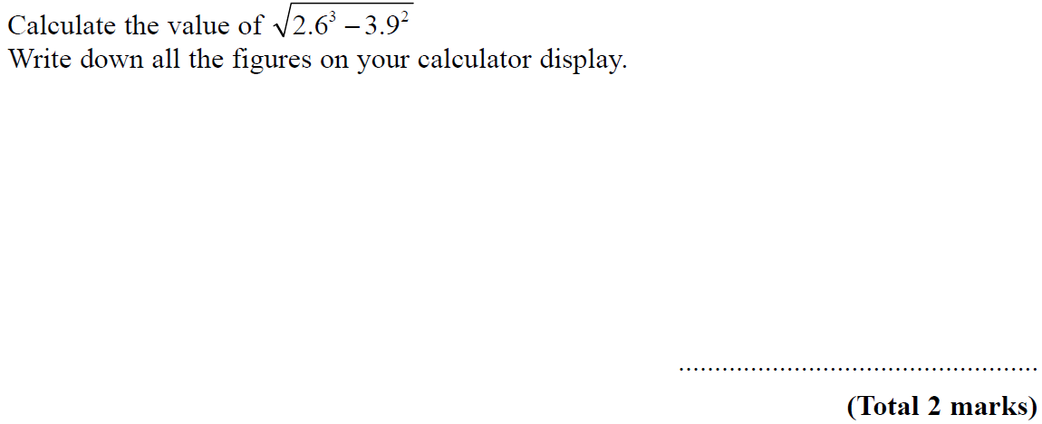
Using a Calculator / BIDMAS
Nov 2004 4H Q5

Slide 6
Using a Calculator / BIDMAS
Nov 2004 4H Q5
A

Slide 7
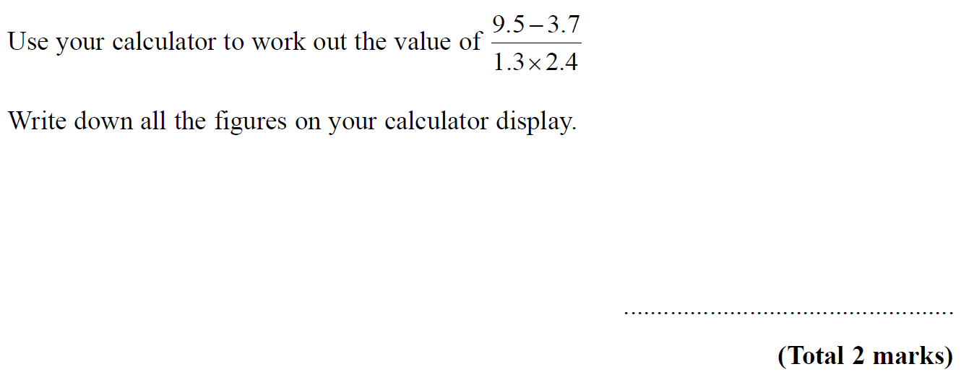
Using a Calculator / BIDMAS
May 2005 3H Q1

Slide 8
Using a Calculator / BIDMAS
May 2005 3H Q1
A

Slide 9
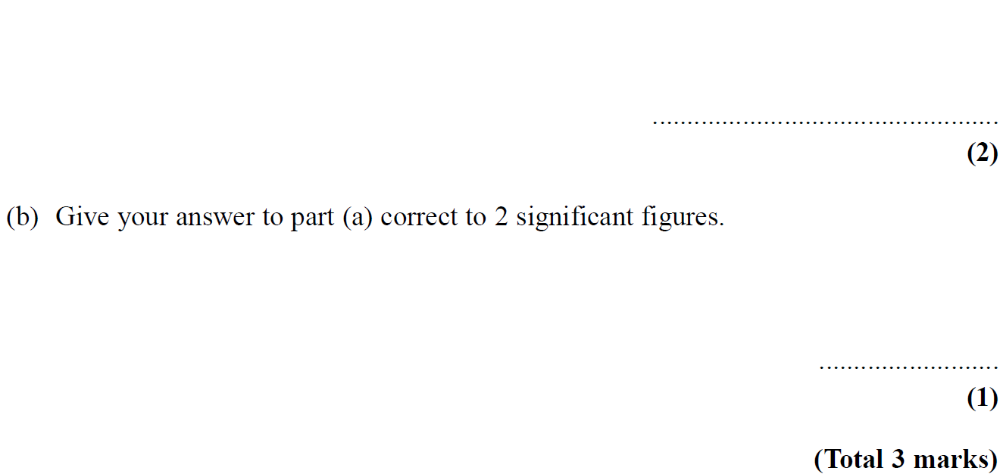
Using a Calculator / BIDMAS
Nov 2005 3H Q1

Slide 10
Using a Calculator / BIDMAS
Nov 2005 3H Q1
A
B

Slide 11
Using a Calculator / BIDMAS
May 2006 4H Q6

Slide 12
Using a Calculator / BIDMAS
May 2006 4H Q6
A
B
C

Slide 13
Using a Calculator / BIDMAS
Nov 2006 4H Q1

Slide 14
Using a Calculator / BIDMAS
Nov 2006 4H Q1
A

Slide 15
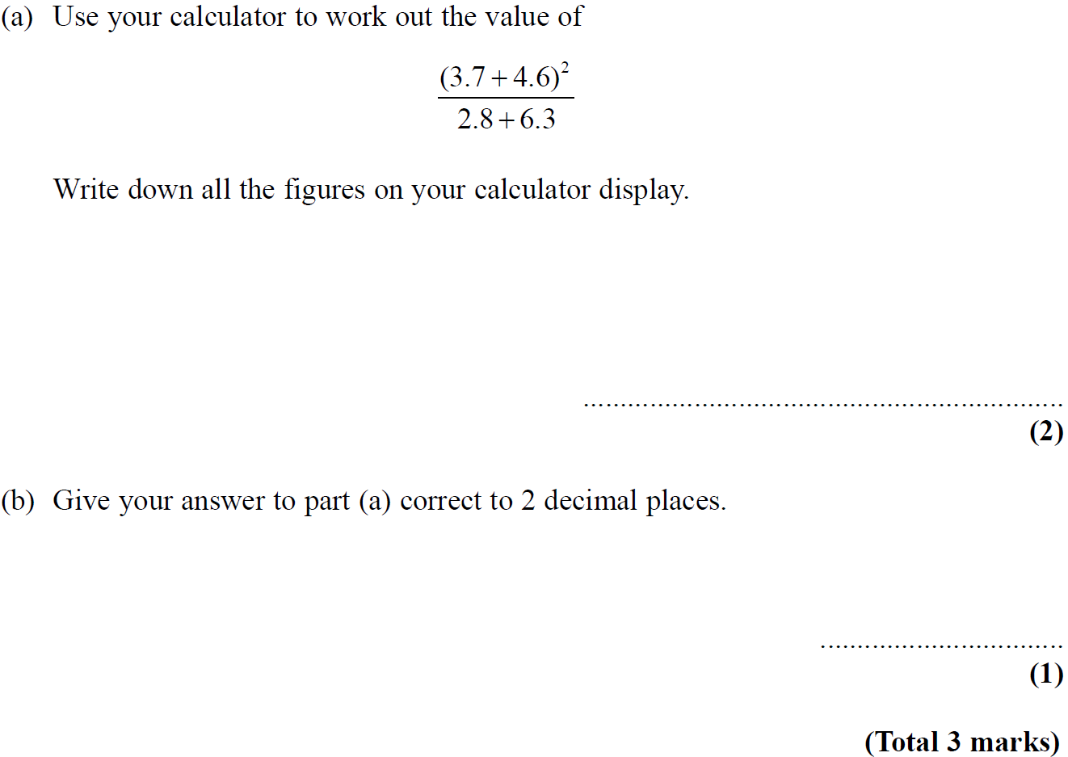
Using a Calculator / BIDMAS
May 2007 3H Q1

Slide 16
Using a Calculator / BIDMAS
May 2007 3H Q1
A
B

Slide 17
Using a Calculator / BIDMAS
Nov 2007 4H Q1

Slide 18
Using a Calculator / BIDMAS
Nov 2007 4H Q1
A

Slide 19
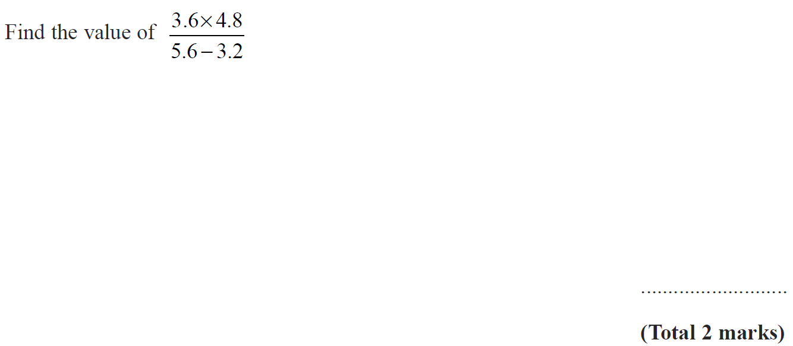
Using a Calculator / BIDMAS
May 2008 3H Q1

Slide 20
Using a Calculator / BIDMAS
May 2008 3H Q1
A

Slide 21
Using a Calculator / BIDMAS
Nov 2008 3H Q1

Slide 22
Using a Calculator / BIDMAS
Nov 2008 3H Q1
A

Slide 23
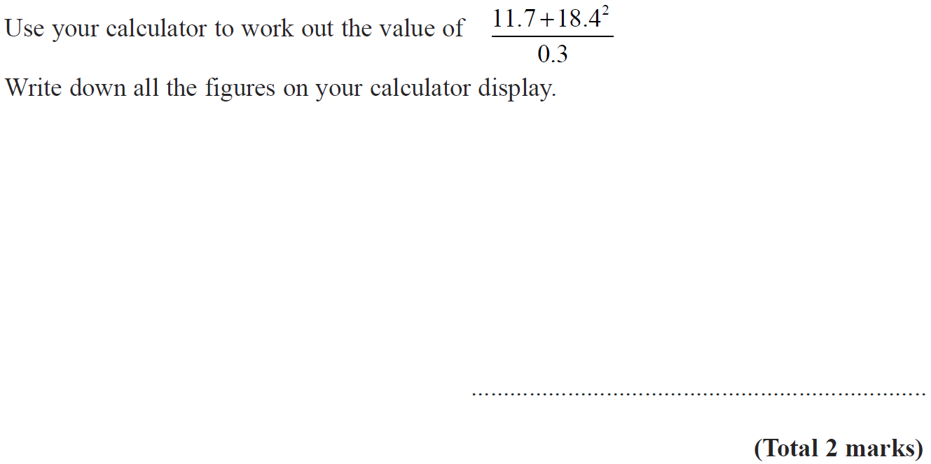
Using a Calculator / BIDMAS
Nov 2009 4H Q1

Slide 24
Using a Calculator / BIDMAS
Nov 2009 4H Q1
A

Slide 25
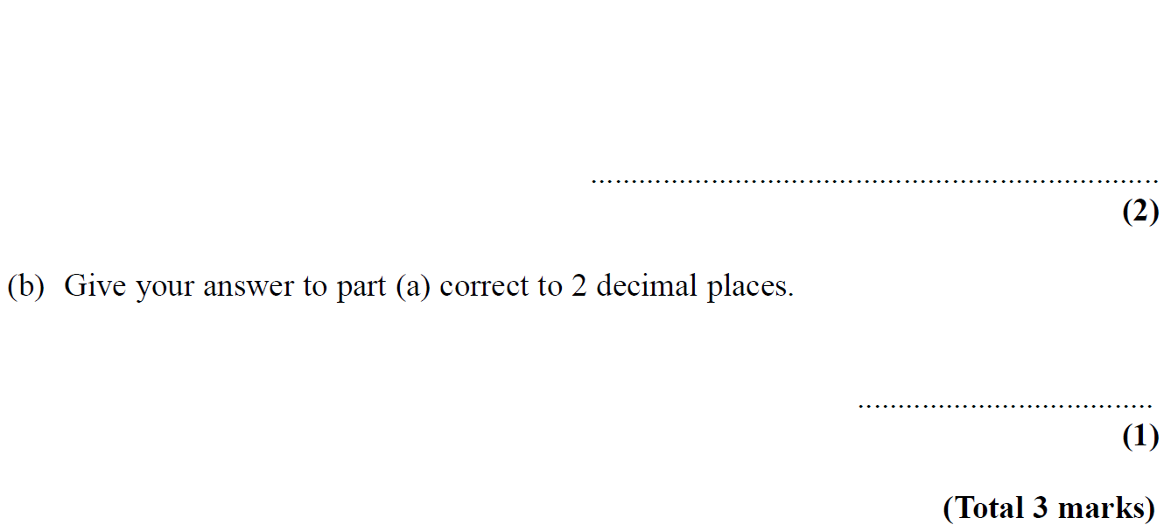
Using a Calculator / BIDMAS
Nov 2010 4H Q1

Slide 26
Using a Calculator / BIDMAS
Nov 2010 4H Q1
A

Slide 27
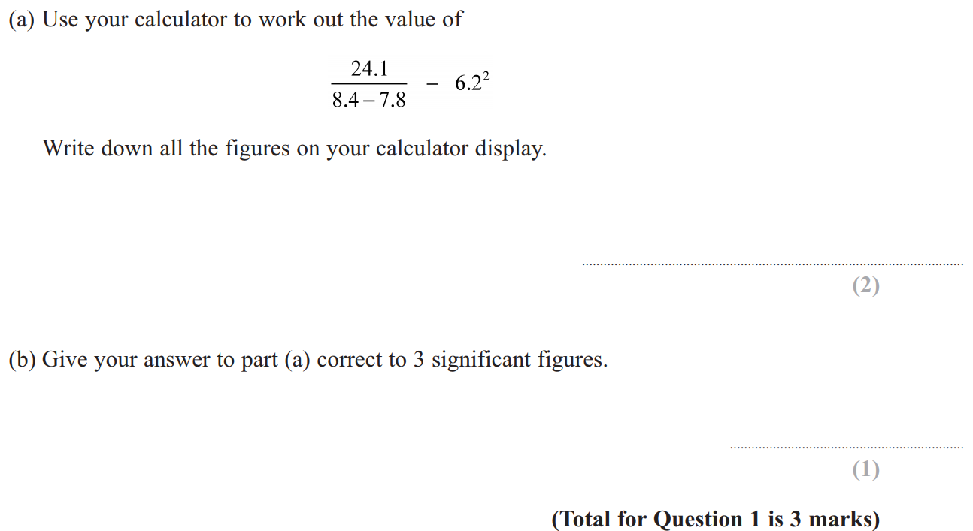
Using a Calculator / BIDMAS
June 2011 3H Q1

Slide 28
Using a Calculator / BIDMAS
June 2011 3H Q1
A
B

Slide 29
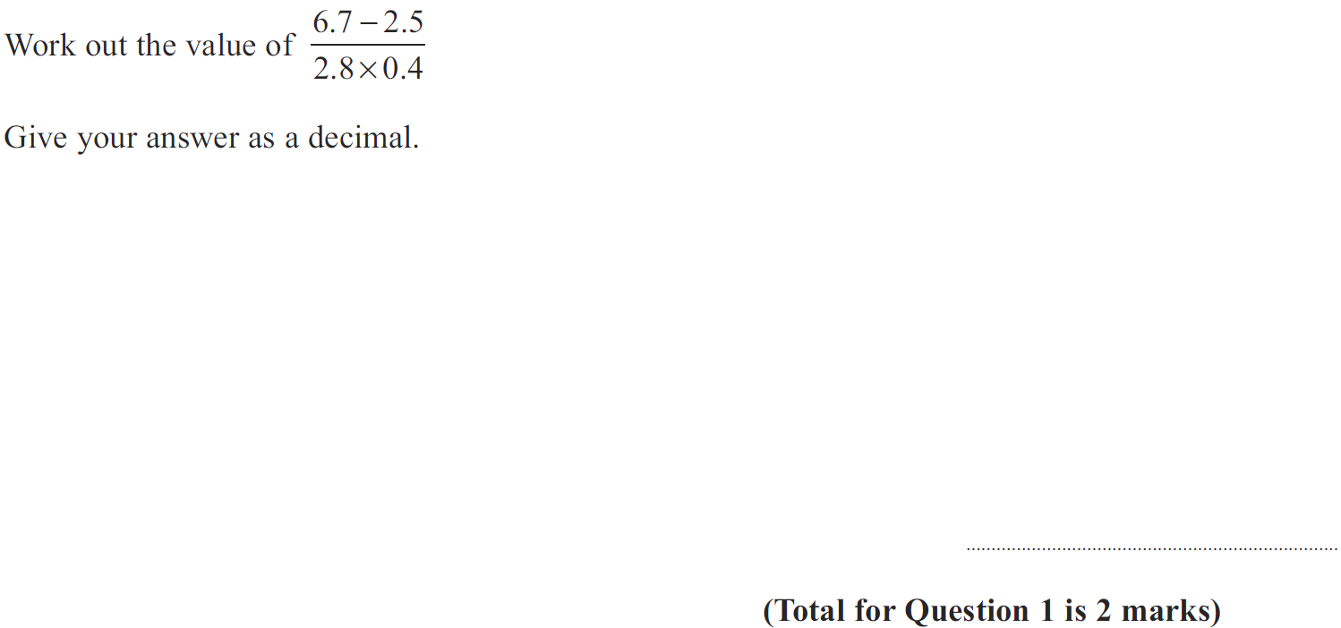
Using a Calculator / BIDMAS
Jan 2012 4H Q1

Slide 30
Using a Calculator / BIDMAS
Jan 2012 4H Q1
A

Slide 31
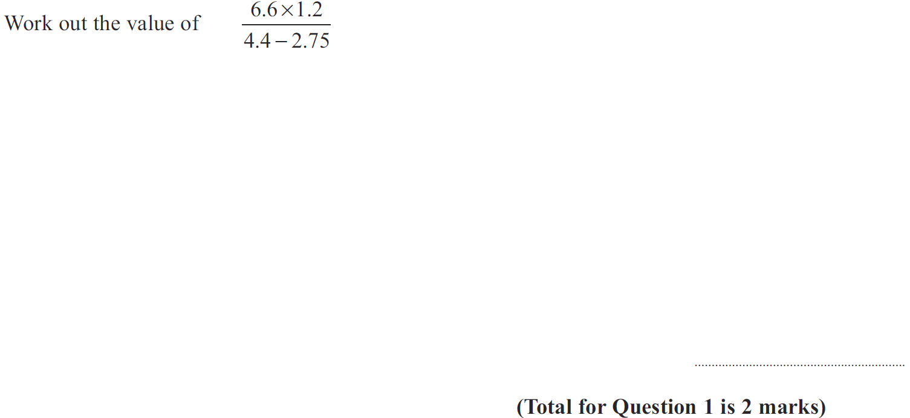
Using a Calculator / BIDMAS
May 2012 4H Q1

Slide 32
Using a Calculator / BIDMAS
May 2012 4H Q1
A

Slide 33
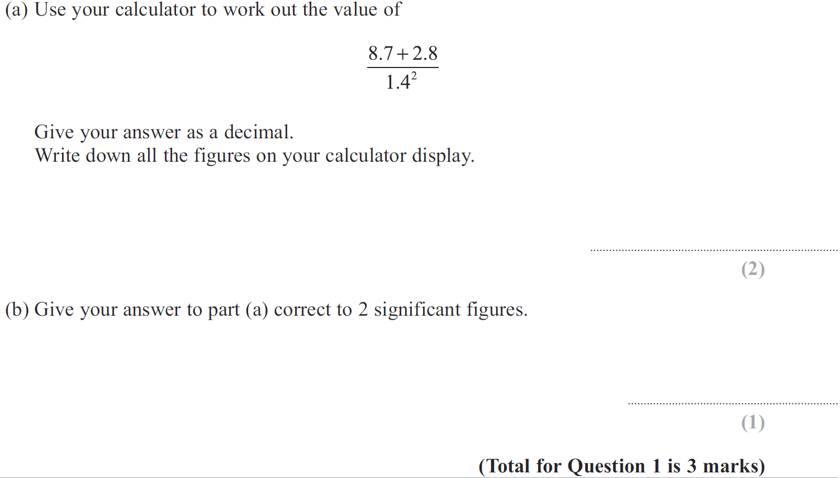
Using a Calculator / BIDMAS
Jan 2013 4H Q1

Slide 34
Using a Calculator / BIDMAS
Jan 2013 4H Q1
A
B

Slide 35
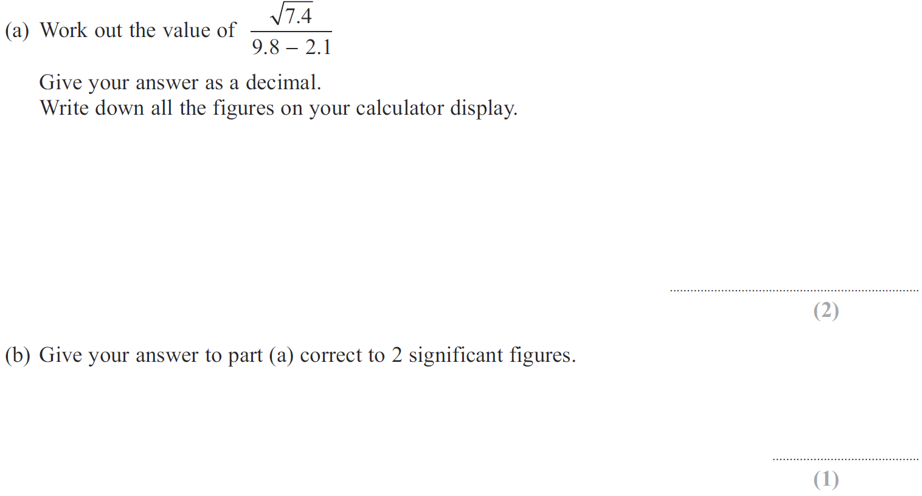
Using a Calculator / BIDMAS
May 2013 3H Q2

Slide 36
Using a Calculator / BIDMAS
May 2013 3H Q2
A
B

Slide 37
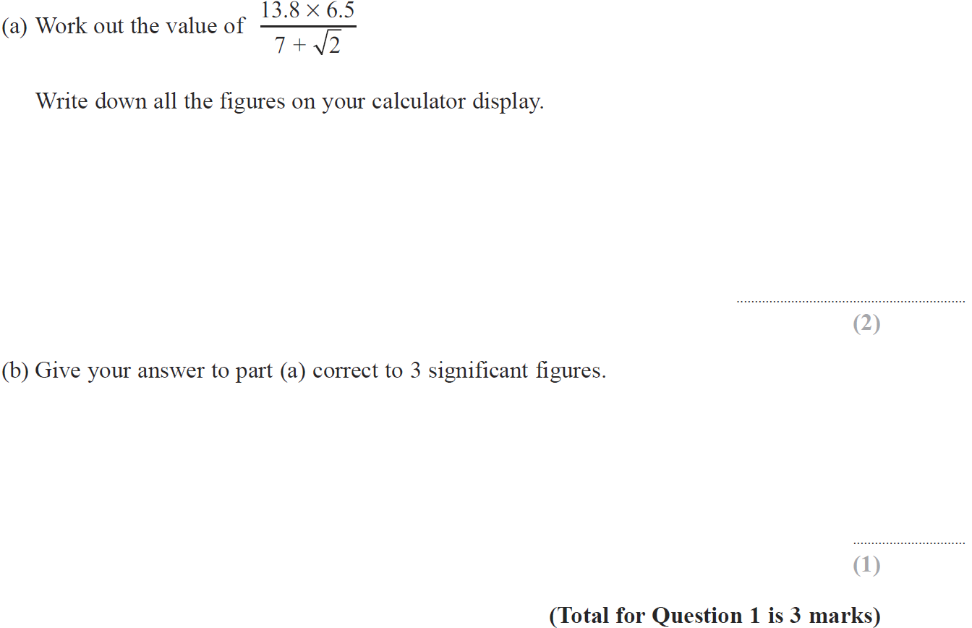
Using a Calculator / BIDMAS
May 2014 3H Q1

Slide 38
Using a Calculator / BIDMAS
May 2014 3H Q1
A
B

Slide 39
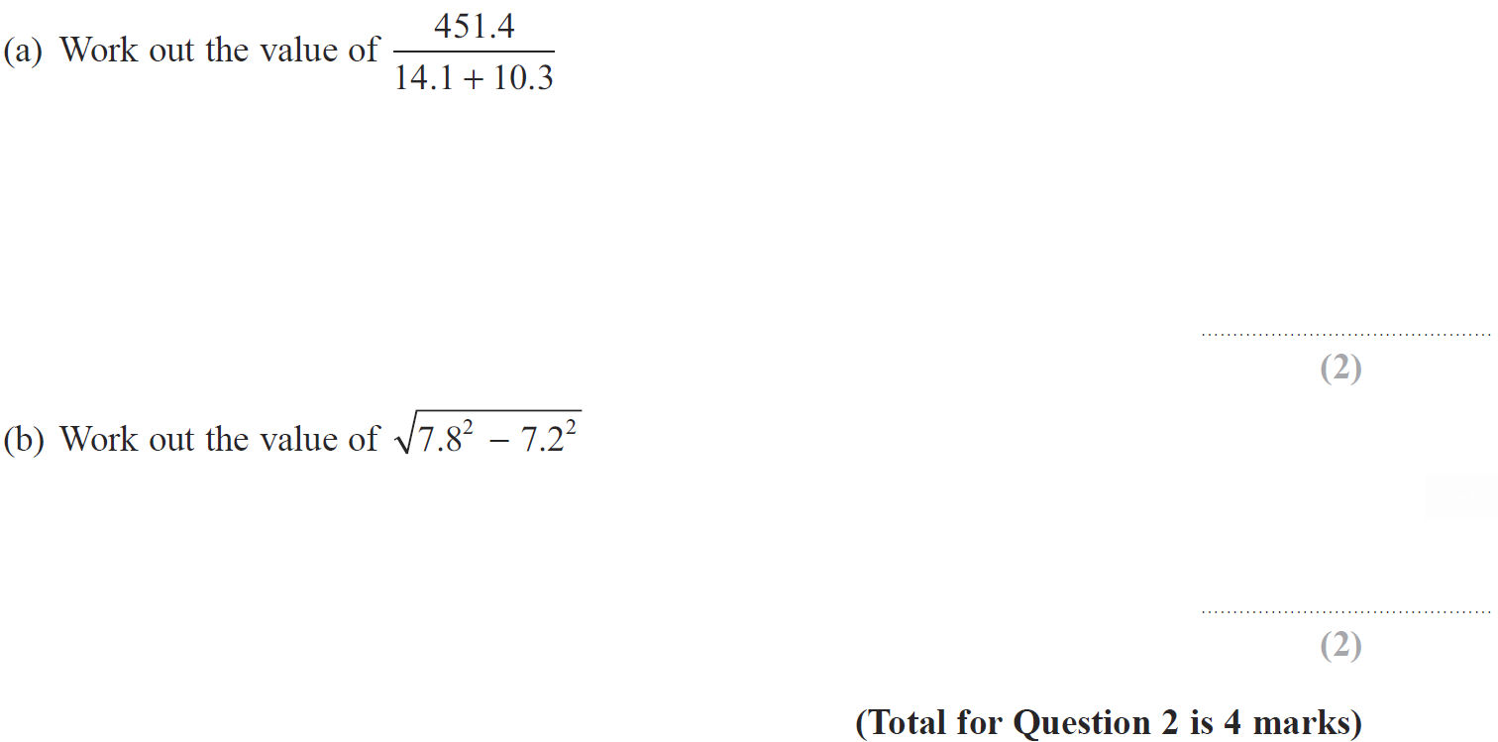
Using a Calculator / BIDMAS
Jan 2015 3H Q2

Slide 40
Using a Calculator / BIDMAS
Jan 2015 3H Q2
A
B

Slide 41
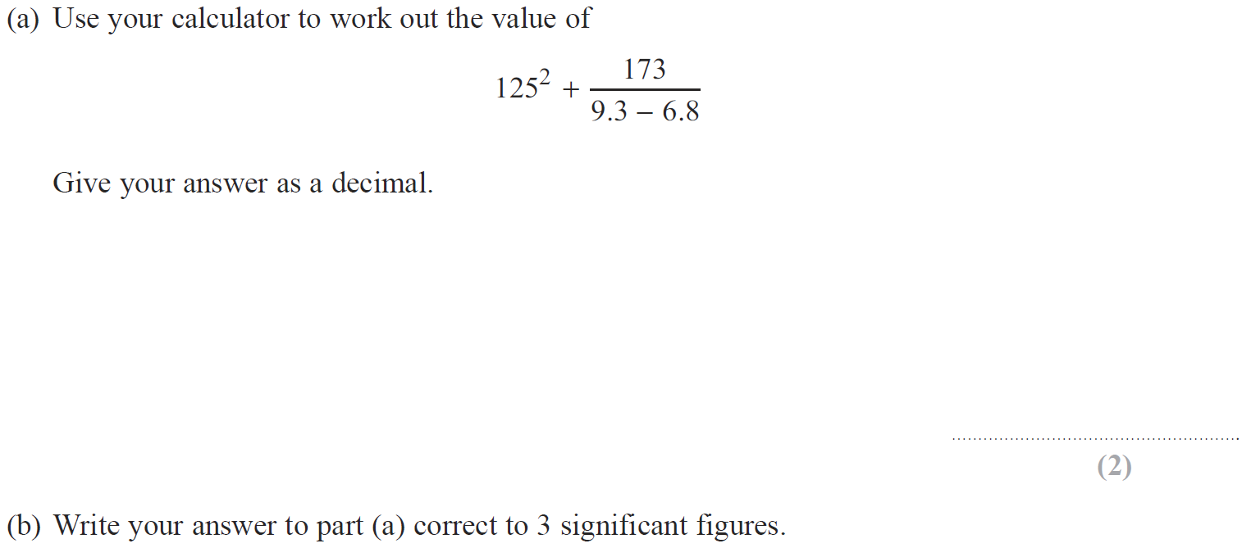
Using a Calculator / BIDMAS
Jan 2015 3HR Q2

Slide 42
Using a Calculator / BIDMAS
Jan 2015 3HR Q2
A
B

Slide 43
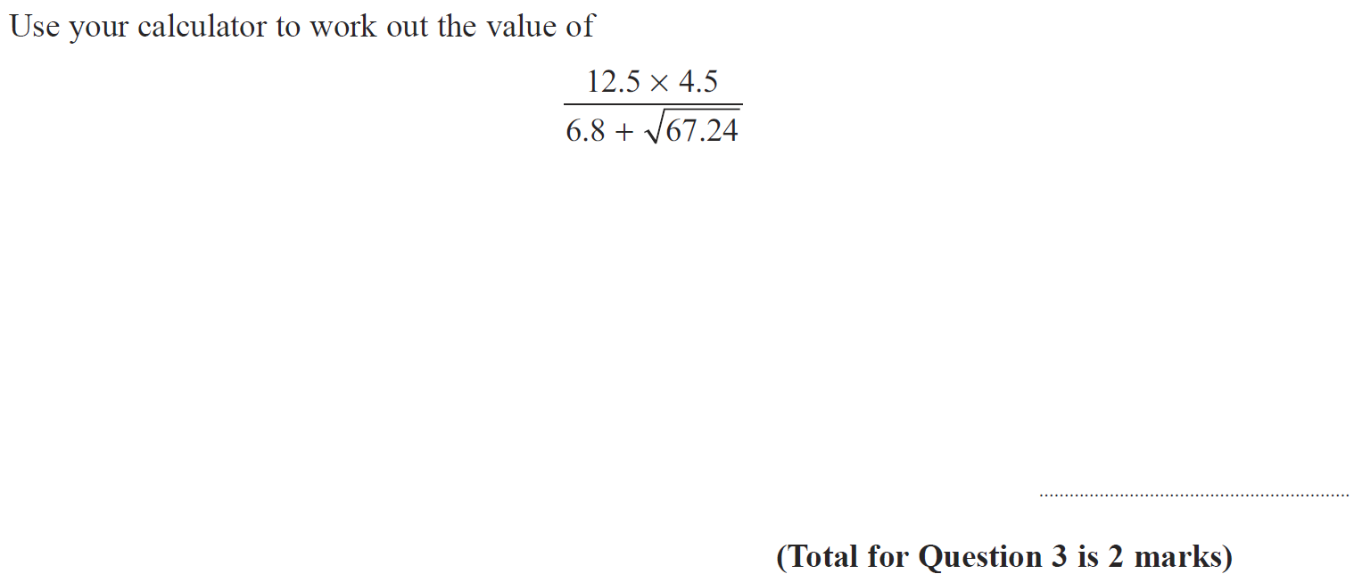
Using a Calculator / BIDMAS
May 2015 3HR Q3

Slide 44
Using a Calculator / BIDMAS
May 2015 3HR Q3
A

Slide 45
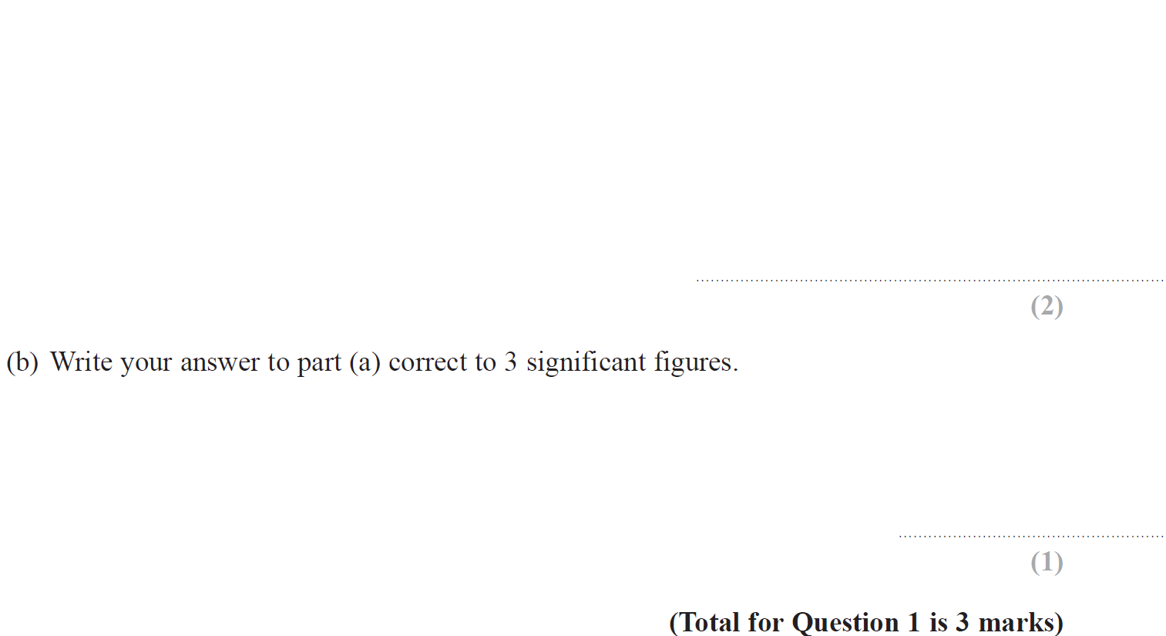
Using a Calculator / BIDMAS
Jan 2016 4H Q1

Slide 46
Using a Calculator / BIDMAS
Jan 2016 4H Q1
A
B

Slide 47
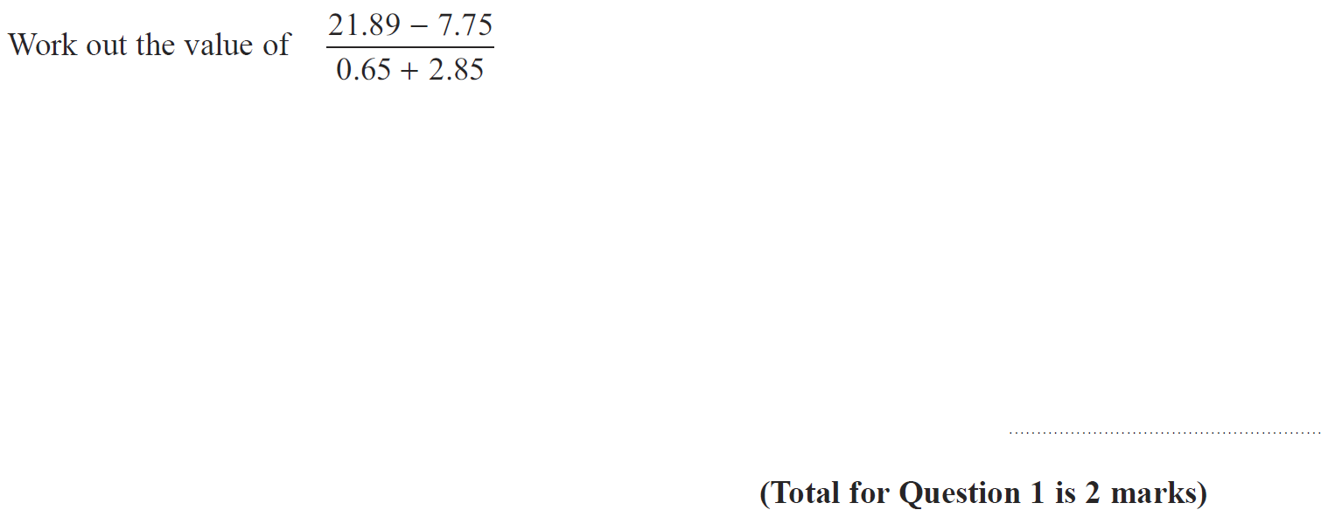
Using a Calculator / BIDMAS
Jan 2016 3HR Q1

Slide 48
Using a Calculator / BIDMAS
Jan 2016 3HR Q1
A

Slide 49
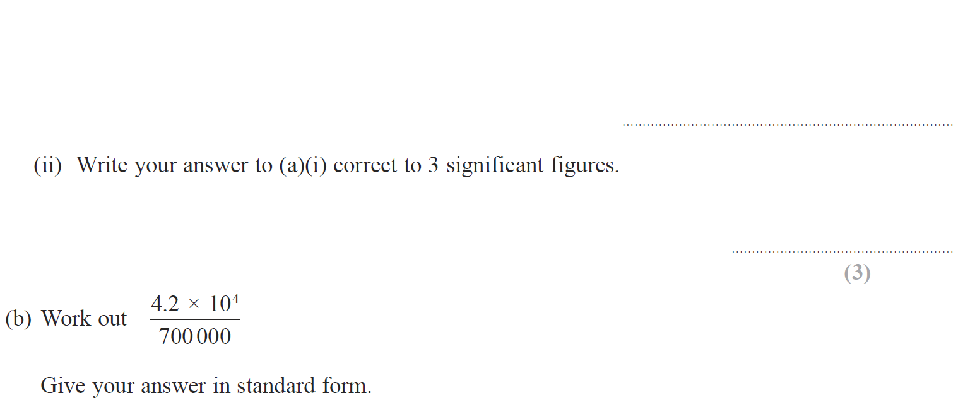
Using a Calculator / BIDMAS
Jan 2017 4H Q4

Slide 50
Using a Calculator / BIDMAS
Jan 2017 4H Q4
A (i)
A (ii)
B

Slide 51
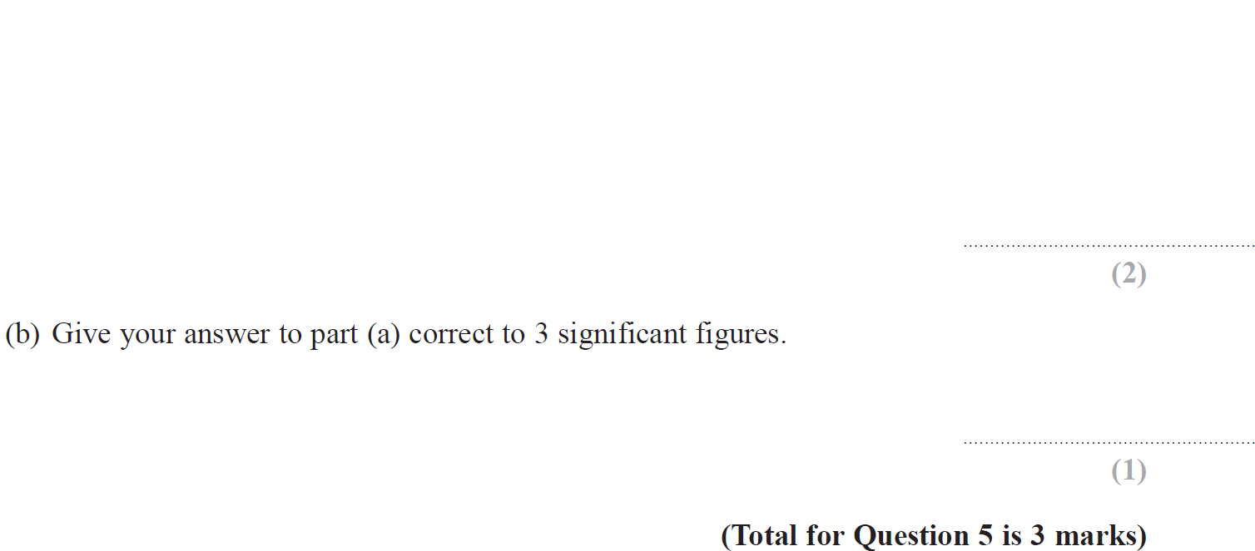
Using a Calculator / BIDMAS
May 2017 3H Q5

Slide 52
Using a Calculator / BIDMAS
May 2017 3H Q5
A
B

Slide 53
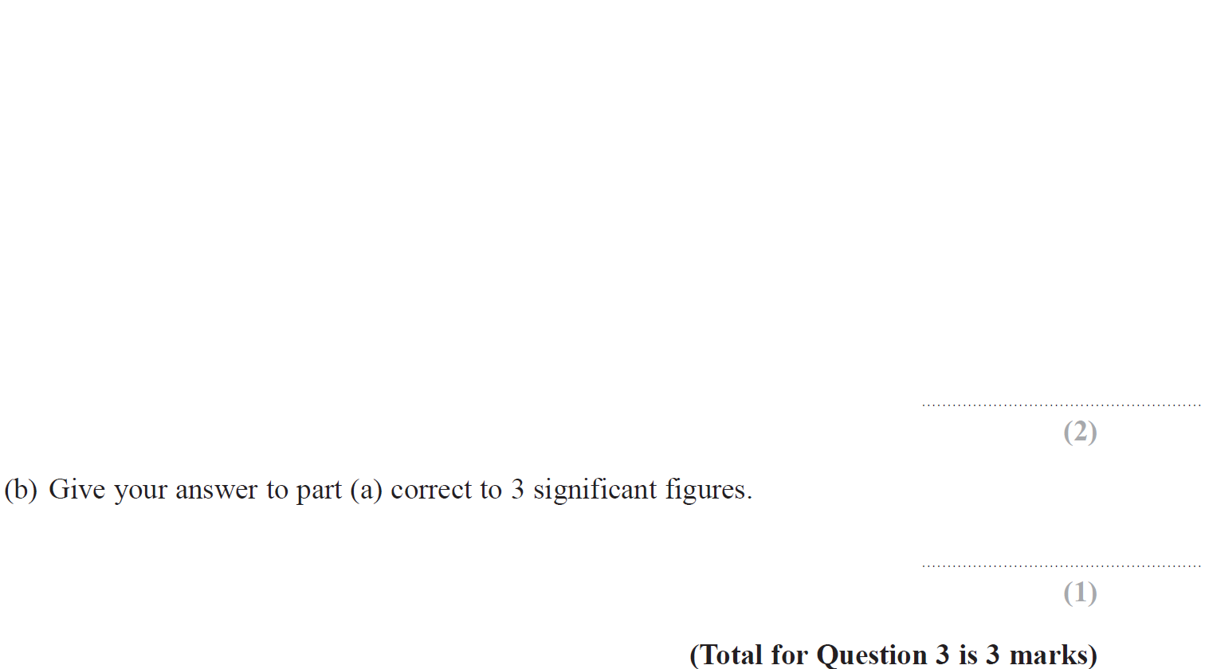
Using a Calculator / BIDMAS
June 2017 4HR Q3

Slide 54
Using a Calculator / BIDMAS
June 2017 4HR Q3
A
B

Slide 55
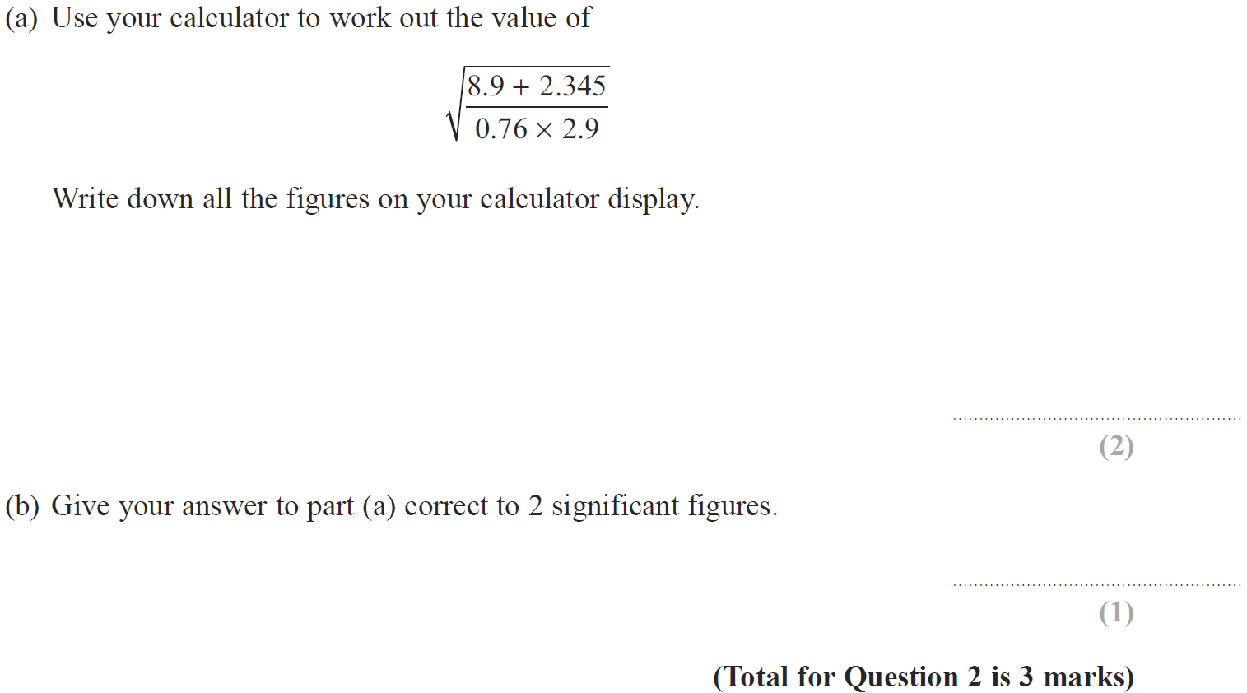
Using a Calculator / BIDMAS
Jan 2018 3H Q2

Slide 56
Using a Calculator / BIDMAS
Jan 2018 3H Q2
A
B

Slide 57
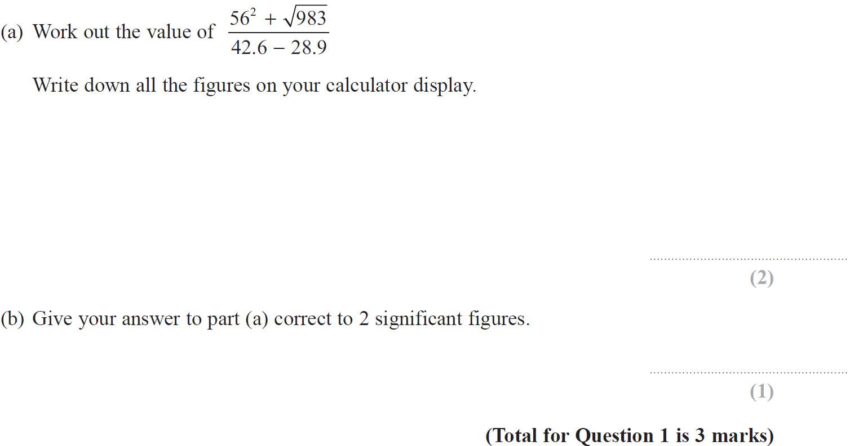
Using a Calculator / BIDMAS
May 2018 3H Q1

Slide 58
Using a Calculator / BIDMAS
May 2018 3H Q1
A
B

Slide 59
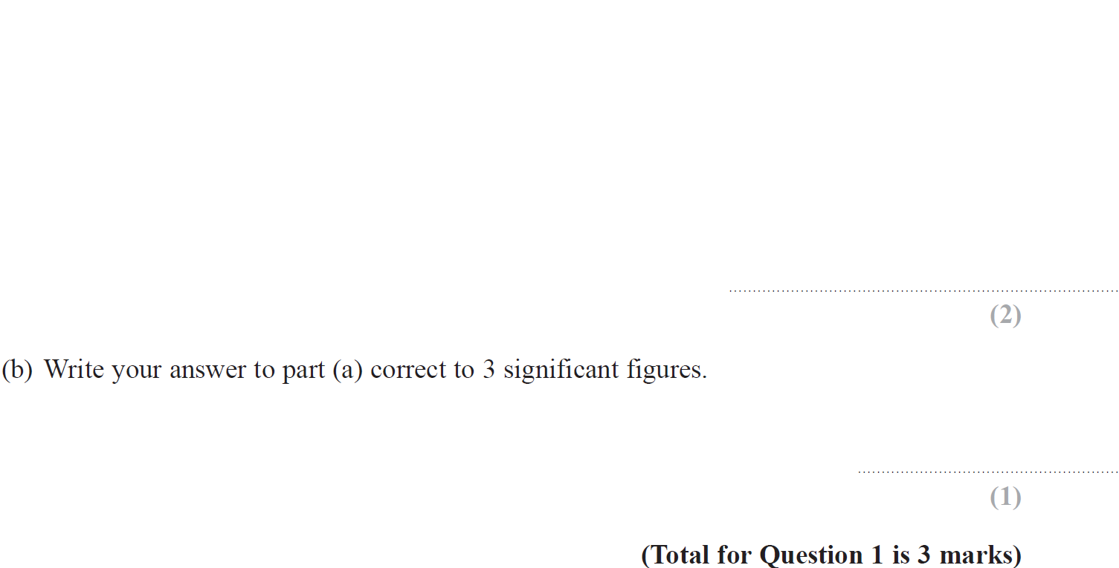
Using a Calculator / BIDMAS
May 2018 3HR Q1

Slide 60
Using a Calculator / BIDMAS
May 2018 3HR Q1
A
B

