Slide 1
Using a Calculator/ BIDMAS
Using a Calculator / BIDMAS
Spec 1
2H Q12
Nov 2017 2H Q8
Spec 1
3H Q15
Nov 2018 3H Q1
Spec 1
2H Q16
June 2019 3H Q7

Slide 2
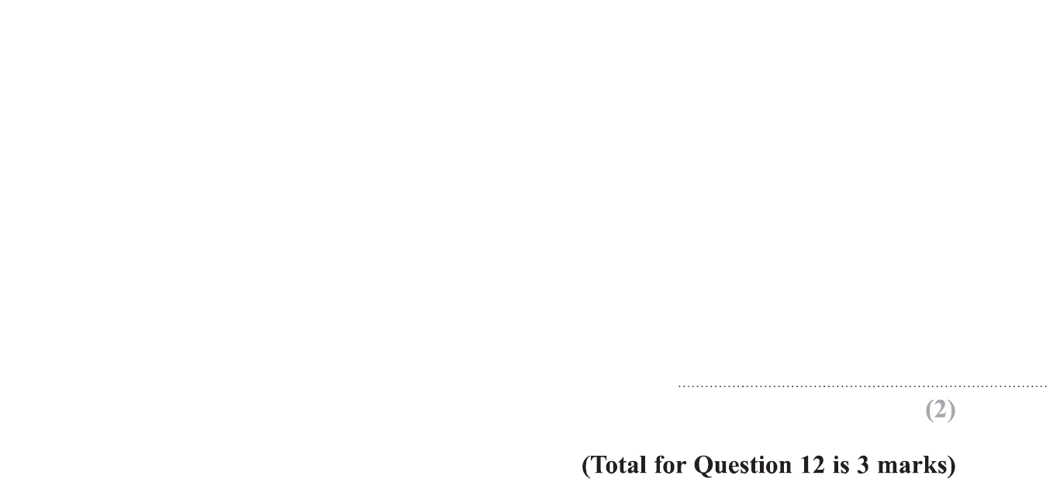
Using a Calculator / BIDMAS
Specimen Set 1 2H Q12

Slide 3
Using a Calculator / BIDMAS
Specimen Set 1 2H Q12
A
B

Slide 4
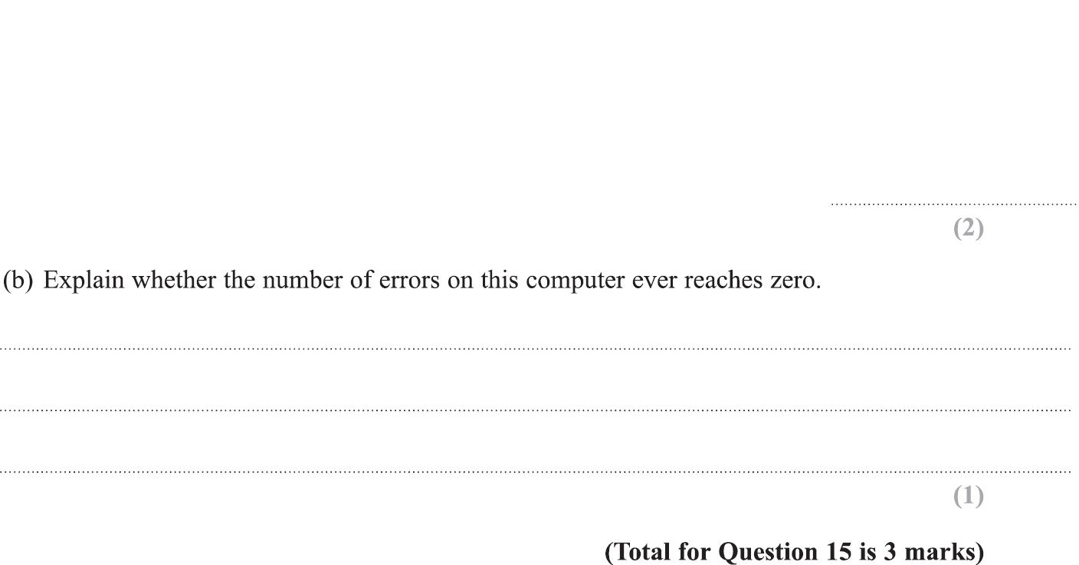
Using a Calculator / BIDMAS
Specimen Set 1 3H Q15

Slide 5
Using a Calculator / BIDMAS
Specimen Set 1 3H Q15
A
B

Slide 6
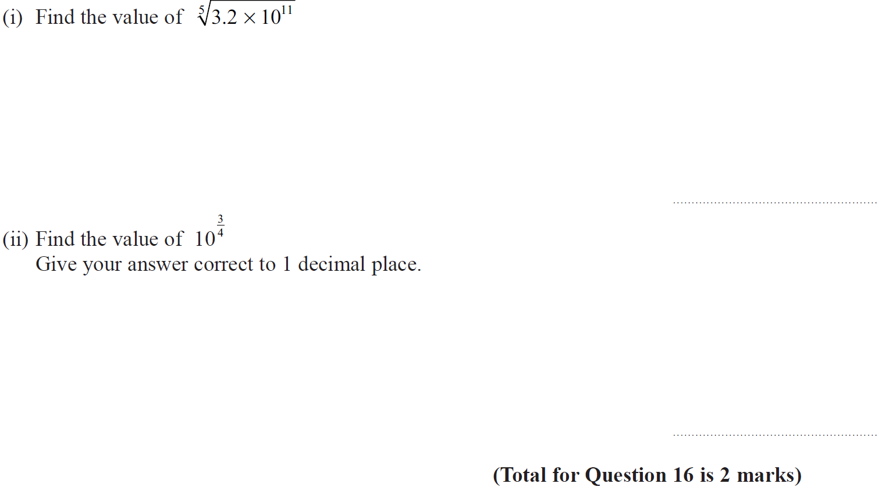
Using a Calculator / BIDMAS
Specimen Set 2 2H Q16

Slide 7
Using a Calculator / BIDMAS
Specimen Set 2 2H Q16
(i)
(ii)

Slide 8
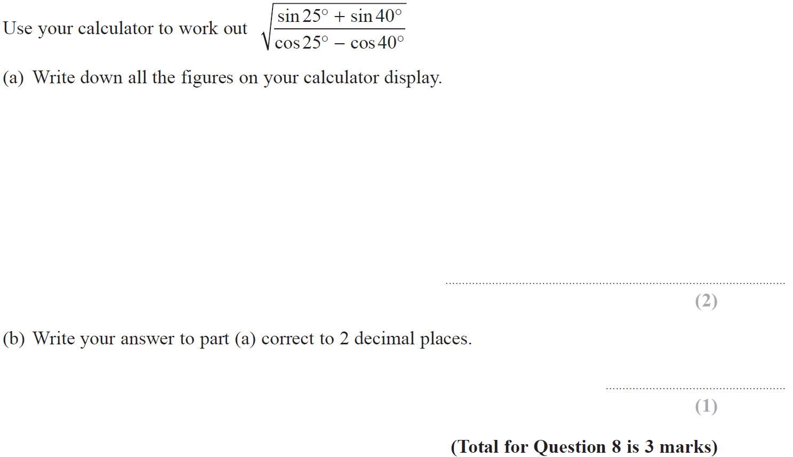
Using a Calculator / BIDMAS
Nov 2017 2H Q8

Slide 9
Using a Calculator / BIDMAS
Nov 2017 2H Q8
A
B

Slide 10
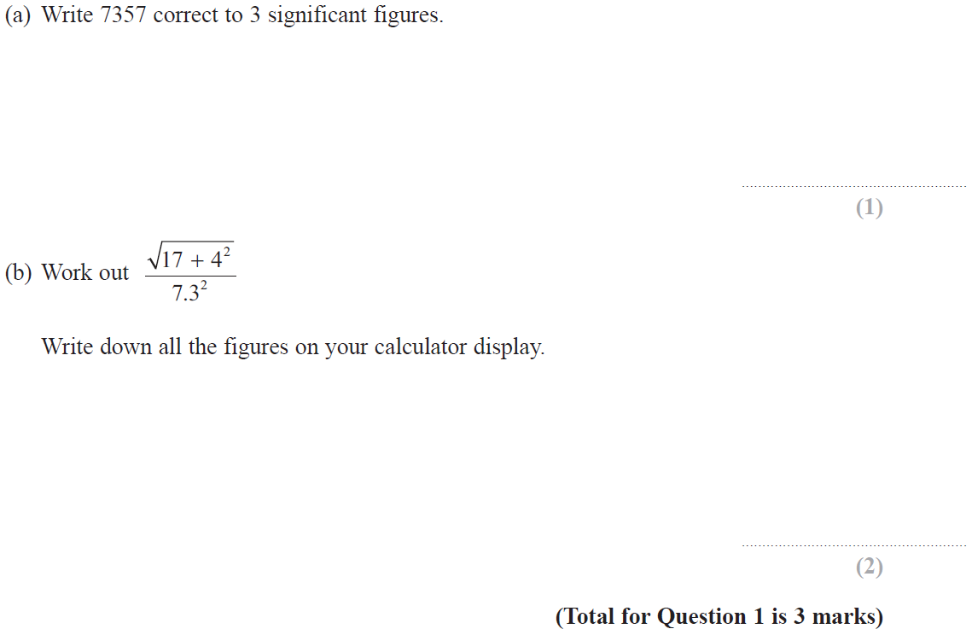
Using a Calculator / BIDMAS
Nov 2018 3H Q1

Slide 11
Using a Calculator / BIDMAS
Nov 2018 3H Q1
A
B

Slide 12
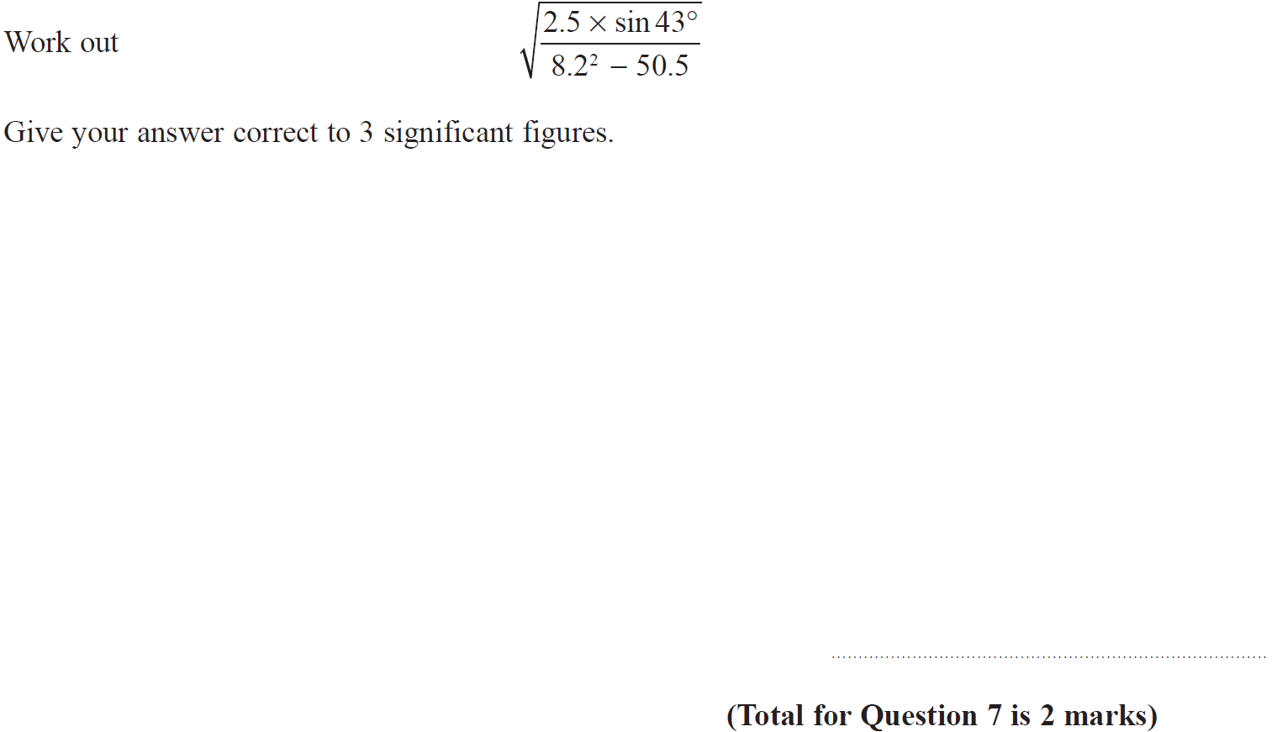
Using a Calculator / BIDMAS
June 2019 3H Q7

Slide 13
Using a Calculator / BIDMAS
June 2019 3H Q7
A
A SF

