Slide 1
Averages
Averages
Old Spec Q’s
SAM
1H Q3
Jan 2019
2H Q11
SAM
1H Q12
Jan 2019
2H Q13
SAM
2H Q7
Jan 2019
1HR Q4
May 2018
1H Q1
Jan 2019
1HR Q11
June 2018
2H Q7
Jan 2019
2HR Q1
May 2018
1HR Q2
Jan 2019
2HR Q12
June 2018
2HR Q1
June 2019
2H Q1
June 2018
2HR Q11
June 2019
2H Q7
IQR
Table of Data

Slide 2
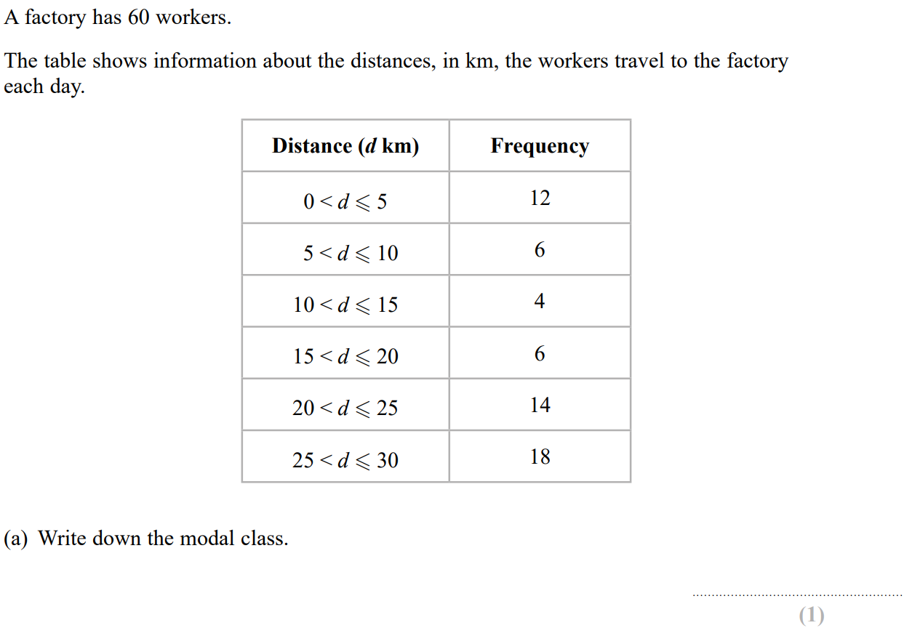
Averages
SAM 1H Q3

Slide 3
Averages
SAM 1H Q3
A
B
C

Slide 4
Averages
SAM 1H Q12

Slide 5
Averages
SAM 1H Q12
A
B

Slide 6
Averages
SAM 2H Q7

Slide 7
Averages
SAM 2H Q7
A
B

Slide 8
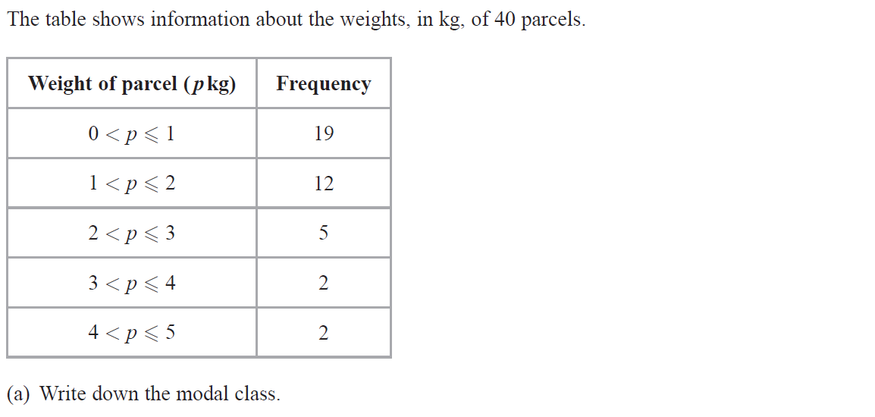
Averages
May 2018 1H Q1

Slide 9
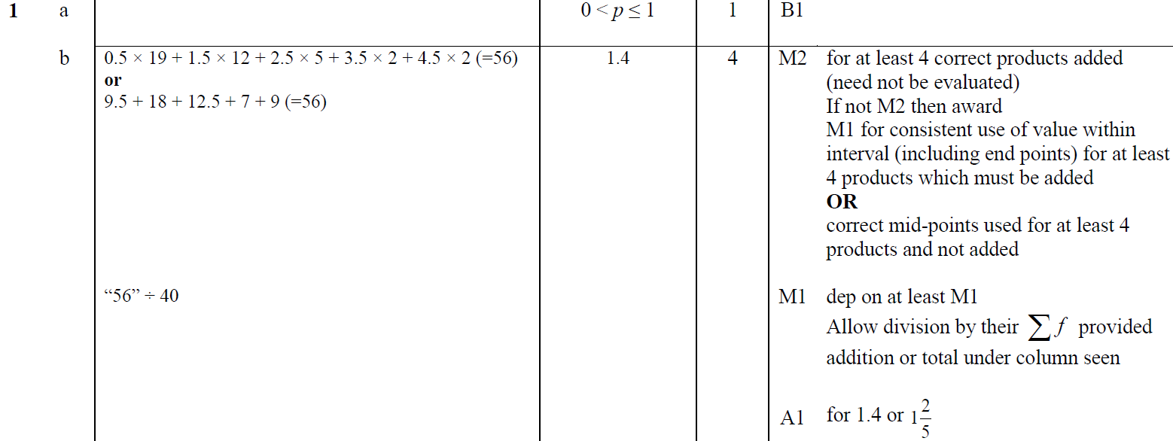
Averages
May 2018 1H Q1
A
B

Slide 10
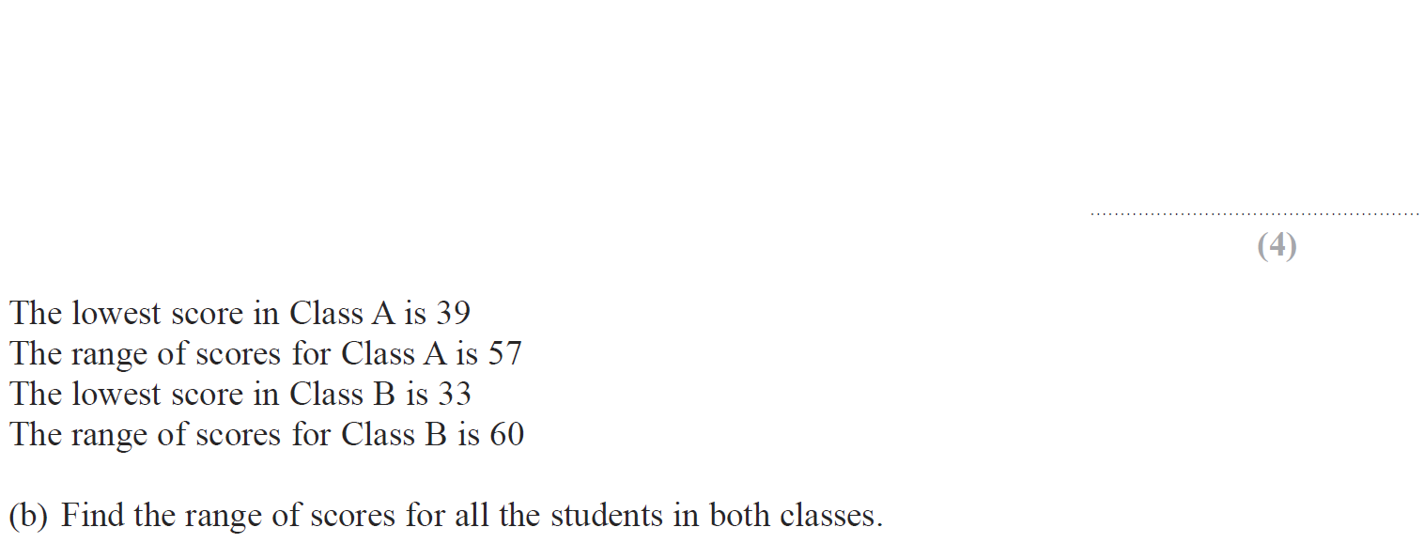
Averages
June 2018 2H Q7

Slide 11
Averages
June 2018 2H Q7
A
B

Slide 12
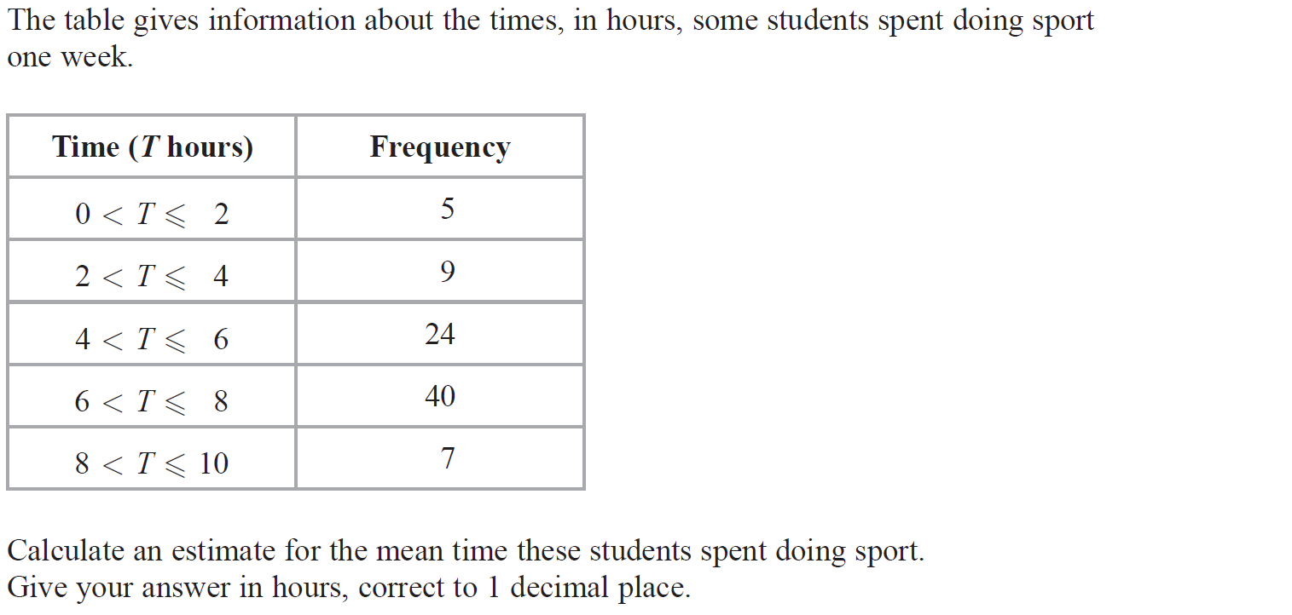
Averages
May 2018 1HR Q2

Slide 13
Averages
May 2018 1HR Q2
A

Slide 14
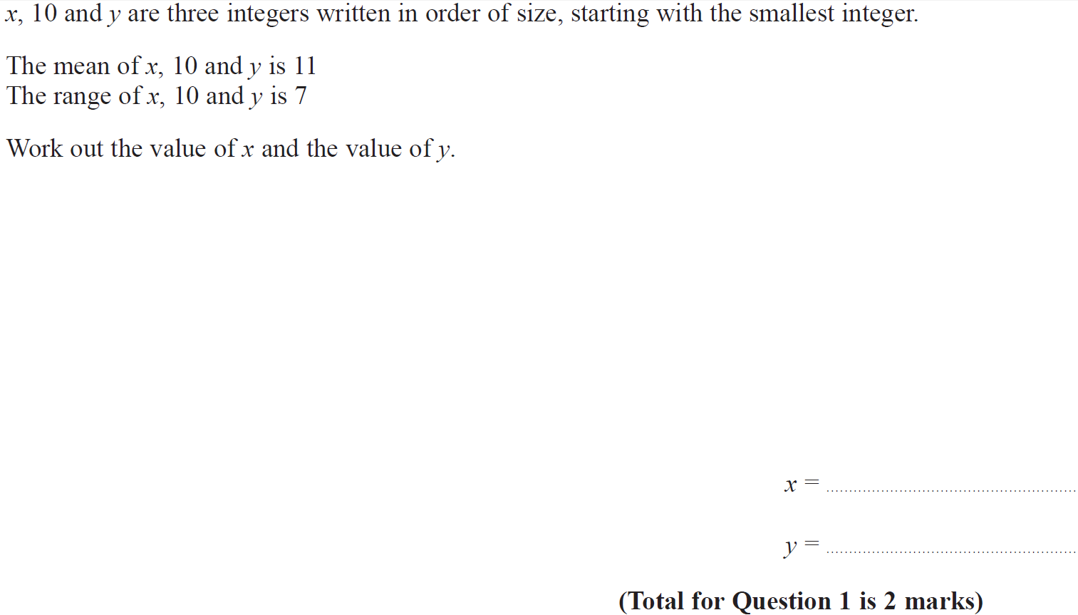
Averages
June 2018 2HR Q1

Slide 15
Averages
June 2018 2HR Q1
A

Slide 16
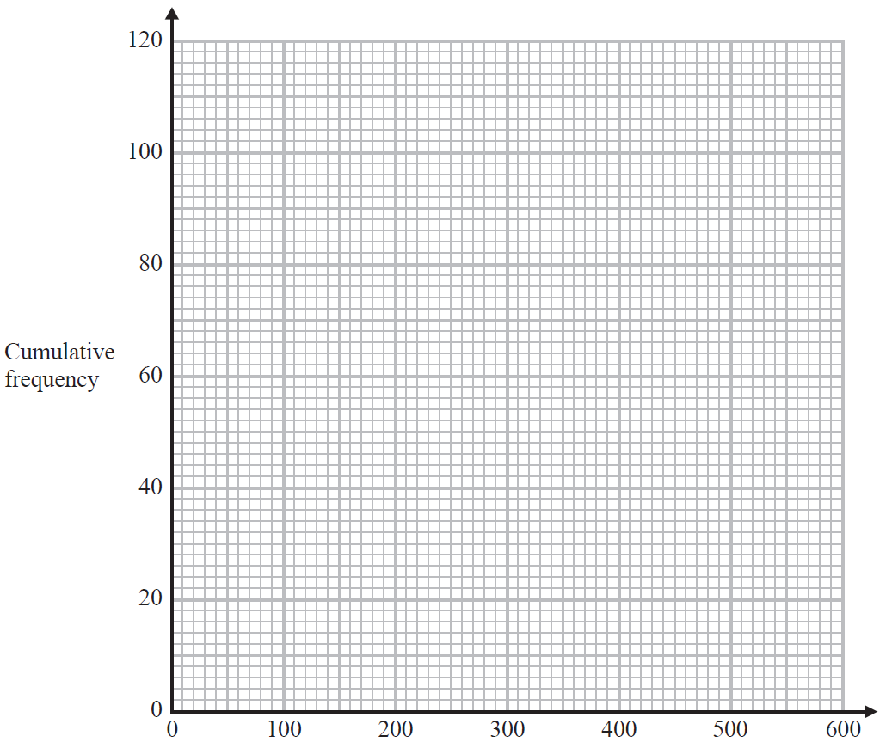
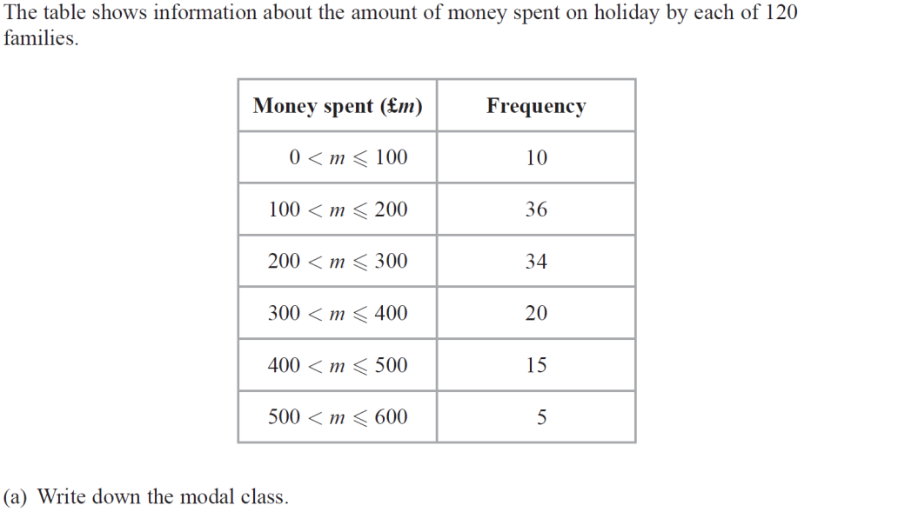
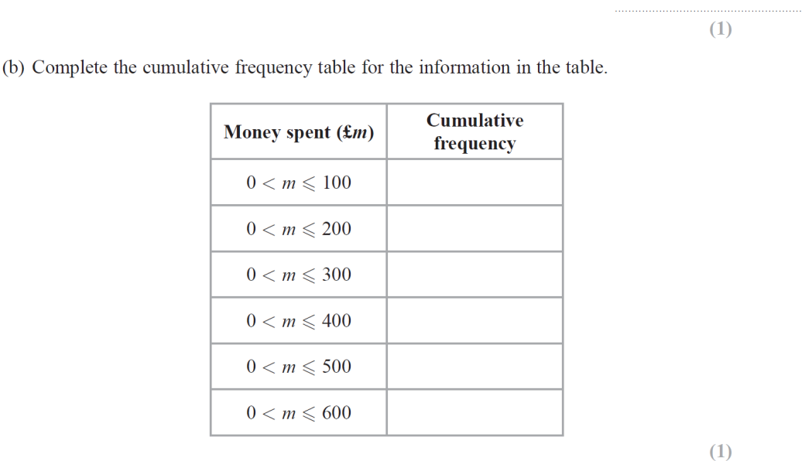
Averages
June 2018 2HR Q11
Reveal graph

Slide 17
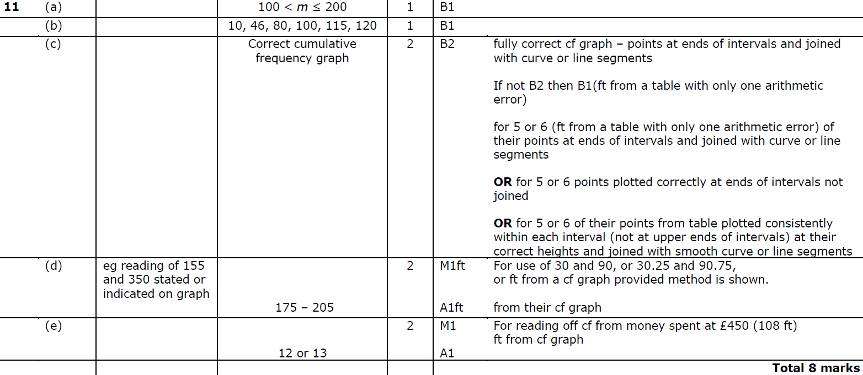
Averages
June 2018 2HR Q11
A
B
C
D
E

Slide 18
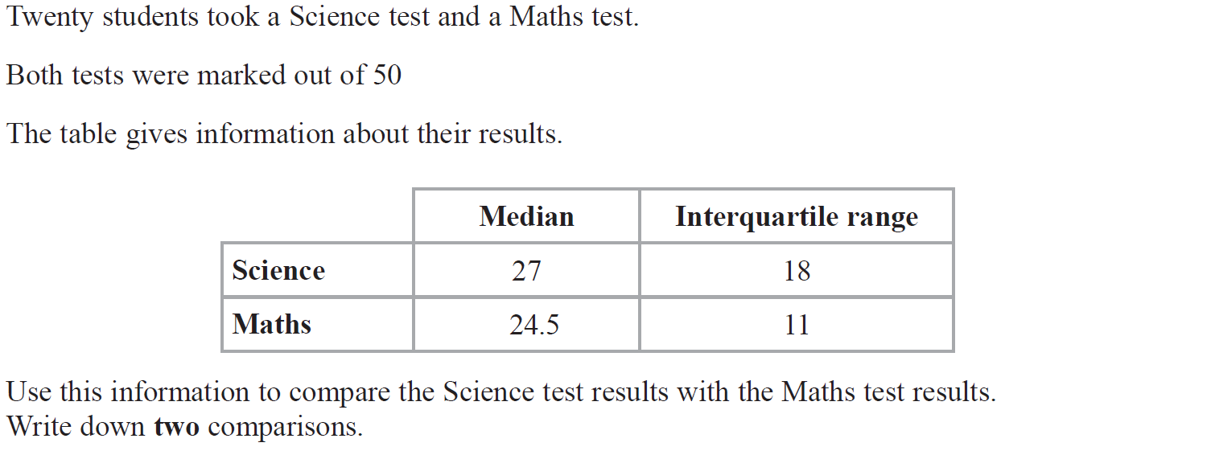
Averages
Jan 2019 2H Q11

Slide 19
Averages
Jan 2019 2H Q11
A

Slide 20
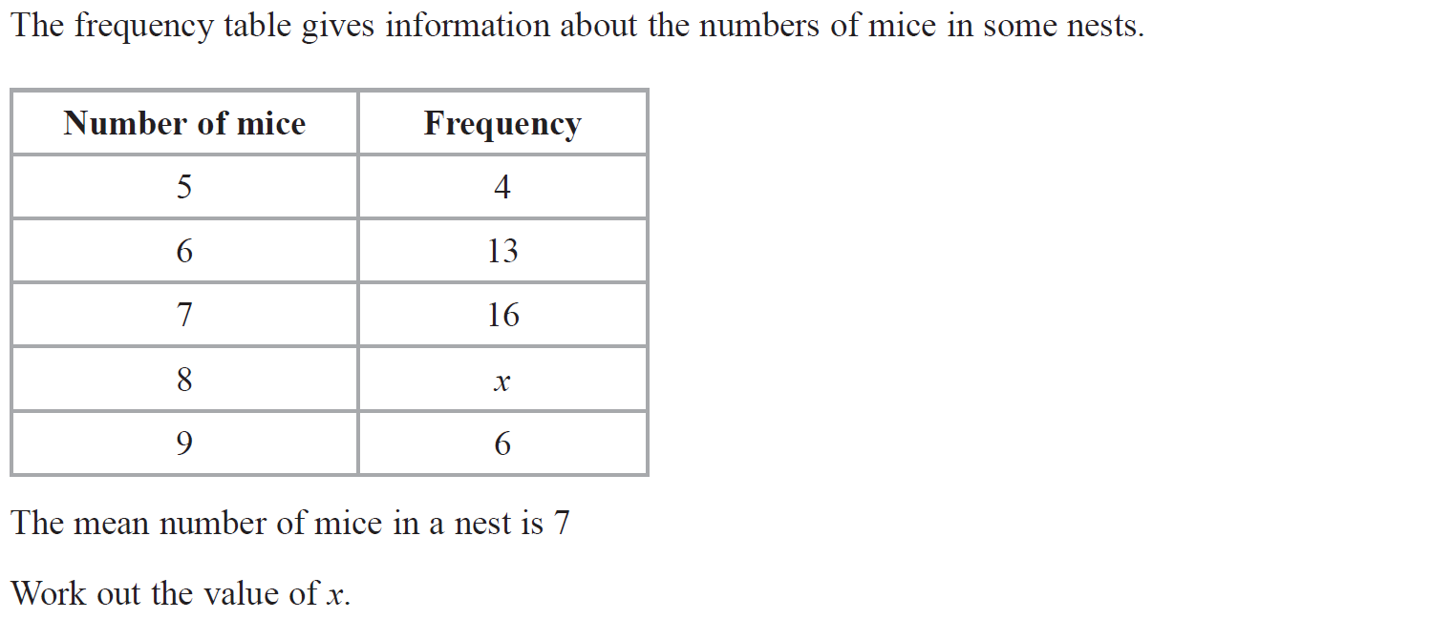
Averages
Jan 2019 2H Q13

Slide 21
Averages
Jan 2019 2H Q13
A

Slide 22
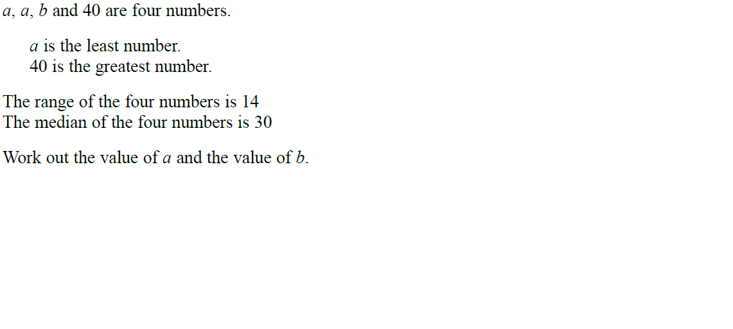
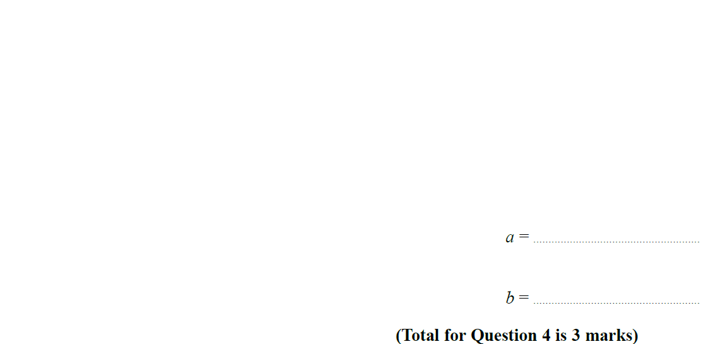
Averages
Jan 2019 1HR Q4

Slide 23
Averages
Jan 2019 1HR Q4
A

Slide 24
Averages
Jan 2019 1HR Q11

Slide 25
Averages
Jan 2019 1HR Q11
A

Slide 26
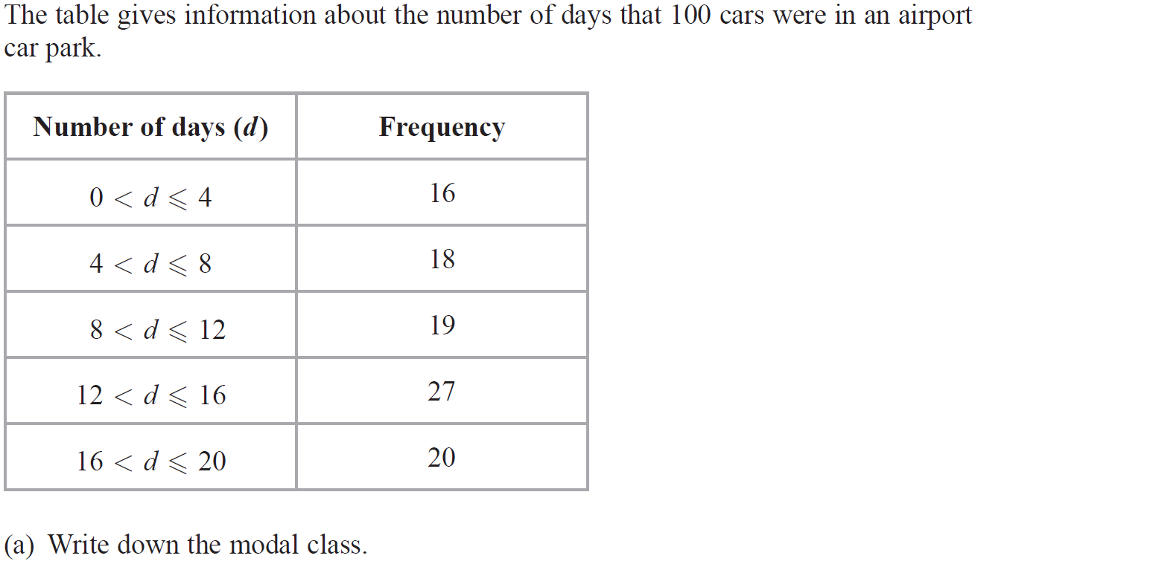
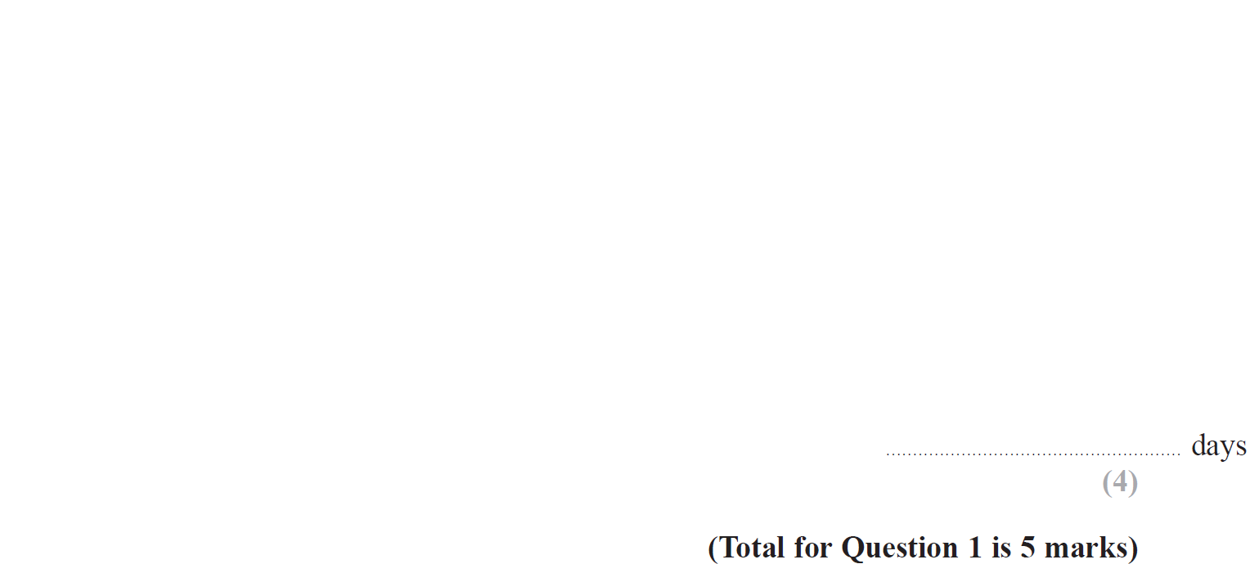
Averages
Jan 2019 2HR Q1

Slide 27
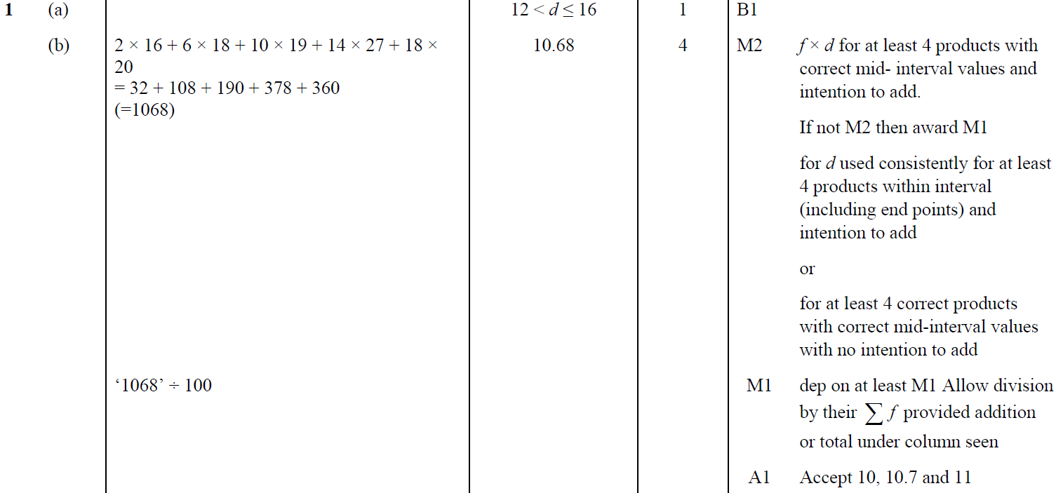
Averages
Jan 2019 2HR Q1
A
B

Slide 28
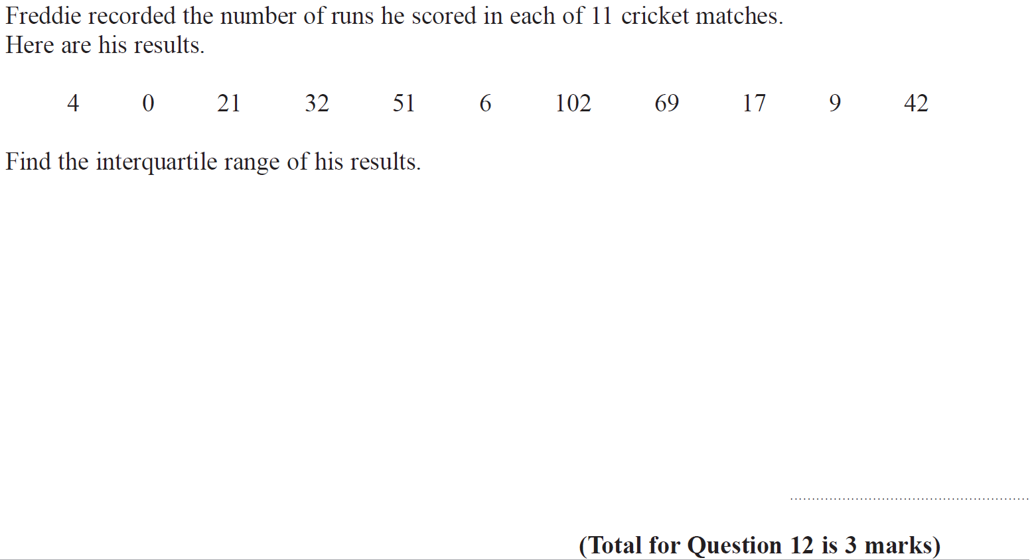
Averages
Jan 2019 2HR Q12

Slide 29
Averages
Jan 2019 2HR Q12
A

Slide 30
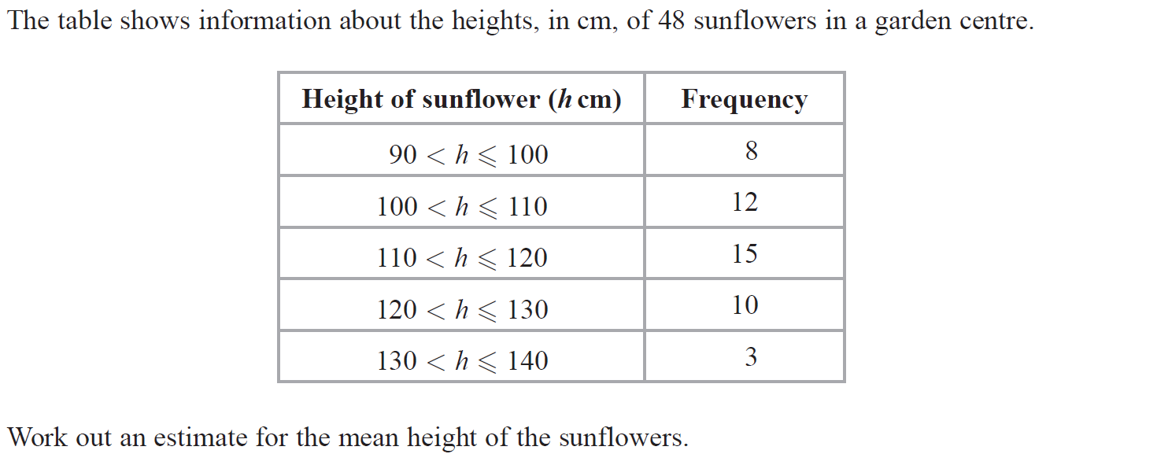
Averages
June 2019 2H Q1

Slide 31
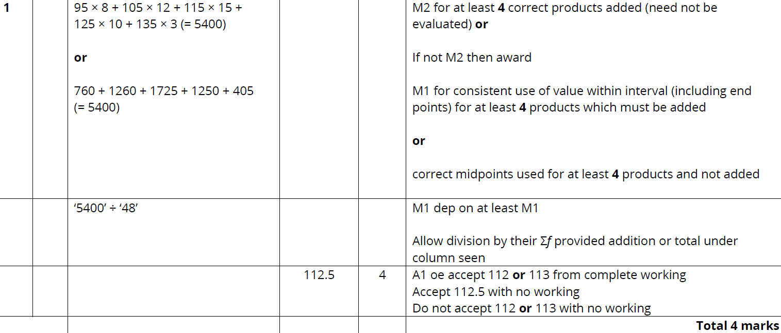
Averages
June 2019 2H Q1
A

Slide 32
Averages
June 2019 2H Q7

Slide 33
Averages
June 2019 2H Q7
A

Slide 34
Averages
Averages
New Spec Q’s
May 2004
3H Q9
Nov 2007
3H Q2
Nov 2010
3H Q9
Jan 2014 4H Q4
Jan 2015 4H Q9
Jan 2016 3H Q13
June 2017 4H Q12
June 2018 4HR Q3
May 2004
4H Q4
May 2008
3H Q11
June 2011 4H Q7
Jan 2014 4H Q10
Jan 2015 3HR Q12
Jan 2016 4H Q3
May 2017 3HR Q6
June 2018 4HR Q11
Nov 2004
3H Q8
May 2008
4H Q3
Jan 2012 3H Q7
Jan 2014 3HR Q1
Jan 2015 4HR Q6
Jan 2016 4HR Q7
June 2017 4HR Q6
Nov 2005
3H Q4
Nov 2008
3H Q3
Jan 2012 4H Q4
Jan 2014 4HR Q2
May 2015 3H Q4
May 2016 3H Q3
Jan 2018 3H Q4
May 2006
3H Q5
May 2009
3H Q10
May 2012 3H Q5
May 2014 3H Q10
May 2015 3H Q12
June 2016 4HR Q6
Jan 2018 3H Q14
May 2006
4H Q7
June 2009
4H Q4
May 2012 3H Q10
May 2014 4H Q10
June 2015 4H Q4
June 2016 4HR Q9
Jan 2018 4HR Q6
Nov 2006
3H Q4
Nov 2009
3H Q4
May 2012 4H Q2
May 2014 3HR Q4
May 2015 3HR Q1
Jan 2017 3H Q2
May 2018 3H Q10
Nov 2006
3H Q11
June 2010
3H Q3
Jan 2013 4H Q3
May 2014 4HR Q11
May 2015 3HR Q6
Jan 2017 3H Q6
June 2018 4H Q3
May 2007
3H Q3
June 2010
3H Q6
May 2013 3H Q1
May 2014 4HR Q13
June 2015 4HR Q5
Jan 2017 4H Q1
May 2018 3HR Q8
May 2007
4H Q13
Nov 2010
3H Q1
May 2013 4HR Q3
Jan 2015 4H Q1
Jan 2016 3H Q5
May 2017 3H Q4
June 2018 4HR Q1
IQR
Table of Data

Slide 35
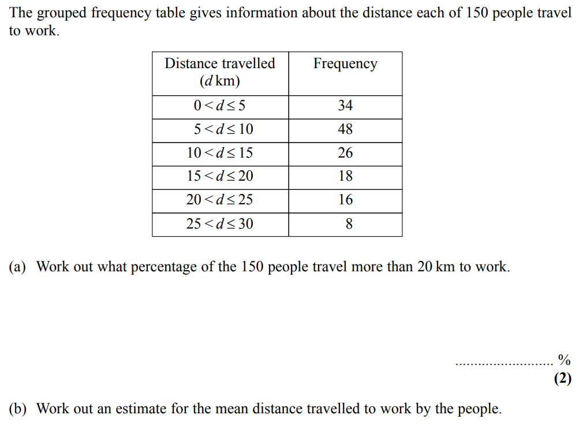
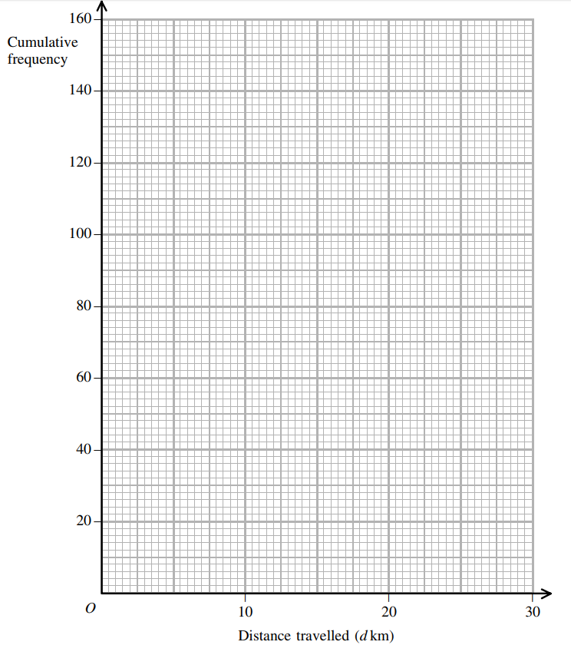
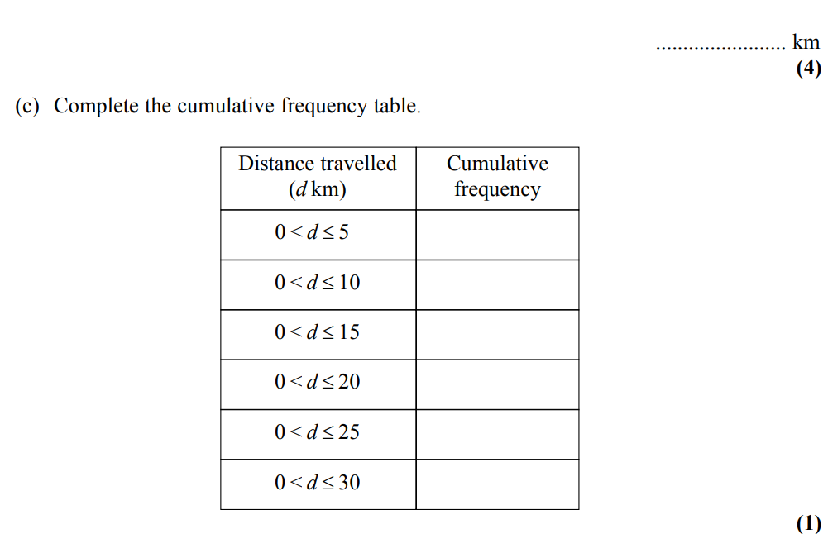
Averages
May 2004 3H Q9

Slide 36
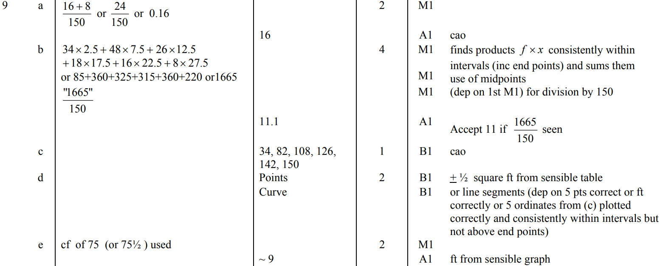
Averages
May 2004 3H Q9
A
B
C
D
E

Slide 37
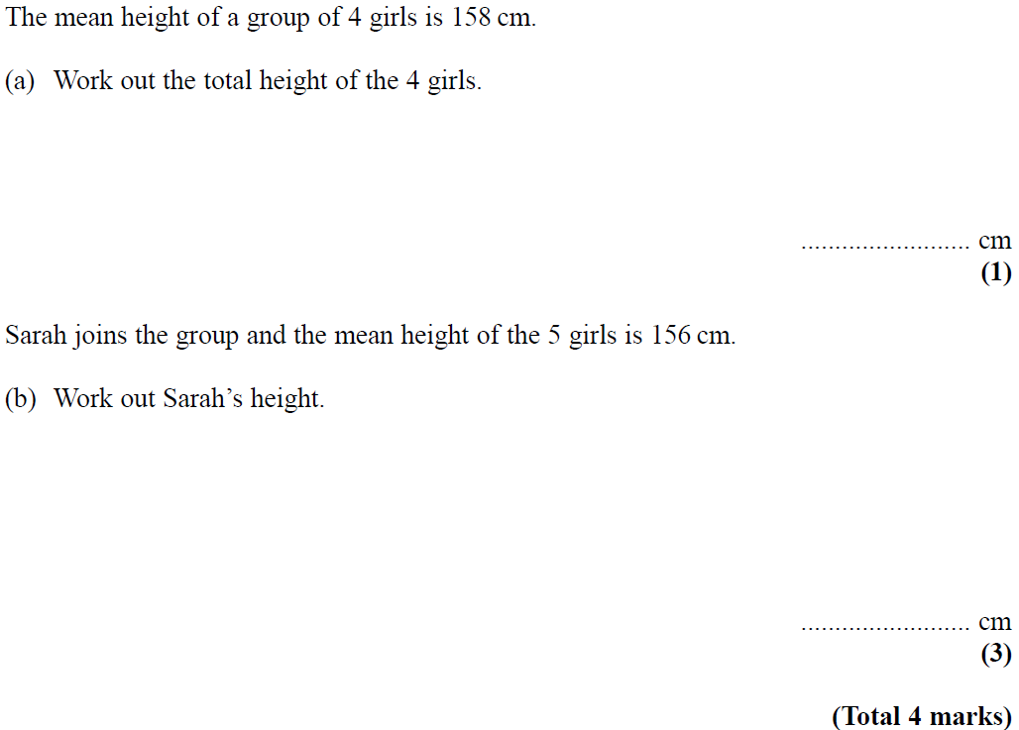
Averages
May 2004 4H Q4

Slide 38
Averages
May 2004 4H Q4
A
B

Slide 39
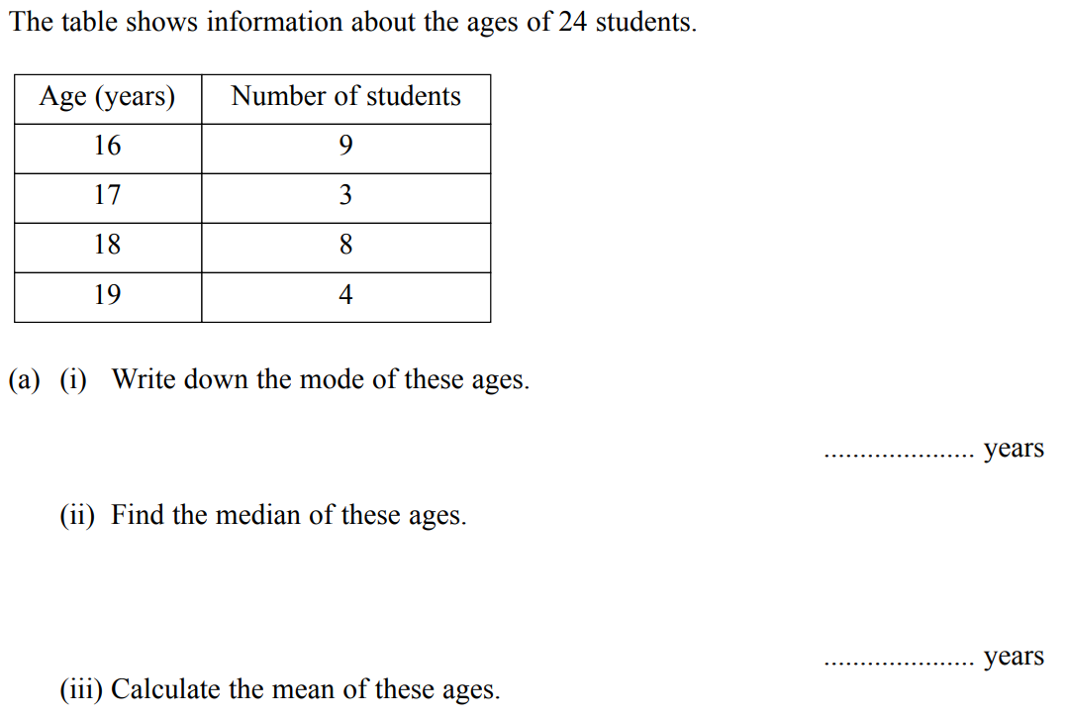
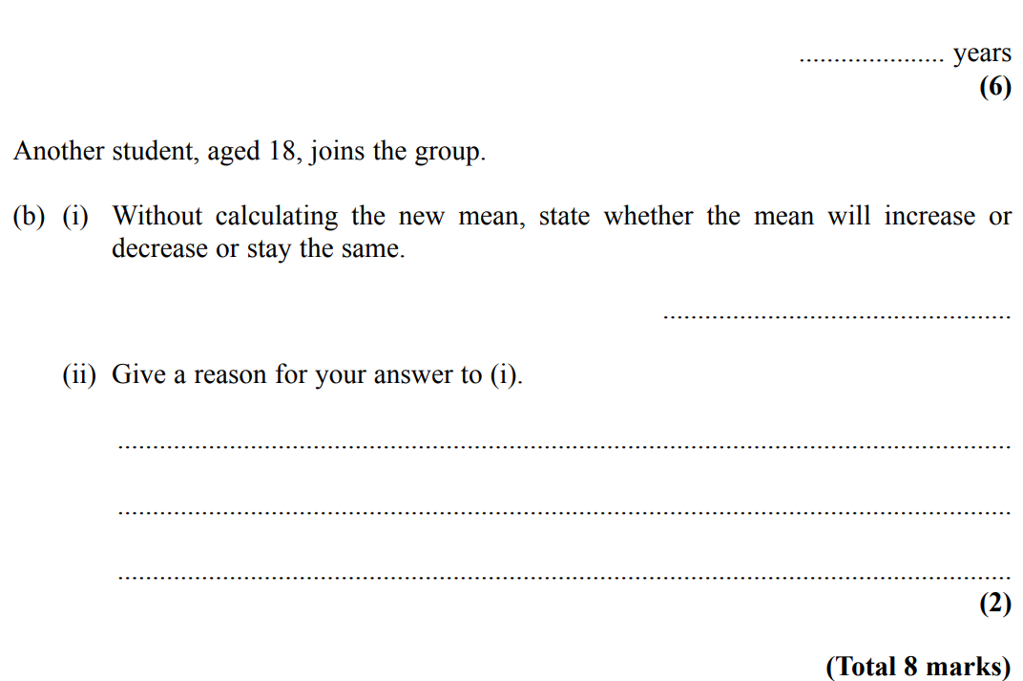
Averages
Nov 2004 3H Q8

Slide 40
Averages
Nov 2004 3H Q8
A (i)
A (ii)
A (iii)
B

Slide 41
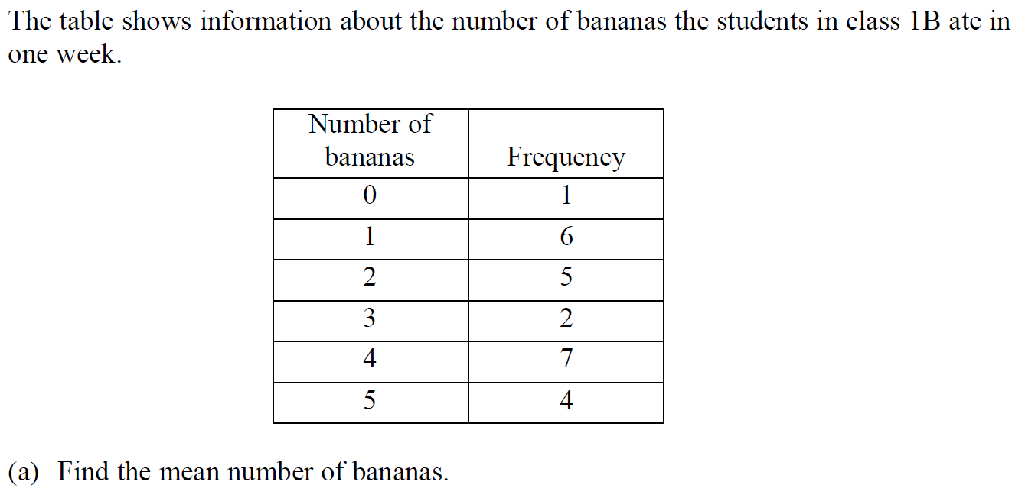
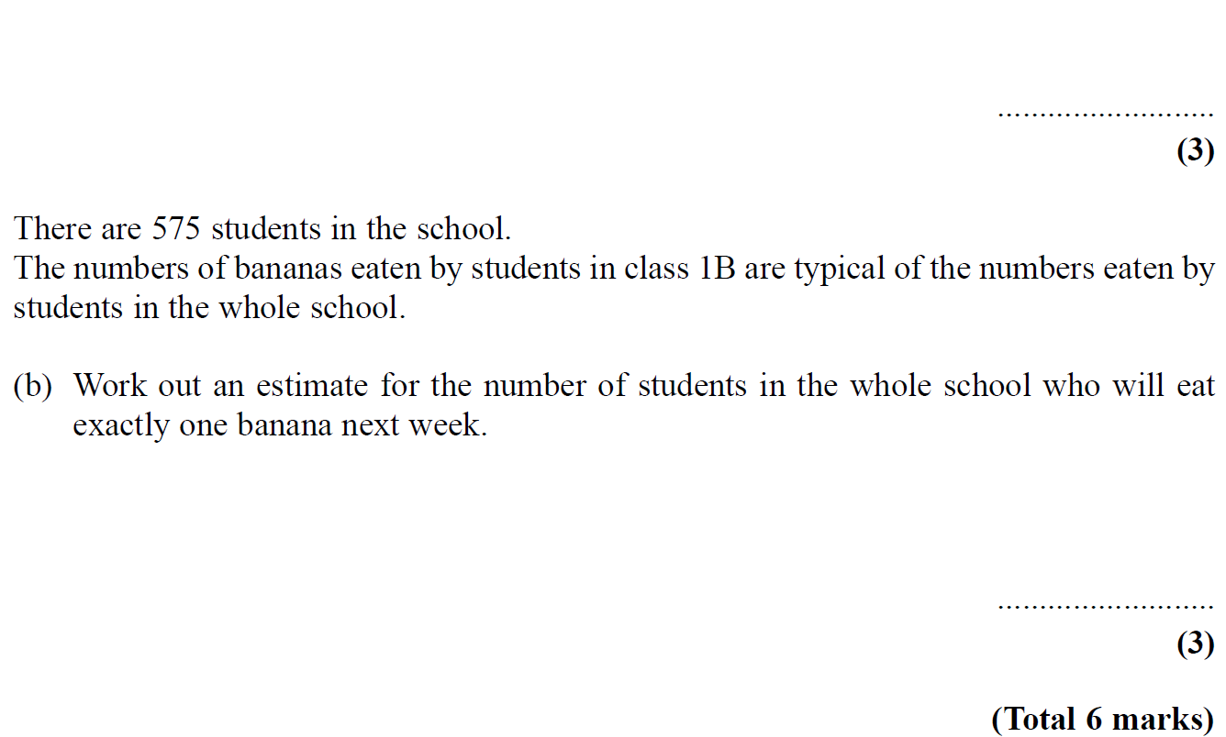
Averages
Nov 2005 3H Q4

Slide 42
Averages
Nov 2005 3H Q4
A
B

Slide 43
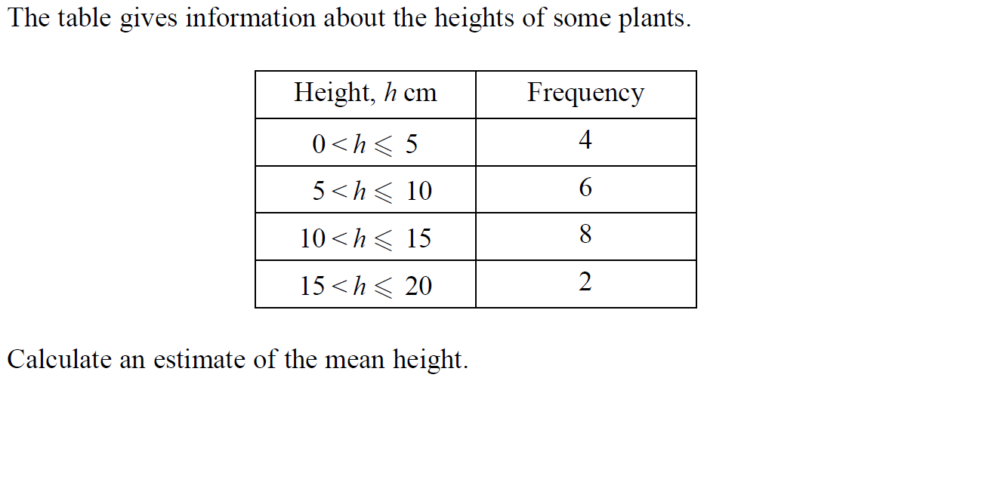
Averages
Nov 2005 4H Q8

Slide 44
Averages
Nov 2005 4H Q8
A

Slide 45
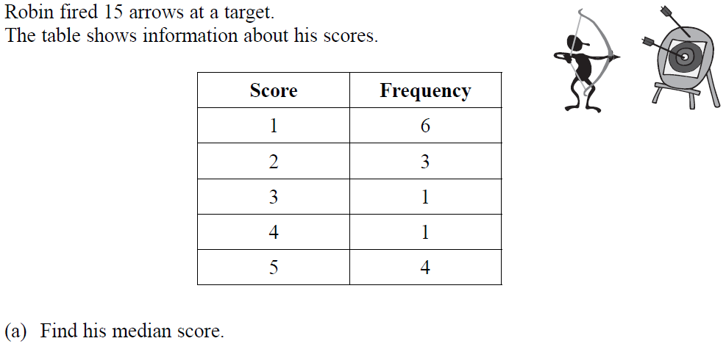
Averages
May 2006 3H Q5

Slide 46
Averages
May 2006 3H Q5
A
B

Slide 47
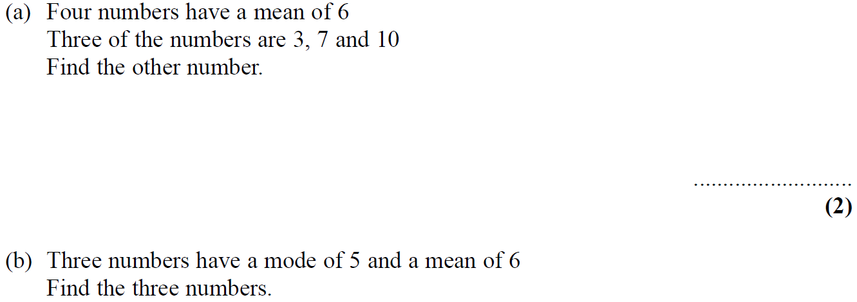
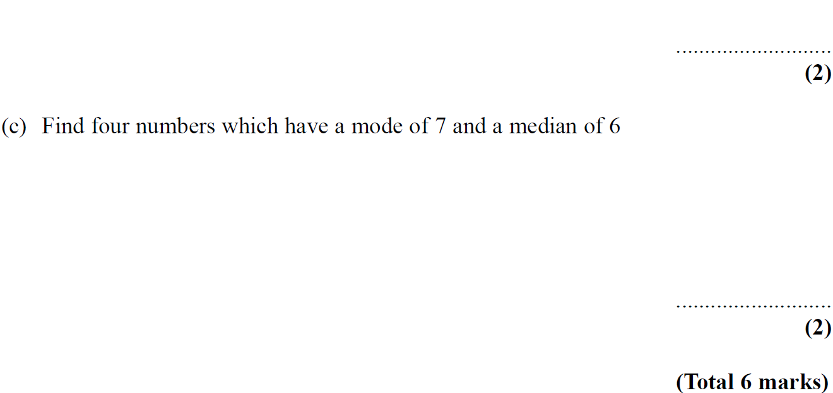
Averages
May 2006 4H Q7

Slide 48
Averages
May 2006 4H Q7
A
B
c

Slide 49
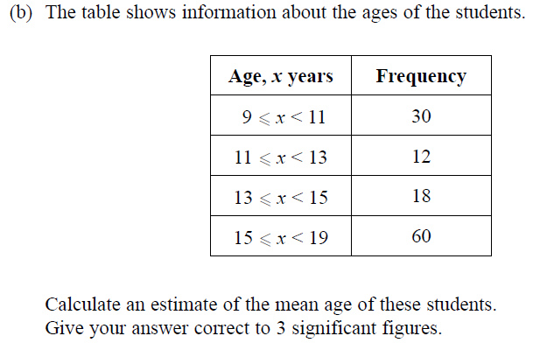
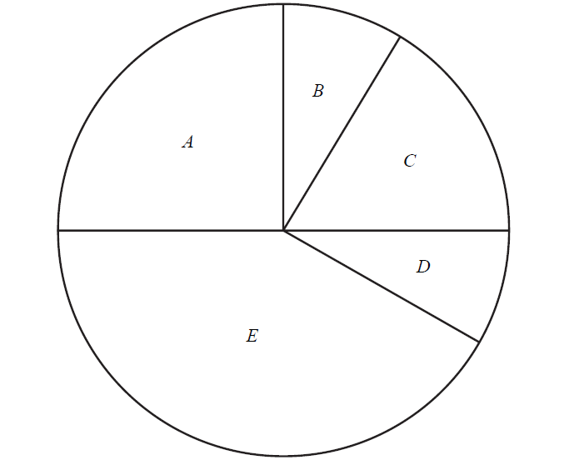
Averages
Nov 2006 3H Q4

Slide 50
Averages
Nov 2006 3H Q4
A
B

Slide 51
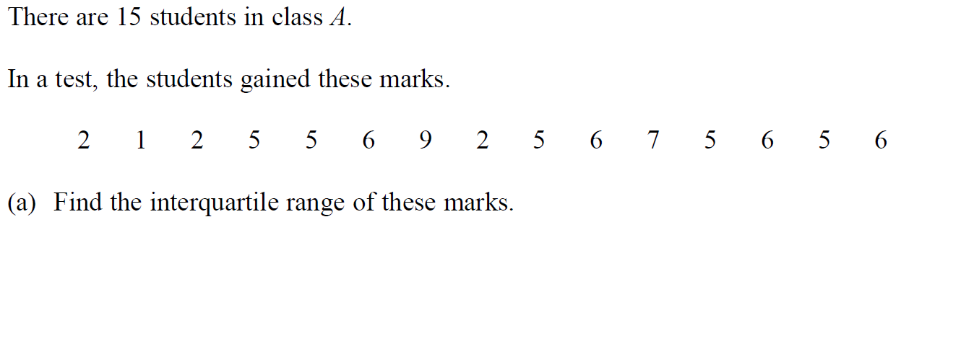
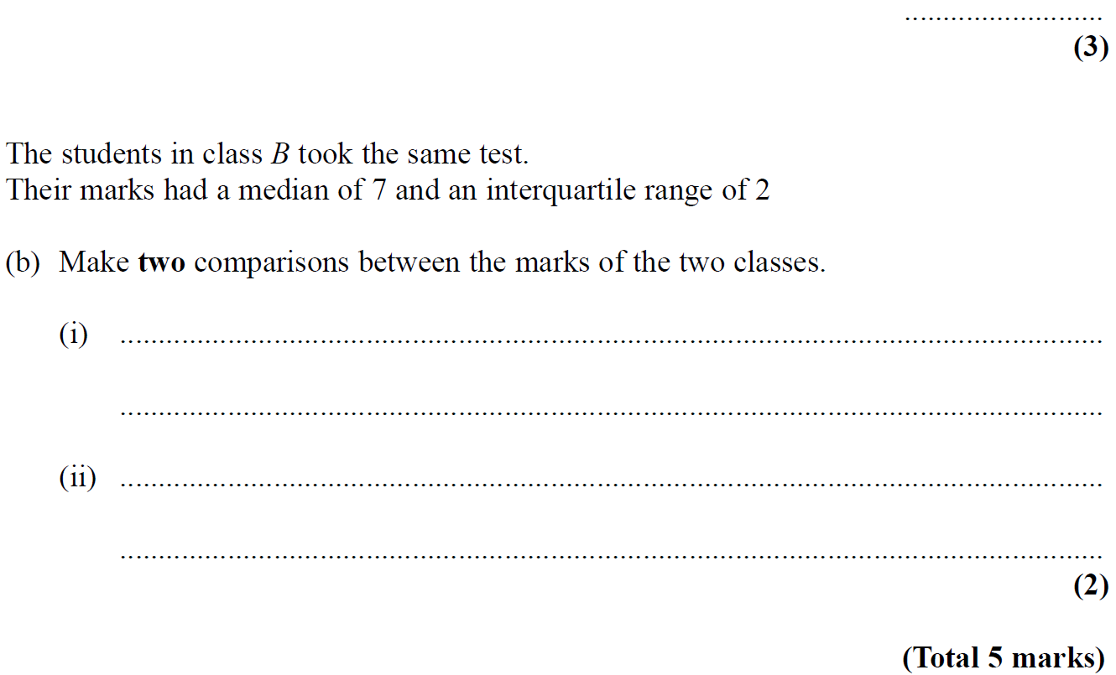
Averages
Nov 2006 3H Q11

Slide 52
Averages
Nov 2006 3H Q11
A
B (i)
B (ii)

Slide 53
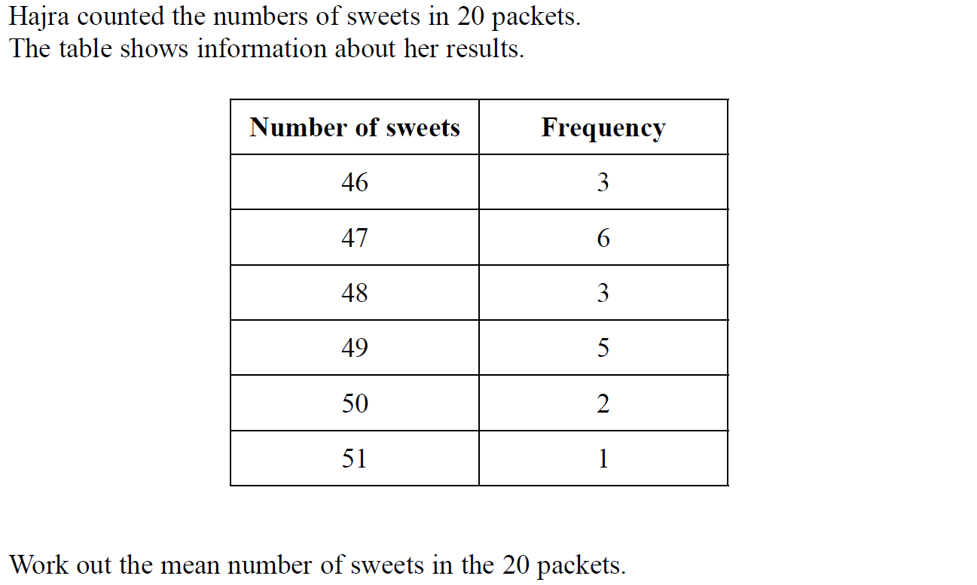
Averages
May 2007 3H Q3

Slide 54
Averages
May 2007 3H Q3
A

Slide 55
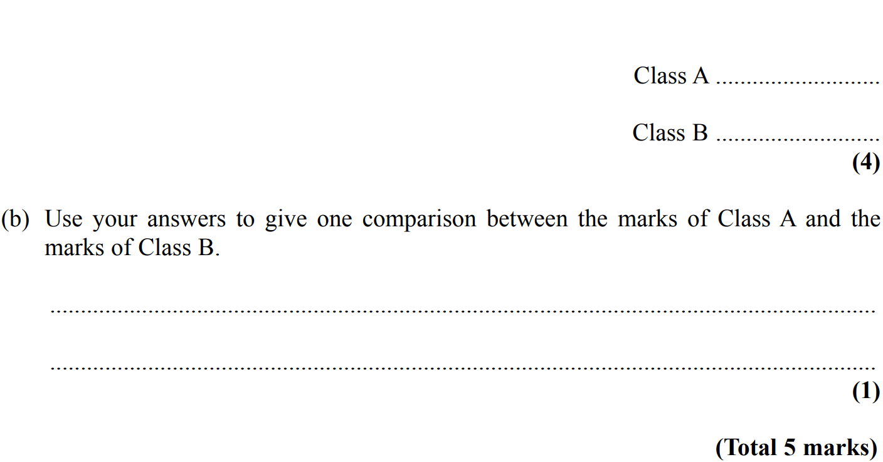
Averages
May 2007 4H Q13

Slide 56
Averages
May 2007 4H Q13
A
B

Slide 57
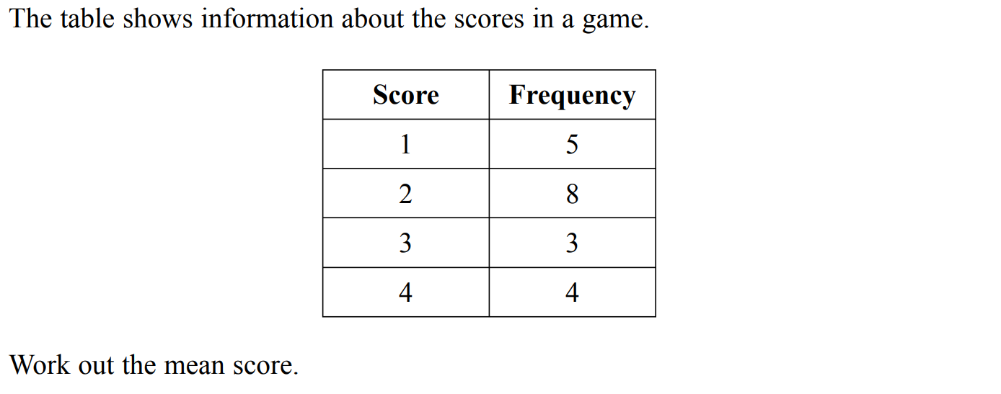
Averages
Nov 2007 3H Q2

Slide 58
Averages
Nov 2007 3H Q2
A

Slide 59
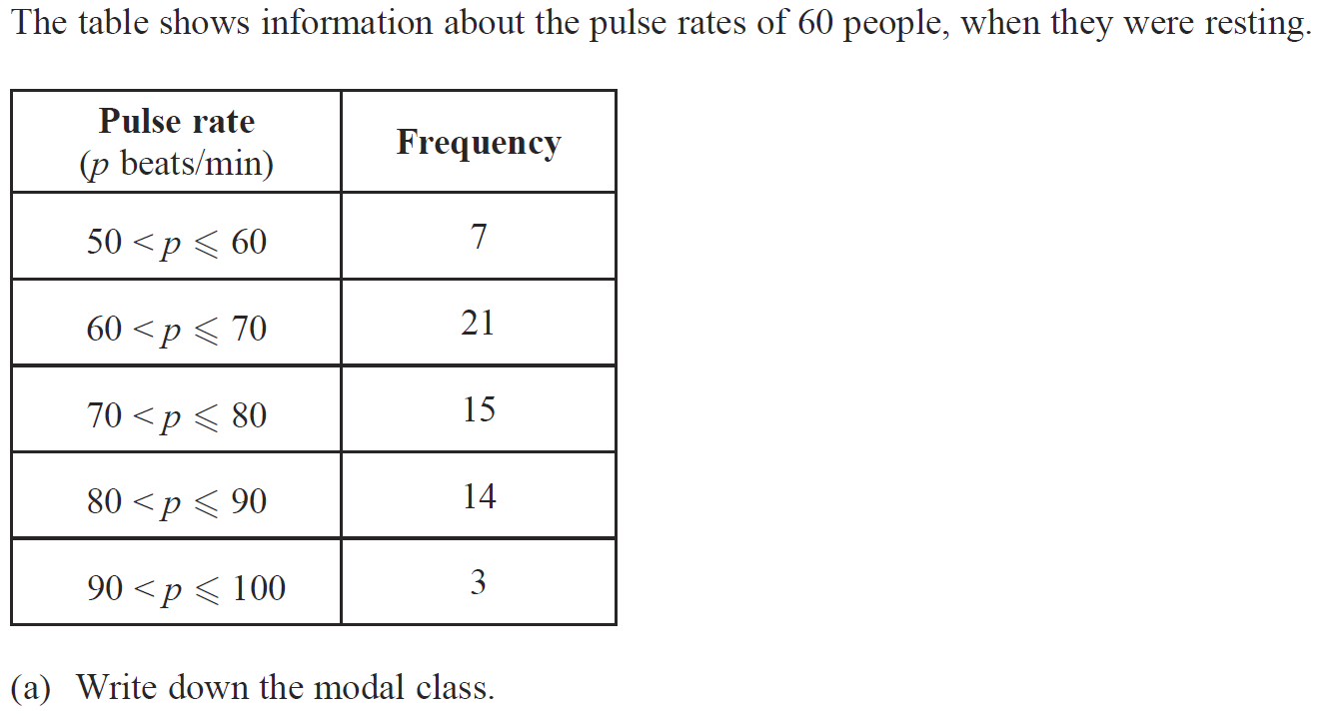
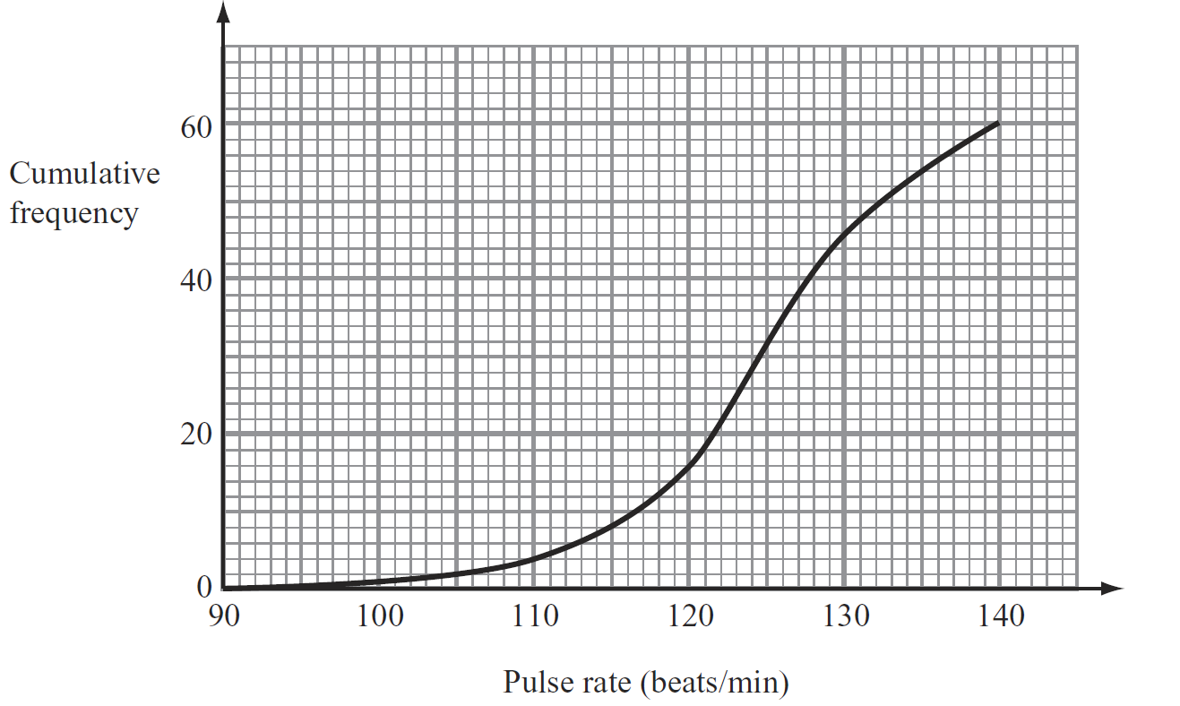
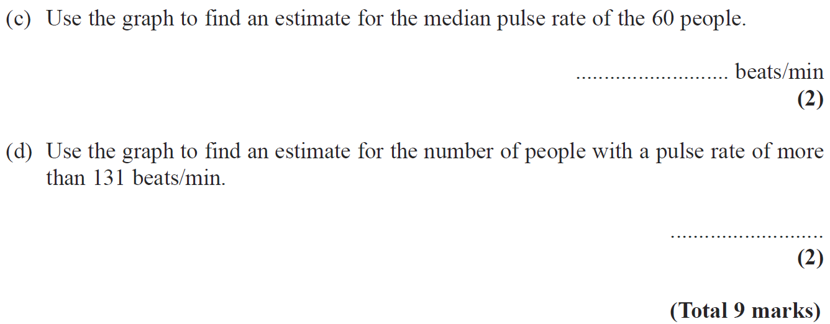
Averages
May 2008 3H Q11

Slide 60
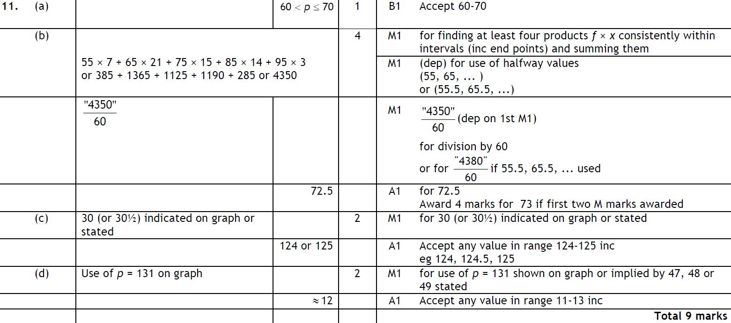
Averages
May 2008 3H Q11
A
B
C
D

Slide 61
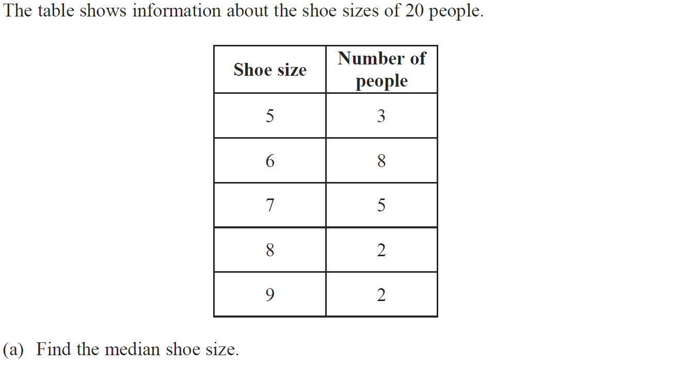
Averages
May 2008 4H Q3

Slide 62
Averages
May 2008 4H Q3
A
B

Slide 63
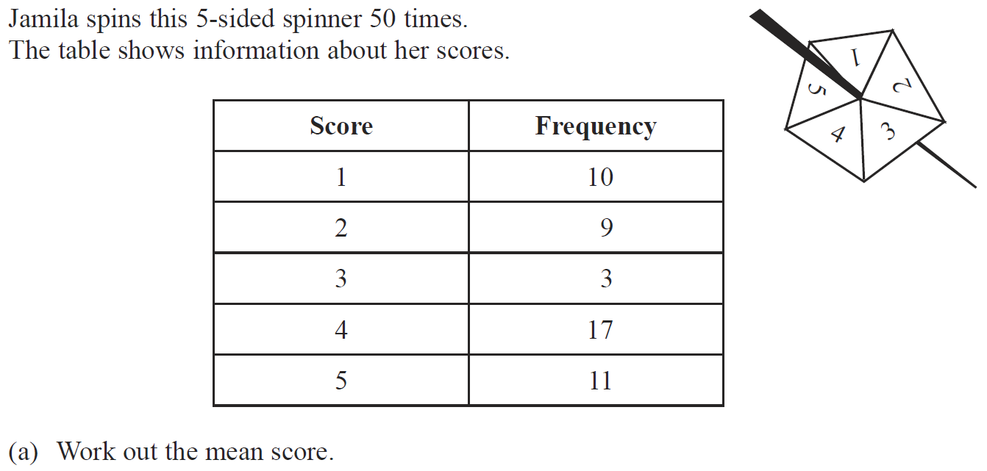
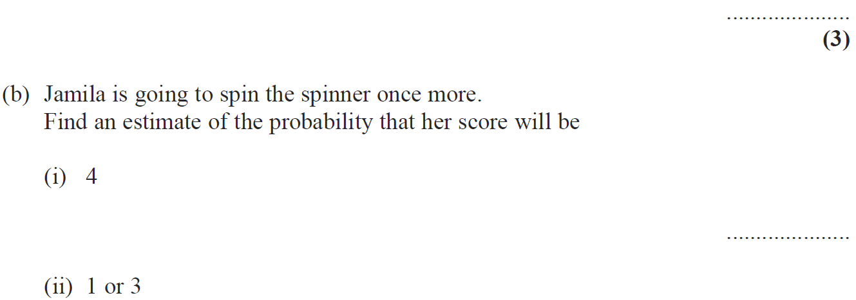
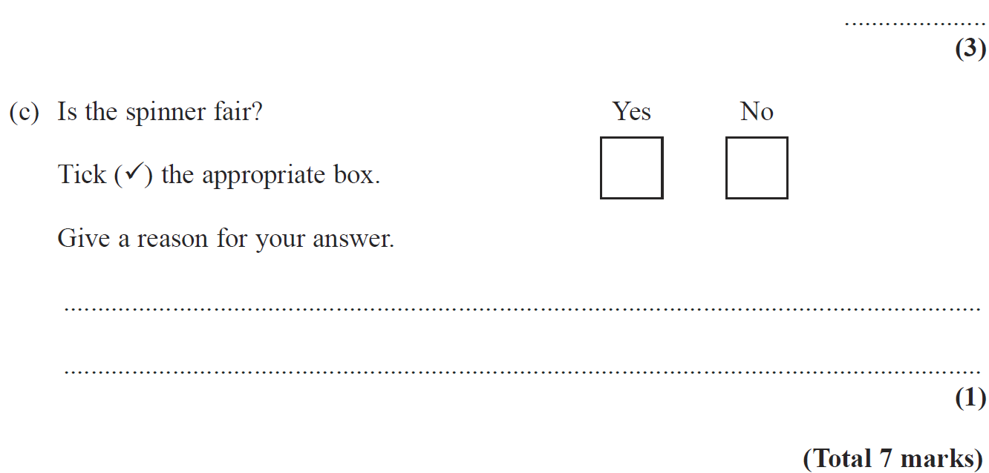
Averages
Nov 2008 3H Q3

Slide 64
Averages
Nov 2008 3H Q3
A
B (i)
B (ii)
C

Slide 65
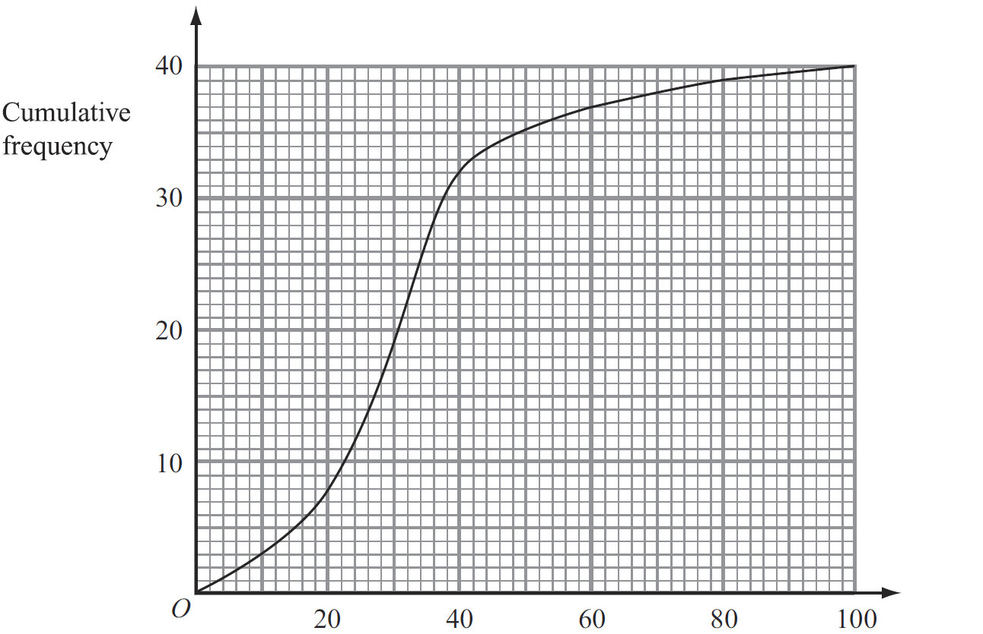
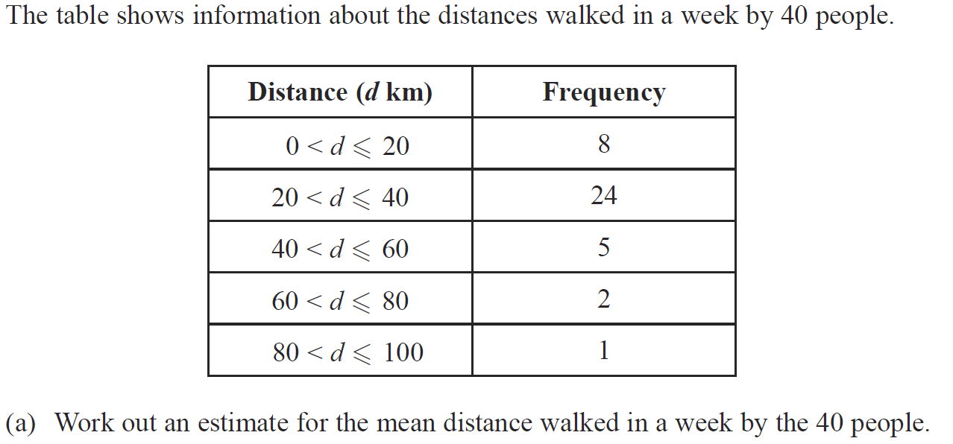
Averages
May 2009 3H Q10

Slide 66
Averages
May 2009 3H Q10
A
B
C

Slide 67
Averages
June 2009 4H Q4

Slide 68
Averages
June 2009 4H Q4
A

Slide 69
Averages
Nov 2009 3H Q4

Slide 70
Averages
Nov 2009 3H Q4
A

Slide 71
Averages
June 2010 3H Q3

Slide 72
Averages
June 2010 3H Q3
A
B

Slide 73
Averages
June 2010 3H Q6
Show Graph
Hide Graph

Slide 74
Averages
June 2010 3H Q6
A
B
C
D
E

Slide 75
Averages
Nov 2010 3H Q1

Slide 76
Averages
Nov 2010 3H Q1
A

Slide 77
Averages
Nov 2010 3H Q9

Slide 78
Averages
Nov 2010 3H Q9
A
B

Slide 79
Averages
June 2011 4H Q7

Slide 80
Averages
June 2011 4H Q7
A

Slide 81
Averages
Jan 2012 3H Q7

Slide 82
Averages
Jan 2012 3H Q7
A
B (i)
B (ii)

Slide 83
Averages
Jan 2012 4H Q4

Slide 84
Averages
Jan 2012 4H Q4
A

Slide 85
Averages
May 2012 3H Q5

Slide 86
Averages
May 2012 3H Q5
A

Slide 87
Averages
May 2012 3H Q10

Slide 88
Averages
May 2012 3H Q10
A
B
C (i)
C (ii)

Slide 89
Averages
May 2012 4H Q2

Slide 90
Averages
May 2012 4H Q2
A

Slide 91
Averages
Jan 2013 4H Q3

Slide 92
Averages
Jan 2013 4H Q3
A

Slide 93
Averages
May 2013 3H Q1

Slide 94
Averages
May 2013 3H Q1
A

Slide 95
Averages
May 2013 4HR Q3

Slide 96
Averages
May 2013 4HR Q3
(i)
(ii)

Slide 97
Averages
Jan 2014 4H Q4

Slide 98
Averages
Jan 2014 4H Q4
A

Slide 99
Averages
Jan 2014 4H Q10

Slide 100
Averages
Jan 2014 4H Q10
A

Slide 101
Averages
Jan 2014 3HR Q1

Slide 102
Averages
Jan 2014 3HR Q1
A

Slide 103
Averages
Jan 2014 4HR Q2

Slide 104
Averages
Jan 2014 4HR Q2
A

Slide 105
Averages
May 2014 3H Q10

Slide 106
Averages
May 2014 3H Q10
A

Slide 107
Averages
May 2014 4H Q10

Slide 108
Averages
May 2014 4H Q10
A

Slide 109
Averages
May 2014 3HR Q4

Slide 110
Averages
May 2014 3HR Q4
A
B
C

Slide 111
Averages
May 2014 4HR Q11

Slide 112
Averages
May 2014 4HR Q11
A
B

Slide 113
Averages
May 2014 4HR Q13

Slide 114
Averages
May 2014 4HR Q13
A
B

Slide 115
Averages
Jan 2015 4H Q1

Slide 116
Averages
Jan 2015 4H Q1
A

Slide 117
Averages
Jan 2015 4H Q9

Slide 118
Averages
Jan 2015 4H Q9
A

Slide 119
Averages
Jan 2015 3HR Q12

Slide 120
Averages
Jan 2015 3HR Q12
A
B

Slide 121
Averages
Jan 2015 4HR Q6

Slide 122
Averages
Jan 2015 4HR Q6
A
B

Slide 123
Averages
May 2015 3H Q4

Slide 124
Averages
May 2015 3H Q4
A
B

Slide 125
Averages
May 2015 3H Q12

Slide 126
Averages
May 2015 3H Q12
A

Slide 127
Averages
June 2015 4H Q4

Slide 128
Averages
June 2015 4H Q4
A
B

Slide 129
Averages
May 2015 3HR Q1

Slide 130
Averages
May 2015 3HR Q1
A
B

Slide 131
Averages
May 2015 3HR Q6

Slide 132
Averages
May 2015 3HR Q6
A

Slide 133
Averages
June 2015 4HR Q5

Slide 134
Averages
June 2015 4HR Q5
A
B

Slide 135
Averages
Jan 2016 3H Q5

Slide 136
Averages
Jan 2016 3H Q5
A
B
C

Slide 137
Averages
Jan 2016 3H Q13

Slide 138
Averages
Jan 2016 3H Q13
A
B
C

Slide 139
Averages
Jan 2016 4H Q3

Slide 140
Averages
Jan 2016 4H Q3
A

Slide 141
Averages
Jan 2016 4HR Q7

Slide 142
Averages
Jan 2016 4HR Q7
A
B

Slide 143
Averages
May 2016 3H Q3

Slide 144
Averages
May 2016 3H Q3
A

Slide 145
Averages
June 2016 4HR Q6

Slide 146
Averages
June 2016 4HR Q6
A

Slide 147
Averages
June 2016 4HR Q9

Slide 148
Averages
June 2016 4HR Q9
A

Slide 149
Averages
Jan 2017 3H Q2

Slide 150
Averages
Jan 2017 3H Q2
A

Slide 151
Averages
Jan 2017 3H Q6

Slide 152
Averages
Jan 2017 3H Q6
A

Slide 153
Averages
Jan 2017 4H Q1

Slide 154
Averages
Jan 2017 4H Q1
A

Slide 155
Averages
May 2017 3H Q4

Slide 156
Averages
May 2017 3H Q4
A
B

Slide 157
Averages
June 2017 4H Q12

Slide 158
Averages
June 2017 4H Q12
A

Slide 159
Averages
May 2017 3HR Q6

Slide 160
Averages
May 2017 3HR Q6
A
B

Slide 161
Averages
June 2017 4HR Q6

Slide 162
Averages
June 2017 4HR Q6
A
B

Slide 163
Averages
Jan 2018 3H Q4

Slide 164
Averages
Jan 2018 3H Q4
A
B
C

Slide 165
Averages
Jan 2018 3H Q14

Slide 166
Averages
Jan 2018 3H Q14
A

Slide 167
Averages
Jan 2018 4HR Q6

Slide 168
Averages
Jan 2018 4HR Q6
A
B
C

Slide 169
Averages
May 2018 3H Q10
Show Graph
Hide Graph

Slide 170
Averages
May 2018 3H Q10
A
B
C
D
E

Slide 171
Averages
June 2018 4H Q3

Slide 172
Averages
June 2018 4H Q3
A
B

Slide 173
Averages
May 2018 3HR Q8

Slide 174
Averages
May 2018 3HR Q8
A
B

Slide 175
Averages
June 2018 4HR Q1

Slide 176
Averages
June 2018 4HR Q1
A

Slide 177
Averages
June 2018 4HR Q3

Slide 178
Averages
June 2018 4HR Q3
A
B

Slide 179
Averages
June 2018 4HR Q11

Slide 180
Averages
June 2018 4HR Q11
A

