Slide 1
9.6) Finding perpendiculars

Slide 2
Worked example
Your turn
Find the shortest distance between the parallel lines with equations:
$r=2i−j+6k+λ\left(3i+4j+5k\right)$ and
$r=3j−k+μ\left(6i+8j+10k\right)$,
Where $λ$ and $μ$ are scalars
Find the shortest distance between the parallel lines with equations:
$r=i+2j−k+λ\left(5i+4j+3k\right)$ and
$r=2i+k+μ\left(5i+4j+3k\right)$,
Where $λ$ and $μ$ are scalars
$$\frac{21\sqrt{2}}{10}$$

Slide 3
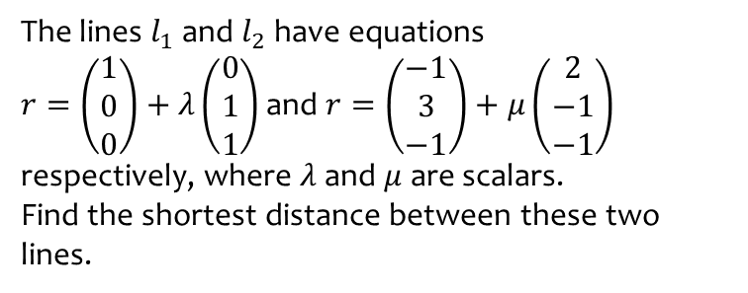
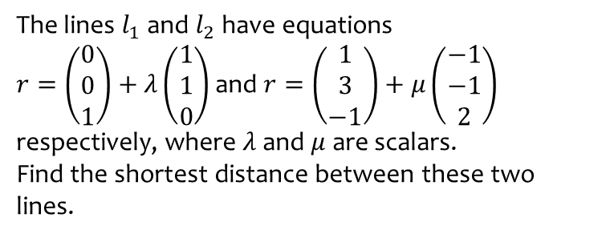
Worked example
Your turn
The lines $l_{1}$ and $l_{2}$ have equations
$r=\left(\begin{matrix}0 \\ 0 \\ 1\end{matrix}\right)+λ\left(\begin{matrix}1 \\ 1 \\ 0\end{matrix}\right)$ and $r=\left(\begin{matrix}1 \\ 3 \\ −1\end{matrix}\right)+μ\left(\begin{matrix}−1 \\ −1 \\ 2\end{matrix}\right)$ respectively, where $λ$ and $μ$ are scalars.
Find the shortest distance between these two lines.
The lines $l_{1}$ and $l_{2}$ have equations
$r=\left(\begin{matrix}1 \\ 0 \\ 0\end{matrix}\right)+λ\left(\begin{matrix}0 \\ 1 \\ 1\end{matrix}\right)$ and $r=\left(\begin{matrix}−1 \\ 3 \\ −1\end{matrix}\right)+μ\left(\begin{matrix}2 \\ −1 \\ −1\end{matrix}\right)$ respectively, where $λ$ and $μ$ are scalars.
Find the shortest distance between these two lines.
$$2\sqrt{2}$$

Slide 4
Worked example
Your turn
The line $l$ has equation $\frac{x−1}{−2}=\frac{y−1}{2}=\frac{z+3}{1}$, and the point $A$ has coordinates $\left(−1,2,1\right)$.
Find the shortest distance between $A$ and $l$.
Find the Cartesian equation of the line that is perpendicular to $l$ and passes through $A$.
The line $l$ has equation $\frac{x−1}{2}=\frac{y−1}{−2}=\frac{z+3}{−1}$, and the point $A$ has coordinates $\left(1,2,−1\right)$.
Find the shortest distance between $A$ and $l$.
Find the Cartesian equation of the line that is perpendicular to $l$ and passes through $A$.
(a) $\frac{\sqrt{29}}{3}$
(b) $\frac{x−1}{8}=\frac{y−2}{1}=\frac{z+1}{14}$

