Slide 1
9.5) Points of intersection

Slide 2
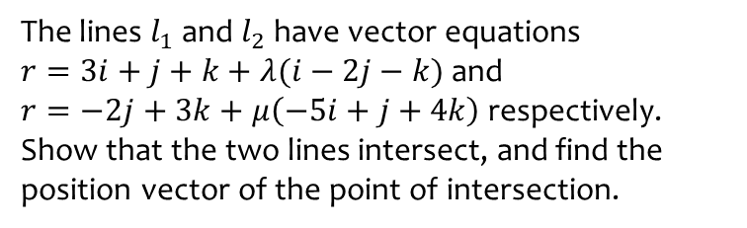
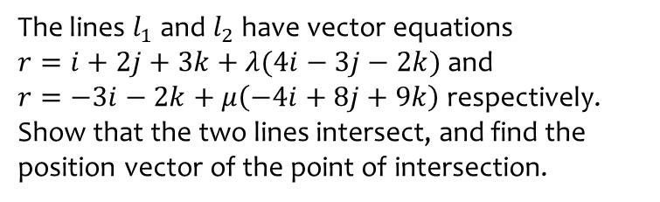
Worked example
Your turn
The lines $l_{1}$ and $l_{2}$ have vector equations
$r=i+2j+3k+λ(4i−3j−2k)$ and
$r=−3i−2k+μ\left(−4i+8j+9k\right)$ respectively.
Show that the two lines intersect, and find the position vector of the point of intersection.
The lines $l_{1}$ and $l_{2}$ have vector equations
$r=3i+j+k+λ(i−2j−k)$ and
$r=−2j+3k+μ\left(−5i+j+4k\right)$ respectively. Show that the two lines intersect, and find the position vector of the point of intersection.
$$(5, −3, −1)$$

Slide 3
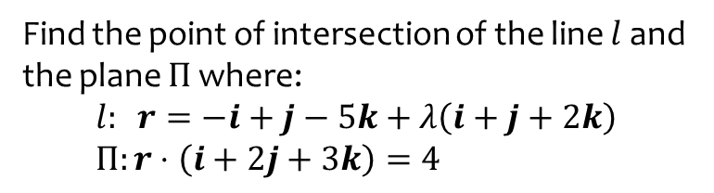
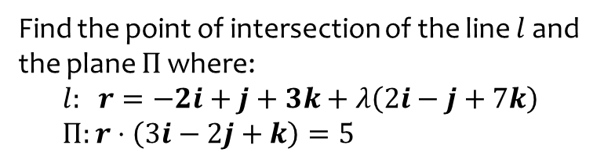
Worked example
Your turn
Find the point of intersection of the line $l$ and the plane $Π$ where:
$$l: r=−2i+j+3k+λ\left(2i−j+7k\right) \\ Π:r⋅\left(3i−2j+k\right)=5$$
Find the point of intersection of the line $l$ and the plane $Π$ where:
$$l: r=−i+j−5k+λ\left(i+j+2k\right) \\ Π:r⋅\left(i+2j+3k\right)=4$$
$$(1, 3, −1)$$

Slide 4
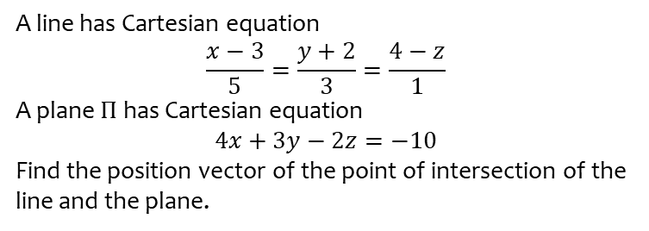
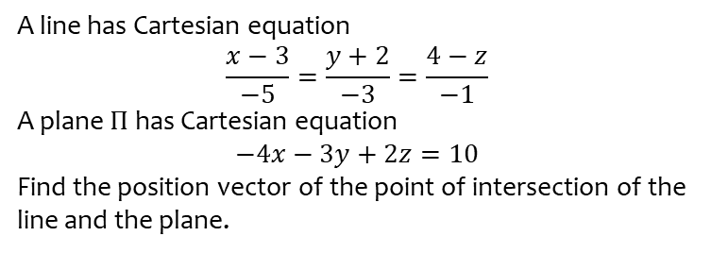

Worked example
Your turn
A line has Cartesian equation
$$\frac{x−3}{−5}=\frac{y+2}{−3}=\frac{4−z}{−1}$$
A plane $Π$ has Cartesian equation
$$−4x−3y+2z=10$$
Find the position vector of the point of intersection of the line and the plane.
A line has Cartesian equation
$$\frac{x−3}{5}=\frac{y+2}{3}=\frac{4−z}{1}$$
A plane $Π$ has Cartesian equation
$$4x+3y−2z=−10$$
Find the position vector of the point of intersection of the line and the plane.
$$\left(\frac{53}{31},−\frac{86}{31},\frac{132}{32}\right)$$

Slide 5
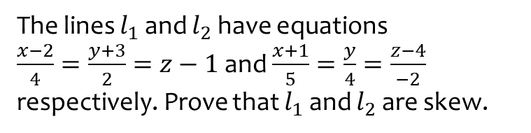
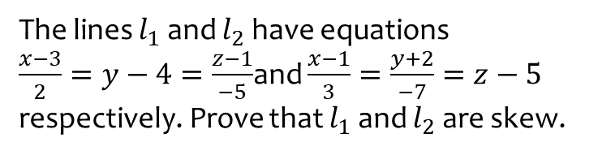
Worked example
Your turn
The lines $l_{1}$ and $l_{2}$ have equations
$\frac{x−3}{2}=y−4=\frac{z−1}{−5}$and $\frac{x−1}{3}=\frac{y+2}{−7}=z−5$ respectively. Prove that $l_{1}$ and $l_{2}$ are skew.
The lines $l_{1}$ and $l_{2}$ have equations
$\frac{x−2}{4}=\frac{y+3}{2}=z−1$ and $\frac{x+1}{5}=\frac{y}{4}=\frac{z−4}{−2}$ respectively. Prove that $l_{1}$ and $l_{2}$ are skew.
Proof

