Slide 1
9.4) Calculating angles between lines and planes

Slide 2
Worked example
Your turn
Find the acute angle between the line $l$ with equation
$r=−5i+j+2k+λ\left(−12i+4j+3k\right)$
and the plane with equation $r⋅\left(−i−2j+2k\right)=2$.
Find the acute angle between the line $l$ with equation
$r=2i+j−5k+λ\left(3i+4j−12k\right)$
and the plane with equation $r⋅\left(2i−2j−k\right)=2$.
$14.9°$(3 sf)

Slide 3
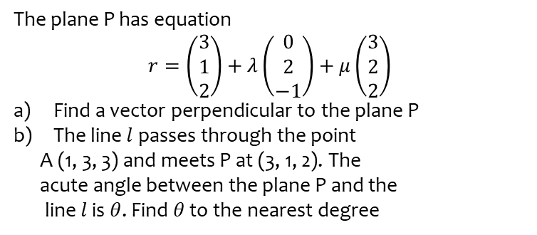
Worked example
Your turn
The plane P has equation
$$r=\left(\begin{aligned}2 \\ 1 \\ 3\end{aligned}\right)+λ\left(\begin{aligned}−1 \\ 2 \\ 0\end{aligned}\right)+μ\left(\begin{aligned}2 \\ 2 \\ 3\end{aligned}\right)$$
Find a vector perpendicular to the plane P
The line $l$passes through the point
A (3, 3, 1) and meets P at (2, 1, 3). The
acute angle between the plane P and the
line $l$ is $θ$. Find $θ$ to the nearest degree
The plane P has equation
$$r=\left(\begin{aligned}3 \\ 1 \\ 2\end{aligned}\right)+λ\left(\begin{aligned}0 \\ 2 \\ −1\end{aligned}\right)+μ\left(\begin{aligned}3 \\ 2 \\ 2\end{aligned}\right)$$
Find a vector perpendicular to the plane P
The line $l$passes through the point
A (1, 3, 3) and meets P at (3, 1, 2). The
acute angle between the plane P and the
line $l$ is $θ$. Find $θ$ to the nearest degree
$θ=63°$ (nearest degree)

Slide 4
Worked example
Your turn
Find the acute angle between the planes:
$$Π_{1}: r⋅\left(3i−j+k\right)=4 \\ Π_{2}: r⋅\left(2i+3j\right)=7$$
Find the acute angle between the planes:
$$Π_{1}: r⋅\left(4i+4j−7k\right)=13 \\ Π_{2}: r⋅\left(7i−4j+4k\right)=6$$
$θ=78.6°$ (1 dp)

Slide 5
Worked example
Your turn
The lines $l_{1}$ and $l_{2}$ have Cartesian equations
$\frac{x+6}{−1}=\frac{y−3}{2}=\frac{z−2}{3}$ and $\frac{x+8}{−2}=\frac{y−4}{3}=\frac{z+13}{−1}$ respectively.
(a) Show that the point $A (−2, −5, −10)$ lies on both lines
(b) Find the size of the acute angle between the lines at $A$
The lines $l_{1}$ and $l_{2}$ have Cartesian equations
$\frac{x−6}{−1}=\frac{y+3}{2}=\frac{z+2}{3}$ and $\frac{x+5}{2}=\frac{y−15}{−3}=\frac{z−3}{1}$ respectively.
(a) Show that the point $A (3, 3, 7)$ lies on both lines
(b) Find the size of the acute angle between the lines at $A$
Shown
$69.1°$(1 dp)

