Slide 1
9.3) Scalar product

Slide 2

Worked example
Your turn
$$\left(\begin{matrix}3 \\ 2 \\ 1\end{matrix}\right)⋅\left(\begin{matrix}4 \\ 0 \\ 1\end{matrix}\right)$$
$$\left(\begin{matrix}a \\ 5 \\ 1\end{matrix}\right)⋅\left(\begin{matrix}3 \\ b \\ 10\end{matrix}\right)$$
$$\left(\begin{matrix}5 \\ −2 \\ 0\end{matrix}\right)⋅\left(\begin{matrix}3 \\ 3 \\ 1\end{matrix}\right)$$
$$9$$

Slide 3
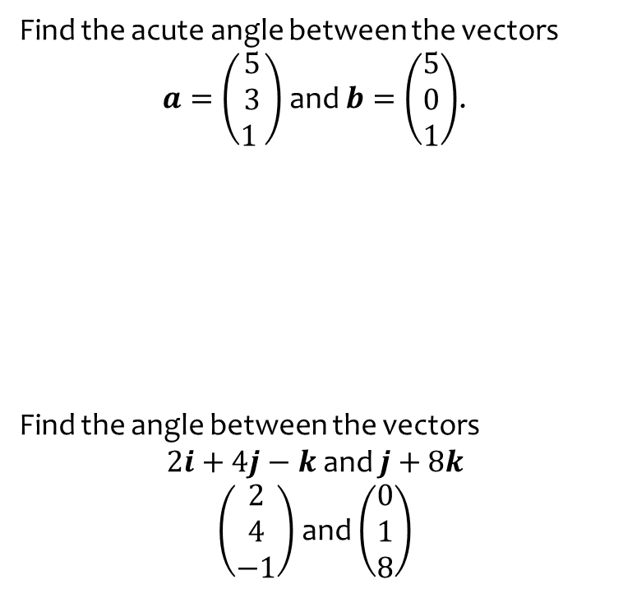
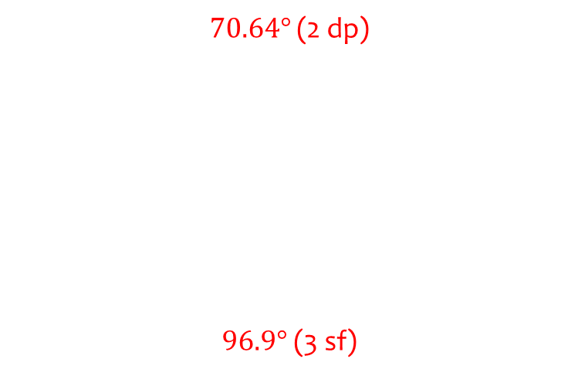
Worked example
Your turn
Find the acute angle between the vectors
$a=\left(\begin{matrix}5 \\ 3 \\ 1 \end{matrix}\right)$ and $b=\left(\begin{matrix}5 \\ 0 \\ 1\end{matrix}\right)$.
Find the angle between the vectors
$2i+4j−k$ and $j+8k$
$\left(\begin{matrix}2 \\ 4 \\ −1\end{matrix}\right)$ and $\left(\begin{matrix}0 \\ 1 \\ 8\end{matrix}\right)$
$$\text{Find} \text{the} \text{acute} \text{angle} \text{between} \text{the} \text{vectors}$$
$$a=\left(\begin{matrix}5 \\ 3 \\ 1 \end{matrix}\right) \text{and} b=\left(\begin{matrix}1 \\ 0 \\ 5\end{matrix}\right)\text{.}$$
Find the angle between the vectors
$−i+j+3k$ and $7i−2j+2k$
$70.64°$ (2 dp)
$96.9°$(3 sf)

Slide 4
Worked example
Your turn
If $A\left(5,3,2\right), B(4,0,5)$ and $C\left(2,−3,4\right)$ , find the area of triangle ABC
$\text{If} A\left(2,3,5\right), B(5,0,4) \text{and} C\left(4,−3,2\right)$, find the area of triangle ABC
$7.10$ (3 sf)

Slide 5
Worked example
Your turn
Show that $a=\left(\begin{matrix}3 \\ 1 \\ 2 \end{matrix}\right)$ and $b=\left(\begin{matrix}−1 \\ 7 \\ −2\end{matrix}\right)$ are perpendicular.
Show that $a=\left(\begin{matrix}2 \\ 3 \\ 1 \end{matrix}\right)$ and $b=\left(\begin{matrix}1 \\ 0 \\ −2\end{matrix}\right)$ are perpendicular.
Shown

Slide 6
Worked example
Your turn
Given that the vectors $a=1i−6j+2k$ and $b=λi−2j+5k$ are perpendicular, find the value of $λ$
Given that the vectors $a=2i−6j+k$ and $b=5i+2j+λk$ are perpendicular, find the value of $λ$
$$λ=2$$

Slide 7
Worked example
Your turn
Show that the two lines are perpendicular:
l₁: $r=\left(−9i+10k\right)+λ\left(3i+2j−k\right)$
l₂: $r=\left(−3i+5k\right)+μ\left(2i−j+4k\right)$
Show that the two lines are perpendicular:
l₁: $r=\left(−9i+10k\right)+λ\left(2i+j−k\right)$
l₂: $r=\left(−3i+5k\right)+μ\left(3i−j+5k\right)$
Shown

Slide 8
Worked example
Your turn
Given that
$a=2i−5j+4k$ and $b=−4+8j−5k$,
find a vector which is perpendicular to both $a$ and $b$.
Given that
$a=−2i+5j−4k$ and $b=4i−8j+5k$,
find a vector which is perpendicular to both $a$ and $b$.
$$7i+6j+4k$$

Slide 9
Worked example
Your turn
Find, to the nearest tenth of a degree, the angle that the vector $9i−5j+3k$ makes with:
The positive $x$-axis
The positive $y$-axis
Find, to the nearest tenth of a degree, the angle that the vector $i+11j−4k$ makes with:
The positive $z$-axis
$109.9°$(1 dp)

Slide 10
Worked example
Your turn
The points $P, Q$ and $R$ have coordinates $\left(6, −1, 1\right), (4, 5, −2)$ and $(−5, 3, 0)$ respectively.
Show that $PQ$ is perpendicular to $QR$
Hence find the centre and radius of the circle that passes through points $P, Q$ and $R$
The points $P, Q$ and $R$ have coordinates $\left(1, −1, 6\right), (−2, 5, 4)$ and $(0, 3, −5)$ respectively.
Show that $PQ$ is perpendicular to $QR$
Hence find the centre and radius of the circle that passes through points $P, Q$ and $R$
Shown
Centre $\left(\frac{1}{2}, 1,\frac{1}{2}\right),$radius $\frac{\sqrt{138}}{2}$

