Slide 1
9.2) Equation of a plane in three dimensions

Slide 2
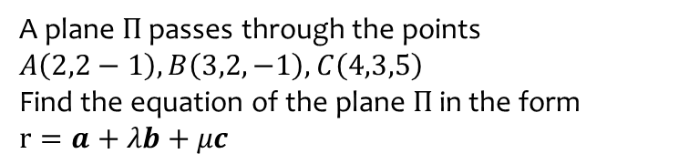
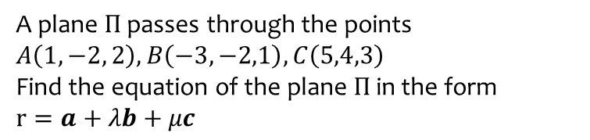
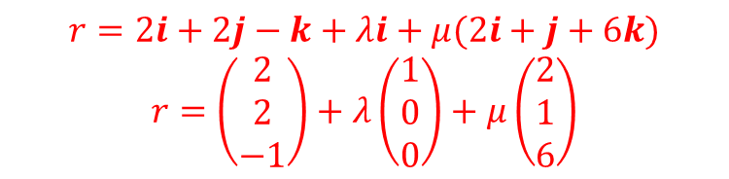
Worked example
Your turn
A plane $Π$ passes through the points $A\left(1,−2, 2\right), B\left(−3,−2,1\right), C\left(5,4,3\right)$
Find the equation of the plane $Π$ in the form
$$r=a+λb+μc$$
A plane $Π$ passes through the points
$$A\left(2,2−1\right), B\left(3,2,−1\right), C\left(4,3,5\right)$$
Find the equation of the plane $Π$ in the form
$$r=a+λb+μc$$
$$r=2i+2j−k+λi+μ(2i+j+6k)$$
$$r=\left(\begin{matrix}2 \\ 2 \\ −1\end{matrix}\right)+λ\left(\begin{matrix}1 \\ 0 \\ 0\end{matrix}\right)+μ\left(\begin{matrix}2 \\ 1 \\ 6\end{matrix}\right)$$

Slide 3
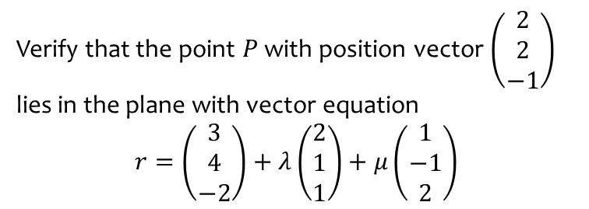
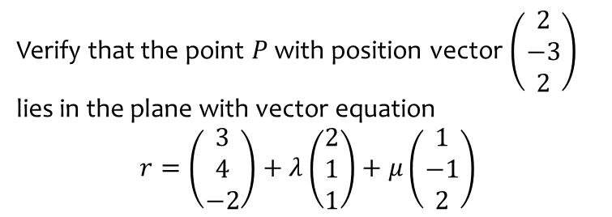
Worked example
Your turn
Verify that the point $P$ with position vector $\left(\begin{matrix}2 \\ −3 \\ 2\end{matrix}\right)$ lies in the plane with vector equation
$$r=\left(\begin{matrix}3 \\ 4 \\ −2\end{matrix}\right)+λ\left(\begin{matrix}2 \\ 1 \\ 1\end{matrix}\right)+μ\left(\begin{matrix}1 \\ −1 \\ 2\end{matrix}\right)$$
Verify that the point $P$ with position vector $\left(\begin{matrix}2 \\ 2 \\ −1\end{matrix}\right)$ lies in the plane with vector equation
$$r=\left(\begin{matrix}3 \\ 4 \\ −2\end{matrix}\right)+λ\left(\begin{matrix}2 \\ 1 \\ 1\end{matrix}\right)+μ\left(\begin{matrix}1 \\ −1 \\ 2\end{matrix}\right)$$
Shown

