Slide 1
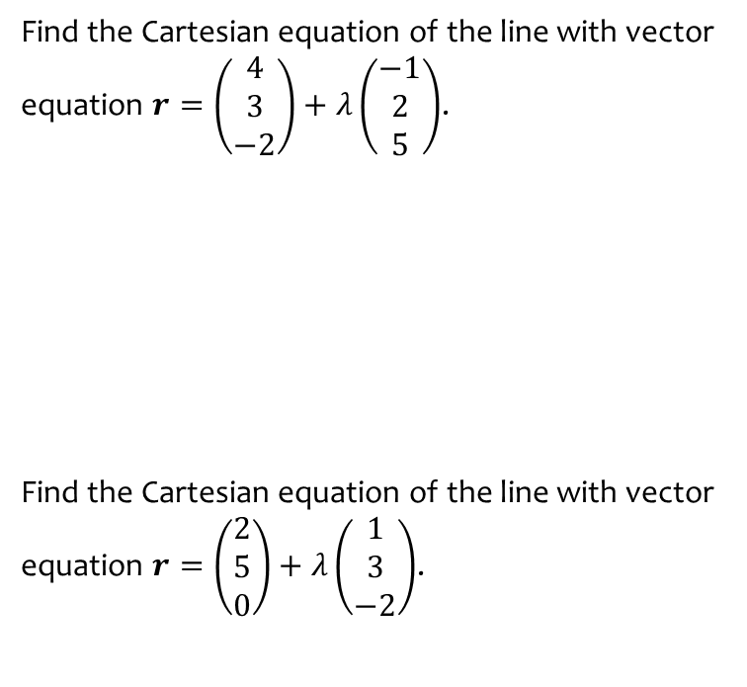
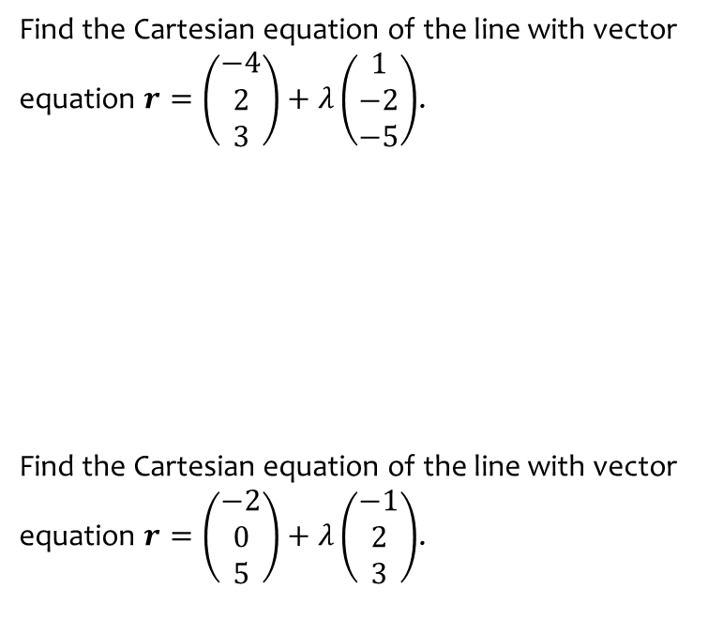

Worked example
Your turn
Find the Cartesian equation of the line with vector equation $r=\left(\begin{matrix}−4 \\ 2 \\ 3\end{matrix}\right)+λ\left(\begin{matrix}1 \\ −2 \\ −5\end{matrix}\right)$.
Find the Cartesian equation of the line with vector equation $r=\left(\begin{matrix}−2 \\ 0 \\ 5\end{matrix}\right)+λ\left(\begin{matrix}−1 \\ 2 \\ 3\end{matrix}\right)$.
Find the Cartesian equation of the line with vector equation $r=\left(\begin{matrix}4 \\ 3 \\ −2\end{matrix}\right)+λ\left(\begin{matrix}−1 \\ 2 \\ 5\end{matrix}\right)$.
Find the Cartesian equation of the line with vector equation $r=\left(\begin{matrix}2 \\ 5 \\ 0\end{matrix}\right)+λ\left(\begin{matrix}1 \\ 3 \\ −2\end{matrix}\right)$.
$$\frac{x−4}{−1}=\frac{y−3}{2}=\frac{z+2}{5}$$
$$\frac{x−2}{1}=\frac{y−5}{3}=\frac{z}{−2}$$

Slide 2
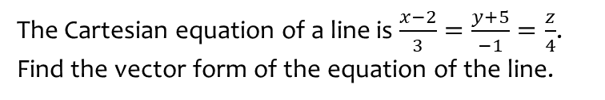


Worked example
Your turn
The Cartesian equation of a line is $\frac{x+2}{−3}=\frac{y}{−4}=\frac{z−5}{1}$. Find the vector form of the equation of the line.
The Cartesian equation of a line is $\frac{2−x}{3}=\frac{y+3}{−1}=\frac{5−z}{−4}$. Find the vector form of the equation of the line.
The Cartesian equation of a line is $\frac{x−2}{3}=\frac{y+5}{−1}=\frac{z}{4}$. Find the vector form of the equation of the line.
$$r=\left(\begin{matrix}2 \\ −5 \\ 0\end{matrix}\right)+λ\left(\begin{matrix}3 \\ −1 \\ 4\end{matrix}\right)$$

Slide 3
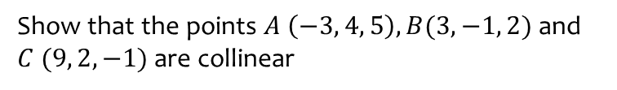
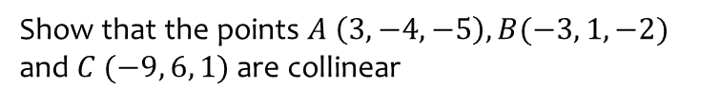
Worked example
Your turn
Show that the points $A \left(3, −4, −5\right), B(−3, 1, −2)$ and $C (−9, 6, 1)$ are collinear
Show that the points $A \left(−3, 4, 5\right), B(3, −1, 2)$ and $C (9, 2, −1)$ are collinear
Shown

Slide 4
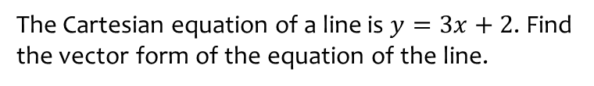


Worked example
Your turn
The Cartesian equation of a line is $y=2x−3$. Find the vector form of the equation of the line.
The Cartesian equation of a line is $y=3x−2$. Find the vector form of the equation of the line.
The Cartesian equation of a line is $y=3x+2$. Find the vector form of the equation of the line.
$$\left(\begin{matrix}0 \\ 2\end{matrix}\right)+λ\left(\begin{matrix}1 \\ 3\end{matrix}\right)$$

