Slide 1
9.1) Equation of a line in three dimensions

Slide 2
Worked example
Your turn
The straight line has vector equation $r=\left(i+5j−3k\right)+t\left(2i−j−6k\right)$. Given that the point $\left(0,a,b\right)$ lines on $l$, find the value of $a$ and the value of $b$.
The straight line has vector equation $r=\left(3i+2j−5k\right)+t\left(i−6j−2k\right)$. Given that the point $\left(a,b,0\right)$ lines on $l$, find the value of $a$ and the value of $b$.
$$a=\frac{1}{2}, b=17$$

Slide 3
Worked example
Your turn
The straight line $l$ has vector equation $r=\left(1i+4j−3k\right)+λ\left(10i−15j+5k\right)$. Show that another vector equation of $l$ is $$r=\left(7i−5j\right)+μ\left(2i−3j+k\right)$$
The straight line $l$ has vector equation $r=\left(2i+5j−3k\right)+λ\left(6i−2j+4k\right)$. Show that another vector equation of $l$ is $$r=\left(8i+3j+k\right)+μ\left(3i−j+2k\right)$$
$$\left(\begin{matrix}6 \\ −2 \\ 4\end{matrix}\right)=2\left(\begin{matrix}3 \\ −1 \\ 2\end{matrix}\right)$$
$∴$lines parallel
Let$λ=0$ -> $r=\left(\begin{matrix}2 \\ 5 \\ −3\end{matrix}\right)$
Let $μ=−2$ -> $r=\left(\begin{matrix}8+3(−2) \\ 3−(−2) \\ 1+2(−2)\end{matrix}\right)=\left(\begin{matrix}2 \\ 5 \\ −3\end{matrix}\right)$
$∴$ point in common
Lines parallel and shared point$∴$ same line

Slide 4
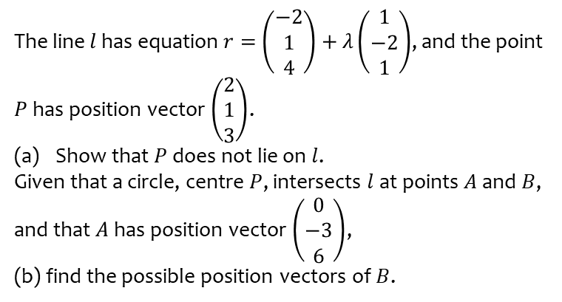
Worked example
Your turn
The line $l$ has equation $r=\left(\begin{matrix}4 \\ 1 \\ −2\end{matrix}\right)+λ\left(\begin{matrix}−1 \\ 2 \\ −1\end{matrix}\right)$, and the point $P$ has position vector $\left(\begin{matrix}3 \\ 1 \\ 2\end{matrix}\right)$.
Show that $P$ does not lie on $l$.
Given that a circle, centre $P$, intersects $l$ at points $A$ and $B$, and that $A$ has position vector $\left(\begin{matrix}−6 \\ 3 \\ 0\end{matrix}\right)$,
(b) find the possible position vectors of $B$.
The line $l$ has equation $r=\left(\begin{matrix}−2 \\ 1 \\ 4\end{matrix}\right)+λ\left(\begin{matrix}1 \\ −2 \\ 1\end{matrix}\right)$, and the point $P$ has position vector $\left(\begin{matrix}2 \\ 1 \\ 3\end{matrix}\right)$.
Show that $P$ does not lie on $l$.
Given that a circle, centre $P$, intersects $l$ at points $A$ and $B$, and that $A$ has position vector $\left(\begin{matrix}0 \\ −3 \\ 6\end{matrix}\right)$,
(b) find the possible position vectors of $B$.
Shown
$(−3, 3, 3)$ or $(0, −3, 6)$

