Slide 1
9) Vectors
9.1) Equation of a line in three dimensions
9.2) Equation of a plane in three dimensions
9.3) Scalar product
9.4) Calculating angles between lines and planes
9.5) Points of intersection
9.6) Finding perpendiculars

Slide 2
9.1) Equation of a line in three dimensions
Chapter CONTENTS

Slide 3
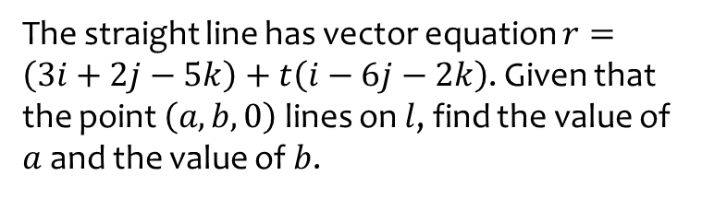
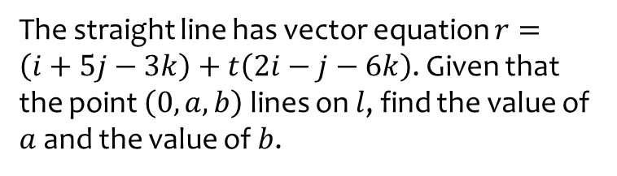

Worked example
Your turn
The straight line has vector equation $r=\left(i+5j−3k\right)+t\left(2i−j−6k\right)$. Given that the point $\left(0,a,b\right)$ lines on $l$, find the value of $a$ and the value of $b$.
The straight line has vector equation $r=\left(3i+2j−5k\right)+t\left(i−6j−2k\right)$. Given that the point $\left(a,b,0\right)$ lines on $l$, find the value of $a$ and the value of $b$.
$$a=\frac{1}{2}, b=17$$

Slide 4
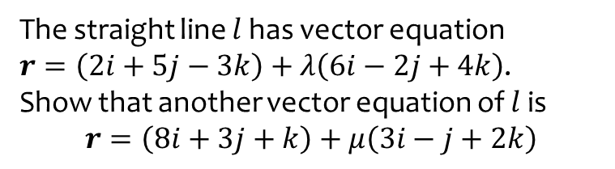
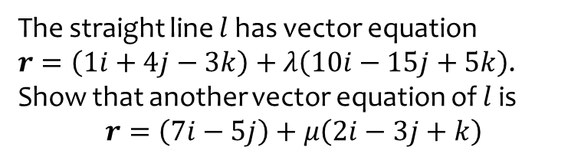
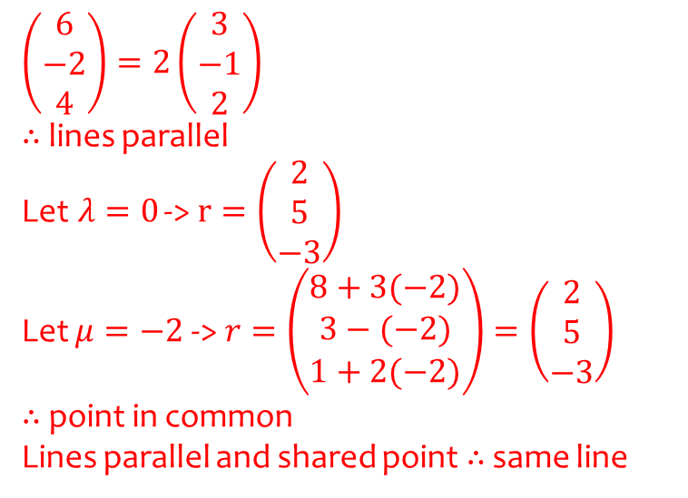
Worked example
Your turn
The straight line $l$ has vector equation
$r=\left(1i+4j−3k\right)+λ\left(10i−15j+5k\right)$.
Show that another vector equation of $l$ is
$$r=\left(7i−5j\right)+μ\left(2i−3j+k\right)$$
The straight line $l$ has vector equation
$r=\left(2i+5j−3k\right)+λ\left(6i−2j+4k\right)$.
Show that another vector equation of $l$ is
$$r=\left(8i+3j+k\right)+μ\left(3i−j+2k\right)$$
$$\left(\begin{matrix}6 \\ −2 \\ 4\end{matrix}\right)=2\left(\begin{matrix}3 \\ −1 \\ 2\end{matrix}\right)$$
$∴$lines parallel
Let$λ=0$ -> $r=\left(\begin{matrix}2 \\ 5 \\ −3\end{matrix}\right)$
Let $μ=−2$ -> $r=\left(\begin{matrix}8+3(−2) \\ 3−(−2) \\ 1+2(−2)\end{matrix}\right)=\left(\begin{matrix}2 \\ 5 \\ −3\end{matrix}\right)$
$∴$ point in common
Lines parallel and shared point$∴$ same line

Slide 5
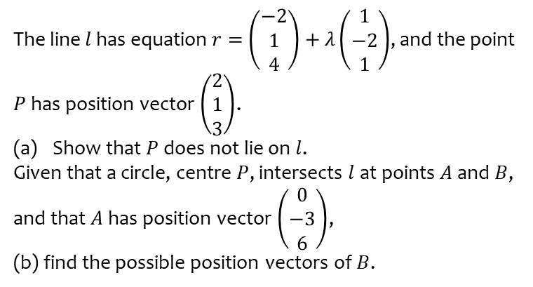
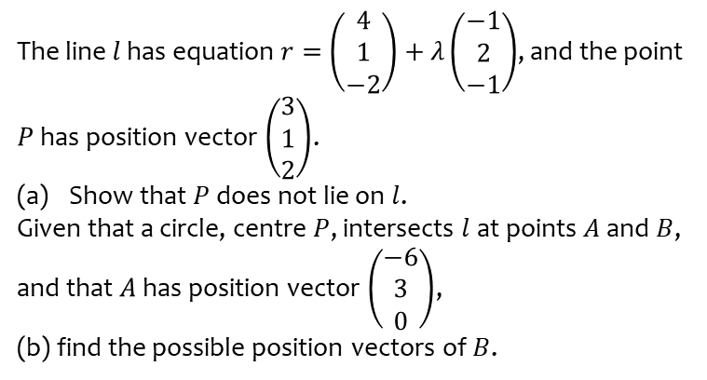

Worked example
Your turn
The line $l$ has equation $r=\left(\begin{matrix}4 \\ 1 \\ −2\end{matrix}\right)+λ\left(\begin{matrix}−1 \\ 2 \\ −1\end{matrix}\right)$, and the point $P$ has position vector $\left(\begin{matrix}3 \\ 1 \\ 2\end{matrix}\right)$.
Show that $P$ does not lie on $l$.
Given that a circle, centre $P$, intersects $l$ at points $A$ and $B$, and that $A$ has position vector $\left(\begin{matrix}−6 \\ 3 \\ 0\end{matrix}\right)$,
(b) find the possible position vectors of $B$.
The line $l$ has equation $r=\left(\begin{matrix}−2 \\ 1 \\ 4\end{matrix}\right)+λ\left(\begin{matrix}1 \\ −2 \\ 1\end{matrix}\right)$, and the point $P$ has position vector $\left(\begin{matrix}2 \\ 1 \\ 3\end{matrix}\right)$.
Show that $P$ does not lie on $l$.
Given that a circle, centre $P$, intersects $l$ at points $A$ and $B$, and that $A$ has position vector $\left(\begin{matrix}0 \\ −3 \\ 6\end{matrix}\right)$,
(b) find the possible position vectors of $B$.
Shown
$(−3, 3, 3)$ or $(0, −3, 6)$

Slide 6
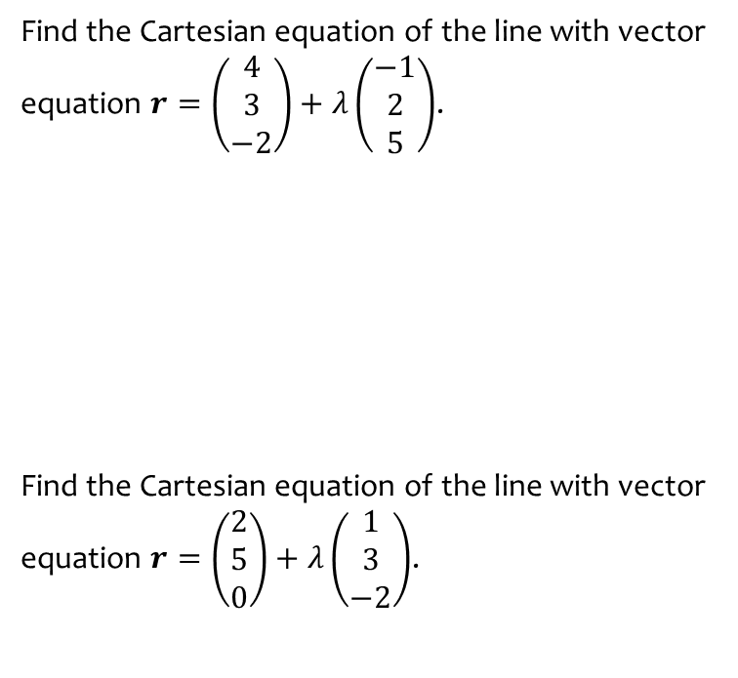
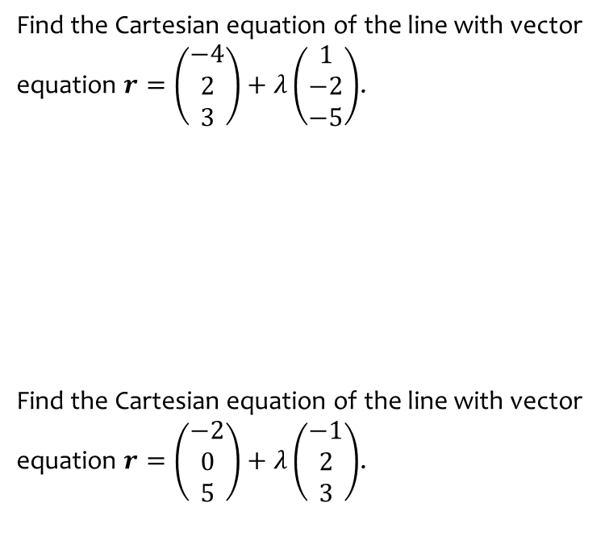

Worked example
Your turn
Find the Cartesian equation of the line with vector equation $r=\left(\begin{matrix}−4 \\ 2 \\ 3\end{matrix}\right)+λ\left(\begin{matrix}1 \\ −2 \\ −5\end{matrix}\right)$.
Find the Cartesian equation of the line with vector equation $r=\left(\begin{matrix}−2 \\ 0 \\ 5\end{matrix}\right)+λ\left(\begin{matrix}−1 \\ 2 \\ 3\end{matrix}\right)$.
Find the Cartesian equation of the line with vector equation $r=\left(\begin{matrix}4 \\ 3 \\ −2\end{matrix}\right)+λ\left(\begin{matrix}−1 \\ 2 \\ 5\end{matrix}\right)$.
Find the Cartesian equation of the line with vector equation $r=\left(\begin{matrix}2 \\ 5 \\ 0\end{matrix}\right)+λ\left(\begin{matrix}1 \\ 3 \\ −2\end{matrix}\right)$.
$$\frac{x−4}{−1}=\frac{y−3}{2}=\frac{z+2}{5}$$
$$\frac{x−2}{1}=\frac{y−5}{3}=\frac{z}{−2}$$

Slide 7
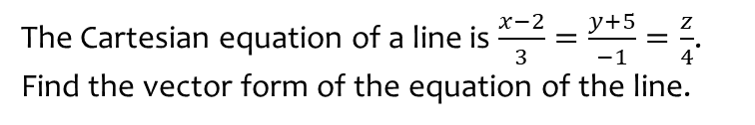


Worked example
Your turn
The Cartesian equation of a line is $\frac{x+2}{−3}=\frac{y}{−4}=\frac{z−5}{1}$. Find the vector form of the equation of the line.
The Cartesian equation of a line is $\frac{2−x}{3}=\frac{y+3}{−1}=\frac{5−z}{−4}$. Find the vector form of the equation of the line.
The Cartesian equation of a line is $\frac{x−2}{3}=\frac{y+5}{−1}=\frac{z}{4}$. Find the vector form of the equation of the line.
$$r=\left(\begin{matrix}2 \\ −5 \\ 0\end{matrix}\right)+λ\left(\begin{matrix}3 \\ −1 \\ 4\end{matrix}\right)$$

Slide 8
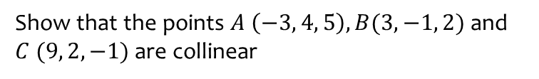
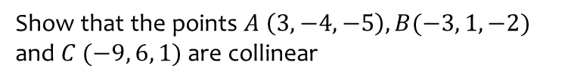
Worked example
Your turn
Show that the points $A \left(3, −4, −5\right), B(−3, 1, −2)$ and $C (−9, 6, 1)$ are collinear
Show that the points $A \left(−3, 4, 5\right), B(3, −1, 2)$ and $C (9, 2, −1)$ are collinear
Shown

Slide 9



Worked example
Your turn
The Cartesian equation of a line is $y=2x−3$. Find the vector form of the equation of the line.
The Cartesian equation of a line is $y=3x−2$. Find the vector form of the equation of the line.
The Cartesian equation of a line is $y=3x+2$. Find the vector form of the equation of the line.
$$\left(\begin{matrix}0 \\ 2\end{matrix}\right)+λ\left(\begin{matrix}1 \\ 3\end{matrix}\right)$$

Slide 10
9.2) Equation of a plane in three dimensions
Chapter CONTENTS

Slide 11
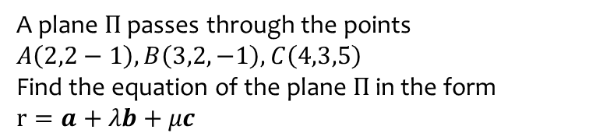
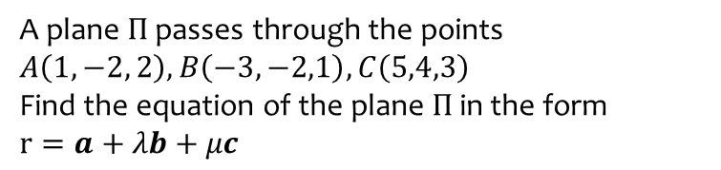
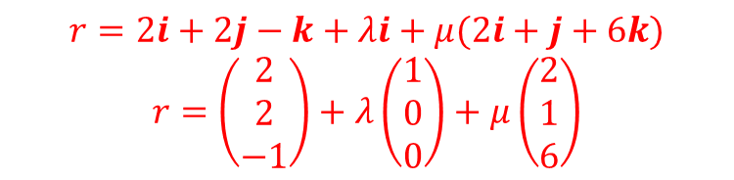
Worked example
Your turn
A plane $Π$ passes through the points $A\left(1,−2, 2\right), B\left(−3,−2,1\right), C\left(5,4,3\right)$
Find the equation of the plane $Π$ in the form
$$r=a+λb+μc$$
A plane $Π$ passes through the points
$$A\left(2,2−1\right), B\left(3,2,−1\right), C\left(4,3,5\right)$$
Find the equation of the plane $Π$ in the form
$$r=a+λb+μc$$
$$r=2i+2j−k+λi+μ(2i+j+6k)$$
$$r=\left(\begin{matrix}2 \\ 2 \\ −1\end{matrix}\right)+λ\left(\begin{matrix}1 \\ 0 \\ 0\end{matrix}\right)+μ\left(\begin{matrix}2 \\ 1 \\ 6\end{matrix}\right)$$

Slide 12
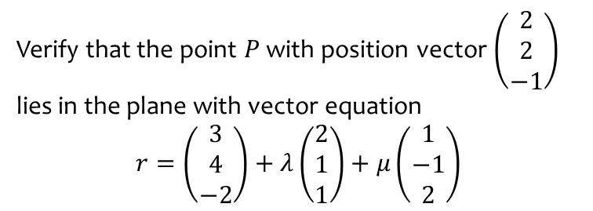
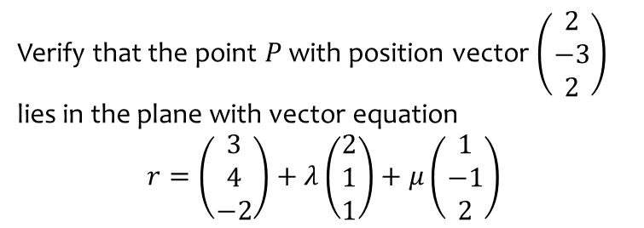
Worked example
Your turn
Verify that the point $P$ with position vector $\left(\begin{matrix}2 \\ −3 \\ 2\end{matrix}\right)$ lies in the plane with vector equation
$$r=\left(\begin{matrix}3 \\ 4 \\ −2\end{matrix}\right)+λ\left(\begin{matrix}2 \\ 1 \\ 1\end{matrix}\right)+μ\left(\begin{matrix}1 \\ −1 \\ 2\end{matrix}\right)$$
Verify that the point $P$ with position vector $\left(\begin{matrix}2 \\ 2 \\ −1\end{matrix}\right)$ lies in the plane with vector equation
$$r=\left(\begin{matrix}3 \\ 4 \\ −2\end{matrix}\right)+λ\left(\begin{matrix}2 \\ 1 \\ 1\end{matrix}\right)+μ\left(\begin{matrix}1 \\ −1 \\ 2\end{matrix}\right)$$
Shown

Slide 13
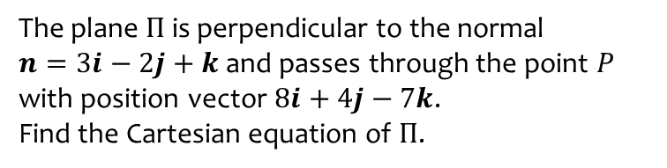
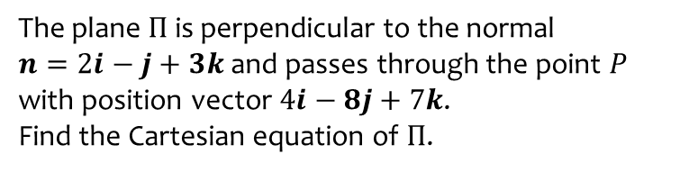
Worked example
Your turn
The plane $Π$ is perpendicular to the normal
$n=2i−j+3k$ and passes through the point $P$ with position vector $4i−8j+7k$.
Find the Cartesian equation of $Π$.
The plane $Π$ is perpendicular to the normal
$n=3i−2j+k$ and passes through the point $P$ with position vector $8i+4j−7k$.
Find the Cartesian equation of $Π$.
$$3x−2y+z=9$$

Slide 14
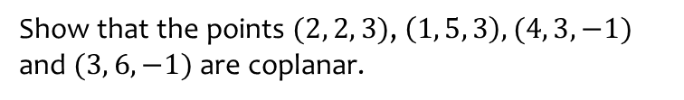
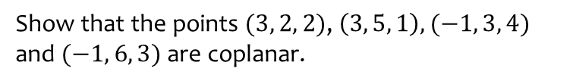
Worked example
Your turn
Show that the points $(3, 2, 2)$, $\left(3, 5, 1\right), (−1, 3, 4)$ and $(−1, 6, 3)$ are coplanar.
Show that the points $(2, 2, 3)$, $\left(1, 5, 3\right), (4, 3, −1)$ and $(3, 6, −1)$ are coplanar.
Shown

Slide 15
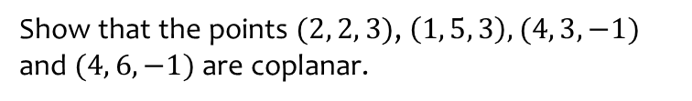
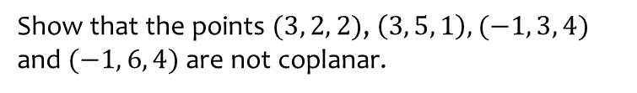
Worked example
Your turn
Show that the points $(3, 2, 2)$, $\left(3, 5, 1\right), (−1, 3, 4)$ and $(−1, 6, 4)$ are not coplanar.
Show that the points $(2, 2, 3)$, $\left(1, 5, 3\right), (4, 3, −1)$ and $(4, 6, −1)$ are coplanar.
Shown

Slide 16
9.3) Scalar product
Chapter CONTENTS

Slide 17


Worked example
Your turn
$$\left(\begin{matrix}3 \\ 2 \\ 1\end{matrix}\right)⋅\left(\begin{matrix}4 \\ 0 \\ 1\end{matrix}\right)$$
$$\left(\begin{matrix}a \\ 5 \\ 1\end{matrix}\right)⋅\left(\begin{matrix}3 \\ b \\ 10\end{matrix}\right)$$
$$\left(\begin{matrix}5 \\ −2 \\ 0\end{matrix}\right)⋅\left(\begin{matrix}3 \\ 3 \\ 1\end{matrix}\right)$$
$$9$$

Slide 18

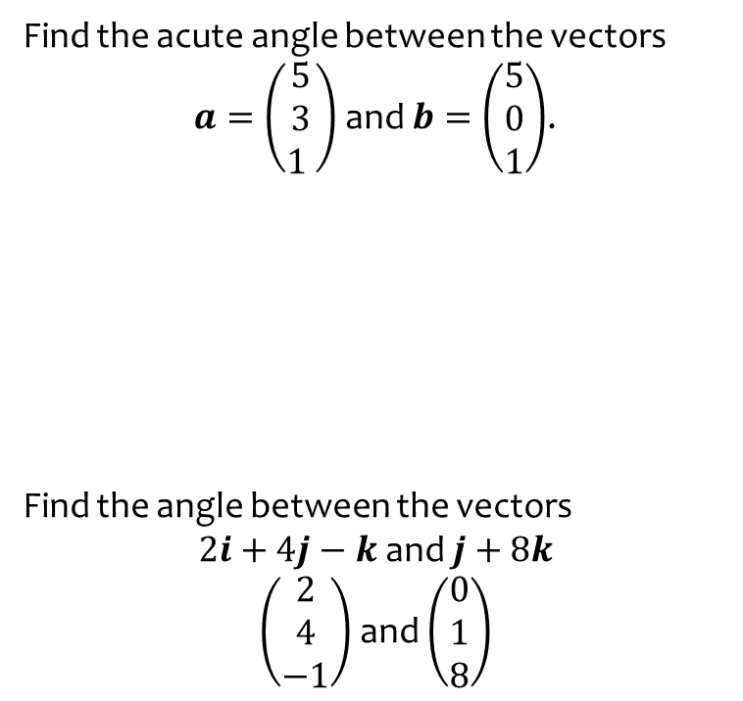
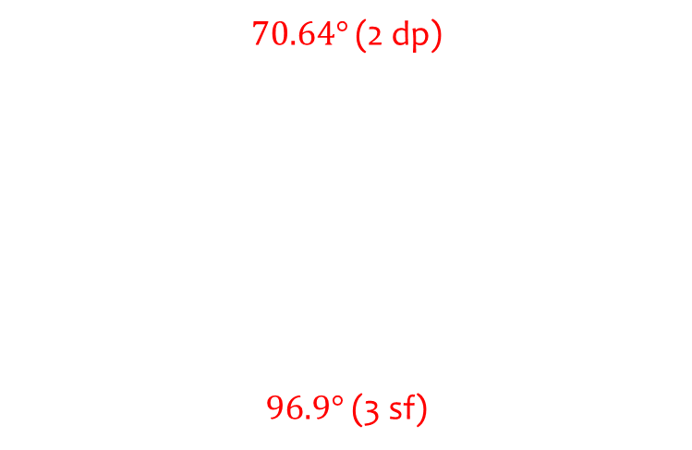
Worked example
Your turn
Find the acute angle between the vectors
$a=\left(\begin{matrix}5 \\ 3 \\ 1 \end{matrix}\right)$ and $b=\left(\begin{matrix}5 \\ 0 \\ 1\end{matrix}\right)$.
Find the angle between the vectors
$2i+4j−k$ and $j+8k$
$\left(\begin{matrix}2 \\ 4 \\ −1\end{matrix}\right)$ and $\left(\begin{matrix}0 \\ 1 \\ 8\end{matrix}\right)$
$$\text{Find} \text{the} \text{acute} \text{angle} \text{between} \text{the} \text{vectors}$$
$$a=\left(\begin{matrix}5 \\ 3 \\ 1 \end{matrix}\right) \text{and} b=\left(\begin{matrix}1 \\ 0 \\ 5\end{matrix}\right)\text{.}$$
Find the angle between the vectors
$−i+j+3k$ and $7i−2j+2k$
$70.64°$ (2 dp)
$96.9°$(3 sf)

Slide 19
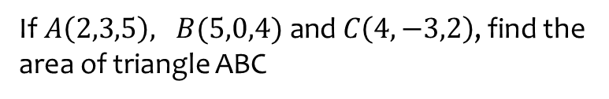
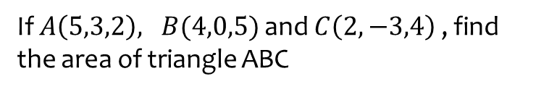

Worked example
Your turn
If $A\left(5,3,2\right), B(4,0,5)$ and $C\left(2,−3,4\right)$ , find the area of triangle ABC
$\text{If} A\left(2,3,5\right), B(5,0,4) \text{and} C\left(4,−3,2\right)$, find the area of triangle ABC
$7.10$ (3 sf)

Slide 20
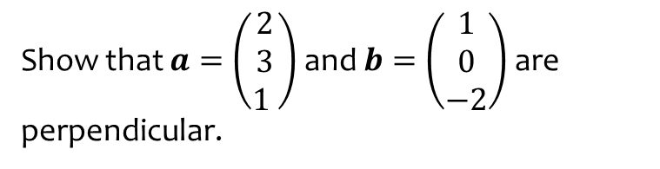
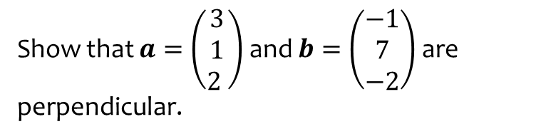
Worked example
Your turn
Show that $a=\left(\begin{matrix}3 \\ 1 \\ 2 \end{matrix}\right)$ and $b=\left(\begin{matrix}−1 \\ 7 \\ −2\end{matrix}\right)$ are perpendicular.
Show that $a=\left(\begin{matrix}2 \\ 3 \\ 1 \end{matrix}\right)$ and $b=\left(\begin{matrix}1 \\ 0 \\ −2\end{matrix}\right)$ are perpendicular.
Shown

Slide 21
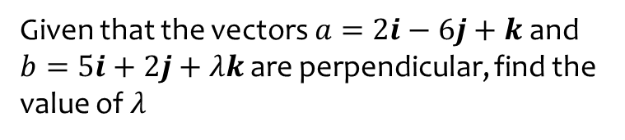
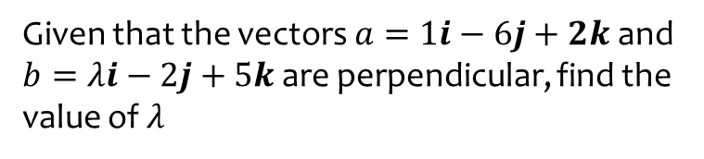
Worked example
Your turn
Given that the vectors $a=1i−6j+2k$ and $b=λi−2j+5k$ are perpendicular, find the value of $λ$
Given that the vectors $a=2i−6j+k$ and $b=5i+2j+λk$ are perpendicular, find the value of $λ$
$$λ=2$$

Slide 22
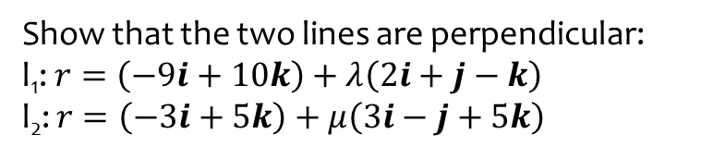
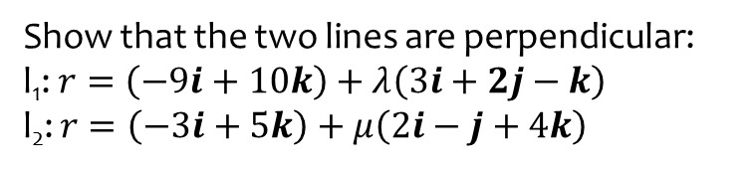
Worked example
Your turn
Show that the two lines are perpendicular:
l₁: $r=\left(−9i+10k\right)+λ\left(3i+2j−k\right)$
l₂: $r=\left(−3i+5k\right)+μ\left(2i−j+4k\right)$
Show that the two lines are perpendicular:
l₁: $r=\left(−9i+10k\right)+λ\left(2i+j−k\right)$
l₂: $r=\left(−3i+5k\right)+μ\left(3i−j+5k\right)$
Shown

Slide 23
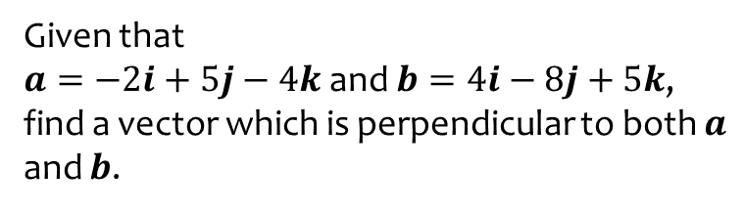
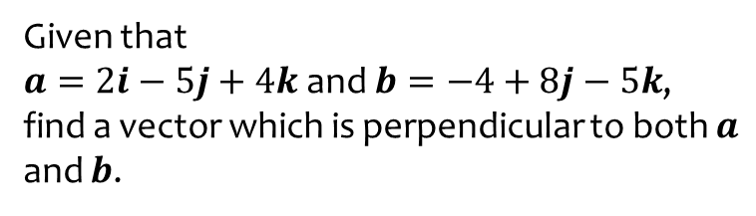
Worked example
Your turn
Given that
$a=2i−5j+4k$ and $b=−4+8j−5k$,
find a vector which is perpendicular to both $a$ and $b$.
Given that
$a=−2i+5j−4k$ and $b=4i−8j+5k$,
find a vector which is perpendicular to both $a$ and $b$.
$$7i+6j+4k$$

Slide 24
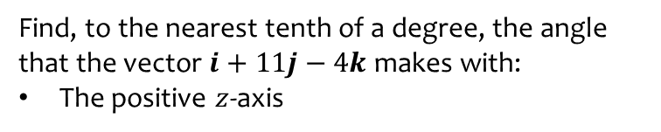


Worked example
Your turn
Find, to the nearest tenth of a degree, the angle that the vector $9i−5j+3k$ makes with:
The positive $x$-axis
The positive $y$-axis
Find, to the nearest tenth of a degree, the angle that the vector $i+11j−4k$ makes with:
The positive $z$-axis
$109.9°$(1 dp)

Slide 25
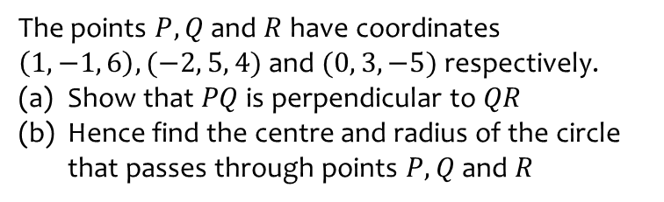
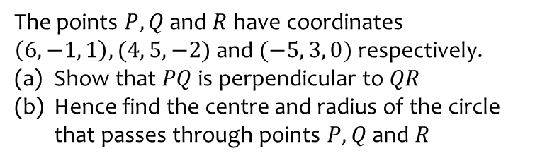

Worked example
Your turn
The points $P, Q$ and $R$ have coordinates $\left(6, −1, 1\right), (4, 5, −2)$ and $(−5, 3, 0)$ respectively.
Show that $PQ$ is perpendicular to $QR$
Hence find the centre and radius of the circle that passes through points $P, Q$ and $R$
The points $P, Q$ and $R$ have coordinates $\left(1, −1, 6\right), (−2, 5, 4)$ and $(0, 3, −5)$ respectively.
Show that $PQ$ is perpendicular to $QR$
Hence find the centre and radius of the circle that passes through points $P, Q$ and $R$
Shown
Centre $\left(\frac{1}{2}, 1,\frac{1}{2}\right),$radius $\frac{\sqrt{138}}{2}$

Slide 26
9.4) Calculating angles between lines and planes
Chapter CONTENTS

Slide 27
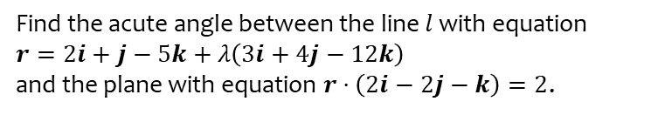
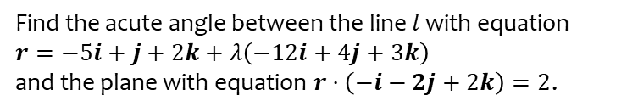
Worked example
Your turn
Find the acute angle between the line $l$ with equation
$r=−5i+j+2k+λ\left(−12i+4j+3k\right)$
and the plane with equation $r⋅\left(−i−2j+2k\right)=2$.
Find the acute angle between the line $l$ with equation
$r=2i+j−5k+λ\left(3i+4j−12k\right)$
and the plane with equation $r⋅\left(2i−2j−k\right)=2$.
$14.9°$(3 sf)

Slide 28
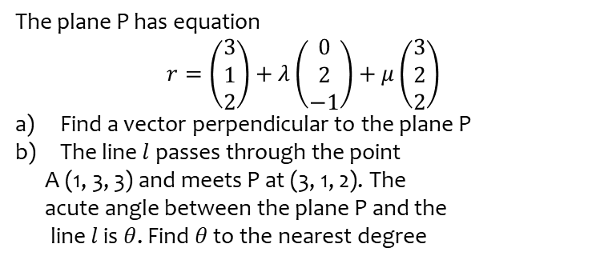
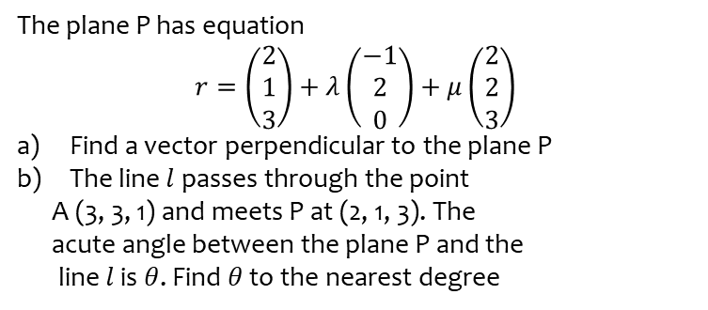
Worked example
Your turn
The plane P has equation
$$r=\left(\begin{aligned}2 \\ 1 \\ 3\end{aligned}\right)+λ\left(\begin{aligned}−1 \\ 2 \\ 0\end{aligned}\right)+μ\left(\begin{aligned}2 \\ 2 \\ 3\end{aligned}\right)$$
Find a vector perpendicular to the plane P
The line $l$passes through the point
A (3, 3, 1) and meets P at (2, 1, 3). The
acute angle between the plane P and the
line $l$ is $θ$. Find $θ$ to the nearest degree
The plane P has equation
$$r=\left(\begin{aligned}3 \\ 1 \\ 2\end{aligned}\right)+λ\left(\begin{aligned}0 \\ 2 \\ −1\end{aligned}\right)+μ\left(\begin{aligned}3 \\ 2 \\ 2\end{aligned}\right)$$
Find a vector perpendicular to the plane P
The line $l$passes through the point
A (1, 3, 3) and meets P at (3, 1, 2). The
acute angle between the plane P and the
line $l$ is $θ$. Find $θ$ to the nearest degree
$θ=63°$ (nearest degree)

Slide 29


Worked example
Your turn
Find the acute angle between the planes:
$$Π_{1}: r⋅\left(3i−j+k\right)=4 \\ Π_{2}: r⋅\left(2i+3j\right)=7$$
Find the acute angle between the planes:
$$Π_{1}: r⋅\left(4i+4j−7k\right)=13 \\ Π_{2}: r⋅\left(7i−4j+4k\right)=6$$
$θ=78.6°$ (1 dp)

Slide 30
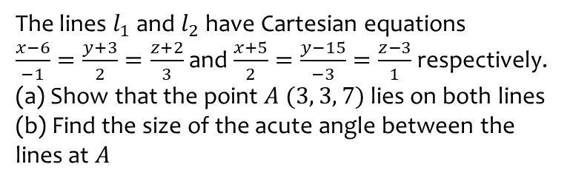
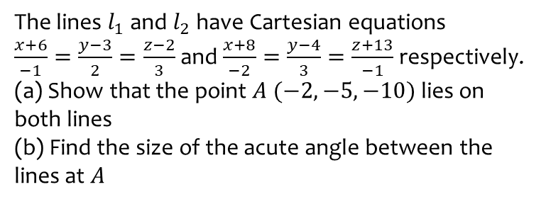

Worked example
Your turn
The lines $l_{1}$ and $l_{2}$ have Cartesian equations
$\frac{x+6}{−1}=\frac{y−3}{2}=\frac{z−2}{3}$ and $\frac{x+8}{−2}=\frac{y−4}{3}=\frac{z+13}{−1}$ respectively.
(a) Show that the point $A (−2, −5, −10)$ lies on both lines
(b) Find the size of the acute angle between the lines at $A$
The lines $l_{1}$ and $l_{2}$ have Cartesian equations
$\frac{x−6}{−1}=\frac{y+3}{2}=\frac{z+2}{3}$ and $\frac{x+5}{2}=\frac{y−15}{−3}=\frac{z−3}{1}$ respectively.
(a) Show that the point $A (3, 3, 7)$ lies on both lines
(b) Find the size of the acute angle between the lines at $A$
Shown
$69.1°$(1 dp)

Slide 31
9.5) Points of intersection
Chapter CONTENTS

Slide 32


Worked example
Your turn
The lines $l_{1}$ and $l_{2}$ have vector equations
$r=i+2j+3k+λ(4i−3j−2k)$ and
$r=−3i−2k+μ\left(−4i+8j+9k\right)$ respectively.
Show that the two lines intersect, and find the position vector of the point of intersection.
The lines $l_{1}$ and $l_{2}$ have vector equations
$r=3i+j+k+λ(i−2j−k)$ and
$r=−2j+3k+μ\left(−5i+j+4k\right)$ respectively. Show that the two lines intersect, and find the position vector of the point of intersection.
$$(5, −3, −1)$$

Slide 33


Worked example
Your turn
Find the point of intersection of the line $l$ and the plane $Π$ where:
$$l: r=−2i+j+3k+λ\left(2i−j+7k\right) \\ Π:r⋅\left(3i−2j+k\right)=5$$
Find the point of intersection of the line $l$ and the plane $Π$ where:
$$l: r=−i+j−5k+λ\left(i+j+2k\right) \\ Π:r⋅\left(i+2j+3k\right)=4$$
$$(1, 3, −1)$$

Slide 34



Worked example
Your turn
A line has Cartesian equation
$$\frac{x−3}{−5}=\frac{y+2}{−3}=\frac{4−z}{−1}$$
A plane $Π$ has Cartesian equation
$$−4x−3y+2z=10$$
Find the position vector of the point of intersection of the line and the plane.
A line has Cartesian equation
$$\frac{x−3}{5}=\frac{y+2}{3}=\frac{4−z}{1}$$
A plane $Π$ has Cartesian equation
$$4x+3y−2z=−10$$
Find the position vector of the point of intersection of the line and the plane.
$$\left(\frac{53}{31},−\frac{86}{31},\frac{132}{32}\right)$$

Slide 35


Worked example
Your turn
The lines $l_{1}$ and $l_{2}$ have equations
$\frac{x−3}{2}=y−4=\frac{z−1}{−5}$and $\frac{x−1}{3}=\frac{y+2}{−7}=z−5$ respectively. Prove that $l_{1}$ and $l_{2}$ are skew.
The lines $l_{1}$ and $l_{2}$ have equations
$\frac{x−2}{4}=\frac{y+3}{2}=z−1$ and $\frac{x+1}{5}=\frac{y}{4}=\frac{z−4}{−2}$ respectively. Prove that $l_{1}$ and $l_{2}$ are skew.
Proof

Slide 36
9.6) Finding perpendiculars
Chapter CONTENTS

Slide 37



Worked example
Your turn
Find the shortest distance between the parallel lines with equations:
$r=2i−j+6k+λ\left(3i+4j+5k\right)$ and
$r=3j−k+μ\left(6i+8j+10k\right)$,
Where $λ$ and $μ$ are scalars
Find the shortest distance between the parallel lines with equations:
$r=i+2j−k+λ\left(5i+4j+3k\right)$ and
$r=2i+k+μ\left(5i+4j+3k\right)$,
Where $λ$ and $μ$ are scalars
$$\frac{21\sqrt{2}}{10}$$

Slide 38


Worked example
Your turn
The lines $l_{1}$ and $l_{2}$ have equations
$r=\left(\begin{matrix}0 \\ 0 \\ 1\end{matrix}\right)+λ\left(\begin{matrix}1 \\ 1 \\ 0\end{matrix}\right)$ and $r=\left(\begin{matrix}1 \\ 3 \\ −1\end{matrix}\right)+μ\left(\begin{matrix}−1 \\ −1 \\ 2\end{matrix}\right)$ respectively, where $λ$ and $μ$ are scalars.
Find the shortest distance between these two lines.
The lines $l_{1}$ and $l_{2}$ have equations
$r=\left(\begin{matrix}1 \\ 0 \\ 0\end{matrix}\right)+λ\left(\begin{matrix}0 \\ 1 \\ 1\end{matrix}\right)$ and $r=\left(\begin{matrix}−1 \\ 3 \\ −1\end{matrix}\right)+μ\left(\begin{matrix}2 \\ −1 \\ −1\end{matrix}\right)$ respectively, where $λ$ and $μ$ are scalars.
Find the shortest distance between these two lines.
$$2\sqrt{2}$$

Slide 39



Worked example
Your turn
The line $l$ has equation $\frac{x−1}{−2}=\frac{y−1}{2}=\frac{z+3}{1}$, and the point $A$ has coordinates $\left(−1,2,1\right)$.
Find the shortest distance between $A$ and $l$.
Find the Cartesian equation of the line that is perpendicular to $l$ and passes through $A$.
The line $l$ has equation $\frac{x−1}{2}=\frac{y−1}{−2}=\frac{z+3}{−1}$, and the point $A$ has coordinates $\left(1,2,−1\right)$.
Find the shortest distance between $A$ and $l$.
Find the Cartesian equation of the line that is perpendicular to $l$ and passes through $A$.
(a) $\frac{\sqrt{29}}{3}$
(b) $\frac{x−1}{8}=\frac{y−2}{1}=\frac{z+1}{14}$

Slide 40



Worked example
Your turn
Find the perpendicular distance from the point with coordinates $\left(1,−2, 3\right)$ to the plane with equation $3x−2y−z=5$.
Find the perpendicular distance from the point with coordinates $\left(3,2,−1\right)$ to the plane with equation $2x−3y+z=5$.
$$\frac{6}{\sqrt{14}}$$

Slide 41


Worked example
Your turn
The plane $Π$has vector equation
$$r⋅\left(2i−3j−k\right)=5$$
Find the perpendicular distance from the point $\left(2, −12, −23\right)$ to the plane
The plane $Π$has vector equation
$$r⋅\left(3i−4j+2k\right)=5$$
Find the perpendicular distance from the point $\left(6, 2, 12\right)$ to the plane
$$\sqrt{29}$$

Slide 42



Worked example
Your turn
The plane $Π$ has equation $r⋅\left(2i+2j+1k\right)=5$.
The point $P$ has coordinates $\left(−2,3,1\right)$.
Find the shortest distance between $P$ and $Π$.
The plane $Π$ has equation $r⋅\left(i+2j+2k\right)=5$. The point $P$ has coordinates $\left(1,3,−2\right)$.
Find the shortest distance between $P$ and $Π$.
$$\frac{2}{3}$$

Slide 43



Worked example
Your turn
The plane $Π$ has equation $r⋅\left(2i+2j+1k\right)=5$.
The point $P$ has coordinates $\left(−2,3,1\right)$.
The point $Q$ is the reflection of the point $P$ in $Π$.
Find the coordinates of point $Q$.
The plane $Π$ has equation $r⋅\left(i+2j+2k\right)=5$. The point $P$ has coordinates $\left(1,3,−2\right)$.
The point $Q$ is the reflection of the point $P$ in $Π$.
Find the coordinates of point $Q$.
$$\left(\frac{12}{9},\frac{35}{9}, −\frac{10}{9}\right)$$

Slide 44



Worked example
Your turn
The line $l_{1}$ has equation $\frac{x−2}{−2}=\frac{y−4}{2}=\frac{z+6}{−1}$.
The plane $Π$ has equation $x−3y+2z=8$.
The line $l_{2}$ is the reflection of line $l_{1}$ in the plane $Π$. Find a vector equation of the line $l_{2}$.
The line $l_{1}$ has equation $\frac{x−2}{2}=\frac{y−4}{−2}=\frac{z+6}{1}$.
The plane $Π$ has equation $2x−3y+z=8$.
The line $l_{2}$ is the reflection of line $l_{1}$ in the plane $Π$. Find a vector equation of the line $l_{2}$.
$$\left(\begin{matrix}6 \\ 0 \\ −4\end{matrix}\right)+t\left(\begin{matrix}8 \\ −19 \\ 4\end{matrix}\right)$$

