Slide 1
8.4) Coupled first-order simultaneous differential equations

Slide 2
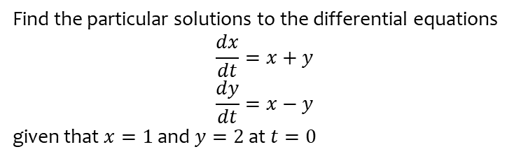
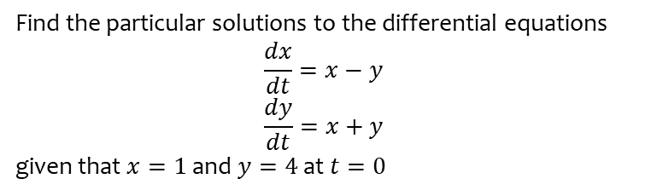
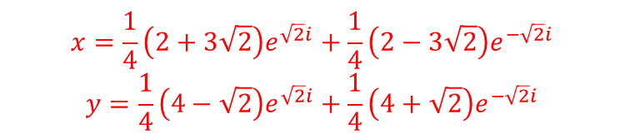
Worked example
Your turn
Find the particular solutions to the differential equations
$$\frac{dx}{dt}=x−y$$
$$\frac{dy}{dt}=x+y$$
given that $x=1$ and $y=4$ at $t=0$
Find the particular solutions to the differential equations
$$\frac{dx}{dt}=x+y$$
$$\frac{dy}{dt}=x−y$$
given that $x=1$ and $y=2$ at $t=0$
$$x=\frac{1}{4}\left(2+3\sqrt{2}\right)e^{\sqrt{2}i}+\frac{1}{4}\left(2−3\sqrt{2}\right)e^{−\sqrt{2}i}$$
$$y=\frac{1}{4}\left(4−\sqrt{2}\right)e^{\sqrt{2}i}+\frac{1}{4}\left(4+\sqrt{2}\right)e^{−\sqrt{2}i}$$

Slide 3
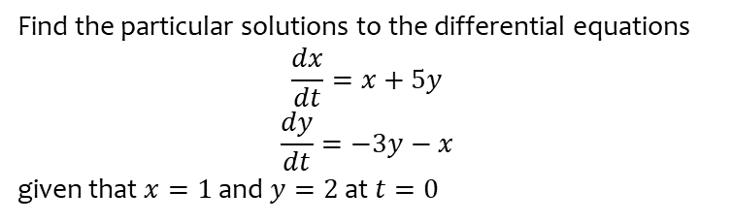
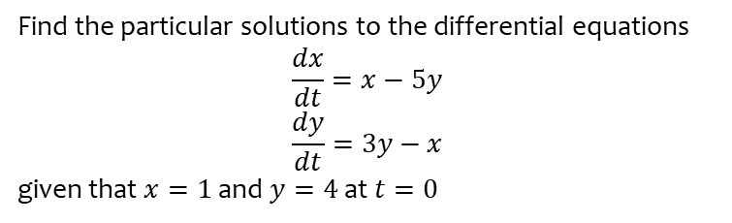

Worked example
Your turn
Find the particular solutions to the differential equations
$$\frac{dx}{dt}=x−5y$$
$$\frac{dy}{dt}=3y−x$$
given that $x=1$ and $y=4$ at $t=0$
Find the particular solutions to the differential equations
$$\frac{dx}{dt}=x+5y$$
$$\frac{dy}{dt}=−3y−x$$
given that $x=1$ and $y=2$ at $t=0$
$$x=e^{−t}(\cos{t}+12\sin{t})$$
$$y=e^{−t}(2\cos{t}−5\sin{t})$$

Slide 4
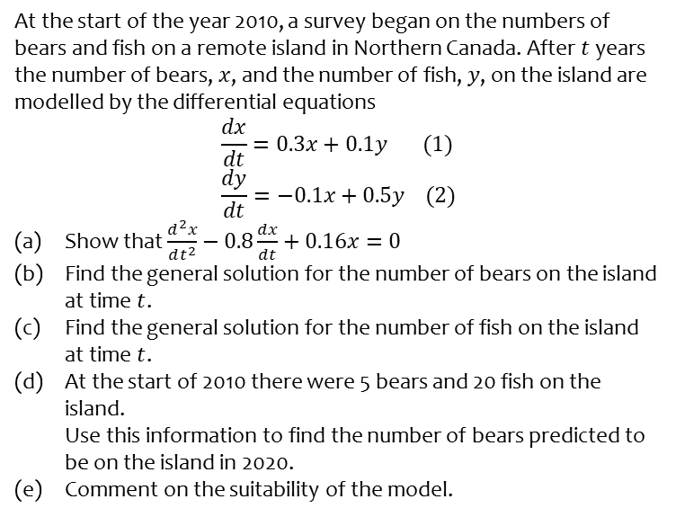
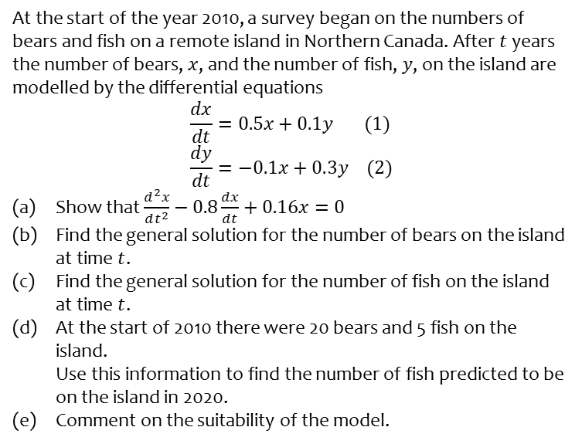
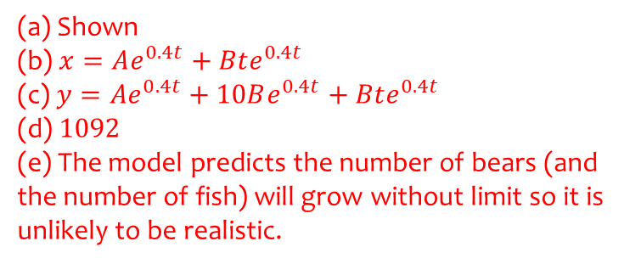
Worked example
Your turn
At the start of the year 2010, a survey began on the numbers of bears and fish on a remote island in Northern Canada. After $t$ years the number of bears, $x$, and the number of fish, $y$, on the island are modelled by the differential equations
$$\frac{dx}{dt}=0.5x+0.1y (1) \\ \frac{dy}{dt}=−0.1x+0.3y (2)$$
Show that $\frac{d^{2}x}{dt^{2}}−0.8\frac{dx}{dt}+0.16x=0$
Find the general solution for the number of bears on the island at time $t$.
Find the general solution for the number of fish on the island at time $t$.
At the start of 2010 there were 20 bears and 5 fish on the island.
Use this information to find the number of fish predicted to be on the island in 2020.
Comment on the suitability of the model.
At the start of the year 2010, a survey began on the numbers of bears and fish on a remote island in Northern Canada. After $t$ years the number of bears, $x$, and the number of fish, $y$, on the island are modelled by the differential equations
$$\frac{dx}{dt}=0.3x+0.1y (1) \\ \frac{dy}{dt}=−0.1x+0.5y (2)$$
Show that $\frac{d^{2}x}{dt^{2}}−0.8\frac{dx}{dt}+0.16x=0$
Find the general solution for the number of bears on the island at time $t$.
Find the general solution for the number of fish on the island at time $t$.
At the start of 2010 there were 5 bears and 20 fish on the island.
Use this information to find the number of bears predicted to be on the island in 2020.
Comment on the suitability of the model.
(a) Shown
(b) $x=Ae^{0.4t}+Bte^{0.4t}$
(c) $y=Ae^{0.4t}+10Be^{0.4t}+Bte^{0.4t}$
(d) $1092$
(e) The model predicts the number of bears (and the number of fish) will grow without limit so it is unlikely to be realistic.

Slide 5
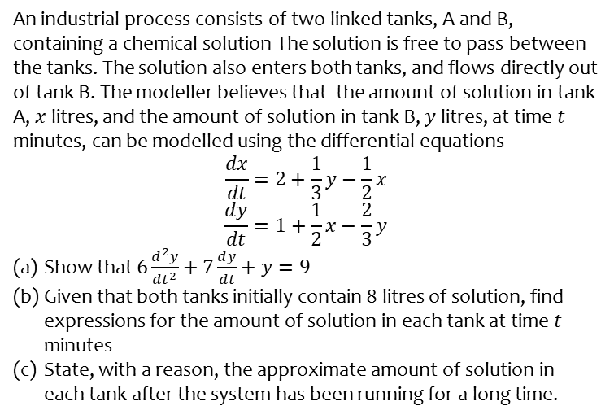
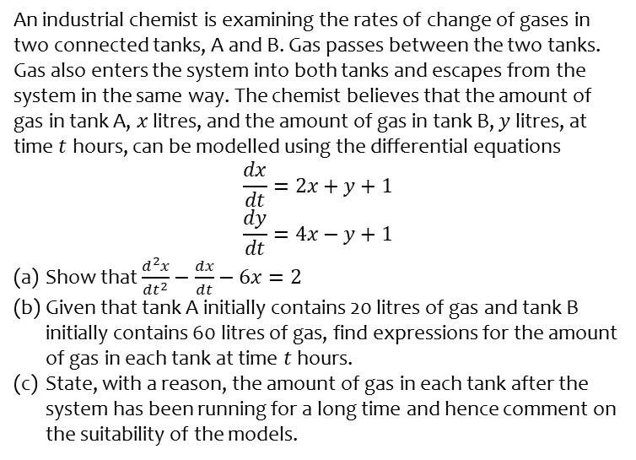
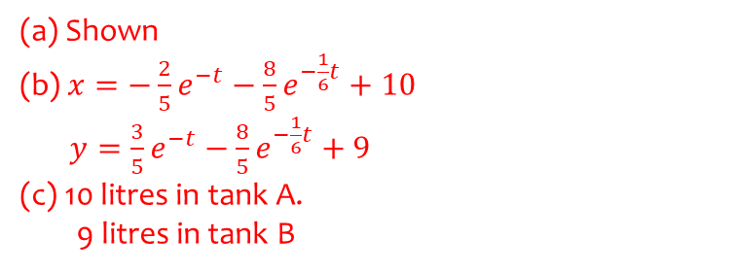
Worked example
Your turn
An industrial chemist is examining the rates of change of gases in two connected tanks, A and B. Gas passes between the two tanks. Gas also enters the system into both tanks and escapes from the system in the same way. The chemist believes that the amount of gas in tank A, $x$ litres, and the amount of gas in tank B, $y$ litres, at time $t$ hours, can be modelled using the differential equations
$$\frac{dx}{dt}=2x+y+1$$
$$\frac{dy}{dt}=4x−y+1$$
Show that $\frac{d^{2}x}{dt^{2}}−\frac{dx}{dt}−6x=2$
Given that tank A initially contains 20 litres of gas and tank B initially contains 60 litres of gas, find expressions for the amount of gas in each tank at time $t$ hours.
State, with a reason, the amount of gas in each tank after the system has been running for a long time and hence comment on the suitability of the models.
An industrial process consists of two linked tanks, A and B, containing a chemical solution The solution is free to pass between the tanks. The solution also enters both tanks, and flows directly out of tank B. The modeller believes that the amount of solution in tank A, $x$ litres, and the amount of solution in tank B, $y$ litres, at time $t$ minutes, can be modelled using the differential equations
$$\frac{dx}{dt}=2+\frac{1}{3}y−\frac{1}{2}x$$
$$\frac{dy}{dt}=1+\frac{1}{2}x−\frac{2}{3}y$$
Show that $6\frac{d^{2}y}{dt^{2}}+7\frac{dy}{dt}+y=9$
Given that both tanks initially contain 8 litres of solution, find expressions for the amount of solution in each tank at time $t$ minutes
State, with a reason, the approximate amount of solution in each tank after the system has been running for a long time.
(a) Shown
(b) $x=−\frac{2}{5}e^{−t}−\frac{8}{5}e^{−\frac{1}{6}t}+10$
$y=\frac{3}{5}e^{−t}−\frac{8}{5}e^{−\frac{1}{6}t}+9$
(c) 10 litres in tank A.
9 litres in tank B

