Slide 1
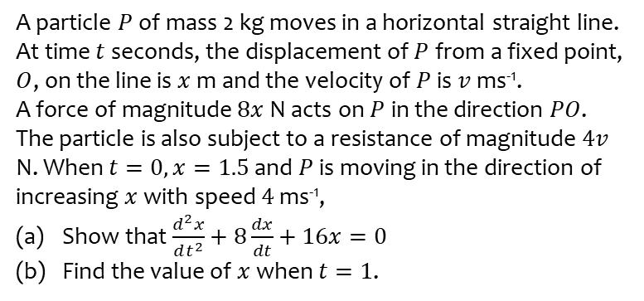
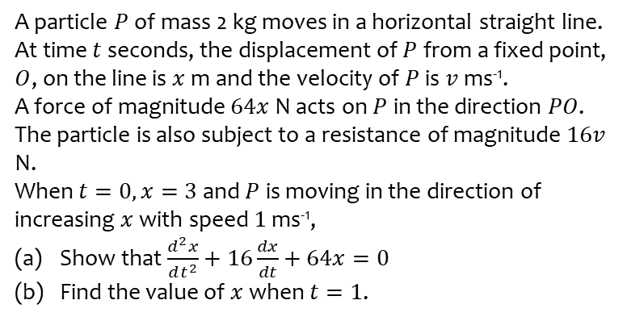
Worked example
Your turn
A particle $P$ of mass 2 kg moves in a horizontal straight line.
At time $t$ seconds, the displacement of $P$ from a fixed point, $O$, on the line is $x$ m and the velocity of $P$ is $v$ ms⁻¹.
A force of magnitude $64x$ N acts on $P$ in the direction $PO$. The particle is also subject to a resistance of magnitude $16v$ N.
When $t=0, x=3$ and $P$ is moving in the direction of increasing $x$ with speed $1$ ms⁻¹,
Show that $\frac{d^{2}x}{dt^{2}}+16\frac{dx}{dt}+64x=0$
Find the value of $x$ when $t=1$.
A particle $P$ of mass 2 kg moves in a horizontal straight line.
At time $t$ seconds, the displacement of $P$ from a fixed point, $O$, on the line is $x$ m and the velocity of $P$ is $v$ ms⁻¹.
A force of magnitude $8x$ N acts on $P$ in the direction $PO$. The particle is also subject to a resistance of magnitude $4v$ N. When $t=0, x=1.5$ and $P$ is moving in the direction of increasing $x$ with speed $4$ ms⁻¹,
Show that $\frac{d^{2}x}{dt^{2}}+8\frac{dx}{dt}+16x=0$
Find the value of $x$ when $t=1$.
Shown
$x=0.211$(3 sf)

Slide 2
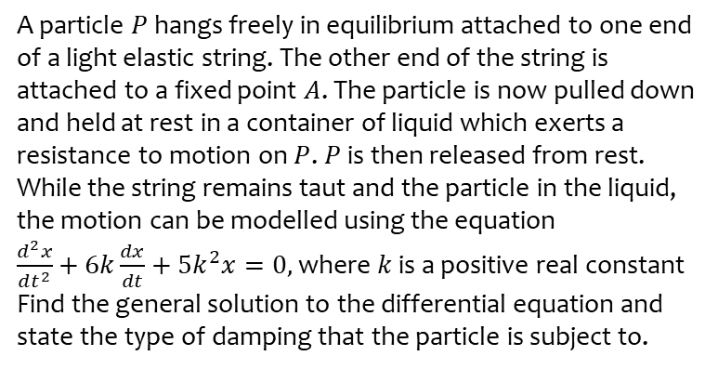
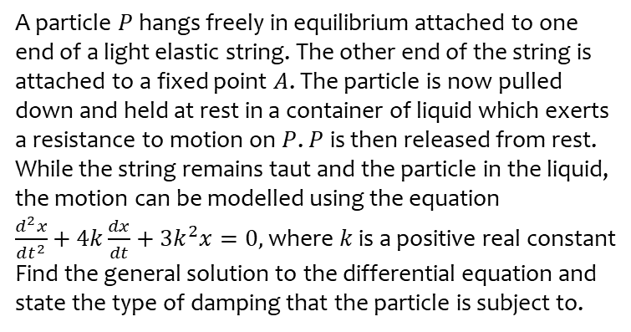
Worked example
Your turn
A particle $P$ hangs freely in equilibrium attached to one end of a light elastic string. The other end of the string is attached to a fixed point $A$. The particle is now pulled down and held at rest in a container of liquid which exerts a resistance to motion on $P$. $P$ is then released from rest. While the string remains taut and the particle in the liquid, the motion can be modelled using the equation
$\frac{d^{2}x}{dt^{2}}+4k\frac{dx}{dt}+3k^{2}x=0,$ where $k$ is a positive real constant
Find the general solution to the differential equation and state the type of damping that the particle is subject to.
A particle $P$ hangs freely in equilibrium attached to one end of a light elastic string. The other end of the string is attached to a fixed point $A$. The particle is now pulled down and held at rest in a container of liquid which exerts a resistance to motion on $P$. $P$ is then released from rest. While the string remains taut and the particle in the liquid, the motion can be modelled using the equation
$\frac{d^{2}x}{dt^{2}}+6k\frac{dx}{dt}+5k^{2}x=0,$ where $k$ is a positive real constant
Find the general solution to the differential equation and state the type of damping that the particle is subject to.
$$x=Ae^{−5kt}+Be^{−kt}$$
Heavy damping

Slide 3
Worked example
Your turn
One end of a light elastic spring is attached to a fixed point $A$. A particle $P$ is attached to the other end and hangs in equilibrium vertically below $A$. At time $t=0$, $P$ is projected vertically downwards with speed $u$. A resistance proportional to the speed of $P$ acts on $P$. The equation of motion of $P$ is given as
$$\frac{d^{2}x}{dt^{2}}+8k\frac{dx}{dt}+16k^{2}x=0$$
where $k$ is a positive real constant and $x$ is the displacement of $P$ from its equilibrium position.
Find the general solution to the differential equation.
Find the time at which $P$ comes to instantaneous rest.
State the type of damping that the particle is subject to
One end of a light elastic spring is attached to a fixed point $A$. A particle $P$ is attached to the other end and hangs in equilibrium vertically below $A$. At time $t=0$, $P$ is projected vertically downwards with speed $u$. A resistance proportional to the speed of $P$ acts on $P$. The equation of motion of $P$ is given as
$$\frac{d^{2}x}{dt^{2}}+4k\frac{dx}{dt}+4k^{2}x=0$$
where $k$ is a positive real constant and $x$ is the displacement of $P$ from its equilibrium position.
Find the general solution to the differential equation.
Find the time at which $P$ comes to instantaneous rest.
State the type of damping that the particle is subject to
(a) $x=ute^{−2kt}$
(b) After $\frac{1}{2k}$ seconds
(c) Critical damping

Slide 4
Worked example
Your turn
One end of a light elastic spring is attached to a fixed point $A$. A particle $P$ is attached to the other end and hangs in equilibrium vertically below $A$. The particle is pulled vertically down from its equilibrium position and released from rest. A resistance proportional to the speed of $P$ acts on $P$. The equation of motion of $P$ is given as
$$\frac{d^{2}x}{dt^{2}}+4k\frac{dx}{dt}+8k^{2}x=0$$
where $k$ is a positive real constant and $x$ is the displacement of $P$ from its equilibrium position.
Find the general solution to the differential equation.
Write down the period of oscillation in terms of $k$.
State the type of damping that the particle is subject to
One end of a light elastic spring is attached to a fixed point $A$. A particle $P$ is attached to the other end and hangs in equilibrium vertically below $A$. The particle is pulled vertically down from its equilibrium position and released from rest. A resistance proportional to the speed of $P$ acts on $P$. The equation of motion of $P$ is given as
$$\frac{d^{2}x}{dt^{2}}+2k\frac{dx}{dt}+2k^{2}x=0$$
where $k$ is a positive real constant and $x$ is the displacement of $P$ from its equilibrium position.
Find the general solution to the differential equation.
Write down the period of oscillation in terms of $k$.
State the type of damping that the particle is subject to
(a) $x=e^{−kt}\left(A\cos{kt}+B\sin{kt}\right)$
(b) $\frac{2π}{k}$
(c) Light damping

Slide 5
Worked example
Your turn
A particle $P$ of mass 1.5 kg is moving on the $x$-axis.
At time $t$ the displacement of $P$ from the origin $O$ is $x$ metres and the speed of $P$ is $v$ ms⁻¹.
Three forces act on $P$, namely a restoring force of magnitude $7.5x$ N, a resistance to the motion of $P$ of magnitude $3v$ N and a force of magnitude $6\sin{t}$ N acting in the direction $OP$.
When $t=0, x=5$ and $\frac{dx}{dt}=2$.
Show that $\frac{dx^{2}}{dt^{2}}+2\frac{dx}{dt}+5x=4\sin{t}$
Find $x$ as a function of $t$.
Describe the motion when $t$ is large.
A particle $P$ of mass 1.5 kg is moving on the $x$-axis.
At time $t$ the displacement of $P$ from the origin $O$ is $x$ metres and the speed of $P$ is $v$ ms⁻¹.
Three forces act on $P$, namely a restoring force of magnitude $7.5x$ N, a resistance to the motion of $P$ of magnitude $6v$ N and a force of magnitude $12\sin{t}$ N acting in the direction $OP$.
When $t=0, x=5$ and $\frac{dx}{dt}=2$.
Show that $\frac{dx^{2}}{dt^{2}}+4\frac{dx}{dt}+5x=8\sin{t}$
Find $x$ as a function of $t$.
Describe the motion when $t$ is large.
(a) Shown
(b) $x=e^{−2t}\left(6\cos{t}+13\sin{t}\right)+\sin{t}−\cos{t}$
(c) Simple harmonic motion with amplitude $\sqrt{2}$ and period $2π$

Slide 6
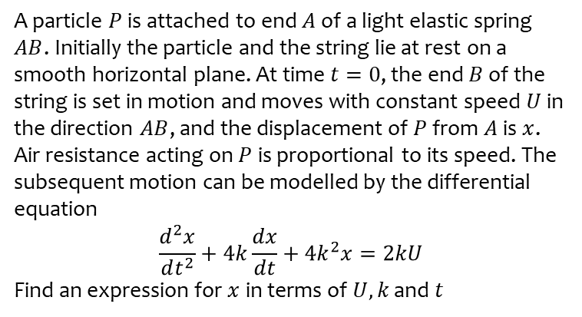
Worked example
Your turn
A particle $P$ is attached to end $A$ of a light elastic spring $AB$. Initially the particle and the string lie at rest on a smooth horizontal plane. At time $t=0$, the end $B$ of the string is set in motion and moves with constant speed $U$ in the direction $AB$, and the displacement of $P$ from $A$ is $x$. Air resistance acting on $P$ is proportional to its speed. The subsequent motion can be modelled by the differential equation
$$\frac{d^{2}x}{dt^{2}}+4k\frac{dx}{dt}+{4k}^{2}x=2kU$$
Find an expression for $x$ in terms of $U, k$ and $t$
A particle $P$ is attached to end $A$ of a light elastic spring $AB$. Initially the particle and the string lie at rest on a smooth horizontal plane. At time $t=0$, the end $B$ of the string is set in motion and moves with constant speed $U$ in the direction $AB$, and the displacement of $P$ from $A$ is $x$. Air resistance acting on $P$ is proportional to its speed. The subsequent motion can be modelled by the differential equation
$$\frac{d^{2}x}{dt^{2}}+2k\frac{dx}{dt}+k^{2}x=2kU$$
Find an expression for $x$ in terms of $U, k$ and $t$
$$x=\left(−\frac{2U}{k}−Ut\right)e^{−kt}+\frac{2U}{k}$$

