Slide 1
Teachings for
Exercise 8B

Slide 2
Modelling with Differential Equations
a
You can solve problems about a particle which is moving in a straight line with simple harmonic motion
Simple harmonic motion is motion where the acceleration of a particle P is always directed towards a single fixed point which is on the line of motion of P.
It creates an oscillating pattern around a fixed centre.
Let’s look at a diagram. Imagine that left to right is the positive direction…
P
On this side:
Displacement = positive
Acceleration = negative
a
P
On this side:
Displacement = negative
Acceleration = positive
The acceleration is always directed towards the centre point, and increases in size as the distance does
So if the particle is further from the centre, the acceleration towards the centre will be larger
As is passes through the centre, the acceleration changes direction
8B

Slide 3





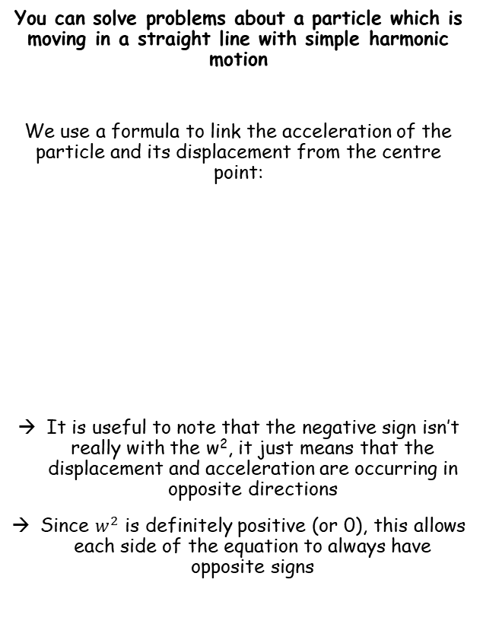








Modelling with Differential Equations
$$\ddot{x}=−w^{2}x$$
Dot notation is Isaac Newton’s notation for calculus, and is often still used in Physics…
You can solve problems about a particle which is moving in a straight line with simple harmonic motion
We use a formula to link the acceleration of the particle and its displacement from the centre point:
It is useful to note that the negative sign isn’t really with the w², it just means that the displacement and acceleration are occurring in opposite directions
Since $w^{2}$ is definitely positive (or 0), this allows each side of the equation to always have opposite signs
$$x$$
Differentiate once
$$\frac{dx}{dt}$$
$$=\dot{x}$$
$$=v$$
$$\ddot{x}=−w^{2}x$$
Differentiate again
$$\frac{d^{2}x}{dt^{2}}$$
$$=\ddot{x}$$
$$=a$$
Acceleration, in Newton’s notation
The letter w is a constant dependent on the question
The value x is the displacement
You can also use the chain rule to write equivalent expressions like this…
$$\ddot{x}=\frac{dv}{dt}$$
Write the right side using the chain rule
$$=\frac{dv}{dx}×\frac{dx}{dt}$$
Remember that $\frac{dx}{dt}=v$
We will use this on the next slide…
$$=v\frac{dv}{dx}$$
8B

Slide 4











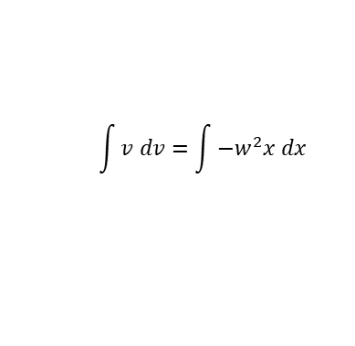
Modelling with Differential Equations
$$v^{2}=w^{2}\left(a^{2}−x^{2}\right)$$
$$\ddot{x}=−w^{2}x$$
$$\ddot{x}=−w^{2}x$$
You can solve problems about a particle which is moving in a straight line with simple harmonic motion
The equation we just saw links the acceleration and the displacement of a particle moving with simple harmonic motion
We can manipulate this equation to create links between other variables…
Replace $\ddot{x}$ with $v\frac{dv}{dx}$
$$v\frac{dv}{dx}=−w^{2}x$$
Multiply by dx
$$v dv=−w^{2}x dx$$
$$\int{v dv}=\int{−w^{2}x dx }$$
Take Integrals of both sides
Integrate each side
$$\frac{1}{2}v^{2}=−\frac{1}{2}w^{2}x^{2}+C$$
Let the maximum displacement be ‘a’. At this point, the velocity is 0 as it is changing direction
P
$$\frac{1}{2}{(0)}^{2}=−\frac{1}{2}w^{2}{(a)}^{2}+C$$
At a, the maximum displacement, v = 0 as the direction of movement changes
Calculate C
$$C=\frac{1}{2}w^{2}a^{2}$$
Replace C in the equation from before
$$\frac{1}{2}v^{2}=−\frac{1}{2}w^{2}x^{2}+\frac{1}{2}w^{2}a^{2}$$
Multiply by 2
$$v^{2}=−w^{2}x^{2}+w^{2}a^{2}$$
This is another important relationship to remember!
Factorise the right side
$$v^{2}=w^{2}\left(a^{2}−x^{2}\right)$$
8B

Slide 5


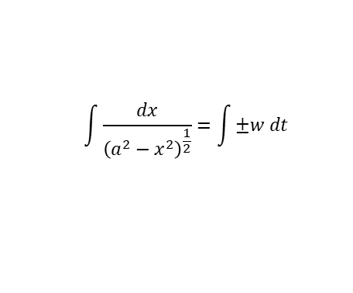






Modelling with Differential Equations
$$v^{2}=w^{2}\left(a^{2}−x^{2}\right)$$
$$\ddot{x}=−w^{2}x$$
You can solve problems about a particle which is moving in a straight line with simple harmonic motion
There is one further manipulation we can do:
So far we have a formula linking the acceleration and displacement
And we have one linking velocity and displacement
However, we might want to know the displacement at a given time, and hence we need a relationship between displacement and time
$$v^{2}=w^{2}\left(a^{2}−x^{2}\right)$$
Square root both sides
$$v=±w{\left(a^{2}−x^{2}\right)}^{\frac{1}{2}}$$
Write v as ^{dx}/_{dt} (this brings t into the equation)
$$\frac{dx}{dt}=±w{\left(a^{2}−x^{2}\right)}^{\frac{1}{2}}$$
Multiply by dt
$$dx=±w{\left(a^{2}−x^{2}\right)}^{\frac{1}{2}} dt$$
Divide by the whole bracket on the right
$$\frac{1}{{\left(a^{2}−x^{2}\right)}^{\frac{1}{2}}} dx=±w dt$$
$$\ddot{x}=−w^{2}x$$
The left side can be written with dx as the numerator
$$\frac{dx}{{\left(a^{2}−x^{2}\right)}^{\frac{1}{2}}}=±w dt$$
Take Integrals of both sides
$$v^{2}=w^{2}\left(a^{2}−x^{2}\right)$$
$$\int{\frac{dx}{{\left(a^{2}−x^{2}\right)}^{\frac{1}{2}}}}=\int{±w dt }$$
To Integrate the left side, we will need to use a substitution
8B

Slide 6

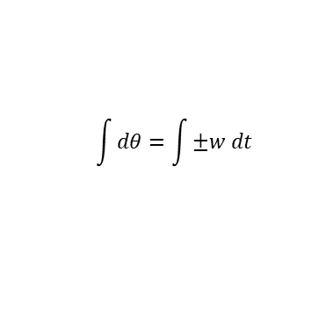

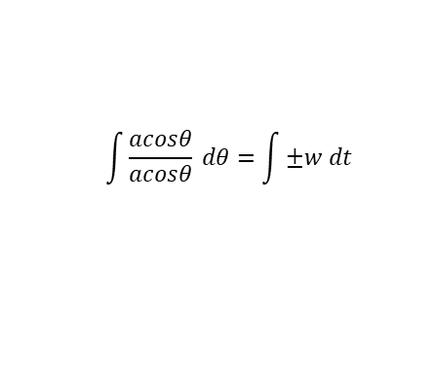


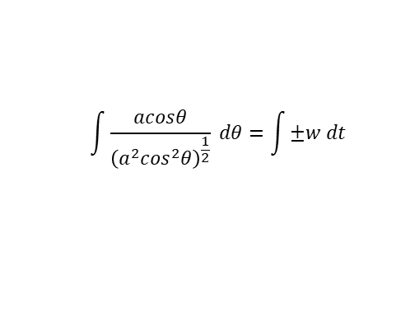
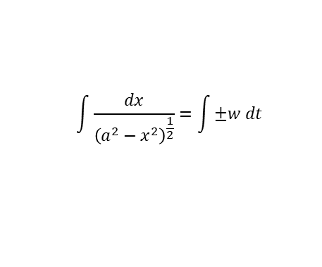

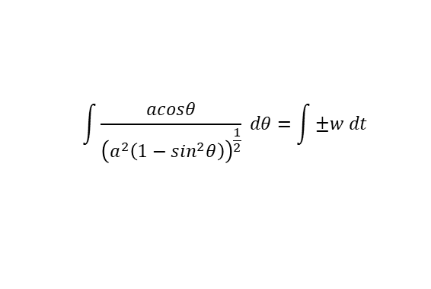
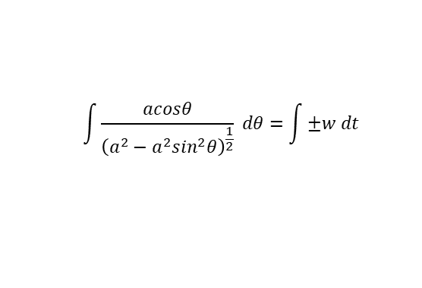

Modelling with Differential Equations
$$v^{2}=w^{2}\left(a^{2}−x^{2}\right)$$
$$\ddot{x}=−w^{2}x$$
$$\int{\frac{dx}{{\left(a^{2}−x^{2}\right)}^{\frac{1}{2}}}}=\int{±w dt }$$
You can solve problems about a particle which is moving in a straight line with simple harmonic motion
Let:
Replace terms with the equivalents we have created
$$\int{\frac{acosθ}{{\left(a^{2}−a^{2}\sin^{2}θ\right)}^{\frac{1}{2}}} dθ}=\int{±w dt }$$
Factorise the denominator
$$x=asinθ$$
$$\int{\frac{acosθ}{{\left(a^{2}\left(1−\sin^{2}θ\right)\right)}^{\frac{1}{2}}} dθ}=\int{±w dt }$$
Differentiate with respect to θ
Simplify using sin²θ + cos²θ = 1
$$\int{\frac{acosθ}{{\left(a^{2}\cos^{2}θ\right)}^{\frac{1}{2}}} dθ}=\int{±w dt }$$
$$\frac{dx}{dθ}=acosθ$$
Square root the denominator
Multiply by dθ
$$\int{\frac{acosθ}{acosθ} dθ}=\int{±w dt }$$
The fraction cancels out
$$dx=acosθ dθ$$
$$\int{dθ}=\int{±w dt }$$
Integrate each side, remember w is a constant and add C (in the books, ‘alpha’ is used. I have used C to avoid confusion with a, the amplitude!)
We can ignore the negative value of wt here…
It just represents the oscillation starting in a different direction first ie) left then right, rather than right then left
Resolving in the direction you want means you can just use the positive value
$$θ=±wt+C$$
Do ‘asin’ of each side
$$asinθ=asin\left(wt+C \right)$$
Remember that asinθ is equal to ‘x’
$$x=asin\left(wt+C \right)$$
8B

Slide 7


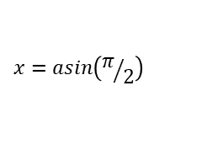





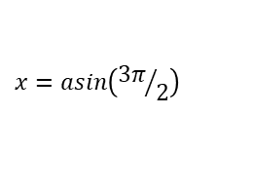








Modelling with Differential Equations
$$v^{2}=w^{2}\left(a^{2}−x^{2}\right)$$
$$\ddot{x}=−w^{2}x$$
You can solve problems about a particle which is moving in a straight line with simple harmonic motion
This represents the displacement of the particle from the centre in terms of t, the time.
As sine is involved, the pattern will be periodic ie) oscillating, like the sin graph
Remember that a is the amplitude of the motion, ie) the greatest displacement from the centre
(The amplitude is not the distance between the opposite ‘extremes’, it is the distance from the centre to one ‘extreme’)
Therefore: -a ≤ x ≤ a
There are ‘special cases’ that are very useful!
$$x=asin\left(wt+C \right)$$
Case number 1: C = 0
$$x=asin(wt)$$
x
$$x=asin\left(wt+C \right)$$
a
$$0$$
t
$$\frac{π}{2w}$$
$$\frac{π}{w}$$
$$\frac{3π}{2w}$$
$$\frac{2π}{w}$$
-a
$$x=asin(wt)$$
Let t = 0
$$x=asin(0)$$
$$x=0$$
$$x=asin(wt)$$
Let t = ^{π}/_{2w}
$$x=asin\left(π/2\right)$$
$$x=a$$
$$x=asin(wt)$$
Let t = ^{π}/_{w}
$$x=asin\left(π\right)$$
$$x=0$$
$$x=asin(wt)$$
Let t = ^{3π}/_{2w}
$$x=asin\left({3π}/2\right)$$
$$x=−a$$
$$x=asin(wt)$$
Let t = ^{2π}/_{w}
$$x=asin\left(2π\right)$$
$$x=0$$
8B

Slide 8

Modelling with Differential Equations
$$x=asin\left(wt\right) if the particle starts at the centre$$
$$v^{2}=w^{2}\left(a^{2}−x^{2}\right)$$
$$\ddot{x}=−w^{2}x$$
You can solve problems about a particle which is moving in a straight line with simple harmonic motion
This represents the displacement of the particle from the centre in terms of t, the time.
As sine is involved, the pattern will be periodic ie) oscillating, like the sin graph
Remember that a is the amplitude of the motion, ie) the greatest displacement from the centre
(The amplitude is not the distance between the opposite ‘extremes’, it is the distance from the centre to one ‘extreme’)
Therefore: -a ≤ x ≤ a
There are ‘special cases’ that are very useful!
$$x=asin\left(wt+C \right)$$
Case number 1: C = 0
$$x=asin(wt)$$
x
$$x=asin\left(wt+C \right)$$
a
$$0$$
t
$$\frac{π}{2w}$$
$$\frac{π}{w}$$
$$\frac{3π}{2w}$$
$$\frac{2π}{w}$$
-a
You can use $x=asin(wt)$
for situations when the particle starts at the centre of oscillation
→ Ensure you correctly interpret the direction you are resolving in!
8B

Slide 9
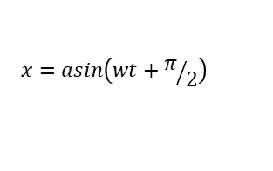

Modelling with Differential Equations
$$x=asin\left(wt\right) if the particle starts at the centre$$
$$x=acos\left(wt\right) if the particle starts at one edge$$
$$\ddot{x}=−w^{2}x$$
$$v^{2}=w^{2}\left(a^{2}−x^{2}\right)$$
You can solve problems about a particle which is moving in a straight line with simple harmonic motion
This represents the displacement of the particle from the centre in terms of t, the time.
As sine is involved, the pattern will be periodic ie) oscillating, like the sin graph
Remember that a is the amplitude of the motion, ie) the greatest displacement from the centre
(The amplitude is not the distance between the opposite ‘extremes’, it is the distance from the centre to one ‘extreme’)
Therefore: -a ≤ x ≤ a
There are ‘special cases’ that are very useful!
$$x=asin\left(wt+C \right)$$
Case number 2: C = ^{π}/₂
$$x=asin\left(wt+π/2\right)$$
x
a
$$x=asin\left(wt+C \right)$$
a
$$0$$
t
$$\frac{π}{2w}$$
$$\frac{π}{w}$$
$$\frac{3π}{2w}$$
$$\frac{2π}{w}$$
-a
If we calculate points in a similar way to before, we end up with the graph above, which is the same as the cos graph…
You can use $x=acos\left(wt\right)$ for situations when the particle starts at one edge of the oscillation, ie) at the maximum value of x
8B

Slide 10



Modelling with Differential Equations
$$x=asin\left(wt\right) if the particle starts at the centre$$
$$x=acos\left(wt\right) if the particle starts at one edge$$
$$\ddot{x}=−w^{2}x$$
$$Period=\frac{2π}{w}$$
$$v^{2}=w^{2}\left(a^{2}−x^{2}\right)$$
You can solve problems about a particle which is moving in a straight line with simple harmonic motion
This represents the displacement of the particle from the centre in terms of t, the time.
As sine is involved, the pattern will be periodic ie) oscillating, like the sin graph
Remember that a is the amplitude of the motion, ie) the greatest displacement from the centre
(The amplitude is not the distance between the opposite ‘extremes’, it is the distance from the centre to one ‘extreme’)
Therefore: -a ≤ x ≤ a
There are ‘special cases’ that are very useful!
$$x=asin\left(wt+C \right)$$
Case number 3:
C is neither 0 or ^{π}/₂
x
$$x=asin\left(wt+C \right)$$
a
$$0$$
t
$$\frac{π}{2w}$$
$$\frac{π}{w}$$
$$\frac{3π}{2w}$$
$$\frac{2π}{w}$$
-a
This graph will be a translation of x = asin(wt) a distance C to the left
You use $x=asin\left(wt+C\right)$ for situations when the particle starts at neither the centre nor an extreme point of the oscillation (it starts ‘C’ on one side!)
Note that in all cases, the period of the motion is given by: $\frac{2π}{w}$
8B

Slide 11


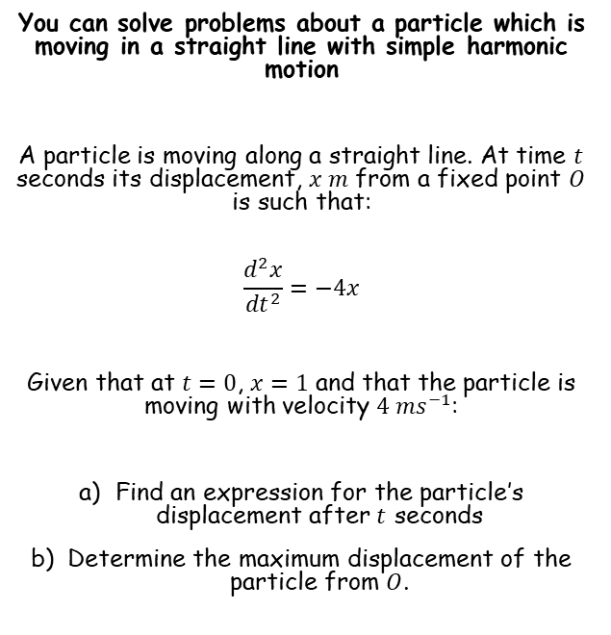








Modelling with Differential Equations
$$Ae^{m_{1}x}+Be^{m_{2}x}$$
$$(A+Bx)e^{mx}$$
$$e^{px}\left(Acosqx+Bsinqx\right)$$
$$\ddot{x}=−w^{2}x$$
$$Period=\frac{2π}{w}$$
$$v^{2}=w^{2}\left(a^{2}−x^{2}\right)$$
You can solve problems about a particle which is moving in a straight line with simple harmonic motion
A particle is moving along a straight line. At time $t$ seconds its displacement, $x m$ from a fixed point $O$ is such that:
$$\frac{d^{2}x}{{dt}^{2}}=−4x$$
Given that at $t=0$, $x=1$ and that the particle is moving with velocity $4 {ms}^{−1}$:
Find an expression for the particle’s displacement after $t$ seconds
Determine the maximum displacement of the particle from $O$.
$$\frac{d^{2}x}{{dt}^{2}}=−4x$$
Rearrange so we can use the techniques for second-order differentials
$$\frac{d^{2}x}{{dt}^{2}}+4x=0$$
Write the auxiliary equation
$$m^{2}+4=0$$
Subtract 4
$$m^{2}=−4$$
Square root
$$m=±2i$$
Use the appropriate form from above (remember in this case $p=0$ as there is no real part)
$$x=Acos2t+Bsin2t$$
8B

Slide 12













Modelling with Differential Equations
$$Ae^{m_{1}x}+Be^{m_{2}x}$$
$$(A+Bx)e^{mx}$$
$$e^{px}\left(Acosqx+Bsinqx\right)$$
$$\ddot{x}=−w^{2}x$$
$$Period=\frac{2π}{w}$$
$$v^{2}=w^{2}\left(a^{2}−x^{2}\right)$$
You can solve problems about a particle which is moving in a straight line with simple harmonic motion
A particle is moving along a straight line. At time $t$ seconds its displacement, $x m$ from a fixed point $O$ is such that:
$$\frac{d^{2}x}{{dt}^{2}}=−4x$$
Given that at $t=0$, $x=1$ and that the particle is moving with velocity $4 {ms}^{−1}$:
Find an expression for the particle’s displacement after $t$ seconds
Determine the maximum displacement of the particle from $O$.
$$x=Acos2t+Bsin2t$$
When $t=0$, $x=1$
$$1=Acos2(0)+Bsin2(0)$$
Calculate
$$1=A$$
We can now include this in the relationship we have
$$x=cos2t+Bsin2t$$
Now we need to use the information we are given regarding velocity
$$x=cos2t+Bsin2t$$
Differentiate since $\frac{dx}{dt}$ is the velocity
$$\frac{dx}{dt}=−2sin2t+2Bcos2t$$
When $t=0$, $\frac{dx}{dt}=4$
$$4=−2sin2(0)+2Bcos2(0)$$
Simplify
$$4=2B$$
Calculate
$$2=B$$
Now we have the full equation for displacement!
$$x=cos2t+2sin2t$$
8B

Slide 13








Modelling with Differential Equations
$$Ae^{m_{1}x}+Be^{m_{2}x}$$
$$(A+Bx)e^{mx}$$
$$e^{px}\left(Acosqx+Bsinqx\right)$$
$$\ddot{x}=−w^{2}x$$
$$Period=\frac{2π}{w}$$
$$v^{2}=w^{2}\left(a^{2}−x^{2}\right)$$
You can solve problems about a particle which is moving in a straight line with simple harmonic motion
A particle is moving along a straight line. At time $t$ seconds its displacement, $x m$ from a fixed point $O$ is such that:
$$\frac{d^{2}x}{{dt}^{2}}=−4x$$
Given that at $t=0$, $x=1$ and that the particle is moving with velocity $4 {ms}^{−1}$:
Find an expression for the particle’s displacement after $t$ seconds
Determine the maximum displacement of the particle from $O$.
To find the maximum displacement, we need the amplitude of the graph
→ So we will need to write it in terms of sine or cosine only
$$x=cos2t+2sin2t$$
Write the left side as a bracket including sine
$$Rsin\left(2t+θ\right)=cos2t+2sin2t$$
Expand the bracket
$$Rsin2tcosθ+Rcos2tsinθ=cos2t+2sin2t$$
Compare terms on each side…
$$Rcosθ=2$$
$$Rsinθ=1$$
$$tanθ=\frac{1}{2}$$
Combine
Calculate $θ$
$$x=cos2t+2sin2t$$
$$θ=0.4636..$$
We can then use the exact value of $θ$ to find that $R=\sqrt{5}$
8B

Slide 14



Modelling with Differential Equations
$$Ae^{m_{1}x}+Be^{m_{2}x}$$
$$(A+Bx)e^{mx}$$
$$e^{px}\left(Acosqx+Bsinqx\right)$$
$$\ddot{x}=−w^{2}x$$
$$Period=\frac{2π}{w}$$
$$v^{2}=w^{2}\left(a^{2}−x^{2}\right)$$
You can solve problems about a particle which is moving in a straight line with simple harmonic motion
A particle is moving along a straight line. At time $t$ seconds its displacement, $x m$ from a fixed point $O$ is such that:
$$\frac{d^{2}x}{{dt}^{2}}=−4x$$
Given that at $t=0$, $x=1$ and that the particle is moving with velocity $4 {ms}^{−1}$:
Find an expression for the particle’s displacement after $t$ seconds
Determine the maximum displacement of the particle from $O$.
$$x=cos2t+2sin2t$$
Replace using the expression we worked out
$$x=\sqrt{5}sin\left(2t+0.4636…\right)$$
The greatest value of this will be $\sqrt{5}$, so this is the maximum displacement of the particle from $O$.
$$x=cos2t+2sin2t$$
8B

Slide 15
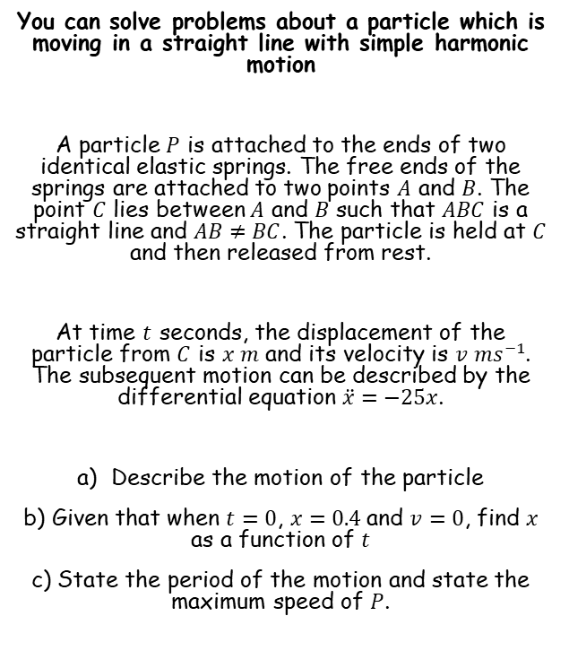
Modelling with Differential Equations
$$Ae^{m_{1}x}+Be^{m_{2}x}$$
$$(A+Bx)e^{mx}$$
$$e^{px}\left(Acosqx+Bsinqx\right)$$
$$\ddot{x}=−w^{2}x$$
$$Period=\frac{2π}{w}$$
$$v^{2}=w^{2}\left(a^{2}−x^{2}\right)$$
You can solve problems about a particle which is moving in a straight line with simple harmonic motion
A particle $P$ is attached to the ends of two identical elastic springs. The free ends of the springs are attached to two points $A$ and $B$. The point $C$ lies between $A$ and $B$ such that $ABC$ is a straight line and $AB≠BC$. The particle is held at $C$ and then released from rest.
At time $t$ seconds, the displacement of the particle from $C$ is $x m$ and its velocity is $v {ms}^{−1}$. The subsequent motion can be described by the differential equation $\ddot{x}=−25x$.
Describe the motion of the particle
b) Given that when $t=0$, $x=0.4$and $v=0$, find $x$ as a function of $t$
c) State the period of the motion and state the maximum speed of $P$.
‘The particle moves with simple harmonic motion’
8B

Slide 16






Modelling with Differential Equations
$$Ae^{m_{1}x}+Be^{m_{2}x}$$
$$(A+Bx)e^{mx}$$
$$e^{px}\left(Acosqx+Bsinqx\right)$$
$$\ddot{x}=−w^{2}x$$
$$Period=\frac{2π}{w}$$
$$v^{2}=w^{2}\left(a^{2}−x^{2}\right)$$
You can solve problems about a particle which is moving in a straight line with simple harmonic motion
A particle $P$ is attached to the ends of two identical elastic springs. The free ends of the springs are attached to two points $A$ and $B$. The point $C$ lies between $A$ and $B$ such that $ABC$ is a straight line and $AB≠BC$. The particle is held at $C$ and then released from rest.
At time $t$ seconds, the displacement of the particle from $C$ is $x m$ and its velocity is $v {ms}^{−1}$. The subsequent motion can be described by the differential equation $\ddot{x}=−25x$.
Describe the motion of the particle
b) Given that when $t=0$, $x=0.4$and $v=0$, find $x$ as a function of $t$
c) State the period of the motion and state the maximum speed of $P$.
$$\ddot{x}=−25x$$
Rearrange so that second order differential techniques can be used
$$\frac{d^{2}x}{dt^{2}}+25x=0$$
Write the auxiliary equation
$$m^{2}+25=0$$
Subtract 25
$$m^{2}=−25$$
Square root
$$m=±5i$$
Choose the appropriate form above
$$x=Acos5t+Bsin5t$$
8B

Slide 17











Modelling with Differential Equations
$$Ae^{m_{1}x}+Be^{m_{2}x}$$
$$(A+Bx)e^{mx}$$
$$e^{px}\left(Acosqx+Bsinqx\right)$$
$$\ddot{x}=−w^{2}x$$
$$Period=\frac{2π}{w}$$
$$v^{2}=w^{2}\left(a^{2}−x^{2}\right)$$
You can solve problems about a particle which is moving in a straight line with simple harmonic motion
A particle $P$ is attached to the ends of two identical elastic springs. The free ends of the springs are attached to two points $A$ and $B$. The point $C$ lies between $A$ and $B$ such that $ABC$ is a straight line and $AB≠BC$. The particle is held at $C$ and then released from rest.
At time $t$ seconds, the displacement of the particle from $C$ is $x m$ and its velocity is $v {ms}^{−1}$. The subsequent motion can be described by the differential equation $\ddot{x}=−25x$.
Describe the motion of the particle
b) Given that when $t=0$, $x=0.4$and $v=0$, find $x$ as a function of $t$
c) State the period of the motion and state the maximum speed of $P$.
$$x=Acos5t+Bsin5t$$
When $t=0$, $x=0.4$
$$0.4=Acos5(0)+Bsin5(0)$$
Simplify
$$0.4=A$$
Now we know part of the relationship
$$x=0.4cos5t+Bsin5t$$
Now we can differentiate to use the information we have about the velocity of the particle..
$$x=0.4cos5t+Bsin5t$$
$$\frac{dx}{dt}=−2sin5t+5Bcos5t$$
Differentiate
When $t=0$, $v=0$
$$0=−2sin5(0)+5Bcos5(0)$$
Calculate
$$0=B$$
We now have the full relationship between $x$ and $t$
$$x=0.4cos5t$$
8B

Slide 18






Modelling with Differential Equations
$$Ae^{m_{1}x}+Be^{m_{2}x}$$
$$(A+Bx)e^{mx}$$
$$e^{px}\left(Acosqx+Bsinqx\right)$$
$$\ddot{x}=−w^{2}x$$
$$Period=\frac{2π}{w}$$
$$v^{2}=w^{2}\left(a^{2}−x^{2}\right)$$
You can solve problems about a particle which is moving in a straight line with simple harmonic motion
A particle $P$ is attached to the ends of two identical elastic springs. The free ends of the springs are attached to two points $A$ and $B$. The point $C$ lies between $A$ and $B$ such that $ABC$ is a straight line and $AB≠BC$. The particle is held at $C$ and then released from rest.
At time $t$ seconds, the displacement of the particle from $C$ is $x m$ and its velocity is $v {ms}^{−1}$. The subsequent motion can be described by the differential equation $\ddot{x}=−25x$.
Describe the motion of the particle
b) Given that when $t=0$, $x=0.4$and $v=0$, find $x$ as a function of $t$
c) State the period of the motion and state the maximum speed of $P$.
$$Period=\frac{2π}{w}$$
We can get the value of $w$ from the original equation we were given
$$=\frac{2π}{5}$$
To get the maximum speed, we can differentiate the relationship we worked out…
$$x=0.4cos5t$$
Differentiate (in this case I used dot notation, but alternatives would be ok)
$$\dot{x}=−2sin5t$$
So the maximum speed would be $2 ms^{−1}$
$$x=0.4cos5t$$
8B

