Slide 1
8.1) Modelling with first-order differential equations

Slide 2
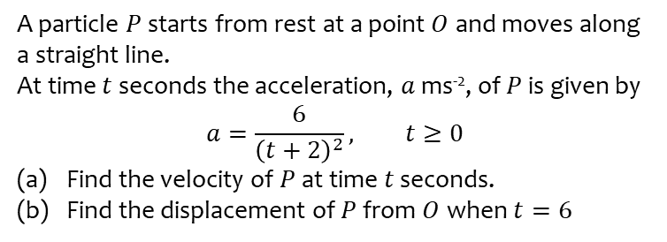
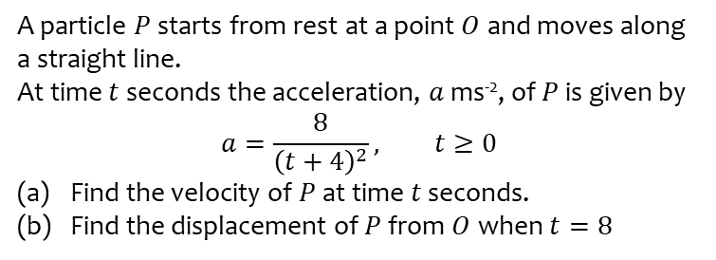
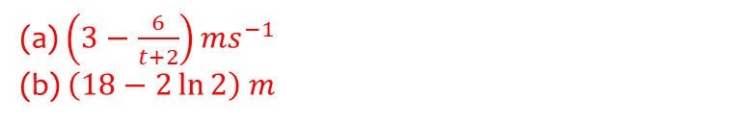
Worked example
Your turn
A particle $P$ starts from rest at a point $O$ and moves along a straight line.
At time $t$ seconds the acceleration, $a$ ms⁻², of $P$ is given by
$$a=\frac{8}{{\left(t+4\right)}^{2}}, t≥0$$
Find the velocity of $P$ at time $t$ seconds.
Find the displacement of $P$ from $O$ when $t=8$
A particle $P$ starts from rest at a point $O$ and moves along a straight line.
At time $t$ seconds the acceleration, $a$ ms⁻², of $P$ is given by
$$a=\frac{6}{{\left(t+2\right)}^{2}}, t≥0$$
Find the velocity of $P$ at time $t$ seconds.
Find the displacement of $P$ from $O$ when $t=6$
(a) $\left(3−\frac{6}{t+2}\right)ms^{−1}$
(b) $\left(18−2\ln{2}\right) m$

Slide 3
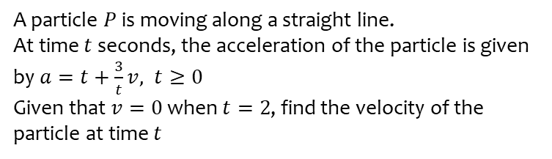
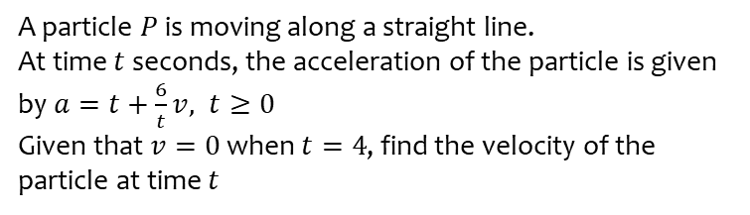

Worked example
Your turn
A particle $P$ is moving along a straight line.
At time $t$ seconds, the acceleration of the particle is given by $a=t+\frac{6}{t}v, t≥0$
Given that $v=0$ when $t=4$, find the velocity of the particle at time $t$
A particle $P$ is moving along a straight line.
At time $t$ seconds, the acceleration of the particle is given by $a=t+\frac{3}{t}v, t≥0$
Given that $v=0$ when $t=2$, find the velocity of the particle at time $t$
$$v=\frac{1}{2}t^{3}−t^{2}$$

Slide 4
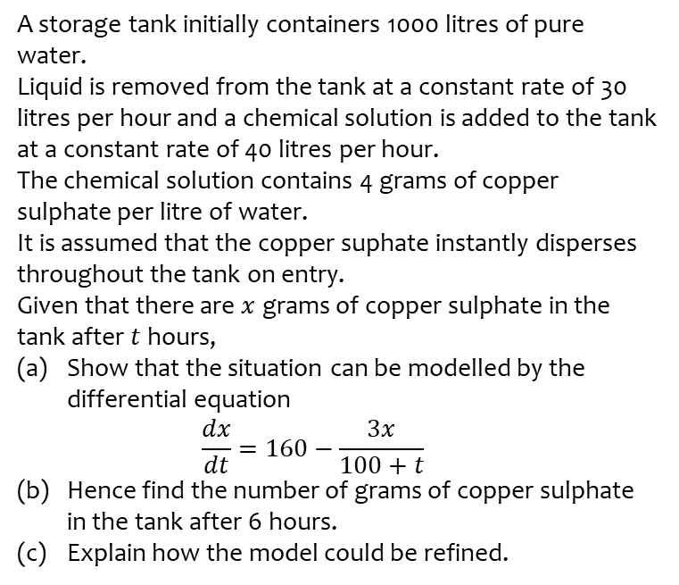
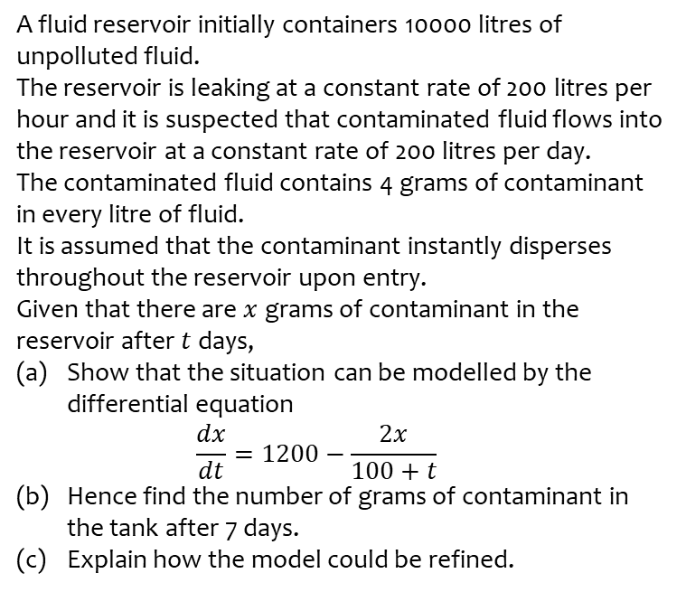
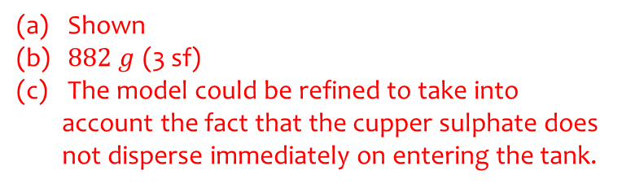
Worked example
Your turn
A fluid reservoir initially containers 10000 litres of unpolluted fluid.
The reservoir is leaking at a constant rate of 200 litres per hour and it is suspected that contaminated fluid flows into the reservoir at a constant rate of 200 litres per day.
The contaminated fluid contains 4 grams of contaminant in every litre of fluid.
It is assumed that the contaminant instantly disperses throughout the reservoir upon entry.
Given that there are $x$ grams of contaminant in the reservoir after $t$ days,
Show that the situation can be modelled by the differential equation
$\frac{dx}{dt}=1200−\frac{2x}{100+t}$
Hence find the number of grams of contaminant in the tank after 7 days.
Explain how the model could be refined.
A storage tank initially containers 1000 litres of pure water.
Liquid is removed from the tank at a constant rate of 30 litres per hour and a chemical solution is added to the tank at a constant rate of 40 litres per hour.
The chemical solution contains 4 grams of copper sulphate per litre of water.
It is assumed that the copper suphate instantly disperses throughout the tank on entry.
Given that there are $x$ grams of copper sulphate in the tank after $t$ hours,
Show that the situation can be modelled by the differential equation
$\frac{dx}{dt}=160−\frac{3x}{100+t}$
Hence find the number of grams of copper sulphate in the tank after 6 hours.
Explain how the model could be refined.
Shown
$882 g$ (3 sf)
The model could be refined to take into account the fact that the cupper sulphate does not disperse immediately on entering the tank.

