Slide 1
Proof by Induction
Twitter: @Owen134866
www.mathsfreeresourcelibrary.com

Slide 2


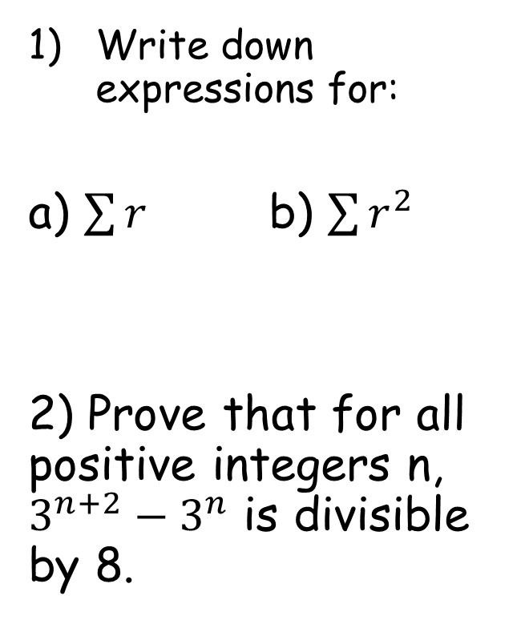




Prior Knowledge Check
3) $M=\left[\begin{matrix}k & 2 \\ k+1 & −3\end{matrix}\right]$ and $N=\left[\begin{matrix}5 & −8 \\ 0 & 2\end{matrix}\right]$
Find $MN$ in terms of $k$.
Write down expressions for:
a) $\sum{r}$ b) $\sum{r^{2}}$
2) Prove that for all positive integers n, $3^{n+2}−3^{n}$ is divisible by 8.
$$n$$
$$n+1$$
$$r=1$$
$$r=1$$
$$\frac{1}{2}n(n+1)$$
$$\frac{1}{6}(n+1)(n+2)(2n+3)$$
$$\left[\begin{matrix}5k & 4−8k \\ 5k+5 & −8k−14\end{matrix}\right]$$

Slide 3
Teachings for
Exercise 8A

Slide 4
Proof by Induction
You can obtain a proof for the summation of a series, by using the induction method
The way ‘proof by mathematical induction’ works is often likened to knocking dominoes over
If the dominoes are lined up, then you knock over the first one, every domino afterwards will fall down
iPhone Dominoes
Mathematically, if we want to prove that something is true for all possible cases, we cannot do it numerically (as the numbers would just go on forever)
However, if we show that if one case is true, and so is the next case, then we can therefore show it is true for every case…
How this works mathematically
BASIS
→ Show that the statement to be proven works for the case n = 1
ASSUMPTION
→ Assume that the statement is true for n = k (just replace the ns with ks!)
INDUCTIVE
Show that if the statement is true for n = k, it is also true for n = k + 1 (ie – the next case)
This is harder to explain without an example. Essentially you find a way to express the next ‘case’ using k and show that it is equivalent to replacing k with ‘k + 1’
CONCLUSION
You have shown that if the statement is true for one case, it must be true for the next
As it was true for n = 1, it must therefore be true for n = 2, 3, 4 and so on, PROVING the statement!
8A

Slide 5
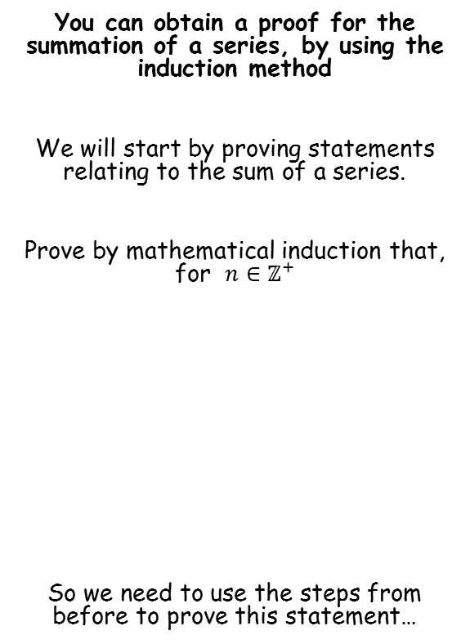
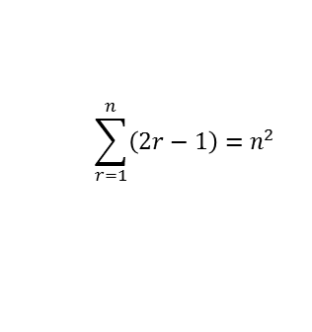
Proof by Induction
You can obtain a proof for the summation of a series, by using the induction method
We will start by proving statements relating to the sum of a series.
Prove by mathematical induction that, for $n∈{\text{ℤ}}^{+}$
So we need to use the steps from before to prove this statement…
This means ‘n can be any positive integer’
$$\sum_{r=1}^{n}{\left(2r−1\right)=n^{2}}$$
This is the formula for the sequence
This is the formula for the sum of the first n terms of the sequence
8A

Slide 6
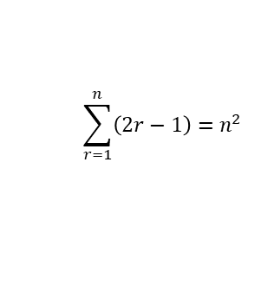

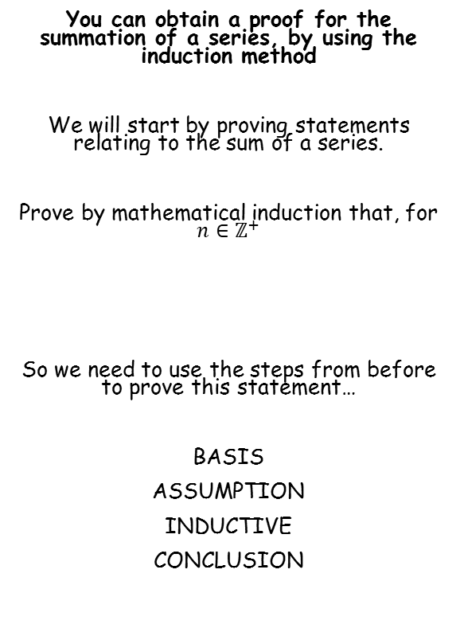

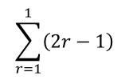
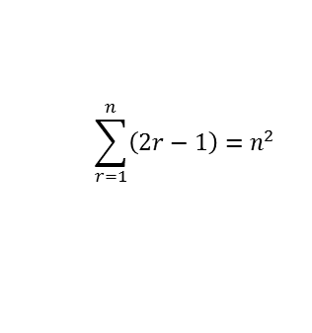
Proof by Induction
You can obtain a proof for the summation of a series, by using the induction method
We will start by proving statements relating to the sum of a series.
Prove by mathematical induction that, for $n∈{\text{ℤ}}^{+}$
So we need to use the steps from before to prove this statement…
BASIS
ASSUMPTION
INDUCTIVE
CONCLUSION
BASIS
→ Show that the statement is true for n = 1
$$\sum_{r=1}^{n}{\left(2r−1\right)=n^{2}}$$
Replace n with 1
Replace n with 1
$$\sum_{r=1}^{n}{\left(2r−1\right)=n^{2}}$$
$$\sum_{r=1}^{1}{\left(2r−1\right)}$$
There will only be one term here, that we get by subbing n = 1 into the expression
$${(1)}^{2}$$
Calculate
$$=1$$
$$=1$$
The statement given is therefore true for n = 1
8A

Slide 7


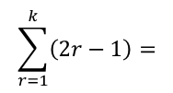
Proof by Induction
ASSUMPTION
You can obtain a proof for the summation of a series, by using the induction method
We will start by proving statements relating to the sum of a series.
Prove by mathematical induction that, for $n∈{\text{ℤ}}^{+}$
So we need to use the steps from before to prove this statement…
BASIS
ASSUMPTION
INDUCTIVE
CONCLUSION
→ Assume the statement is true for n = k
$$\sum_{r=1}^{n}{\left(2r−1\right)=n^{2}}$$
$$\sum_{r=1}^{k}{\left(2r−1\right)=}$$
$$1+3+5+7+9 +.. ..+ (2k−1)$$
$$=k^{2}$$
$$\sum_{r=1}^{n}{\left(2r−1\right)=n^{2}}$$
Write out the first few terms in the sequence, and the last term, which will be in terms of k
We are going to assume that this sequence is true for k, and hence the sum will be equal to k²
8A

Slide 8
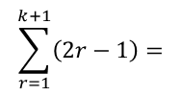




Proof by Induction
ASSUMPTION
You can obtain a proof for the summation of a series, by using the induction method
We will start by proving statements relating to the sum of a series.
Prove by mathematical induction that, for $n∈{\text{ℤ}}^{+}$
So we need to use the steps from before to prove this statement…
BASIS
ASSUMPTION
INDUCTIVE
CONCLUSION
→ Assume the statement is true for n = k
$$\sum_{r=1}^{n}{\left(2r−1\right)=n^{2}}$$
$$\sum_{r=1}^{k}{\left(2r−1\right)=}$$
$$1+3+5+7+9 +.. ..+ (2k−1)$$
$$=k^{2}$$
$$\sum_{r=1}^{n}{\left(2r−1\right)=n^{2}}$$
INDUCTIVE
→ Show the statement is then true for (k + 1) ie) The next term
The sequence will be the same, but with an extra term → (sub in (k + 1)) for it!
$$\sum_{r=1}^{k+1}{\left(2r−1\right)=}$$
$$1+3+5+7+9 +.. ..+ \left(2k−1\right)$$
$$+ (2\left(k+1\right)−1)$$
$$= 1+3+5+7+9 +.. ..+ \left(2k−1\right)+(2k+1)$$
You can replace the first part as we assumed it was equal to k² earlier
$$= k^{2}+(2k+1)$$
$$={\left(k+1\right)}^{2}$$
8A

Slide 9
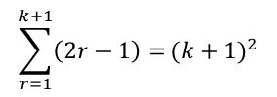
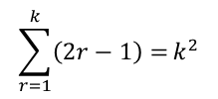
Proof by Induction
CONCLUSION
You can obtain a proof for the summation of a series, by using the induction method
We will start by proving statements relating to the sum of a series.
Prove by mathematical induction that, for $n∈{\text{ℤ}}^{+}$
So we need to use the steps from before to prove this statement…
BASIS
ASSUMPTION
INDUCTIVE
CONCLUSION
$$\sum_{r=1}^{n}{\left(2r−1\right)=n^{2}}$$
$$\sum_{r=1}^{k}{\left(2r−1\right)=}k^{2}$$
$$\sum_{r=1}^{k+1}{\left(2r−1\right)=}{(k+1)}^{2}$$
We assumed that for n = k, the sum of the series would be equal to k²
Using this assumption, we showed that the summation for (k + 1) is equal to (k + 1)²
$$\sum_{r=1}^{n}{\left(2r−1\right)=n^{2}}$$
So if the statement is true for one value, it will therefore be true for the next value
As it is true for the next value, it will therefore be true for the value after that, and so on…
However, this all relies on the assumption being correct…
Remember for the BASIS step, we showed that the statement is true for n = 1?
Well because it is true for n = 1, it must therefore be true for n = 2, n = 3……… and so on!
The statement is therefore true for all values of n!
8A

Slide 10


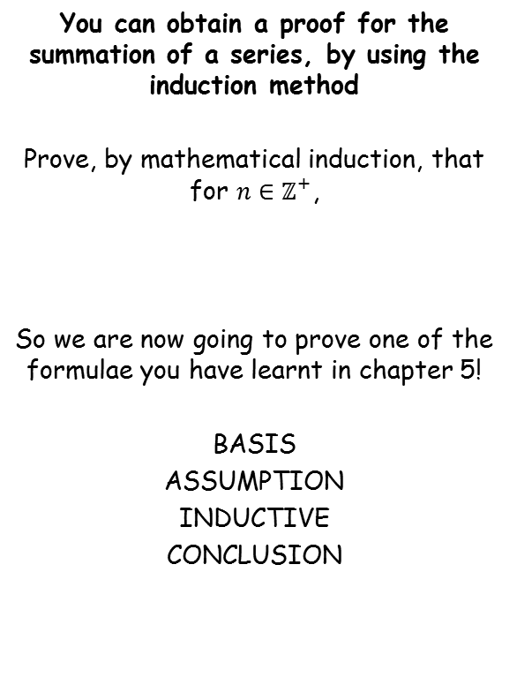
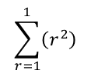
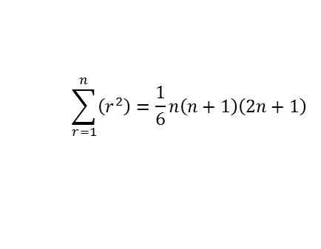
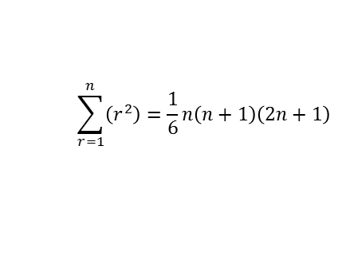
Proof by Induction
You can obtain a proof for the summation of a series, by using the induction method
Prove, by mathematical induction, that for $n∈{\text{ℤ}}^{+}$,
So we are now going to prove one of the formulae you have learnt in chapter 5!
BASIS
ASSUMPTION
INDUCTIVE
CONCLUSION
BASIS
→ Show that the statement is true for n = 1
$$\sum_{r=1}^{n}{\left(r^{2}\right)=\frac{1}{6}n\left(n+1\right)\left(2n+1\right)}$$
Replace n with 1
Replace n with 1
$$\sum_{r=1}^{n}{\left(r^{2}\right)=\frac{1}{6}n\left(n+1\right)\left(2n+1\right)}$$
$$\sum_{r=1}^{1}{\left(r^{2}\right)}$$
There will only be one term here, that we get by subbing n = 1 into the expression
$$\frac{1}{6}(1)\left(1+1\right)\left(2+1\right)$$
Calculate
$$=1$$
$$=1$$
The statement given is therefore true for n = 1
8A

Slide 11


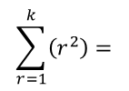
Proof by Induction
You can obtain a proof for the summation of a series, by using the induction method
Prove, by mathematical induction, that for $n∈{\text{ℤ}}^{+}$,
So we are now going to prove one of the formulae you have learnt in chapter 5!
BASIS
ASSUMPTION
INDUCTIVE
CONCLUSION
ASSUMPTION
→ Assume the statement is true for n = k
$$\sum_{r=1}^{k}{\left(r^{2}\right)=}$$
$$= \frac{1}{6}k\left(k+1\right)\left(2k+1\right)$$
$$1+4+9+16………+k^{2}$$
$$\sum_{r=1}^{n}{\left(r^{2}\right)=\frac{1}{6}n\left(n+1\right)\left(2n+1\right)}$$
Write out the first few terms in the sequence, and the last term, which will be in terms of k
We are going to assume that this sequence is true for k, and hence the sum will be equal to the expression above
8A

Slide 12
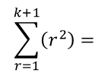





Proof by Induction
You can obtain a proof for the summation of a series, by using the induction method
Prove, by mathematical induction, that for $n∈{\text{ℤ}}^{+}$,
So we are now going to prove one of the formulae you have learnt in chapter 5!
BASIS
ASSUMPTION
INDUCTIVE
CONCLUSION
ASSUMPTION
→ Assume the statement is true for n = k
$$\sum_{r=1}^{k}{\left(r^{2}\right)=}$$
$$= \frac{1}{6}k\left(k+1\right)\left(2k+1\right)$$
$$1+4+9+16………+k^{2}$$
INDUCTIVE
$$\sum_{r=1}^{n}{\left(r^{2}\right)=\frac{1}{6}n\left(n+1\right)\left(2n+1\right)}$$
→ Show the statement is then true for (k + 1) ie) The next term
The sequence will be the same, but with an extra term → (sub in (k + 1)) for it!
$$\sum_{r=1}^{k+1}{\left(r^{2}\right)=}$$
$$1+4+9+16………+k^{2}$$
$${+ (k+1)}^{2}$$
Replace the first part with the assumed formula from earlier!
$$= \frac{1}{6}k\left(k+1\right)\left(2k+1\right)$$
$${+ (k+1)}^{2}$$
This requires more simplification which will be shown on the next slide!!
8A

Slide 13










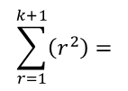







Proof by Induction
You can obtain a proof for the summation of a series, by using the induction method
Prove, by mathematical induction, that for $n∈{\text{ℤ}}^{+}$,
So we are now going to prove one of the formulae you have learnt in chapter 5!
BASIS
ASSUMPTION
INDUCTIVE
CONCLUSION
INDUCTIVE
→ Show the statement is then true for (k + 1) ie) The next term
The sequence will be the same, but with an extra term → (sub in (k + 1)) for it!
$$\sum_{r=1}^{k+1}{\left(r^{2}\right)=}$$
$$1+4+9+16………+k^{2}$$
$${+ (k+1)}^{2}$$
Replace the first part with the assumed formula from earlier!
$$\sum_{r=1}^{n}{\left(r^{2}\right)=\frac{1}{6}n\left(n+1\right)\left(2n+1\right)}$$
$$= \frac{1}{6}k\left(k+1\right)\left(2k+1\right)$$
$${+ (k+1)}^{2}$$
Rewrite both as fractions over 6
$$= \frac{k\left(k+1\right)\left(2k+1\right)}{6}$$
$$+ \frac{6{\left(k+1\right)}^{2}}{6}$$
Combine
$$= \frac{k\left(k+1\right)\left(2k+1\right)+6{(k+1)}^{2}}{6}$$
‘Clever factorisation’ method!
$$[$$
$$]$$
$$=$$
$$(k+1)$$
$$k(2k+1)$$
$$+ 6(k+1)$$
$$6$$
Expand and simplify the inner brackets
$$[$$
$$]$$
$$=$$
$$(k+1)$$
$$2k^{2}+7k+6$$
$$6$$
Factorise the inner part
$$=$$
$$(k+1)$$
$$(k+2)(2k+3)$$
$$6$$
8A
6A

Slide 14



Proof by Induction
You can obtain a proof for the summation of a series, by using the induction method
Prove, by mathematical induction, that for $n∈{\text{ℤ}}^{+}$,
So we are now going to prove one of the formulae you have learnt in chapter 5!
BASIS
ASSUMPTION
INDUCTIVE
CONCLUSION
CONCLUSION
→ Explain why it proves the original statement
For n = k
For n = (k + 1)
$$= \frac{1}{6}k\left(k+1\right)\left(2k+1\right)$$
$$= \frac{1}{6}(k+1)\left(k+2\right)\left(2k+3\right)$$
$$\sum_{r=1}^{n}{\left(r^{2}\right)=\frac{1}{6}n\left(n+1\right)\left(2n+1\right)}$$
Rewrite some of the brackets
$$= \frac{1}{6}(k+1)\left(k+1+1\right)\left(2(k+1)+1\right)$$
Written in this way, you can see that the k’s in the first statement have all been replaced with ‘k + 1’s
→ So the statement was true for n = 1
We also showed that if it is true for one statement, it is true for the next
Therefore the formula has been proven!
8A

Slide 15


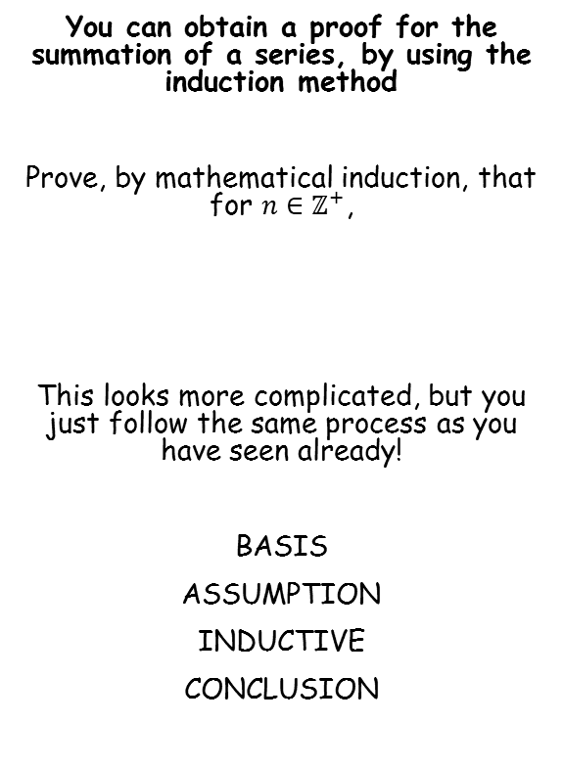
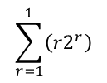


Proof by Induction
You can obtain a proof for the summation of a series, by using the induction method
Prove, by mathematical induction, that for $n∈{\text{ℤ}}^{+}$,
This looks more complicated, but you just follow the same process as you have seen already!
BASIS
ASSUMPTION
INDUCTIVE
CONCLUSION
BASIS
→ Show that the statement is true for n = 1
$$\sum_{r=1}^{n}{\left({r2}^{r}\right)=2\left[1+(n−1)2^{n}\right]}$$
Replace n with 1
Replace n with 1
$$\sum_{r=1}^{n}{\left(r2^{r}\right)=2\left[1+(n−1)2^{n}\right]}$$
$$\sum_{r=1}^{1}{\left({r2}^{r}\right)}$$
There will only be one term here, that we get by subbing n = 1 into the expression
$$2\left[1+(1−1)2^{1}\right]$$
Calculate
$$=2$$
$$=2$$
The statement given is therefore true for n = 1
8A

Slide 16



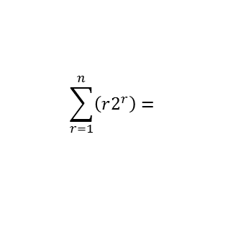
Proof by Induction
You can obtain a proof for the summation of a series, by using the induction method
Prove, by mathematical induction, that for $n∈{\text{ℤ}}^{+}$,
This looks more complicated, but you just follow the same process as you have seen already!
BASIS
ASSUMPTION
INDUCTIVE
CONCLUSION
ASSUMPTION
→ Assume the statement is true for n = k
$$\sum_{r=1}^{n}{\left(r2^{r}\right)=}$$
$$2+8+24+64……$$
$$+ k(2^{k})$$
$$= 2\left[1+{\left(k−1\right)2}^{k}\right]$$
$$\sum_{r=1}^{n}{\left(r2^{r}\right)=2\left[1+(n−1)2^{n}\right]}$$
Write out the first few terms in the sequence, and the last term, which will be in terms of k
We are going to assume that this sequence is true for k, and hence the sum will be equal to the expression above
8A

Slide 17





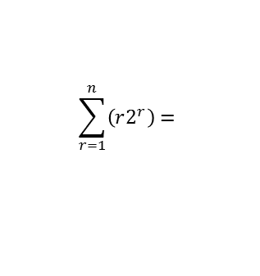

Proof by Induction
You can obtain a proof for the summation of a series, by using the induction method
Prove, by mathematical induction, that for $n∈{\text{ℤ}}^{+}$,
This looks more complicated, but you just follow the same process as you have seen already!
BASIS
ASSUMPTION
INDUCTIVE
CONCLUSION
ASSUMPTION
→ Assume the statement is true for n = k
$$\sum_{r=1}^{n}{\left(r2^{r}\right)=}$$
$$2+8+24+64……$$
$$+ k(2^{k})$$
$$= 2\left[1+{\left(k−1\right)2}^{k}\right]$$
INDUCTIVE
$$\sum_{r=1}^{n}{\left(r2^{r}\right)=2\left[1+(n−1)2^{n}\right]}$$
→ Show the statement is then true for (k + 1) ie) The next term
The sequence will be the same, but with an extra term → (sub in (k + 1)) for it!
$$\sum_{r=1}^{n}{\left(r2^{r}\right)=}$$
$$2+8+24+64……$$
$$+ k(2^{k})$$
$$+ (k+1)2^{k+1}$$
Replace the first part with the assumed formula from earlier!
$$= 2\left[1+{\left(k−1\right)2}^{k}\right]$$
$$+ (k+1)2^{k+1}$$
$$=2+2(k−1)2^{k}$$
$$+ (k+1)2^{k+1}$$
The simplification for this is difficult
→ You need to aim for the power of 2 to be ‘k + 1’ (as it was ‘k’ originally)
8A

Slide 18






Proof by Induction
INDUCTIVE
You can obtain a proof for the summation of a series, by using the induction method
Prove, by mathematical induction, that for $n∈{\text{ℤ}}^{+}$,
This looks more complicated, but you just follow the same process as you have seen already!
BASIS
ASSUMPTION
INDUCTIVE
CONCLUSION
→ Show the statement is then true for (k + 1) ie) The next term
$$=2+2(k−1)2^{k}$$
$$+ (k+1)2^{k+1}$$
2 x 2^{k} = 2^{k+1}
(add the powers)
$$=2+(k−1)2^{k+1}$$
$$+ (k+1)2^{k+1}$$
$$\sum_{r=1}^{n}{\left(r2^{r}\right)=2\left[1+(n−1)2^{n}\right]}$$
In total, we have (k – 1) + (k + 1) 2^{k+1}s
$$=2+(k−1+k+1)2^{k+1}$$
Simplify the bracket
$$=2+2k2^{k+1}$$
Re-factorise the bracket
$$=2(1+k2^{k+1})$$
8A

Slide 19



Proof by Induction
CONCLUSION
You can obtain a proof for the summation of a series, by using the induction method
Prove, by mathematical induction, that for $n∈{\text{ℤ}}^{+}$,
This looks more complicated, but you just follow the same process as you have seen already!
BASIS
ASSUMPTION
INDUCTIVE
CONCLUSION
→ Explain why this shows the statement is true
For n = k
For n = (k + 1)
$$2\left[1+{\left(k−1\right)2}^{k}\right]$$
$$2(1+k2^{k+1})$$
$$\sum_{r=1}^{n}{\left(r2^{r}\right)=2\left[1+(n−1)2^{n}\right]}$$
Rewrite the first ‘k’ as ‘k + 1 – 1’
$$2(1+(k+1−1)2^{k+1})$$
Written in this way, you can see that the k’s in the first statement have all been replaced with ‘k + 1’s
→ So the statement was true for n = 1
We also showed that if it is true for one statement, it is true for the next
Therefore the formula has been proven!
You will need to become familiar with manipulating powers in the way shown here!
8A
6A

