Slide 1
8) Modelling with differential equations
8.1) Modelling with first-order differential equations
8.2) Simple harmonic motion
8.3) Damped and forced harmonic motion
8.4) Coupled first-order simultaneous differential equations

Slide 2
8.1) Modelling with first-order differential equations
Chapter CONTENTS

Slide 3
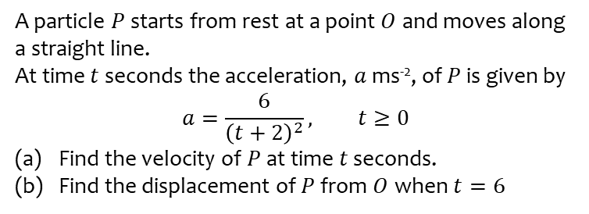
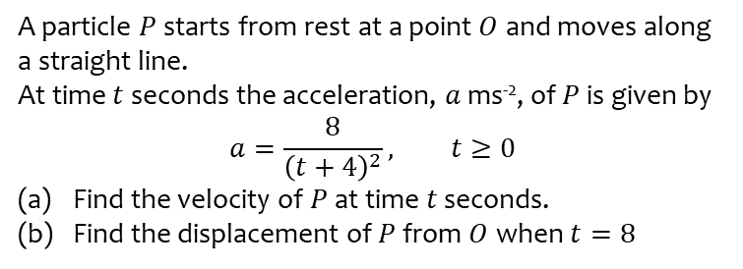
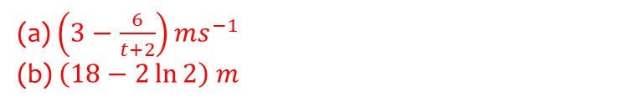
Worked example
Your turn
A particle $P$ starts from rest at a point $O$ and moves along a straight line.
At time $t$ seconds the acceleration, $a$ ms⁻², of $P$ is given by
$$a=\frac{8}{{\left(t+4\right)}^{2}}, t≥0$$
Find the velocity of $P$ at time $t$ seconds.
Find the displacement of $P$ from $O$ when $t=8$
A particle $P$ starts from rest at a point $O$ and moves along a straight line.
At time $t$ seconds the acceleration, $a$ ms⁻², of $P$ is given by
$$a=\frac{6}{{\left(t+2\right)}^{2}}, t≥0$$
Find the velocity of $P$ at time $t$ seconds.
Find the displacement of $P$ from $O$ when $t=6$
(a) $\left(3−\frac{6}{t+2}\right)ms^{−1}$
(b) $\left(18−2\ln{2}\right) m$

Slide 4
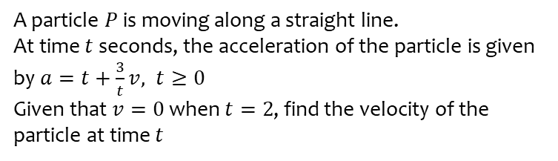
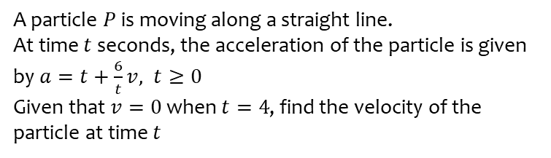

Worked example
Your turn
A particle $P$ is moving along a straight line.
At time $t$ seconds, the acceleration of the particle is given by $a=t+\frac{6}{t}v, t≥0$
Given that $v=0$ when $t=4$, find the velocity of the particle at time $t$
A particle $P$ is moving along a straight line.
At time $t$ seconds, the acceleration of the particle is given by $a=t+\frac{3}{t}v, t≥0$
Given that $v=0$ when $t=2$, find the velocity of the particle at time $t$
$$v=\frac{1}{2}t^{3}−t^{2}$$

Slide 5
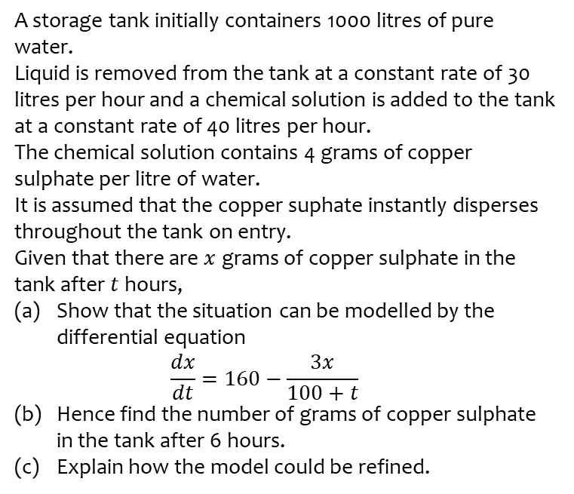
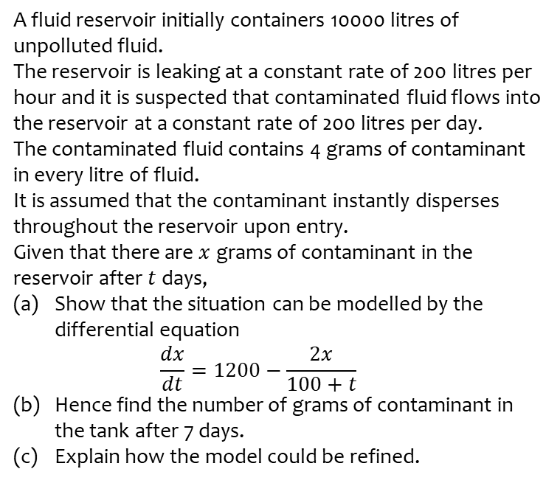
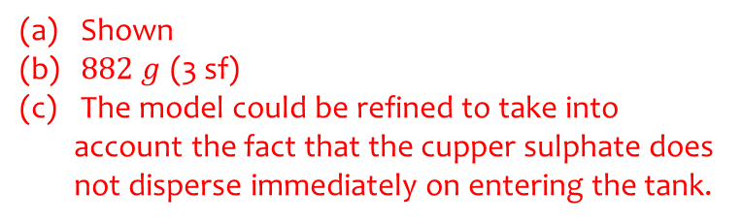
Worked example
Your turn
A fluid reservoir initially containers 10000 litres of unpolluted fluid.
The reservoir is leaking at a constant rate of 200 litres per hour and it is suspected that contaminated fluid flows into the reservoir at a constant rate of 200 litres per day.
The contaminated fluid contains 4 grams of contaminant in every litre of fluid.
It is assumed that the contaminant instantly disperses throughout the reservoir upon entry.
Given that there are $x$ grams of contaminant in the reservoir after $t$ days,
Show that the situation can be modelled by the differential equation
$\frac{dx}{dt}=1200−\frac{2x}{100+t}$
Hence find the number of grams of contaminant in the tank after 7 days.
Explain how the model could be refined.
A storage tank initially containers 1000 litres of pure water.
Liquid is removed from the tank at a constant rate of 30 litres per hour and a chemical solution is added to the tank at a constant rate of 40 litres per hour.
The chemical solution contains 4 grams of copper sulphate per litre of water.
It is assumed that the copper suphate instantly disperses throughout the tank on entry.
Given that there are $x$ grams of copper sulphate in the tank after $t$ hours,
Show that the situation can be modelled by the differential equation
$\frac{dx}{dt}=160−\frac{3x}{100+t}$
Hence find the number of grams of copper sulphate in the tank after 6 hours.
Explain how the model could be refined.
Shown
$882 g$ (3 sf)
The model could be refined to take into account the fact that the cupper sulphate does not disperse immediately on entering the tank.

Slide 6
8.2) Simple harmonic motion
Chapter CONTENTS

Slide 7
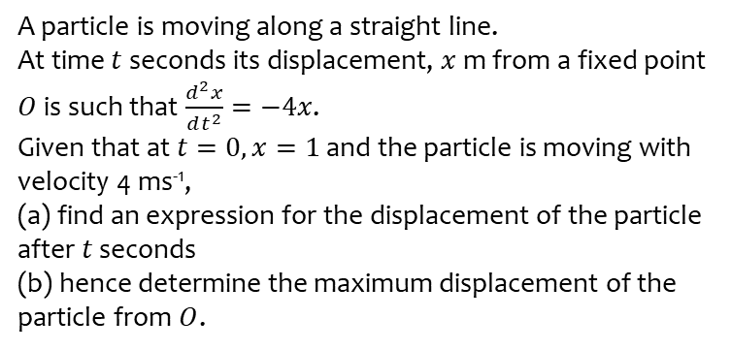
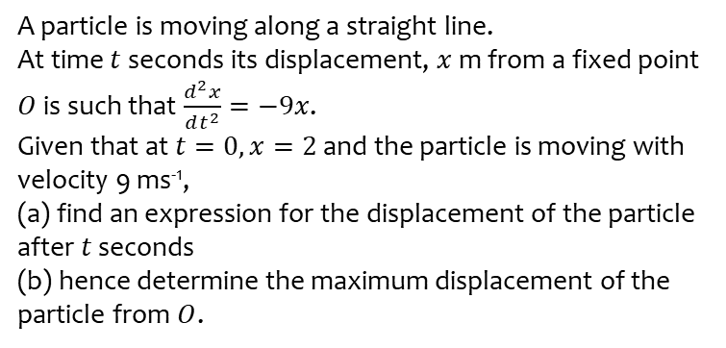
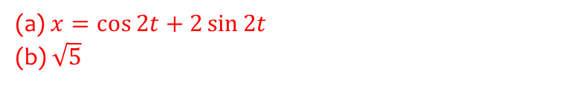
Worked example
Your turn
A particle is moving along a straight line.
At time $t$ seconds its displacement, $x$ m from a fixed point $O$ is such that $\frac{d^{2}x}{dt^{2}}=−9x$.
Given that at $t=0, x=2$ and the particle is moving with velocity 9 ms⁻¹,
(a) find an expression for the displacement of the particle after $t$ seconds
(b) hence determine the maximum displacement of the particle from $O$.
A particle is moving along a straight line.
At time $t$ seconds its displacement, $x$ m from a fixed point $O$ is such that $\frac{d^{2}x}{dt^{2}}=−4x$.
Given that at $t=0, x=1$ and the particle is moving with velocity 4 ms⁻¹,
(a) find an expression for the displacement of the particle after $t$ seconds
(b) hence determine the maximum displacement of the particle from $O$.
(a)$x=\cos{2t}+2\sin{2t}$
(b) $\sqrt{5}$

Slide 8
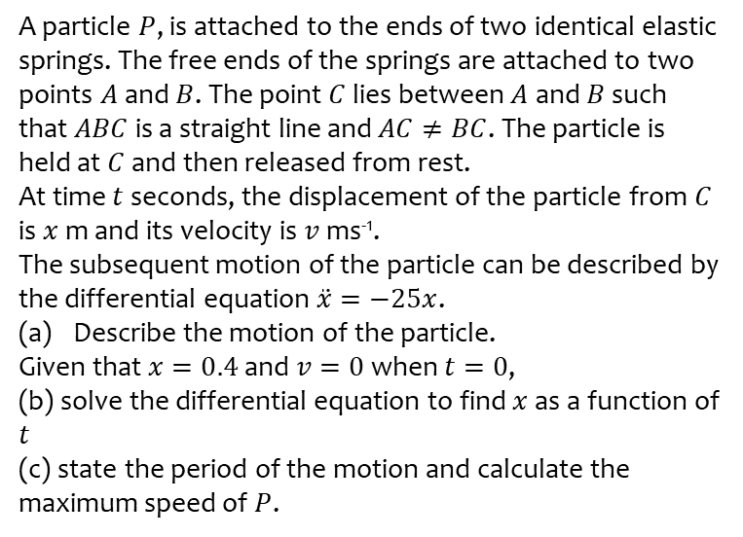
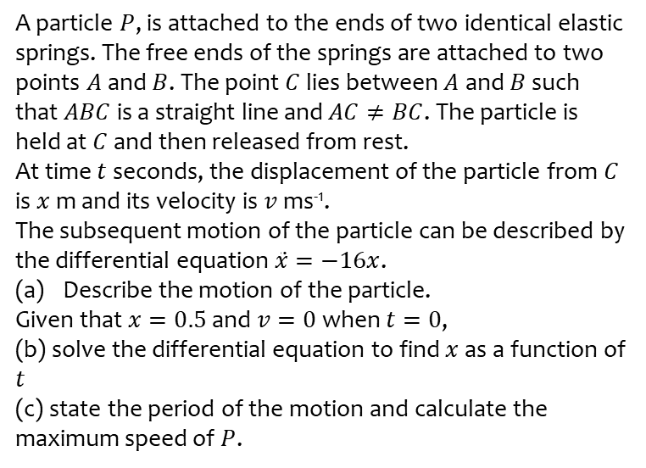
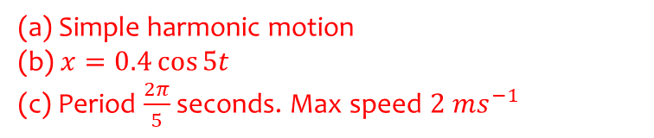
Worked example
Your turn
A particle $P$, is attached to the ends of two identical elastic springs. The free ends of the springs are attached to two points $A$ and $B$. The point $C$ lies between $A$ and $B$ such that $ABC$ is a straight line and $AC≠BC$. The particle is held at $C$ and then released from rest.
At time $t$ seconds, the displacement of the particle from $C$ is $x$ m and its velocity is $v$ ms⁻¹.
The subsequent motion of the particle can be described by the differential equation $\ddot{x}=−16x$.
Describe the motion of the particle.
Given that $x=0.5$ and $v=0$ when $t=0$,
(b) solve the differential equation to find $x$ as a function of $t$
(c) state the period of the motion and calculate the maximum speed of $P$.
A particle $P$, is attached to the ends of two identical elastic springs. The free ends of the springs are attached to two points $A$ and $B$. The point $C$ lies between $A$ and $B$ such that $ABC$ is a straight line and $AC≠BC$. The particle is held at $C$ and then released from rest.
At time $t$ seconds, the displacement of the particle from $C$ is $x$ m and its velocity is $v$ ms⁻¹.
The subsequent motion of the particle can be described by the differential equation $\ddot{x}=−25x$.
Describe the motion of the particle.
Given that $x=0.4$ and $v=0$ when $t=0$,
(b) solve the differential equation to find $x$ as a function of $t$
(c) state the period of the motion and calculate the maximum speed of $P$.
(a) Simple harmonic motion
(b) $x=0.4\cos{5t}$
(c) Period $\frac{2π}{5}$ seconds. Max speed $2 ms^{−1}$

Slide 9
8.3) Damped and forced harmonic motion
Chapter CONTENTS

Slide 10
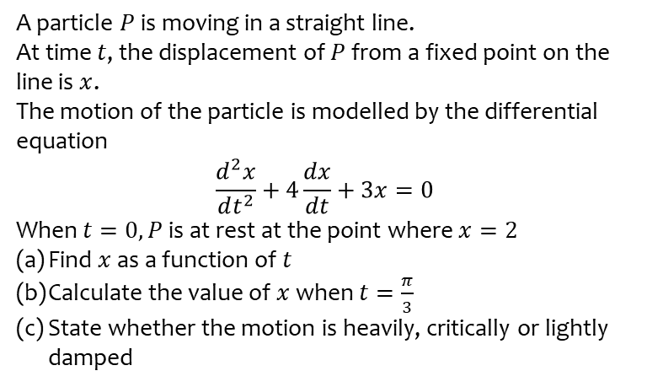
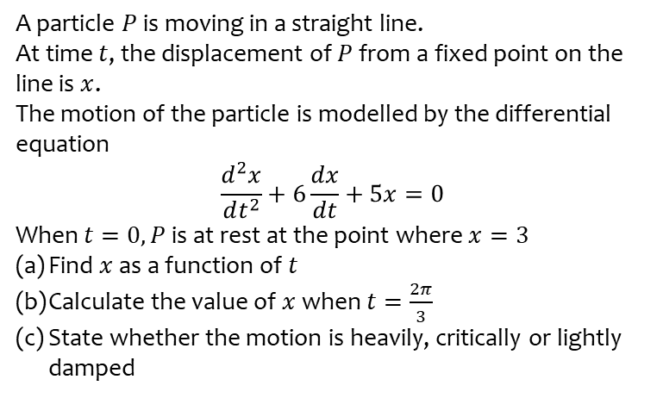
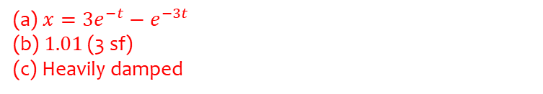
Worked example
Your turn
A particle $P$ is moving in a straight line.
At time $t$, the displacement of $P$ from a fixed point on the line is $x$.
The motion of the particle is modelled by the differential equation
$$\frac{d^{2}x}{dt^{2}}+6\frac{dx}{dt}+5x=0$$
When $t=0, P$ is at rest at the point where $x=3$
Find $x$ as a function of $t$
Calculate the value of $x$ when $t=\frac{2π}{3}$
State whether the motion is heavily, critically or lightly damped
A particle $P$ is moving in a straight line.
At time $t$, the displacement of $P$ from a fixed point on the line is $x$.
The motion of the particle is modelled by the differential equation
$$\frac{d^{2}x}{dt^{2}}+4\frac{dx}{dt}+3x=0$$
When $t=0, P$ is at rest at the point where $x=2$
Find $x$ as a function of $t$
Calculate the value of $x$ when $t=\frac{π}{3}$
State whether the motion is heavily, critically or lightly damped
(a) $x=3e^{−t}−e^{−3t}$
(b) $1.01$ (3 sf)
(c) Heavily damped

Slide 11
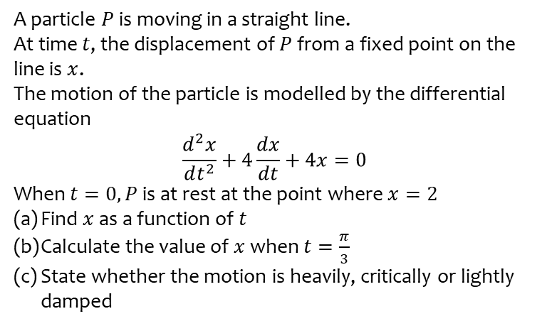
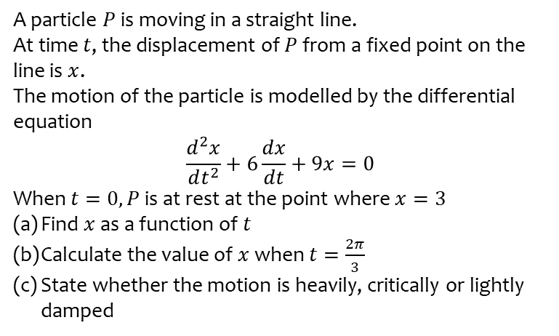
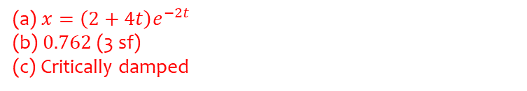
Worked example
Your turn
A particle $P$ is moving in a straight line.
At time $t$, the displacement of $P$ from a fixed point on the line is $x$.
The motion of the particle is modelled by the differential equation
$$\frac{d^{2}x}{dt^{2}}+6\frac{dx}{dt}+9x=0$$
When $t=0, P$ is at rest at the point where $x=3$
Find $x$ as a function of $t$
Calculate the value of $x$ when $t=\frac{2π}{3}$
State whether the motion is heavily, critically or lightly damped
A particle $P$ is moving in a straight line.
At time $t$, the displacement of $P$ from a fixed point on the line is $x$.
The motion of the particle is modelled by the differential equation
$$\frac{d^{2}x}{dt^{2}}+4\frac{dx}{dt}+4x=0$$
When $t=0, P$ is at rest at the point where $x=2$
Find $x$ as a function of $t$
Calculate the value of $x$ when $t=\frac{π}{3}$
State whether the motion is heavily, critically or lightly damped
(a) $x=\left(2+4t\right)e^{−2t}$
(b) $0.762$ (3 sf)
(c) Critically damped

Slide 12
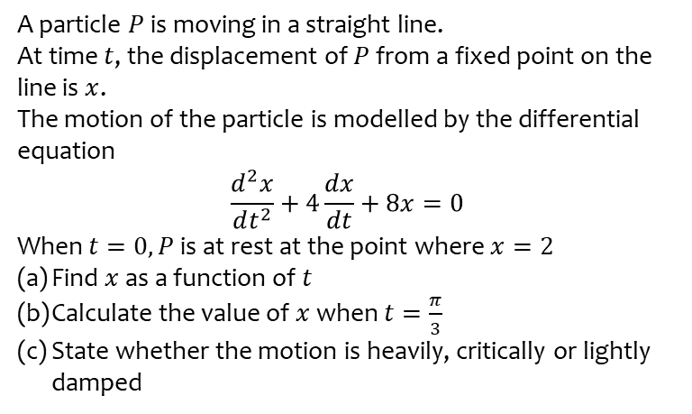
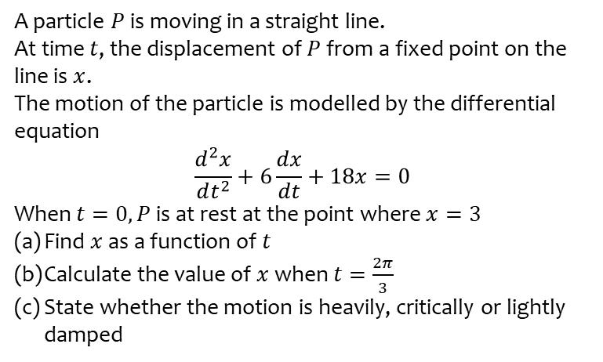
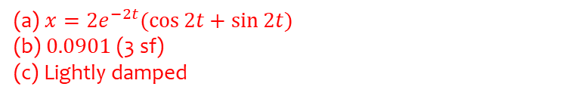
Worked example
Your turn
A particle $P$ is moving in a straight line.
At time $t$, the displacement of $P$ from a fixed point on the line is $x$.
The motion of the particle is modelled by the differential equation
$$\frac{d^{2}x}{dt^{2}}+6\frac{dx}{dt}+18x=0$$
When $t=0, P$ is at rest at the point where $x=3$
Find $x$ as a function of $t$
Calculate the value of $x$ when $t=\frac{2π}{3}$
State whether the motion is heavily, critically or lightly damped
A particle $P$ is moving in a straight line.
At time $t$, the displacement of $P$ from a fixed point on the line is $x$.
The motion of the particle is modelled by the differential equation
$$\frac{d^{2}x}{dt^{2}}+4\frac{dx}{dt}+8x=0$$
When $t=0, P$ is at rest at the point where $x=2$
Find $x$ as a function of $t$
Calculate the value of $x$ when $t=\frac{π}{3}$
State whether the motion is heavily, critically or lightly damped
(a) $x=2e^{−2t}(\cos{2t}+\sin{2t})$
(b) $0.0901$ (3 sf)
(c) Lightly damped

Slide 13
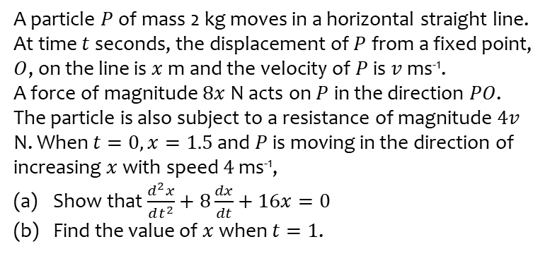
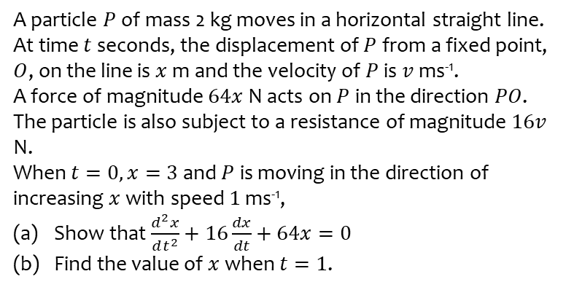
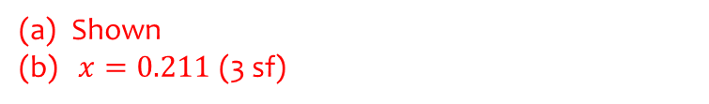
Worked example
Your turn
A particle $P$ of mass 2 kg moves in a horizontal straight line.
At time $t$ seconds, the displacement of $P$ from a fixed point, $O$, on the line is $x$ m and the velocity of $P$ is $v$ ms⁻¹.
A force of magnitude $64x$ N acts on $P$ in the direction $PO$. The particle is also subject to a resistance of magnitude $16v$ N.
When $t=0, x=3$ and $P$ is moving in the direction of increasing $x$ with speed $1$ ms⁻¹,
Show that $\frac{d^{2}x}{dt^{2}}+16\frac{dx}{dt}+64x=0$
Find the value of $x$ when $t=1$.
A particle $P$ of mass 2 kg moves in a horizontal straight line.
At time $t$ seconds, the displacement of $P$ from a fixed point, $O$, on the line is $x$ m and the velocity of $P$ is $v$ ms⁻¹.
A force of magnitude $8x$ N acts on $P$ in the direction $PO$. The particle is also subject to a resistance of magnitude $4v$ N. When $t=0, x=1.5$ and $P$ is moving in the direction of increasing $x$ with speed $4$ ms⁻¹,
Show that $\frac{d^{2}x}{dt^{2}}+8\frac{dx}{dt}+16x=0$
Find the value of $x$ when $t=1$.
Shown
$x=0.211$(3 sf)

Slide 14
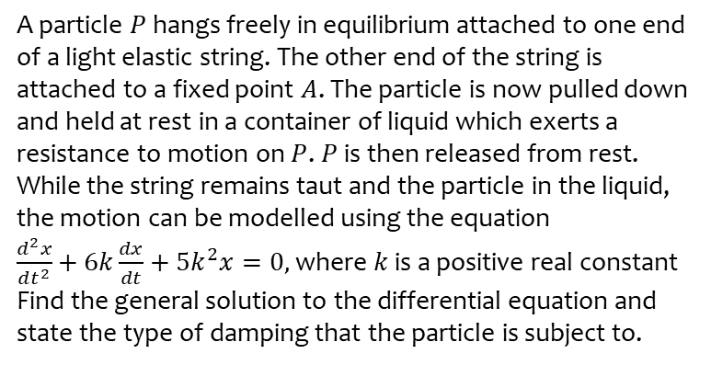
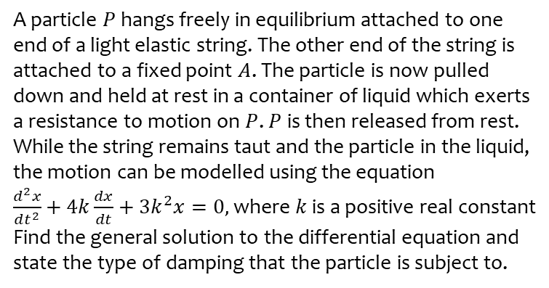

Worked example
Your turn
A particle $P$ hangs freely in equilibrium attached to one end of a light elastic string. The other end of the string is attached to a fixed point $A$. The particle is now pulled down and held at rest in a container of liquid which exerts a resistance to motion on $P$. $P$ is then released from rest. While the string remains taut and the particle in the liquid, the motion can be modelled using the equation
$\frac{d^{2}x}{dt^{2}}+4k\frac{dx}{dt}+3k^{2}x=0,$ where $k$ is a positive real constant
Find the general solution to the differential equation and state the type of damping that the particle is subject to.
A particle $P$ hangs freely in equilibrium attached to one end of a light elastic string. The other end of the string is attached to a fixed point $A$. The particle is now pulled down and held at rest in a container of liquid which exerts a resistance to motion on $P$. $P$ is then released from rest. While the string remains taut and the particle in the liquid, the motion can be modelled using the equation
$\frac{d^{2}x}{dt^{2}}+6k\frac{dx}{dt}+5k^{2}x=0,$ where $k$ is a positive real constant
Find the general solution to the differential equation and state the type of damping that the particle is subject to.
$$x=Ae^{−5kt}+Be^{−kt}$$
Heavy damping

Slide 15
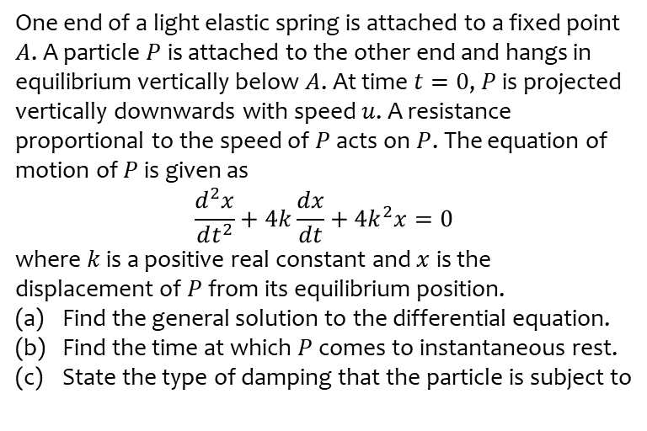
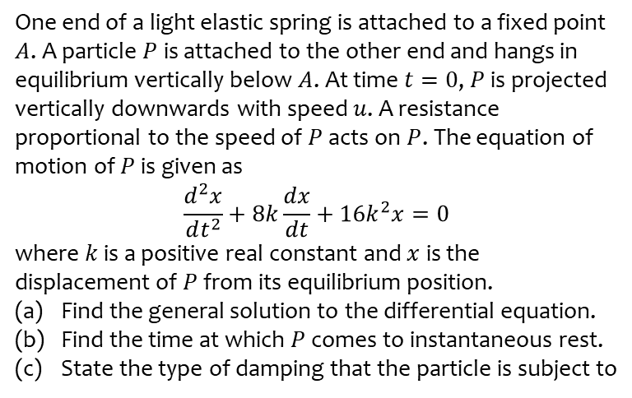
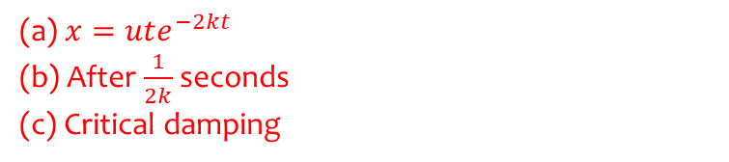
Worked example
Your turn
One end of a light elastic spring is attached to a fixed point $A$. A particle $P$ is attached to the other end and hangs in equilibrium vertically below $A$. At time $t=0$, $P$ is projected vertically downwards with speed $u$. A resistance proportional to the speed of $P$ acts on $P$. The equation of motion of $P$ is given as
$$\frac{d^{2}x}{dt^{2}}+8k\frac{dx}{dt}+16k^{2}x=0$$
where $k$ is a positive real constant and $x$ is the displacement of $P$ from its equilibrium position.
Find the general solution to the differential equation.
Find the time at which $P$ comes to instantaneous rest.
State the type of damping that the particle is subject to
One end of a light elastic spring is attached to a fixed point $A$. A particle $P$ is attached to the other end and hangs in equilibrium vertically below $A$. At time $t=0$, $P$ is projected vertically downwards with speed $u$. A resistance proportional to the speed of $P$ acts on $P$. The equation of motion of $P$ is given as
$$\frac{d^{2}x}{dt^{2}}+4k\frac{dx}{dt}+4k^{2}x=0$$
where $k$ is a positive real constant and $x$ is the displacement of $P$ from its equilibrium position.
Find the general solution to the differential equation.
Find the time at which $P$ comes to instantaneous rest.
State the type of damping that the particle is subject to
(a) $x=ute^{−2kt}$
(b) After $\frac{1}{2k}$ seconds
(c) Critical damping

Slide 16
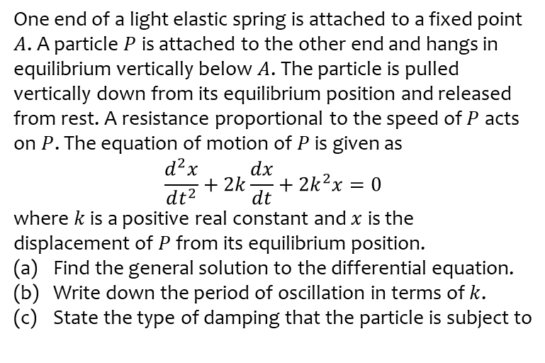
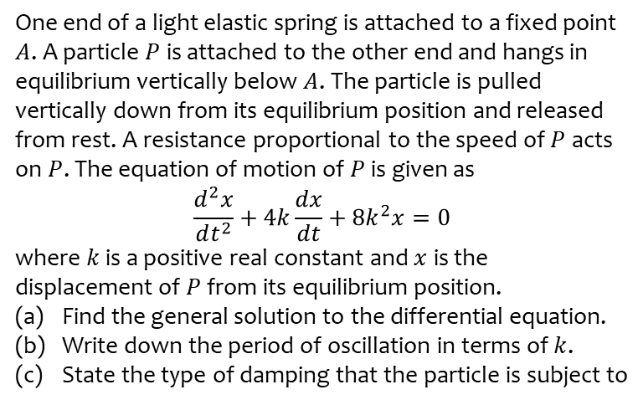
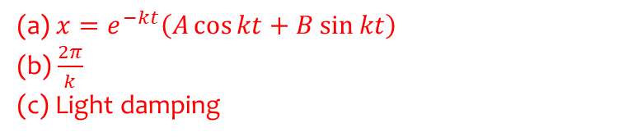
Worked example
Your turn
One end of a light elastic spring is attached to a fixed point $A$. A particle $P$ is attached to the other end and hangs in equilibrium vertically below $A$. The particle is pulled vertically down from its equilibrium position and released from rest. A resistance proportional to the speed of $P$ acts on $P$. The equation of motion of $P$ is given as
$$\frac{d^{2}x}{dt^{2}}+4k\frac{dx}{dt}+8k^{2}x=0$$
where $k$ is a positive real constant and $x$ is the displacement of $P$ from its equilibrium position.
Find the general solution to the differential equation.
Write down the period of oscillation in terms of $k$.
State the type of damping that the particle is subject to
One end of a light elastic spring is attached to a fixed point $A$. A particle $P$ is attached to the other end and hangs in equilibrium vertically below $A$. The particle is pulled vertically down from its equilibrium position and released from rest. A resistance proportional to the speed of $P$ acts on $P$. The equation of motion of $P$ is given as
$$\frac{d^{2}x}{dt^{2}}+2k\frac{dx}{dt}+2k^{2}x=0$$
where $k$ is a positive real constant and $x$ is the displacement of $P$ from its equilibrium position.
Find the general solution to the differential equation.
Write down the period of oscillation in terms of $k$.
State the type of damping that the particle is subject to
(a) $x=e^{−kt}\left(A\cos{kt}+B\sin{kt}\right)$
(b) $\frac{2π}{k}$
(c) Light damping

Slide 17
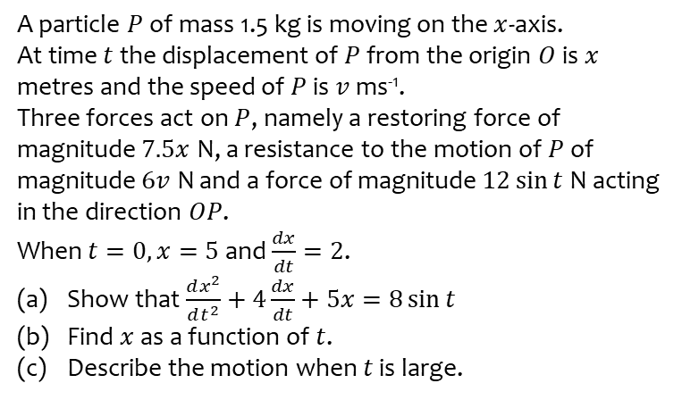
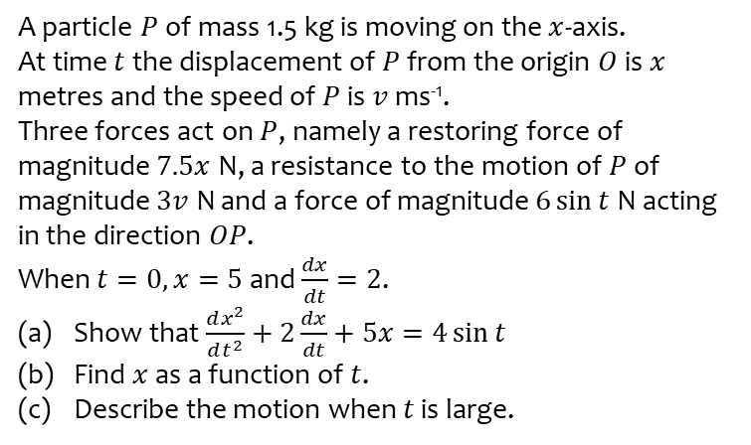
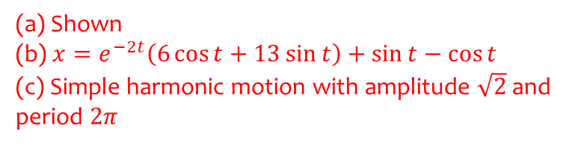
Worked example
Your turn
A particle $P$ of mass 1.5 kg is moving on the $x$-axis.
At time $t$ the displacement of $P$ from the origin $O$ is $x$ metres and the speed of $P$ is $v$ ms⁻¹.
Three forces act on $P$, namely a restoring force of magnitude $7.5x$ N, a resistance to the motion of $P$ of magnitude $3v$ N and a force of magnitude $6\sin{t}$ N acting in the direction $OP$.
When $t=0, x=5$ and $\frac{dx}{dt}=2$.
Show that $\frac{dx^{2}}{dt^{2}}+2\frac{dx}{dt}+5x=4\sin{t}$
Find $x$ as a function of $t$.
Describe the motion when $t$ is large.
A particle $P$ of mass 1.5 kg is moving on the $x$-axis.
At time $t$ the displacement of $P$ from the origin $O$ is $x$ metres and the speed of $P$ is $v$ ms⁻¹.
Three forces act on $P$, namely a restoring force of magnitude $7.5x$ N, a resistance to the motion of $P$ of magnitude $6v$ N and a force of magnitude $12\sin{t}$ N acting in the direction $OP$.
When $t=0, x=5$ and $\frac{dx}{dt}=2$.
Show that $\frac{dx^{2}}{dt^{2}}+4\frac{dx}{dt}+5x=8\sin{t}$
Find $x$ as a function of $t$.
Describe the motion when $t$ is large.
(a) Shown
(b) $x=e^{−2t}\left(6\cos{t}+13\sin{t}\right)+\sin{t}−\cos{t}$
(c) Simple harmonic motion with amplitude $\sqrt{2}$ and period $2π$

Slide 18
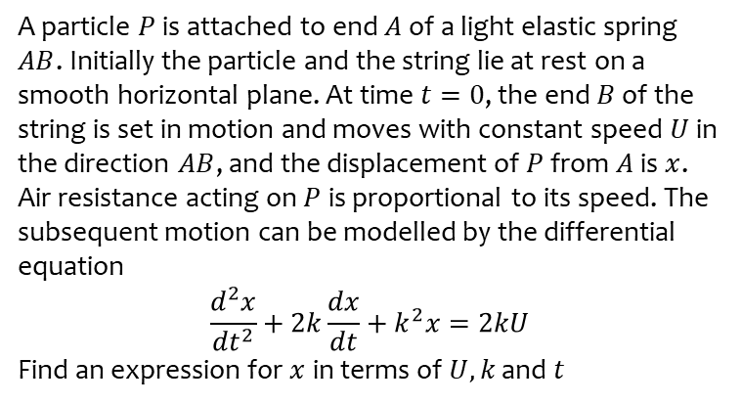
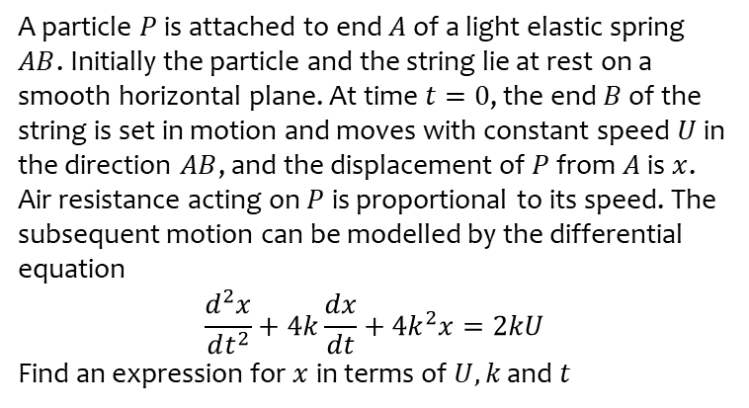

Worked example
Your turn
A particle $P$ is attached to end $A$ of a light elastic spring $AB$. Initially the particle and the string lie at rest on a smooth horizontal plane. At time $t=0$, the end $B$ of the string is set in motion and moves with constant speed $U$ in the direction $AB$, and the displacement of $P$ from $A$ is $x$. Air resistance acting on $P$ is proportional to its speed. The subsequent motion can be modelled by the differential equation
$$\frac{d^{2}x}{dt^{2}}+4k\frac{dx}{dt}+{4k}^{2}x=2kU$$
Find an expression for $x$ in terms of $U, k$ and $t$
A particle $P$ is attached to end $A$ of a light elastic spring $AB$. Initially the particle and the string lie at rest on a smooth horizontal plane. At time $t=0$, the end $B$ of the string is set in motion and moves with constant speed $U$ in the direction $AB$, and the displacement of $P$ from $A$ is $x$. Air resistance acting on $P$ is proportional to its speed. The subsequent motion can be modelled by the differential equation
$$\frac{d^{2}x}{dt^{2}}+2k\frac{dx}{dt}+k^{2}x=2kU$$
Find an expression for $x$ in terms of $U, k$ and $t$
$$x=\left(−\frac{2U}{k}−Ut\right)e^{−kt}+\frac{2U}{k}$$

Slide 19
8.4) Coupled first-order simultaneous differential equations
Chapter CONTENTS

Slide 20
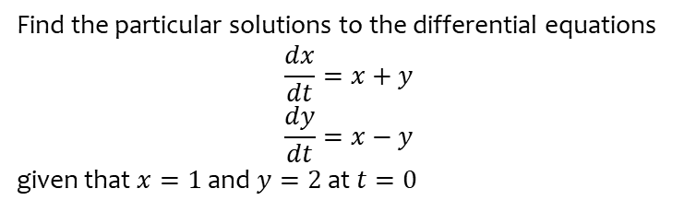
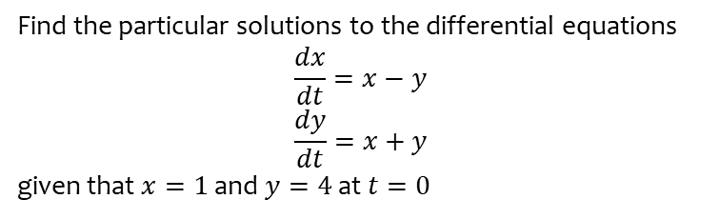
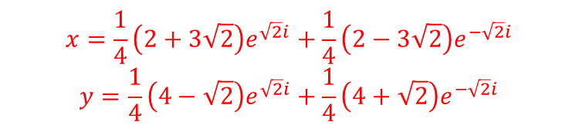
Worked example
Your turn
Find the particular solutions to the differential equations
$$\frac{dx}{dt}=x−y$$
$$\frac{dy}{dt}=x+y$$
given that $x=1$ and $y=4$ at $t=0$
Find the particular solutions to the differential equations
$$\frac{dx}{dt}=x+y$$
$$\frac{dy}{dt}=x−y$$
given that $x=1$ and $y=2$ at $t=0$
$$x=\frac{1}{4}\left(2+3\sqrt{2}\right)e^{\sqrt{2}i}+\frac{1}{4}\left(2−3\sqrt{2}\right)e^{−\sqrt{2}i}$$
$$y=\frac{1}{4}\left(4−\sqrt{2}\right)e^{\sqrt{2}i}+\frac{1}{4}\left(4+\sqrt{2}\right)e^{−\sqrt{2}i}$$

Slide 21
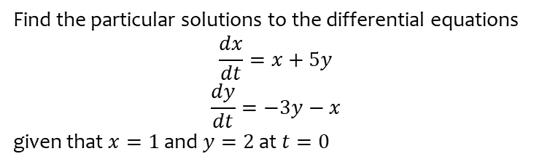
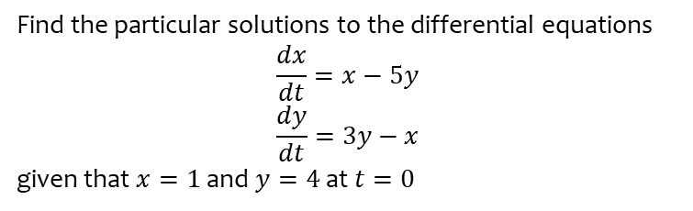

Worked example
Your turn
Find the particular solutions to the differential equations
$$\frac{dx}{dt}=x−5y$$
$$\frac{dy}{dt}=3y−x$$
given that $x=1$ and $y=4$ at $t=0$
Find the particular solutions to the differential equations
$$\frac{dx}{dt}=x+5y$$
$$\frac{dy}{dt}=−3y−x$$
given that $x=1$ and $y=2$ at $t=0$
$$x=e^{−t}(\cos{t}+12\sin{t})$$
$$y=e^{−t}(2\cos{t}−5\sin{t})$$

Slide 22
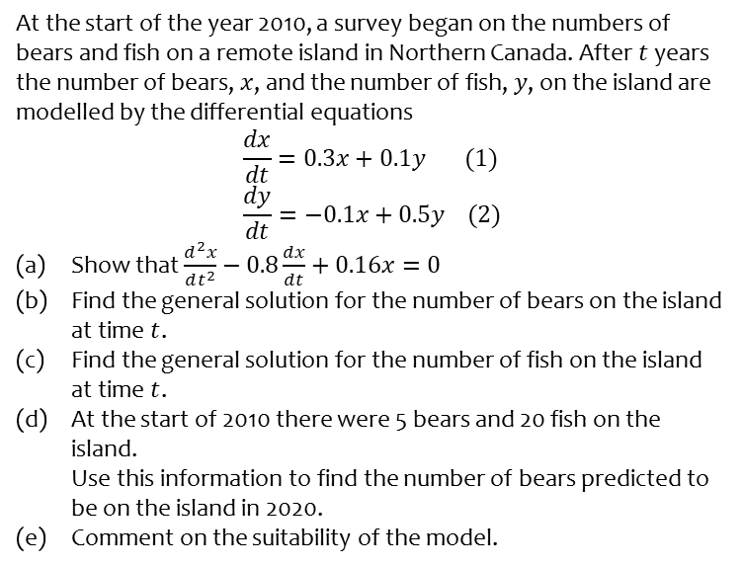
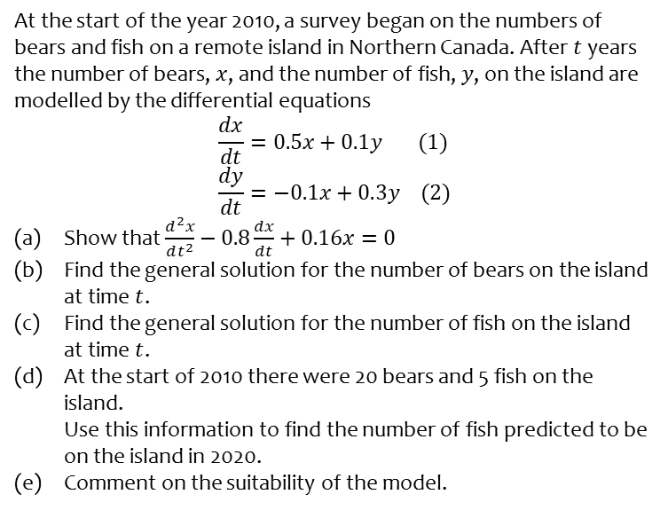
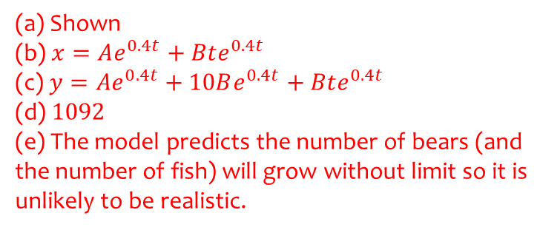
Worked example
Your turn
At the start of the year 2010, a survey began on the numbers of bears and fish on a remote island in Northern Canada. After $t$ years the number of bears, $x$, and the number of fish, $y$, on the island are modelled by the differential equations
$$\frac{dx}{dt}=0.5x+0.1y (1) \\ \frac{dy}{dt}=−0.1x+0.3y (2)$$
Show that $\frac{d^{2}x}{dt^{2}}−0.8\frac{dx}{dt}+0.16x=0$
Find the general solution for the number of bears on the island at time $t$.
Find the general solution for the number of fish on the island at time $t$.
At the start of 2010 there were 20 bears and 5 fish on the island.
Use this information to find the number of fish predicted to be on the island in 2020.
Comment on the suitability of the model.
At the start of the year 2010, a survey began on the numbers of bears and fish on a remote island in Northern Canada. After $t$ years the number of bears, $x$, and the number of fish, $y$, on the island are modelled by the differential equations
$$\frac{dx}{dt}=0.3x+0.1y (1) \\ \frac{dy}{dt}=−0.1x+0.5y (2)$$
Show that $\frac{d^{2}x}{dt^{2}}−0.8\frac{dx}{dt}+0.16x=0$
Find the general solution for the number of bears on the island at time $t$.
Find the general solution for the number of fish on the island at time $t$.
At the start of 2010 there were 5 bears and 20 fish on the island.
Use this information to find the number of bears predicted to be on the island in 2020.
Comment on the suitability of the model.
(a) Shown
(b) $x=Ae^{0.4t}+Bte^{0.4t}$
(c) $y=Ae^{0.4t}+10Be^{0.4t}+Bte^{0.4t}$
(d) $1092$
(e) The model predicts the number of bears (and the number of fish) will grow without limit so it is unlikely to be realistic.

Slide 23
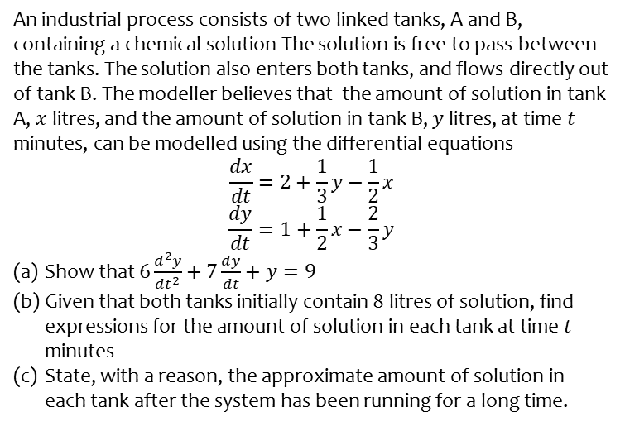
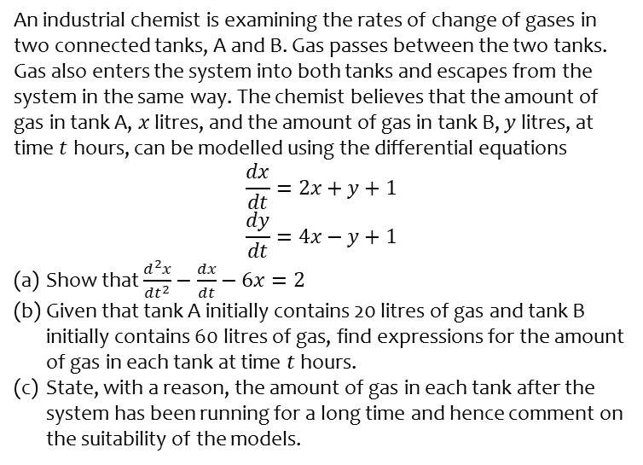
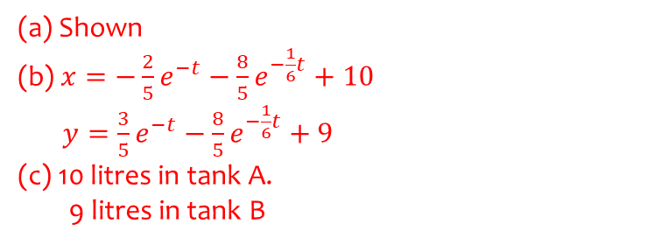
Worked example
Your turn
An industrial chemist is examining the rates of change of gases in two connected tanks, A and B. Gas passes between the two tanks. Gas also enters the system into both tanks and escapes from the system in the same way. The chemist believes that the amount of gas in tank A, $x$ litres, and the amount of gas in tank B, $y$ litres, at time $t$ hours, can be modelled using the differential equations
$$\frac{dx}{dt}=2x+y+1$$
$$\frac{dy}{dt}=4x−y+1$$
Show that $\frac{d^{2}x}{dt^{2}}−\frac{dx}{dt}−6x=2$
Given that tank A initially contains 20 litres of gas and tank B initially contains 60 litres of gas, find expressions for the amount of gas in each tank at time $t$ hours.
State, with a reason, the amount of gas in each tank after the system has been running for a long time and hence comment on the suitability of the models.
An industrial process consists of two linked tanks, A and B, containing a chemical solution The solution is free to pass between the tanks. The solution also enters both tanks, and flows directly out of tank B. The modeller believes that the amount of solution in tank A, $x$ litres, and the amount of solution in tank B, $y$ litres, at time $t$ minutes, can be modelled using the differential equations
$$\frac{dx}{dt}=2+\frac{1}{3}y−\frac{1}{2}x$$
$$\frac{dy}{dt}=1+\frac{1}{2}x−\frac{2}{3}y$$
Show that $6\frac{d^{2}y}{dt^{2}}+7\frac{dy}{dt}+y=9$
Given that both tanks initially contain 8 litres of solution, find expressions for the amount of solution in each tank at time $t$ minutes
State, with a reason, the approximate amount of solution in each tank after the system has been running for a long time.
(a) Shown
(b) $x=−\frac{2}{5}e^{−t}−\frac{8}{5}e^{−\frac{1}{6}t}+10$
$y=\frac{3}{5}e^{−t}−\frac{8}{5}e^{−\frac{1}{6}t}+9$
(c) 10 litres in tank A.
9 litres in tank B

