Slide 1
7.6) The inverse of a linear transformation

Slide 2
Worked example
Your turn
The triangle $T$ has vertices at $A$, $B$ and $C$.
The matrix $M=\left(\begin{matrix}1 & 3 \\ −1 & 4\end{matrix}\right)$ transforms $T$ to the triangle $T′$ with vertices at $A′\left(3, 4\right), B′\left(10, 4\right)$ and $C′\left(−3, −4\right)$. Determine the coordinates of $A$, $B$ and $C$.
The triangle $T$ has vertices at $A$, $B$ and $C$. The matrix $M=\left(\begin{matrix}4 & −1 \\ 3 & 1\end{matrix}\right)$ transforms $T$ to the triangle $T′$ with vertices at $A′\left(4,3\right), B′\left(4,10\right)$ and $C′\left(−4,−3\right)$. Determine the coordinates of $A$, $B$ and $C$.
$$A \left(1, 0\right) B\left(2, 4\right) C(−1, 0)$$

Slide 3
Worked example
Your turn
$$M=\left(\begin{matrix}5 & −2 \\ 4 & −3\end{matrix}\right)$$
$$A=\left(\begin{matrix}0 & 1 \\ −1 & 0\end{matrix}\right)$$
Find det M
Describe fully the single geometrical transformation represented by A
The transformation represented by A followed by the transformation represented by B is equivalent to the transformation represented by M. Find B
$$M=\left(\begin{matrix}3 & 4 \\ 2 & −5\end{matrix}\right)$$
$$A=\left(\begin{matrix}0 & −1 \\ 1 & 0\end{matrix}\right)$$
Find det M
Describe fully the single geometrical transformation represented by A
The transformation represented by A followed by the transformation represented by B is equivalent to the transformation represented by M. Find B
a) $−23$
b) Rotation $90°$ anticlockwise about $(0, 0)$
c) $\left(\begin{matrix}−4 & 3 \\ 5 & 2\end{matrix}\right)$

Slide 4
Worked example
Your turn
$$M=\left(\begin{matrix}1 & 0 & 1 \\ 1 & 3 & −1 \\ 0 & 2 & −2\end{matrix}\right)$$
The point $(a, b, c)$ is mapped onto $(−3, −2, 1)$ under $M$. Find the values of $a, b$ and $c$
$$M=\left(\begin{matrix}1 & 0 & 1 \\ 0 & 2 & −2 \\ 1 & 3 & −1\end{matrix}\right)$$
The point $(a, b, c)$ is mapped onto $(3, 2, −1)$ under $M$. Find the values of $a, b$ and $c$
$$a=10, b=−6, c=−7$$

Slide 5
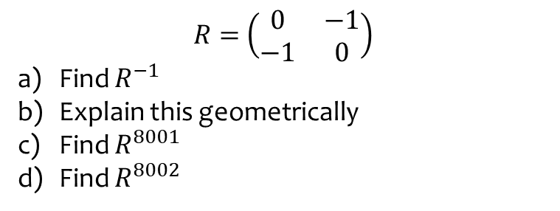
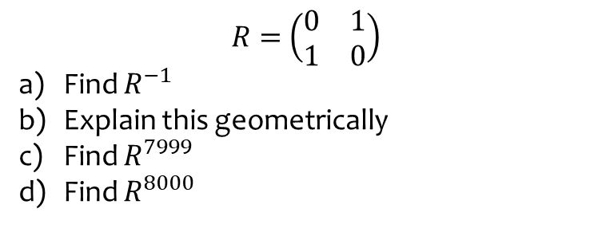
Worked example
Your turn
$R=$ $\left(\begin{matrix}0 & 1 \\ 1 & 0\end{matrix}\right)$
Find $R^{−1}$
Explain this geometrically
Find $R^{7999}$
Find $R^{8000}$
$R=$ $\left(\begin{matrix}0 & −1 \\ −1 & 0\end{matrix}\right)$
Find $R^{−1}$
Explain this geometrically
Find $R^{8001}$
Find $R^{8002}$
a) $\left(\begin{matrix}0 & −1 \\ −1 & 0\end{matrix}\right)$
b) Reflection is self-inverse. The inverse of reflection in the line $y=−x$ is reflection in the line $y=−x$ again
c) $\left(\begin{matrix}0 & −1 \\ −1 & 0\end{matrix}\right)$
d) $\left(\begin{matrix}1 & 0 \\ 0 & 1\end{matrix}\right)$

