Slide 1
7.5) Linear transformations in three dimensions

Slide 2
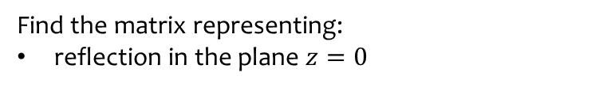


Worked example
Your turn
Find the matrix representing:
reflection in the plane $x=0$
reflection in the plane $y=0$
Find the matrix representing:
reflection in the plane $z=0$
$$\left(\begin{matrix}1 & 0 & 0 \\ 0 & 1 & 0 \\ 0 & 0 & −1\end{matrix}\right)$$

Slide 3
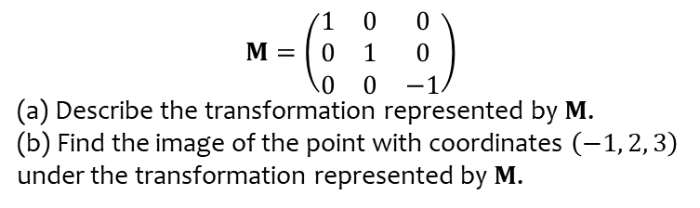
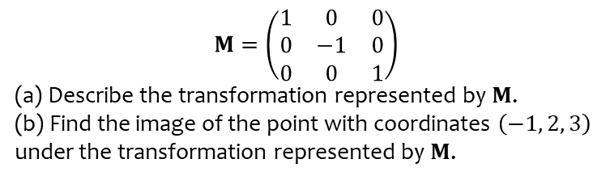

Worked example
Your turn
$$M=\left(\begin{matrix}1 & 0 & 0 \\ 0 & −1 & 0 \\ 0 & 0 & 1\end{matrix}\right)$$
(a) Describe the transformation represented by $M$.
(b) Find the image of the point with coordinates $\left(−1, 2, 3\right)$ under the transformation represented by $M$.
$$M=\left(\begin{matrix}1 & 0 & 0 \\ 0 & 1 & 0 \\ 0 & 0 & −1\end{matrix}\right)$$
(a) Describe the transformation represented by $M$.
(b) Find the image of the point with coordinates $\left(−1, 2, 3\right)$ under the transformation represented by $M$.
(a) Reflection in the plane $z=0$
(b) $(−1, 2, −3)$

Slide 4



Worked example
Your turn
Find the matrix representing:
Rotation, angle $θ$, anticlockwise about the $x$-axis
Rotation, angle $θ$, anticlockwise about the $y$-axis
Find the matrix representing:
Rotation, angle $θ$, anticlockwise about the $z$-axis
$$\left(\begin{matrix}\cos{θ} & −\sin{θ} & 0 \\ \sin{θ} & \cos{θ} & 0 \\ 0 & 0 & 1\end{matrix}\right)$$

Slide 5



Worked example
Your turn
Find the matrix representing:
Rotation, angle $90°$, anticlockwise about the $x$-axis
Rotation, angle $180°$, anticlockwise about the $z$-axis
Find the matrix representing:
Rotation, angle $270°$, anticlockwise about the $y$-axis
$$\left(\begin{matrix}0 & 0 & −1 \\ 0 & 1 & 0 \\ 1 & 0 & 0\end{matrix}\right)$$

Slide 6
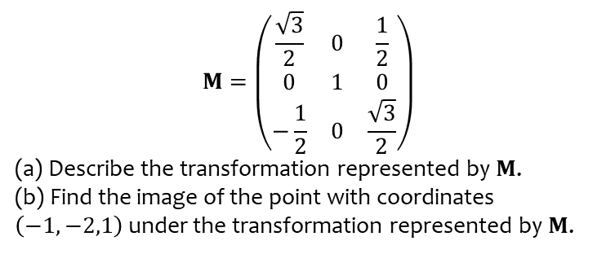
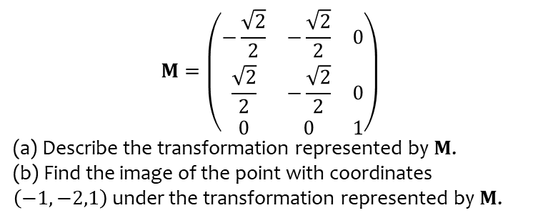
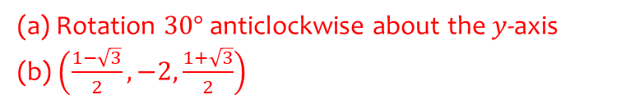
Worked example
Your turn
$$M=\left(\begin{matrix}−\frac{\sqrt{2}}{2} & −\frac{\sqrt{2}}{2} & 0 \\ \frac{\sqrt{2}}{2} & −\frac{\sqrt{2}}{2} & 0 \\ 0 & 0 & 1\end{matrix}\right)$$
(a) Describe the transformation represented by $M$.
(b) Find the image of the point with coordinates $\left(−1,−2,1\right)$ under the transformation represented by $M$.
$$M=\left(\begin{matrix}\frac{\sqrt{3}}{2} & 0 & \frac{1}{2} \\ 0 & 1 & 0 \\ −\frac{1}{2} & 0 & \frac{\sqrt{3}}{2}\end{matrix}\right)$$
(a) Describe the transformation represented by $M$.
(b) Find the image of the point with coordinates $\left(−1,−2,1\right)$ under the transformation represented by $M$.
(a) Rotation $30°$ anticlockwise about the $y$-axis
(b) $\left(\frac{1−\sqrt{3}}{2}, −2,\frac{1+\sqrt{3}}{2}\right)$

